Slide 1



Status of the ChDR
Bunch Length Monitor for Run 2c
C. Davut ^{(1,4)}, O. Apsimon ^{(1,4)}, P. Karataev ⁽²⁾, S. Mazzoni ⁽³⁾, T. Lefevre ⁽³⁾, G. Xia^{(1,4)}
1 - | University of Manchester, Manchester, UK
2 - | Royal Holloway, University of London, London, UK
3 - | CERN, Geneva, Switzerland
4 - | Cockcroft Institute, Daresbury, UK

Slide 2
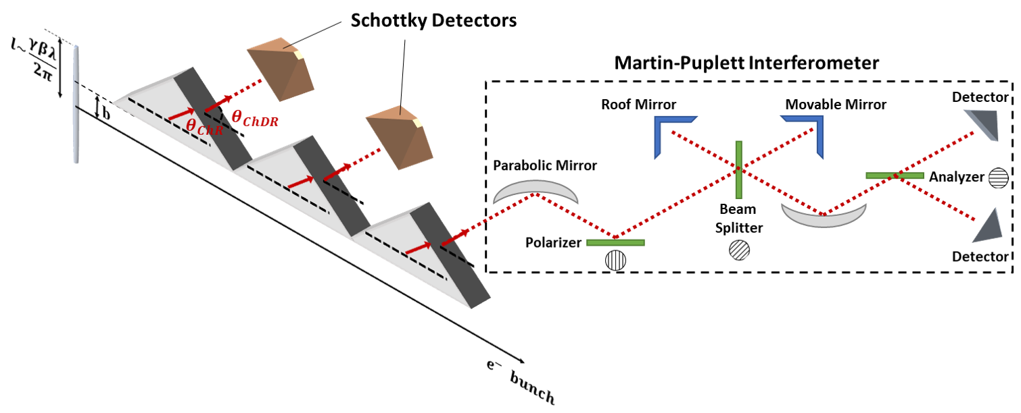
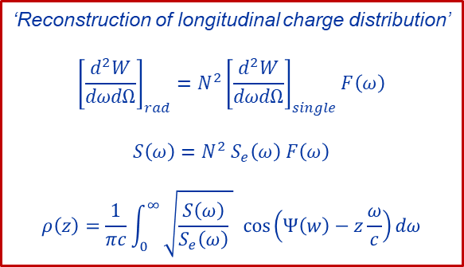
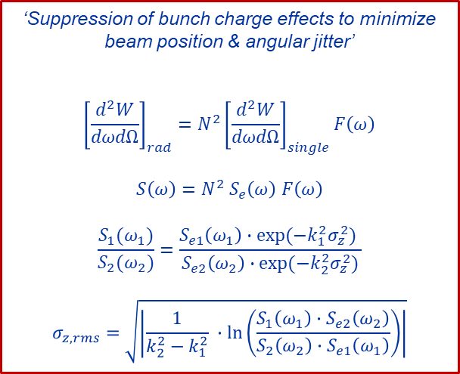
Bunch Length Monitor for AWAKE Run 2c
Goal : | Simultaneous RMS Bunch length & longitudinal profile measurement by using coherent Cherenkov diffraction radiation (ChDR)
‘Suppression of bunch charge effects to minimize
beam position & angular jitter’
$${\left[\frac{d^{2}W}{dωdΩ}\right]}_{rad}=N^{2}{\left[\frac{d^{2}W}{dωdΩ}\right]}_{single}F\left(ω\right)$$
$$S\left(ω\right)=N^{2} S_{e}\left(ω\right) F\left(ω\right)$$
$$\frac{S_{1}(ω_{1})}{S_{2}(ω_{2})}=\frac{S_{e1}\left(ω_{1}\right)∙exp⁡(−k_{1}^{2}σ_{z}^{2}) }{S_{e2}\left(ω_{2}\right)∙exp⁡(−k_{2}^{2}σ_{z}^{2})}$$
$$σ_{z,rms}=\sqrt{\left|\frac{1}{k_{2}^{2}−k_{1}^{2}} ∙\ln\left(\frac{S_{1}\left(ω_{1}\right)∙S_{e2}\left(ω_{2}\right)}{{S_{2}\left(ω_{2}\right)∙S}_{e1}\left(ω_{1}\right)}\right)\right|}$$
‘Reconstruction of longitudinal charge distribution’
$${\left[\frac{d^{2}W}{dωdΩ}\right]}_{rad}=N^{2}{\left[\frac{d^{2}W}{dωdΩ}\right]}_{single}F\left(ω\right)$$
$$S\left(ω\right)=N^{2} S_{e}\left(ω\right) F\left(ω\right)$$
$$ρ\left(z\right)=\frac{1}{πc}\int_{0}^{∞}{\sqrt{\frac{S\left(ω\right)}{S_{e}\left(ω\right)} } cos⁡\left(Ψ\left(w\right)−z\frac{ω}{c}\right)dω}$$
Two independent methods provide a cross-check in the measurements.
Notes:
Reminder slide
Schottky diodes different frequency ranges – single shot, relative measurement & Martin Pupplett as a reference for bunch profile multi shot, absolute measurement

Slide 3
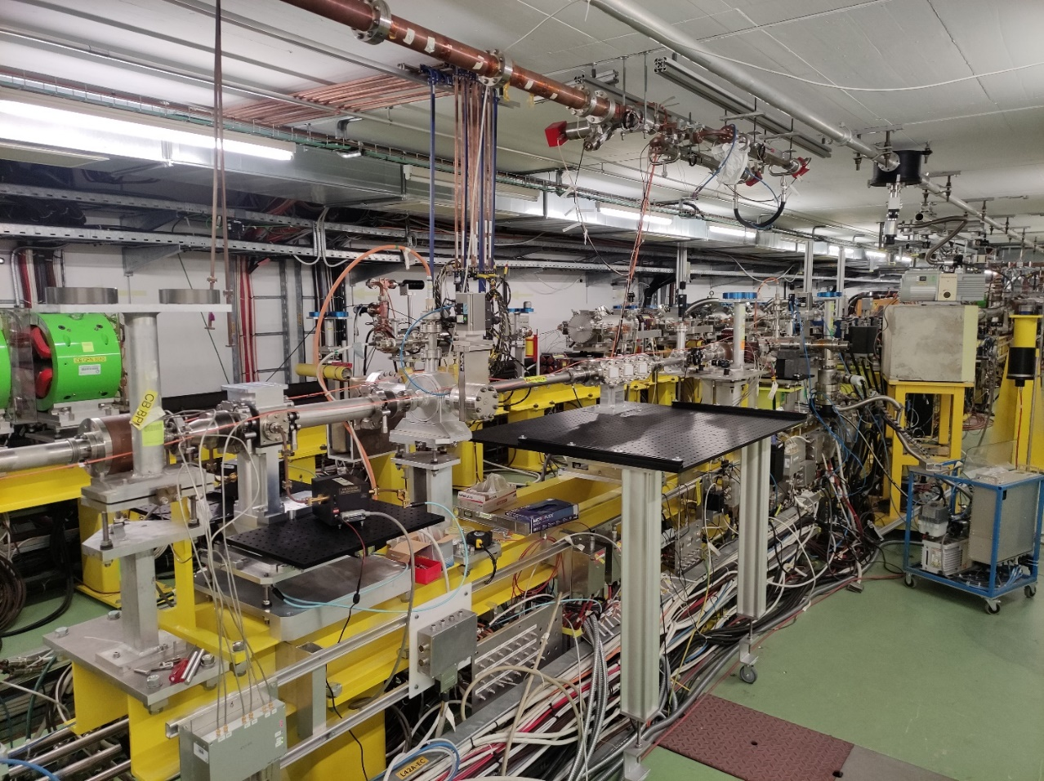
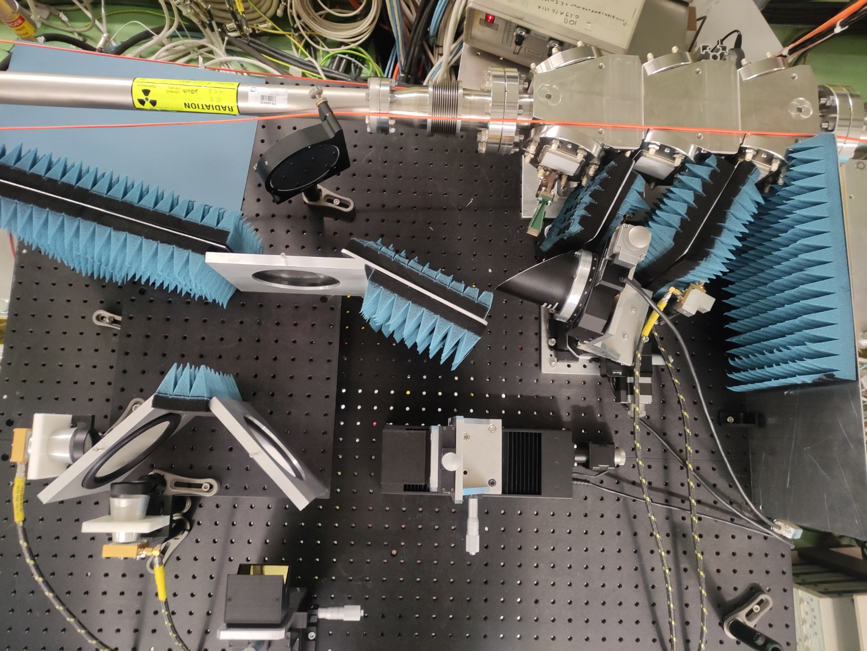
Installation for the Tests @CLEAR
Installation of vacuum chamber, breadboard, supports and hardware has been completed in CLEAR test facility.
Cavity BPMs
ChDR Bunch Length Monitor
Notes:
Initial location changed : located to upstream of the beam line compared
Cavity BPMs are not calibrated to be used !

Slide 4
Test Schedule & Outlook
 | Scheduled | Performed | Comment
Installation of Vacuum Chamber | 15th July | 18th, 19th July | Leak Test completed on Tuesday evening.
1st Test | 18th – 22nd July | 22nd, 23rd July (eq. 1 full day) | Poor data. 1st improvement of the system : 20 dB attenuator between horn and Schottky diode
2nd Test | 22nd and 26th August | - | No data. RF deflector couldn’t used for bunch length measurement.
3rd Test (Night Shifts) | 30th and 31st August | 30th – 31st August (eq. 1 full day) | Poor data. 2nd improvement of the system. THz lenses and metallic cone to shield the QODs
4th Test | 22nd September (parasitic measurement w/ChDR BPM) | - | No data. Klystron break down.
5th Test | 10th – 14th October (2.5 days)
6th Test | 31st October – 4th November
7th Test | 28th and 29th November
shared
Dedicated
beam time
Effective beam time usage (including parasitic measurements) | 2 / 10 days
Dedicated beam time duration (until the end of year) | 9.5 days + ? (parasitic measurements)

Slide 5
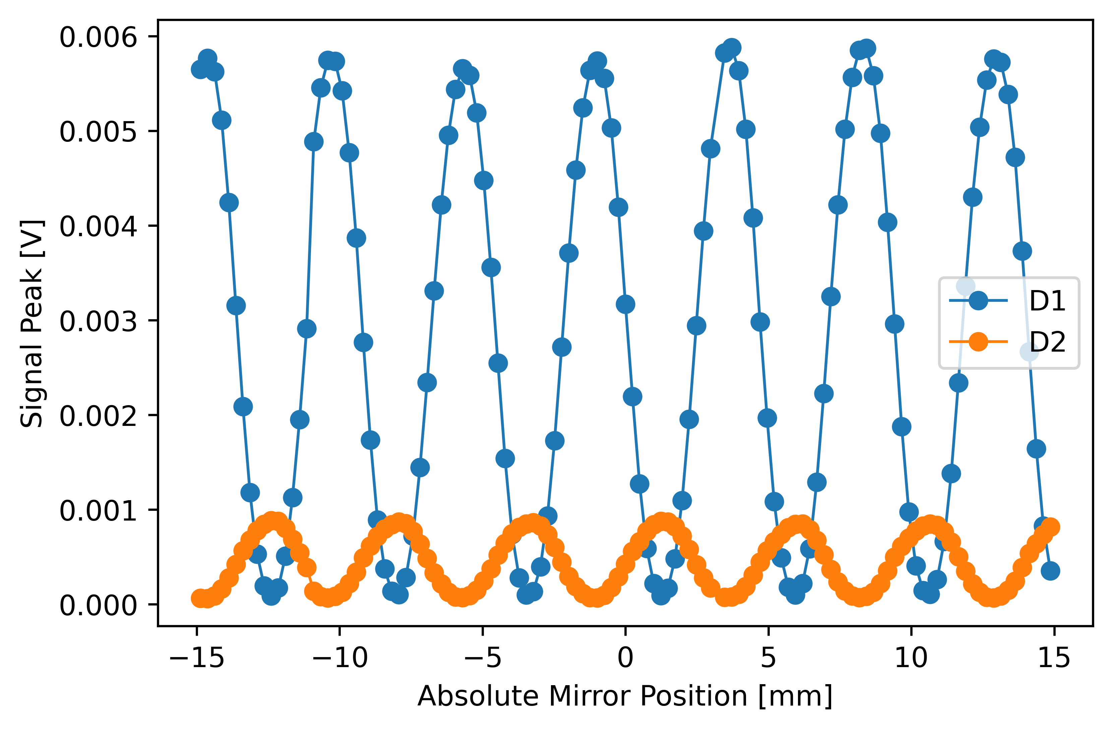
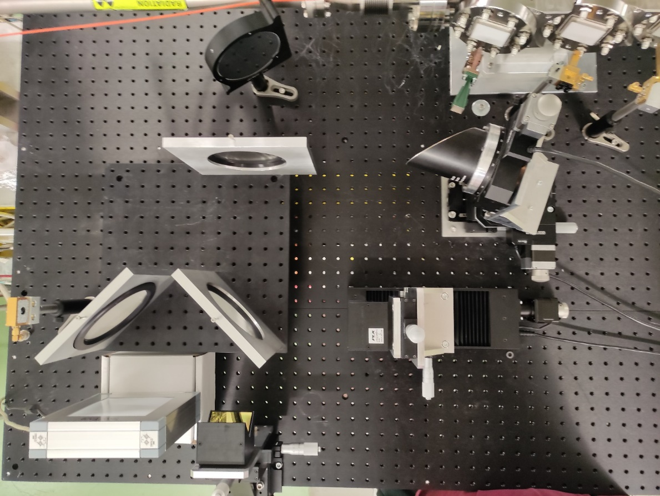

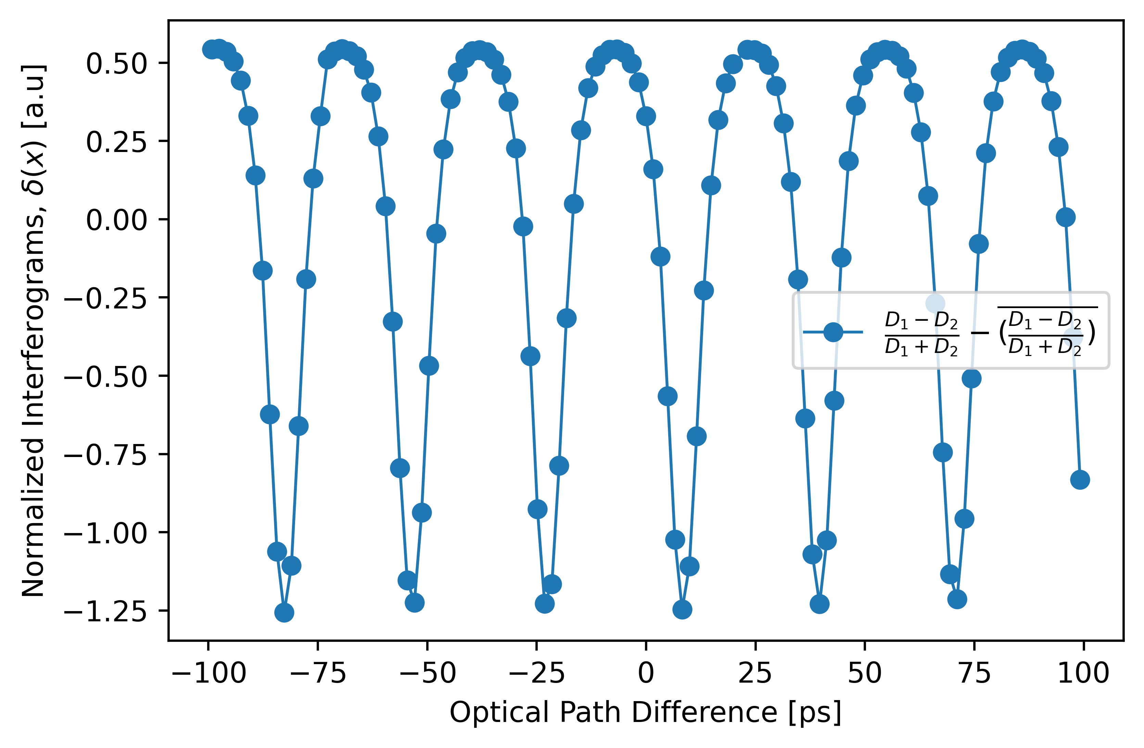




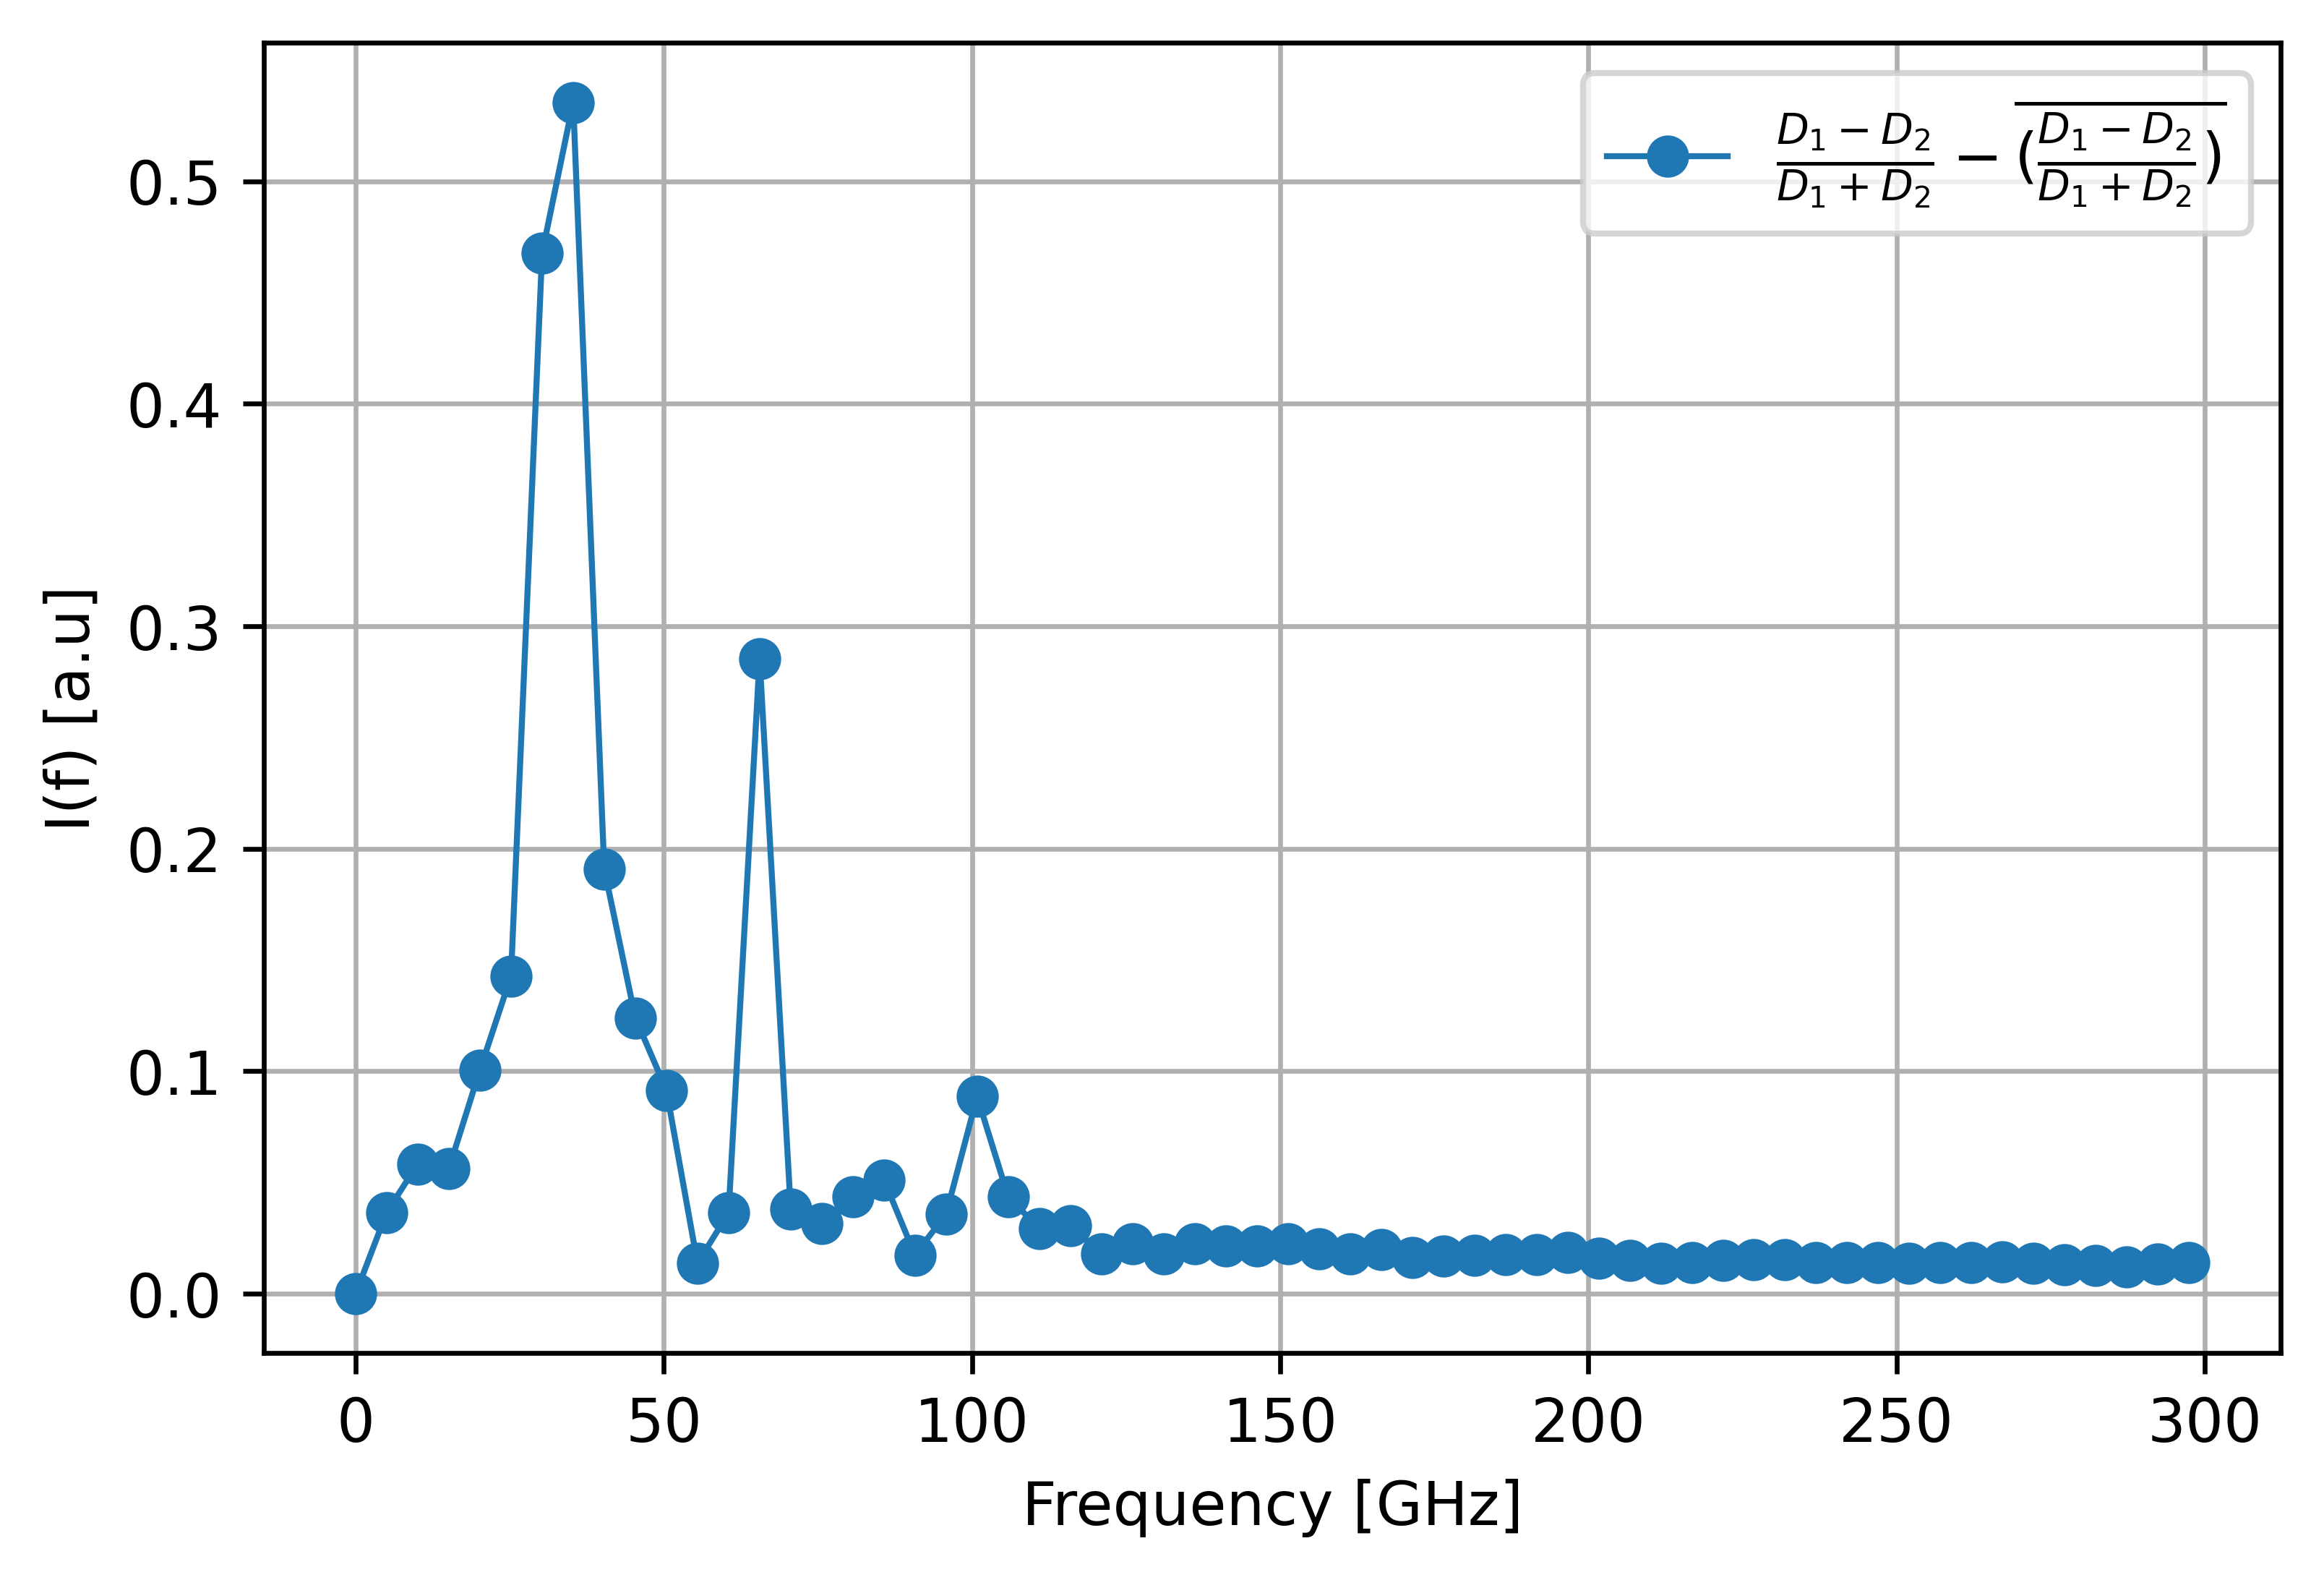

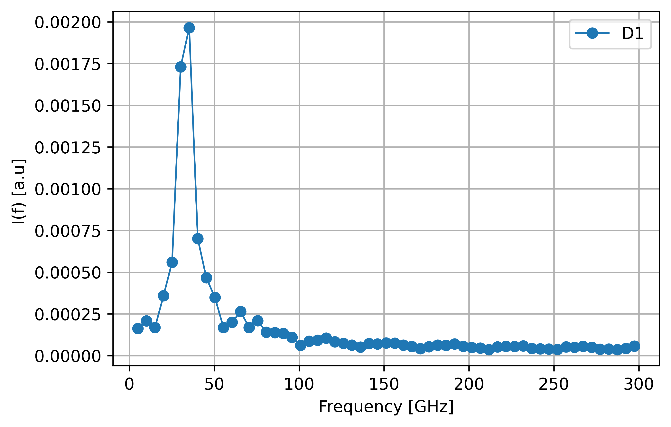
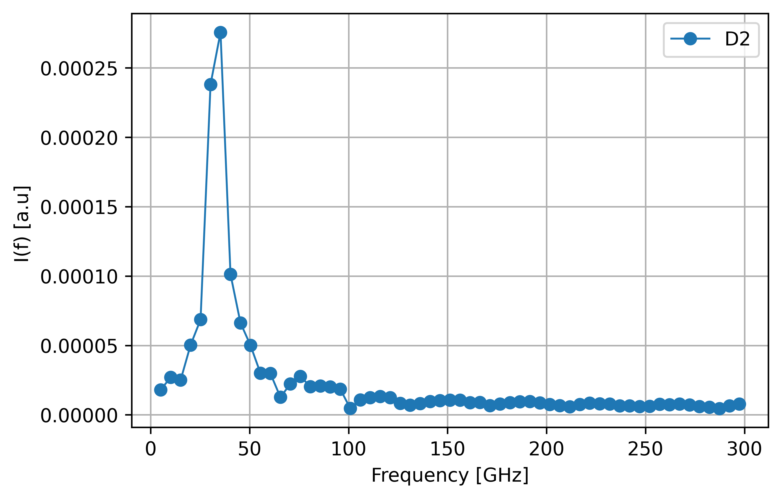
Tests @CLEAR – Preparation of the Setup
Alignment of the Interferometer
≈35 GHz
Emitter : | 26.5 – 40 GHz
Wire Grid Polarizers : | 10 µm thickness, 25 µm spacing
Quasi Optical Detectors : | 100 GHz – 1 THz
THz camera : | 4096 pixel & 0.05 – 0.7 THz
Schottky Diodes : | 60 – 90 GHz (low freq.) & 140 – 220 GHz & 400 – 600 GHz (high freq.)

Slide 6
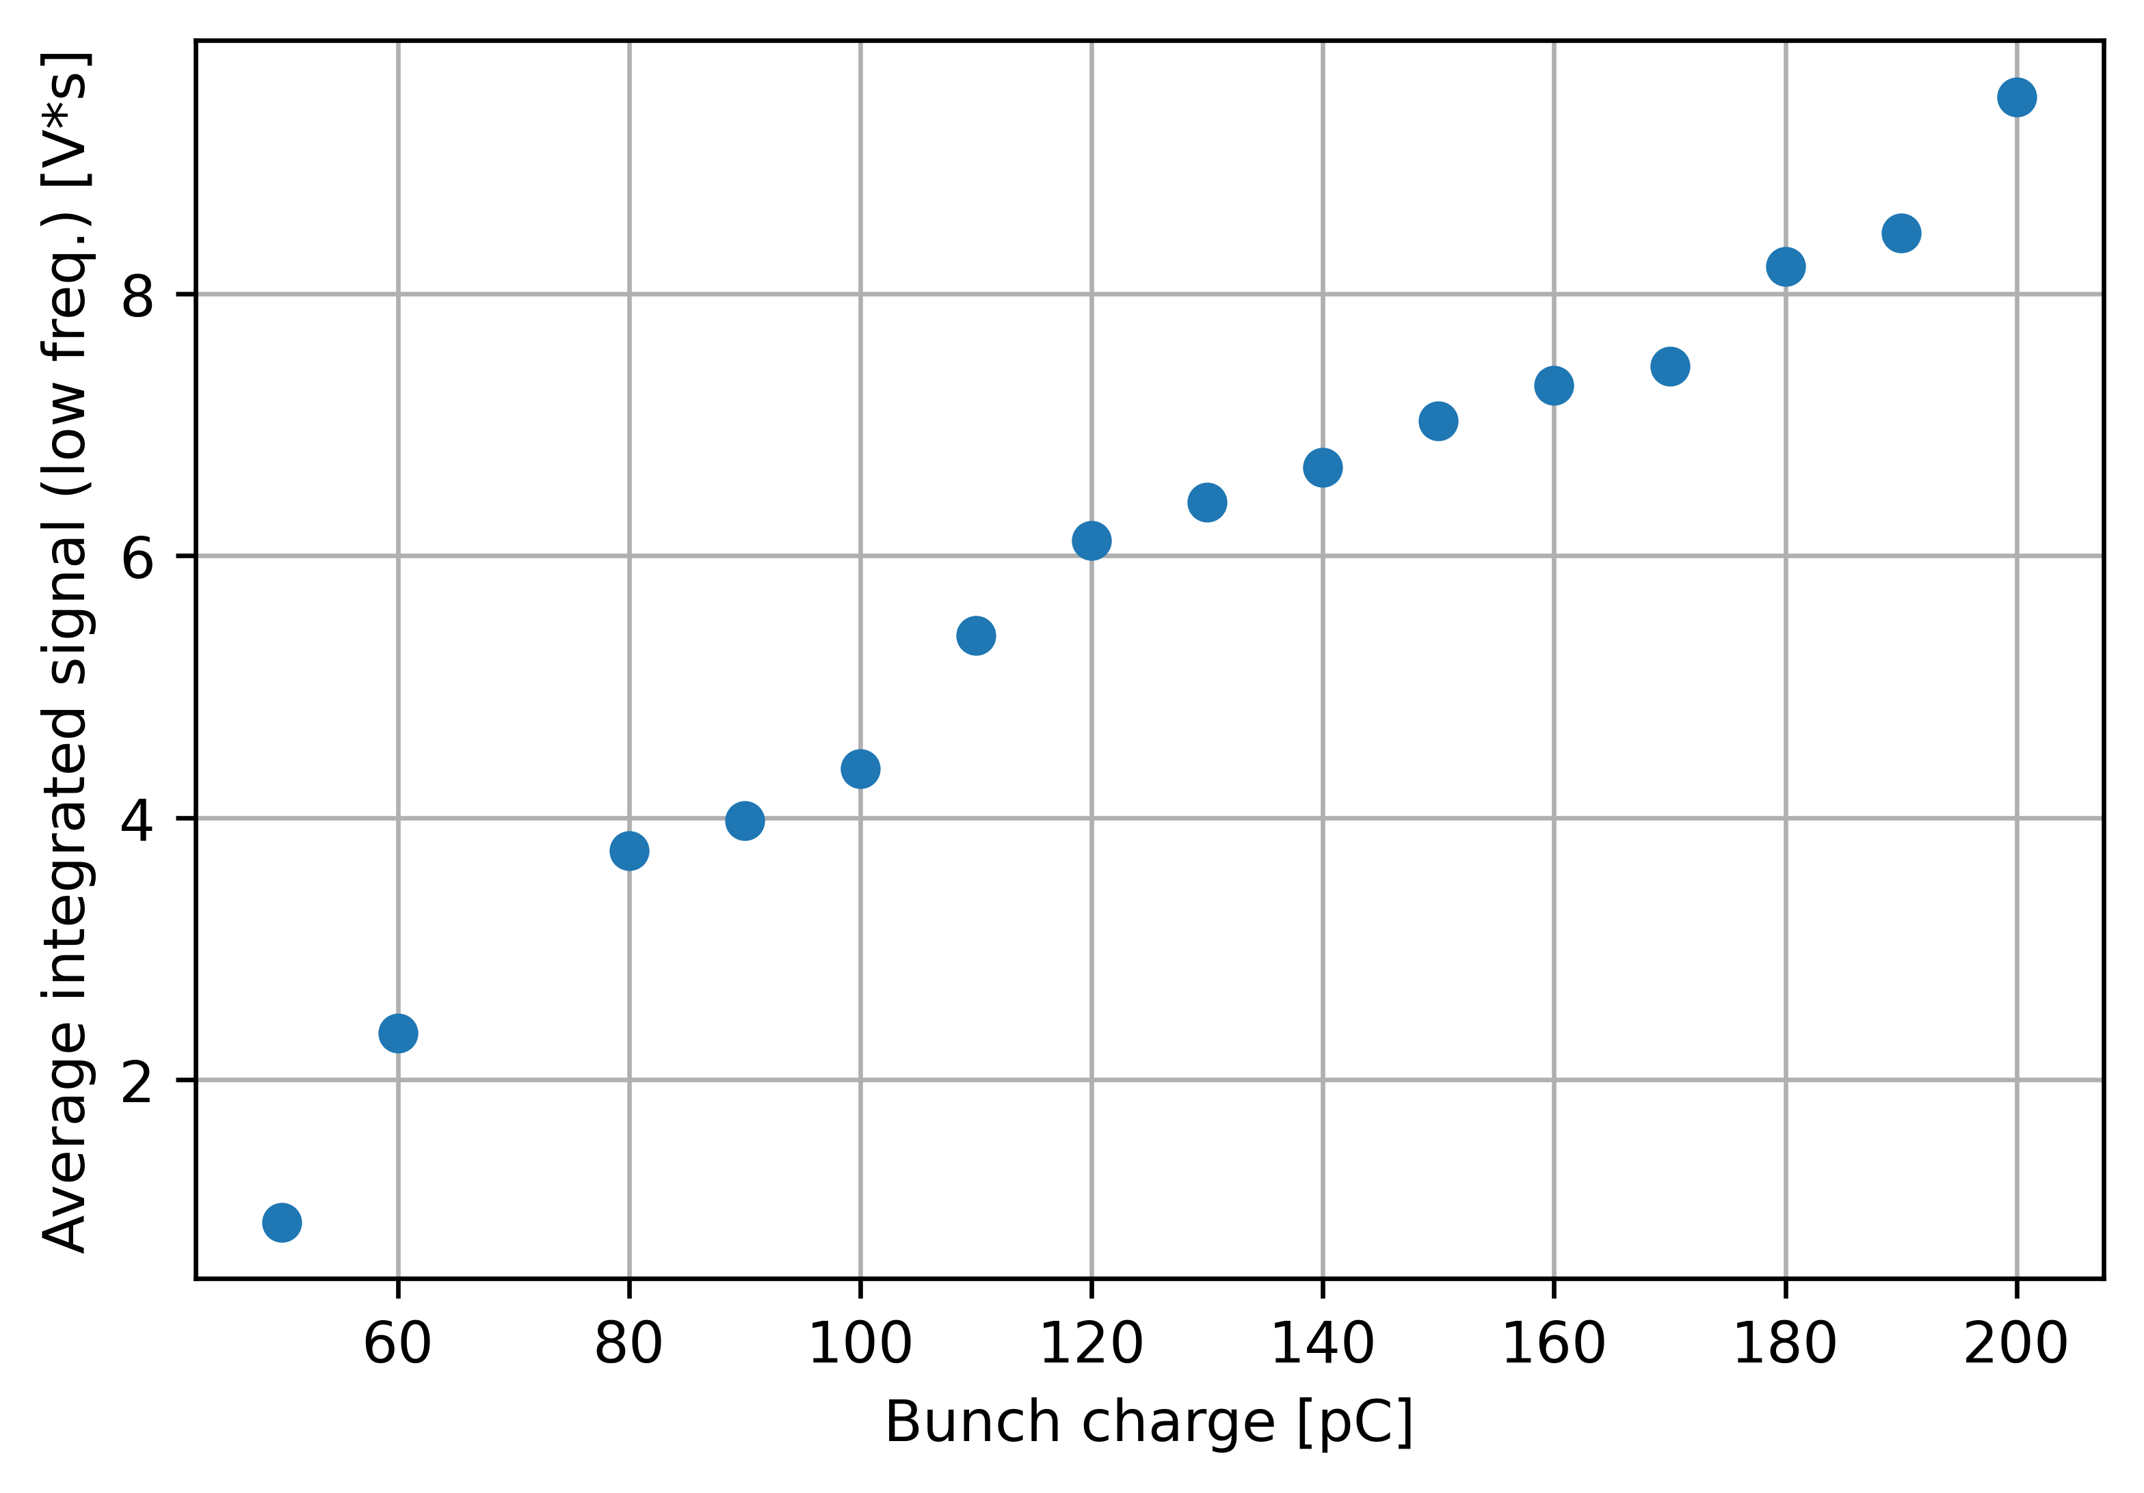
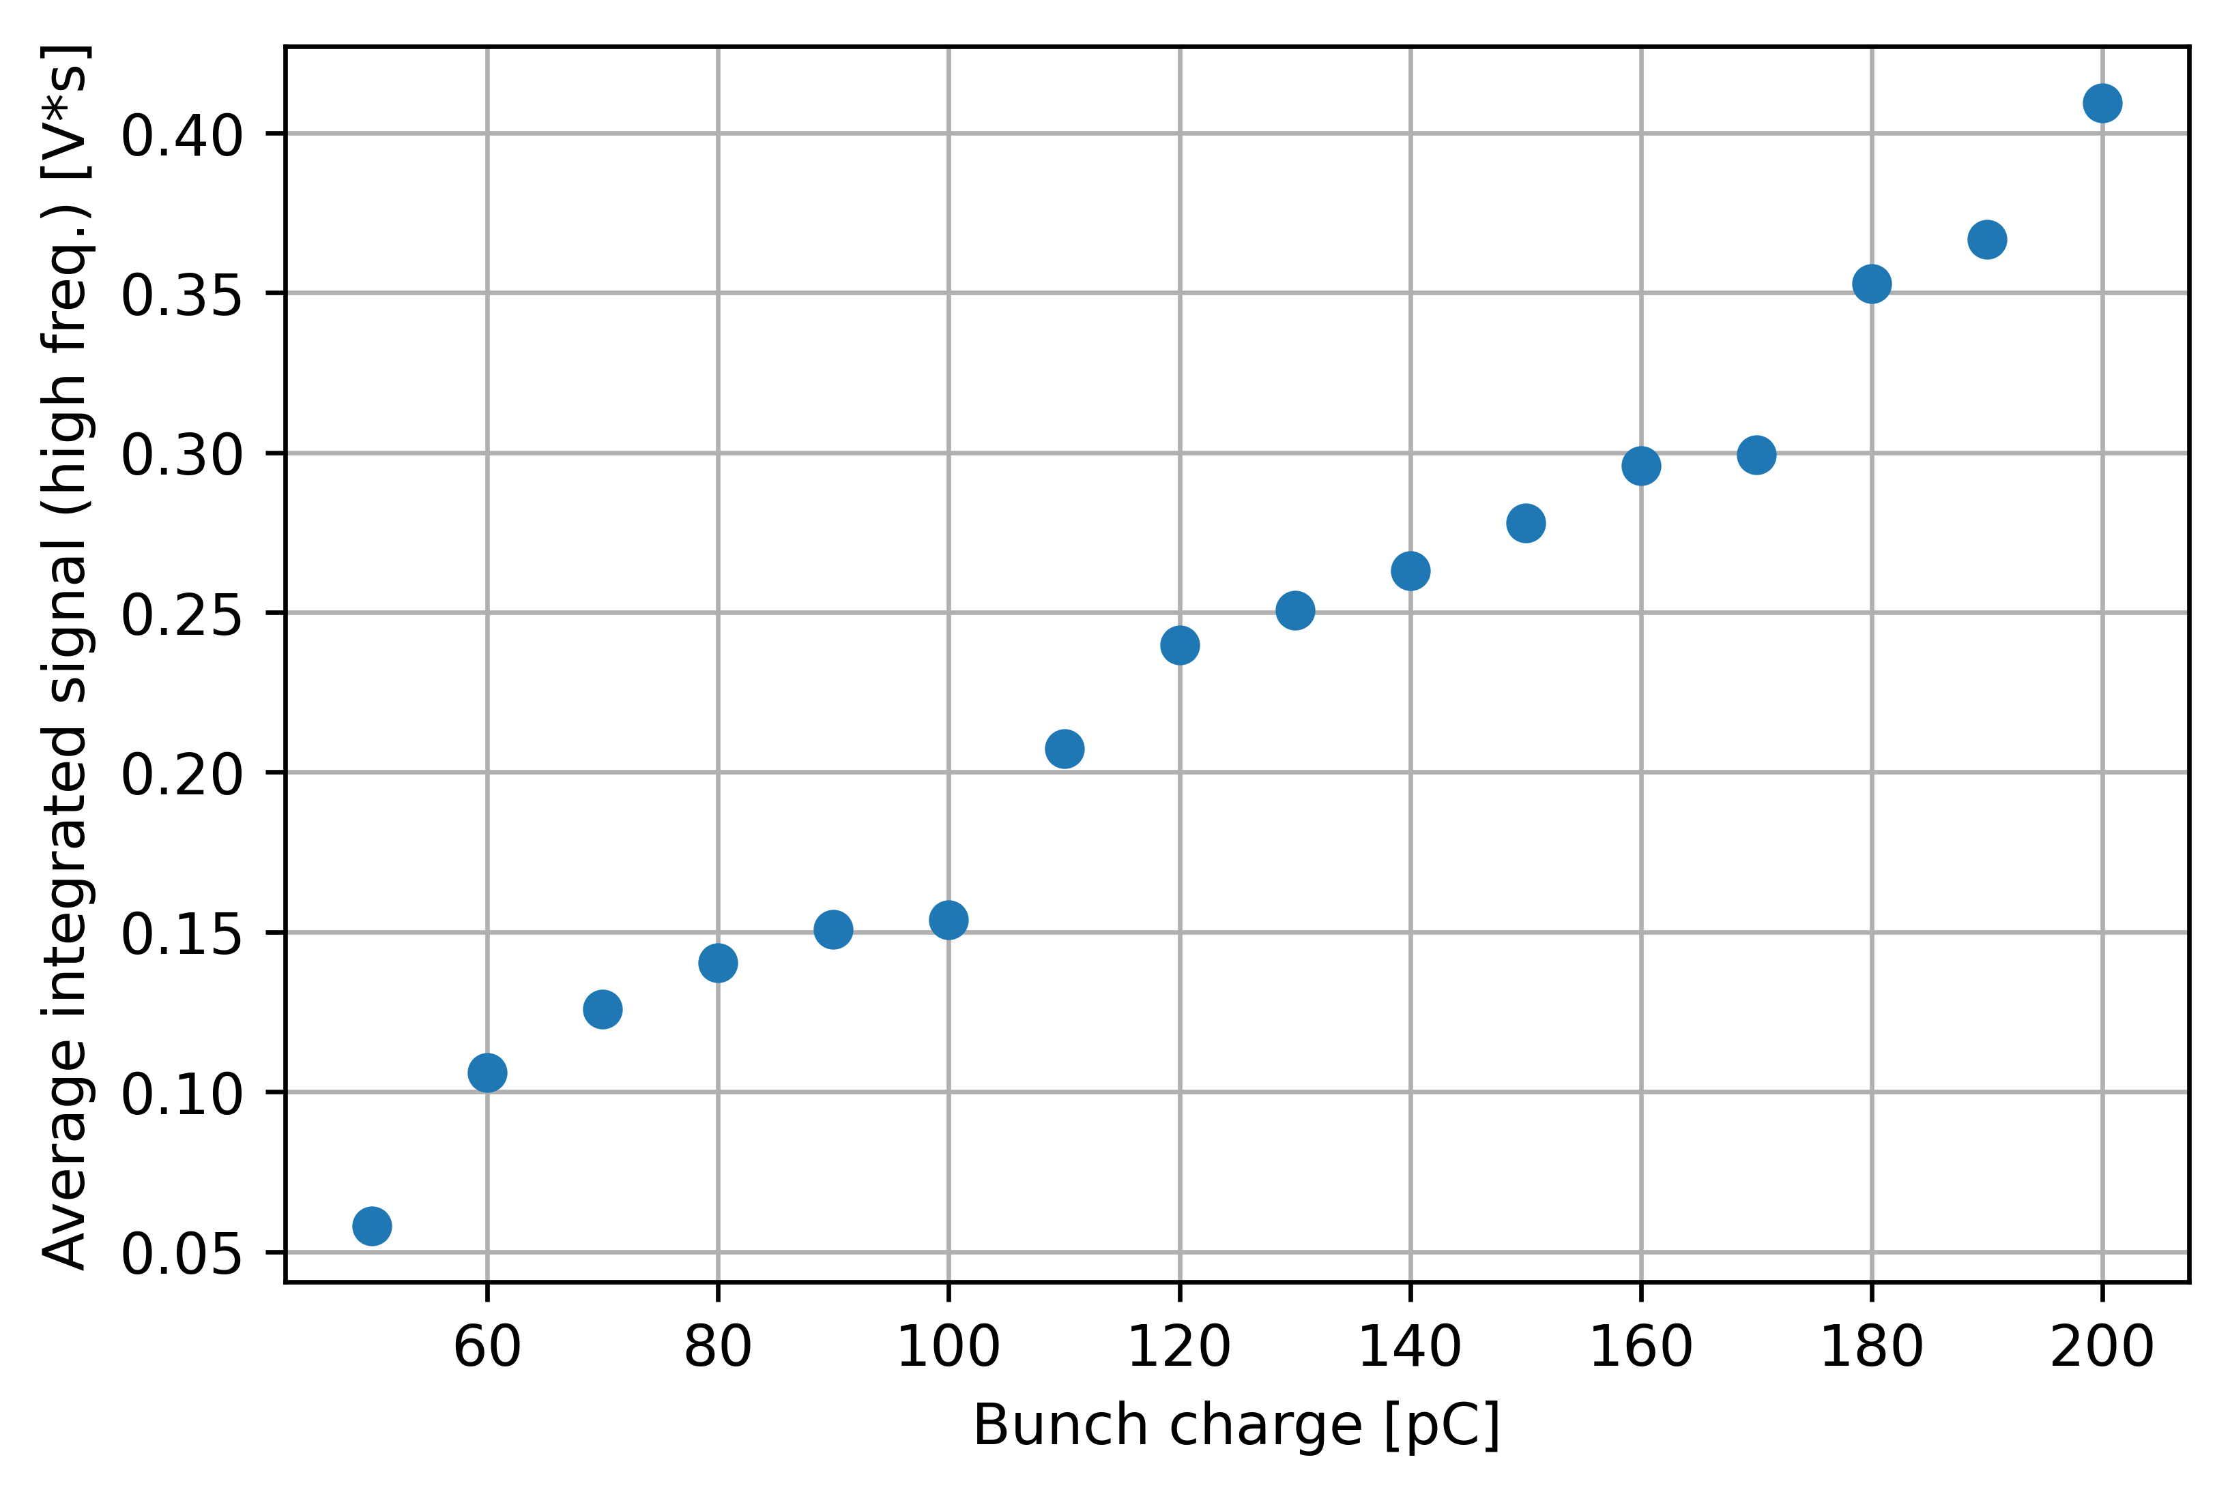
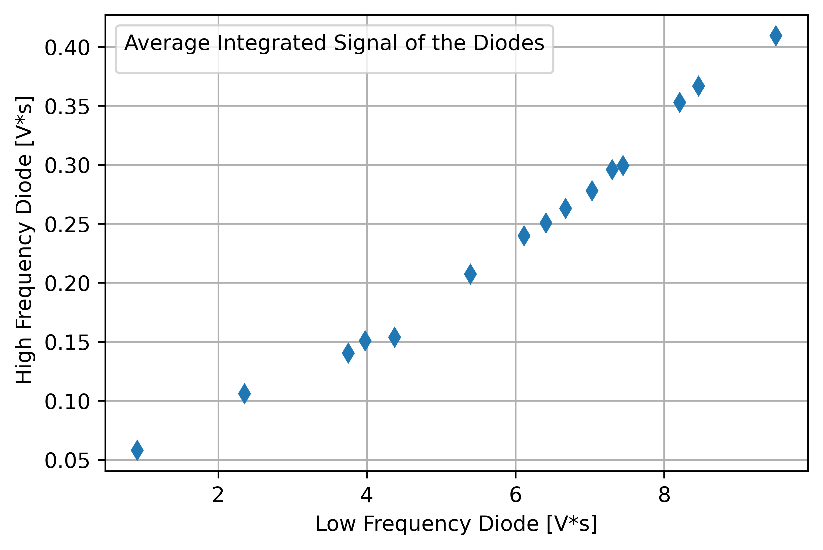
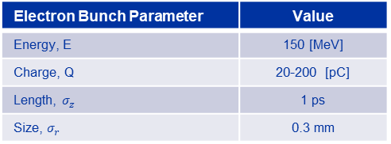
Tests @CLEAR – Charge Scan
Short bunch lengths (<1 ps) couldn’t obtained during the beam time !
Frequency ranges of Schottky diodes : 60 – 90 GHz & 140-220 GHz (instead of 400-600 GHz)
Electron Bunch Parameter | Value
Energy, E | 150 [MeV]
Charge, Q | 20-200 [pC]
Length, $σ_{z}$ | 1 ps
Size, $σ_{r}$ | 0.3 mm
three bunches
single & two bunches
two bunches
The response of the diodes are in the same operation regime as it is shows linear response to the charge.

Slide 7
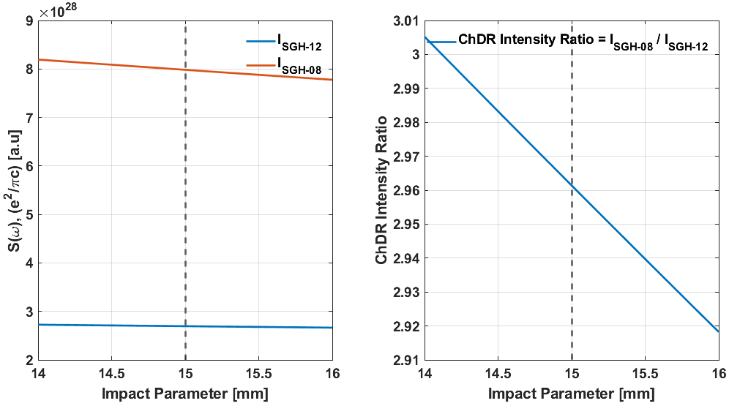
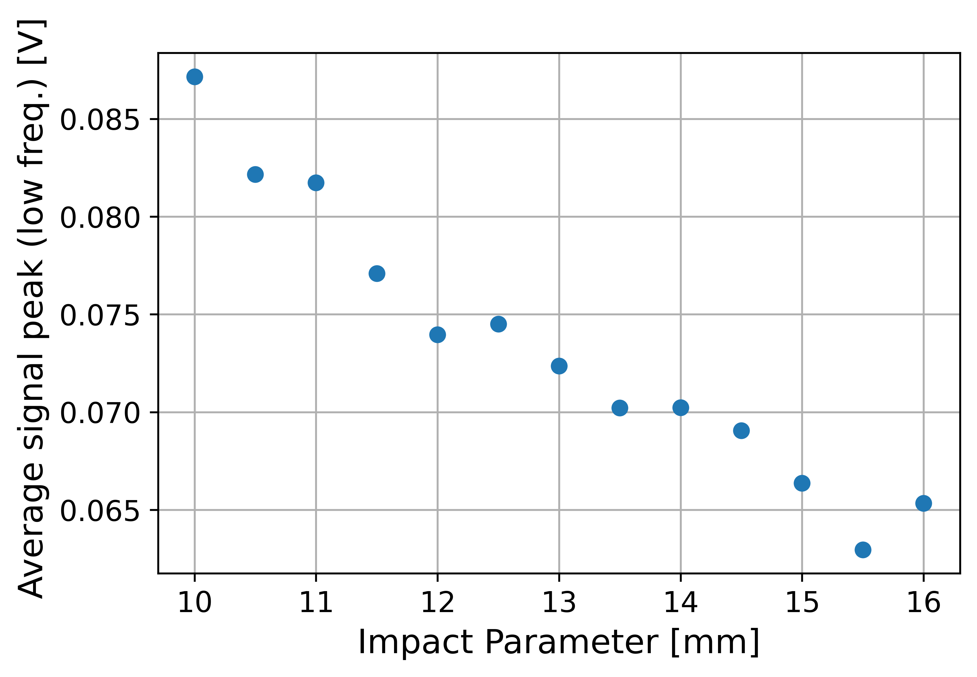
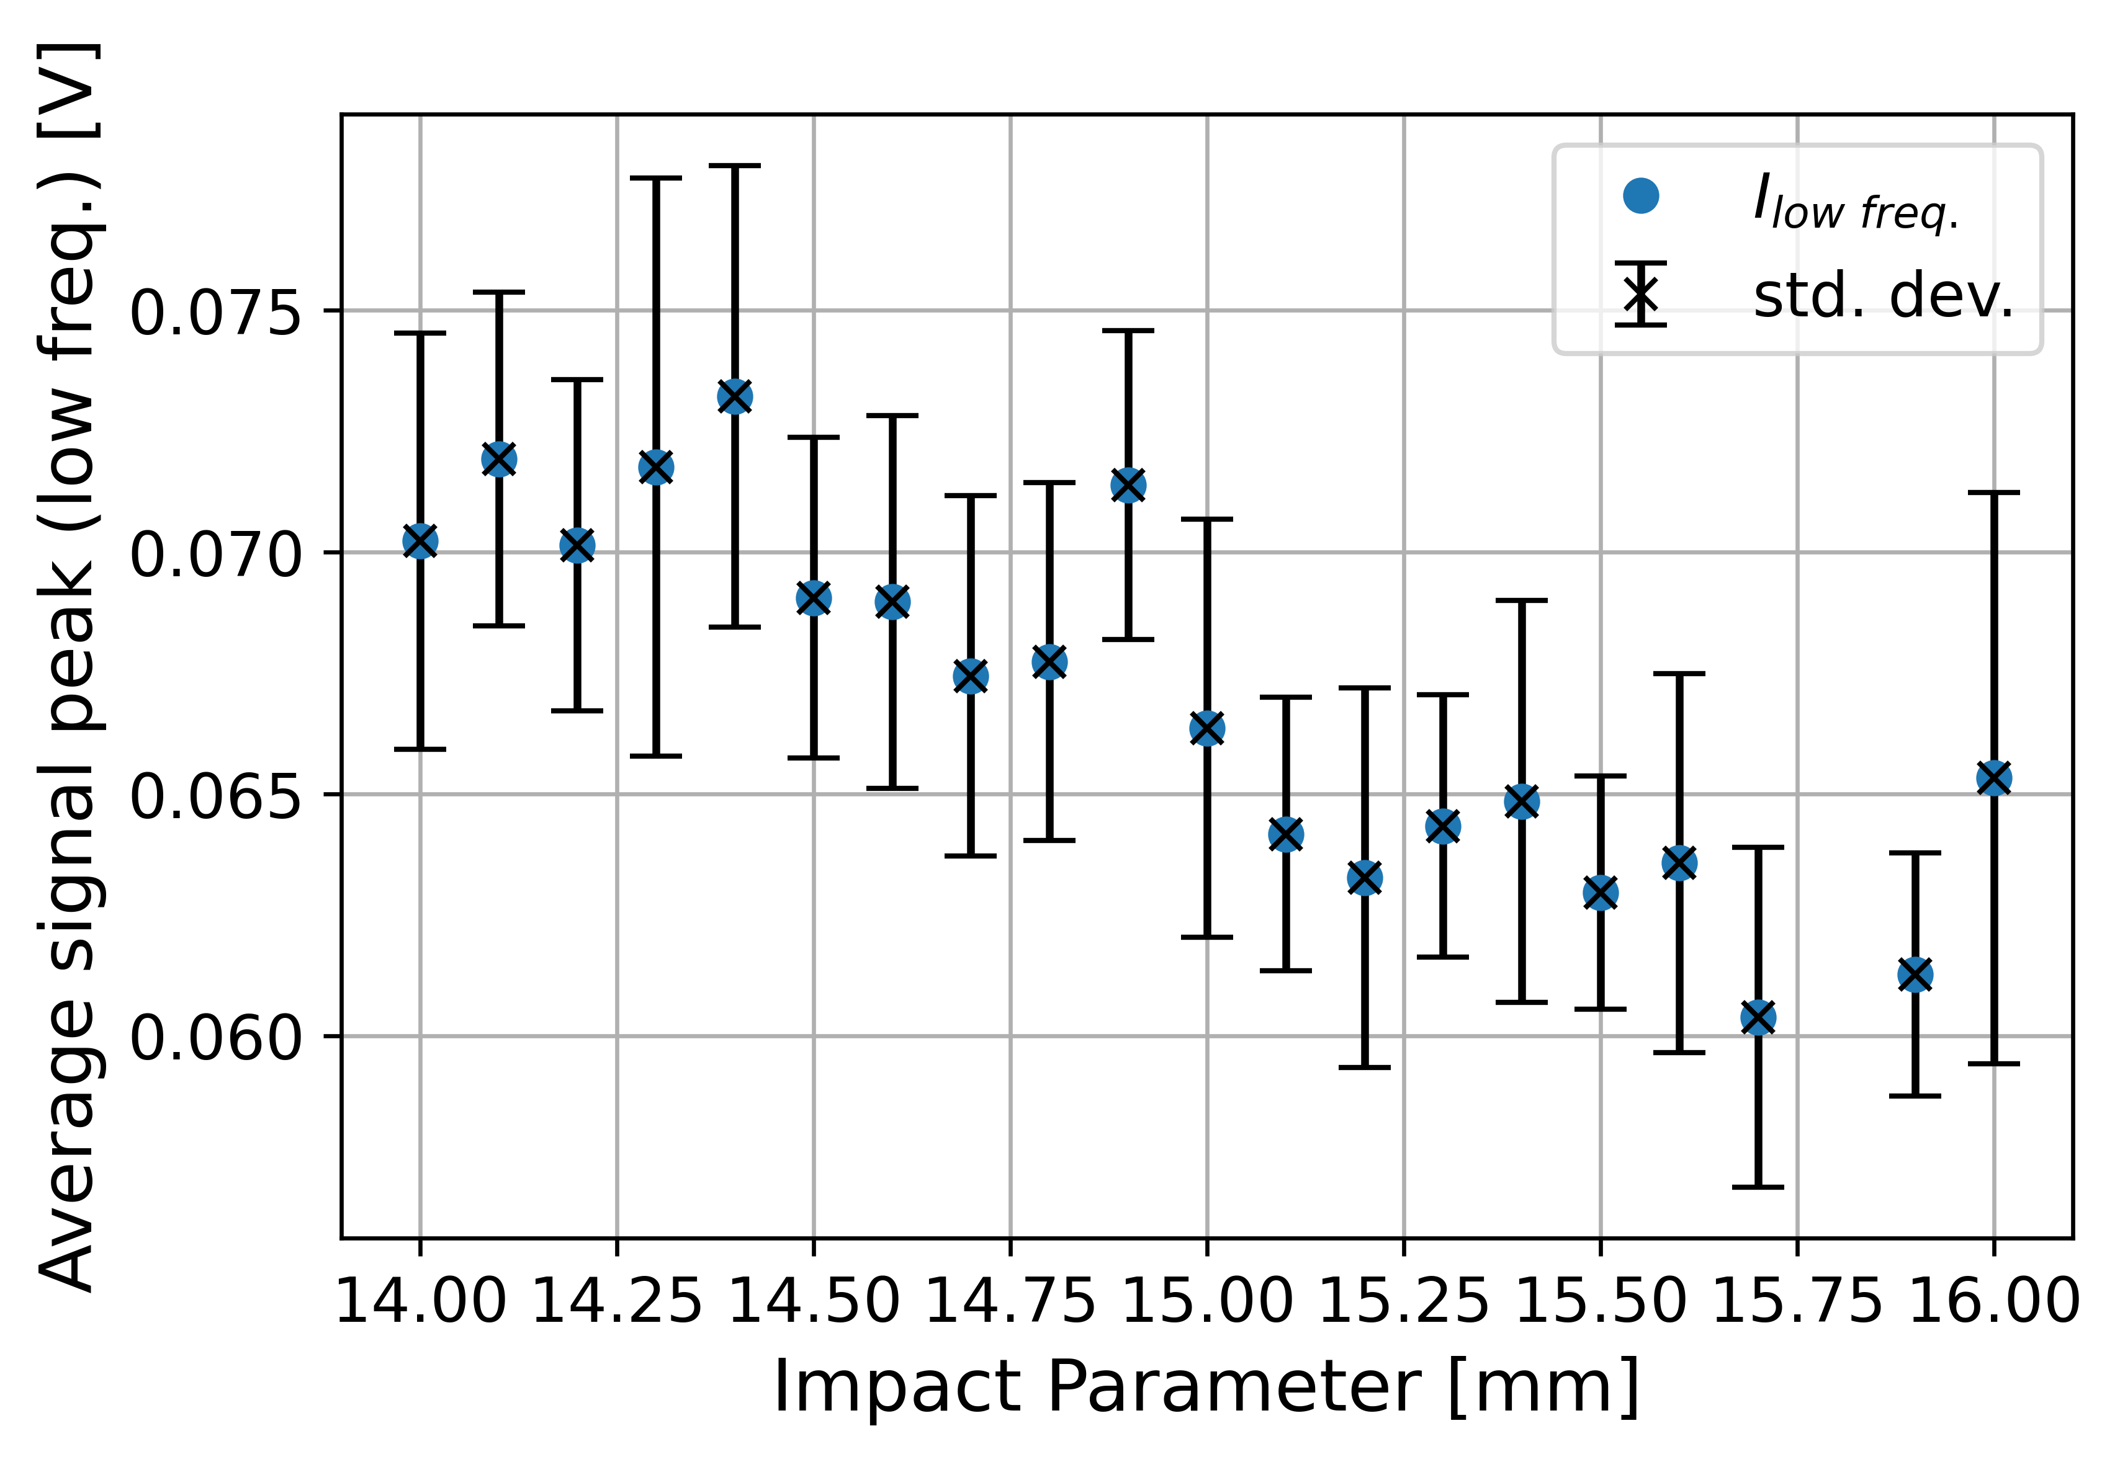
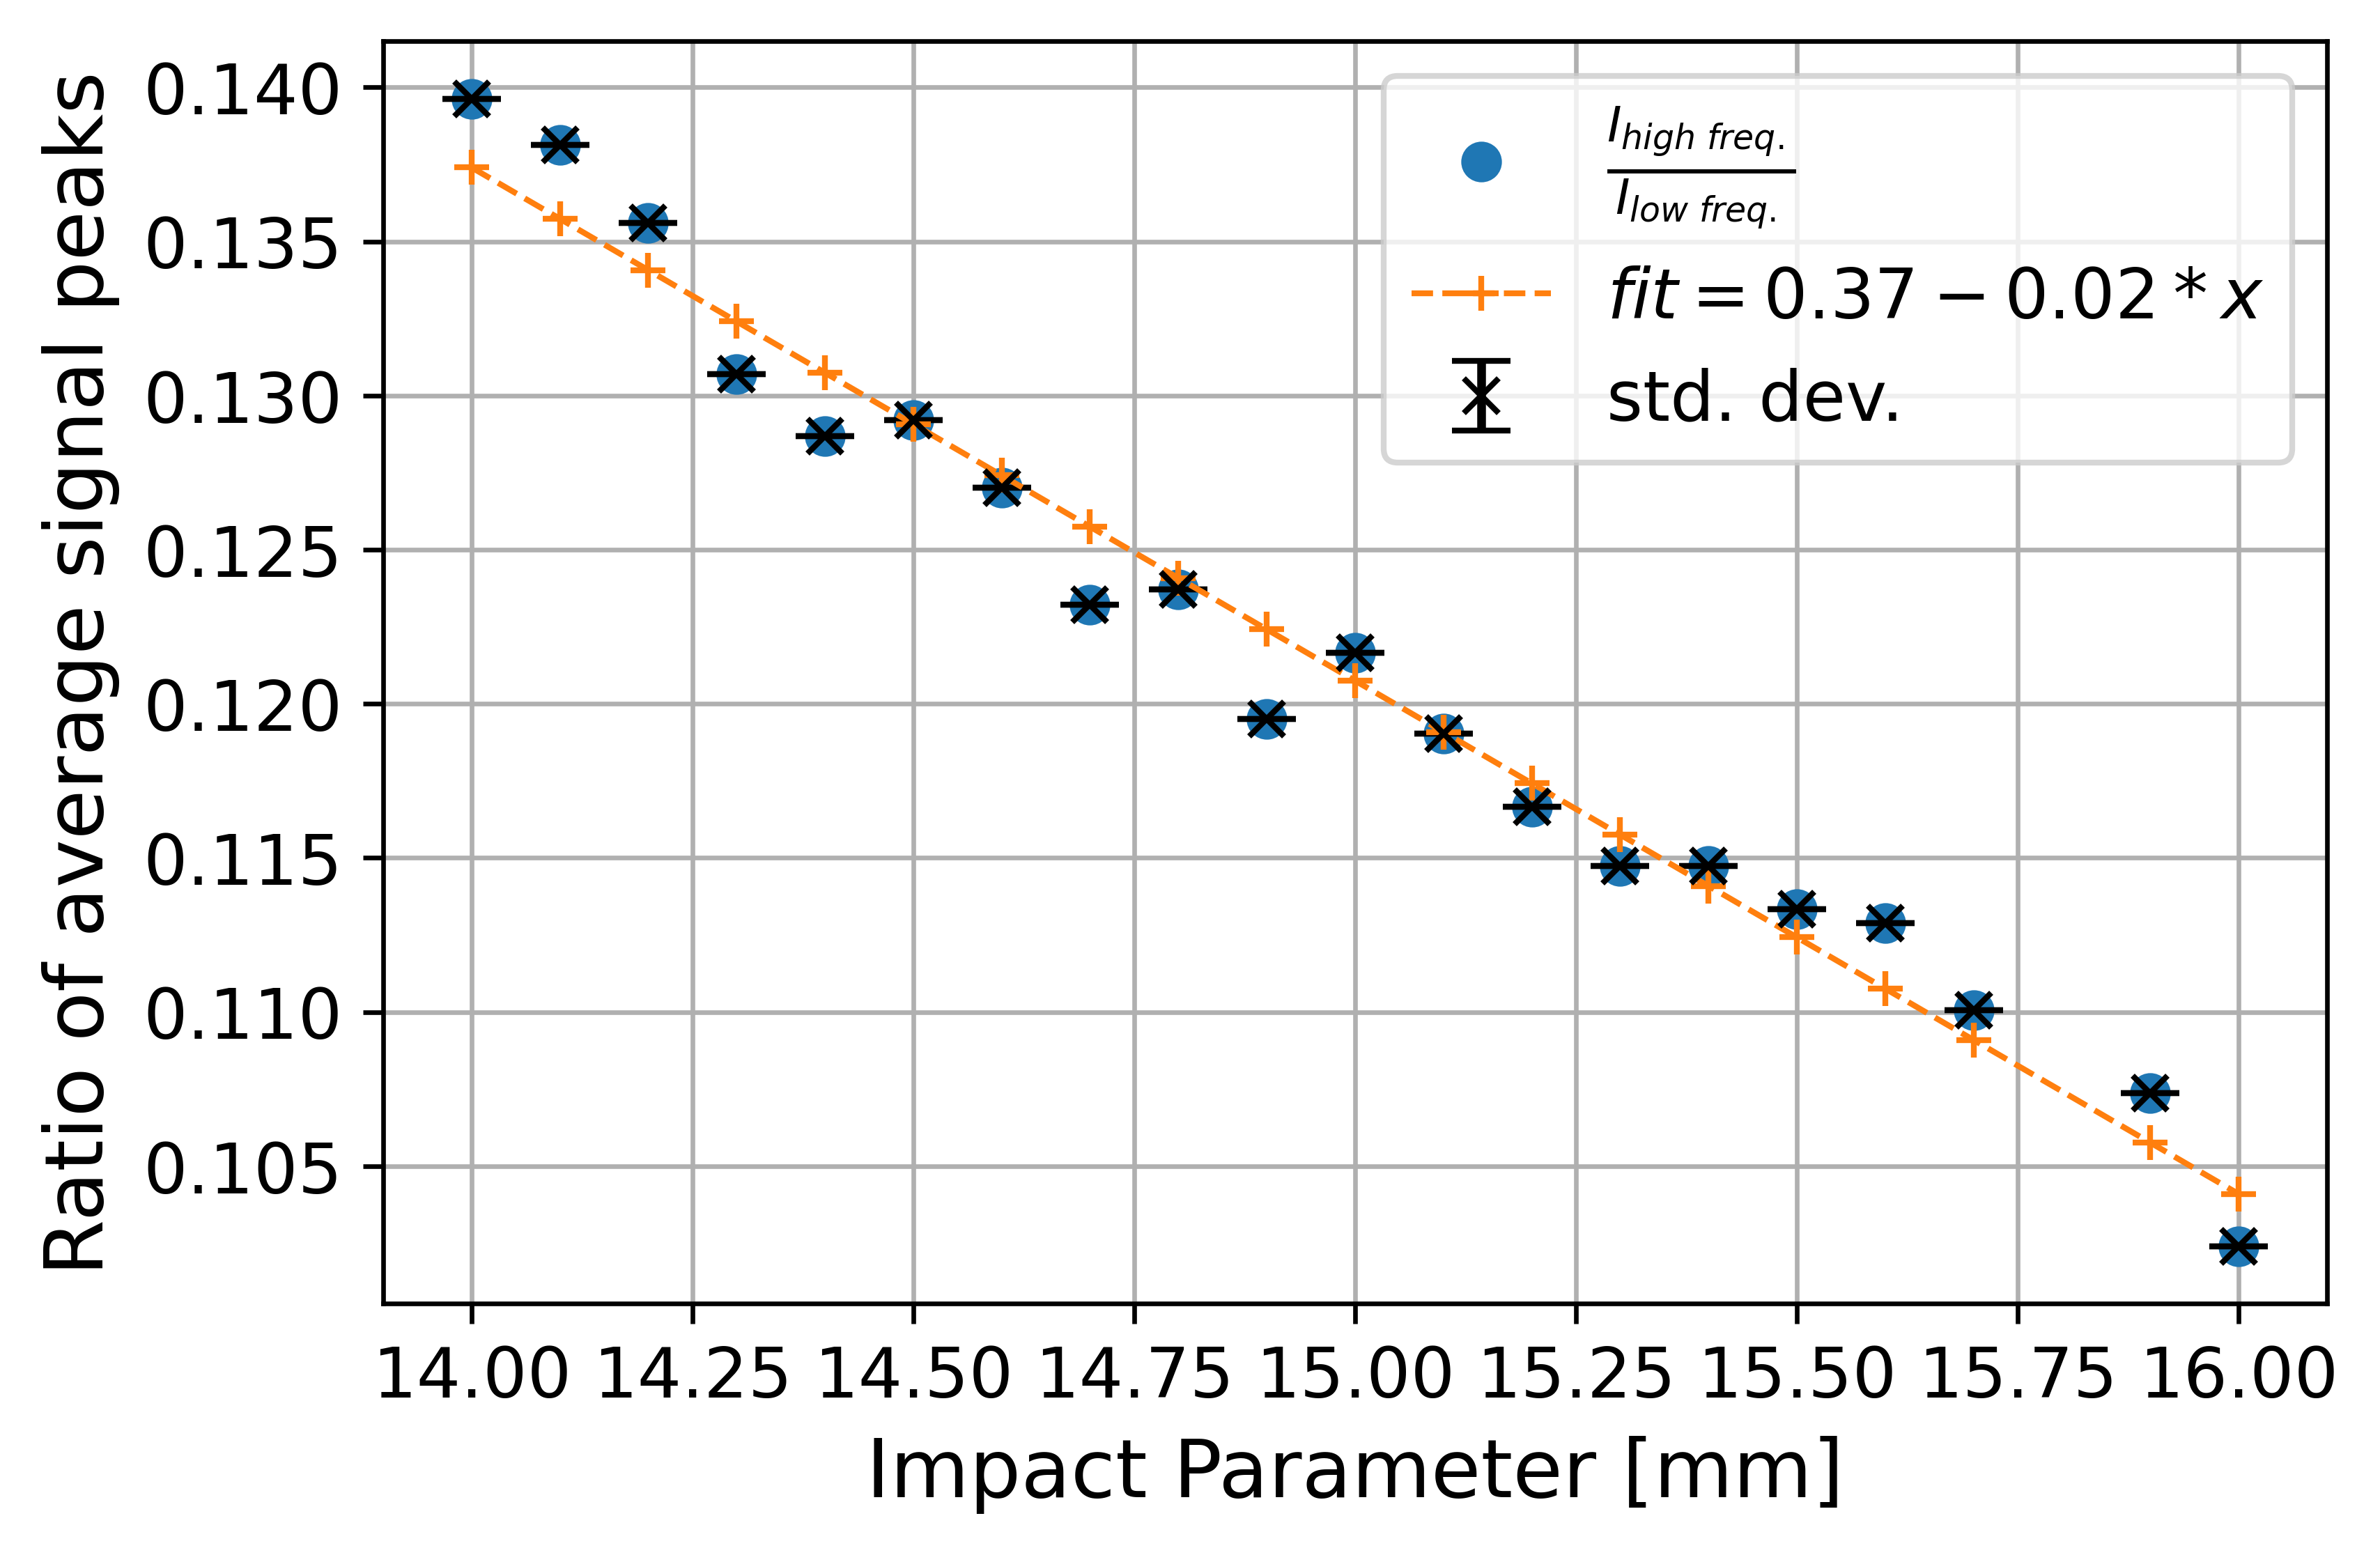
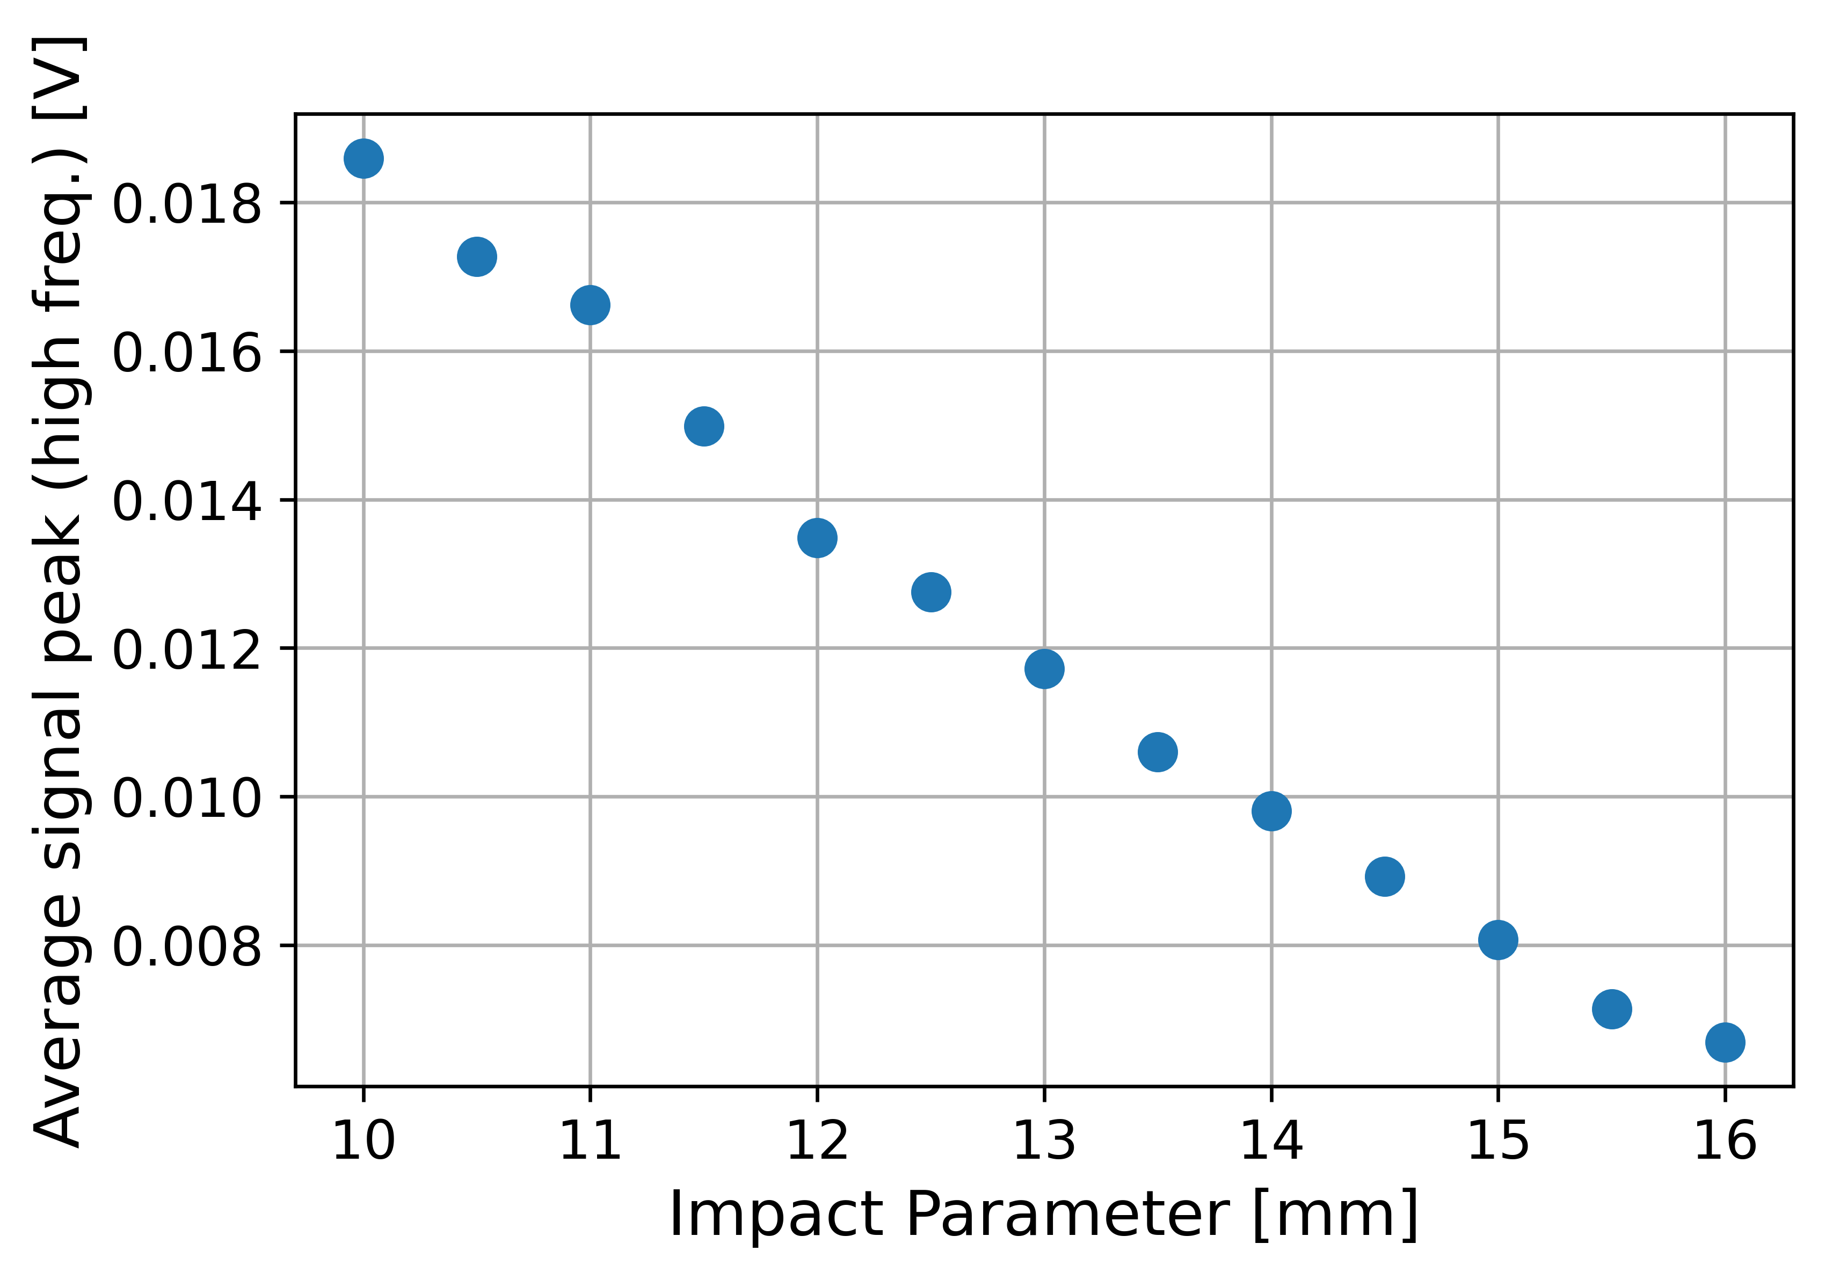
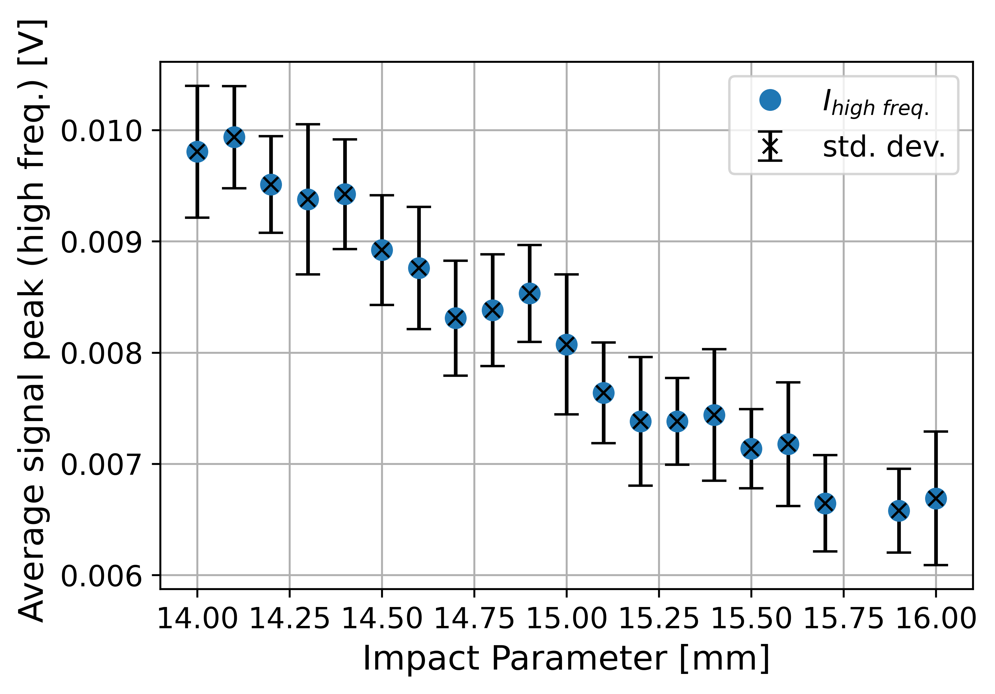
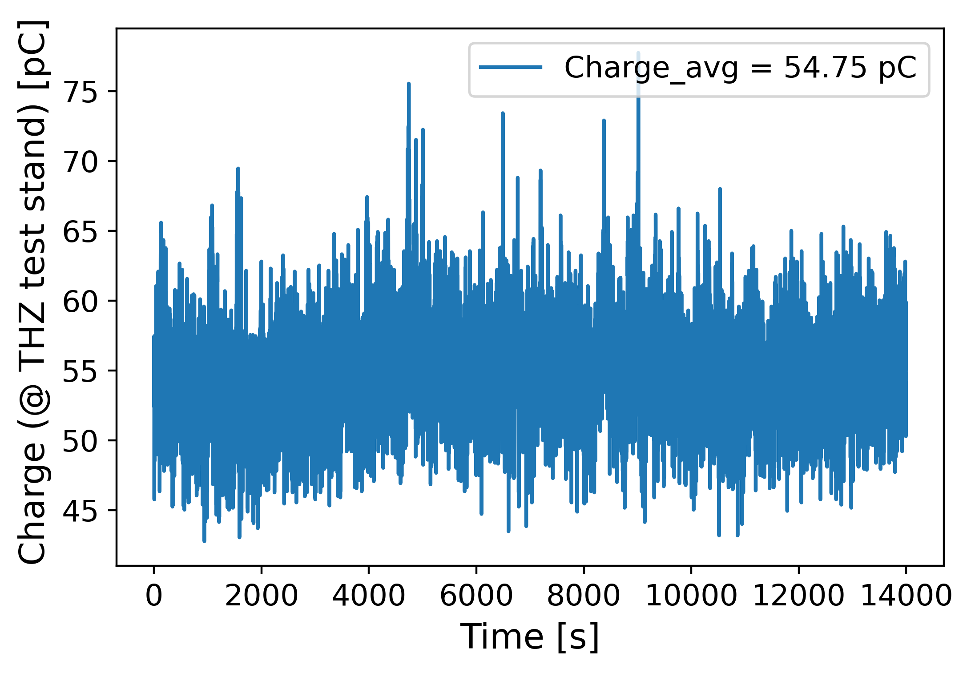
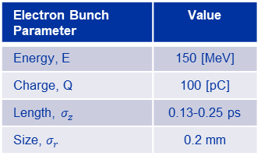
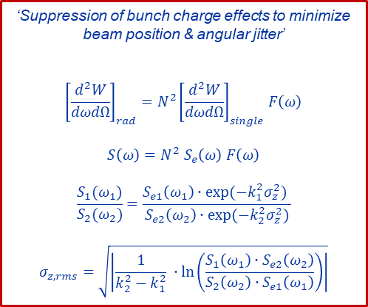
Tests @CLEAR - Impact Parameter Scan
Electron Bunch Parameter | Value
Energy, E | 150 [MeV]
Charge, Q | 100 [pC]
Length, $σ_{z}$ | 0.13-0.25 ps
Size, $σ_{r}$ | 0.2 mm
‘Suppression of bunch charge effects to minimize
beam position & angular jitter’
$${\left[\frac{d^{2}W}{dωdΩ}\right]}_{rad}=N^{2}{\left[\frac{d^{2}W}{dωdΩ}\right]}_{single}F\left(ω\right)$$
$$S\left(ω\right)=N^{2} S_{e}\left(ω\right) F\left(ω\right)$$
$$\frac{S_{1}(ω_{1})}{S_{2}(ω_{2})}=\frac{S_{e1}\left(ω_{1}\right)∙exp⁡(−k_{1}^{2}σ_{z}^{2}) }{S_{e2}\left(ω_{2}\right)∙exp⁡(−k_{2}^{2}σ_{z}^{2})}$$
$$σ_{z,rms}=\sqrt{\left|\frac{1}{k_{2}^{2}−k_{1}^{2}} ∙\ln\left(\frac{S_{1}\left(ω_{1}\right)∙S_{e2}\left(ω_{2}\right)}{{S_{2}\left(ω_{2}\right)∙S}_{e1}\left(ω_{1}\right)}\right)\right|}$$
±1 mm position jitter | ≈ | %1.5 change in CHDR intensity ratio (PCA Theory)
±1 mm position jitter | ≈ | %14 change in CHDR intensity ratio (Experiment)
Notes:
Dependence of the beam position jitter
Jitter effects the measurements more than expected since we haven’t taken into account the radiator width during the design.

Slide 8
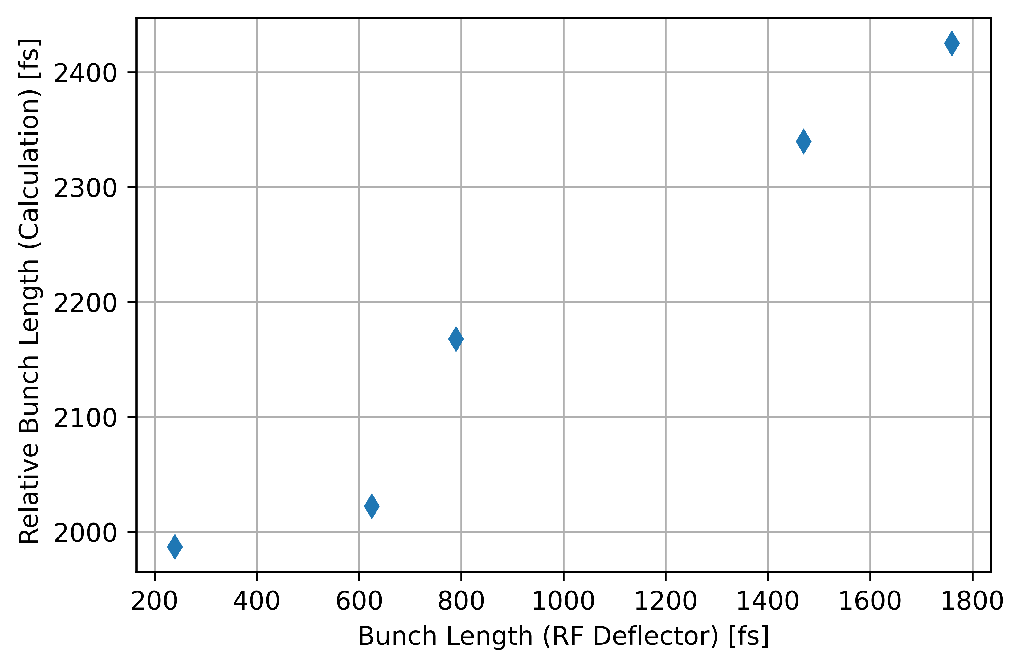
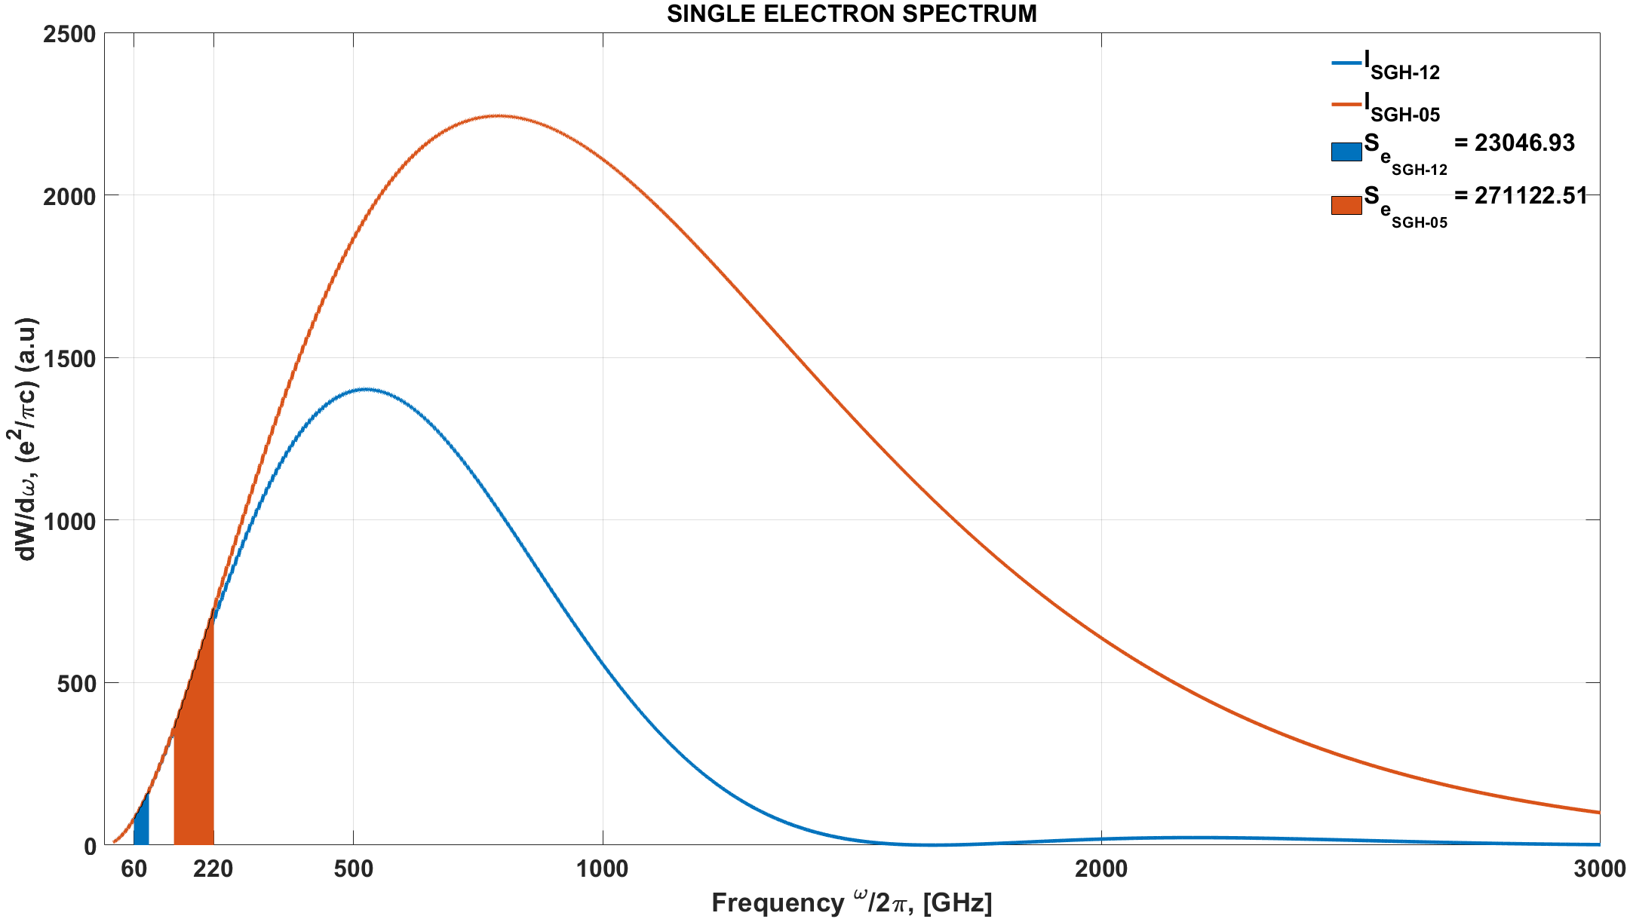
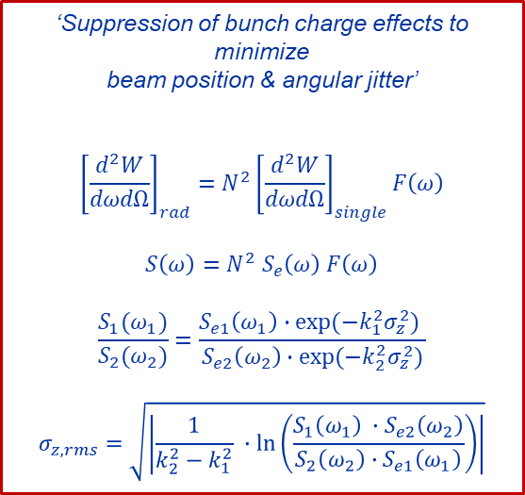
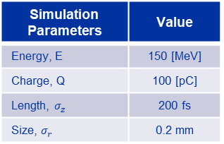
Tests @CLEAR – Bunch Length Sensitivity
Reference : Transverse Deflecting Cavity measurements
RF Deflector : 0.2 ps to 2 ps
CHDR : 2 ps to 2.4 ps
‘Suppression of bunch charge effects to minimize
beam position & angular jitter’
$${\left[\frac{d^{2}W}{dωdΩ}\right]}_{rad}=N^{2}{\left[\frac{d^{2}W}{dωdΩ}\right]}_{single}F\left(ω\right)$$
$$S\left(ω\right)=N^{2} S_{e}\left(ω\right) F\left(ω\right)$$
$$\frac{S_{1}(ω_{1})}{S_{2}(ω_{2})}=\frac{S_{e1}\left(ω_{1}\right)∙exp⁡(−k_{1}^{2}σ_{z}^{2}) }{S_{e2}\left(ω_{2}\right)∙exp⁡(−k_{2}^{2}σ_{z}^{2})}$$
$$σ_{z,rms}=\sqrt{\left|\frac{1}{k_{2}^{2}−k_{1}^{2}} ∙\ln\left(\frac{S_{1}\left(ω_{1}\right) ∙S_{e2}\left(ω_{2}\right)}{{S_{2}\left(ω_{2}\right)∙S}_{e1}\left(ω_{1}\right)}\right)\right|}$$
Simulation Parameters | Value
Energy, E | 150 [MeV]
Charge, Q | 100 [pC]
Length, $σ_{z}$ | 200 fs
Size, $σ_{r}$ | 0.2 mm
Both detectors are working in DR dominated part : no bunch length sensitivity !
Insensitivity to bunch length leads to have compressed changes in the RMS bunch length calculation !

Slide 9
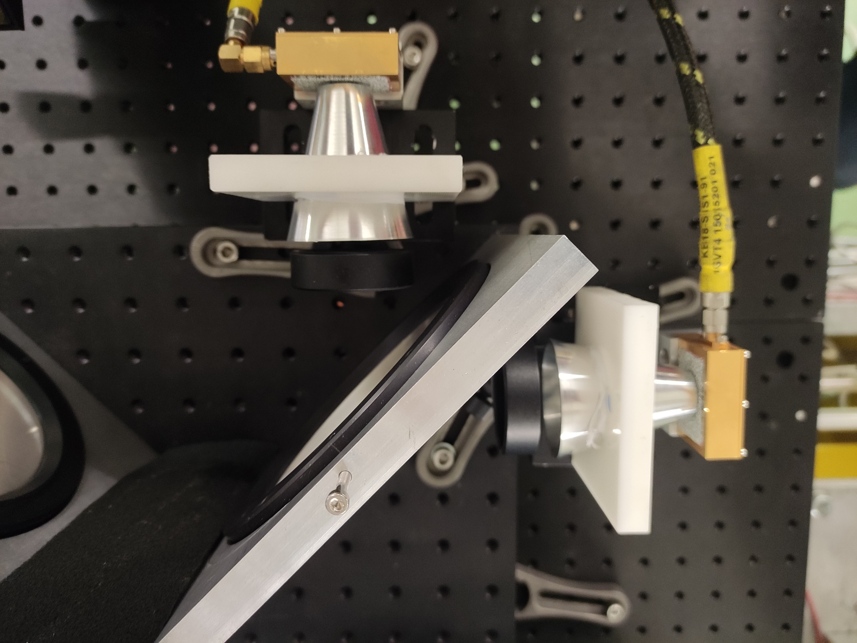

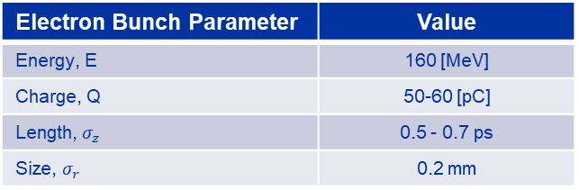

Tests @CLEAR - MP Interferometer
TPX50 THz lenses is located after the analyser.
Cylindrical metallic shield between detector and lens to avoid low frequency domination of the spectrum.
Motor step size : 0.25 mm (100 steps)
$$f_{max}= \frac{c}{2×(2,5 μm ×2)}=30 THz$$
$$f_{test}= \frac{c}{2×(250 μm ×2)}=300 GHz$$
$∆f_{resolution}= \frac{c}{2×max optical path difference}=1.43 GHz$
$∆f_{test, resolution}= \frac{c}{2×max optical path difference}=6 GHz$
Electron Bunch Parameter | Value
Energy, E | 160 [MeV]
Charge, Q | 50-60 [pC]
Length, $σ_{z}$ | 0.5 - 0.7 ps
Size, $σ_{r}$ | 0.2 mm

Slide 10
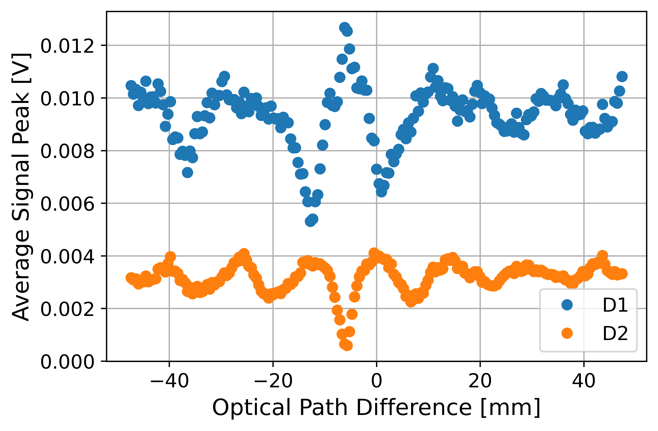
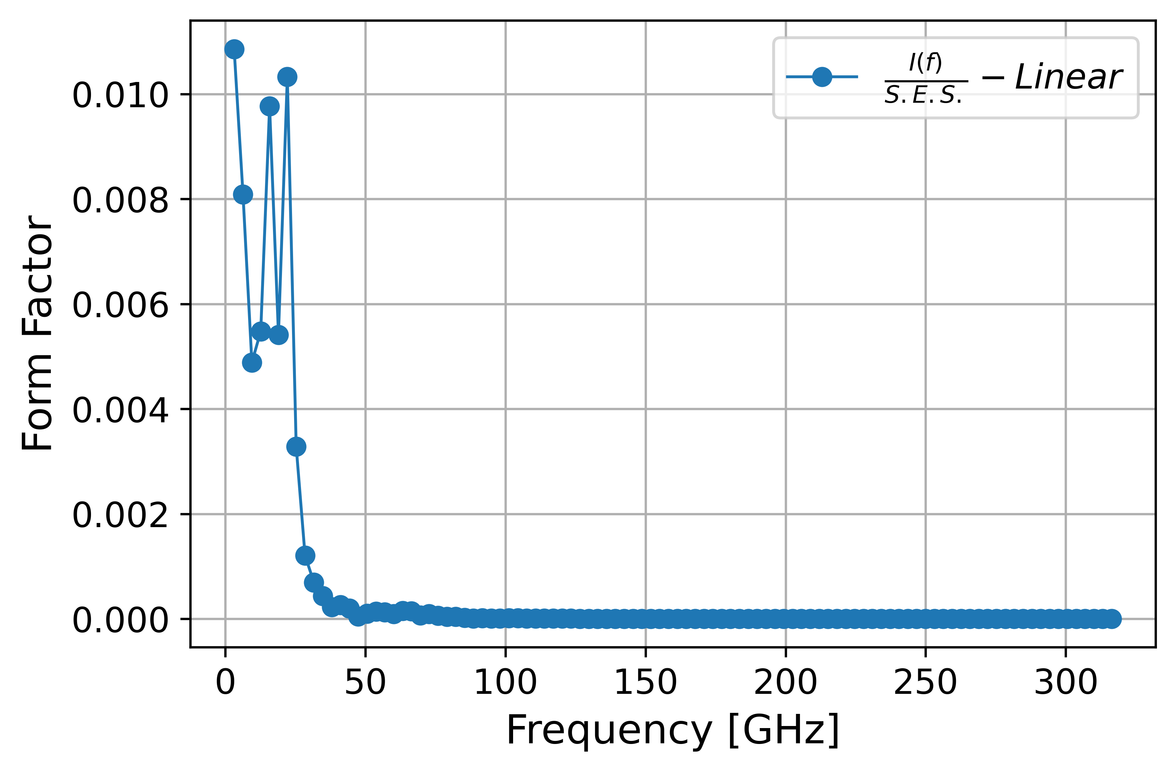
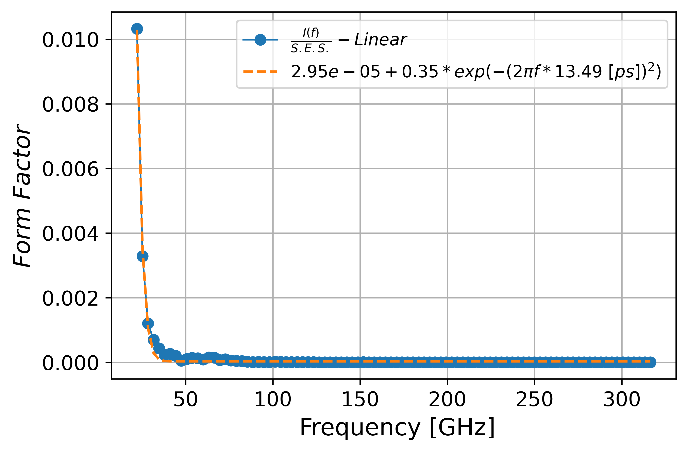
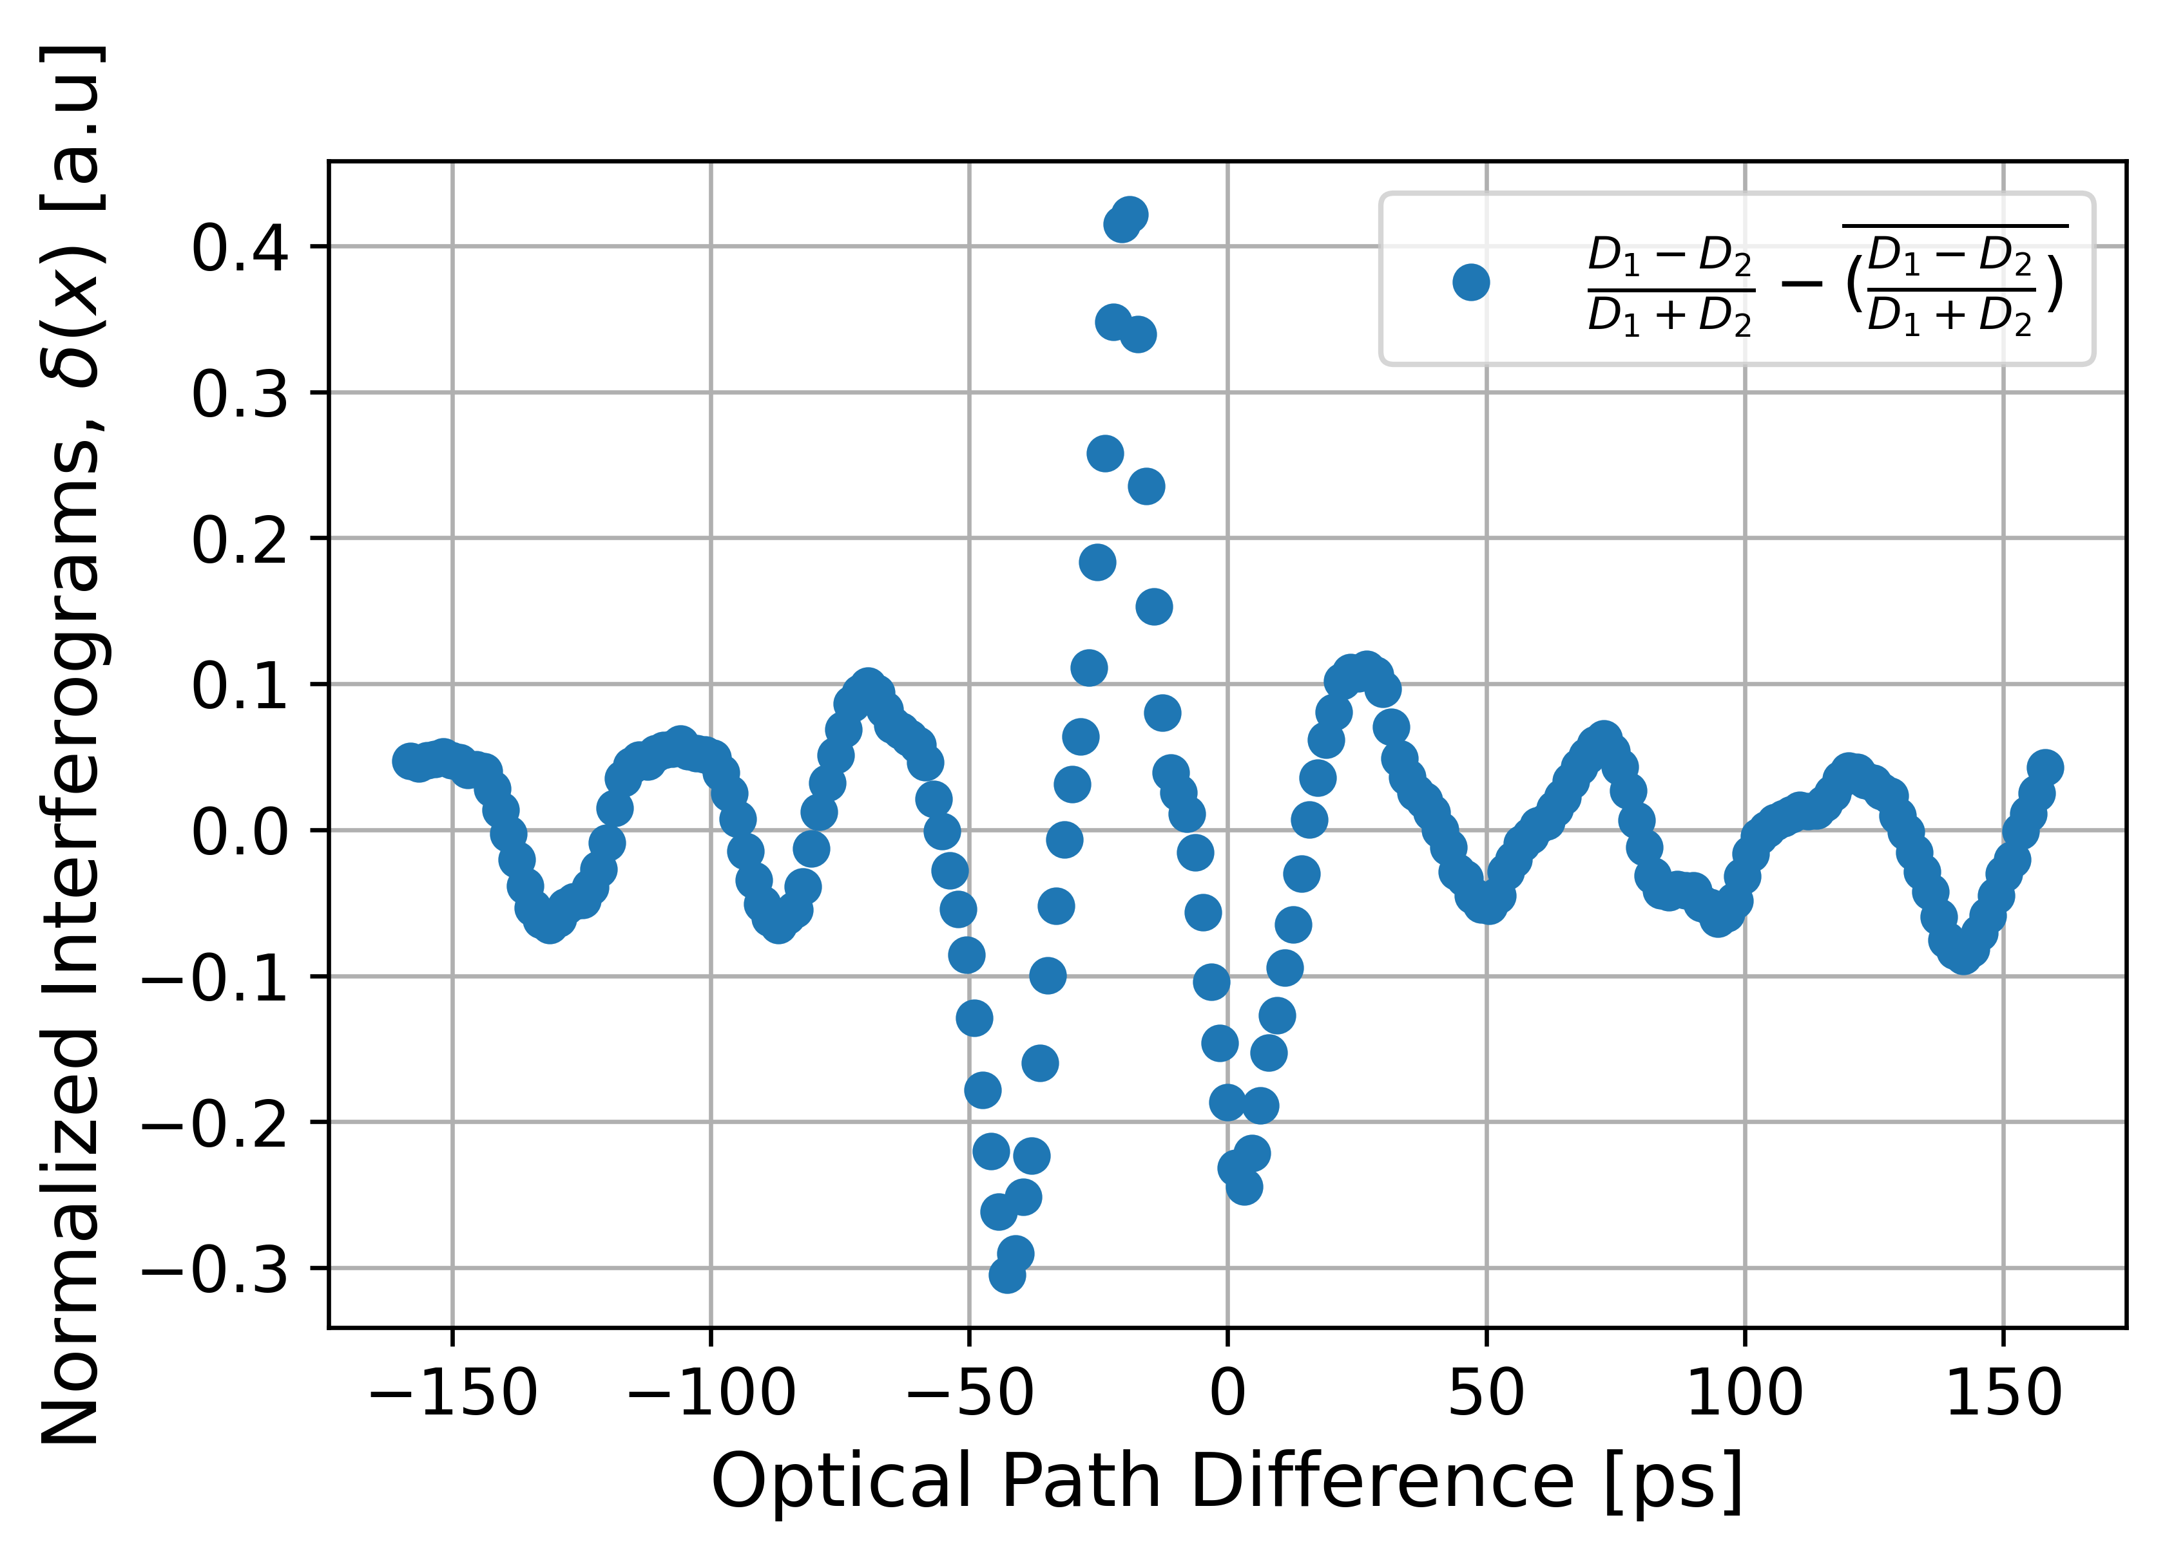
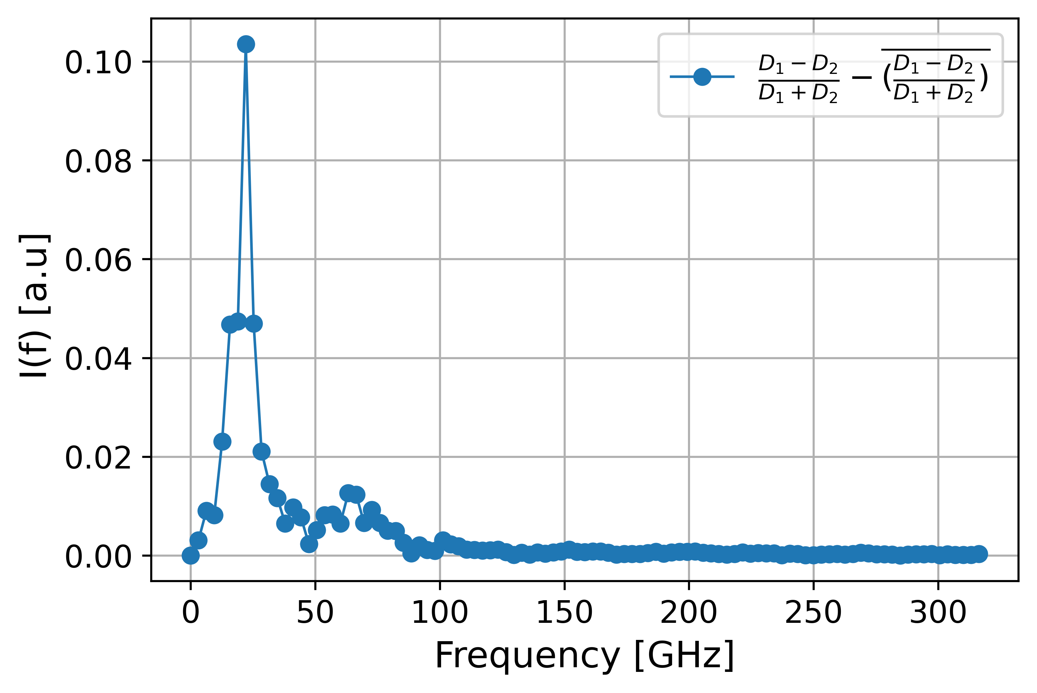
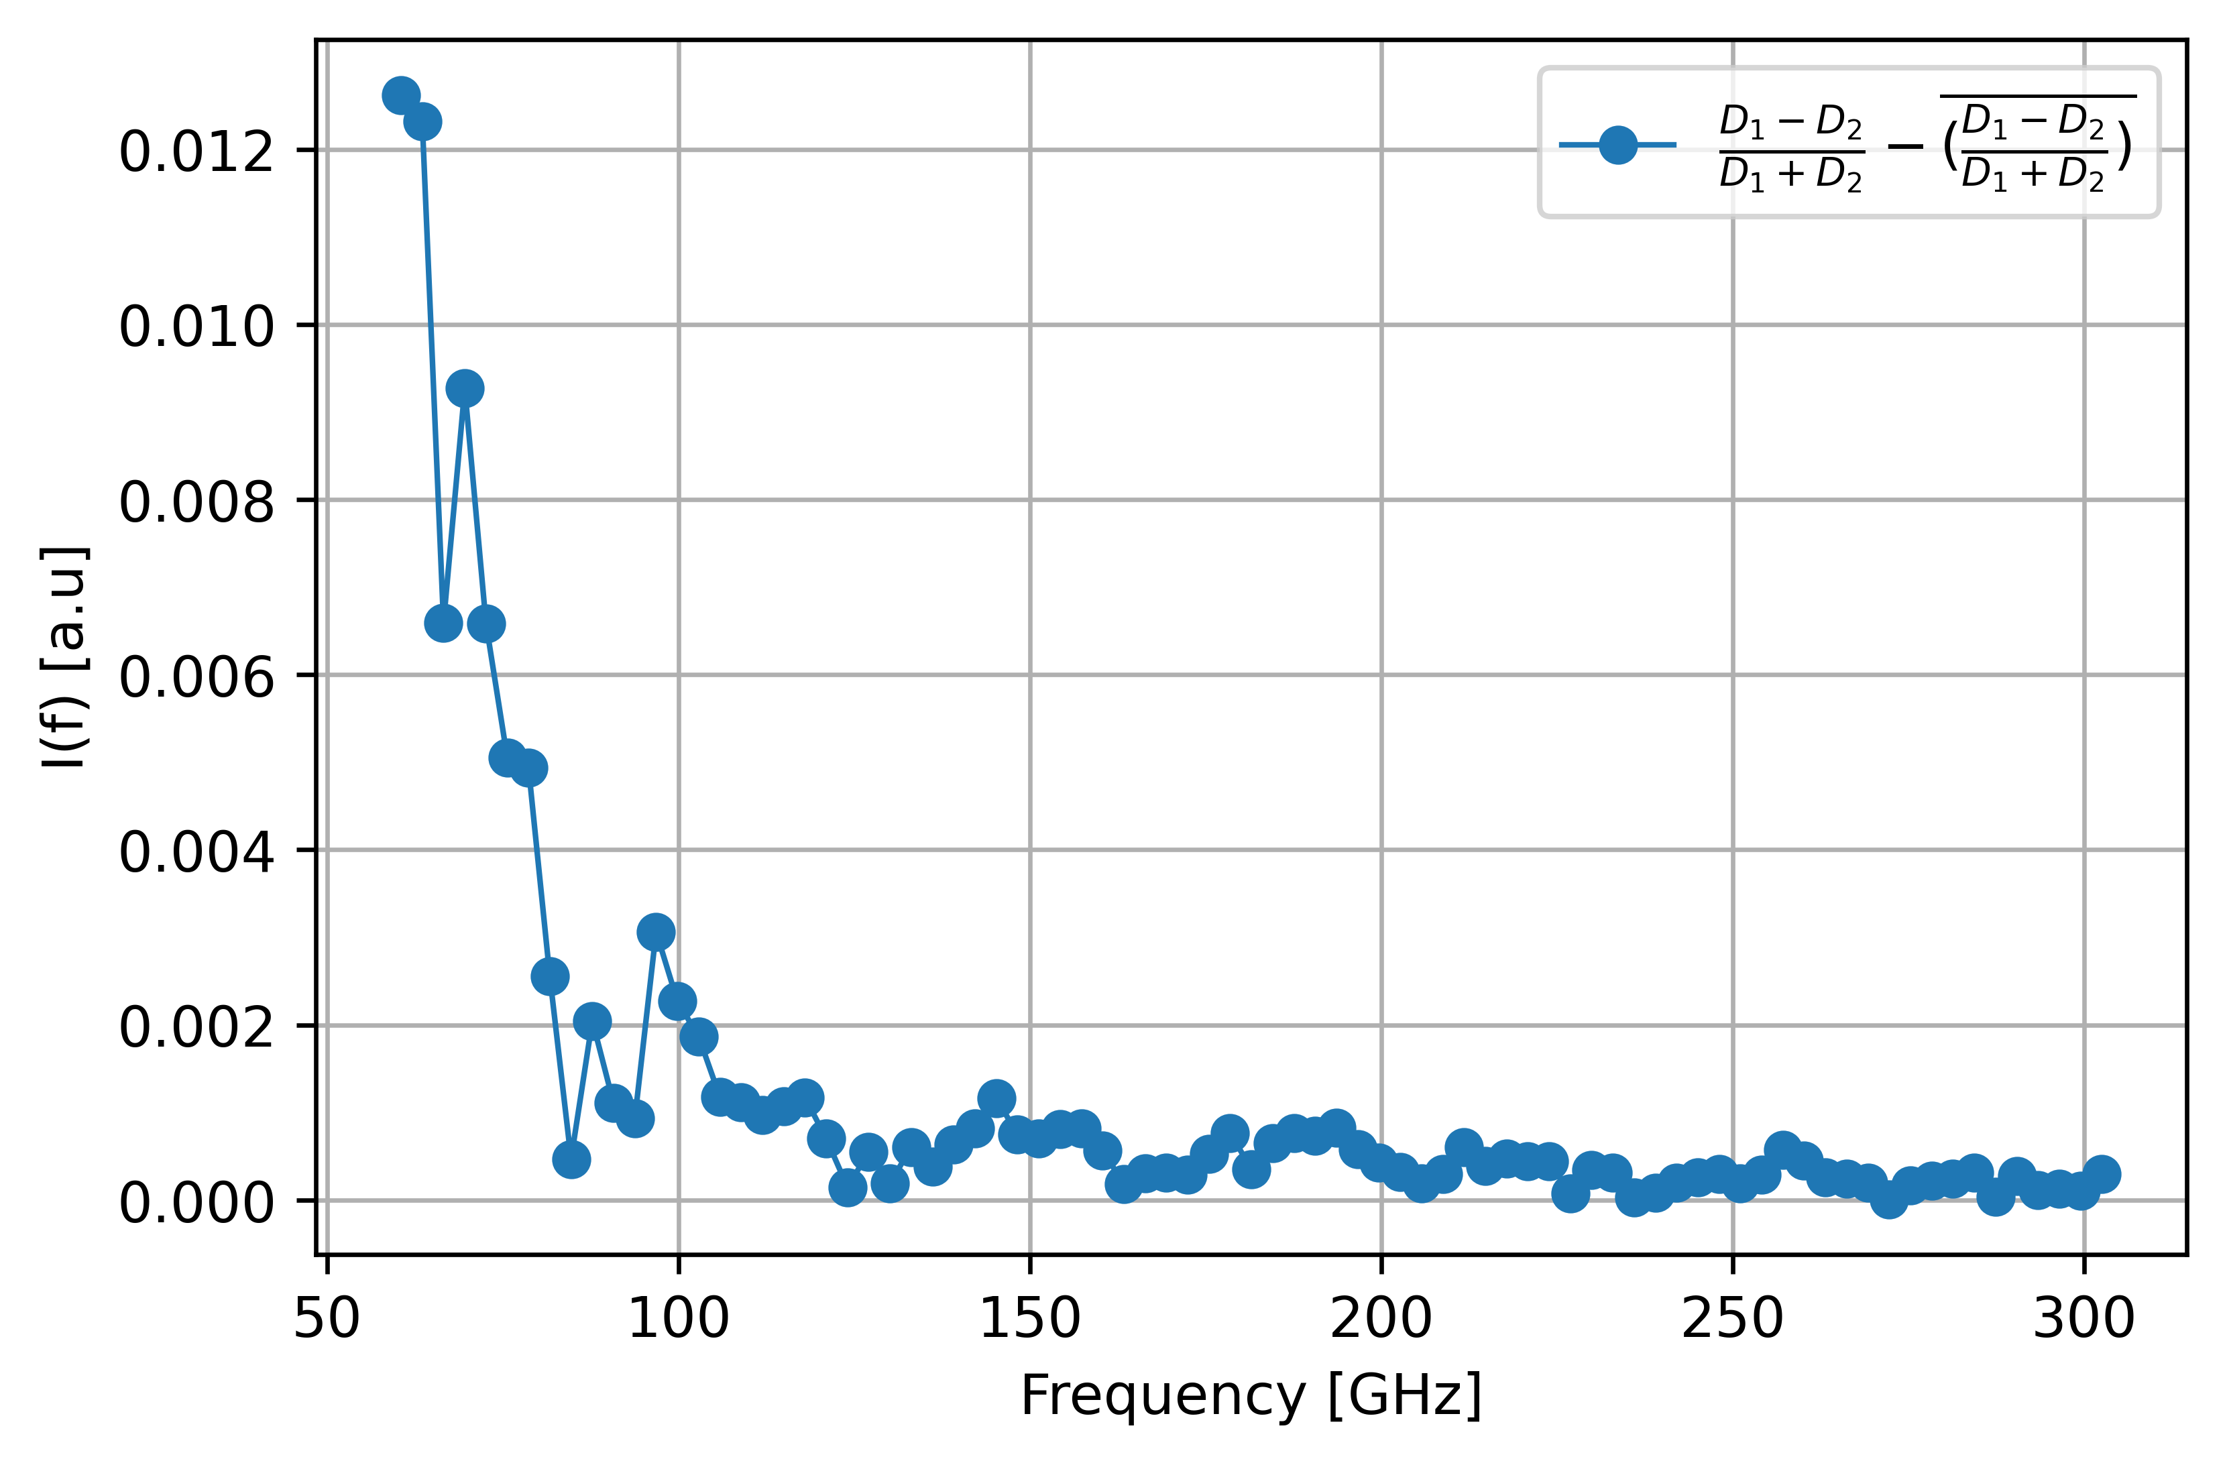
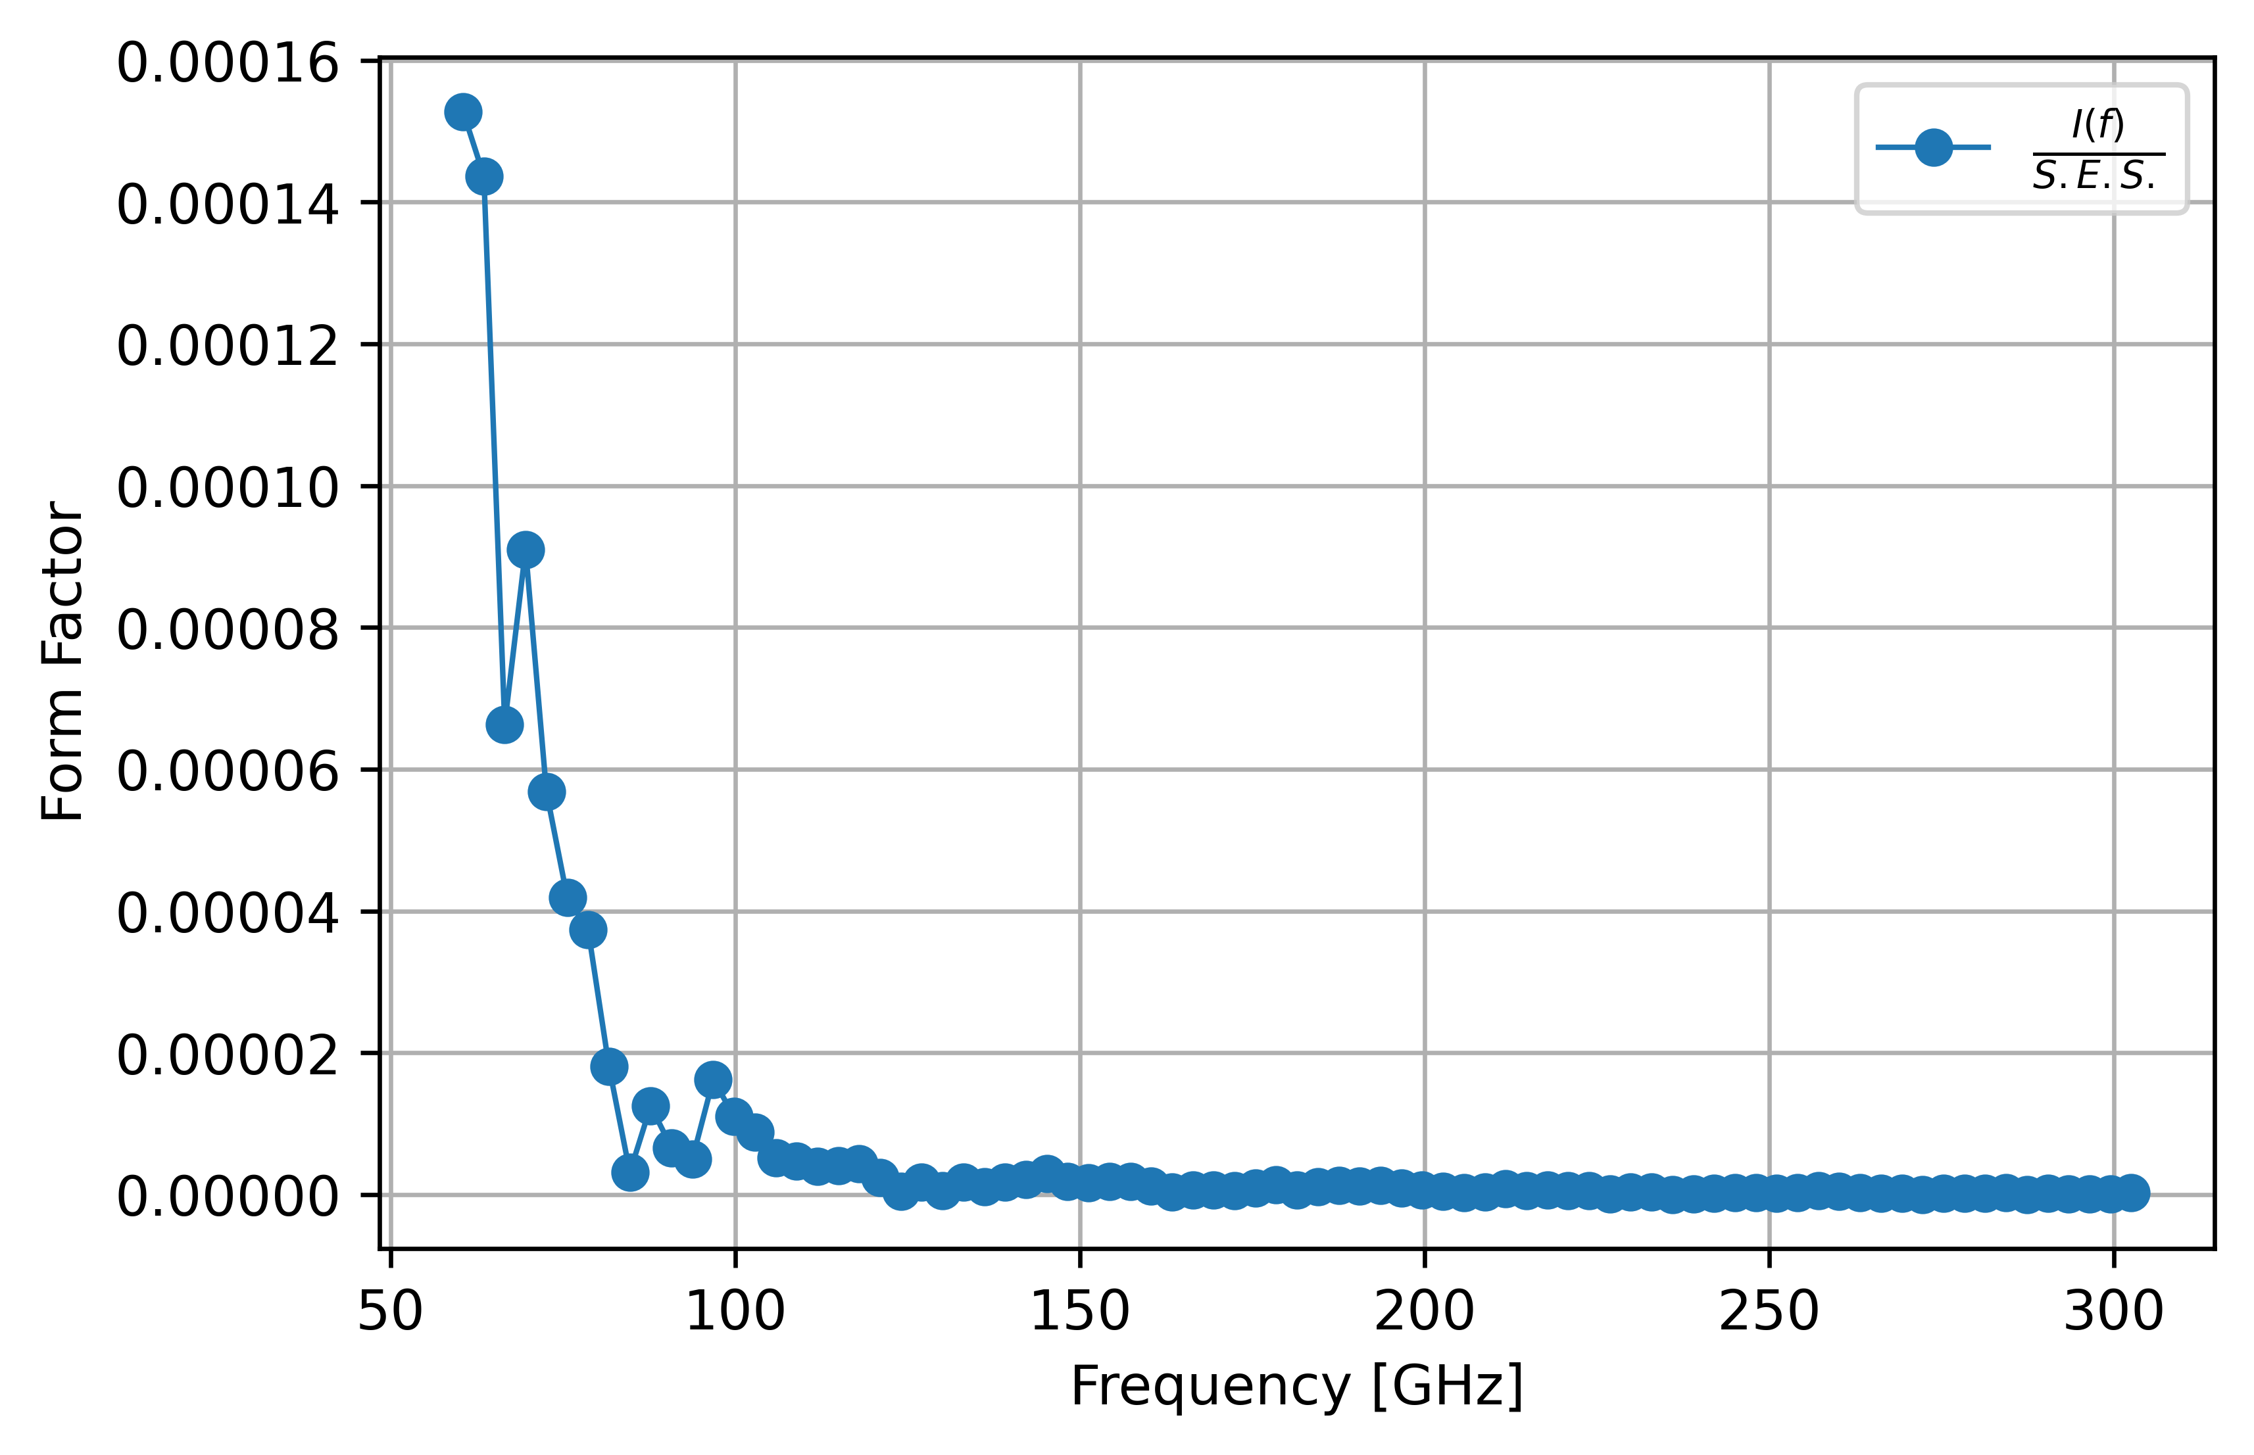
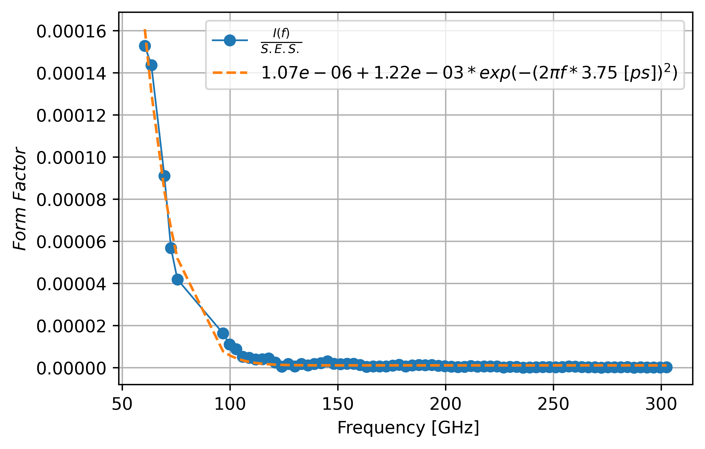
Tests @CLEAR – MP Interferometer
Missing the high frequency component of ChDR due to large impact parameter (b=15mm) !

Slide 11
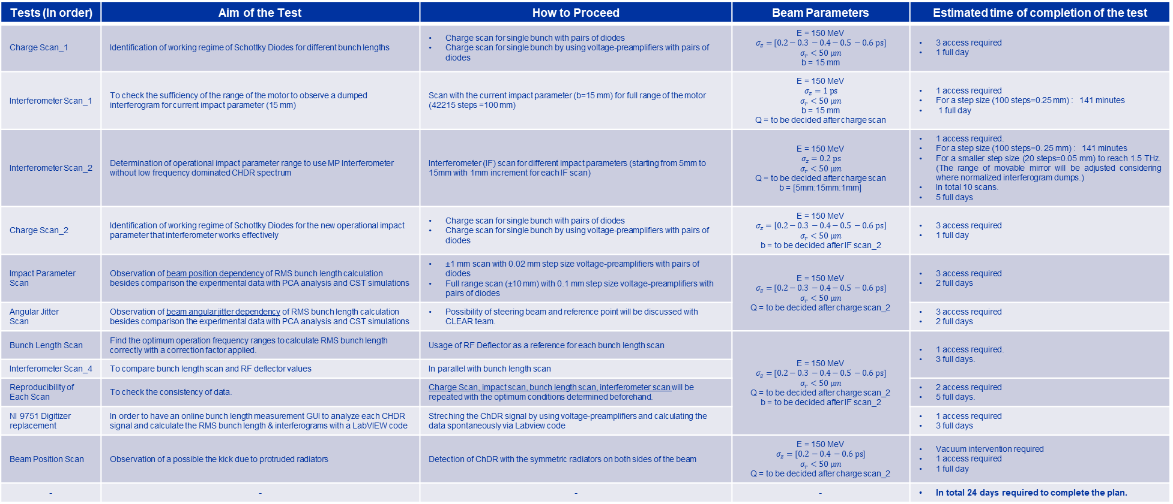
Experiment Plan - (%100)
Tests (In order) | Aim of the Test | How to Proceed | Beam Parameters | Estimated time of completion of the test
Charge Scan_1 | Identification of working regime of Schottky Diodes for different bunch lengths | Charge scan for single bunch with pairs of diodes Charge scan for single bunch by using voltage-preamplifiers with pairs of diodes | E = 150 MeV $$σ_{z}=[0.2−0.3 −0.4−0.5 −0.6 ps]$$ $$σ_{r}<50 μm$$ b = 15 mm | 3 access required 1 full day
Interferometer Scan_1 | To check the sufficiency of the range of the motor to observe a dumped interferogram for current impact parameter (15 mm) | Scan with the current impact parameter (b=15 mm) for full range of the motor (42215 steps =100 mm) | E = 150 MeV $$σ_{z}=1 ps$$ $$σ_{r}<50 μm$$ b = 15 mm Q = to be decided after charge scan | 1 access required For a step size (100 steps=0.25 mm) : 141 minutes 1 full day
Interferometer Scan_2 | Determination of operational impact parameter range to use MP Interferometer without low frequency dominated CHDR spectrum | Interferometer (IF) scan for different impact parameters (starting from 5mm to 15mm with 1mm increment for each IF scan) | E = 150 MeV $$σ_{z}=0.2 ps$$ $$σ_{r}<50 μm$$ Q = to be decided after charge scan b = [5mm:15mm:1mm] | 1 access required. For a step size (100 steps=0. 25 mm) : 141 minutes For a smaller step size (20 steps=0.05 mm) to reach 1.5 THz. (The range of movable mirror will be adjusted considering where normalized interferogram dumps.) In total 10 scans. 5 full days
Charge Scan_2 | Identification of working regime of Schottky Diodes for the new operational impact parameter that interferometer works effectively | Charge scan for single bunch with pairs of diodes Charge scan for single bunch by using voltage-preamplifiers with pairs of diodes | E = 150 MeV $$σ_{z}=\left[0.2−0.3 −0.4−0.5 −0.6 ps\right]$$ $$σ_{r}<50 μm$$ b = to be decided after IF scan_2 | 3 access required 1 full day
Impact Parameter Scan | Observation of beam position dependency of RMS bunch length calculation besides comparison the experimental data with PCA analysis and CST simulations | ±1 mm scan with 0.02 mm step size voltage-preamplifiers with pairs of diodes Full range scan (±10 mm) with 0.1 mm step size voltage-preamplifiers with pairs of diodes | E = 150 MeV $$σ_{z}=[0.2−0.3 −0.4−0.5 −0.6 ps]$$ $$σ_{r}<50 μm$$ Q = to be decided after charge scan_2 | 3 access required 2 full days
Angular Jitter Scan | Observation of beam angular jitter dependency of RMS bunch length calculation besides comparison the experimental data with PCA analysis and CST simulations | Possibility of steering beam and reference point will be discussed with CLEAR team. |  | 3 access required 2 full days
Bunch Length Scan | Find the optimum operation frequency ranges to calculate RMS bunch length correctly with a correction factor applied. | Usage of RF Deflector as a reference for each bunch length scan | E = 150 MeV $$σ_{z}=[0.2−0.3 −0.4−0.5 −0.6 ps]$$ $$σ_{r}<50 μm$$ Q = to be decided after charge scan_2 b = to be decided after IF scan_2 | 1 access required. 3 full days.
Interferometer Scan_4 | To compare bunch length scan and RF deflector values | In parallel with bunch length scan |  | 1 full day.
Reproducibility of Each Scan | To check the consistency of data. | Charge Scan, impact scan, bunch length scan, interferometer scan will be repeated with the optimum conditions determined beforehand. |  | 2 access required 5 full days.
NI 9751 Digitizer replacement | In order to have an online bunch length measurement GUI to analyze each CHDR signal and calculate the RMS bunch length & interferograms with a LabVIEW code | Streching the ChDR signal by using voltage-preamplifiers and calculating the data spontaneously via Labview code |  | 1 access required 3 full days
Beam Position Scan | Observation of a possible the kick due to protruded radiators | Detection of ChDR with the symmetric radiators on both sides of the beam | E = 150 MeV $$σ_{z}=[0.2 −0.4 −0.6 ps]$$ $$σ_{r}<50 μm$$ Q = to be decided after charge scan_2 | Vacuum intervention required 1 access required 1 full day
- | - | - | - | In total 24 days required to complete the plan.

Slide 12
Conclusion
Data analysed carefully and the issues leading calculation errors were diagnosed to improve the quality of the measurements and data.
  Voltage-preamplifiers will be used for low charge scan to identify the working regime of the all diodes.
  Impact parameter will be decreased in order to ;
    reduce the effect of the radiator width on the beam position sensitivity (impact parameter).
    avoid low frequency dominance in the interferometric measurement.
  Bunch length scan will be repeated (in a narrow span) after further PCA analysis to use the sensitivity diodes (140-220 Ghz & 400-600 GHz) in the bunch form factor dominated area of the ChDR spectrum to find an effective correction factor to be used in the RMS bunch length calculation.
  Upcoming beam time : Next week (hopefully !)
  Commissioning of the bunch length monitor will be completed until the end of year.
  Further improvements – such as online monitoring, preparation of a GUI etc. - will be done in the next year.

