Slide 1



Run 2c Diagnostics Development
Catherine Swain, Joseph Wolfenden, Carsten Welsch
04/10/2022

Slide 2
Overview
Broadband imaging of CxR bunch length monitor
Single-shot emittance diagnostic development
Optical fibre beam loss monitor
C. Swain (catherine.swain@liverpool.ac.uk)
AWAKE collaboration meeting 05/10/2022
1

Slide 3
Broadband imaging of CxR bunch length monitor
C. Swain (catherine.swain@liverpool.ac.uk)
AWAKE collaboration meeting 05/10/2022
2

Slide 4


Broadband imaging of CxR bunch length monitor
Types of CxR under investigation
  CTR – Coherent Transition Radiation
  CSR – Coherent Synchrotron Radiation
Experimental work at MAX IV
Machine learning
Simulation work
C. Swain (catherine.swain@liverpool.ac.uk)
AWAKE collaboration meeting 05/10/2022
3

Slide 5
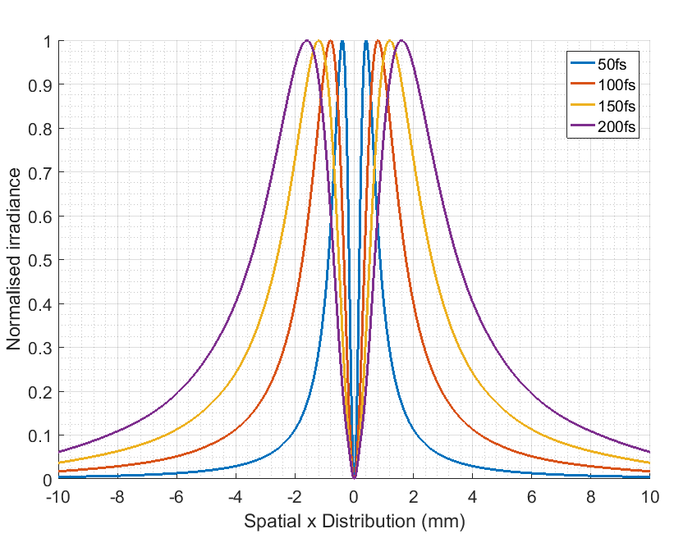
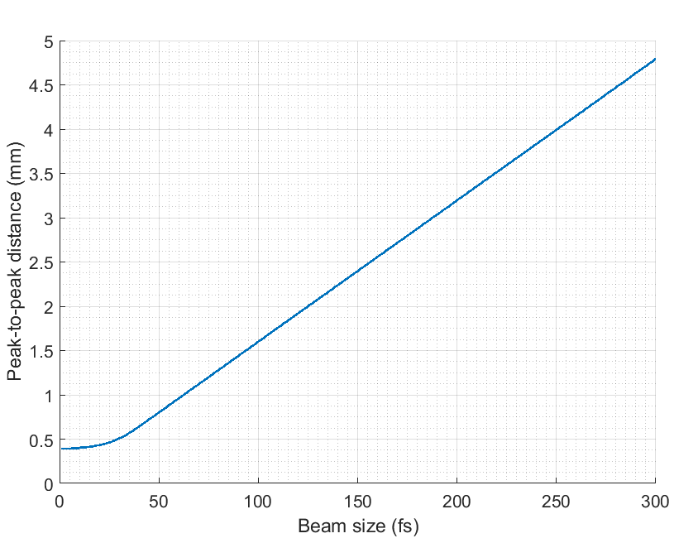
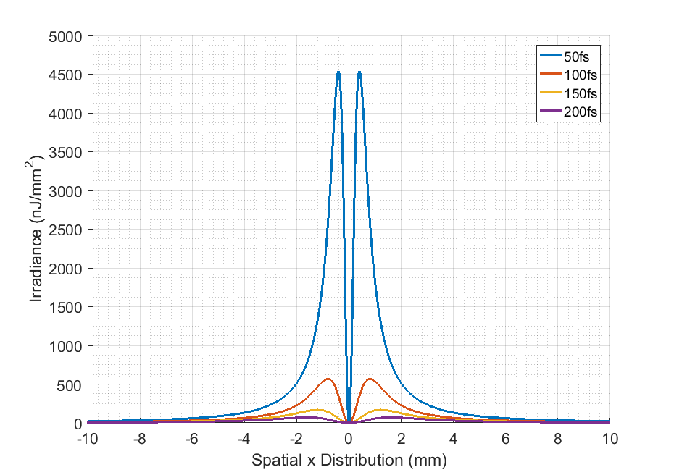
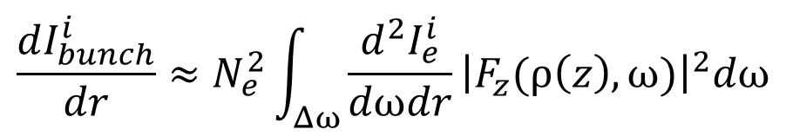
Broadband imaging of CxR bunch length monitor
$$\frac{dI_{bunch}^{i}}{dr}≈N_{e}^{2}\int_{Δω}{\frac{d^{2}I_{e}^{i}}{dωdr}{\left|F_{z}(ρ\left(z\right),ω)\right|}^{2}dω}$$
Bunch Image
No. of e⁻
Bandwidth
Single e⁻ Spectral Image
Bunch Form Factor
C. Swain (catherine.swain@liverpool.ac.uk)
AWAKE collaboration meeting 05/10/2022
4

Slide 6
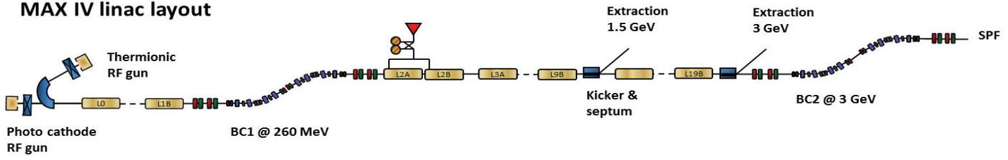
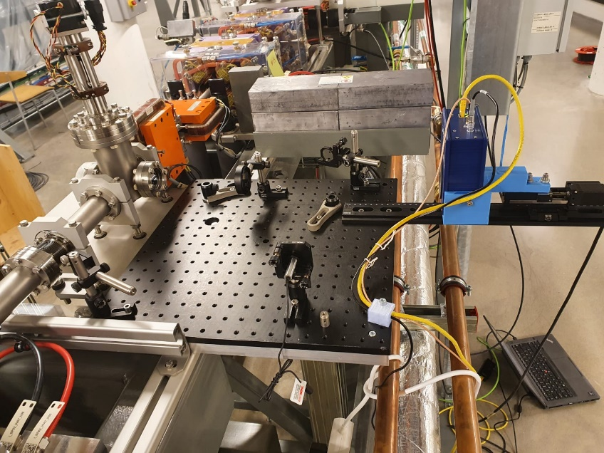
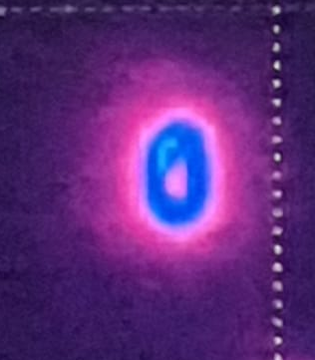
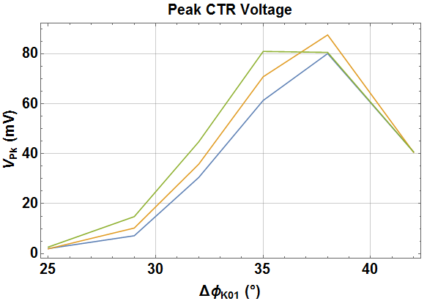
Broadband imaging of CxR bunch length monitor
[1]
HRFZ Si Lens
[2]
Pyrocam
Pyrocam
C. Swain (catherine.swain@liverpool.ac.uk)
AWAKE collaboration meeting 05/10/2022
5

Slide 7
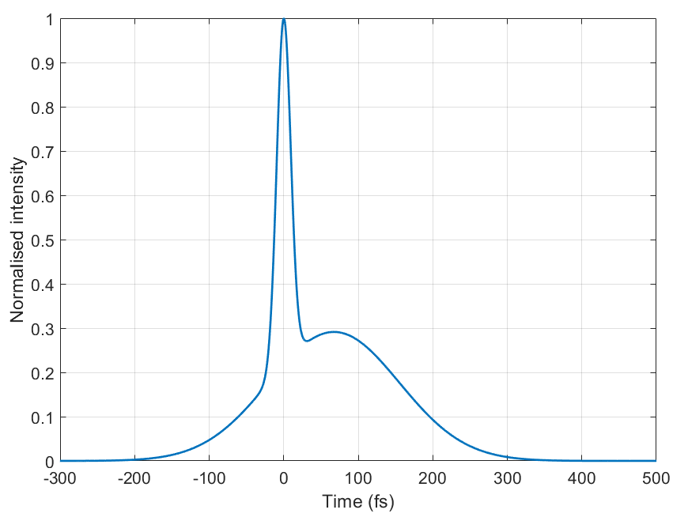
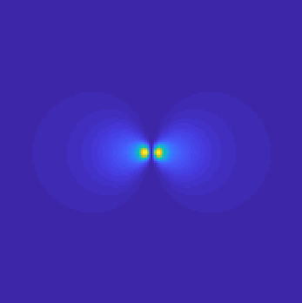
Broadband imaging of CxR bunch length monitor
Machine Learning simulations
Generated 100,000 double Gaussians with varying amplitudes, offsets, and widths
Simulated CTR image for each
Verified physics by fixing certain parameters and checking model outputs, ensuring phase couldn’t be predicted
x100,000
C. Swain (catherine.swain@liverpool.ac.uk)
AWAKE collaboration meeting 05/10/2022
6

Slide 8
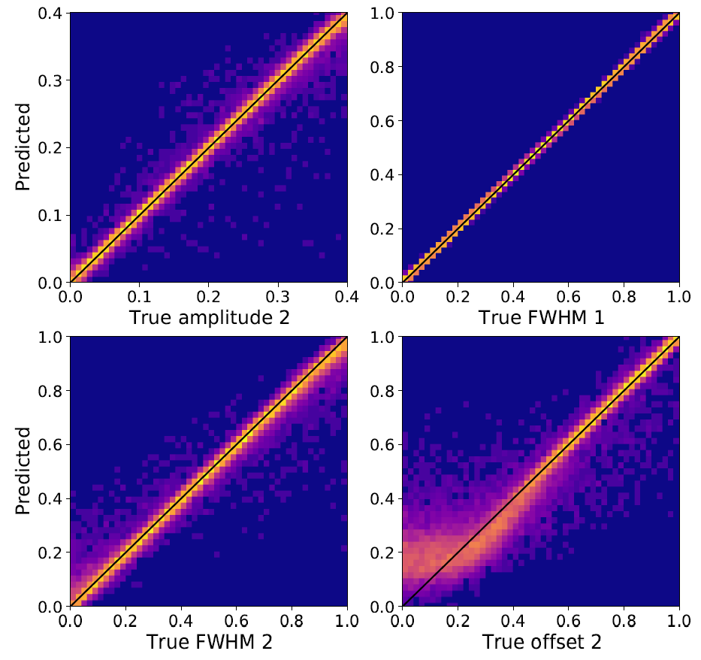
Broadband imaging of CxR bunch length monitor
6.7% RMSE
1.0% RMSE
x100,000
6.2% RMSE
17.2% RMSE
C. Swain (catherine.swain@liverpool.ac.uk)
AWAKE collaboration meeting 05/10/2022
7

Slide 9
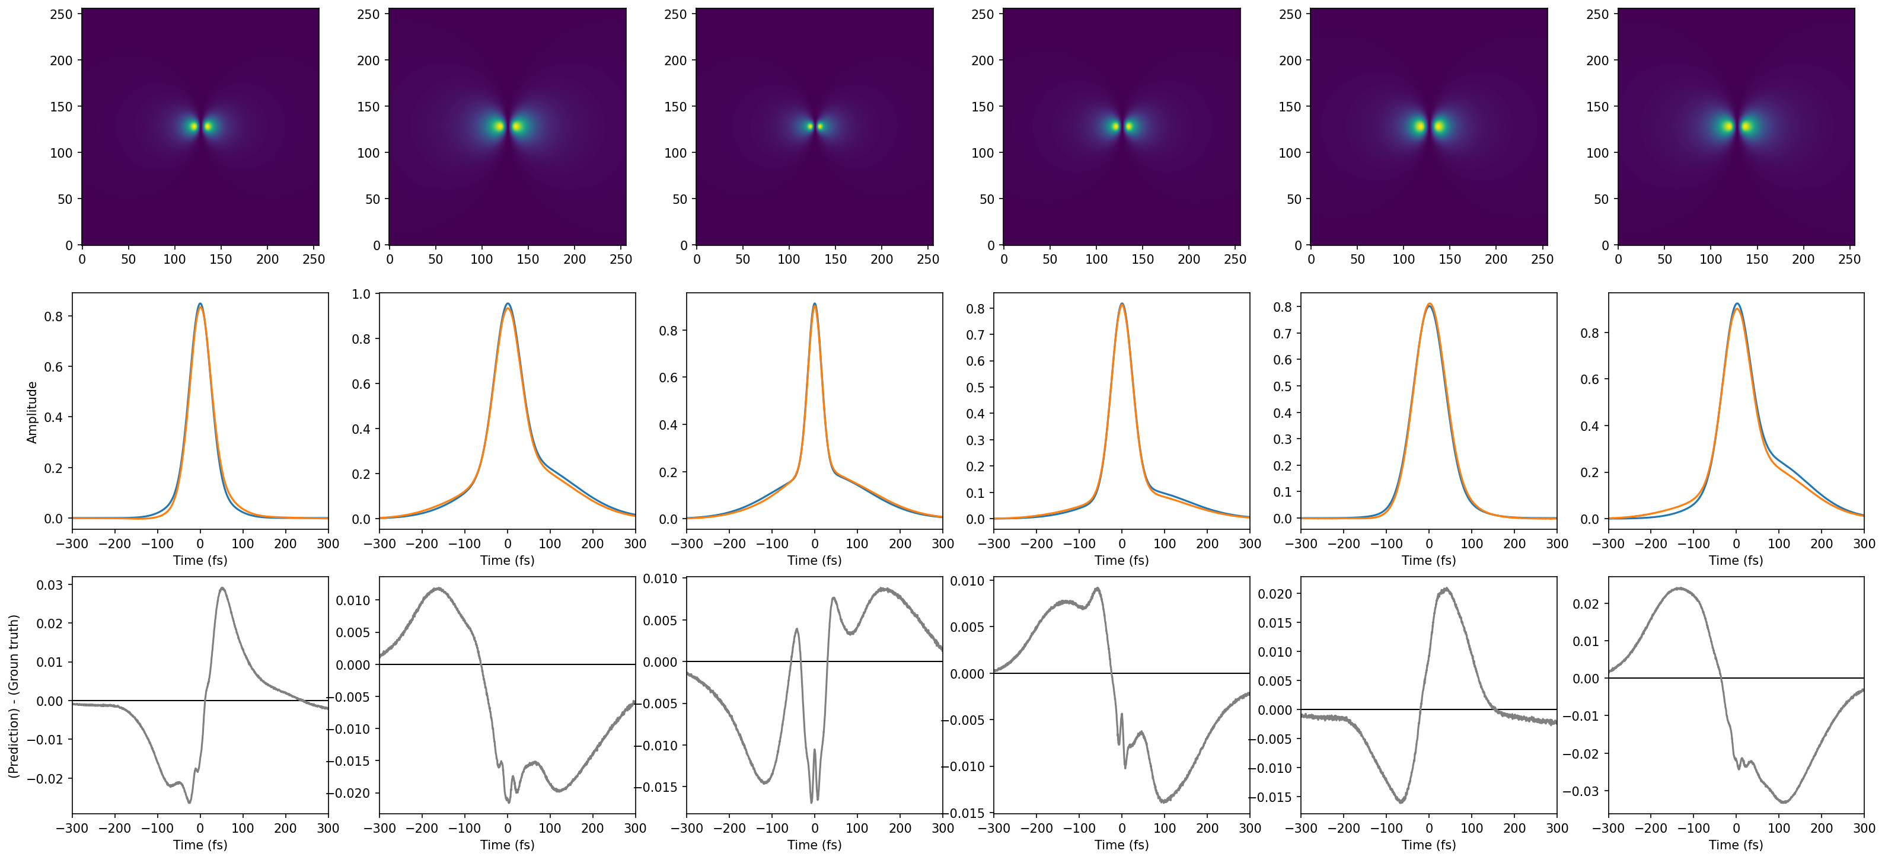
Broadband imaging of CxR bunch length monitor
Ground Truth
Model Prediction
C. Swain (catherine.swain@liverpool.ac.uk)
AWAKE collaboration meeting 05/10/2022
8

Slide 10
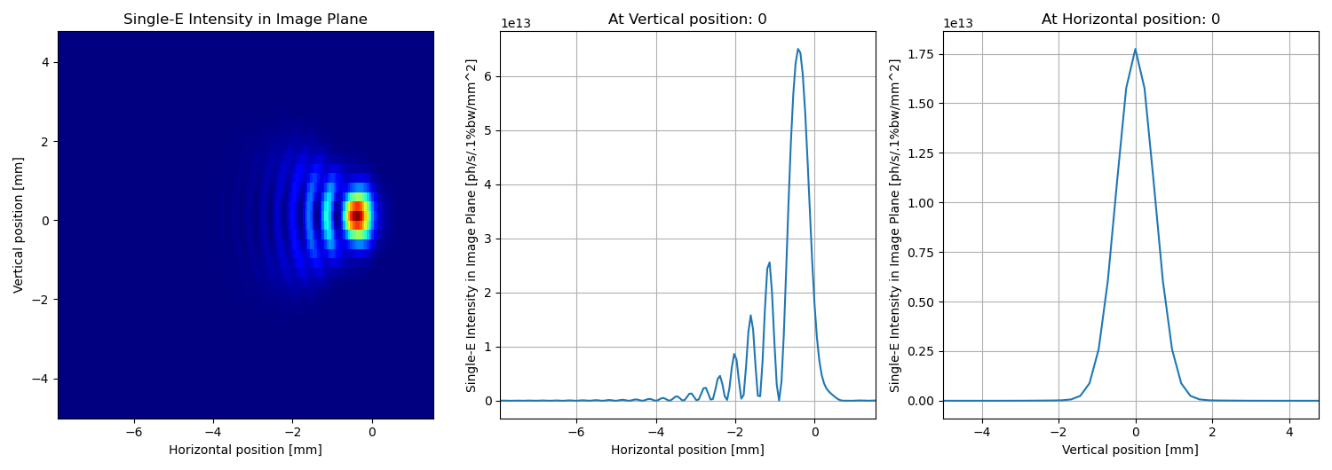
Broadband imaging of CxR bunch length monitor
HRFZ Si Lens
Pyrocam
Pyrocam
C. Swain (catherine.swain@liverpool.ac.uk)
AWAKE collaboration meeting 05/10/2022
9

Slide 11
Single-shot emittance diagnostic development
C. Swain (catherine.swain@liverpool.ac.uk)
AWAKE collaboration meeting 05/10/2022
10

Slide 12
Single-shot emittance diagnostic development
Focusing on OTR – Optical Transition Radiation
  Could also be done with other types of radiation, e.g. OSR
Two methods under investigation:
  MLA – Micro Lens Array
  DMD – Digital Micromirror Device
C. Swain (catherine.swain@liverpool.ac.uk)
AWAKE collaboration meeting 05/10/2022
11

Slide 13
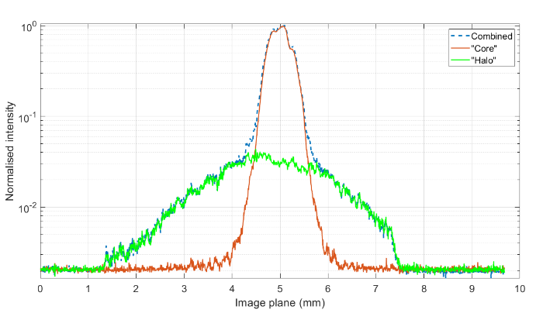
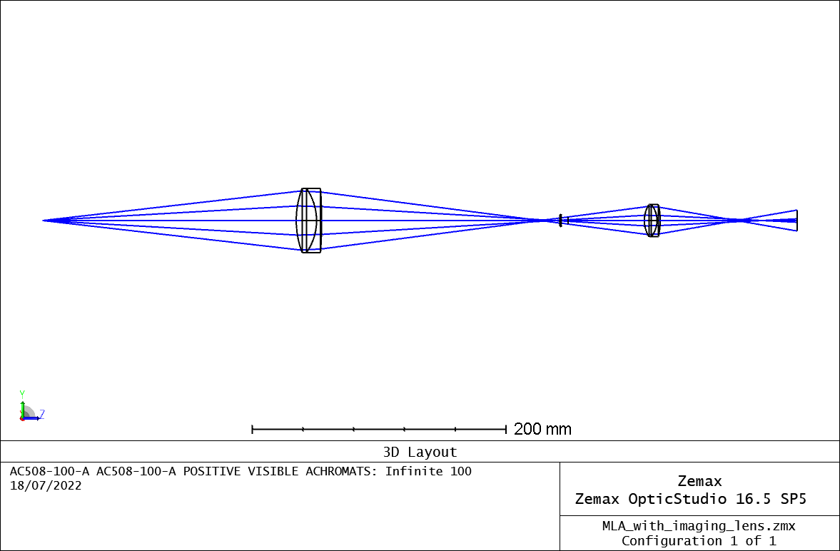
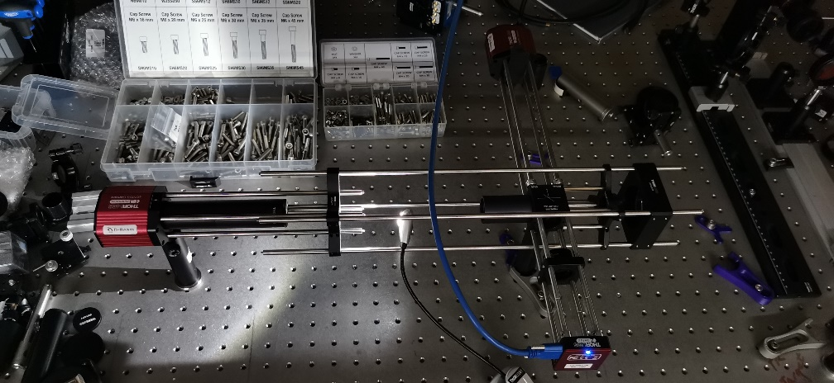
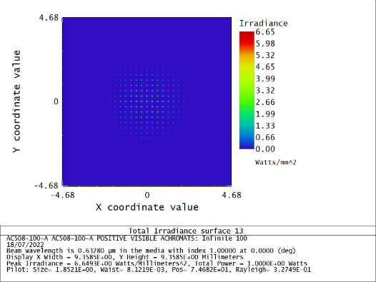
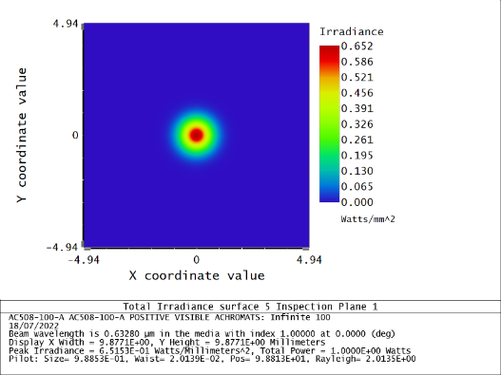
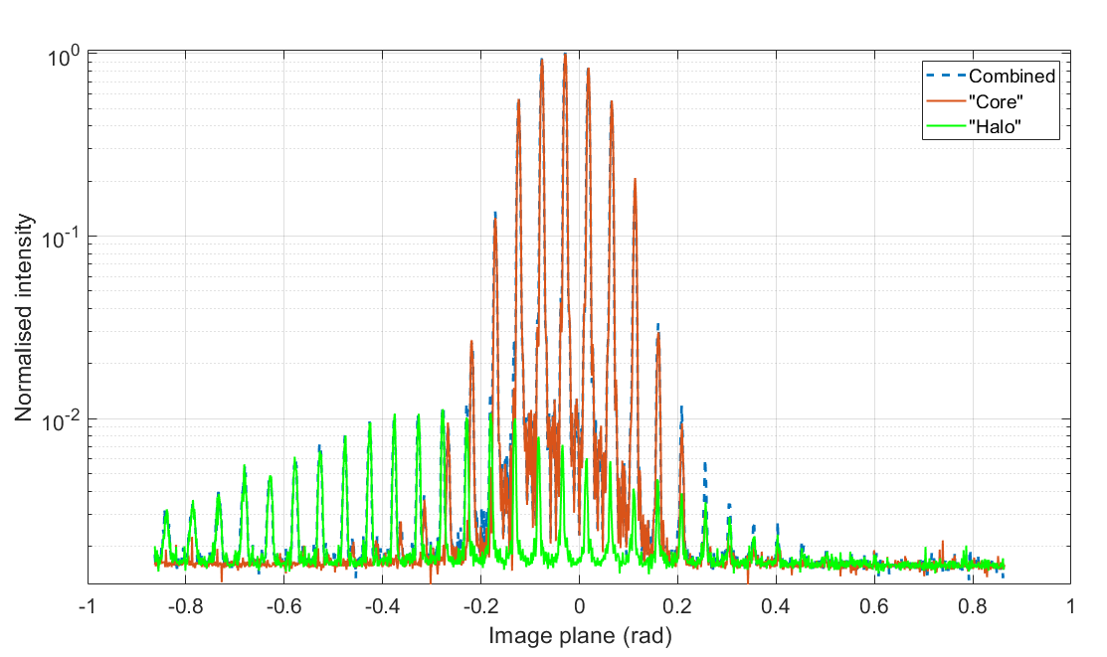
Single-shot emittance diagnostic development
Micro-Lens Array
C. Swain (catherine.swain@liverpool.ac.uk)
AWAKE collaboration meeting 05/10/2022
12

Slide 14
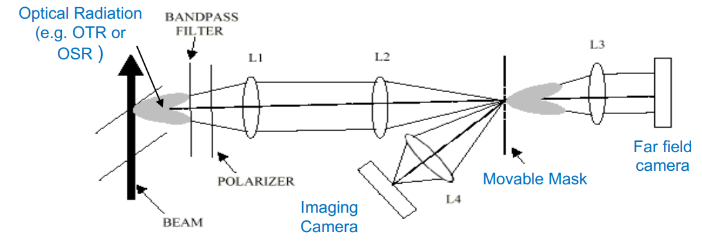
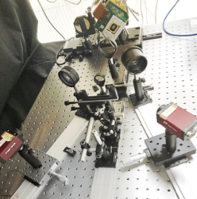
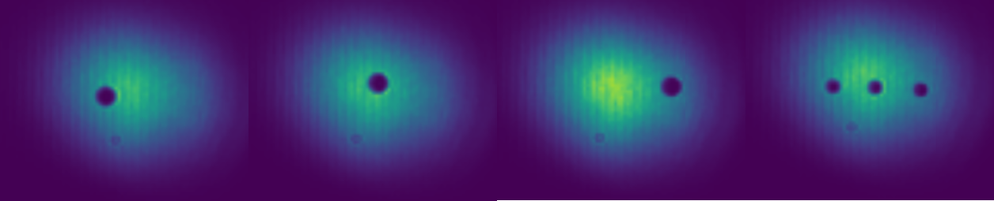
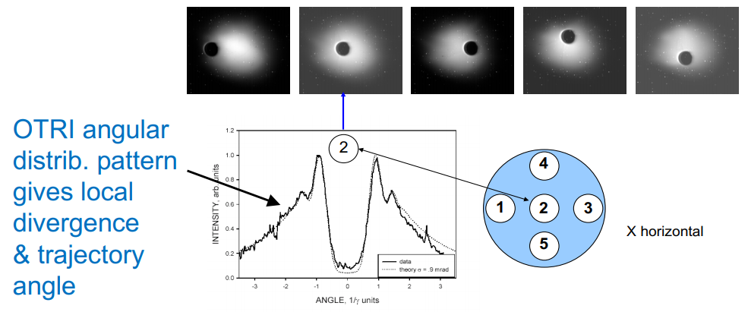
Single-shot emittance diagnostic development
0
DMD Stage
[3, 4]
Beam Image
Angular Image
C. Swain (catherine.swain@liverpool.ac.uk)
AWAKE collaboration meeting 05/10/2022
13

Slide 15
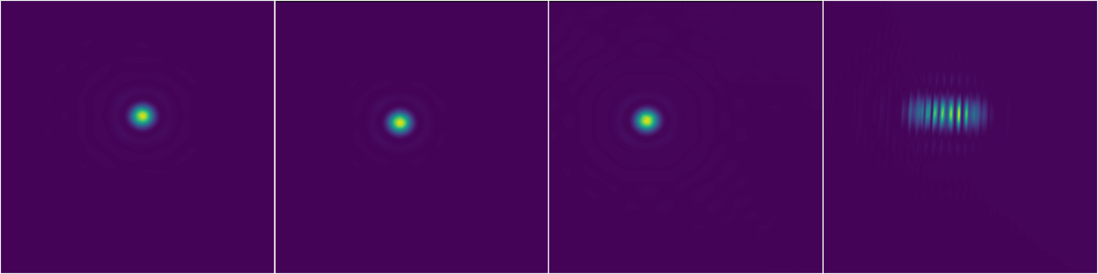
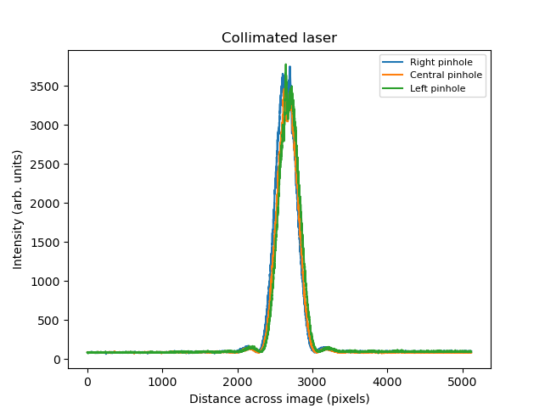
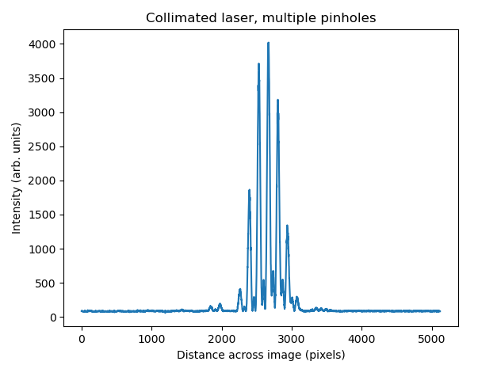
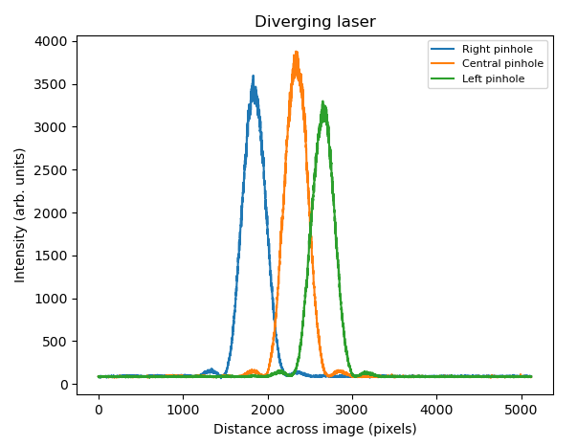
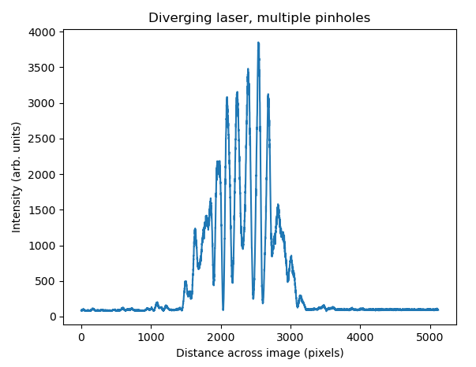
Single-shot emittance diagnostic development
C. Swain (catherine.swain@liverpool.ac.uk)
AWAKE collaboration meeting 05/10/2022
14

Slide 16
Optical fibre beam loss monitor
C. Swain (catherine.swain@liverpool.ac.uk)
AWAKE collaboration meeting 05/10/2022
15

Slide 17

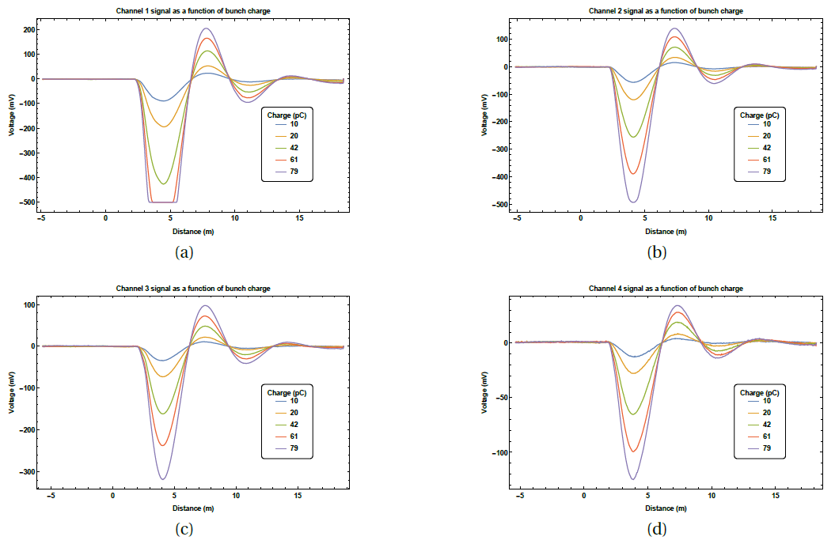
Optical fibre beam loss monitor
Improved loss location resolution, <10cm
New PhD student
Simulation studies
RF breakdown detection
Ideas for plasma diagnostic capability
Particle bunch
Screen
v
Beam pipe
Sensor Unit
Optical-fibre
Charge shower
Cherenkov radiation
oBLM operating principle
[5, 6, 7]
C. Swain (catherine.swain@liverpool.ac.uk)
AWAKE collaboration meeting 05/10/2022
16

Slide 18
Summary
C. Swain (catherine.swain@liverpool.ac.uk)
AWAKE collaboration meeting 05/10/2022
17

Slide 19
Summary
CxR bunch length monitor
  CTR imaging set up currently in place in MAX IV and operational as a compression monitor
  ML analysis of simulated CTR images model capable of predicting bunch profiles at high level of accuracy (no phase), and will be tested on experimental data in the near future
  SR simulations of CSR version of monitor are underway
Single-shot emittance diagnostic development
  Both MLA and DMD systems currently being tested and benchmarked at CI
  Plans in place to test both systems at SPARCLab and FEBE CLARA
Optical fibre beam loss monitor
  Loss location resolution improved to <10 cm
  New PhD student focused solely on OBLM started this week
C. Swain (catherine.swain@liverpool.ac.uk)
AWAKE collaboration meeting 05/10/2022
18

Slide 20
Thank you for your attention!
Questions?
References:
[1] S. Thorin et al., Proc. IPAC2017, TUPAB099
[2] B. Kyle et al., Proc. IPAC2019, MOPRB061
[3] G. Le Sage et al., PRAB (1999)
[4] R. Fiorito et al., AIP Conf. Proc. 648, (2002)
[5] M. Kastriotou et al., Proc. IBIC2016, WEPG20
[6] A. Alexandrova et al., Proc. IBIC2017, WEPWC01.
[7] A. Alexandrova et al., Proc. IPAC2018, THPML090.
J. Wolfenden (joseph.wolfenden@cockcroft.ac.uk)

