Slide 1

UV-laser system for AWAKE run 2c
Miguel Martinez-Calderon
On behalf of SY-STI-LP

Slide 2
AWAKE Run 2a,b
No major changes in the setup of the laser beams. Continue to support laser operations and maintenance/repair of equipment:
  Replacement of lamps in CFR200 performed in Sept 2022.
  Cooling systems maintenance done in the summer.
  Shutter issues fixed (LSSE2).
  Laser synchronization issues.
Low power interlock in commissioning process:
  Logic table has been completed.
  Implementation in PLC completed.
  To be done: direct cabling to some actuators such as OTR/CTR screens etc.
Improvements in some diagnostics during run 2a:
  New UV autocorrelator for direct characterization of UV beams (no streak camera needed), already in use.
  Camera systems, migration away from PXI (BI group) already done.
Cathode needs to be characterized before the next run:
  Cathode was exchanged on March 2022, so it’s relatively new. Production of an additional spare will be done in the next 6 months. Preparation chamber under repair.
  QE measurements and map to be performed early November.
  Improvements to UV beam profile and tuning of pulse duration in the following weeks.

Slide 3
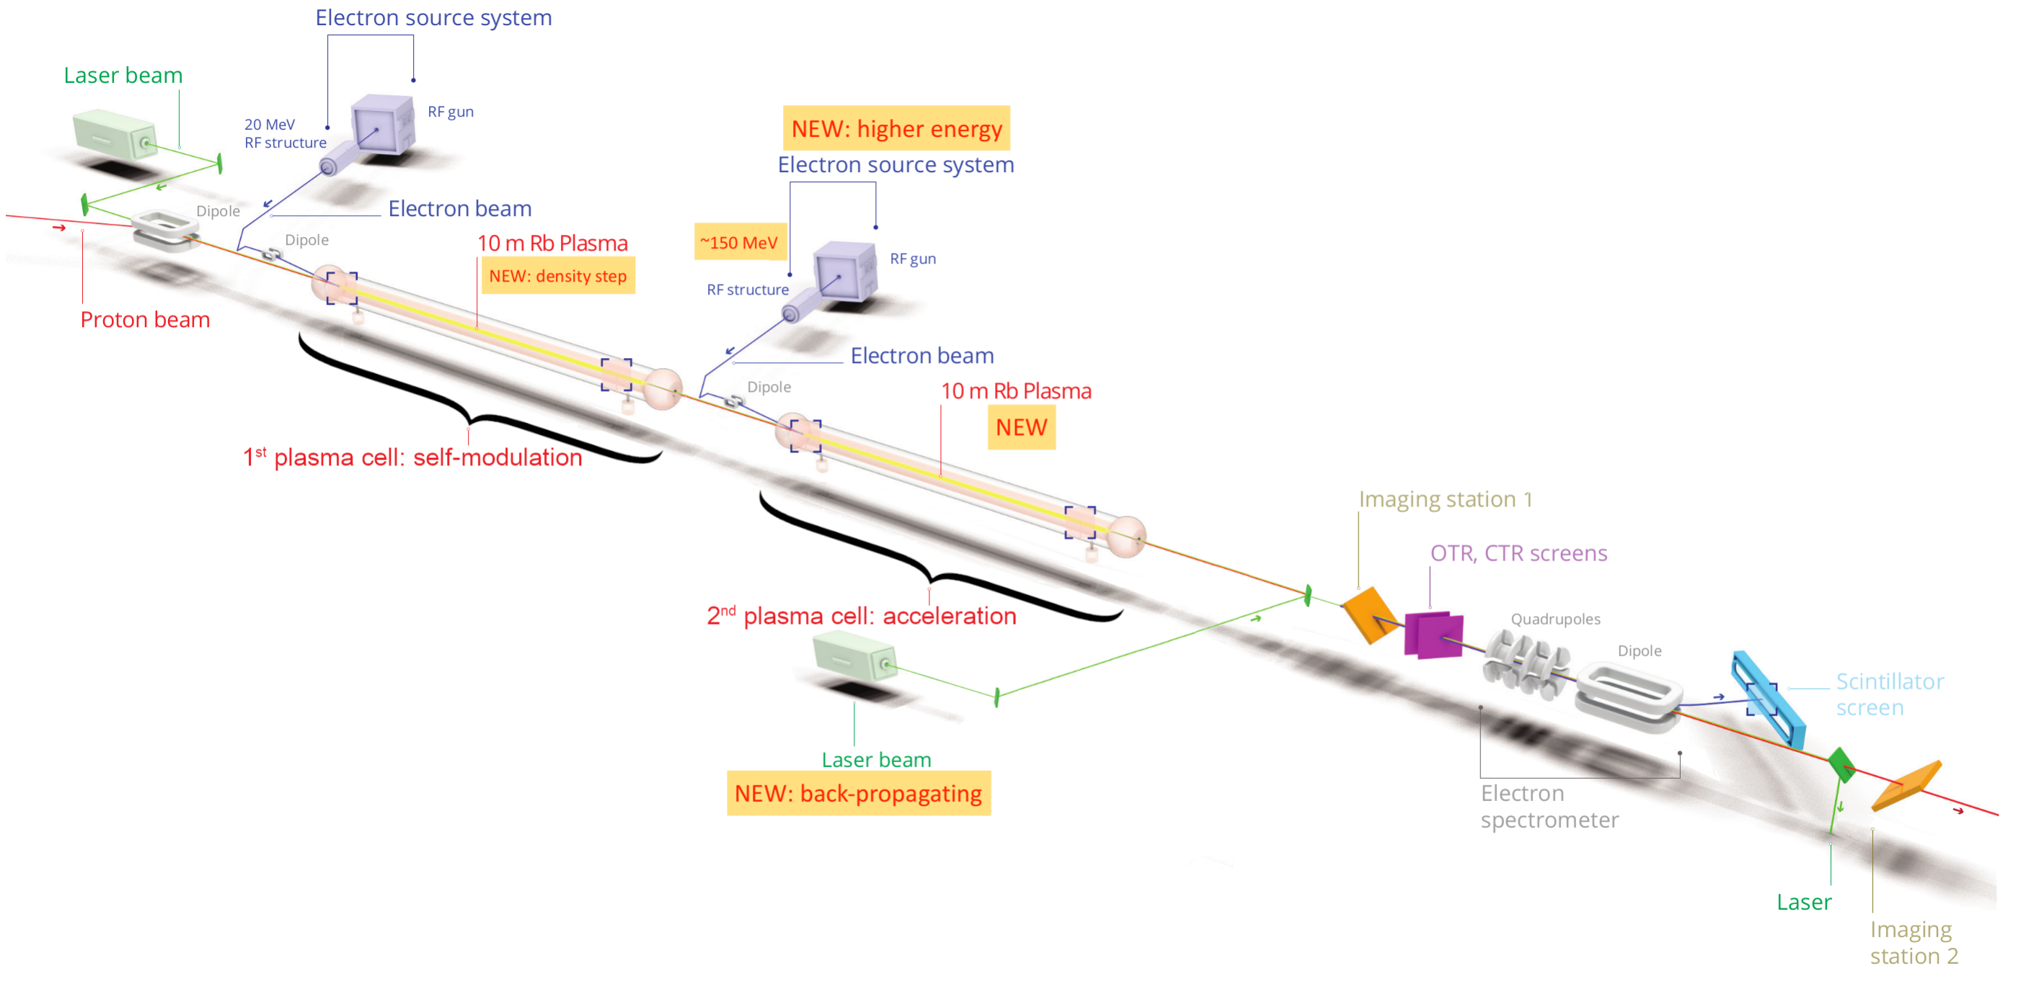
AWAKE Run 2c
Gschwendtner, E.; Lotov, K.; Muggli, P. et al, “The AWAKE Run 2 Programme and Beyond” Symmetry. 2022; 14(8):1680.

Slide 4

AWAKE Run 2c laser beamlines
IR beamlines
UV beamlines
3 GHz
RF ref
3 GHz
Existing Ti:Sapphire laser
New photo-injectors laser
TSG40
TSG4
SYNC 10 Hz
SYNC 1 kHz
f*100
TT41
TSG42
Split / Delay
TCC4
TCC4
Split / Delay
Compressor 1
Compressor 2
e- gun 1
e- gun 2
Rb cell 1
Rb cell 2

Slide 5
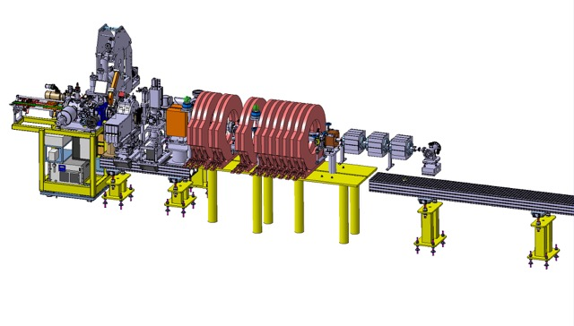
AWAKE Run 2c electron gun
Demonstrate velocity bunching with x-band and emittance preservation/control
Show reliable high gradient x-band operation
Study mechanical/integration aspects
Test diagnostics
Optimise final design for AWAKE
Layout in CTF2
Courtesy: Steffen Doebert
Prototype injector in CTF2:
60-70 MeV and typically 100 pC single bunch, bunch length 200-300 fs (goal), emittance ~ 1 um, Laser osc. frequency 75 MHz, rep. rate up to 3 kHz, Length: 5 m

Slide 6
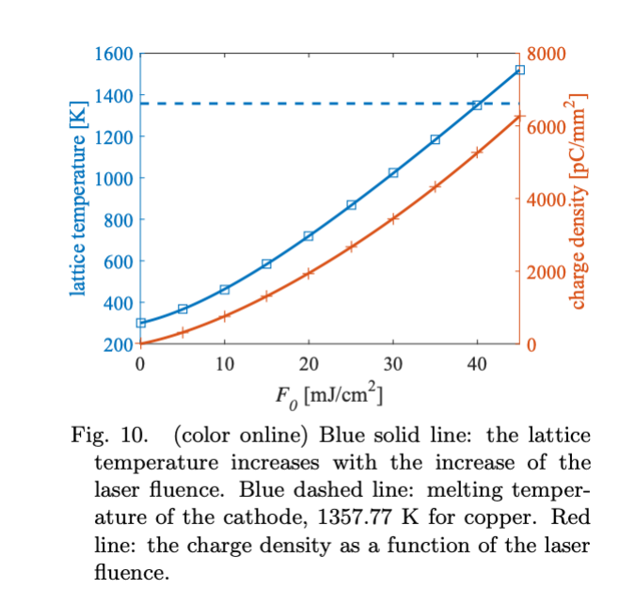
Photocathode materials
NEED: Laser system able to operate with Cu (low bunch charge) or Cs₂Te (high bunch charge)
Both materials require UV-laser wavelength
Cs₂Te -> QE > 1% (up to 15-25%) -> ideal candidate BUT...
Cu => QE (λ = 257nm) ~ 0.005 - 0.01%
500pC bunch charge will require a laser system providing > 20 µJ per pulse
Strict vacuum level requirements (<1e-10 mbar)
Load-lock system
Limited lifetime
Safe approach: Keep Fluence bellow 40 mJ/cm²
Implications for laser beam size at the cathode
500 pC bunch charge
Beam diameter 200µm -> Fluence > 77 mJ/cm²
Beam diameter 2mm -> Fluence > 0.77 mJ/cm²
Consider implications for the emittance
“Effects of laser pulse heating of copper photocathodes on high brightness electron beam production at blowout regime”
Lian-Min Zheng, et. al 2017 Chinese Phys. C

Slide 7
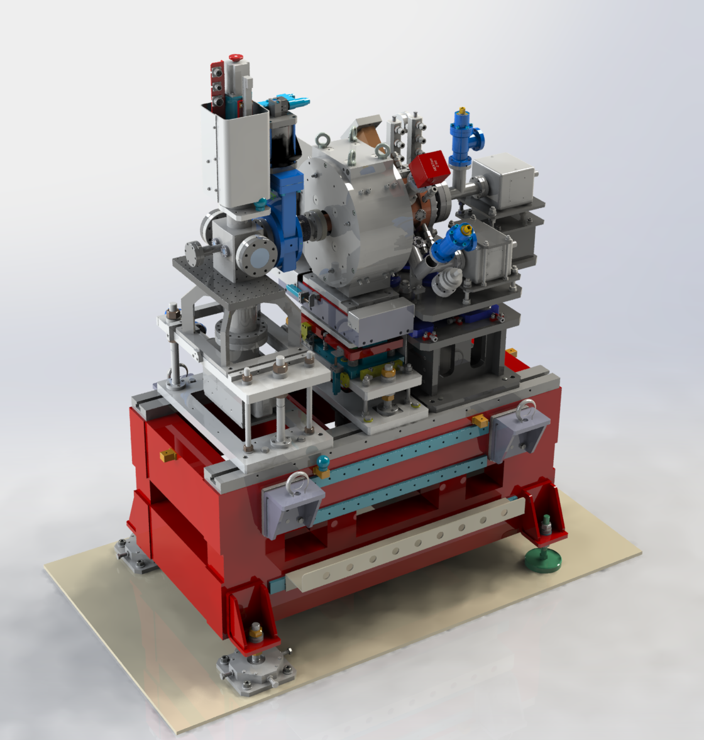
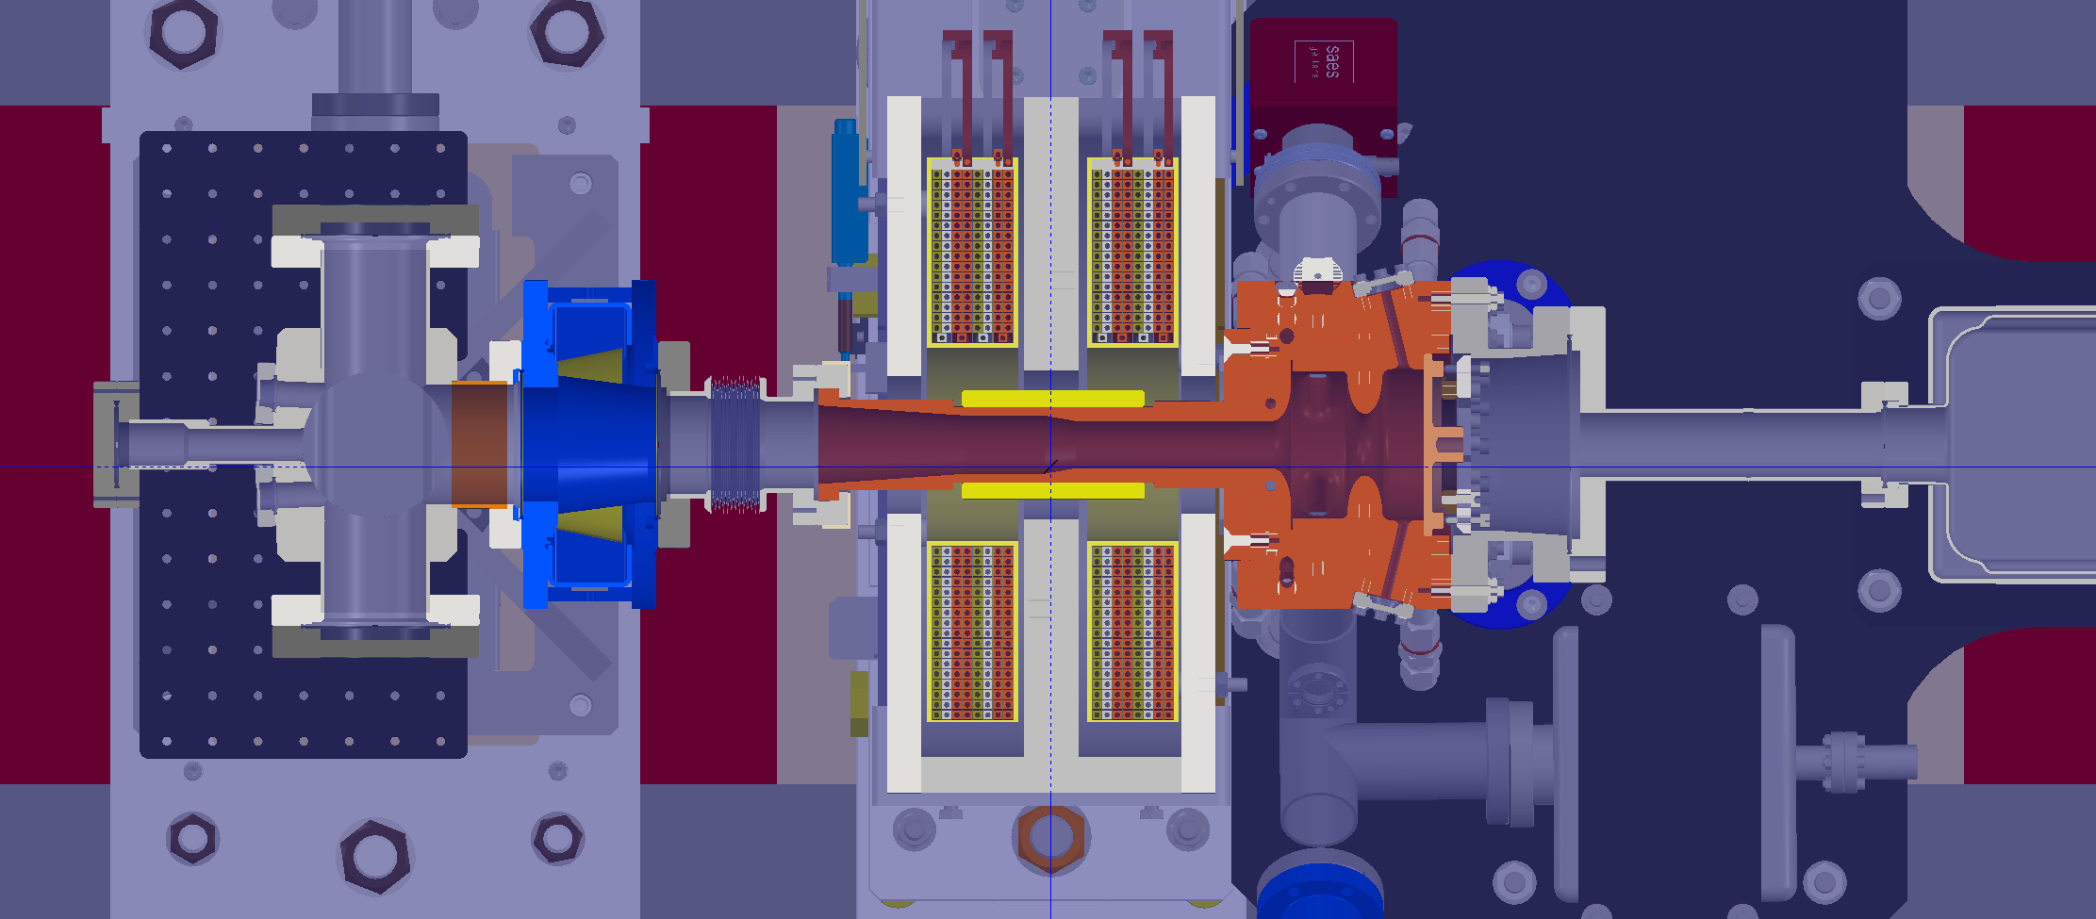
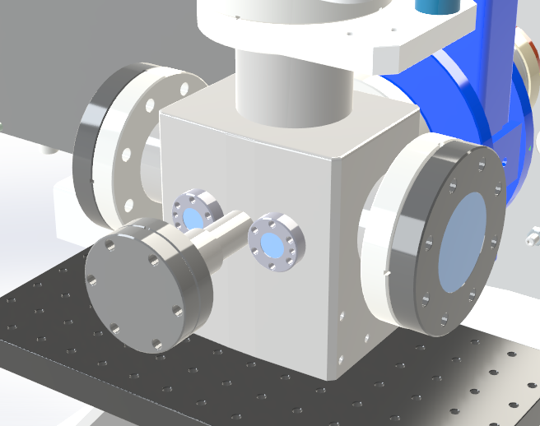
AWAKE Run 2c electron gun
Femtosecond gun from INFN
IR ultrafast laser system (PHAROS), upstairs inside CLEAR laser lab
4th harmonic conversion to generate required UV fs-laser pulses for photocathode excitation
Laser synchronization to the RF reference at the laser oscillator level
Beamline for UV-beam transport from upstairs to CTF-2 area + online monitoring systems
Beam size at the cathode requirements: 50 – 2000 µm
UV input
Photocathode
🤙electron beam! 👌
Vacuum windows
UV reflected beam (diagnostics)

Slide 8
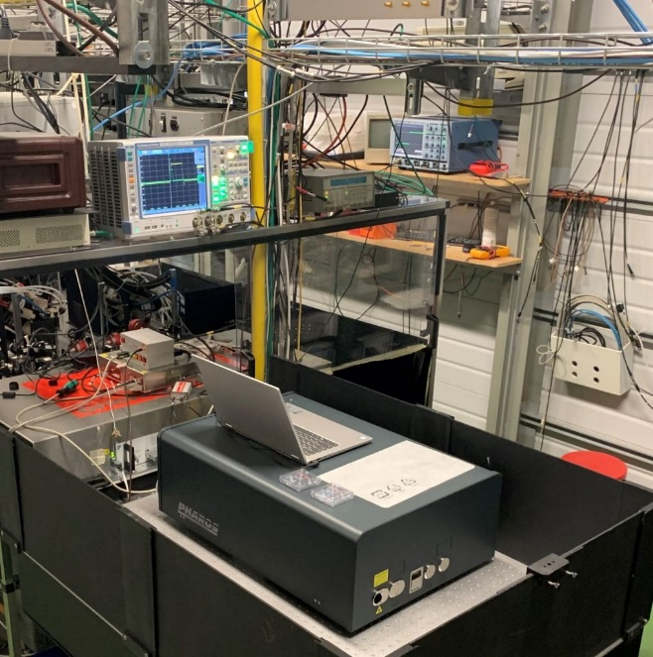
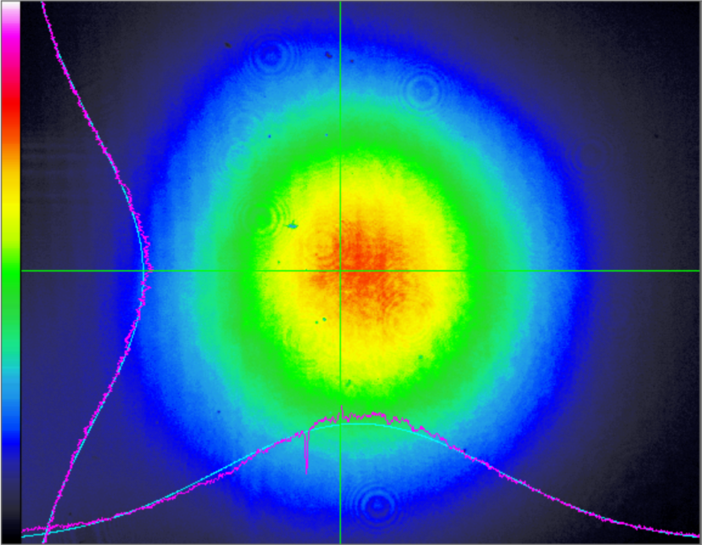
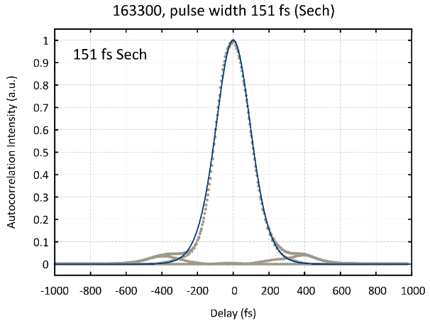
Laser system AWAKE run 2c
Light Conversion PHAROS system already installed and tested at CLEAR laser-lab
Total conversion efficiency to UV up to 20%, stability!
Variable pulse duration from < 300 fs up to > 5 ps (0.11% RMS)
  *Requires multiple harmonic stages or UV stretcher
  *Conversion efficiency dependent on pulse duration
Transport loses and beam profile after transport to CTF-2
to be measured from 11-Oct
Wavelength | Pulse energy | RMS | Pk-Pk
1030 nm | 2.21 mJ | 0.043% | 0.099%
515 nm | 1.23 mJ | 0.053% | 0.38%
257 nm | 415 uJ | 0.11% | 0.77%
Over 10,000 shots at 10 Hz - externally triggered
Repetition rate up to 3kHz!

Slide 9
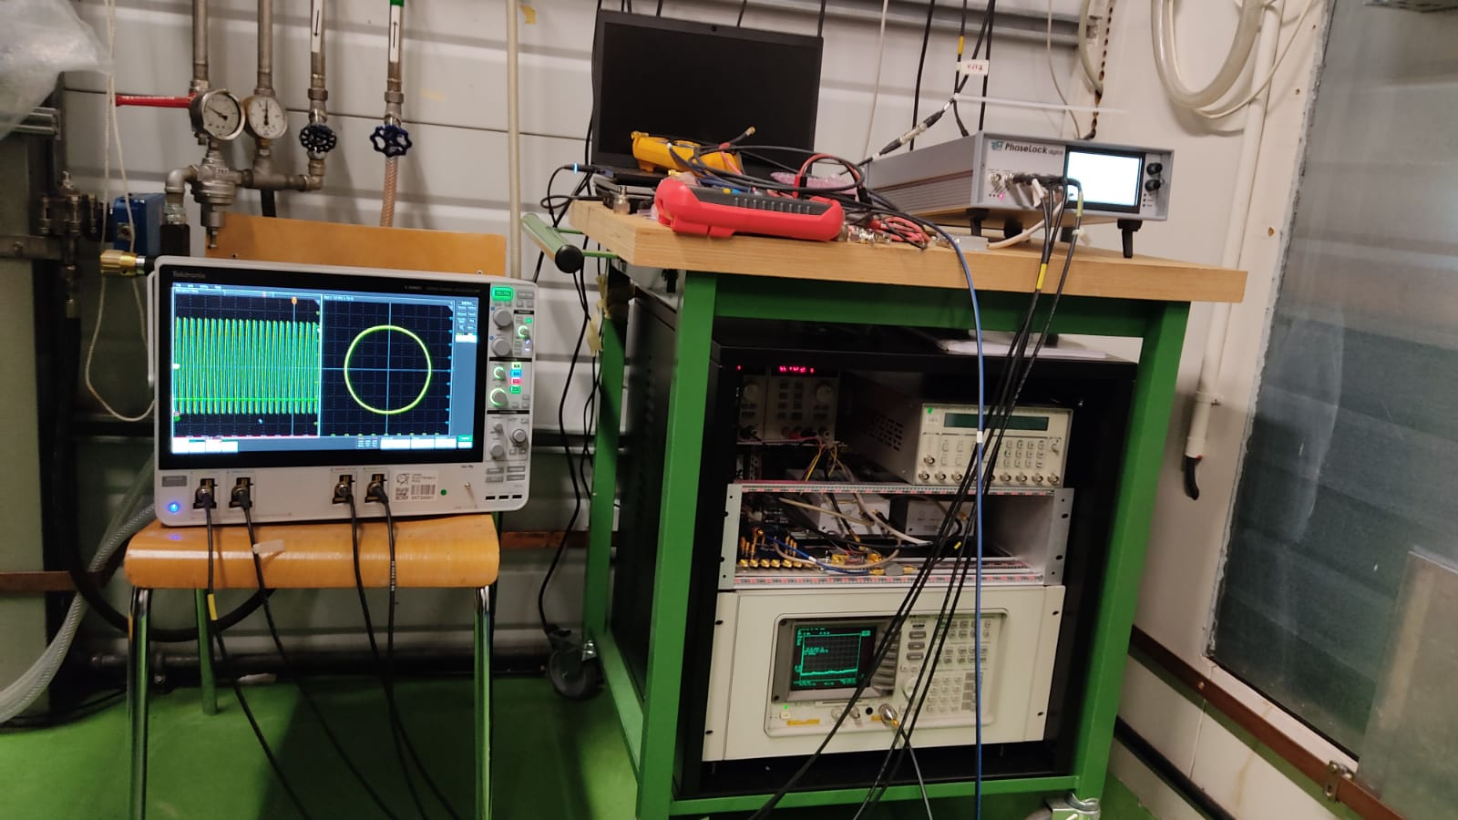
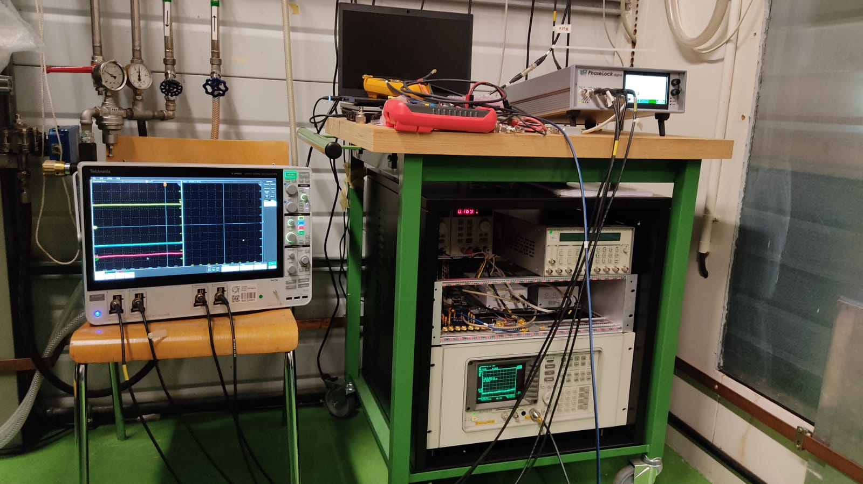

AWAKE Run 2c laser synchronization and timing
Timing system and Synchronization to the RF ready
Expected integrated jitter in the order of 25 fs (dependent on RF signal jitter)
To be commissioned and evaluated in detail during the incoming weeks
Timing
RF ref (1.5 GHz)
SYNC
1 kHz
User input
Single-shot, 10 Hz…
Bucket control + phase
φ
Oscillator
75 MHz
Regenerative Amplifier
Pulse Picker
To Harmonic stages and photo-gun
RF SYNC
1.5GHz
Oscillator
Divide by 20
Monitor 1 out
Phaselock
1.5 GHz
phase comparator
PID x2
Serial/ethernet port?
ADC + Control
75 MHz phase comparator
Special thanks to: Davide Gamba
Ben Wooley
HV1
HV2
1.5 GHz BPF
Laser
Wideband splitter
75MHz LPF

Slide 10
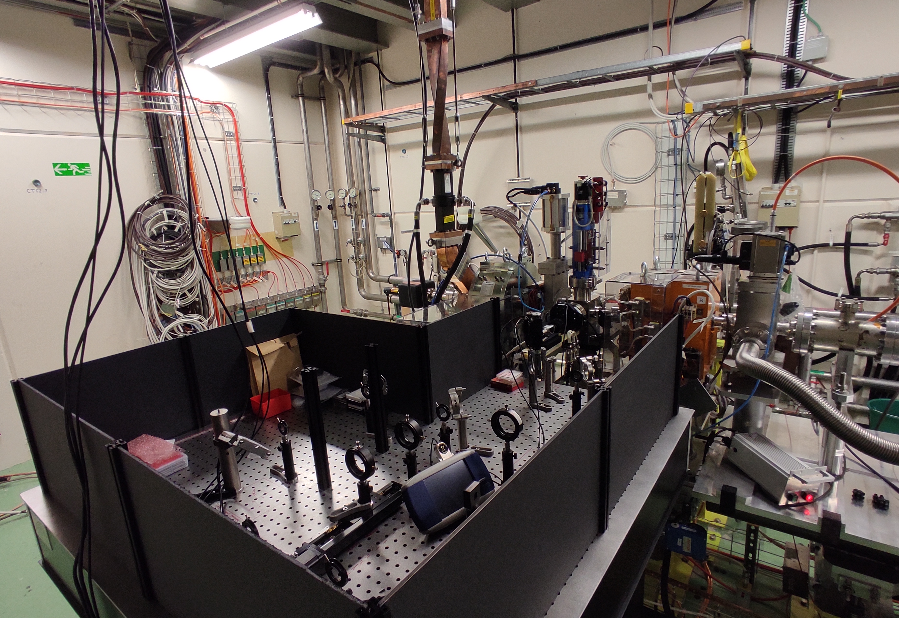
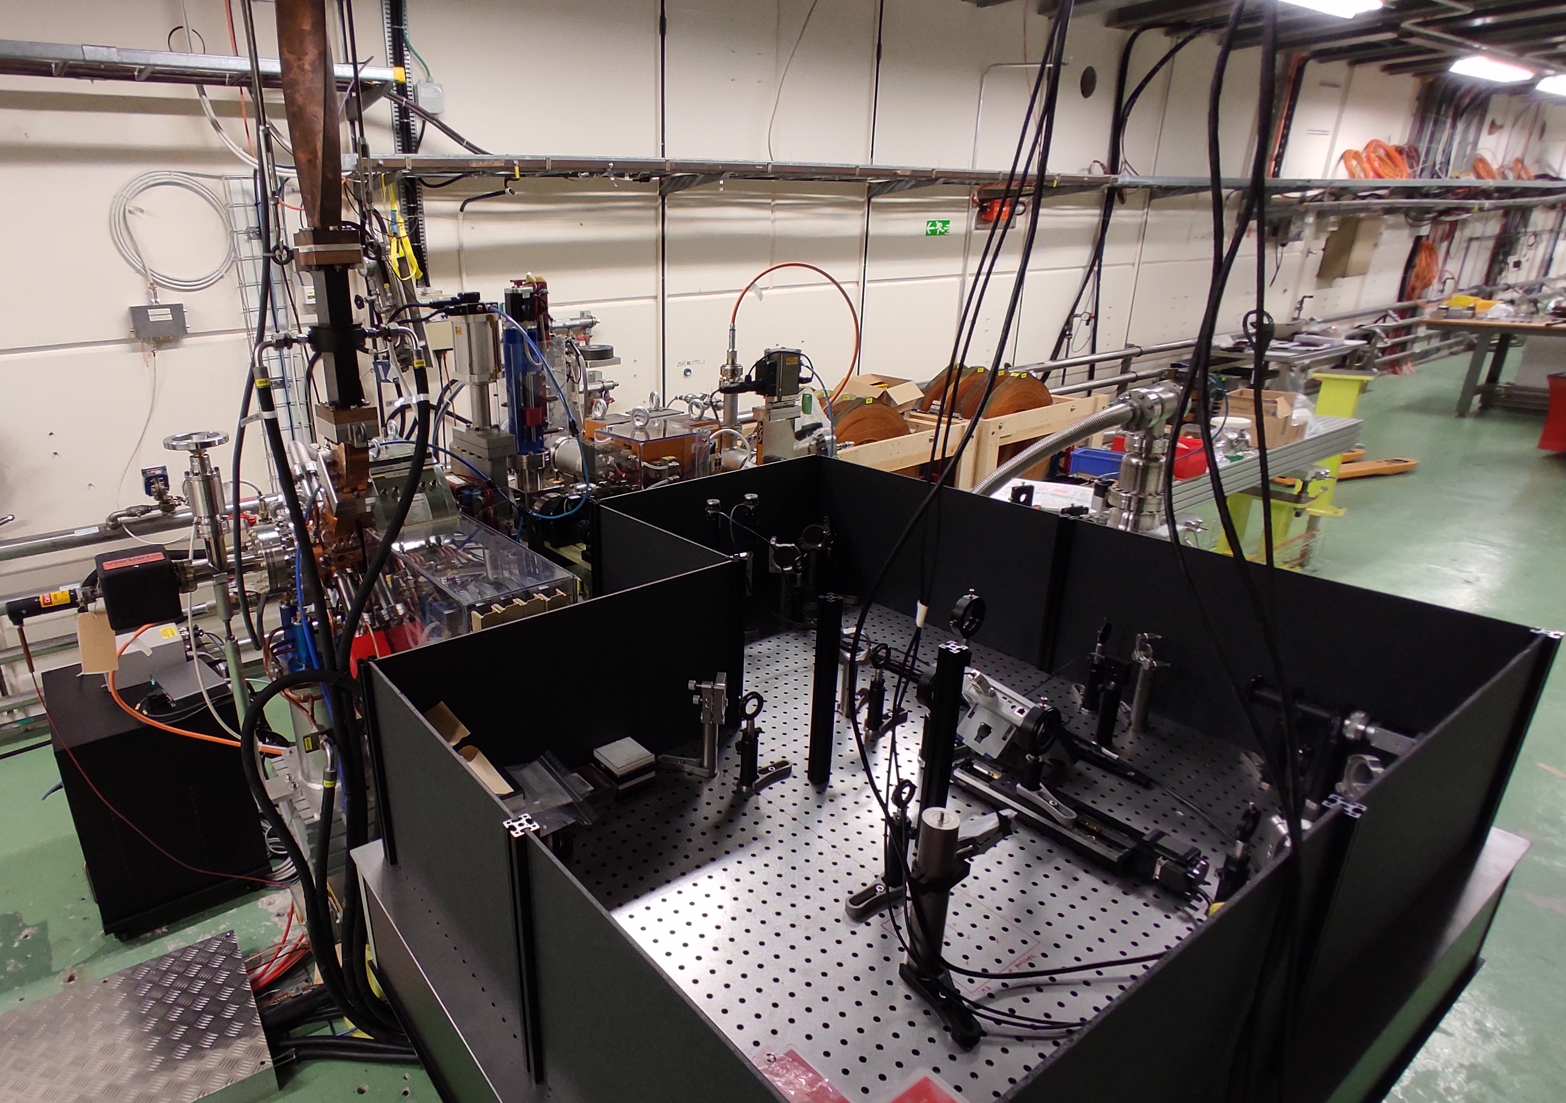
AWAKE Run 2c electron gun
STATUS October 2022

Slide 11
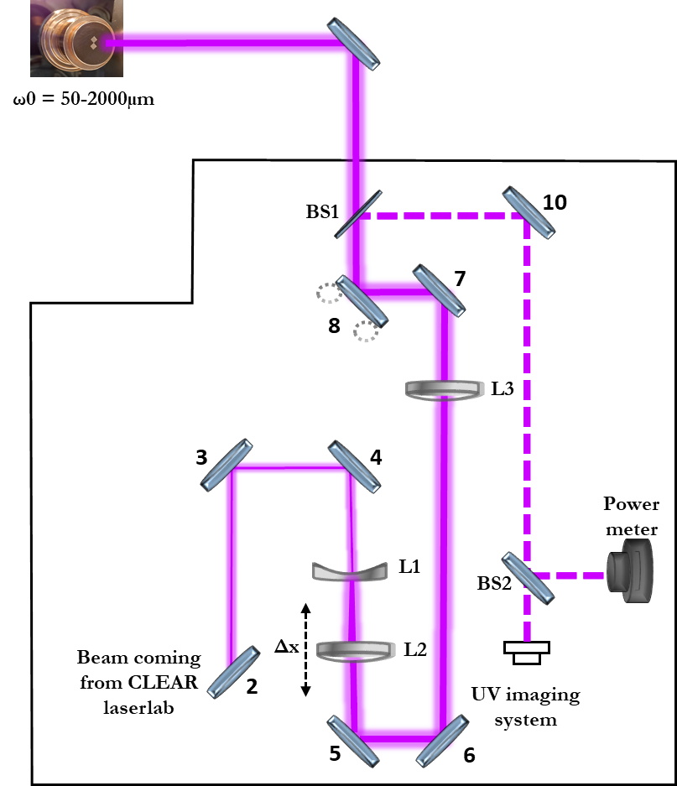
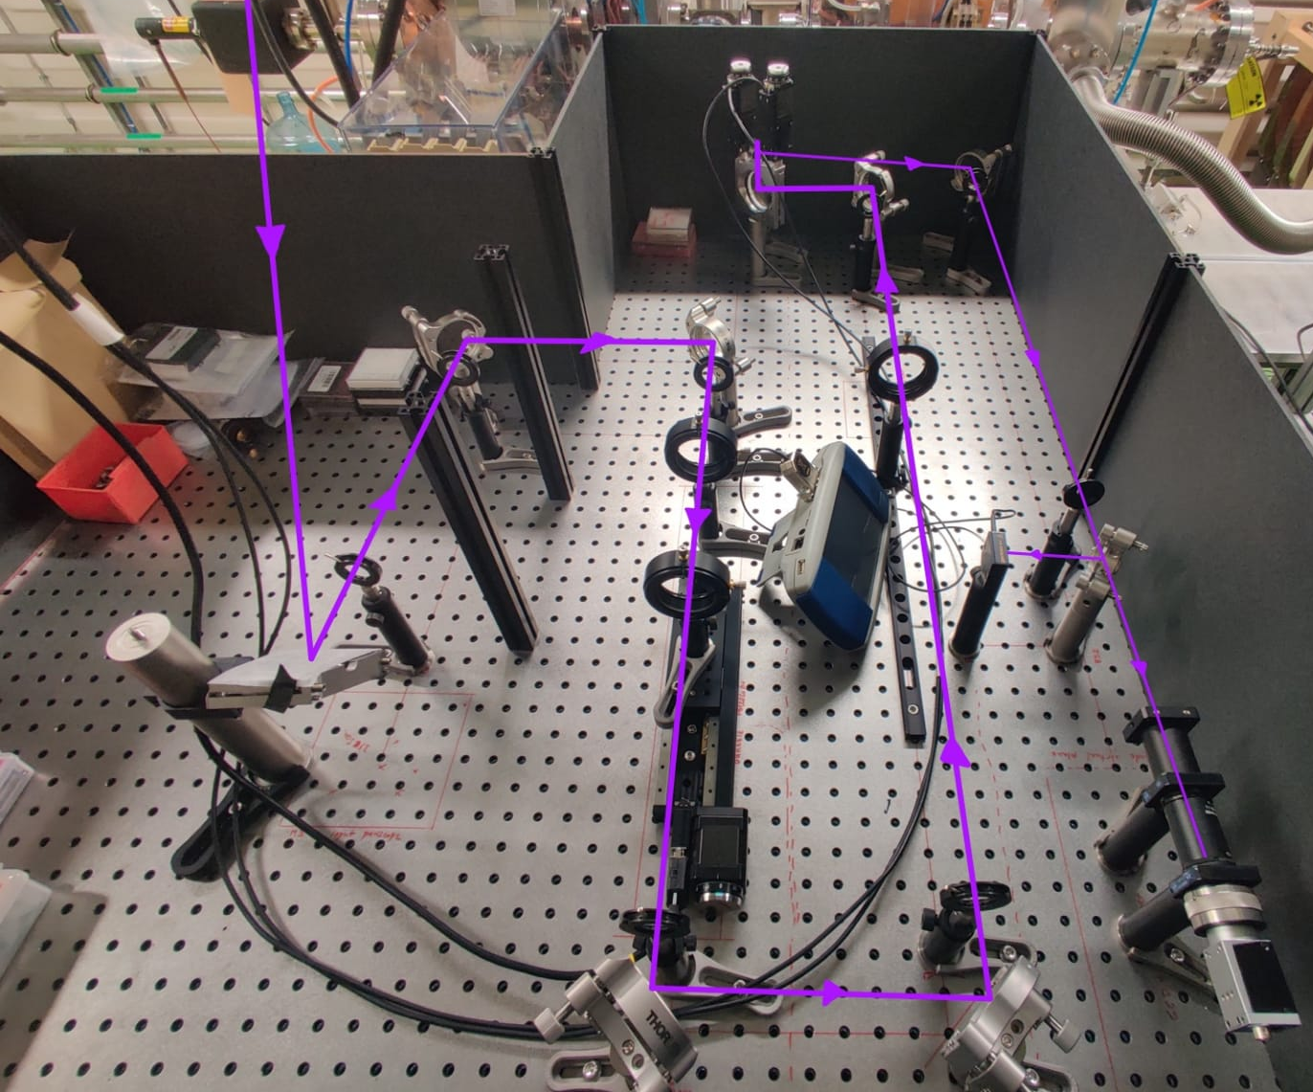
UV beamline scheme
1,2
λ conversion
TFP
λ/2
PHAROS
INTERLOCKED SHUTTER
✓

Slide 12
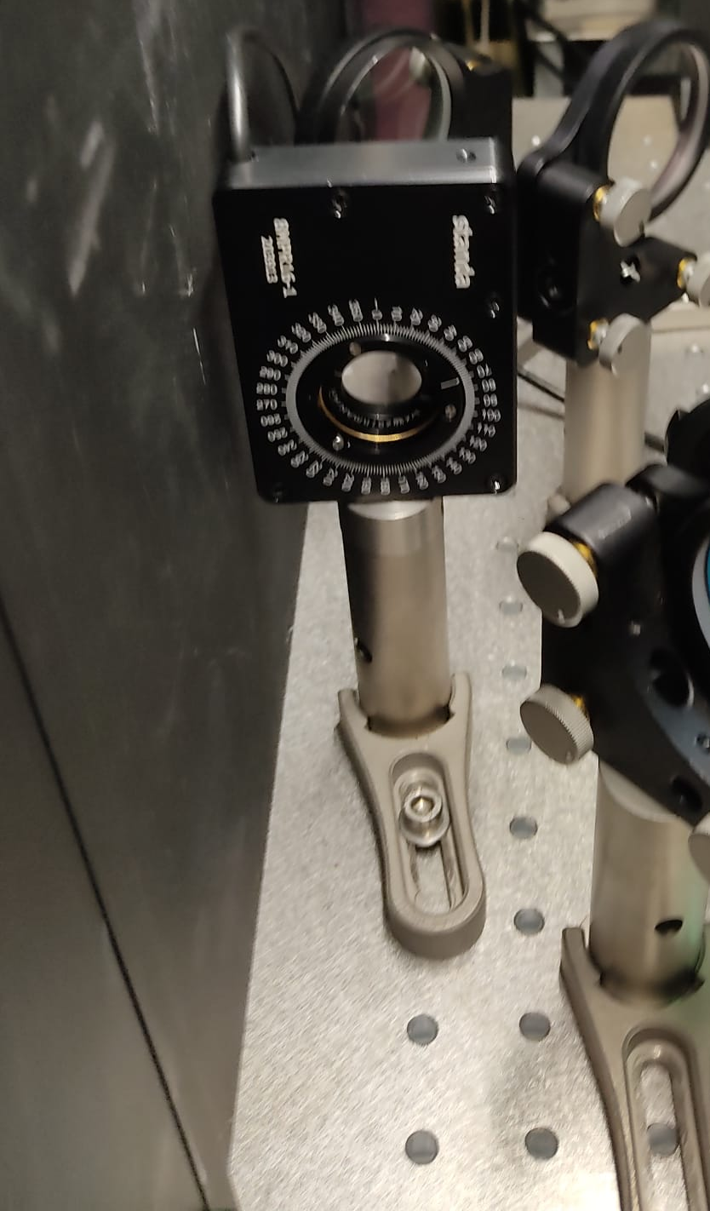
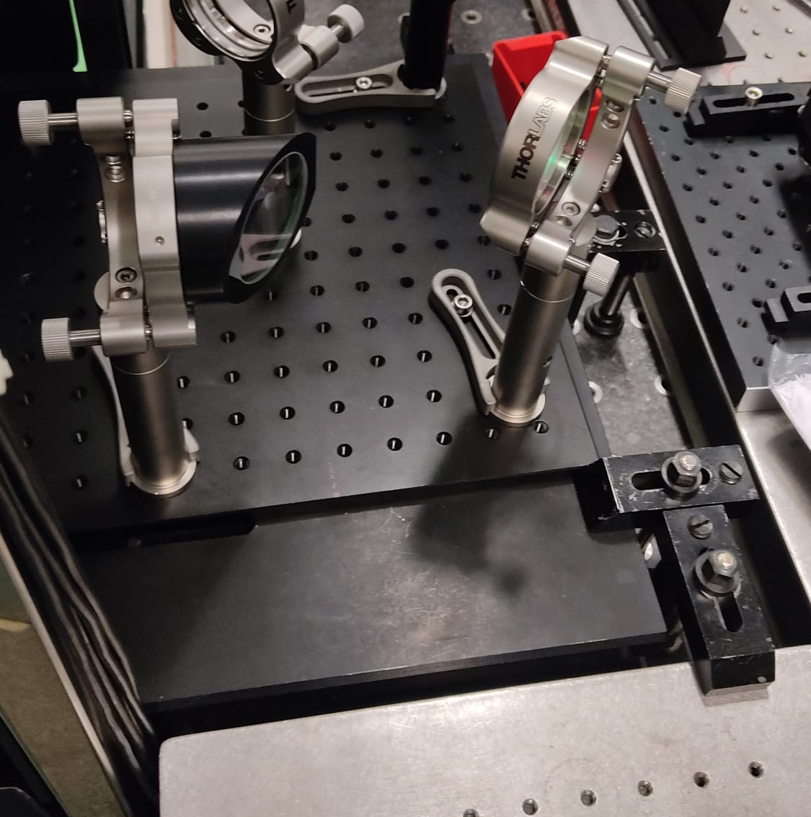
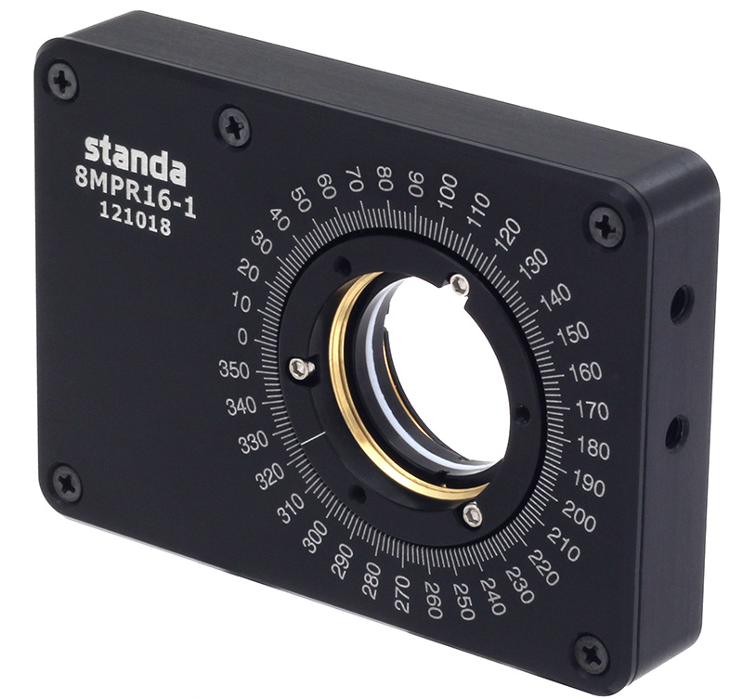
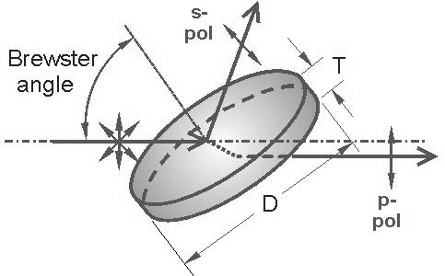
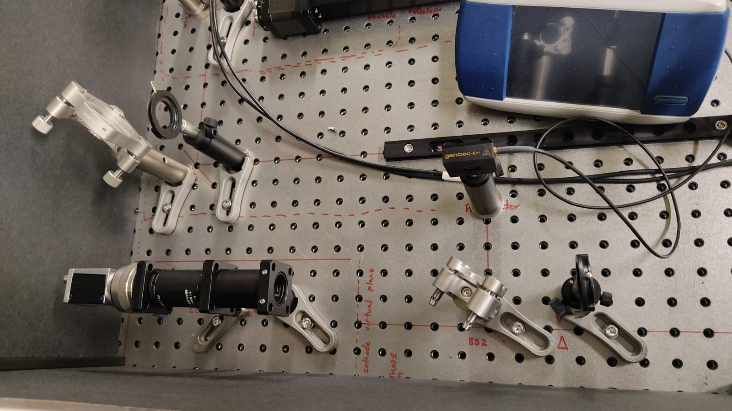
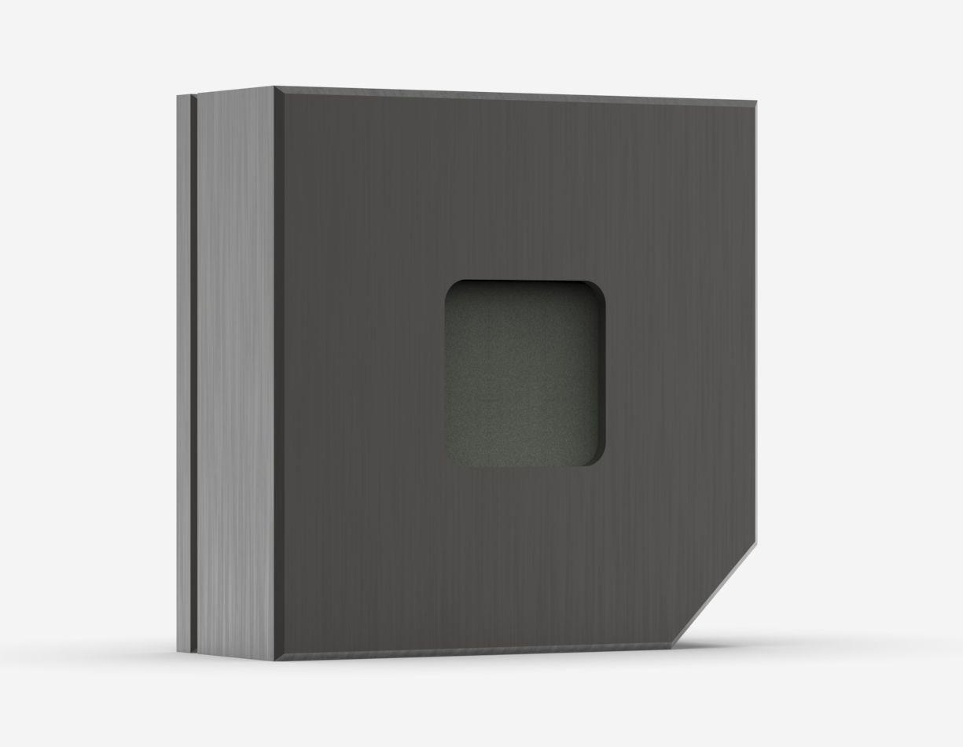
UV energy control hardware and performance
Parameter | Diagnostic | Control
Pulse energy | Sampler + energy meter | Motorized waveplate + Thin film Polarizer
Energy control: Motorized Waveplate + Thin Film Polarizer (CLEAR laser-lab)
Resolution 0.012°
95 – 5 % Energy tuning
Working set integration ✓
Energy diagnostic: Beam sampler + Gentec Pyroelectric detector (CTF-2 area)
0.93 – 20 µm
Rise time 550 µs
0.7µJ – 0.85J
300 Hz

Slide 13
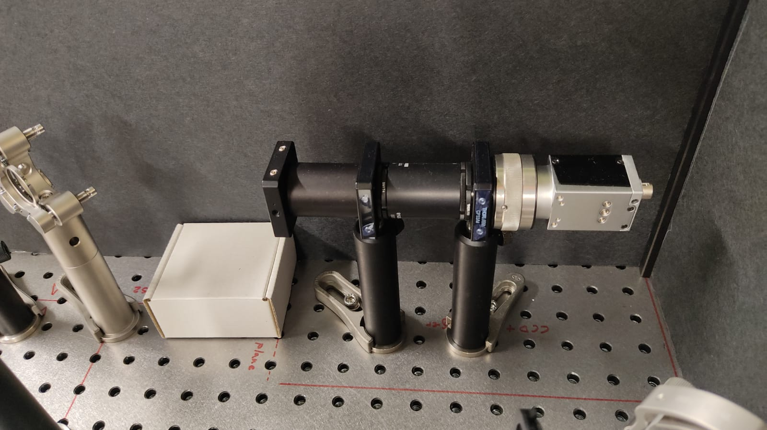
UV energy control hardware and performance
Parameter | Diagnostic | Control
Beam position | Virtual cathode camera | Motorized mirror
Beam position diagnostic: Virtual cathode camera + 20mm YAG screen (CTF-2 area)
Real-time monitoring of laser beam properties at the photocathode surface
20mm YAG-screen matching the distance from BS1 to photocathode surface
1:1 telescope to collimate the generated light
BASLER ACS-gm40 camera
Preliminary tests without YAG screen => Resolution of approximately 20 µm

Slide 14
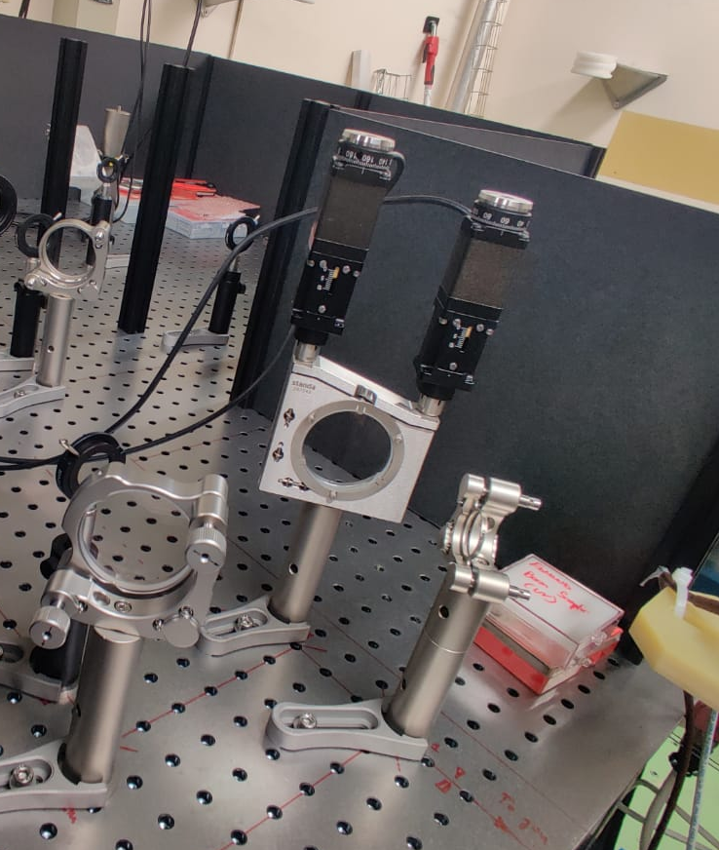
UV energy control hardware and performance
Parameter | Diagnostic | Control
Beam position | Virtual cathode camera | Motorized mirror (stepper motors)
Beam position control: STANDA “5KVDOM-2” (CTF-2 area)
Resolution 1.25µm
Travel 6mm
Working set integration ✓

Slide 15
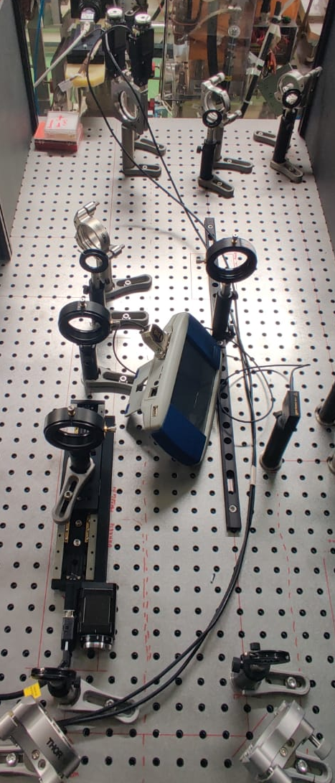
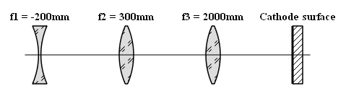
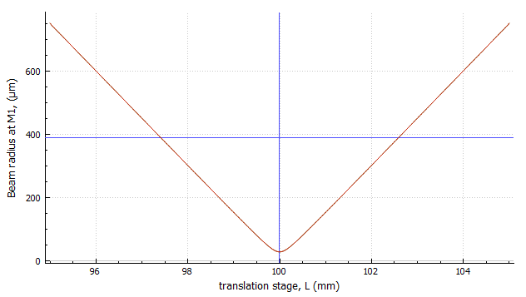
UV energy control hardware and performance
Parameter | Diagnostic | Control
Beam size | Virtual cathode camera | Variable mismatched telescope
Beam size control: Galilean telescope + variable distance (motorized stage) + focusing lens
Keplerian telescope NOT possible => air ionization! (AWAKE run 2b)
Target focused beam size at the photocathode surface: 0.05 – 2 mm
L2 => Plano-convex lens mounted on a motorized translation stage
STANDA 8MT175 – 150 (resolution 0.31 µm)
Working set integration ✓
90 – 110 mm
(mot. stage)
~ 750 mm
~ 2000 mm
Theoretical minimum
Beam size ~ 30 µm
*Input beam = 4.5mm

Slide 16
Thanks for your attention!
Acknowledgements:
SY-STI-LP :
Eric Chevallay, Valentin Fedosseev, Eduardo Granados, Baptiste Groussin,
Bruce Marsh, Ralf Rossel
Steffen Doebert, Ben Wooley SY-RF

