Slide 1
FCC ACCELERATOR STATUS and R&D
Tor Raubenheimer
FCC IS Workshop
December 5-9, 2022
SPACE FOR ADDITIONAL LOGOS

Slide 2
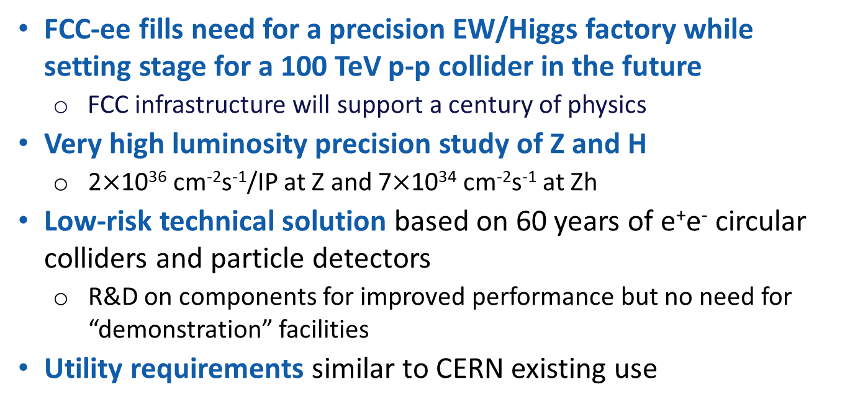
Introduction

Slide 3
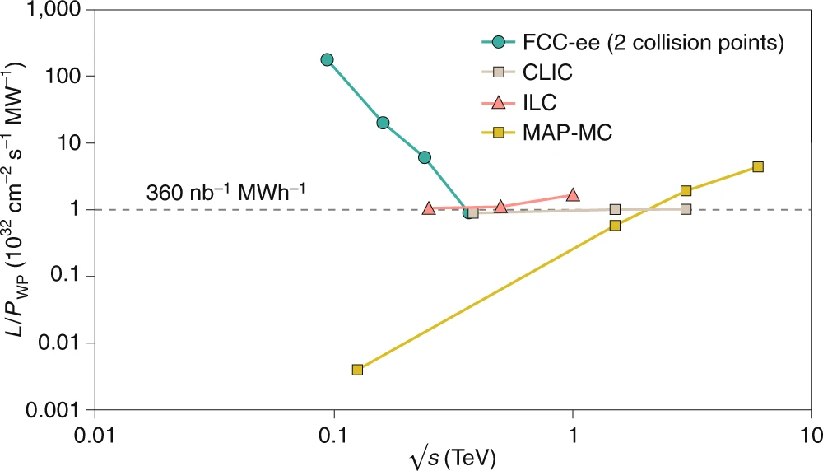
FCC-ee Luminosity
Luminosity vs. electricity consumption
FCC-ee efficient L from Z to 𝑡𝑡 ̅
  Thanks to twin-aperture magnets, SRF, efficient RF power, top-off injection
Accumulate >2.5 ab⁻¹ with ~0.5x10⁶ H produced per IP
Accumulate >75 ab⁻¹ with ~2x10¹² Z produced per IP
Run plan naturally starts at Z but is under discussion
Highest lumi per AC site power of all proposals
Electricity cost ~200 CHF per Higgs boson

Slide 4
Challenges and Drivers
High beam energy → large circumference to reduce synchrotron radiation and strong luminosity dependance on energy
  Large circumference → challenging tuning and tolerances and long runs for facilities
  Tunnel radiation → may limit in-tunnel electronics
High luminosity → strong beam-beam with beamstrahlung and reduced lifetimes
  High beam current → large RF power with collective instabilities and collimation
  Requires top-up injection and large dynamic aperture

Slide 5
Outline
Overall requirements and status
Parameters
Main e+/e- rings beam optics
Collective effects, Dynamic aperture, Injection, Collimation, …
SRF and Energy efficiency
Full-energy booster and e+/e- injector
R&D Issues

Slide 6
Accelerator Design Status
New ~90 km circumference placement with 8 access points
Layout with 4 IP’s that is consistent with upgrade to FCC-hh
Optimizing allocation of straight sections
New FCC-ee optics to optimize beam-beam
400 MHz and 800 MHz RF systems
Starting tunnel integration studies for RF and Arc sections
Full energy booster that will fit in FCC tunnel for top-up injection
e+ / e- injector to fill booster 24 / 7

Slide 7
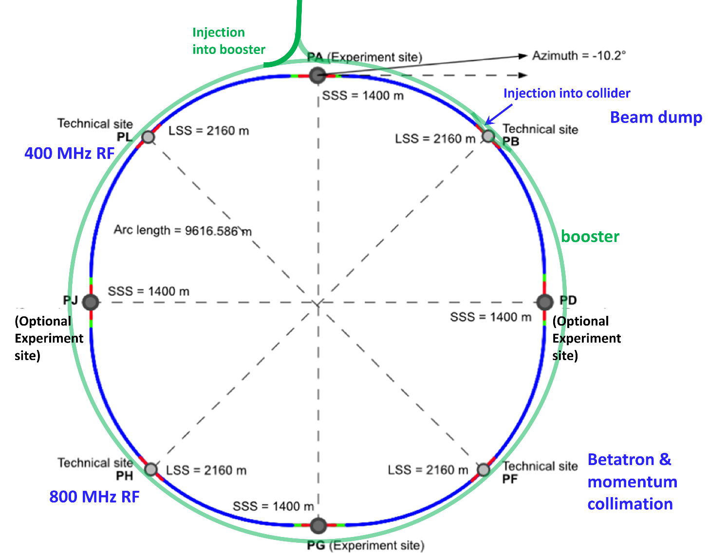
Basic Design Choices
Double ring e+e- collider
Common footprint with FCC-hh, except around IPs
Asymmetric IR layout and optics to limit synchrotron radiation towards the detector
Perfect 4-fold superperiodicity allowing 2 or 4 IPs; large horizontal crossing angle 30 mrad, crab-waist collision optics
Synchrotron radiation power 50 MW/beam at all beam energies
Top-up injection scheme for high luminosity Requires booster synchrotron in collider tunnel
Or MR RF?
Or Booster RF?

Slide 8
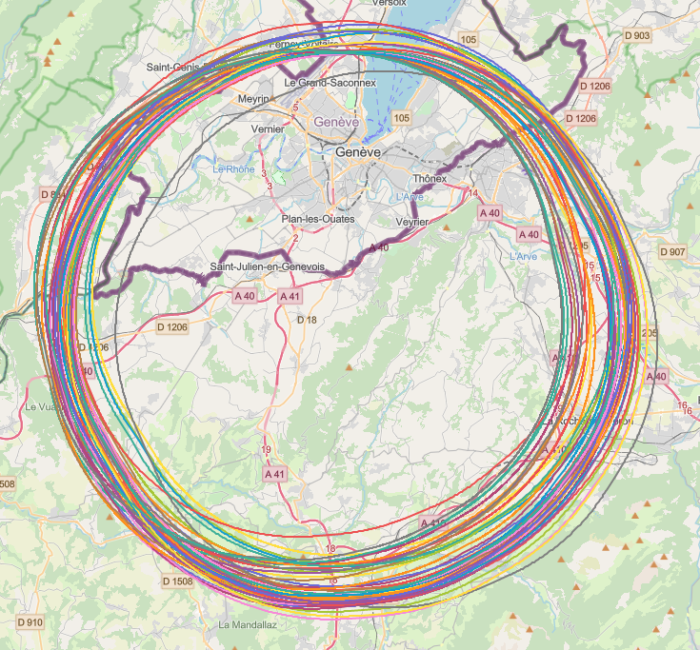
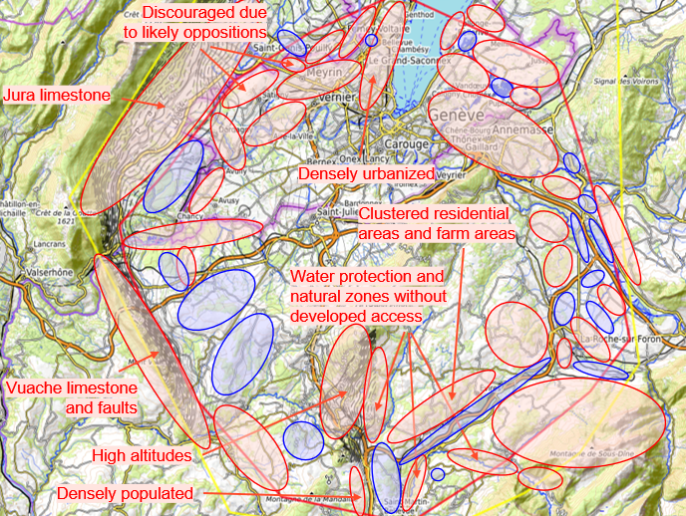
Accelerator Placement Optimization
J. Gutleber, V. Mertens

Slide 9
Placement Impact
New PA31 layout proposed in 2021
PA31-1.0 had a 91.2 km circumference
Needed to modify to have matched harmonic number for injector chain → 91.1 km (Dec. 2021)
Further circumference reduction needed to support surface sites leading to 90.8 km optics (Summer 2022)
Settling on 90.7 km circumference with a harmonic number of 121,200 at 400.79 MHz which supports surface sites as well FCC-hh injector chain

Slide 10
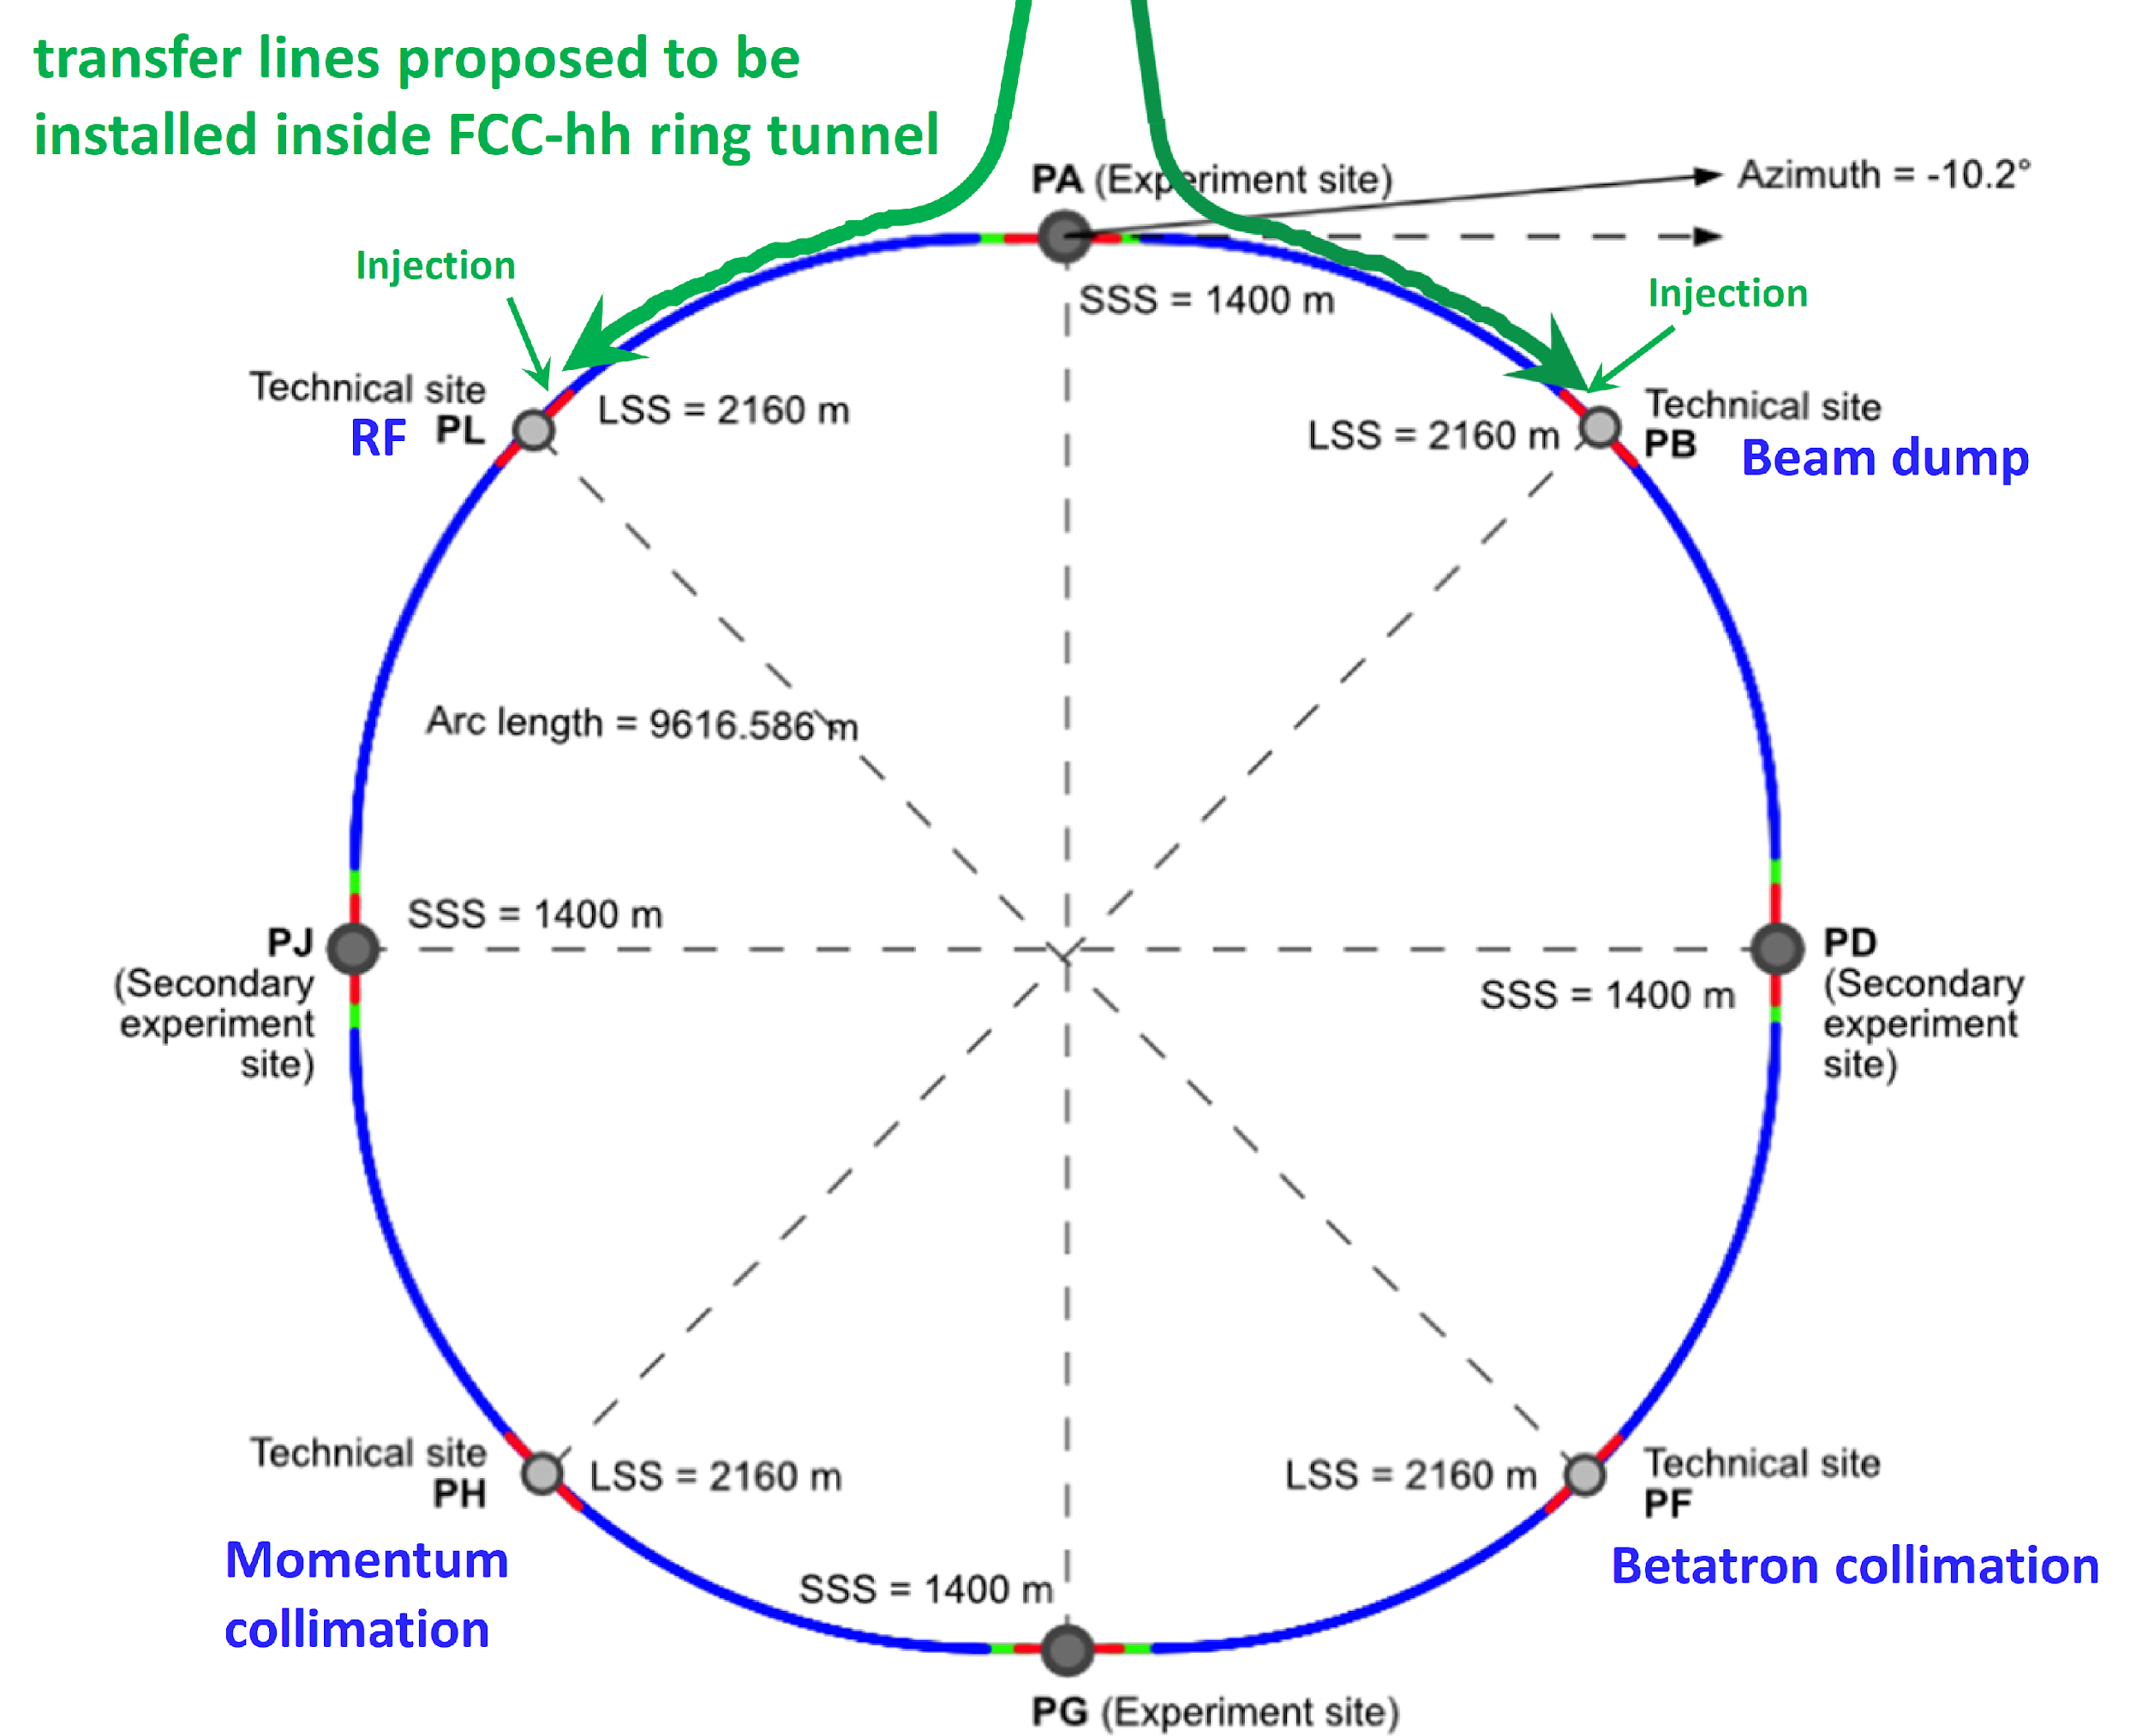
FCC-ee layout consistent with FCC-hh
FCC-ee
FCC-hh
Or MR RF?
Or Booster RF?

Slide 11
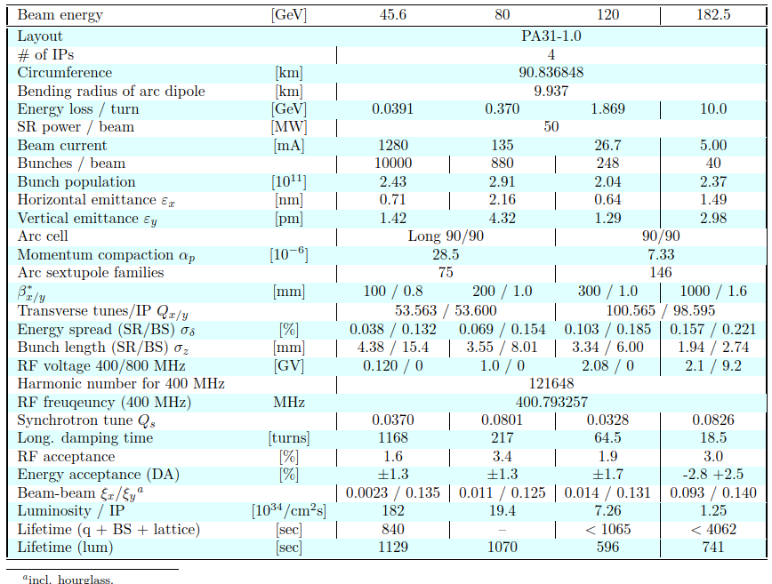
FCC-ee Parameters
K. Oide, Nov. 2022

Slide 12
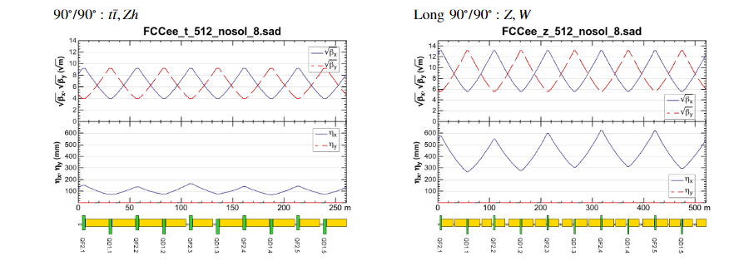
FCC-ee Arc FODO optics
Configuration for arc optics with long ~100 m cells at Z & W and short ~50 m cells at Zh and t-tbar
  Reduces ε_{x} at high E and increases α_{c} at low E
K. Oide

Slide 13
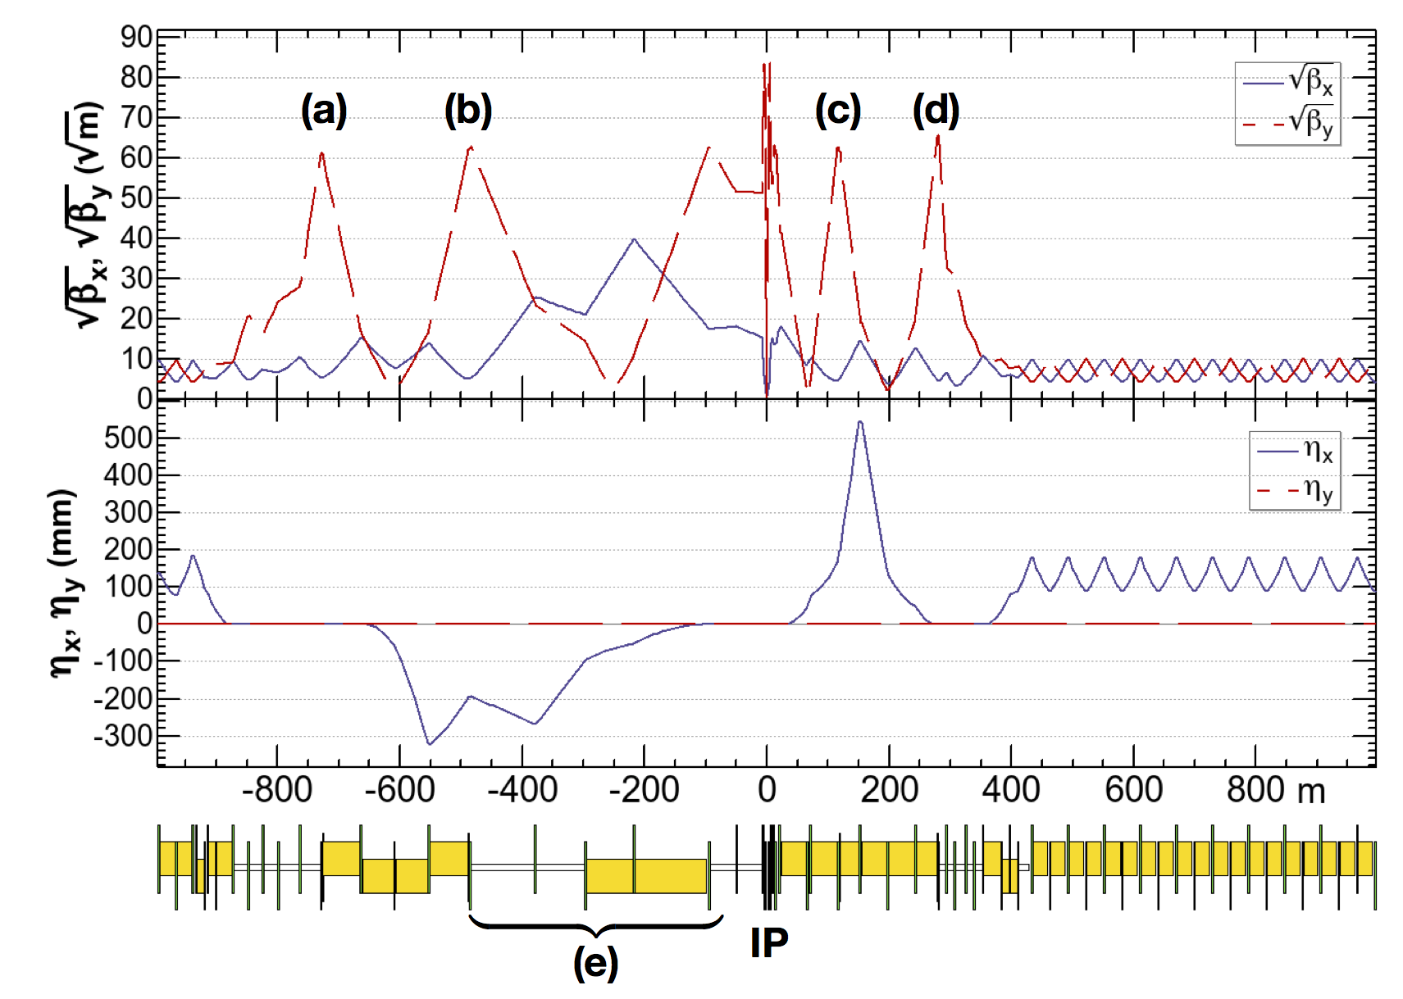
FCC-ee IR optics
CDR optics, ttbar 182.5 GeV
Novel ‘virtual’ crab waist
combining local vertical
chromaticity correction
  Crab waist was demon-
  strated at DAFNE
  Crab waist is also being
  used at SuperKEKB
Optimized optics
configurations for each
of the 4 working points
beam
K. Oide

Slide 14
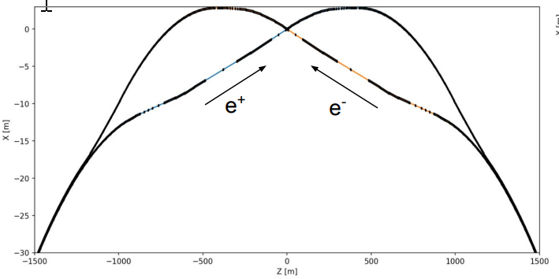
FCC-ee IR geometry
FCC-ee and FCC-hh IP’s
moved to same location
to reduce IR tunnel width
Asymmetric IR layout is
chosen to minimize the
incoming synchrotron
radiation
  Photon E_{crit} < 100 keV from magnets within ~500 m of IP
  Collimators and masks further protect detectors
  Optimization is ongoing as part of MDI effort
A. Ciarma

Slide 15
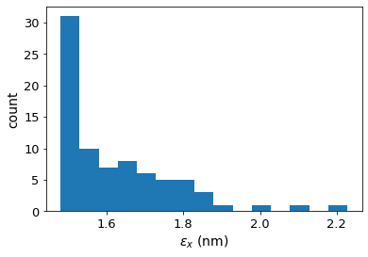
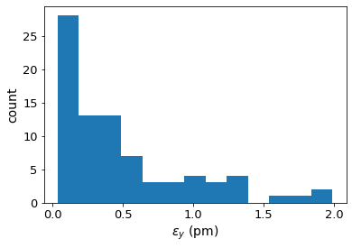
FCC-ee Tuning and Correction
Extensive studies on emittance tuning and dynamic aperture
  Emittance tuning looks good given a ‘reasonable’ set of errors
  Working to develop beam-based alignment models to combine with mechanical alignment specifications
  Sets requirements on diagnostics but eases installation and stability requirements
T. Charles

Slide 16
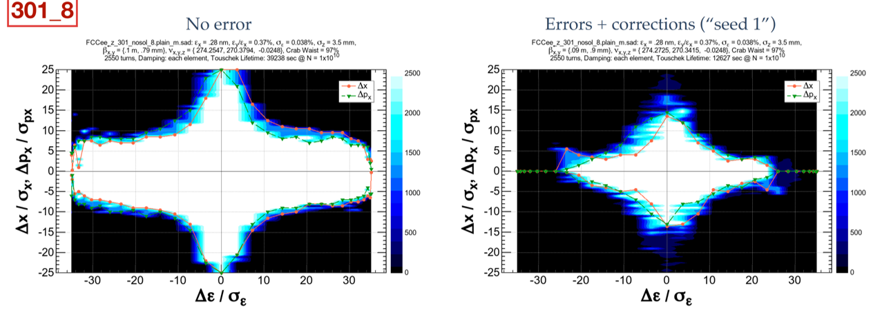
FCC-ee Dynamic Aperture
Large dynamic aperture is needed for top-up injection and lifetime due to high beamstrahlung energy tails
  Dynamic aperture optimized with ~150 families of sextupoles
  Aperture is good without errors but still need to improve error correction

Slide 17
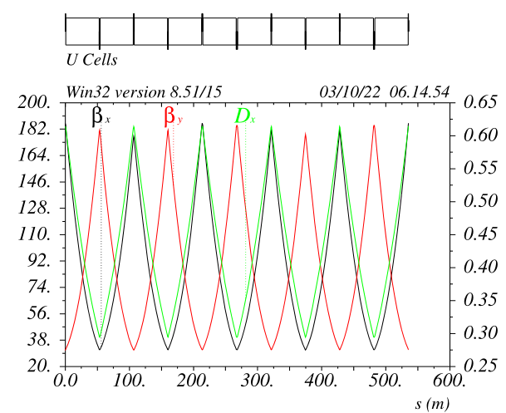
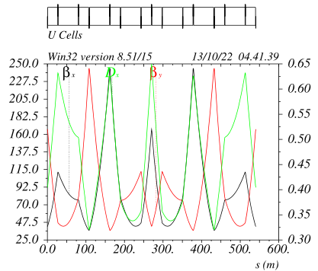
Alternate Ring Optics
P. Raimondi
Nominal arc cells are 90-degree FODO cells
  Consider cell concepts from LC damping rings or light sources that may have better chromatic behavior → better DA

Slide 18

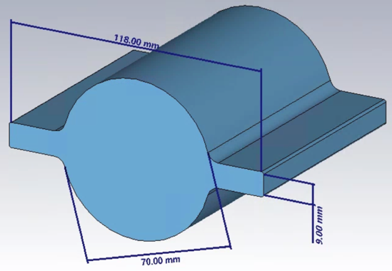
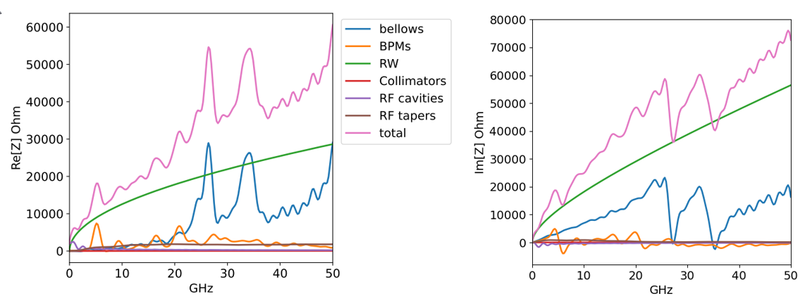
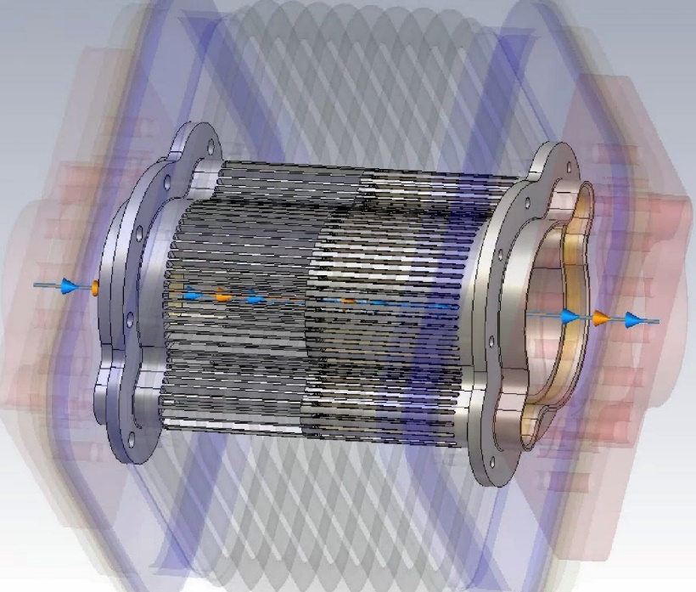
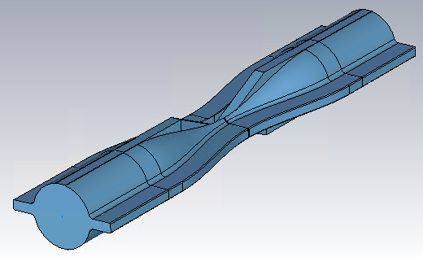
FCC-ee Collective effects
Single bunch instabilities calculated with impedance, beam-beam, and ring optics but there is complicated interplay
  Building detailed impedance model: vacuum chamber, RF, bellows, BPMs, collimators working with Super KEKB, EIC, ….
  Longitudinal wake and beam-beam constrains tunes
  Beam-beam stabilizes the transverse mode-coupling instability

Slide 19
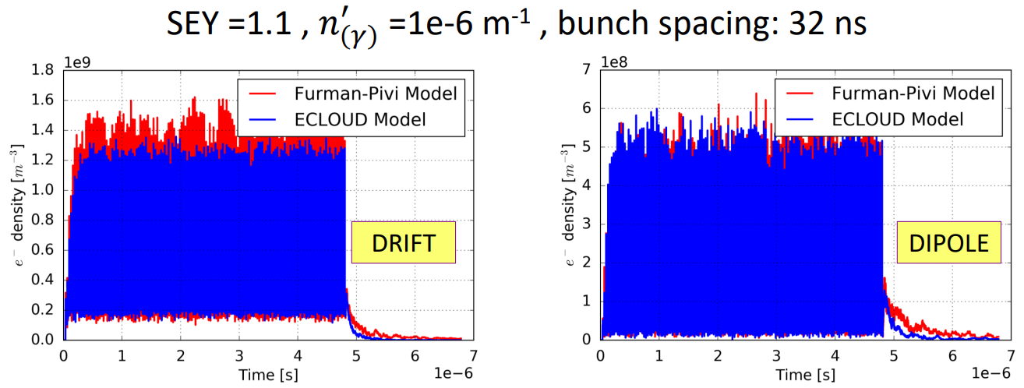
FCC-ee Long-range Collective effects
Multibunch instabilities constrain bunch spacing
  Requires low SEY and n_{γ} on vacuum chamber to avoid significant e-cloud
  Damped RF cavities and electron cloud limits Δt ≥ 15 ns – ongoing studies
Large ring circumference limits feedback gain
  Developing integrated simulations for collective effects with feedback
Fatih Yaman, STFC
Luca Sabato, EPFL
FCC IS and CHART

Slide 20
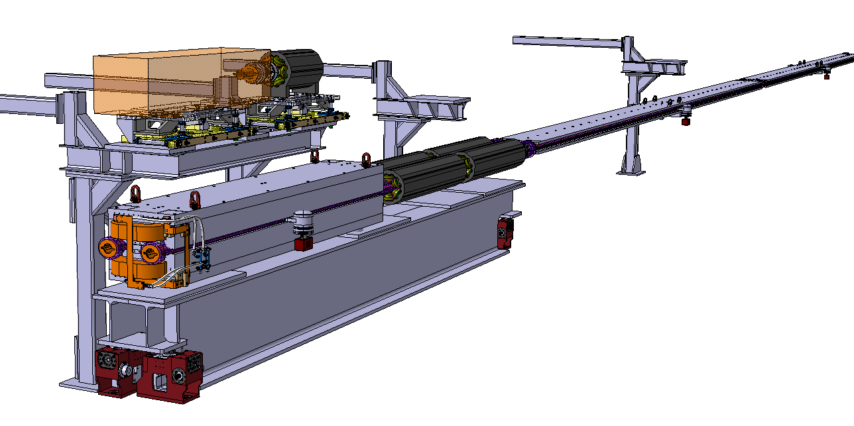
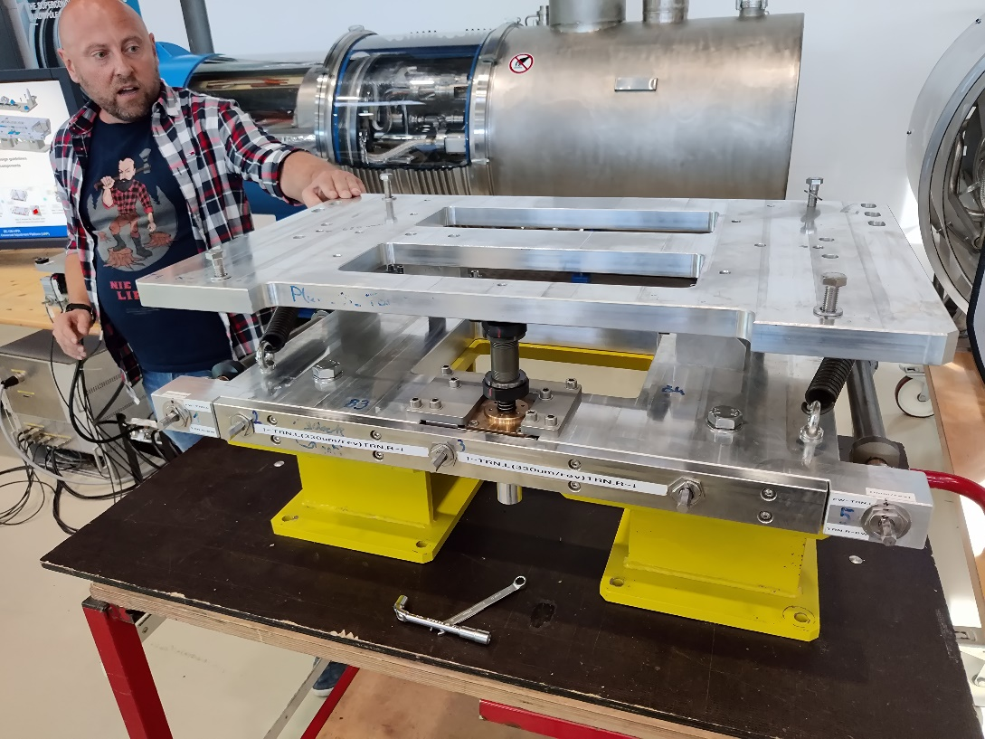
FCC-ee Accelerator Layout
The arc cells are repeated 2000 times around the ring
  Critical to understand and optimize the layout for cost, installation, alignment, operation, and maintenance
  Includes placement of the
  main rings and the Booster
The RF regions are also
tightly constrained
  Optimize cryomodule
  lengths and waveguides
Common support for booster’s quadrupoles & sextupoles
Preliminary single cantilever dipole supports
F. Carra et al
C. Tetrault
Common girder for main collider quadrupoles & sextupoles
HL-LHC 2t Universal Adjustment Platform (UAP)
HL-LHC jacks

Slide 21
FCC-ee SRF Systems
Baseline uses established SRF technologies in use at CERN
800 MHz for booster and 400 MHz at Z, W, Zh while adding 800 MHz at t-tbar
  Z with very high current → 120 MV of low frequency (400 MHz) single-cell cavities with RF dedicated to e+ or e-
  Upgrade to 2-cell cavities at W with 1 GV in each ring
  Increase to 2.1 GV shared between e+ and e- at Zh
  Add 9 GV of 5-cell 800 MHz to e+ and e- rings along with a total of 11 GV 800 MHz for the booster
Consider more aggressive options as alternates in future

Slide 22
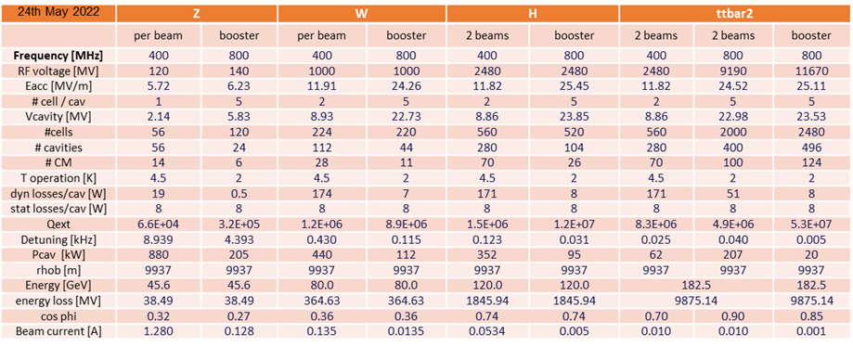
FCC-ee SRF Systems
F. Peauger and O. Brunner

Slide 23
FCC-ee SRF R&D
400 MHz Cu/Nb cavities with Q₀ of >3e9 at 12 MV/m and 4.5K
  Require strong damping of single-cell cavities to reduce HOMs at Amp-level current
  Coupler design for ~MW RF power
  Compact cryomodule design for W, Zh, and t-tbar
800 MHz Nb cavities with Q₀ of >3e10 at 25 MV/m and 2K
  Require strong damping of HOMs in 5-cell cavities for 100 mA
  Recently increased Q₀ spec from 2e10 to >3e10
  Coupler design for 250 kW RF power
  Compact cryomodule design for t-tbar

Slide 24

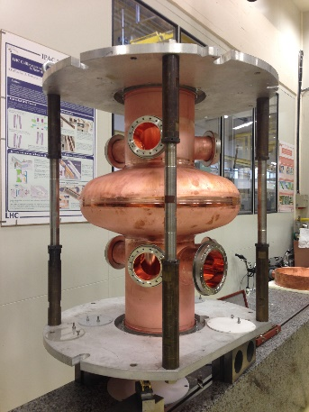
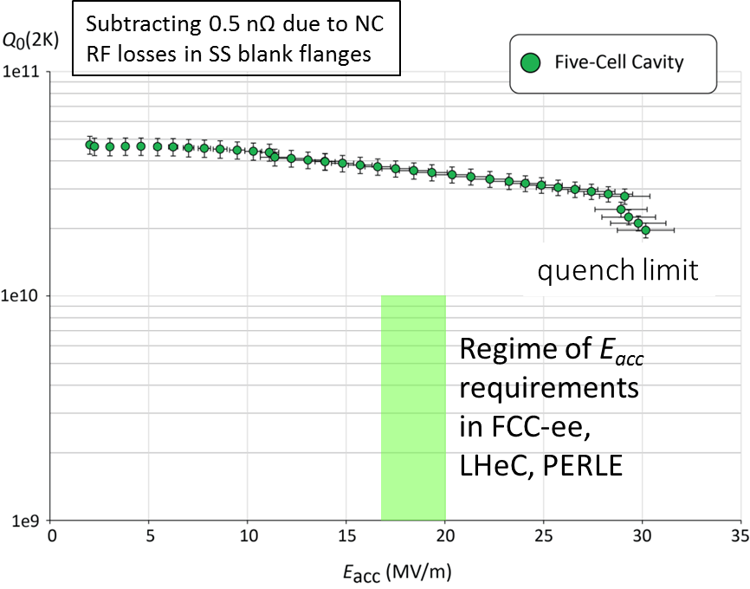
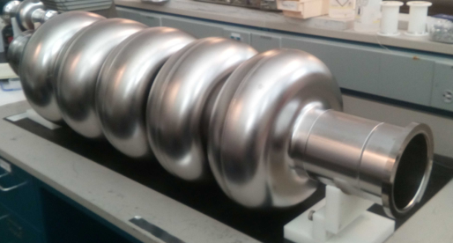
FCC-ee 400 and 800 MHz SRF Systems
R&D is on-going around the world on high Q₀ cavities
400 MHz is based on thin-film coatings of Cu cavities while 800 MHz are bulk Nb
LHC is pushing
the 400 MHz
development
of HiPIMS
sputtering
Jlab tested a
bare 800 MHz
cavity

Slide 25
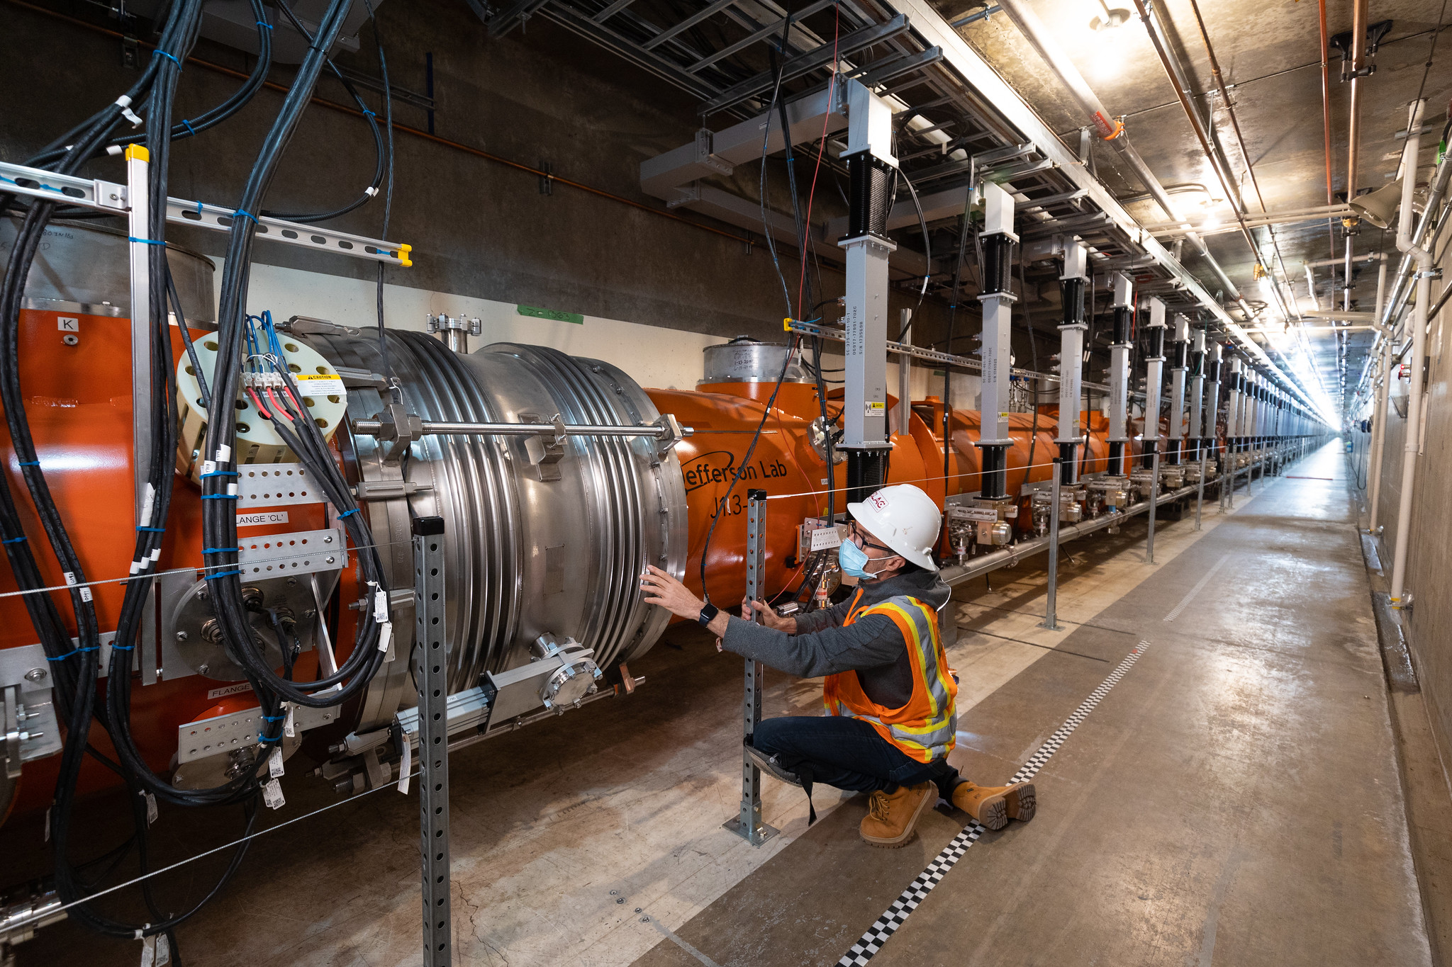
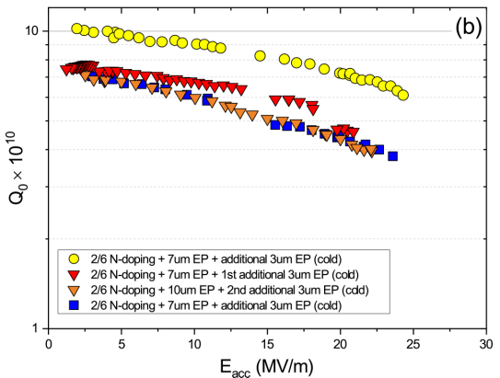
High Q₀ SRF Systems
LCLS-II developed new N₂ doping approach → is operating cryomodules at 1.3 GHz with Q₀ = 2.7x10¹⁰ at 16 MV/m
PIP-II is developing high Q
cavities at 650 MHz
PIP-II
LCLS-II
LCLS-II-HE has built two cryomodules
with Q0 = 2.7x10¹⁰ and >21 MV/m

Slide 26
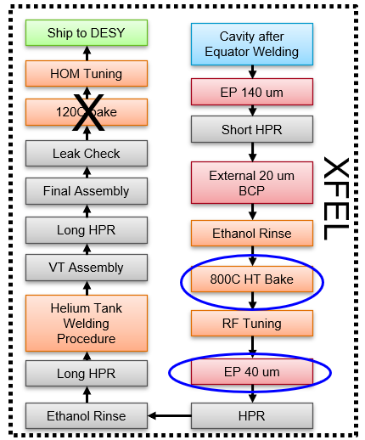
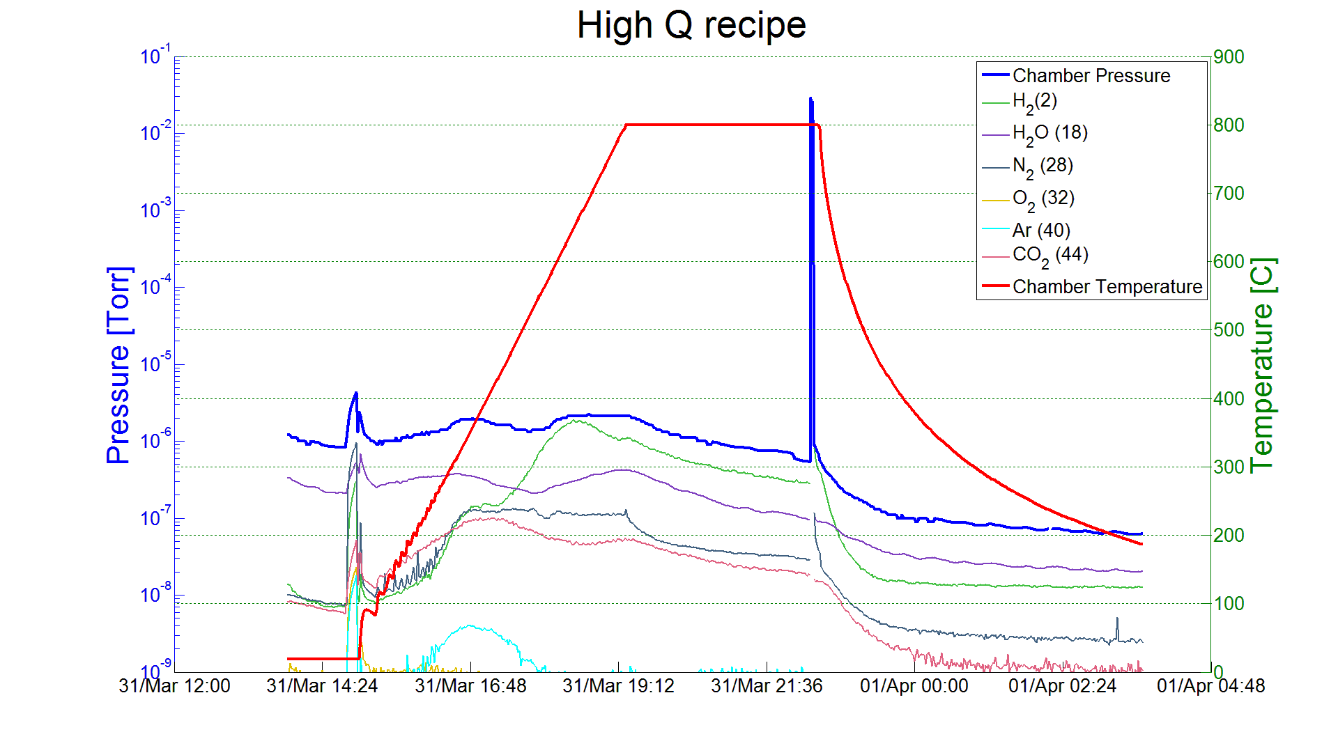
Developing High Q Cavities
Development of cavities is guided by theory but still very much an exploration
LCLS-II developed 2/6 N₂ recipe;
LCLS-II-HE 2/0 and 3/60 recipes;
ILC low-T bake; PIP-II mid-T bake

Slide 27

Sustainability compared with other Higgs factories
TWh / year for the “Higgs factory” centre-of-mass energy
Patrick Janot
https://indico.cern.ch/event/1178975/
    √s = 240 GeV for CEPC/FCC-ee, 250 GeV for ILC/C³, 380 GeV for CLIC
P. Janot and A. Blondel, Who is the greenest? - The environmental footprint of future Higgs boson studies, arXiv 2208.10466 (2022); https://arxiv.org/abs/2208.10466
CLIC | ILC | C³ | FCC-ee | CEPC
0.8 | 0.9 | 0.9 | 1.1 | 2.0
Energy consumption in MWh / Higgs
CLIC | ILC | C³ | CEPC | FCC-ee
30 | 20 | 21 | 10 | 3.3
      becomes 2 MWh / Higgs for FCC-ee with 4 IPs
Present carbon footprint for electrical energy in tons CO₂ / Higgs
CLIC@CERN | ILC@KEK | C³@FNAL | CEPC@China | FCC-ee@CERN
2.1 | 7.8 | 8.5 | 6.1 | 0.24
0.14 ton CO₂ / Higgs for FCC-ee with 4 IPs

Slide 28
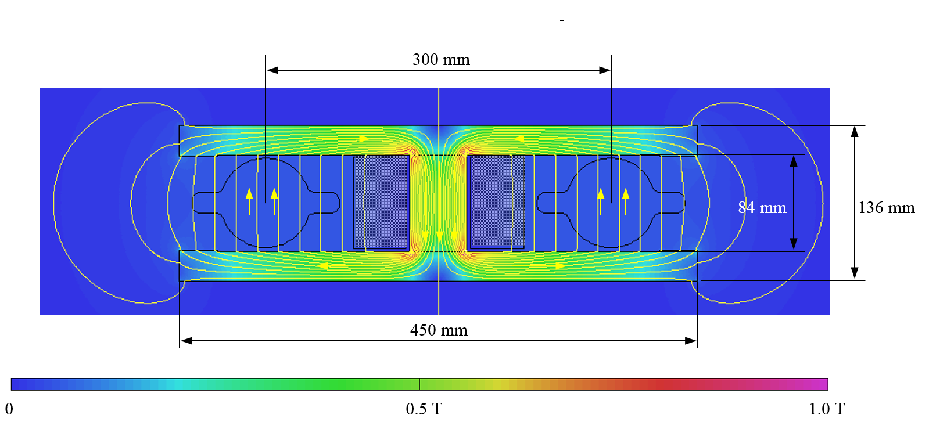
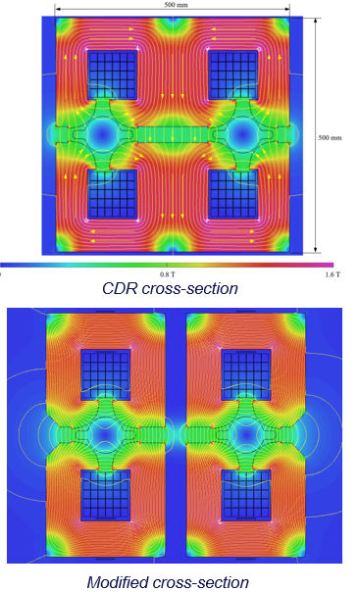
FCC-ee Power Consumption
Roughly 300 MW operating at Higgs
  Complete power accounting
High efficiency RF sources (150 MW) 80 → 90%
High Q RF Cavities (20 MW)
Magnet systems (40 MW)
  Dipole quite efficient
  Quadrupole and sextupole magnets simplified and
  power reduced with smaller bore or HTS
  Cable losses may be reduced with in-tunnel PS
Efficient cooling and ventilation (40 MW)

Slide 29

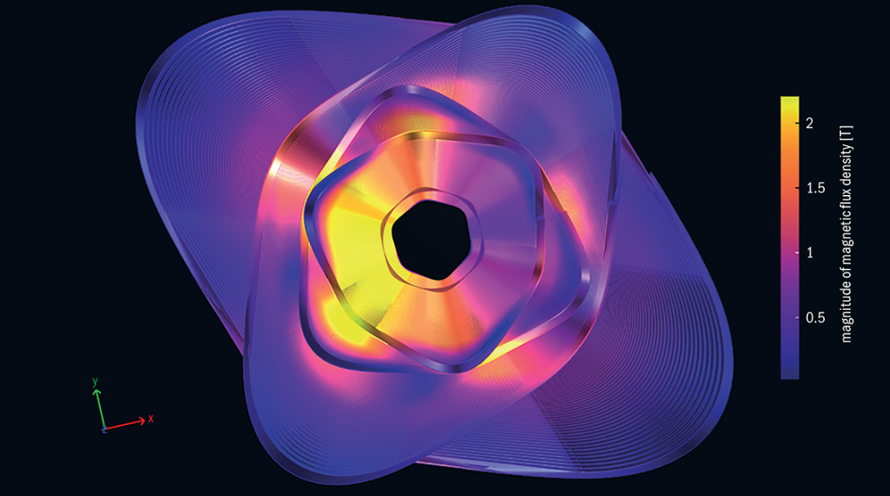
HTS Arc Quadrupole / Sextupole / Dipole
Develop HTS magnets for arc quadrupole / sextupoles
  Reduce power consumption with nested quadrupole and sextupole
  Cryo-coolers for compact installation
  Add weak dipoles to reduce SR power by 10% at Z and 20% at Higgs
HTS4 R&D program supported
by CHART led by M. Koratzinos
  Produce a 1-m protype section
  leveraging HTS development
  as part of CHART
  Understand radiation
  environment and magnet and
  cooler radiation damage
CERN Courier, Nov. 2022

Slide 30

Full Energy Booster
Booster ramps from 20 GeV to Main Ring energy
  Accumulate electrons or positrons for injection to Main Ring
  Accumulation times of ~25 seconds at Z
  Damp beams and transients to Main Ring equilibrium values
  Alternate injection of e- and e+ to maintain +/- 3 to 5% charge
Layouts are being developed with IP Bypasses, Inj/Ext, and RF
  Arc cell structure mirrors Main Ring
  Laminated magnet concepts are being considered
  Developing integrated model of arc structure including both Main Rings and Booster
  Collective effects, dynamic aperture and tolerances are being studied

Slide 31
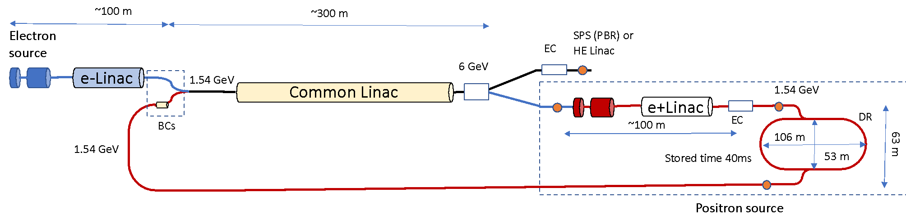
FCC-ee Pre-Injector
P. Craievich, A. Grudiev
Design concept being developed with PSI
  High brightness e- source and efficient e+ source with damping ring to generate pairs of 6 GeV bunches at 200 Hz (for Z)
  Acceleration to Booster at ~20 GeV in SPS (CDR) or high energy linac (FCC IS)

Slide 32
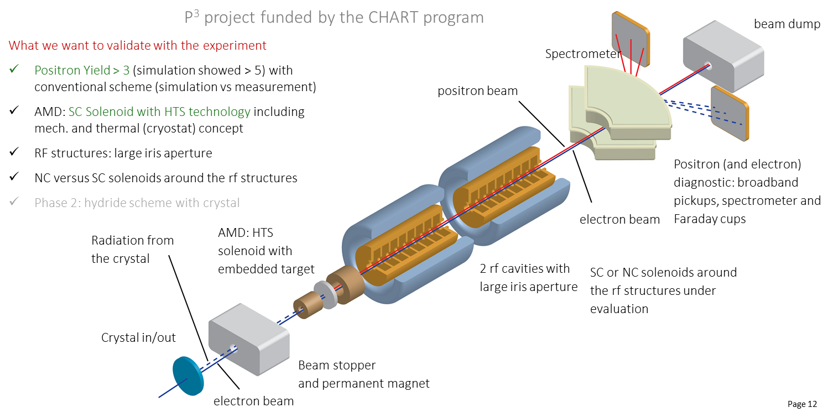
FCC-ee Pre-Injector R&D

Slide 33
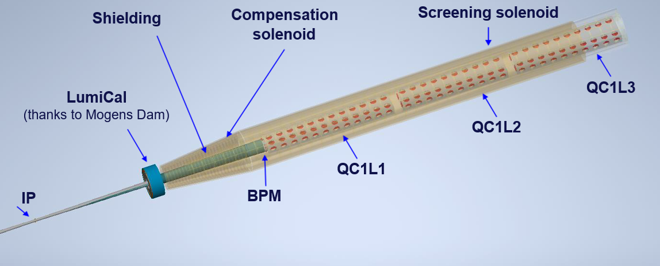
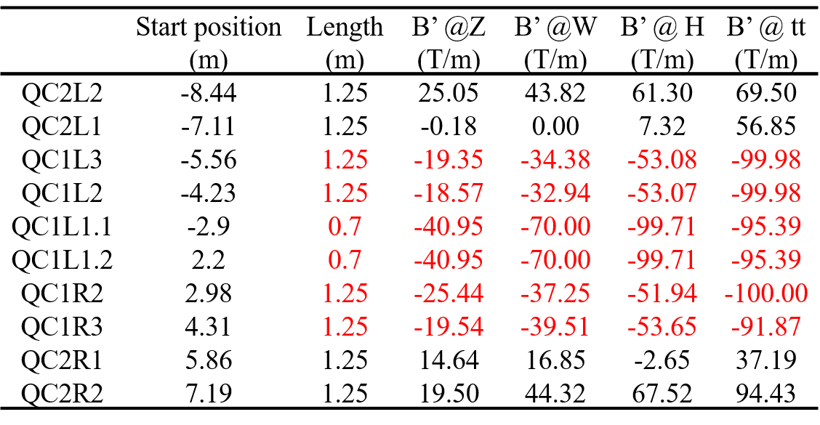
FCC-ee MDI and IR design
Complicated integration with SC quadrupoles, solenoids, IR chamber, LumiCal, shielding, and diagnostics
M. Boscolo
M. Koratzinos,
B. Parker, et al
Quadrupoles
thanks to M. Koratzinos

Slide 34
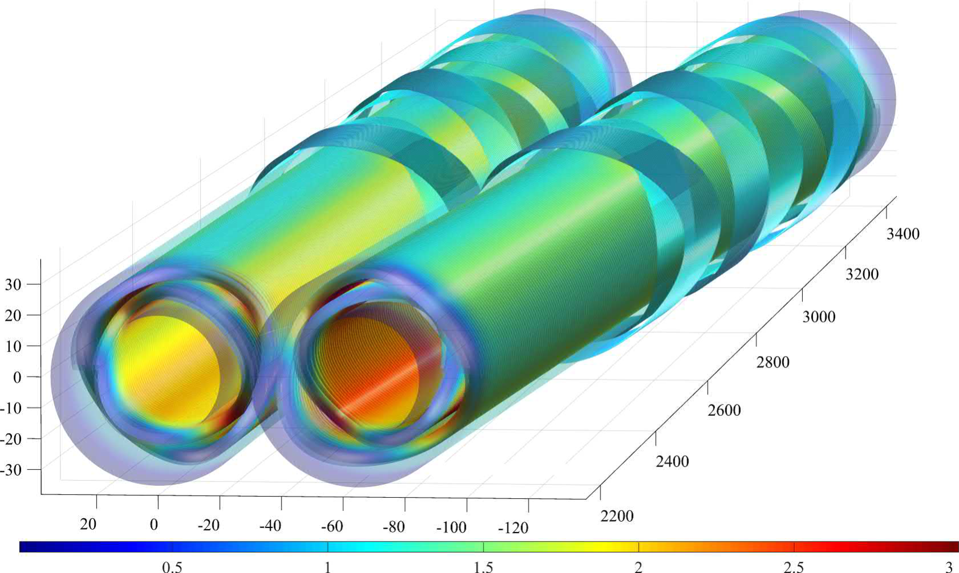
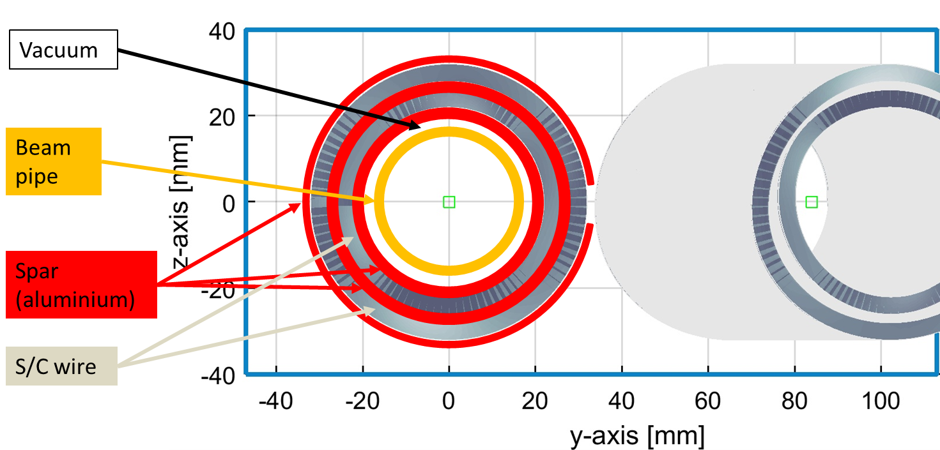
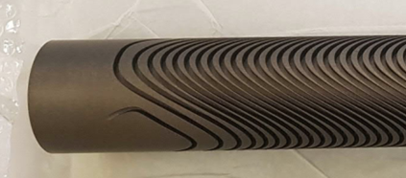

FCC-ee IR Magnet R&D
Many similarities with EIC IR
Double Helical $≡$ CCT
H. Witte
Direct Wind Tapered Double Helical Coil
FCC R&D CCT Magnet
M. Koratzinos
Grooved Double Helical Coil Support
Baseline FCC-ee Coils and Beam Pipe

Slide 35


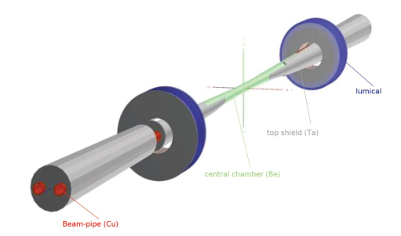

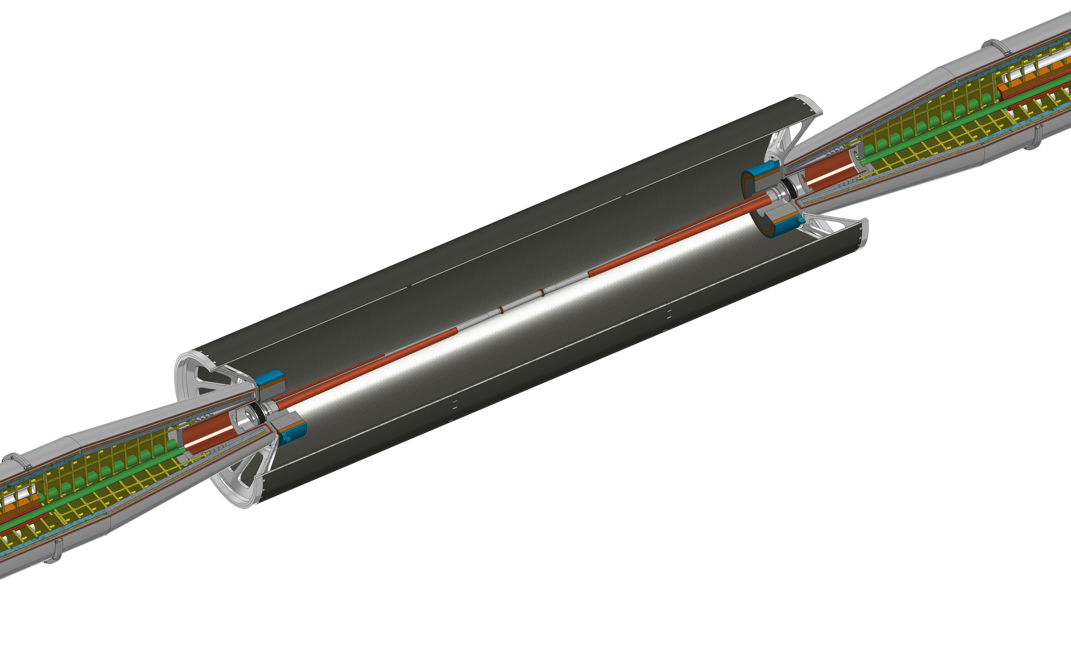
FCC-ee IR Mock-up
IP chamber: critical for performance, MDI
Step 1: Central IP vacuum chamber (test cooling and vacuum systems), AlBeMet162 & steel transition (shape of transition, EBW process), Bellows (vacuum and thermal tests), Welding (EBW for elliptical geometry), C-fibre support structure
Step 2: Trapezoidal vacuum chamber with remote vacuum connection, first quadrupole QC1, cryostat, beam pipe and quadrupole and cryostat support, vibration & alignment sensors
support tube with carbon fiber cylinder

Slide 36
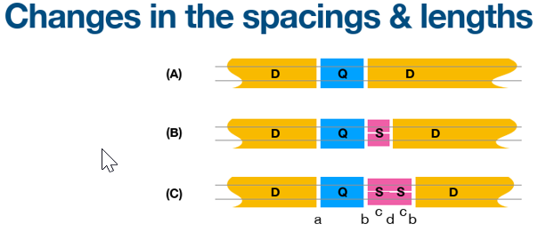
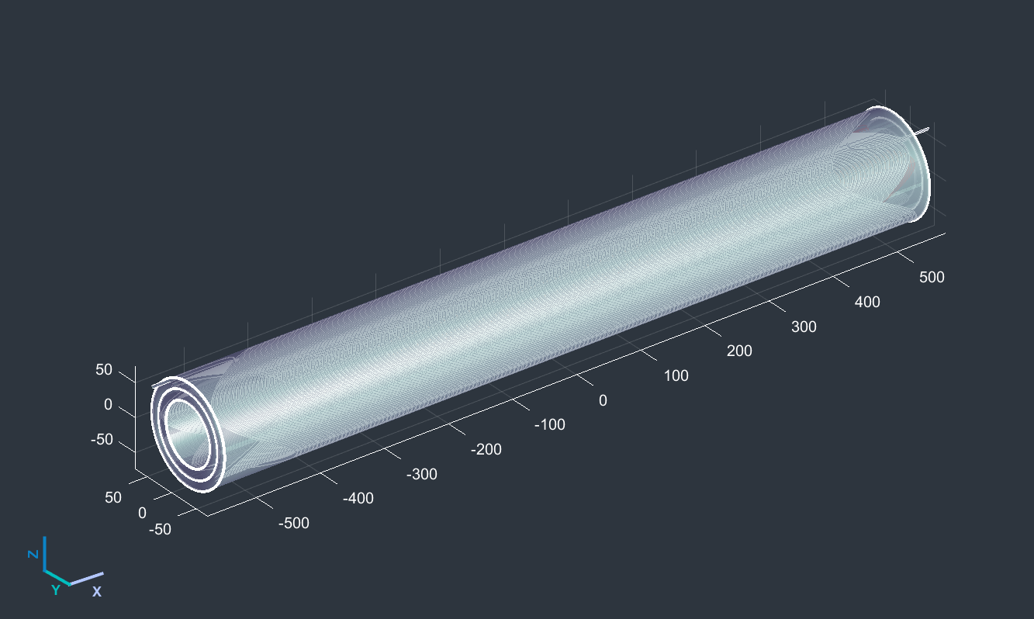
FCC-ee Alternative technologies
Developing technologies with significant potential impact in parallel to baseline, e.g.
  HTS arc quadrupole/sextupole magnets
  High efficiency RF sources
  Radiation hard electronics
  HE linac as a pre-booster
  Positron target using crystal channeling
  Advanced cooling tower design
  Advanced cryogenic design
  …
M. Koratzinos
Combined function HTS magnet

Slide 37

Synergistic Programs
Collaborators around the world
Many synergies with other large accelerator projects
  Super KEKB (KEK)
  CEPC (China)
  Electron Ion Collider (BNL / Jlab)
  PIP-II (Fermilab)
  Synchrotron radiation facilities (world-wide)
147
Institutes
30
Companies
34
Countries
EC
H2020

Slide 38
FCC accelerator summary and timeline
Finalizing layouts with correct circumference
FCC-ee baseline parameters are established
  Main ring substems, full-energy booster, and injector all being defined
Technical systems making good progress
  Vacuum, magnets, SRF, cryogenics, diagnostics, integration, …
  Already most efficient Higgs solution but working to improve overall η
  Extensive world-wide R&D program
Luminosity requires all systems work together in large facility
  Still many challenges in developing robust integrated design
Will have baseline established in 2023 and optimize further to complete feasibility study at end of 2025

Slide 39
Thank you for your attention.
Date / Name of the event
Name of the speaker/author
SPACE FOR ADDITIONAL LOGOS
39

