Slide 1


Technical Infrastructure
K Hanke, CERN

Slide 2
Technical Inffrastructure
K Hanke, CERN

Slide 3
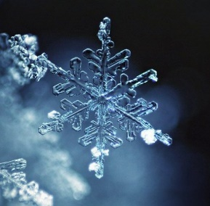
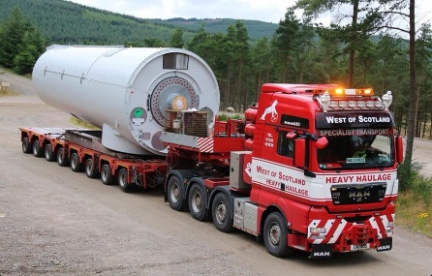
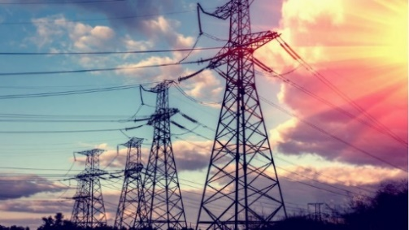
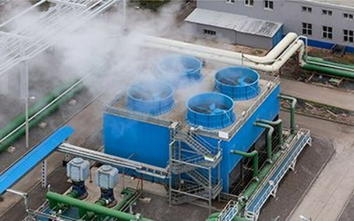
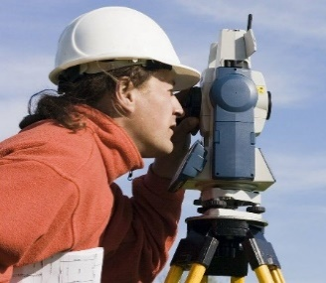
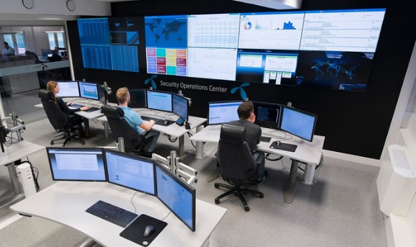
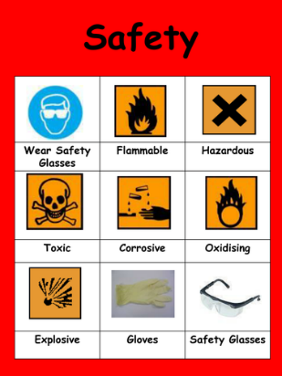
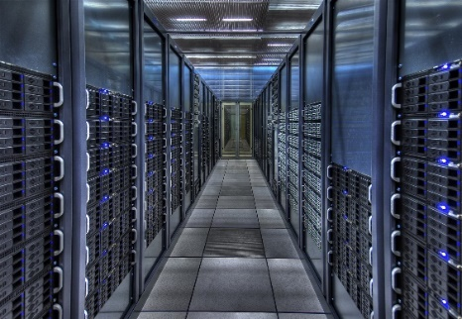
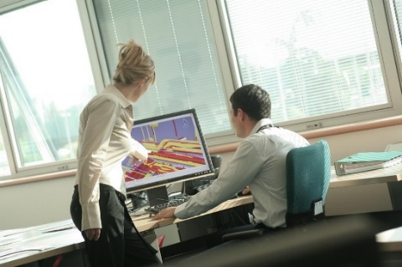
3
3
3
3
K Hanke
FCCIS Workshop Dec 5 – 9, 2022
3
Technical Infrastructure Working Group
integration ● geodesy ● electricity & energy management ● cooling & ventilation ● cryogenic systems ● computing infrastructure
● safety ● operation & maintenance ● transport, installation & logistics

Slide 4
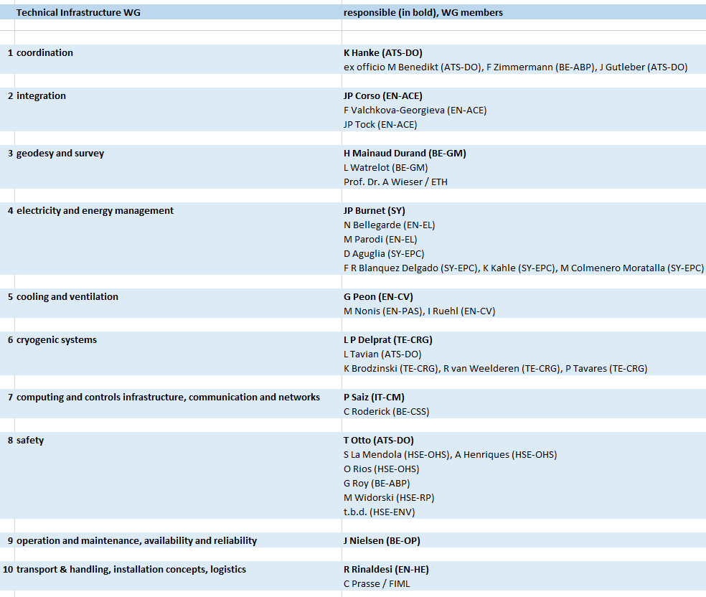
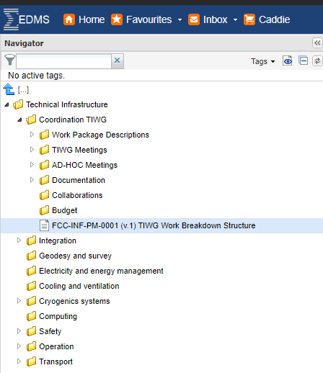
4
4
4
4
K Hanke
FCCIS Workshop Dec 5 – 9, 2022
4
Coordination
WBS with responsible WP Holders
Work Package Descriptions
Bi-weekly Working Group Meetings
Ad-hoc meetings to address specific topics
Minutes & Documentation on EDMS
Interfacing with Study Mgmt. and other Pillars
Work Breakdown Structure WBS

Slide 5
5
5
5
5
5
K Hanke
FCCIS Workshop Dec 5 – 9, 2022
5
Collaborations
Geodesy and Survey: ETH Zürich, Switzerland
Transport and Logistics: Fraunhofer-Institut für Materialfluss und Logistik IML, Germany
Safety: Presently setting up collaboration with University College London, UK

Slide 6
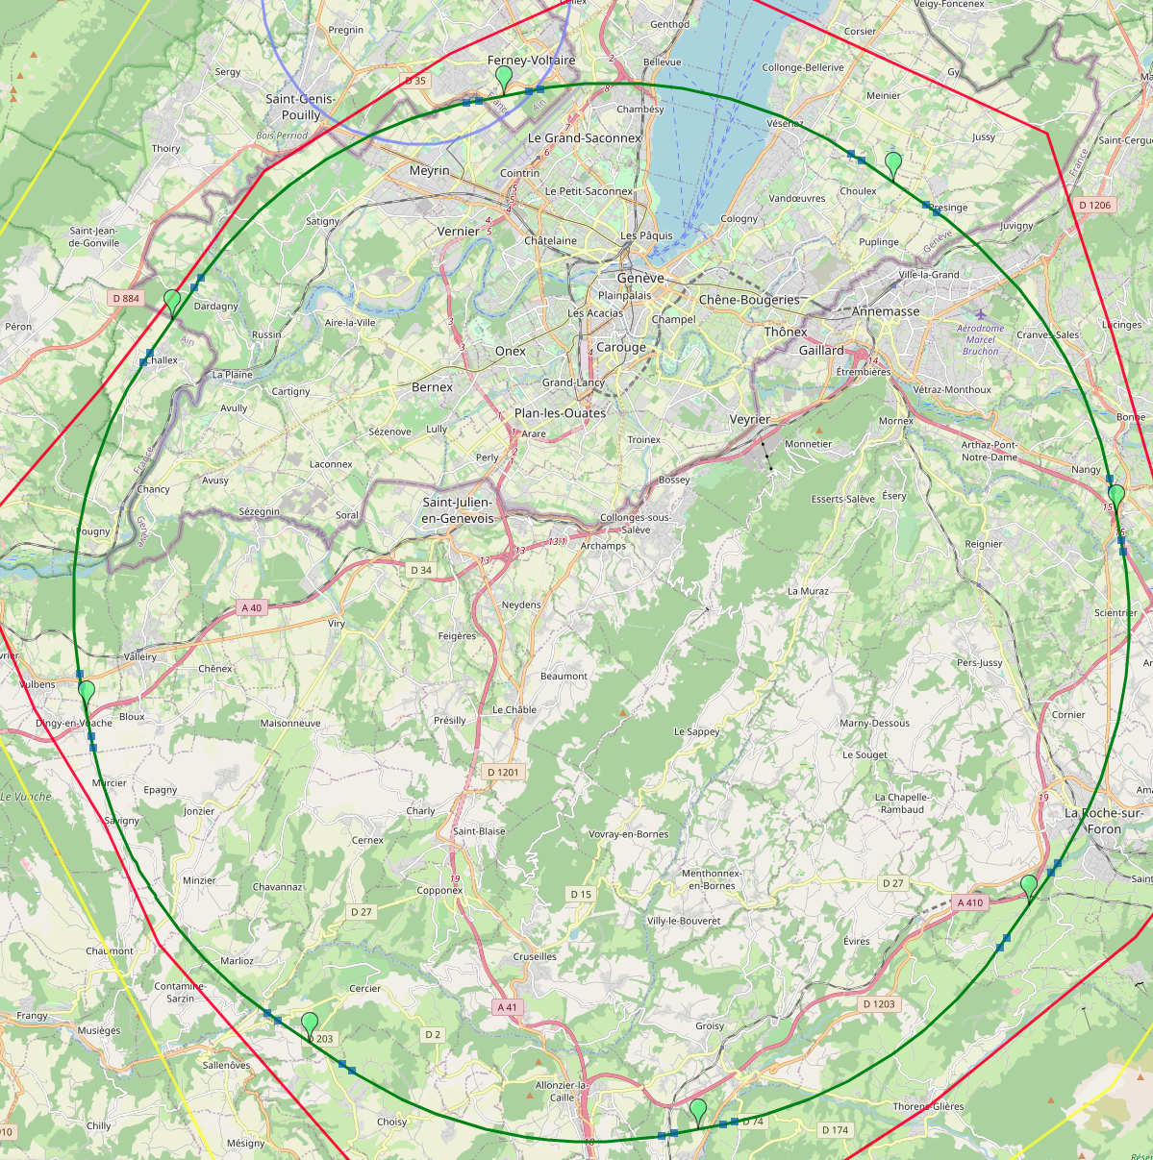
8-site baseline ”PA31”
K Hanke
FCCIS Workshop Dec 5 – 9, 2022
PA: Experiment
Number of surface sites | 8
LSS@IP (PA, PD, PG, PJ) | 1400 m
LSS@TECH (PB, PF, PH, PL) | 2143 m
Arc length | 9.6 km
Sum of arc lengths | 76.9 m
Total length | 91.1 km
PB: technical
PL: technical
PD: experiment
8 sites – less use of land, <40 ha instead 62 ha
Possibility for 4 experiment sites in FCC-ee
All sites close to road infrastructures (< 5 km of new road constructions for all sites)
Vicinity of several sites to 400 kV grid lines
Good road connection of PD, PF, PG, PH suggest operation pole around Annecy/LAPP
PJ: experiment
PF: technical
PH: technical
M. Benedikt, FCC Week 2022
PG: experiment

Slide 7
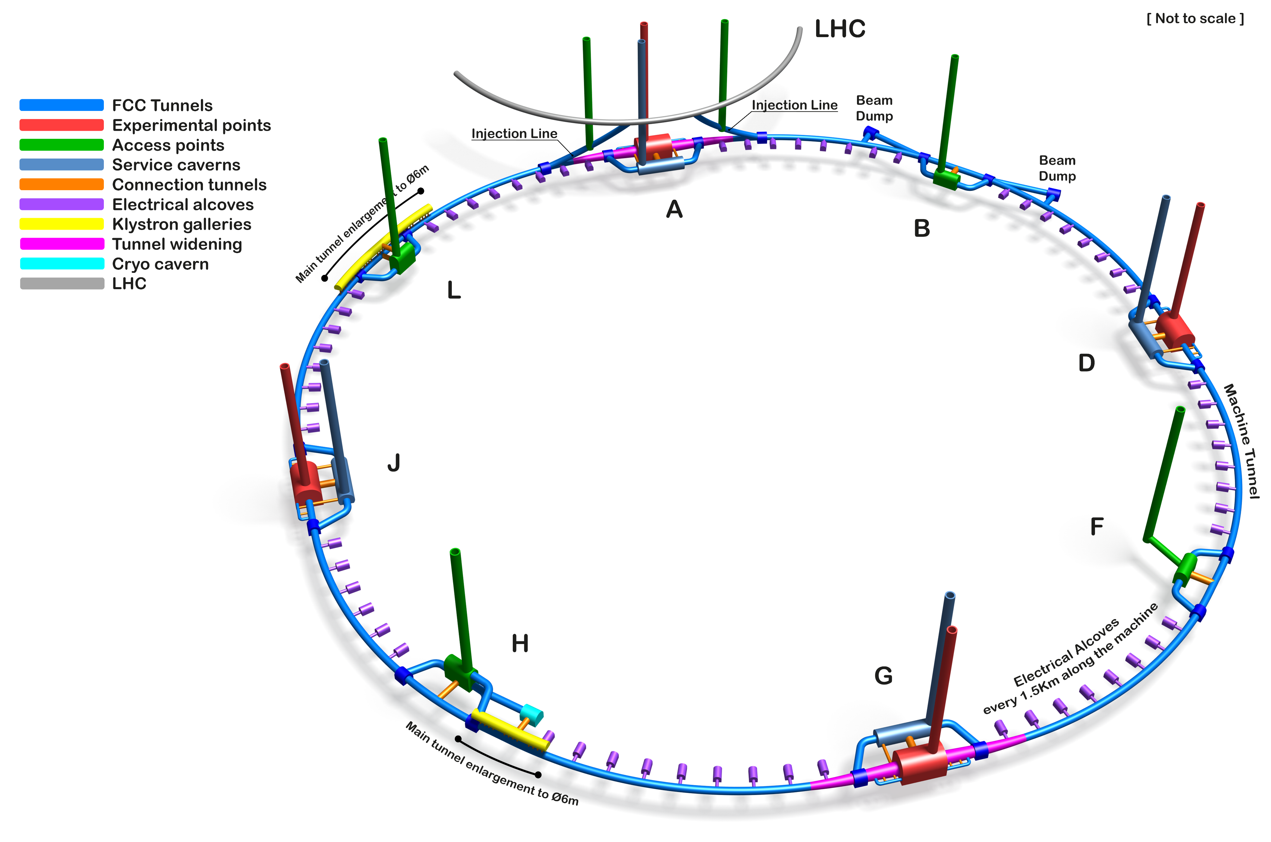
7
7
7
7
7
K Hanke
FCCIS Workshop Dec 5 – 9, 2022
7
Only schematic, and not to scale.
  FCC-ee Underground Structure Overview
Courtesy A. Navascues Cornago

Slide 8
8
8
8
8
8
K Hanke
FCCIS Workshop Dec 5 – 9, 2022
8
  Integration of FCC-ee Arc Cell

Slide 9
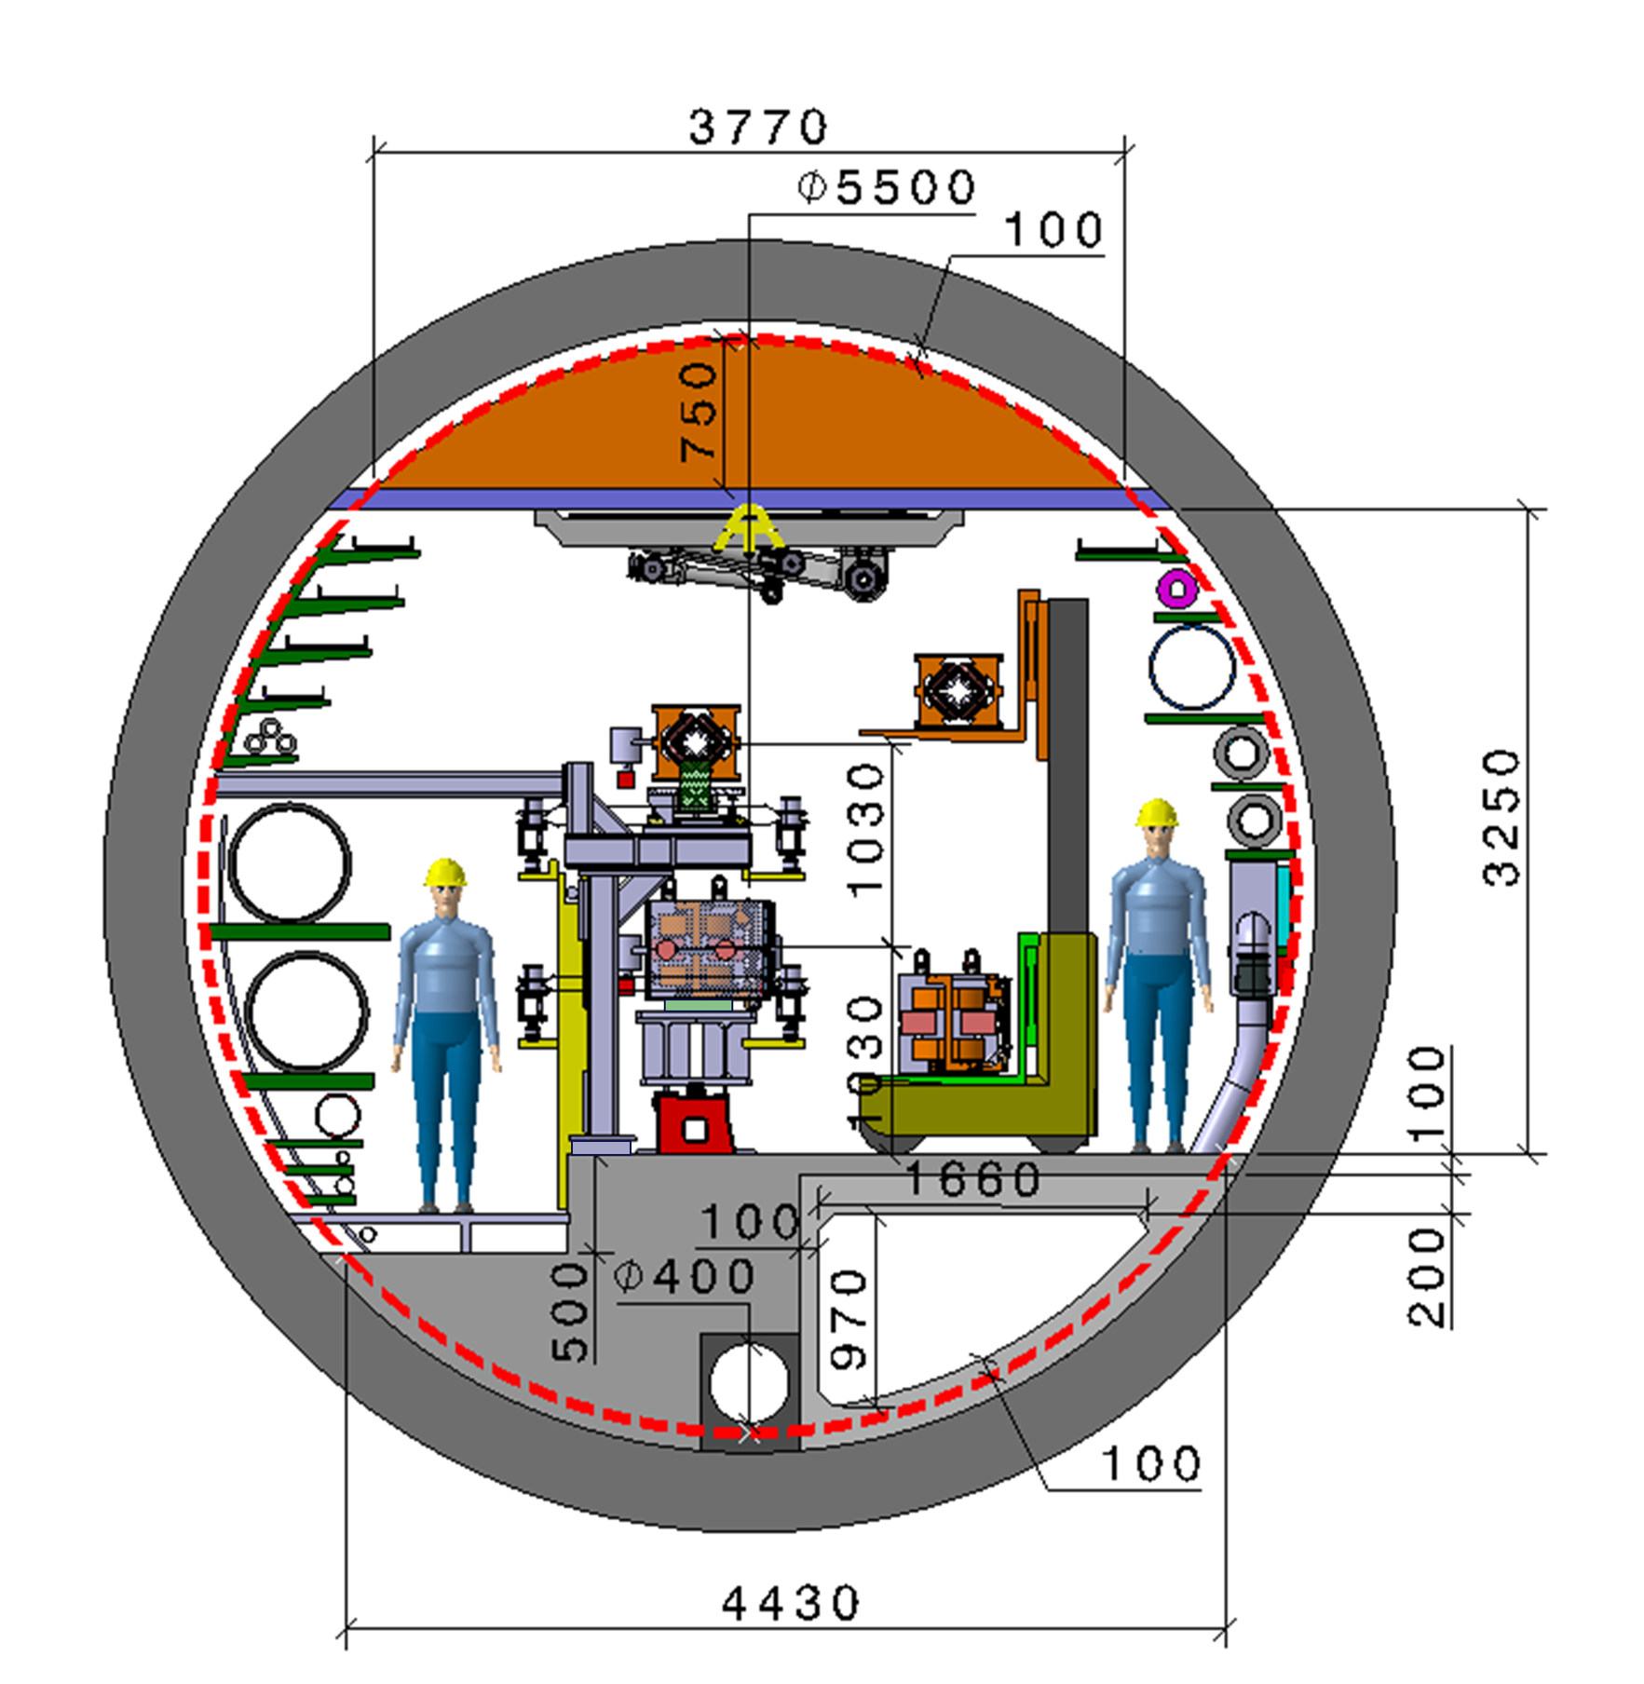
9
9
9
9
9
K Hanke
FCCIS Workshop Dec 5 – 9, 2022
9
  Integration of FCC-ee machine elements (regular arc)
Machine tunnel 5.5m in diameter
Main cross section as for FCC-hh
Main ring below of booster ring
Main ring and booster ring 1.03 m distant
Water distribution changed to DN550
Collider Center
Courtesy F. Valckkova-Georgieva

Slide 10
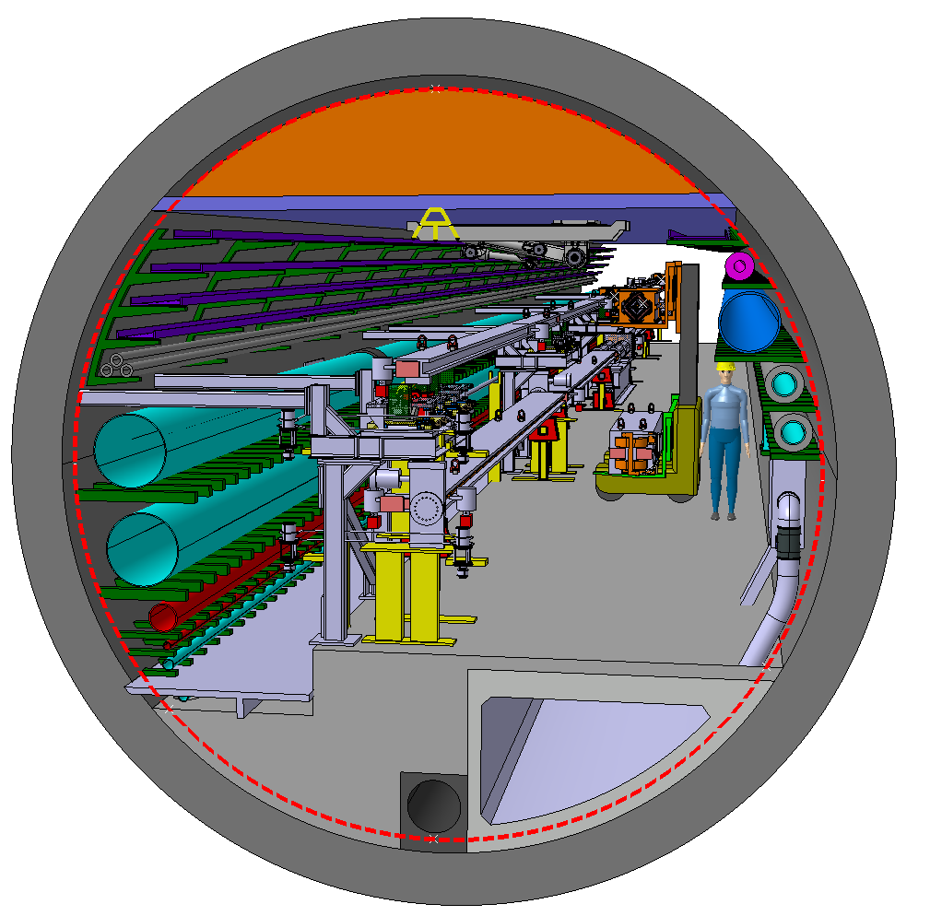
10
10
10
10
10
K Hanke
FCCIS Workshop Dec 5 – 9, 2022
10
  Integration of FCC-ee machine elements (regular arc)
Perspective view
Machine tunnel 5.5m in diameter
Collider Center
Courtesy F. Valckkova-Georgieva

Slide 11
11
11
11
11
11
K Hanke
FCCIS Workshop Dec 5 – 9, 2022
11
  Alternative Integration of FCC-ee Arc Cell

Slide 12
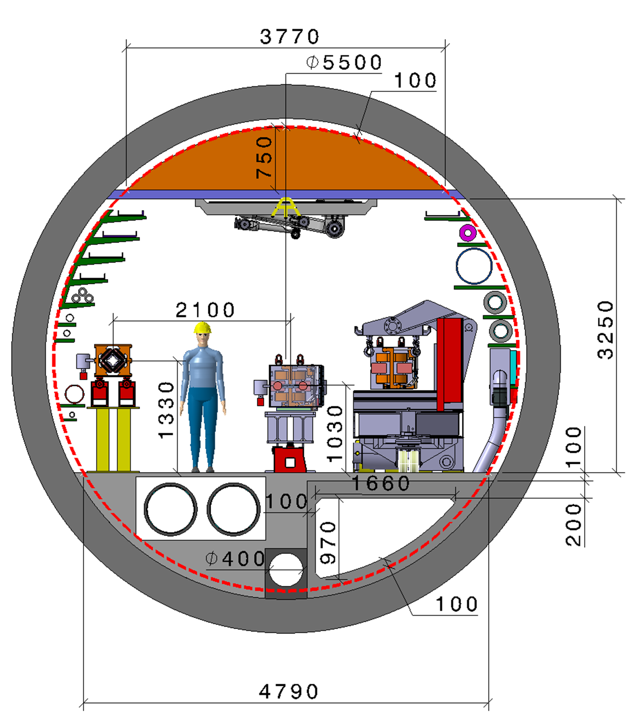
12
12
12
12
12
K Hanke
FCCIS Workshop Dec 5 – 9, 2022
12
  Alternative Integration of FCC-ee machine elements (regular arc)
Machine tunnel 5.5m in diameter
Booster ring next to the main ring
Main ring and booster ring 1.81 m distant
Demineralized water circuit DN 550 in a trench
Collider Center
Courtesy F. Valckkova-Georgieva

Slide 13
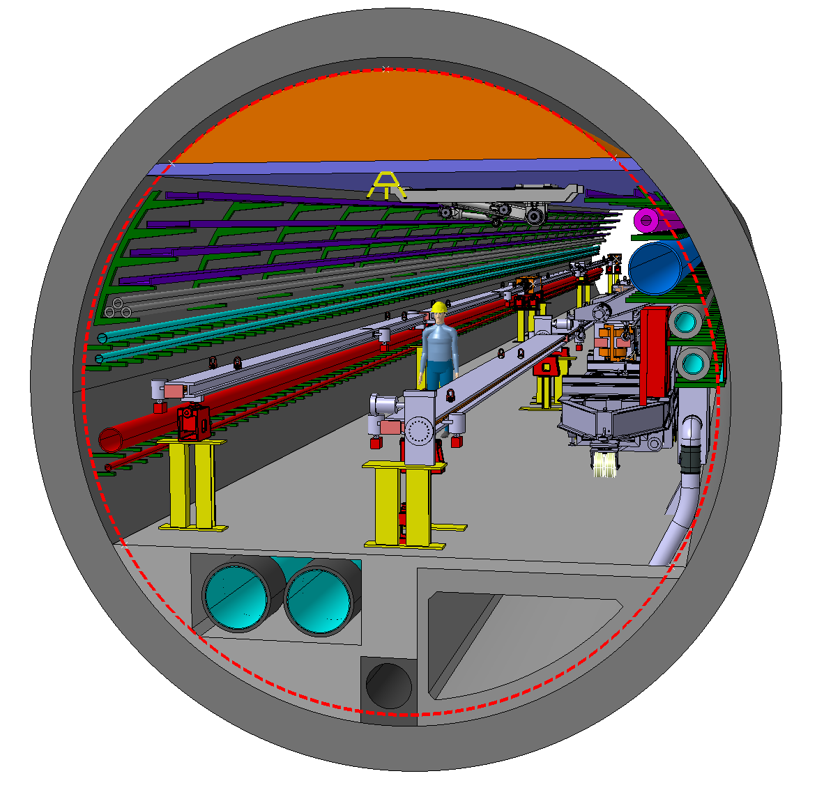
13
13
13
13
13
K Hanke
FCCIS Workshop Dec 5 – 9, 2022
13
  Alternative Integration of FCC-ee machine elements (regular arc)
Perspective view
Machine tunnel 5.5m in diameter
Collider Center
Courtesy F. Valckkova-Georgieva

Slide 14
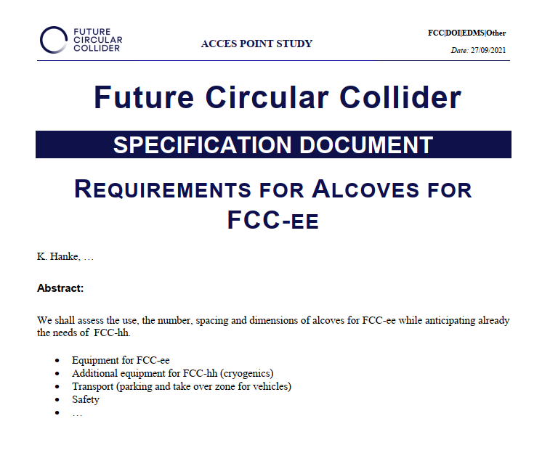
14
14
14
14
14
K Hanke
FCCIS Workshop Dec 5 – 9, 2022
14
Alcoves
Under study
Present base line is alcoves every 1.5 km (from study 1), i.e. 60 alcoves
Users:
Transport (parking, overtaking vehicles)
Safety
Cryogenics (minor user for FCC-ee, but a lot for FCC-hh!)
Cooling & Ventilation
Equipment groups (power supplies, racks, vacuum, BI, …)
The need for smaller trenches close the magnets / equipment around the ring was also discussed (in order to reduce cable length)

Slide 15
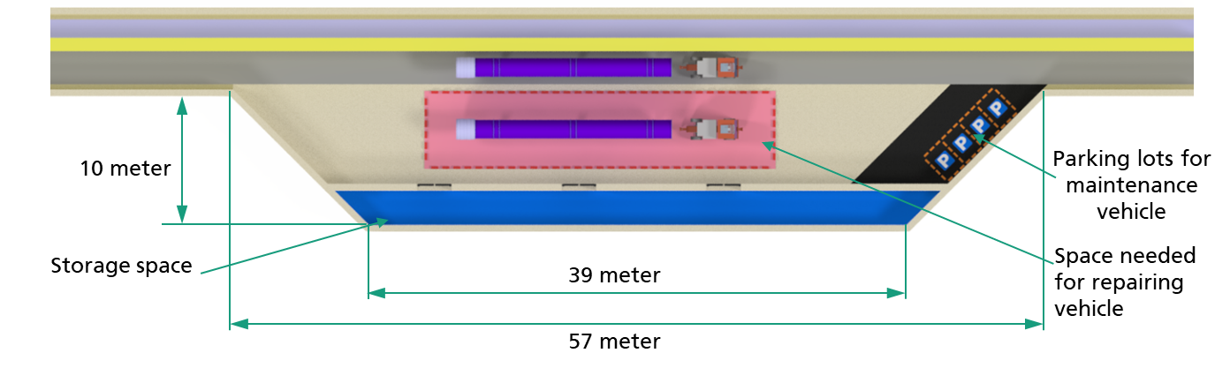
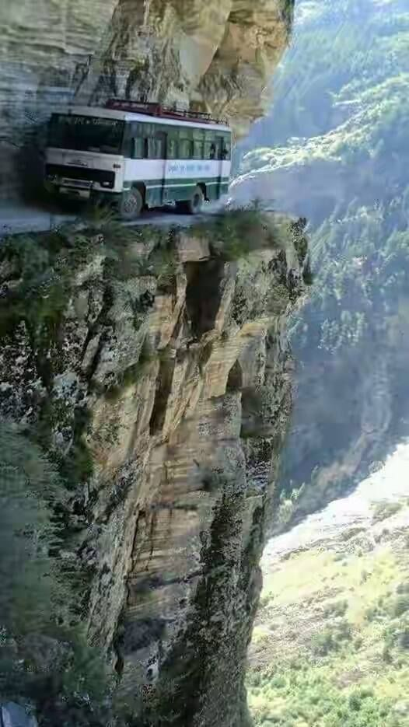
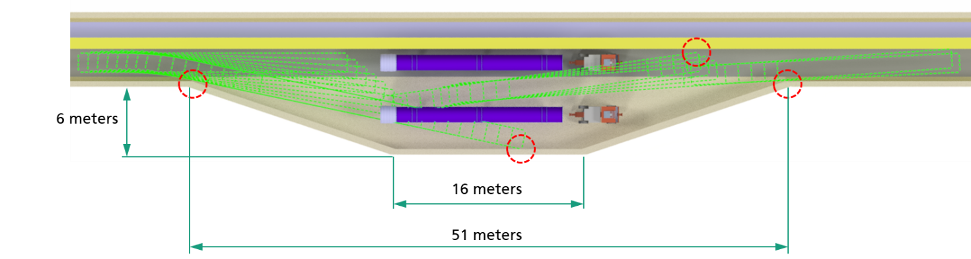
15
15
15
15
15
15
K Hanke
FCCIS Workshop Dec 5 – 9, 2022
15
Alcoves
Two possible layouts for a layby zones (FIML Dortmund)
Tentatively 8 out of the 60

Slide 16
16
16
16
16
K Hanke
FCCIS Workshop Dec 5 – 9, 2022
16
Surface Sites
For all technical and experimental points the surface installations have been compiled in large tables
https://twiki.cern.ch/twiki/bin/viewauth/FCC/ProjectElements
These tables summarise to our best present knowledge the requirements in terms of surface, location, capacity etc. for all infrastructure services
Tables are continuously being updated and are the basis for a more detailed CE integration study
Good data available for FCC-ee, to be transferred to EDMS
FCC-hh still to be adressed

Slide 17
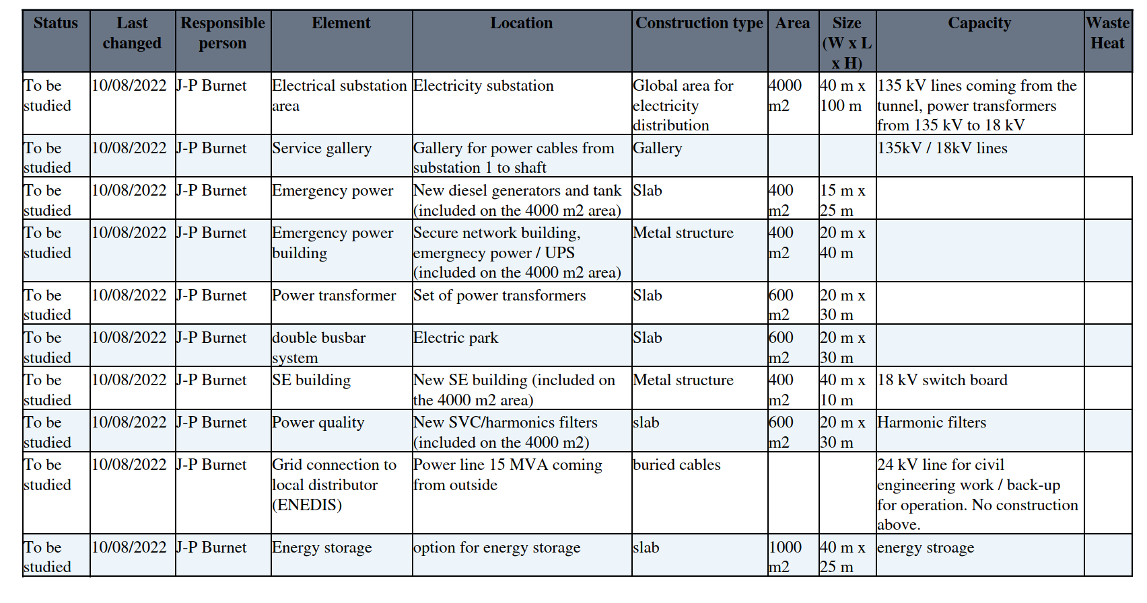
17
17
17
17
K Hanke
FCCIS Workshop Dec 5 – 9, 2022
17
Surface Sites
Example: FCC-ee PA extract

Slide 18
18
18
18
18
18
18
K Hanke
FCCIS Workshop Dec 5 – 9, 2022
18
RF Points
The constraint is to have only one RF station for the “first phase” of FCC-ee (Z, WW, HZ, eeH)
The high energy (top) situation requires two RF stations each accelerating both e+ and e-
It is not a constraint that the two RF points be opposite points
We exclude Experiment Sites (A, D, G, and J). Furthermore we recommend that point B not be an RF site (highly sensitive area, difficult access, no resources).
Therefore, from an infrastructure point of view, three of the points are eligible to house the RF for FCC-ee (H, L, and F).

Slide 19
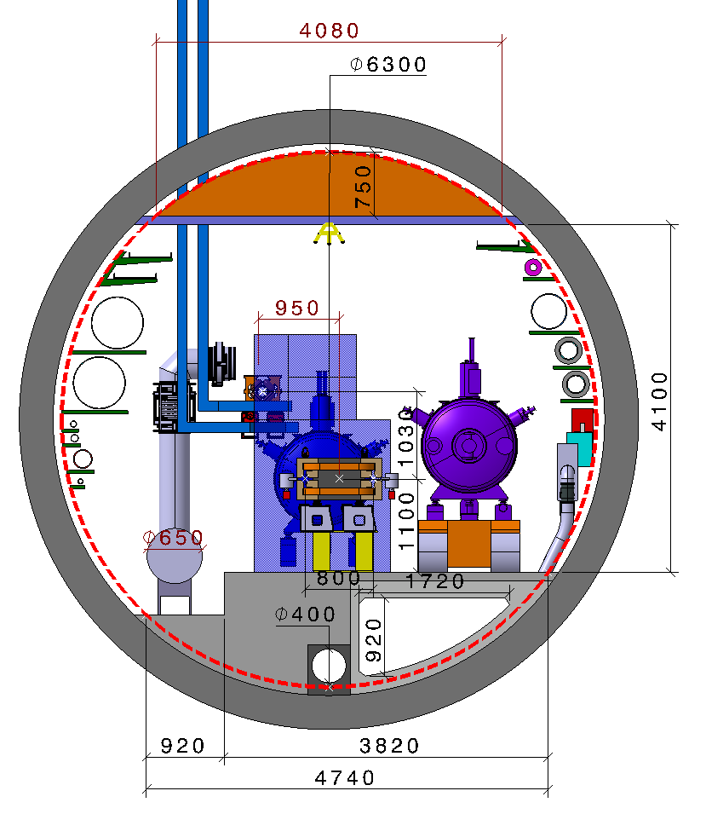
19
19
19
19
19
19
19
K Hanke
FCCIS Workshop Dec 5 – 9, 2022
19
RF Points
RF Task Force convened throughout 2022
Identify RF points for the different stages
Integration of RF points
Baseline layout for RF and Cryo systems
Review held October 2022
Task force resumed for remainder of 2022
Presently studying:
Separation of Booster and Collider RF
Horizontal alignment of Booster/Collider
Propose a base line before FCC week 2023
Example:
PL (Z,W, H machine)
400 MHz Collider RF
Booster Ring vertically stacked
See presentation by F. Valckkova-Georgieva

Slide 20
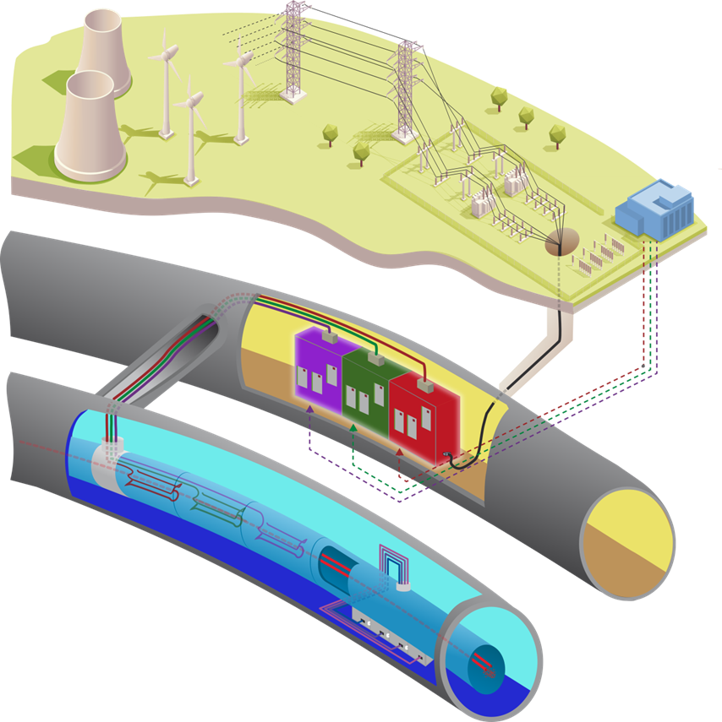
20
20
20
20
20
20
20
20
K Hanke
FCCIS Workshop Dec 5 – 9, 2022
20
Electricity & Energy Management
Physics program |  | Z | W | H | TT
Beam energy (GeV) |  | 45.6 | 80 | 120 | 182.5
Magnet current |  | 25% | 44% | 66% | 100%
Power ratio |  | 6% | 19% | 43% | 100%
PRF EL (MW) | Storage | 146 | 146 | 146 | 146
PRFb EL (MW) | Booster | 2 | 2 | 2 | 2
Pcryo (MW) | all | 1,3 | 12,6 | 15,8 | 47,5
Pcv (MW) | all | 33 | 34 | 36 | 40.2
PEL magnets (MW) | Stroage | 6 | 17 | 39 | 89
PEL magnets (MW) | Booster | 1 | 3 | 5 | 11
Experiments (MW) | Pt A & G | 8 | 8 | 8 | 8
Data centers (MW) | Pt A & G | 4 | 4 | 4 | 4
General services (MW) |  | 36 | 36 | 36 | 36
Max Power beam operation (MW) |  | 237 | 263 | 292 | 385
J.-P. Burnet

Slide 21
21
21
21
21
K Hanke
FCCIS Workshop Dec 5 – 9, 2022
21
Proposal for grid connection points
Infrastructure needed to cover all FCC configuration
PDL1, 200MW
The goal is to built an electrical infrastructure which will cover all the configuration of the FCC machine without need to built new sub-stations.
This proposal includes also the possibility to operate the FCC-ee machine without one sub-station, which will ease the maintenance and repairs.
The proposal is to have 3 grid connection points rated at 200 MW.
Under study with French transmission system operator (RTE).
PDL2, 200MW
J.-P. Burnet
PDL3,200MW

Slide 22
Ways to reduce energy consumption
22
22
22
22
22
K Hanke
FCCIS Workshop Dec 5 – 9, 2022
22
Focus on reduction of the energy consumption
The management of the accelerator systems and of the infrastructure have a large input on the energy consumption.
Priority to physics (system readiness) but at the same level energy saving
A lot of energy is consumed without beams, this is also where energy saving can be developed.
Economic mode for magnets (Switch-off magnets during short or long stops)
Economic mode for cryoplant (Static losses represent less than 10%, can we operate cryoplants at 20%,50% for short or long stop?)
Economic mode for cooling an ventilation
can we reduce the tunnel ventilation when nobody is inside or regulated it on temperature? Different from fixed speed.
can we adapt the water flow rate depending on the power dissipation? Motor drive systems regulated on power demand.
can we modulate the cooling tower with the power dissipation? Motor drive systems regulated on power demand.
Economic mode for experiments
can we identify some systems that can be put in sleep mode?
…
Under discussion, a proposal for a working group on energy saving
Target 10% ? 200 GWh
J.-P. Burnet

Slide 23
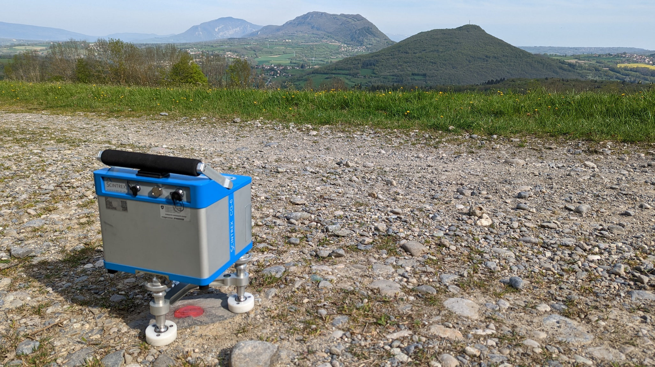
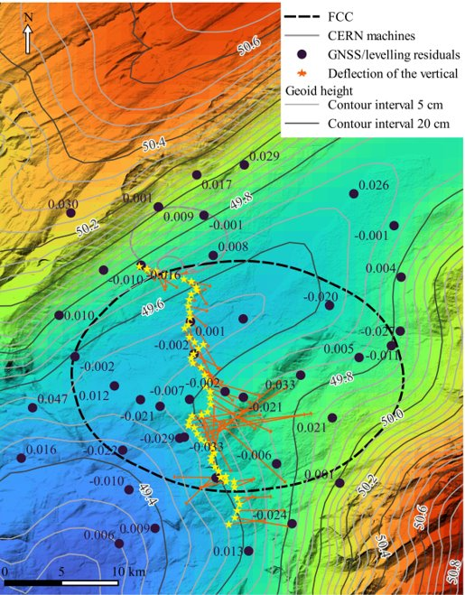
Geodesy and Survey
23
23
23
23
23
23
K Hanke
FCCIS Workshop Dec 5 – 9, 2022
23
2022 achievements
Desk study and software development:
Definition of new coordinate reference systems
Implementation of a transformation model between MAD-X coordinate system and “real world”
Data acquisition:
Relative gravity observations (densification of existing observations)
Data processing:
Computation of geodetic-control profile (processing of GNSS, levelling and astro-zenithal observations)
Computation of a first solution of local geoid model (master thesis project): accuracy improved by 30% compared to French and Swiss models
Gravity observation
B. Weyer
Geoid model

Slide 24
24
24
24
24
24
K Hanke
FCCIS Workshop Dec 5 – 9, 2022
24
Other WPs
Cooling & Ventilation
Consultant contract DAIs are waiting for signature
Kick off meetings probably at the beginning of next week
Discussions ongoing with electrical service for further input from our side
Meeting with Beamstrahlung dump experts as clients of the demi water in the tunnel.
Advancing on the logistics data for the tunnel
Transport
CERN Transport Group in Collaboration with Fraunhofer-Institut für Materialfluss und Logistik Dortmund / Germany; regular meetings
Logistics studies ongoing
Design of a transport system for installation, interventions and evacuation ongoing
Safety
Hazard Inventory
Risks at the surface areas (radiation, magnetic field)
Contributions in all areas

Slide 25

25
25
25
25
K Hanke
FCCIS Workshop Dec 5 – 9, 2022
25
Next Steps
conceptual phase, towards a baseline
Dec 2022
FCC week 2023: baseline & costing
Mid 2023
Mid-term review: baseline and cost of this baseline
Autumn 2023
refined technical work and costing exercise
t

Slide 26
Thank you for your attention

