Slide 1


FCCIS: WP2 Overview
I. Agapov, FCCIS week Dec 2022

Slide 2
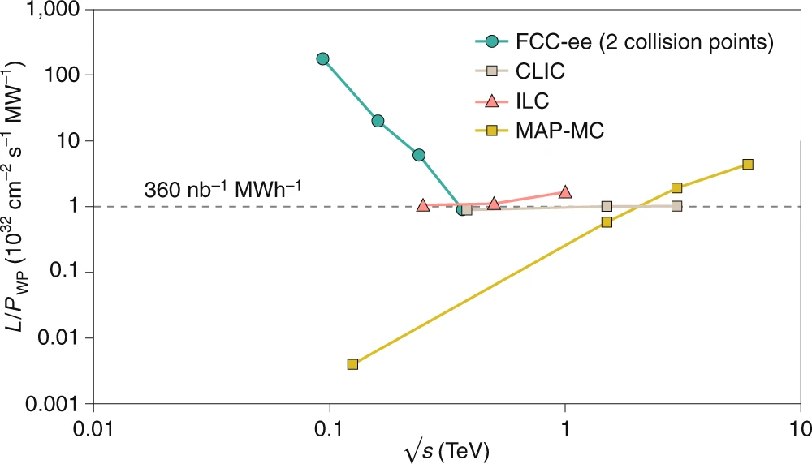
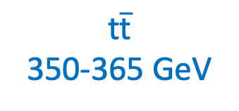
2
2
2
2
I Agapov
FCCIS Workshop Dec 5 – 9, 2022
2
FCC-ee: efficient Higgs/electroweak factory and a first step towards FCC-hh
Cost-efficient Higgs factory
Technology ready
First stage of an integrated programme for a 100 TeV collider
Synergies with other accelerator projects (light sources, EIC, SuperKEKB)
Next design stage started after CDR
Z
91 GeV
WW
160 GeV
ZH
240 GeV
$\text{t}\overline{\text{t}}$
350-365 GeV
M. Benedikt, A. Blondel, P. Janot, et al., Nat. Phys. 16, 402-407 (2020), and
European Strategy for Particle Physics Preparatory Group, Physics Briefing Book (CERN, 2019)

Slide 3
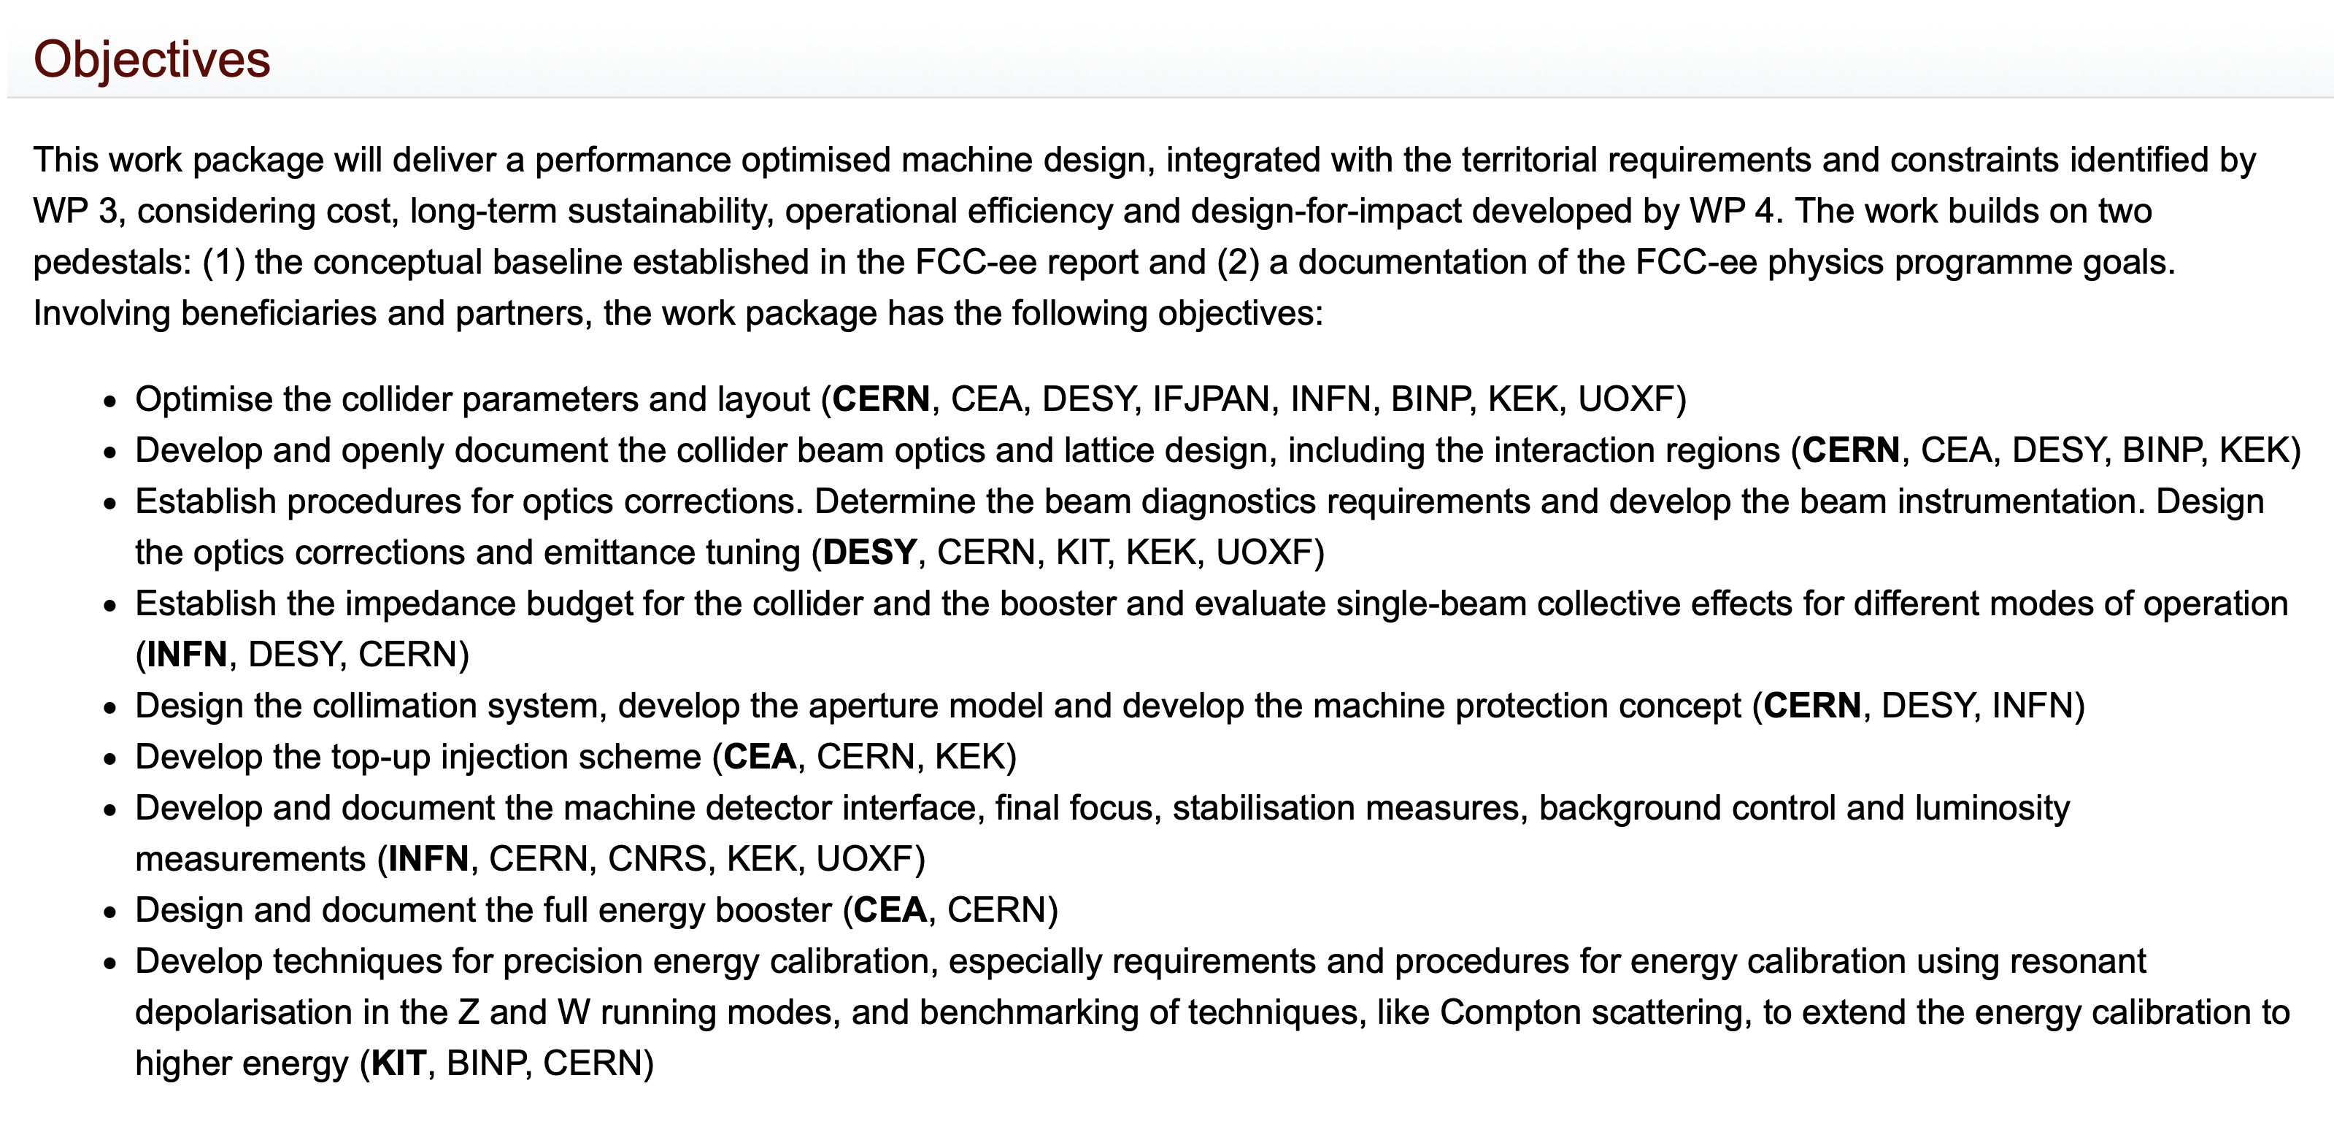
3
3
3
3
I Agapov
FCCIS Workshop Dec 5 – 9, 2022
3
Objectives and role of the FCCIS WP2
ca. 40 associated members
Funding junior positions (PhD Student, postdoc) at 3rd party labs

Slide 4
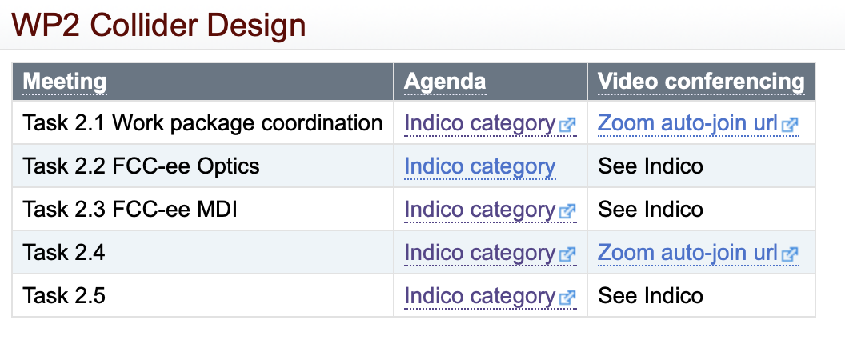
4
4
4
4
I Agapov
FCCIS Workshop Dec 5 – 9, 2022
4
WP2 organizaton
Booster
EPOL

Slide 5
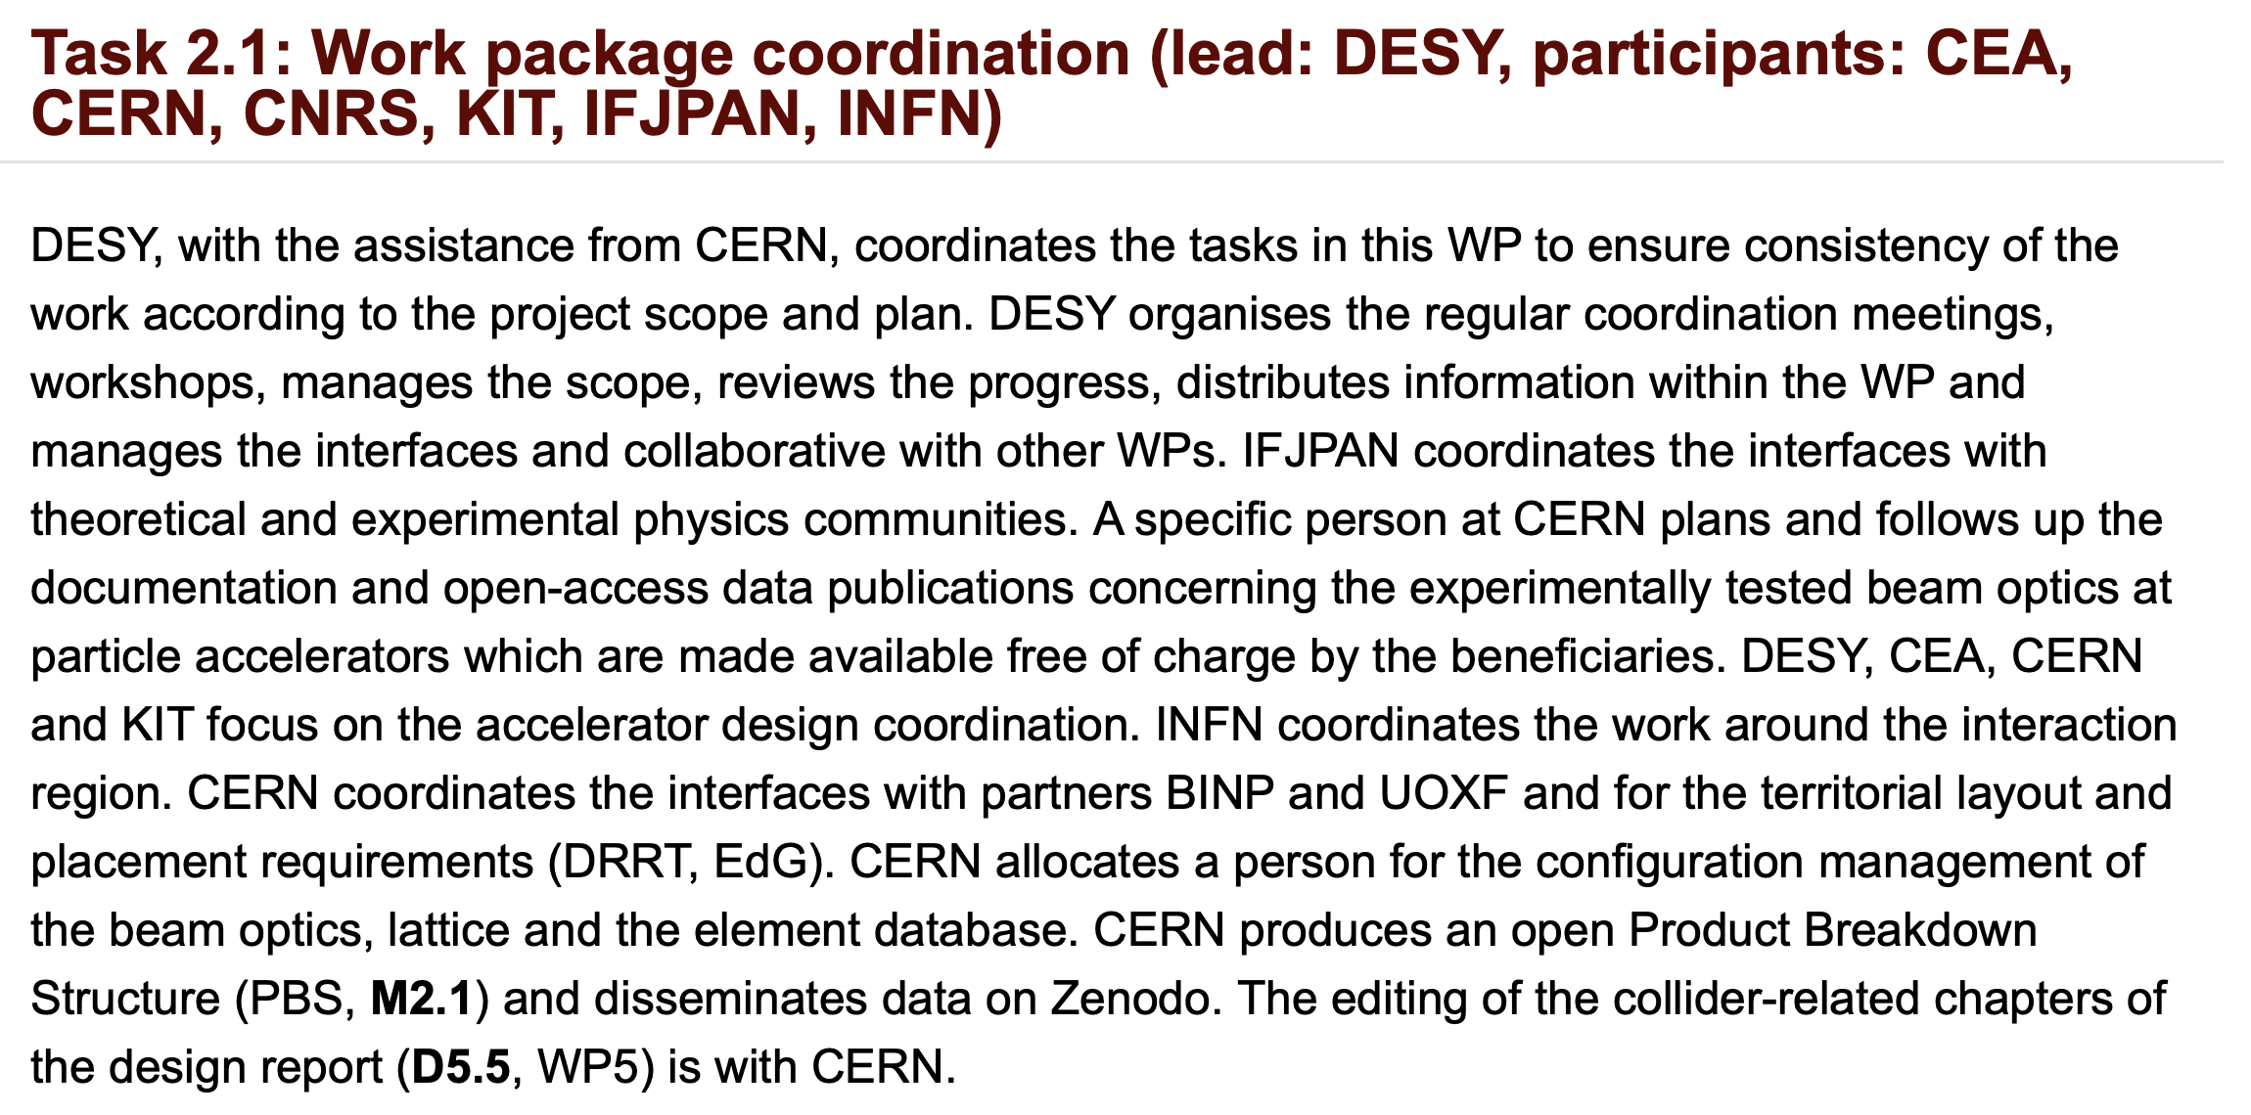
5
5
5
5
I Agapov
FCCIS Workshop Dec 5 – 9, 2022
5
Tasks

Slide 6
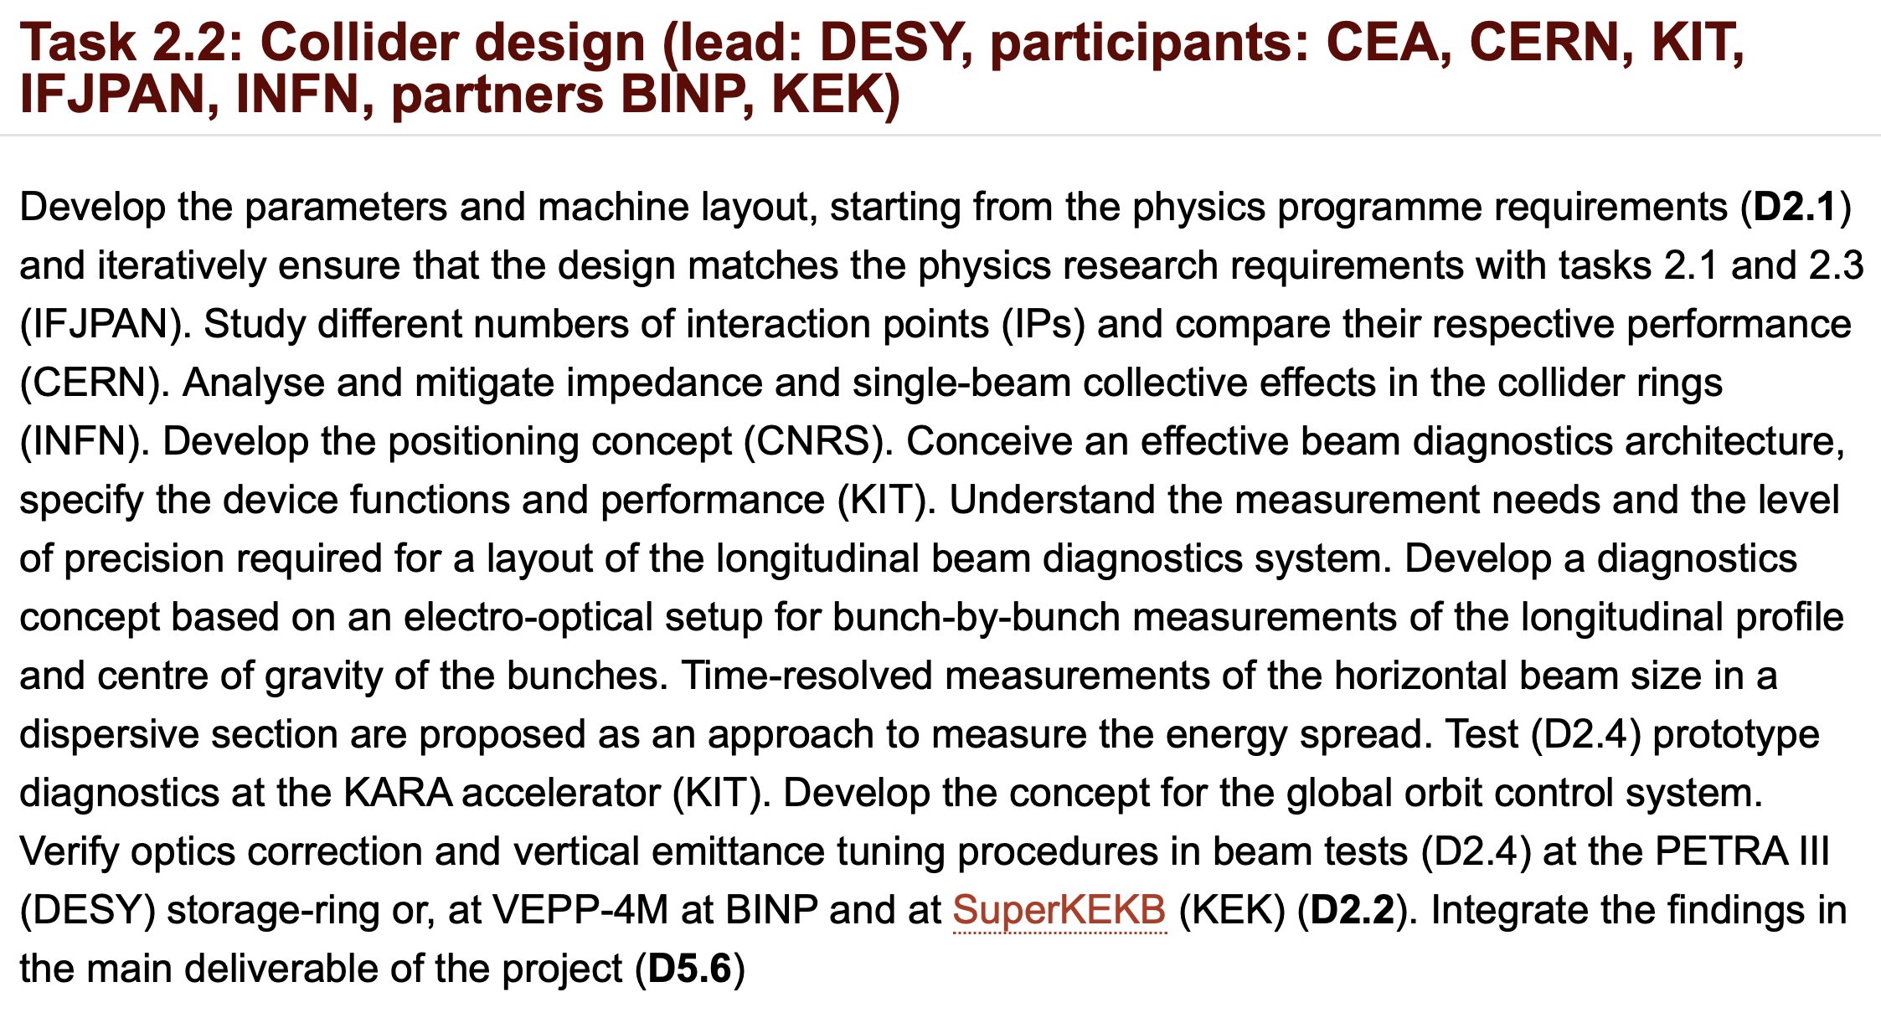
6
6
6
6
I Agapov
FCCIS Workshop Dec 5 – 9, 2022
6
Tasks
Many developments within FCC Study
FCCIS resources matrixed to the study

Slide 7
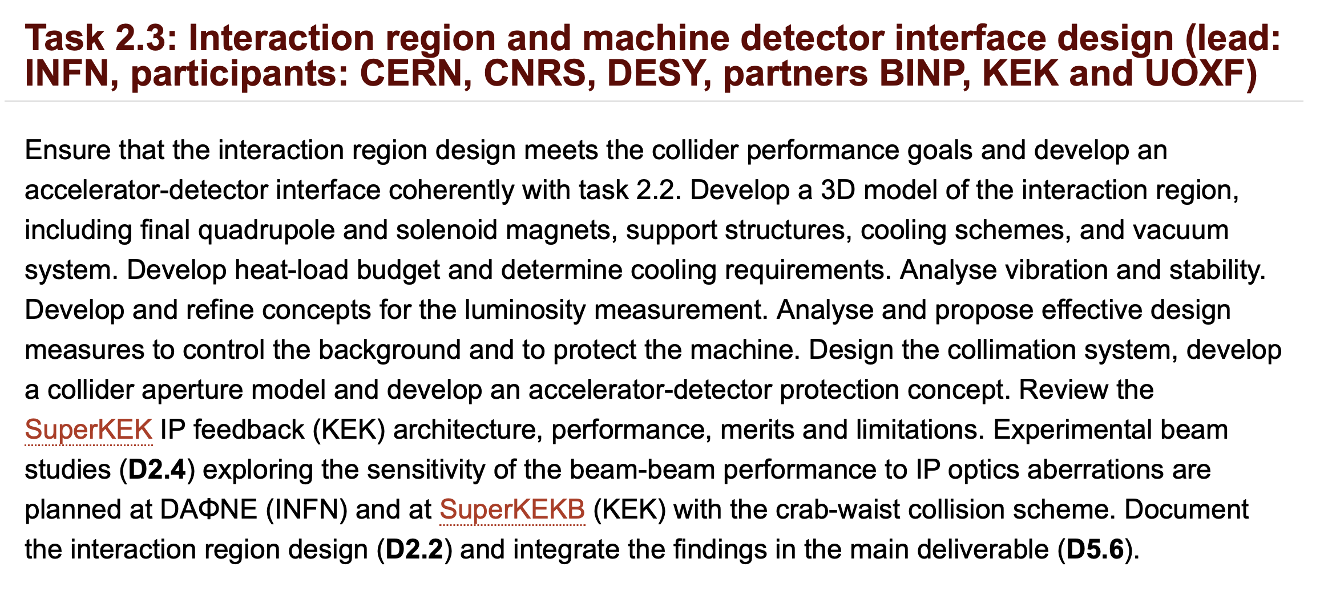
7
7
7
7
I Agapov
FCCIS Workshop Dec 5 – 9, 2022
7
Tasks
INFN successfully leads the MDI effort

Slide 8
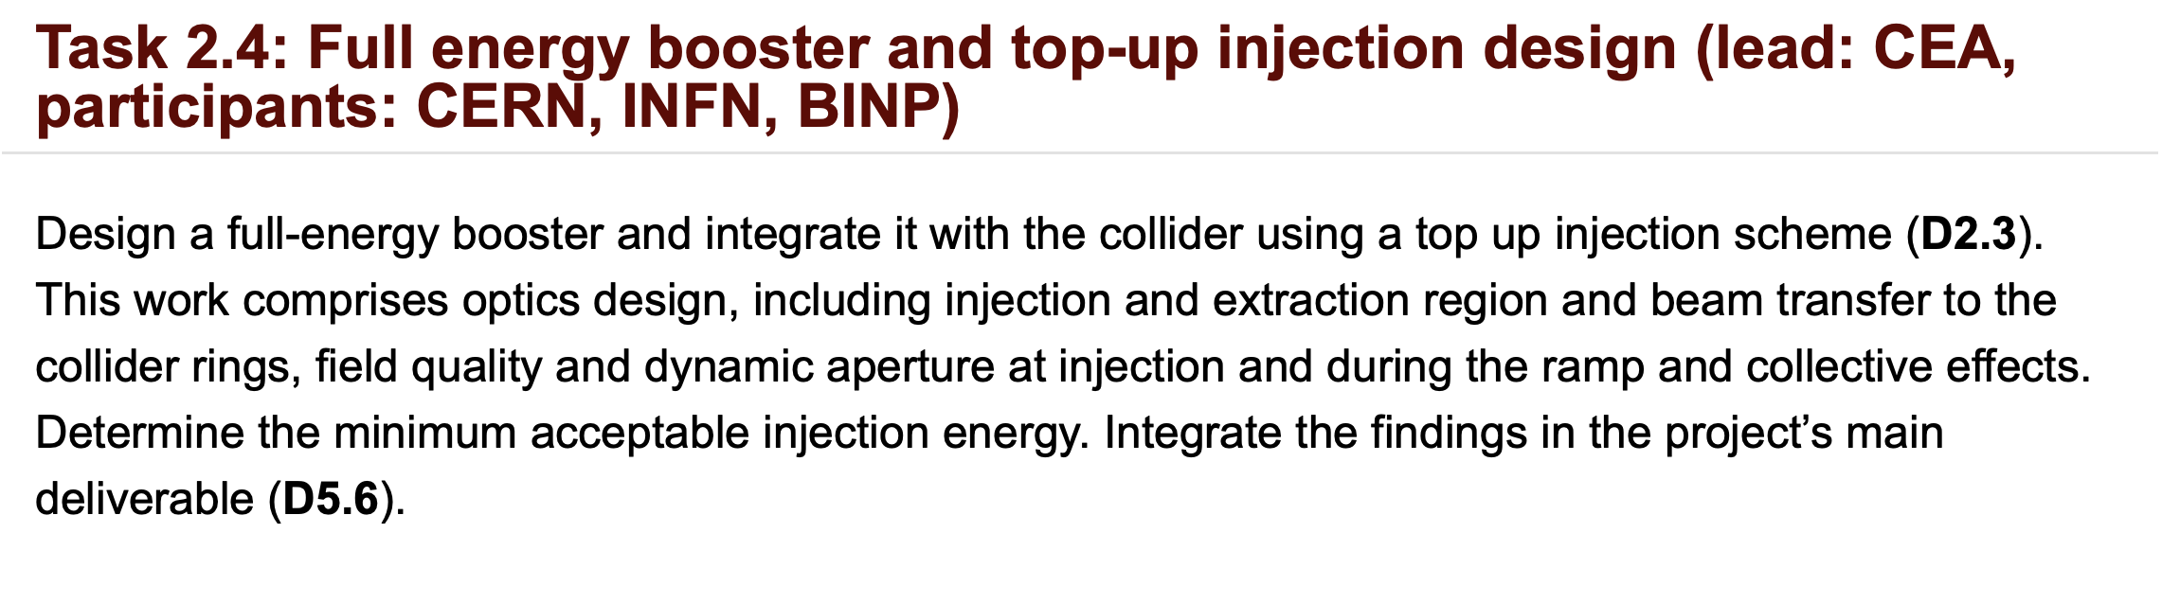
8
8
8
8
I Agapov
FCCIS Workshop Dec 5 – 9, 2022
8
Tasks
CEA successfully leads the booster effort

Slide 9
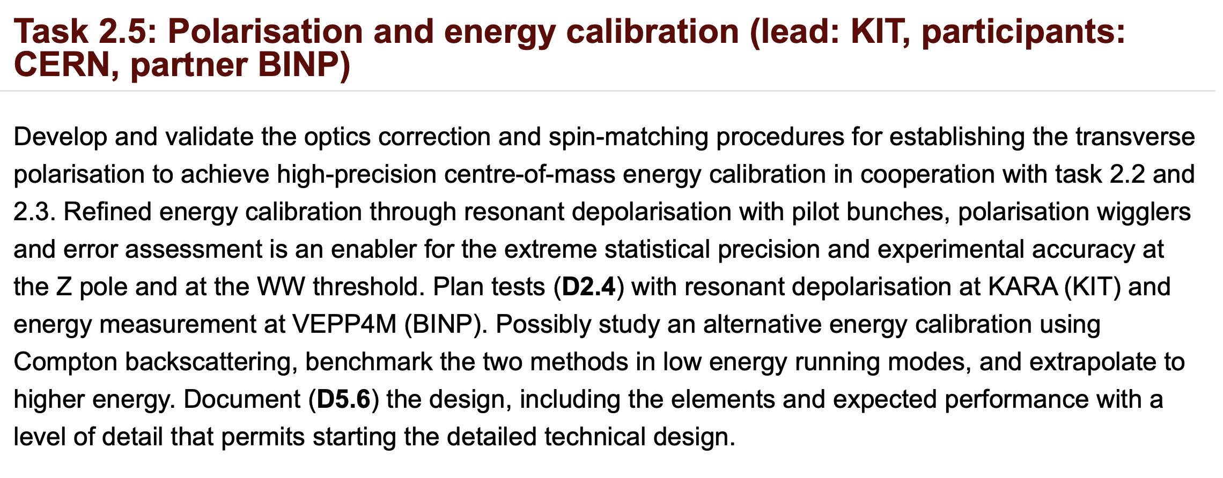
9
9
9
9
I Agapov
FCCIS Workshop Dec 5 – 9, 2022
9
Tasks
EPOL working group established

Slide 10
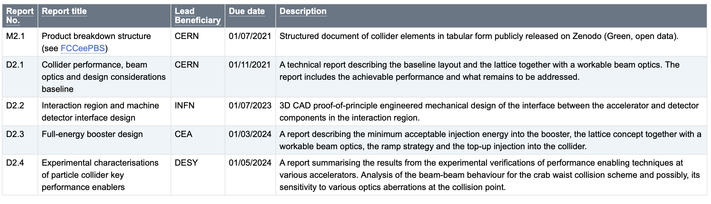
10
10
10
10
I Agapov
FCCIS Workshop Dec 5 – 9, 2022
10
Objectives

Slide 11
11
11
11
11
I Agapov
FCCIS Workshop Dec 5 – 9, 2022
11
Challenges and problems encountered
Project proposal written pre-pandemic, project started in the pandemic
Ways of work changed in the meantime
Even last year’s FCCIS workshop was during travel and access restrictions
Some participants became unavailable due to unfolding of later events
While other players entered the FCC Study
Organization of the FCC study progressed
FCCIS will meet all the goals, but some revision of objectives and role within the FCC study might be beneficial

Slide 12
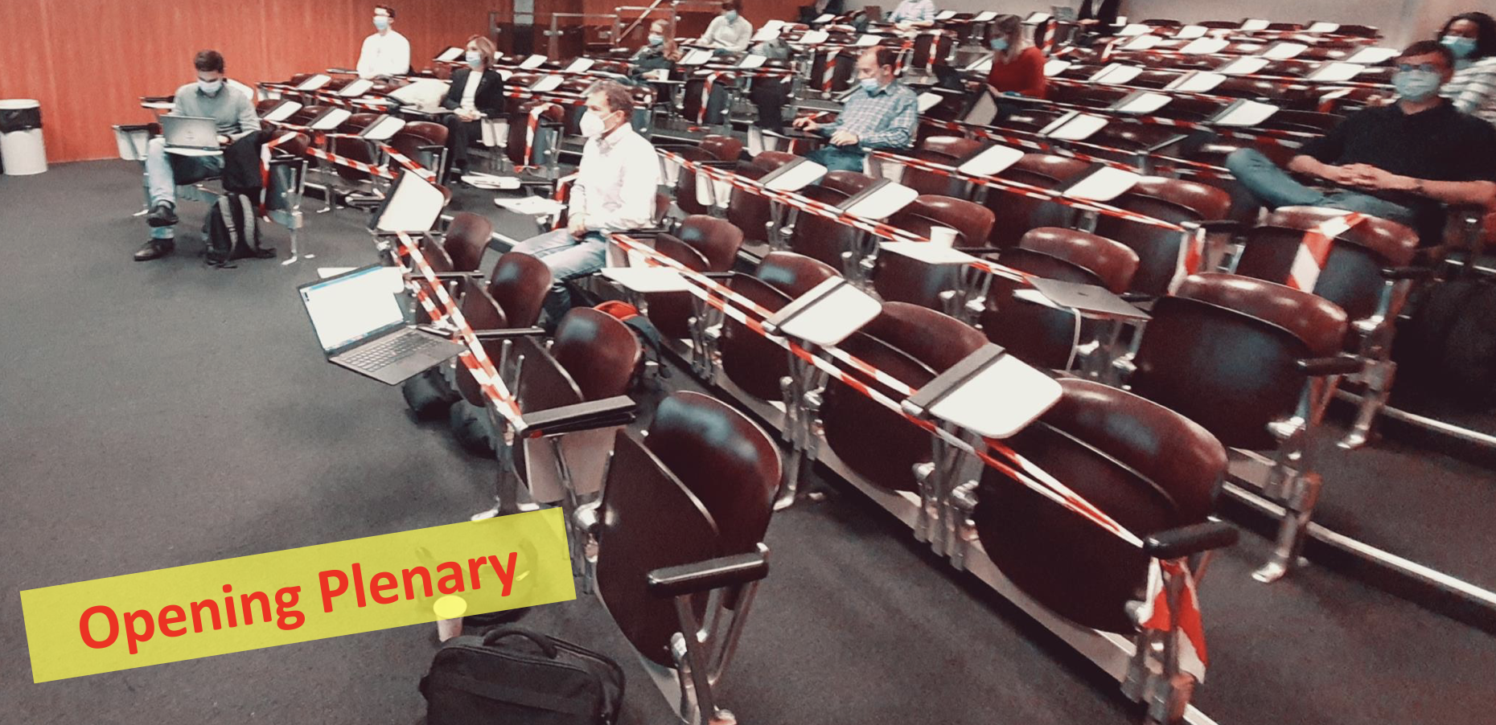
12
12
12
12
I Agapov
FCCIS Workshop Dec 5 – 9, 2022
12
FCCIS events
FCCIS drives a large number of meetings and exchange activities, in particular the now becoming traditional FCCIS week in addition to the summer FCC week

Slide 13
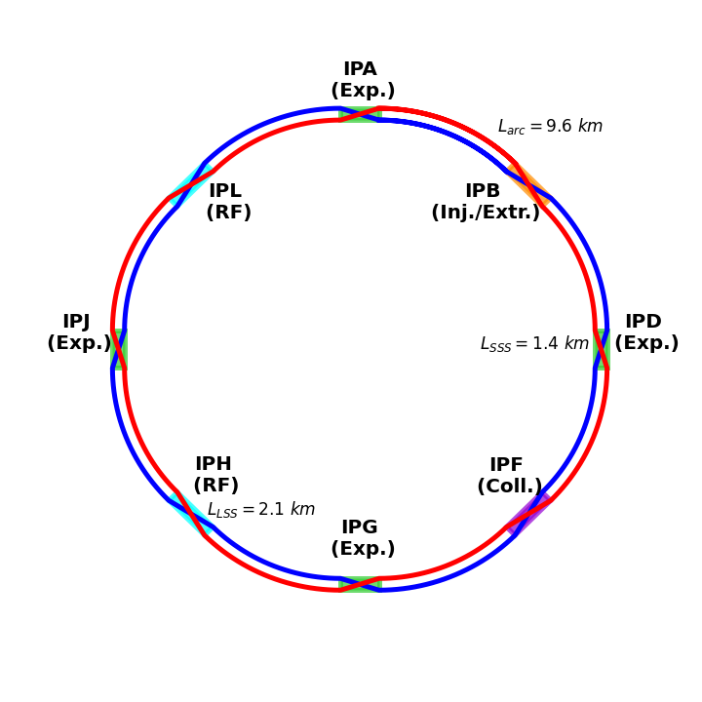
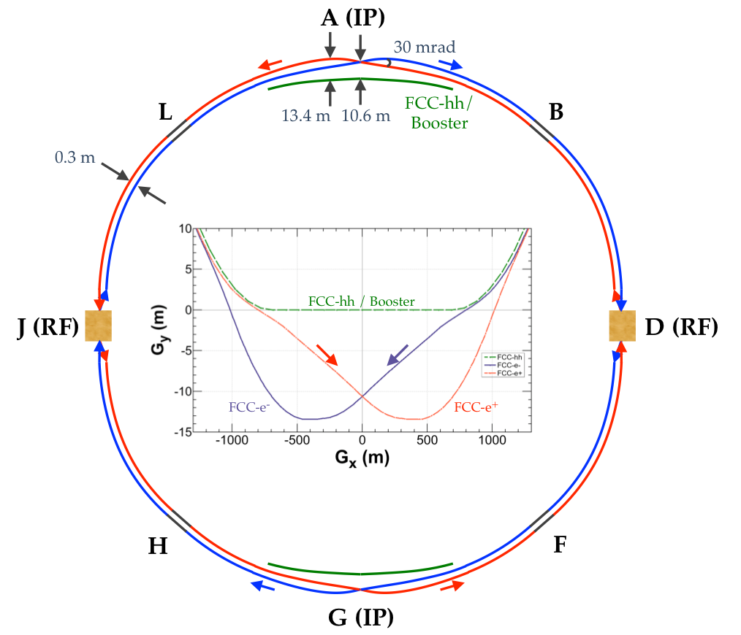
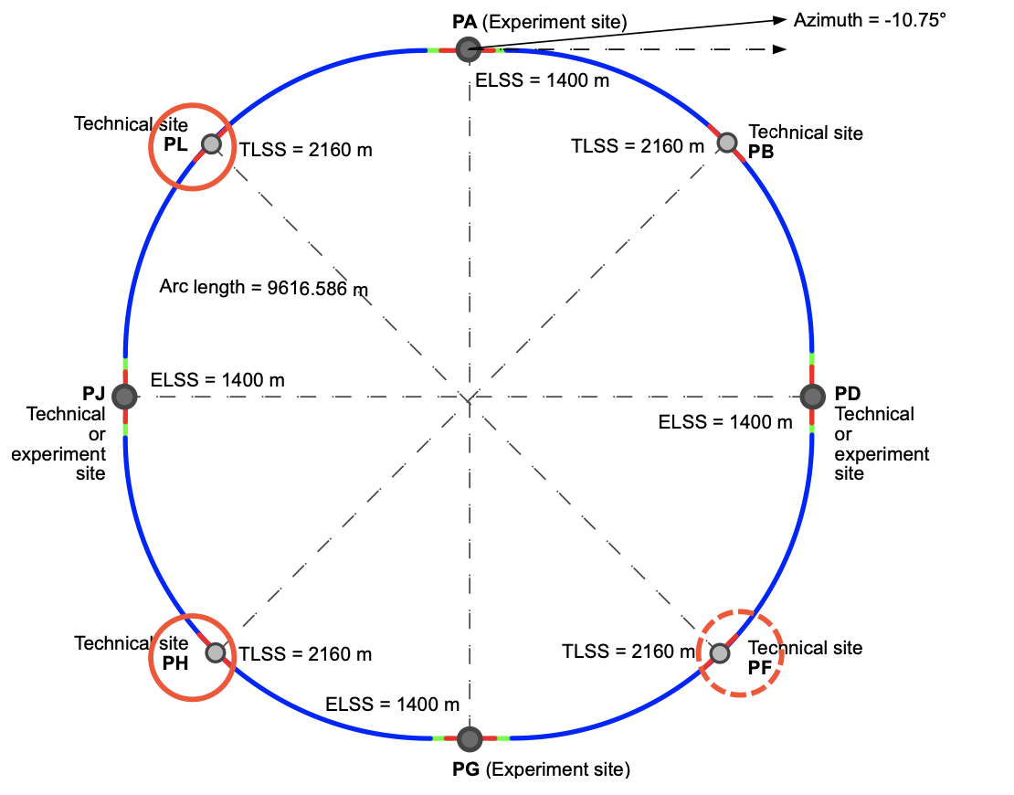
13
13
13
13
I Agapov
FCCIS Workshop Dec 5 – 9, 2022
13
Collider design evolution
Reduced circumference
4 IP baseline

Slide 14
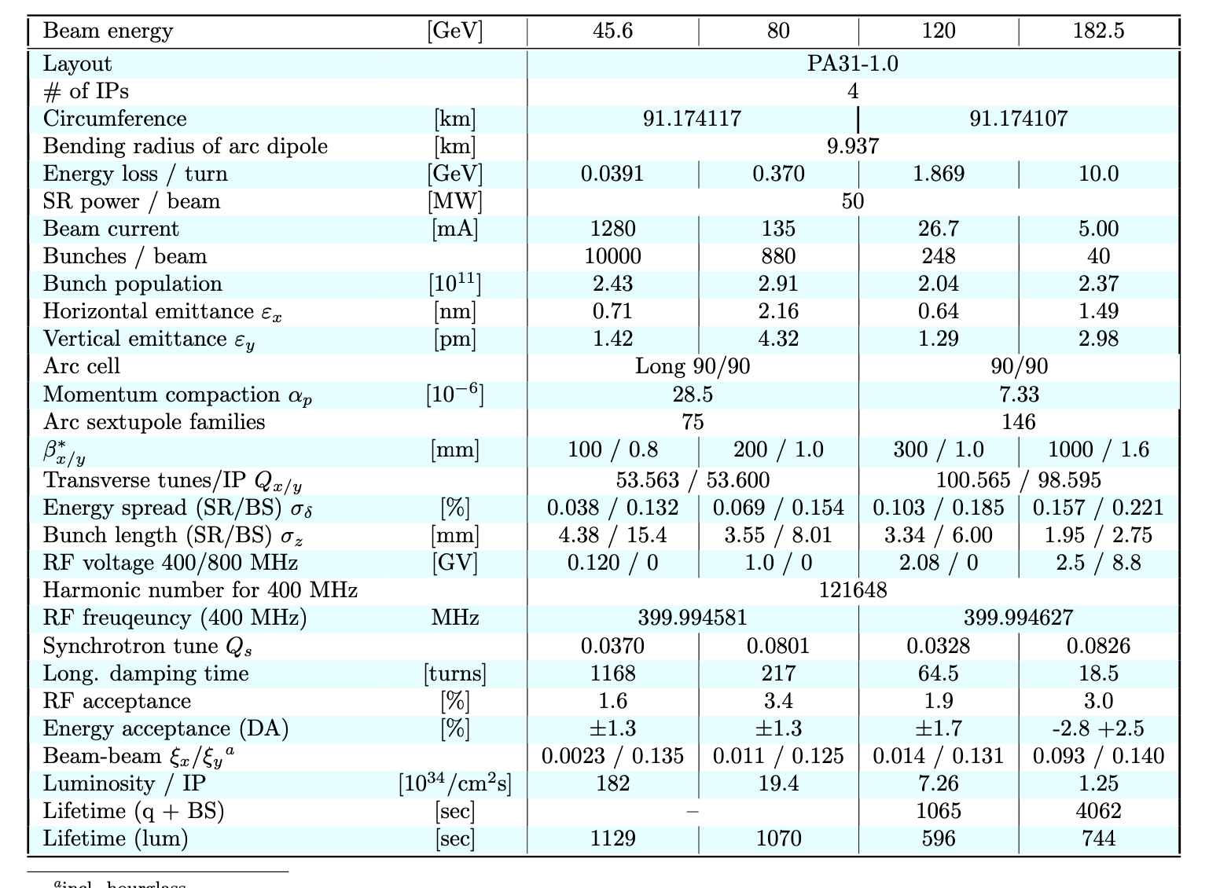
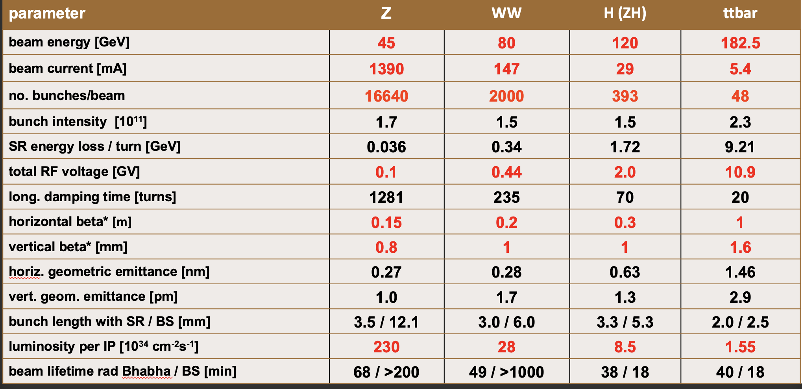
14
14
14
14
I Agapov
FCCIS Workshop Dec 5 – 9, 2022
14
Evolution of collider parameters
Reduced circumference and 4 IP leads to relaxation of beam parameters

Slide 15
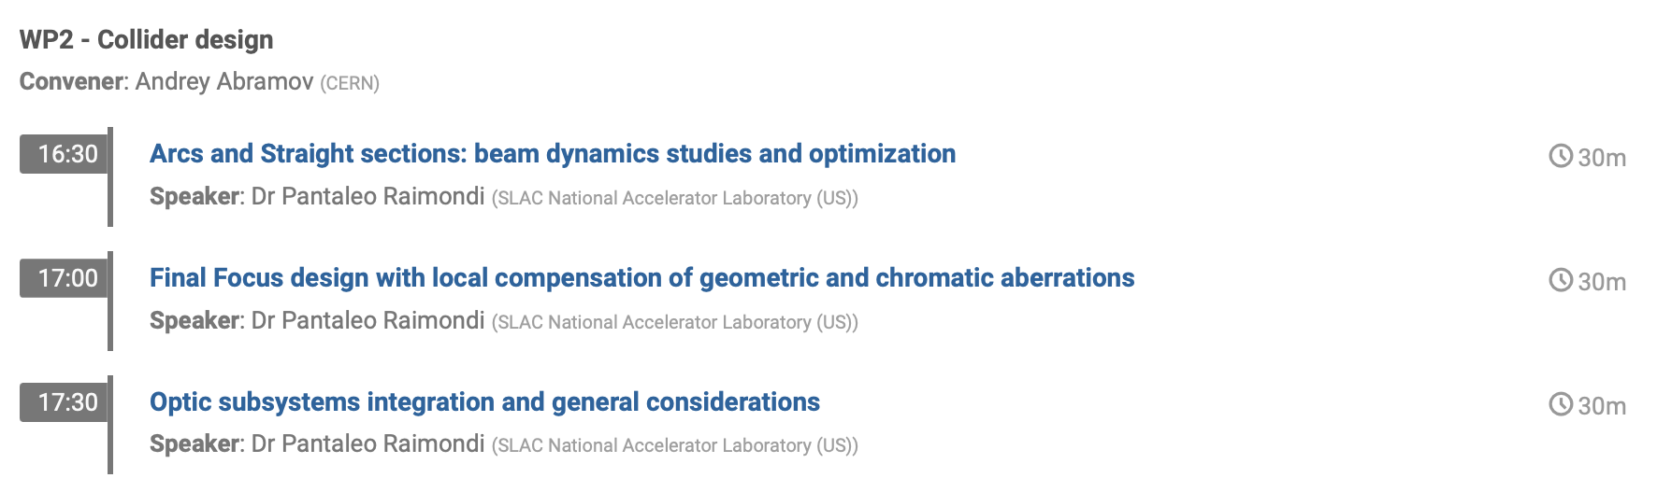
15
15
15
15
I Agapov
FCCIS Workshop Dec 5 – 9, 2022
15
Evolution of collider design
Baseline with smaller circumference in place, performance evaluated
New lattice ideas (Pantaleo)

Slide 16
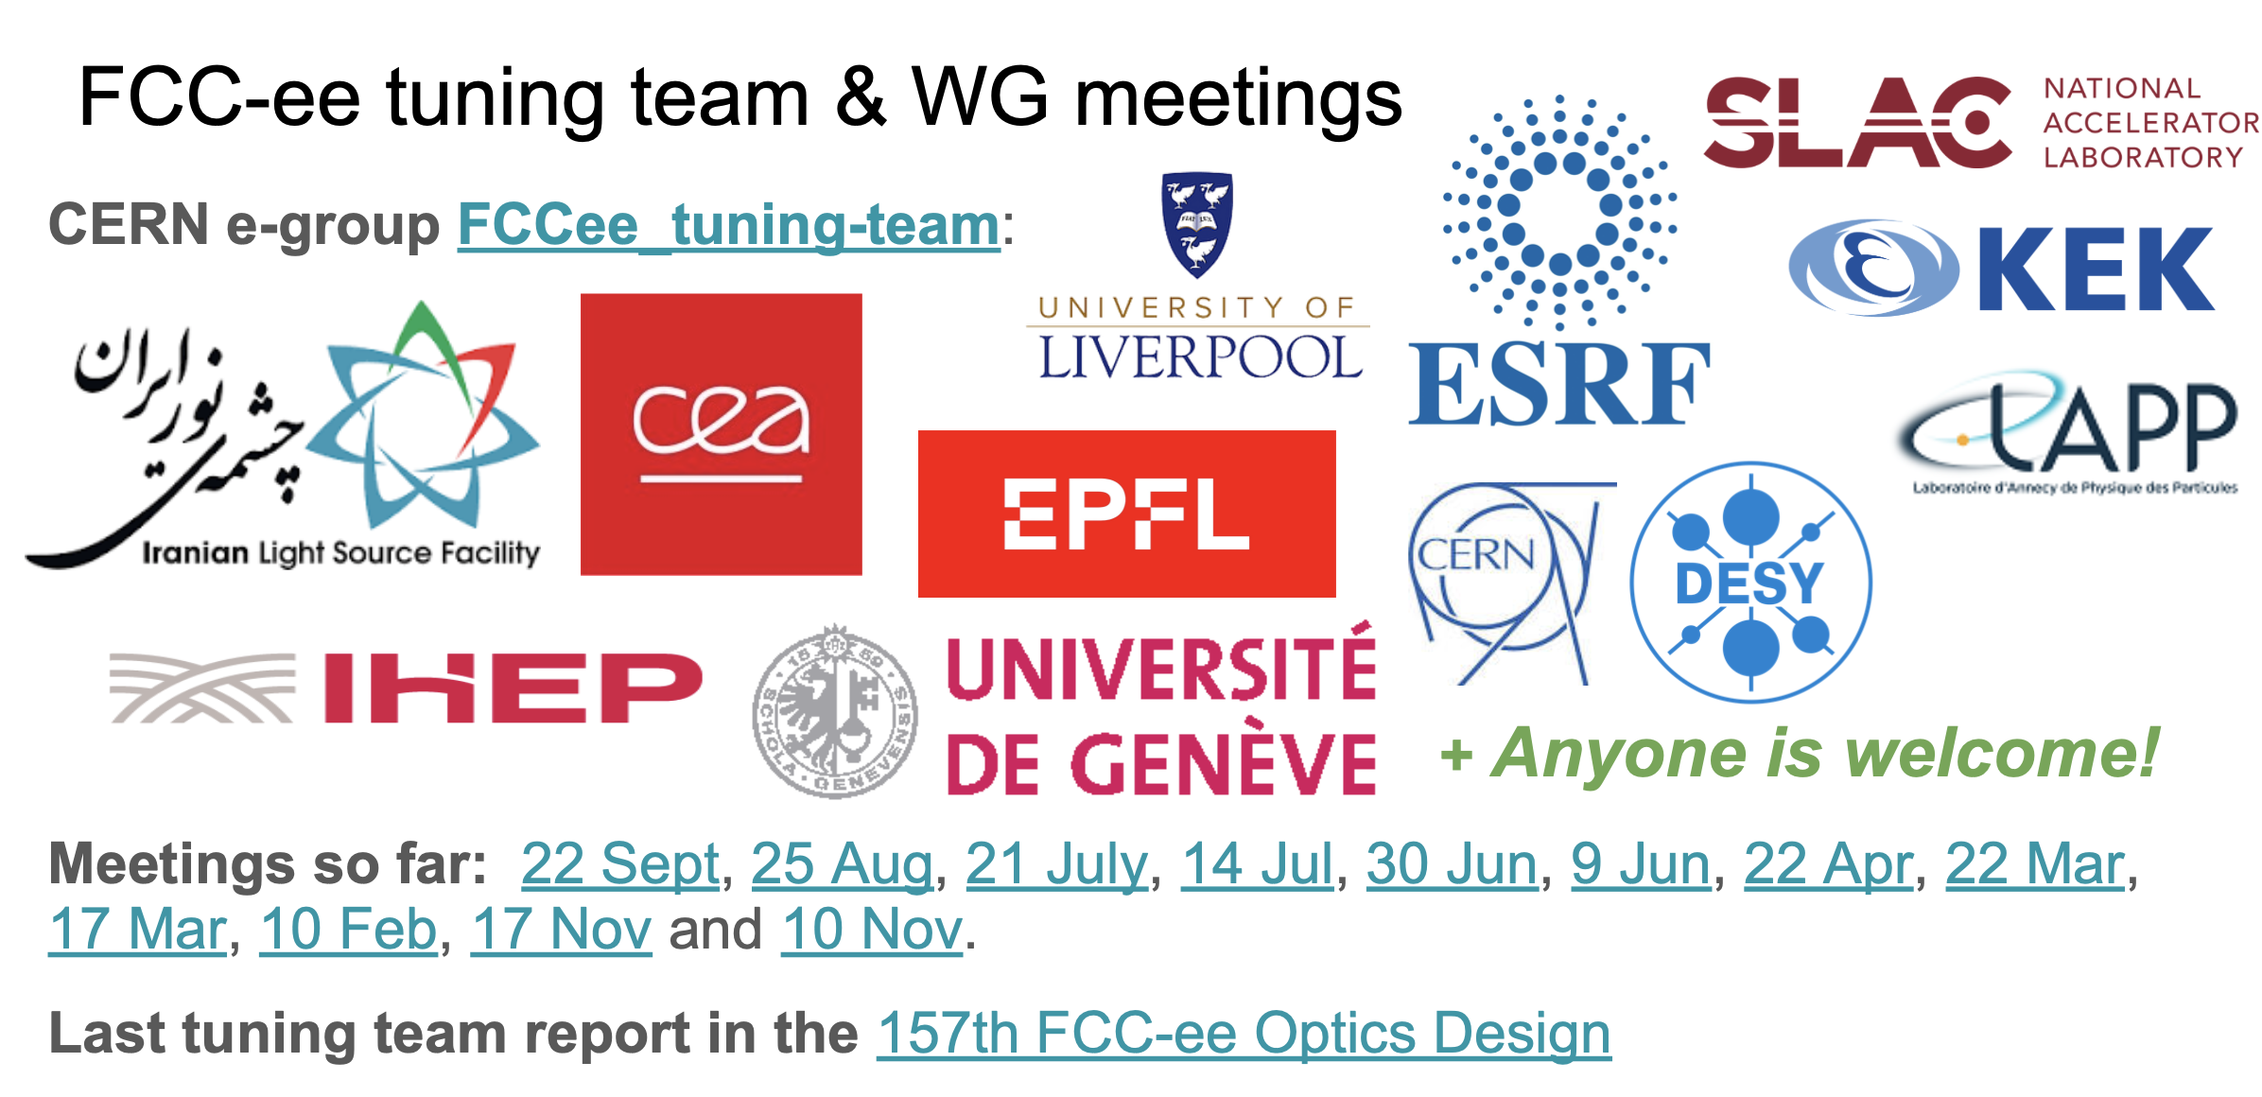
16
16
16
16
I Agapov
FCCIS Workshop Dec 5 – 9, 2022
16
Focus on tuning
Strong collaboration with light source community on optics measurement and correction
Several common MD shifts performed
Common software framework emerging (based on pyAT)
Further synergies via the EU EURIZON programme
16

Slide 17

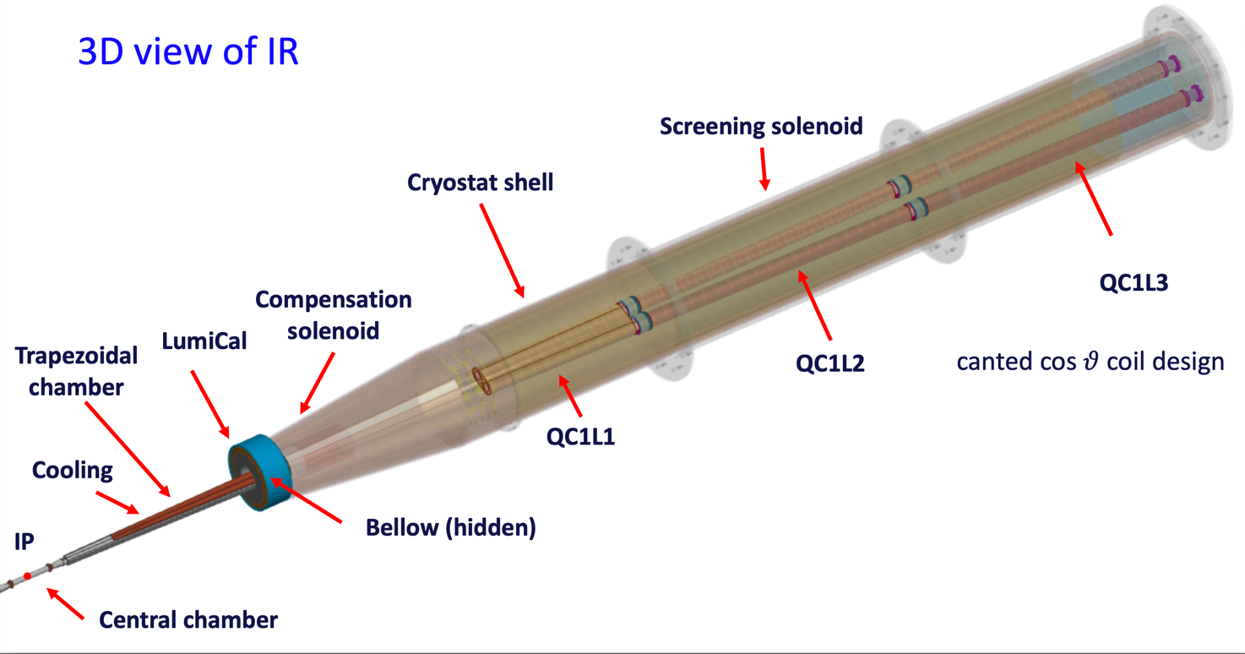
17
17
17
17
I Agapov
FCCIS Workshop Dec 5 – 9, 2022
17
Progress on MDI

Slide 18
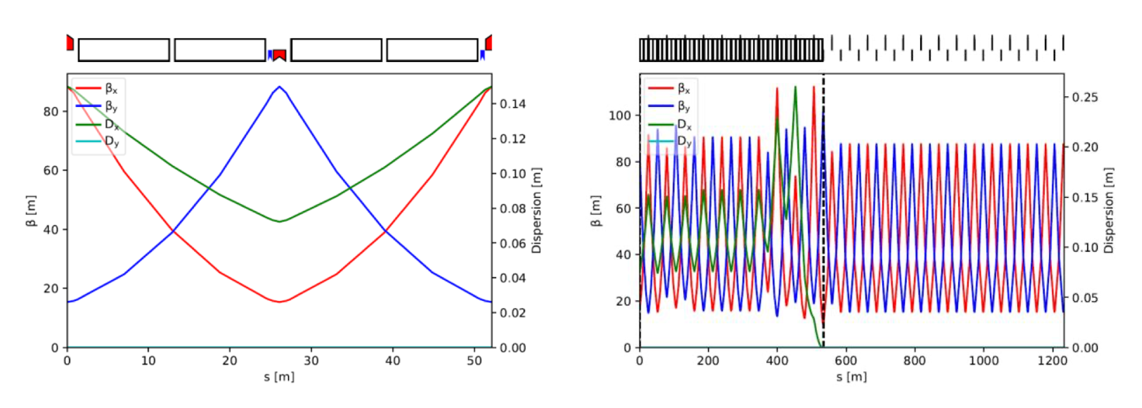
18
18
18
18
I Agapov
FCCIS Workshop Dec 5 – 9, 2022
18
Progress on Booster
Booster design ongoing, adaptation to latest layout in place

Slide 19
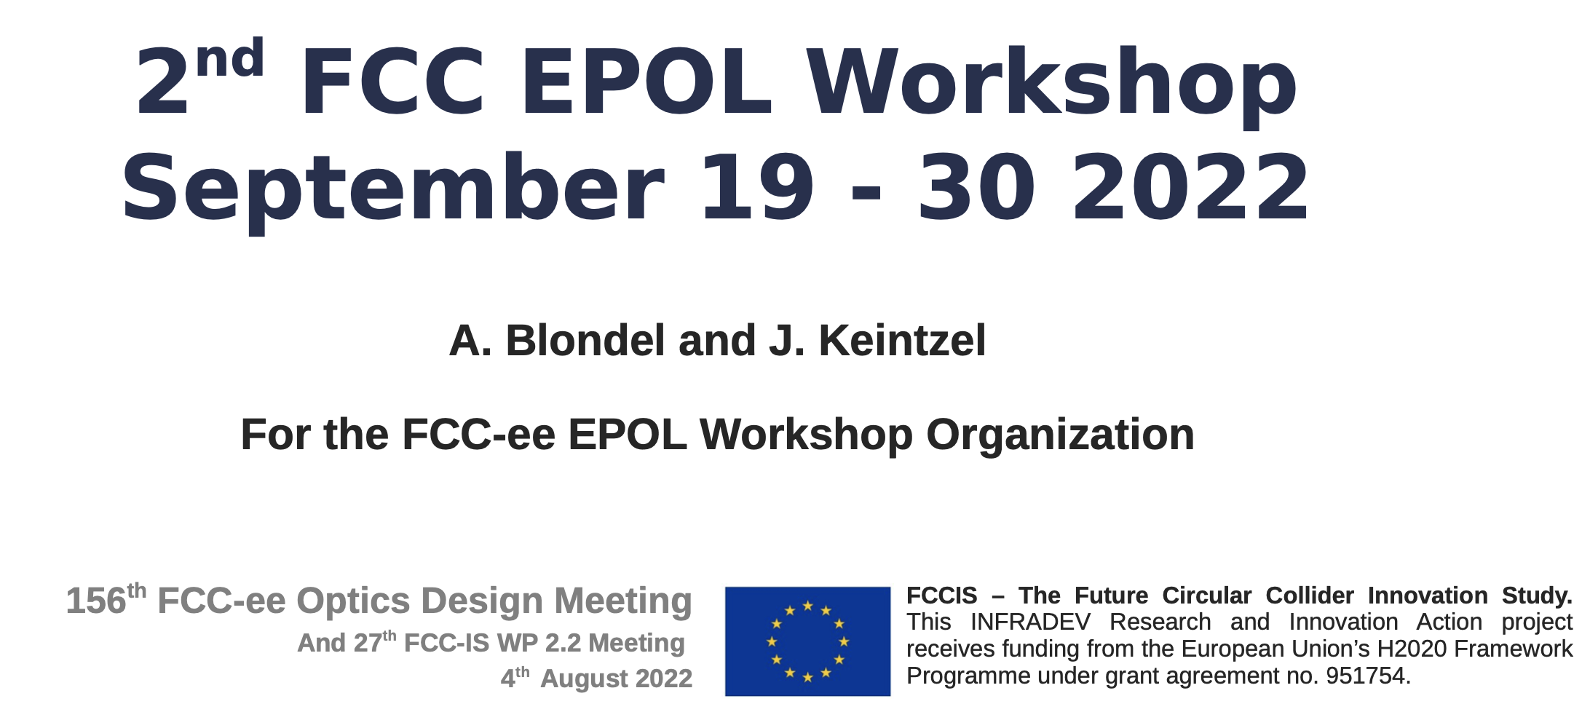
19
19
19
19
I Agapov
FCCIS Workshop Dec 5 – 9, 2022
19
EPOL working group active

Slide 20
Program WP2 sessions

Slide 21
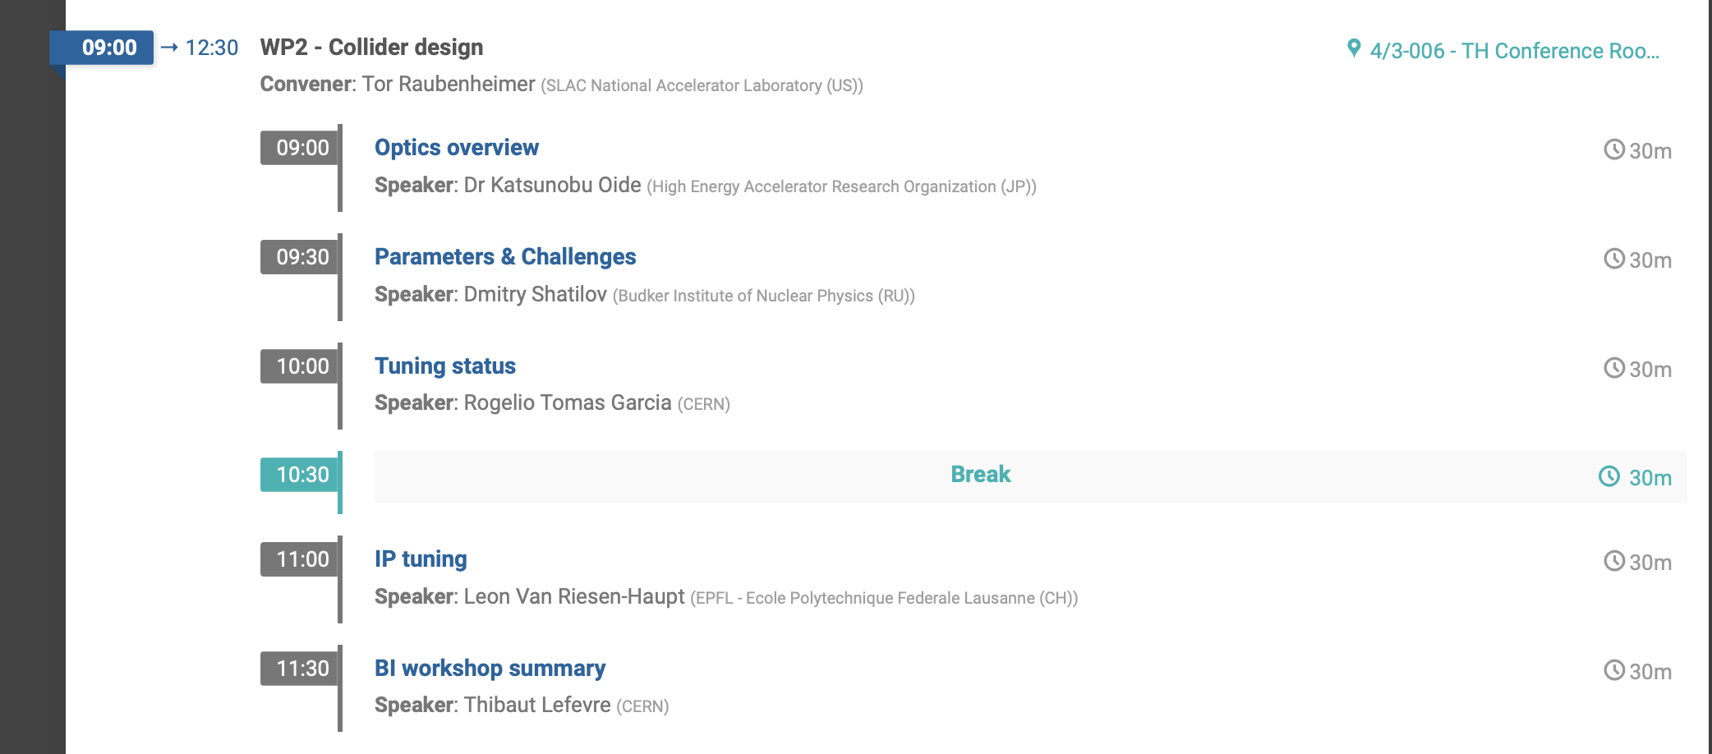
TUE

Slide 22
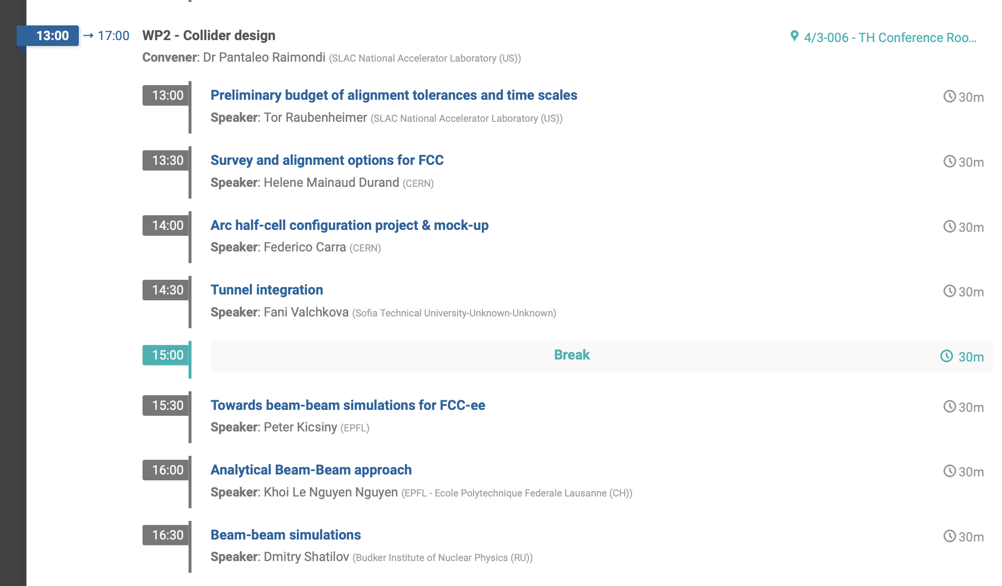
TUE

Slide 23
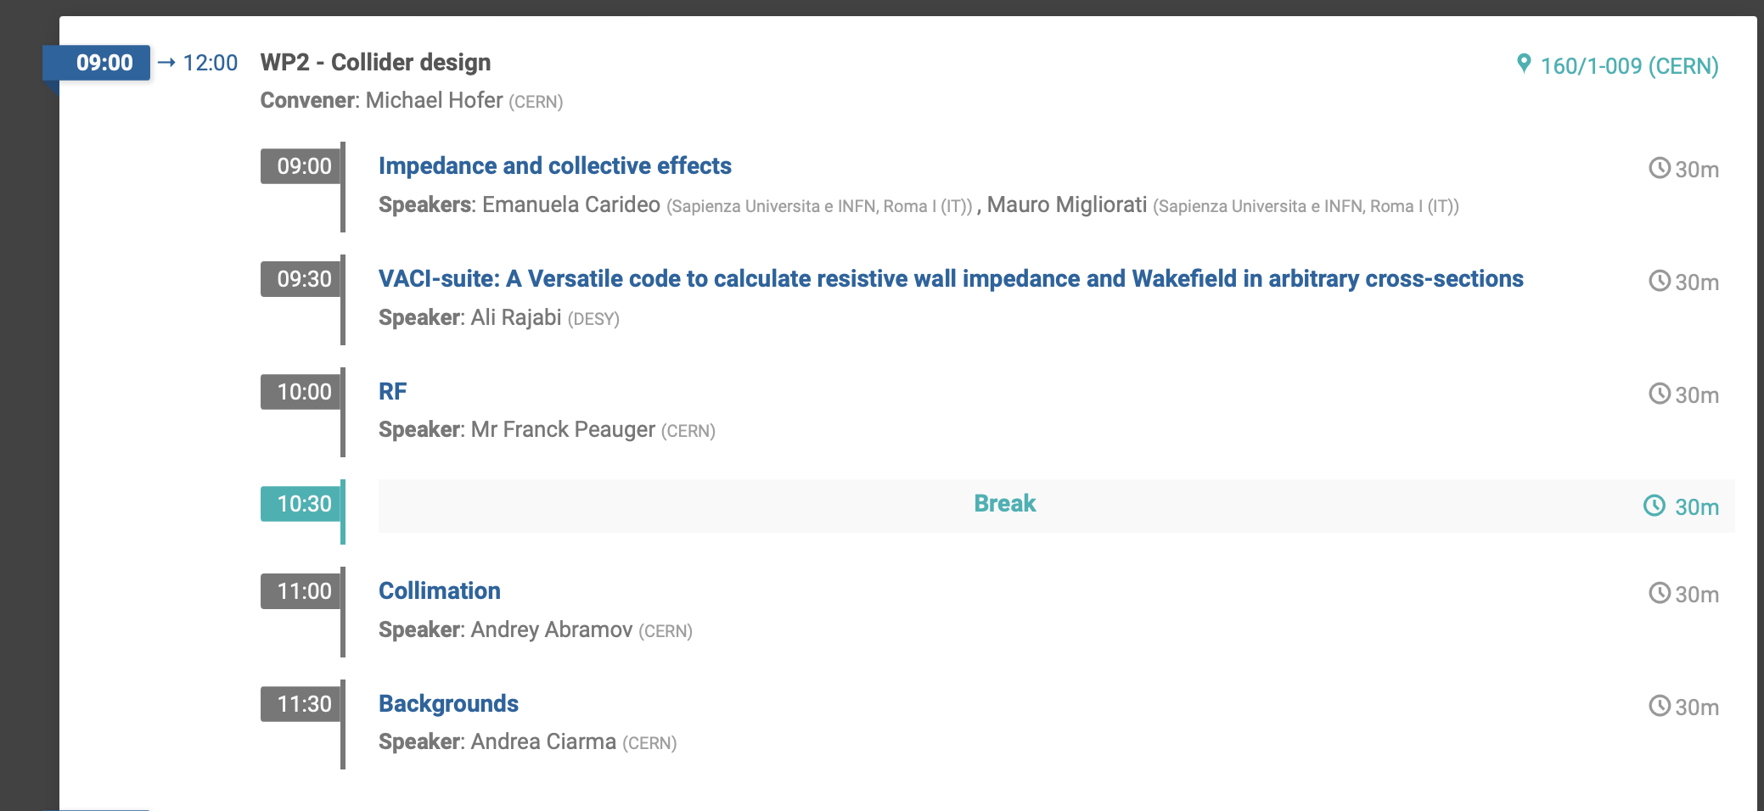
WED

Slide 24
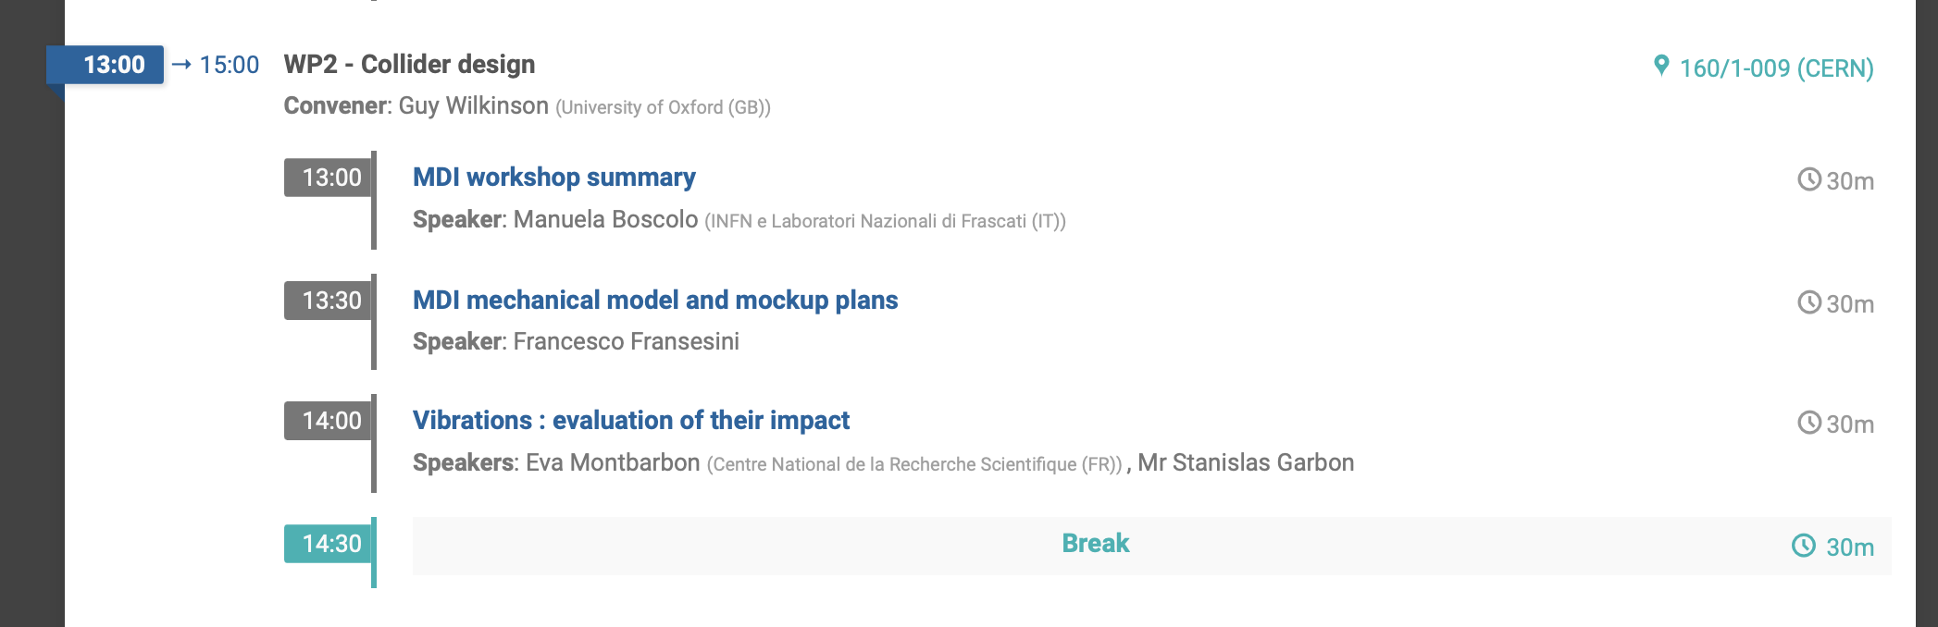
WED

Slide 25
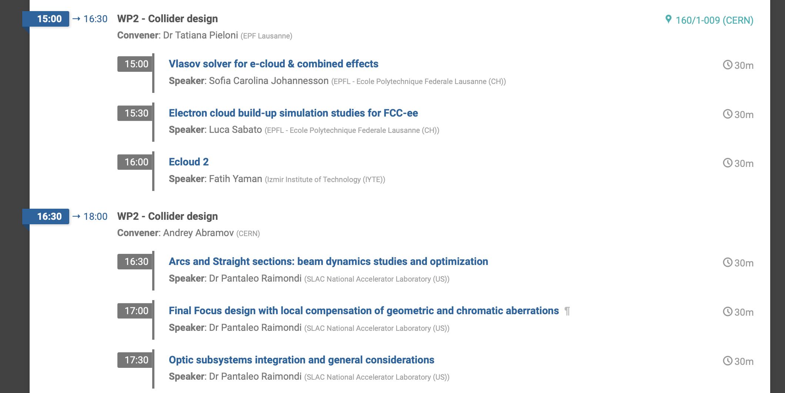
WED

Slide 26
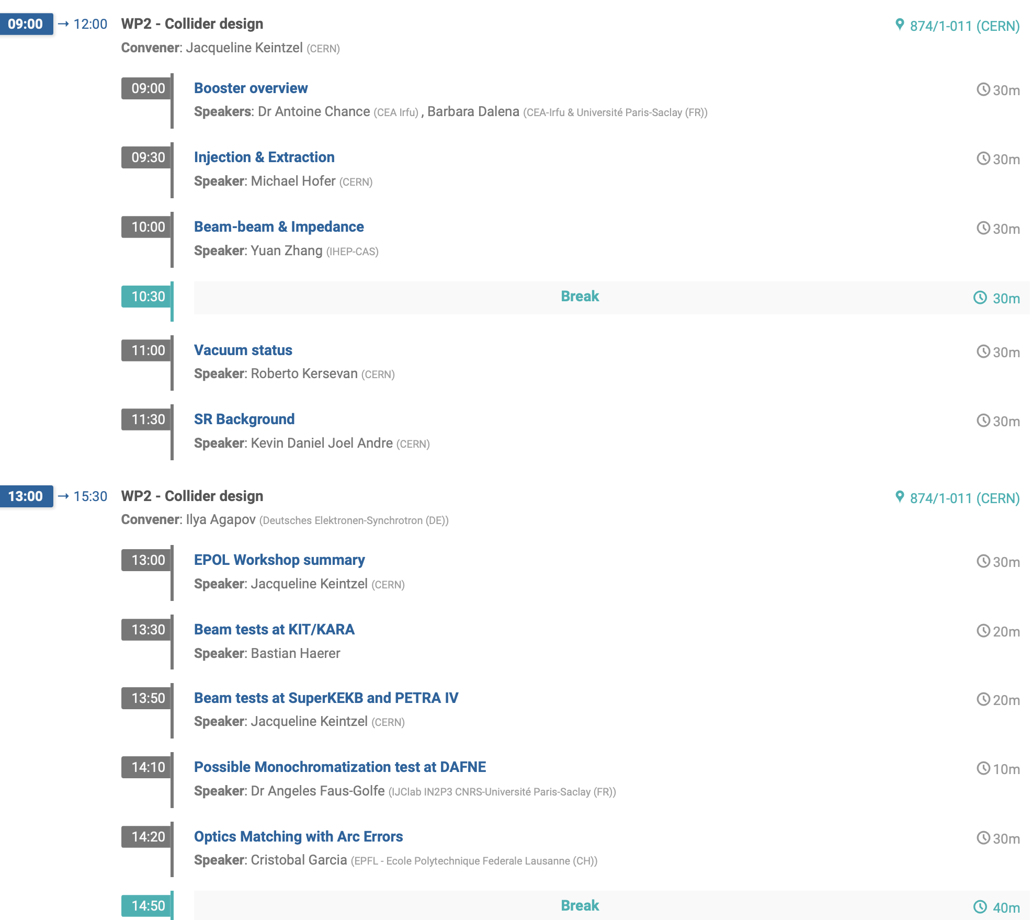
THU

Slide 27
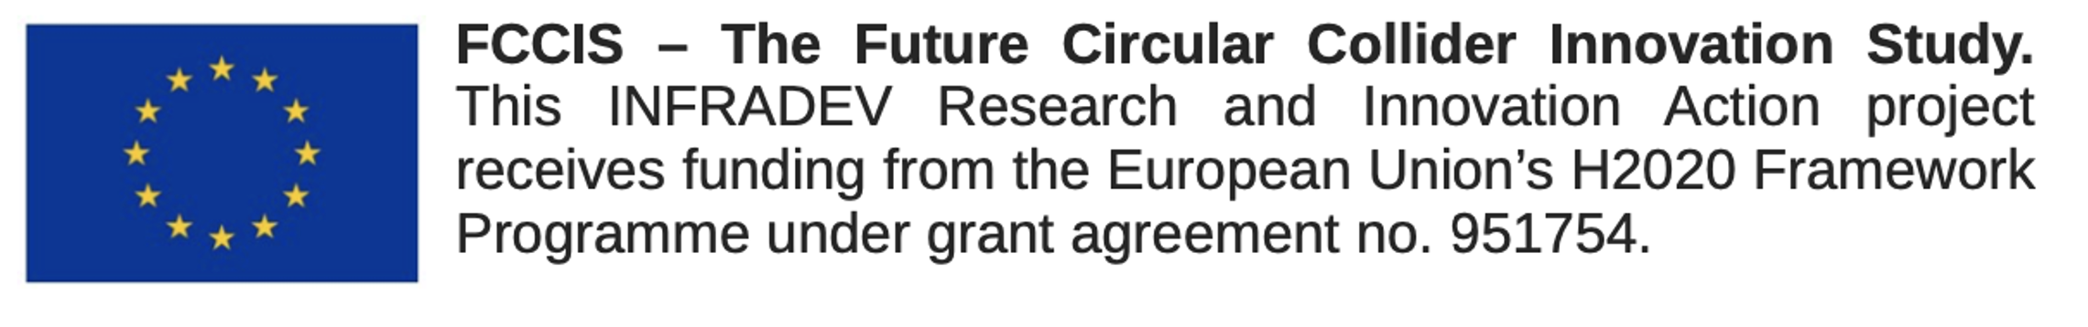
Thank you

