Slide 1




FCCIS 2022 Workshop WP2, 5 – 9 Dec 2022
- summaries and highlights
40 talks in total
Ilya Agapov, DESY
Frank Zimmermann, CERN
9 December 2022

Slide 2
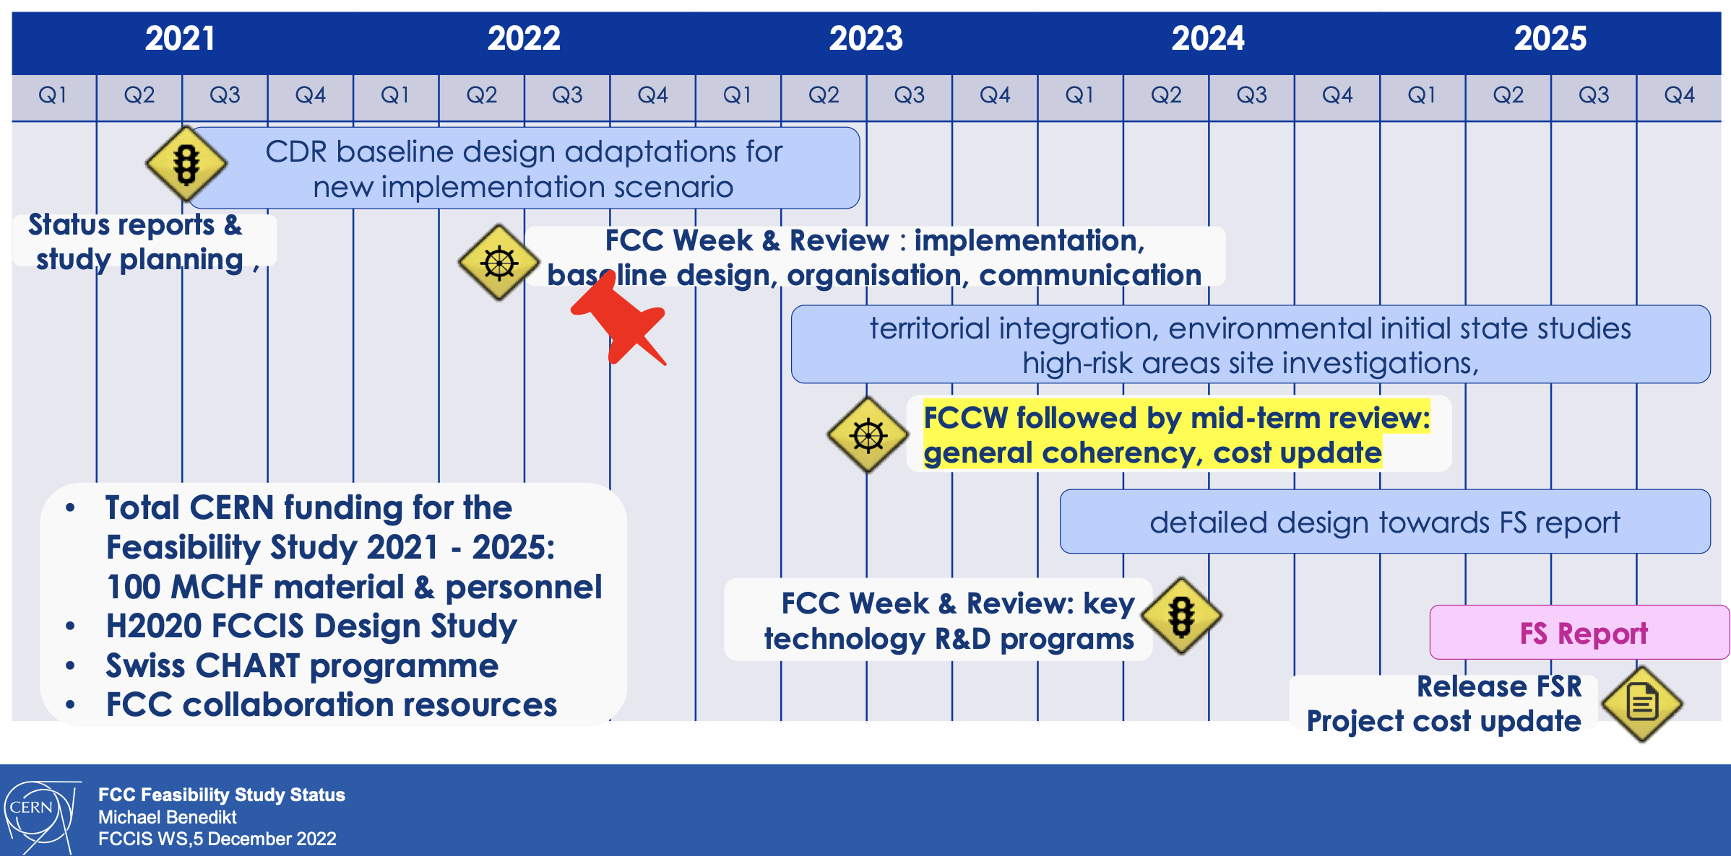
Michael Benedikt

Slide 3
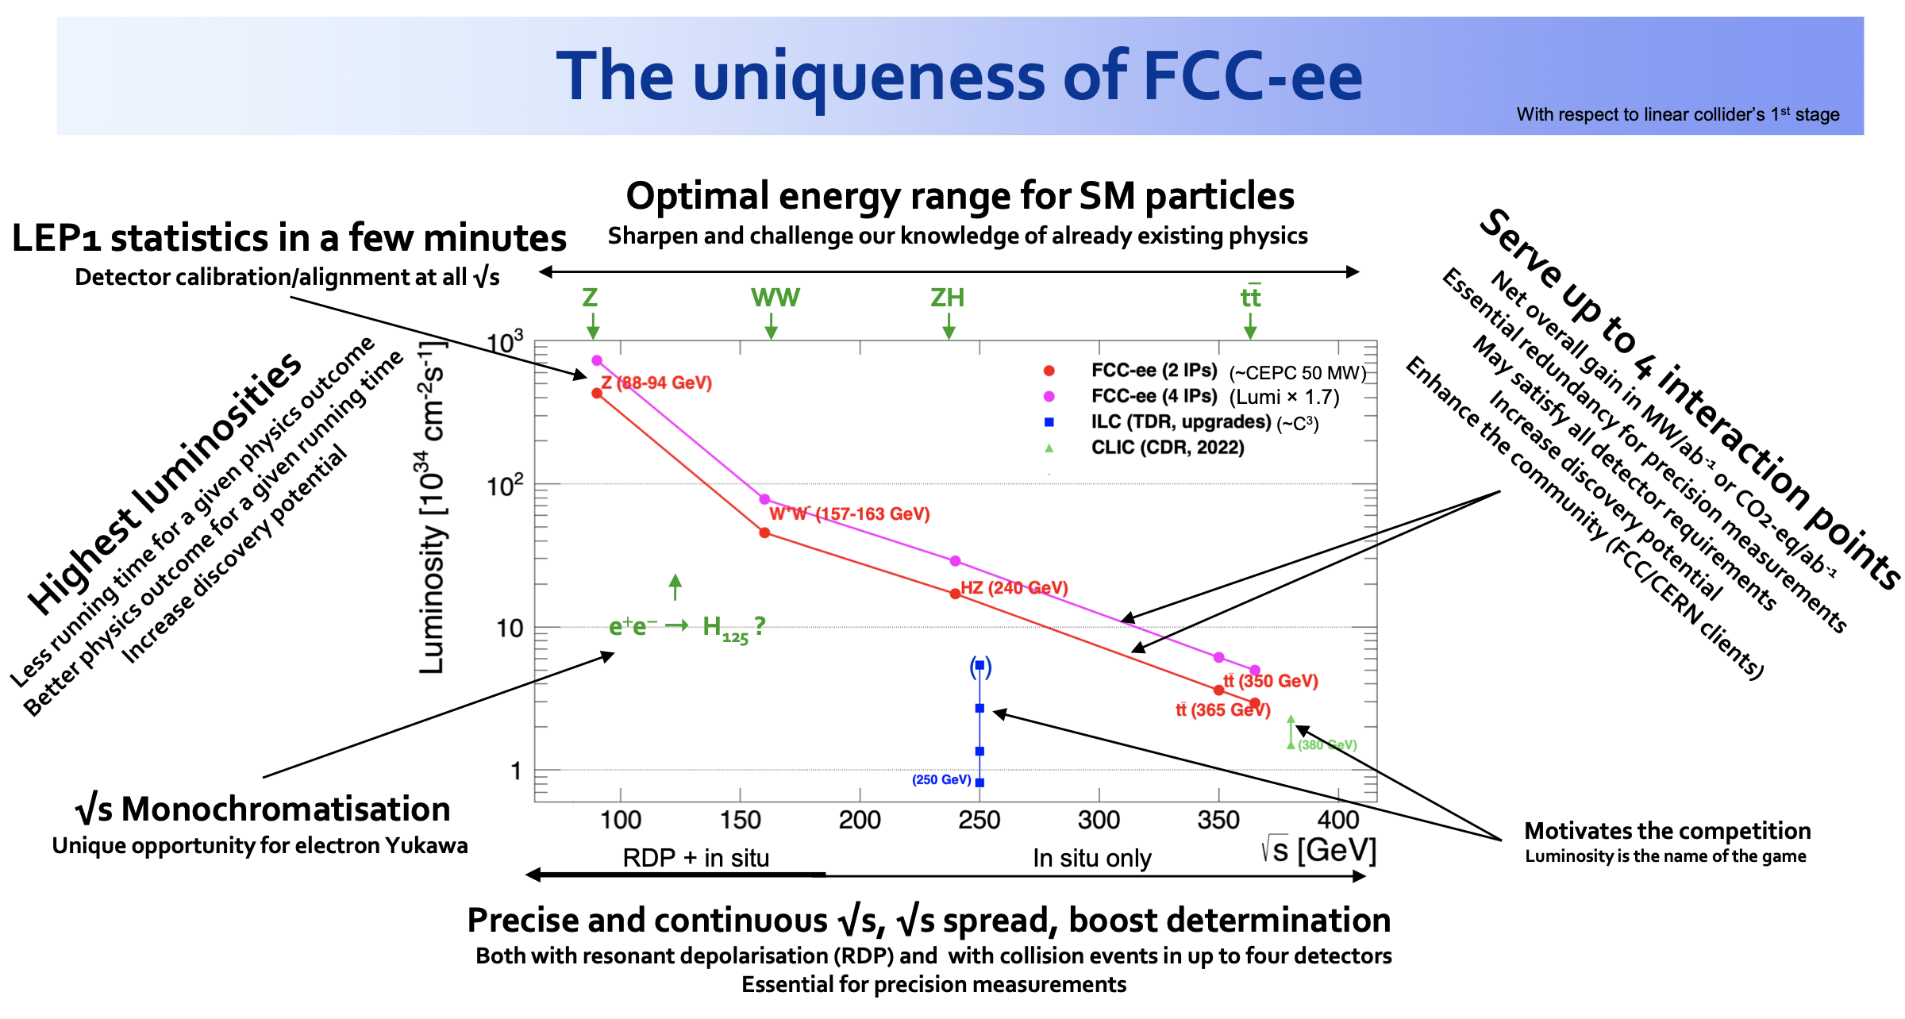
Patrick Janot

Slide 4
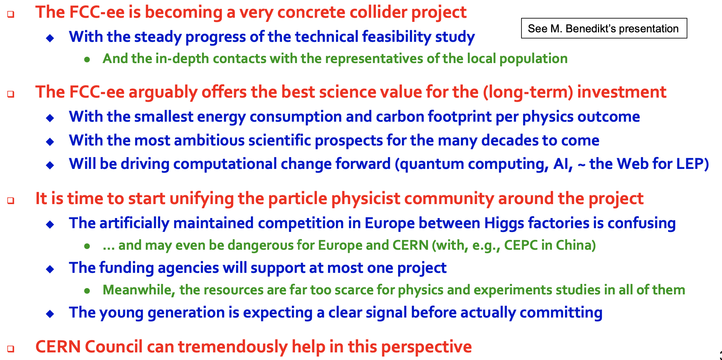
Patrick Janot

Slide 5
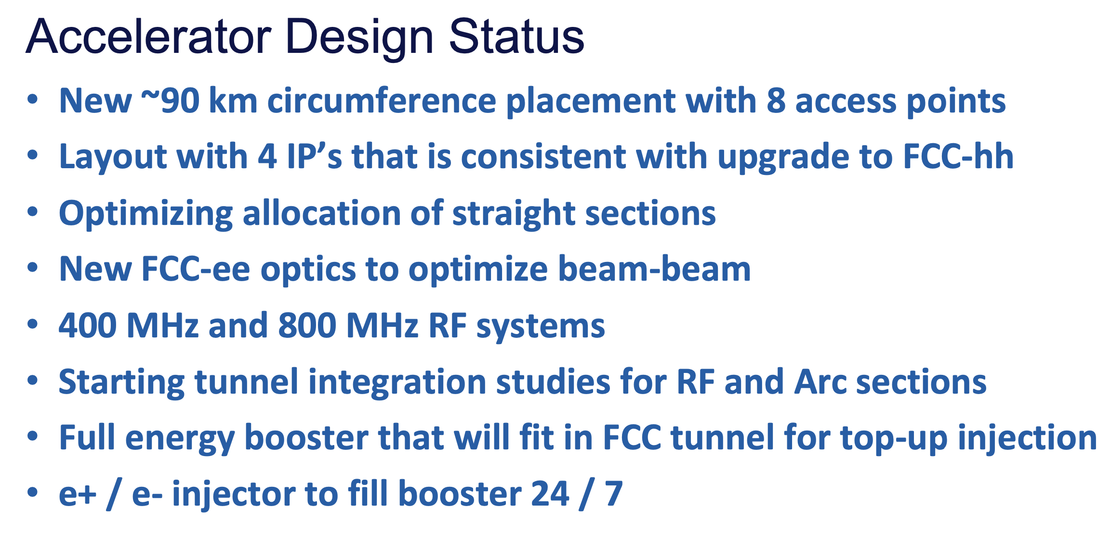
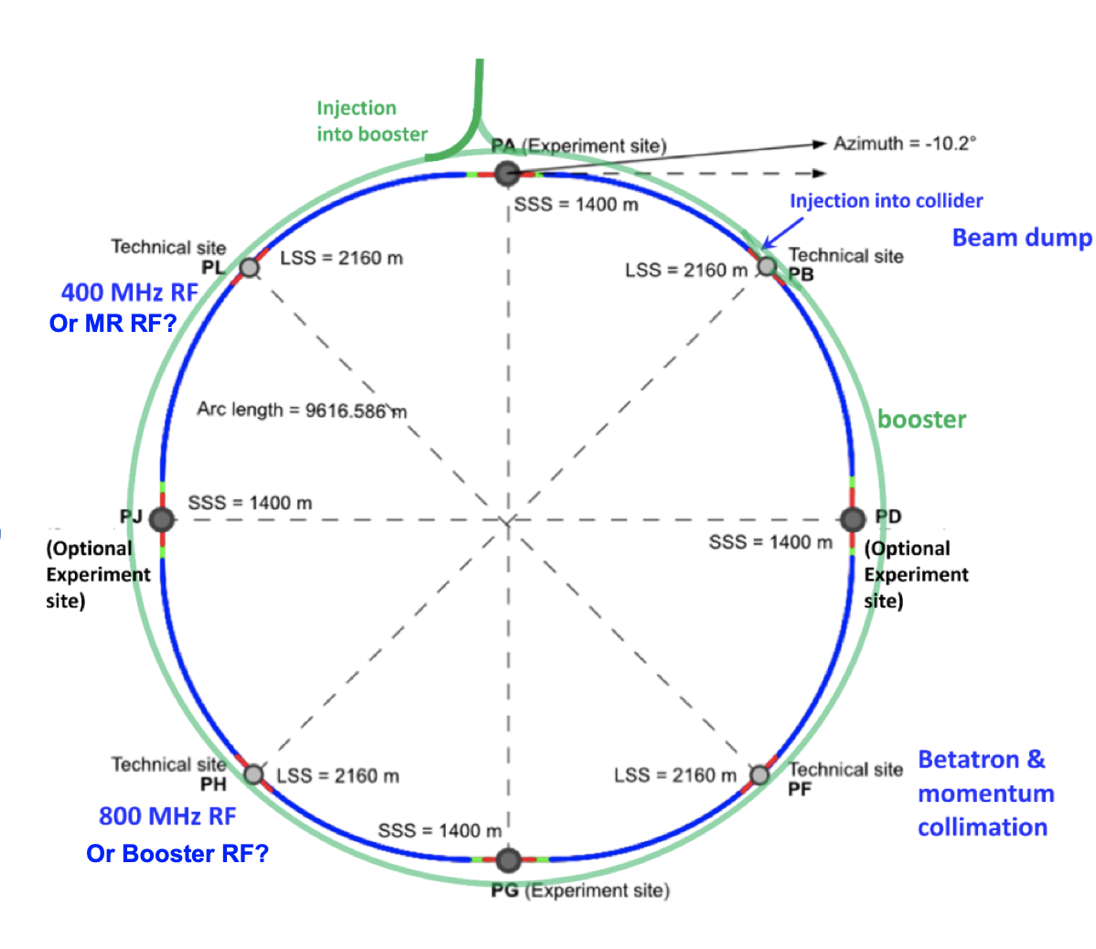
Tor Raubenheimer

Slide 6
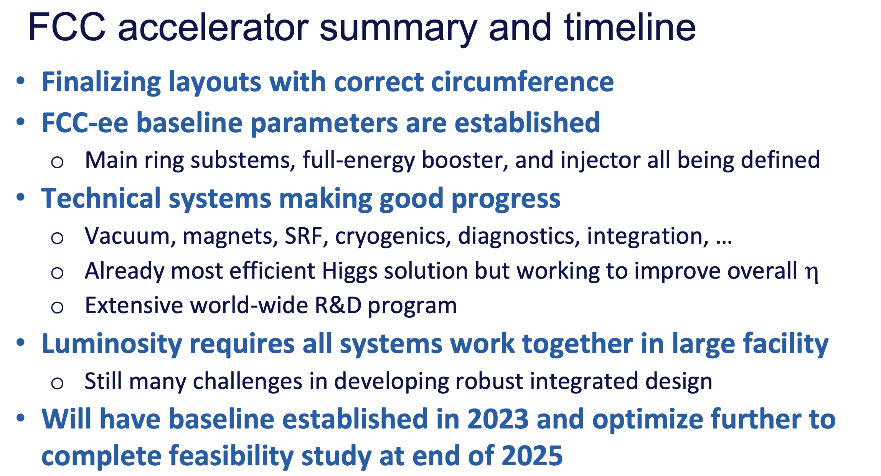
Tor Raubenheimer

Slide 7
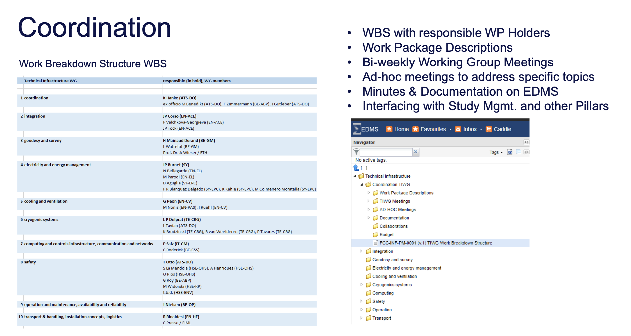
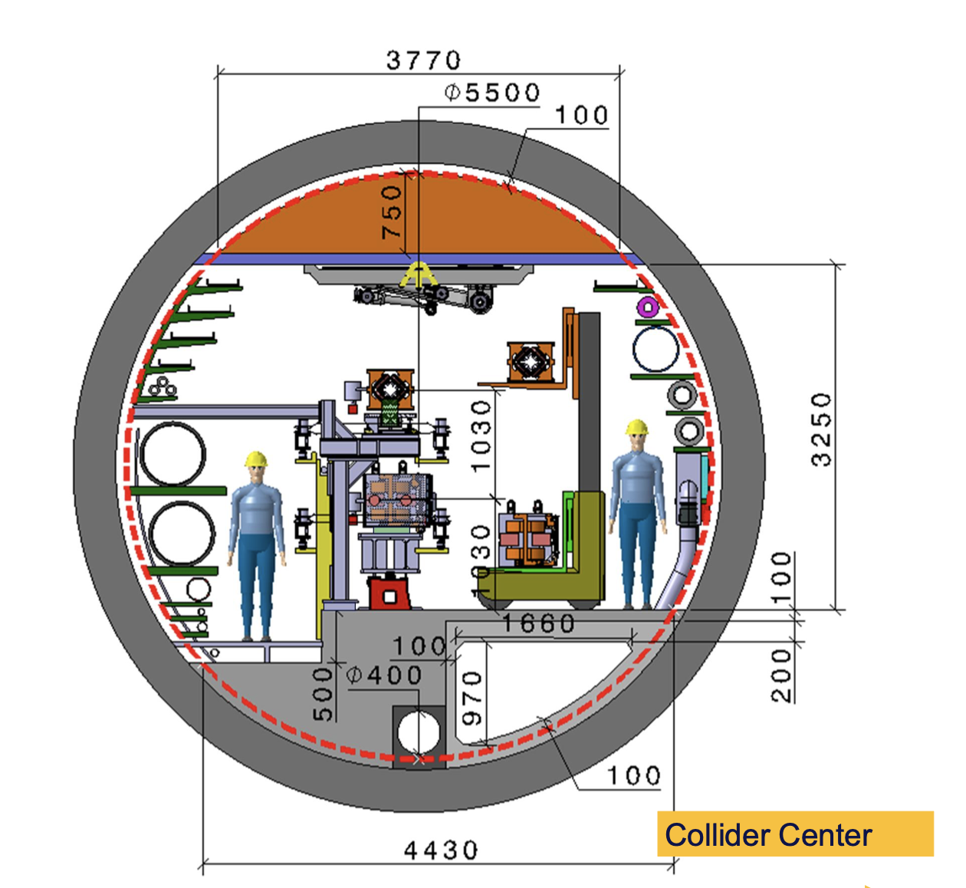
Klaus Hanke

Slide 8
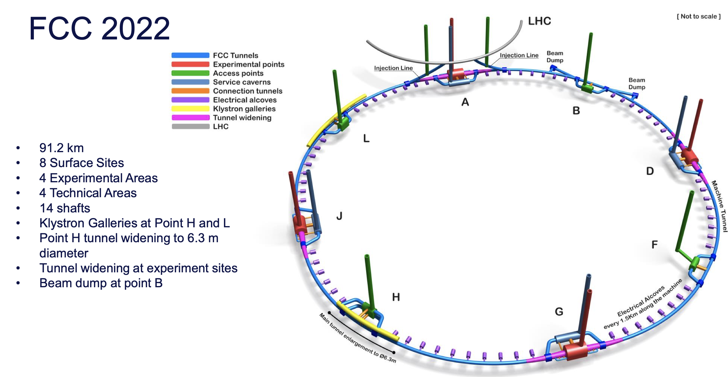
Liam Bromiley

Slide 9
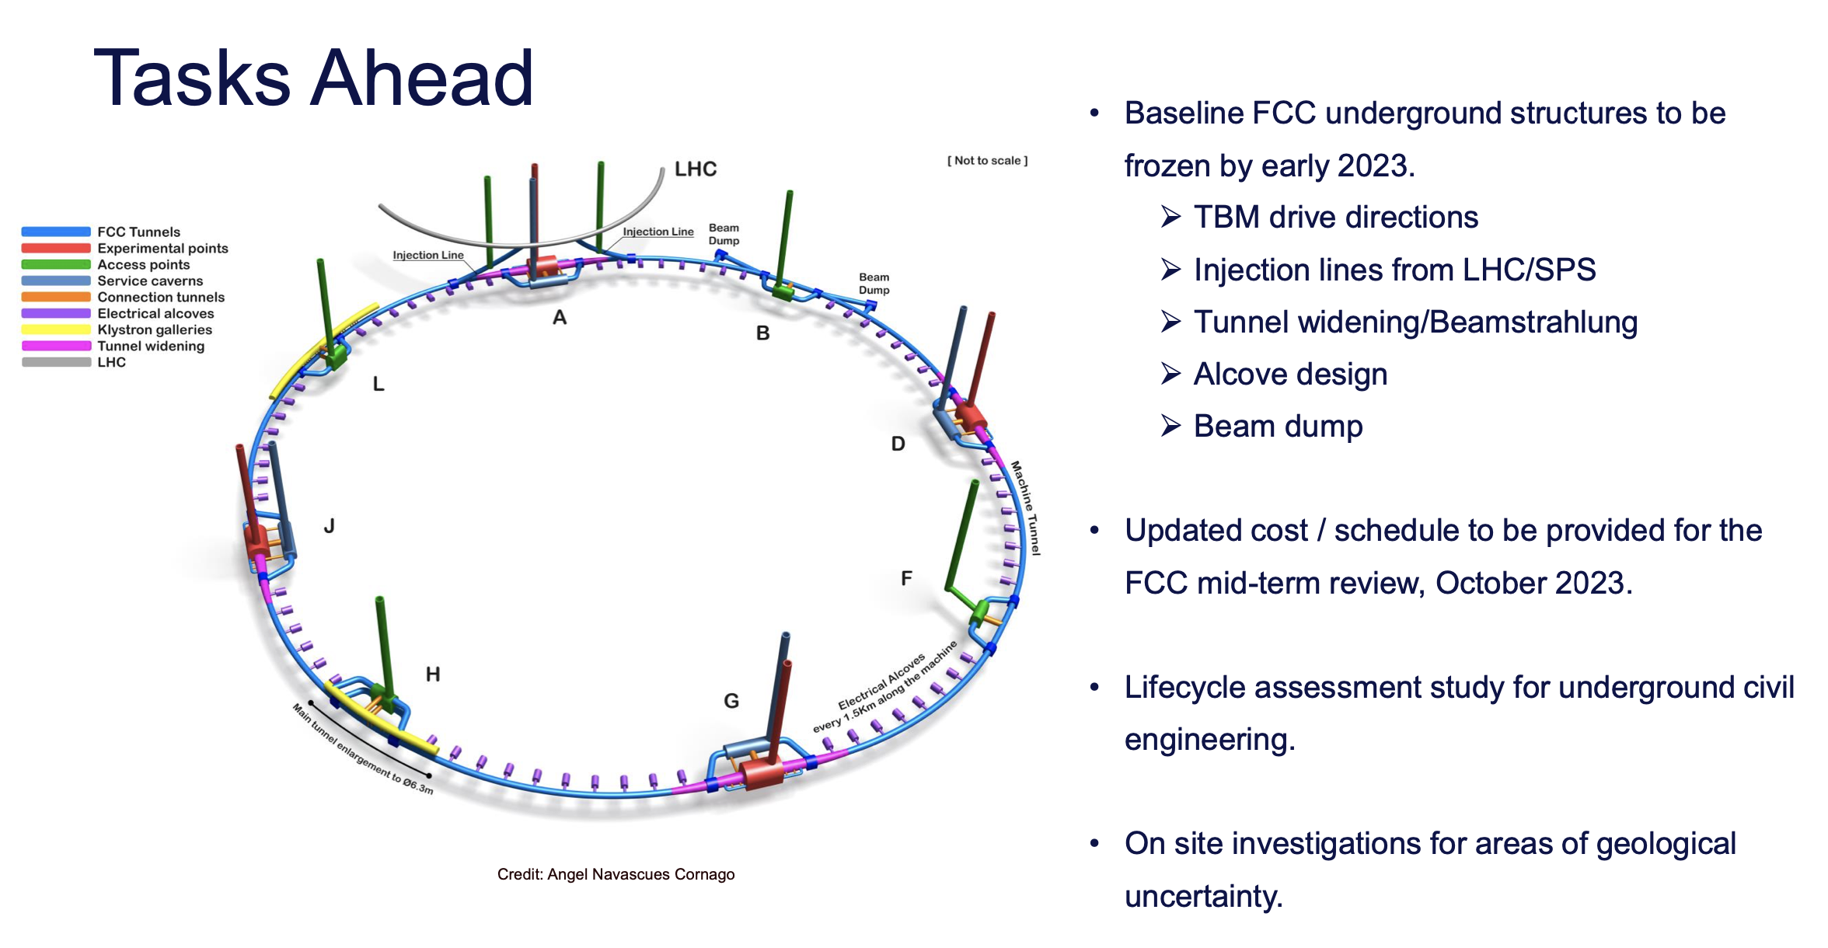
Liam Bromiley

Slide 10
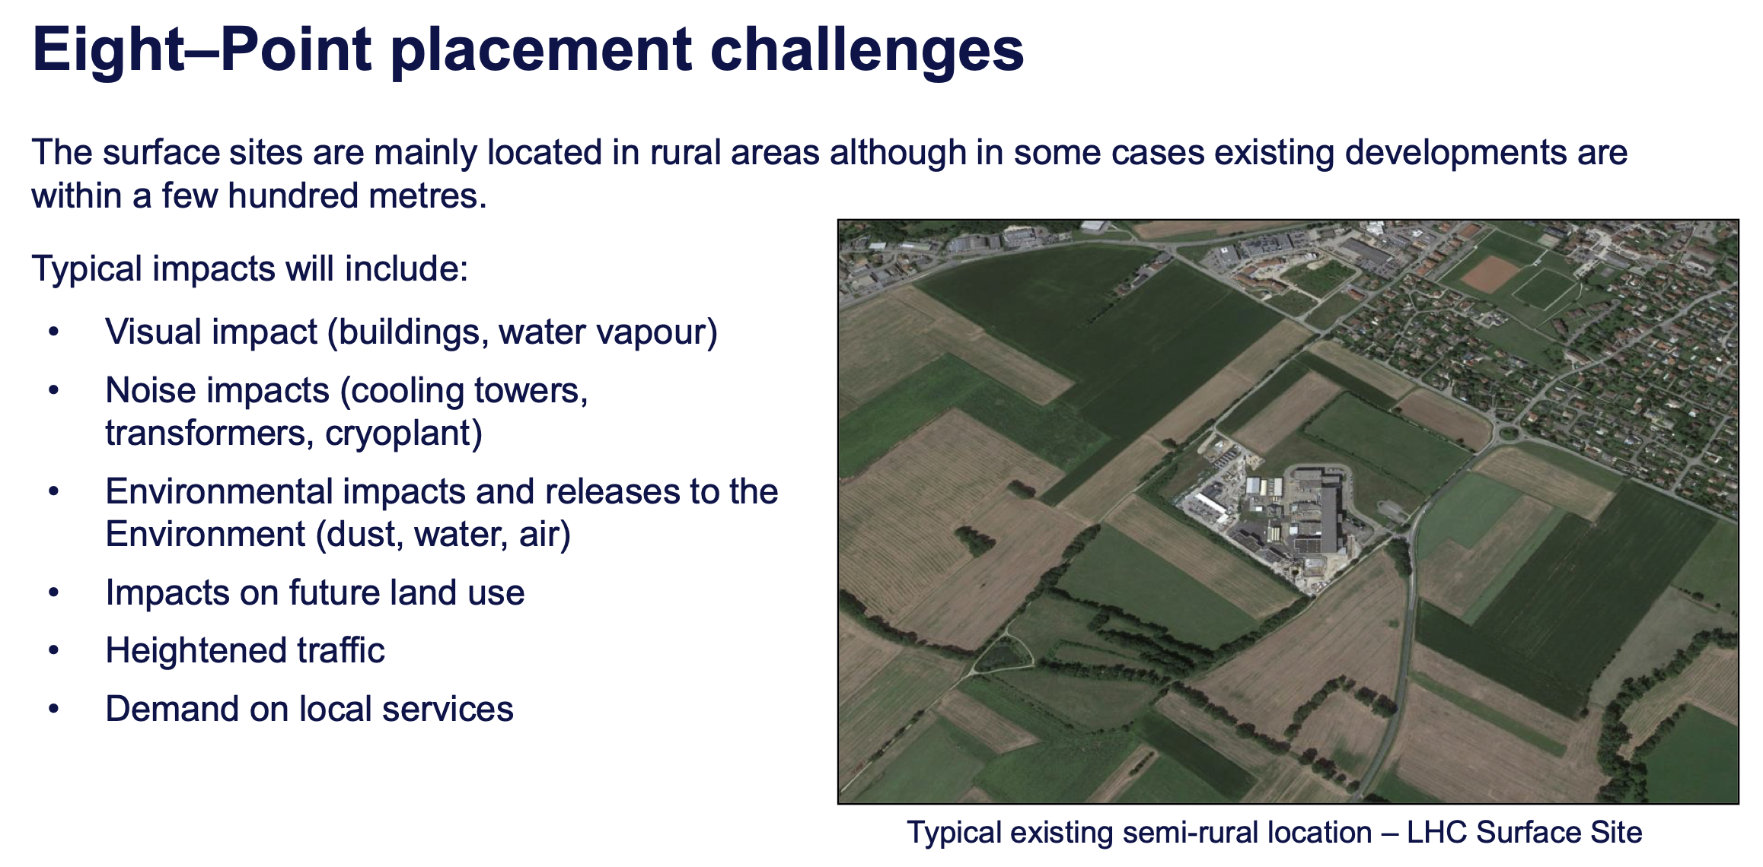
Antoine Mayoux

Slide 11
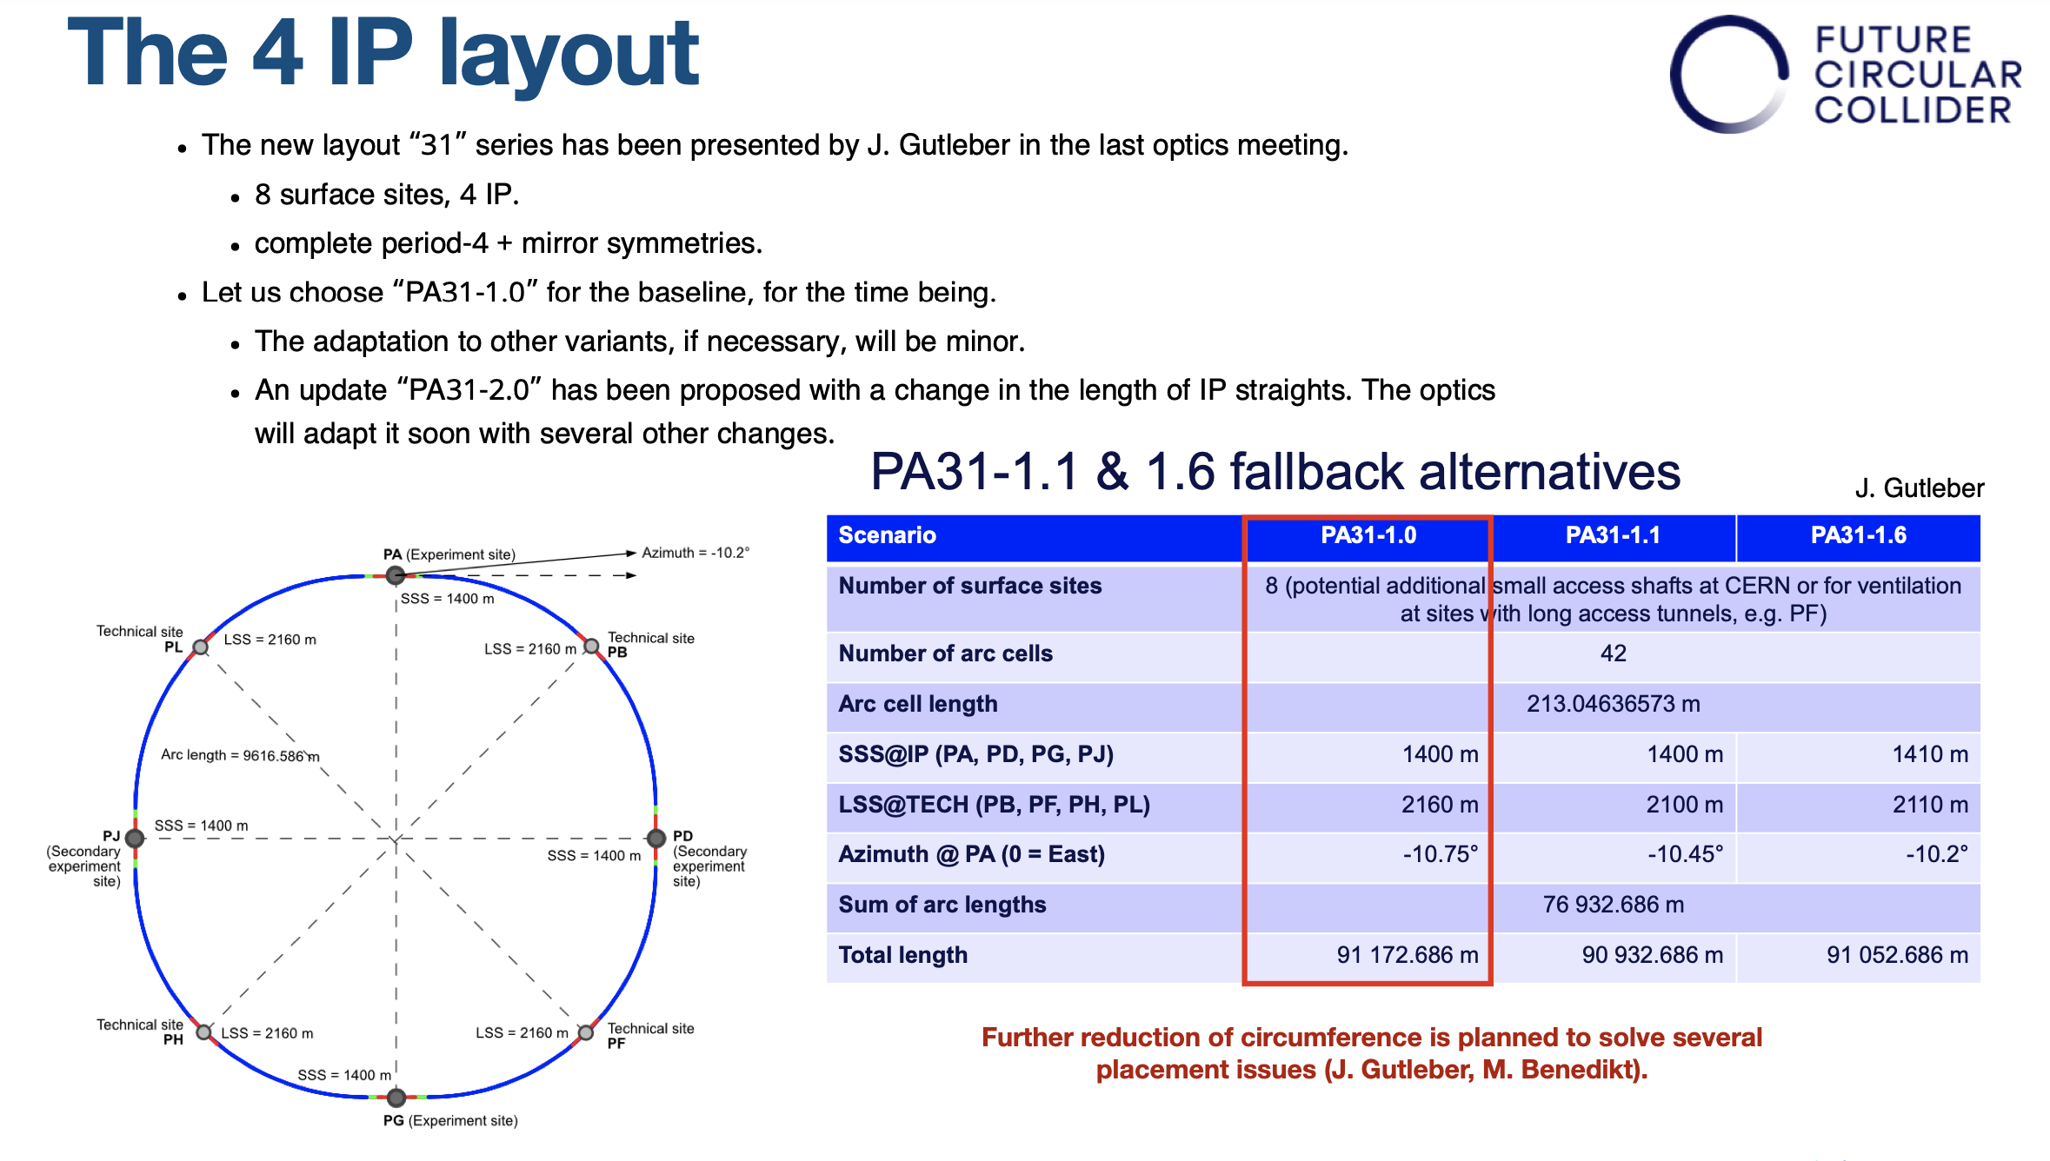
Katsunobu Oide

Slide 12
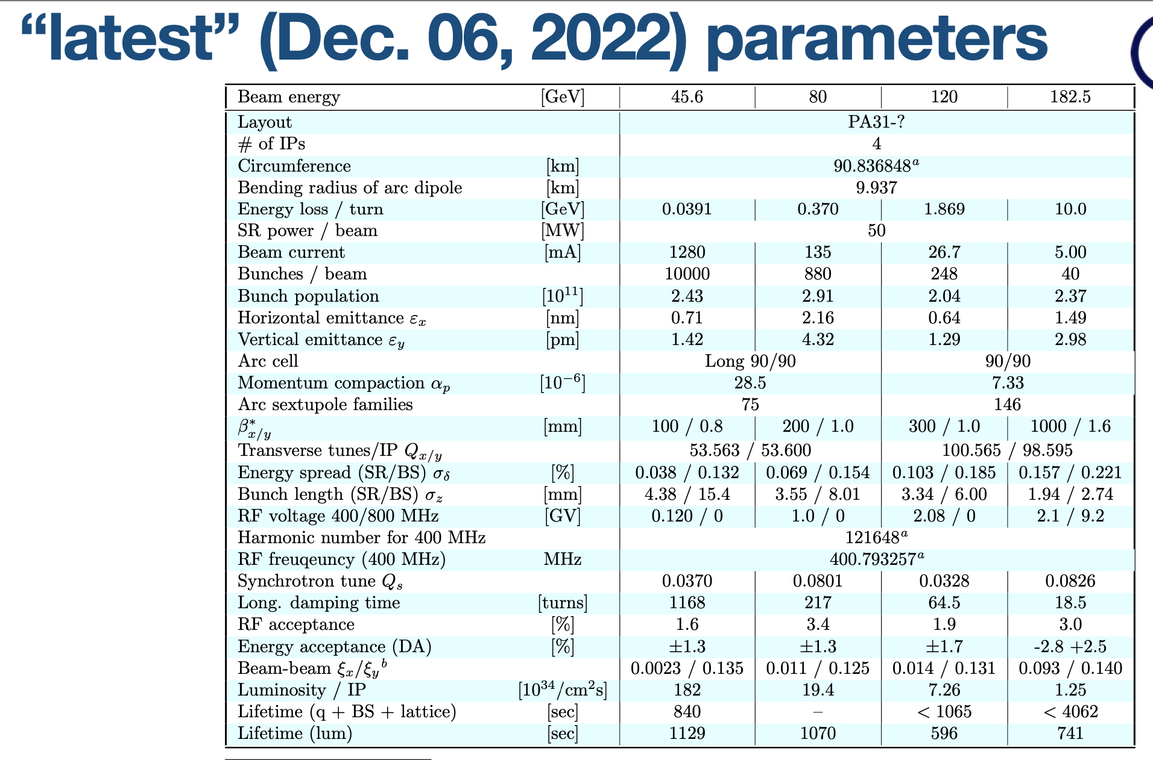
Katsunobu Oide

Slide 13
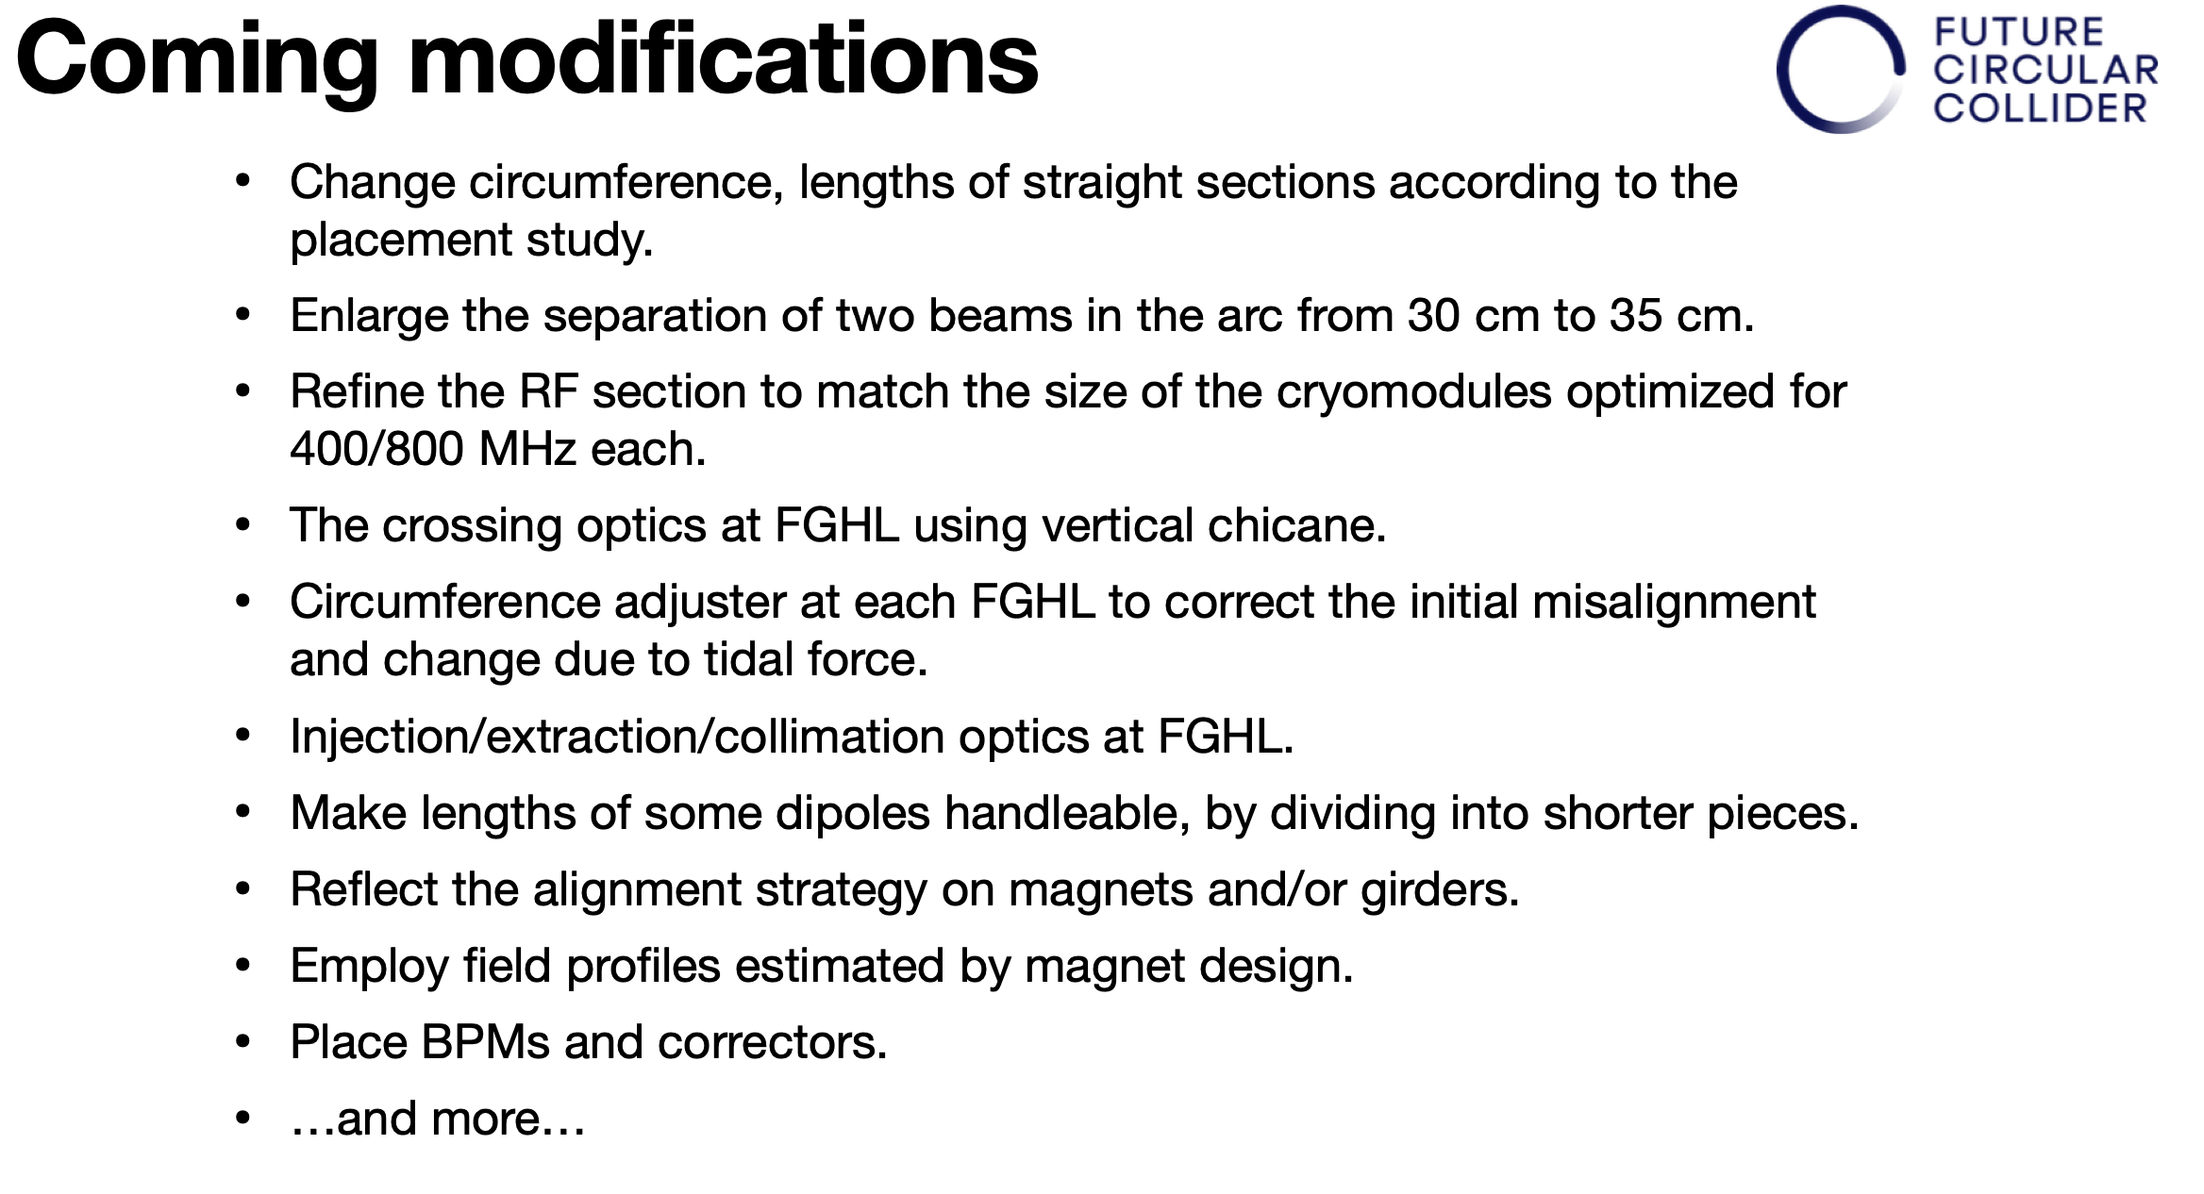
Katsunobu Oide

Slide 14
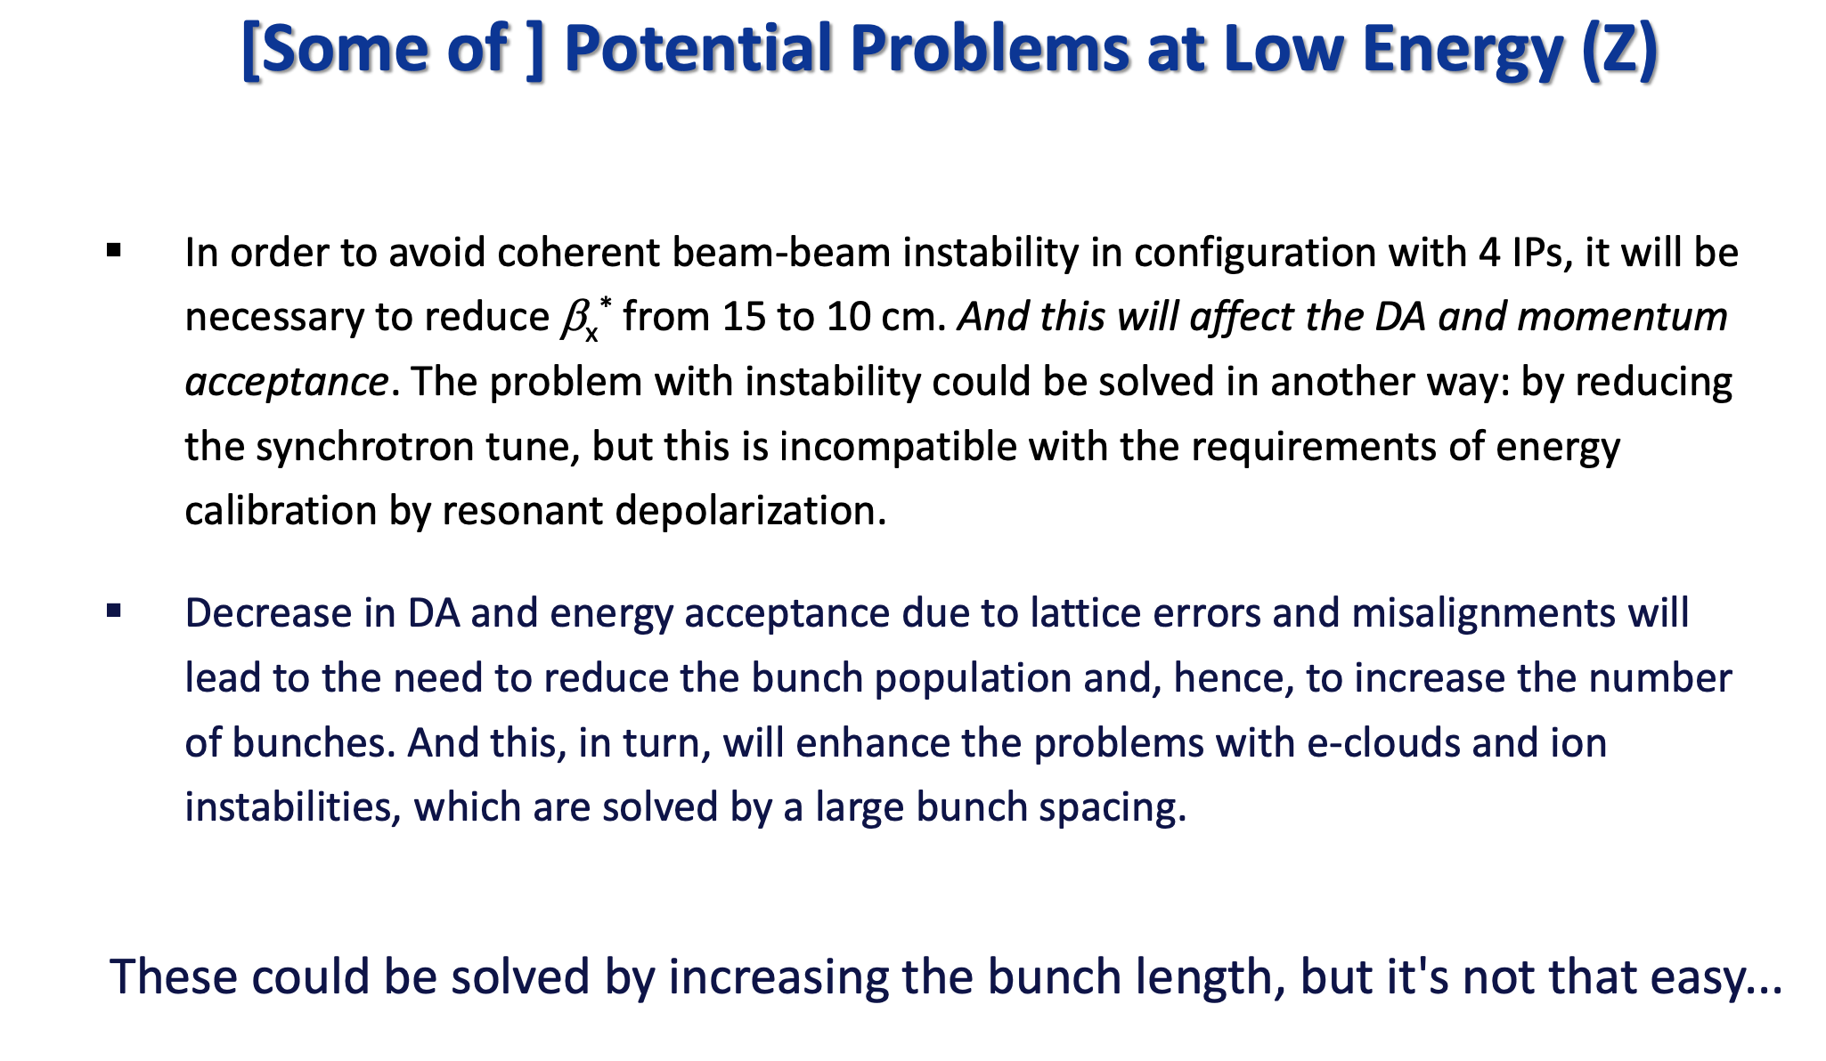
Dmitry Shatilov

Slide 15
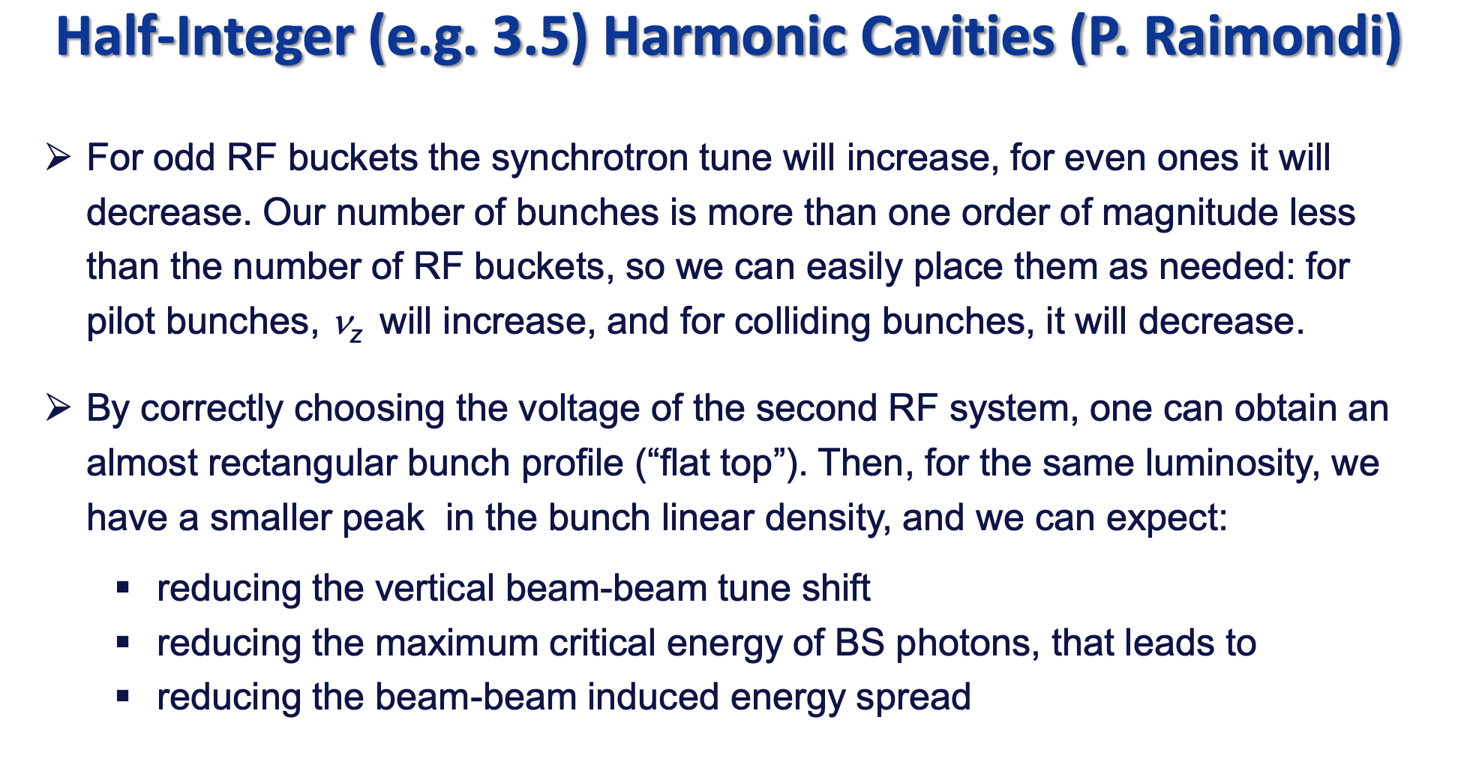
Dmitry Shatilov

Slide 16
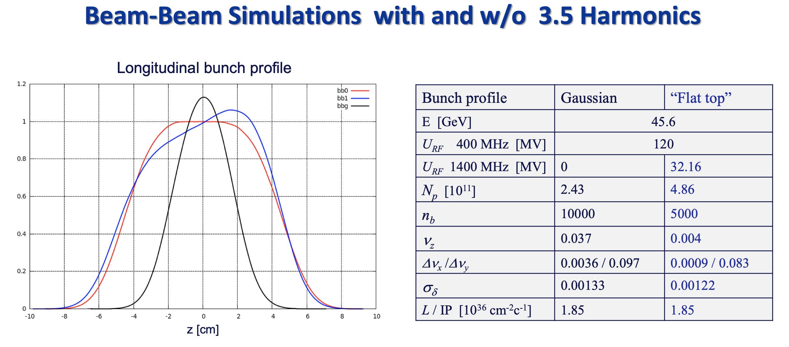
Dmitry Shatilov

Slide 17
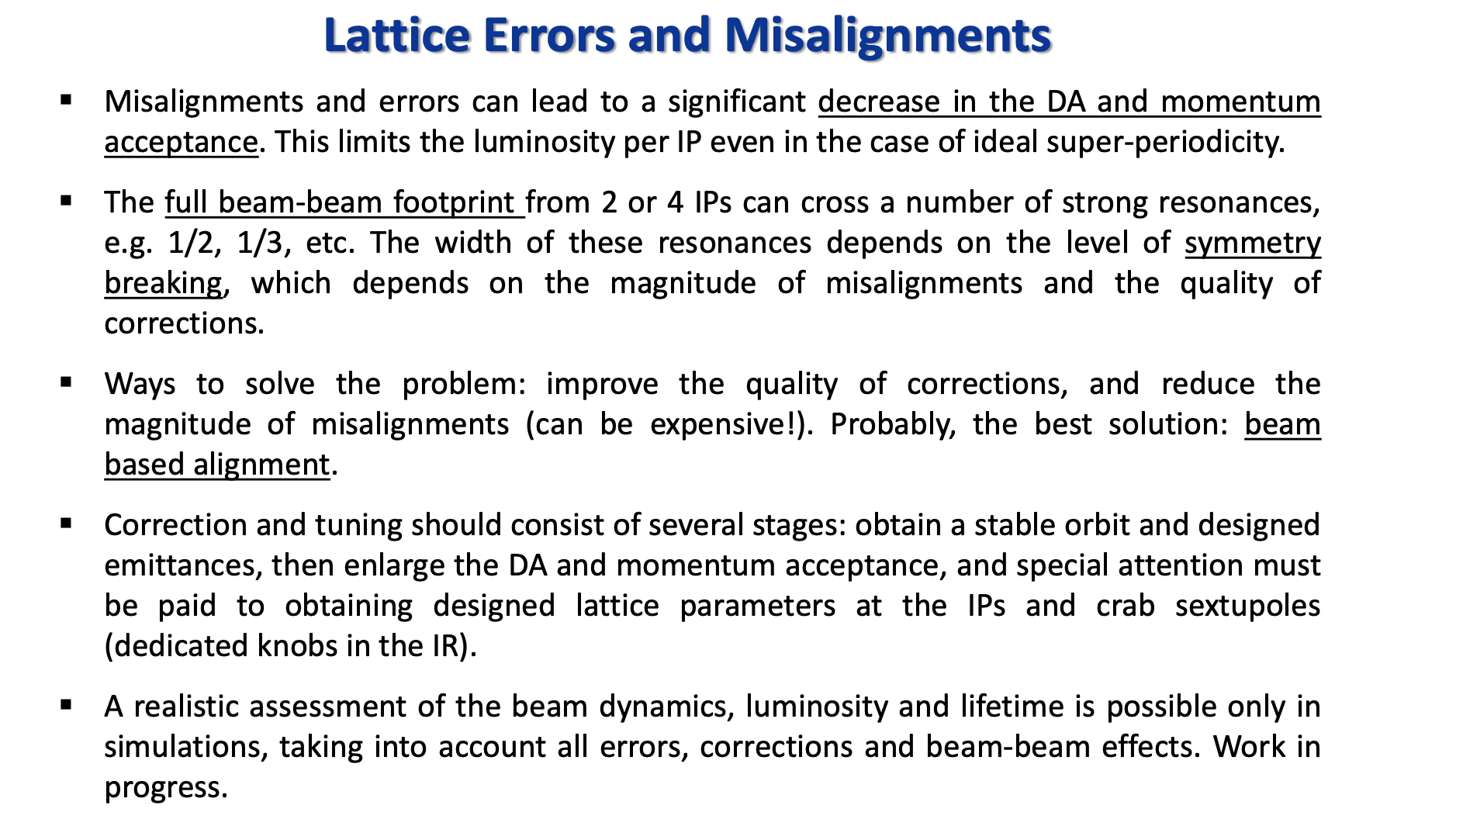
Dmitry Shatilov

Slide 18
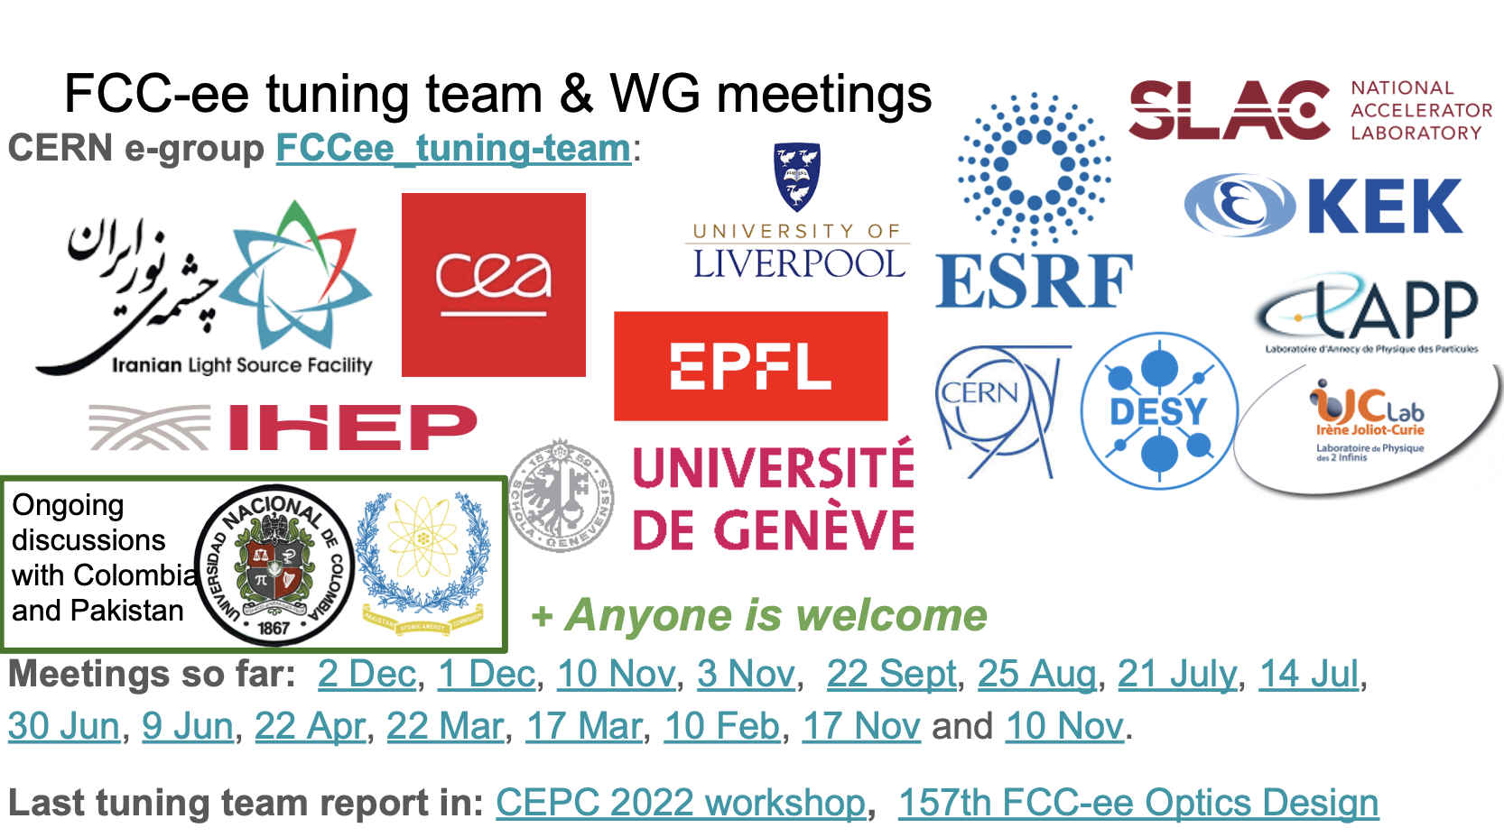
Rogelio Tomas

Slide 19
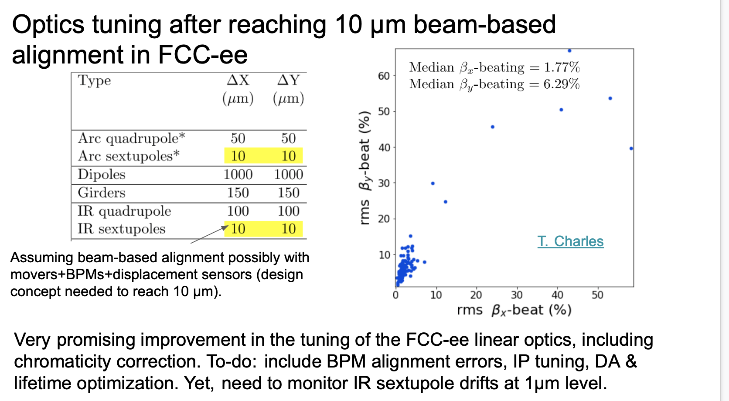
Rogelio Tomas

Slide 20
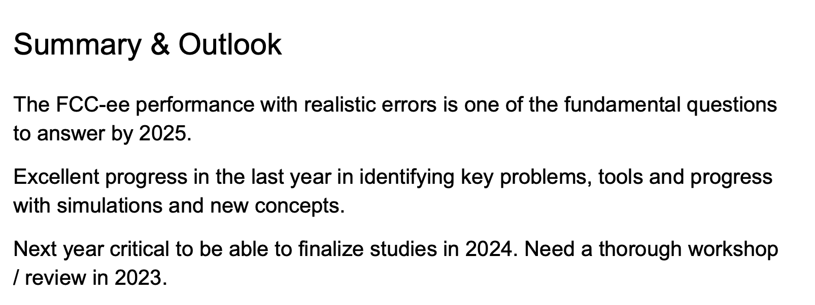
Rogelio Tomas

Slide 21
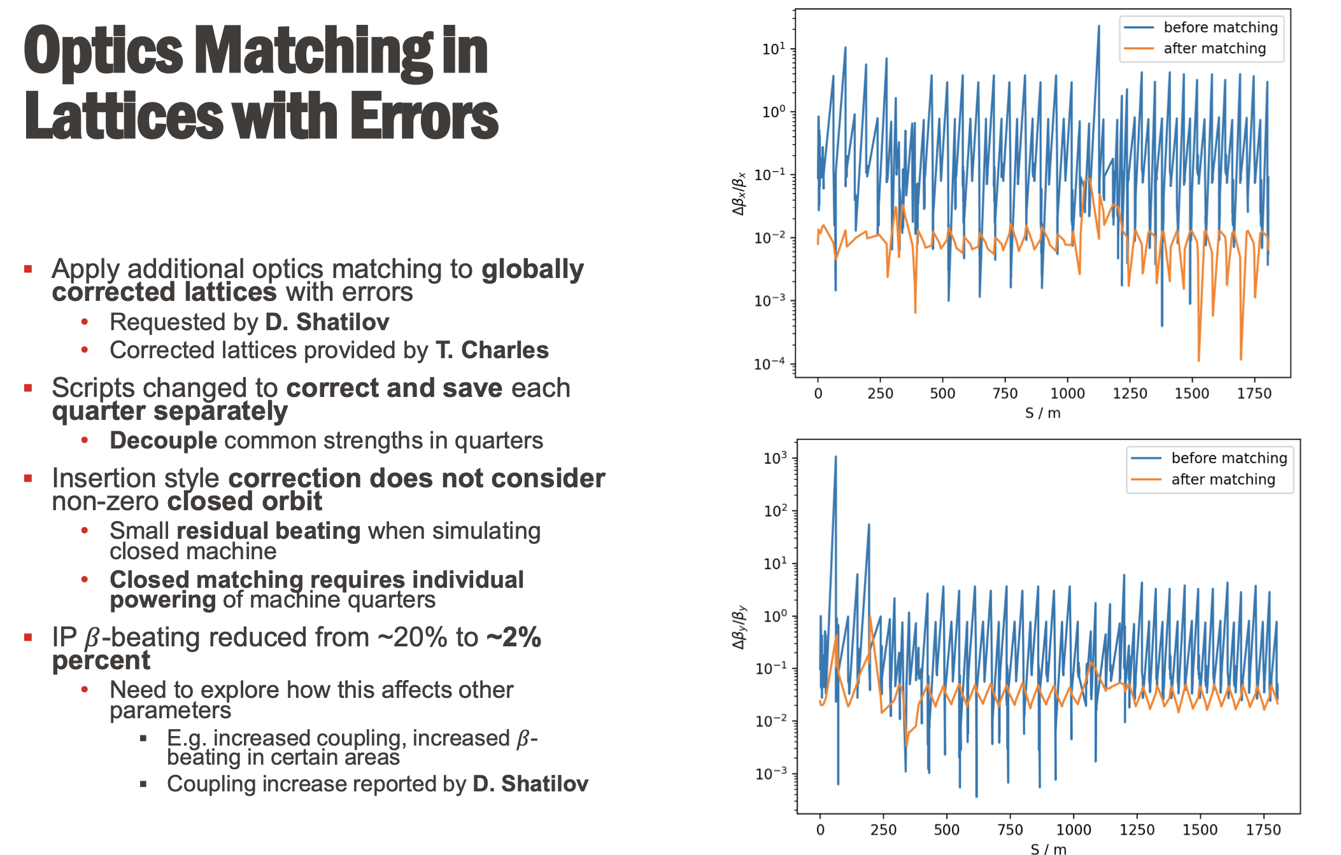
Leon van Riesen-Haupt

Slide 22
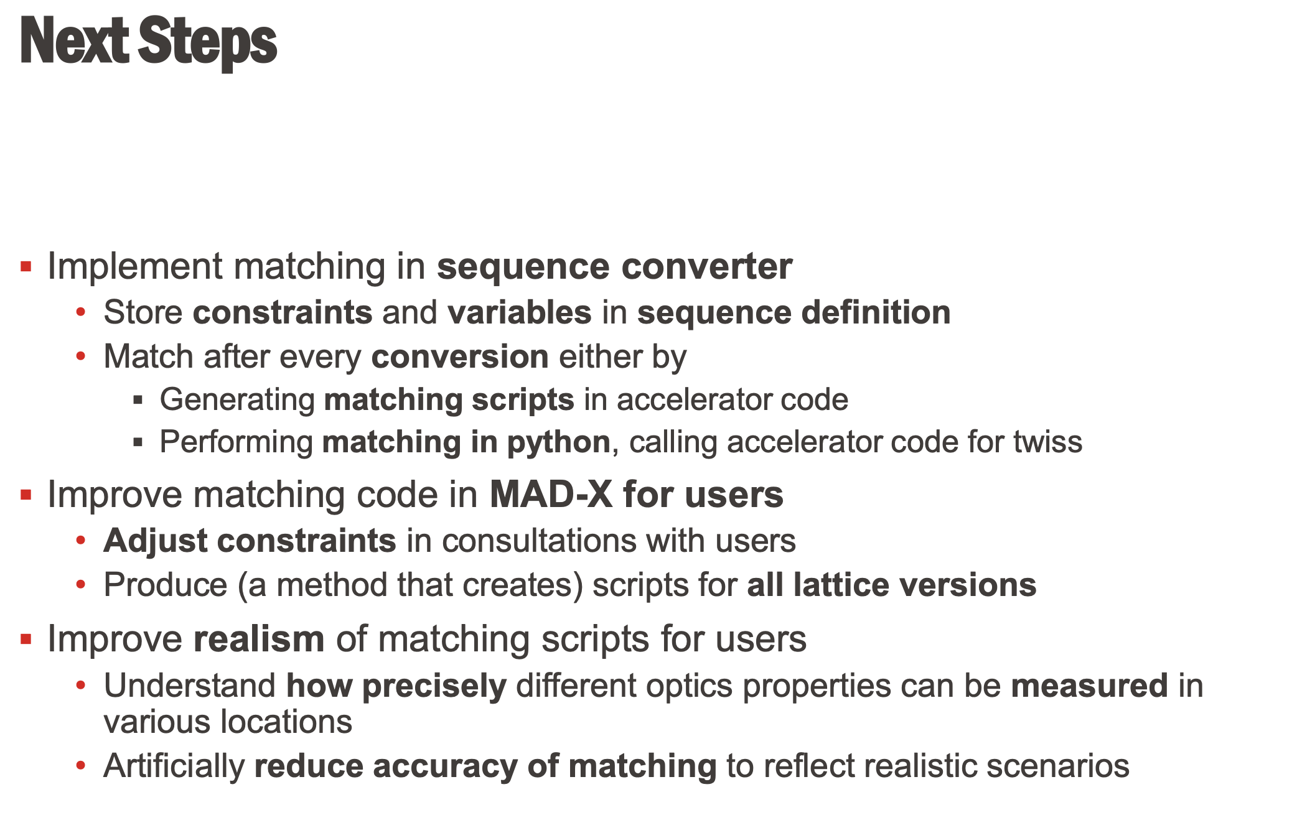
Leon van Riesen-Haupt

Slide 23
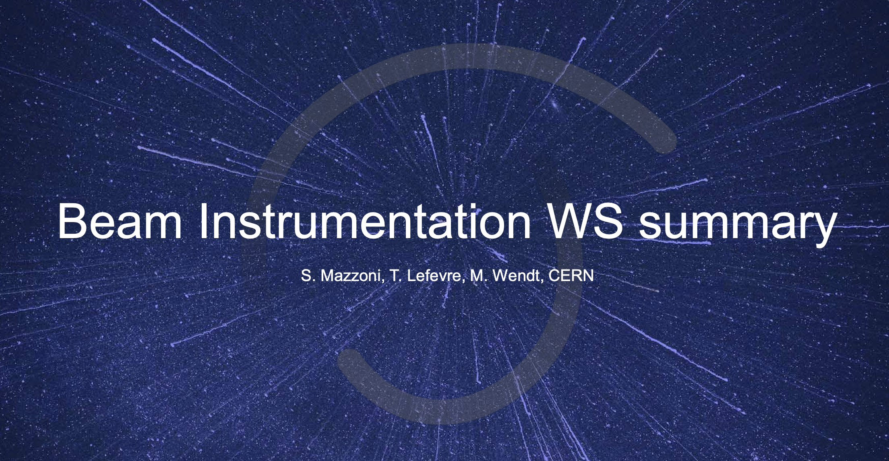
Stefano Mazzoni

Slide 24
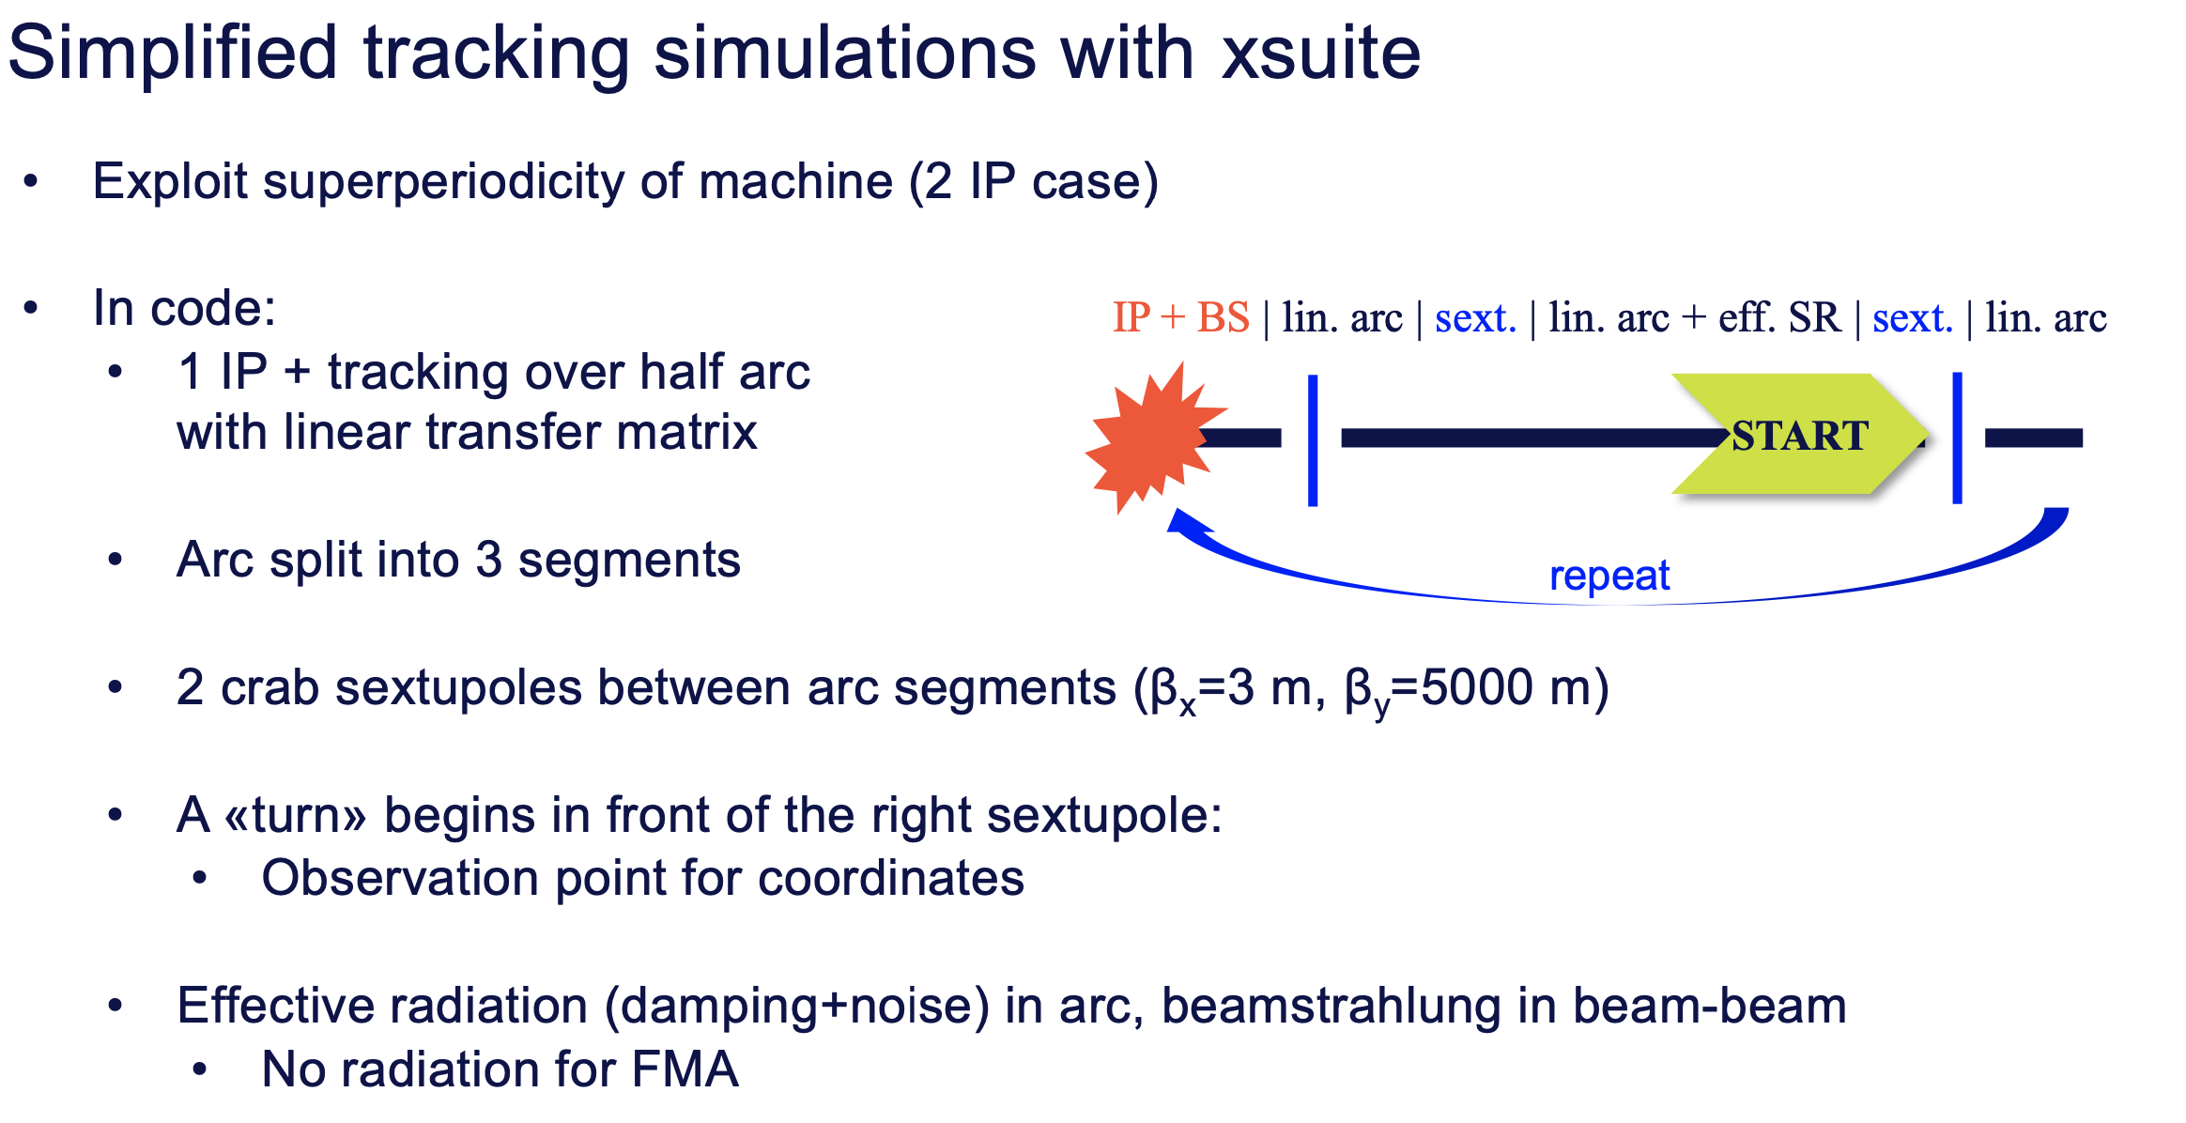
Peter Kisciny

Slide 25
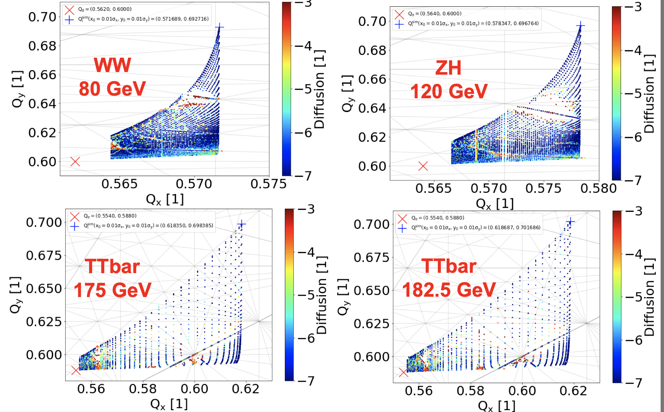
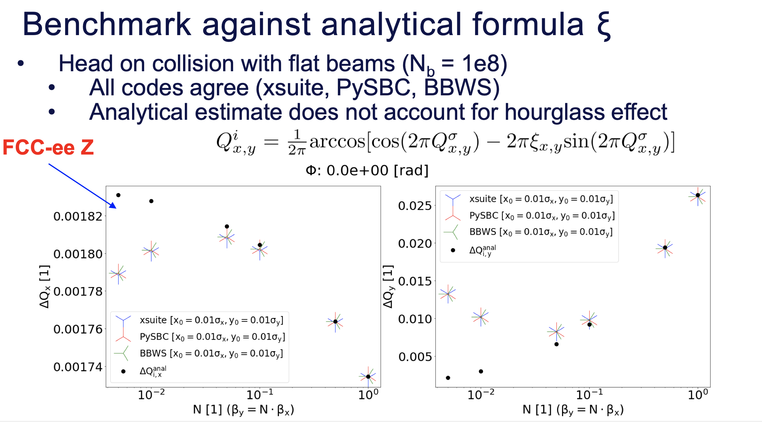
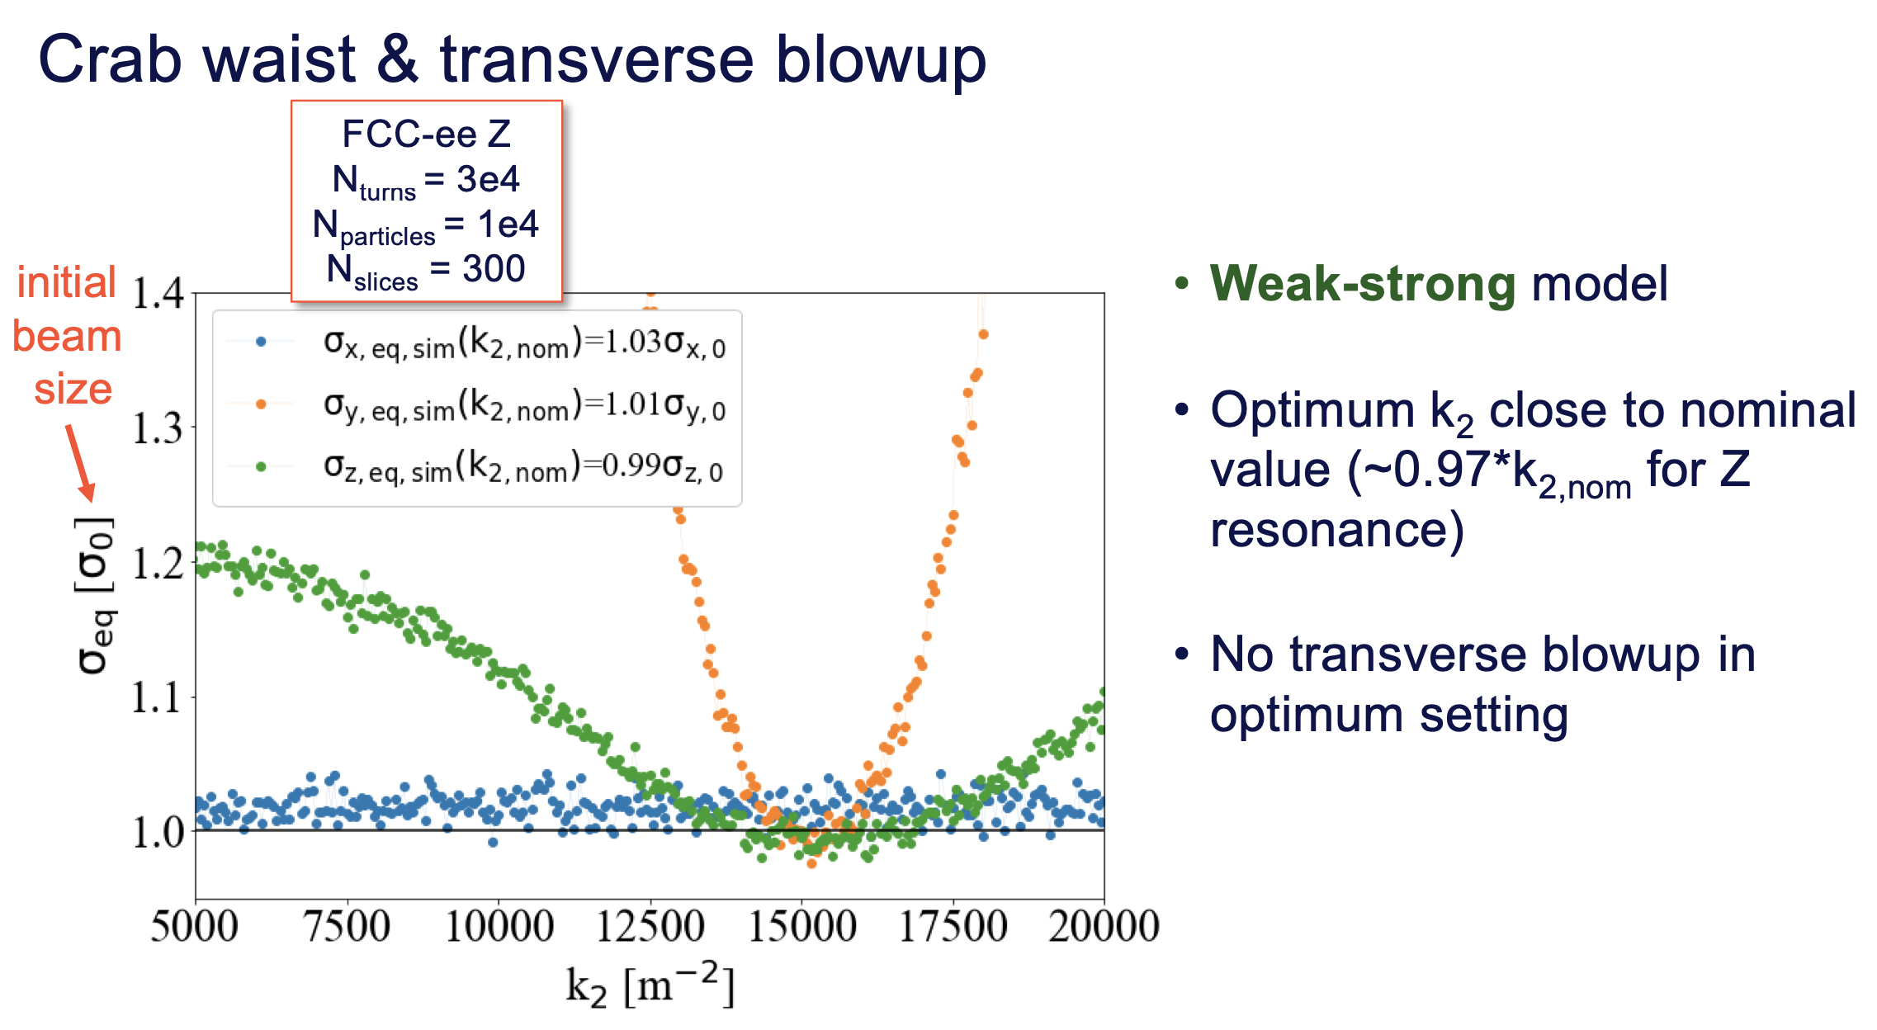
Peter Kisciny

Slide 26
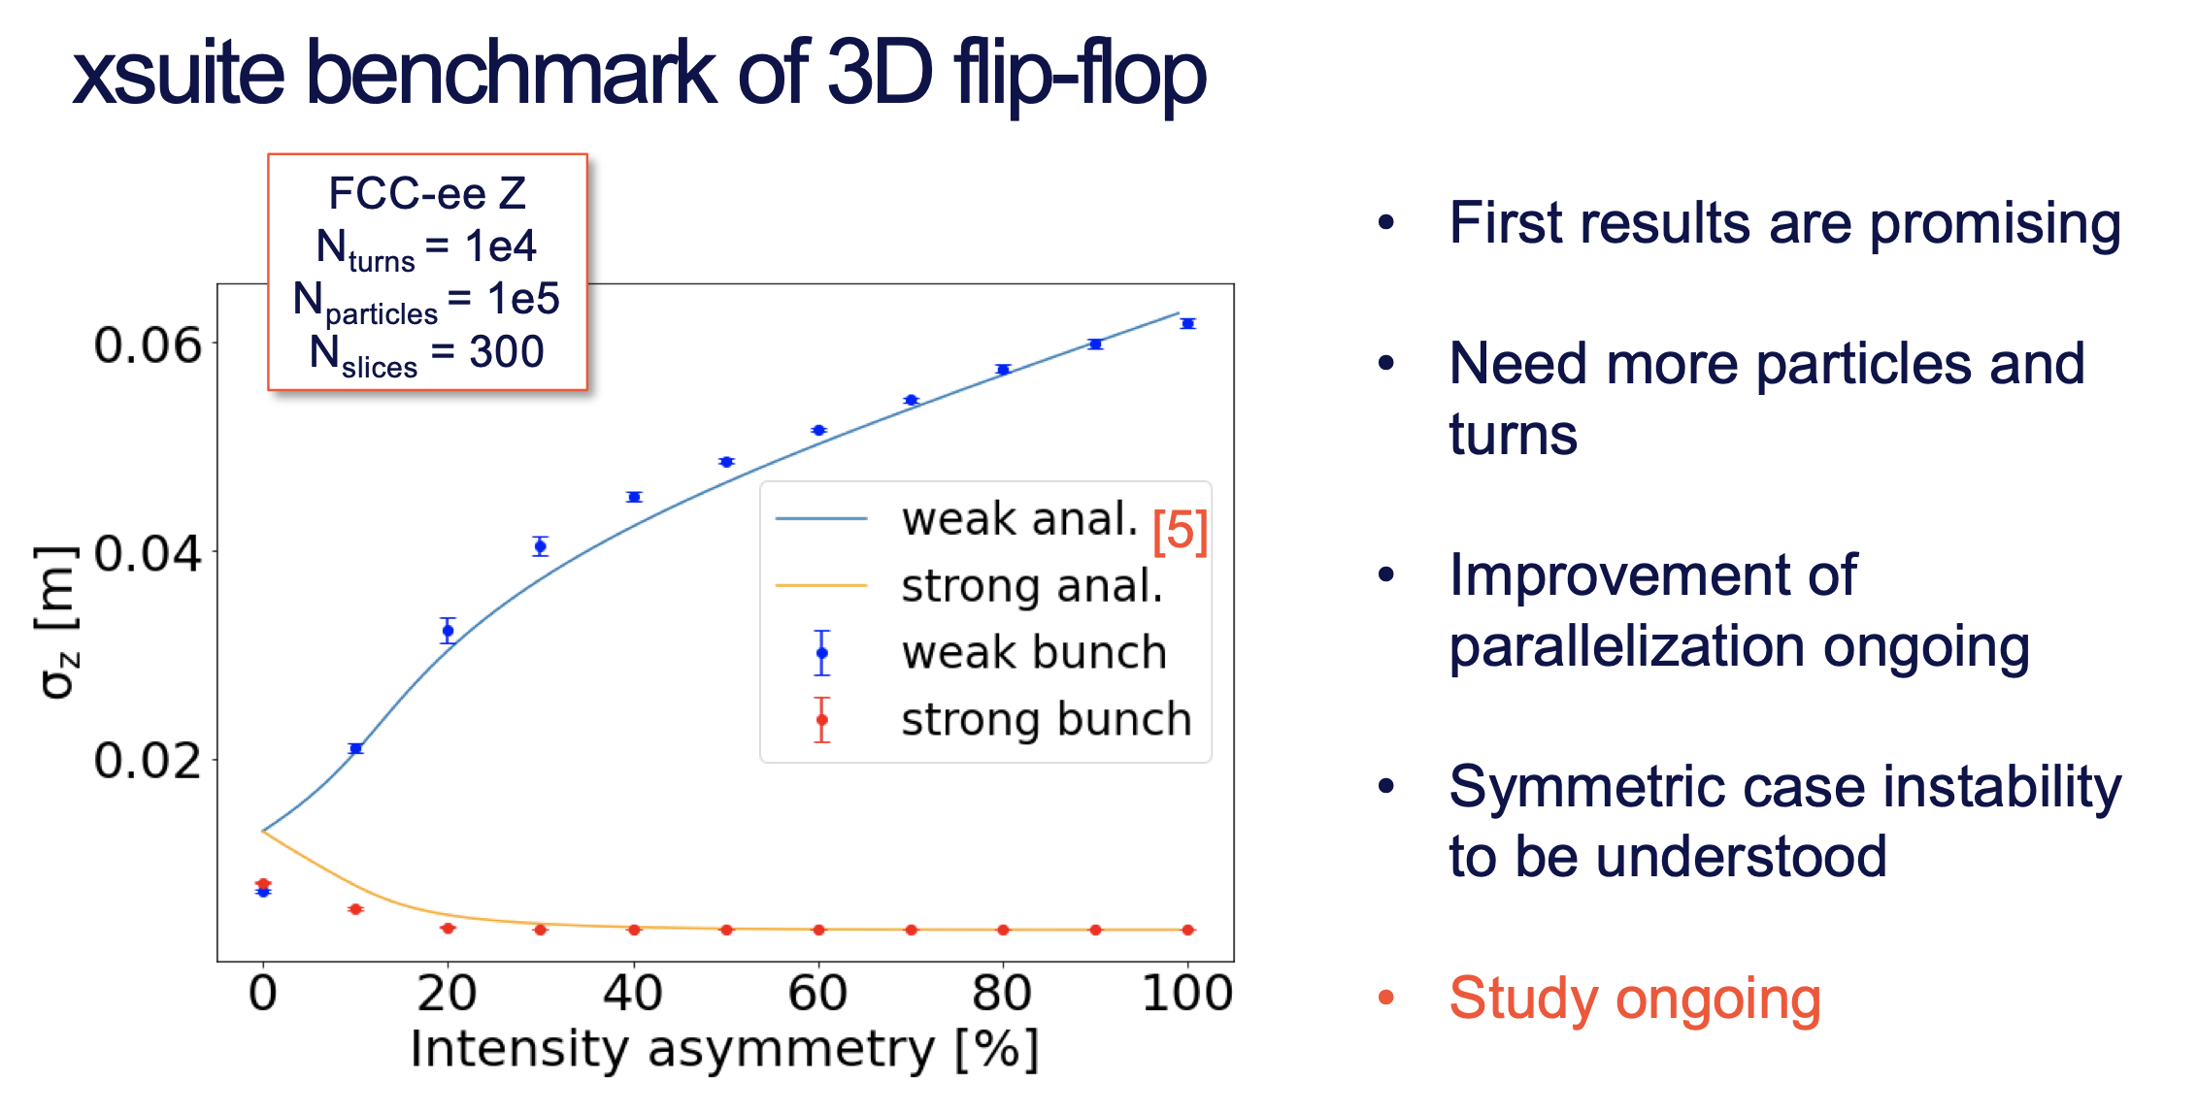
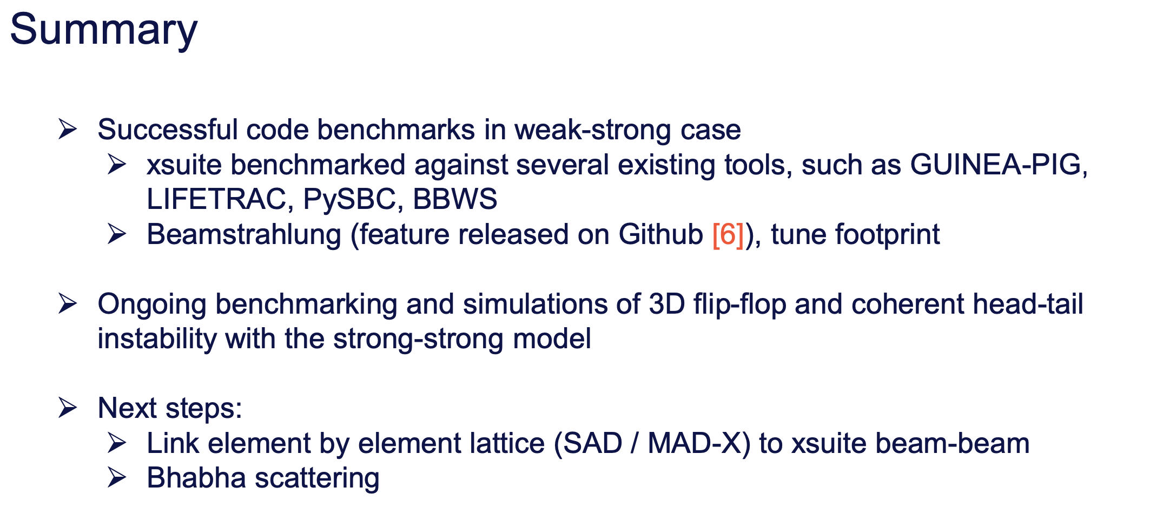
Peter Kisciny

Slide 27
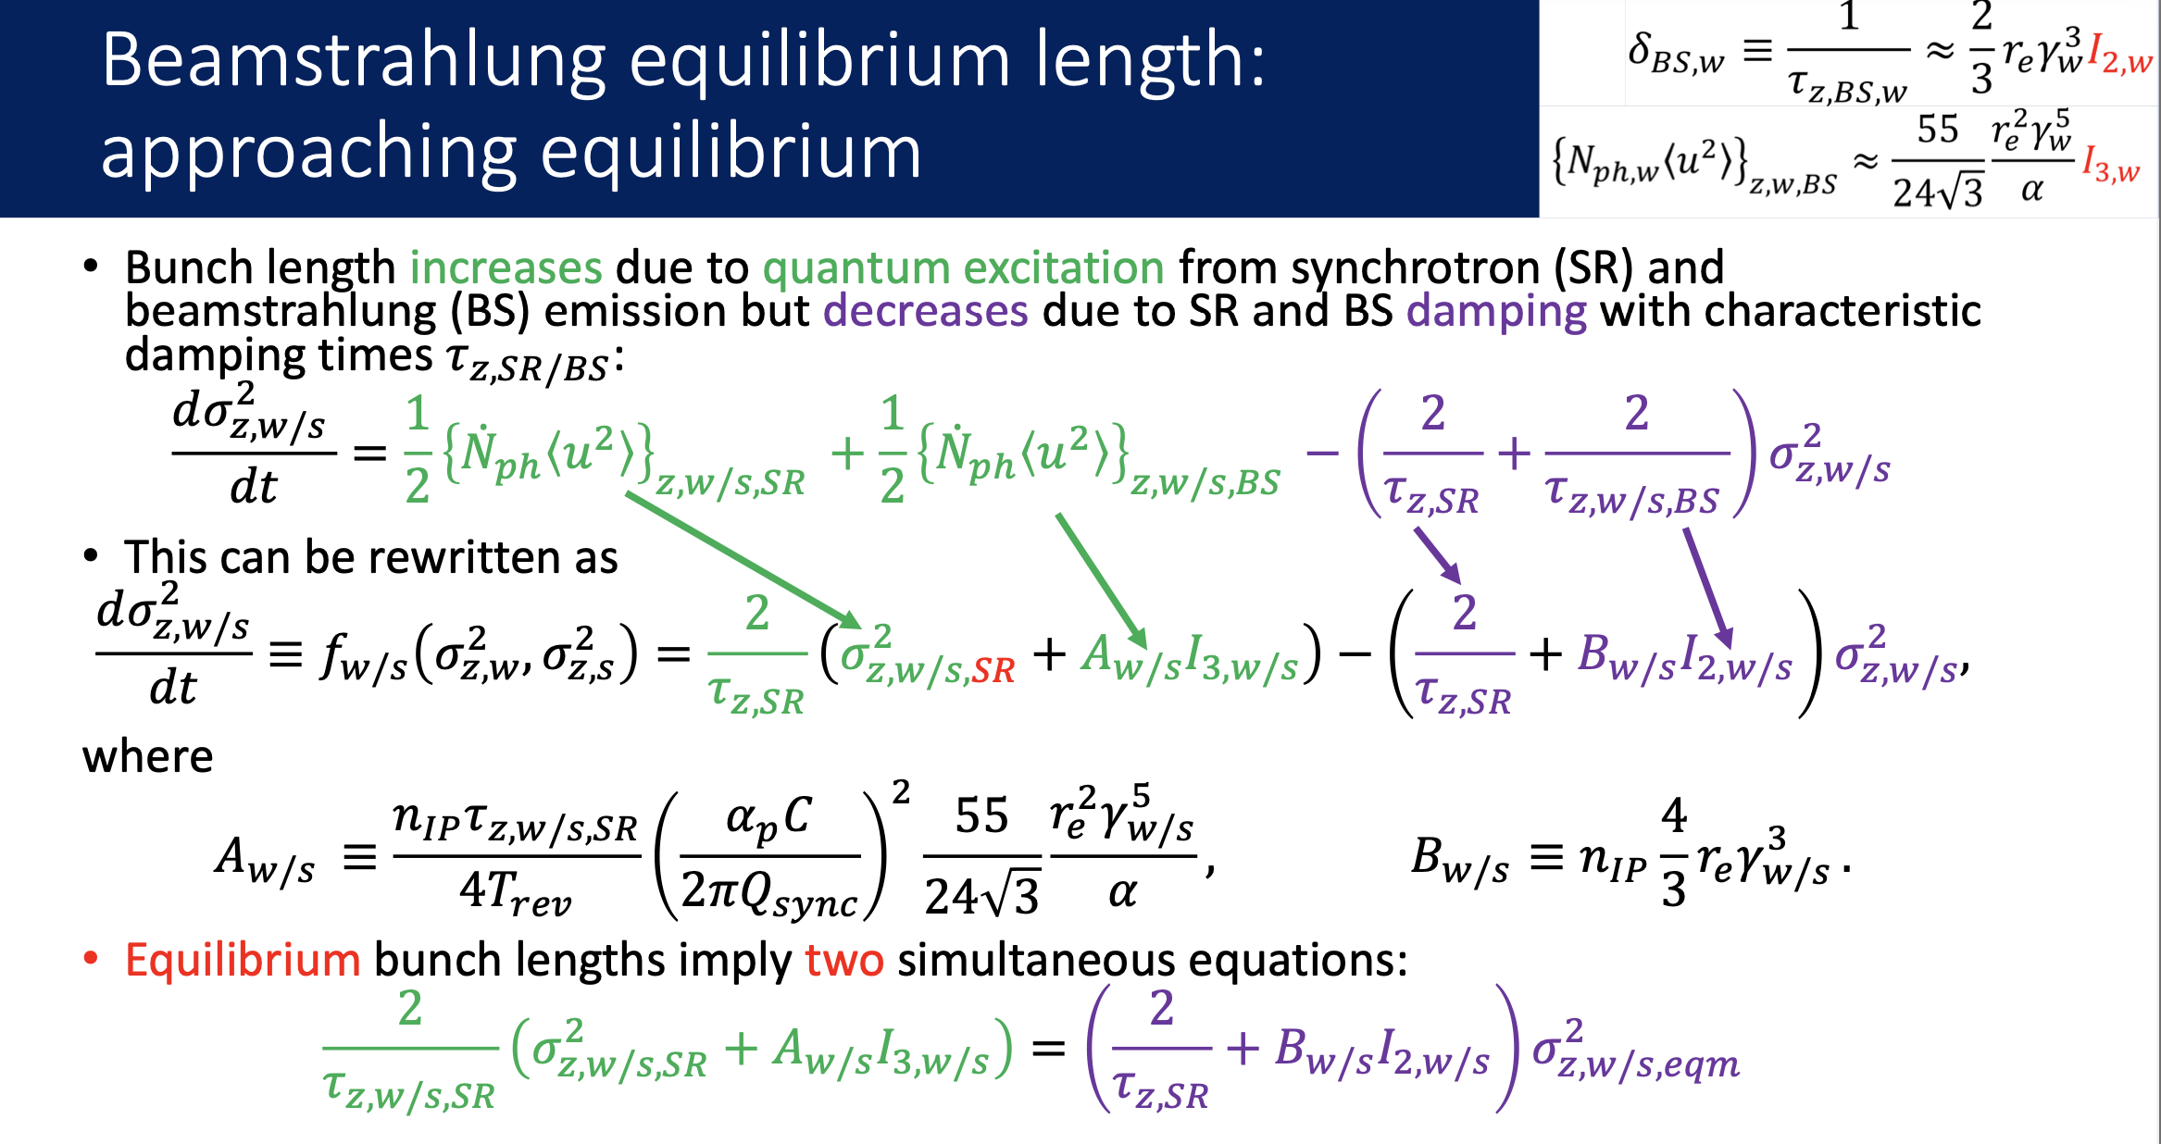
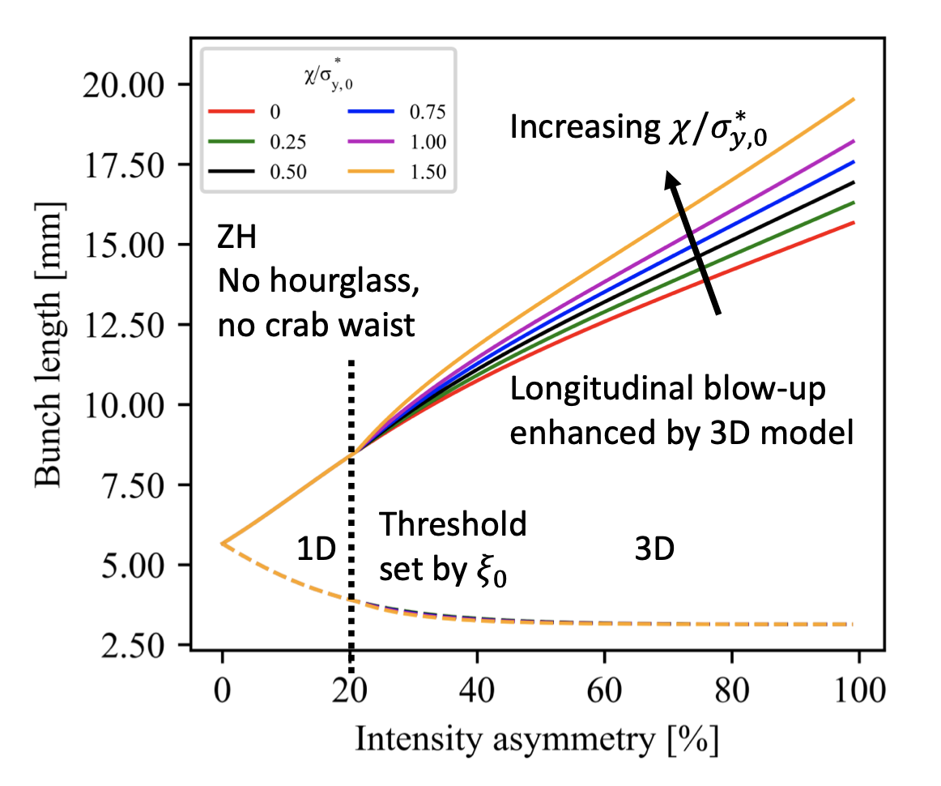
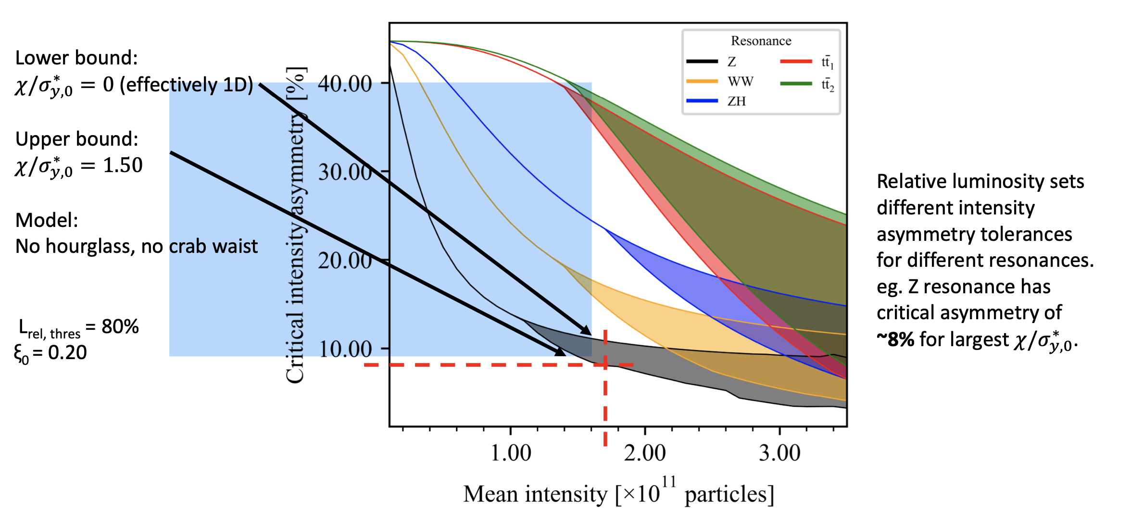
K. Le Nguyen Nguyen

Slide 28
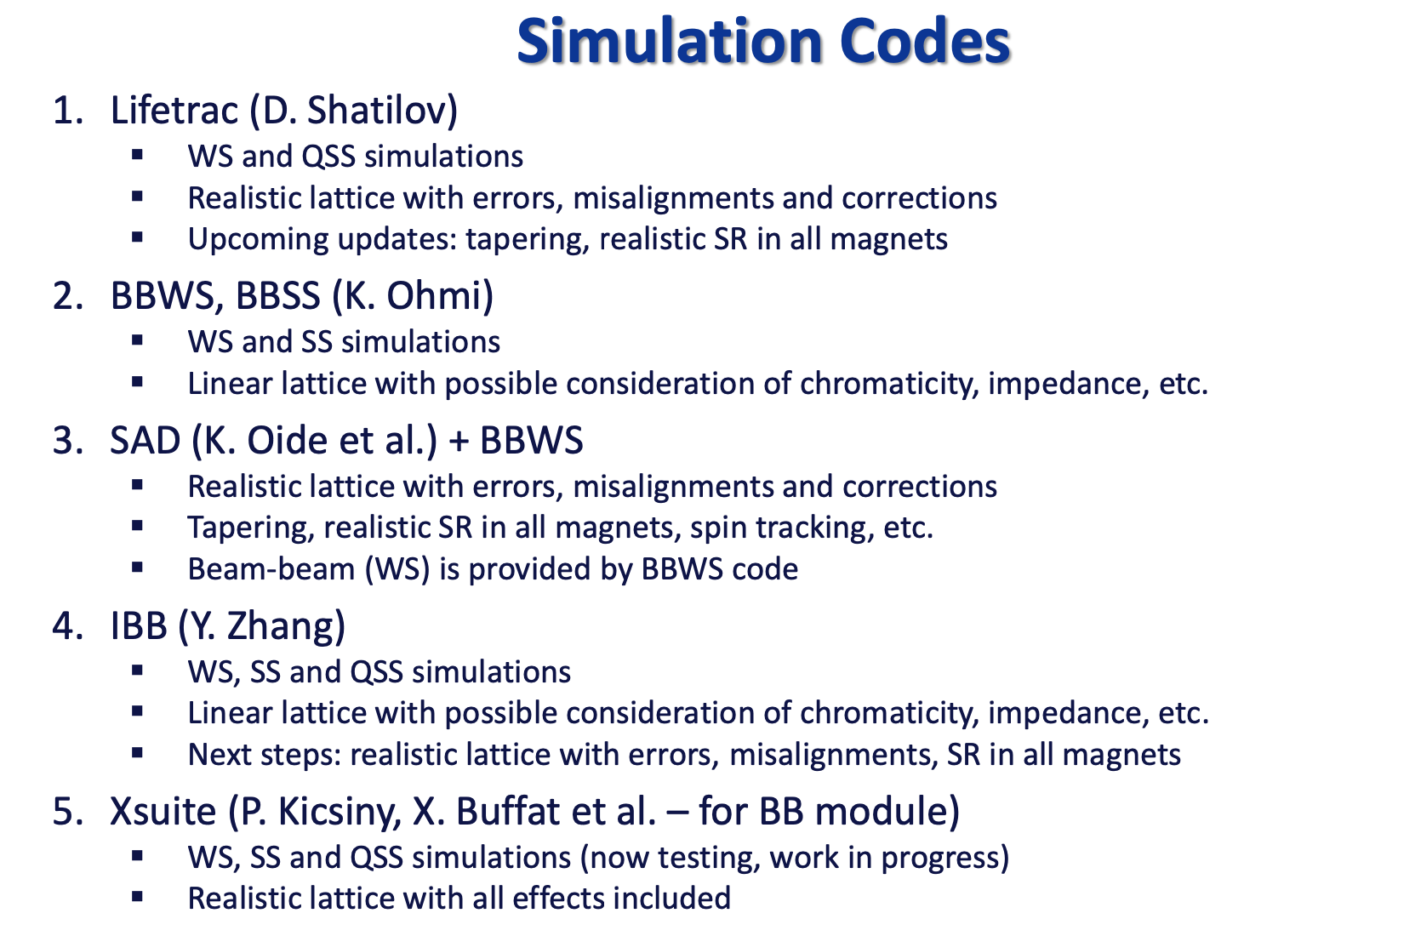
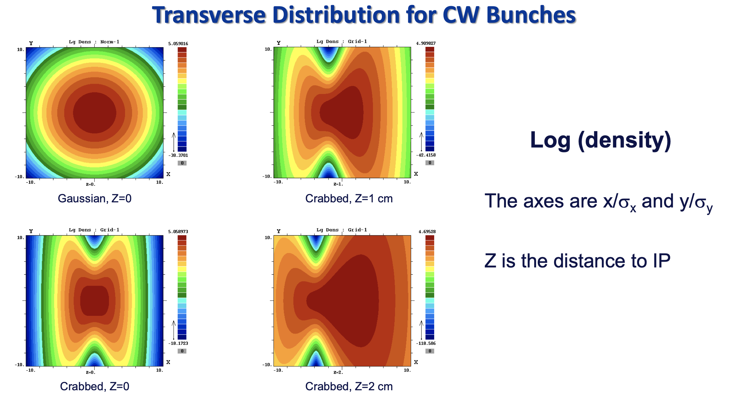
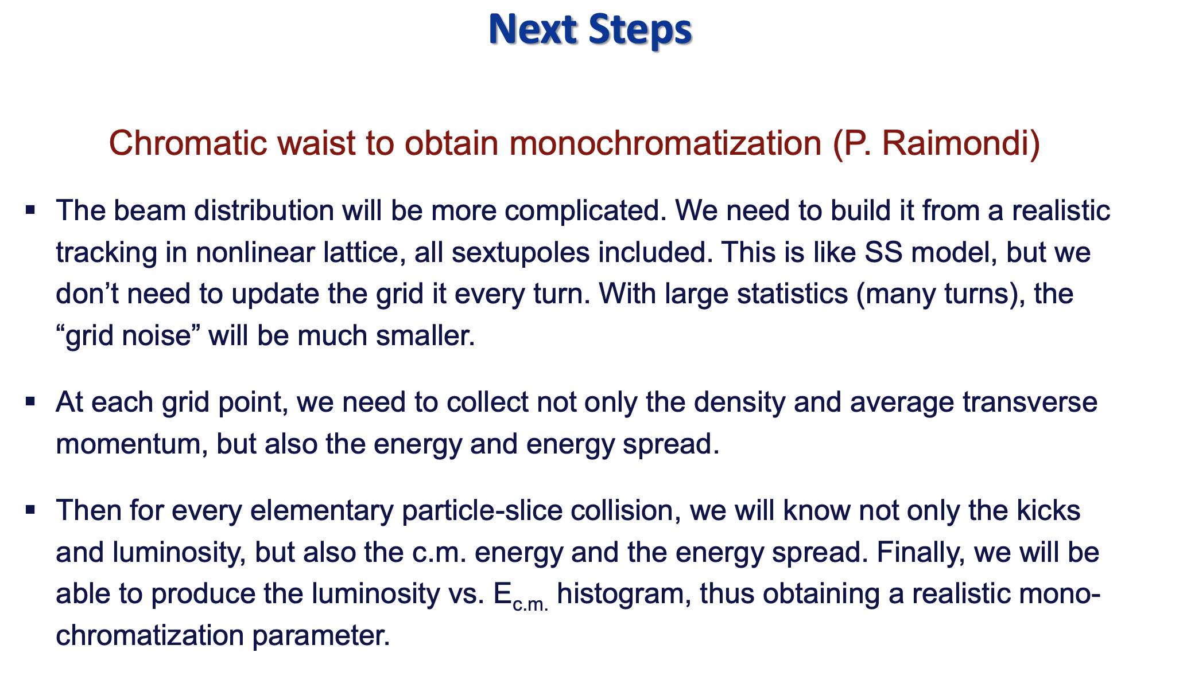
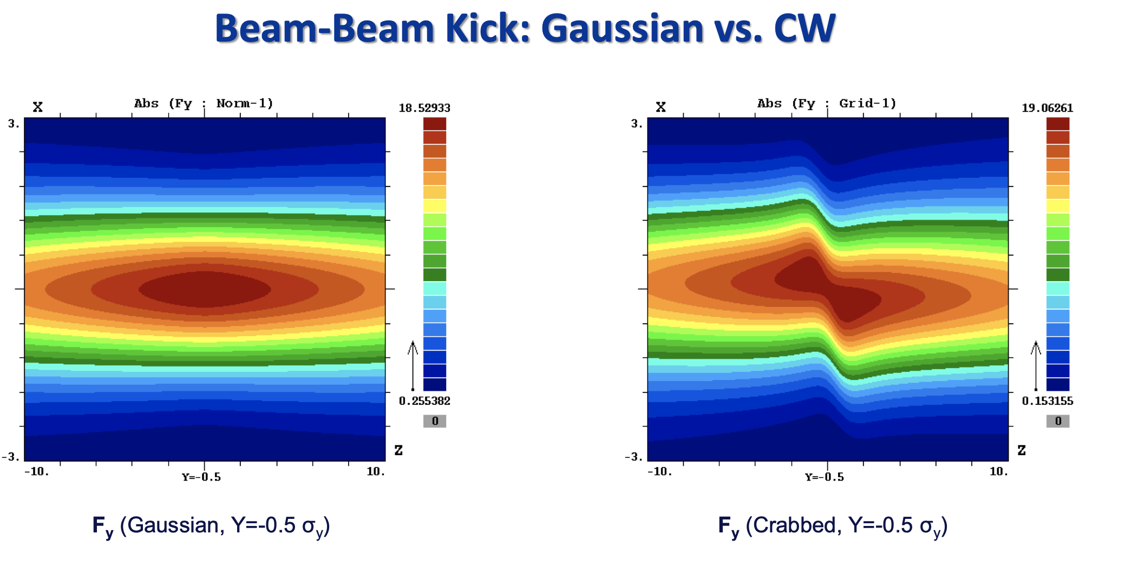
Dmitry Shatilov

Slide 29
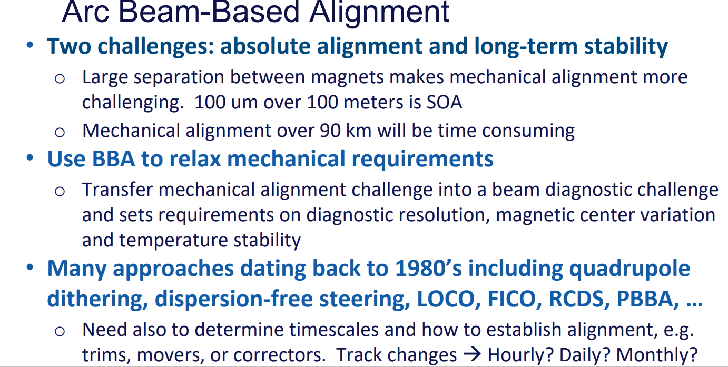
Tor Raubenheimer

Slide 30
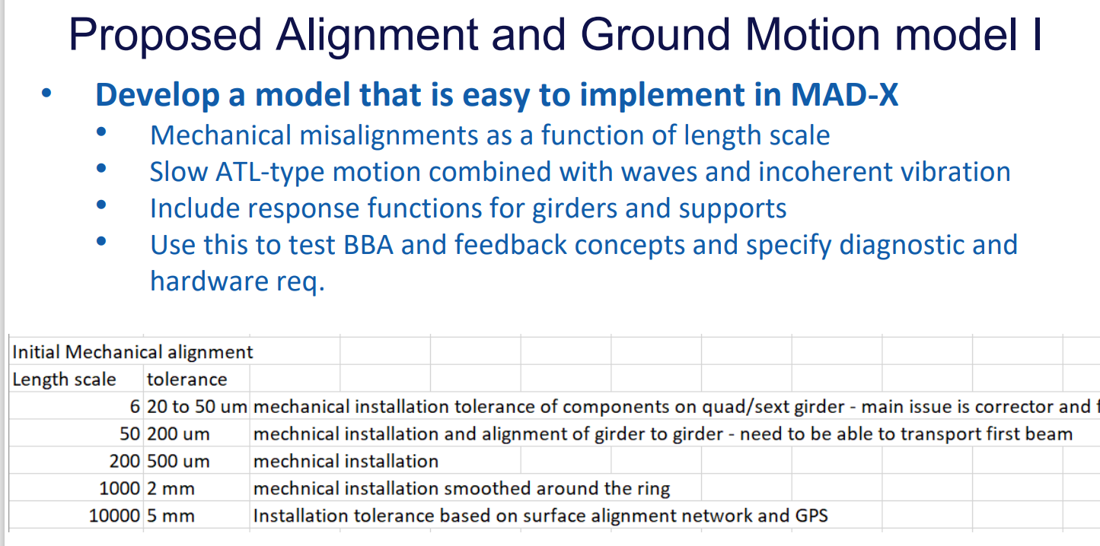
Tor Raubenheimer

Slide 31
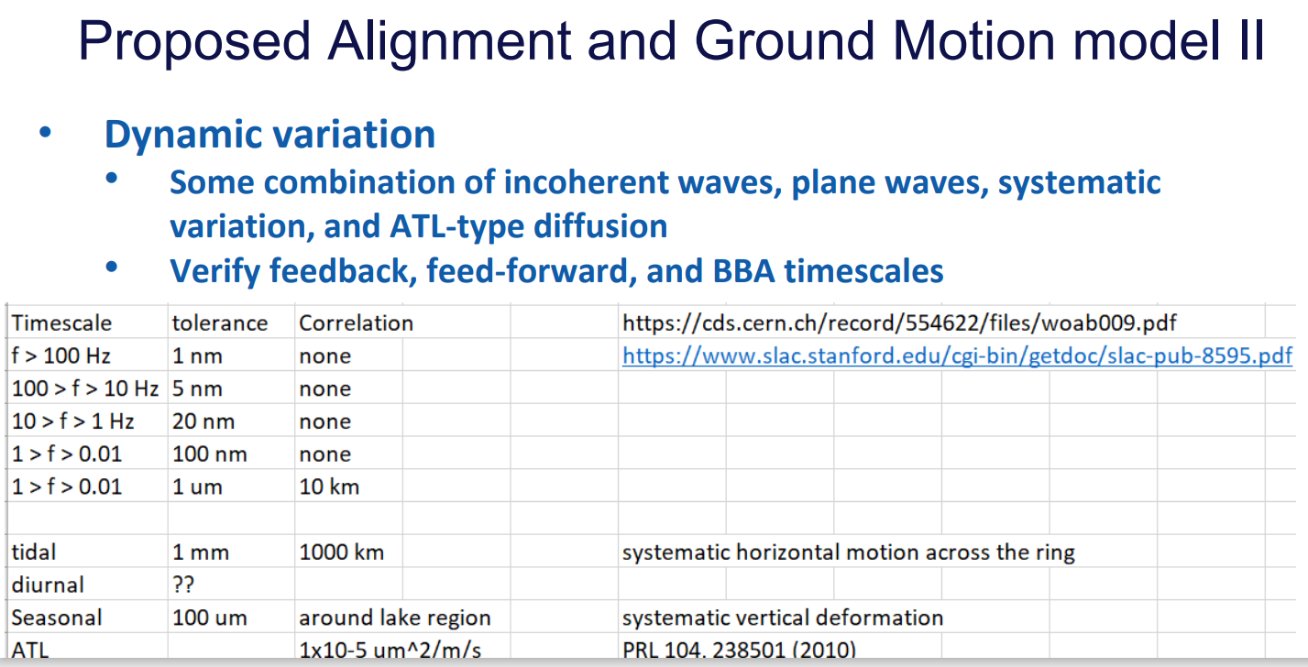
Tor Raubenheimer

Slide 32
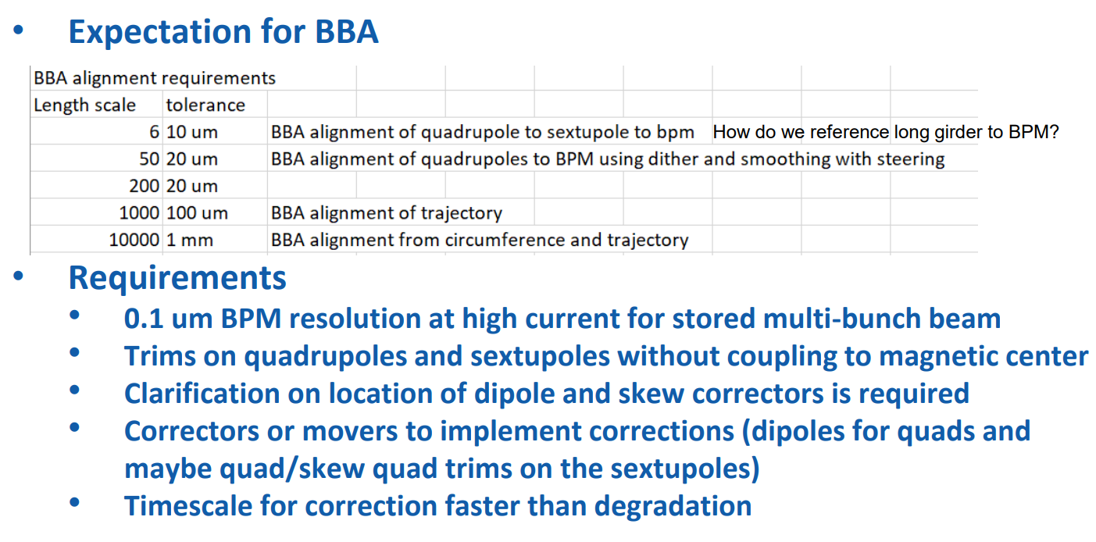
Tor Raubenheimer

Slide 33
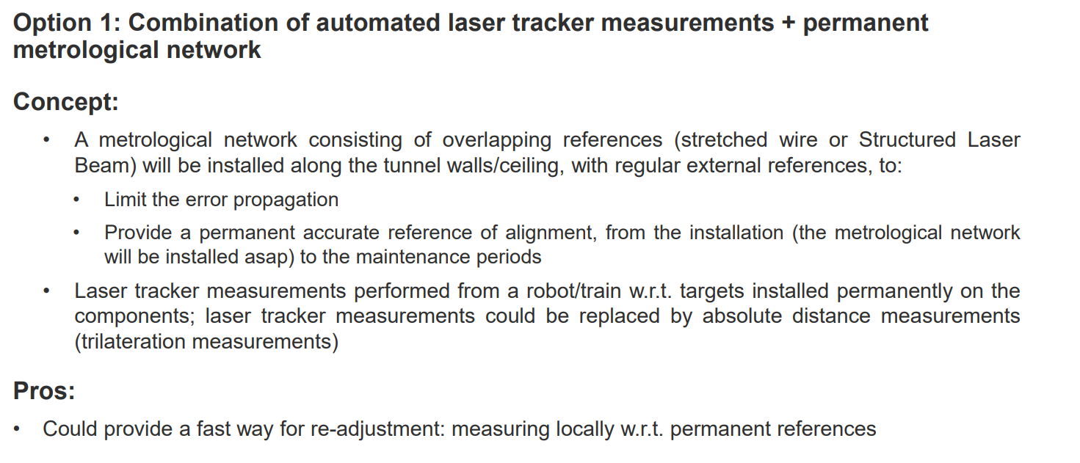
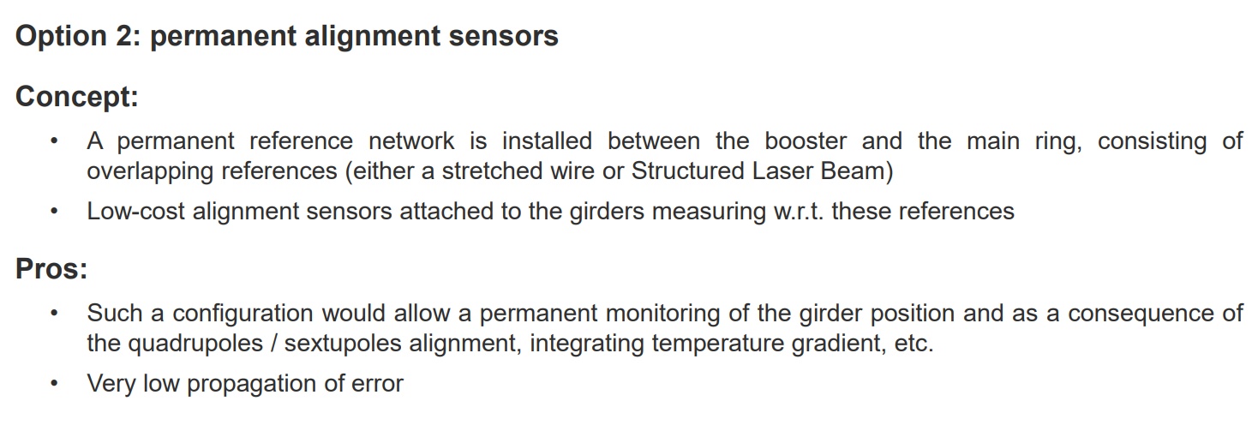
alignment options
Helene Mainaud Durand

Slide 34
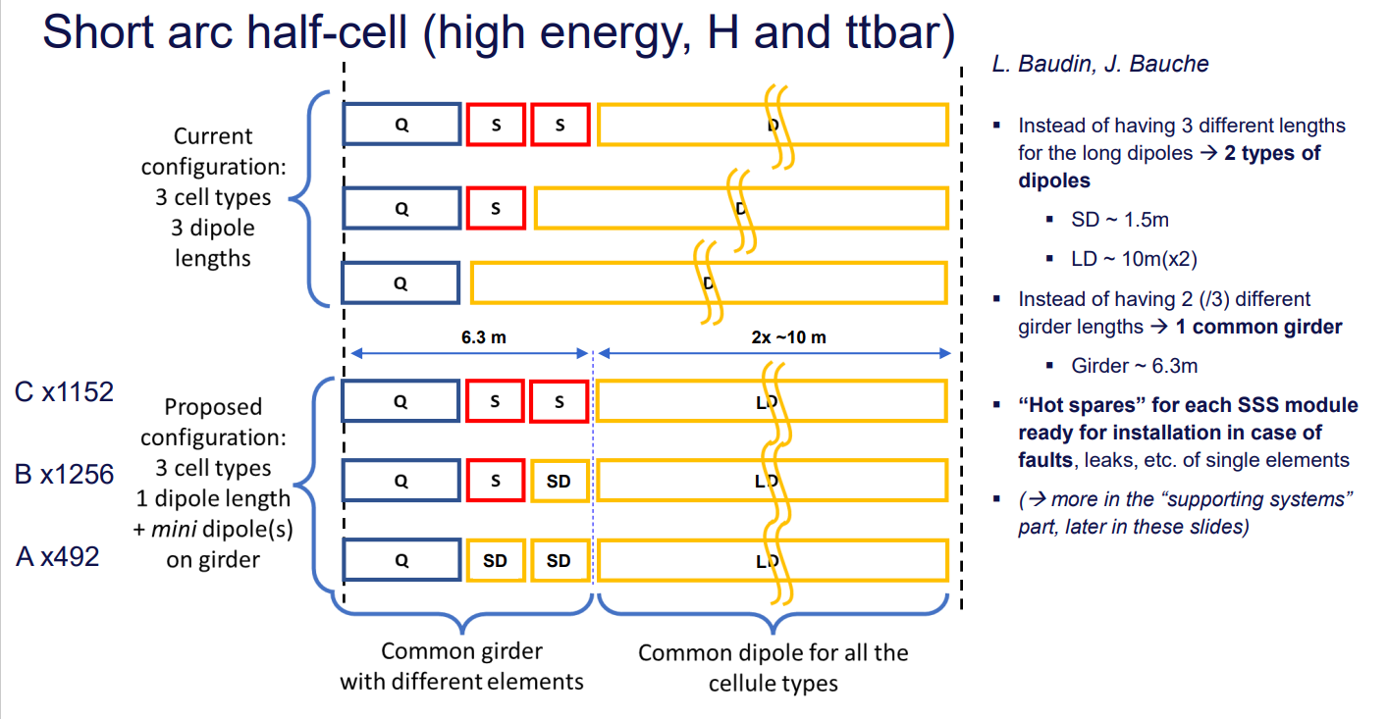
Federico Carra

Slide 35
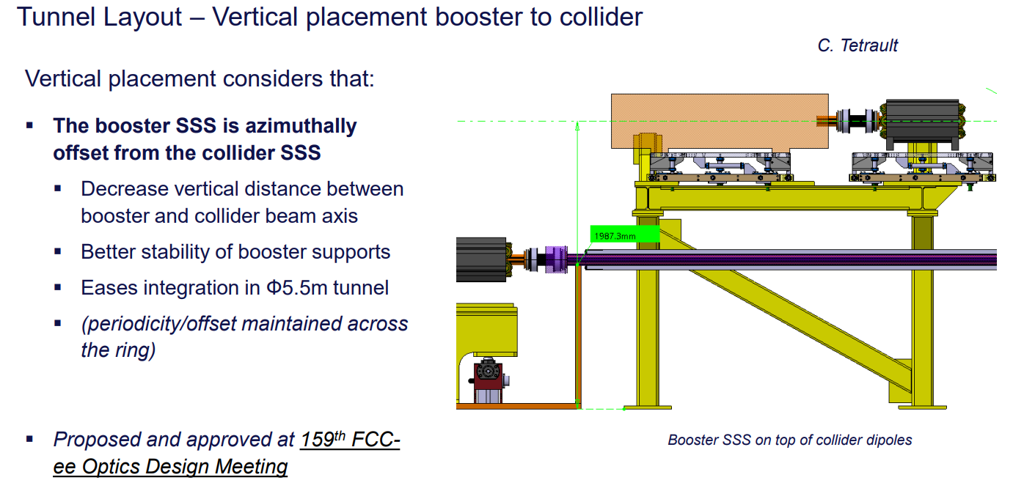
Federico Carra

Slide 36
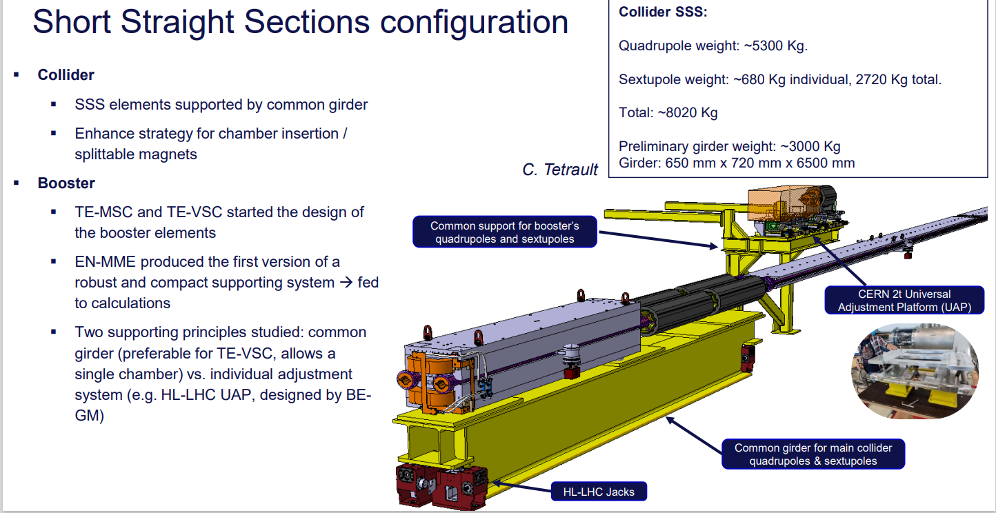
Federico Carra

Slide 37
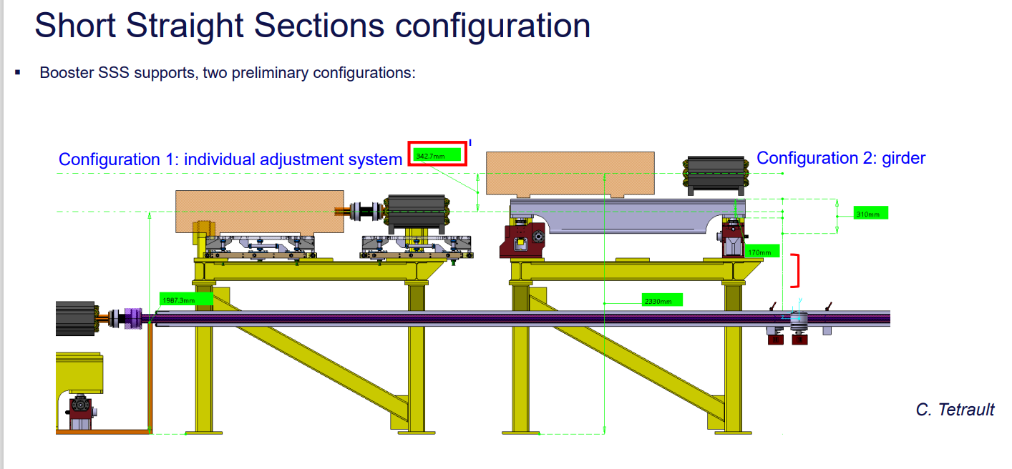
Federico Carra

Slide 38
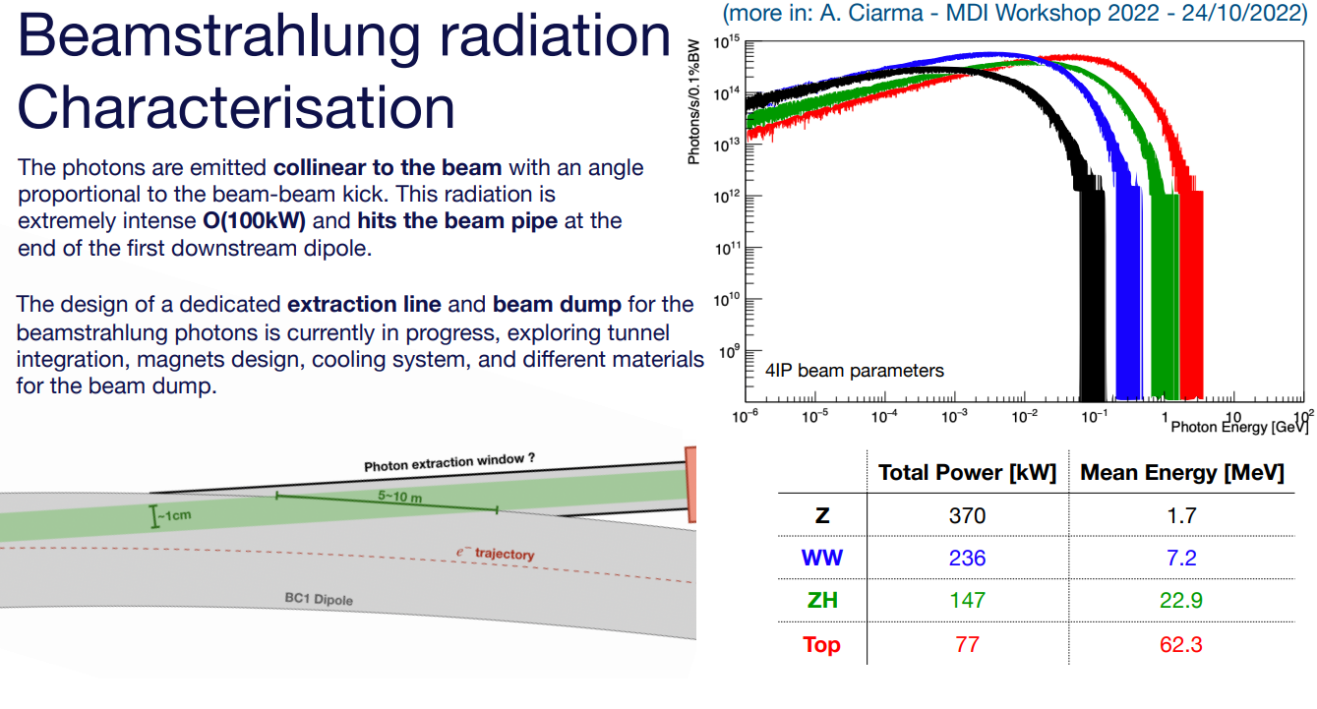
Andrea Ciarma

Slide 39
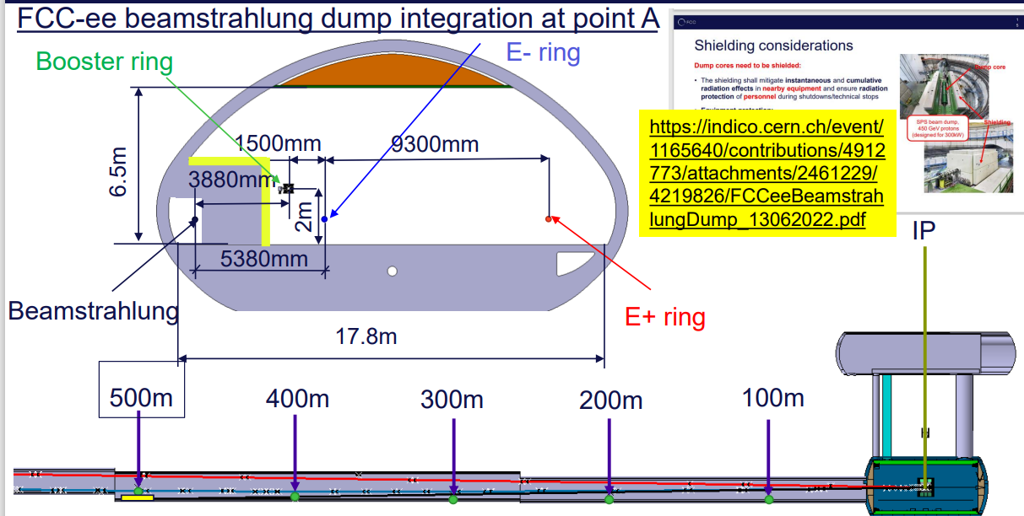
handling of beamstrahlung
Fani Valchkova

Slide 40
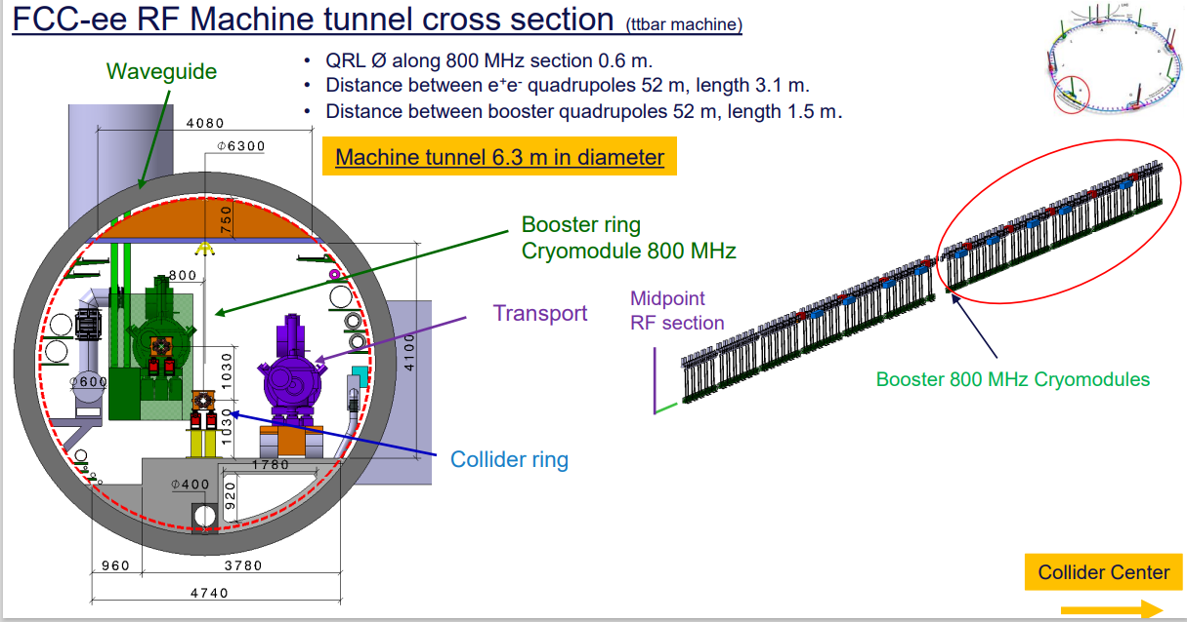
booster RF integration in Point H
Fani Valchkova
can we reduce the tunnel diameter to standard 5.5 m? what happens if we change the RF frequency?

Slide 41

Franck Peauger

Slide 42

400 MHz Nb/Cu
Franck Peauger

Slide 43

400 MHz Nb/Cu
Franck Peauger

Slide 44

alternative 600 MHz scenario
Franck Peauger

Slide 45

Andrey Abramov

Slide 46

Andrey Abramov

Slide 47

Andrey Abramov

Slide 48


Andrea Ciarma
detector occupancy for 5 min lifetime

Slide 49

IR mock-up
Manuela Boscolo

Slide 50

Eva Montbarbon,
Stanislas Grabon

Slide 51

longitudinal impedance
Mauro Migliorati

Slide 52

transverse impedance
Mauro Migliorati

Slide 53

Ali Rajabi

Slide 54

Vlasov solver for e-cloud, impedance & perhaps beam-beam
Francesco Fransesini

Slide 55

effect of longitudinal impedance
Yuan Zhang

Slide 56

beam-beam with longit. & transv. impedance
Yuan Zhang

Slide 57

Yuan Zhang

Slide 58

Sofia Carolina Johannesson

Slide 59

Sofia Carolina Johannesson

Slide 60


Luca Sabato
Larger bunch charge & larger spacing reduce cloud density
Behavior during injection?

Slide 61

Fatih Yaman
SEY=1.4 still OK
Can we achieve n_{γ}’<10⁻³ / e+/m?

Slide 62


$\sim$2 hours with complete solution

Slide 63

Pantaleo Raimondi

Slide 64

Pantaleo Raimondi
This new FCC FF optics as good as the iPhone !

Slide 65


Slide 66

Pantaleo Raimondi
Implementation for FCC
Solution for SuperKEKB ?

Slide 67

Kevin Andre

Slide 68

Kevin Andre

Slide 69

Kevin Andre
IR collimators sometimes closer to beam than primary or secondary collimators

Slide 70

booster
design
Antoine Chancé
larger dipole field errors?
Orbit sawtooth effect on the ramp and at top energy
minimum injection energy?

Slide 71



booster cycle
Antoine Chancé

Slide 72

Antoine Chancé

Slide 73

Multipole kicker injection
Michael Hofer

Slide 74

Michael Hofer
machine protection concern (kicker failure modes), impact on experiments;
how fast can the beam be extracted?

Slide 75


Roberto Kersevan
Vacuum system
- bake-out, bellows

Slide 76

Vacuum system - BPMs
Roberto Kersevan

Slide 77

Vacuum system – status
Roberto Kersevan

Slide 78

Jacqueline Keintzel

Slide 79

Jacqueline Keintzel

Slide 80

Jacqueline Keintzel

Slide 81

Bastian Haerer

Slide 82

Bastian Haerer

Slide 83

Jacqueline Keintzel

Slide 84

Jacqueline Keintzel

Slide 85

Jacqueline Keintzel

Slide 86

Cristobal Garcia

Slide 87

Cristobal Garcia

Slide 88


thank you !

