Slide 1

06 Dec 2022 / FCCIS 2022
FCC-ee Parameters and Challenges
D. Shatilov, P. Raimondi
Many thanks to all colleagues from the FCC-ee collaboration

Slide 2
06 Dec 2022 / FCCIS 2022
D. Shatilov “Parameters and Challenges”
Outline
The main factors determining the choice of parameters for FCC-ee. Parameter changes after the CDR.
Potential problems at low energy, 3rd harmonic cavities.
Recent idea from P. Raimondi: half-integer harmonic cavities and "rectangular" longitudinal profile. First simulation results.
Lattice errors, misalignments and corrections. Next steps.

Slide 3
06 Dec 2022 / FCCIS 2022
D. Shatilov “Parameters and Challenges”
Basic Equations
x
Piwinski angle:
Length of overlap:
Luminosity:
+
-
e
L_{i}
e
θ
φ ∙σ_{x}
z
2σ_{z}
2σ_{x}
Collision scheme with large Piwinski angle
linear density
There is no sense to optimize the luminosity per bunch (or per collision). Attention should only be paid to ξ_{y}.
σ_{z} is one of the most variable parameters: it depends on many factors, including the bunch population N_{p}. Accordingly, N_{p} should be adjusted to obtain the desired ξ_{y}.
The number of bunches n_{b} ∝ 1/N_{p}. We don't need to worry about this (except for Z) since the range of valid values is quite wide.
The beam-beam limit in the Crab Waist collision scheme can be high, but to obtain it, a small vertical emittance and a sufficiently high bunch linear density are required. The latter is an important parameter for collective instabilities and impedance-related issues, so this is another limitation.

Slide 4
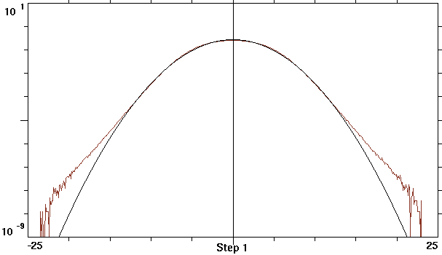
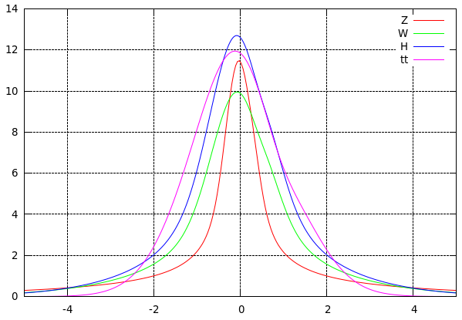
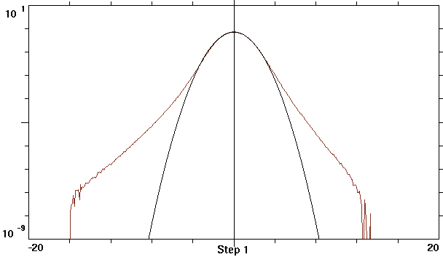
06 Dec 2022 / FCCIS 2022
D. Shatilov “Parameters and Challenges”
Beamstrahlung
Bending radius in the field of the opposite bunch
With increasing energy, beta functions at IP should grow while ξ_{y} almost does not change => ρ increases.
Bending radius is not constant along the trajectory, and it depends on the particle coordinates.
All initial coordinates = 0, except y₀ = 2σ_{y}
Critical energy of BS photons: u_{c} ∝ γ ³/ρ ∝ ξ_{y} ∝ L
Equilibrium energy distribution
Momentum acceptance determines the maximum allowable critical energy for BS photons, which in turn is proportional to ξ_{y} (and hence luminosity).
surface density
45.6 GeV
The factor of increasing the energy spread is higher at low energies. The explanation is that it depends on the ratio of the bending radii in the arcs (SR) and in the IPs (BS).
For low-energy colliders, ρ_{min} at the IP can be even smaller, but the effect of BS is negligible there, since the arc radius is much smaller than in the FCC.
At 45.6 GeV, the energy loss due to BS is ∼0.31 MeV per IP, compared to ∼37 MeV in the arcs due to SR.
Long tails at ttbar are produced by single emitted BS photons. Here the ratio u_{c} /σ_{δ} is important, which grows with γ.
For asymmetry of the tails, an important parameter is the damping factor during the period of synchrotron oscillations. Therefore, asymmetry grows with γ.
≈ 0.002
σ_{δ} = 3.5σ_{δ0}
δE/σ_{δ0}
182.5 GeV
γ/ρ [mm⁻¹]
σ_{δ} = 1.3σ_{δ0}
δE/σ_{δ0}
Distance to IP [mm]

Slide 5
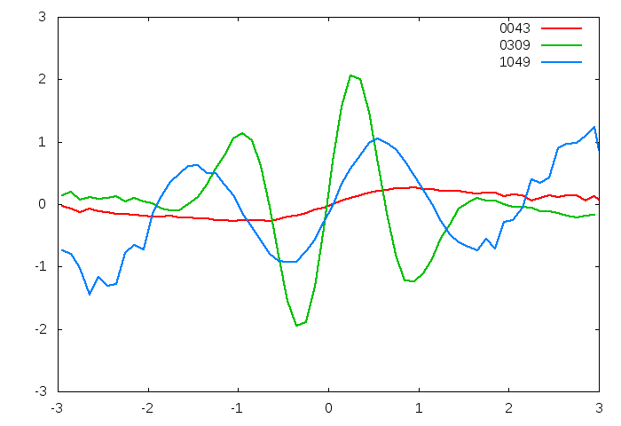
06 Dec 2022 / FCCIS 2022
D. Shatilov “Parameters and Challenges”
Parameter Optimization at Z, WW and ZH
Coherent beam-beam instability (TMCI)
An important parameter for this instability is the ratio ξ_{x} /ν_{z}, which needs to be minimized.
Mitigation of instability:
Decrease in β_{x}*
Increase in the momentum compaction factor (but there is a side effect: increased emittances) – only at Z and WW
Decrease in RF voltage – only at Z
Proper choice of the working point
Changes after CDR
Arc optics at Z and WW: 60°/60° => 90°/90°, long cell. This is needed to increase the momentum compaction factor and mitigate the coherent instabilities.
The baseline scenario now assumes 4 IPs. In this case, at Z energy, it will be necessary to reduce β_{x}* from 15 to 10 cm. And it will affect the DA and momentum acceptance…
The RF voltage at WW increased to 1 GV. This increases the synchrotron tune to 0.08, which is necessary for precise energy calibration by the resonant depolarization.
At ZH energy – no significant changes.
Bunch shape at some turns
Excited coherent modes are associated with synchro-betatron resonances:
If φ is not too large, we can solve the problem by choosing
We are close to this requirement at ZH and are fulfilling it at ttbar.
x /σ_{x}
z /σ_{z}

Slide 6
06 Dec 2022 / FCCIS 2022
D. Shatilov “Parameters and Challenges”
Parameter Optimization at ttbar
Luminosity is limited by BS lifetime (single photon):
α – fine structure constant
η – momentum acceptance
ρ – bending radius of trajectories at the IP
L_{i} – length of interaction area
The major tool for increasing the lifetime is making ρ larger. For flat beams, the minimum value of ρ is inversely proportional to the surface charge density:
(assuming )
We need to increase ρ with large luminosity => small emittances (90°/90° short arc cell optics) and increase L_{i} (i.e. σ_{x}) and .
Since ε_{x} should be small, σ_{x} is controlled by which was increased to 1 m. This is the main difference in parameter optimization: at lower energies, must be minimized to mitigate coherent beam-beam instability. There is no such problem at ttbar, so becomes a free parameter.
Asymmetrical momentum acceptance to match the actual energy distribution (K. Oide).
Recent change: increasing ν_{y} from 0.59 to 0.64 to move away from the main coupling resonance.

Slide 7
06 Dec 2022 / FCCIS 2022
D. Shatilov “Parameters and Challenges”
[Some of ] Potential Problems at Low Energy (Z)
In order to avoid coherent beam-beam instability in configuration with 4 IPs, it will be necessary to reduce β_{x}* from 15 to 10 cm. And this will affect the DA and momentum acceptance. The problem with instability could be solved in another way: by reducing the synchrotron tune, but this is incompatible with the requirements of energy calibration by resonant depolarization.
Decrease in DA and energy acceptance due to lattice errors and misalignments will lead to the need to reduce the bunch population and, hence, to increase the number of bunches. And this, in turn, will enhance the problems with e-clouds and ion instabilities, which are solved by a large bunch spacing.
These could be solved by increasing the bunch length, but it's not that easy...

Slide 8
06 Dec 2022 / FCCIS 2022
D. Shatilov “Parameters and Challenges”
3rd Harmonic Cavities, Transient Beam Loading
(as presented at FCC Week 2021)
Asymmetric longitudinal shift of colliding bunches
LPA collision + beamstrahlung
Asymmetry in the energy loss due to BS → asymmetry in the bunch lengths and the energy spreads. This can trigger a 3D flip-flop.
Here we considered the option of RF 650 MHz
If we want to control the number of bunches at a given luminosity and in a given magnetic lattice, this can be done only by changing the bunch length, i.e. the synchrotron tune.
To reduce ν_{z} without affecting the RF acceptance, we can use the 3rd harmonic cavities. For example, 22 MV at the 3rd harmonic decreases ν_{z} from 0.046 to 0.03.
3rd harmonic cavities with moderate voltage and no energy transfer to the beam add flexibility in parameter selection. It is like another degree of freedom.
One of the main disadvantages is associated with the enhancement of transient beam loading. This issue becomes especially acute in the presence of beamstrahlung.
P_{z}
Z
dZ [mm] | σ_{z} [mm] | σ_{δ} [10⁻³]
0 | 12 / 12 | 1.3 / 1.3
5 | 11.3 / 12.4 | 1.24 / 1.33
10 | 8.7 / 14.5 | 0.97 / 1.55

Slide 9
06 Dec 2022 / FCCIS 2022
D. Shatilov “Parameters and Challenges”
Half-Integer (e.g. 3.5) Harmonic Cavities (P. Raimondi)
For odd RF buckets the synchrotron tune will increase, for even ones it will decrease. Our number of bunches is more than one order of magnitude less than the number of RF buckets, so we can easily place them as needed: for pilot bunches, ν_{z} will increase, and for colliding bunches, it will decrease.
By correctly choosing the voltage of the second RF system, one can obtain an almost rectangular bunch profile (“flat top”). Then, for the same luminosity, we have a smaller peak in the bunch linear density, and we can expect:
  reducing the vertical beam-beam tune shift
  reducing the maximum critical energy of BS photons, that leads to
  reducing the beam-beam induced energy spread

Slide 10
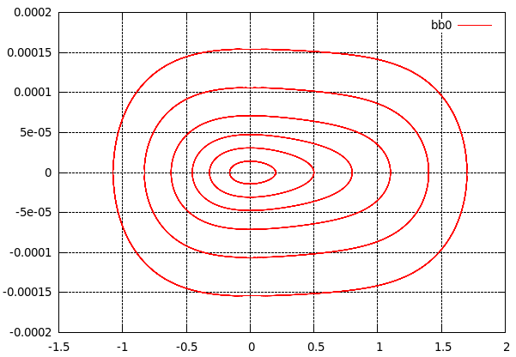
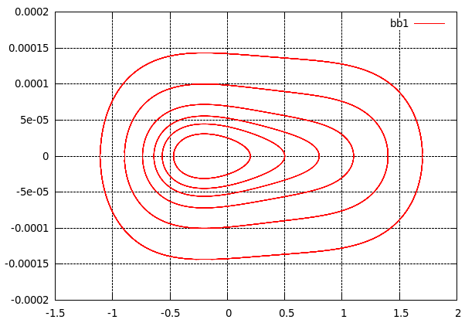
06 Dec 2022 / FCCIS 2022
D. Shatilov “Parameters and Challenges”
Phase Space Trajectories (Z – δ_{E}) with and w/o Beam-Beam
E = 45.6 GeV, RF: 400 MHz – 120 MV, 1400 MHz – 30.16 MV
δ_{E}
δ_{E}
z [cm]
z [cm]
The phase trajectories are not symmetrical, and this strongly depends on the ratio of voltages and phases of the two RF cavities.
The counter beam (especially in collision with LPA) acts as a nonlinear cavity. This effect is usually small, but in this case, when the potential well is almost flat, it leads to a noticeable distortions of the phase trajectories. As a result, we get an asymmetric longitudinal bunch profile.

Slide 11
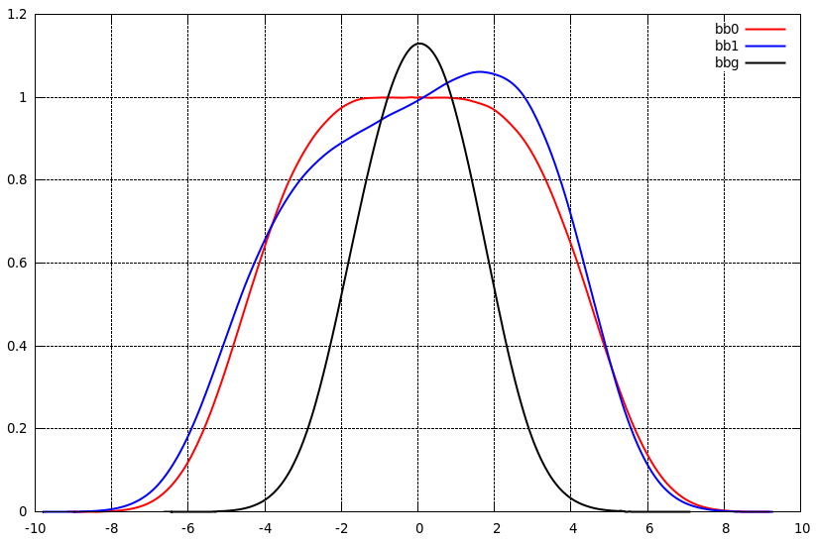
06 Dec 2022 / FCCIS 2022
D. Shatilov “Parameters and Challenges”
Beam-Beam Simulations with and w/o 3.5 Harmonics
Longitudinal bunch profile
Bunch profile | Gaussian | “Flat top”
E [GeV] | 45.6
U_{RF} 400 MHz [MV] | 120
U_{RF} 1400 MHz [MV] | 0 | 32.16
N_{p} [10¹¹] | 2.43 | 4.86
n_{b} | 10000 | 5000
ν_{z} | 0.037 | 0.004
Δν_{x} /Δν_{y} | 0.0036 / 0.097 | 0.0009 / 0.083
σ_{δ} | 0.00133 | 0.00122
L / IP [10³⁶ cm⁻²c⁻¹] | 1.85 | 1.85
z [cm]
Fortunately, the effect of the asymmetry of longitudinal shifts on the BS turned out to be much smaller than for Gaussian bunches. This needs to be further explored and explained.

Slide 12
06 Dec 2022 / FCCIS 2022
D. Shatilov “Parameters and Challenges”
Half-Integer Harmonics: Open Questions and Next Steps
The peak of charge density becomes lower and wider. Does it help for impedance-related problems?
How the coherent beam-beam instability is affected? Can we relax β_{x}* ?
What is the optimal harmonic number: 3.5, 7.5, something else?
Since BS is decreased, this technique will help at the top energy too. What is the optimal harmonic there?
More questions …

Slide 13
06 Dec 2022 / FCCIS 2022
D. Shatilov “Parameters and Challenges”
Lattice Errors and Misalignments
Misalignments and errors can lead to a significant decrease in the DA and momentum acceptance. This limits the luminosity per IP even in the case of ideal super-periodicity.
The full beam-beam footprint from 2 or 4 IPs can cross a number of strong resonances, e.g. 1/2, 1/3, etc. The width of these resonances depends on the level of symmetry breaking, which depends on the magnitude of misalignments and the quality of corrections.
Ways to solve the problem: improve the quality of corrections, and reduce the magnitude of misalignments (can be expensive!). Probably, the best solution: beam based alignment.
Correction and tuning should consist of several stages: obtain a stable orbit and designed emittances, then enlarge the DA and momentum acceptance, and special attention must be paid to obtaining designed lattice parameters at the IPs and crab sextupoles (dedicated knobs in the IR).
A realistic assessment of the beam dynamics, luminosity and lifetime is possible only in simulations, taking into account all errors, corrections and beam-beam effects. Work in progress.

Slide 14
Thank you for your attention.
06 Dec 2022 / FCCIS 2022
D. Shatilov “Parameters and Challenges”
14

