Slide 1
FCC-ee Arc Half-Cell Configuration Project & Mock-up
6th December 2022 / FCCIS Workshop 2022
Federico Carra / CERN
F. Carra (CERN)
On behalf of the Arc Half-Cell Configuration Project, with inputs from many FCC WG and colleagues

Slide 2
Outline
6th December 2022 / FCCIS Workshop 2022
Federico Carra / CERN
Aim of the project
Project organization & timeline
Arc cell configuration(s)
Main studies
  Integration layout & booster placement
  Arc systems interfaces & inter-beam distance
  Accelerators supporting systems & SSS girders
Arc half-cell mock-up & Novel concepts
Conclusions

Slide 3
Outline
6th December 2022 / FCCIS Workshop 2022
Federico Carra / CERN
Aim of the project
Project organization & timeline
Arc cell configuration(s)
Phase I main studies
  Integration layout & booster placement
  Arc systems interfaces & inter-beam distance
  Accelerators supporting systems & SSS girders
Arc half-cell mock-up & Novel concepts
Conclusions

Slide 4
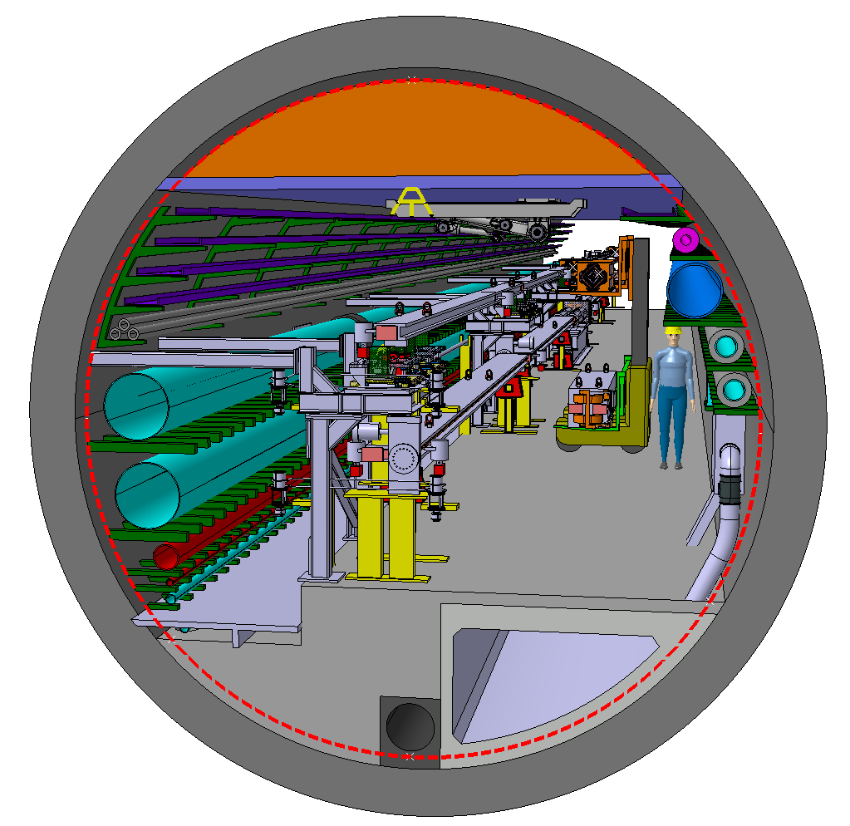
Aim of the project
6th December 2022 / FCCIS Workshop 2022
Federico Carra / CERN
Arc half-cell: most recurrent assembly of mechanical hardware in the accelerator (~1500 similar FODO cells in the FCC-ee)
Building a mock-up allows optimizing and testing fabrication, integration, assembly, transport, installation, alignment, maintenance
Working with demonstrators of the different equipment, and/or structures with equivalent volumes, weights, stiffness
First proposal later in this presentation!
Arc perspective view, F. Valchkova-Georgieva

Slide 5
Outline
6th December 2022 / FCCIS Workshop 2022
Federico Carra / CERN
Aim of the project
Project organization & timeline
Arc cell configuration(s)
Phase I main studies
  Integration layout & booster placement
  Arc systems interfaces & inter-beam distance
  Accelerators supporting systems & SSS girders
Arc half-cell mock-up & Novel concepts
Conclusions

Slide 6
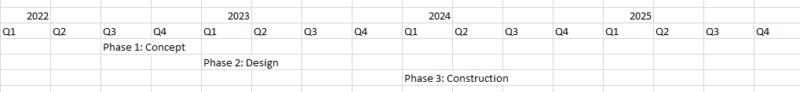
Timeline
6th December 2022 / FCCIS Workshop 2022
F. Carra
Phase I main deliverables
  3D model + 2D cross-section drawings of arc region
  Compact report explaining main choices
  To be presented at FCCIS meeting in December ‘22
Phase 1
Phase 2
Phase 3
Phase 1: Concept development → functional spec + integration studies. Develop 3D model for ‘representative’ arc half-cell.
Phase 2: Engineering design of half-cell mock-up systems and delivery of 2D functional and fabrication drawings.
Phase 3: Fabrication of half-cell mock-up with tunnel boundary with representative components and systems (non-operational).

Slide 7
Phase I setup
6th December 2022 / FCCIS Workshop 2022
Federico Carra / CERN
Dedicated working group representing all domains involved
  PL: Federico Carra (overall mechanical concept)
  Scientific secretary & Calculations: L. Baudin
  FCC Integration (enlarged) F. Valtchkova, J. P. Corso, S. Grillot, J. Etheridge, S. Chemli
  Design & Stabilization: M. Timmins, C. Tetrault, K. Artoos, O. Capatina, M. Guinchard, L. Baudin
  Alignment: H. Mainaud-Durand;
  Beam Instrumentation: M. Wendt
  Accelerator hardware aspects: via R. Losito as coordinator for Technology R&D
  RF: O. Brunner
  Technical infrastructure: via K. Hanke as coordinator of Technical Infrastructure Pillar
  CE tunnel: J. Osborne
  Accelerator design: K. Oide (FCCee) and A. Chance (Booster)
  + additional team members, full list in e-group: fcc-ee-arc-cell-mockup-project (FCC-ee arc-cell mock-up meeting members);
Oversight directly by Accelerator Pillar Coordinators (T. Raubenheimer, F. Zimmermann)
Regular meetings with Senior Advisors Panel to report on status, collect feedback & proposed actions (A. Bertarelli, F. Bertinelli, P. Fessia, F. Lackner, J.P. Tock, J. Wickstrom, P. Raimondi with M. Benedikt, T. Raubenheimer & F. Zimmermann)

Slide 8
Outline
6th December 2022 / FCCIS Workshop 2022
Federico Carra / CERN
Aim of the project
Project organization & timeline
Arc cell configuration(s)
Phase I main studies
  Integration layout & booster placement
  Arc systems interfaces & inter-beam distance
  Accelerators supporting systems & SSS girders
Arc half-cell mock-up & Novel concepts
Conclusions

Slide 9
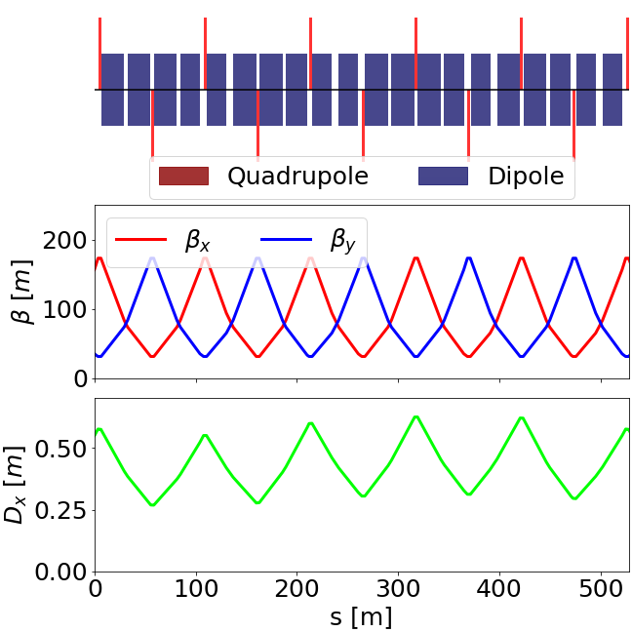
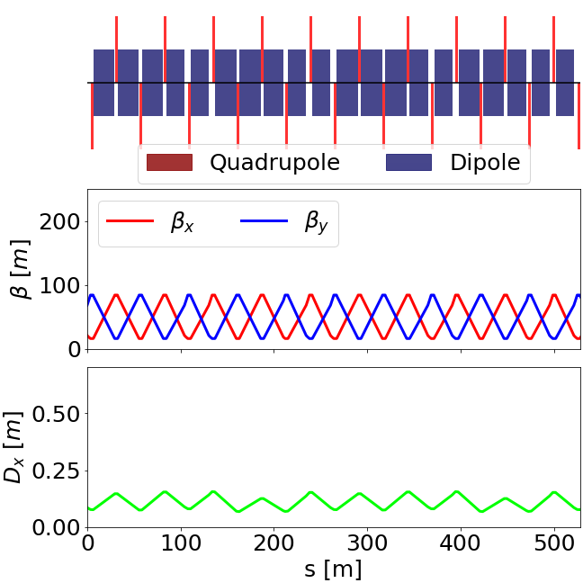
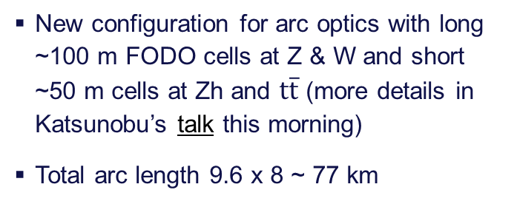


Arc cell configuration(s)
2nd June 2022 / FCC week 2022
Federico Carra / CERN
T. Raubenheimer, "Accelerator Overview", FCC week, 30th May 2022.
M. Hofer, "Baseline optics and layout of the FCC-ee collider ring", FCC week, 31st May 2022.
$$Z$$
$$t\overline{t}$$
New configuration for arc optics with long ~100 m FODO cells at Z & W and short ~50 m cells at Zh and $t\overline{t}$ (more details in Katsunobu’s talk this morning)
Total arc length 9.6 x 8 ~ 77 km
FCC arcs are constructed from roughly 750 long cells or 1500 short cells
Integration study (Phase I): to give also inputs on how to best evolve from long cell (low energy) to short cell

Slide 10
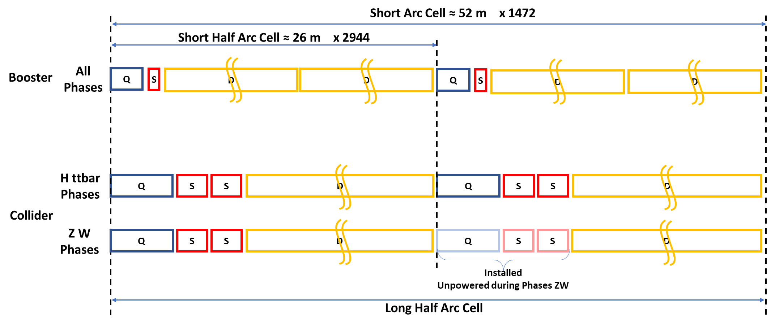
Arc cell configuration: from low to high energy
6th December 2022 / FCCIS Workshop 2022
F. Carra
L. Baudin
1.5 m
0.5 m
11.1 m
11.1 m
2.9 m
1.5 m
1.5 m
6.3 m
~20 m (likely 2x ~10m)

Slide 11
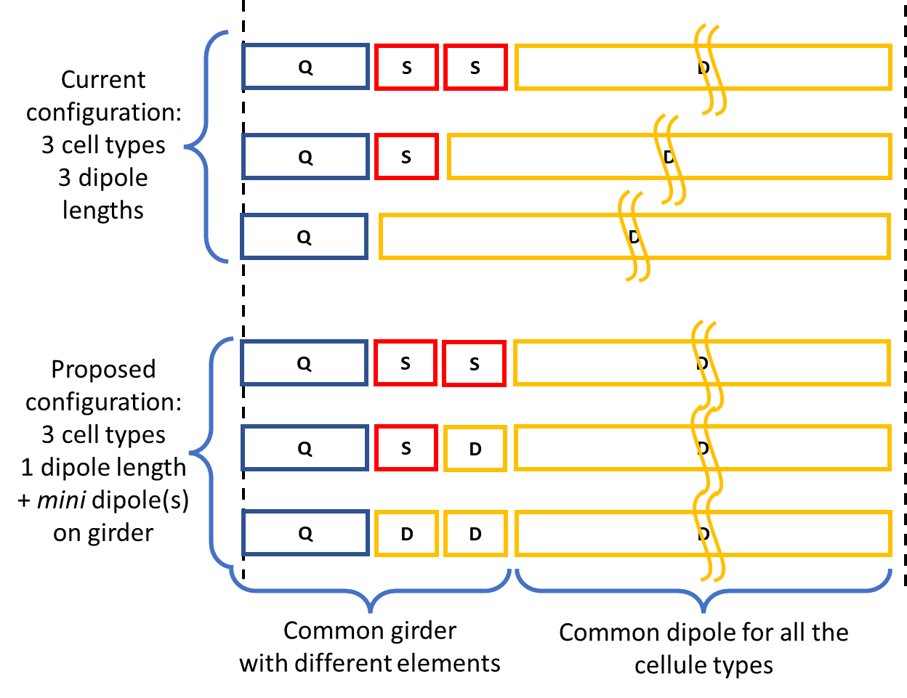
Short arc half-cell (high energy, H and ttbar)
6th December 2022 / FCCIS Workshop 2022
F. Carra
L. Baudin, J. Bauche
Instead of having 3 different lengths for the long dipoles → 2 types of dipoles
  SD ~ 1.5m
  LD ~ 10m(x2)
Instead of having 2 (/3) different girder lengths → 1 common girder
  Girder ~ 6.3m
“Hot spares” for each SSS module ready for installation in case of faults, leaks, etc. of single elements
(→ more in the “supporting systems” part, later in these slides)
6.3 m
2x ~10 m
C x1152
L
B x1256
SD
L
A x492
SD
SD
L

Slide 12
Outline
6th December 2022 / FCCIS Workshop 2022
Federico Carra / CERN
Aim of the project
Project organization & timeline
Arc cell configuration(s)
Phase I main studies
  Integration layout & booster placement
  Arc systems interfaces & inter-beam distance
  Accelerators supporting systems & SSS girders
Arc half-cell mock-up & Novel concepts
Conclusions

Slide 13
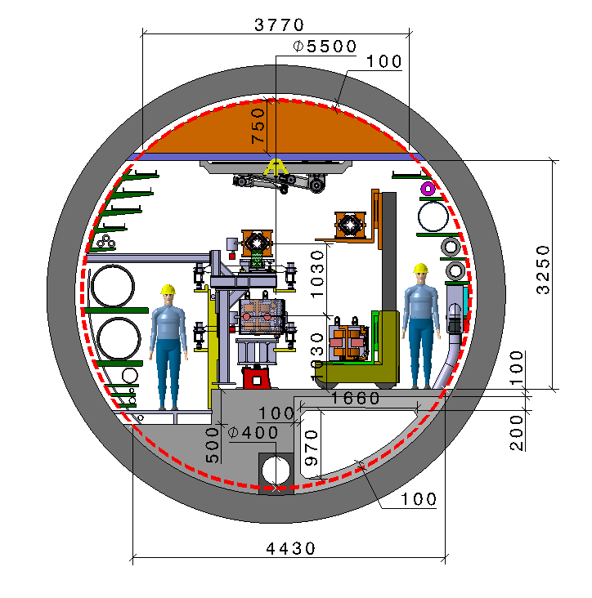
Tunnel Layout – Vertical placement booster to collider
6th December 2022 / FCCIS Workshop 2022
F. Carra
F. Valchkova-Georgieva
Machine tunnel 5.5m in diameter
Main cross section as for FCC-hh
Main ring below of booster ring
Main ring and booster ring 1.03 m distant
Demineralized water circuit decreased to DN550 (can possibly be less, requirement update exercise triggered with G. Peon and equipment owners)
Collider Center

Slide 14
Tunnel Layout – Vertical placement booster to collider
6th December 2022 / FCCIS Workshop 2022
F. Carra
F. Valchkova-Georgieva
Machine tunnel 5.5m in diameter
Perspective view
Collider Center

Slide 15
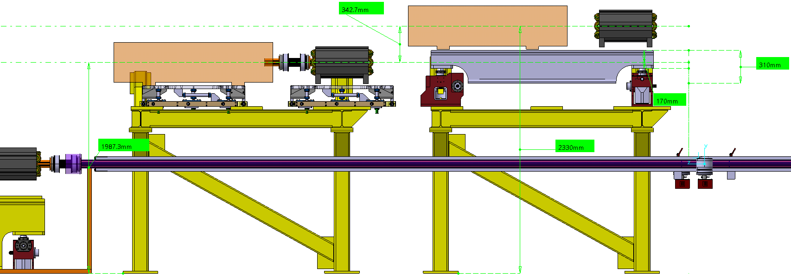
Tunnel Layout – Vertical placement booster to collider
6th December 2022 / FCCIS Workshop 2022
F. Carra
C. Tetrault
  Vertical placement considers that:
  The booster SSS is azimuthally offset from the collider SSS
    Decrease vertical distance between booster and collider beam axis
    Better stability of booster supports
    Eases integration in Ф5.5m tunnel
    (periodicity/offset maintained across the ring)
  Proposed and approved at 159th FCC-ee Optics Design Meeting
Booster SSS on top of collider dipoles

Slide 16
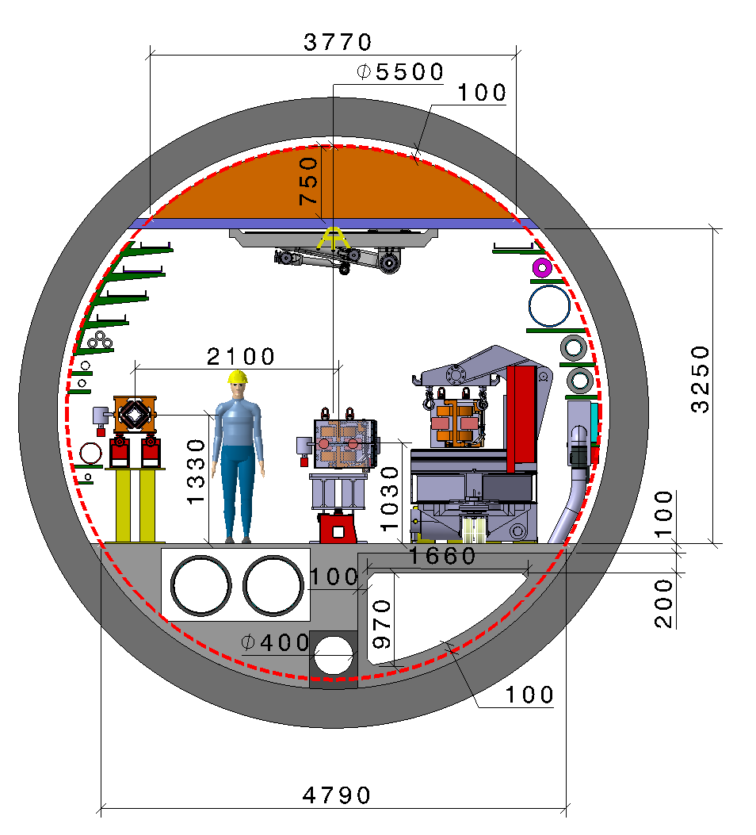
Tunnel Layout – Horizontal placement booster to collider
6th December 2022 / FCCIS Workshop 2022
F. Carra
F. Valchkova-Georgieva
Machine tunnel 5.5m in diameter
Main ring and booster ring 2.1 m distant
Demineralized water circuit DN550 in a trench
Collider Center

Slide 17
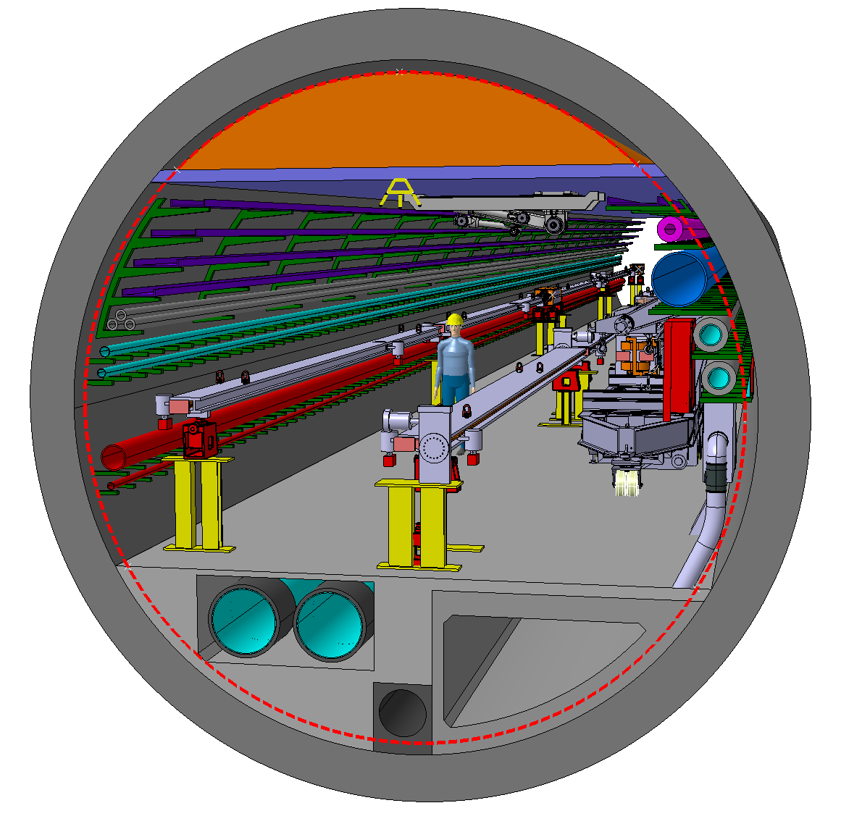
Tunnel Layout – Horizontal placement booster to collider
6th December 2022 / FCCIS Workshop 2022
F. Carra
F. Valchkova-Georgieva
Machine tunnel 5.5m in diameter
Perspective view
Collider Center

Slide 18
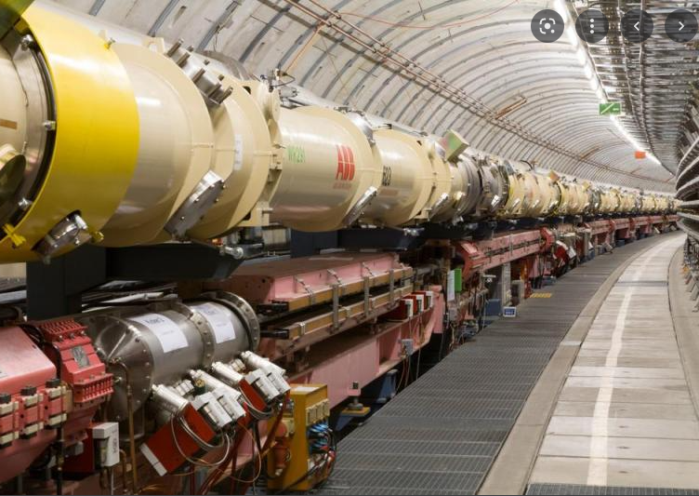
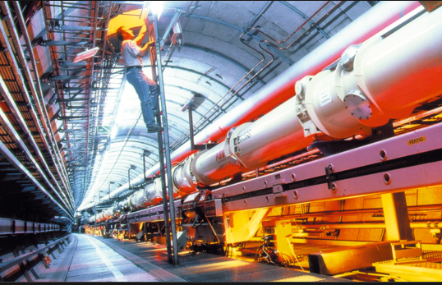
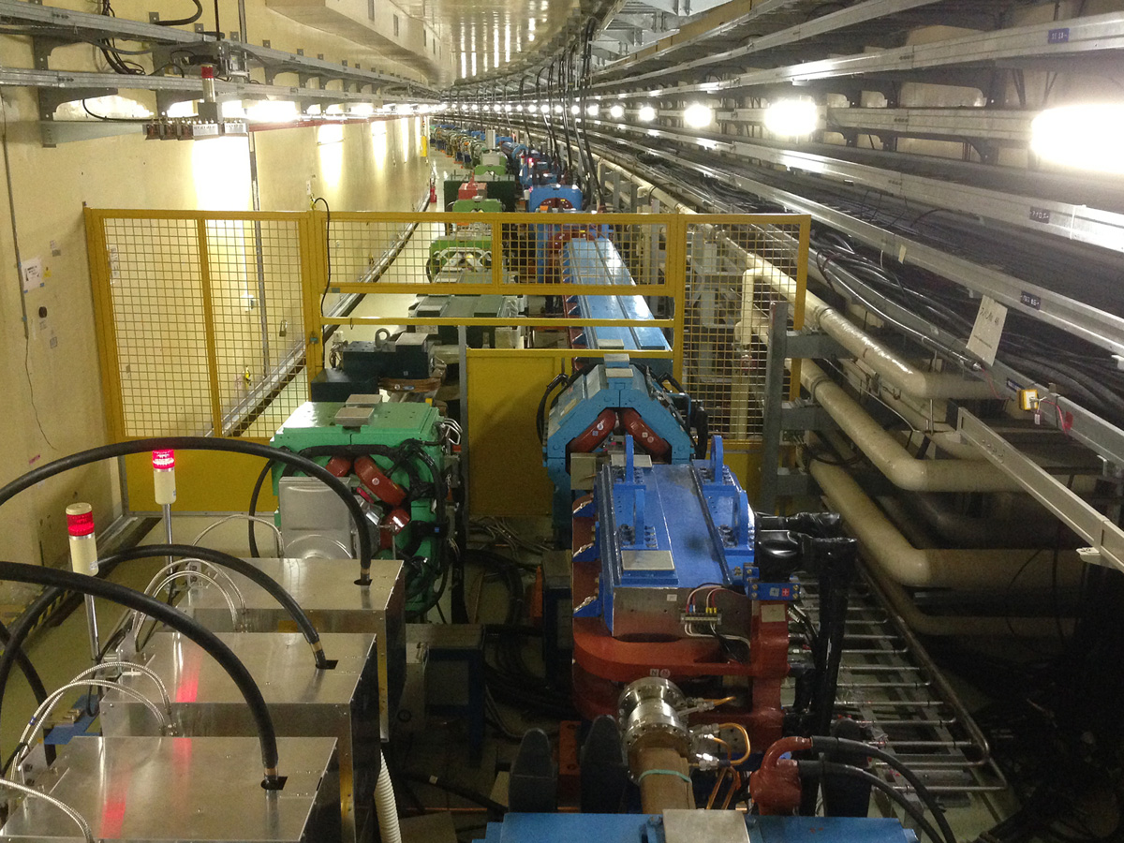
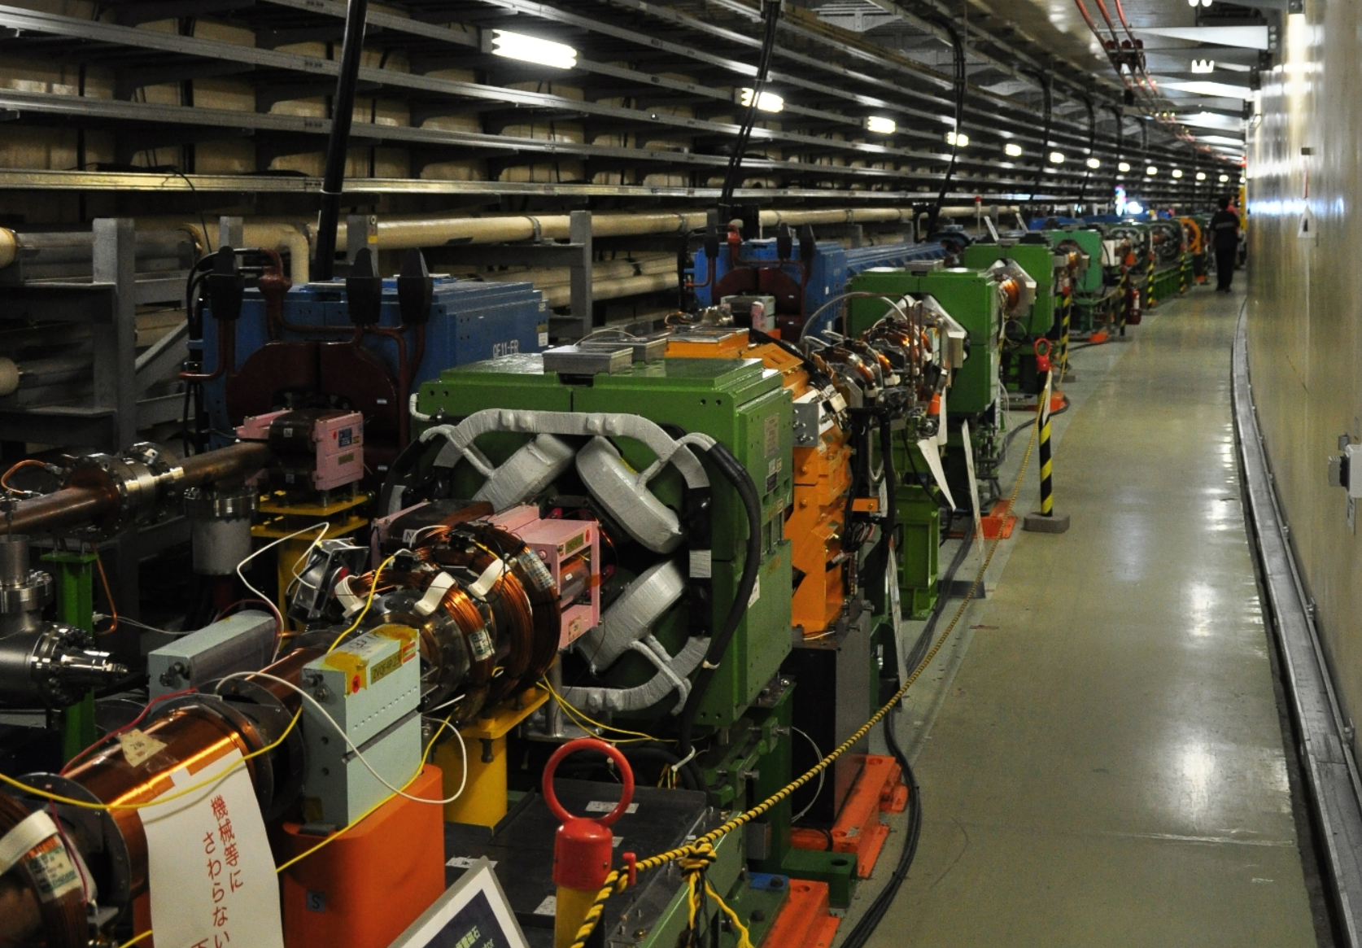
Booster-Collider positioning – Inspiration from the past
6th December 2022 / FCCIS Workshop 2022
F. Carra
Hera DESY
6.3 km Lepton-Proton rings
KEKB, SuperKEKB
3 km Electron-Positron rings

Slide 19
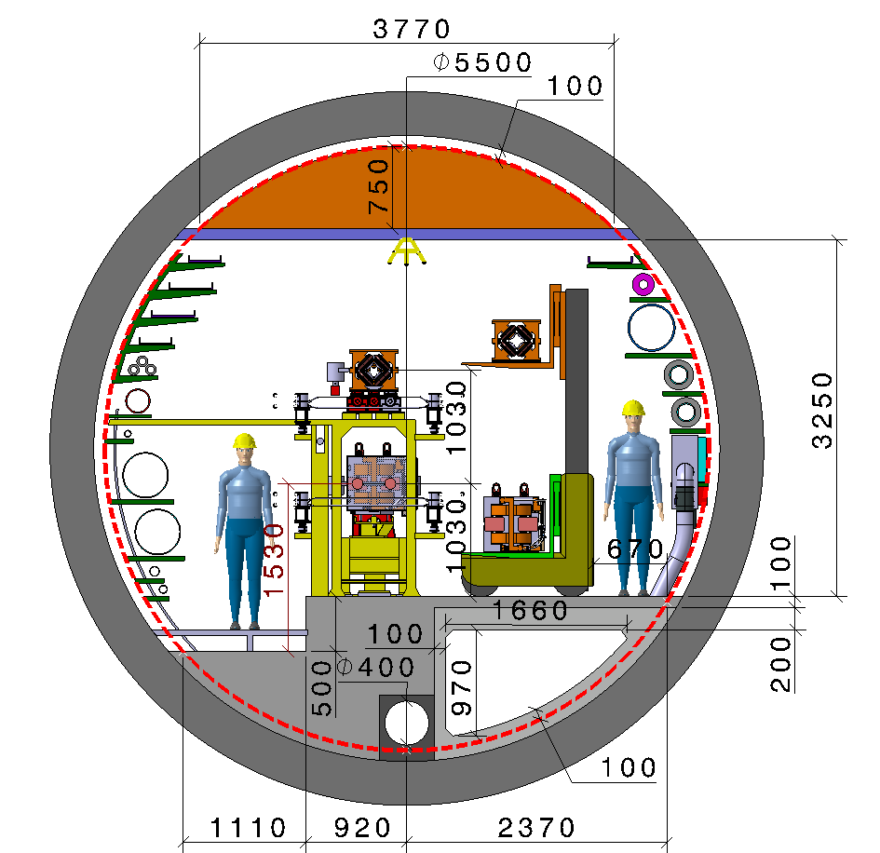
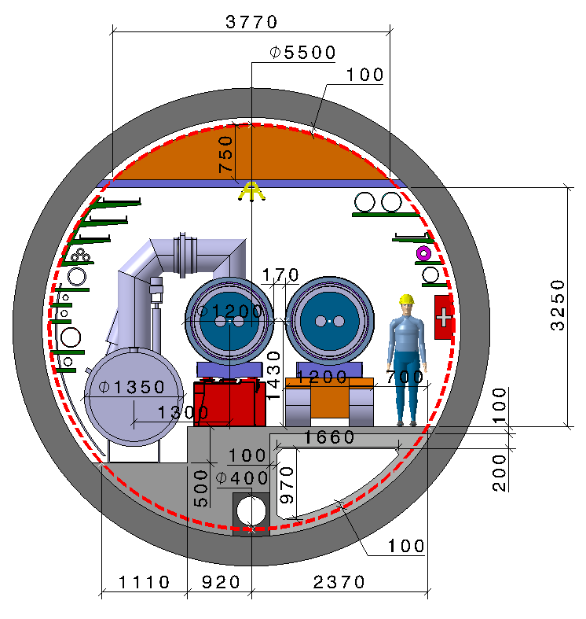
Horizontal (wrt Vertical) configuration
6th December 2022 / FCCIS Workshop 2022
F. Carra
Pros
Overall better stability
  Less vibrations to the booster
  Collider more decoupled from the booster → less vibration crosstalk
Easier access to collider
Cons
Demineralized water circuit in trenches presents complications:
  Water-induced vibrations to accelerators
  Lower stiffness of ground close to accelerators
  Difficult access to valves and connection water pipes DN80 (every some tens of meters)
Complex integration of alignment system, with reduced space for maintenance
Imposes larger diameters to other tunnel regions than arcs (e.g. RF 6.8m points L/H vs. 5.5-6.3/6.3m L/H; IP…)
EN-HE perspective: more problematic transport and maintenance.
  To remove outer ring magnets, necessary to remove inner ring ones, beampipe and survey equipment to gain access
  Slightly less space for the passage of vehicles
Ground adaptation required when moving to FCC-hh
FCC-hh: Machine tunnel 5.5m in diameter
Collider Center
Notes:
Every ~50 meters or so ( frequency to be decided) we will need branches for a manifold which will feed several magnets. These branches would come out of the floor (obstacle for people).
Besides, the main pipes need sectorization valves which will be DN500 valves which would also come out of the floor adding other obstacle for people.

Slide 20
Outline
6th December 2022 / FCCIS Workshop 2022
Federico Carra / CERN
Aim of the project
Project organization & timeline
Arc cell configuration(s)
Phase I main studies
  Integration layout & booster placement
  Arc systems interfaces & inter-beam distance
  Accelerators supporting systems & SSS girders
Arc half-cell mock-up & Novel concepts
Conclusions

Slide 21
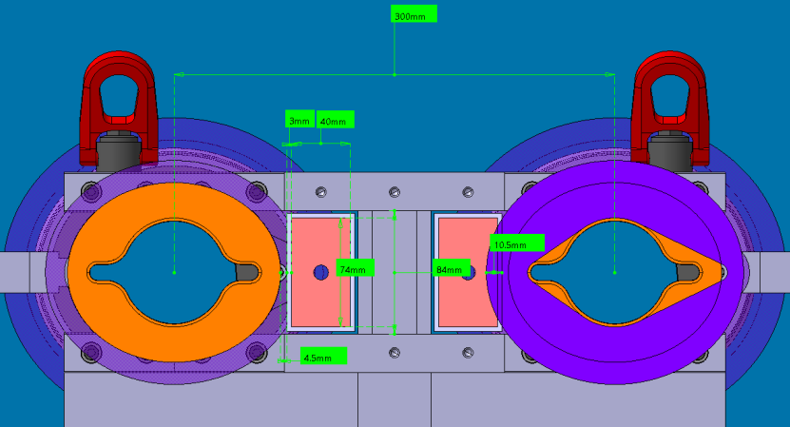
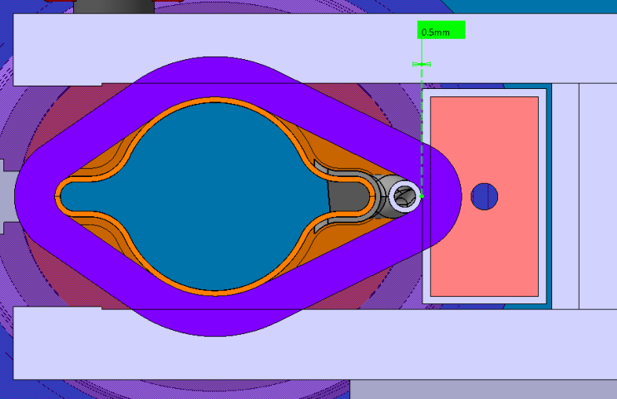
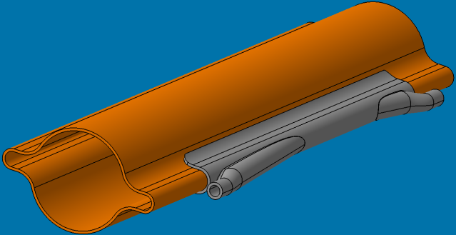
Collider: e+e- interbeam distance
6th December 2022 / FCCIS Workshop 2022
F. Carra
  Mechanical design study of magnetic & vacuum system and interfaces of collider
    Larger space required for SR absorbers (water cooling piping and fittings; safety distance to busbar wrt voltage)
    Proposed to increase the inter-beam distance from 300 to 350 mm
Conflict:
SR absorber - busbar
Dipole cross-section with SMA flanges
    Discussed and approved at 160th FCC-ee Optics Design Meeting
C. Tetrault
SR absorber integration in dipole
SR absorber

Slide 22
Outline
6th December 2022 / FCCIS Workshop 2022
Federico Carra / CERN
Aim of the project
Project organization & timeline
Arc cell configuration(s)
Phase I main studies
  Integration layout & booster placement
  Arc systems interfaces & inter-beam distance
  Accelerators supporting systems & SSS girders
Arc half-cell mock-up & Novel concepts
Conclusions

Slide 23
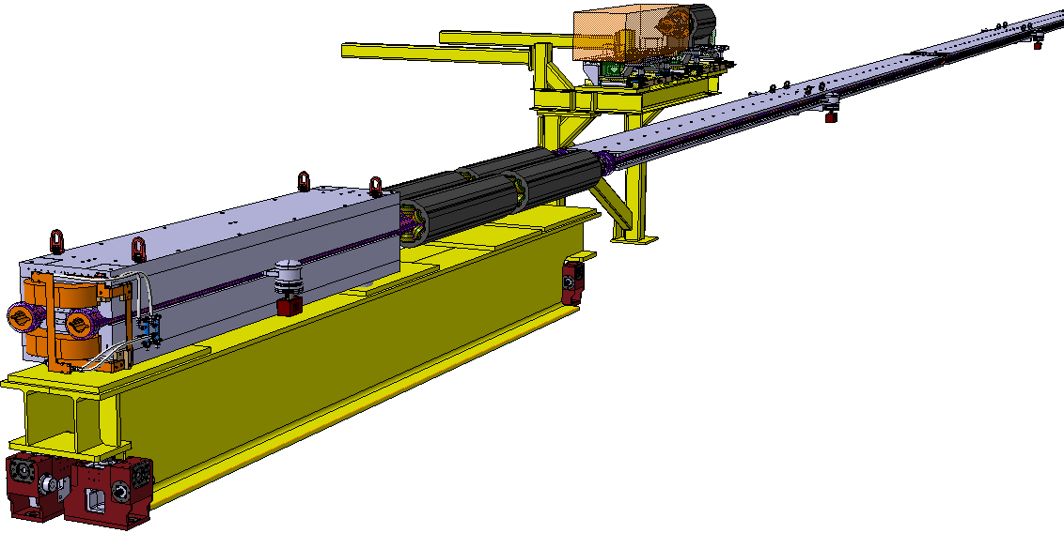
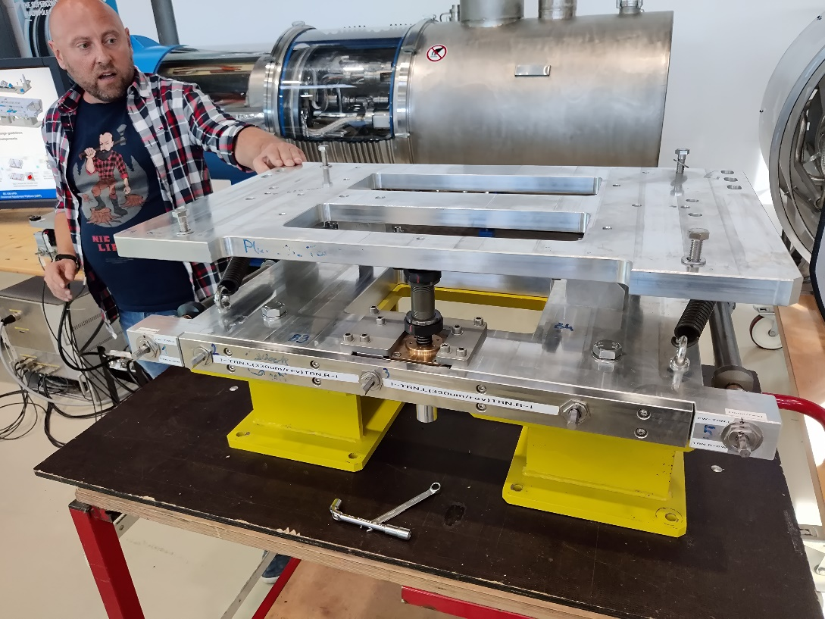
Short Straight Sections configuration
6th December 2022 / FCCIS Workshop 2022
F. Carra
Collider SSS:
Quadrupole weight: ~5300 Kg.
Sextupole weight: ~680 Kg individual, 2720 Kg total.
Total: ~8020 Kg
Preliminary girder weight: ~3000 Kg
Girder: 650 mm x 720 mm x 6500 mm
Collider
  SSS elements supported by common girder
  Enhance strategy for chamber insertion / splittable magnets
Booster
  TE-MSC and TE-VSC started the design of the booster elements
  EN-MME produced the first version of a robust and compact supporting system → fed to calculations
  Two supporting principles studied: common girder (preferable for TE-VSC, allows a single chamber) vs. individual adjustment system (e.g. HL-LHC UAP, designed by BE-GM)
C. Tetrault
Common support for booster’s quadrupoles and sextupoles
CERN 2t Universal Adjustment Platform (UAP)
Common girder for main collider quadrupoles & sextupoles
HL-LHC Jacks

Slide 24
Short Straight Sections configuration
6th December 2022 / FCCIS Workshop 2022
F. Carra
Booster SSS supports, two preliminary configurations:
Configuration 1: individual adjustment system
Configuration 2: girder
C. Tetrault

Slide 25
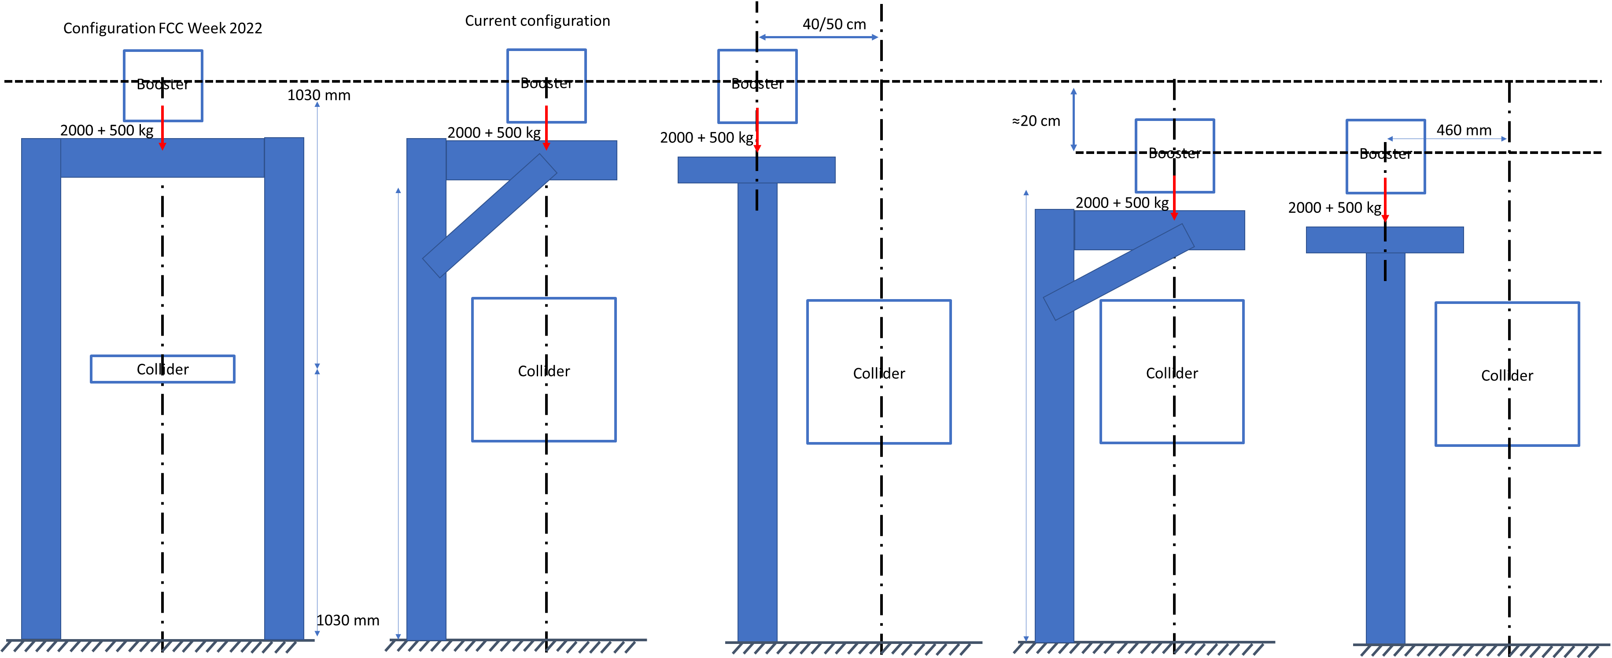
Booster support – design iterations
6th December 2022 / FCCIS Workshop 2022
F. Carra
L. Baudin
Collider Center
Proposals to allow compacting/stiffening the booster to collider placement discussed and approved at the Arc Half-Cell mock-up meeting, at the Accelerator Pillar meeting and at the FCC-ee Optics Design Meeting

Slide 26
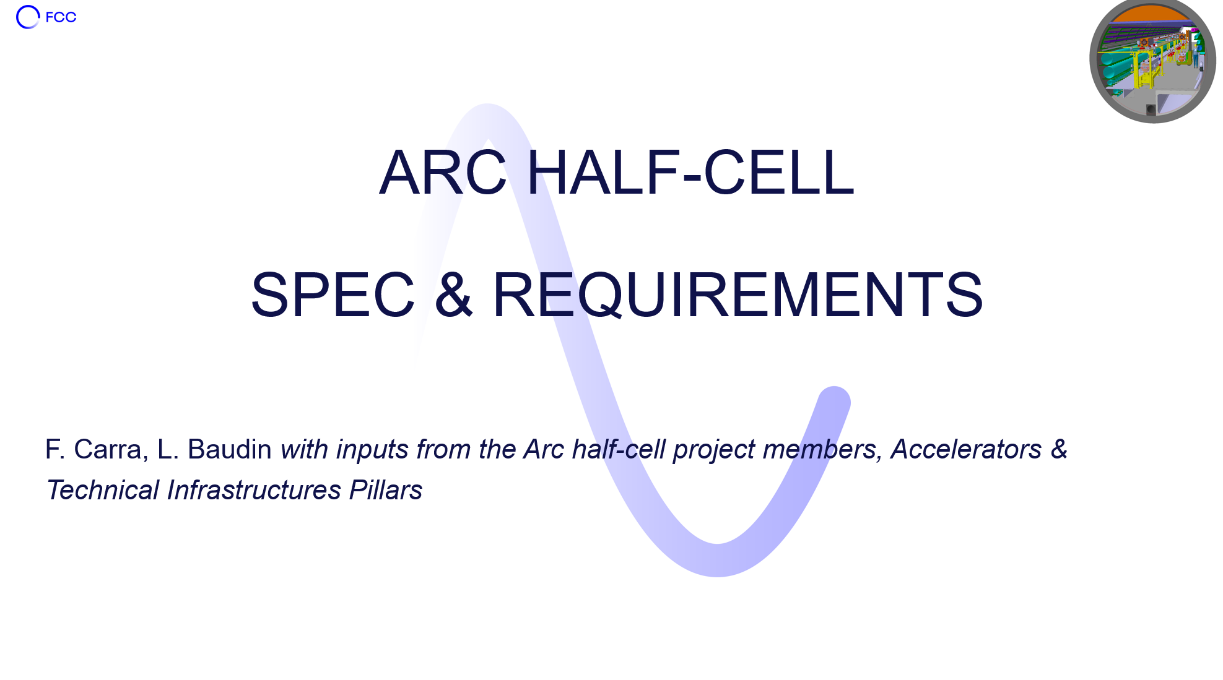
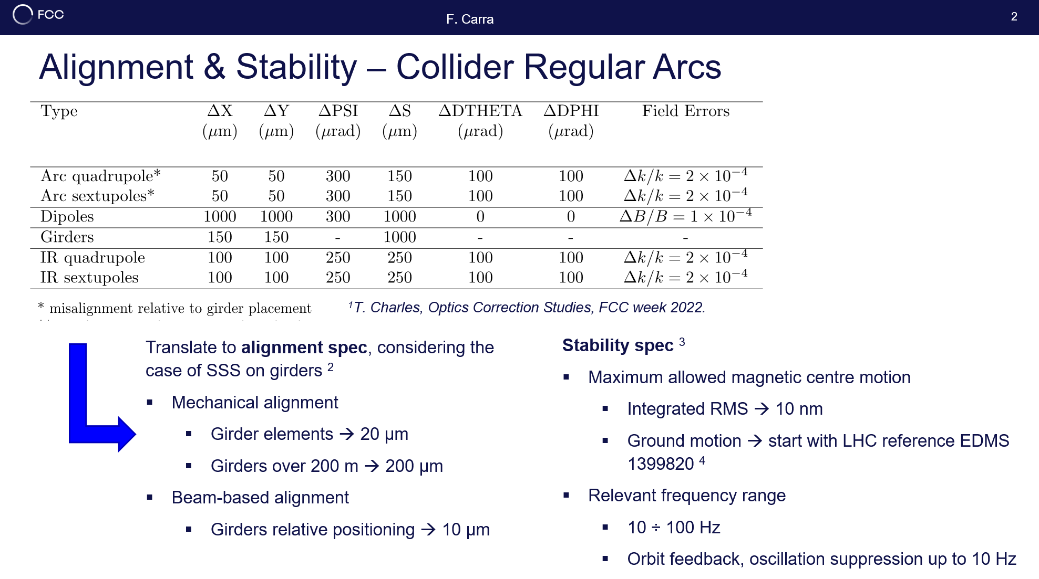
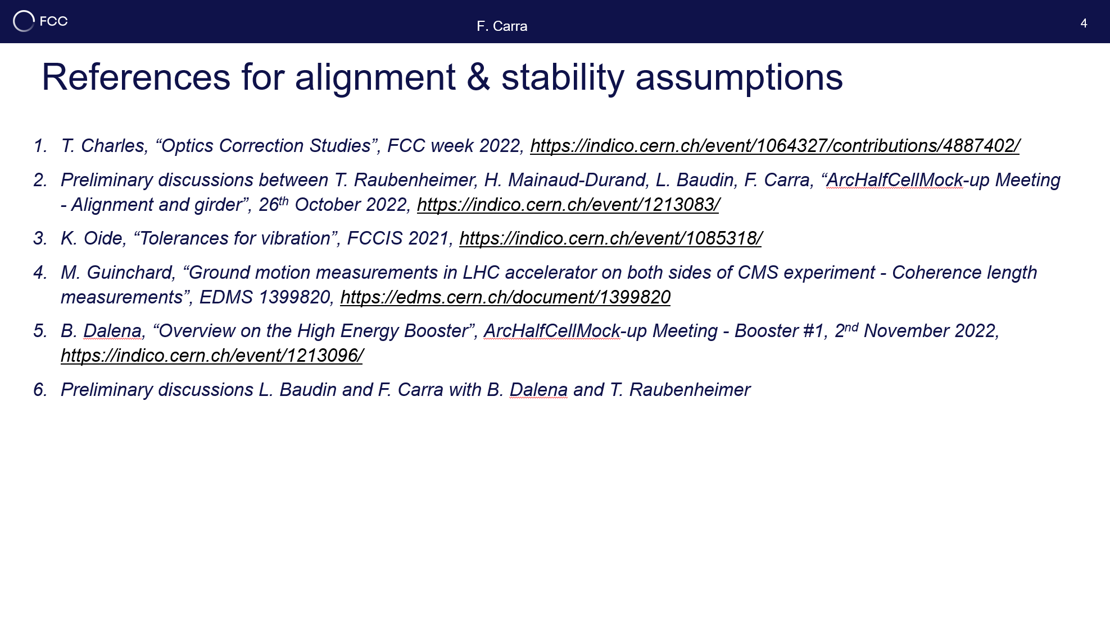
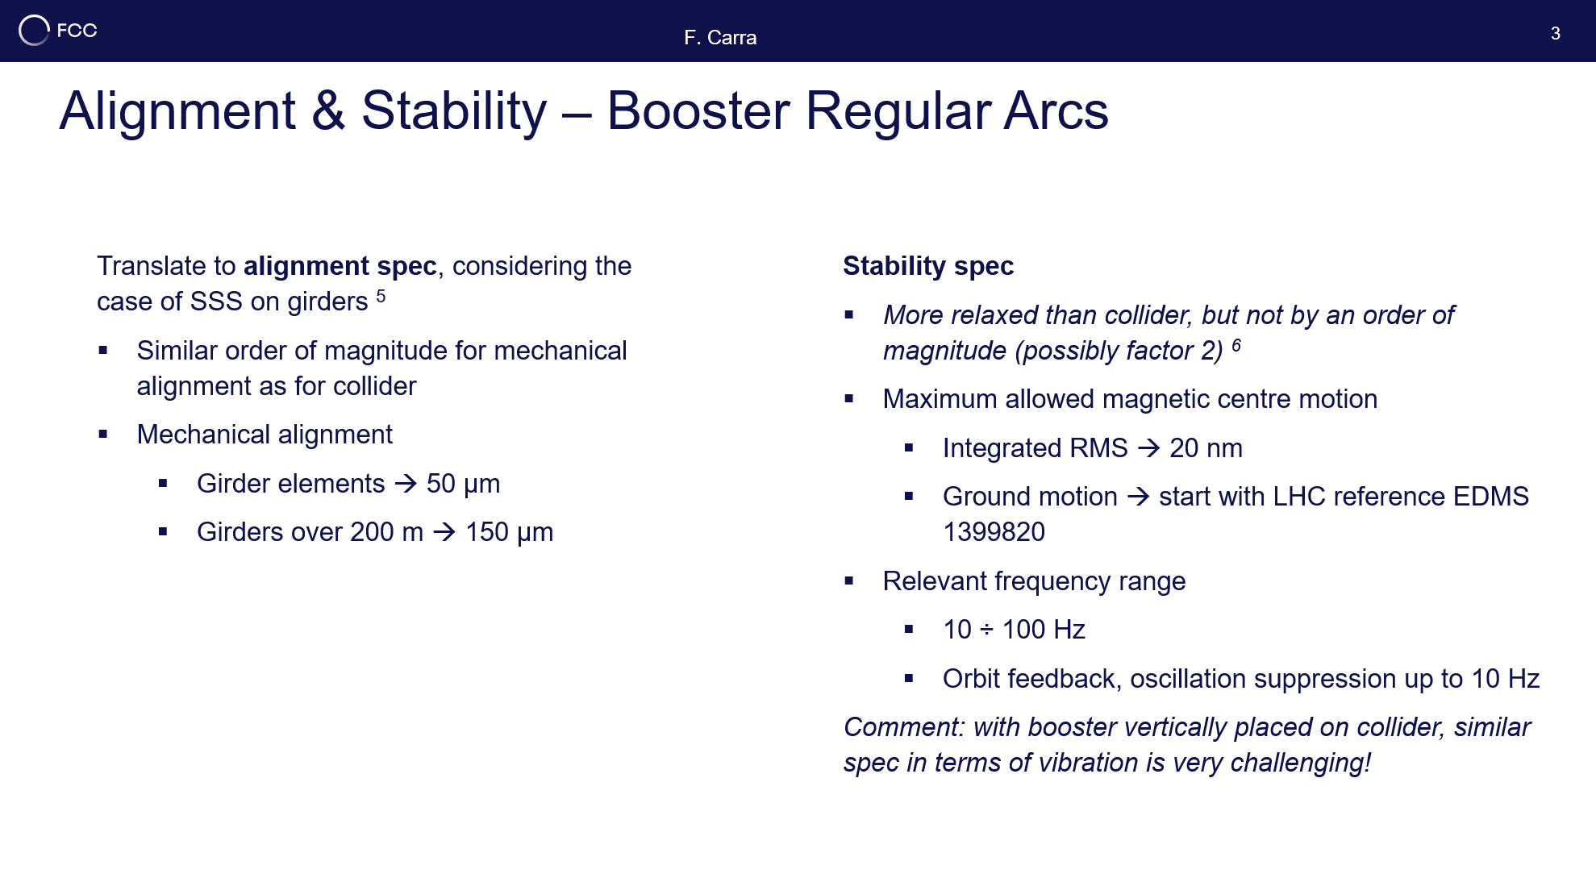
Booster (and collider) stability: functional spec
22nd November 2022 / Senior Advisors Panel
F. Carra
Draft version collecting outcome of several discussions with Tor, Frank, Katsunobu, Antoine, Barbara, Michael G., etc. link

Slide 27
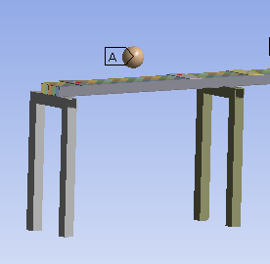
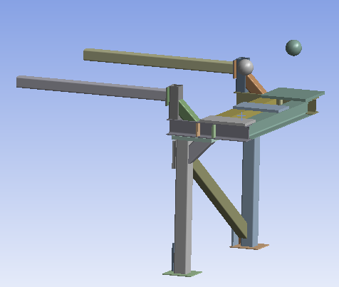
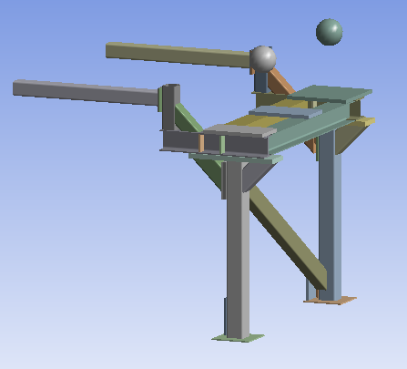
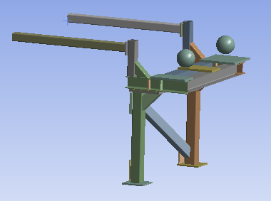
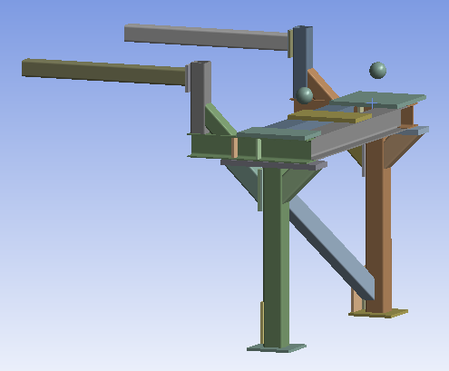
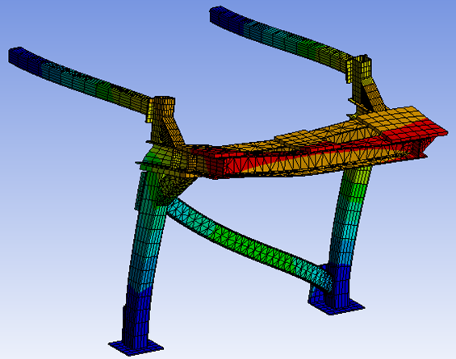
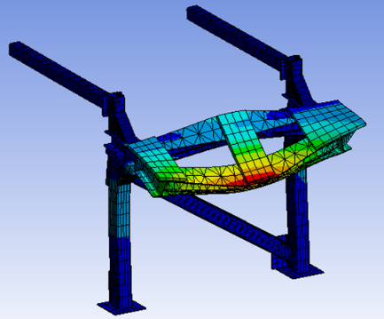
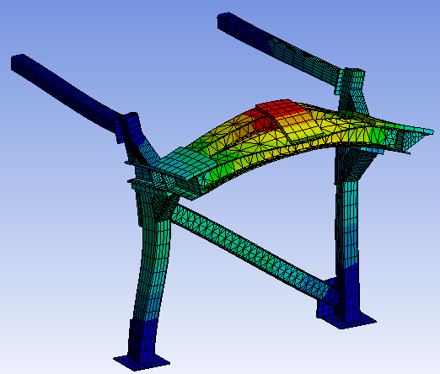
Booster supports – calculations
6th December 2022 / FCCIS Workshop 2022
F. Carra
L. Baudin
Optimization leading x15 higher stiffness and x4 higher natural frequencies
Likely conservative (2.5t total magnet weight, 50% less seems feasible)
Some room for further improvement but already a reasonably robust result
  PETRA IV girder 46 Hz
  PSB LIU girder 29 Hz
Next steps
Add ground motion & harmonic response to evaluate expected vibration amplitude, compare with specs (20 nm @10-100 Hz)
Add collider to the model, to evaluate vibrations crosstalk
Mode Shape | FCC Week ‘22 Frequency [Hz] | First Iteration Frequency [Hz] | Shifted Horizontally Frequency [Hz] | Shifted Vertically Frequency [Hz] | Shifted Vertically & Horizontally Frequency [Hz]
Longitudinal | 7 | 18 | 24 | 21 | 29
Bending Cantilever Arms/ Torsion Horizontal Beam | 7 | 19 | 23 | 29 | 29
Bending Horizontal Beam | 14 | 36 | 41 | 40 | 54

Slide 28
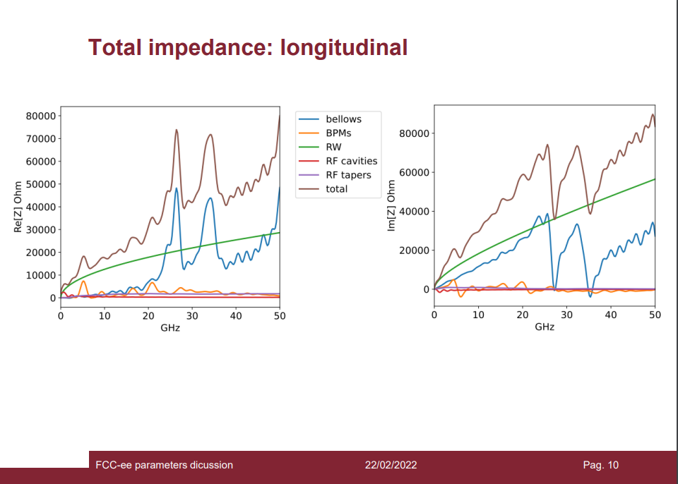
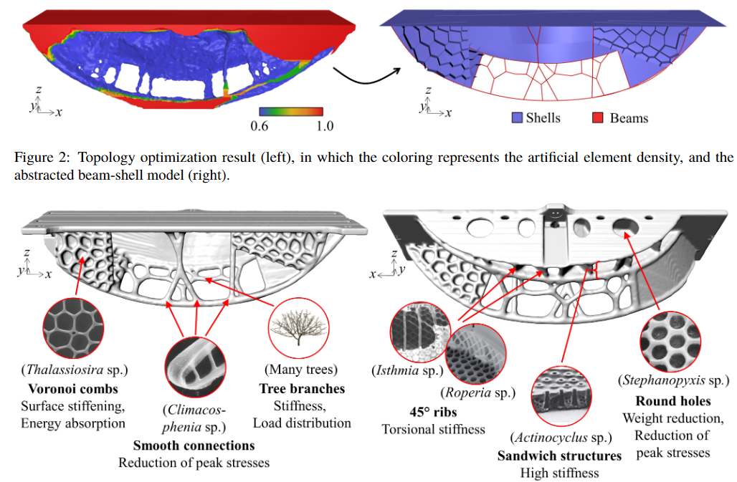
Recap of girder concept for SSS, pros’ and cons’
6th December 2022 / FCCIS Workshop 2022
F. Carra
Pros
Pre-assembly and pre-alignment on the surface leaving in-tunnel connections with bellows at ends: better tools, more space, clean environment
Reduced time for installation and alignment in the machine
Less bellows: easier azimuthal integration, important gain in impedance
Single chamber for elements in the SSS
Reduced need for sextupole beam-based alignment (weak trims, less BPMs, …)
Easier maintenance of faulty elements (hot spare SSS on girders)
Cons
Require design/material/supporting optimization to prevent higher vibrations, but solutions exist:
  Biologically inspired structures à la PETRA IV (topology optimization Materials with higher stiffness/mass ratio (e.g. polymer concrete)
  Increased number of feet (4-6), alignment with wedges
Potentially higher hardware cost (collider: ~2000 girders, 15 kCHF/girder ballpark → 30 MCHF), but to be weighed against:
  Extra costs of bellows, flanges and alternative supporting system
  Possibly shorter (cheaper) overall assembling and alignment time
Triggered discussions with PSI (J. Wickstrom, M. Wurm) around collaboration on girder/jacks concepts and design
S. Andresen et al., “Innovative and biologically inspired PETRA IV girder design”, MEDSI2020
M. Migliorati, FCCIS 2021

Slide 29
Outline
6th December 2022 / FCCIS Workshop 2022
Federico Carra / CERN
Aim of the project
Project organization & timeline
Arc cell configuration(s)
Phase I main studies
  Integration layout & booster placement
  Arc systems interfaces & inter-beam distance
  Accelerators supporting systems & SSS girders
Arc half-cell mock-up & Novel concepts
Conclusions

Slide 30
Arc half-cell mock-up: 1st proposal
6th December 2022 / FCCIS Workshop 2022
F. Carra
Objectives:
Test different integration options in terms of element positioning & supporting
Test accessibility to equipment, handling, logistic
Test safety aspects & procedures
Test interfaces and connections between systems, mechanical alignment of SSS
Benchmark numerical simulations in terms of rigidity, stability of supporting systems (girder, jacks) and magnets
Test instrumentation systems (“standard” DAQ, Digital Twins, …)
Host prototypes of the main systems under responsibility of equipment groups
Better estimation of costs and technological feasibility of systems
Having a visual and clear representation of a region characteristic of ~90% of the FCC tunnel, in view of the next update of the ESPP

Slide 31
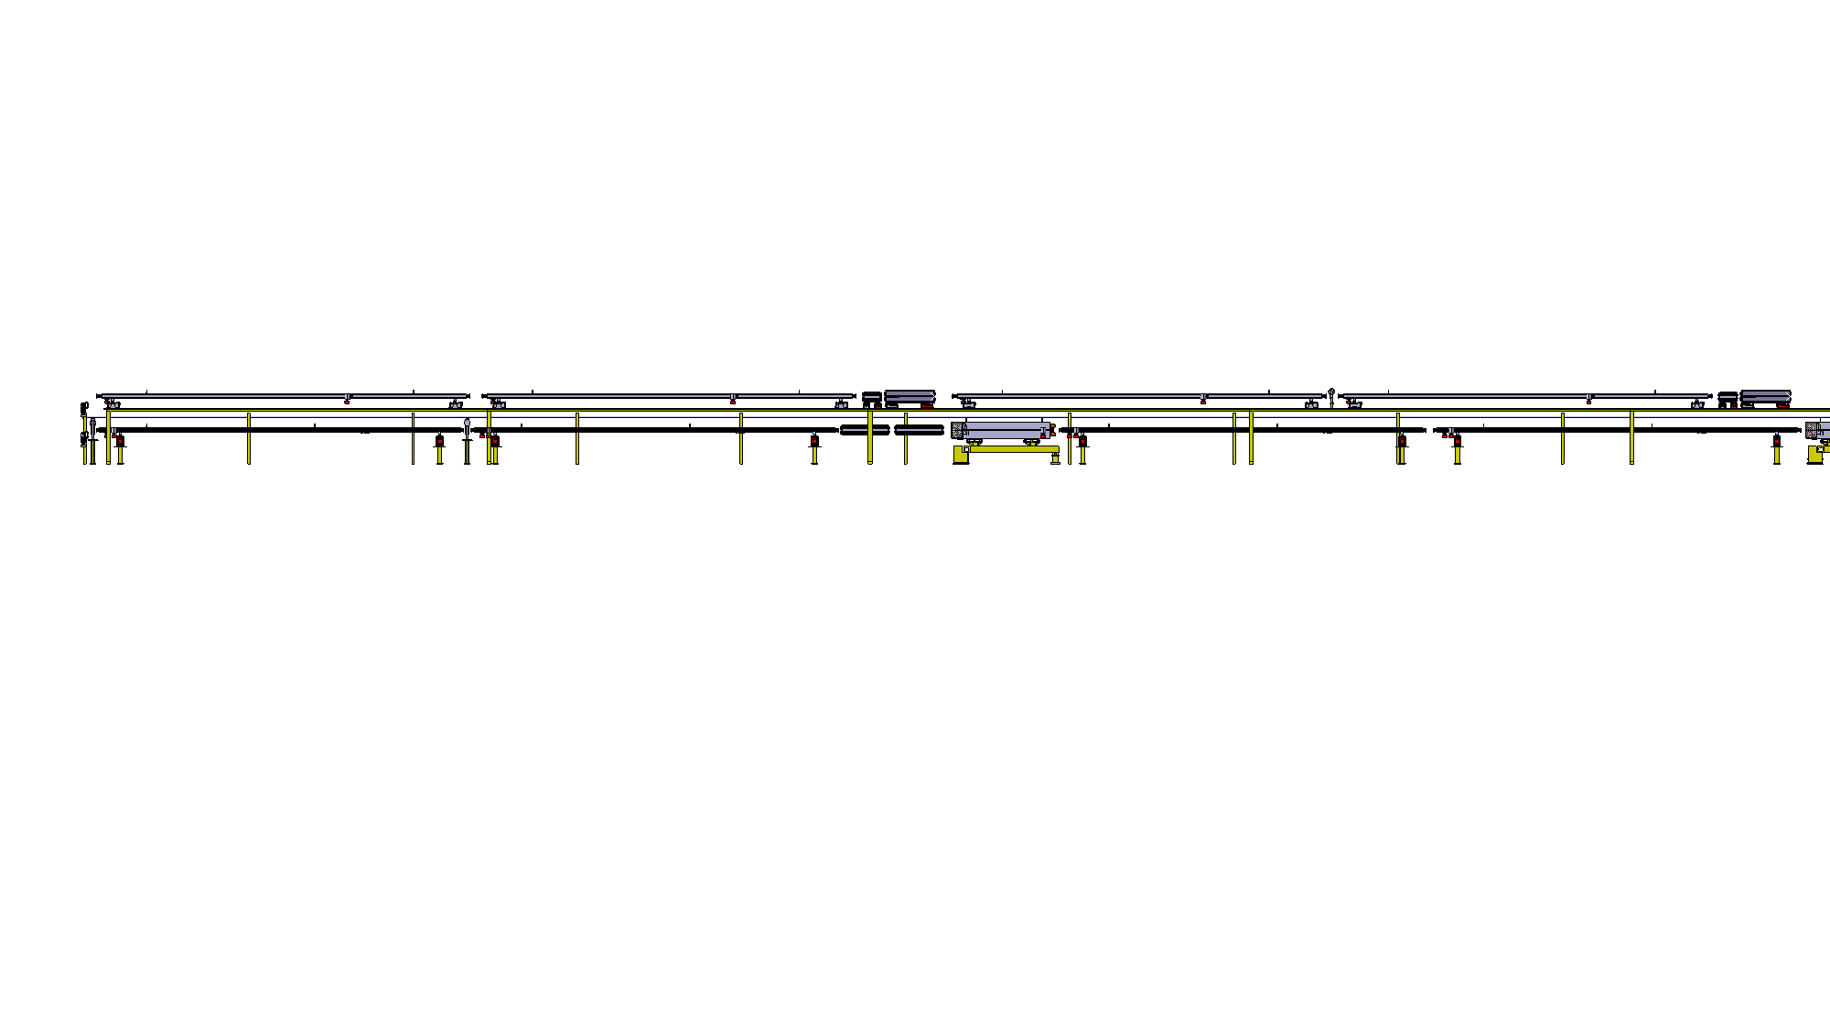
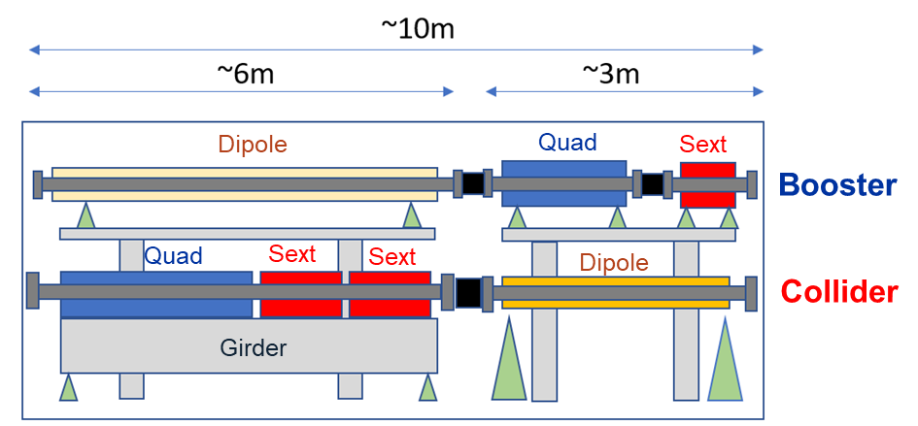
Arc half-cell mock-up: 1st proposal
6th December 2022 / FCCIS Workshop 2022
F. Carra
(example for booster / collider vertical placement)
Dipole
Quadrupole
Sextupole
Dipole
Booster ring
Mock-up region
Girder
Main ring
With 0.5% tunnel slope → 5 cm every 10m
Dipole
Quadrupole
Sextupole
Dipole
Characteristic size:
Section: 5.5m diameter tube
Length: ~10m
Functional elements:
Ideally: build magnet/vacuum system prototypes and mock-up as a functional testing platform (last Senior Advisors Panel: technical potential should be exploited as much as possible, F. Lackner). Including alcoves, fire compartmentation?
Lower-budget option: cost-effective solution combining magnet, vacuum, beam instrumentation prototypes and cheap “maquettes” (dipole extra-length, C&V systems, shelves, etc.)
M. Timmins

Slide 32
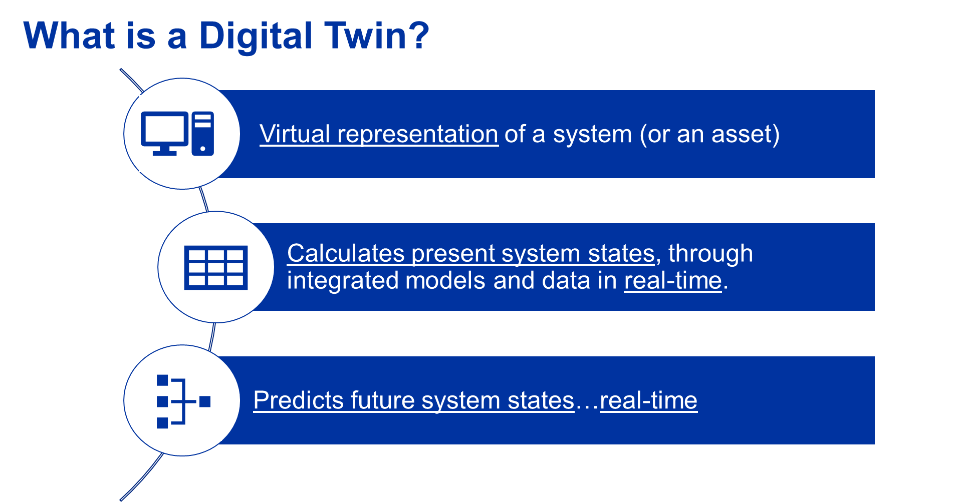
Novel concepts: Digital Twins
6th December 2022 / FCCIS Workshop 2022
Federico Carra / CERN
D. Smakulska, M. Garlasché

Slide 33
Novel concepts: Digital Twins
6th December 2022 / FCCIS Workshop 2022
Federico Carra / CERN
Digital Twin IS MORE than just
data acquisition & monitoring
a set of simulations
experience from historical
OUTPUT
Normal Operation:
Determine system state through data acquisition
Real time, ALSO for parameters not directly acquired
Failure:
Forecast system state, real time interpretation
Repair scenarios: real time analysis, system-wide
Complexity of the system is tailored to the specific needs
  To be considered for mock-up girder and magnets: displacements, vibrations, strains, temperature, etc.
D. Smakulska, M. Garlasché

Slide 34
Outline
6th December 2022 / FCCIS Workshop 2022
Federico Carra / CERN
Aim of the project
Project organization & timeline
Arc cell configuration(s)
Phase I main studies
  Integration layout & booster placement
  Arc systems interfaces & inter-beam distance
  Accelerators supporting systems & SSS girders
Arc half-cell mock-up & Novel concepts
Conclusions

Slide 35
Conclusions
6th December 2022 / FCCIS Workshop 2022
Federico Carra / CERN
The design and construction of a mock-up of an arc half-cell of the FCC-ee is proposed, in order to investigate aspects such as fabrication techniques, integration, installation, assembly, transport, maintenance.
The project is divided into three phases:
  Phase I (end of 2022) focused on the integration studies of the arc configuration and the interfaces between its systems
  Phase II (2023-2024) will tackle the engineering design of each element
  Phase III (2024-2025) will involve fabrication and assembling steps
The Phase I, under conclusion, led to important results, including (but not limited to):
  Definition of inter-beam distance
  Design study of magnet and vacuum systems interfaces
  Optimization of booster and collider supporting frames
  Study and recommendations on booster-to-collider placement and integration, as well as of supporting concepts for the SSS
  Proposals for the standardization of the equipment and for the switch from low to high energy
Concise summary report will be prepared in January to document the study
A preliminary proposal for a mock-up was discussed, and will be refined (and costed) once the Phase II is approved
Discussions for collaborations on different tasks are ongoing with University La Sapienza (Rome), University of Malta, PSI, …

Slide 36
Thank you for your attention.
2nd June 2022 / FCC week 2022
Federico Carra / CERN
36
36

Slide 37
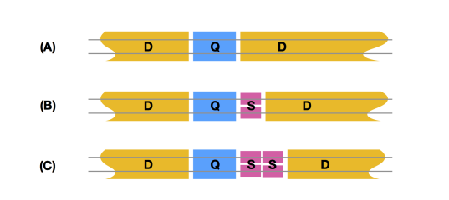
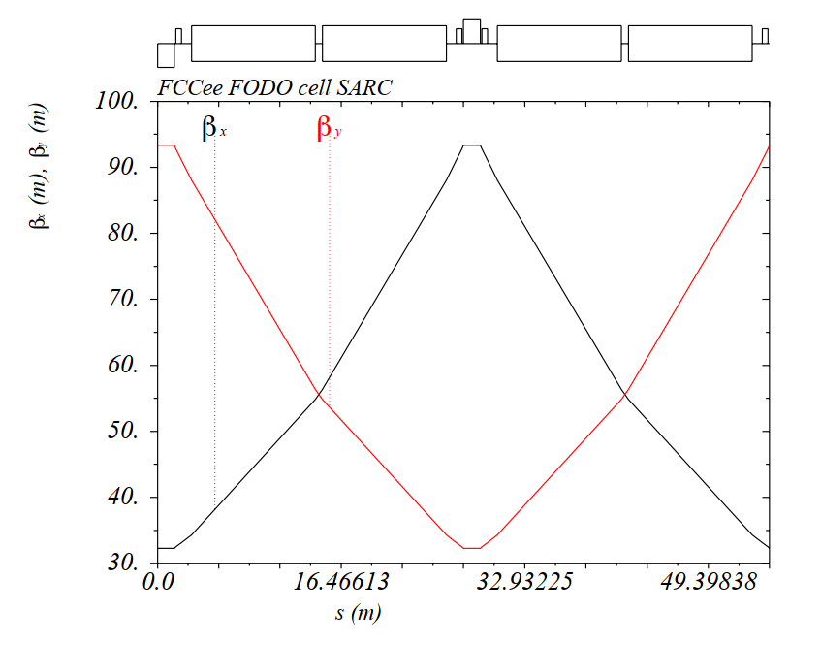
Arc cell configuration(s)
2nd June 2022 / FCC week 2022
Federico Carra / CERN
Arc half-cell
  1 Quadrupole
  0, 1, 2 Sextupoles
  Up to ~24 m Dipoles (segmented, variable length)
F. Valchkova-Georgieva
Booster

