Slide 1




INTENSITY ASYMMETRY IN COLLIDERS WITH STRONG BEAMSTRAHLUNG
K. Le Nguyen Nguyen^{1, 2, 3} P. Kicsiny^{1, 2} X. Buffat¹ T. Pieloni²
¹ European Organisation for Nuclear Research (CERN)
² Ecole Polytechnique Fédérale de Lausanne (EPFL)
³ Cavendish Laboratory, University of Cambridge
Notes:
Put logos and countries (for LPAP)

Slide 2
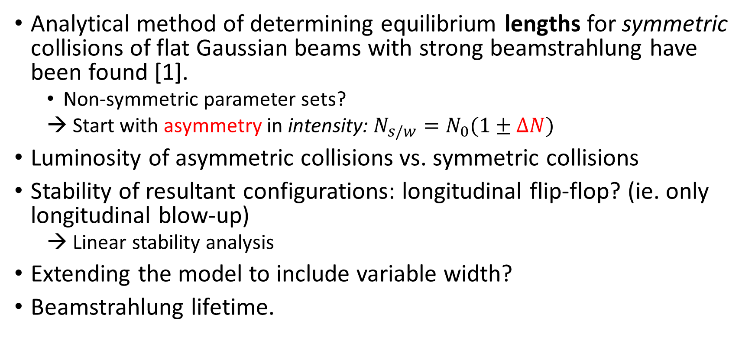
Motivations and contents
Analytical method of determining equilibrium lengths for symmetric collisions of flat Gaussian beams with strong beamstrahlung have been found [1].
  Non-symmetric parameter sets?
  Start with asymmetry in intensity: $N_{s/w}=N_{0}(1±ΔN)$
Luminosity of asymmetric collisions vs. symmetric collisions
Stability of resultant configurations: longitudinal flip-flop? (ie. only longitudinal blow-up)
  → Linear stability analysis
Extending the model to include variable width?
Beamstrahlung lifetime.
Notes:
This is where I can explain what is meant by weak and strong.
“Width” → “Transverse width/transverse size”.

Slide 3
Beamstrahlung equilibrium length: assumptions
Dispersive effects at the interaction point (IP) are ignored.
Corrections due to the hourglass effect and the crab-waist collision scheme are either taken to be negligible or weak in various models.
Other effects of beamstrahlung not directly related to the equilibrium bunch lengths, such as the reduction of particle number, are assumed to be absent.

Slide 4
Beamstrahlung equilibrium length:
assumptions [1]
For typical crossing angles (30mrad), differences in beam and photon energies between the boosted and lab frames are negligible.
Ignore disruption effects and horizontal rms angular beam divergence compared with crossing angle, but account for vertical hourglass effect.
Flat beam shape (σ_{y}<<σ_{x}*) in the collision region of interest.

Slide 5

Beamstrahlung equilibrium length: hourglass effect, crab waist optics [1]
Hourglass/ crab waist factor:
$$σ_{y, w/s}\left(x,s\right)=σ_{y, w/s}^{∗}×G{\left(x,s\right)}_{w/s}$$
$$G{\left(x,s\right)}_{w/s}=\sqrt{1+{\left(\frac{s∓\frac{x}{θ_{c}}}{β_{y}^{∗}}\right)}^{2}}$$
Crab waist optics
Hourglass effect
Twiss y-parameter at IP

Slide 6
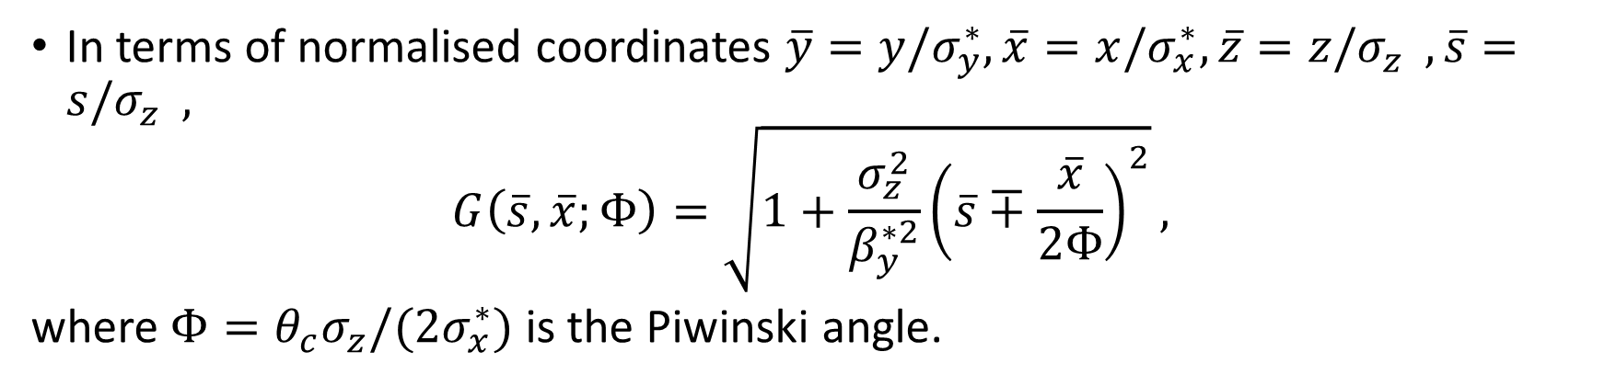
Beamstrahlung equilibrium length:
hourglass effect, crab waist optics [1]
In terms of normalised coordinates $\overline{y}=y/σ_{y}^{∗},\overline{x}=x/σ_{x}^{∗},\overline{z}=z/σ_{z}^{},\overline{s}=s/σ_{z}^{},$
$$G\left(\overline{s}, \overline{x};Φ\right)=\sqrt{1+\frac{σ_{z}^{2}}{β_{y}^{∗2}}{\left(\overline{s}∓\frac{\overline{x}}{2Φ}\right)}^{2}},$$
where $Φ=θ_{c}σ_{z}/(2σ_{x}^{∗})$ is the Piwinski angle.

Slide 7
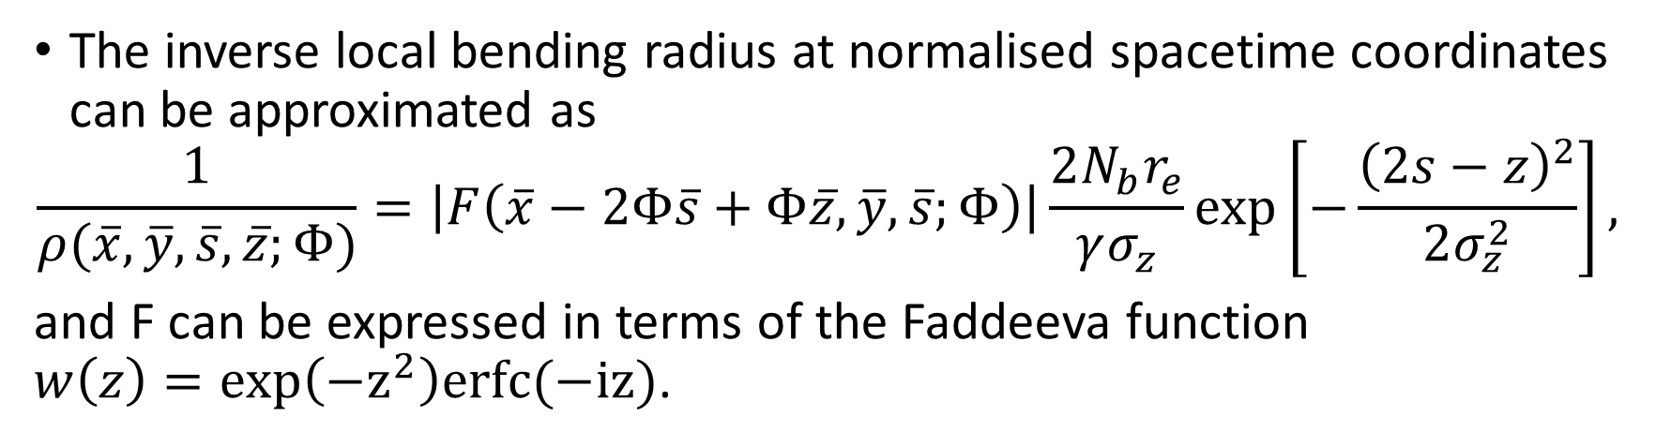
Beamstrahlung equilibrium length:
assumptions [1]
The inverse local bending radius at normalised spacetime coordinates can be approximated as
$$\frac{1}{ρ(\overline{x}, \overline{y}, \overline{s}, \overline{z};Φ)}=\left|F\left(\overline{x}−2Φ\overline{s}+Φ\overline{z}, \overline{y}, \overline{s};Φ\right)\right|\frac{2N_{b}r_{e}}{γσ_{z}}\exp\left[−\frac{{\left(2s−z\right)}^{2}}{2σ_{z}^{2}}\right],$$
and F can be expressed in terms of the Faddeeva function
$w\left(z\right)=exp\left(−z^{2}\right)erfc(−iz)$.

Slide 8
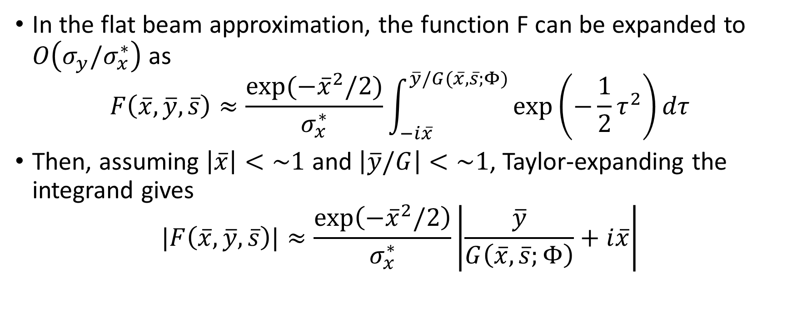
Beamstrahlung equilibrium length:
assumptions [1]
In the flat beam approximation, the function F can be expanded to $O\left(σ_{y}/σ_{x}^{∗}\right)$ as
$$F\left(\overline{x}, \overline{y}, \overline{s}\right)≈\frac{exp⁡(−{\overline{x}}^{2}/2)}{σ_{x}^{∗}}\int_{−i\overline{x}}^{\overline{y}/G(\overline{x}, \overline{s};Φ)}{\exp\left(−\frac{1}{2}τ^{2}\right)dτ}$$
Then, assuming $\left|\overline{x}\right|<\sim 1$ and $\left|\overline{y}/G\right|<\sim 1$, Taylor-expanding the integrand gives
$$|F\left(\overline{x}, \overline{y}, \overline{s}\right)|≈\frac{\exp\left(−{\overline{x}}^{2}/2\right)}{σ_{x}^{∗}}\left|\frac{\overline{y}}{G\left(\overline{x}, \overline{s};Φ\right)}+i\overline{x}\right|$$

Slide 9
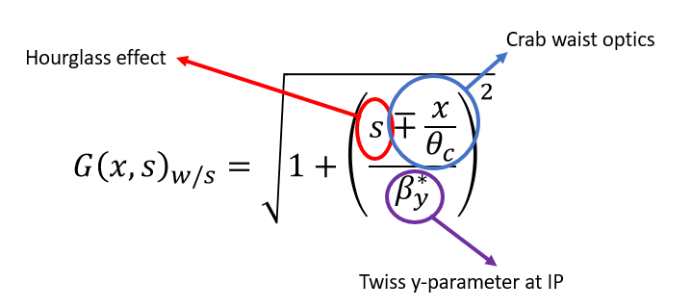
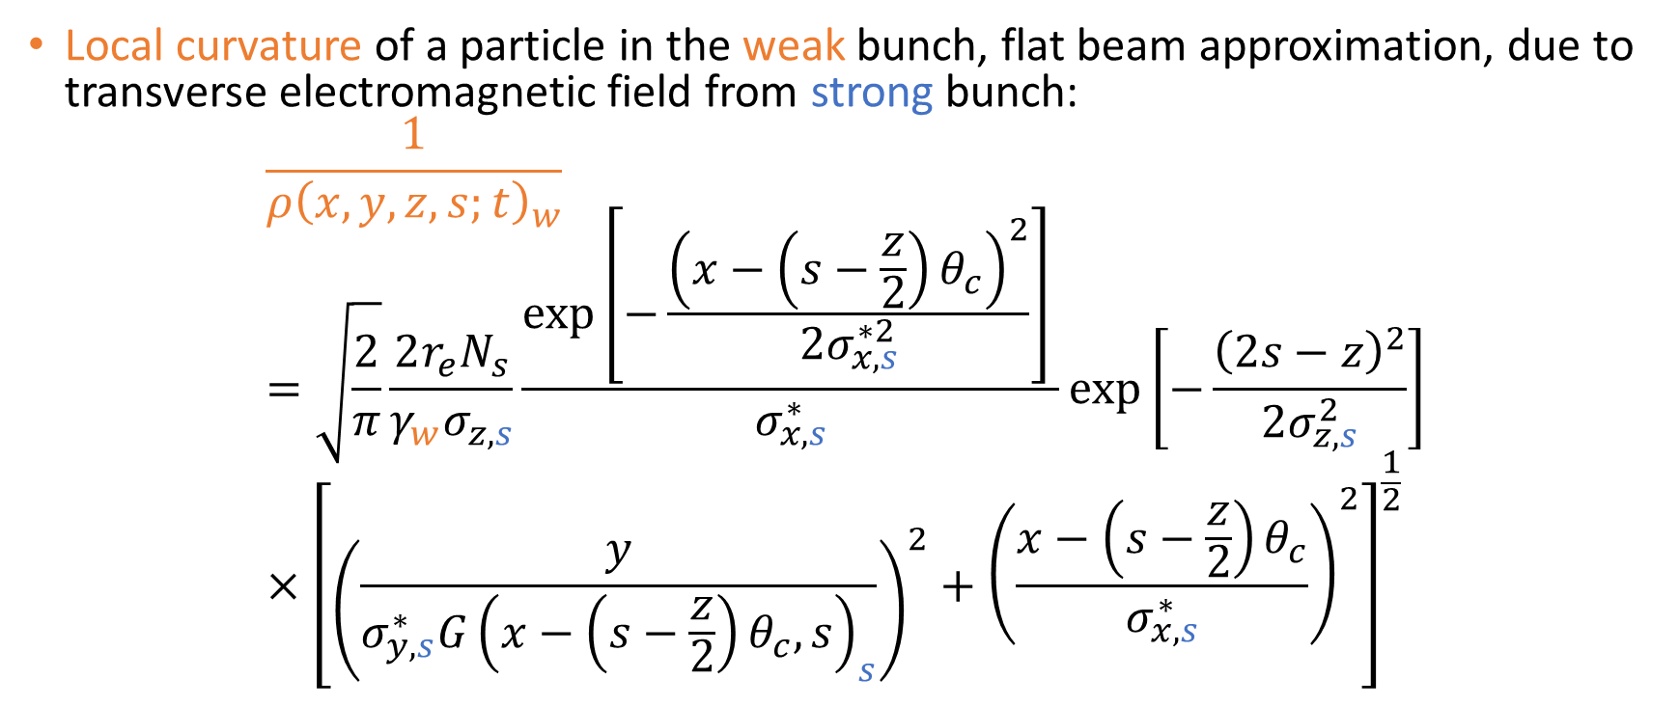
Beamstrahlung equilibrium length: local curvature
Local curvature of a particle in the weak bunch, flat beam approximation, due to transverse electromagnetic field from strong bunch:
$$\frac{1}{ρ{\left(x,y,z,s;t\right)}_{w}}=\sqrt{\frac{2}{π}}\frac{2r_{e}N_{s}}{γ_{w}σ_{z, s}}\frac{\exp\left[−\frac{{\left(x−\left(s−\frac{z}{2}\right)θ_{c}\right)}^{2}}{{2σ}_{x,s}^{∗2}}\right] }{σ_{x,s}^{∗}}\exp\left[−\frac{{\left(2s−z\right)}^{2}}{2σ_{z,s}^{2}}\right]×{\left[{\left(\frac{y}{σ_{y,s}^{∗}G{\left(x−\left(s−\frac{z}{2}\right)θ_{c},s\right)}_{s}}\right)}^{2}+{\left(\frac{x−\left(s−\frac{z}{2}\right)θ_{c}}{σ_{x,s}^{∗}}\right)}^{2}\right]}^{\frac{1}{2}}$$
Notes:
Fadeeva function: flat beam approximation

Slide 10
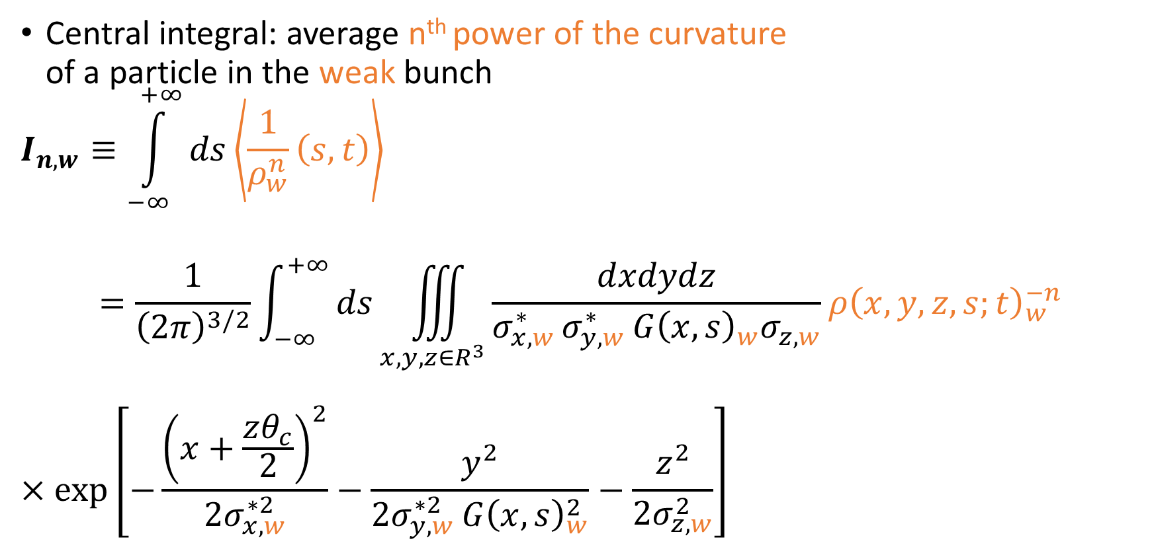
Beamstrahlung equilibrium length: central integral
Central integral: average n^{th} power of the curvature
of a particle in the weak bunch
$$I_{n,w}≡\int_{−∞}^{+∞}{ds\left\langle \frac{1}{ρ_{w}^{n}}\left(s,t\right)\right\rangle }$$
$$=\frac{1}{{\left(2π\right)}^{3/2}}\int_{−∞}^{+∞}{ds\iiint_{x,y,z∈R^{3}}^{ }{\frac{dxdydz}{σ_{x,w }^{∗}σ_{y,w }^{∗}G{\left(x,s\right)}_{w}σ_{z,w}}ρ{\left(x,y,z,s;t\right)}_{w}^{−n}}}$$
$$×\exp\left[−\frac{{\left(x+\frac{zθ_{c}}{2}\right)}^{2}}{2σ_{x,w}^{∗2}}−\frac{y^{2}}{2σ_{y,w }^{∗2}G{\left(x,s\right)}_{w}^{2}}−\frac{z^{2}}{2σ_{z,w}^{2}}\right]$$
Averaged over Gaussian distribution of particles in the weak bunch
Complicate Gaussian integrals
→ Approximations required!
Notes:
What is the model? What are the terms? What are the assumptions?
Give indication of the tricks used to evaluate integrals
Add: A slide of the force with the error function and mention the Taylor expansion. Clarify the approximation used. This approximation has Gaussians which will normalise the integral: if the force is wrong then the Gaussian will cancel it. Intermediate region will be poorly approximated but it’s ok. Just a first-order approximation.
Mention two colours: asymmetric
Introduce briefly Appell and hypergeometric functions (mention can find in books with properties).
Introduce that the spectrum is dependent on the bending radius (dependent on other beam’s properties and crossing angle, hourglass, crab waist, …)
MAKE SURE PEOPLE UNDERSTAND WHAT THESE THINGS MEAN!
Link between crossing and spectrum – why do we end up with the integral of 1/rho?

Slide 11
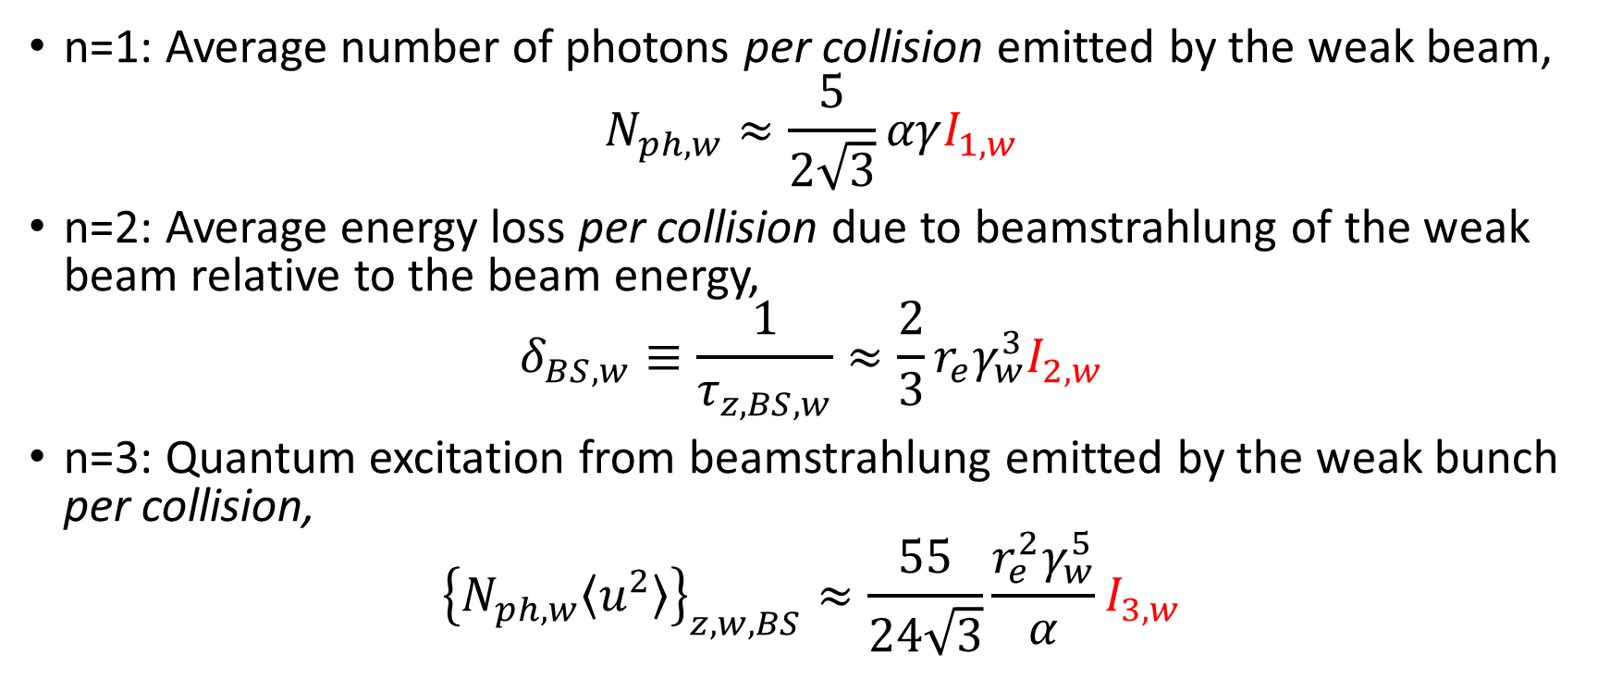
Beamstrahlung equilibrium length: central integral [1]
n=1: Average number of photons per collision emitted by the weak beam,
$$N_{ph, w}≈\frac{5}{2\sqrt{3}}αγI_{1,w}$$
n=2: Average energy loss per collision due to beamstrahlung of the weak beam relative to the beam energy,
$$δ_{BS, w}≡\frac{1}{τ_{z, BS, w}}≈\frac{2}{3}r_{e}γ_{w}^{3}I_{2,w}$$
n=3: Quantum excitation from beamstrahlung emitted by the weak bunch per collision,
$${\left\{N_{ph,w}\left\langle u^{2}\right\rangle \right\}}_{z,w,BS}≈\frac{55}{24\sqrt{3}}\frac{r_{e}^{2}γ_{w}^{5}}{α}I_{3,w}$$

Slide 12
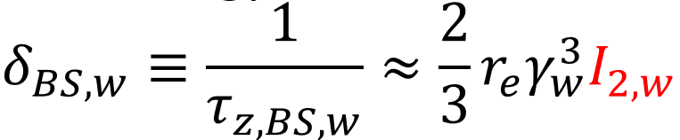
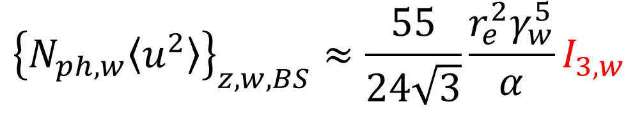
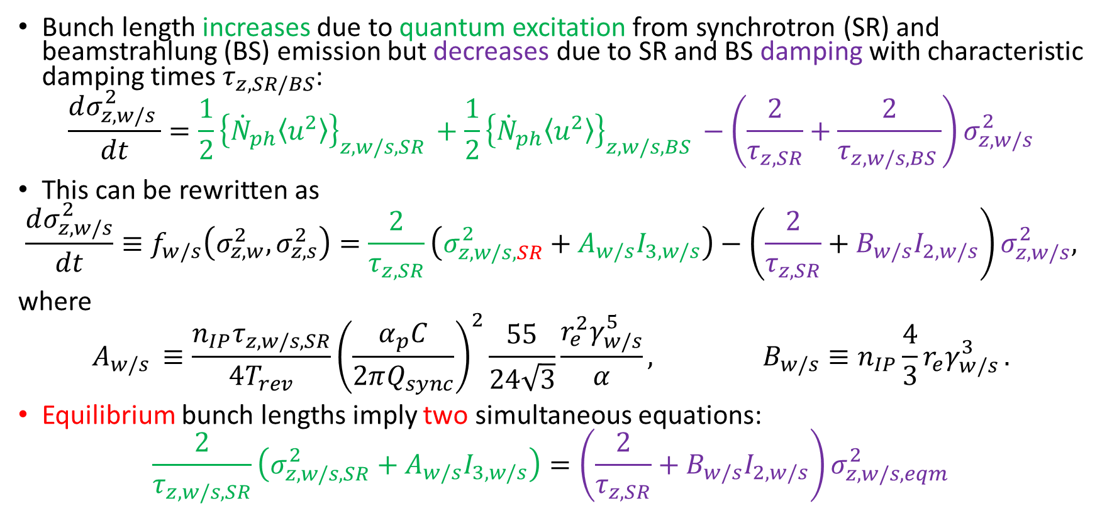
Beamstrahlung equilibrium length: approaching equilibrium
Bunch length increases due to quantum excitation from synchrotron (SR) and beamstrahlung (BS) emission but decreases due to SR and BS damping with characteristic damping times $τ_{z, SR/BS}$:
$$\frac{dσ_{z,w/s }^{2}}{dt}=\frac{1}{2}{\left\{{\dot{N}}_{ph}\left\langle u^{2}\right\rangle \right\}}_{z,w/s,SR }+\frac{1}{2}{\left\{{\dot{N}}_{ph}\left\langle u^{2}\right\rangle \right\}}_{z,w/s,BS }−\left(\frac{2}{τ_{z,SR}}+\frac{2}{τ_{z,w/s,BS }}\right)σ_{z,w/s}^{2}$$
This can be rewritten as
$$\frac{dσ_{z,w/s}^{2}}{dt}≡f_{w/s}\left(σ_{z,w}^{2},σ_{z,s}^{2}\right)=\frac{2}{τ_{z,SR}}\left(σ_{z,w/s,SR}^{2}+A_{w/s}I_{3,w/s}\right)−\left(\frac{2}{τ_{z,SR}}+B_{w/s}I_{2,w/s}\right)σ_{z,w/s}^{2},$$
where
$$A_{w/s }≡\frac{n_{IP}τ_{z,w/s,SR}}{4T_{rev}}{\left(\frac{α_{p}C}{2πQ_{sync}}\right)}^{2}\frac{55}{24\sqrt{3}}\frac{r_{e}^{2}γ_{w/s}^{5}}{α}, B_{w/s}≡n_{IP}\frac{4}{3}r_{e}γ_{w/s }^{3}.$$
Equilibrium bunch lengths imply two simultaneous equations:
$$\frac{2}{τ_{z,w/s,SR}}\left(σ_{z,w/s,SR}^{2}+A_{w/s}I_{3,w/s}\right)=\left(\frac{2}{τ_{z,SR}}+B_{w/s}I_{2,w/s}\right)σ_{z,w/s,eqm}^{2}$$
Notes:
The dot represents a time derivative.

Slide 13
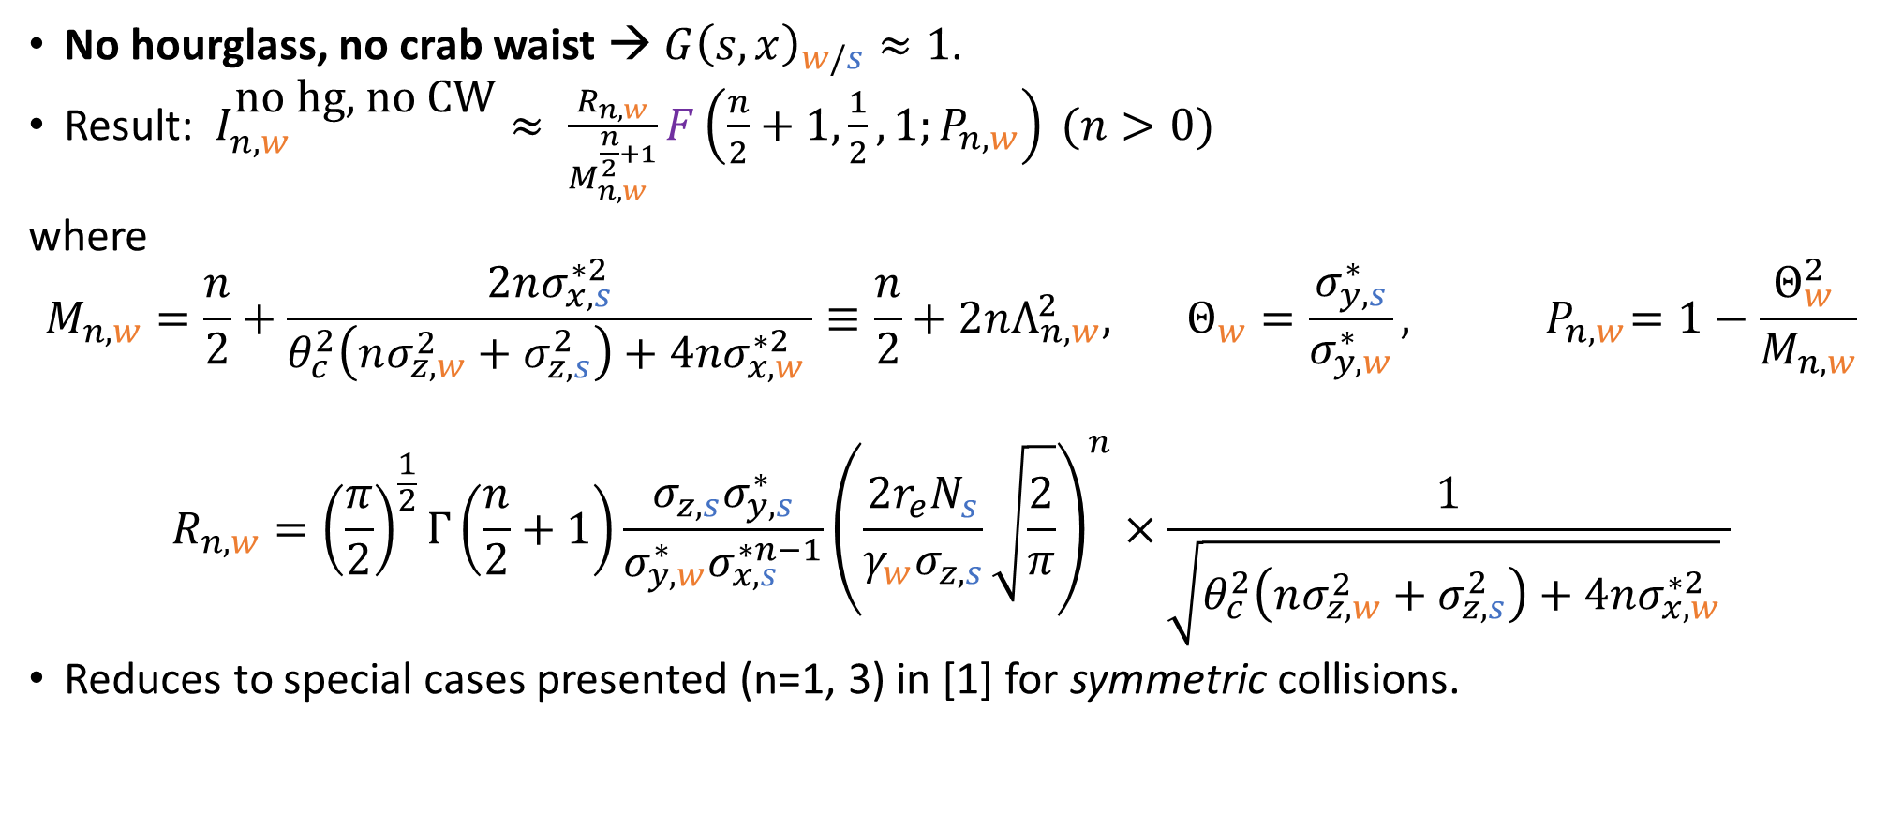
Beamstrahlung equilibrium length: simplifying assumptions
No hourglass, no crab waist → $G{\left(s,x\right)}_{w/s}≈1$.
Result: $I_{n,w}^{\text{no} \text{hg}\text{, }\text{no} \text{CW}}≈ \frac{R_{n,w}}{M_{n,w}^{\frac{n}{2}+1}}F\left(\frac{n}{2}+1,\frac{1}{2},1;P_{n,w}\right) (n>0)$
where
$$M_{n,w}=\frac{n}{2}+\frac{2nσ_{x,s}^{∗2}}{θ_{c}^{2}\left(nσ_{z,w}^{2}+σ_{z,s}^{2}\right)+4nσ_{x,w }^{∗2}}≡\frac{n}{2}+2nΛ_{n,w}^{2}, { Θ_{w}=\frac{σ_{y,s}^{∗}}{σ_{y,w}^{∗}}, P}_{n,w}=1−\frac{Θ_{w}^{2} }{M_{n,w}}$$
$$R_{n,w}={\left(\frac{π}{2}\right)}^{\frac{1}{2}}Γ\left(\frac{n}{2}+1\right)\frac{σ_{z,s}σ_{y,s}^{∗}}{σ_{y,w}^{∗}σ_{x,s}^{∗n−1}}{\left(\frac{2r_{e}N_{s}}{γ_{w}σ_{z,s}}\sqrt{\frac{2}{π}}\right)}^{n}×\frac{1}{\sqrt{θ_{c}^{2}\left(nσ_{z,w}^{2}+σ_{z,s}^{2}\right)+4nσ_{x,w}^{∗2}} }$$
Reduces to special cases presented (n=1, 3) in [1] for symmetric collisions.
Hypergeometric function
Notes:
What has to be clear in the presentation is why I am doing this: get equilibrium from asymmetry.
Not necessary to explain all symbols.
Highlight (circle, colour) some parts that e.g. are dependent only on the strong beam, a function that is bound between certain values, etc.

Slide 14
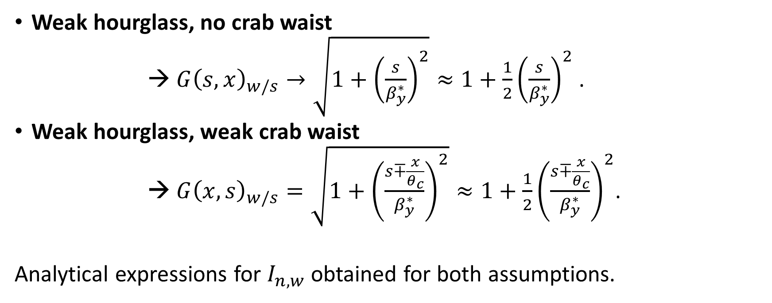
Beamstrahlung equilibrium length:
simplifying assumptions
Weak hourglass, no crab waist
→ $G{\left(s,x\right)}_{w/s}→\sqrt{1+{\left(\frac{s}{β_{y}^{∗}}\right)}^{2}}≈1+\frac{1}{2}{\left(\frac{s}{β_{y}^{∗}}\right)}^{2}$ .
Weak hourglass, weak crab waist
→ $G{\left(x,s\right)}_{w/s}=\sqrt{1+{\left(\frac{s∓\frac{x}{θ_{c}}}{β_{y}^{∗}}\right)}^{2}}≈1+\frac{1}{2}{\left(\frac{s∓\frac{x}{θ_{c}}}{β_{y}^{∗}}\right)}^{2}$.
Analytical expressions for $I_{n,w}$ obtained for both assumptions.

Slide 15

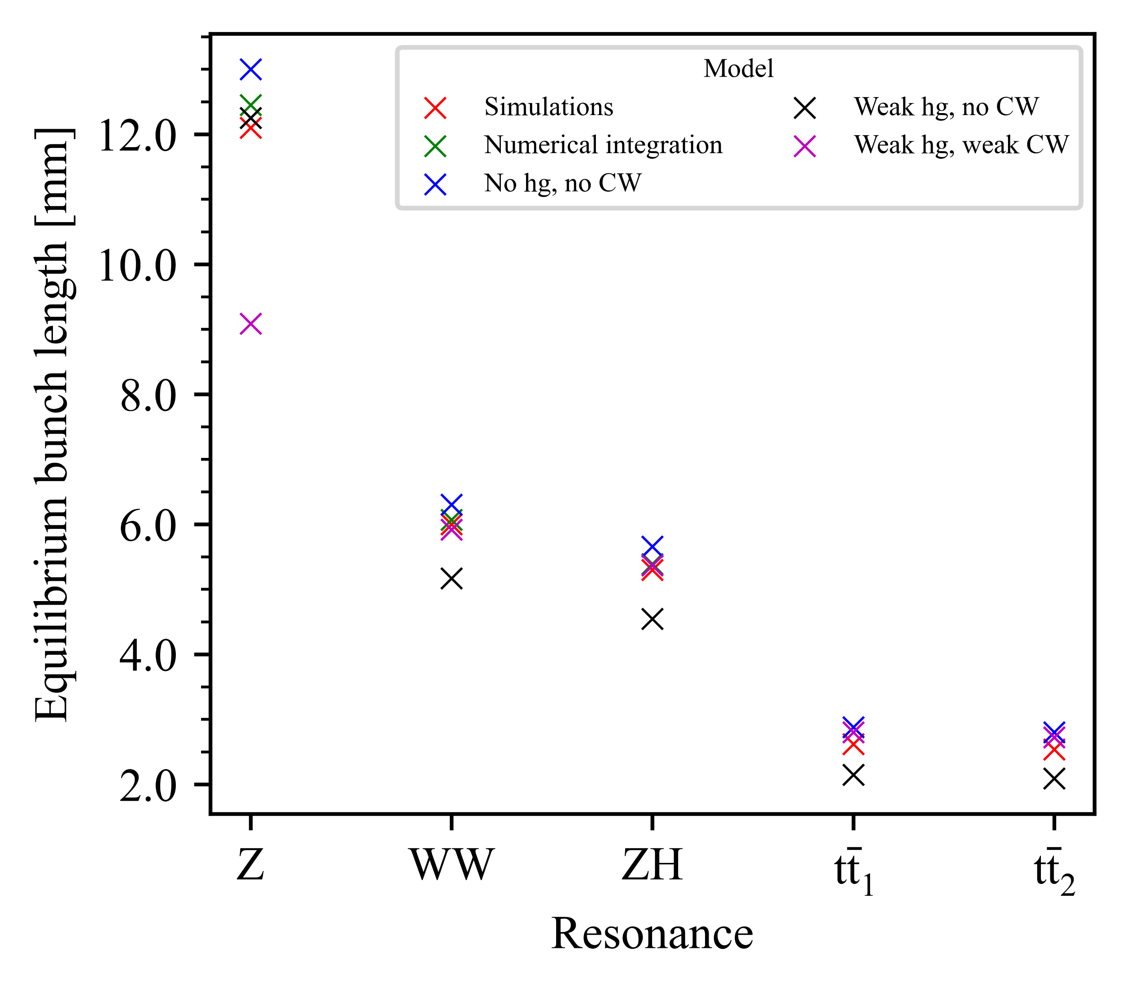
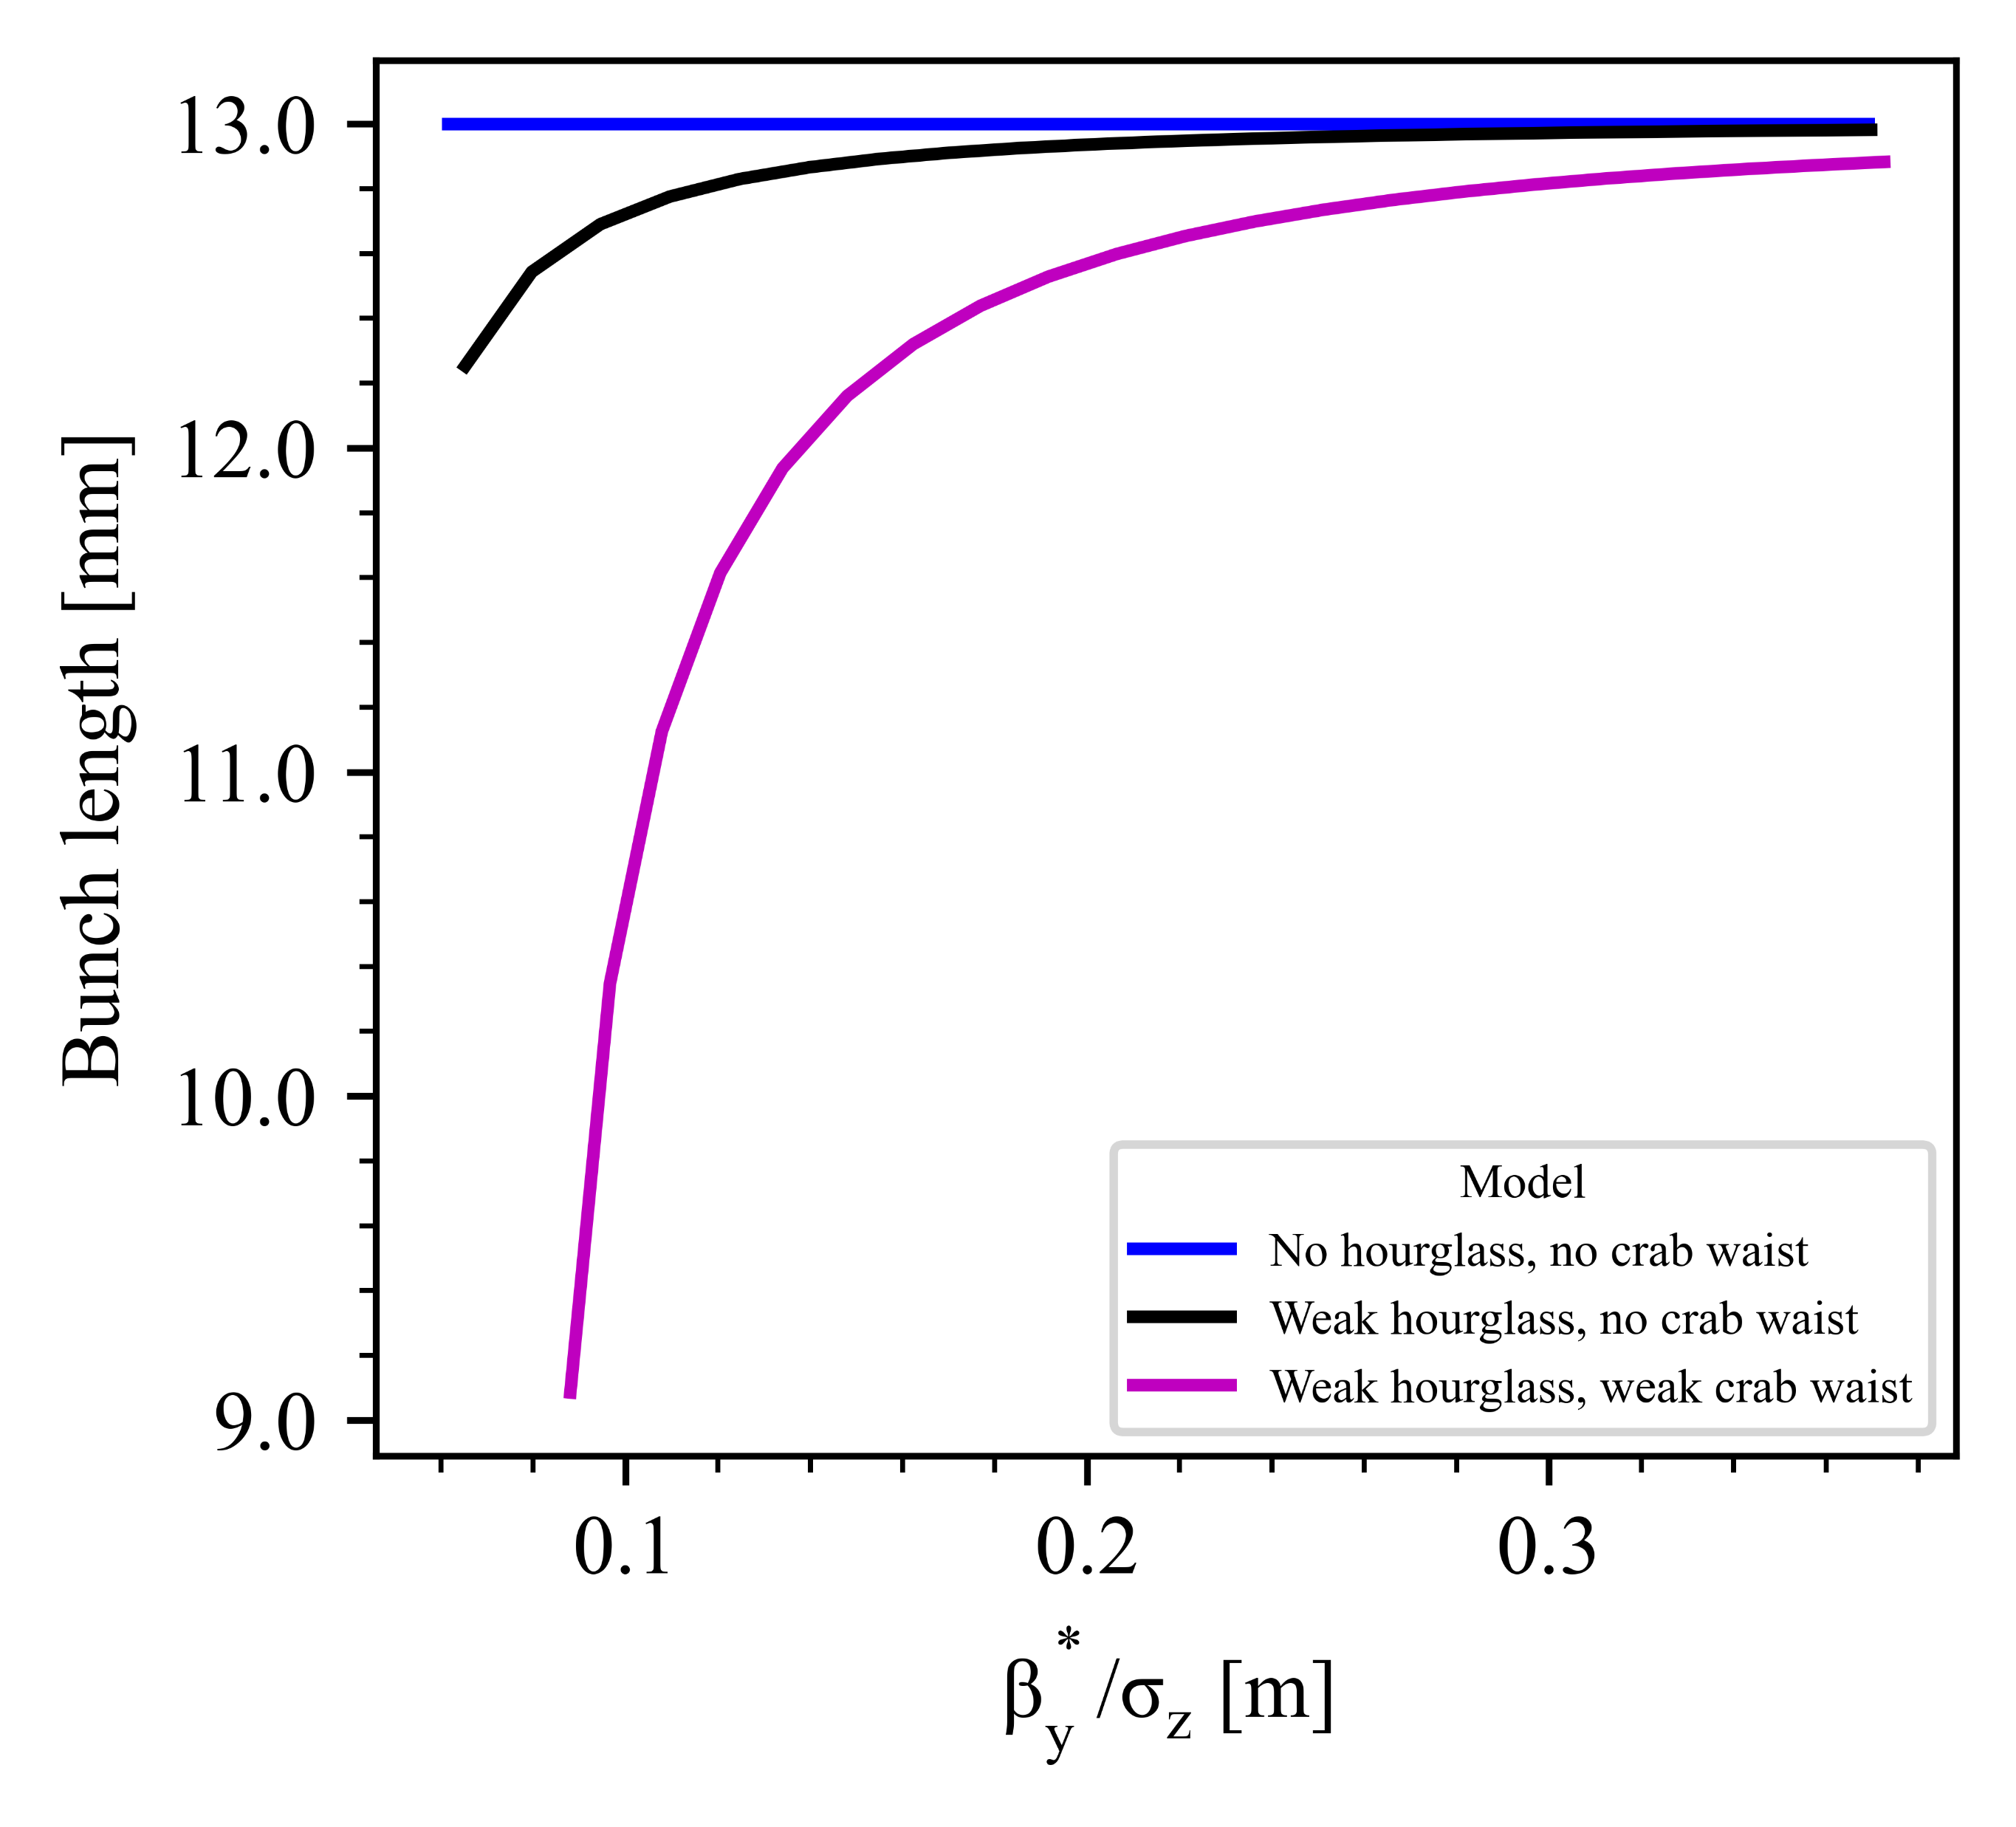

Beamstrahlung equilibrium lengths: symmetric intensities
Calculations [1], Simulations [2]
Z has smallest β_{y}* and largest σ_{z}: vary β_{y}* to investigate
Too low β_{y}*/ σ_{z}
→Taylor series invalid
(Correction ~ ${{(β}_{y}^{∗}/σ_{z})}^{−2}$) → Result from approximation invalid
Weak hg weak CW is
worst approximation for Z
Weak hg weak CW is best approximation for WW, ZH, tt1, tt2
Notes:
Focus on lifetime first before fitting a curve into right figure
Draw right figure in lg lg to see how the error varies.

Slide 16
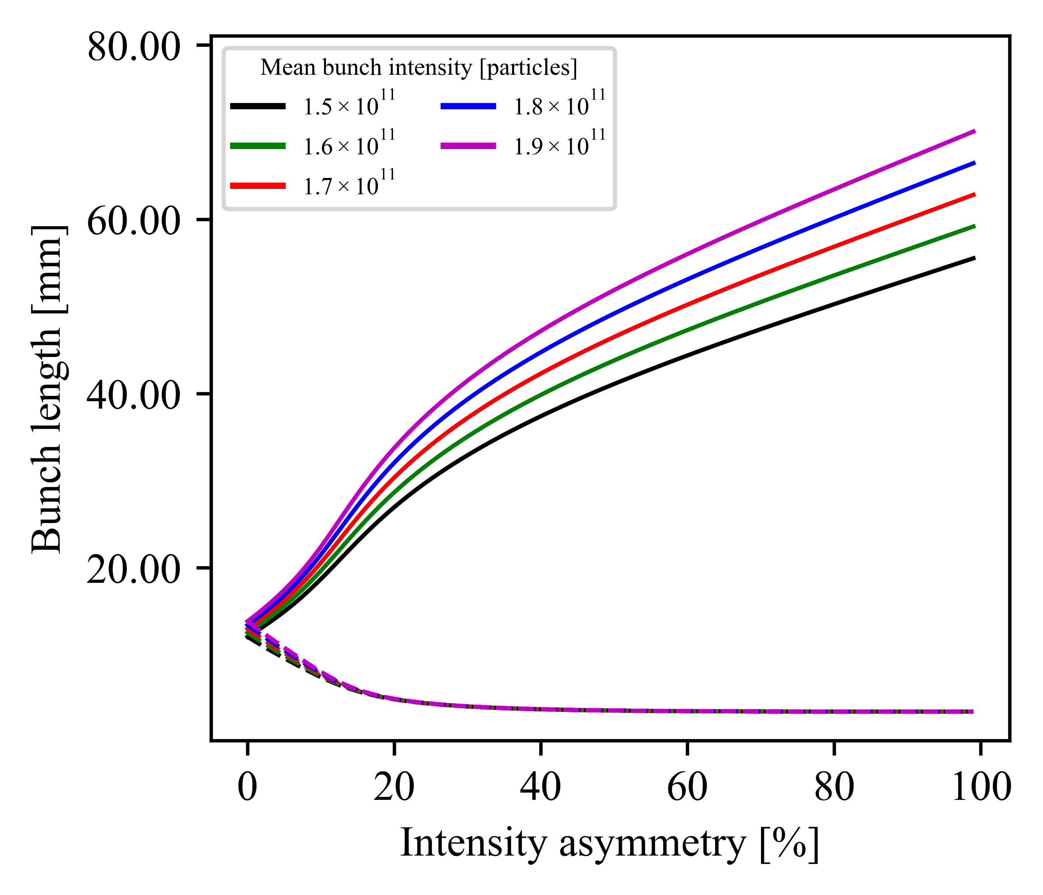
Beamstrahlung equilibrium lengths:
asymmetric intensities
Increasing
mean intensity
Weak blows up
Z, no hg, no CW
Strong shrinks to SR value

Slide 17
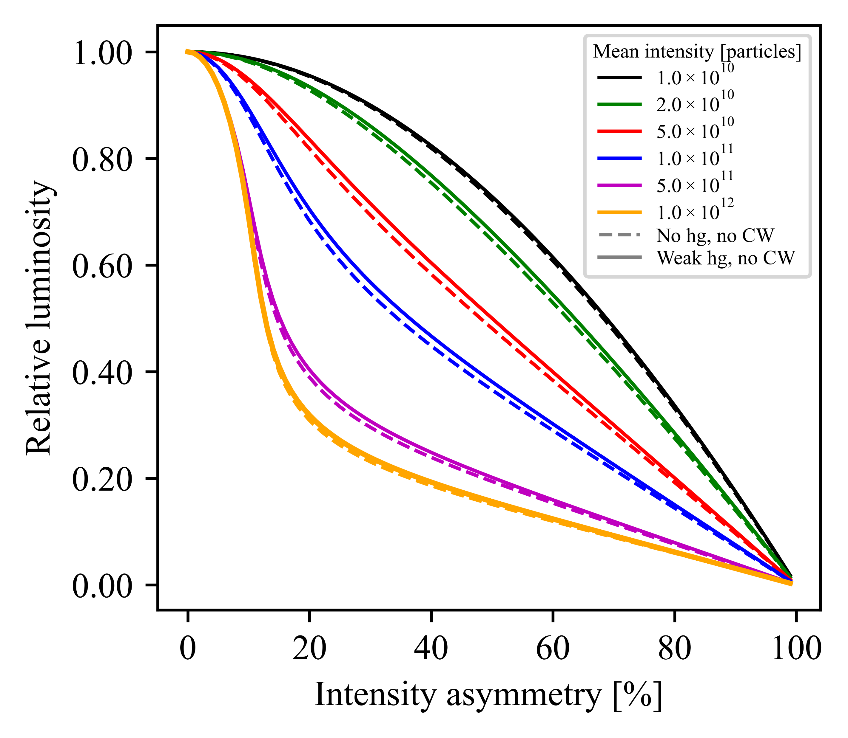
Luminosity per interaction point [3]
Accounting for weak hg/cw only
slightly affects relative luminosity
SR-dominated: Relative luminosity drops at an increasing rate with increasing intensity asymmetry.
BS-dominated: Relative luminosity drops rapidly at low intensity asymmetry.
Z resonance

Slide 18
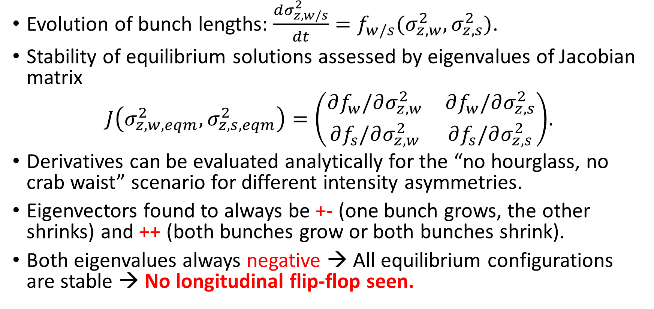
Stability analysis of equilibrium solutions
Evolution of bunch lengths: $\frac{dσ_{z,w/s}^{2}}{dt}=f_{w/s}(σ_{z,w}^{2},σ_{z,s}^{2})$.
Stability of equilibrium solutions assessed by eigenvalues of Jacobian matrix
$J\left(σ_{z,w,eqm}^{2},σ_{z,s,eqm}^{2}\right)=\left(\begin{matrix}∂f_{w}/∂σ_{z,w}^{2} & ∂f_{w}/∂σ_{z,s}^{2} \\ ∂f_{s}/∂σ_{z,w}^{2} & ∂f_{s}/∂σ_{z,s}^{2}\end{matrix}\right)$.
Derivatives can be evaluated analytically for the “no hourglass, no crab waist” scenario for different intensity asymmetries.
Eigenvectors found to always be +- (one bunch grows, the other shrinks) and ++ (both bunches grow or both bunches shrink).
Both eigenvalues always negative → All equilibrium configurations are stable → No longitudinal flip-flop seen.
Notes:
(Don’t say that I am sad → say that the arc damping is dominant in the end)

Slide 19
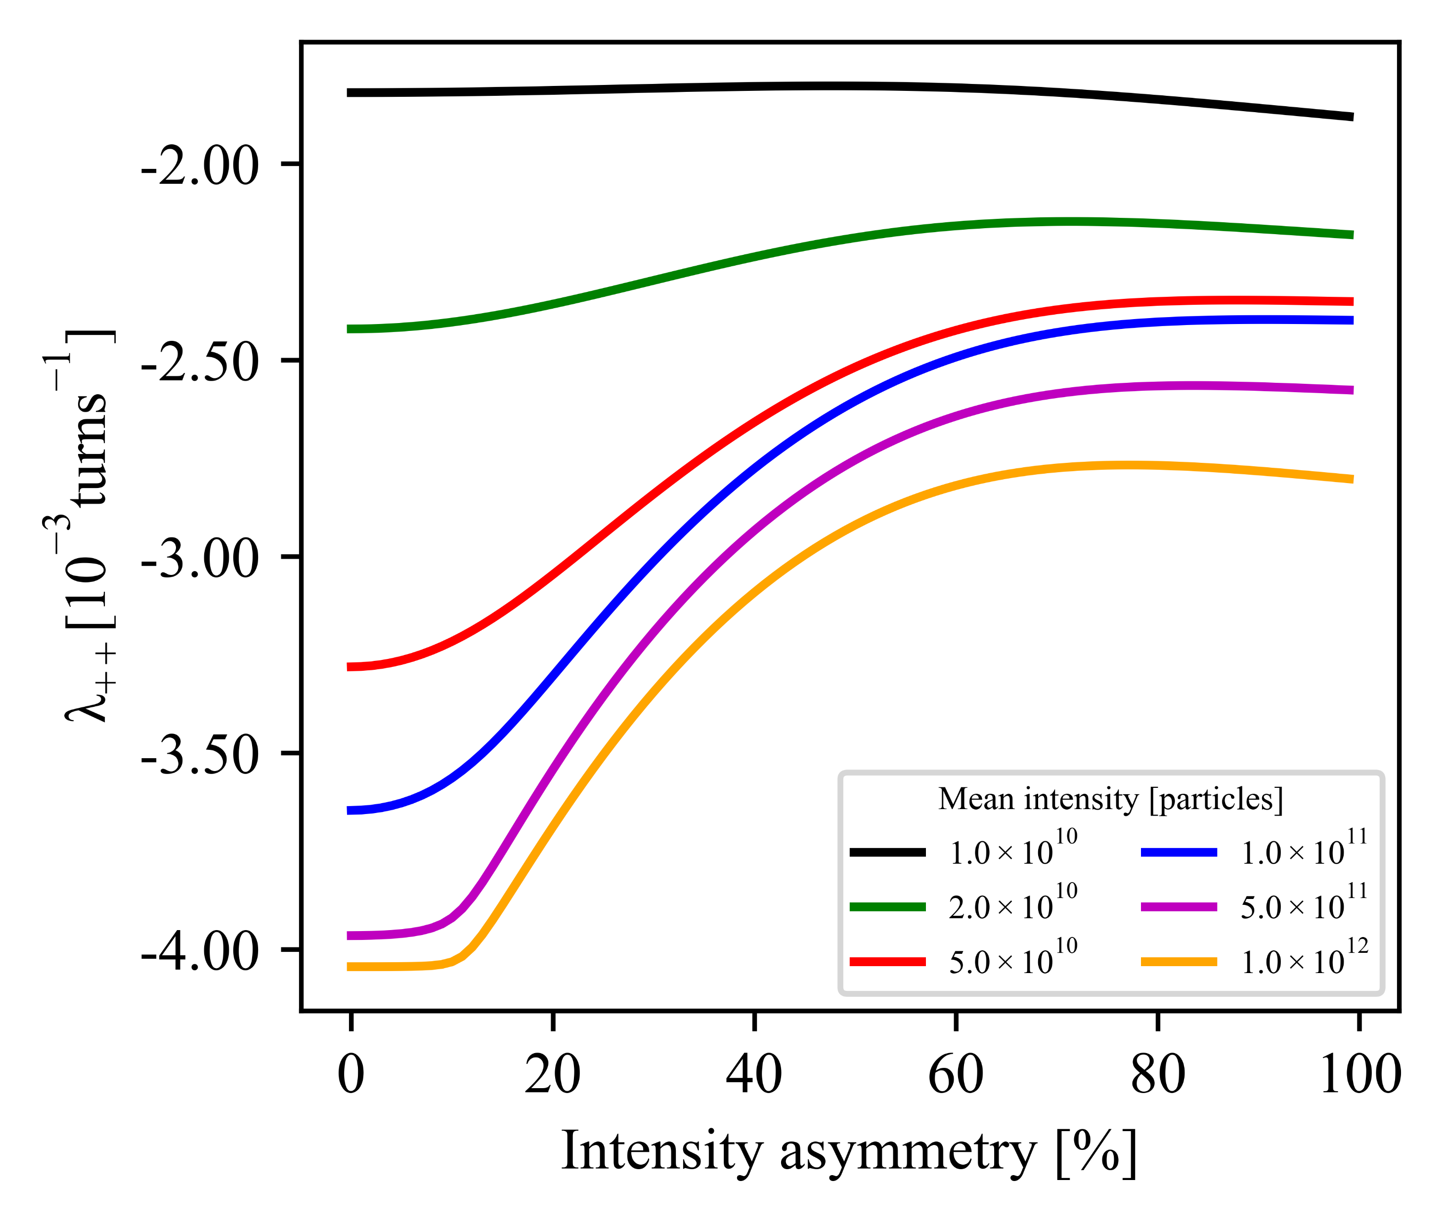
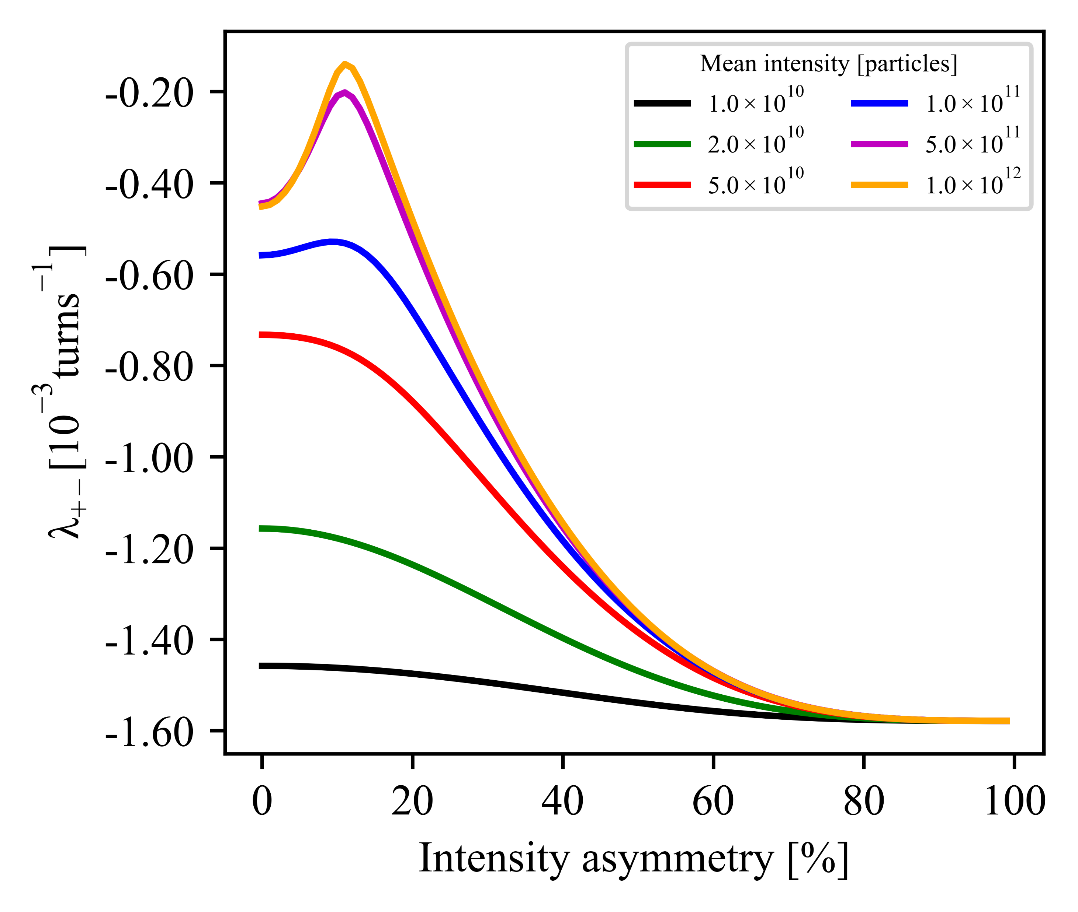



Stability analysis of equilibrium solutions
Increasing intensity
|+- eigenvalue| small
→ damping time ~ $10τ_{z, SR}$.
|++ eigenvalue| large
→ damping times $≪τ_{z, SR}$.
Z, +-
Increasing intensity
$${\sim τ}_{z,SR}^{−1}$$
Z, ++
+- perturbation mode slow to dissipate in these parameter ranges, affecting top-up injection mechanism at high mean intensity.
Notes:
Annotate diagrams with increasing mean intensity and expected SR damping time. Then include a table of the ratio of max eigenvalue with expected SR damping time.

Slide 20
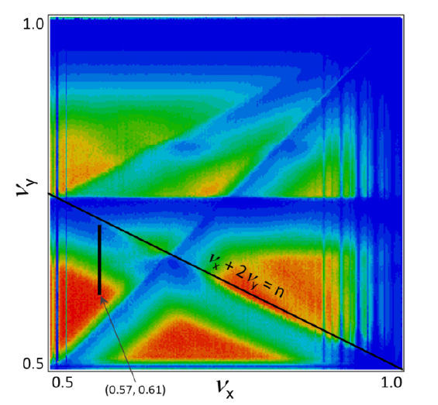



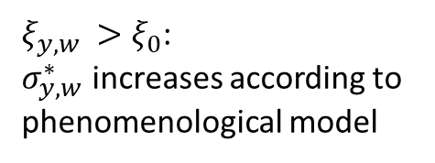
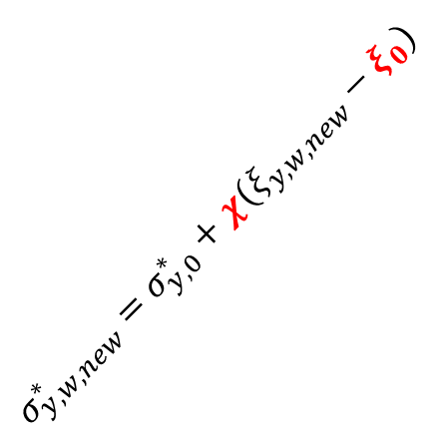
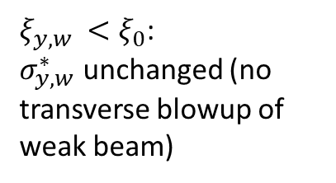
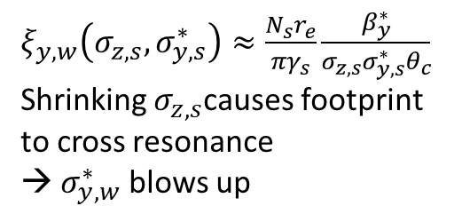

Transverse blow-up:
a phenomenological model
$$σ_{y,w}^{∗}$$
$ξ_{y,w}\left(σ_{z,s},σ_{y,s}^{∗}\right)≈\frac{N_{s}r_{e}}{πγ_{s}}\frac{β_{y}^{∗}}{σ_{z,s}σ_{y,s}^{∗}θ_{c}}$
Shrinking $σ_{z,s}$causes footprint to cross resonance
→ $σ_{y,w}^{∗}$ blows up
Parameters to be found from simulations
$ξ_{y,w }<ξ_{0}$:
$σ_{y,w}^{∗}$ unchanged (no transverse blowup of weak beam)
$$σ_{y, w, new}^{∗}=σ_{y, 0}^{∗}+χ(ξ_{y,w,new}−ξ_{0})$$
$ξ_{y,w }>ξ_{0}$:
$σ_{y,w}^{∗}$ increases according to phenomenological model
$$σ_{y, 0}^{∗}$$
Tune footprint
Luminosity as a function of betatron tunes [2]
$$ξ_{0}$$
$$ξ_{y, w}$$

Slide 21
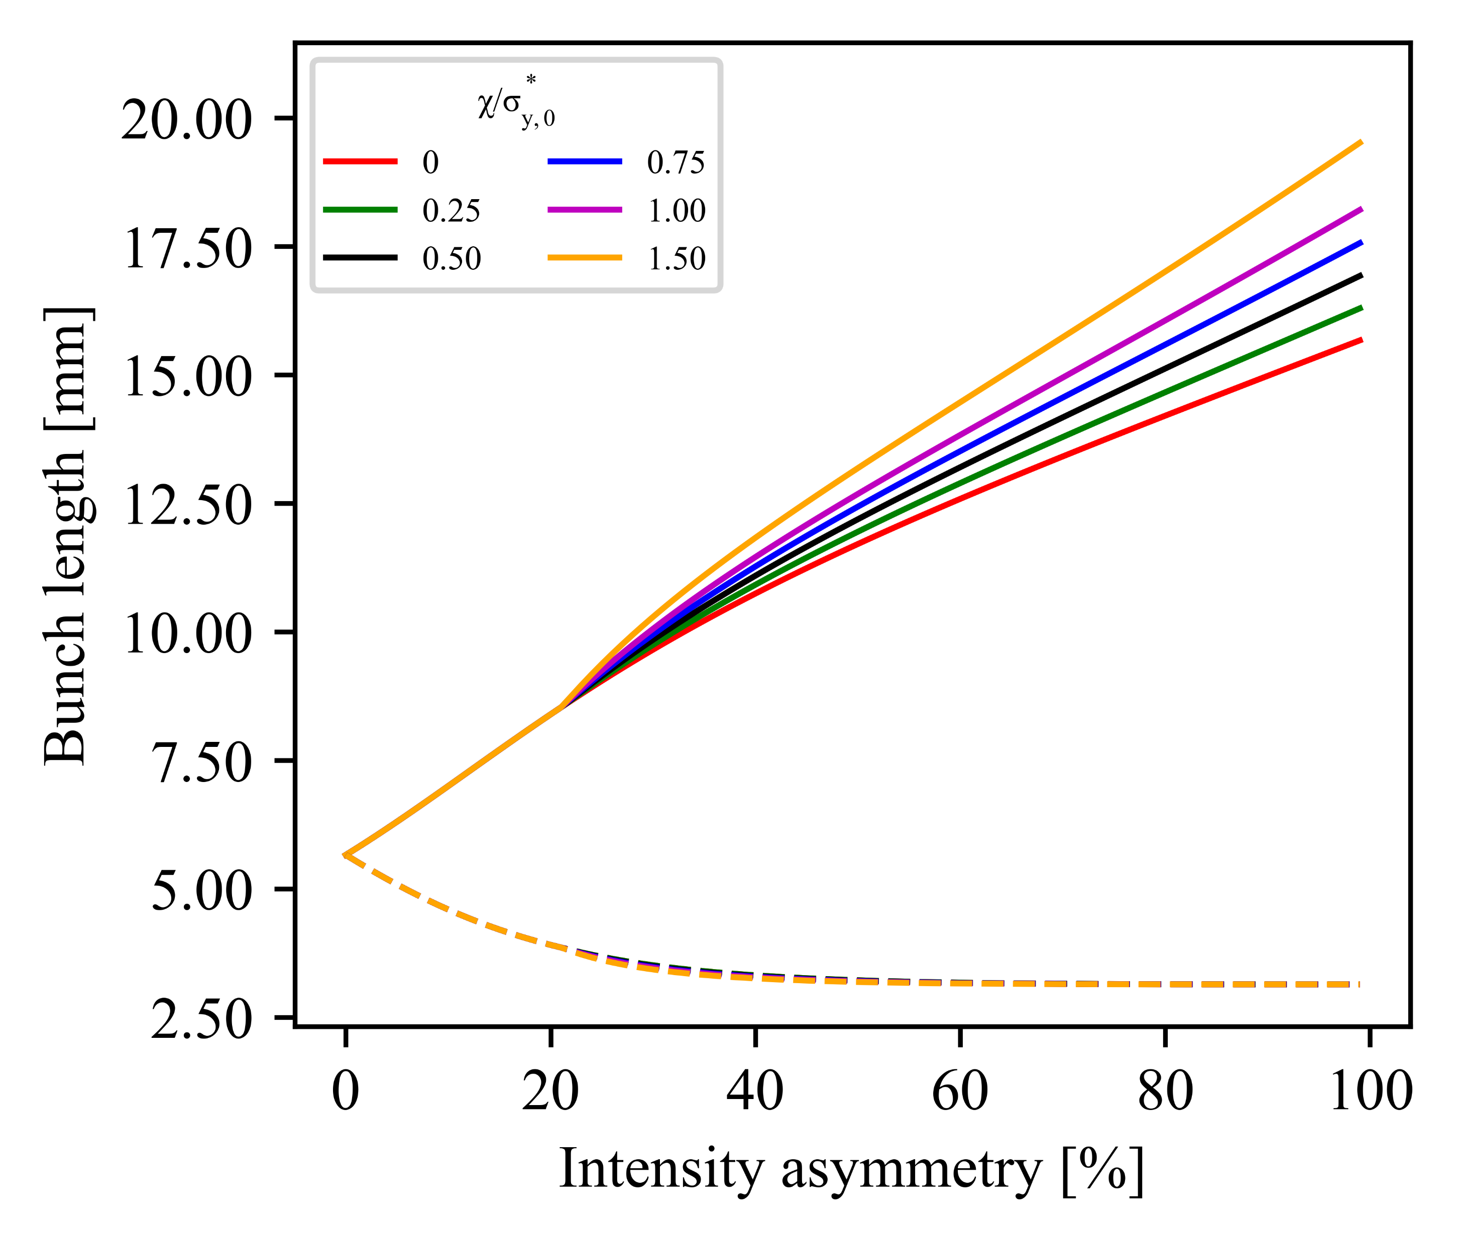
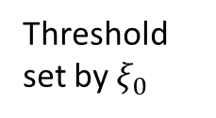

Transverse blow-up: bunch lengths
Increasing $χ/σ_{y,0}^{∗}$
ZH
No hourglass, no crab waist
Hg/CW slightly reduces longitudinal blowup.
Longitudinal blow-up enhanced by 3D model
Threshold set by $ξ_{0}$
1D
3D

Slide 22
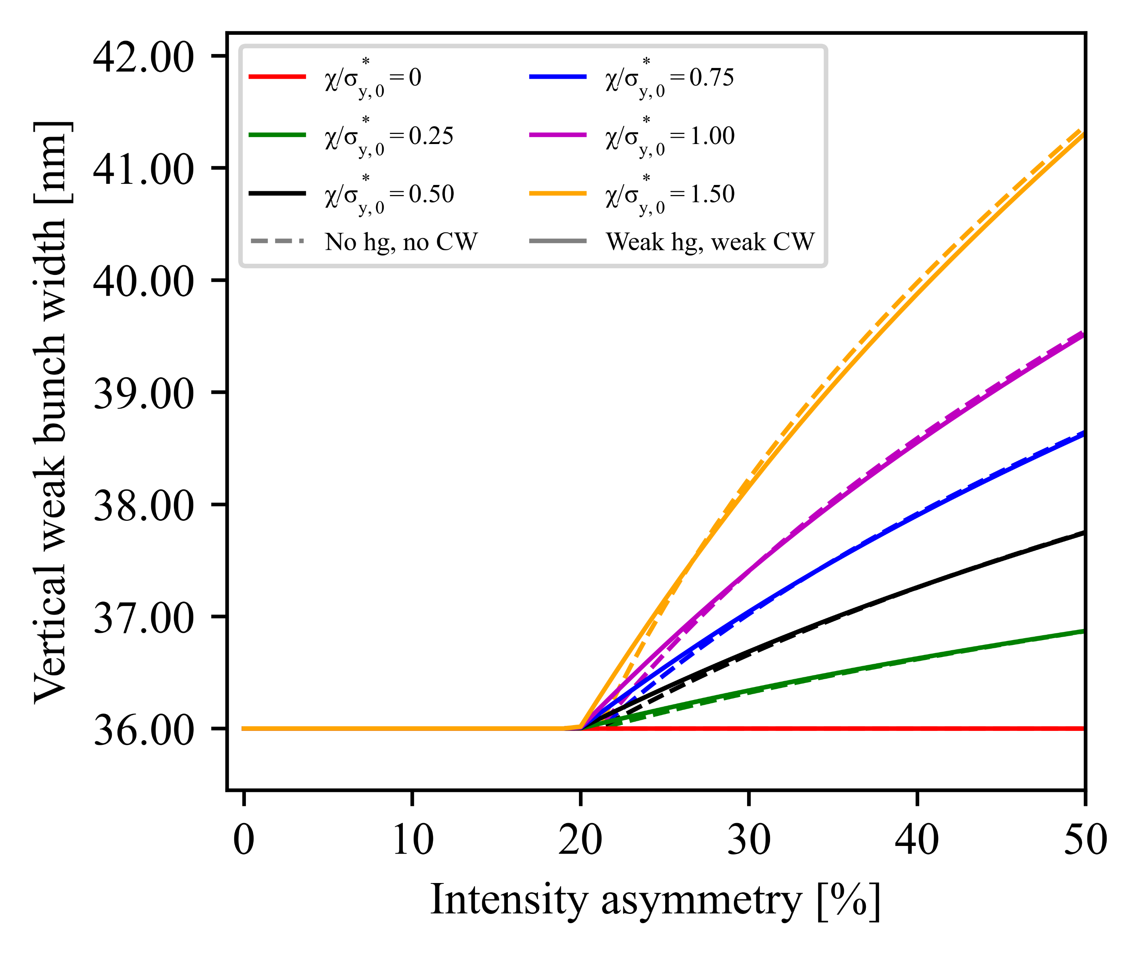
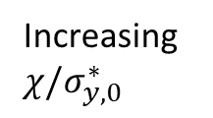
Transverse blow-up: weak y-width
Increasing $χ/σ_{y,0}^{∗}$
Effect of hg+CW on
y-width is complicated
Transversal blow-up caused by 3D model
ZH
ξ₀ = 0.20
1D
3D

Slide 23
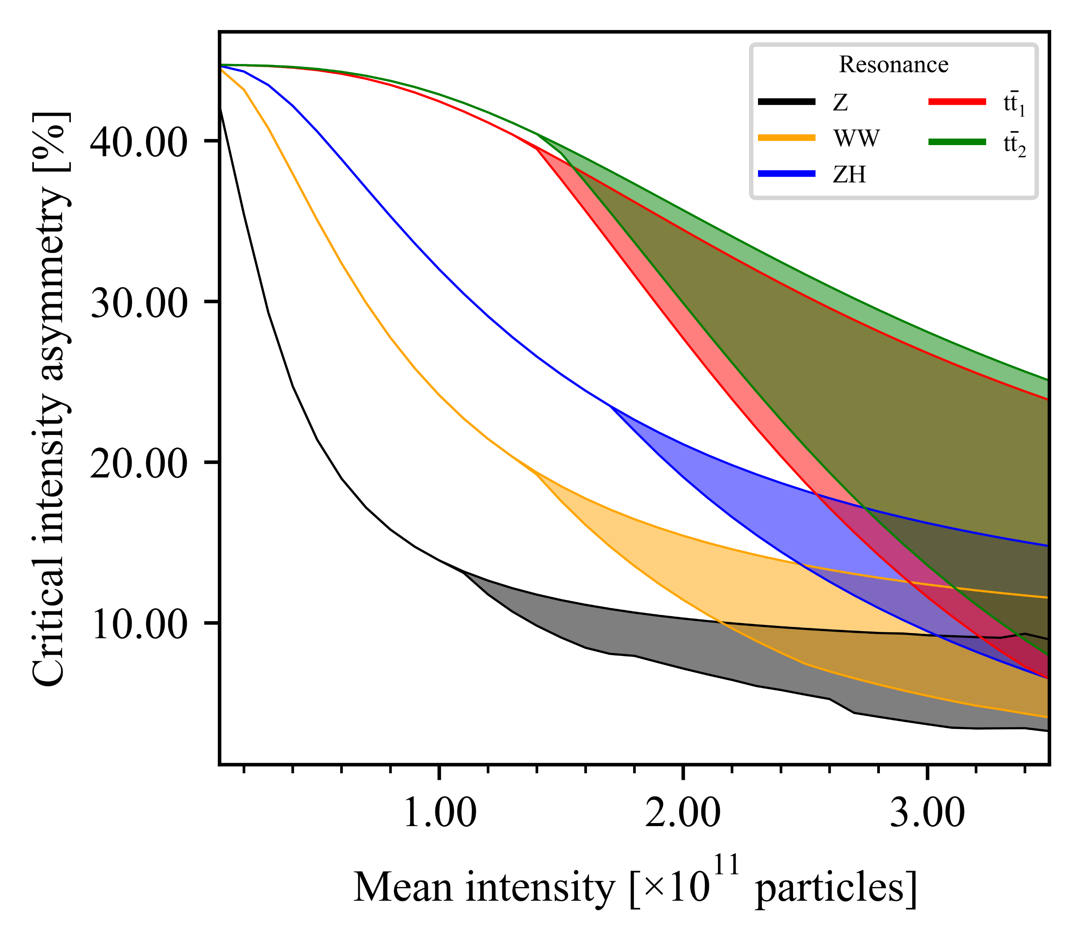
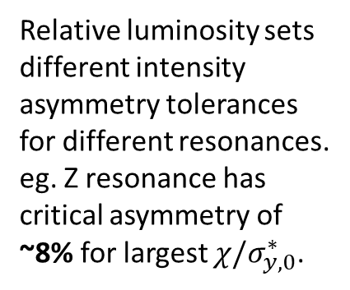

Impact of transverse blow-up on luminosity
Lower bound:
$χ/σ_{y,0}^{∗}=0$ (effectively 1D)
Upper bound:
$χ/σ_{y,0}^{∗}=1.50$
Model:
No hourglass, no crab waist
Relative luminosity sets different intensity asymmetry tolerances for different resonances.
eg. Z resonance has critical asymmetry of ~8% for largest $χ/σ_{y,0}^{∗}$.
L_{rel, thres} = 80%
ξ₀ = 0.20
Notes:
Arbitrary → “Educated guess” (needs to be looked at more carefully with simulations)

Slide 24
Beamstrahlung lifetime
The “beamstrahlung lifetime” has been measured in simulations [4], giving intensity asymmetry thresholds of ±5% (Z) and ±3% (other resonances).
→ Almost the same for Z resonance luminosity restriction with current range of parameters, but much more stringent for other resonances.
Analytical formulae [5] are for symmetric collisions only and would only include strong parameters for asymmetric collisions → No additional formula found.
Analytical results greatly overestimates lifetime [4].

Slide 25
Summary and conclusions
Developed analytical methods to evaluate equilibrium bunch lengths for collisions between Gaussian beams with arbitrary parameters, including crossing angle, hourglass effect and crab waist optics.
Step up from previous work.
Expressions used to calculate luminosity and to show via linear stability analysis that longitudinal flip-flop does not exist.
However, eigenvalues corresponding to long damping times may still impact top-up injection scheme.
Extended the model to account for 3D flip-flop in transversal blow-up of the weak beam; verify models and find phenomenological parameters by comparing with future simulations.
Explored constraints on allowed intensity asymmetry through luminosity degradation limit, comparing with beamstrahlung lifetime requirements.
Thresholds are almost the same for Z resonance but BS lifetime is more stringent for others.

Slide 26
References
[1] M. A. V. Garcia and F. Zimmermann, Beam blow up due to beamstrahlung in circular e⁺e⁻ colliders, The European Physical Journal Plus 136, 501 (2021).
[2] D. Shatilov, FCC-ee parameter optimisation, ICFA Beam Dynamics Newsletter 72, 30 (2017).
[3] H. Damerau, Creation and storage of long and flat bunches in the LHC, Ph.D. thesis, Technische Universität Darmstadt (2005).
[4] A. Abada, M. Abbrescia, S. AbdusSalam, et al., FCC-ee: The lepton collider, The European Physical Journal Special Topics 228, 261 (2019).
[5] A. Bogomyagkov, E. Levichev, and D. Shatilov, Beam-beam effects investigation and parameters optimization for a circular e⁺e⁻ collider at very high energies, Physical Review Special Topics – Accelerators and Beams 17 (2014).

Slide 28
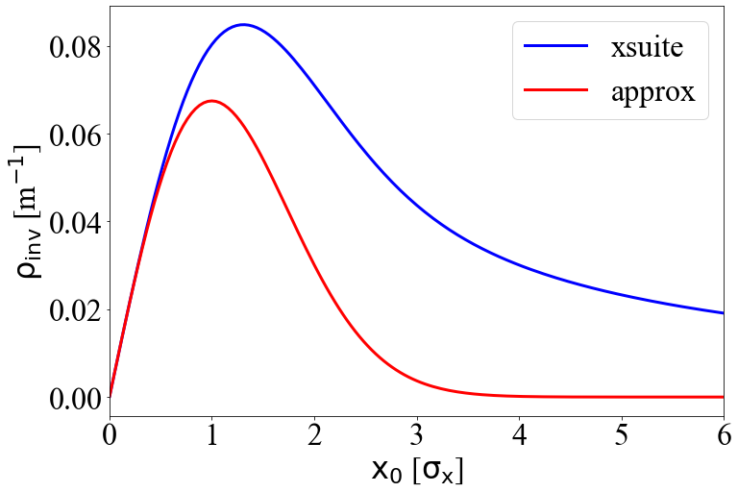
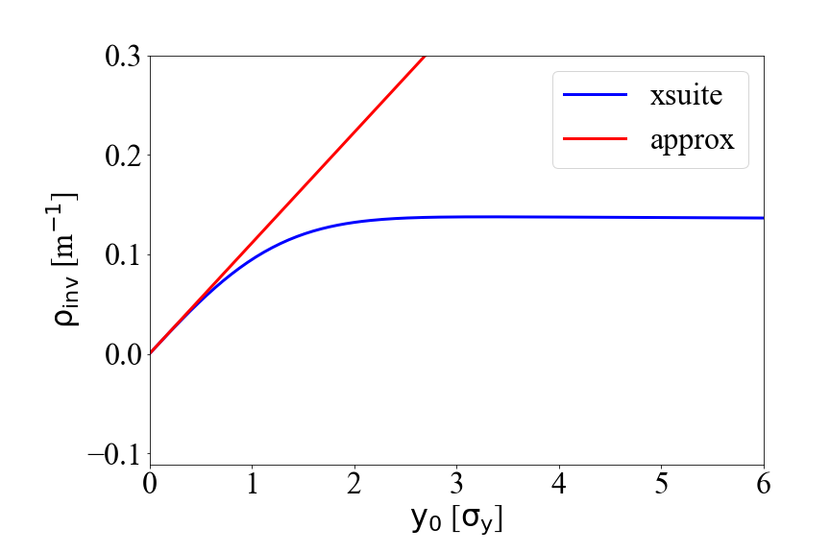
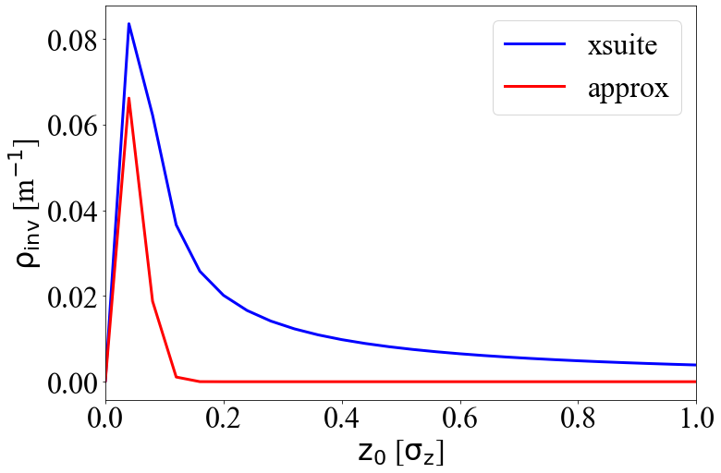
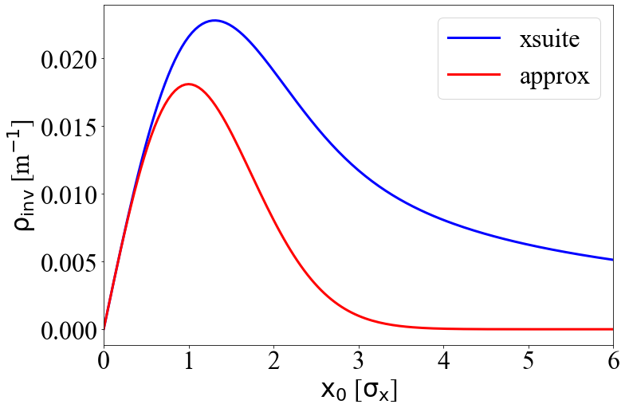
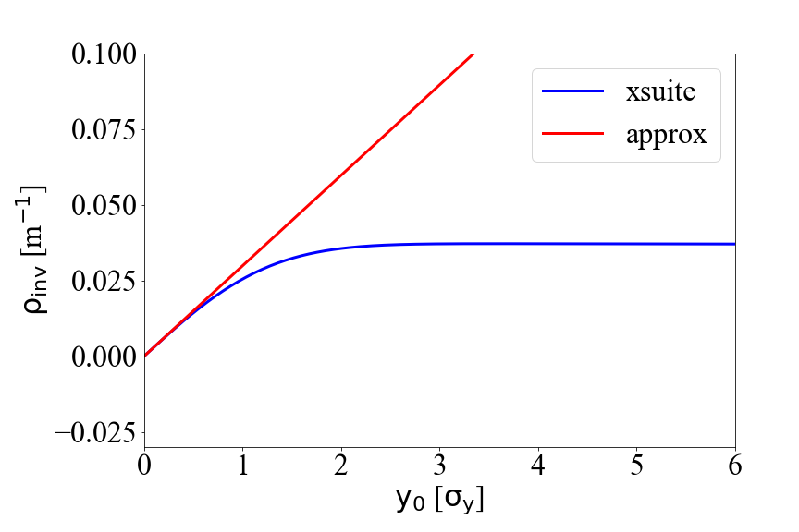
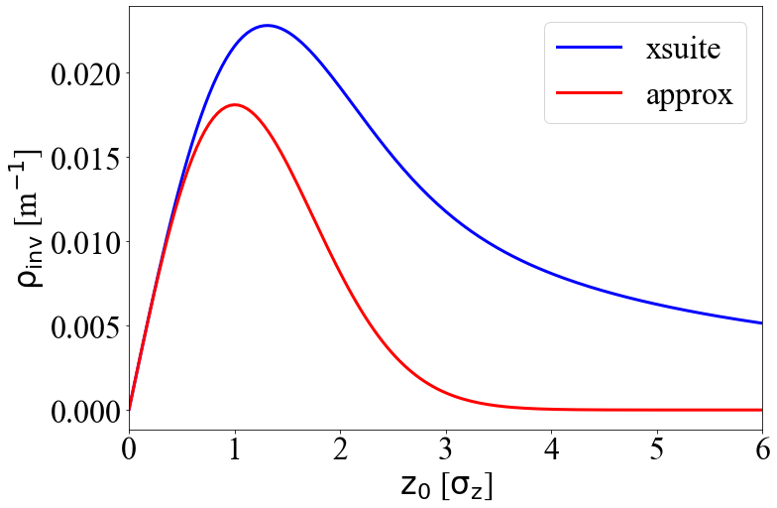
Validity of analytical approximation
Backup (P. Kicsiny)
Z
45.6 GeV
ttbar
182.5 GeV
Notes:
to investigate thsi transverse blowup we have performed a scan in the X tune to see the working points where coherenet instabilitiy is present. on this plot you can see the equilibrium horizontal bunch length as a function of the horizontal tune for the two beams in a strongstrong simulation. the red vertical line on the plots indicate the nominal fcc working point. you can see that we are on a peak so that is the cause of the blowup. when we decrease the horizontal beta function by half we saw that these peaks got narrower which is what we expected since reducting the beta is a common way to mitigate transverse blowup. but in general the nominal working point is not supposed to sit on a peak so this is under investigation.

Slide 29
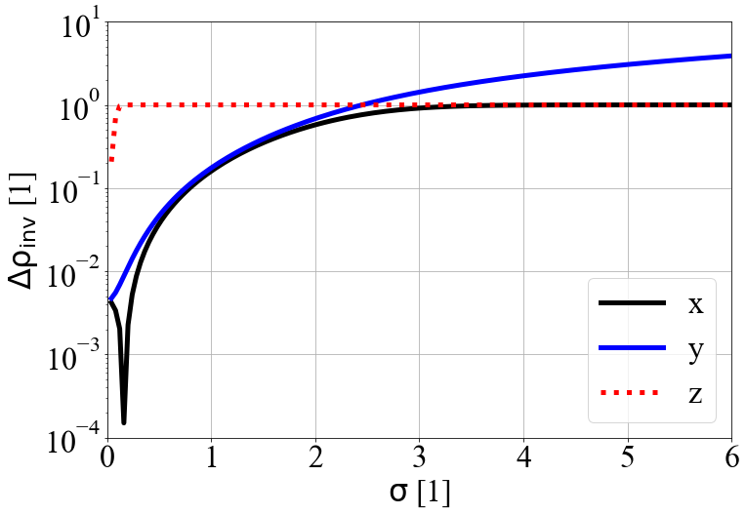
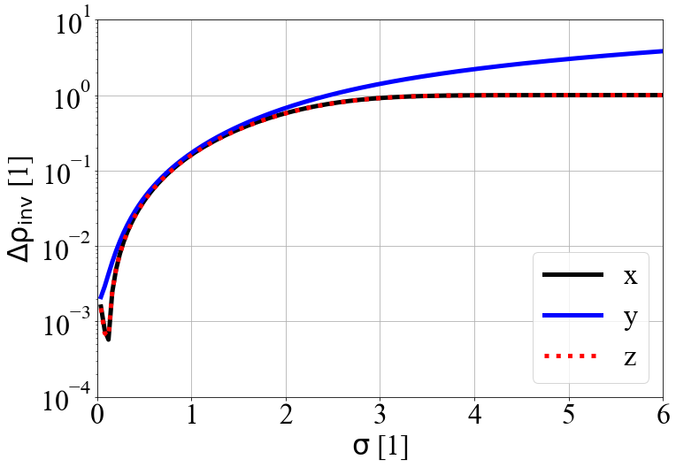
Validity of analytical approximation
Backup (P. Kicsiny)
Z
45.6 GeV
ttbar
182.5 GeV
Comparison to xsuite
Within +/- 1σ up to 10% rel. abs. error between simulation and theoretical approximation (|rho_approx-rho_xsuite| / rho_xsuite)
Notes:
to investigate thsi transverse blowup we have performed a scan in the X tune to see the working points where coherenet instabilitiy is present. on this plot you can see the equilibrium horizontal bunch length as a function of the horizontal tune for the two beams in a strongstrong simulation. the red vertical line on the plots indicate the nominal fcc working point. you can see that we are on a peak so that is the cause of the blowup. when we decrease the horizontal beta function by half we saw that these peaks got narrower which is what we expected since reducting the beta is a common way to mitigate transverse blowup. but in general the nominal working point is not supposed to sit on a peak so this is under investigation.

Slide 30
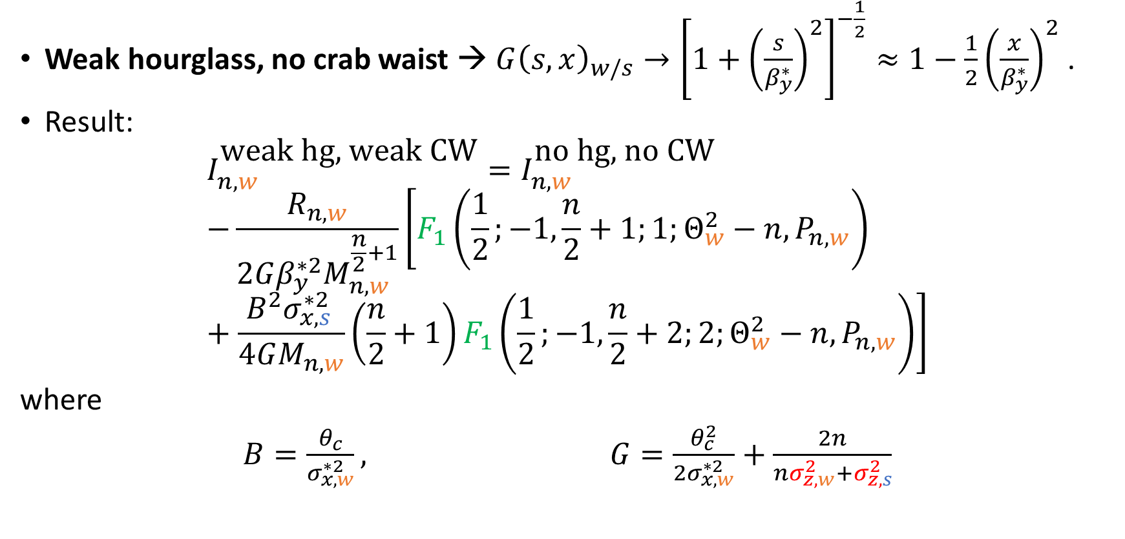
Beamstrahlung equilibrium length: simplifying assumptions
Weak hourglass, no crab waist → $G{\left(s,x\right)}_{w/s}→{\left[1+{\left(\frac{s}{β_{y}^{∗}}\right)}^{2}\right]}^{−\frac{1}{2}}≈1−\frac{1}{2}{\left(\frac{x}{β_{y}^{∗}}\right)}^{2}$ .
Result:
$$I_{n,w}^{\text{weak} \text{hg}\text{, }\text{weak} \text{CW}}=I_{n,w}^{\text{no} \text{hg}\text{, }\text{no} \text{CW}} \\ −\frac{R_{n,w}}{2Gβ_{y}^{∗2}M_{n,w}^{\frac{n}{2}+1}}\left[F_{1}\left(\frac{1}{2};−1,\frac{n}{2}+1;1;Θ_{w}^{2}−n, P_{n,w}\right)+\frac{B^{2}σ_{x,s }^{∗2}}{4GM_{n,w}}\left(\frac{n}{2}+1\right)F_{1}\left(\frac{1}{2};−1,\frac{n}{2}+2;2;Θ_{w}^{2}−n, P_{n,w}\right)\right]$$
where
$B=\frac{θ_{c}}{σ_{x,w}^{∗2 }}, G=\frac{θ_{c}^{2}}{2σ_{x,w}^{∗2}}+\frac{2n}{nσ_{z,w}^{2}+σ_{z,s}^{2}}$
Correction terms
Notes:
Make the link between the expressions with the physics → what do they represent?
Have a picture of the collisions. Explain what is meant by crossing angle, hourglass effect…

Slide 31
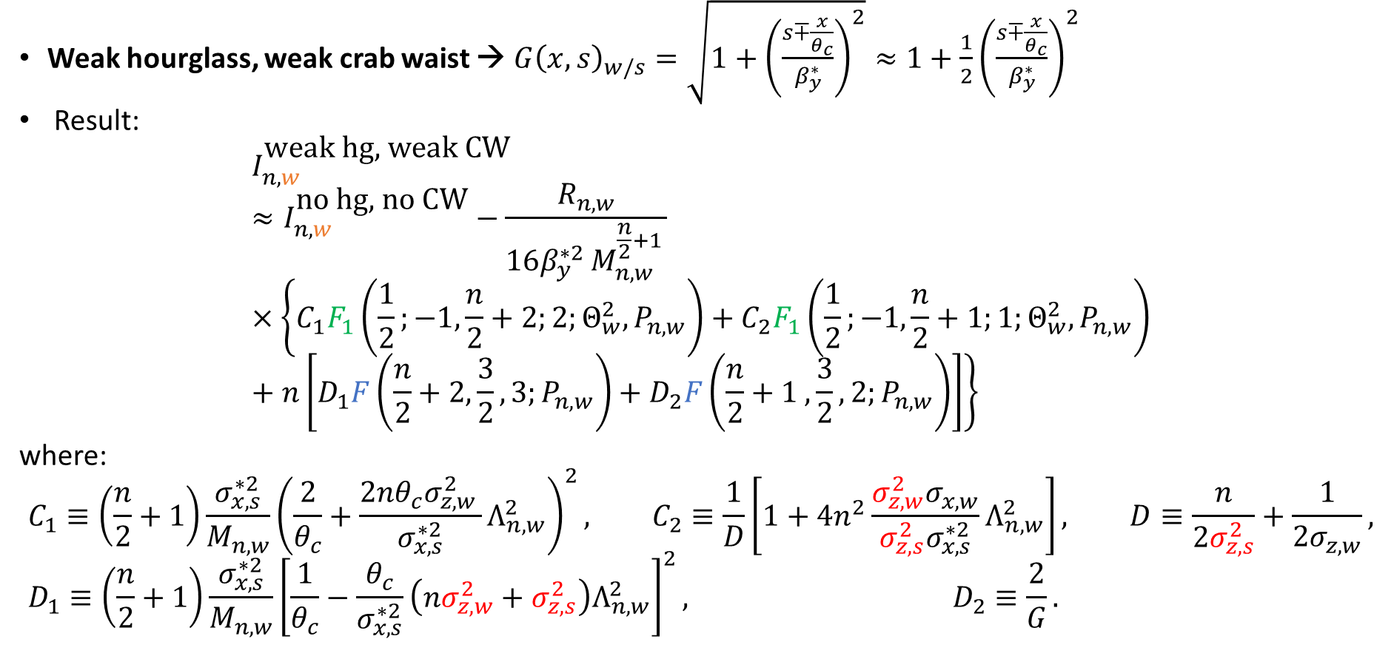
Beamstrahlung equilibrium length: simplifying assumptions
Weak hourglass, weak crab waist → $G{\left(x,s\right)}_{w/s}=\sqrt{1+{\left(\frac{s∓\frac{x}{θ_{c}}}{β_{y}^{∗}}\right)}^{2}}≈1+\frac{1}{2}{\left(\frac{s∓\frac{x}{θ_{c}}}{β_{y}^{∗}}\right)}^{2}$
Result:
$$I_{n,w }^{\text{weak} \text{hg}\text{, }\text{weak} \text{CW}}≈I_{n,w }^{\text{no} \text{hg}\text{, }\text{no} \text{CW}}−\frac{R_{n,w}}{16β_{y}^{∗2 }M_{n,w }^{\frac{n}{2}+1 }}×\left\{C_{1}F_{1}\left(\frac{1}{2};−1,\frac{n}{2}+2;2;Θ_{w}^{2},P_{n,w}\right)+C_{2}F_{1}\left(\frac{1}{2};−1,\frac{n}{2}+1;1;Θ_{w}^{2},P_{n,w}\right)+n\left[D_{1}F\left(\frac{n}{2}+2,\frac{3}{2},3;P_{n,w}\right)+D_{2}F\left(\frac{n}{2}+1 ,\frac{3}{2},2;P_{n,w}\right)\right]\right\}$$
where:
$$C_{1}≡\left(\frac{n}{2}+1\right)\frac{σ_{x,s}^{∗2}}{M_{n,w}}{\left(\frac{2}{θ_{c}}+\frac{2nθ_{c}σ_{z,w }^{2}}{σ_{x,s}^{∗2}}Λ_{n,w}^{2}\right)}^{2}, C_{2}≡\frac{1}{D}\left[1+4n^{2}\frac{σ_{z,w}^{2}σ_{x,w}}{σ_{z,s}^{2}σ_{x,s}^{∗2}}Λ_{n,w}^{2}\right], D≡\frac{n}{2σ_{z,s}^{2}}+\frac{1}{2σ_{z,w}}, \\ D_{1}≡\left(\frac{n}{2}+1\right)\frac{σ_{x,s}^{∗2}}{M_{n,w}}{\left[\frac{1}{θ_{c}}−\frac{θ_{c}}{σ_{x,s}^{∗2}}\left(nσ_{z,w}^{2}+σ_{z,s}^{2}\right)Λ_{n,w}^{2}\right]}^{2}, D_{2}≡\frac{2}{G}.$$
Correction terms

Slide 32
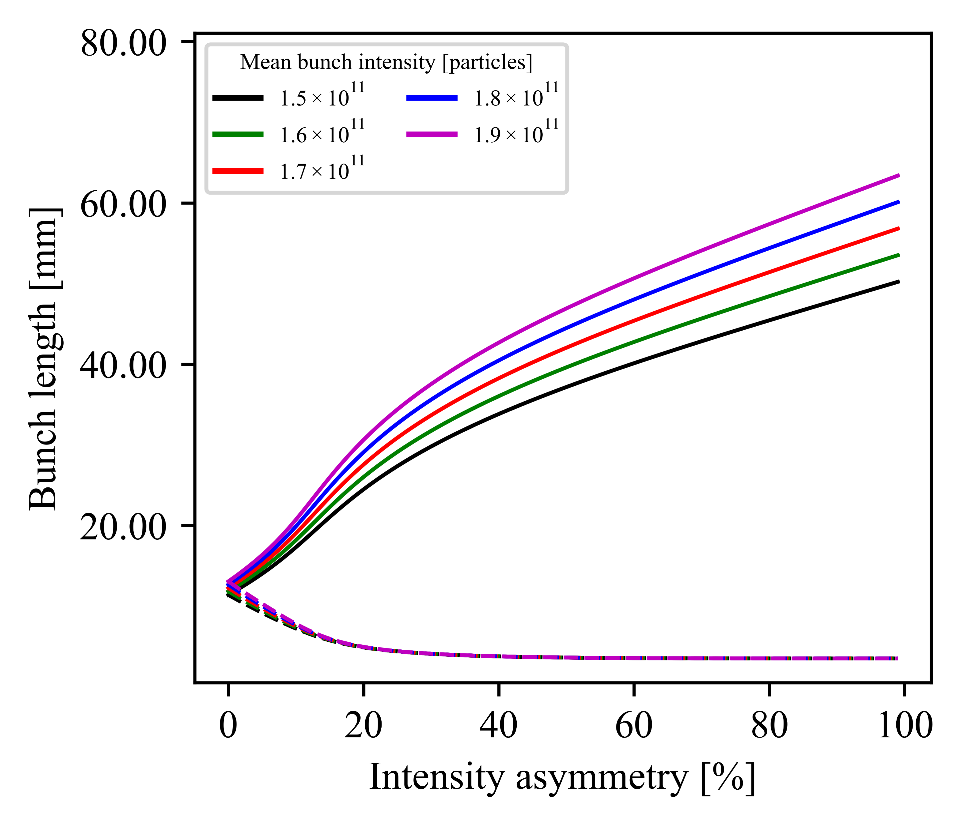
Beamstrahlung equilibrium lengths:
asymmetric intensities
Increasing
mean intensity
Weak blows up
HG suppresses
weak blowup
Z, no hg, no CW
Z, weak hg, no CW
Strong shrinks to SR value

Slide 33
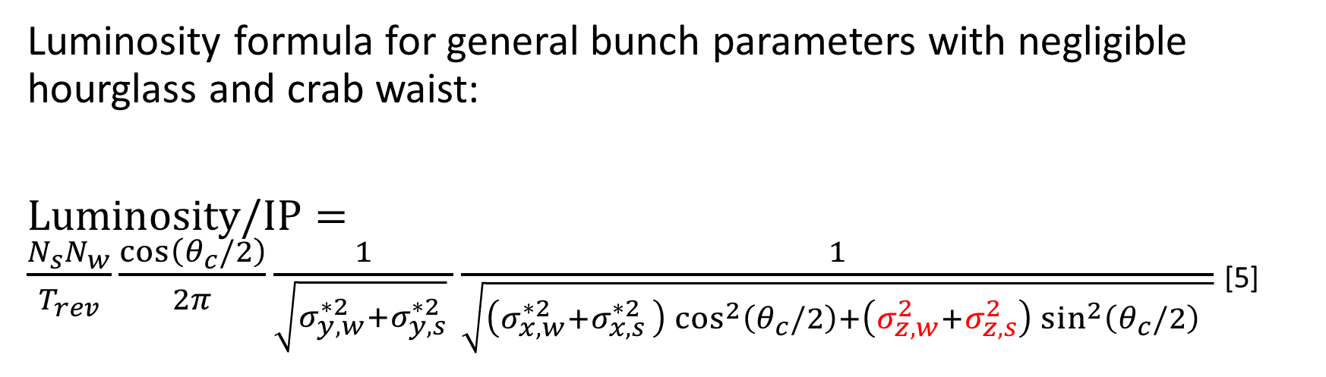
Luminosity per interaction point
Luminosity formula for general bunch parameters with negligible hourglass and crab waist:
$\text{Luminosity}\text{/}\text{IP}=\frac{N_{s}N_{w}}{T_{rev}}\frac{cos\left(θ_{c}/2\right)}{2π}\frac{1}{\sqrt{σ_{y,w}^{∗2}+σ_{y,s}^{∗2}} }\frac{1}{\sqrt{\left(σ_{x,w}^{∗2}+σ_{x,s }^{∗2}\right)\cos^{2}\left(θ_{c}/2\right)+\left(σ_{z,w}^{2}+σ_{z,s}^{2}\right)\sin^{2}\left(θ_{c}/2\right) }}$ [5]

Slide 34
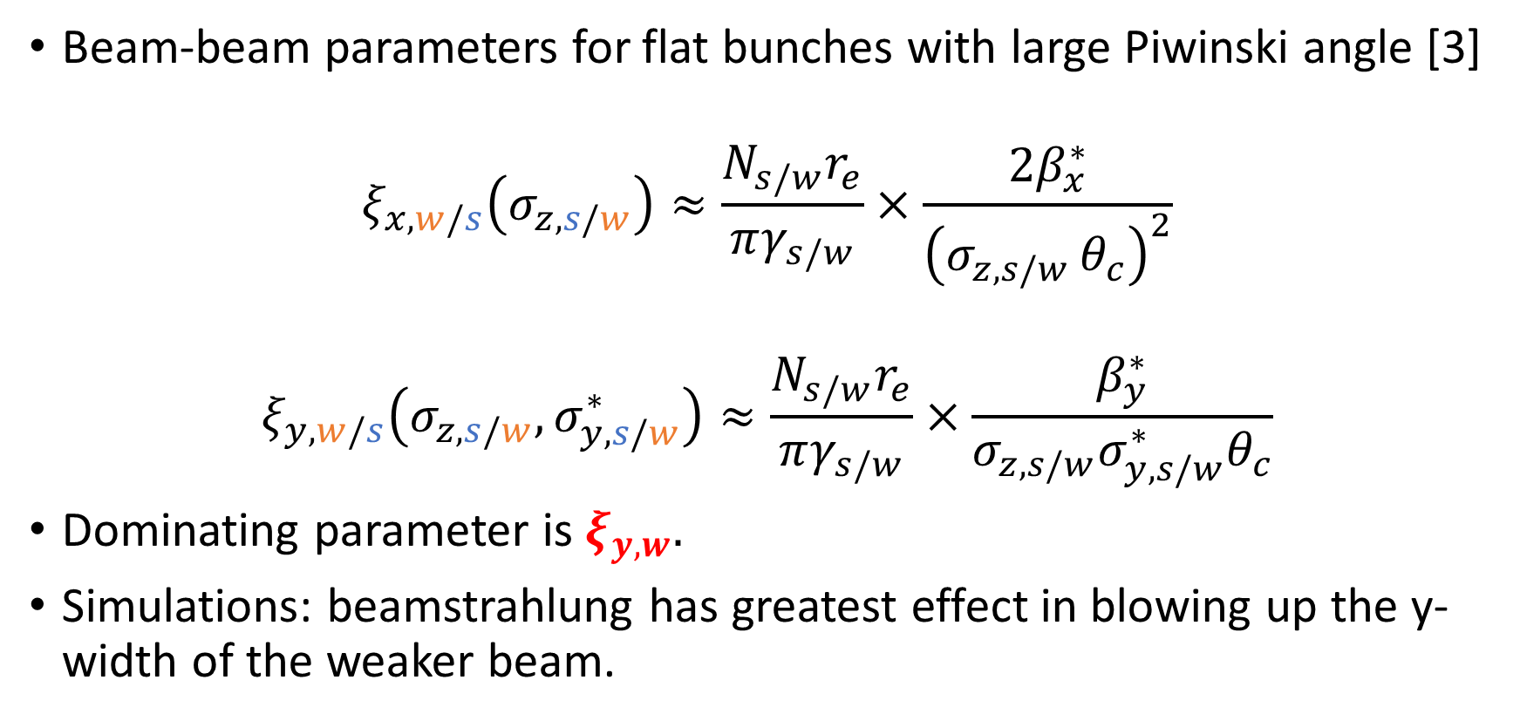
Modelling transverse blow-up
Beam-beam parameters for flat bunches with large Piwinski angle [3]
$$ξ_{x, w/s}\left(σ_{z, s/w}\right)≈\frac{N_{s/w}r_{e}}{πγ_{s/w}}×\frac{2β_{x}^{∗}}{{\left(σ_{z,s/w }θ_{c}\right)}^{2}}$$
$$ξ_{y,w/s}\left(σ_{z,s/w},σ_{y,s/w}^{∗}\right)≈\frac{N_{s/w}r_{e}}{πγ_{s/w}}×\frac{β_{y}^{∗}}{σ_{z,s/w}σ_{y,s/w}^{∗}θ_{c}}$$
Dominating parameter is $ξ_{y,w}.$
Simulations: beamstrahlung has greatest effect in blowing up the y-width of the weaker beam.

Slide 35
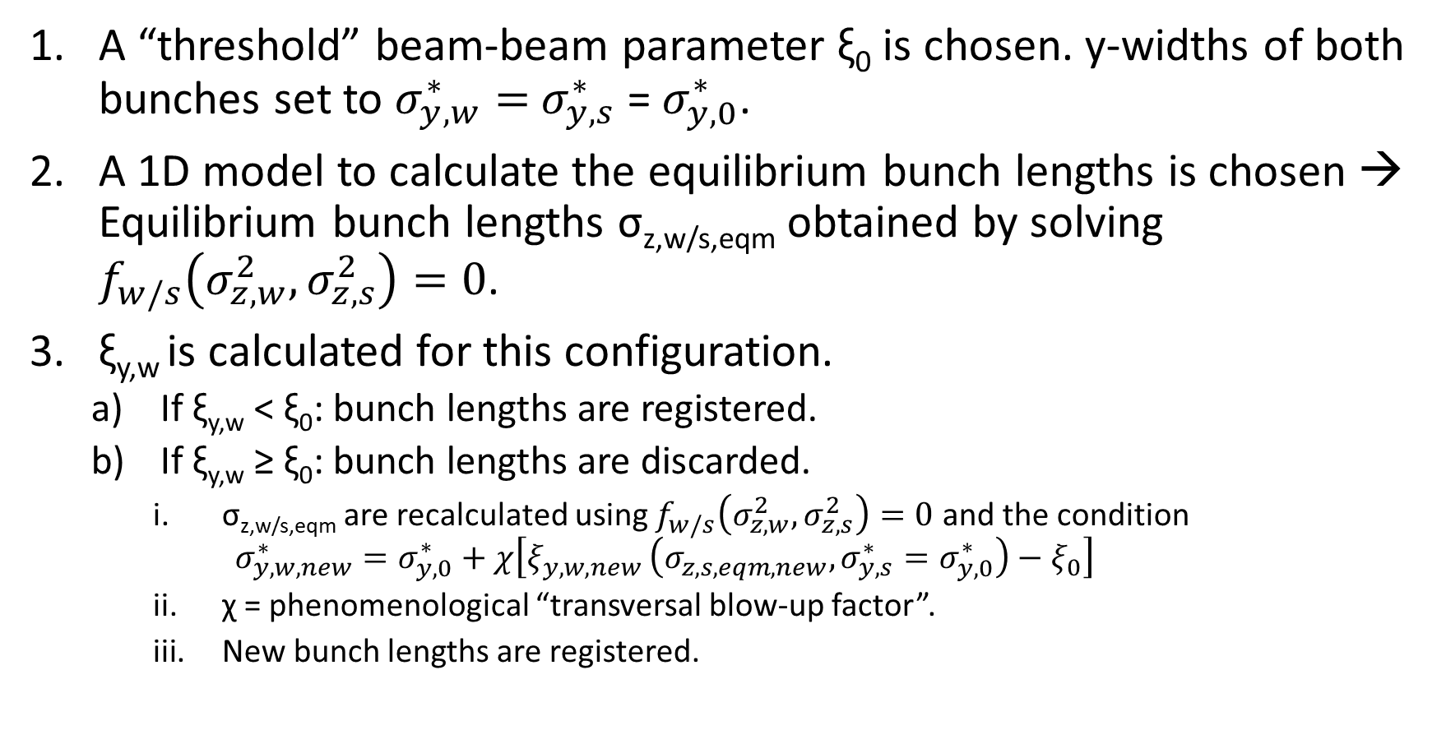
Modelling transverse blow-up
A “threshold” beam-beam parameter ξ₀ is chosen. y-widths of both bunches set to $σ_{y,w}^{∗}=$ $σ_{y,s}^{∗}$ = $σ_{y,0}^{∗}$.
A 1D model to calculate the equilibrium bunch lengths is chosen → Equilibrium bunch lengths σ_{z,w/s,eqm} obtained by solving $f_{w/s}\left(σ_{z,w}^{2},σ_{z,s}^{2}\right)=0$.
ξ_{y,w} is calculated for this configuration.
  If ξ_{y,w} < ξ₀: bunch lengths are registered.
  If ξ_{y,w} ≥ ξ₀: bunch lengths are discarded.
    σ_{z,w/s,eqm} are recalculated using $f_{w/s}\left(σ_{z,w}^{2},σ_{z,s}^{2}\right)=0$ and the condition
    $σ_{y, w, new}^{∗}=σ_{y, 0}^{∗}+χ\left[ξ_{y, w, new }\left(σ_{z, s, eqm, new}, σ_{y, s}^{∗}=σ_{y, 0}^{∗}\right)−ξ_{0}\right]$
    χ = phenomenological “transversal blow-up factor”.
    New bunch lengths are registered.

Slide 36



Transverse blow-up: bunch lengths
Longitudinal blow-up suppressed by hg+CW
Increasing $χ/σ_{y,0}^{∗}$
ZH
No hourglass, no crab waist
ZH
Weak hourglass, weak crab waist
Longitudinal blow-up enhanced by 3D model
Threshold set by $ξ_{0}$
1D
3D
1D
3D

