Slide 1



Resistive wall impedance for pipes with arbitrary cross-section
VACI Suite
Ali Rajabi
This project has received funding from the European Union’s Horizon 2020 research and innovation program under grant agreement No 951754

Slide 2
Contents
01 Resistive Wall Impedance (Basic theory behind the code)
02 VACI Suite and Benchmarks
03 Results
04 Future plans

Slide 3
Resistive Wall Impedance

Slide 4
Electromagnetic field carried by an ultra-relativistic point charge
A simplified concept of resistive wall wake field
E
E
Perfect Conductive Wall
Finite Conductivity
c
v
E
E
$$\frac{1}{γ}$$
b
b
q
v
q
c
q
c
q
c
Free space
Chao, Alexander Wu. "Physics of collective beam instabilities in high energy accelerators." Wiley series in beam physics and accelerator technology (1993)

Slide 5

NEG coating
Why NEG is important
To achieve ultra high vacuum (UHV) in accelerators people usually use Non-Evaporable Getter (NEG) coating on the inner side of vacuum chambers. Many accelerators such as CERN LHC, ESRF, etc. utilize this method and they successfully reached to UHV.
One of the NEG coating that I know is TiZrV ternary alloy (such as 30% Titanium, 30% Zirconium and 40% Vanadium). A typical conductivity of such chamber materials is around $σ=1.098e6$ which is around ~50 times less than copper conductivity of $σ=5.87e7$.
NEG coating may increase the resistive-wall impedance of the machine significantly.

Slide 6
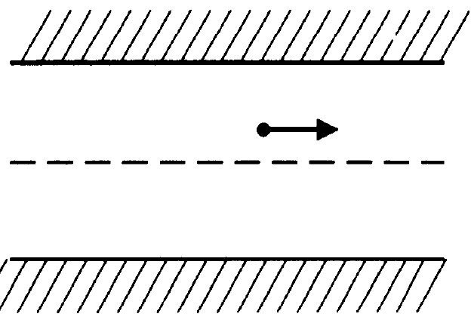
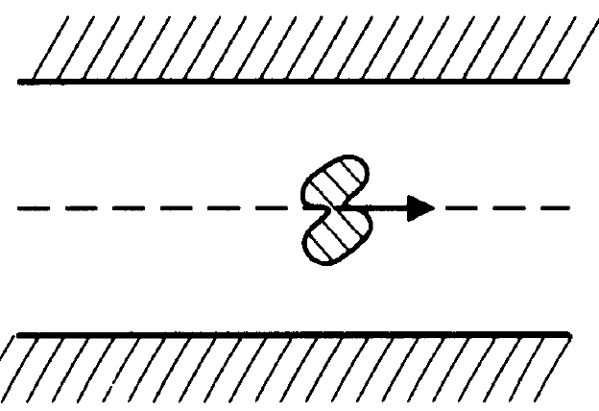
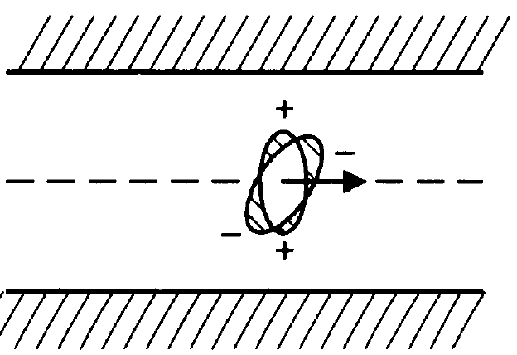
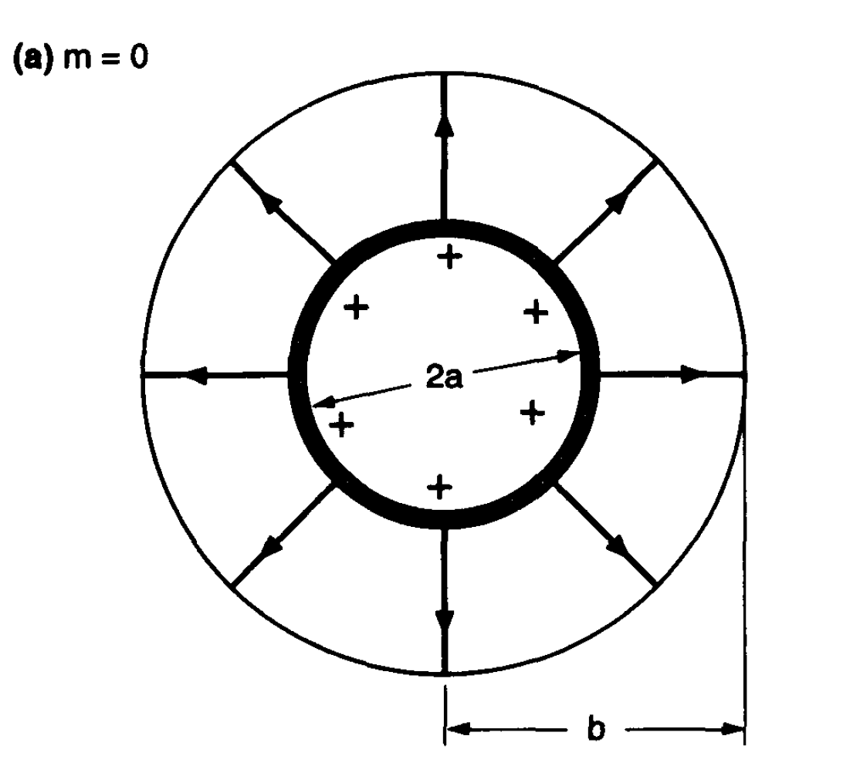
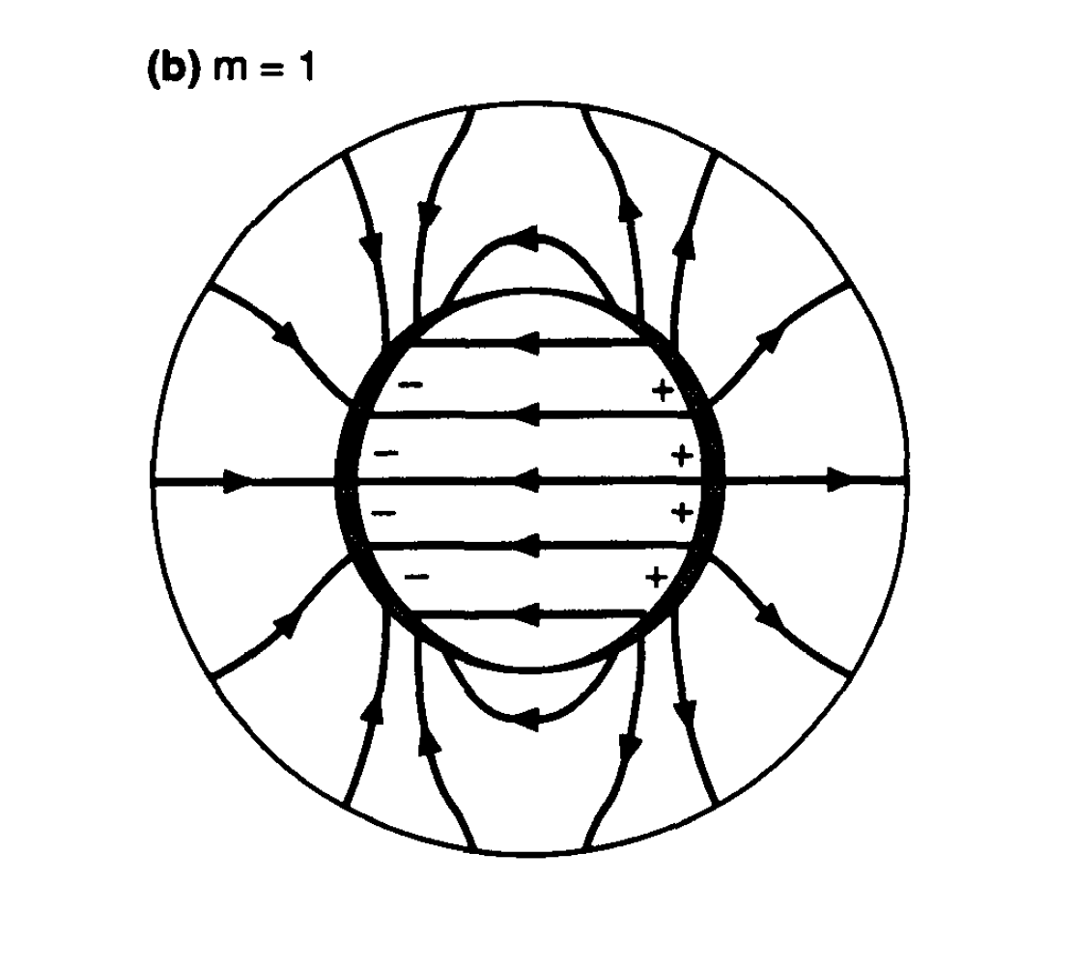
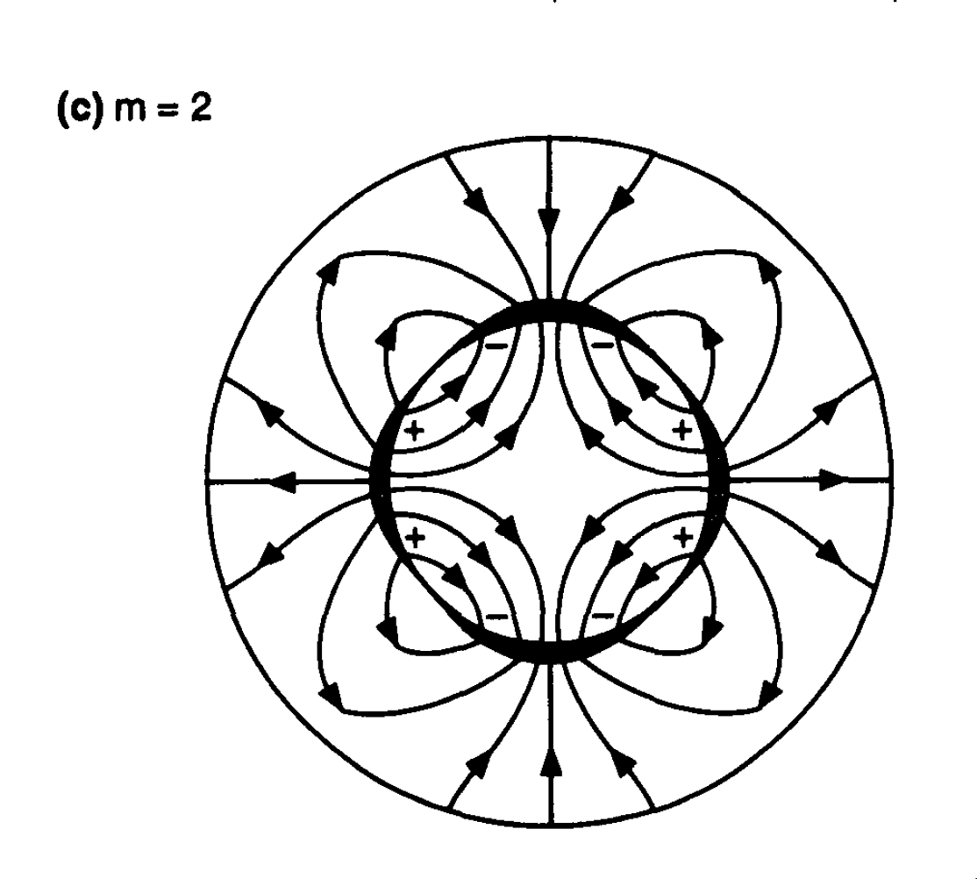
Electric Field patterns
Due to Monopole, Dipole and Quadrupole electron distribution

Slide 7
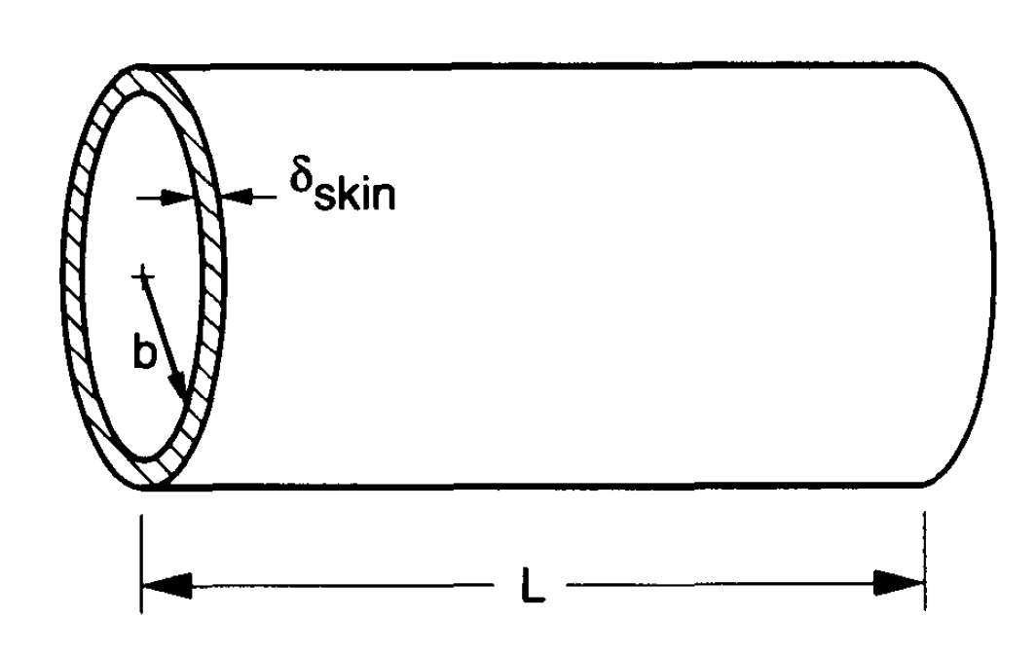
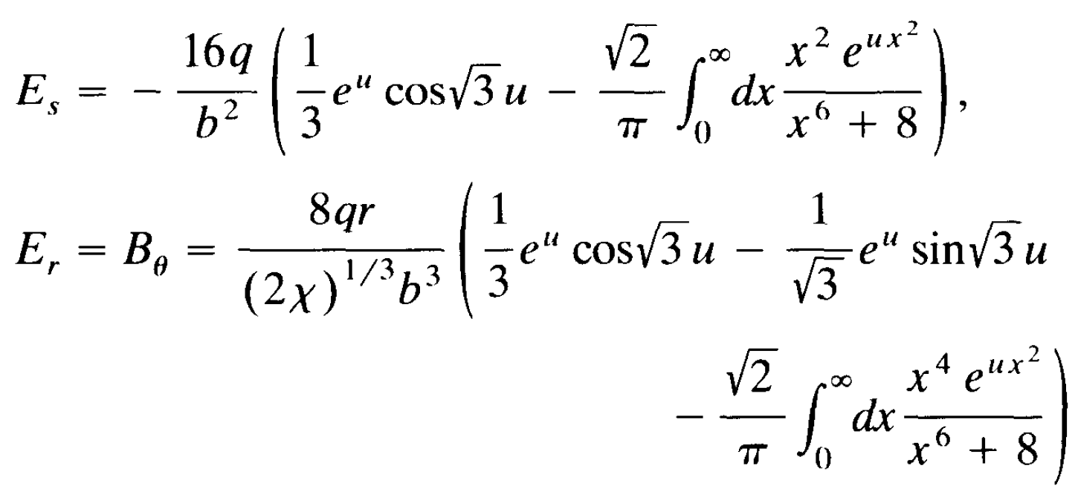
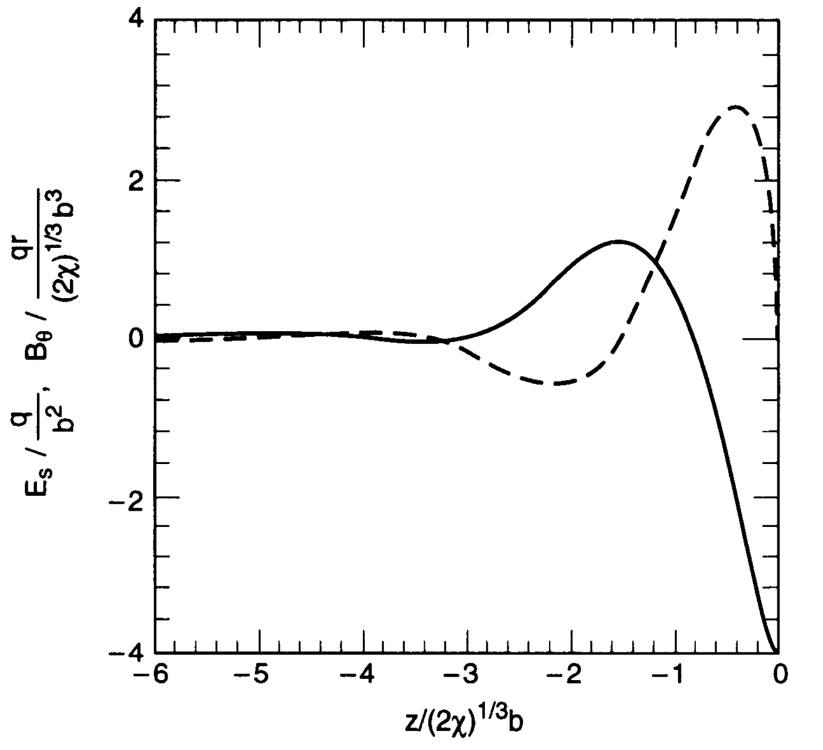
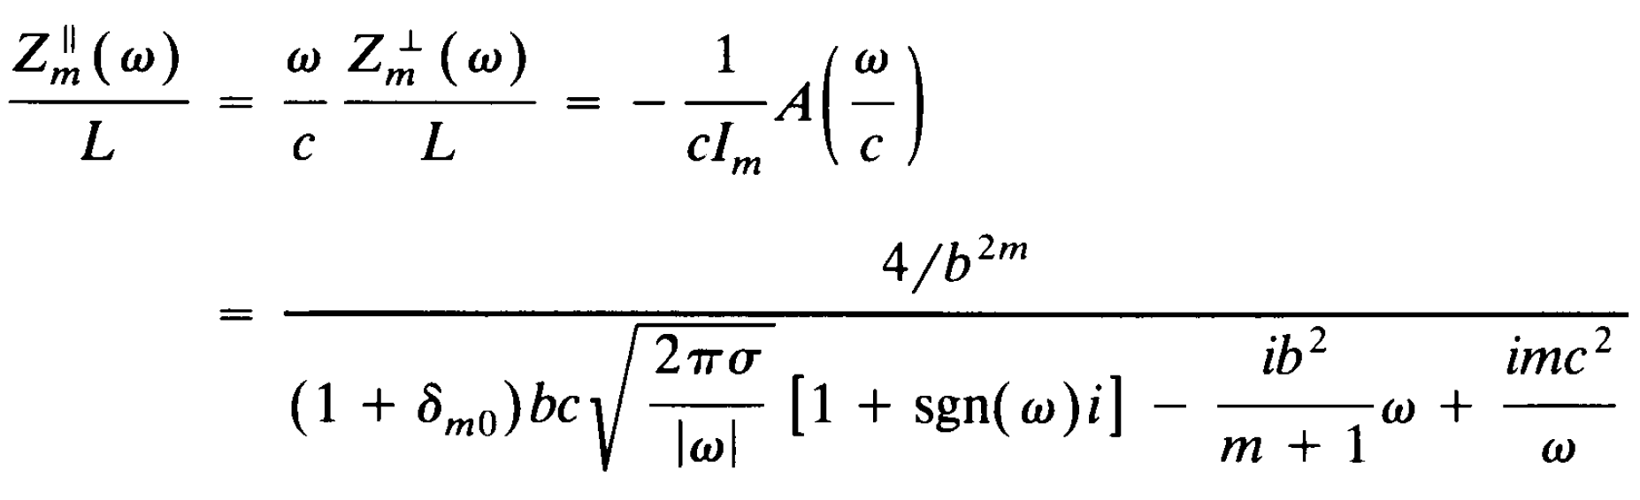
A mathematical approach to RW impedance
Solving maxwell’s equations
Wake field (for uniform ring)
Wake Function
FFT
Resistive Wall Impedance (general form)

Slide 8
Resistive Wall Impedance
Simulation

Slide 9
Existing Simulation Codes
Maxwell Solvers vs Analytical Solvers
Maxwell’s Equations solvers:
ImpedanceWake2D by Mounet * (free)
BeamImpedance2D by Niedermayer ** (free)
Yokoya’s Code *** (free)
ECHO -1 / 2 / 3D code by Zagorodnov **** (free)
CST Microwave Studio (commercially available)
GDFIDL (commercially available)
VACI Suite
Analytical formulas solvers:
ReWall developed by Mounet et al CERN
Numerical impedance calculations by Doliwa et al and Niedermayer
Mathematica code developed in DESY
CETA by Chao Li @ DESY for RW Impedance
And …
* https://twiki.cern.ch/twiki/bin/view/ABPComputing/ImpedanceWake2D
** Niedermayer, Uwe, Oliver Boine-Frankenheim, and Herbert De Gersem. "Space charge and resistive wall impedance computation in the frequency domain using the finite element method." Physical Review Special Topics-Accelerators and Beams 18.3 (2015): 032001.
*** Yokoya, Kaoru. "Resistive wall impedance of beam pipes of general cross section." Part. Accel. 41.KEK-Preprint-92-196 (1993): 221-248.
**** https://echo4d.de/

Slide 10
VACI suite a versatile tool to calculate RW impedance
Introduction
VACI (VAcuum Chamber Impedance) suite
Creating Geometry
Specifying Physical Groups
Converting Mesh to a readable format
Applying the Finite Element Method
Post Processing the results
Creating Mesh
Plotting the Results

Slide 11
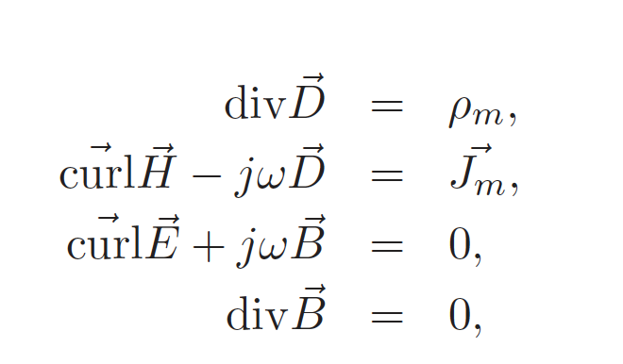
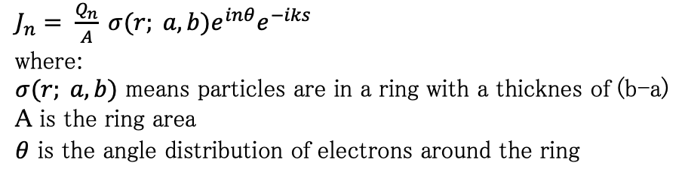

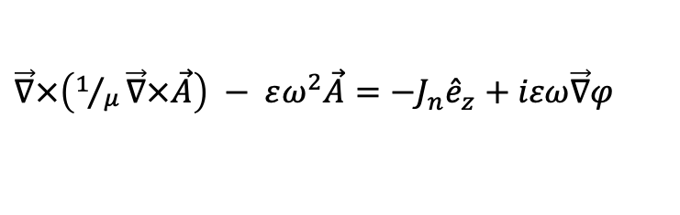

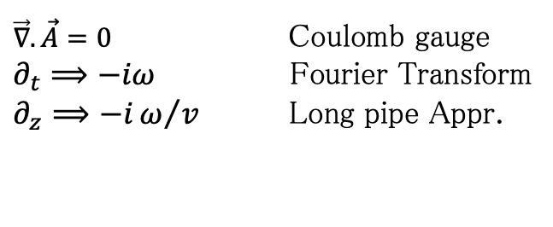

Resistive Wall impedance
Maxwell’s Equations
$\vec{E}=− \vec{∇}φ − \frac{∂}{∂t}\vec{A}$ And $\vec{B}= \vec{∇}×\vec{A}$
$\vec{∇}.\vec{A}=0$ Coulomb gauge
$∂_{t}⟹−iω$ Fourier Transform
$∂_{z}⟹−iω/v$ Long pipe Appr.
$\vec{∇}.\left(ε\vec{∇}φ\right)= ρ_{m}$
$$ρ\left(r,z;ω\right)=J_{z}(r,z;ω)$$
$\vec{∇}×\left(1/μ\vec{∇}×\vec{A}\right) − εω^{2}\vec{A}=−J_{n}{\hat{e}}_{z}+iεω\vec{∇}φ$
$J_{n}= \frac{Q_{n}}{A} σ(r; a,b)e^{inθ}e^{−iks}$
where:
$σ(r; a,b)$ means particles are in a ring with a thicknes of (b-a)
A is the ring area
$θ$ is the angle distribution of electrons around the ring

Slide 12
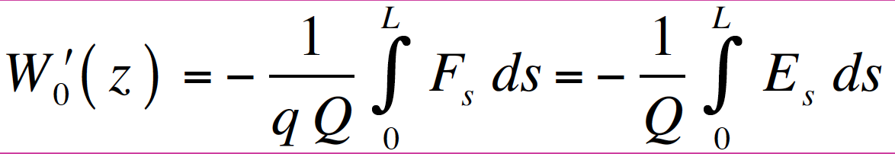
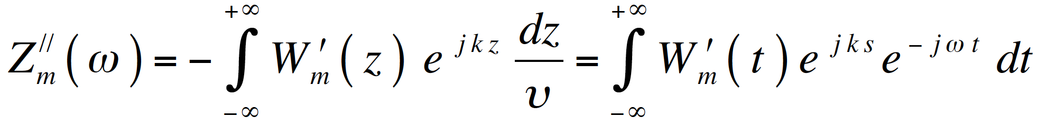
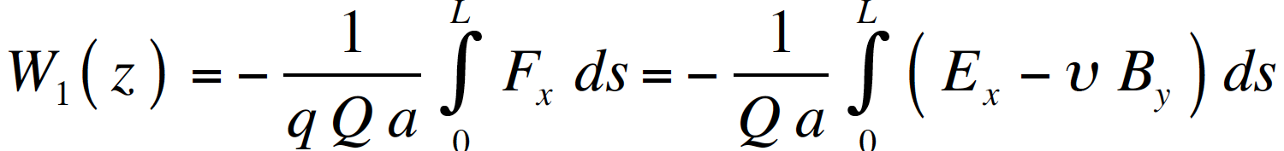
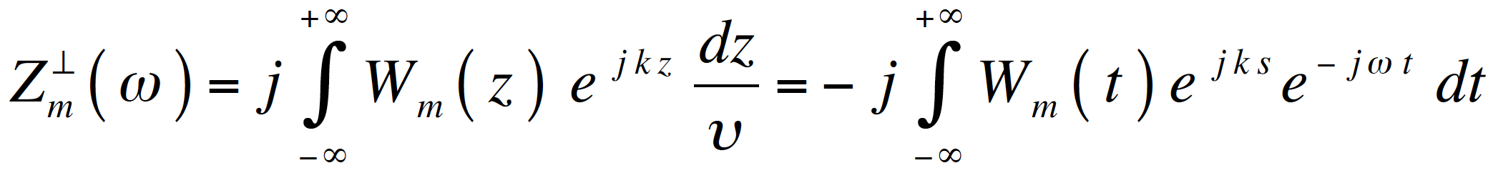
Resistive Wall impedance
Based on: Robert L. Gluckstern, Elias Métral, and Uwe Niedermayer

Slide 13
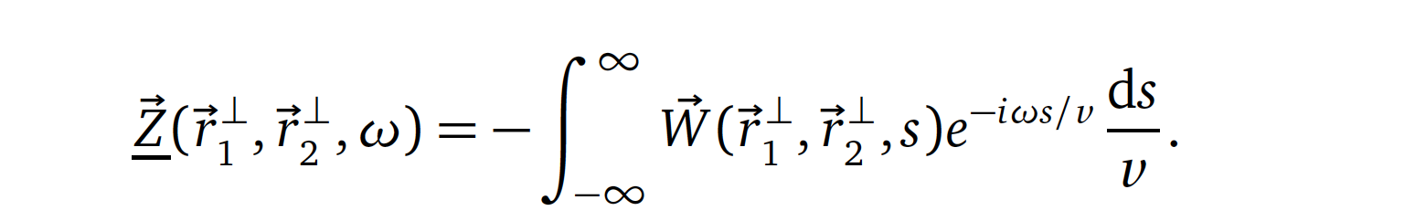
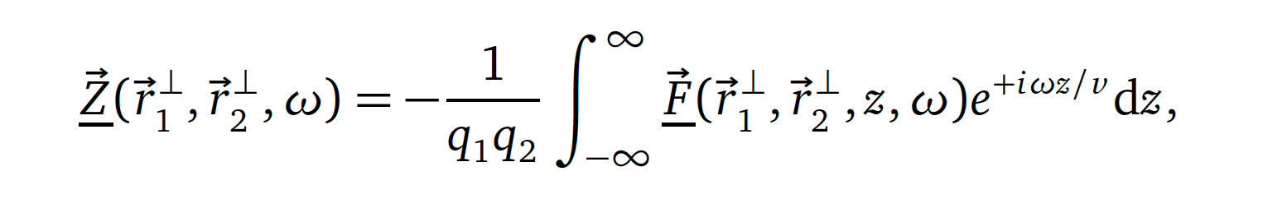
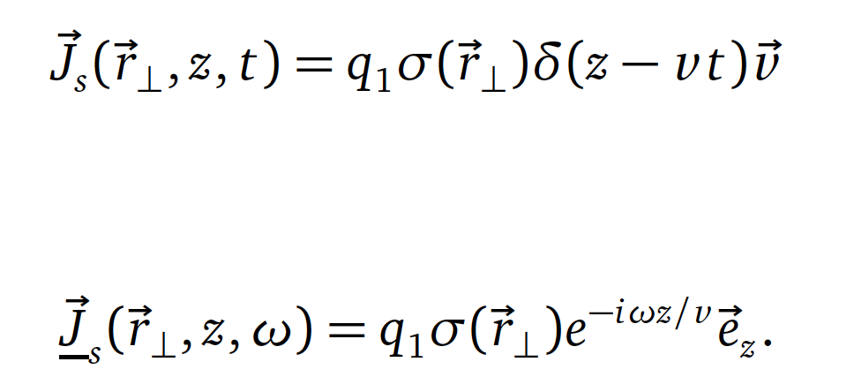
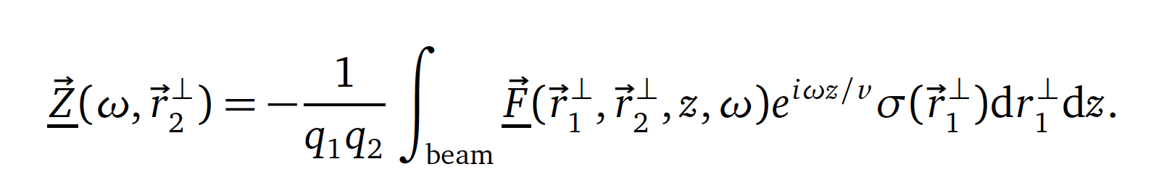
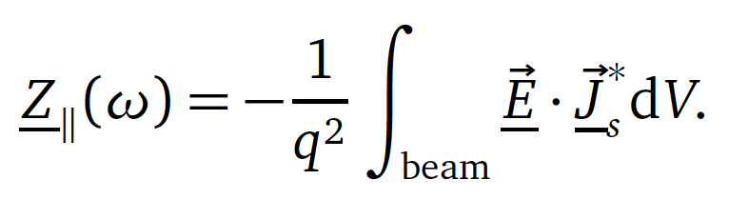
Resistive Wall impedance
Based on: Robert L. Gluckstern, Elias Métral, and Uwe Niedermayer
Single particle
one should note that the integral is not a Fourier transform, but the wake integration in the frequency domain.
Integrating over the beam in FD
Like Convolution in TD

Slide 14
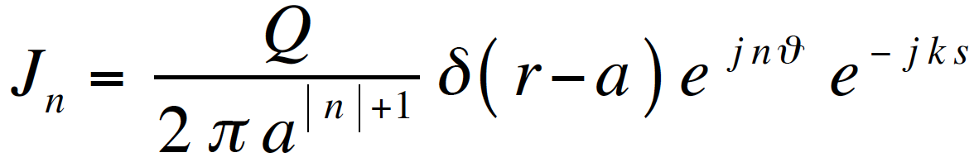
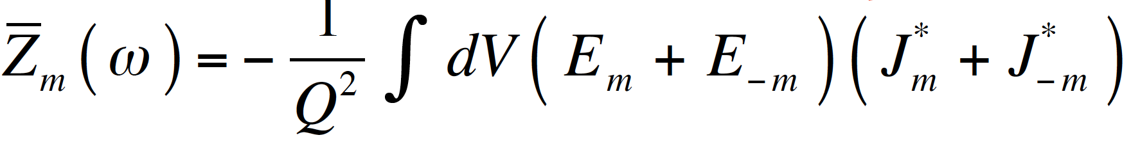
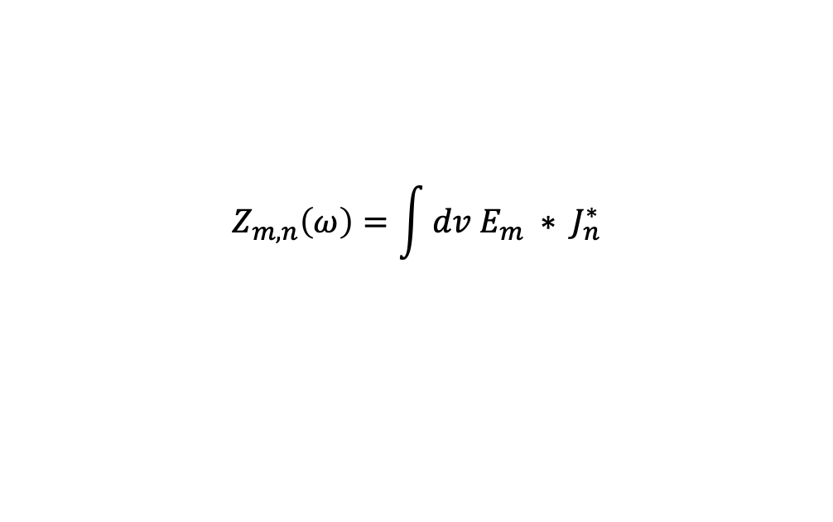



Resistive Wall impedance
Based on: Robert L. Gluckstern, Elias Métral, and Uwe Niedermayer
Non axis-symmetric structures => A current density with some azimuthal Fourier component may create an electromagnetic field with various different azimuthal Fourier components => A more general beam coupling impedance is defined in order to treat coupling of different azimuthal Fourier components
$$Z_{m,n}\left(ω\right)=\int{dv E_{m} ∗ J_{n}^{∗}}$$
over the beam area
and $m,n=0, ±1, ±2, …$
assuming the principle of superposition:
$${\overline{J}}_{m}=J_{m}+J_{−m}$$
$${\overline{E}}_{m}=E_{m}+E_{−m}$$

Slide 15
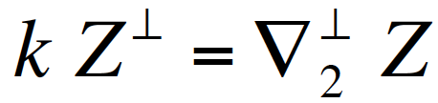
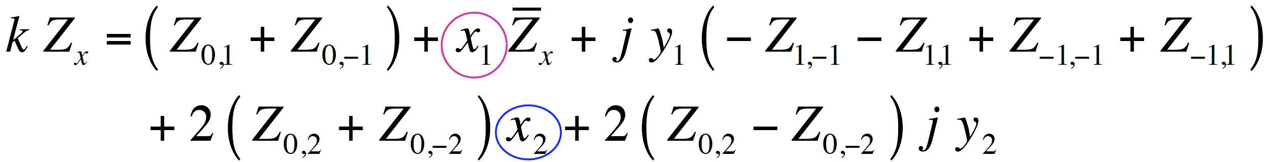
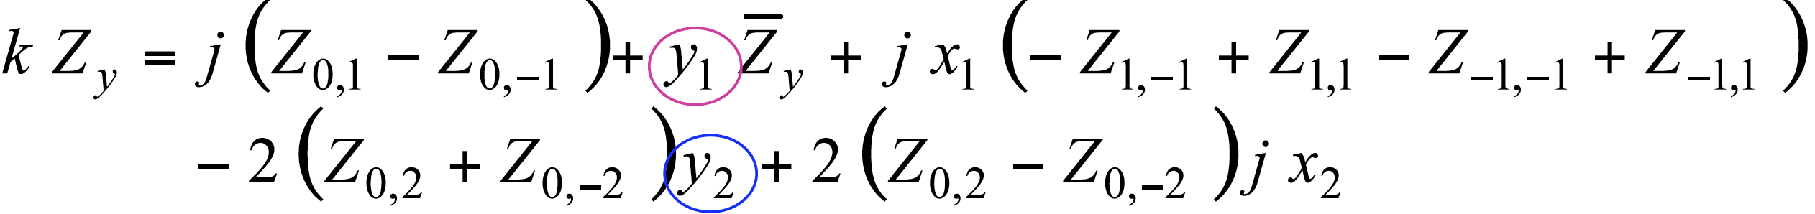
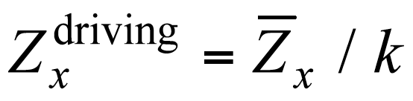
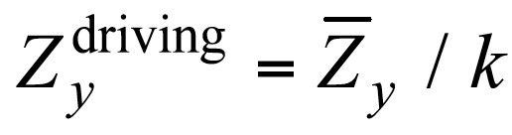
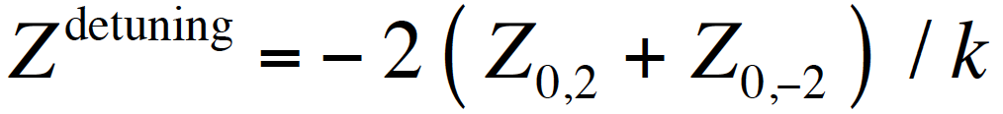
Resistive Wall impedance
Based on: Robert L. Gluckstern, Elias Métral, and Uwe Niedermayer
Applying Panofksy-Wenzel theorem, one can obtain transverse impedance based on Longitudinal one:
Here, Indice of 2 means witness particle

Slide 16
VACI Results

Slide 17
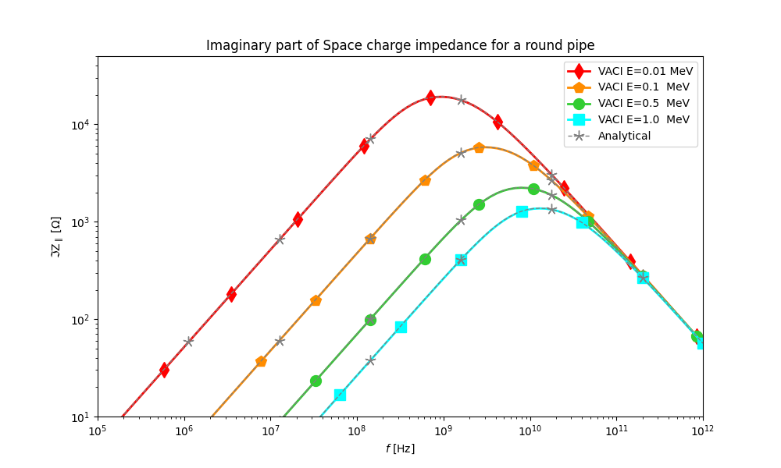
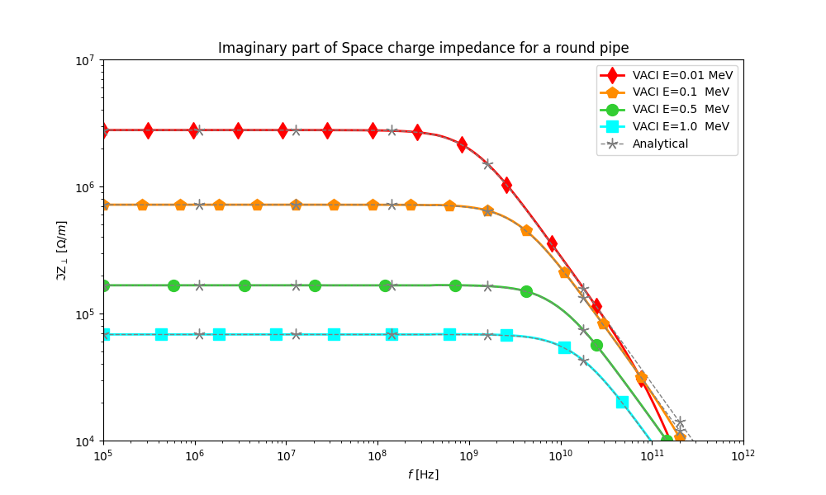
VACI results for Space-Charge
Round pipe
Gluckstern, Robert L. "Analytic methods for calculating coupling impedances." (2000).

Slide 18
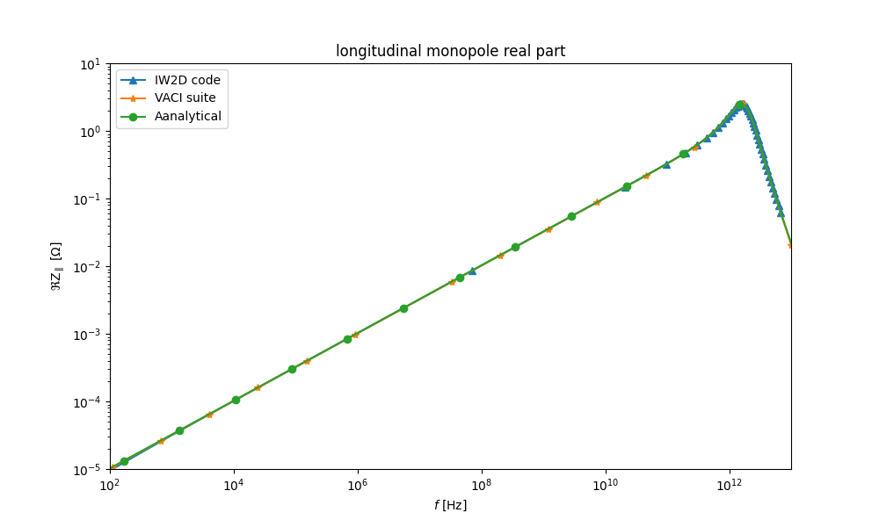
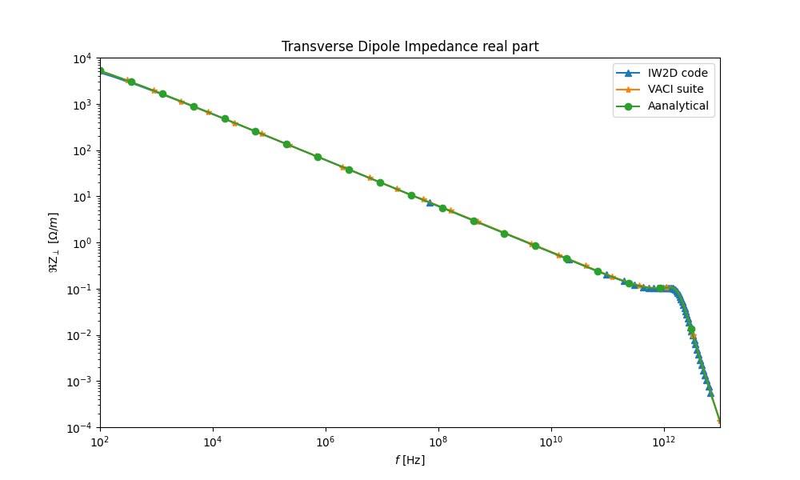
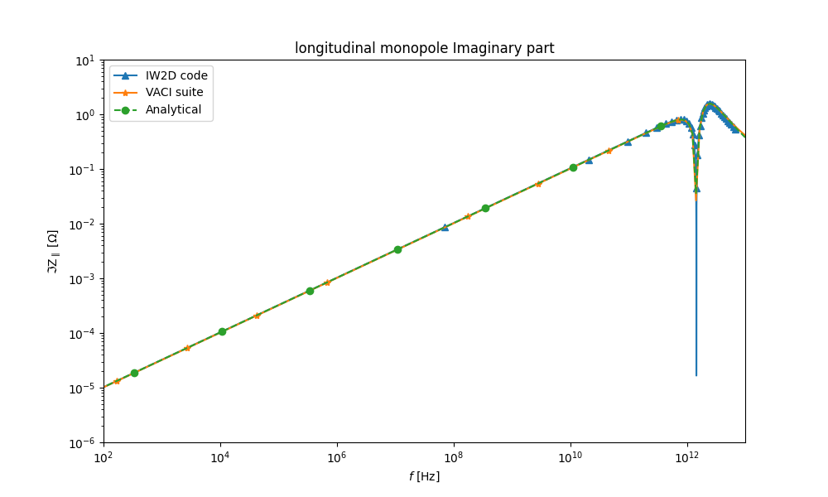
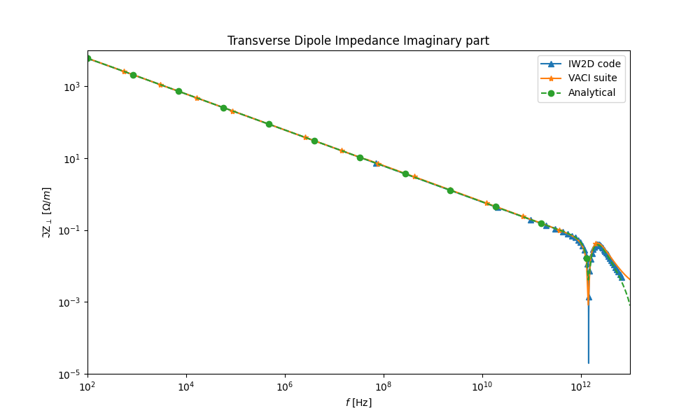
VACI results for Round pipe
Impedance calculation
Energy: 15 GeV,
Round Pipe: r = 35 mm
Length = 1 m

Slide 19
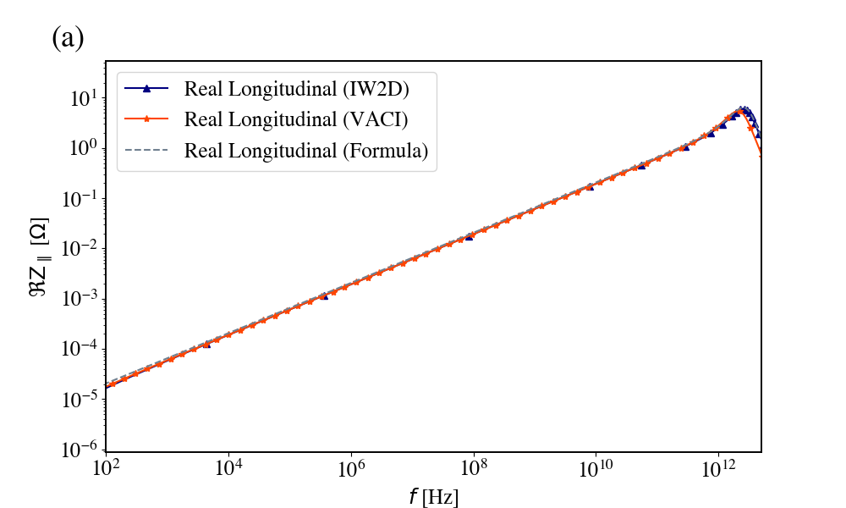
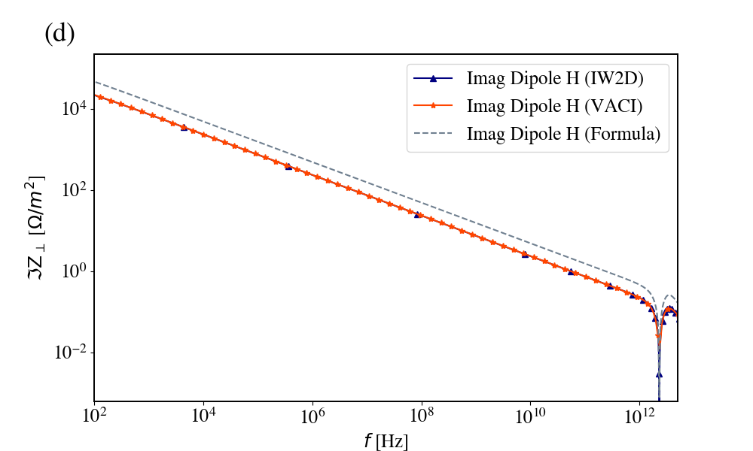
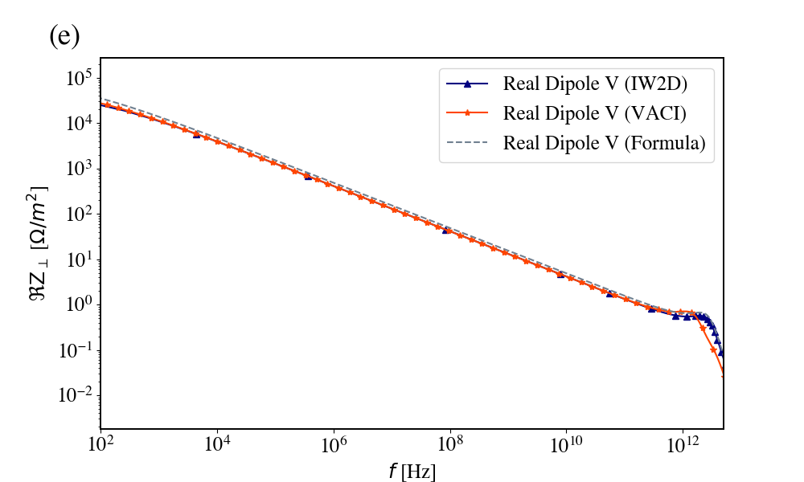
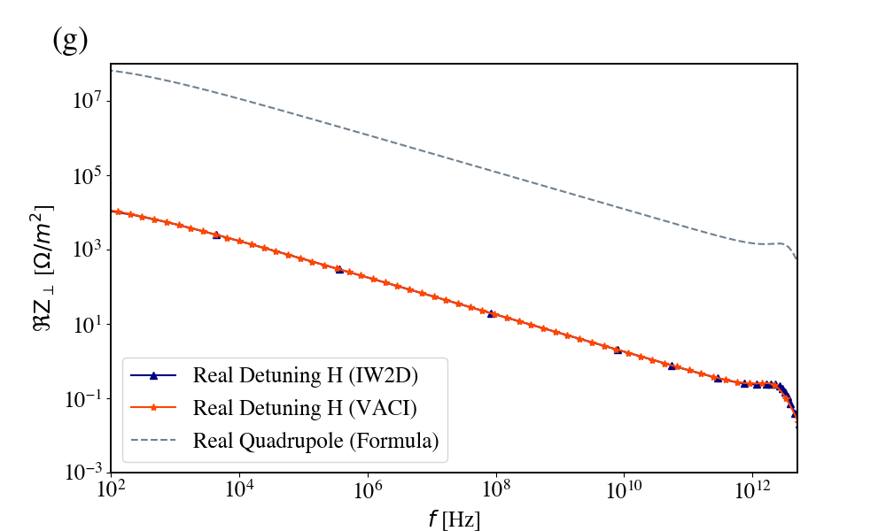
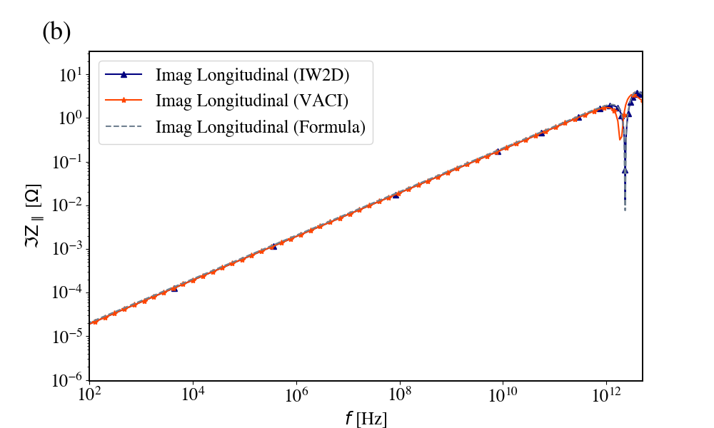
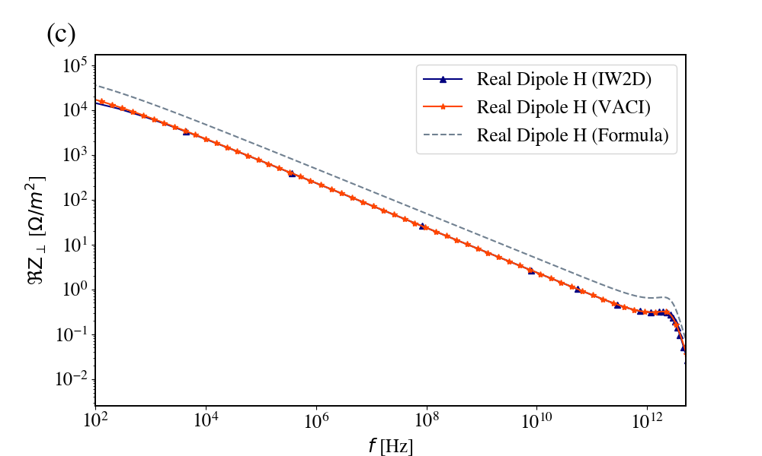
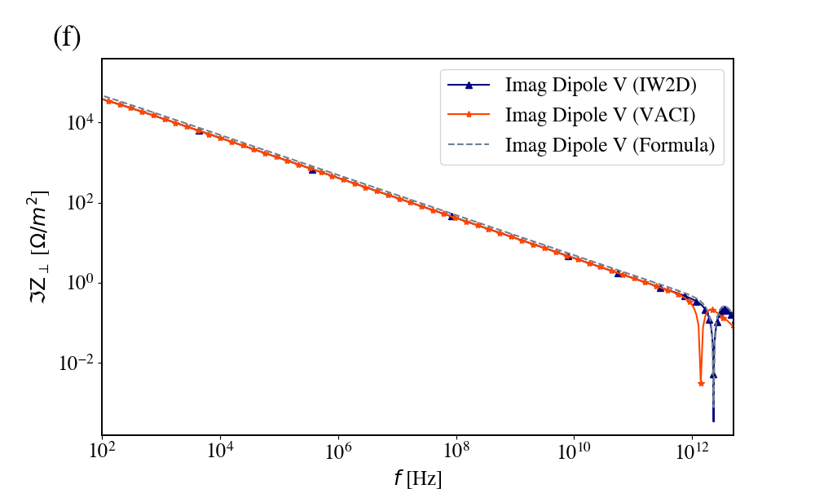
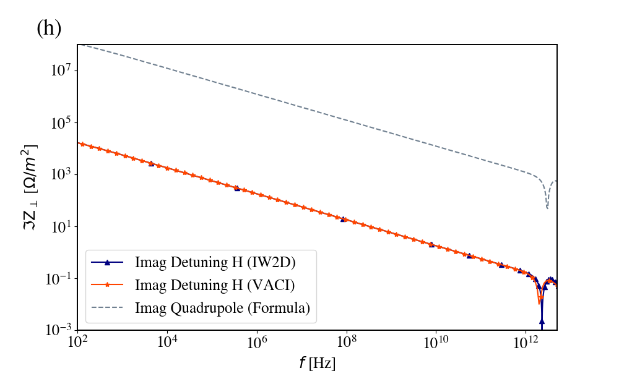
VACI results for Oval pipe
Energy: 15 GeV,
Ellipese pipe: r1 =35 mm- r2=20 mm,
Round Pipe: r = 20 mm
Impedance calculation
Yokoya’s Form Factors:
R [mm] | Long | X dip | Y dip | X quad | Y quad
20 | 1.0 | 0.46323 | 0.84038 | -0.37701 | 0.38219
Monopole
Dipole
Detuning

Slide 20
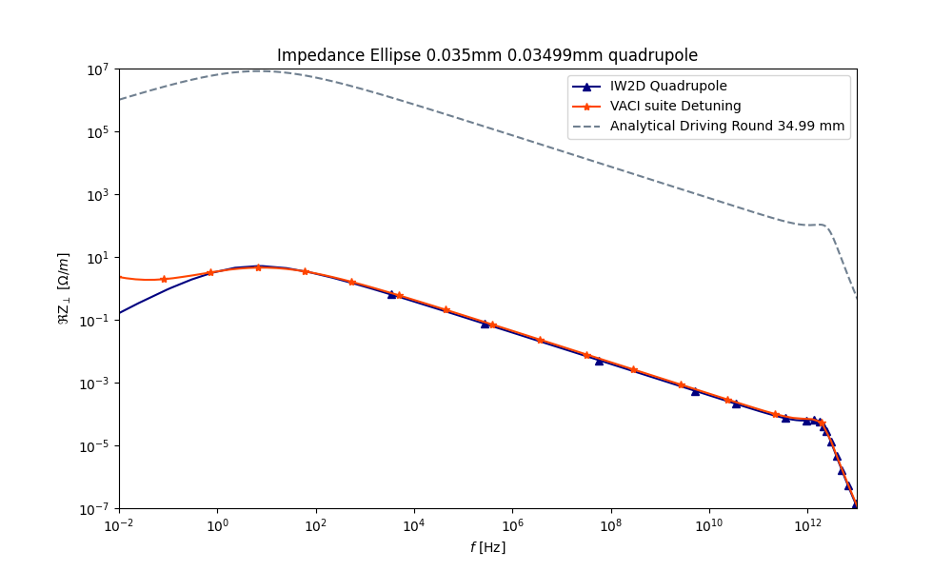
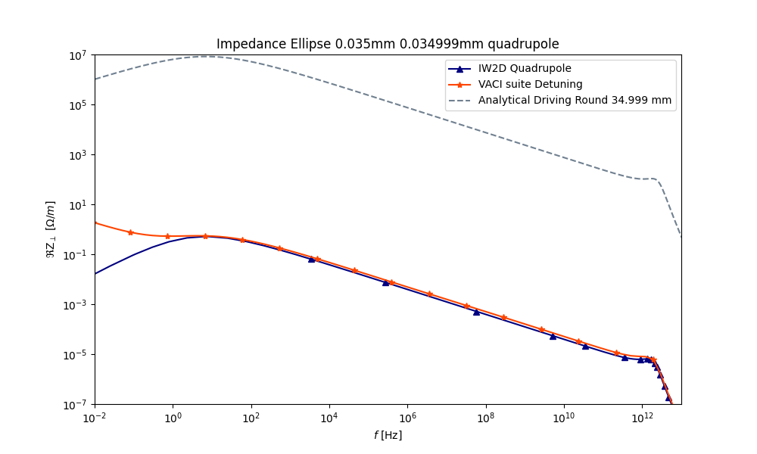
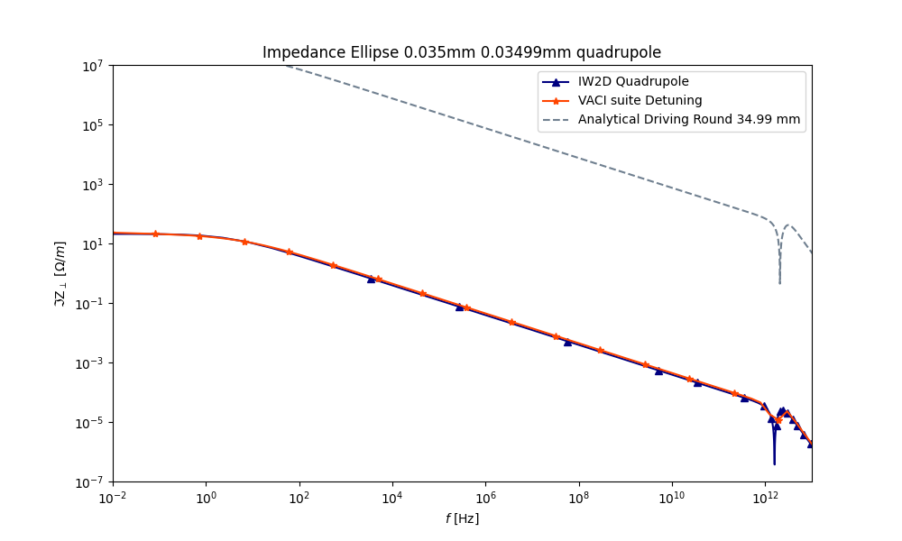

VACI results for Semi-Round pipe
Energy: 15 GeV,
Ellipese pipe: r1 =35.00 mm- r2=34.99 & 34.999 mm
Round Pipe: r = 35.00 mm
Detuning Impedance calculation

Slide 21





VACI results for Multi-Layer vacuum chamber
Impedance calculation of Round pipe With NEG coating
NEG properties:
$σ=1.098e6$,
Thichness: 10 $μm$
Material: TiZrV alloy

Slide 22


VACI also can give results in time domain
Longitudinal Wake field ($E_{z}$ )
iFFT method:
uneven sampling and a piecewise polynomial interpolation (cubic Hermite interpolation)
{Based on Nicolas Mounet Ph.D. thesis + some small upgrades}
Mounet, Nicolas. The LHC transverse coupled-bunch instability. No. THESIS. EPFL, 2012.

Slide 23






VACI also → Wakefields with and without NEG

Slide 24





VACI also → Wakefields with and without NEG

Slide 25
Undulator chamber
PETRA IV

Slide 26




VACI results for PETRA IV
Monopole and Dipole impedances
Copper Vacuum chamber
Length: 1m
No NEG considered.

Slide 27




VACI results for PETRA IV
Dipole and Detuning impedances

Slide 28
Undulator APPLE III
PETRA IV

Slide 29




Apple III
APPLE Designs
APPLE II, APPLE III [1], DELTA [2], proposed SwissFEL UE40 [3].
UE40
[1] J. Bahrdt et al., “Undulators for the BESSY Soft XRay-FEL”, FEL2004, Trieste, 2004 , pp.610-613.
[2] A. Temnykh, “Delta undulator for Cornell energy recovery linac”, Physical Review Special Topics Accelerators and Beams 11, 120702 (2008).
[3] Schmidt, Th, et al. "Magnetic design of an APPLE III undulator for SwissFEL." Proceedings of FEL. 2014.

Slide 30
VACI results for Star shape pipe
Copper Vacuum chamber
Length: 1m
No NEG considered.
Monopole and dipole impedance

Slide 31

VACI results for star shape vs Petra IV
Dipole and Detuning impedance

Slide 32
FCC Booster elements and vacuum chamber

Slide 33




FCC booster and main rings Geometries
Impedance sources
Beam pipes and Resistive Wall Impedance
RF Cavities (No. 56 in a 4-cell array)
RF Cavity Tapers (No. 14 double tapers)
Synchrotron Radiation (SR) absorbers
Collimators (No. 20)
Beam Position Monitors (No. 4000)
Comb-Type RF shielding for bellows (No. 8000)
Booster ring
Main ring

Slide 34








VACI results for FCC main ring
Copper Vacuum chamber
Length: 1m
No NEG considered.
RW impedance

Slide 35
VACI results for FCC main ring
Copper Vacuum chamber
Length: 1m
No NEG considered.
RW wakefield

Slide 36

VACI results for FCC main ring
Copper Vacuum chamber
Length: 1m
No NEG considered.
RW wakefield

Slide 37
VACI results for FCC main ring
Copper Vacuum chamber
Length: 1m
No NEG considered.
RW compare

Slide 38

VACI results for FCC main ring
Copper Vacuum chamber
Length: 1m
No NEG considered.
Star shape

Slide 39
Conclusion
And Future plans
Code can calculate 2D Impedance and wakefield in General Cross Section
3D solver is under development.
GPU acceleration is going to be added to the code for 3D version.
For FCC main ring and booster:
  Obtaining wakefields for the correct geometry
  Studying the NEG thickness in main ring and copper thickness in booster ring
  Using X-suite for beam dynamic simulation based previous step.

Slide 40
Thank you for your Attention
Please feel free to share any Ideas, discussion, suggestions?
Ali Rajabi
MPY – PETRA III
Ali.Rajabi@desy.de

