Slide 1
RF systems for FCCee
Franck Peauger
on behalf of the FCC RF team
FCCIS workshop
07-12-22

Slide 2
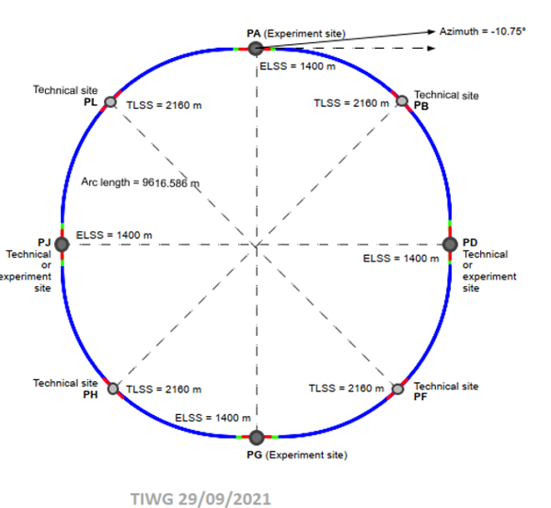
RF system for FCCee
  91 km
  Designed to provide 100 MW of RF power in CW
  to compensate losses by synchrotron radiation
 | Energy (GeV) | Current (mA) | RF voltage (GV)
Z | 45.6 | 1280 | 0.120
W | 80 | 135 | 1.05
H | 120 | 26.7 | 2.1
ttb | 182.5 | 5 | 11.3
  + Booster: 10% beam current and 15% average duty cycle

Slide 3
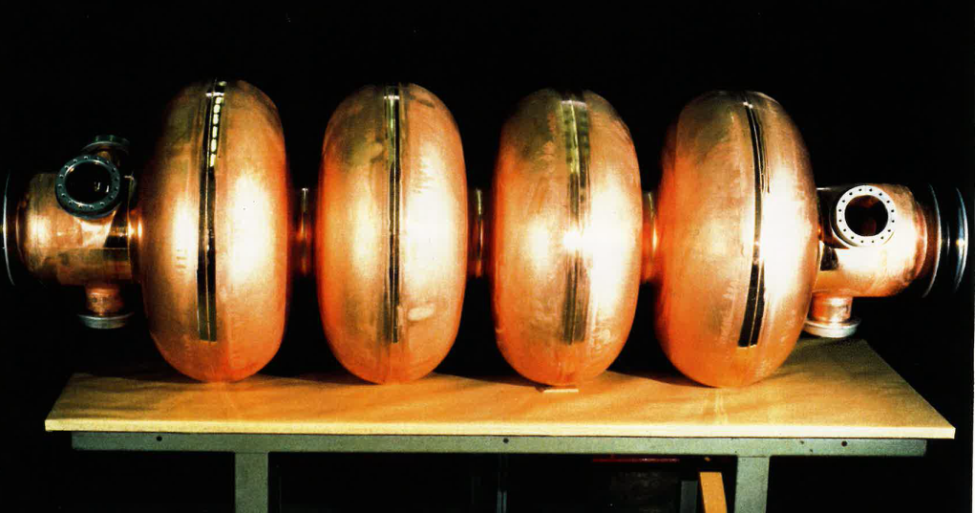
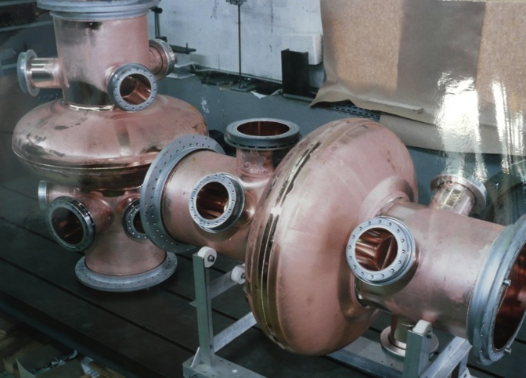
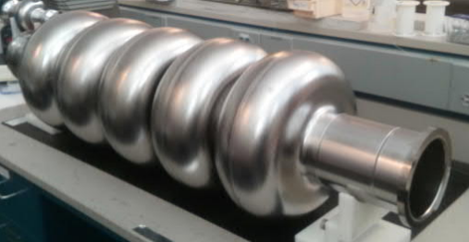
3 different types of SRF cavities for the FCC-ee RF baseline
New compared to CDR
LHC
LEP
JLAB
ttb
Z
W, H
W, H
400 MHz 1-cell cavities
Nb/Cu
Removed after Z operation
800 MHz 5-cell cavities
Bulk Nb
400 MHz 2-cell cavities
Nb/Cu
2-cell is better for W working point
(reduced RF power per cav., improved HOM damping)

Slide 4
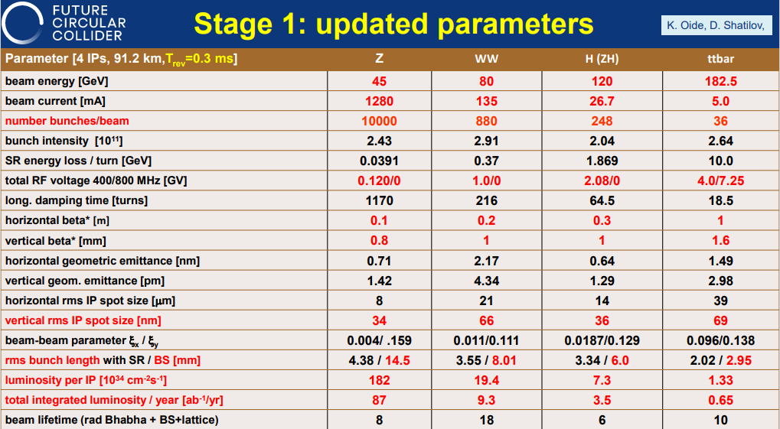
M. Benedikt
Monday

Slide 5
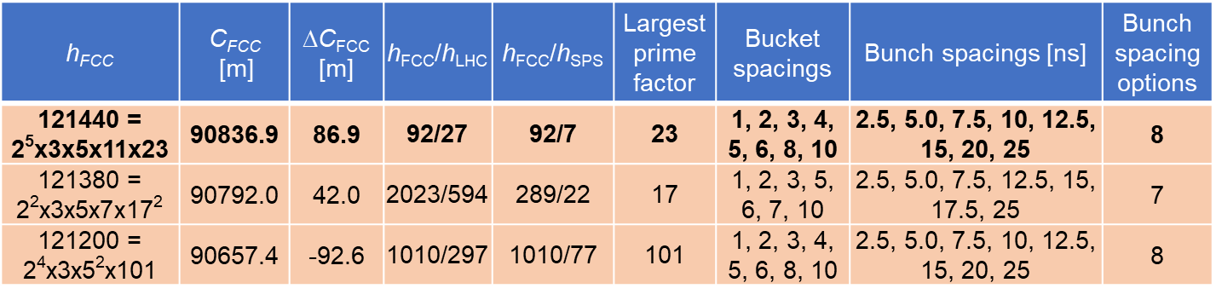
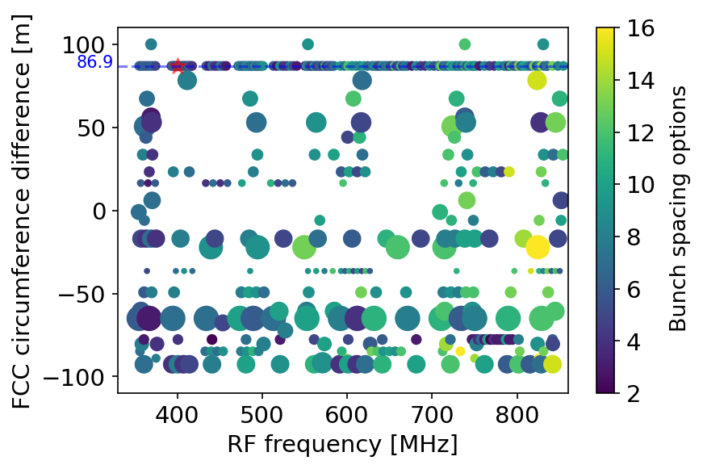
Circumference options assuming 400.79 MHz and 90.75 km +/-100 m for FCChh
Linhao Zhang
Ivan Karpov
Heiko Damerau
  h_{FCC} = 121440 is the most favorable harmonic number from the RF point of view: it has very short transfer wait time, small largest prime factor, and many bunch spacing options
  hFCC = 121200 can also give many bunch spacing options, but the higher larger prime factor and longer LHC-to-FCC transfer wait time
Flexible options for RF frequency
400.79, 500.99, 601.19, 801.58 MHz
Point size indicates the largest prime factor

Slide 6
RF parameters table
  Limiting parameters for RF
07-Dec-22 | Z |  | W |  | H |  | ttbar2
 | per beam | booster | per beam | booster | 2 beams | booster | 2 beams | 2 beams | booster
RF Frequency [MHz] | 400 | 800 | 400 | 800 | 400 | 800 | 400 | 800 | 800
RF voltage [MV] | 120 | 140 | 1050 | 1050 | 2100 | 2100 | 2100 | 9200 | 11300
Eacc [MV/m] | 5.72 | 5.34 | 10.95 | 21.55 | 10.78 | 22.42 | 10.78 | 22.52 | 22.50
# cell / cav | 1 | 5 | 2 | 5 | 2 | 5 | 2 | 5 | 5
Vcavity [MV] | 2.14 | 5.00 | 8.20 | 20.19 | 8.08 | 21.00 | 8.08 | 21.10 | 21.08
#cells | 56 | 140 | 256 | 260 | 520 | 500 | 520 | 2180 | 2680
# cavities | 56 | 28 | 128 | 52 | 260 | 100 | 260 | 436 | 536
# CM | 14 | 7 | 32 | 13 | 65 | 25 | 65 | 109 | 134
T operation [K] | 4.5 | 2 | 4.5 | 2 | 4.5 | 2 | 4.5 | 2 | 2
dyn losses/cav [W] | 22 | 0.3 | 163 | 4 | 158 | 5 | 158 | 32 | 5
stat losses/cav [W] | 8 | 8 | 8 | 8 | 8 | 8 | 8 | 8 | 8
Qext | 6.6E+04 | 2.7E+05 | 1.1E+06 | 8.3E+06 | 1.1E+06 | 1.7E+07 | 9.4E+06 | 4.2E+06 | 9.3E+07
Detuning [kHz] | 8.939 | 5.126 | 0.472 | 0.131 | 0.096 | 0.013 | 0.031 | 0.028 | 0.002
Pcav [kW] | 880 | 176 | 385 | 95 | 379 | 49 | 45 | 202 | 9
rhob [m] | 9937 | 9937 | 9937 | 9937 | 9937 | 9937 | 9937 | 9937 | 9937
Energy [GeV] | 45.6 | 45.6 | 80.0 | 80.0 | 120.0 | 120.0 | 182.5 |  | 182.5
energy loss [MV] | 38.49 | 38.49 | 364.63 | 364.63 | 1845.94 | 1845.94 | 9875.14 |  | 9875.14
cos phi | 0.32 | 0.27 | 0.35 | 0.35 | 0.88 | 0.88 | 0.56 | 0.96 | 0.87
Beam current [A] | 1.280 | 0.128 | 0.135 | 0.0135 | 0.0534 | 0.003 | 0.010 | 0.010 | 0.0005
  one RF system per beam
  common RF system for both beams
  Cavity performances: 20 % margin added on Eacc and Q0 between vertical test and operation
  In total: 336 cryomodules, 1344 cavities, 30% with Nb/Cu technology

Slide 7
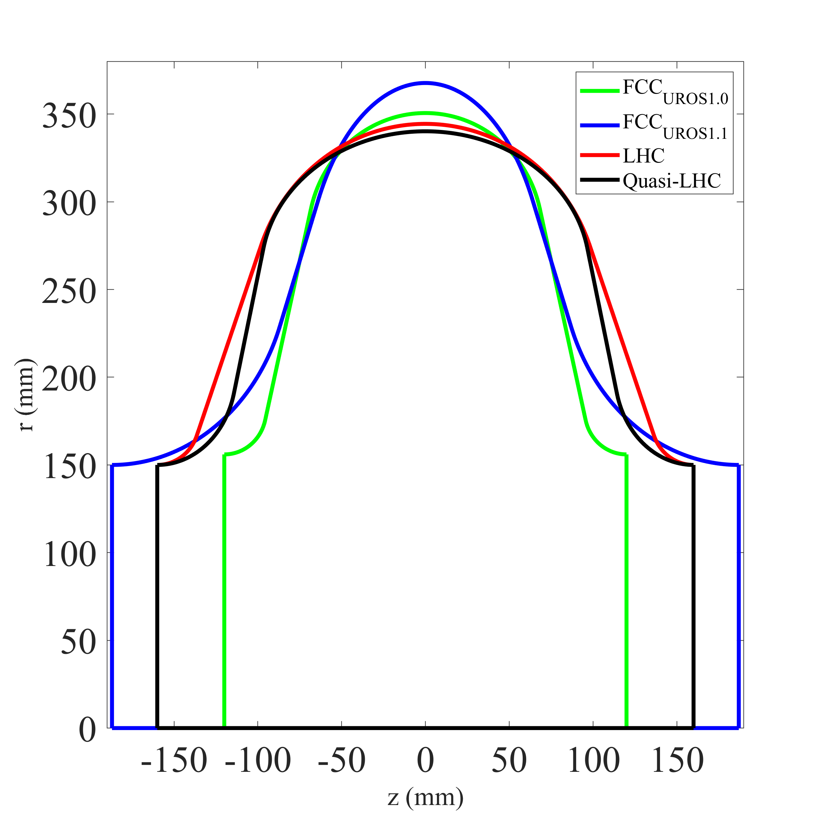
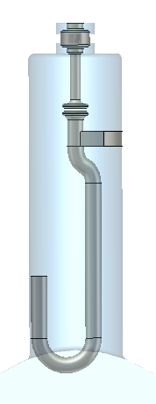
1-cell 400 MHz cavity for Z
S. Gorgi Zadeh
«LHC type», Nb/Cu technology, 4.5 K
E_{acc} = 5.7 MV/m, Q₀ = 2.7e9, P_{RF} = 900 kW
Elliptical shape optimized to eliminate all longitudinal HOMs
Strong transverse HOMs damping with hook type couplers
Z_{transv. max} ~ 10 kΩ/m
Several elliptical profiles under studies
Hook type HOM coupler

Slide 8
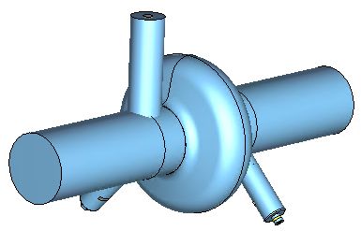
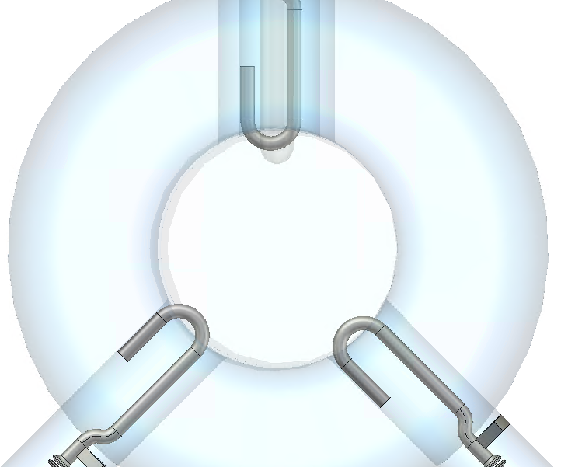
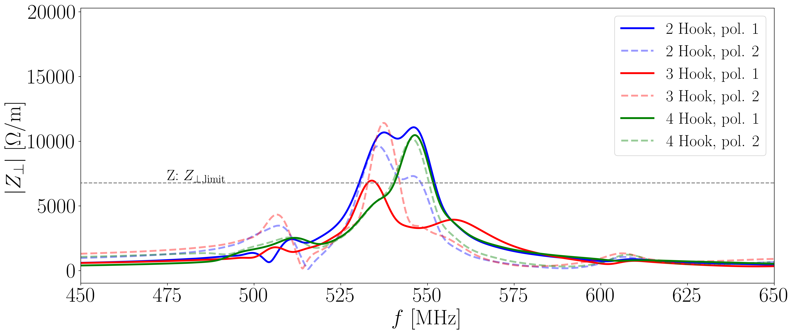
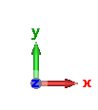
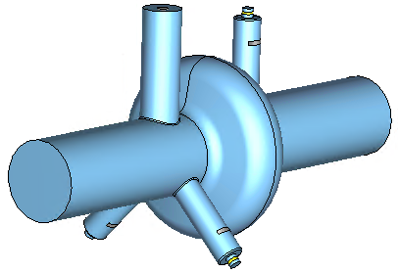
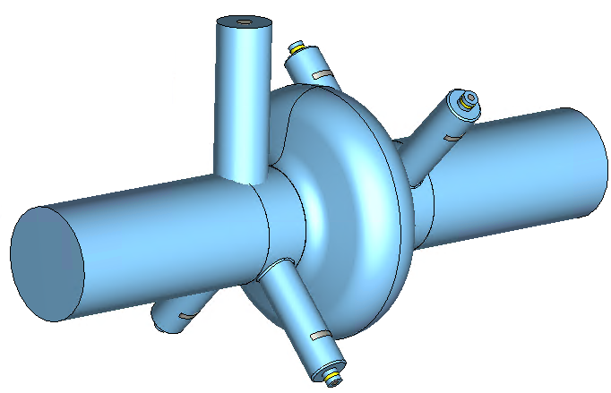
Transverse impedance of the first dipole passband
S. Gorgi Zadeh
Beam location
Pol. 2
Beam location
Pol. 1
  Difficult to stay below the beam stability threshold for Z
  Bunch-by-bunch feedback system to be implemented

Slide 9
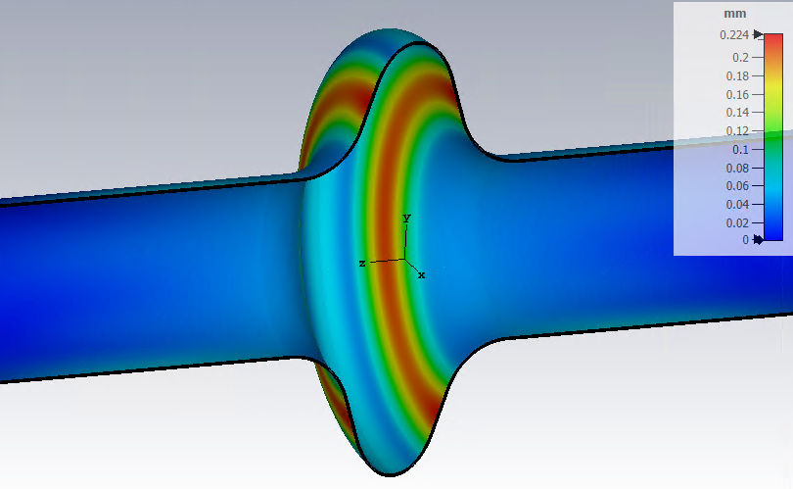
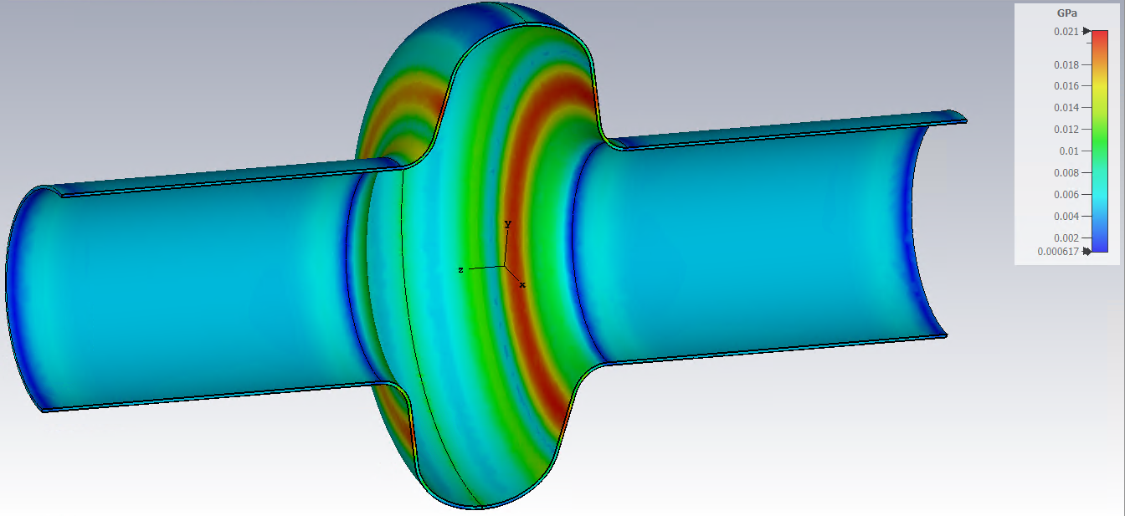
RF/mechanical design – choice of cavity thickness
Parameters | LEP | LHC | UROS 1.1 | Quasi LHC
Thickness (mm) | 3 | 2.75 | 2.75 | 2.75 | 3.5 | 4.25
Tuning Sensitivity Δf/Δz [kHz/mm] | -40.98 | -240.05 | -210.91 | -257.73 | -253.27 | -254.24
Cavity Stiffness Kcav [kN/mm] | 2.25 | 18.30 | 16.39 | 8.00 | 11.41 | 15.95
Lorentz Force Detuning coeff. fixed ends KL [Hz/(MV/m)^2] | -2.00 | -2.22 | -8.05 | -1.64 | -0.75 | -0.44
Lorentz Force Detuning coeff. free ends KL [Hz/(MV/m)^2] | -10.20 | -8.31 | -19.90 | -18.39 | -9.99 | -5.86
Pressure Sensitivity fixed ends Kp [Hz/mbar] | 20.18 | -11.84 | -117.05 | -26.41 | -16.49 | -11.28
Pressure Sensitivity free ends Kp [Hz/mbar] | 62.90 | 51.60 | 21.50 | 184.17 | 135.04 | 95.11
Max VM stress fixed ends [MPa] (1 bar applied) | 33.6 | 30 | 34.40 | 37.9 | 27.5 | 21
Max VM stress free ends [MPa] (1 bar applied) | 42 | 35 | 45.10 | 62.8 | 44.6 | 33.7
Coupled RF/mechanical simulations using CST Studio 2022
Simplified cavity shape : no RF ports, no helium tank
Not decisive in CW mode
with tuner
with tuner
Material properties: Copper (pure)
Young's modulus = 120 kN/mm^2
Poisson's ratio = 0.33
Density = 8930 kg/m^3
0.224 mm
21 MPa
UROS1.1
Displacement
1bar with fixed ends
Quasi-LHC
Von Mises stress
1bar with fixed ends
  From an RF point of view, a thickness of 4.25 mm is recommended with the “Quasi-LHC” single cell 400 MHz cavity
  Manufacturing constraints and compliance with PED to be addressed to converge to the final mechanical design

Slide 10
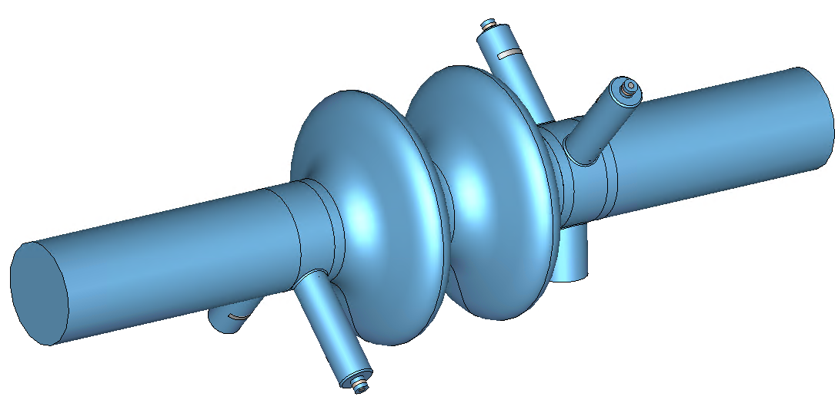
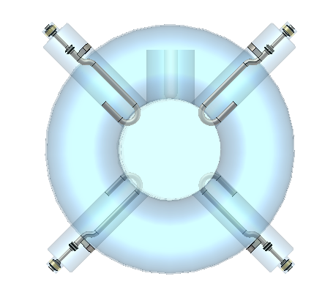
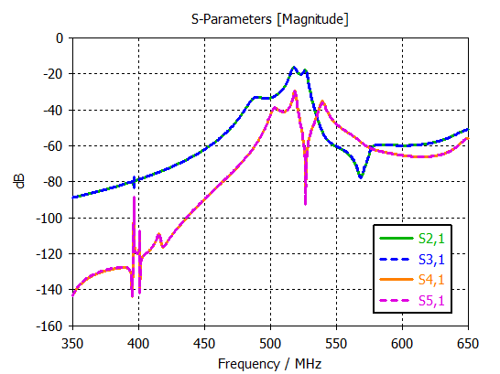
2-cell 400 MHz for W, H
S. Udongwo (Rostock Univ.)
Supervised by R. Calaga
2
1
3
New type, “between LHC and LEP”
Nb/Cu technology, 4.5 K
E_{acc} = 10.8 MV/m, Q₀ = 2.7e9, P_{RF} = 400 kW
Same damping strategy as for Z
- no longitudinal HOM,
- hook-type couplers to damp transverse modes
4
5
  RF transmission FPC → HOM couplers

Slide 11
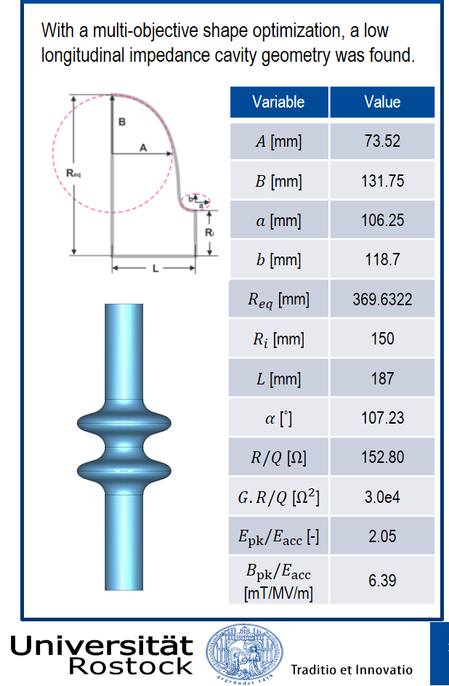
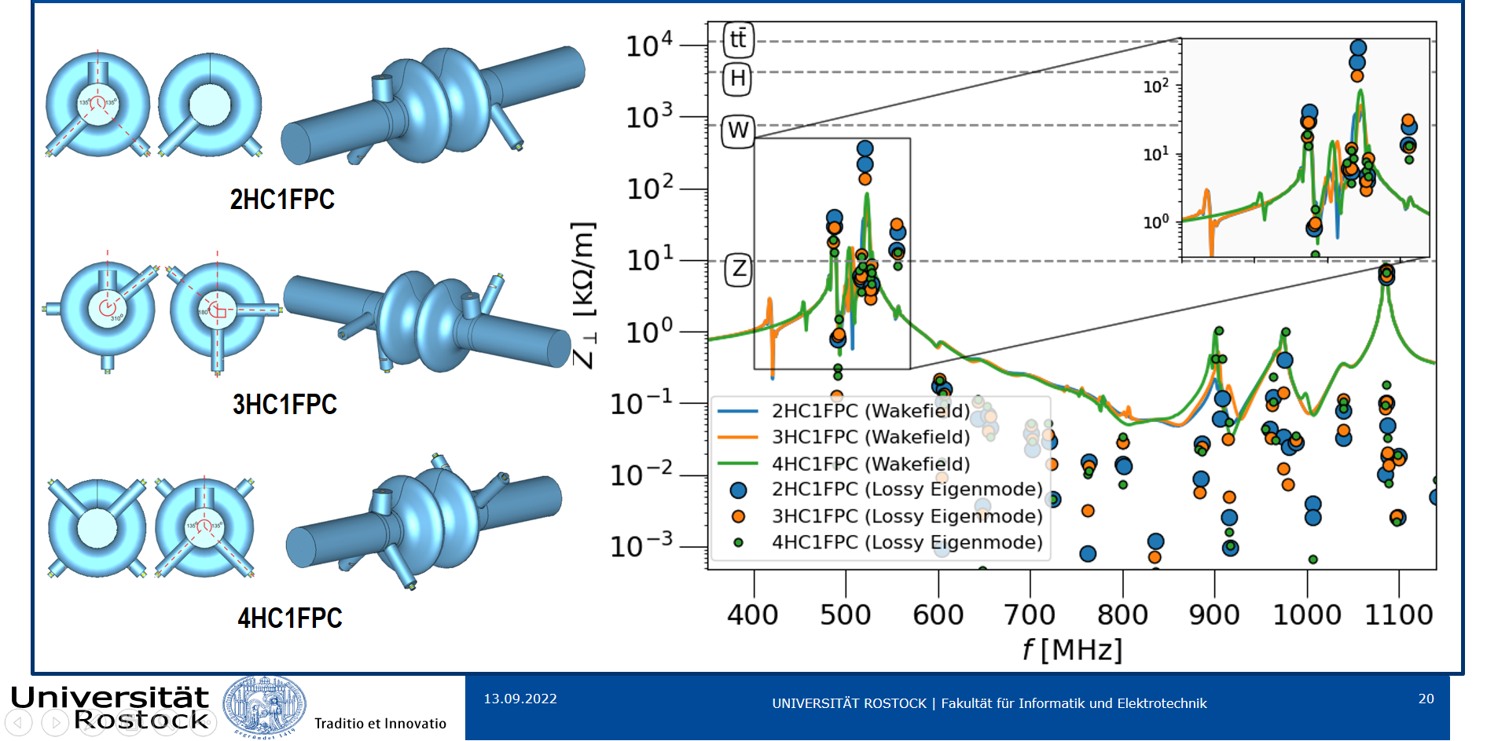
2-cell 400 MHz optimization
S. Udongwo (Rostock Univ.)
Supervised by R. Calaga
S. Udongwo, “The Ell Cavities program at CERN: Baseline cavities designs for FCC_ee”, presented at the FCC Week 2022, Paris, France, May 2022

Slide 12
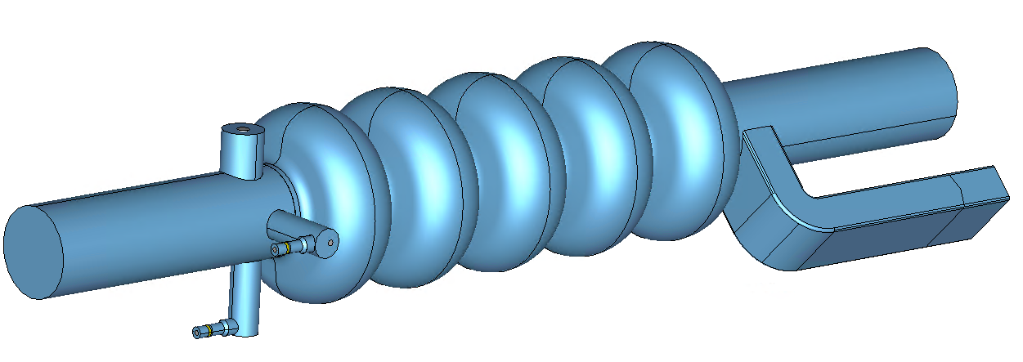
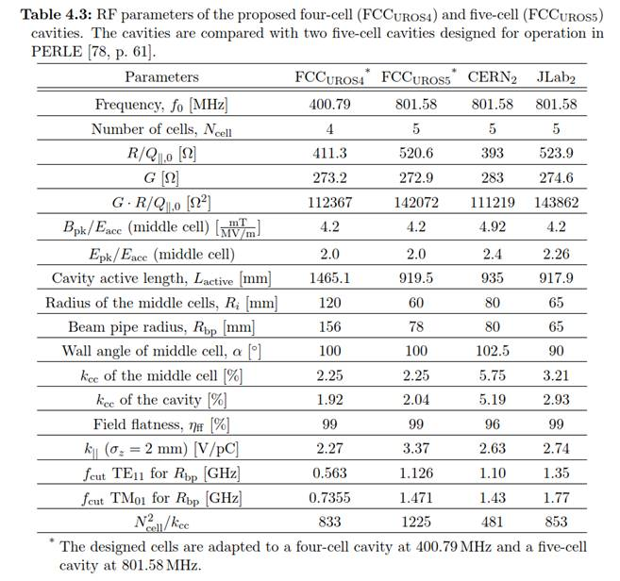
5-cell 800 MHz for ttb and booster
Bulk Nb, 2 K
Similar to SNS, SPL, ESS high beta cavities
High accelerating gradient and high Q0 are required
    E_{acc} = 22.5 MV/m, Q₀ = 2.7e10, P_{RF} = 200 kW
HOMs damping with HOM couplers and rect. WG (TBC)
Considered also for the booster
Bare simplified cavity (without ports) successfully built and tested at JLAB in 2018
  ?
Table from S. Gorgi Zadeh’s thesis

Slide 13
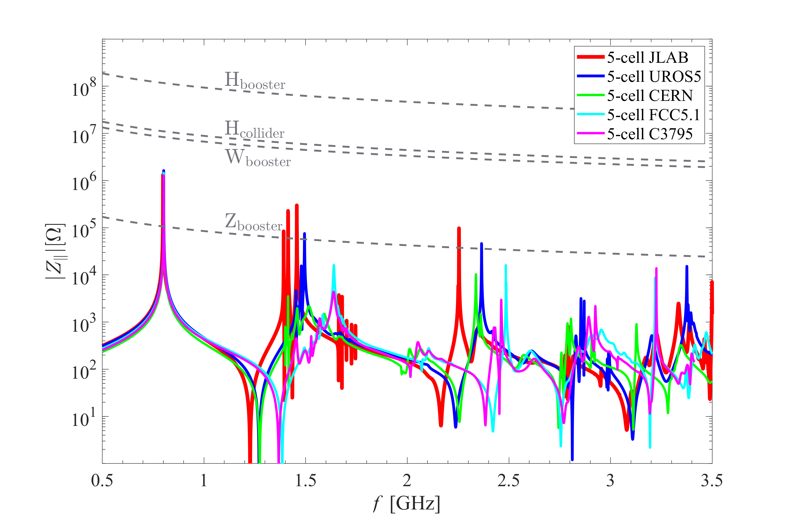
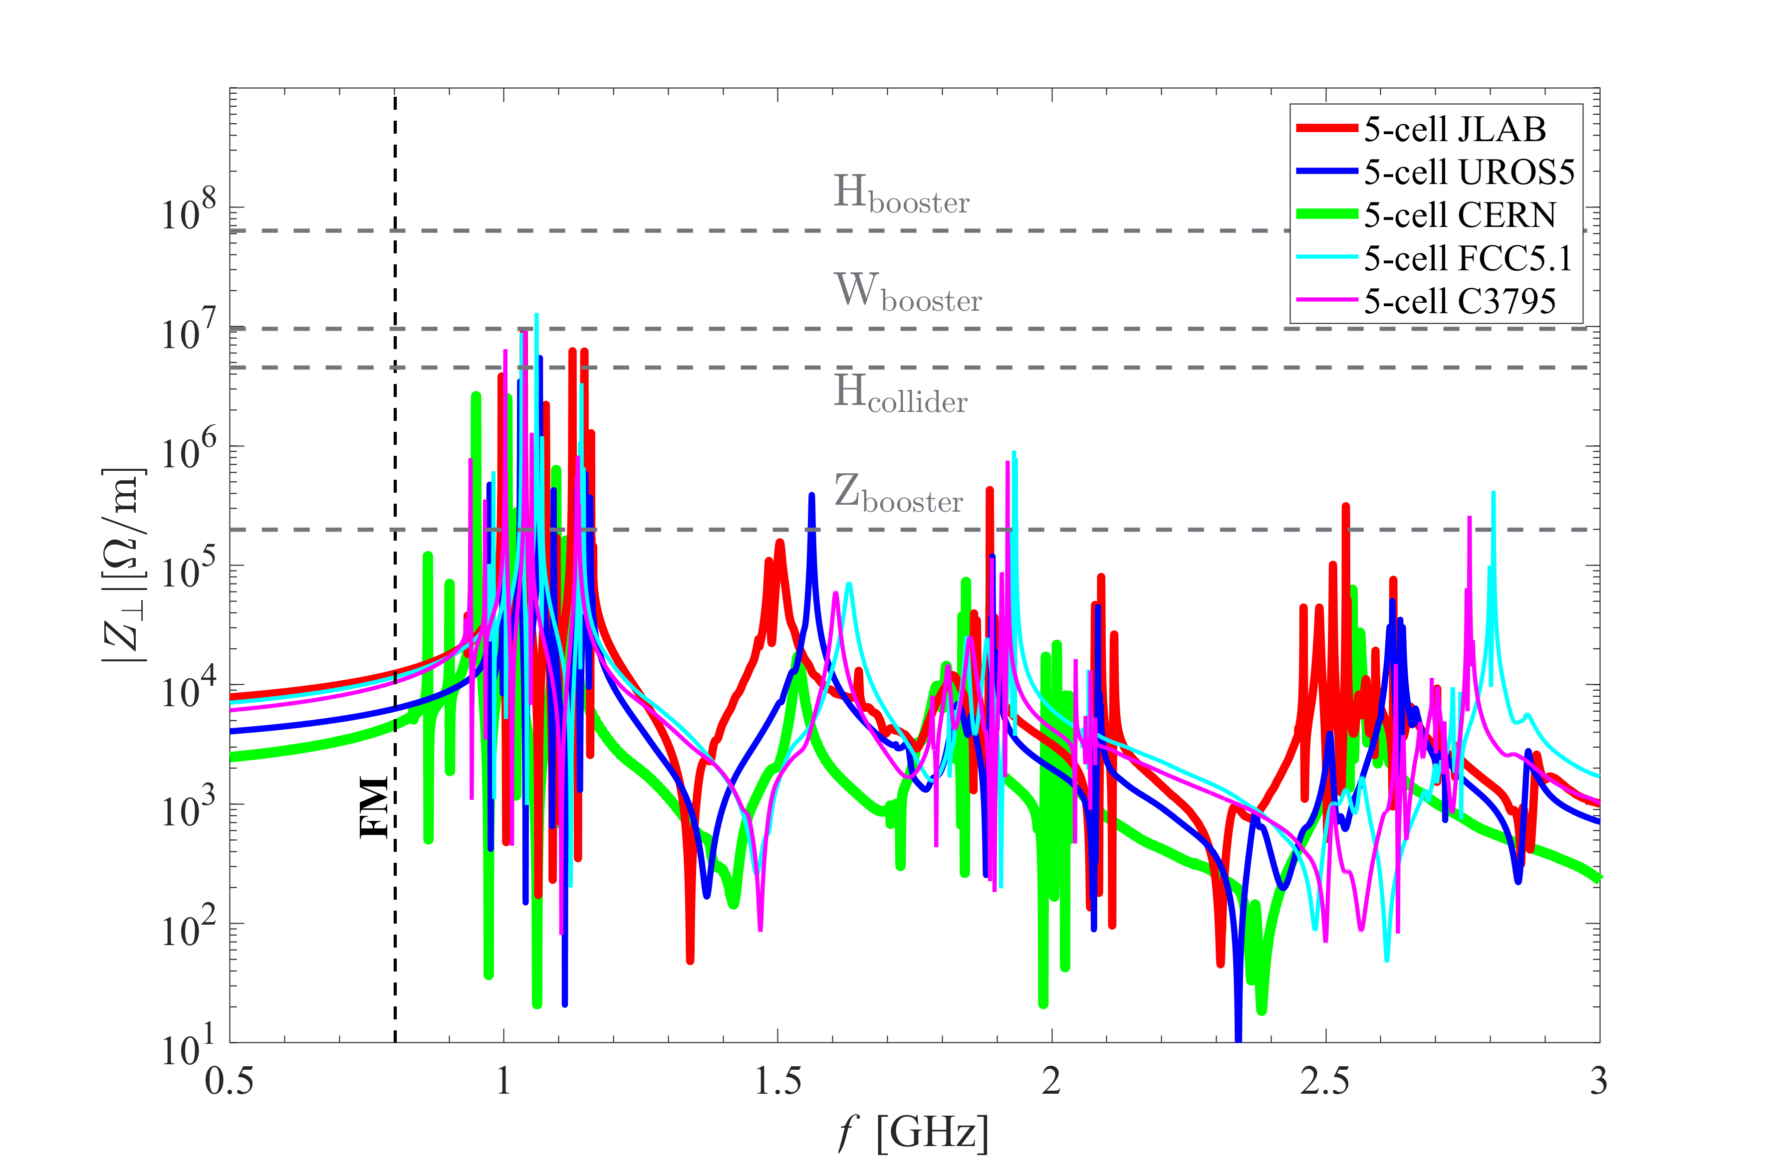
5-cell 800 MHz impedances
S. Gorgi Zadeh
S. Udongwo (Rostock Univ.)
UROS5 is the best design candidate for both the collider and the booster

Slide 14
RF parameters with cavity design choices
07-Dec-22 | Z |  | W |  | H |  | ttbar2
 | per beam | booster | per beam | booster | 2 beams | booster | 2 beams | 2 beams | booster
RF Frequency [MHz] | 400 | 800 | 400 | 800 | 400 | 800 | 400 | 800 | 800
RF voltage [MV] | 120 | 140 | 1050 | 1050 | 2100 | 2100 | 2100 | 9200 | 11300
Eacc [MV/m] | 5.72 | 5.34 | 10.95 | 21.55 | 10.78 | 22.42 | 10.78 | 22.52 | 22.50
# cell / cav | 1 | 5 | 2 | 5 | 2 | 5 | 2 | 5 | 5
Vcavity [MV] | 2.14 | 5.00 | 8.20 | 20.19 | 8.08 | 21.00 | 8.08 | 21.10 | 21.08
#cells | 56 | 140 | 256 | 260 | 520 | 500 | 520 | 2180 | 2680
# cavities | 56 | 28 | 128 | 52 | 260 | 100 | 260 | 436 | 536
# CM | 14 | 7 | 32 | 13 | 65 | 25 | 65 | 109 | 134
T operation [K] | 4.5 | 2 | 4.5 | 2 | 4.5 | 2 | 4.5 | 2 | 2
dyn losses/cav [W] | 22 | 0.3 | 163 | 4 | 158 | 5 | 158 | 32 | 5
stat losses/cav [W] | 8 | 8 | 8 | 8 | 8 | 8 | 8 | 8 | 8
Qext | 6.6E+04 | 2.7E+05 | 1.1E+06 | 8.3E+06 | 1.1E+06 | 1.7E+07 | 9.4E+06 | 4.2E+06 | 9.3E+07
Detuning [kHz] | 8.939 | 5.126 | 0.472 | 0.131 | 0.096 | 0.013 | 0.031 | 0.028 | 0.002
Pcav [kW] | 880 | 176 | 385 | 95 | 379 | 49 | 45 | 202 | 9
rhob [m] | 9937 | 9937 | 9937 | 9937 | 9937 | 9937 | 9937 | 9937 | 9937
Energy [GeV] | 45.6 | 45.6 | 80.0 | 80.0 | 120.0 | 120.0 | 182.5 |  | 182.5
energy loss [MV] | 38.49 | 38.49 | 364.63 | 364.63 | 1845.94 | 1845.94 | 9875.14 |  | 9875.14
cos phi | 0.32 | 0.27 | 0.35 | 0.35 | 0.88 | 0.88 | 0.56 | 0.96 | 0.87
Beam current [A] | 1.280 | 0.128 | 0.135 | 0.0135 | 0.0534 | 0.003 | 0.010 | 0.010 | 0.0005
Lacc [m] | 0.375 | 0.937 | 0.749 | 0.937 | 0.749 | 0.937 | 0.749 | 0.937 | 0.937
#cav/CM | 4 | 4 | 4 | 4 | 4 | 4 | 4 | 4 | 4
R/Q [ohm] | 79 | 521 | 152.8 | 521 | 153 | 521 | 153 | 521 | 521
G [ohm] | 196.20 | 273.20 | 196.34 | 273.20 | 196.34 | 273.20 | 196.34 | 273.20 | 273.20
Q0 | 2.7E+09 | 2.7E+10 | 2.7E+09 | 2.7E+10 | 2.7E+09 | 2.7E+10 | 2.7E+09 | 2.7E+10 | 2.7E+10
Ep/Eacc | 1.90 | 2.00 | 2.05 | 2.00 | 2.05 | 2.00 | 2.05 | 2.00 | 2.00
Bp/Eacc | 4.10 | 4.20 | 6.39 | 4.20 | 6.39 | 4.20 | 6.39 | 4.20 | 4.20
Ep [MV/m] | 10.86 | 10.67 | 22.44 | 43.11 | 22.09 | 44.83 | 22.09 | 45.05 | 45.01
Bp [mT] | 23.44 | 22.42 | 69.94 | 90.52 | 68.86 | 94.15 | 68.86 | 94.60 | 94.51
Cavity design | UROS1 | UROS5 | C3794 | UROS5 | C3794 | UROS5 | C3794 | UROS5 | UROS5

Slide 15
Cavity performances specification
07-Dec-22 | Bare cavity in vertical test stand |  | Jacketed cavity with HOM couplers in vertical test stand |  | Cryomodule (with FPC) in horizontal test stand |  | Operation in the machine
 | Eacc (MV/m) | Q0 | Eacc (MV/m) | Q0 | Eacc (MV/m) | Q0 | Eacc (MV/m) | Q0
1-cell 400 MHz | 6.9 | 3.3E+09 | 6.6 | 3.15E+09 | 6.3 | 3.0E+09 | 5.7 | 2.7E+09
2-cell 400 MHz | 13.2 | 3.3E+09 | 12.6 | 3.15E+09 | 12 | 3.0E+09 | 10.8 | 2.7E+09
5-cell 800 MHz | 27.6 | 3.3E+10 | 26.3 | 3.15E+10 | 25 | 3.0E+10 | 22.5 | 2.7E+10
+5% margin
+5% margin
-10% margin
  Performances degradation between bare and dressed cavity, as well as between vertical test and cryomodule configuration are well known phenomena
    → margins refinement possible after construction and testing of few prototype cavities
  Additional margin in operation is essential for reliable operation

Slide 16
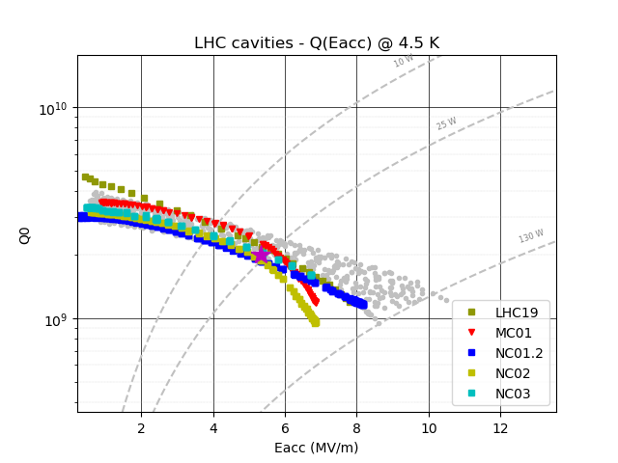
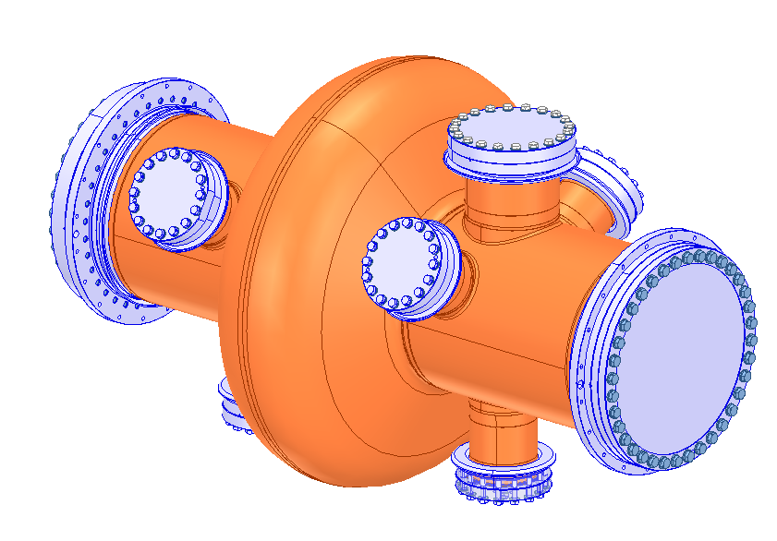
Nb/Cu technology: high gradient / high Q0 challenges
  New LHC spare cavities performances
Compared to LHC cavities, significant improvement of Eacc and reduction Q0 slope shall be achieved for FCCee cavities. New technological process are being developed:
→ Internal welding of copper hall cells or seamless cavity
→ Electropolishing of the copper cavity
→ Highly performant niobium coating :HiPIMS Magnetron Sputtering with a high voltage pulsed power source
→ Application of modern surface preparation and clean room procedures to reach high gradients
4.5 K
FCC spec
Z (1-cell)
FCC spec
W,H (2-cell)
LHC spec

Slide 17
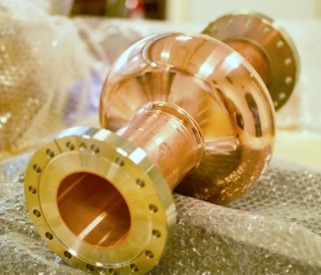
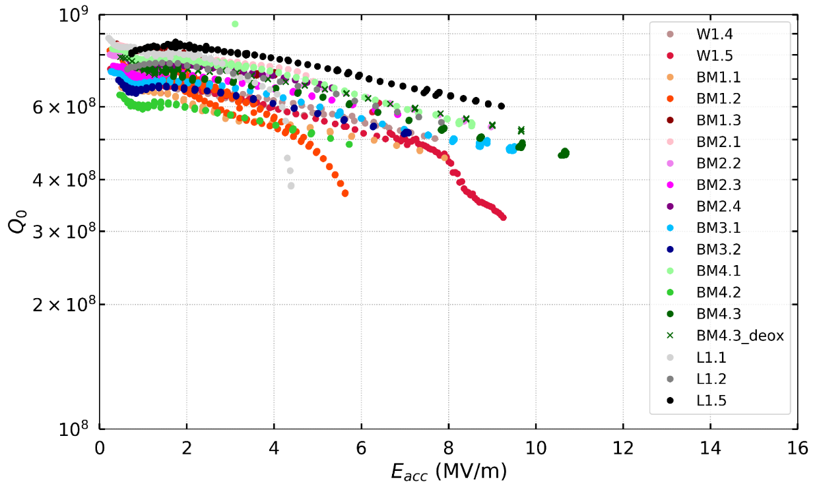
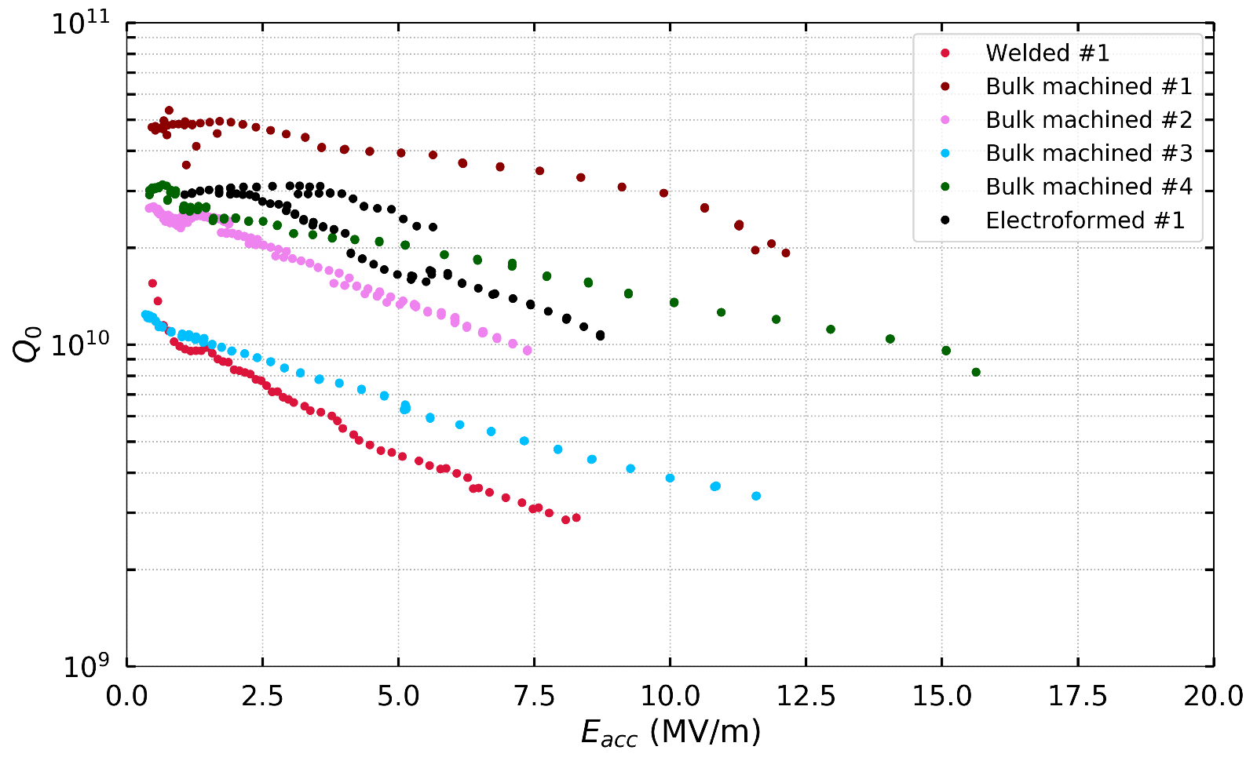
SRF studies with 1.3 GHz cavities
G. Rosaz, W. Venturini Delsolaro, M. Garlasche, G. Bellini, L. M. Antunes Ferrera, C. Pereira Carlos, L.Vega Cid, A.Bianchi, G. Pechaud
Synergy (and co-funding) with general SRF R&D project
Several types of copper substrates studied (BM = machined from bulk, W = welded, L = electrodeposited)
Electropolishing + HiPIMS coating
At 4.2 K, good reproducibility. The tests are stopped are 10 MV/m for administrative limits. Extrapolated at 400 MHz, the results are already satisfactory.
At 1.8 K, a large scatter of the results is observed and not yet fully understood. The Q0 slope is cancelled in some cases.
Scaled FCC goal at 400 MHz
4.2 K
1.85 K
Additional HPR and treatment of outer surface
L. Vega Cid, “RF tests of Nb/Cu 1.3 GHz elliptical cavities”, presented at the FCC Week 2022, Paris, France, May 2022
L. Vega Cid, “Study of the influence of the manufacturing process and thermal cycling on the RF performance of 1.3 GHz Nb/Cu SRF cavities”, presented at the 10th International Workshop on Thin Films and New Ideas for Pushing the Limits of RF Superconductivity, JLAB, Newport News, USA, Sept. 2022

Slide 18
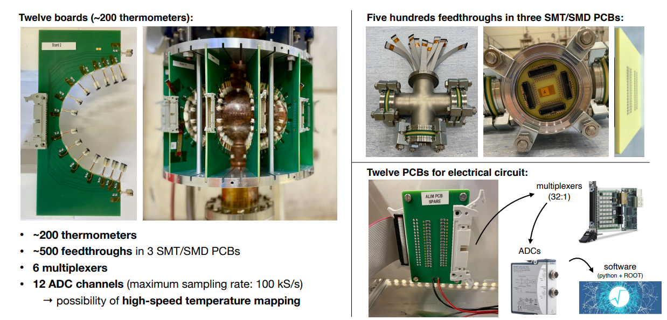
Temperature mapping system for Nb/Cu cavities
A.Bianchi
A. Bianchi, “Temperature Mapping of Niobium-coated 1.3 GHz Copper Cavities”, presented at the 10th International Workshop on Thin Films and New Ideas for Pushing the Limits of RF Superconductivity, JLAB, Newport News, USA, Sept. 2022

Slide 19
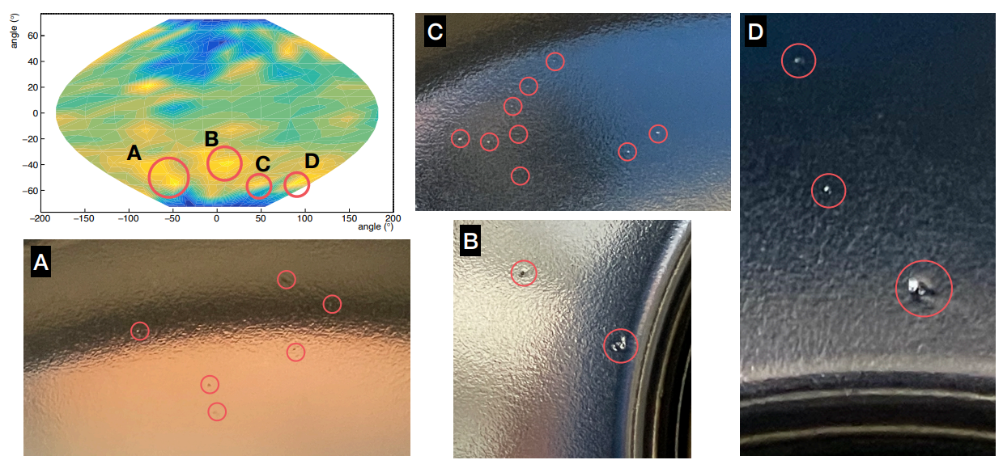
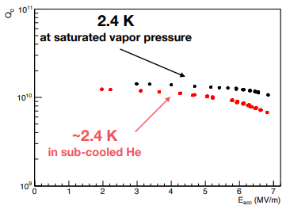
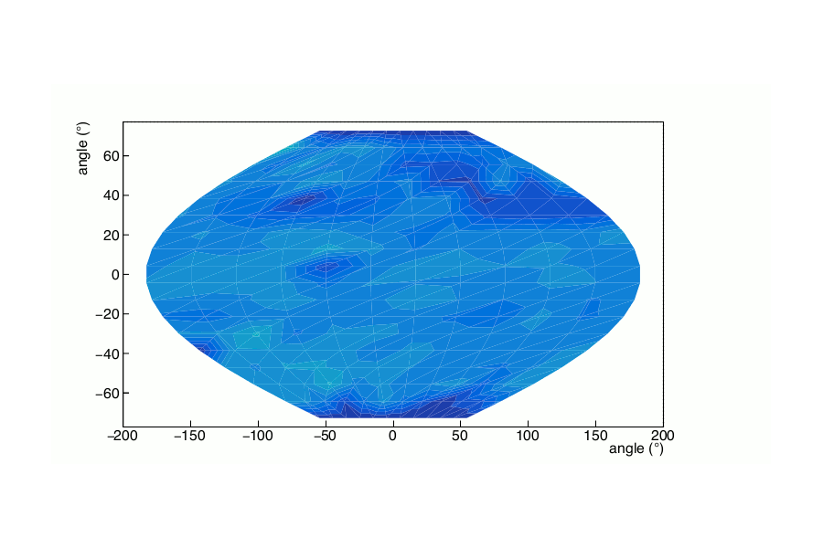
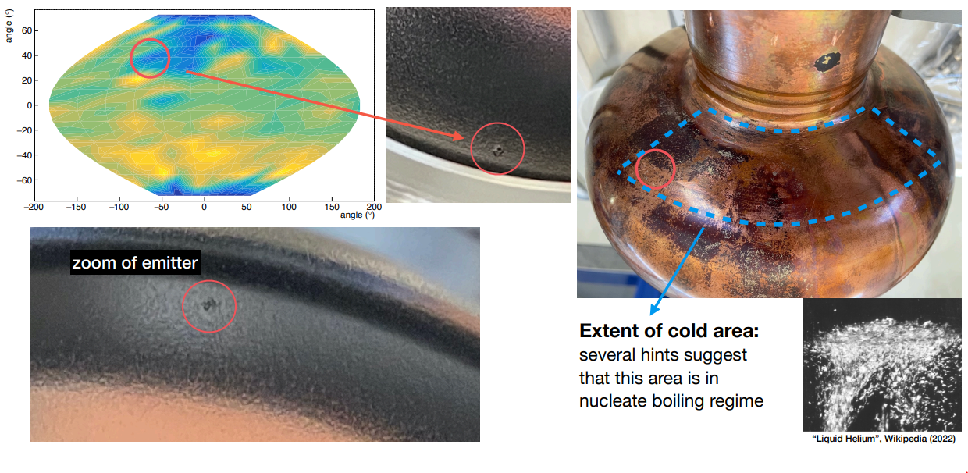
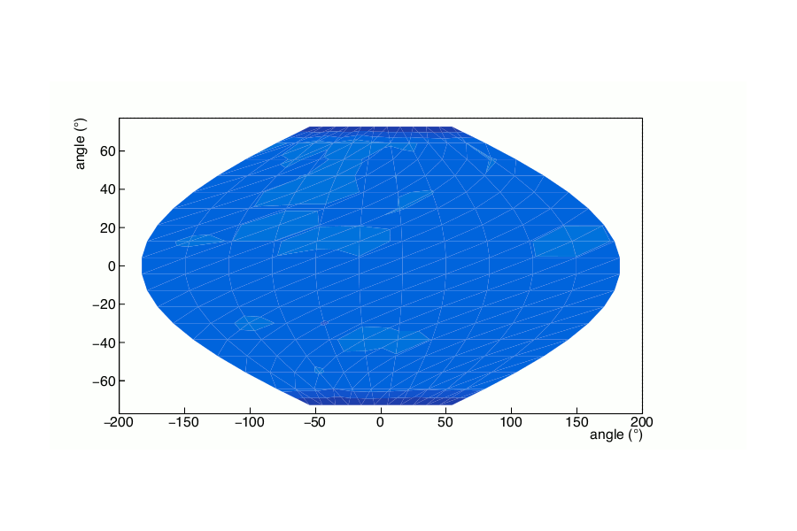
Temperature mapping vs optical inspection
A.Bianchi
Temperature mapping during Q₀ vs E_{acc} scan
2.4 K – 80 mbar
~2.4 K – Patm

Slide 20
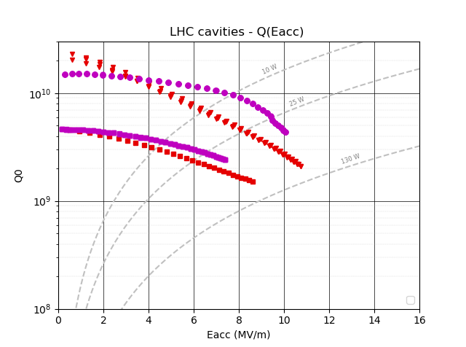
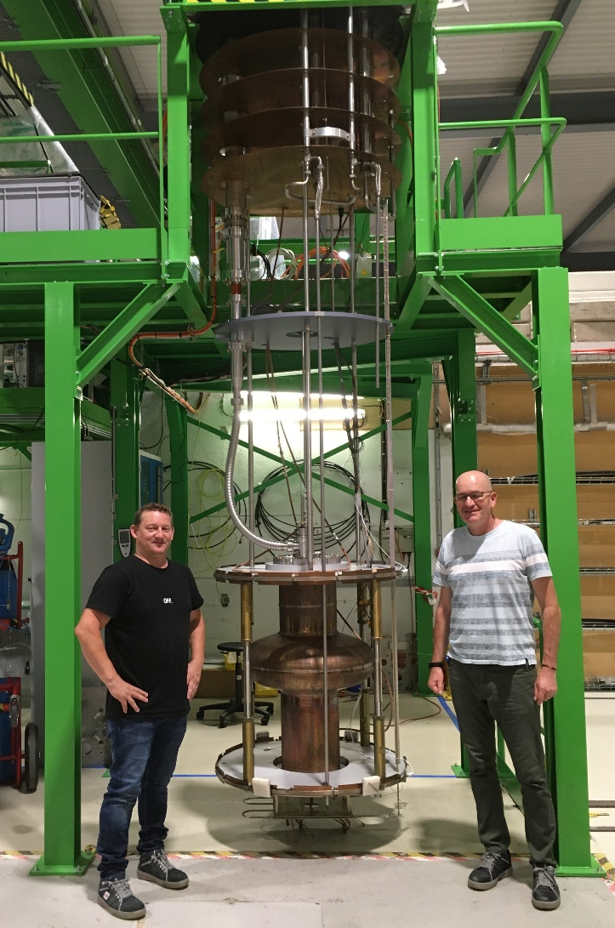
First attempt of HiPIMS coating on a 400 MHz cavity
Reduction Q₀ slope is confirmed
Encouraging result obtained without electropolishing
Test limited by field emission → a new surface preparation in clean room is planned in Q12023 (with niobium coated flanges and HPR)
2 K
HIPIMS coating (2022)
4.5 K
DCMS coating (2020)
PC04 cavity on vertical insert in SM18
G. Rosaz, J. Walker, Y. Cuvet, G. Pechaud

Slide 21
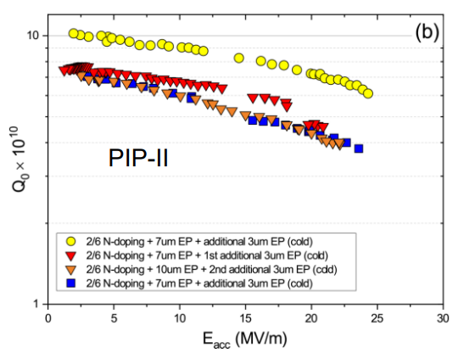
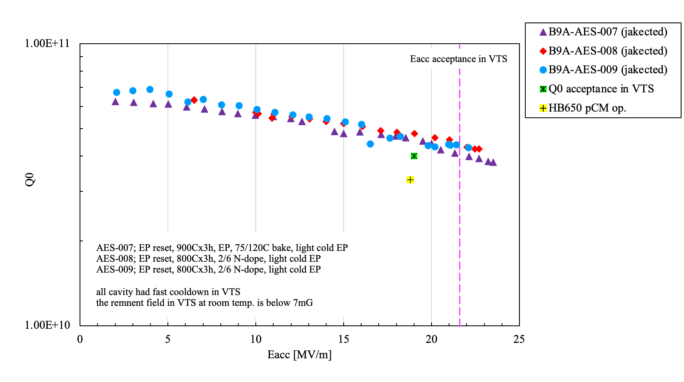
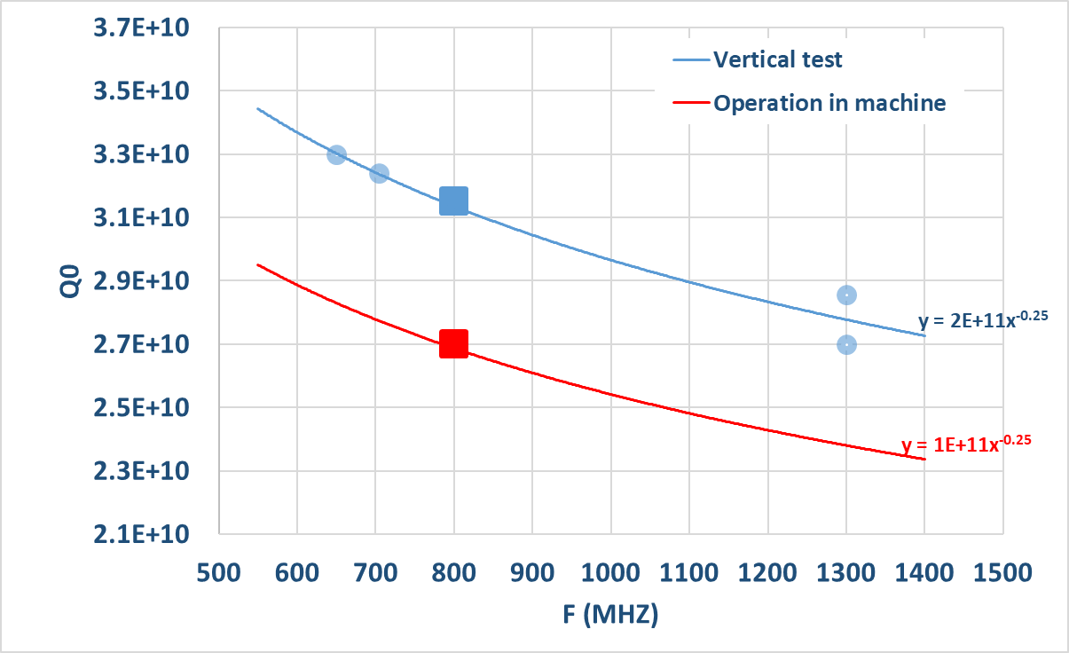
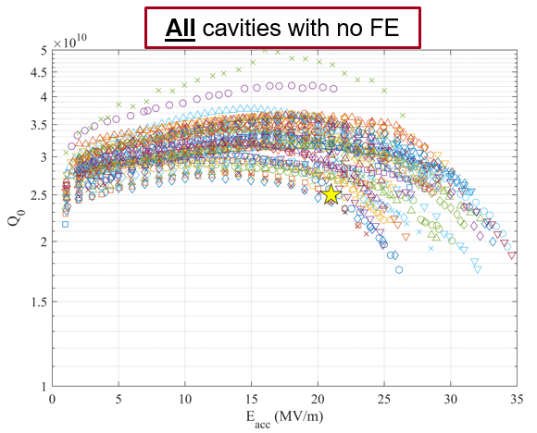
Bulk Niobium SRF technology: high gradient / high Q0 challenges
Cavities with special nitrogen doping and heat treatments
Scaling function Q0 vs RF frequency (empirical) at high gradient (25-27 MV/m)
3.3e10
3.3e10
650 MHz
FNAL-PIP2 (5-cell jacketed)
CEA (1-cell)
FCC 5 cell
PIP-II Technical Meetings (12-July 14, 2022) · INDICO-FNAL (Indico) : https://indico.fnal.gov/event/54738/
Processing histories and test results HB
Fumio Furuta (Fermilab)
15% margin
DESY (1-cell)
t
(20% with bare cavity)
SLAC-LCLS-II-HE (9-cell)
FCC 5-cell in operation
2.7e10
1.3 GHz
LCLS-II-HE Cavities - High Q and High G in Mass Production
James Maniscalco
TTC 2022 Oct 11 – 14, 2022

Slide 22
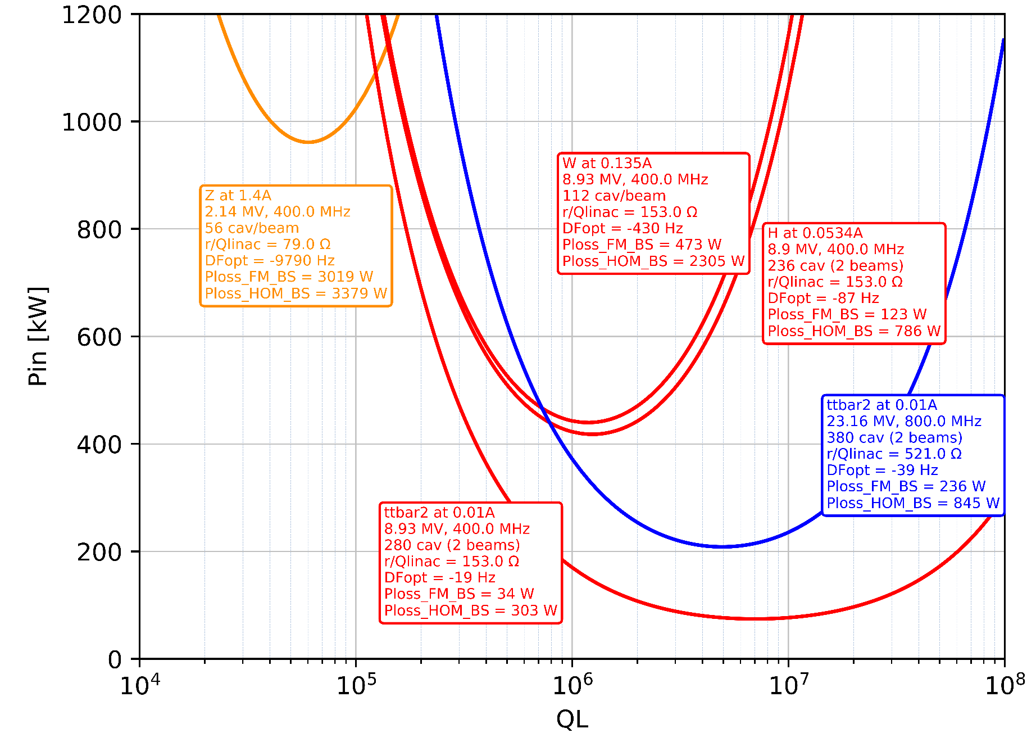
Power requirements for RF Couplers
CW operation
Fundamental Power Couplers:
900 kW - 400 MHz fixed couplers for single cell cavities
400 kW → 50 kW - 400 MHz variable couplers for 2-cell cavities
200 kW - 800 MHz fixed couplers for 5-cell cavities
HOM couplers: ~ 1 kW per coupler at 400 MHz

Slide 23
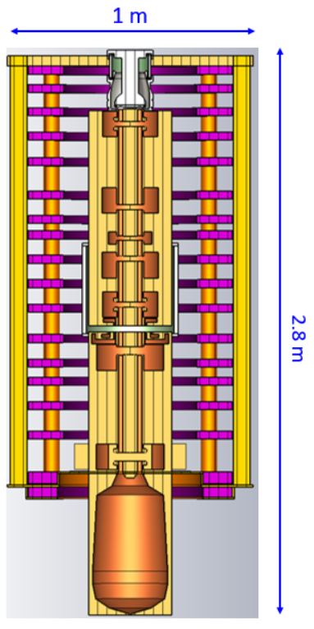
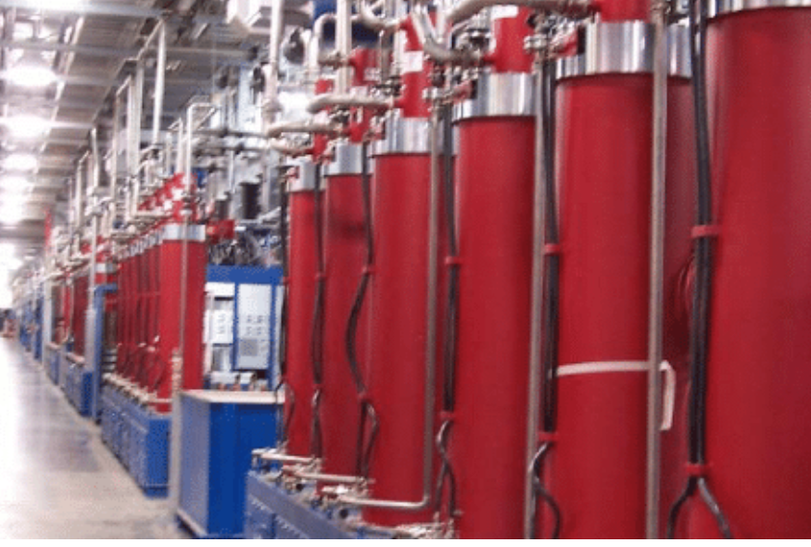
RF power sources
07-Dec-22 | Z |  | W |  | H |  | ttbar2
 | collider | booster | collider | booster | collider | booster | collider | collider | booster
RF source type | 400 MHz 1 MW klystron | 800 MHz 500 kW klystron | 400 MHz 1 MW klystron | 800 MHz 500 kW klystron | 400 MHz 1 MW klystron | 800 MHz 50 kW solid state amplifier | 400 MHz 50 kW solid state amplifier | 800 MHz 500 kW klystron | 800 MHz 50 kW solid state amplifier
Frequency [MHz] | 400 | 800 | 400 | 800 | 400 | 800 | 400 | 800 | 800
Pcav [kW] | 880 | 176 | 385 | 95 | 379 | 49 | 45 | 202 | 9
Prf conditioning [kW] | 220 | 44 | 96 | 24 | 95 | 12 | 11 | 51 | 2
# cavities / RF sources | 1 | 2 | 2 | 4 | 2 | 1 | 1 | 2 | 4
# RF sources | 112 | 14 | 128 | 13 | 130 | 100 | 260 | 218 | 134
Ultra-high efficiency Klystron (Two Stages)
Developed by CERN
400 MHz – 1 MW
Efficiency = 80%
High efficiency klystron
Suppliers: Thales, CPI
800 MHz – 500 kW
Efficiency = 65%
Example of SNS Oak Ridge (long pulse)
Y. Syratchev,
Z. Un Nisa,
J. Cai,
G. Burt

Slide 24

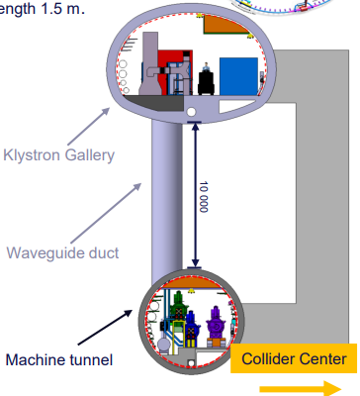
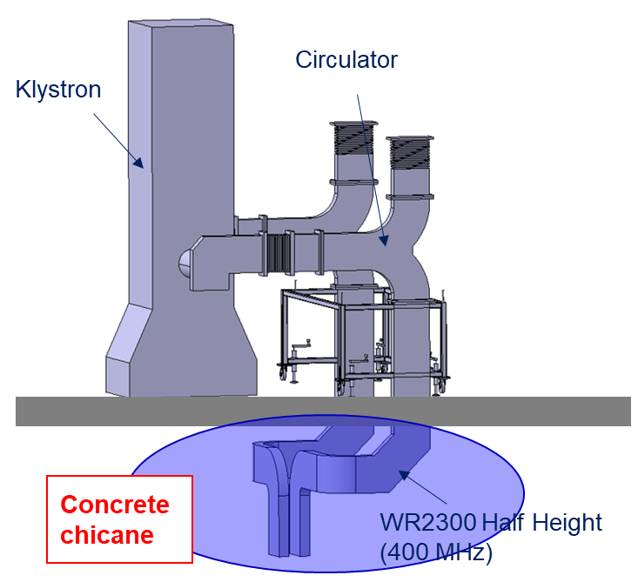
RF integration and waveguide distribution
O. Brunner
F. Valchkova
Vertical arrangement provides benefits:
  Concrete chicane (Linac 4) in the WG duct to protect from the emission of X-rays (access to klystron galleries during commissioning and operation is required), facilitates the WG path in the machine tunnel and the WG installation
1 MW 400 MHz klystrons can be used for:
  Z: re-combine 2 WG to 1 cavity (in the tunnel)
  W and ZH: power 2 cavities

Slide 25
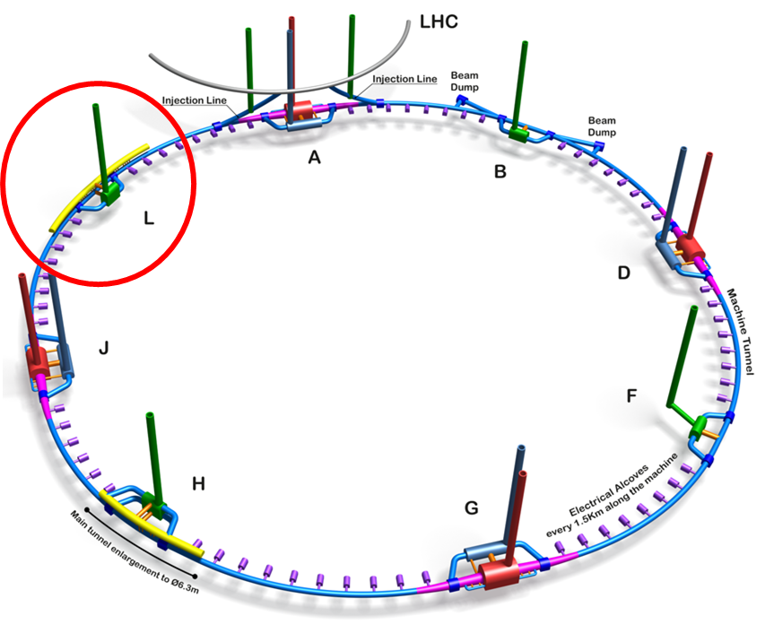
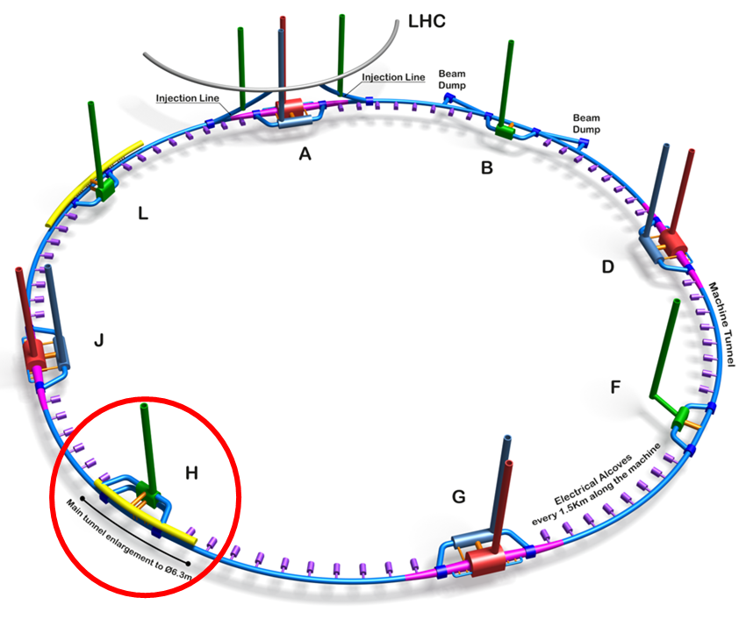


L.Delprat, B.Bradu, K.Brodzinski,
F. Valchkova, V. Parma
Cryogenic distribution
RF for COLLIDER
RF for BOOSTER
TLSS length: 2160 m
TLSS length: 2160 m

Slide 26




The 600 MHz RF Frequency option
scaling laws for single cell elliptical cavity
  Beam induced voltage (Loss factor)
  Cavity size
  a.u.
400 MHz
  LHC
  FCCee Z, W, H
  FCChh
  Transverse α F³
  Surface [dm²] α F²
  High current machines
800 MHz
  Diameter [cm] α F
  FCC ttb – 2nd harm
  Longitudinal α F²
600 MHz
  SWELL option
  [kW]
  [nΩ]
  SC surface resistance (BCS)
  α F⁻²
  Power of RF coupler
  α F⁻¹
  SUPER KEKB
  EIC
  PIP2
  CEPC
  …
  From E. Montesinos
  4.5 K
?
  R&D needed
  2 K (x10)
  Present performances

Slide 27



SWELL 2-cell 600 MHz cavity for Z, W, H
Very interesting alternative cavity option which would cover three machines (no need to remove cryomodules after operation at Z)
Highly damped RF cavity for transverse HOMs thanks 4 waveguide slots and coaxial RF lines
E_{acc} = 12.5 MV/m, P_{RF} = 600 kW
Robust against microphonics and Lorentz forces
Innovative concept compatible with Nb/Cu technology (open RF structure, easy to coat and inspect)
I. Syratchev
F. Peauger
O. Brunner
S. Gorgi Zadeh
F. Peauger et al, SWELL and Other SRF Split Cavity Development, in Proc. LINAC’22, Liverpool, England, Sept. 2022

Slide 28



Impedance and HOM damping of SWELL
S. Gorgi Zadeh
Longitudinal coupled bunch instabilities due to the FM will be mitigated by direct RF feedback, as performed in the LHC
Three transverse modes remain above the stability threshold:
  Spike at the FM frequency is due to coupler and tuning plunger asymmetry and can be compensated by alternating their orientation along the accelerator
  For the two other modes at 748 and 830 MHz a bunch-by-bunch feedback system with a damping time of about 100 turns
$$Q_{ext}\sim 180 max$$

Slide 29


SWELL concept feasibility demonstration
Prototype at reduced scaled (1.3 GHz) successfully machined and ready to be niobium coated
Vertical test at 4.5 K planned in SM18 at CERN in 2023
Nb coating surface
M. Garlasche, R. Ninet,
K. Scibor,
M. Timmins
M. Timmins, M. Therasse, T. Koettig

Slide 30

Collaboration with CNRS – LPSC on multipacting studies
A. Plaçais, Y. Gomez Martinez, F. Bouly

Slide 31
FCCee parameters at 600 MHz (alternative option)
with SWELL 2-cell and elliptical 5-cell cavities
 | Z |  | W |  | H |  | ttb2
 | per beam | booster | per beam | booster | 2 beams | booster | 2 beams | 2 beams | booster
Frequency [MHz] | 600 | 600 | 600 | 600 | 600 | 600 | 600 | 600 | 600
RF voltage [MV] | 120 | 140 | 1050 | 1050 | 2100 | 2100 | 2100 | 9200 | 11300
Eacc [MV/m] | 2.67 | 9.34 | 10.72 | 21.01 | 10.72 | 22.12 | 10.72 | 22.45 | 22.39
# cell / cav | 2 | 5 | 2 | 5 | 2 | 5 | 2 | 5 | 5
Vcavity [MV] | 1.33 | 11.67 | 5.36 | 26.25 | 5.36 | 27.63 | 5.36 | 28.05 | 27.97
#cells | 180 | 60 | 392 | 200 | 784 | 380 | 784 | 1640 | 2020
# cavities | 90 | 12 | 196 | 40 | 392 | 76 | 392 | 328 | 404
# CM | 22.5 | 3 | 49 | 10 | 98 | 19 | 98 | 82 | 101
T operation [K] | 4.5 | 2 | 4.5 | 2 | 4.5 | 2 | 4.5 | 2 | 2
dyn losses/cav [W] | 4 | 1.5 | 64 | 7 | 64 | 8 | 64 | 56 | 8
stat losses/cav [W] | 8 | 8 | 8 | 8 | 8 | 8 | 8 | 8 | 8
Qext | 1.9E+04 | 6.4E+05 | 6.8E+05 | 1.1E+07 | 6.8E+05 | 2.3E+07 | 3.9E+06 | 6.0E+06 | 1.2E+08
Detuning [kHz] | 45.582 | 1.646 | 1.185 | 0.075 | 0.238 | 0.007 | 0.054 | 0.024 | 0.001
Pcav [kW] | 547 | 411 | 251 | 123 | 251 | 65 | 44 | 252 | 12
rhob [m] | 9937 | 9937 | 9937 | 9937 | 9937 | 9937 | 9937 | 9937 | 9937
Energy [GeV] | 45.6 | 45.6 | 80.0 | 80.0 | 120.0 | 120.0 | 182.5 |  | 182.5
energy loss [MV] | 38.49 | 38.49 | 364.63 | 364.63 | 1845.94 | 1845.94 | 9875.14 |  | 9875.14
cos phi | 0.32 | 0.27 | 0.35 | 0.35 | 0.88 | 0.88 | 0.82 | 0.90 | 0.87
Beam current [A] | 1.280 | 0.128 | 0.135 | 0.0135 | 0.0534 | 0.0027 | 0.0100 | 0.0100 | 0.0005
  281 cryomodules
  1124 cavities
  ~35% in Nb/Cu
→ total number of cryomodules reduced by ~ 16 % compared to the 400/800 MHz baseline

Slide 32
SRF cavities and power RF sources specification at 600 MHz
→ only two types of SRF cavities and one type of high efficiency klystron to develop
07-Dec-22 | Bare cavity in vertical test stand |  | Jacketed cavity with HOM couplers in vertical test stand |  | Cryomodule (with FPC) in horizontal test stand |  | Operation in the machine
 | Eacc (MV/m) | Q0 | Eacc (MV/m) | Q0 | Eacc (MV/m) | Q0 | Eacc (MV/m) | Q0
2-cell 600 MHz | 13.2 | 3.3E+09 | 12.6 | 3.15E+09 | 12 | 3.0E+09 | 10.8 | 2.7E+09
5-cell 600 MHz | 27.6 | 3.3E+10 | 26.3 | 3.15E+10 | 25 | 3.0E+10 | 22.5 | 2.7E+10
07-Dec-22 | Z |  | W |  | H |  | ttbar2
 | collider | booster | collider | booster | collider | booster | collider | collider | booster
RF source type | 600 MHz 600 kW klystron | 600 MHz 600 kW klystron | 600 MHz 600 kW klystron | 600 MHz 600 kW klystron | 600 MHz 600 kW klystron | 600 MHz 65 kW solid state amplifier | 600 MHz 65 kW solid state amplifier | 600 MHz 600 kW klystron | 600 MHz 50 kW solid state amplifier
Frequency [MHz] | 600 | 600 | 600 | 600 | 600 | 600 | 600 | 600 | 600
Pcav [kW] | 547.4 | 410.6 | 251.1 | 123.1 | 251.5 | 64.9 | 43.9 | 252.4 | 12.2
Prf conditioning [kW] | 136.9 | 102.6 | 62.8 | 30.8 | 62.9 | 16.2 | 11.0 | 63.1 | 3.1
# cavities / RF sources | 1 | 1 | 2 | 4 | 2 | 1 | 1 | 2 | 4
# RF sources | 180 | 12 | 196 | 10 | 196 | 76 | 392 | 164 | 101

Slide 33
Summary
Solid baseline at 400 / 800 MHz with three types of elliptical cavities to cover the four working points of FCCee.
Intense activity around longitudinal beam dynamics, cavity RF design and high efficiency klystron simulations (not reported here).
Hardware R&D program oriented towards the improvement of Nb/Cu technology which represents almost 400 cavities and covers the full physics program of Z, WW and ZH.
High Q₀ bulk niobium cavities becomes new area of interest for the ttb machine
→ CERN needs strong collaborations with external labs specialized in this field (SLAC, FNAL, …)
New innovative concept of 600 MHz SWELL cavity under evaluation – seems very promising to reduce the overall cost, simplify the installation scenario of the RF system and its development phase.

Slide 34
Thank you for your attention
Questions ?
Acknowledgements
Olivier Brunner, Frank Gerigk, Ivan Karpov, Alice Vanel, Igor Syratchev, Rama Calaga, Heiko Damerau, Shahnam Gorgi Zadeh, Eric Montesinos, Said Atieh, Allessandro Dallochio, Marco Garlasche, Ofelia Capatina, Marc Timmins, Vittorio Parma, Mathieu Therasse, Guillaume Rosaz, Walter Venturini Delsolaro, Sosoho-Abasi Udongwo, Ursula Van Rienen

Slide 35


Why 4 → 2-cells ?
  Eacc limited to ~ 7 MV/m in LEP
  Very large superconducting surface ( ~5 m²) → more “chance” to have surface defects
  Such large cavities require significant SRF infrastructures upgrades at CERN
  Surface treatments recipes for high accelerating gradient will be very painful to adapt
LEP
O. Brunner

Slide 36

1.3 GHz preparation and test workflow
L. Vega Cid

Slide 37

Double frequency RF system
A. Vanel
I. Karpov

Slide 38

CDR FCC-ee: The Lepton Collider, 2019

