Slide 1



Booster Overview
B. Dalena, A. Chance, T. Da Silva (CEA)
A. Mashal (IPM), T. Raubenheimer (SLAC), F. Zimmermann (CERN)
Thanks to:
B. Haerer, L. Van Riesen-Haupt, T. Charles, R. Tomas, T. Persson, F. Antoniou, O. Etisken, M. Zampetakis, S. Bettoni, M. Hofer, F. Carlier, B. Holzer, A. Franchi, A. Latina, K. Oide, S. Farthoukh

Slide 2
Outline
The injector complex
  - Layout of the High Energy Booster (HEB)
Optics design
  - Arcs
  - Insertions
Injection energy and emittances
  - Dynamic Aperture (DA) and Momentum Acceptance (MA)
Correction of imperfections and definitions of tolerances
Emittance evolution and booster operations
Perspectives

Slide 3
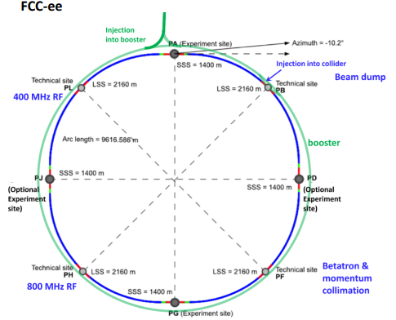
Injectors complex
Injection energy into the booster 20 GeV (or lower ? )
Ramping: 80-100 GeV / s (< 1 s )
Alternatives: SPS as Pre Booster Ring (PRB) and a Linac
See “The FCCee injector complex” by P. Craievich
SPS
CDR study
LINAC
FCCIS study

Slide 4
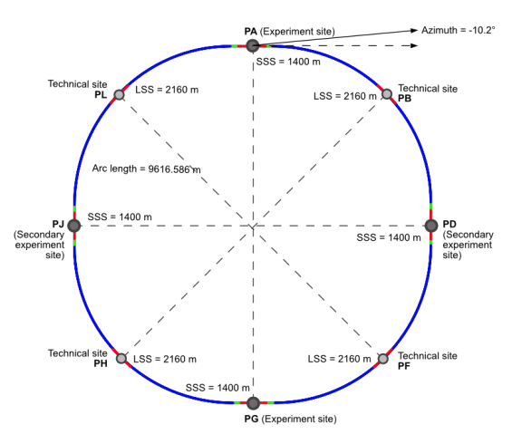
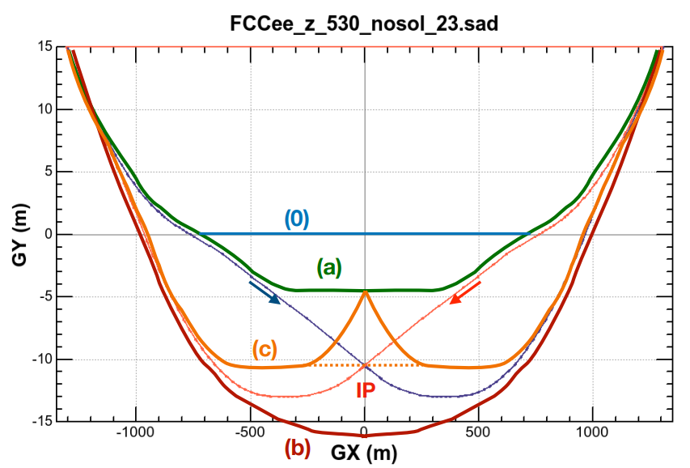
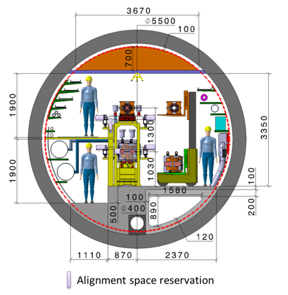
Booster layout (after CDR)
RF section
In the current booster version, cavities are located in sections H and L. Alternative all RF system of the Booster placed in H.
Proposal of the RF group to use 800 MHz only for all mode of the
Booster: https://indico.cern.ch/event/1064327/contributions/4888581/
(F. Peauger)
Bypass of the booster near the detector still under investigation.
Booster on top of the collider. Azimuthal offset required for integration. (see F. Valchkova talk)

Slide 5
60°/60° Optics for Z and W modes
Magnet | Parameter | Unit | Value
Dipole | Field at injection (20 GeV) | G | 71
 | Field at W energy (80 GeV) | G | 284
 | Length | m | 11.1
Quadrupole | Gradient at injection (20 GeV) | T/m | 1.74
 | Gradient at W energy (80 GeV) | T/m | 6.9
 | Length | m | 1.5
Sextupole | Gradient at injection (20 GeV) | T/m² | 75
 | Gradient at W energy (80 GeV) | T/m² | 300
 | Length | m | 0.5
FODO cells of ~52 m
Made of 4 dipole, 2 quadrupoles and 2 sextupoles
Distance between dipoles: 0.4 m
Distance between quadrupole and sextupole: 0.165 m
Distance between dipole and sextupole: 0. 504 m
Distance between quadrupole and dipole: 0.869 m
(it includes space for BPM and dipole correctors)
# dipoles = 2×2944
# quadrupoles = 2944
# sextupoles = 2632/6
⇒ Very challenging low dipole field at injection

Slide 6
90°/90° Optics for H and ttbar modes
Magnet | Parameter | Unit | Value
Dipole | Field at injection (20 GeV) | G | 71
 | Field at ttbar energy (182.5 GeV) | G | 650
 | Length | m | 11.1
Quadrupole | Gradient at injection (20 GeV) | T/m | 2.5
 | Gradient at ttbar energy (182.5 GeV) | T/m | 22.5
 | Length | m | 1.5
Sextupole | Gradient at injection (20 GeV) | T/m² | 174
 | Gradient at ttbar energy (182.5 GeV) | T/m² | 1582
 | Length | m | 0.5
FODO cells of ~52 m
Made of 4 dipole, 2 quadrupoles and 2 sextupoles
Distance between dipoles: 0.4 m
Distance between quadrupole and sextupole: 0.165 m
Distance between dipole and sextupole: 0. 504 m
Distance between quadrupole and dipole: 0.869 m
(it includes space for BPM and dipole correctors)
# dipoles = 2×2944
# quadrupoles = 2944
# sextupoles = 2632/4
Very challenging low dipole field at injection ( preliminary magnet design by J. Bauche @ FCC week 2022 https://indico.cern.ch/event/1064327/contributions/4888487/ )

Slide 7
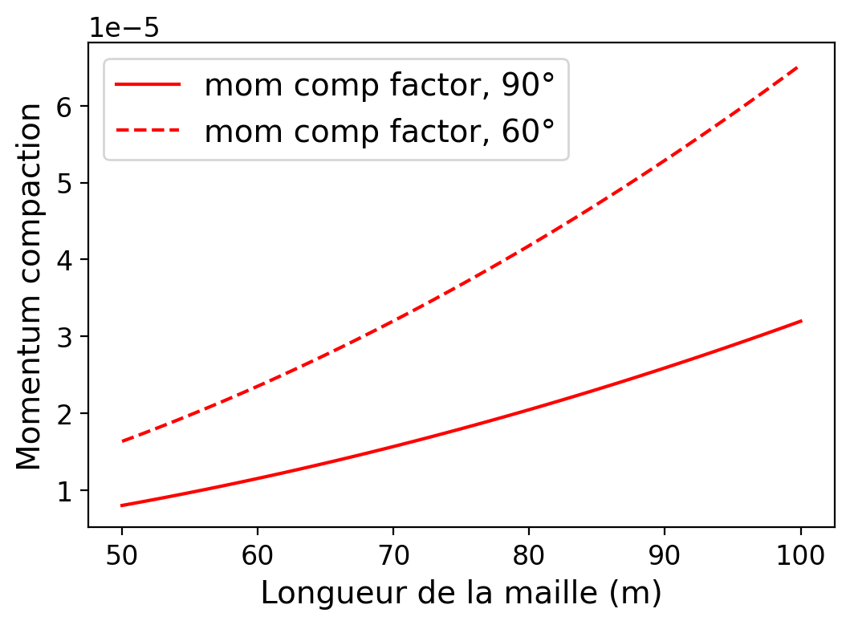
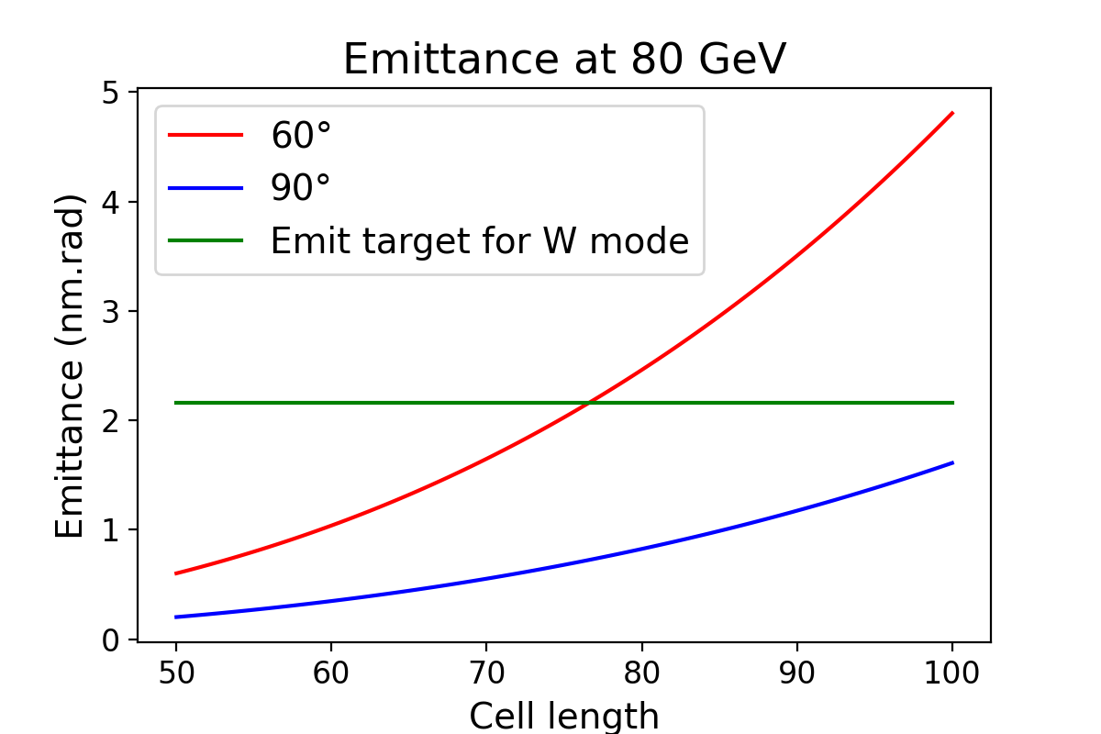
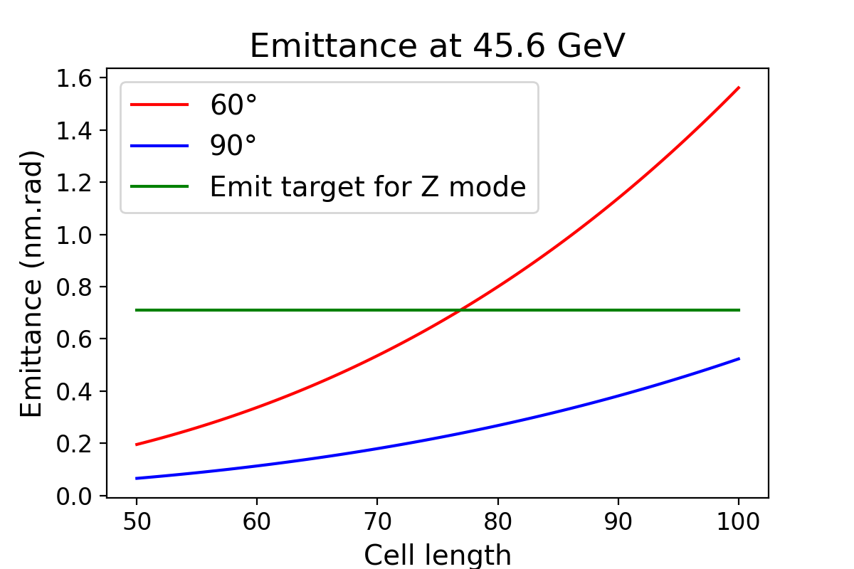
Equilibrium emittances
Booster rms emittance at extraction ≤ collider
new
Beam Energy [GeV] | Eq. Emittance [nm rad] 60°/60° | Eq. Emittance [nm rad] 90°/90° | Eq. Emittance Collider [nm rad]
45.6 (Z) | 0.235 | 0.078 | 0.24
80 (W) | 0.729 | 0.242 | 0.84
120 (H) | 4.229 | 0.545 | 0.63
175 (tt) | 3.540 | 1.172 | 1.48
Eq. emittance Collider new [nm rad]
0.71
2.16
0.64
1.49
Cell length (m)
90°/90° required for H and ttbar final emittances
60°/60° retained for Z and W operation (mitigation of MI and IBS)
90°/90° 100 m cell could gain a bit in momentum compaction at Z & W
Alternatives ?
[m]

Slide 8
Injection/ extraction in the High Energy Booster
R. L. Ramjiawan & E. Howling
Injection scheme with orbit bump and thin electrostatic septum
Possibility to have vertical injection to be studied
Extraction scheme with 10 kickers
Room for optics optimization of both injection and extraction

Slide 9
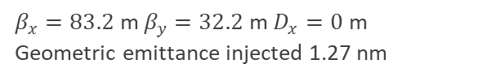
DA at injection (20 GeV) with multipole errors
Static dipole field errors of the CT dipole design at 56Gs considered + 10% random part
Dynamic field effect not taken into account in this simulations: dipole and multipole reproducibility expected to be ≤ 5×10⁻⁴
Courtesy of F. Zimmermann and Jie Gao
 | CT dipole |  | Iron-core dipole
GFR=R26 | 28Gs | 56Gs | 28Gs | 56Gs
B1/B0 | -5.20E-04 | -1.04E-04 | -1.56E-03 | -2.60E-04
B2/B0 | 4.73E-04 | 5.41E-04 | -2.03E-03 | -2.03E-04
B3/B0 | -7.03E-06 | 1.05E-04 | 3.52E-04 | 1.76E-04
B4/B0 | -9.14E-04 | -3.66E-04 | 4.57E-04 | -1.83E-04
B5/B0 | 3.56E-05 | -2.38E-05 | -2.38E-05 | -3.56E-05
B6/B0 | 6.18E-04 | 2.16E-04 | -3.09E-04 | 9.27E-05
Dynamic Aperture defined as
Stable initial amplitude @ 4500 turns (~15% tx 20 GeV)
relative values @ R = 26 mm
91km 60°/60° optics
$β_{x}=83.2$ m $β_{y}=32.2$ m $D_{x}=0$ m
Geometric emittance injected 1.27 nm
preliminary
DA of 91km 90°/90° optics is ~ 5mm (due to strong sextupoles)

Slide 10
Dynamic aperture and momentum acceptance improvement
Investigating alternative sextupoles schemes with 4 non-inteleaved sextupole families. Better 2nd order chromaticity but higher anharmonicity.
1
1
2
2
1
1
2
2
1
1
2
2
1
FCCee CDR
1
180°
2
3
4
5
1
2
3
4
5
6
8 families
180°
Using odd Defocusing Sextupoles families to optimize Resonance Driving Terms, in particular the candidate terms of driving synchro-betatron resonance.
A. Mashal

Slide 11
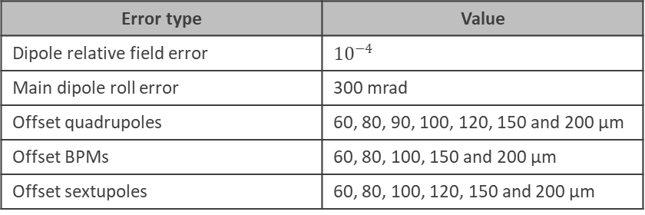
Static magnets imperfections
Define pre-alignment tolerances of the elements and the orbit correctors specifications + establish a correction procedure for orbit correction for the FCC-ee high energy booster.
Tatiana Da Silva
MQ offset, field err MB & MB roll
Orbit correction only
Statistics on 100 seeds
Error type | Value
Dipole relative field error | $${10}^{−4}$$
Main dipole roll error | 300 mrad
Offset quadrupoles | 60, 80, 90, 100, 120, 150 and 200 µm
Offset BPMs | 60, 80, 100, 150 and 200 µm
Offset sextupoles | 60, 80, 100, 120, 150 and 200 µm
MQ offset, field err MB & MB roll, BPMs offset
MQ offset, field err MB & MB roll, BPMs offset, MS offset

Slide 12
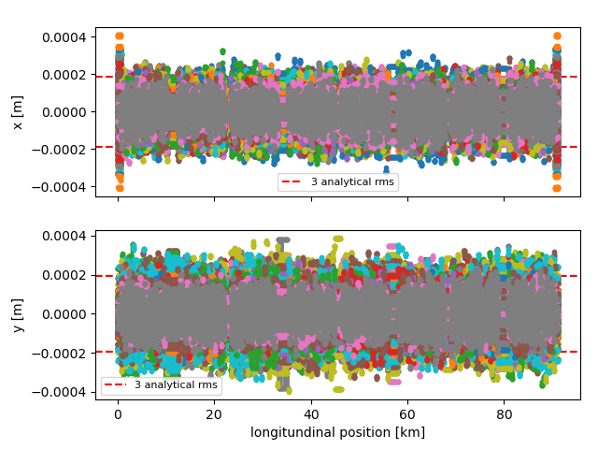
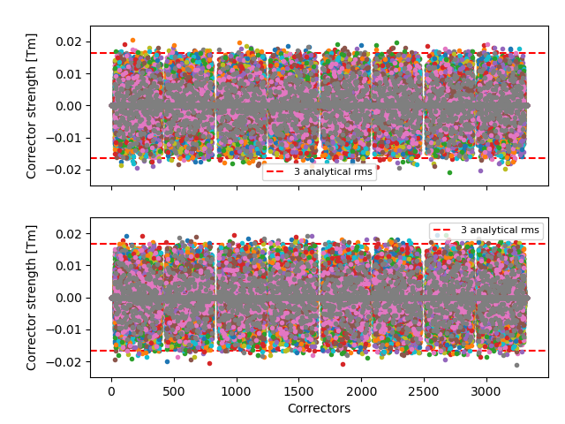
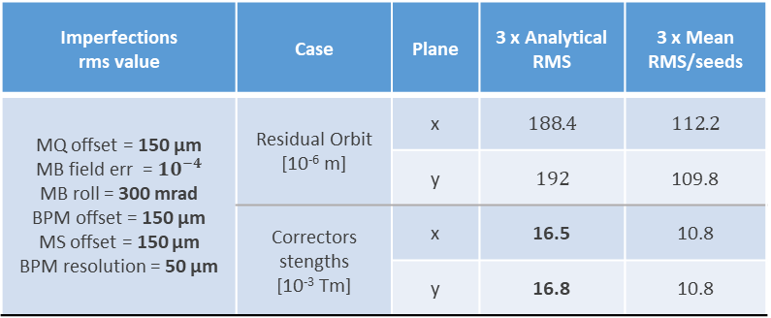
First pre-alignment and correctors specs
Imperfections rms value | Case | Plane | 3 x Analytical RMS | 3 x Mean RMS/seeds
MQ offset = 150 µm MB field err = ${10}^{−4}$ MB roll = 300 mrad BPM offset = 150 µm MS offset = 150 µm BPM resolution = 50 µm | Residual Orbit [10⁻⁶ m] | x | $$188.4$$ | $$112.2$$
 |  | y | $$192$$ | 109.8
 | Correctors stengths [10⁻³ Tm] | x | 16.5 | 10.8
 |  | y | 16.8 | 10.8
First specifications of the main magnets misalignment of the High Energy Booster arcs cells ≃ 150 μm
First definition of the orbit correctors for the booster ≃ 20 mT
In order to preserve transverse emittances need to able to correct also beta-beating, dispersion and coupling (emittance tuning)
T. Da Silva

Slide 13
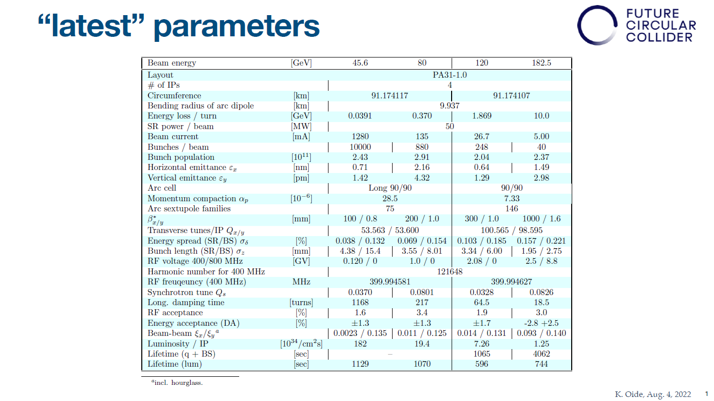
Collider target parameters

Slide 14
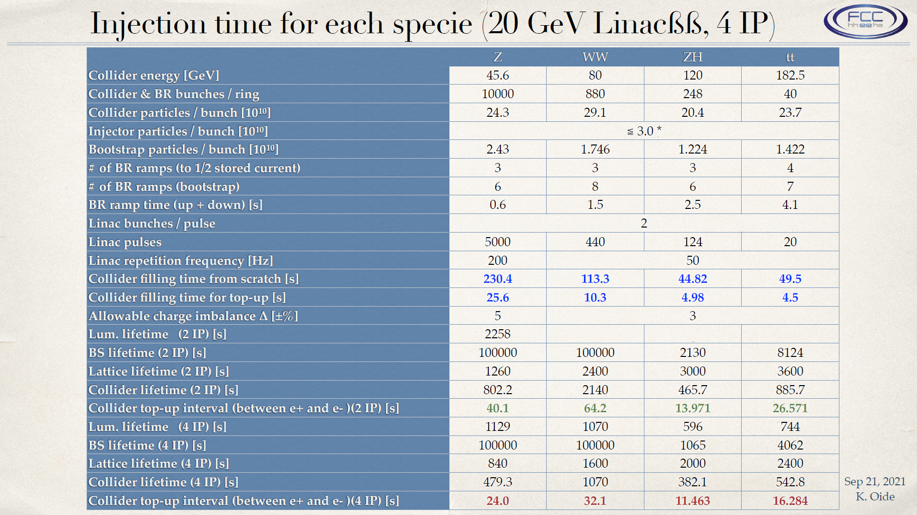
Injectors parameters

Slide 15
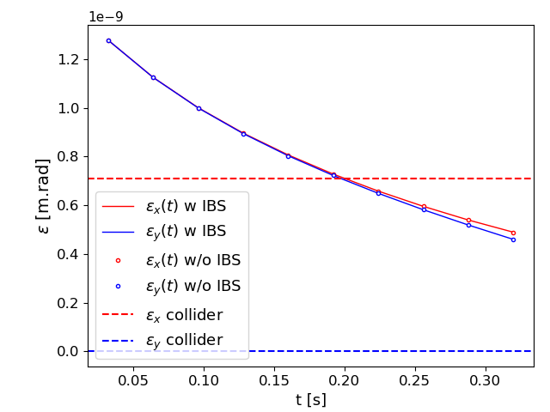
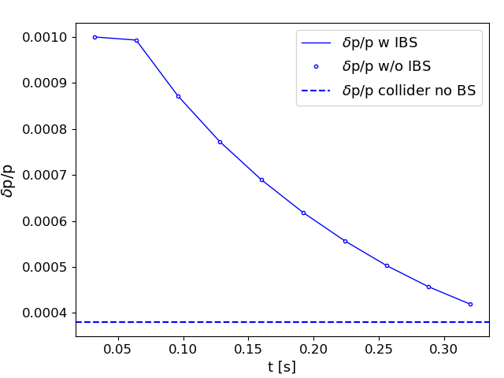
Emittances evolution
We consider the Z mode:
  We accumulate in the booster for 24 s: for the emittance evolution we consider 2 cases:
    1 fresh beam (the ramp begins directly after injection).
    1 accumulation time of 24 s before the ramp.
  We ramp from 20 GeV to 45.6 GeV for 0.32 s.
  We consider also a flat-top of 2.7 s (to get a total cycling time of 27 s) to evaluate the gain of damping at top energy.
The injection is from the LINAC at 20 GeV:
  Normalized emittance of 10 µm x 10 µm.
  Energy spread of 0.1%
  2.53e+10 particles per bunch (4 nC)
We assume a matched beam: the bunch length is deduced from the total voltage, energy spread and momentum compaction.
We consider the case with no IBS and with IBS, using MAD-X routines.
LINAC parameters: S. Bettoni, A. Latina,
A. Grudiev, P. Craievich
Thanks to M. Zampetakis,
F. Antoniou, O. Etisken for IBS
Normalized transverse emittance of 50 µm x 50 µm
Energy spread of 0.1%
No flat-top
Ramp Only

Slide 16
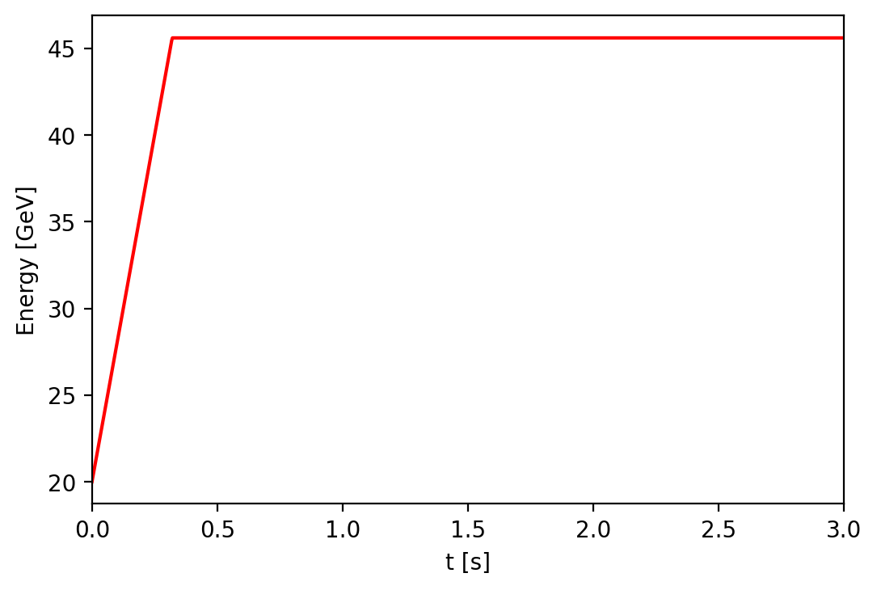
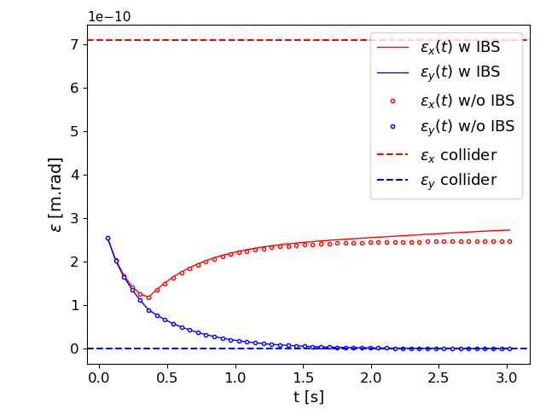
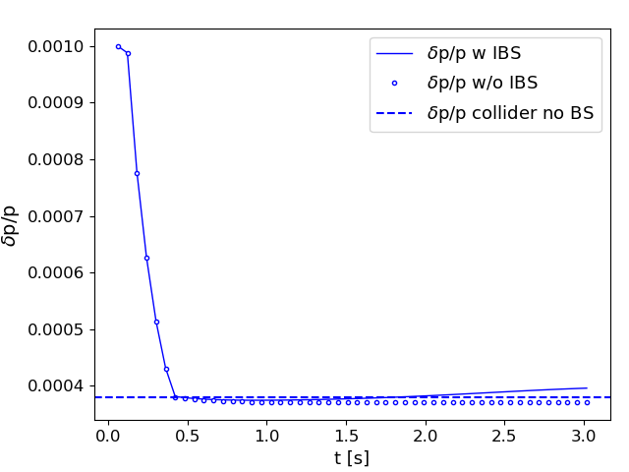
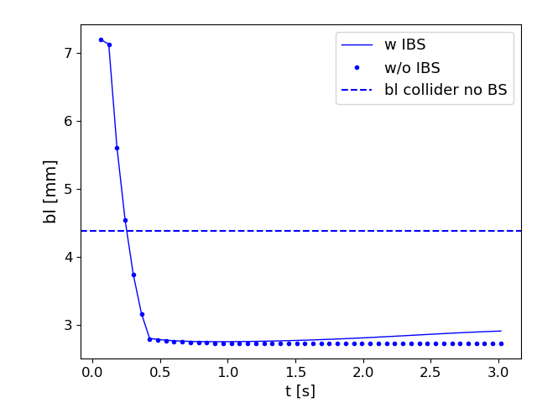
Emittance: ramp only
10µm x 10µm; 0.1%
Vrf = 140 MV
Linear ramp
Vrf = 62 MV

Slide 17
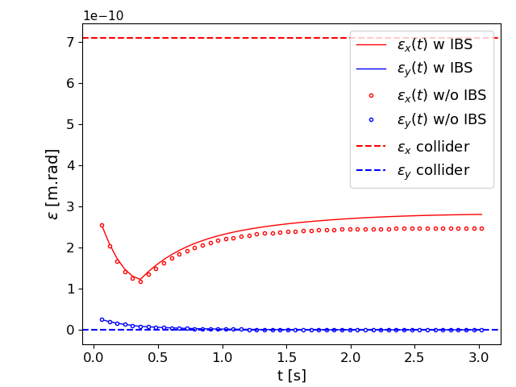
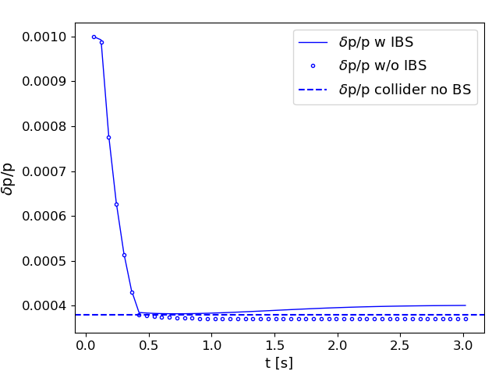

Emittance: ramp only
10µm x 1.0µm; 0.1%
Vrf = 140 MV
Linear ramp
Vrf = 62 MV

Slide 18
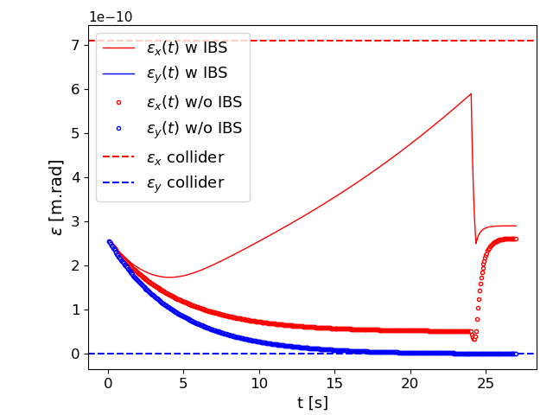
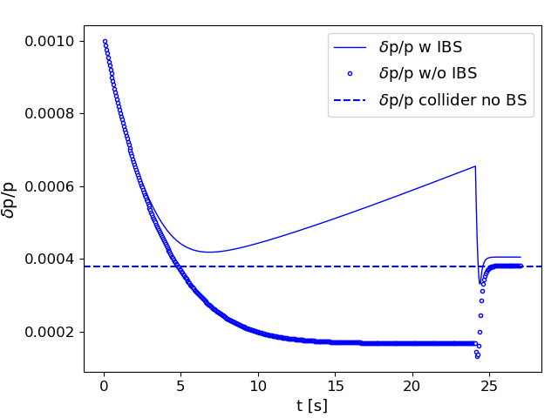
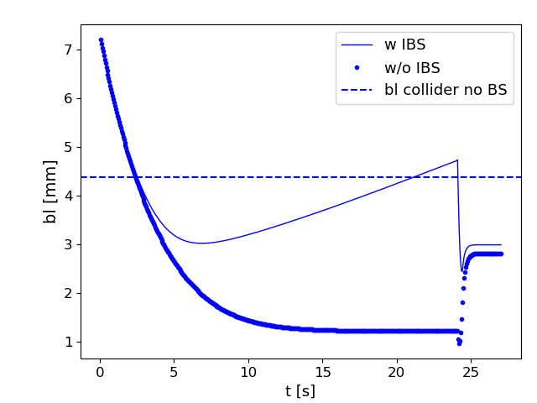
Emittance: accumulation + ramp 10µm x 10µm; 0.1%
Vrf = 140 MV
Linear ramp
Vrf = 62 MV

Slide 19
Parameter variation during the cycling
During the accumulation process,
  IBS processes drive the emittance evolution.
  The bunch parameters (length, emittance, size) vary from a bunch to another bunch. Energy spread doesn’t reach equilibrium emittance at injection.
If we do not modify the I2 function (with different dipole families), we should have a flat top of at least 2 seconds to damp the beam with an initial round normalized emittance of 10 µm.
The duration of the flat top depends on the initial emittances 1-3 s for 1-50 μm.
We have assumed that the beam is matched at the entrance. An initial energy spread of 0.1% gives a bunch length of 7.2 mm. We could reduce a bit the initial bunch length by increasing the initial RF voltage but we are quickly limited by the maximum total RF voltage.
If we do not match the longitudinal parameters, we will have some bunch length and momentum spread breathing. We need to do tracking simulations to check that is not an issue.
We can lengthen the final bunch length by adjusting the final total voltage, to be studied.

Slide 20
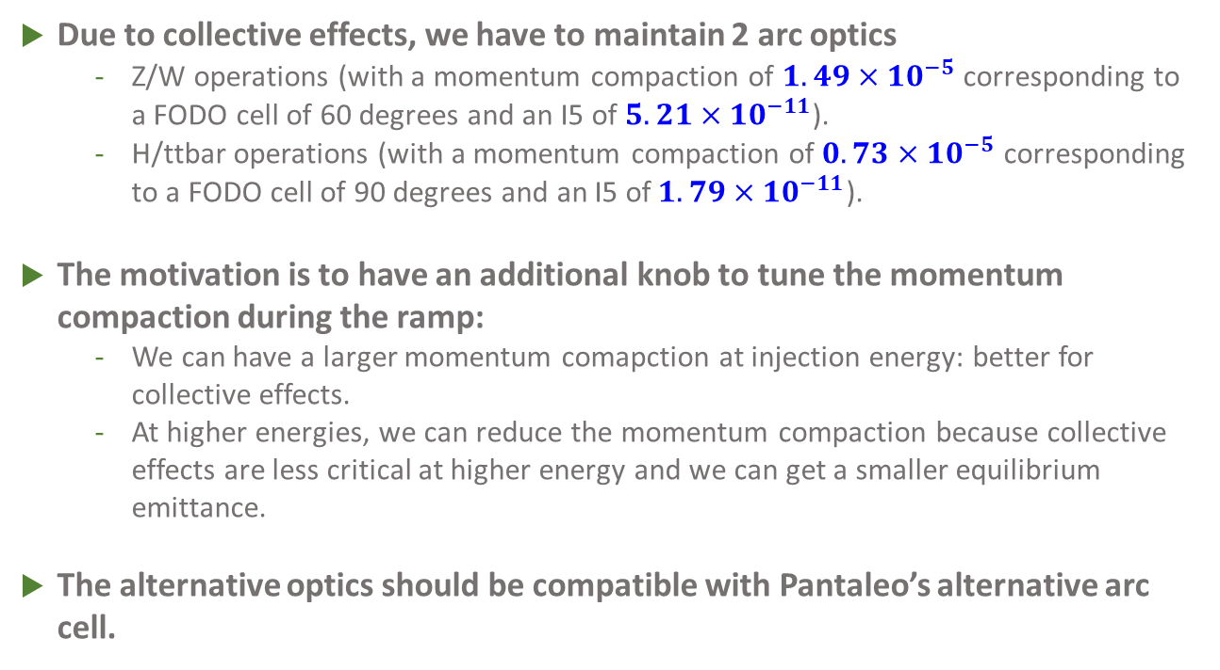
Alternative arc optics
Due to collective effects, we have to maintain 2 arc optics
  Z/W operations (with a momentum compaction of $1.49×10^{−5}$ corresponding to a FODO cell of 60 degrees and an I5 of $5.21×10^{−11}$).
  H/ttbar operations (with a momentum compaction of $0.73×10^{−5}$ corresponding to a FODO cell of 90 degrees and an I5 of$1.79×10^{−11}$).
The motivation is to have an additional knob to tune the momentum compaction during the ramp:
  We can have a larger momentum comapction at injection energy: better for collective effects.
  At higher energies, we can reduce the momentum compaction because collective effects are less critical at higher energy and we can get a smaller equilibrium emittance.
The alternative optics should be compatible with Pantaleo’s alternative arc cell.

Slide 21






Alternative optics: scheme
$$−I, Δμ_{x,y}=180°$$
$$−I,Δμ_{x,y}=180$$
$$k_{0}+Δk$$
$$k_{0}−Δk$$
$${−k}_{0}+Δk$$
$${−k}_{0}−Δk$$
$Δk≈\frac{\sqrt{x}}{2\sqrt{3}}$ with $x=\frac{α}{α_{0}}−1$where $α$ is the momentum compaction and 0 when $Δk$=0
We assume here a sequence of 5 90 degrees cells. However, this scheme should be compatible with Pantaleo’s scheme because it keeps –I cells.
A betatron wave is created by the first quadrupole. It is cancelled at the next quadrupole.
However, the dispersion wave is not cancelled and the effect on the momentum compaction is not zero.
The initial Twiss parameters and the total tune of this sequence is conserved
The total tunes of the arcs do not change when we vary the momentum compaction.

Slide 22
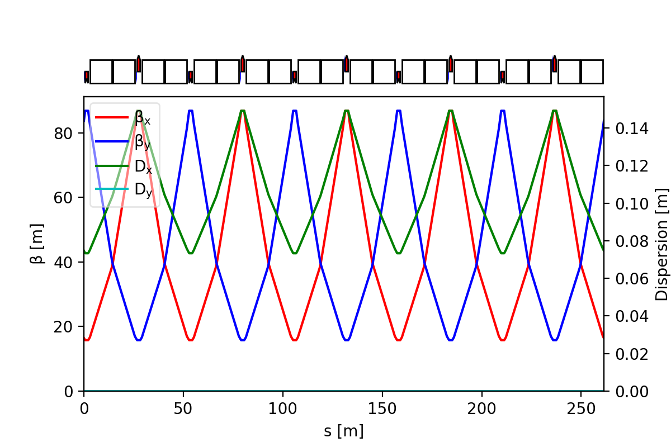
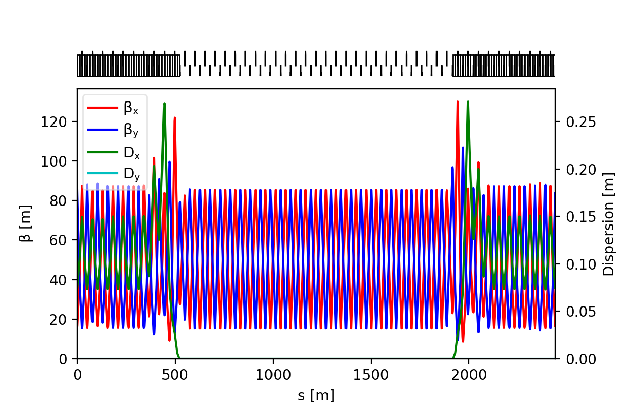
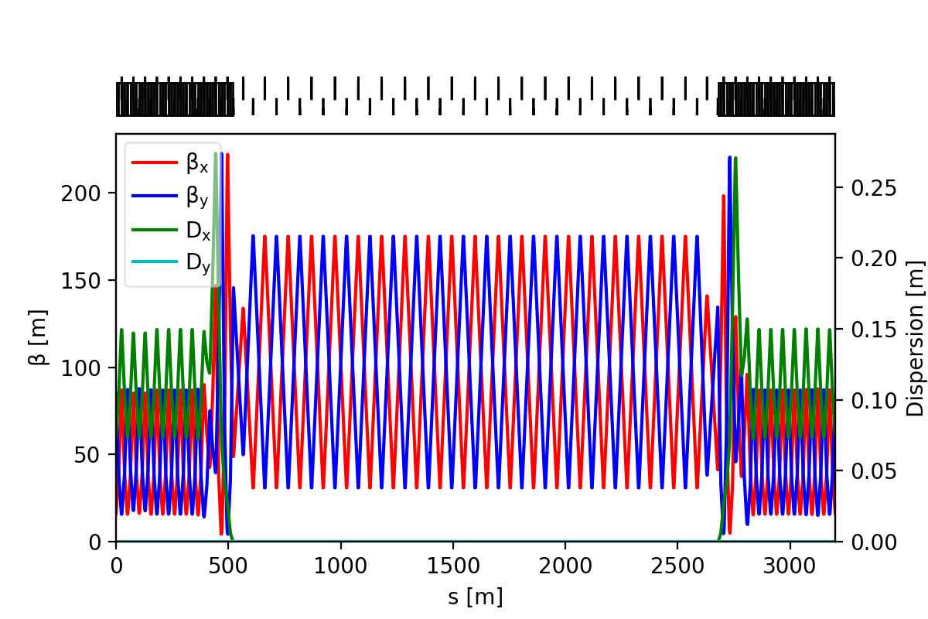
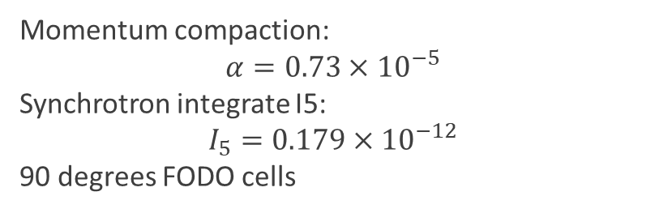
Alternative optics: reference
Arc cell
Section 1
Section 2
Momentum compaction:
$$α=0.73×{10}^{−5}$$
Synchrotron integrate I5:
$$I_{5}=0.179×{10}^{−12}$$
90 degrees FODO cells

Slide 23
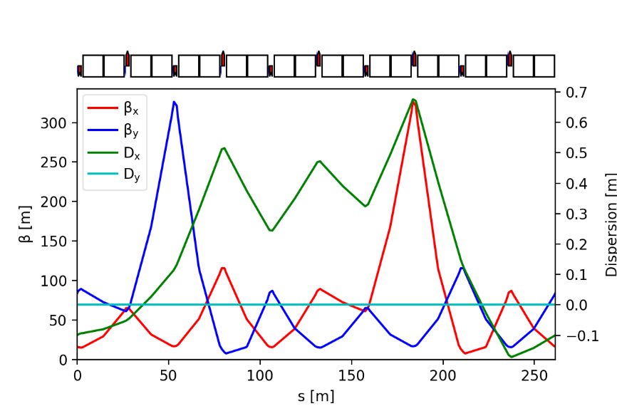
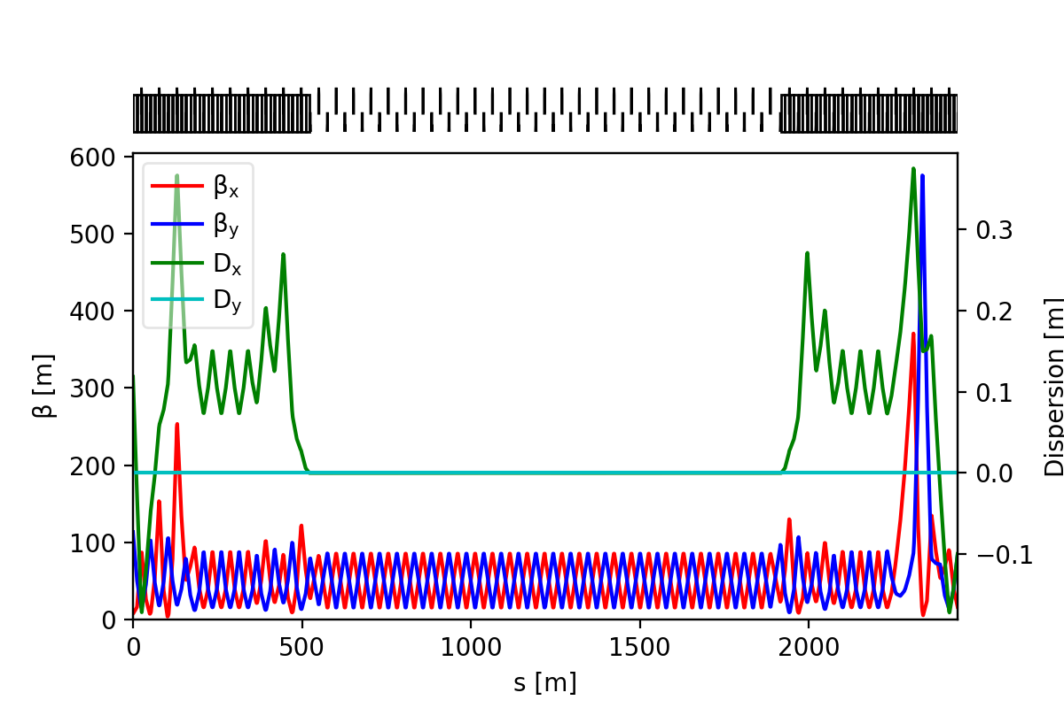
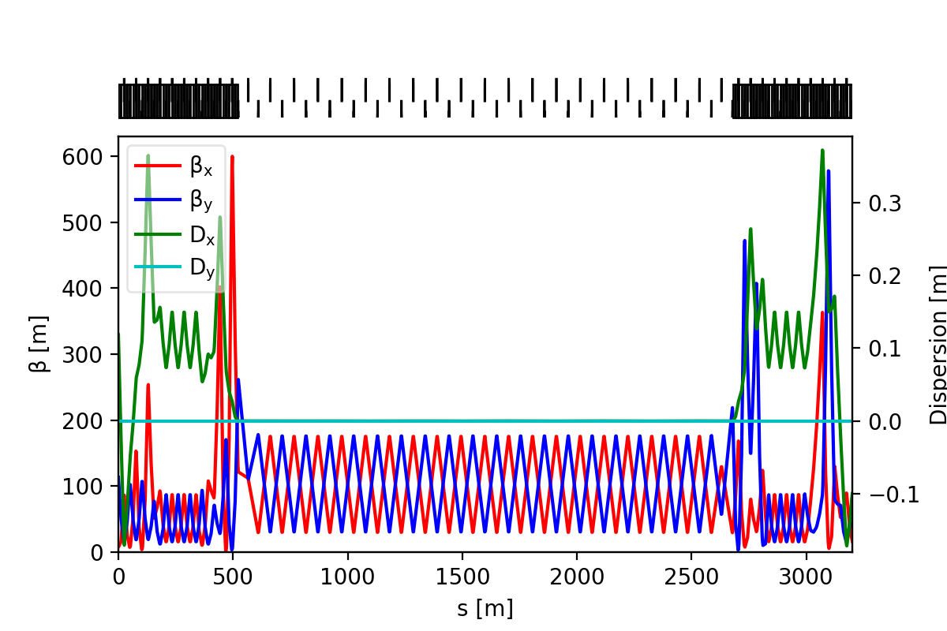
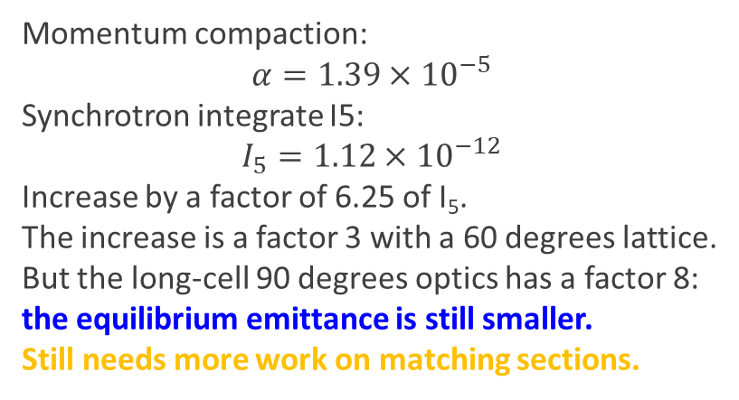
Alternative optics: doubled momentum compaction
Arc cell
Section 1
Section 2
Momentum compaction:
$$α=1.39×{10}^{−5}$$
Synchrotron integrate I5:
$$I_{5}=1.12×{10}^{−12}$$
Increase by a factor of 6.25 of I₅.
The increase is a factor 3 with a 60 degrees lattice.
But the long-cell 90 degrees optics has a factor 8: the equilibrium emittance is still smaller.
Still needs more work on matching sections.

Slide 24
Alternative optics: discussion
The advantages of this alternative optics are:
  Possibility to tune the momentum compaction during the ramp.
    Different I5 at injection and extraction.
    Needs to know the limitation of collective effects at injection but also at extraction to evaluate the optimum momentum comapction during the ramp.
  We keep the same sextupole correction scheme for all modes.
    We could add an additional sextupole at the dispersion peak to correct the extra chromaticity due to the betatron wave (the chromaticity increase is about 50% more in comparison with the reference case). The extra sextupoles are 10 times weaker to double the momentum compaction.
The drawbacks are:
  A larger equilibrium emittance in comparison with FODO cells.
    We are still below the equilibrium emittance of the long 90 degrees cells.
    We can reduce the imapct by decreasing the momentum compaction during the ramp.
  We need to increase the number of quadrupole families and thus power supplies.
    6 families against 2 families.
  Larger maximum peak betatron functions in the arcs.
    Need for more work to improve the matching sections.
We have to evaluate the impact on the dynamic aperture and momentum acceptance.

Slide 25
Conclusions
Optics:
  Optimization of layout and booster positioning in the tunnel
  Two options to bypass the experimental areas inside or outside detector
Improve DA and MA for the 90°/90° optics
  Resonance Driviting terms optimization
  Optimisation strategy for sextupoles families (MOGA,…) ?
  Improve optics design ?
HEB operation and emittance evolution
  Optimization of cycle time at Z
  Effect of mis-matched beam at injection
  Optimization of RF Voltage at injection and extraction
  Study the 800 MHz RF system against 400 MHz + 800 MHz
First definition of the orbit correctors for the booster (≃ 20 mT) and orbit correction scheme. First specifications of elements misalignment (150 μm)
  Finalize the emittance tuning studies
  Integration with DA and MA and Overall Design optimization (exploiting AI)
Finalize injection/extraction in the High Energy Booster (CERN)
An alternative optics to 60° FODO cells has been proposed.

Slide 26
Perspectives
To establish a baseline (June 2023)
Improve DA and MA
  Optimizing sextupoles families, tunes and matching of insertions
Optimize RF Voltage at injection and extraction (for 400 MHz and 800 MHz)
Impact of injecting a mis-matched beam (including collective effects)
Iterate on optics and layout
Evaluate the dynamic aperture and momentum acceptance for the alternative optics.
Long term plan
Finalize emittance tuning
  Static and dynamic imperfections
  Improve overall performances/cost with AI
Optimize the energy ramp and verify emittance reach (start-to-end simulations)
Optimization of insertion sections

Slide 27
Thank you for your attention

Slide 28
First requirements for beam instrumentation
First tolerance studies require for 2944 BPMs in the arcs with a RMS resolution better than 50 µm.
We should be able to measure the current of each bunch with a precision better than 20 pC (less than 1% of the bunch charge).
We should be able to measure the emittance of the bunches at the extraction.
Because of the damping during the accumulation, the bunch properties are not the same from bunch to bunch: beam emittance, beam size and bunch length vary from bunch to bunch.
At extraction, we should be at equilibrium and bunch properties should be roughly the same from bunch to bunch (especially for other modes than Z).

Slide 29
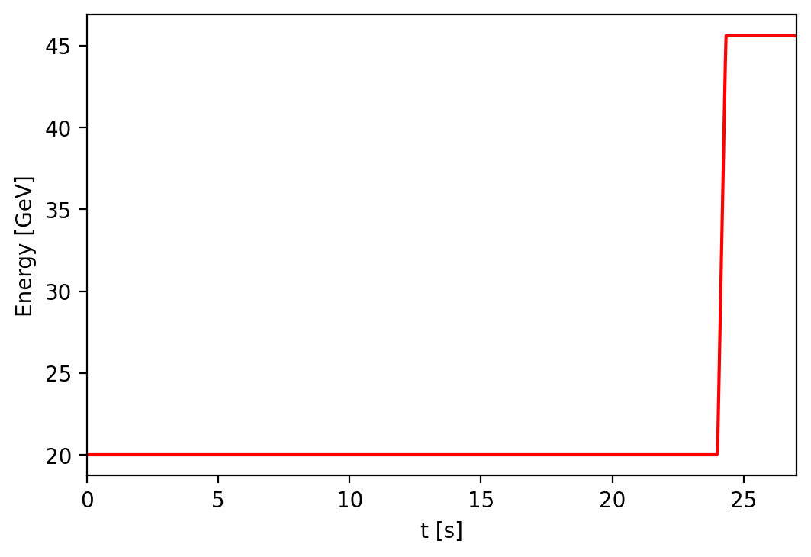
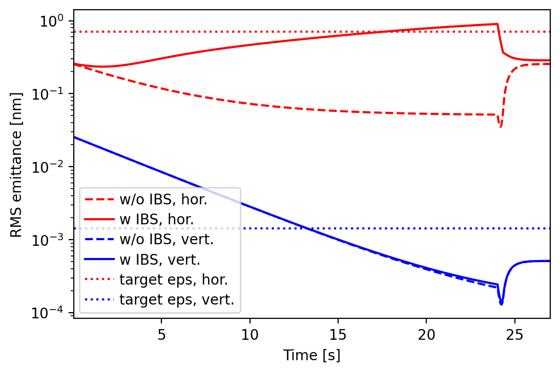
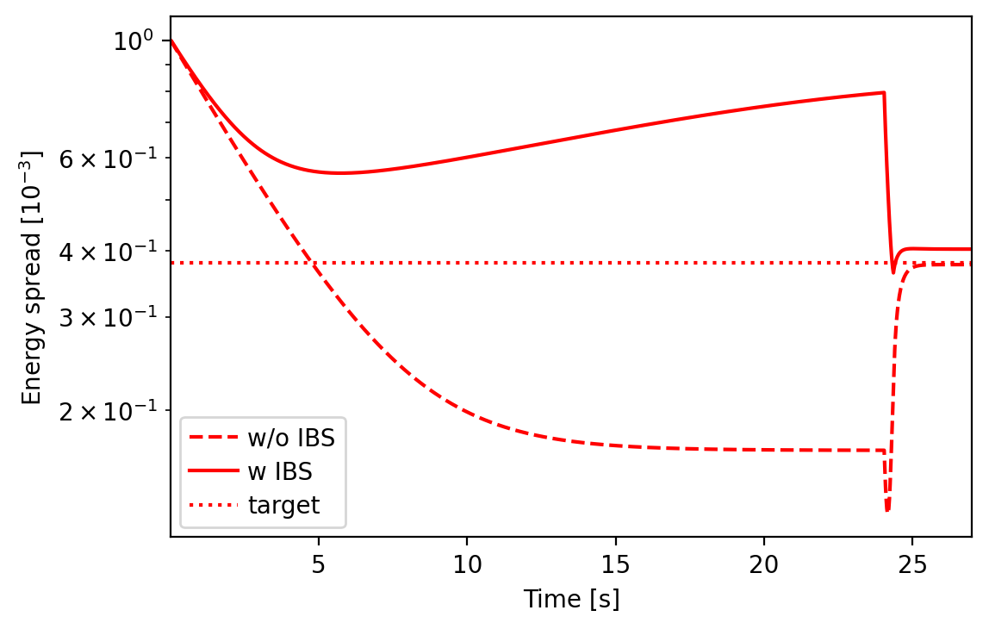
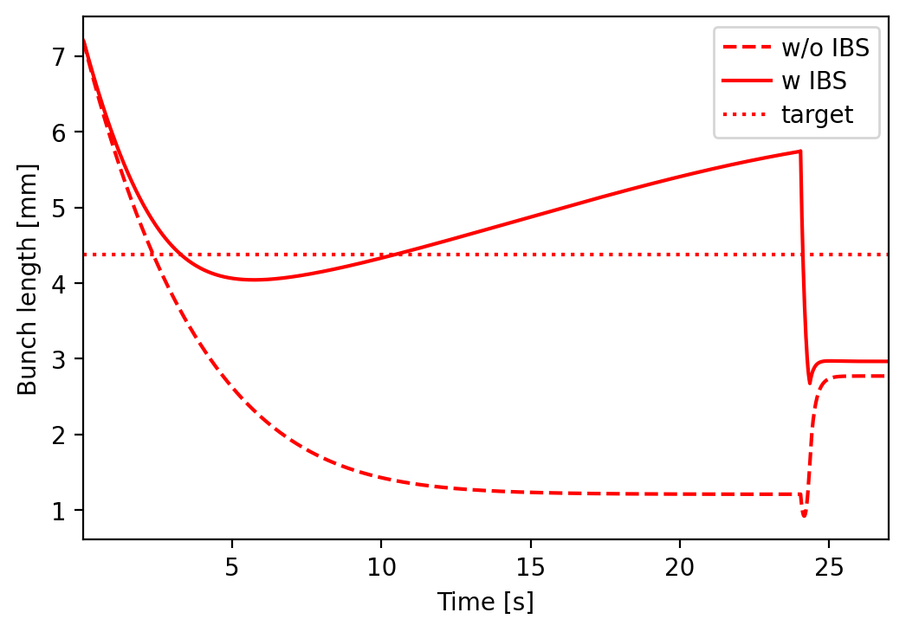
Emittance: accumulation + ramp 10µm x 1.0µm; 0.1%
Vrf = 140 MV
Linear ramp
Vrf = 62 MV

Slide 30
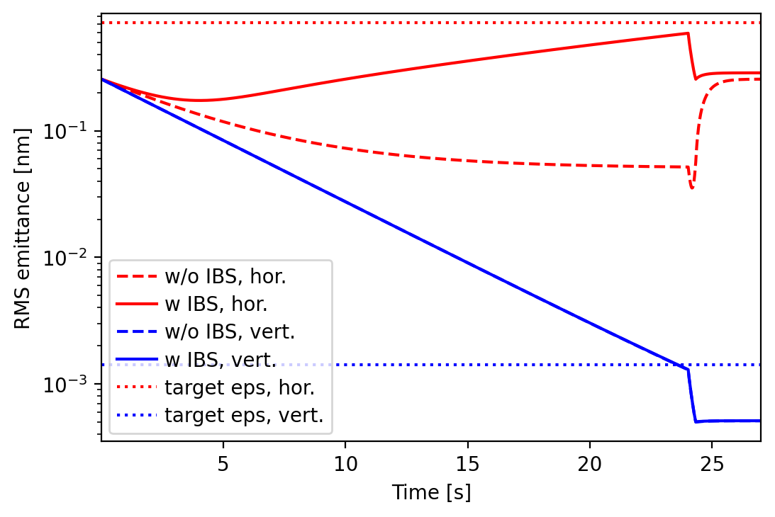
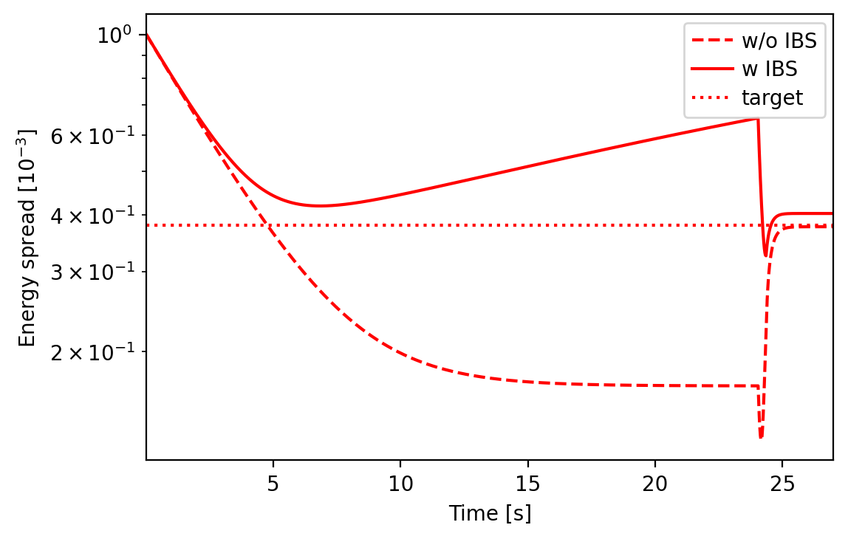
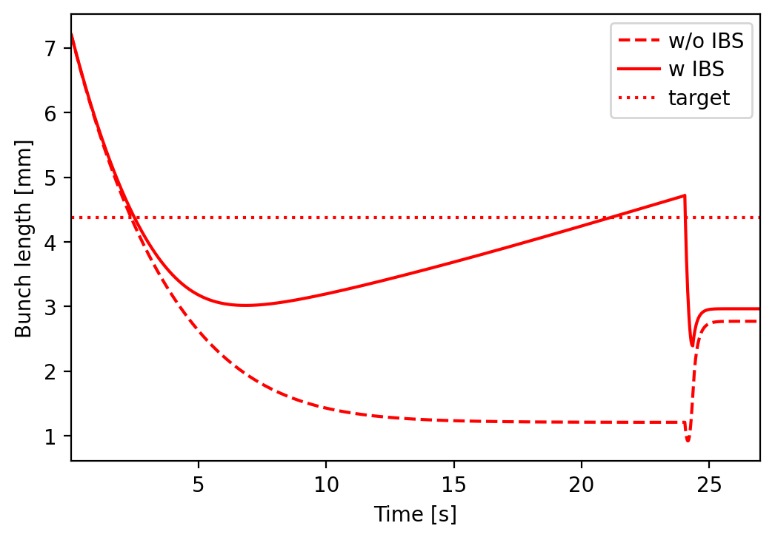
Emittance: accumulation + ramp 10µm x 10µm; 0.1%
Vrf = 140 MV
Linear ramp
Vrf = 62 MV

Slide 31
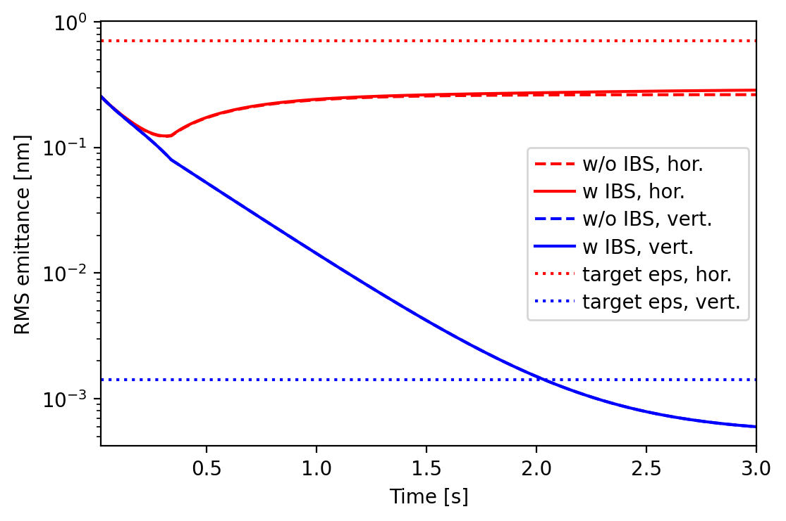
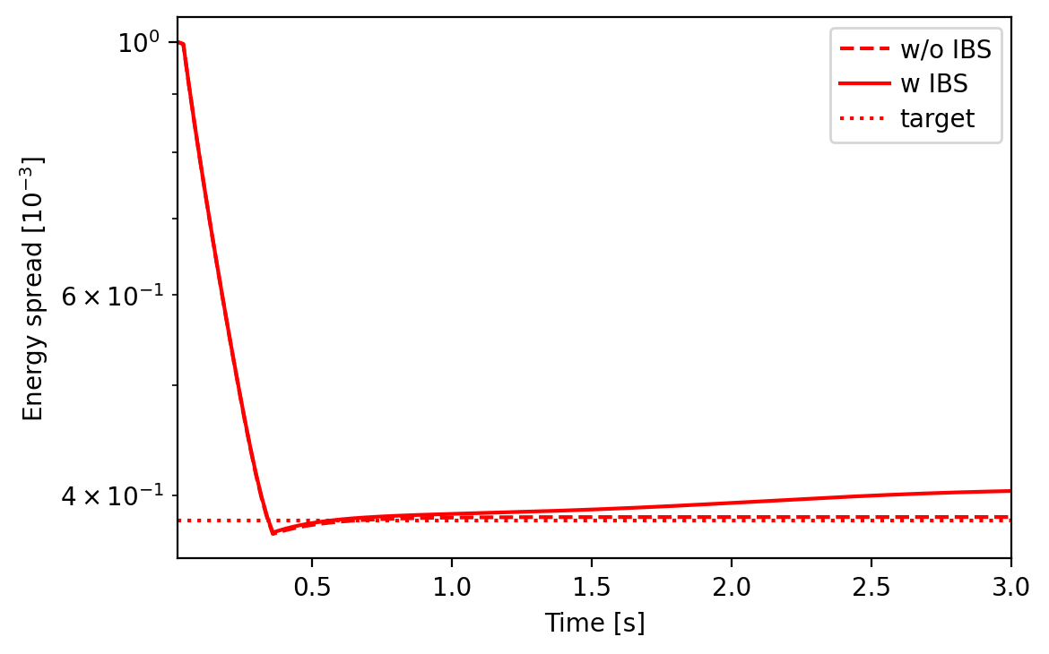
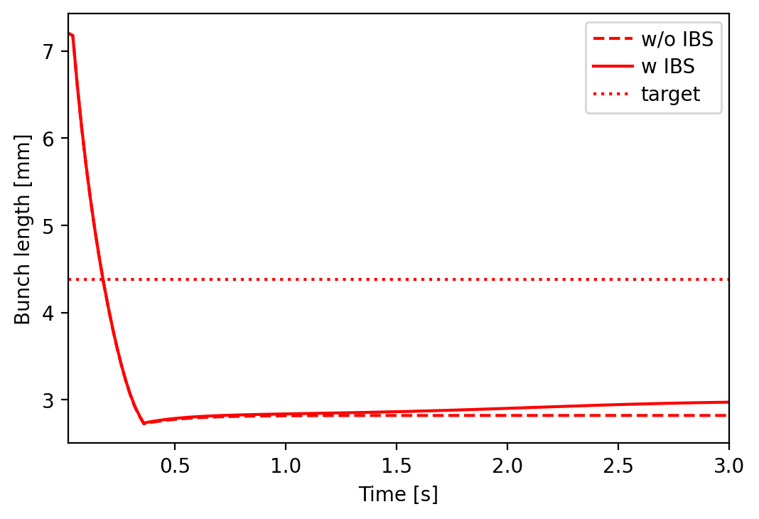
Emittance: ramp only
10µm x 10µm; 0.1%
Vrf = 140 MV
Linear ramp
Vrf = 62 MV

Slide 32
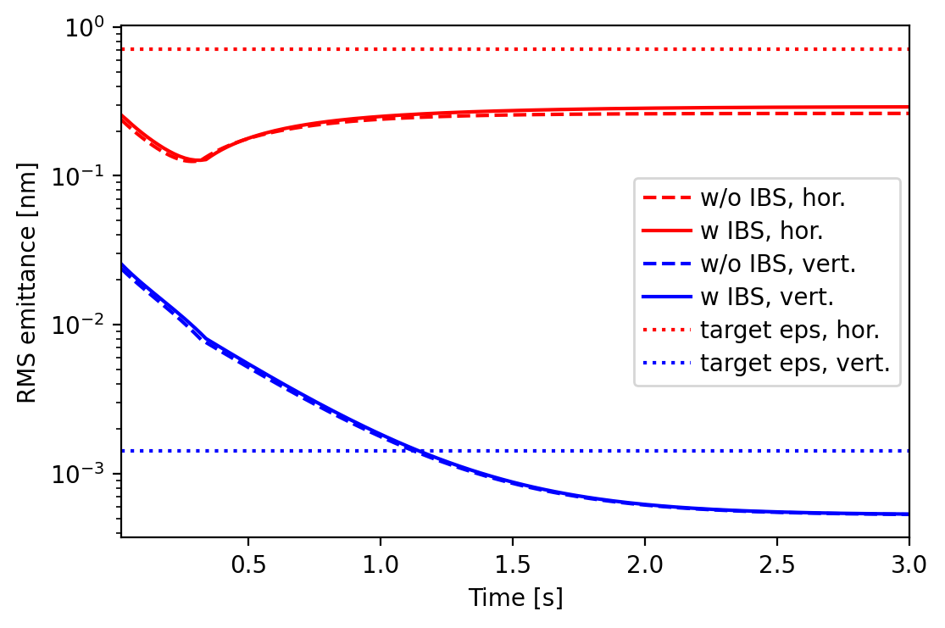
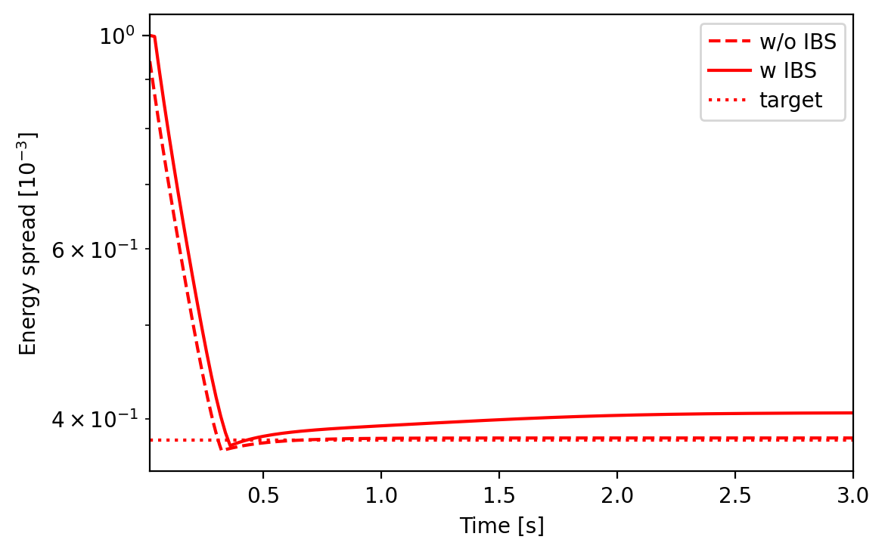
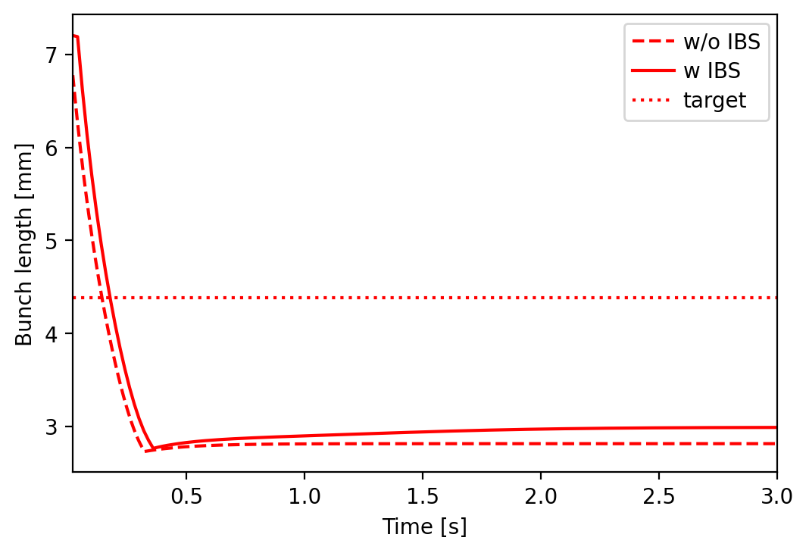
Emittance: ramp only
10µm x 1.0µm; 0.1%
Vrf = 140 MV
Linear ramp
Vrf = 62 MV

Slide 33
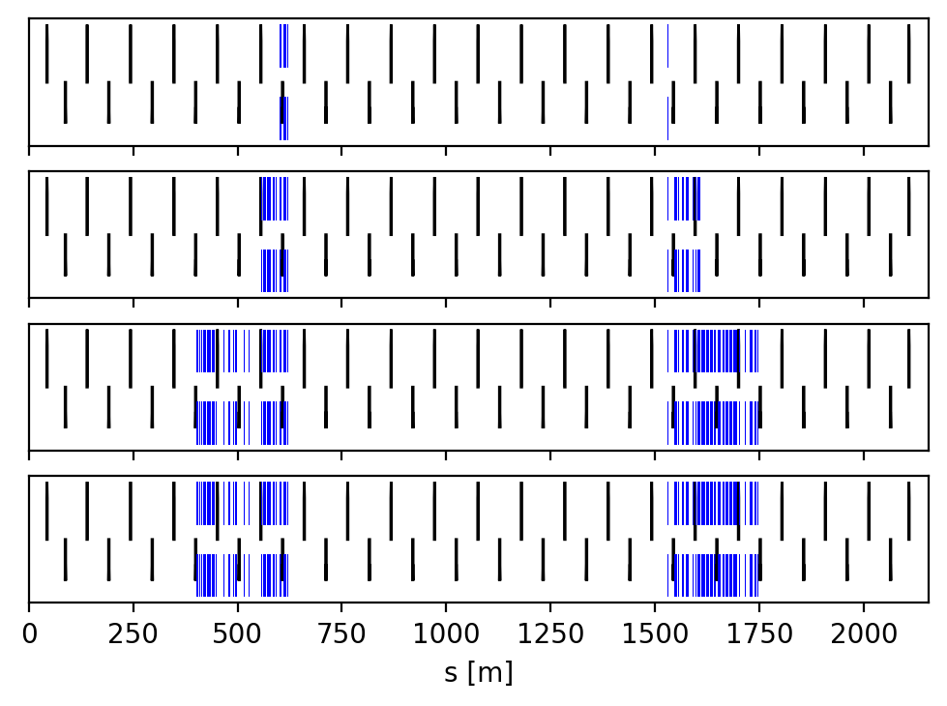
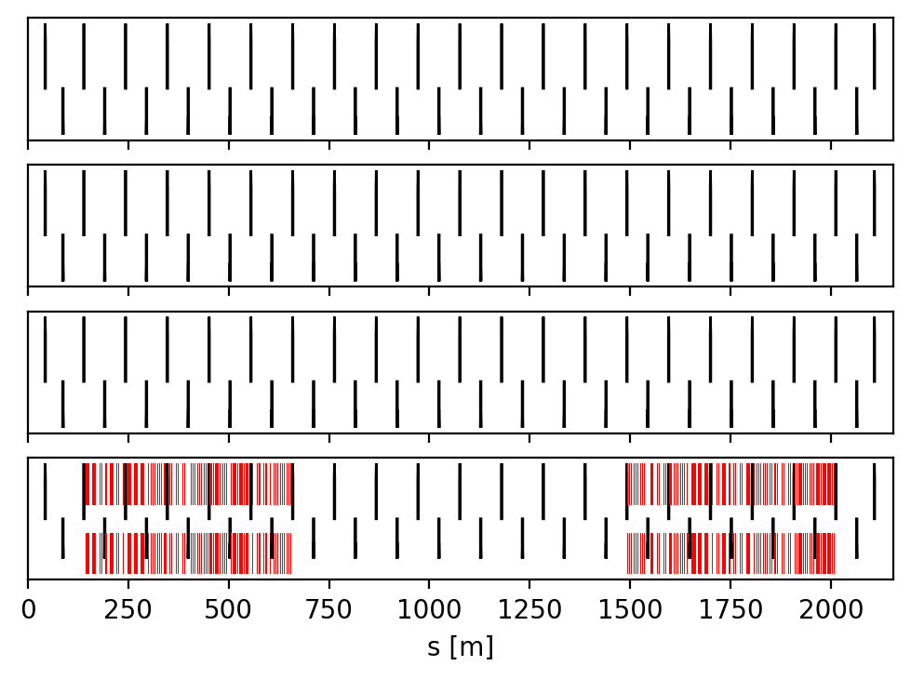
RF insertions
Currently, the cavities are inserted in the insertions H and L.
The cell FODO length in the RF insertion is 104 m.
400 MHz cryomodule length: 11.4 m
800 MHz cryomodule length: 7.5 m
Insertion L
Insertion H
Z mode
W mode
H mode
tt mode
Z mode: 2 CM left, 1 CM right of IPL
W mode: 7 CM left, 6 CM right of IPL
H mode: 17 CM left, 17 CM right of IPL
tt mode: 17 CM left, 17 CM right of IPL
tt mode: 60 CM left, 60 CM right
Proposal of the RF group to use 800 MHz only for all mode of the Booster:
https://indico.cern.ch/event/1064327/contributions/4888581/ (F. Peauger)

Slide 34
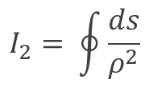


Possible solutions (1/3): Damping Wiggler
B. Haerer, T. Tydecks https://arxiv.org/abs/2111.14462
Target damping time 0.1 s (to fulfill cycle time)
Wigglers reduce damping time and increase eq. emittance :
$$τ_{x}∝\frac{1}{E^{3}I_{2}}$$
$$I_{2}= \oint{\frac{ds}{ρ^{2}}}$$
$$I_{5}=\oint{\frac{H_{x}}{\left|ρ^{3}\right|}ds}$$
A normal conducting wigglers foreseen
can be further optimized for poles length and for number of poles
Hor. Emittance (60° optics) 1.7 nm @ 45.6 GeV
⇒ it should be switched off during acceleration or a parallel line with a fast kicker should be designed
Total length of installed wigglers is of the > 100 m in the same straight line
Possible stimulated additional radiation and instability (like in FEL) to be studied

Slide 35
Possible solutions (2/3): 2s at extraction energy
Tor Raubenheimer
Add 2 seconds after the energy ramp at extraction energy
Pros: no change to the optics design
Cons: small increase Booster Cycle time

Slide 36


Possible solutions (3/3): change I2 integral & ramp time
Simple model with synchrotron radiation only
Injection energy 20 GeV
Injection rms emittance 0.2-1.3 nm
Energy injection + ramp + extraction ~1.2 s
4×I2 (4×I5) synchrotron radiation integrals
dE/dt = 40 GeV/s
k = 2×10⁻³
$$\frac{dε_{x}}{dt}=−2\frac{ε_{x} −ε_{eq}(E\left(t\right),I2,I5)}{τ_{x}(E\left(t\right),I2)}$$
$$\frac{dε_{y}}{dt}=−2\frac{ε_{y} −{k ε}_{eq}(E\left(t\right),I2,I5)}{τ_{x}(E\left(t\right),I2)}$$
Possible solution :
2 dipoles with two different curvatures,
proposed for the electron-ion collider (EIC)
Damping time can be reduced by playing on the ratio between the two different fields.

Slide 37


2 dipoles families optics
4 × I2 can be obtained with L2 ~5,5 m, B2~-128 G, B1 ~128 G at 20 GeV (to be compared with B~71 G with one single magnet family),
Minimum dipole field at injection ~ 2×present lattice
Momentum compaction ~1.8 10⁻⁵ (~ 60°/60° lattice)
Variation of the path length difference below 5 mm
Difference between the different orbits in the dipoles of 5 mm
Advantages:
Increase I2 without damping wigglers
Higher dipole field at injection energy (useful for all modes and maybe possibility to lower injection energy)
Drawbacks:
Different reference orbits ⇒ reduction of beam stay clear?
Change of path length should be followed by RF during acceleration… (Oide)
More synchrotron radiation and in opposite direction of foreseen absorber (at injection) ⇒ vacuum quality to be investigated

Slide 38
First Beam Instrumentation requirements
First tolerance studies require for 2944 BPMs in the arcs with a RMS resolution ~ 50 µm.
We should be able to measure the current of each bunch with a precision better than 20 pC (less than 1% of the bunch charge).
We should be able to measure the emittance of the bunches at the extraction.
Because of the damping and IBS during the accumulation, the bunch properties are not the same from bunch to bunch: beam emittance, beam size and bunch length vary from bunch to bunch.
At extraction, we should be at equilibrium and bunch properties should be roughly the same from bunch to bunch (especially for other modes than Z).

