Slide 1
Vacuum System R&D Status Report
R. Kersevan *
* Reporting for the Vacuum Surfaces and Coatings group, TE Dept., CERN
FCCIS 2022 Workshop, 5-9 Dec 2022, CERN

Slide 2
FCCIS Workshop, 5-9 Dec 2022
Vacuum System R&D Status Report - R. Kersevan, TE-VSC
Outline
Relevant machine and vacuum parameters
Vacuum chamber cross section
Synchrotron radiation spectrum, flux, power
SR absorbers: yes or no?
Pumping solutions
Pressure profiles
Prototyping, experiments, future work…

Slide 3
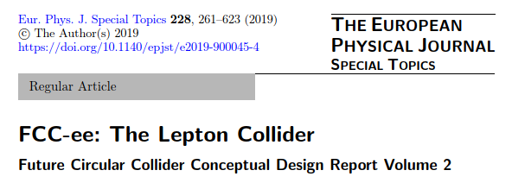
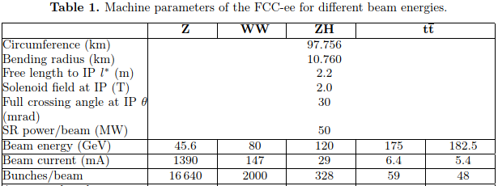
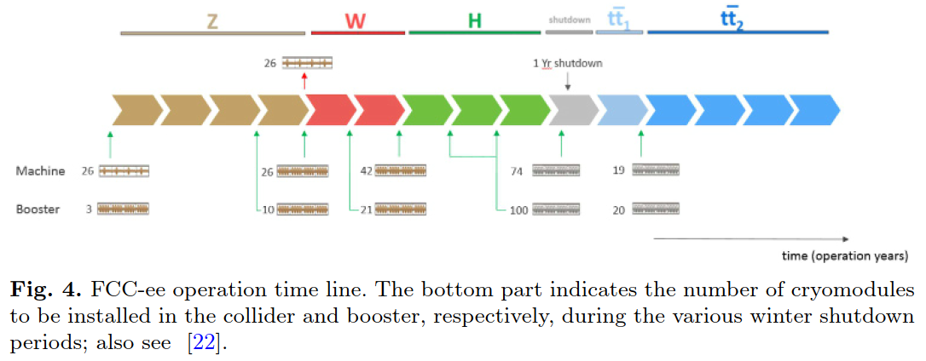
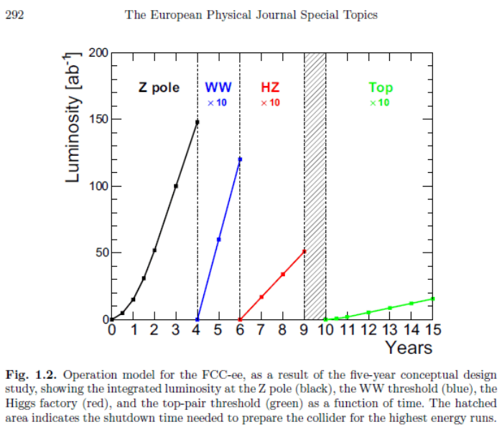
FCCIS Workshop, 5-9 Dec 2022
Vacuum System R&D Status Report - R. Kersevan, TE-VSC
Relevant machine and vacuum parameters
Big variation of nominal current vs beam energy, since all machine versions are limited to 50 MW of synchrotron radiation per beam
P (W) = 88.46 · E⁴(GeV) · I(mA) / ρ(m)
F (ph/s) = 8.08·10¹⁷ · E(GeV) · I(mA)
We aim at an average pressure giving a beam-gas scattering lifetime large enough not to be detrimental to the integrated luminosity, say in the low 10⁻⁹ mbar range or better, with a gas composition of 80~90% hydrogen, and no molecular masses above 44 (CO₂).
Typically, 80~90% H₂, 10~20% CO+CO₂, traces of CH₄

Slide 4
FCCIS Workshop, 5-9 Dec 2022
Vacuum System R&D Status Report - R. Kersevan, TE-VSC
Vacuum chamber cross section
The choice of the vacuum chamber cross section is dictated by many different effects and requirements:
Minimize time to condition (to speed-up integrated luminosity at Z, most difficult case, vacuum wise)
Minimize beam-gas scattering effects, i.e. minimize pressures and improve pumping efficiency
Minimize e-cloud (e+) and ion-trapping (e-)
Deal with large flux of Compton-scattered secondaries (at WZ, H, ttbar)
Keep fabrication complexity to a minimum (2x 92 98 km rings!);
Satisfy impedance requirements (geometric and resistive-wall as well)

Slide 5
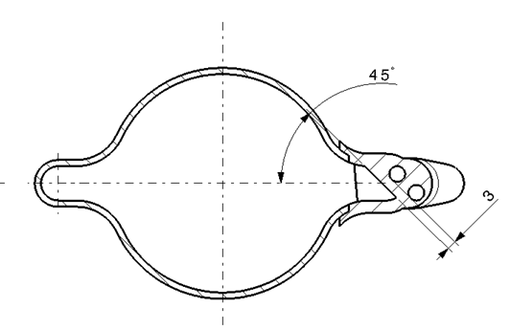
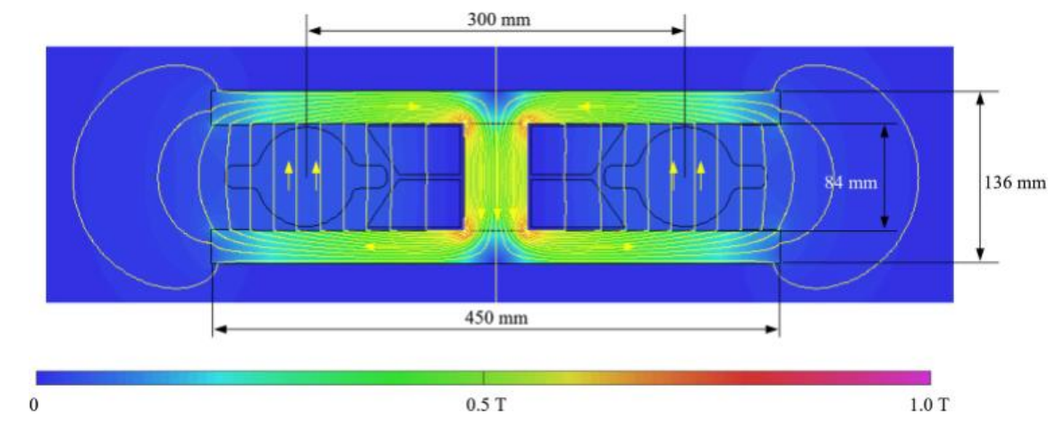
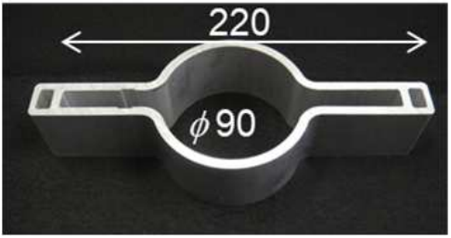
FCCIS Workshop, 5-9 Dec 2022
Vacuum System R&D Status Report - R. Kersevan, TE-VSC
Vacuum chamber cross section
For this reasons we have proposed, in the CDR, to adopt a modification of the SuperKEKB vacuum chamber cross section (*), i.e. a circular chamber with two small symmetric “winglets” in the plane of the orbit
The diameter of the circular part is 70 mm (ID), vs 90 for SuperKEKB; vertical gap in our dipoles is 84 mm, same as the inscribed circle in the quadrupoles
The winglets we can accommodate taking into account the 300 mm horizontal beam-beam separation and the structure of the common-yoke dipoles and quadrupoles (**) are smaller than those of SuperKEKB. In our case the horizontal width is only 120 mm
(*) Y. Suetsugu, KEK
(**) J. Bauche, CERN
70 mm
Important issue with beam separation (300 mm) has been identified: difficulty to place SR absorbers, their cooling lines for internal beam (busbar);
Make it bigger! SEEMS FEASIBLE

Slide 6
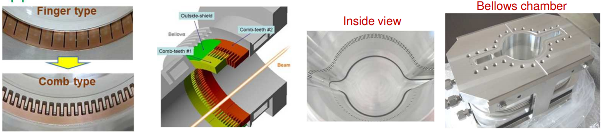
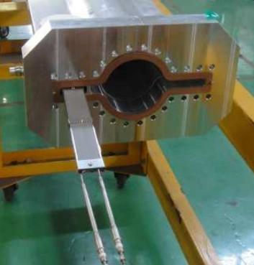
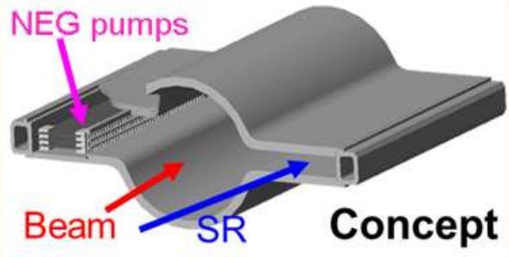
FCCIS Workshop, 5-9 Dec 2022
Vacuum System R&D Status Report - R. Kersevan, TE-VSC
Vacuum chamber cross section
If we adopt the SuperKEKB vacuum chamber cross-section then it comes natural to try and adapt also the SuperKEKB concept for the MO-type flanges, bellows, and gate valves (*). This will probably help reduce the geometric impedance budget:
Unfortunately we can not adopt the distributed NEG strip pumping solution, since our winglets are not wide enough, only ~ 22.5 25 mm
(*) Y. Suetsugu, KEK
We DO NOT have the space to install such distributed NEG-strip pumps

Slide 7
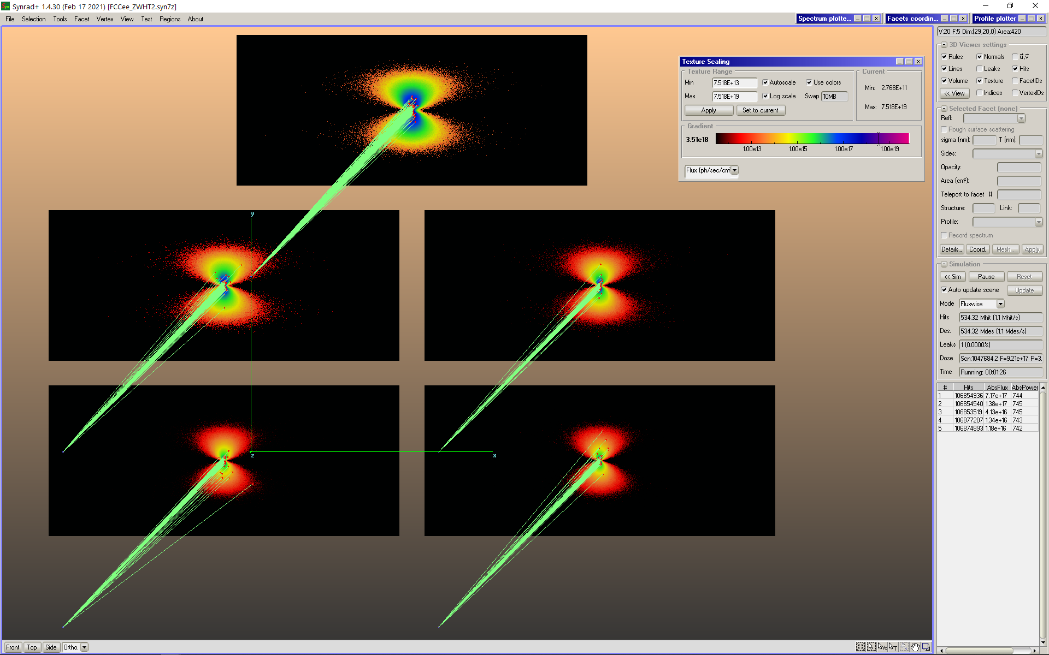
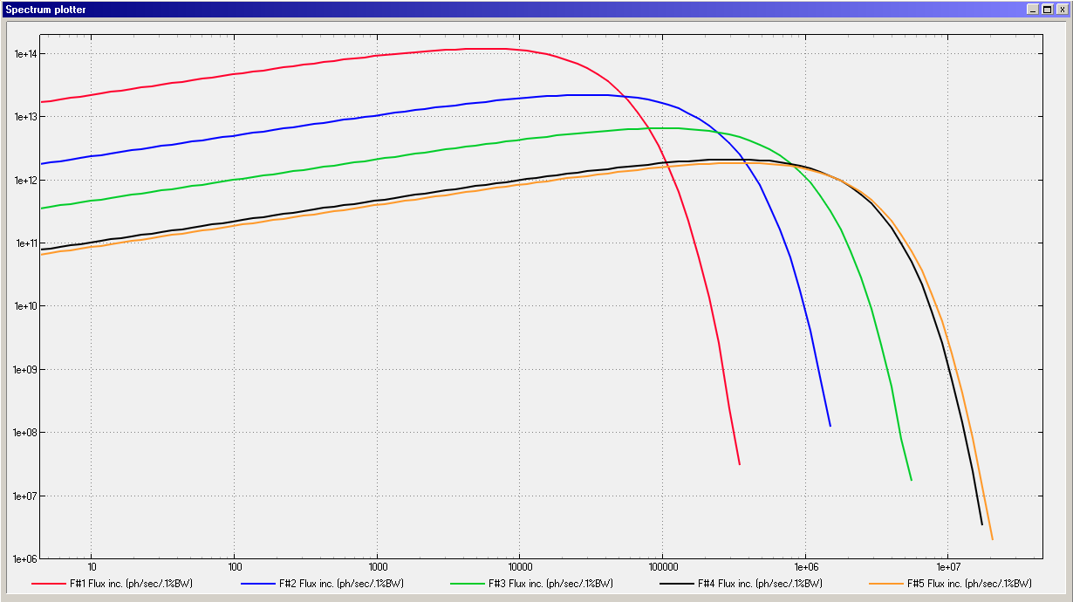
FCCIS Workshop, 5-9 Dec 2022
Vacuum System R&D Status Report - R. Kersevan, TE-VSC
Synchrotron radiation spectrum, flux, power
SR Spectra computed with SYNRAD+ (note: old 98 km lattice!)
- Radiation projected onto
five 14x6 cm² screens;
- 1 cm-long dipole arc trajectories;
- Flux distribution shown here,
- Logarithmic scale for textures,
6 orders of magnitude displayed;
45.6 GeV
80 GeV
120 GeV
175 GeV
182.5 GeV
50 m
Beam Energy E(GeV) | Beam Current I(mA) | Critical Energy (keV) | Photon Flux F’(ph/s/m) | PSD Outgassing Load (mbar l/s/m) @ 1·10⁻⁶(mol/ph)
45.6 | 1390 | 19.5 | 7.17·10¹⁷ | 2.90·10⁻⁸
80 | 147 | 105.5 | 1.38·10¹⁷ | 5.58·10⁻⁹
120 | 29 | 356.2 | 4.13·10¹⁶ | 1.67·10⁻⁹
175 | 6.4 | 1104.9 | 1.34·10¹⁶ | 5.42·10⁻¹⁰
182.5 | 5.4 | 1253.1 | 1.18·10¹⁶ | 4.78·10⁻¹⁰
Units: Vertical: photons/s/(0.1% bandwidth)/m; Range [10⁶ - 2·10¹⁴]
Horizontal eV; Range [4 - 5·10⁶]

Slide 8
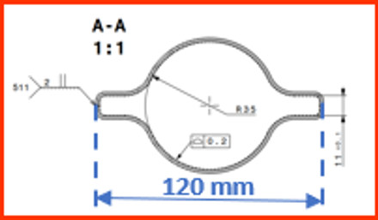
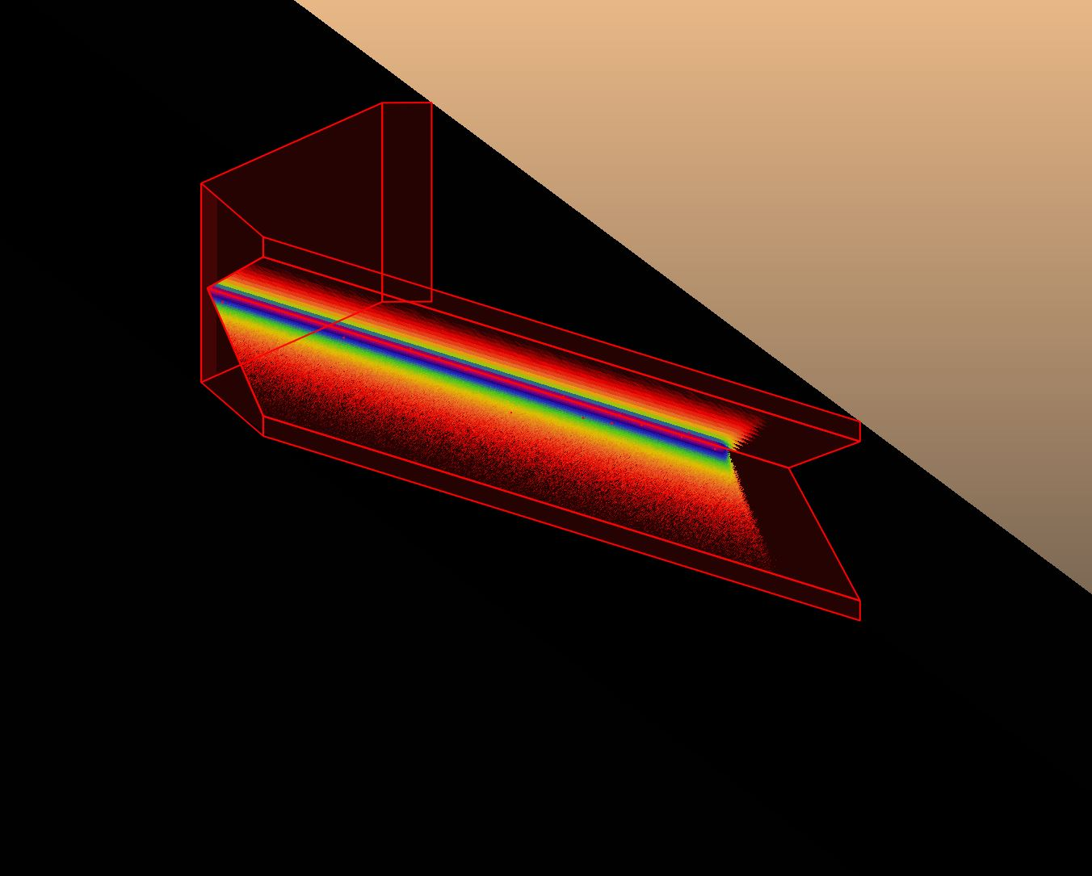
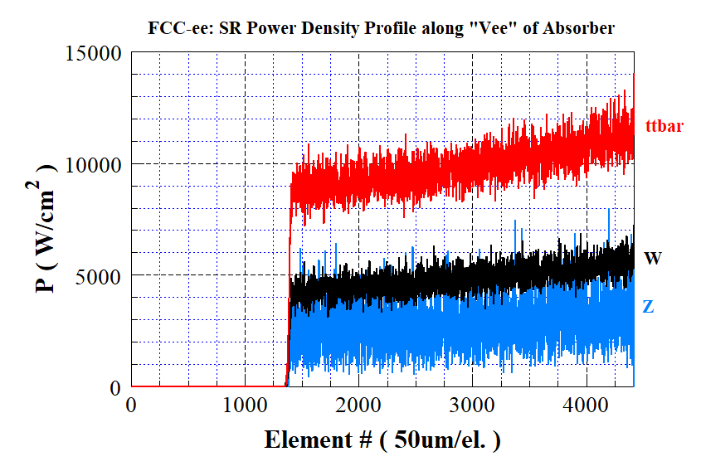
FCCIS Workshop, 5-9 Dec 2022
Vacuum System R&D Status Report - R. Kersevan, TE-VSC
(note: the geometry of the absorber has been modified, see below)
SR absorbers: yes or no?
The high beam energy generates an extremely narrow fan of SR, swiping a strip along the external wall of the vacuum chambers
If the SR is let impinge onto the vertical wall at the end of the winglet on the external side (60 mm from the beam axis), then the average photon travels ~38 m before hitting the wall
If SR absorbers like in the figure are used, 1 every ~5.6 m, then the average distance is ~34.6 m
Beam Energy E(GeV) | Natural SR Vertical Angle, 1/γ (μrad) | Vertical Fan Height at 35 m, (mm) | Beam Current I(mA) | Linear Photon Power Density (*) P’(W/m) | Peak Surface Photon Power Density (*) P’’(W/mm²) | Peak Surface Photon Power Density (**) P’’(W/mm²)
45.6 | 11.2 | 0.40 | 1390 | ~ 620 | ~ 1.4 | ~ 32
80 | 6.4 | 0.22 | 147 | “ | ~ 2.2 | ~ 56
120 | 4.3 | 0.15 | 29 | “ | ~ 3.0 | ~ 85
182.5 | 2.8 | 0.10 | 5.4 | “ | ~ 4.0 | ~115
B
18 mm
300 mm
A
**On absorber
*On external wall
175 mm
A
B

Slide 9
FCCIS Workshop, 5-9 Dec 2022
Vacuum System R&D Status Report - R. Kersevan, TE-VSC
Pumping solutions
The 115 120 mm wide x 10 mm high winglets do not let us install a practical linear NEG strip like SuperKEKB has done
This leaves us with only two choices: use many lumped pumps, or use NEG-coating
The specific conductance of the 70 mm ID chamber with winglets is ~47 l·m/s (ref. LEP ~ 100 l · m/s): This means that the system is rather conductance limited, and we would need to install un unreasonable number of lumped pumps in order to obtain a sufficient effective pumping speed
We plan to use NEG-coating (as thin as 150 nm, to minimize the resistive-wall impedance contribution) in order to profit from its low photon-stimulated molecular desorption (PSD) and also a rather low photoelectron yield (PEY) and secondary electron yield (SEY) as well
Low PEY and SEY are mandatory for the e+ ring, in order to avoid/minimize the electron cloud effect (ECE)
Even a small residual sticking coefficient s for the NEG-coating gives a large distributed pumping speed, 11.8·s (l/s/cm², CO gas), with the coated wall surface of ~ 3120 (cm²/m) or 36700·s (l/s/m)

Slide 10
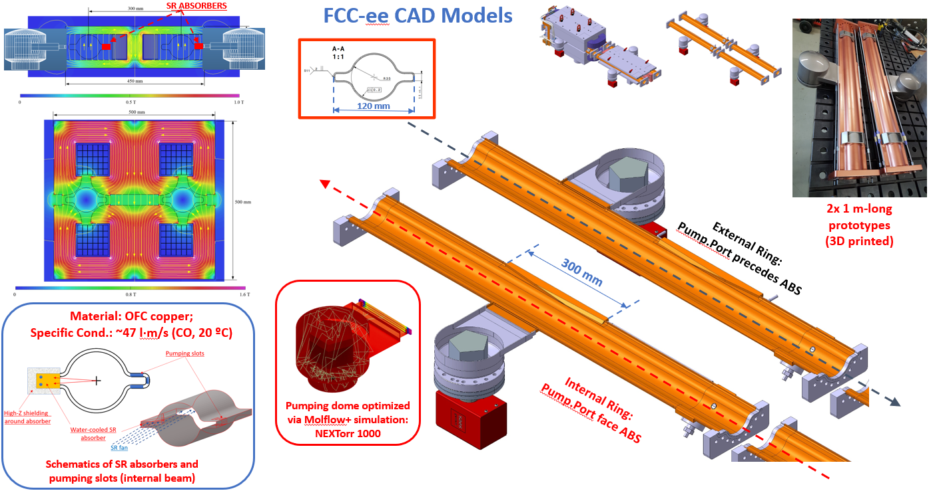
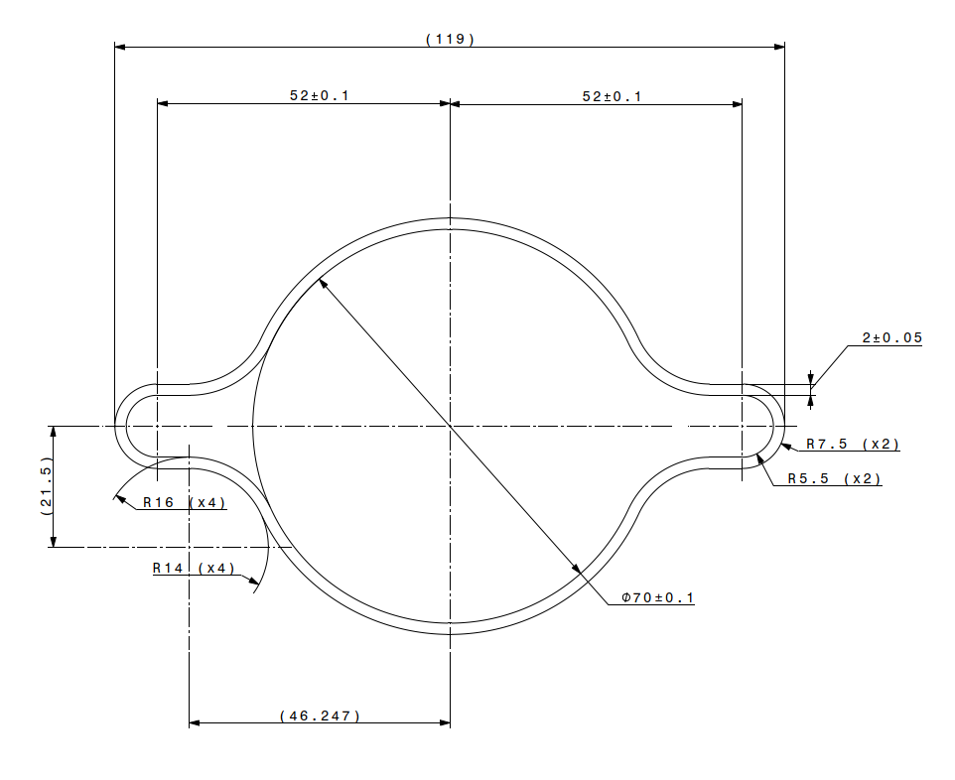
FCCIS Workshop, 5-9 Dec 2022
Vacuum System R&D Status Report - R. Kersevan, TE-VSC
Pumping solutions

Slide 11
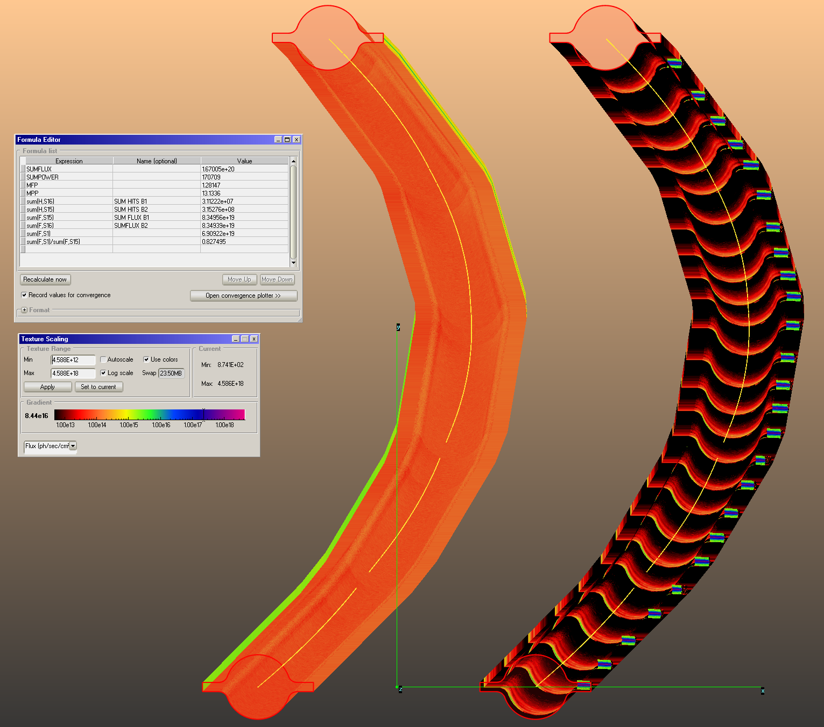
FCCIS Workshop, 5-9 Dec 2022
Vacuum System R&D Status Report - R. Kersevan, TE-VSC
B2
Pressure profiles
We have used Molflow+ to calculate the PSD pressure rise at different beam doses, using the photon irradiation maps calculated by SYNRAD+
A sample 140.7 m-long section of an arc has been considered, with the two beams side by side
The orbits along 5 dipoles interleaved with 5 quadrupoles are simulated, importing the lattice files from MADX into SYNRAD+
The 3D model for B1 has 25 absorbers placed at ~ 5.6 m average spacing (avoiding quadrupoles and sextupoles which have tight coils), while B2 has no absorbers, and the SR fan is let impinge onto the bottom of the external winglet (see also B. Humann, this conf.)
B1

Slide 12
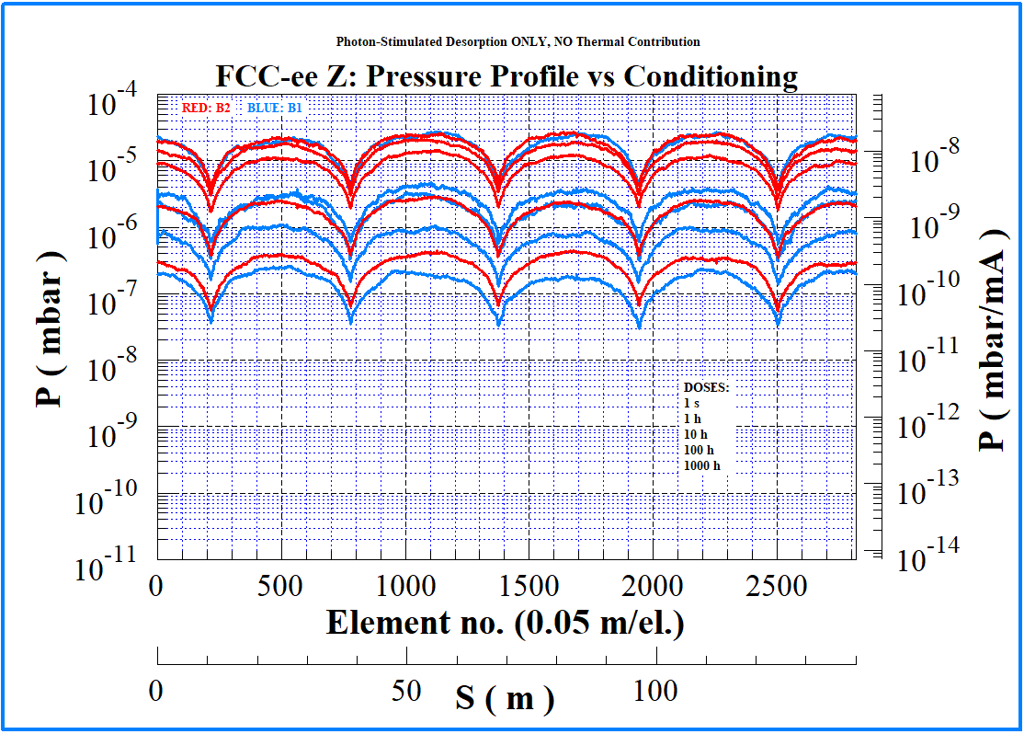
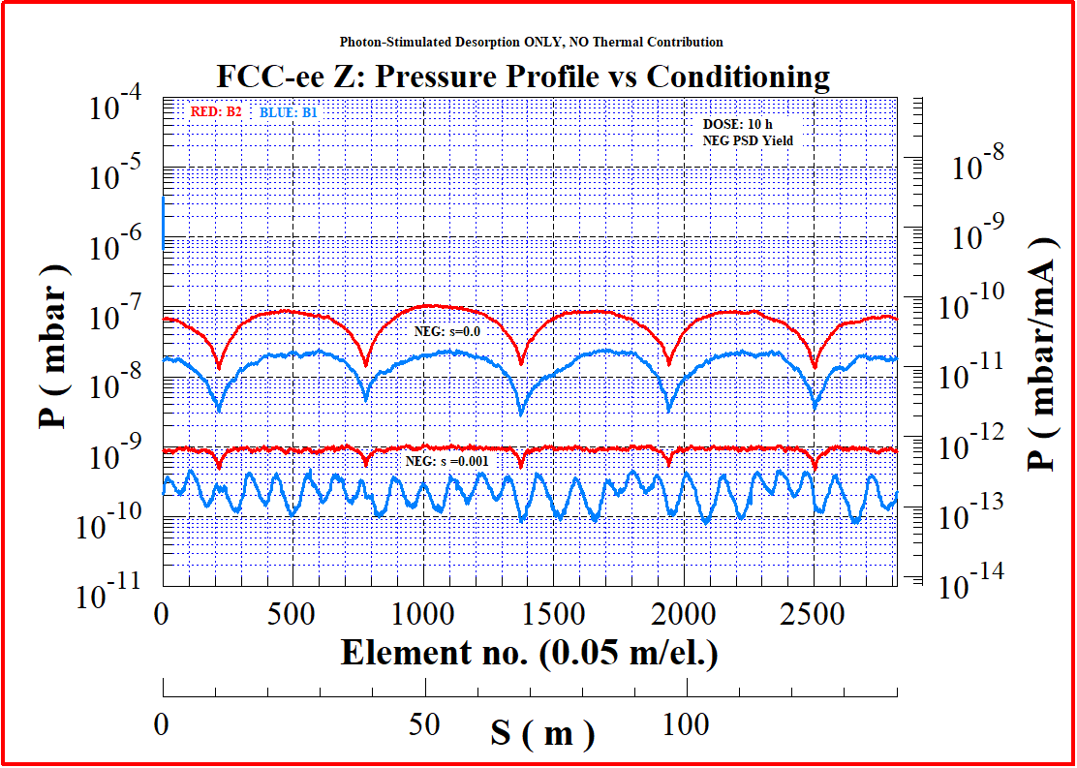
FCCIS Workshop, 5-9 Dec 2022
Vacuum System R&D Status Report - R. Kersevan, TE-VSC
Pressure profiles
We have calculated the PSD pressure profiles for 5 different beam doses, corresponding to times of 1 s, 1 h, 10 h, 100 h, 1000 h. Simulated gas: CO
On the left the case with 5x 100 (l/s) lumped pumps/beam, and no NEG-coating
On the right, the case with NEG-coating, saturated (i.e s=0) and with some residual sticking (s=0.001)

Slide 13
FCCIS Workshop, 5-9 Dec 2022
Vacuum System R&D Status Report - R. Kersevan, TE-VSC
Prototyping, experiments, as per FCC Week 2022 PRESENT STATUS/PLANS
Design prototype vacuum chambers with and without SR absorber (~ 2 m-long) and test them at light source (KARA/KIT?) UNDERWAY
Test behavior of thin NEG-coating at light source SCHEDULED EXPERIMENTS TO MEASURE NEG REFLECTIVITY AT “BEAR” BEAMLINE, ELETTRA LIGHT SOURCE, TRIESTE, Sept-Oct 2022 → DONE!
Define deposition technique for dipolar ~ 12 m-long vacuum chambers (horizontal sputtering with mole?, other techniques?) DESIGN OF 12 m-LONG COATING BENCHES (SCHEDULED BUT CANCELED, LACK OF FUNDS)
In-situ measurement of photoelectron yield at light source CONCURRENTLY WITH No.2, DATA BEING PROCESSED
Test other thin-films with potential application to FCC-ee: amorphous carbon (a-C), hydrophobic silicon films (to reduce pump down time without bakeout); test surface texturing techniques (e.g. LASE) WILL PRODUCE SEVERAL 2m-LONG PROTOTYPES FOR KARA’s “BESTEX” TEST STAND OR OTHER FACILITY (see photos below)
Determine material and fabrication technology of SR absorbers and bonding technique to the vacuum chamber (surface power density above 100 W/mm² at the ttbar energy) UNDER DESIGN/PROTOTYPING & THERMAL ANALYSIS, SEE NEXT SLIDES
Design, fabricate, and test bellows with RF fingers, under elongation and misalignment conditions similar to those expected for FCC-ee, BPM blocks SEVERAL DESIGN OPTIONS UNDER ANALYSIS, SEE NEXT SLIDES
Continue collaboration with FLUKA team (see B. Humann/F. Cerutti), magnet group, tunnel integration working group, and machine optics group (plus MDI) TO BE RESUMED, IMPLEMENTING NEW 92 km LATTICES

Slide 14
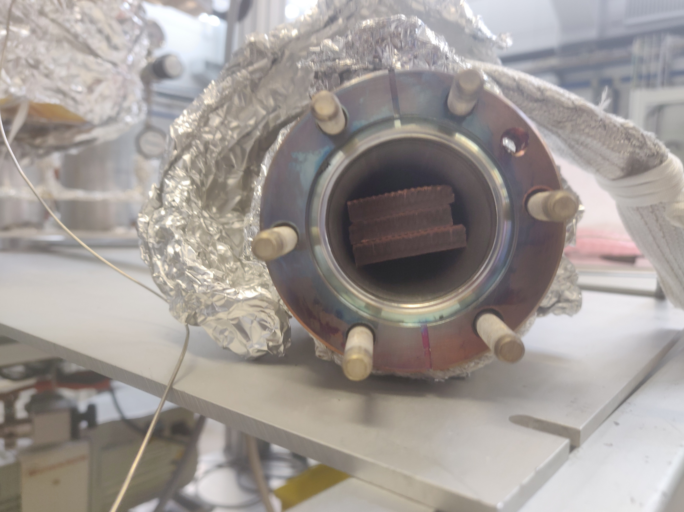
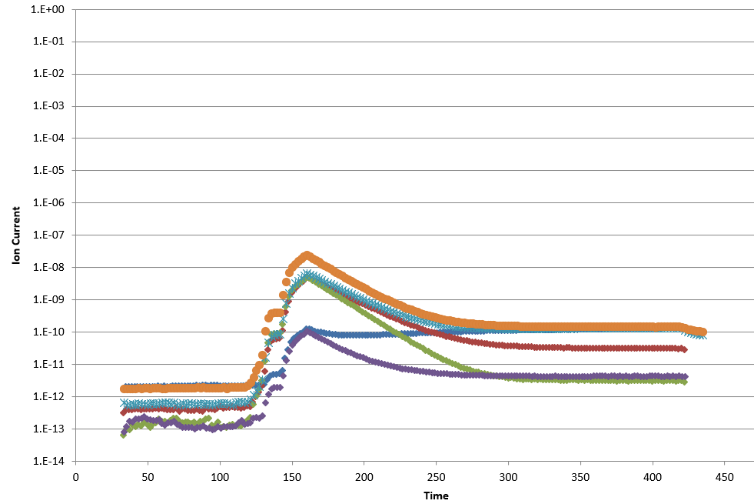
FCCIS Workshop, 5-9 Dec 2022
Vacuum System R&D Status Report - R. Kersevan, TE-VSC
Cold-Sprayed additive manufacturing: validation of vacuum compatibility
Cold-Spray Samples for outgassing measurements
Outgassing campaign ongoing, promising results

Slide 15
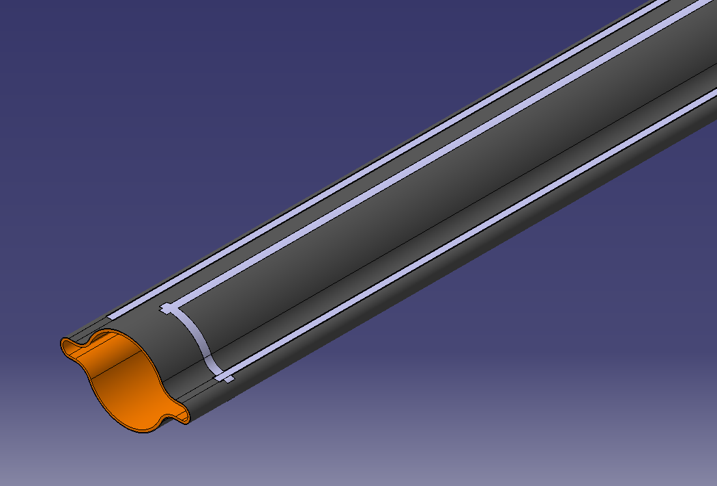
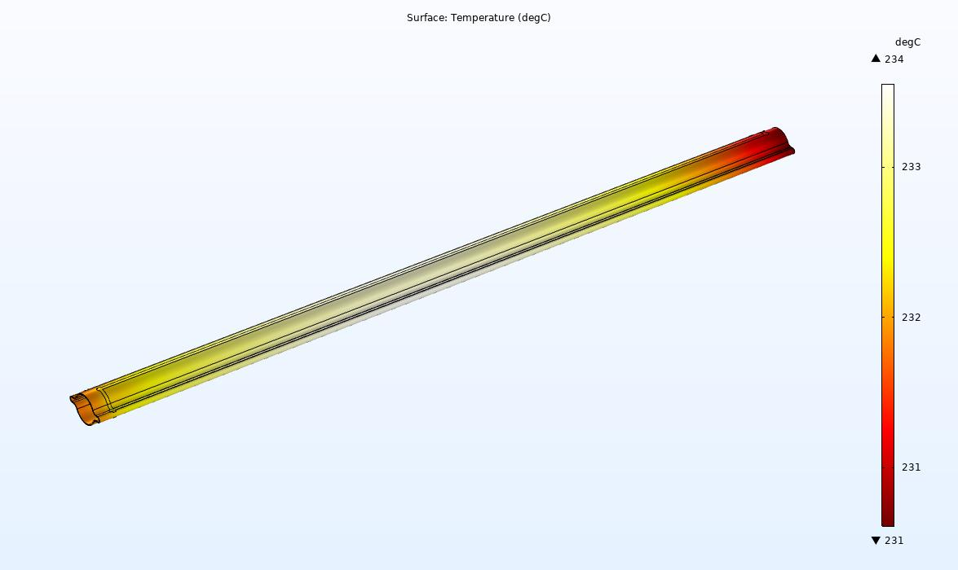
FCCIS Workshop, 5-9 Dec 2022
Vacuum System R&D Status Report - R. Kersevan, TE-VSC
Development of cold-sprayed titanium tracks for ~250 °C bake-out
Development of cold-spray titanium tracks for FCC-ee vacuum chamber
Thermal testing of design suitable for prototyping;
Rather uniform temperature profile
Courtesy S. Rorison, CERN

Slide 16
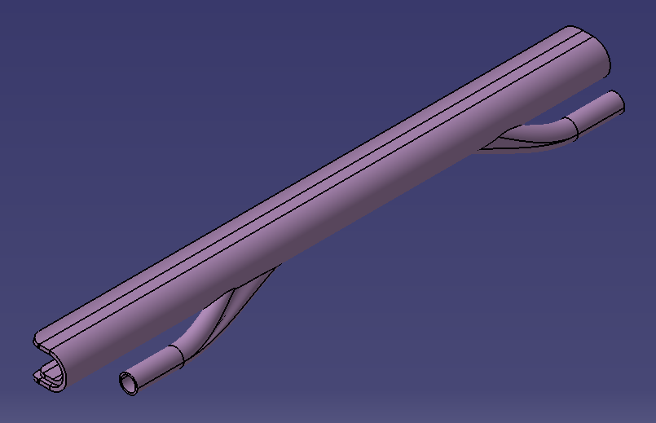
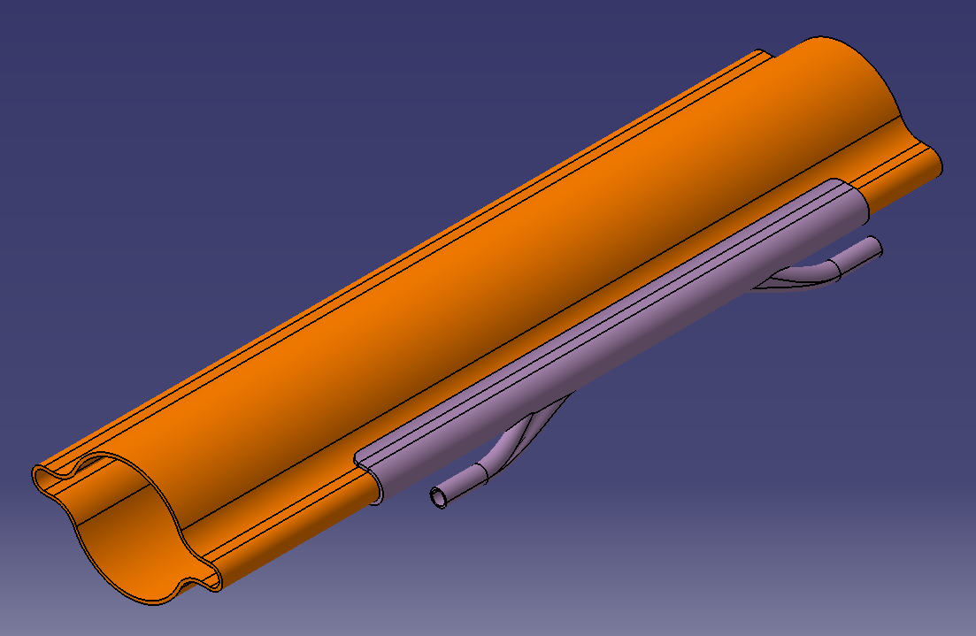
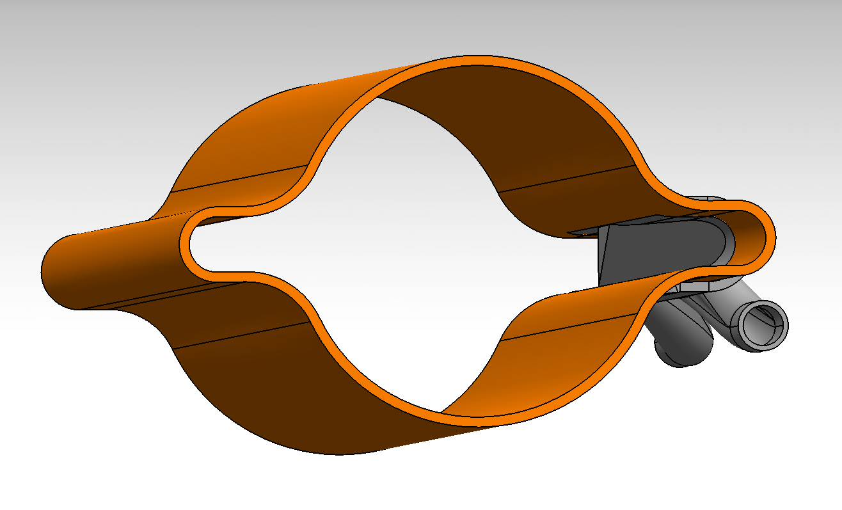
FCCIS Workshop, 5-9 Dec 2022
Vacuum System R&D Status Report - R. Kersevan, TE-VSC
Design of inclined SR absorber: additive manufacturing (3D laser printing)
Implements split cooling channel with built-in swirl inserts, to increase turbulence and boost cooling efficiency (see below)

Slide 17
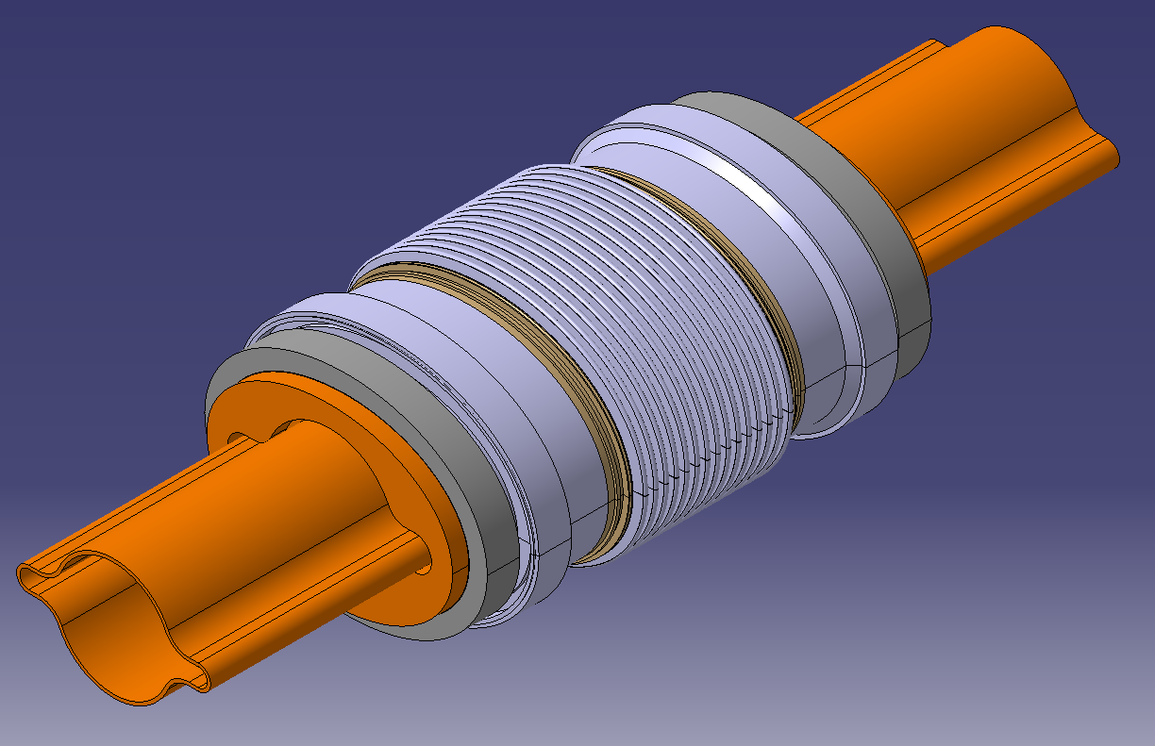
FCCIS Workshop, 5-9 Dec 2022
Vacuum System R&D Status Report - R. Kersevan, TE-VSC
Development of RF contact fingers and bellows
Version with contact-less RF fingers, derived from HL-LHC triplet area
Elliptical flanges with Shape-Memory Alloy rings

Slide 18
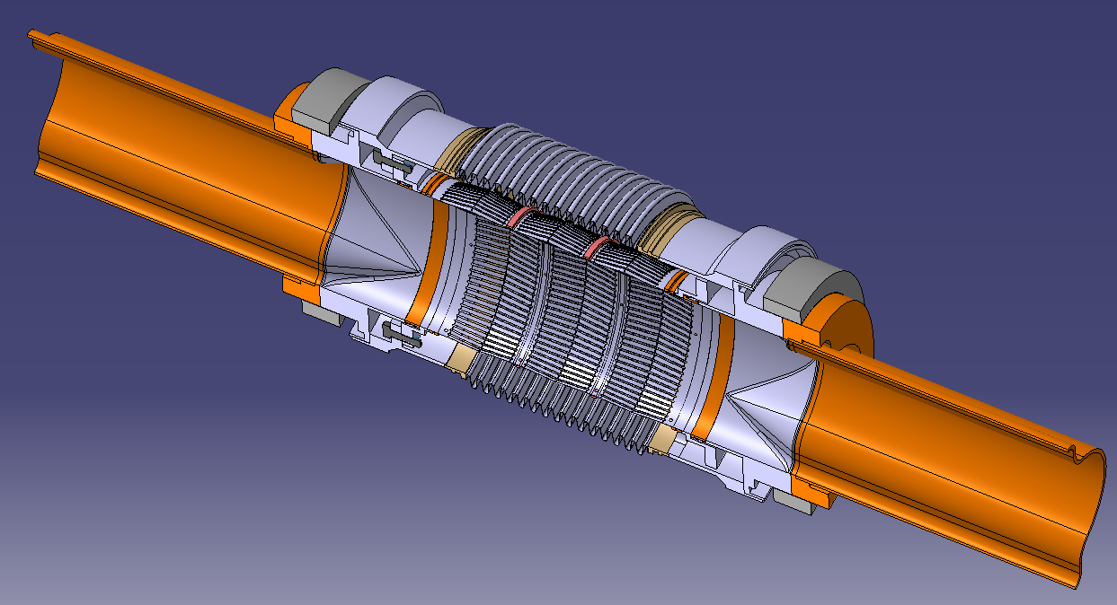
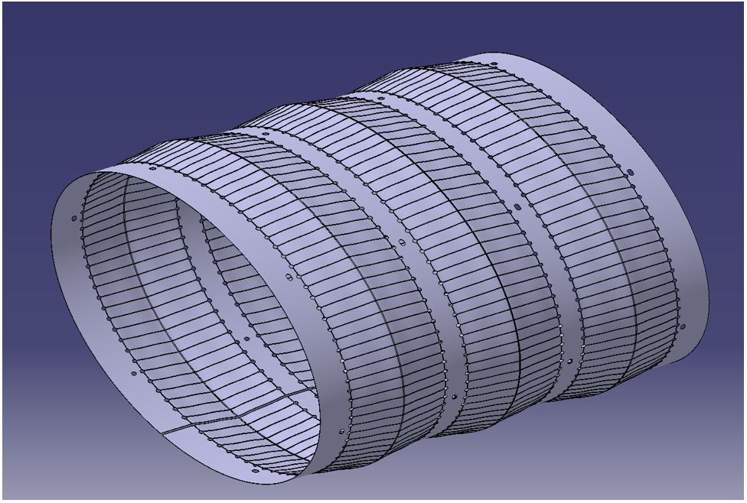
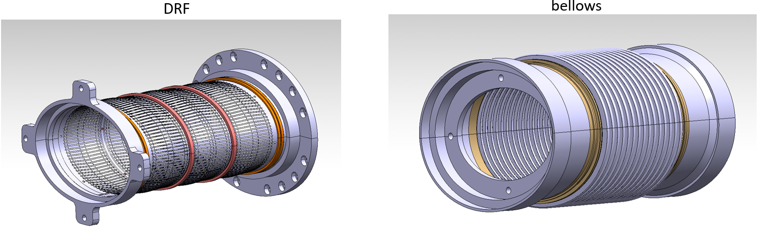
FCCIS Workshop, 5-9 Dec 2022
Vacuum System R&D Status Report - R. Kersevan, TE-VSC
Version with contact-less RF fingers, derived from HL-LHC triplet area
Elliptical flanges with Shape-Memory Alloy rings

Slide 19
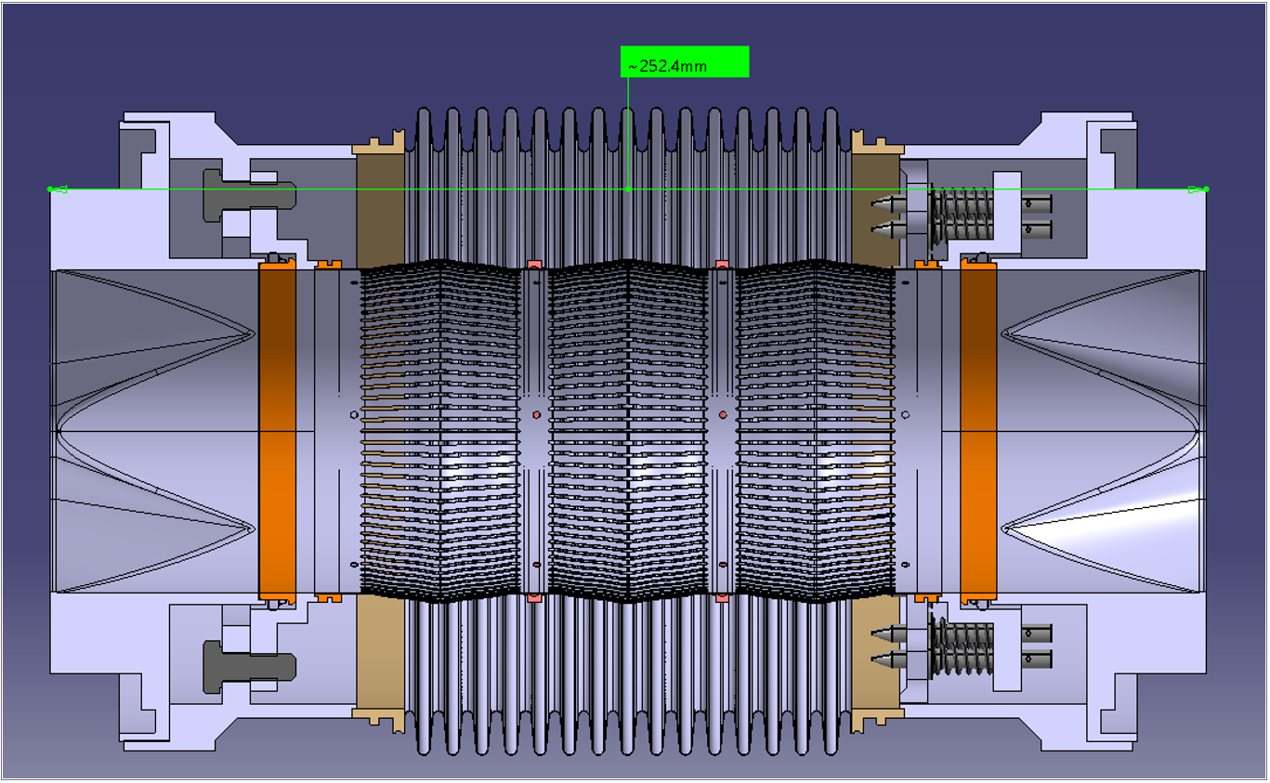
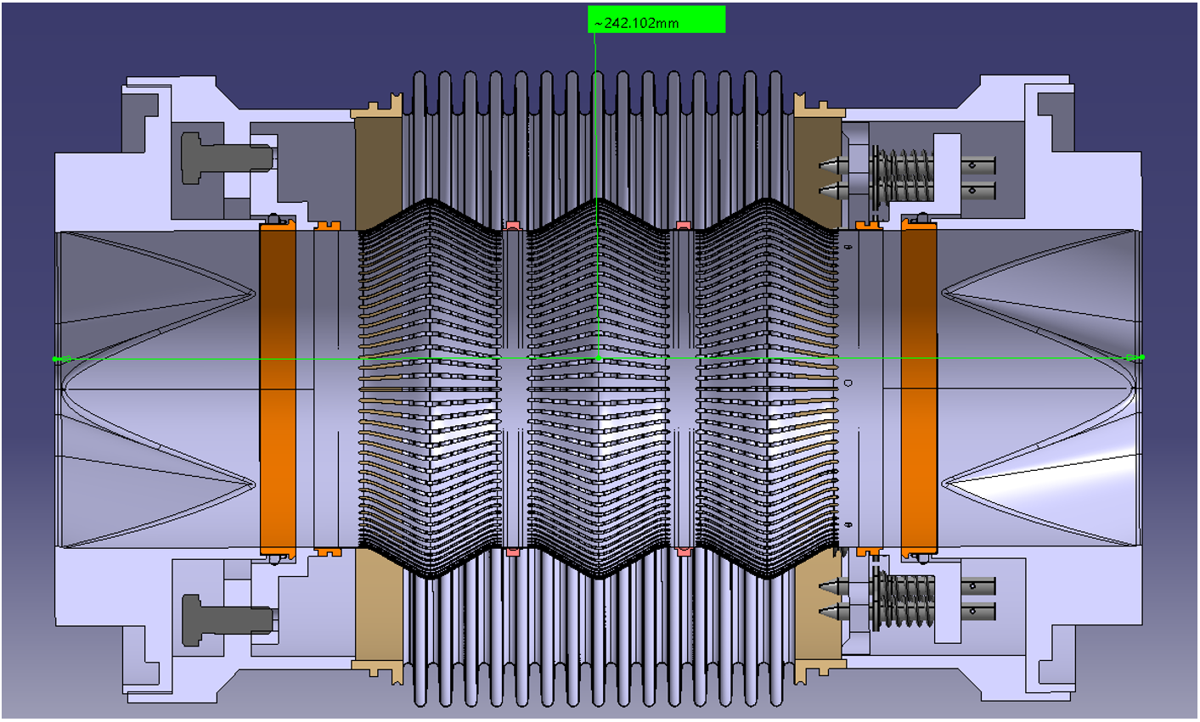
Version with contact-less RF fingers, derived from HL-LHC triplet area
Max and min elongation case, no lateral or angular offset

Slide 20
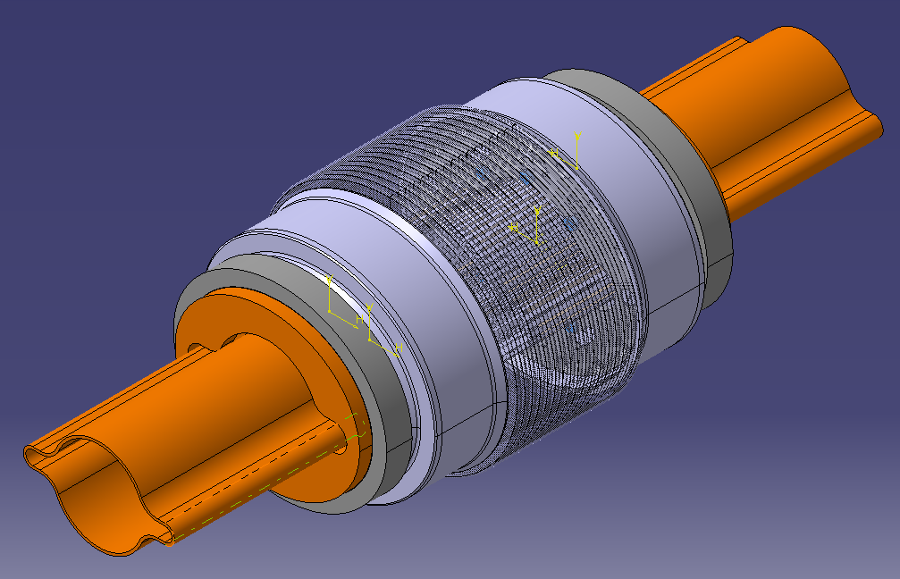
FCCIS Workshop, 5-9 Dec 2022
Vacuum System R&D Status Report - R. Kersevan, TE-VSC
Version with RF contact fingers, derived from SUPERKEKB “comb-type” design
Elliptical flanges with Shape-Memory Alloy rings

Slide 21
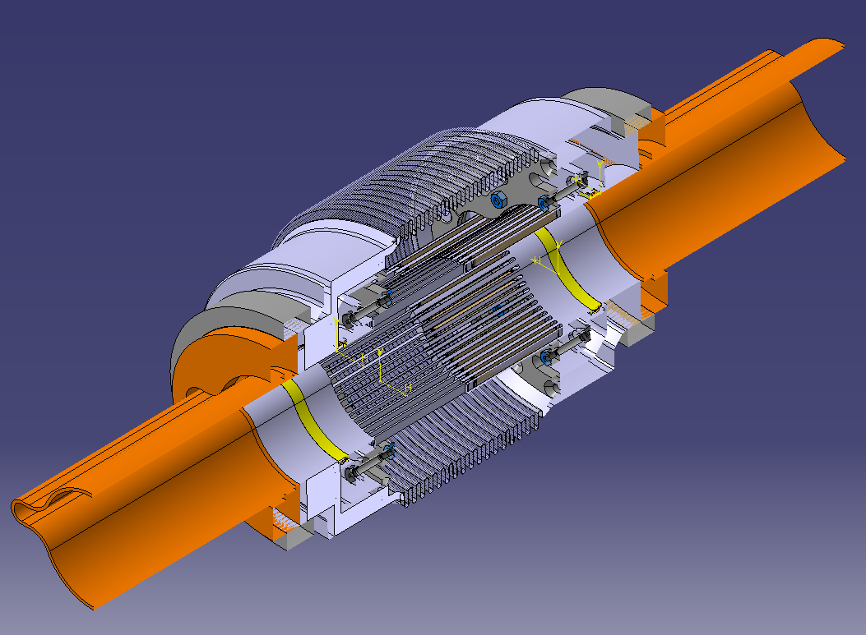
FCCIS Workshop, 5-9 Dec 2022
Vacuum System R&D Status Report - R. Kersevan, TE-VSC
Version with RF contact fingers, derived from SUPERKEKB “comb-type” design
Elliptical flanges with Shape-Memory Alloy rings

Slide 22
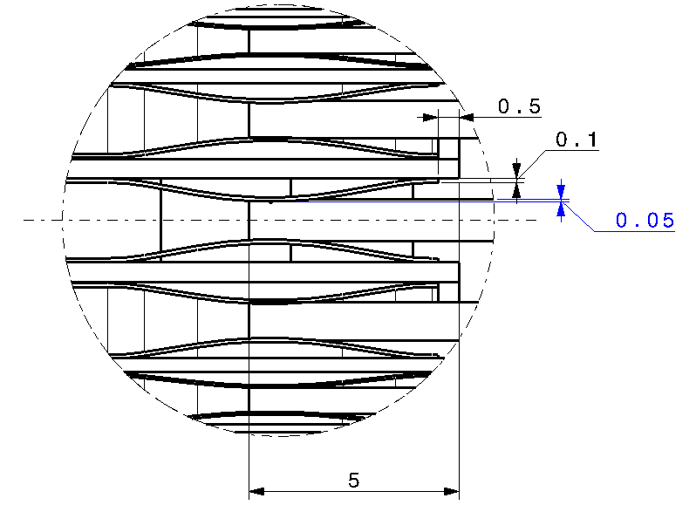
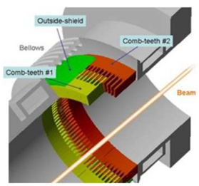
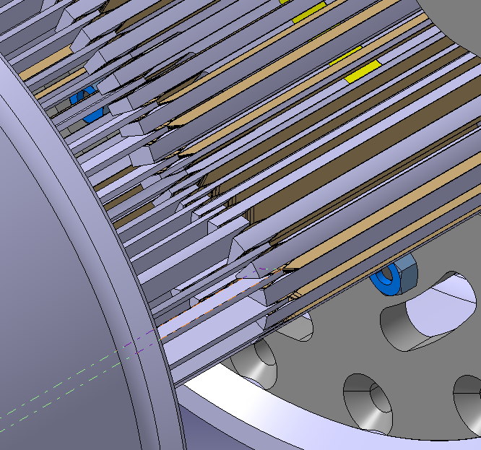
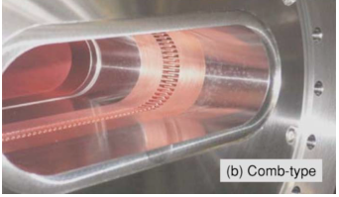
FCCIS Workshop, 5-9 Dec 2022
Vacuum System R&D Status Report - R. Kersevan, TE-VSC
Version with RF contact fingers, derived from SUPERKEKB “comb-type” design;
Some details (right, courtesy of SUPERKEKB) →
Very long fingers (machined or 3D printed), limited lateral movement/angular shift

Slide 23
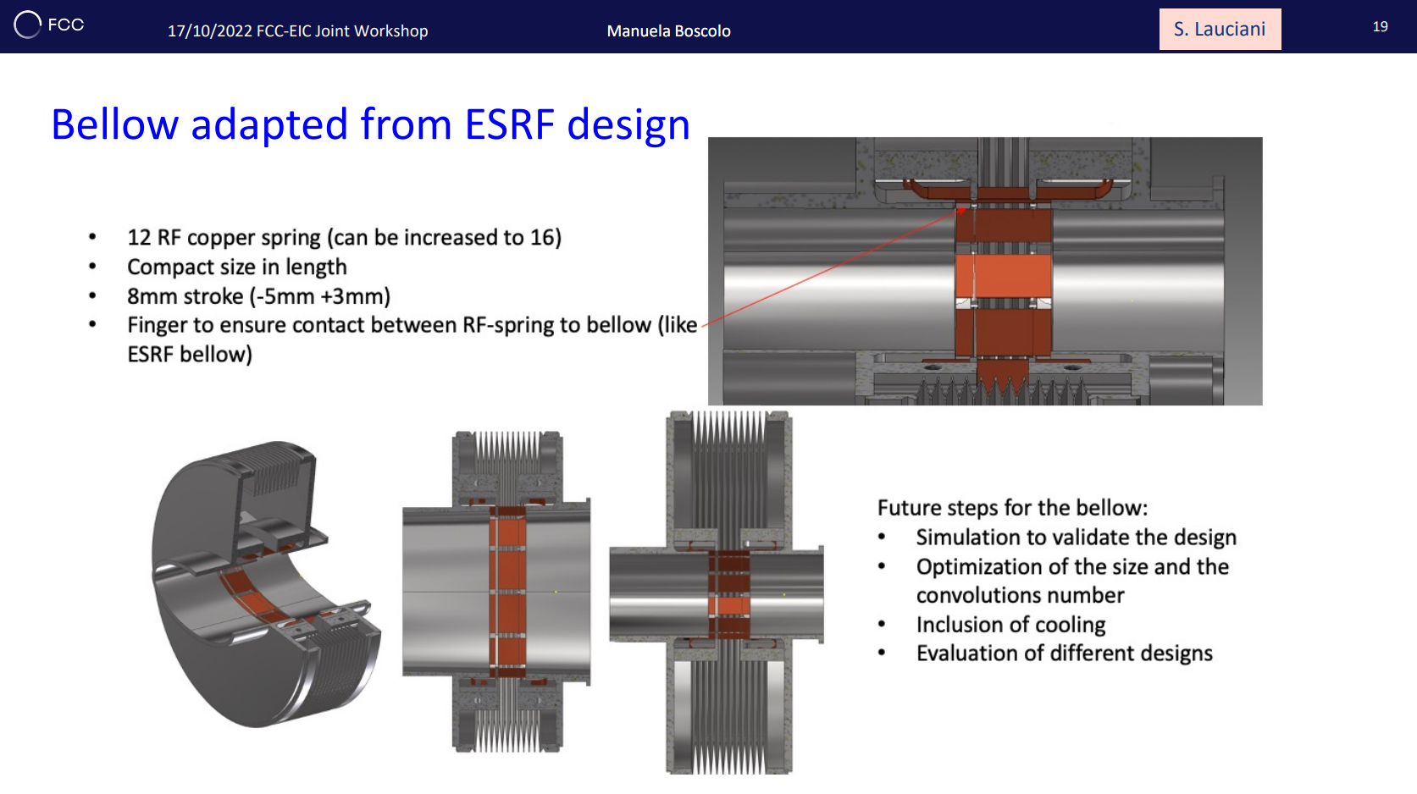
FCCIS Workshop, 5-9 Dec 2022
Vacuum System R&D Status Report - R. Kersevan, TE-VSC
Bellows with RF contact fingers as per ESRF-EBS upgrade: we will look at it and try to adapt it to the chamber with winglets cross-section;
Impedance calculation pending

Slide 24
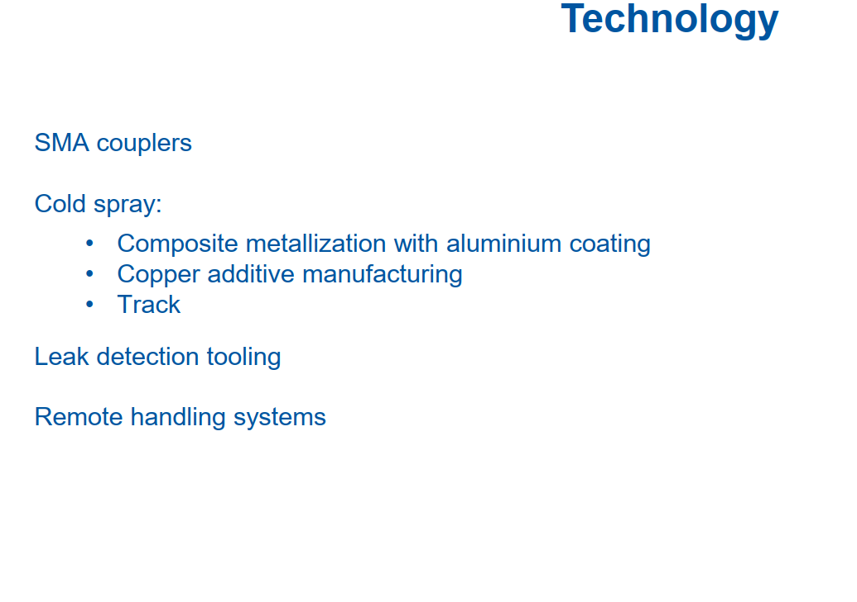
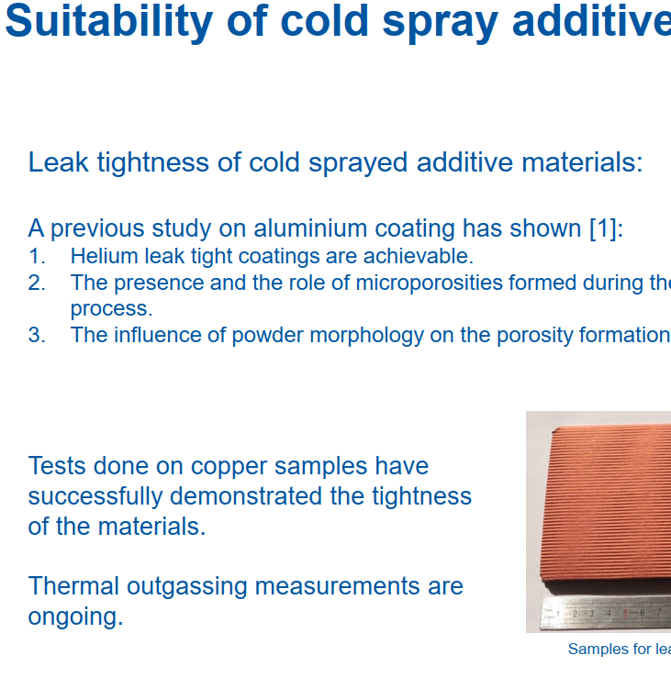
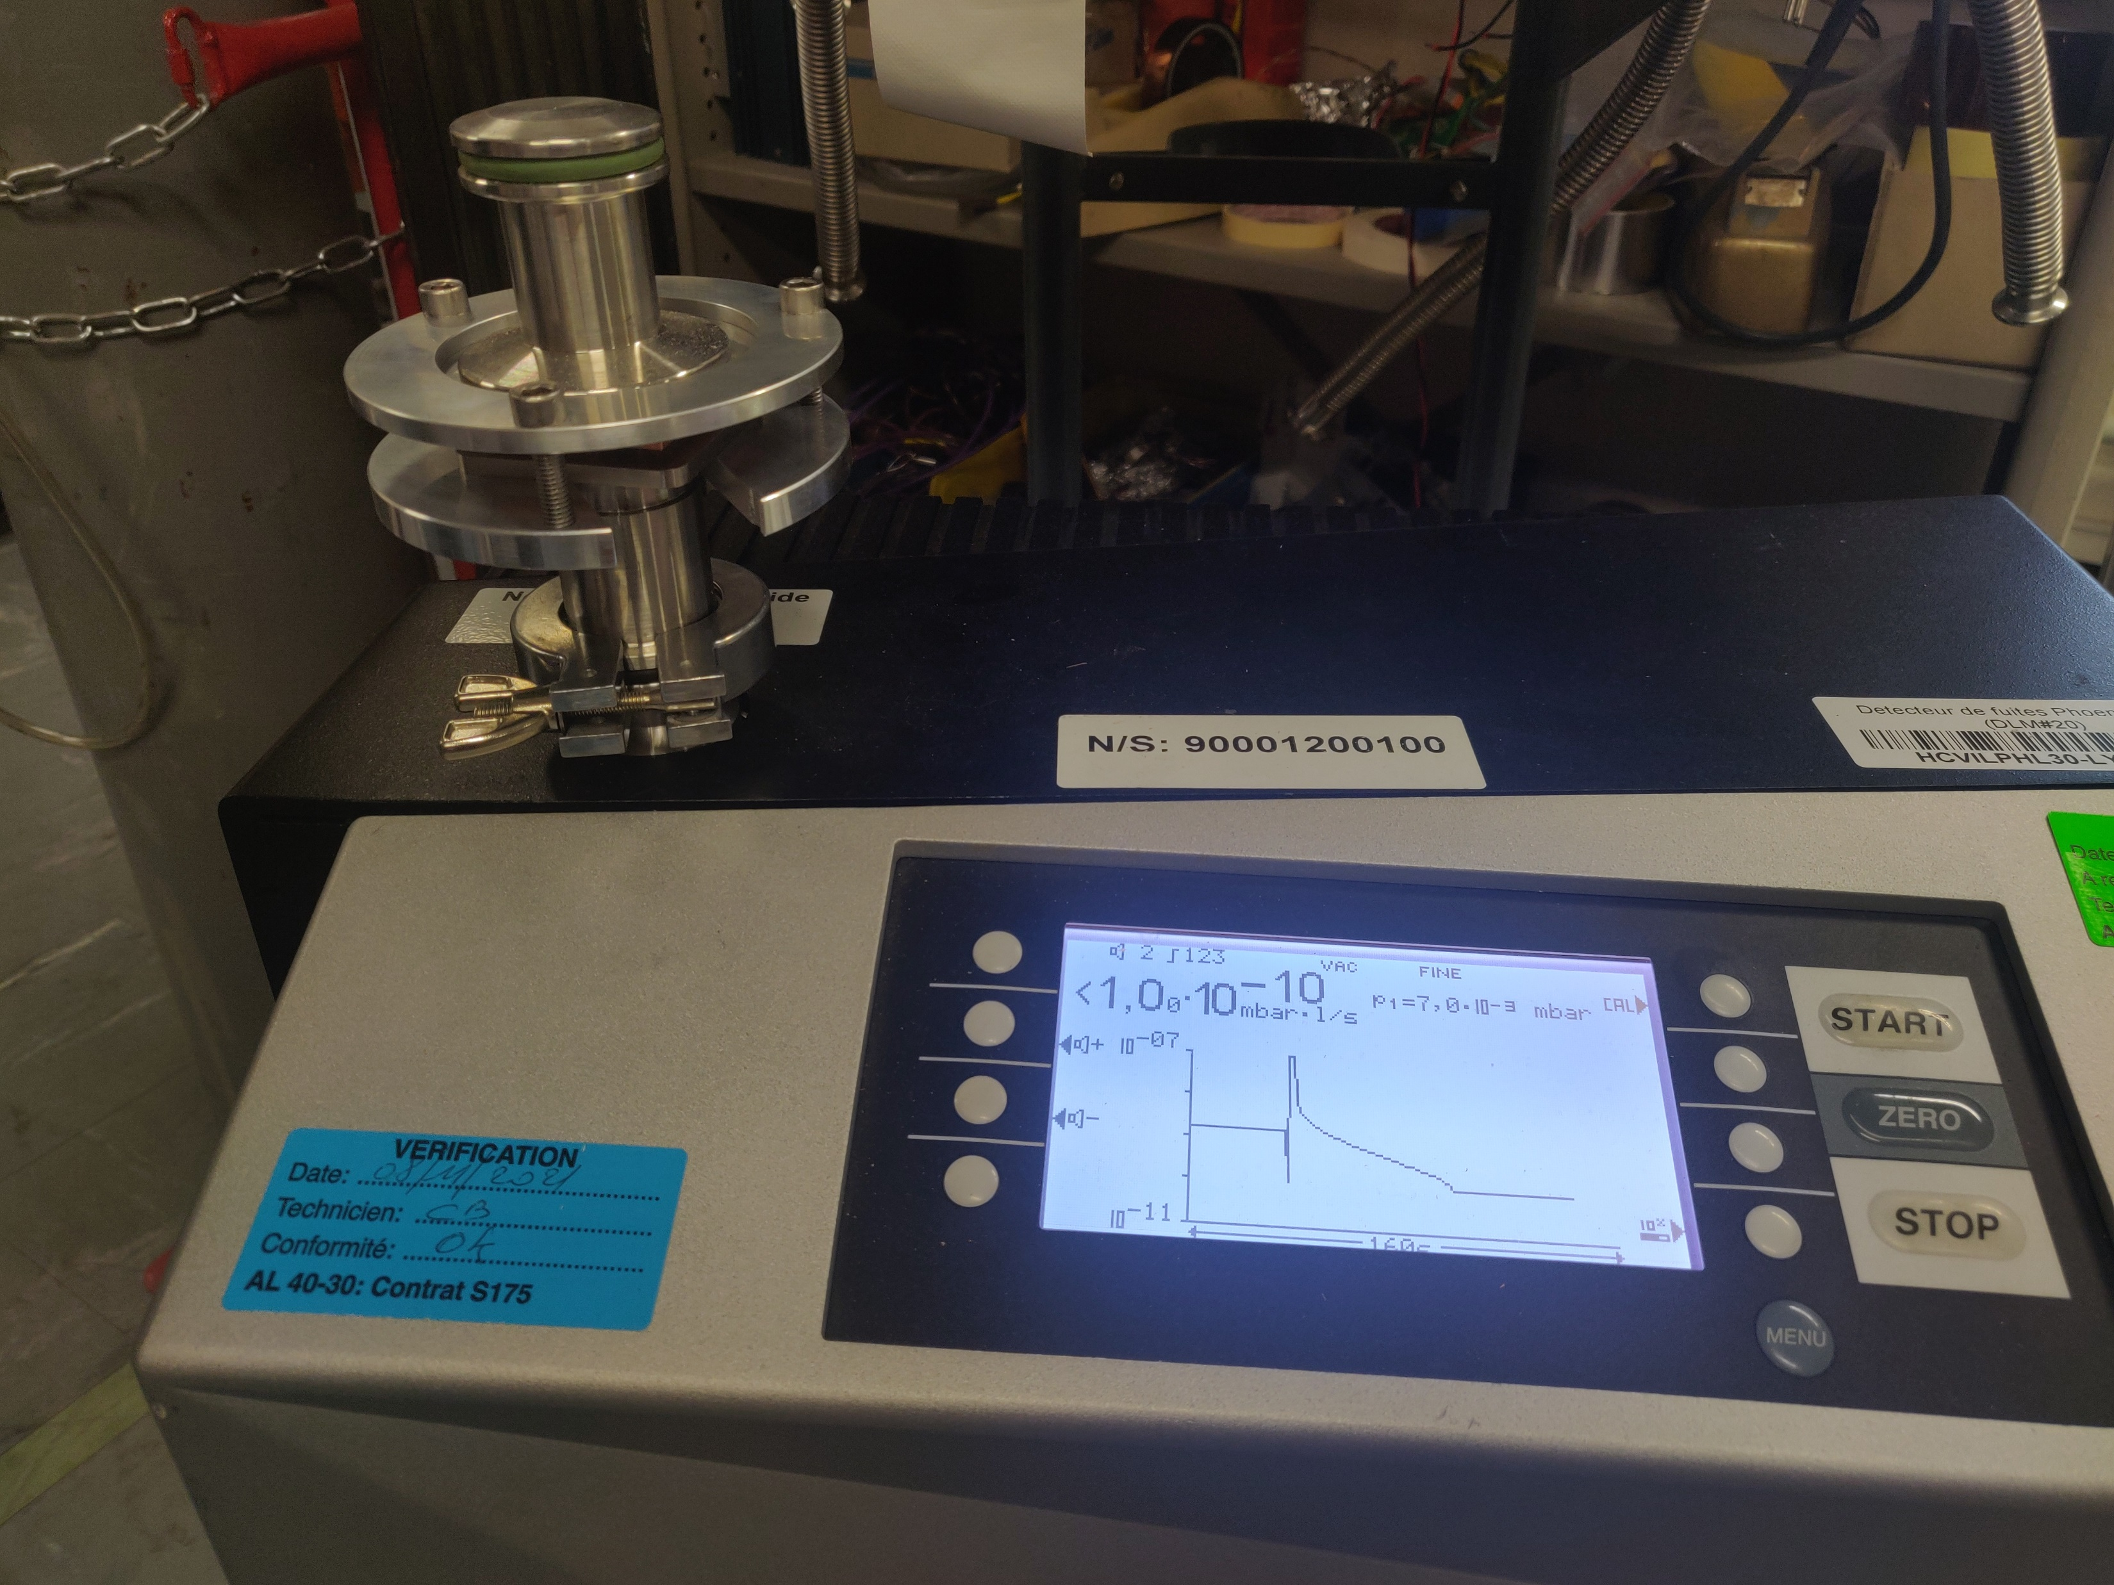
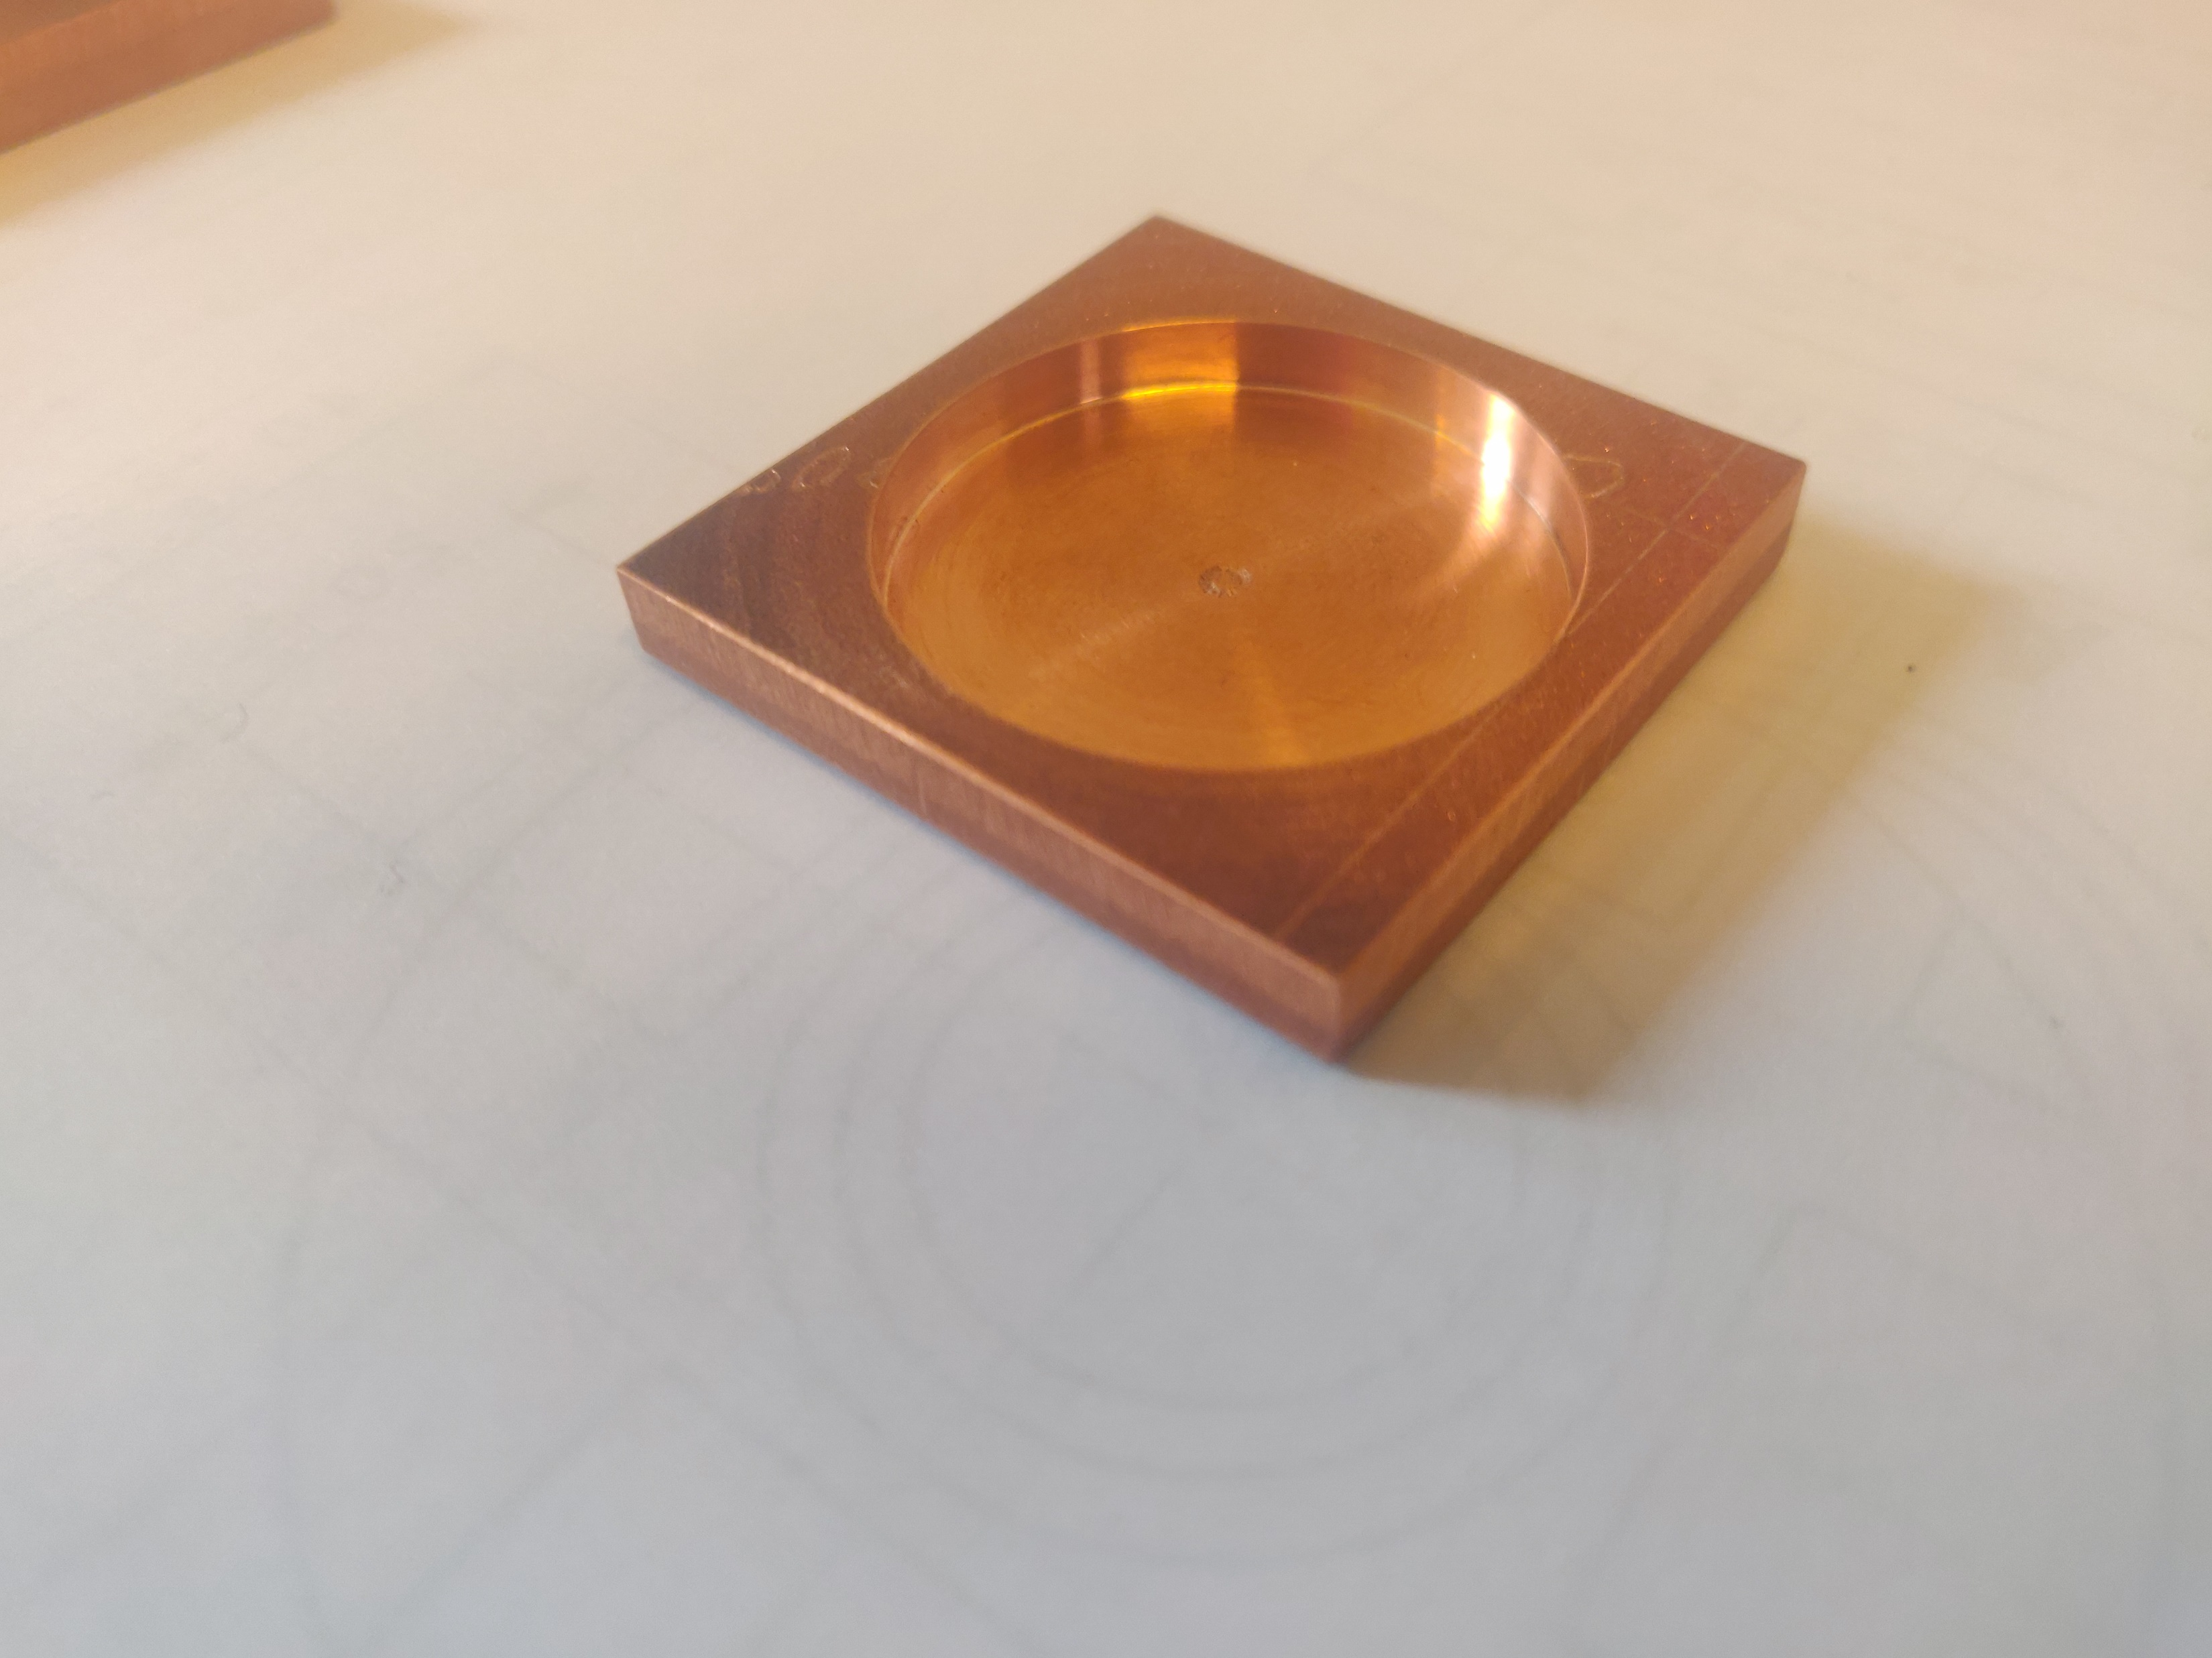
FCCIS Workshop, 5-9 Dec 2022
Vacuum System R&D Status Report - R. Kersevan, TE-VSC
Design of BPM blocks: additive manufacturing (cold spray technol.)
Shape-Memory Alloy (SMA) collars tested for flanges
(reduced machining, no holes for screws)
Cold-sprayed samples of pure copper and various alloys for leak testing
Helium Leak Test tool

Slide 25
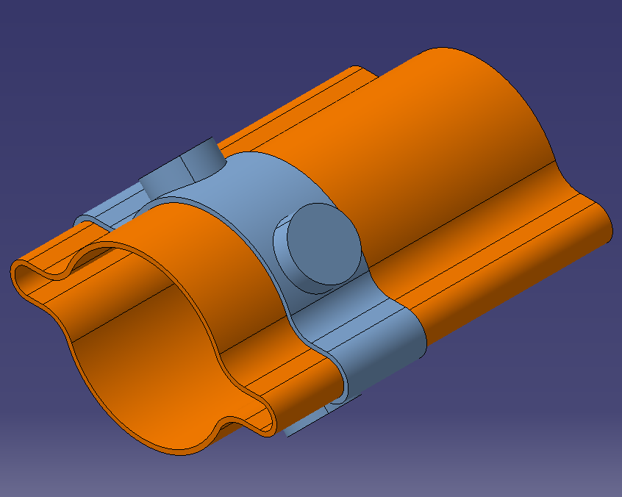
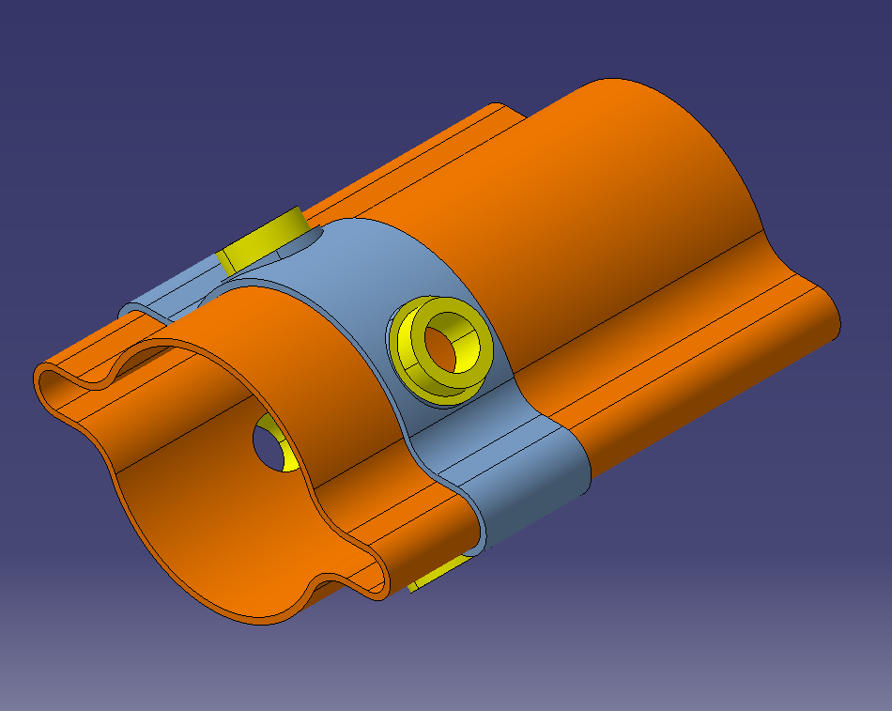
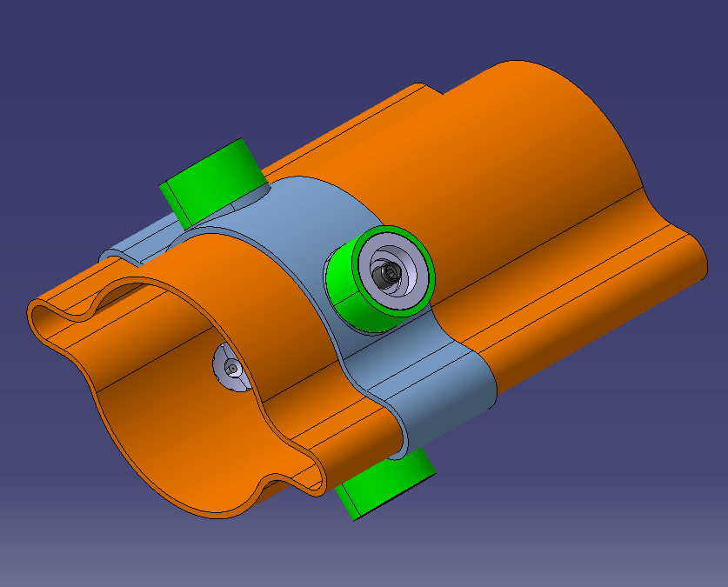
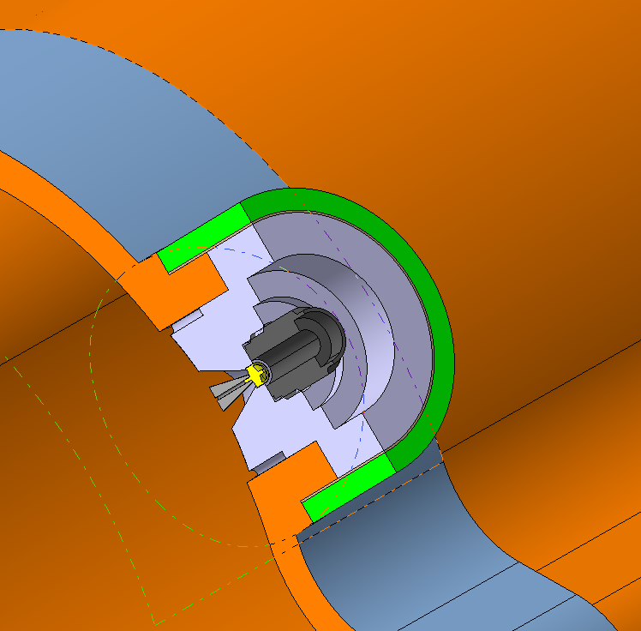
FCCIS Workshop, 5-9 Dec 2022
Vacuum System R&D Status Report - R. Kersevan, TE-VSC
Design of BPM blocks: additive manufacturing (cold spray technol.)
BPM – blue is pre-machining ‘as-sprayed’ cold-spray deposit.
x4 extruded bosses are machined (yellow areas) to accommodate SMA connectors and BPM equipment
Assembly and cross-sectional view of BPM equipment and SMA mini connector
Further work to design mechanical alignment with magnet system on-going
Working in close contact with BPM people (M. Wendt)

Slide 26
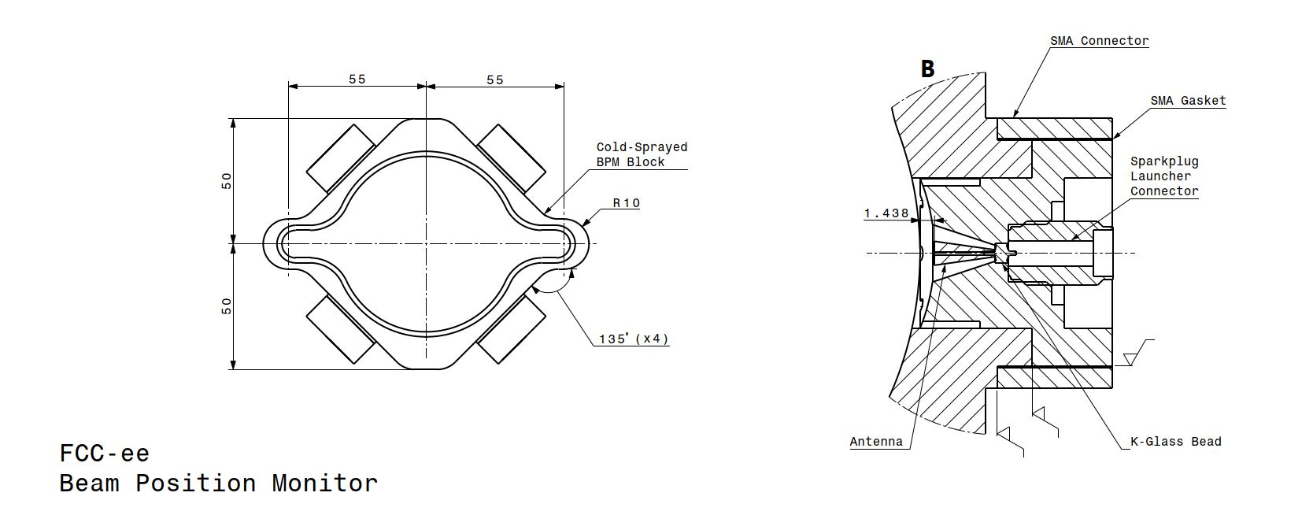
Design of BPM blocks: additive manufacturing (cold spray technol.)

Slide 27
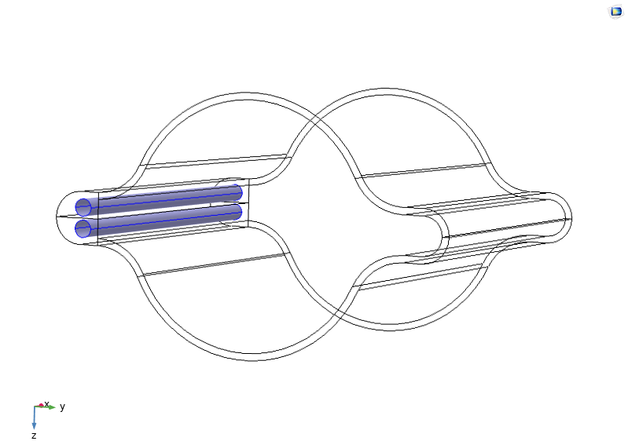


Continuous absorber
FCCIS Workshop, 5-9 Dec 2022
Vacuum System R&D Status Report - R. Kersevan, TE-VSC
Thermomechanical analysis SR absorbers (courtesy M. Morrone, CERN)
Water channels:
2 x Ø 5 mm
η= 523 W/m²/K
(Laminar flow)
Longitudinal Absorber (Ref. case):
Thermal power: 600 W/m
Gaussian distribution vertically

Slide 28




Continuous absorber
FCCIS Workshop, 5-9 Dec 2022
Vacuum System R&D Status Report - R. Kersevan, TE-VSC
Thermomechanical analysis SR absorbers (courtesy M. Morrone, CERN)
h= 20000 W/m2/K
(Turbulent flow)
Water channel:
Ø 10 mm
300 mm
30 mm
170 mm
Half Gaussian applied on each slanted side of the absorber (170 mm long)
Lumped absorber_V1
(V-groove)
700 mm
Integrated power= 4.1 kW
3.8 W power transmitted in the air (over 700 mm)

Slide 29








Thermomechanical analysis SR absorbers (courtesy M. Morrone, CERN)
FCCIS Workshop, 5-9 Dec 2022
Vacuum System R&D Status Report - R. Kersevan, TE-VSC
Cooling efficiency analysis:
2 x water channels
Ø 5 mm (1 INLET Ø 8 mm )
Local absorber V5_gaussian
Temperature Distribution:
Chamber with machined slot for absorber
SR fan footprint on SR Absorber
η= 20000 W/m²/K
(Turbulent flow)
109.2 mm
Power distribution applied as a gaussian fit to MC simulation data
Integrated power is ~ 3.1 kW over ~110 mm

Slide 30



FCCIS Workshop, 5-9 Dec 2022
Vacuum System R&D Status Report - R. Kersevan, TE-VSC
We have received 50 m of chamber extrusion:
8x 5m
5x 2m

Slide 31





FCCIS Workshop, 5-9 Dec 2022
Vacuum System R&D Status Report - R. Kersevan, TE-VSC
Wire-eroded short stubs (AP CERN), used for friction stir welding tests
Tests are promising: good penetration of the weld, with eventual trapped volumes NOT facing the vacuum side

Slide 32


FCCIS Workshop, 5-9 Dec 2022
Vacuum System R&D Status Report - R. Kersevan, TE-VSC
Friction Stir Welding Study
Two Phases
Phase 1
6 Flanges + short chamber profiles for destructive testing to determine optimal weld parameters and refine any design issues with flange and/or chamber.
Short chamber profile made by wire-cutting (Erosion Discharge Machining)
Short chamber profile inserted into flange for Phase 1 welding tests

Slide 33



FCCIS Workshop, 5-9 Dec 2022
Vacuum System R&D Status Report - R. Kersevan, TE-VSC
Results from Phase 1 of Friction Stir Weld (FSW) Tests:
Good shoulder print on part surface
• Small porosities into some locations: no effect on vacuum sealing, as they are internal
porosities; They probably come from the clearance between tube & flange; Porosity maximum size = 0.9 mm
• No residual bond between flange and tube
• On cross section 3, we see copper pushed away on the internal side of the flange

Slide 34


FCCIS Workshop, 5-9 Dec 2022
Vacuum System R&D Status Report - R. Kersevan, TE-VSC
Macroscopic inspection
Good shoulder print on part surface
No visible porosity on surface
Excessive penetration at the end of the weld (tool collapse, too hot)
We can modify the flange for future iterations as below: Better for us, less machining.

Slide 35


FCCIS Workshop, 5-9 Dec 2022
Vacuum System R&D Status Report - R. Kersevan, TE-VSC
Longer chambers, 150mm inserted into flanges.
15 will be welded using newly-determined FSW parameters for UHV validation and other testing at CERN.

Slide 36
FCCIS Workshop, 5-9 Dec 2022
Vacuum System R&D Status Report - R. Kersevan, TE-VSC
Conclusions
The vacuum system for the FCC-ee arc sections has been under study since many years; we look with interest the progress on SUPEKEKB vacuum commissioning and troubleshooting, and CEPC design as well
We have come to the conclusion that the aggressive experimental program with large integrated luminosity values within a rather short amount of time (4 yrs for the Z-pole starting from an unconditioned machine) require two things:
  NEG-coating of the chamber
  Localized (“lumped”) SR absorbers
We have generated several pumping configuration scenarios, changing the number of additional pumps and the partial saturation of the NEG-coating
A series of prototypes are under advanced design and prototyping; we have received a copper extrusion for the chamber which is weld-free and straight, with winglets; we have put ease of fabrication at industrial scale and cost-saving at the forefront of our design; next step is metrology, to check its straightness and surface conditions
Tests on various welding techniques for connecting flanges (e.g. stir-friction weld.) and also of additive manufacturing techniques (e.g. 3D laser and cold-spray) are being pursued for the flanges, BPM blocks, and SR absorbers
2m-long prototype is going to be designed and will be possibly tested with SR irradiation at a SR light source (BESTEX test bench at KARA/KIT?); tests will be also carried out on potential e-cloud mitigation techniques and impedance issues; Installation foreseen on BESTEX/KARA at KIT in H1 2023.
Design of NEG-coating horizontal benches capable to deposit the required thin-film along ~12m-long chambers is pursued (capitalizing on technology developed for HL-LHC); Tunnel integration under study as well (dedicated working group)
Still, lots of work to do on the vacuum system for the full-energy booster, the special chambers for wigglers, the MDI region; Also, more work on modeling the new lattice, and passing the new geometry data to the FLUKA team.

Slide 37
Acknowledgments:
Material, calculations, software support, and fruitful discussions have been provided by TE-VSC colleagues:
S. Rorison, C. Garion, F. Santangelo, M. Morrone, P. Costa Pinto, F. Luiz,
P. Lindquist Henriksen, M. Ady, F. Niccoli (U. Calabria)
I also gratefully acknowledge the constant support of V. Baglin, P. Chiggiato
Thank you for your attention!
37
FCCIS 2022 Workshop, 5-9 Dec 2022, CERN

