Slide 1





Optics Matching Studies
Cristóbal García (EPFL), Rogelio Tomás (CERN), Tatiana Pieloni (EPFL), Leon van Riesen-Haupt (EPFL)
Many thanks to K. Oide, J. Dilly and Optics Tuning Team
This work was carried out under the auspices and with the support of the EPFL-Global Leaders, the Swiss Accelerator Research and Technology (CHART) and FCC-ee studies at CERN.
December 2022

Slide 2
FCC-ee Z Parameters
 | FCCee_z_530_nosol_23 Oide-san sequence
Length [m] | 91174.117
Horizontal tune | 214.260
Vertical tune | 214.380
Beta*x [mm] | 99
Beta*y [mm] | 0.8
Horizontal Natural Chromaticity | -481.842
Vertical Natural Chromaticity | -3041.692
Horizontal Chromaticity | -1.165
Vertical Chromaticity | -1.911
Dispersion_{max} [m] | 0.624
We would like to report on two studies, I´ve been working on:
  re-matching the baseline lattice with systematic b2 errors in dipoles
  start the design of a lattice based on HTS combined function magnets
For our first studies, we focused on the Z mode lattice, which has the most challenging optics due to lowest beta*.

Slide 3
Baseline lattice with b2 errors in dipoles
HTS combined function magnets lattice

Slide 4
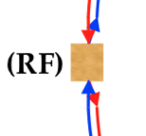
Systematic b2 error in Dipoles
The magnet design team predicts a systematic quadrupolar error “b2” in the arc dipoles.
“b2” means the normalized term for the quadrupolar error in the dipole with a specific radius expressed in units of 10⁻⁴, not in Tesla, the estimate from magnets is 4 units.
The sign of the quadrupolar error depends on whether the beam is on the inside or outside aperture of the dipoles but has the same magnitude in both cases.
The beams cross in the IPs and the Intermediate Straight Sections (ISSs), moving from the inside to the outside of the ring or vice versa. Therefore the sign of the quadrupolar error depends on the arc in which the dipole is located.
What is it the maximum the b2 errors to get a beta beating of 1%?
+
-
-
+

Slide 5
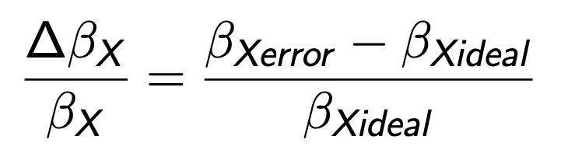
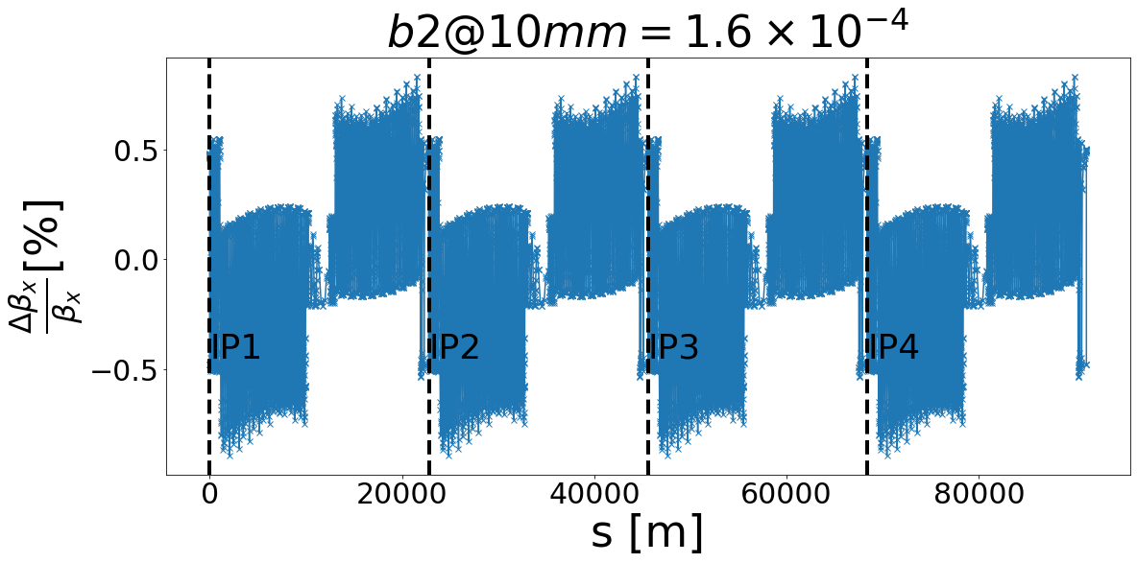
Impact on the Optics
To obtain a beta-beating of 1%, several values of b2 were reviewed, 1.6x10⁻⁴ gives said value.
Apart from the change of tune, we can also look at the change in beta function due to the b2 errors.
The horizontal and vertical tune changes 1.0x10⁻² and 7.6x10⁻³ respectively.
Integrate the errors in the lattice is possible with the matching function.
https://indico.cern.ch/event/1167740/

Slide 6
Matching with MAD-X
Small beta beating is tolerable in arcs but unwanted in the insertion regions.
  Wrong beta functions and dispersion leaking into the IP would reduce Luminosity.
  It is important to recover baseline optics in these region to maintain the initial parameters.
This can be done using matching in MAD-X[1], using quadrupoles close to the Arc-IR interface
  The matching with errors and the design for a new lattice are based to minimizing the differences of optical function with respect to the baseline design by Oide-san (the ideal lattice for this study).
[1] https://madx.web.cern.ch/madx/

Slide 7
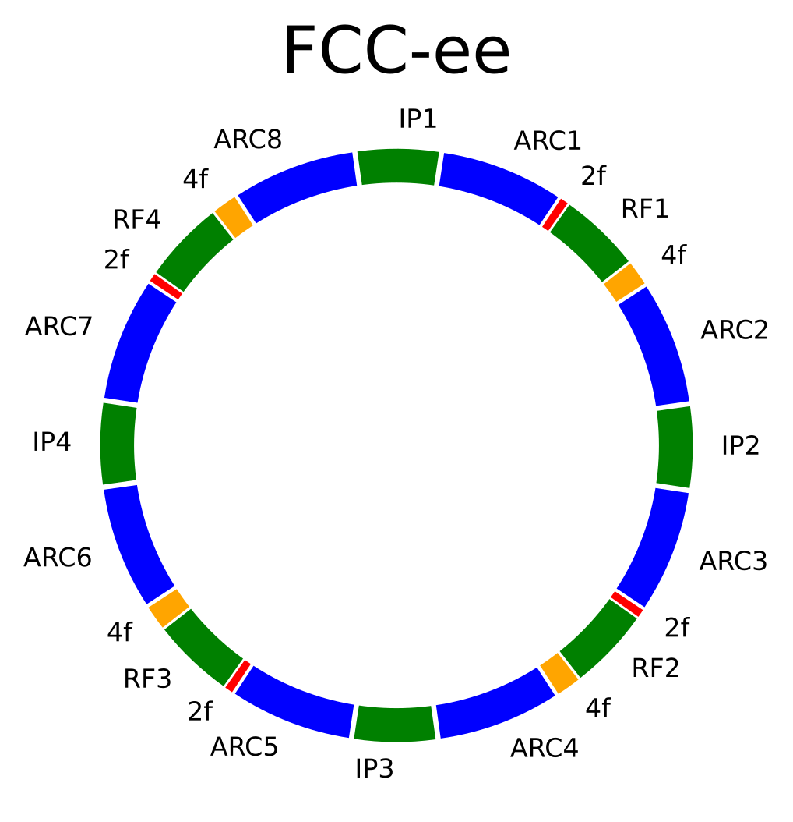
Symmetry in FCC-ee to do matching
8 Interest Region (IR)
4 Interaction Point (IP)
4 Intermediate Straight Section (ISS)
8 ARC
17 super-FODO cells/ARC
24 FODO cells remaining
—----------------------------------------
704 FODO cells in total
Speed up calculations using ¼ of ring due to the symmetry to do Matching
Candidacy Exam
We are using six matching points

Slide 8
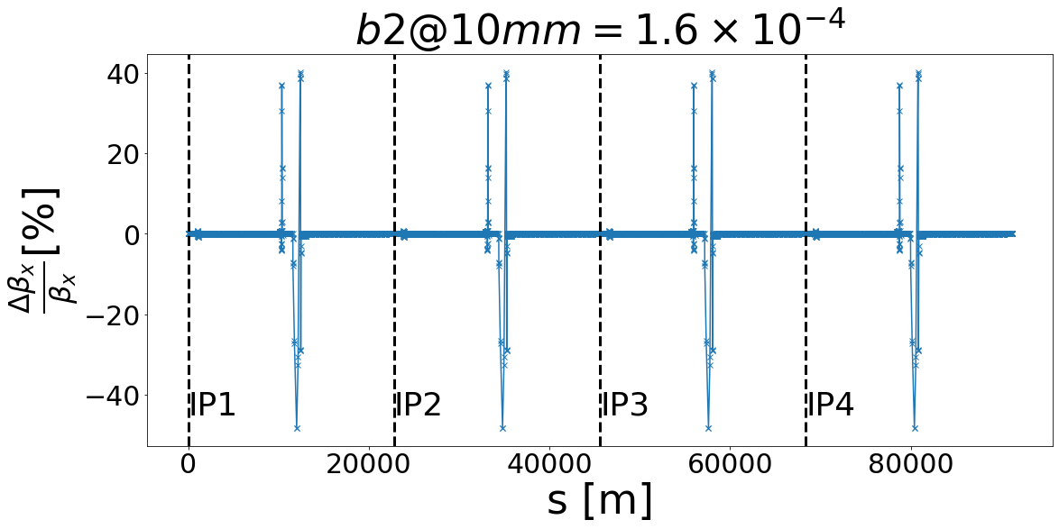
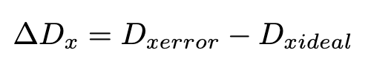
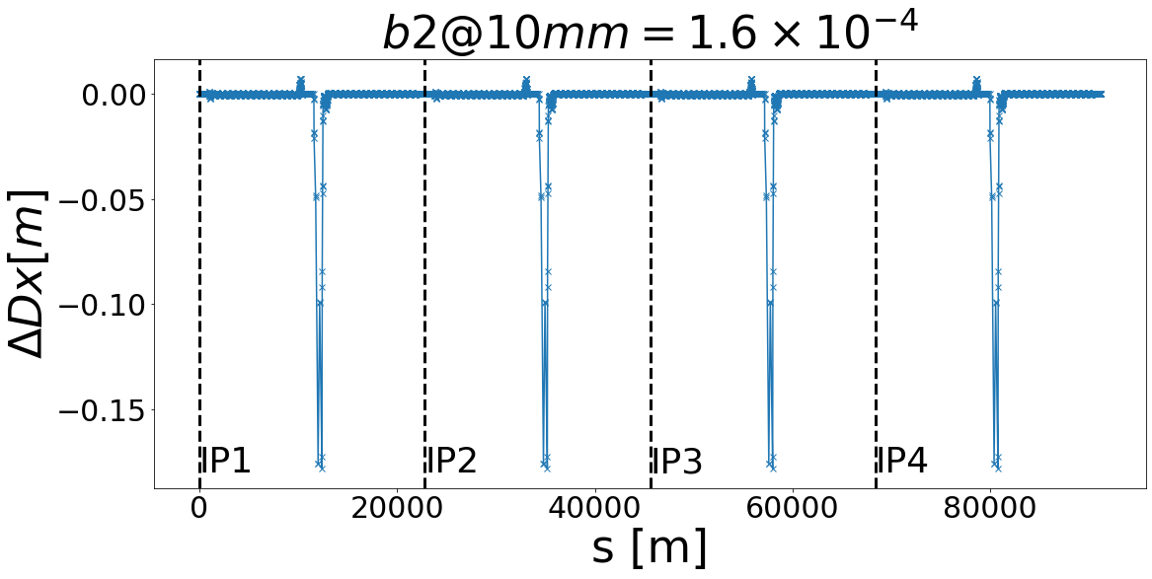
Results of Matching
After the matching, the original tunes are recovered.
The β* in the horizontal and vertical planes are also the same as before.
Further analysis showed that β-beating is below 0.75% in the arcs but peaks in the ISSs. There is not a problem as there are no IPs in these regions.
There is a change in the maximum dispersion in the intermediate straight sections. So it does not compromise the initial parameters for the IPs.

Slide 9
Results of Matching
Matching was used to recover the:
  The correct phase advance in the arcs (and the horizontal and vertical betatron tunes).
  The periodic behaviour in the IPs.
b2 errors in the lattices can be absorbed
Parameters | Ideal Lattice | Lattice with b2 errors | Lattice after the Matching
Horizontal tune | 214.260 | 214.259 | 214.260
Vertical tune | 214.380 | 214.379 | 214.380
Beta*x [mm] | 99 | 99 | 99
Beta*y [mm] | 0.8 | 0.79 | 0.8
Horizontal Chromaticity | -1.165 | -0.986 | -0.945
Vertical Chromaticity | -1.911 | -3.461 | -2.796
Dispersion_{max} [m] | 0.624 | 0.632 | 0.787

Slide 10
Baseline lattice with b2 errors in dipoles
HTS combined function magnets lattice

Slide 11
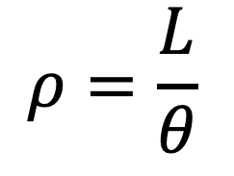
Combined Function Magnets
Combined Function magnets^{1,2} (CF) make it possible to increase the Filling Factor (FF), in order to reduce the Synchrotron Radiation
  When introducing CF the total bending angle (𝜽) of the dipoles is now split among dipoles and quadrupoles, hence increasing the bending radius (ρ).
Many other potential benefits from combined function magnets from discussing with colleagues (Oide-San and others)
  More regular FODO cells
  Better/Easier alignment
  More effective corrections
  Maybe less power consumption when using HTS
[1] Juchno, M. Magnetic Model of the CERN Proton Synchrotron Main Magnetic Unit. (2011), https://cds.cern.ch/record/1407908
[2] Meng, W. & Tanaka, M. Three dimensional field analysis for the AGS combined function magnets. Proceedings Of International Conference On Particle Accelerators. pp. 2907-2909 vol.4 (1993)

Slide 12
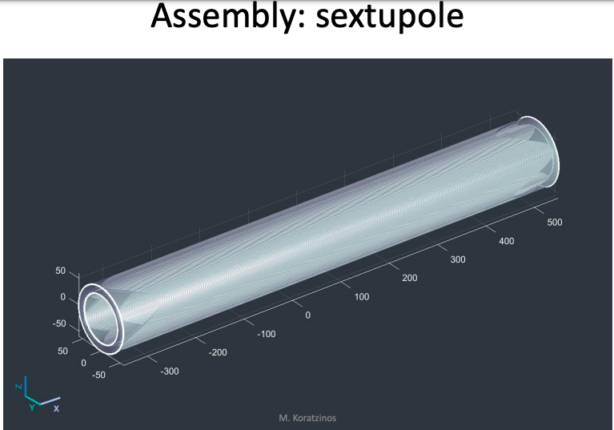
HTS Combined Function Magnets
Combined function magnets proposed by M. Koratzinos¹ use High Temperature Superconductors (HTS).
A project exist at PSI to explore HTS² Combined Function (CF) magnets for the FCC-ee.
Our studies will allow estimating the first tolerances in the components of the magnetic errors to provide feedback to the designers.
[1]https://indico.cern.ch/event/1118297/
[2]https://www.psi.ch/en/science/scientific-highlights/stronger-magnets-faster-particles-new-physics

Slide 13
FODO Cells with Combined Function Magnets
Dipoles
Quadrupoles
Sextupoles
Orbit corrector
Baseline
B1
B1
B1
B1S
Option 1
B1
B1
B1
B1S
Option 2
B1
B1
B1
B1S
Option 3
B1
B1
B1
B1S

Slide 14
Lattice with Combined Functions Magnets
Option 1) Split the total bending angle of dipoles in dipoles+quadrupoles with CF
  We take in consider the super FODO cell as the reference for the bending angle
  The total sum of bending angle in the super FODO cell with CF is the same
Option 2) Split the total bending angle in dipoles+quadrupoles+sextupoles
  The bending angle for the quadrupoles and sextupoles is the same
  The total sum of bending angle for the dipoles, quadrupoles and sextupoles is the same as the beginning.
  The sextupoles has only dipolar component.
Option 3) Split the total bending angle in dipoles+quadrupoles+sextupoles and the quadrupole strength in quadrupoles and sextupoles
  To have three layers the quadrupolar component in the sextupoles and the sextupolar component in quadrupoles is added. Only in the quads next to sextupoles.
  Best option for alignment and corrections

Slide 15
Synchrotron Radiation for Z-mode
The decrease in synchrotron radiation for Option 1 thanks to the increase in bending radius is quantifiable by means of the energy loss per turn.
A reduction of 6.4% was achieved in the 4 modes for the FCC-ee.
This reduction could increase a bit more if the combined function could be applied to sextupoles (Option 2) and then obtain a FF of 74.14%.
There is the possibility of putting a dipole at the location of the tt quadrupoles, that would actually double the 6%.
Parameter | FCC-ee current lattice | FCC-ee with CF (Option 1)
Circumference [m] C_0 | 91,174.11 | 91,174.11
Bending radius [m] ρ | 9,936.69 | 10,618.09
Filling Factor (FF) | 68.47% | 73.17%
E [GeV] | 45.6 | 45.6
I beam [mA] | 1400 | 1400
SR power / beam [MW] | 53.88 | 50.43 (-6.4%)

Slide 16
Lattice with Combined Functions Magnets
The new 𝜽 will be obtained splitting the sum of all dipoles in the super-FODO cell (because there are three types of them) and the distribution is not regular.
To the sum of the length of the dipoles (in the super-FODO cell) is added the 10X length quadrupole (2 for each FODO cell), obtaining:
FCC-ee_Z Parameters from MADX | Lattice with normal magnets | Lattice CF (Option 1)
Length [m] | 91174.117 | 91174.117
Horizontal tune | 214.260 | 214.260
Vertical tune | 214.380 | 214.379
Beta*x [mm] | 99 | 99
Beta*y [mm] | 0.8 | 0.8
Horizontal Chromaticity | -1.165 | -0.824
Vertical Chromaticity | -1.911 | -2.446
Dispersion_{max} [m] | 0.624 | 0.634
Dipolar component | Normal magnets [radians] | Combined Functions [radians] | Length [m]
𝜽 Dipole B1 | 0.00227 | 0.00213 | 22.65
𝜽 Dipole B1S | 0.00194 | 0.00181 | 19.30
𝜽 Dipole B1L | 0.00210 | 0.00197 | 20.95
𝜽 Quadrupole | 0 | 0.00027 | 2.9

Slide 17
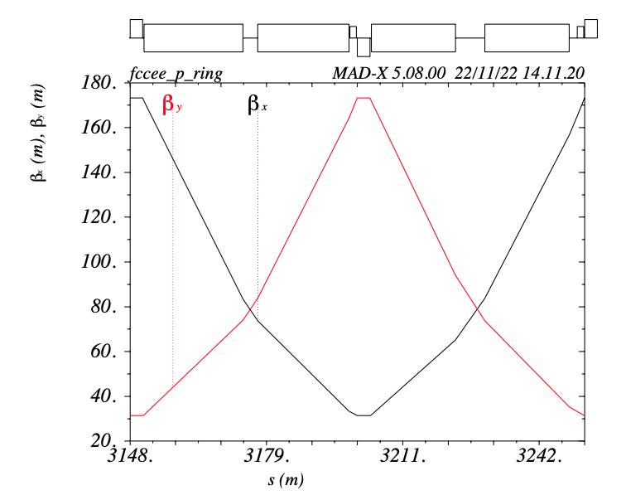
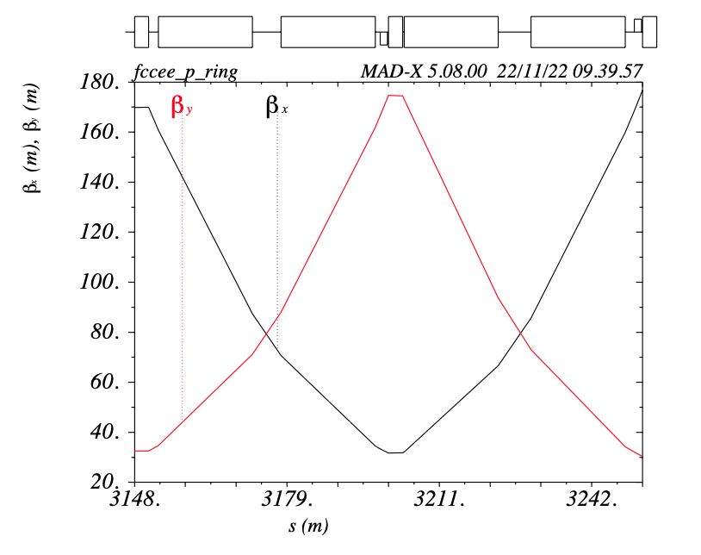
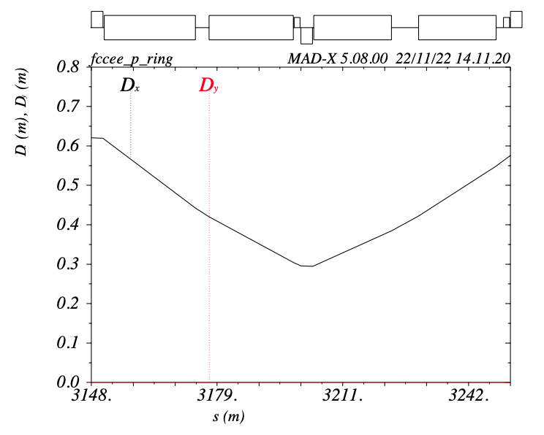
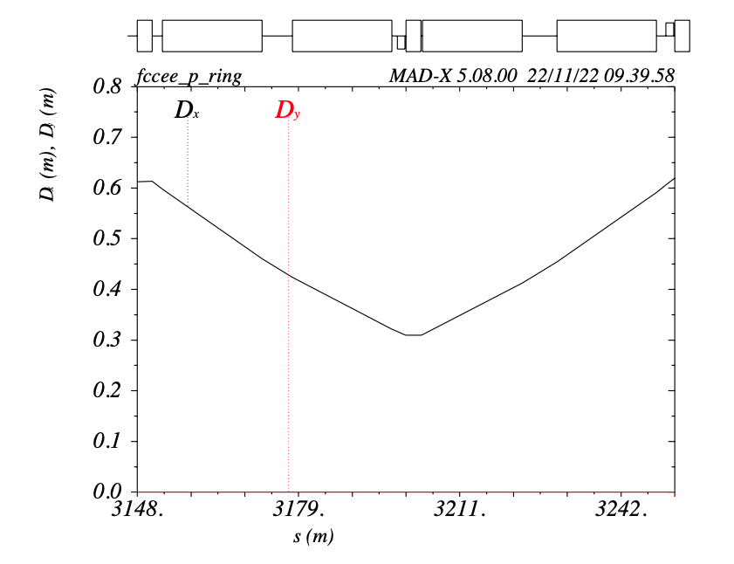
New Lattice with Combined Functions Magnets
Option 1) Quadrupoles are replaced by elements with a quadrupole and dipole component in the same object. In this way we have a combined function magnet effect for the simulations:

Slide 18
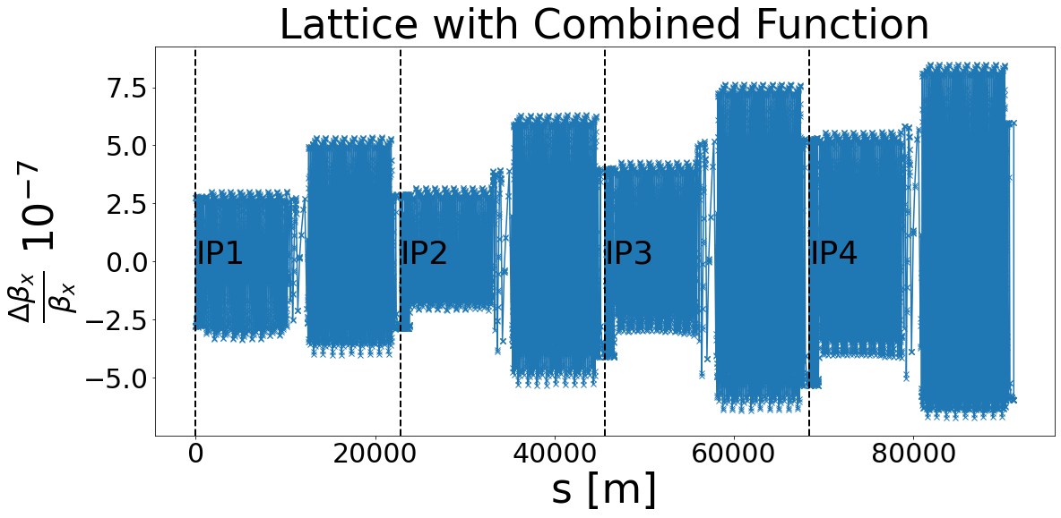
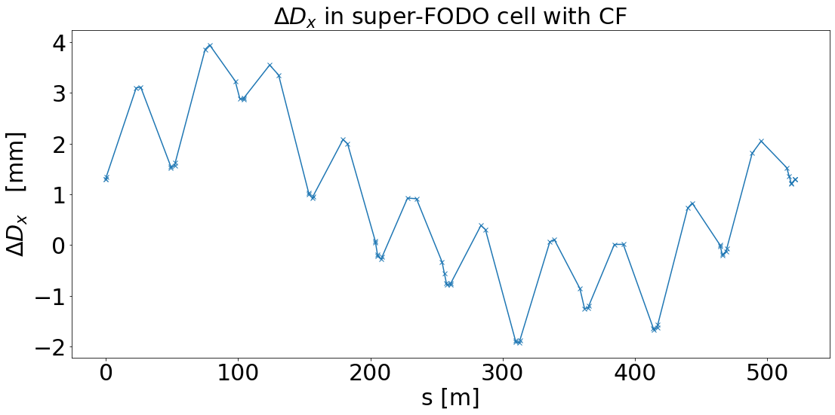
Optical Functions in HTS CF Lattice
Beta-beating with the lattice with Combined Functions in the quadrupoles taking as reference the lattice with normal magnets.
The beta-beating is very close to 0%, indicating that the discrepancy between the two lattices is very small.
The average dispersion has increased by ~1 mm.

Slide 19
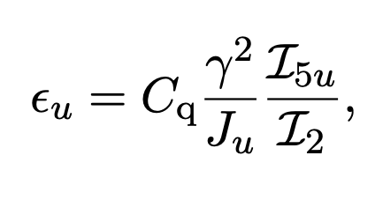
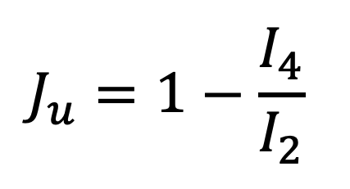
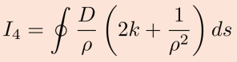
Emittance with Combined Function Magnets
Obtain unphysical “negative” emittances with this new lattice using EMIT module
Due to negative horizontal partition number (no damping)
  Large I4 integral due to quadrupole field overlapping with dipole
Need to develop strategies improve partition number
  E.g by changing bending radius in CF magnets
    First iteration performed
 | Baseline | Option 1 | Option 1 (modified)
Horizontal tune | 214.260 | 214.260 | 214.260
Vertical tune | 214.380 | 214.380 | 214.380
Horizontal Chromaticity | -1.165 | -1.165 | -1.165
Vertical Chromaticity | -1.911 | -1.911 | -1.911
Dispersion_{max} [m] | 0.624 | 0.634 | 0.634
Emittances [pi micro m] | 0.33E-06 | -0.36E-06 | 0.10E-04
J_x, J_y, J_E | 0.999&1.00 2.00 | -0.866&1.00 3.86 | 0.031& 0.999 2.968
I4 / I2 | 0/0.00064 | 0.00110/0.00060 | 0.00058/0.00061

Slide 20
Conclusions and Outlook
First look at lattice with b2 errors
  Showed that if we allow for 1% beta-beating, we can tolerate 1.6 units of b2
    Arc/IR optics rematching can absorb the b2 errors with very similar properties to baseline
Next step to explore b2 systematic errors of 4 units in dipoles
  Predicted by magnet design team
  Generates above 2% beta-beating
  Validate if this can be absorbed by lattice
First steps in lattice design using HTS combined function magnets
  One option explored
    Further options in the close future
  6% decrease in synchrotron radiation
    Perhaps further with other option or if tt-bar quadrupole slots used for Z
  Minor perturbation of most optical functions
Observe negative horizontal partition number
  Unacceptable emittance
  Studies for solutions under way
    e.g. adjust bending radius in quadrupoles

Slide 21

Many thanks!

