Slide 1
FCC Arc Alignment Requirements
Tor Raubenheimer
FCC IS Workshop
December 5-9, 2022
SPACE FOR ADDITIONAL LOGOS

Slide 2
FCC-ee Arc Alignment Challenges
Outline
  Challenges
  Ground motion models
  Beam-Based Alignment approaches
  Movers versus correctors
  Diagnostic requirements

Slide 3
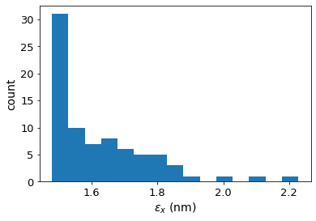
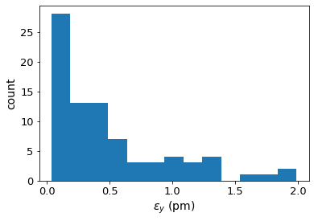
FCC-ee Arc Tuning and Correction
Extensive studies on emittance tuning and dynamic aperture
  Emittance tuning looks good given a ‘reasonable’ set of errors
  Working to develop beam-based alignment models to combine with mechanical alignment specifications
  Sets requirements on diagnostics but eases installation and stability requirements
T. Charles

Slide 4
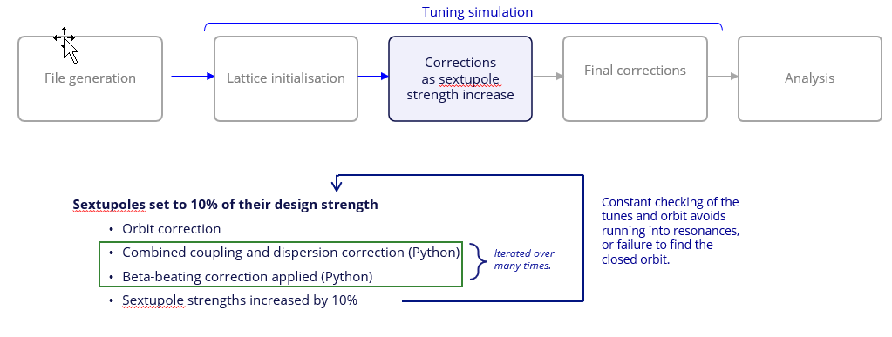
FCC-ee Arc Tuning Approach
Sensitivities mainly due to sextupoles require iterative approach which does not always converge
T. Charles

Slide 5
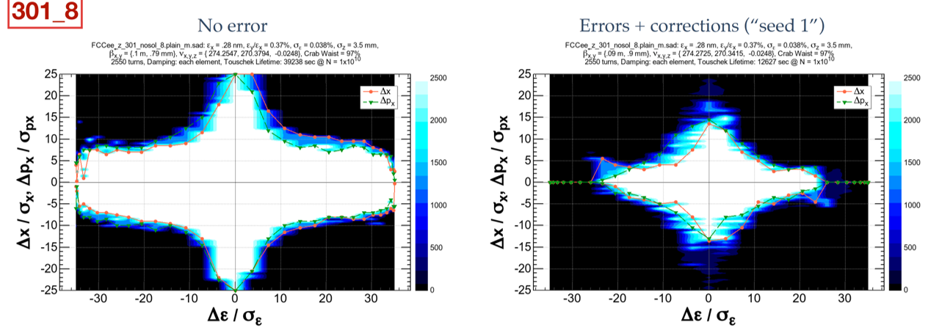
FCC-ee Dynamic Aperture
Large dynamic aperture is needed for top-up injection and lifetime due to high beamstrahlung energy tails
  Dynamic aperture optimized with ~150 families of sextupoles
  Aperture is good without errors but still need to improve error correction
K. Oide

Slide 6
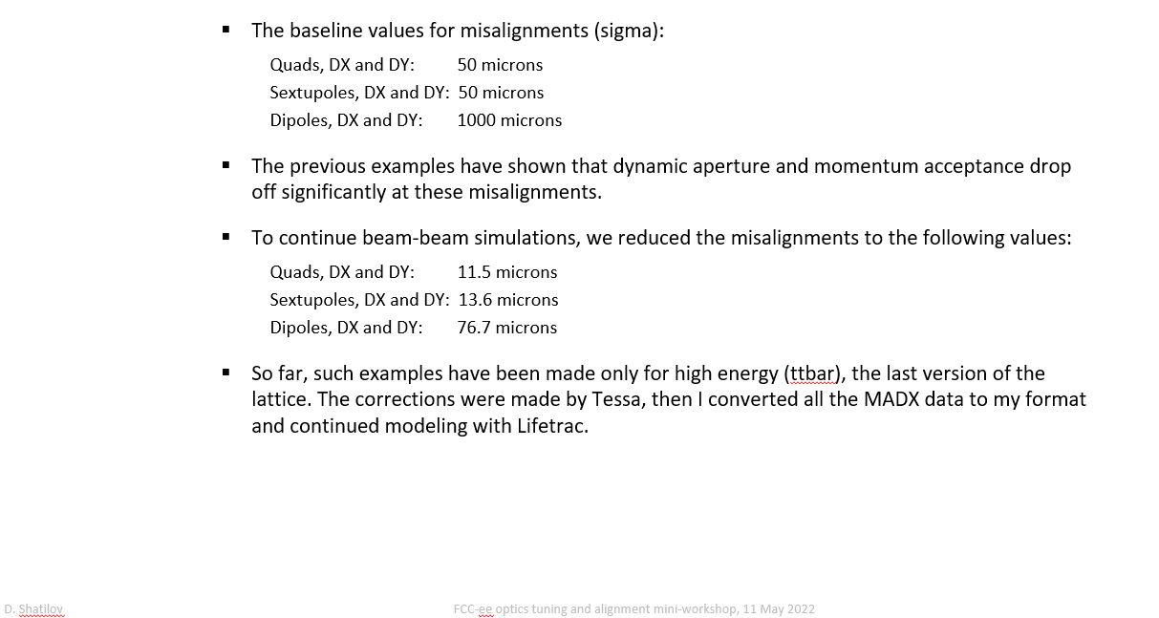
FCC-ee Dynamic Aperture Tol. (May 2022)
D. Shatilov, FCC-ee Tuning Workshop, May 2022

Slide 7
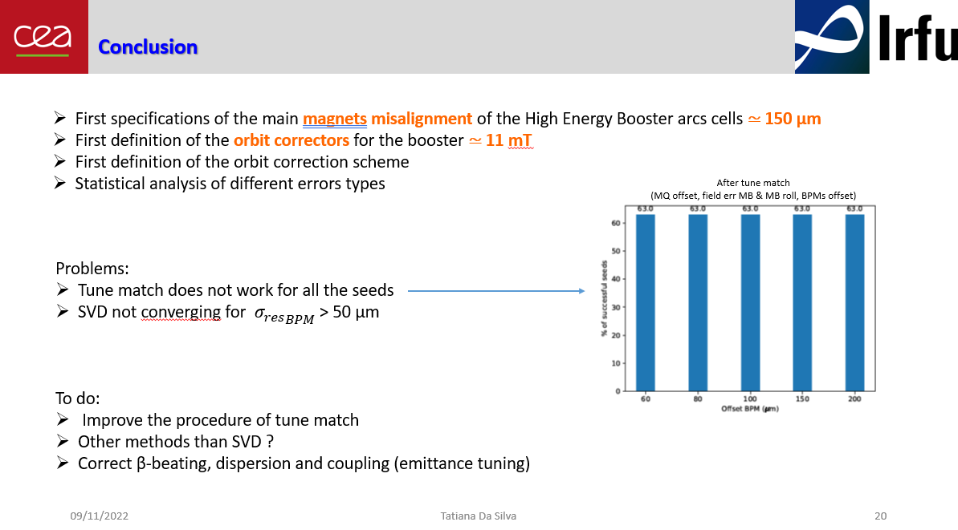
FCC-ee Booster Studies

Slide 8
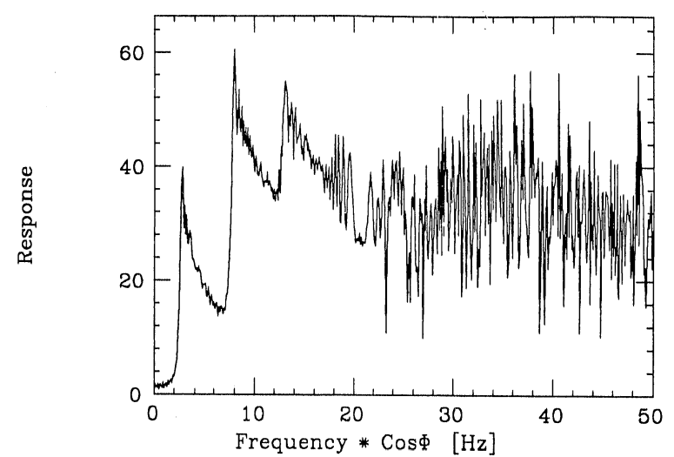
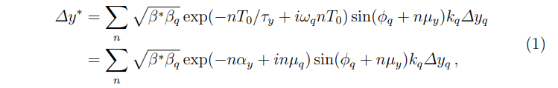
FCC-ee Tolerance Length Scales
The length scale for the tolerances are set by the betatron wavelength
  Long wavelength misalignments have minimal effect
  If static → n=0 and
  resonant at betatron wavelength
  or harmonics
  FCC-ee betatron wavelength is 400-m at Z & W operation
Example from a linac study
K. Oide
L=λβ; L = 3λβ

Slide 9
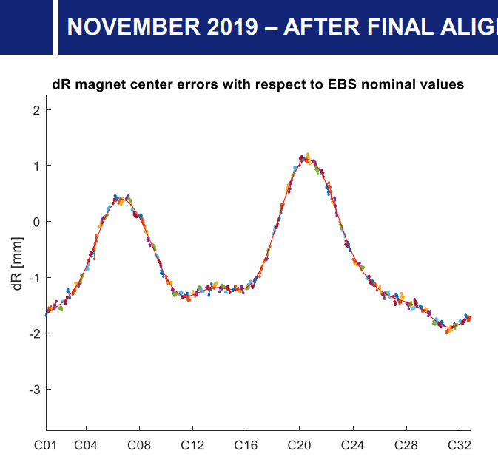
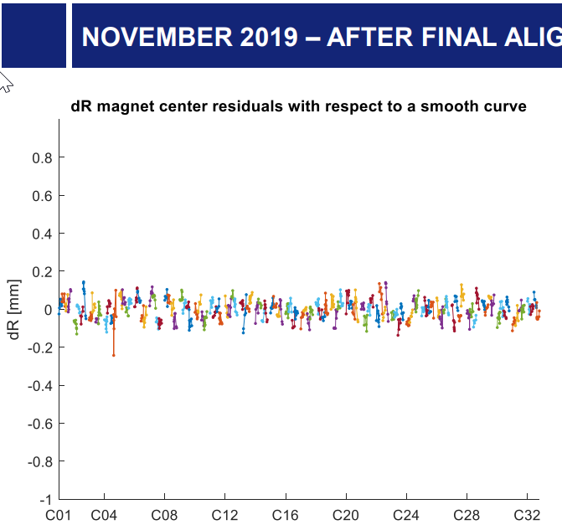

Alignment Length scales – Example from ESRF
ESRF achieved excellent performance
  Long wavelength misalignments have minimal effect
ESRF upgrade
Circ ~ 850 meters
X tunes ~ 70

Slide 10
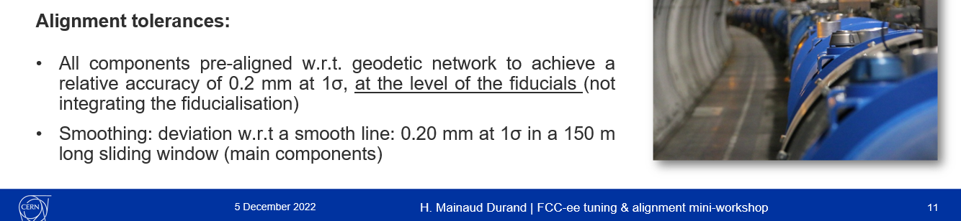
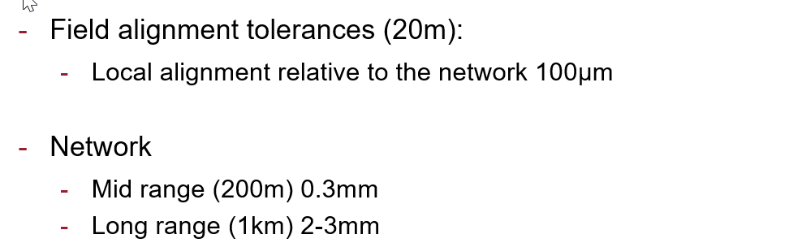
Mechanical Alignment Challenges
Alignment of 100 um over 100-m or 1 cm over 10 km is SOA
  Scales with length (although at short distances limited by fiducialization).
LHC
G. Gassner, SLAC Alignment Network,
FCC-ee Tuning and Alignment Workshop
May, 2022

Slide 11
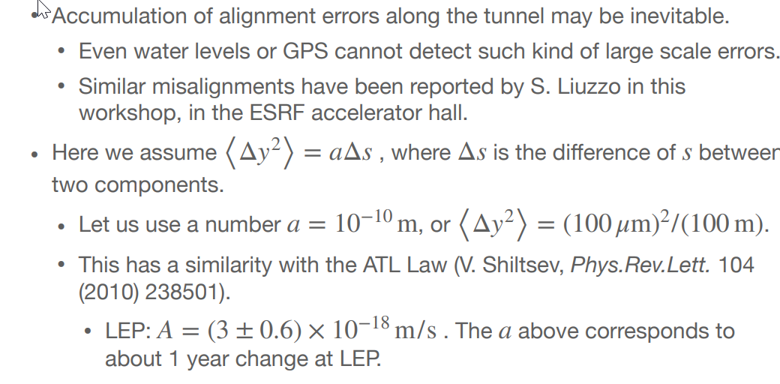
Long-term Stability
Even if you get it, can you keep it?
K. Oide

Slide 12
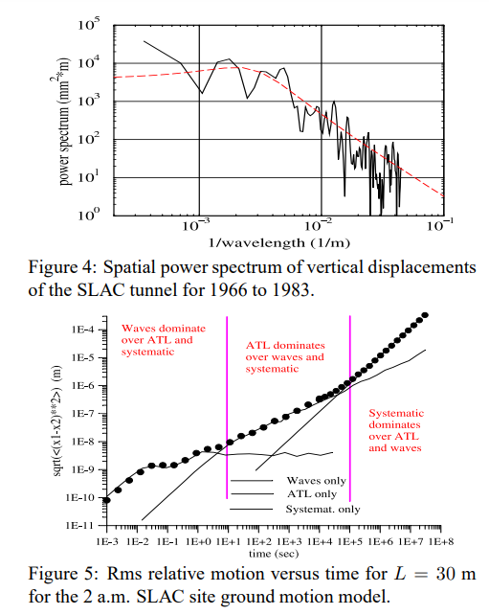
Stability: long-term, mid-term, high frequency
Incoherent, Diffusion, & Waves
  V. Shiltsev proposed ATL-law
  During linear collider program
  we spent years (not hours)
  arguing about details
  Many measurements of wave
  coherence, slow motion, etc
  Many models but ATL is pretty
  good for long-term motion
A. Seryi &
T. Raub...
2000
K. Oide

Slide 13
Arc Beam-Based Alignment
Two challenges: absolute alignment and long-term stability
  Large separation between magnets makes mechanical alignment more challenging. 100 um over 100 meters is SOA
  Mechanical alignment over 90 km will be time consuming
Use BBA to relax mechanical requirements
  Transfer mechanical alignment challenge into a beam diagnostic challenge and sets requirements on diagnostic resolution, magnetic center variation and temperature stability
Many approaches dating back to 1980’s including quadrupole dithering, dispersion-free steering, LOCO, FICO, RCDS, PBBA, …
  Need also to determine timescales and how to establish alignment, e.g. trims, movers, or correctors. Track changes → Hourly? Daily? Monthly?

Slide 14
Beam-Based Alignment Concept – Quadrupoles
Quadrupole Arc BBA techniques can have very high resolution
  LOCO can be used with high precision diagnostics but not clear how errors scale with problem size and fluctuations may prevent convergence
  Quad dithering → 10 um with 1 um BPM resolution at low current beam
  ➔Requires quadrupole center does not vary with excitation ⬅
  LEP achieved quadrupole alignment about 4x BPM resolution while about 5x BPM resolution was measured in SPEAR
  Roughly 6000 arc quads and sextupoles, dithering 10 to 20 per arc paired to cancel tune and beta beating → hour per cycle
  Dipole correctors correcting for 100 um errors will require <10⁻⁴ trim PS stability to limit ΔY/σ_{Y} <10%

Slide 15
Beam-Based Alignment Concept – Sextupoles
Sextupole Arc BBA has had poorer accuracy but may be possible with higher current stored beam
  Sextupole correction has been studied looking at tune shifts (horizontal position), phase shifts, and orbit shifts
  Resolution in past studies is typically 5~10x worse than quadrupole alignment but it should be possible to get 10 um effective alignment with stored beam
  Also might be possible to use quadrupole trim winding on sextupoles to get linear orbit response as was done at ATF and KEKB if magnetic centers stable
  Need to understand how to reference quadrupole to sextupole to BPM
  If BBA is repeated often enough → no need for external tracking but ….

Slide 16
Trim Windings
Trim windings can be used to correct for mechanical misalignments
  X/Y Dipole correctors on quads plus Quad and Skew quad windings on sextupoles for effective alignment
  FCC-ee effectively has independent sextupole PS (need to verify whether strings are necessary) but quadrupoles are on strings
  Also need Quadrupole trims on quads for tapering (and BBA)
  Skew quadrupole trims needed on sextupoles correct for quadrupole rolls → can these also be used for quadrupole excitation?
Depending on required strength, (dipole) trim PS may require high stability

Slide 17
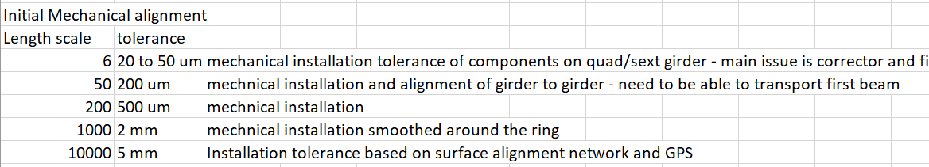
Proposed Alignment and Ground Motion model I
Develop a model that is easy to implement in MAD-X
  Mechanical misalignments as a function of length scale
  Slow ATL-type motion combined with waves and incoherent vibration
  Include response functions for girders and supports
  Use this to test BBA and feedback concepts and specify diagnostic and hardware req.

Slide 18
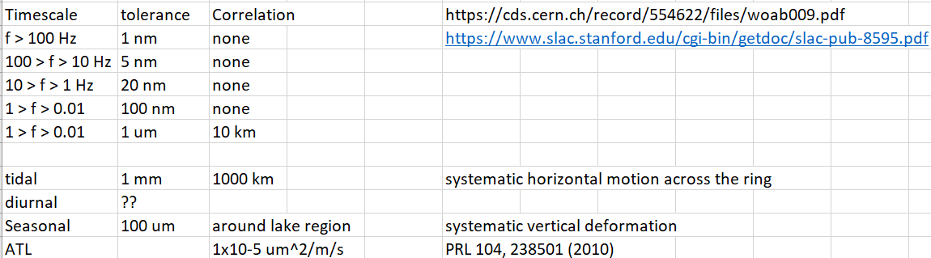
Proposed Alignment and Ground Motion model II
Dynamic variation
  Some combination of incoherent waves, plane waves, systematic variation, and ATL-type diffusion
  Verify feedback, feed-forward, and BBA timescales
=

Slide 19
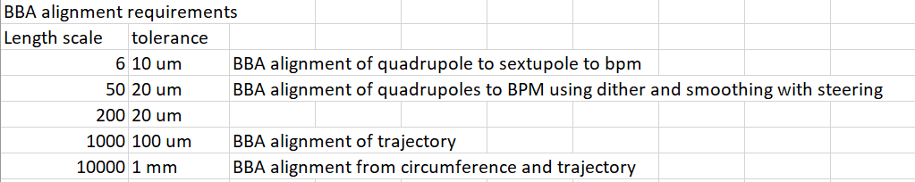
Expectation for BBA
Requirements
  0.1 um BPM resolution at high current for stored multi-bunch beam
  Trims on quadrupoles and sextupoles without coupling to magnetic center
  Clarification on location of dipole and skew correctors is required
  Correctors or movers to implement corrections (dipoles for quads and maybe quad/skew quad trims on the sextupoles)
  Timescale for correction faster than degradation
How do we reference long girder to BPM?

Slide 20
Proposal for BBA
Develop model for results from mechanical alignment
  Starting point for any BBA approach
Develop ground motion and orbit feedback model
  ‘Fast’ motion drives orbit stability
  Mid and Slow motion to understand BBA stability
Study Dithering, PBBA, and LOCO as approaches
  Develop BBA system that can be automated for rapidly check of alignment status – is hourly possible? If not, what are stability requirements.
  Specify diagnostics (BPMs are already more than sufficient) and correctors
=

Slide 21
Thank you for your attention.
Date / Name of the event
Name of the speaker/author
SPACE FOR ADDITIONAL LOGOS
21

