Slide 1
ARC and Long Straight Sections beam dynamics studies
December 7th,2022
Pantaleo Raimondi
SLAC National Accelerator Laboratory

Slide 2
Premise
This work has been triggered by M Benedikt and F Zimmermann, they did ask me to investigate the possibility of relaxing tolerances on machine errors, specifically alignment requirements.
About 3 presentations (minimum) are required to explain in a reasonably analytical/exhaustive way the proposed solution to this not trivial problem.

Slide 3
outline
Objectives
ARC lattices & beam dynamics
Straight sections matching and beam dynamics
Conclusions

Slide 4
Ultimate objectives
increase DA&MA and lifetimes
reduce accelerator number of components
reduce magnet families
reduce integrated gradients requirements
increase tolerances on errors (gradients & misalignments)
relax requirements for tuning
In the following these objectives are being addressed through lattice design optimization

Slide 5
Strategy
Modular FCC lattice design
- Develop an “Ultimate ARC” lattice made by the best possible Achromat&Anharmonic Cell
- Develop a method in order to insert straight sections with minimum impact on breaking of the ring periodicity
- Design the best possible Achromat&Anharmonic Final Focus system that does not relies on ARC sextupoles for DA&MA optimization
- Develop methodology and solutions to accommodate all the necessary lattice adjustments (crossing angle, LSS requirements etc) with minimal impact on beam dynamics and parameters

Slide 6
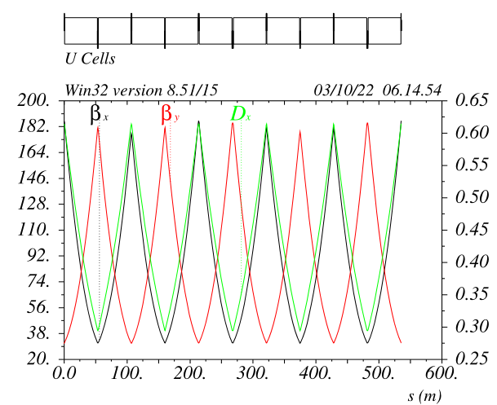
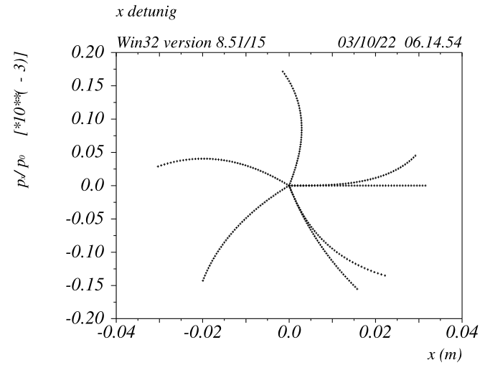
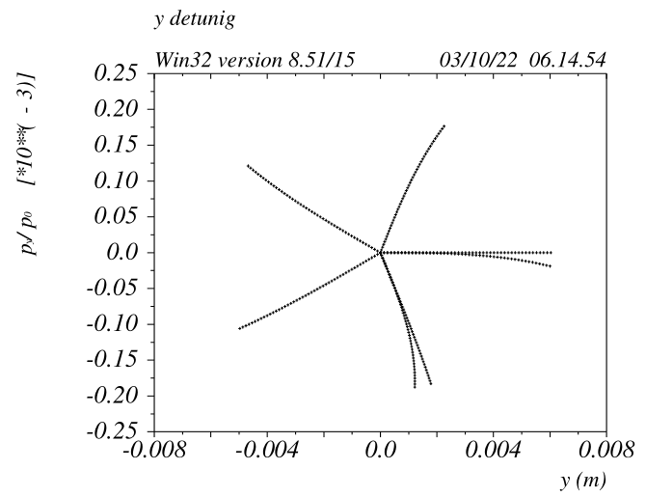
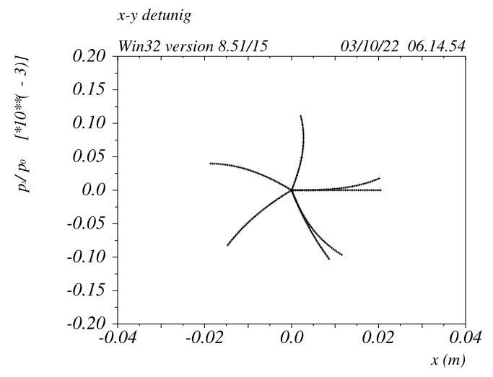
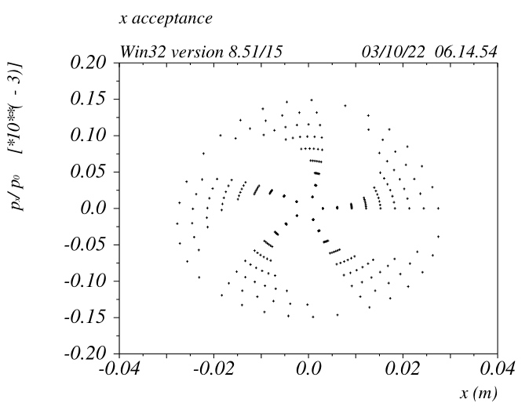
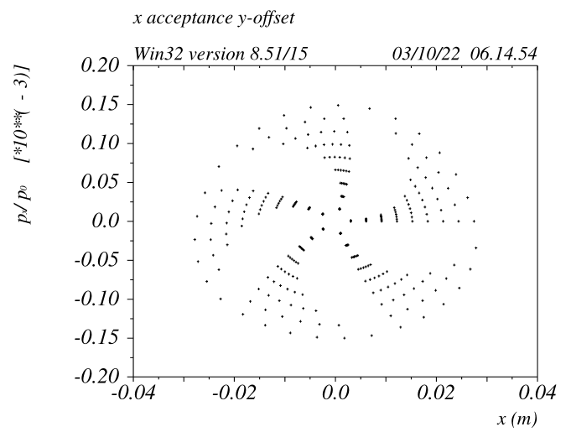
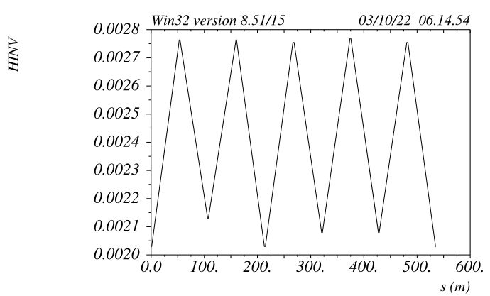
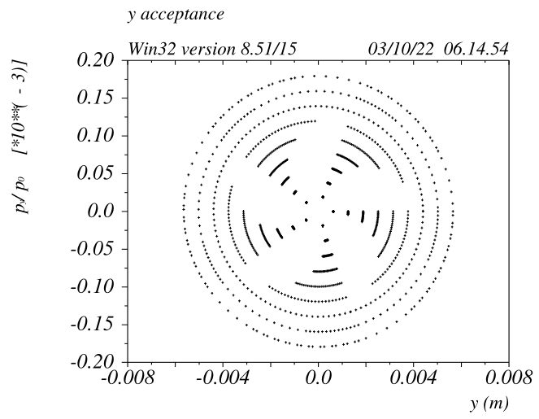
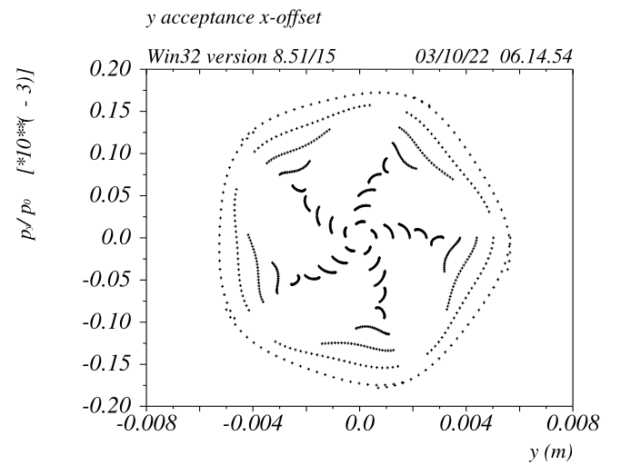
ARC lattice 148 long cells made of FODO9090 (~80KM)
SD -I
SF -I
Transverse beam dynamics checks and
rough optimization of 5 turns.
Ideally beam x/xp/y/yp should come back to initial coordinates after 5 turns
(tunes set to mux=muy=0.2)
FODO 9090 is
very anharmonic !!!

Slide 7
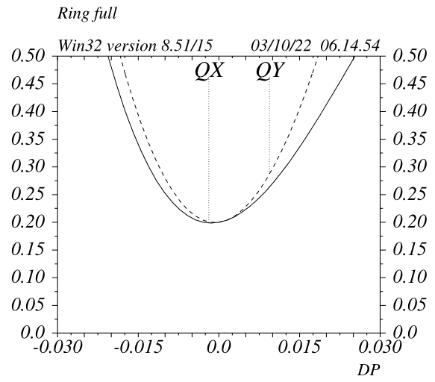
ARC lattice: 148 long FODO9090
FODO9090 cell is only a first order Achromat
Placing sextupoles at every quads will cancel the 2nd order
chromaticity (SOC) but then the cell will not be Anharmonic
EA (defined by the tune footprint to be contained
in one quadrant) is around +/-1.5%
*Chinese approach is to cancel the SOC with sextupole families
on 8 cells

Slide 8
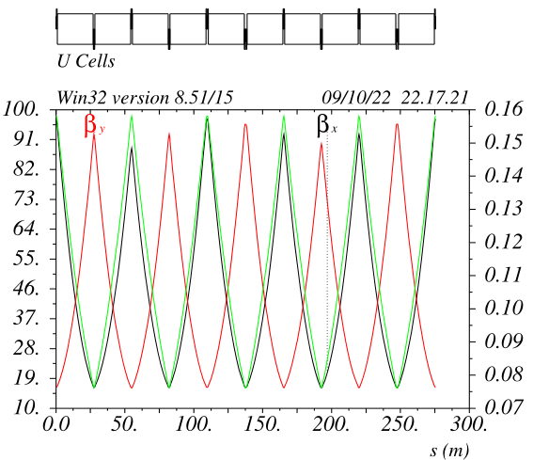
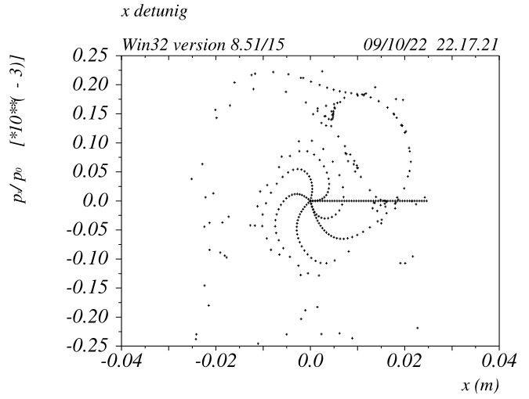
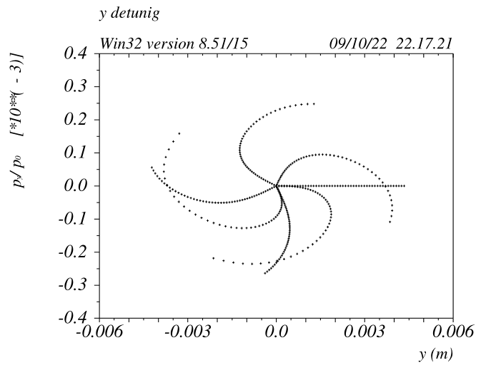
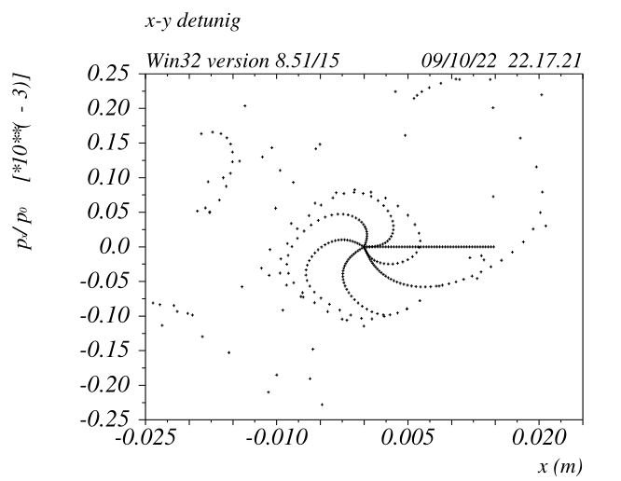
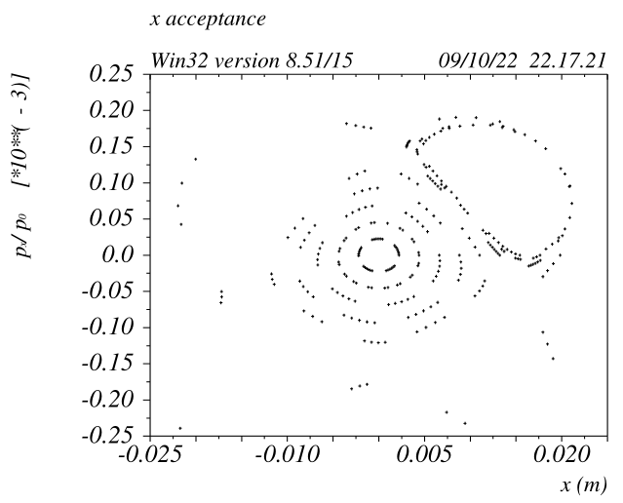
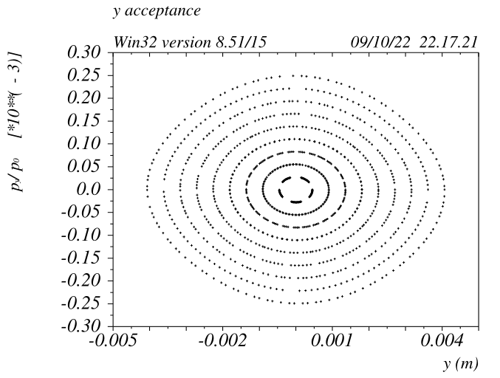
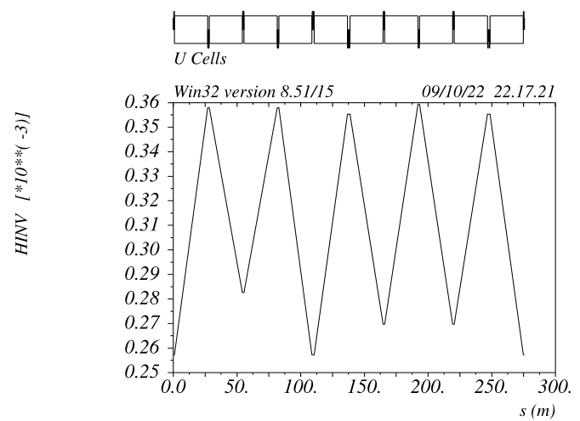
ARC lattice 296 short cells made of FODO9090 (~80KM)
SD -I
SF -I
FODO 9090 is not Anharmonic, some contribution comes
from the long sextupole aberration.
The sensitivity to the –I condition is larger wrt the Long-FODO9090

Slide 9
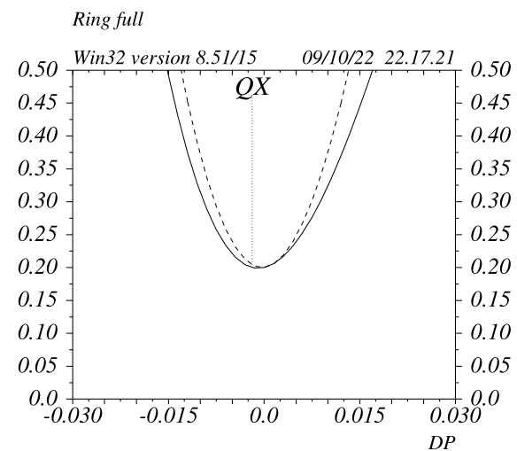
ARC lattice: 296 short FODO9090
EA (defined by the tune footprint to be contained
in one quadrant) is around +/-0.75%

Slide 10
ARC lattice scaling laws
In general, multiplying the number of cells by a factor 2:
- Emittance decreases by 2^3 (8)
Quadrupoles gradient doubles and number of quadrupoles double
Quads power consumption increases by a factor 4 (supposing twice longer quads)
Sextupole gradients increase by 2^3 and number of sextupoles doubles
Sextupoles power consumption increases by a factor 16 (supposing 8 times longer sexts)
EA decreases by a factor 2
DA decreases by a factor > 2^3
FODO9090 with 74 cells has an EA of about +/- 3.0%
148 +/- 1.5%
296 +/- 0.75%
592 0.00% (runaway case)

Slide 11
ARC lattice scaling laws
In fact the length of magnets/sextupoles grows much faster then
linear/linear^3 and in particular the sextupoles reach the asymptotic limit first.
Sexts become longer => there is less space for the other magnets => betas and dispersion decreases => sextupoles need to be even longer => with 592 cells the sextupoles take a large fraction of all the available space
EBS (H7BA) is made of 32 cells, the limit for acceptable performances (DA<3%, MA<100sigmas) is around 40-45cells
Petra4 (H6BA) is made of 72cells, the limit is around 80-90cells
With the same SLSs criteria the limit for acceptable performances of the FODO9090 is ~100
The scaling laws do not depend from ring size, a 200Km ring does not allows twice the number of cells. The only difference is that it pushes a little further the asymptotic limit, since there is more space for the extremely long sextupoles.

Slide 12
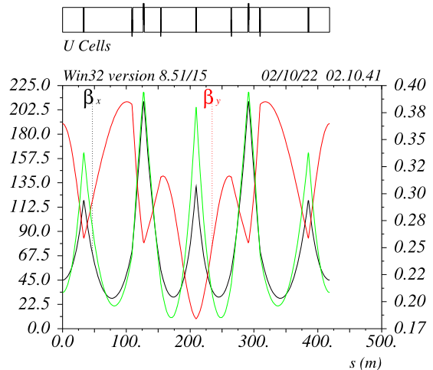
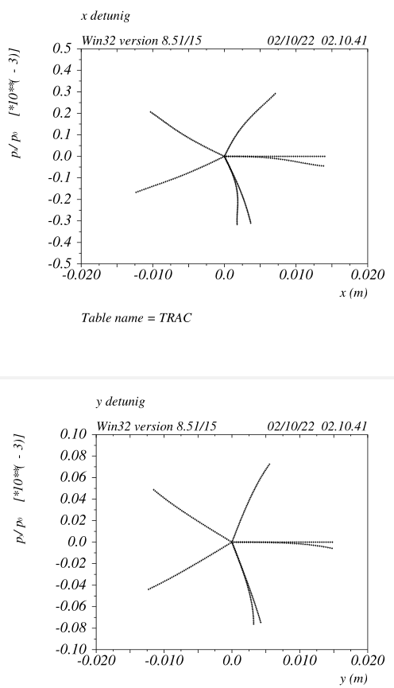
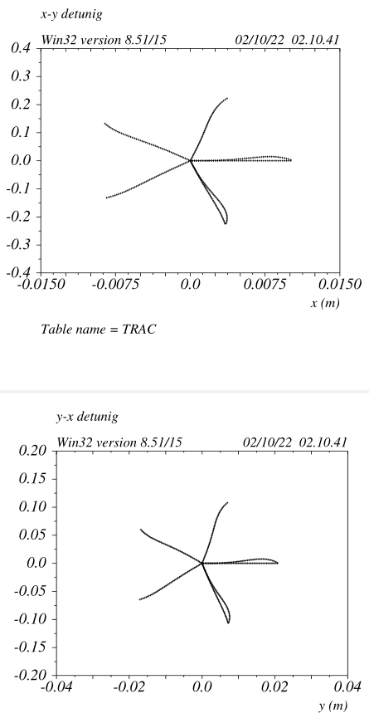
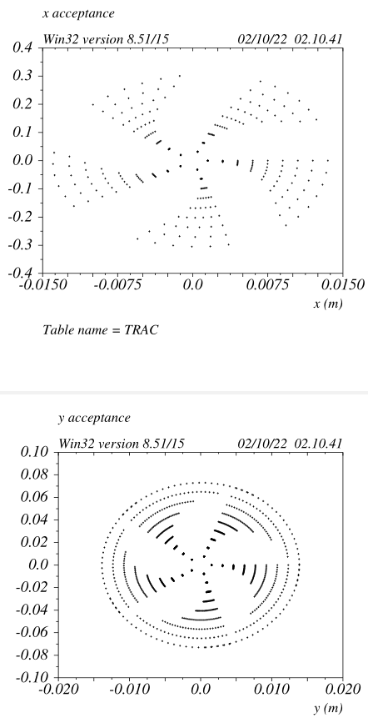
ARC lattice 192 long cells made of HMBA (~80KM)
Sd1
Sd1
Sf
-I
Sf
Sd2
Sd2
HMBA is Anharmonic
R12s&R34s in the –I are optimized
Sd1 and Sd2 are optimized

Slide 13
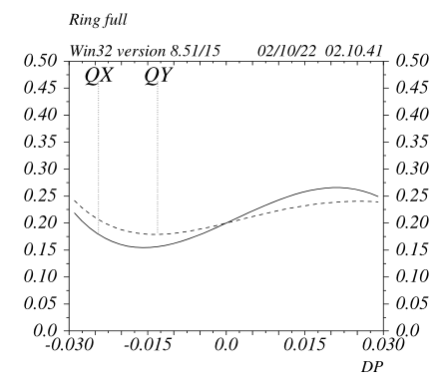
ARC lattice 192 long cells made of HMBA (~80KM)
HMBA is Achromatic up to the third order
HMBA breakdown is around 200 cells
HMBA is just a proof of principle that a A&A cell can be made
However it is an adaption from optics developed for SLSs
Definitely it is not the best solution for a “standalone” ARC

Slide 14
FODO9090 optimization
Ultimate source of SOC is uncorrected chromaticity and
second order dispersion originated by the
quads with no nearby sextupoles (QWOS)
Can this effect/source be reduced?
SD -I
SF -I

Slide 15
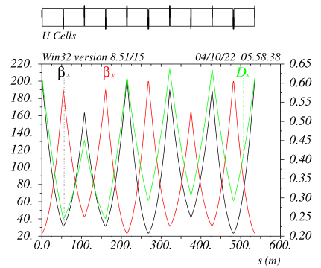
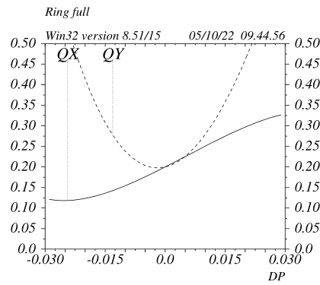
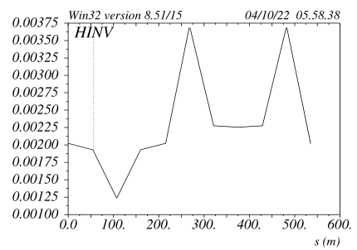
FODO9090 optimization v_2a
Phase advance between the –I pairs has been increased,
this decreases the betafunctions&dispersion on the QWOS
SD -I
EA is about +/-2.2%
Cell is Anharmonic
SF -I
Original lattice
Modified lattice

Slide 16
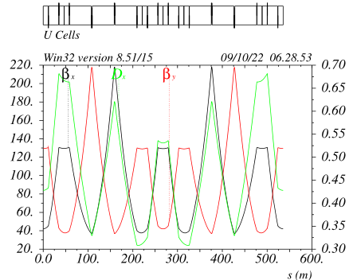
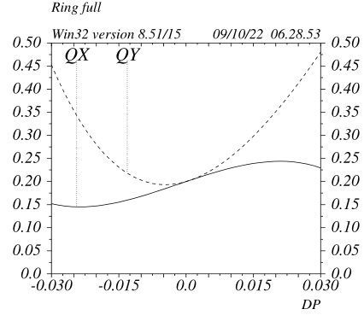
HFD optimization v_5a3
Betas and dispersion have been further decreased on the QWOS by
splitting them.
Overall chromaticity is also lower, and the reductions come from less
chromaticity from QWOS
SF -I
SD -I
EA is about +/-3.2%
Cell is Anharmonic

Slide 17
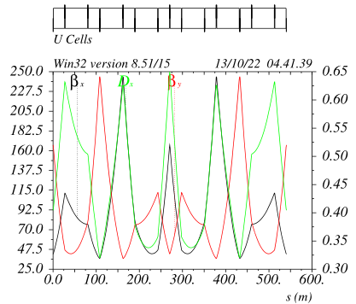
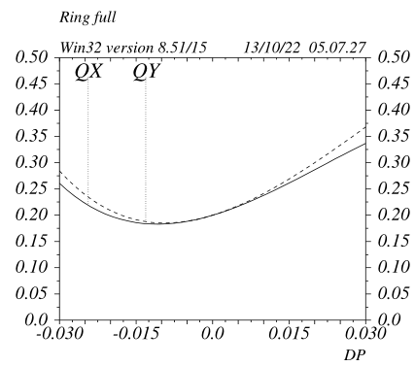
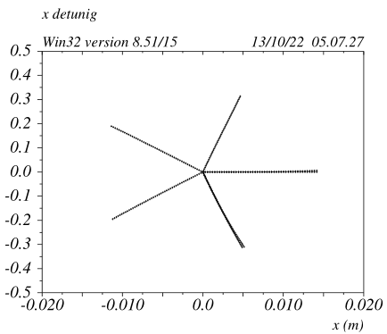
HFD optimization v_11a1
Middle quad has been replaced by two quads, dipoles are 25m and
50m long, their respective lengths have not been optimized.
Betas at QWS and cell phase advance are the only optimized
variables.
Sextupoles are 20% weaker wrt to FODO9090
SF -I
SD -I
Cell is Anharmonic
At least for me this is the first time that I see a second order Achromat and Anharmonic cell
For the case shown the compatibility with the present layout has been retained (only usable when run in long/long mode).
It is also compatible with e-&e+ rings quads pairing
EA is larger than +/-5.0%

Slide 18
HFD optimization v_11b1
SF -I
SD -I
The Hybrid FODO (HFD) cell can be greatly optimized
Possibly the “breakdown” can be pushed toward 200cells
Only difference wrt to FODO9090 is that middle
quad-pair in the –I is split in two (distance roughly optimized)
This adds an additional degree of freedom:
Overall cell phase advances and betas@sexts are free parameters and can be optimized for emittance&beam dynamics.
No sexts families are needed to improve the DA&MA and LMA is maximal
The benefits should overcome the additional complexity
Very interestingly the optics naturally develops the betas&dispersion bump at the sextupole locations, improving their effectiveness
This is one of the key ingredient of the H7BA lattice (EBS) leading to the need of just 6 sestx/cell, despite the increased complexity.
(current 7BA designs do require about 21-25 sextupoles and many octupoles)

Slide 19
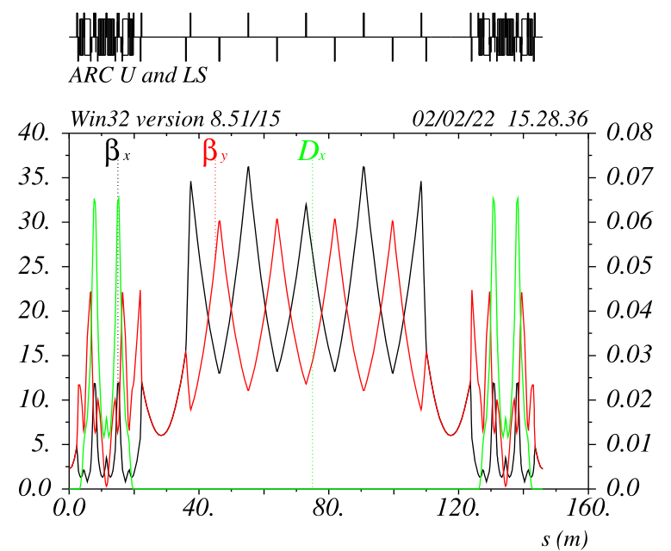
Insert Long Straight section: Transparency Conditions
In the middle of the cell, supposing the Arc+half SS being a
single pass line, the optics must satisfy these constrains:
dmux = 0 +N (wrt the standard cell)
dmuy = 0 +M/2 (“/2” comes from Hamiltonian reasoning)
alphax=alphay=dpx=0
These conditions ensure that the Arc periodicity is kept for
the on-energy electrons
2) dWx=dWy=ddpx = 0
The first order derivatives wrt energy are also set to 0,
These conditions ensure that the full periodicity is kept for
the off-energy electrons as well (at first order)
All these conditions can be achieved by properly adjusting the
linear matching
3) For a superperiodic lattice (eg: ARCs+SSs) the phase advance
between ARCs must be far from 0 and 0.5
(Integer part of the tunes should not be multiple of the superperiodicity)
In general, the overall chromaticity of the section should be minimized as much as possible.
Only the linear optic between the last and first sextupoles
of the adiacent arcs is modified

Slide 20
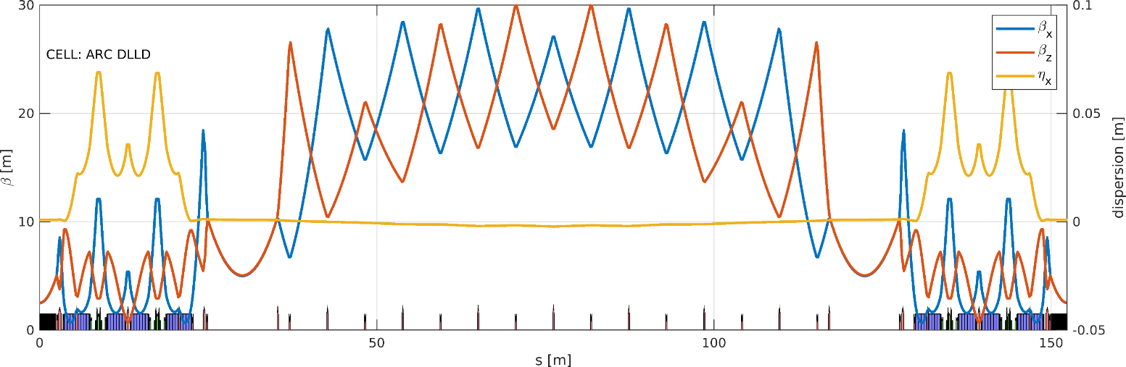
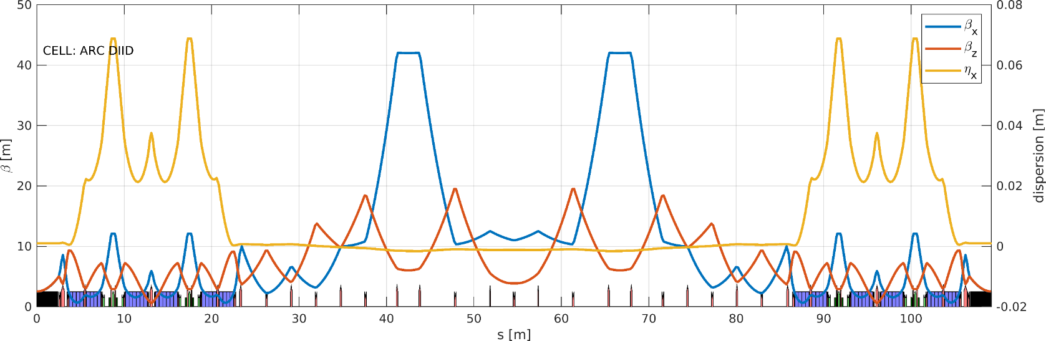
Petra4 examples
Double minibeta section
Injection section
TCs can be met almost independently of the optics requirements in the Long Straight Sections

Slide 21
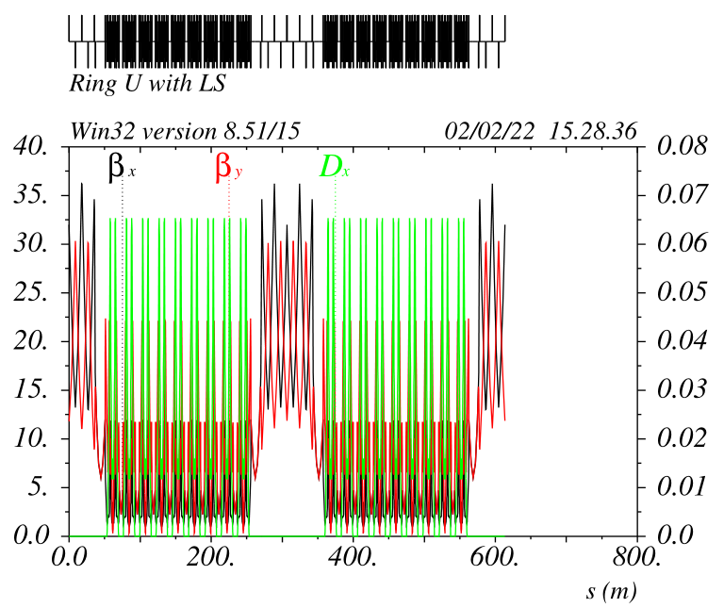
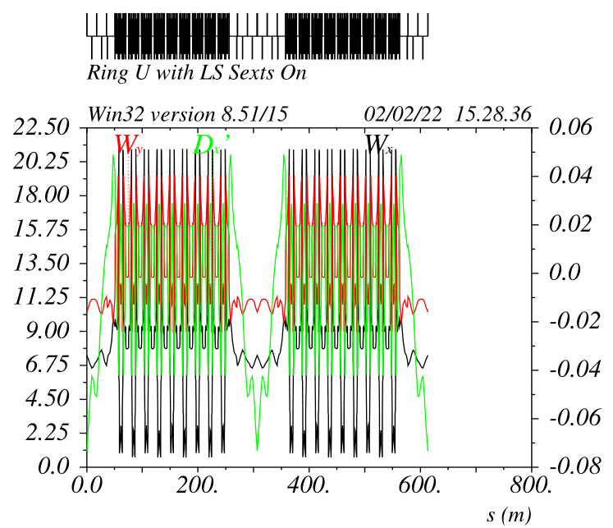
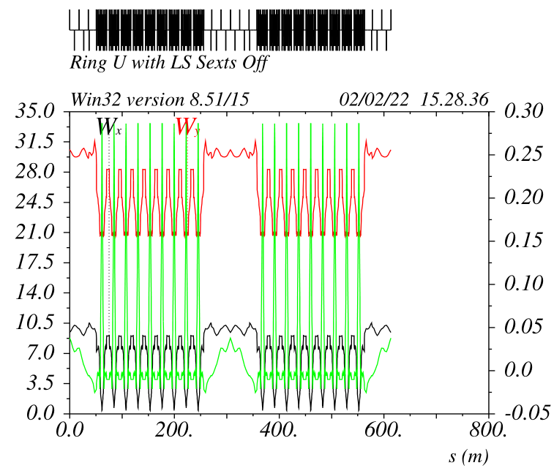
Chromatic functions with insertions with TCs (petra4)
With the transparency conditions everything remains periodic
in the arcs:
Betax and betay
Wx and Wy with sextupoles off and on
No sextupoles families are needed, however with sextupole families
(found by MOPSO for example), the DA and MA reaches values very
close to the periodic ring.

Slide 22
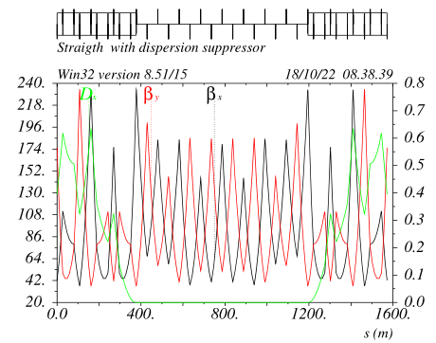
Long straight insertion with TCs V_15a2
Dmux = Dmuy = 2.0
The last SF of the left ARC pairs with the first SF of the right ARC as for
the “standard” SFs ARC pairs

Slide 23
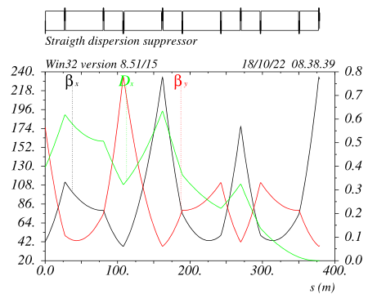
Long straight insertion with TCs V_15a2
In order to match the second order dispersion the “missing dipole” scheme does not work
The solution chosen is to have:
- the total bend angle of the DS ~ half of the nominal
- the first 3 dipoles have a different bend angle wrt the last 3, the value is defined by requiring
the second order dispersion match
Finally the end of the DS is at –I wrt last ARC SF
This means that if an “harmonic” sextupoles is placed there, there is no need of
the transparency condition dmux=dmuy=2
-I

Slide 24
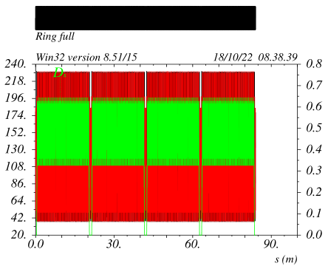
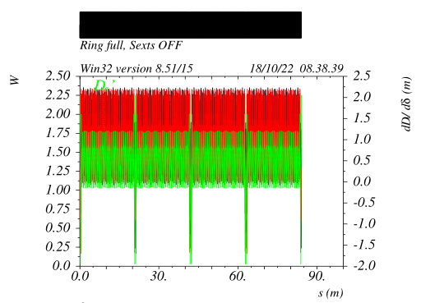
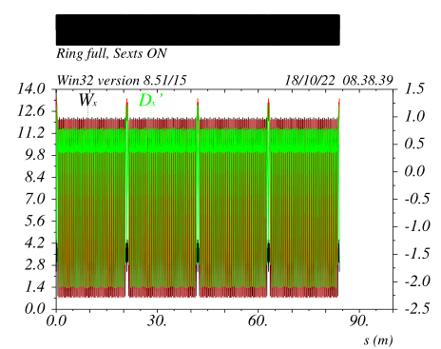
Ring with Long straight insertion v_15a2
The ARC beta functions and their derivatives wrt energy are fully periodic.
They are periodic with sexts off and on by construction.
The LSS do increase the total chromaticity by about 5%, the ARC sextupoles are rescaled correspondingly.
No sextupole families are needed although sextupole families with a moderate modulation (~5%) could further improve performances

Slide 25
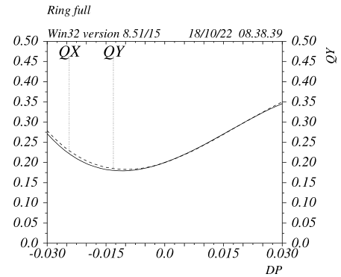
Ring with Long straight insertion v_15a2
ARC only
ARC + 4 LSS
The LSS insertion has a minimal impact on performances
Sextupoles are about 5% stronger wrt ARC alone
(SDs: integrated Ks~0.12 SFs: integrated Ks~0.06 (madx units))

Slide 26
Conclusions
Highly anharmonic and second order achromatic ARC cells can be developed with minor modification of the Oide FODO9090 cell.
Overall ring MA above +-/5% can be achieved for a ring composed of up to ~200cells
Potential use for low emittance rings and even SLSs can be conceived and should be further explored.
A very simple and analytical method to insert sections in the ARC has been described
ARCs with generic straight section insertions with performances comparable to a fully periodic structure can be made

