Slide 1
Final Focus beam dynamic studies
December 7th,2022
Pantaleo Raimondi
SLAC National Accelerator Laboratory

Slide 2
Outline
CEPC FF
Understanding the FF fundamentals
Define criteria for the FF design
Define all the tuning knobs for FF optimization
Insert the FF in the ARC+SS with the TC criteria
Evaluate performances
Conclusions

Slide 3
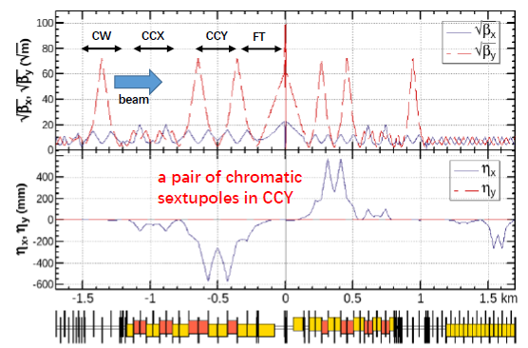

CEPC Final FOCUS
SuperB FF (betay*=0.2mm) was the first design that was inserted in a ring with overall ~acceptable machine performances
DA was in excess of 50sigmas and MA around +/-2%
The crab sextupoles (CS) in the SuperB FF were outside the FF itself. The reason was to minimize the impact on DA&MA due to phase slippage between the two CS and chromatic betas at the CS
Based on these considerations a similar system has been studied and adapted to the FCC needs
CEPC FF based on the expansion/adaption to HE of the SuperB FF design
Do not know how much beyond the SuperB the FF optimization has progressed
Not known also if FF insertion in the ring is done with TCs criteria

Slide 4
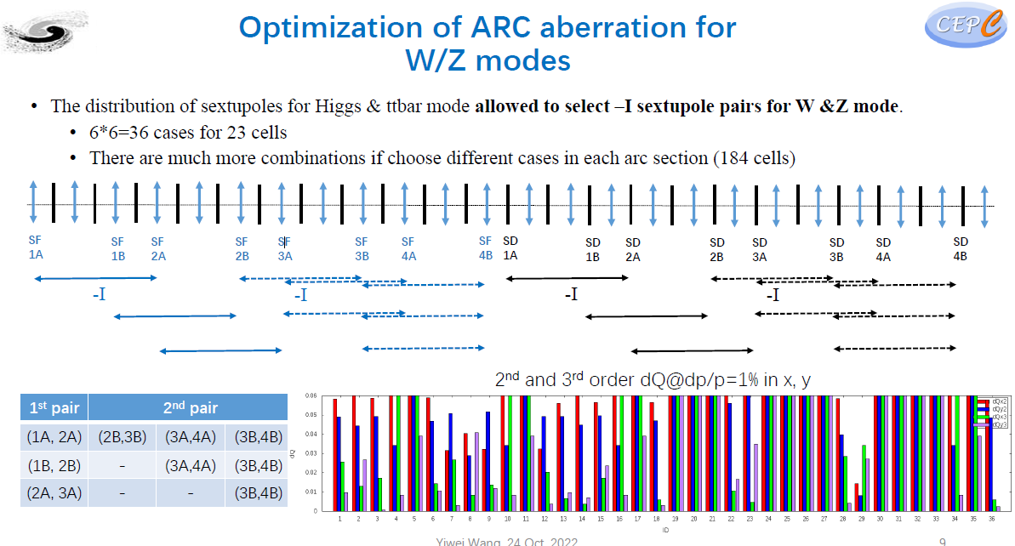
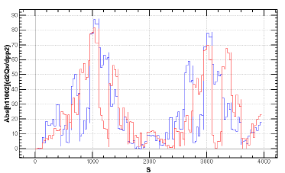
CEPC chromatic correction
Chromatic correction complexity similar to the FCC
Probably (or forcedly) ARC sextupoles do a significant correction of chromatic terms originated in the FF

Slide 5
Fundamentals
The FF is considered as a system that starts from the IP and ends to the ARC-DSS
FF is a telescope (in fact microscope), it matches the beam starting from the IP low-betas to the ARCS betas (and vice versa for the incoming side).
The FF under study relies on being as much as possible a complete Achromat in both planes. Remains to be seen/demonstrated that this solution performs better wrt intermediate ones (e.g only vertical Achromat as present FCC design
In the following it will be described how to optimize the FF system,
define all the tuning knobs built at the moment for this purpose and
show the effect on overall performances
Aim of the work is also to transmit as well as possible to the new generations a clear, reproducible and general method to build a generic low-beta insertion.
The optics designs presented are primarily just means to describe such methodology.

Slide 6
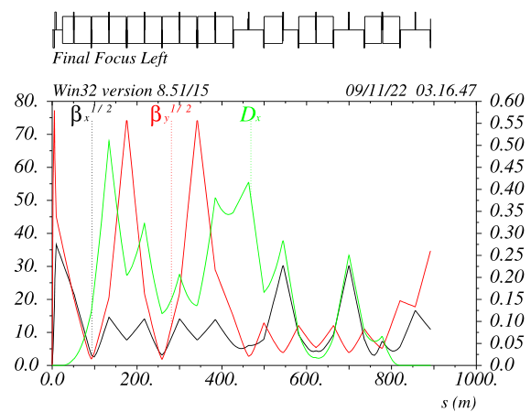
Final Focus chromatic and geometric aberration optimization v_23c
The effect of all these elements/quantities
will be described, together with the results of
their optimization:
1) Main Sextupoles SDy and SFx
2) SDy&SDx phase advance wrt IP
3) IP-phase sextupoles SDM and SFM
4) Etaxp@ CCSY and CCSX
5) Decapole y (&x)
6) Phase advance between –I sextupole pairs
CCY -I
Dmuy~0.25
Crab
sextupole
Dmux~0.25
CCX -I
IP-phase
SDM sext
IP-phase
SFM sext
IP-phase
DECy
IP nearly image points

Slide 7
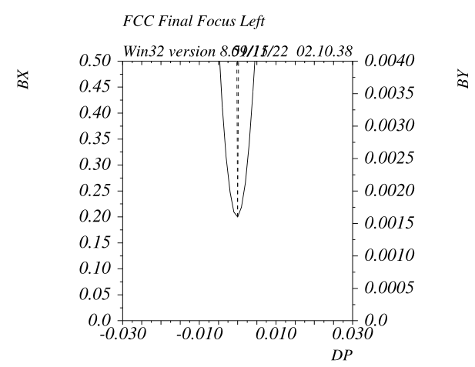
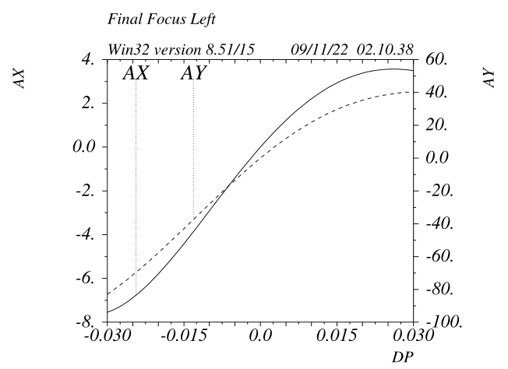
Final Focus with no Chromatic Correction v_23c
All sextupoles are off
FF BandWidth (or MA) without chromatic compensation is infinitesimal
On the positive side the FF is nearly Anharmonic

Slide 8
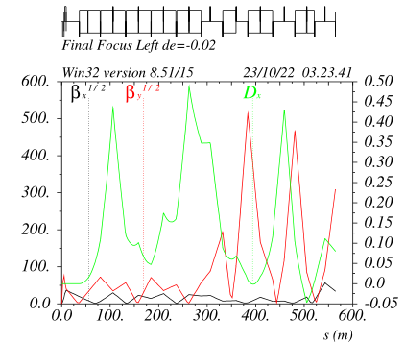
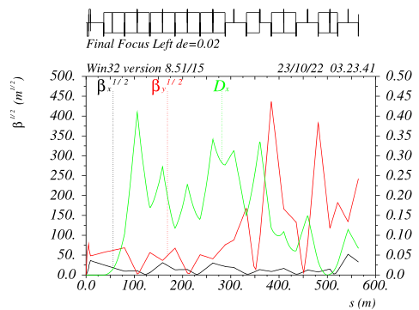
Final Focus natural chromaticity v_17e
Chromatic behaviour becomes evident when an off-energy beam (+- 2% in this case)
is propagated starting from the IP with then design betas*
At the end of the FF the betafunctions are way off: betay@CS~100000, betax@CS~1000
alfax/y and mux/y that are also way off
CS placed before a complete chromatic betas/mus compensation will reduce/limit the MA

Slide 9
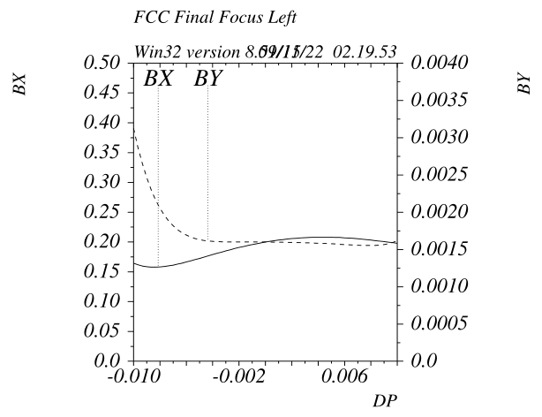
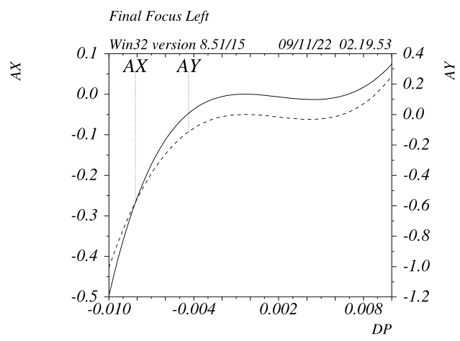
Final Focus with up to First Order Chromatic Correction v_23c
Only the main SDy and SFx pair are set in order to zero the derivatives of alfay&alfax wrt energy.
The horizontal scale is +/-1% (not 3% as in the previous plots)
Higher order terms (at least second and third) remains

Slide 10
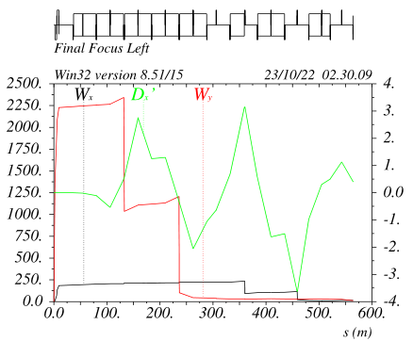
Final Focus with first order chromatic correction v_17e
Sextupoles are effectively turned on
CCY sexts pair
CCX sexts pair

Slide 11
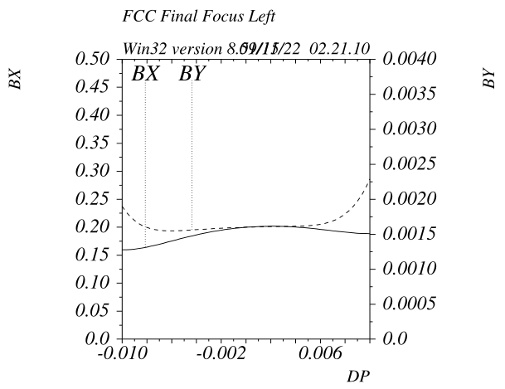
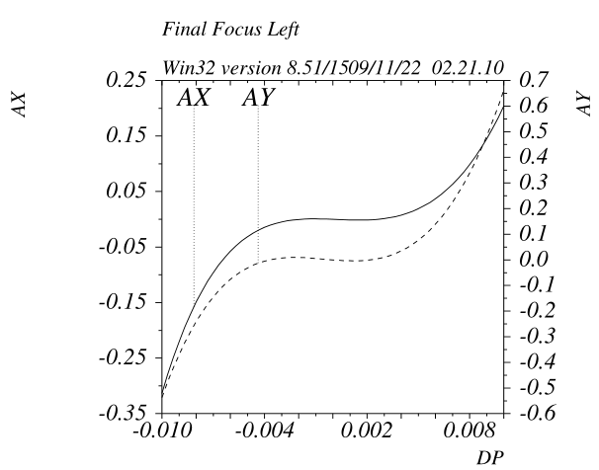
Final Focus with up to Second Order Chromatic Correction v_23c
The phase advance between the sextupole pairs wrt the IP is optimized in order to zero the second order chromaticity. Optimal value is close but not equal to 0.25, the reason is that the overall contributions (vector-like) to the FF chromaticity are not necessarly at 90deg wrt IP
The optimal phases are set with simple linear optics matching.
The present FF quadrupole complement allows the change of these phases while maintaining all the other parameters unchanged (betas, dispersions, other phases etc…)
Higher order terms (third very visible) remains

Slide 12
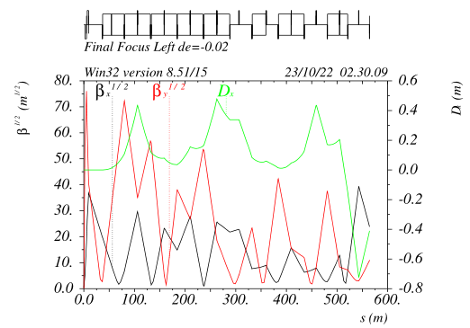
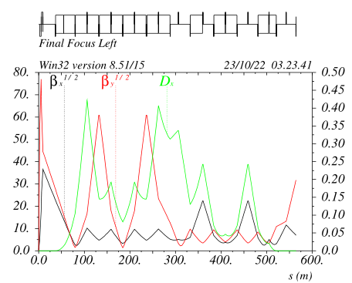
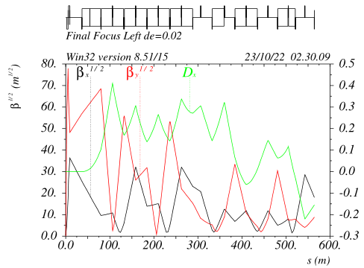
Final Focus source of 3rd order chromatic aberrations v_17e
Chromatic behaviour for off energy beam much heavily affected by third order chromaticity
betas&alfas @CS are still way off (but less way off): betay@CS~100, betax@CS~400
The reason is that the betafunctions on the sextupoles for off energy particles are lower (nominal etay@SD=3600),
so they do not correct completely the chromaticity anymore (also the relative phase wrt FD changes)

Slide 13
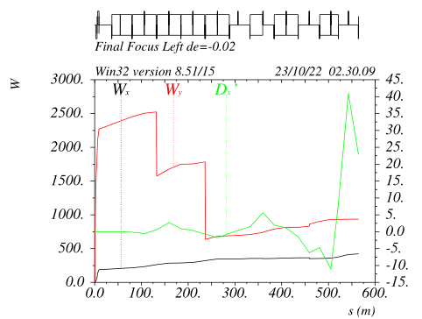
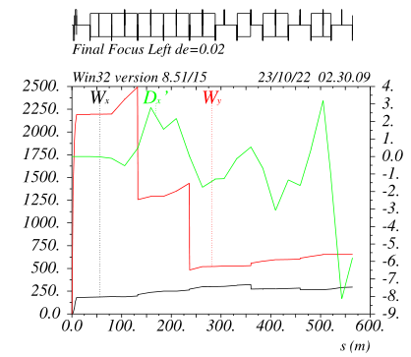
Final Focus source of 3rd order chromatic correction v_17e
SDs are not correcting all the chromaticity for off energy electrons
SFs do not seem to do much at all

Slide 14
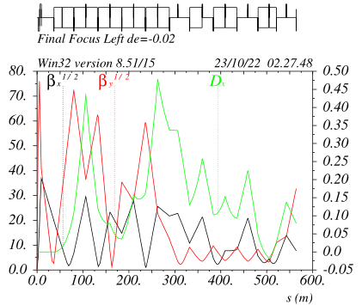
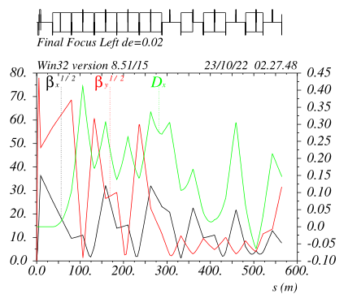
Final Focus 3rd order chromatic correction v_17e
Betas @ SD
SDM1
SFM2
Two additional weak sexts are added in the IP image points outside the –I pairs
They preserve the –I’s and are at lowbeta locations, so the do not harm the FF anaharmonicity
For off energy electrons they are at extremely large betas locations, they successfully restore the
nominal betas and phase advance on the main sextupoles for all energies
The betas @ CS are nominal for all energies as well !

Slide 15
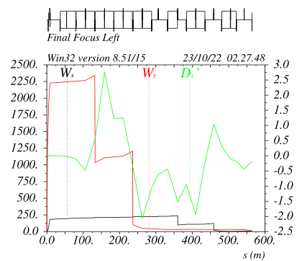
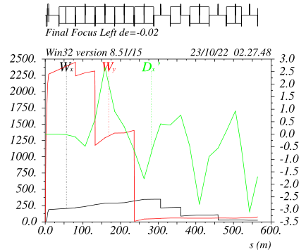
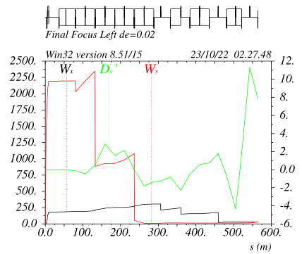
Final Focus 3rd order chromatic correction v_17e
SFM2
Chromaticities are well corrected for off energy beam as well
The contribution of the IP-Phase Sextupoles for off energy beam is evident

Slide 16
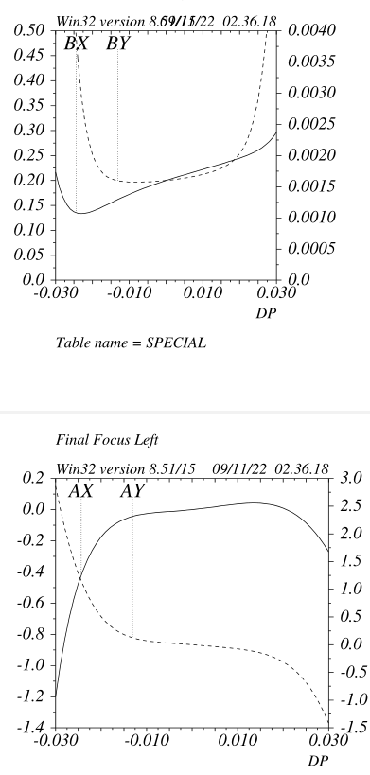
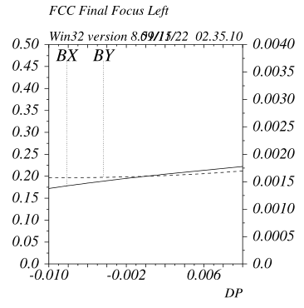
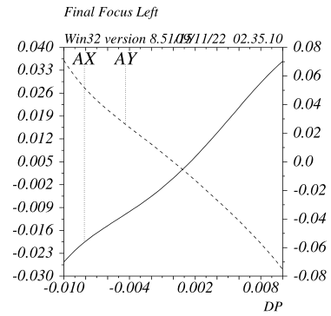
Final Focus with up to Third Order Chromatic Correction v_23c
The IP-phase SDM and SFM sextupoles make the FF a third order achromat (on Nov 3rd presentation it was shown how)
On this scale it is visible that a linear chromaticity different from zero has been set, it will be explained why later.
On a large scale are visible the remaining chromatic terms above the third and their effect on the BW

Slide 17
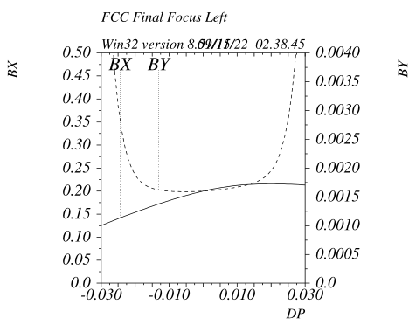
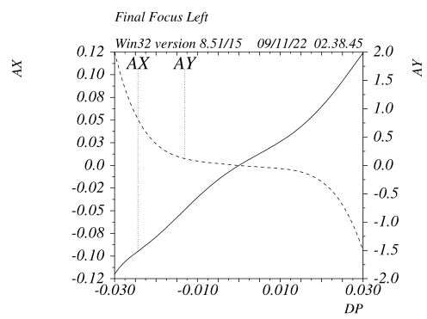
Final Focus with up to Fourth Order Chromatic Correction v_23c
By having different horizontal dispersion across the sextupole pairs the fourth order chromaticity is canceled.
The quantity that is optimized are the etaxp in the middle of the CCSy and CCSx.
Main cause of this aberration is non-linear dispersion propagating through the CCsy/x
The present FF quadrupole complement allows the change of both etaxp while maintaining all the other parameters unchanged
Remaining fifth order terms in the vertical is visible

Slide 18
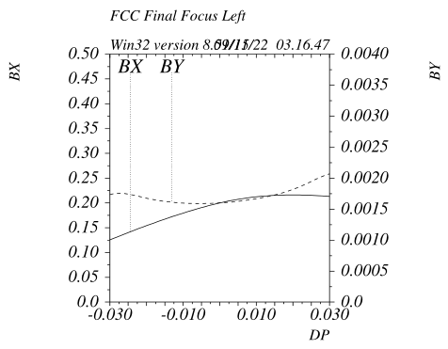
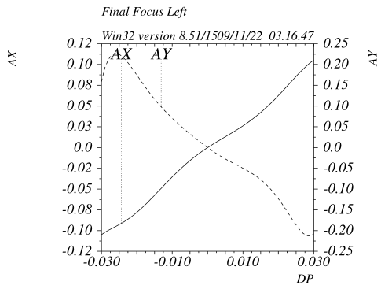
Final Focus with up to Fifth Order Chromatic Correction v_23c
Two (DECy K4L~300 in MADX units) decapoles at the same location of the SDM and SFM are very powerful in order to cancel the fifth order chromaticity.
For the v_22c the optimal value of the DECx is ~zero.
*Without using the decapoles a reduction of the fifth order contribution could be made by overshooting the third order (SDM) correction: ~ intermediate BW between the two cases

Slide 19
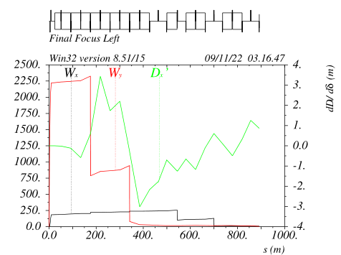
Final Focus chromaticity with Fifth Order Chromatic Correction v_23c
Etap@ CCSy&CCSx is extremely beneficial and also has the “right sign”
Indeed the first SDy sextupole removes about 65% of the chromaticity
(similar for the SFx), so less chromaticity is propagated further in the FF
The “tuning” knobs obviously are not completely independent, although their effect are largely
predominant on their associated aberrations.
It is very straightforward to zero all the terms with the proper setting of each quantity.
The zeroing has been done with MAD8, it seems valid with MADX as well,
It should be checked with other codes SAD/AT etc…

Slide 20
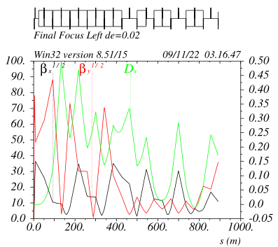
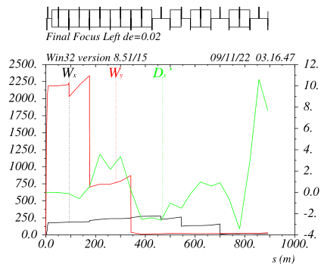
Final Focus with Fifth Order Chromatic Correction v_23c
- The contributions from the SDM and the DECy are evident when we look at the off-energy chromaticity (DECy is much smaller wrt SDM)
- It must be stressed that all the tuning knobs shown so far are not canceling aberrations (as might do a sextupole in the ARC)
- The knobs values are indeed the ones that correspond to do not generate such aberrations as starting with !!!!
- SDM and DECy as well are not canceling the third and fifth order chromaticity, they are set in order to have the SDy pair not to generate such terms (by restoring the proper betas on the SDy for off energy beam)

Slide 21
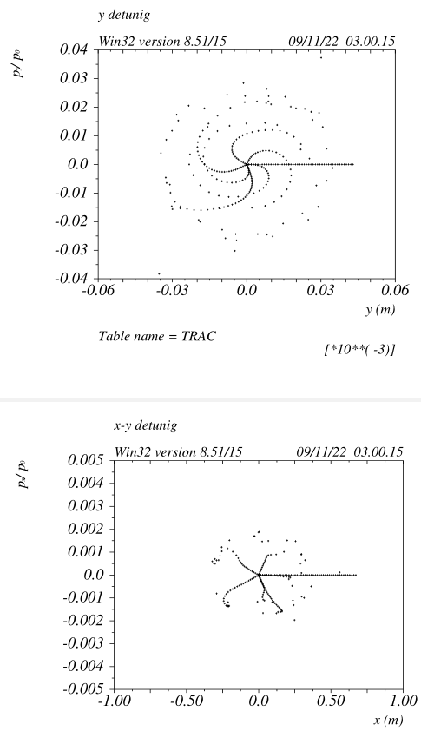
Full ring tracking with Final Focus geometric aberrations v_23c
Full ring tracking in Y supposing the SDy sextupoles thin lenses
The detuning is not negligible but it is present also with sextupoles off.
Probably due to the dipole fringe fields coupled with the large vertical
betas in the CCSy (to be checked)
The horizontal has a similar behavior but on a much smaller scale,
It will not be shown in this presentation to save time

Slide 22
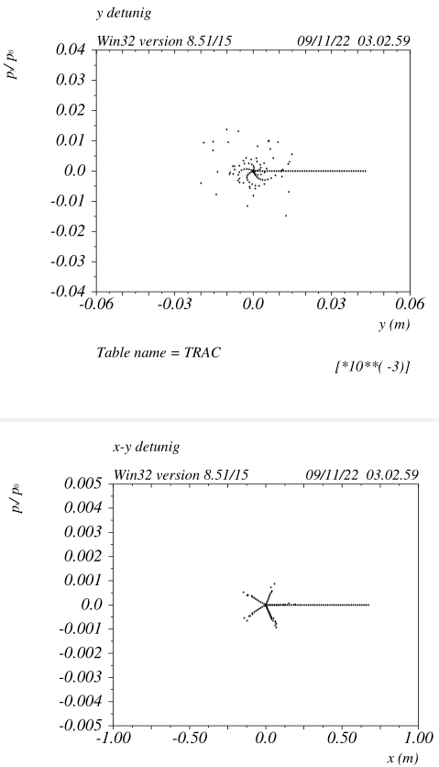
Final Focus geometric aberrations v_23c
Full ring tracking in Y supposing the SDy sextupoles 60cm long
The long sextupole aberration has a large contribution on DA.
The sextupoles should be as short and strong as possible, ideally SC
The contribution from the FD fringe fields is very large as well,
At the moment is not included in the tracking, it will be addressed/reduced
at a later time
Finally it has been checked that the IP-phase sextupoles do not affect the detuning
(not checked the effect on the DA)

Slide 23
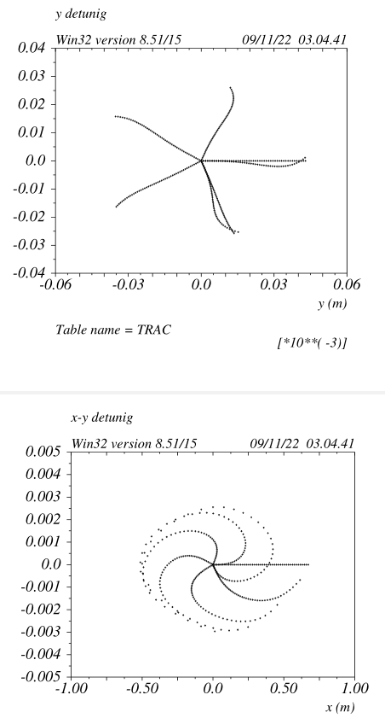
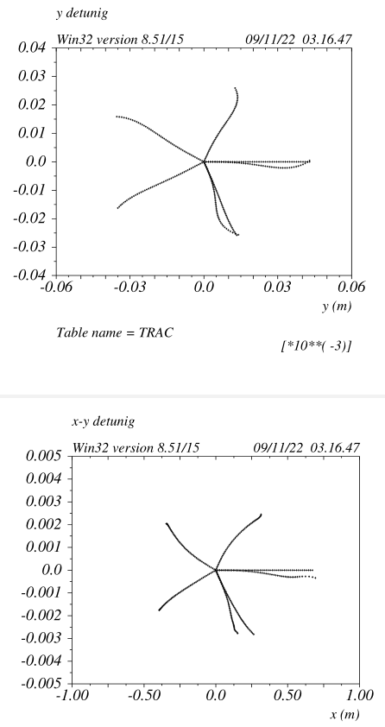
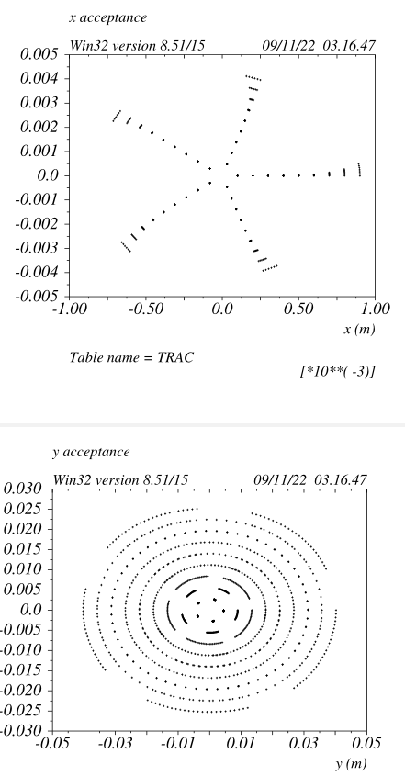
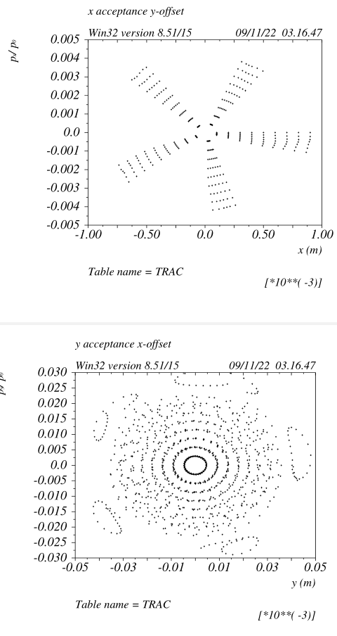
Final Focus geometric aberrations v_23c
R12 ~-0.3*L_sext
between the SDy pair
R34 ~-0.3*L_sext
between the SDy pair
Tracking at the IP, DA very large

Slide 24
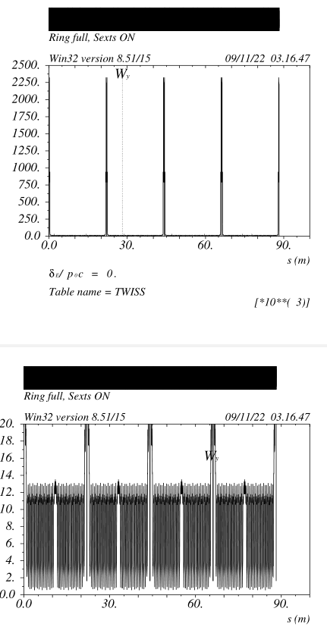
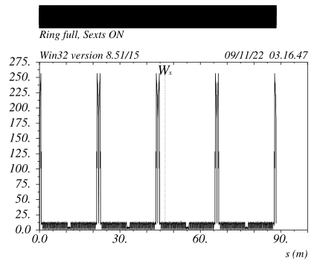
Final Focus insertion in the ring v_23c
alfax&alfay derivatives vs de are set in order to match the derivatives originated at the end of the FF disp suppressor, so the FF insertion is nearly transparent
This correspond to a very small “natural chromaticity” of the FF.
ARC sextupoles are readjusted to zero the total chromaticity and become about 7% stronger wrt to ARCS+LSS only.
To be noted that there is a very similar increase (~7%) when the 4 Long SS are included.

Slide 25
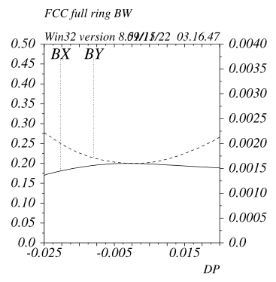
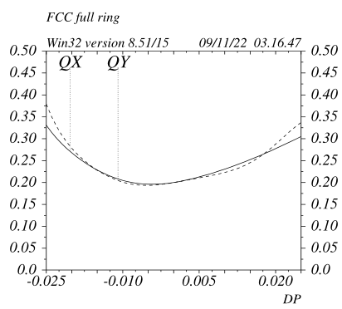
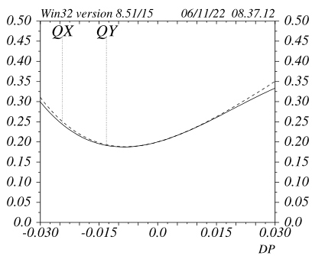
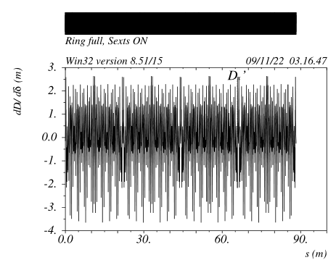
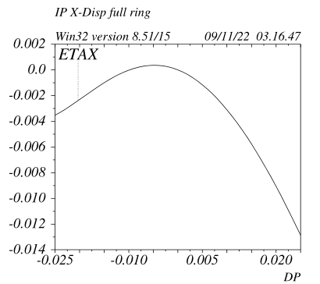
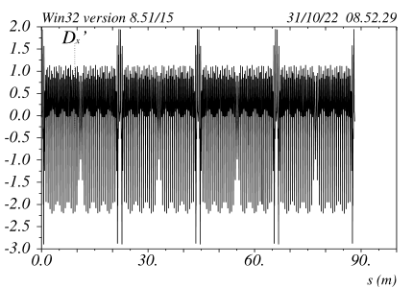
Ring bandwidth v_23c
ARCs+LSS only
(+/-3% scale)
Arcs+LSS+FF
(+/-2.5% scale)
Arcs+LSS+FF
The bandwidth is obtained by just inserting the
FF in between the FF dispersion suppressors
In order to improve the TCs and BW in general it would be useful to:
Reduce the chromatic betas
Match the second order dispersion
(done in earlier versions, not yet for the 23c)
v_20d

Slide 26
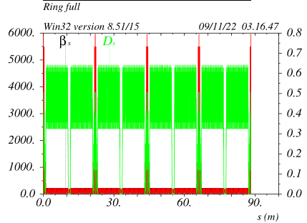
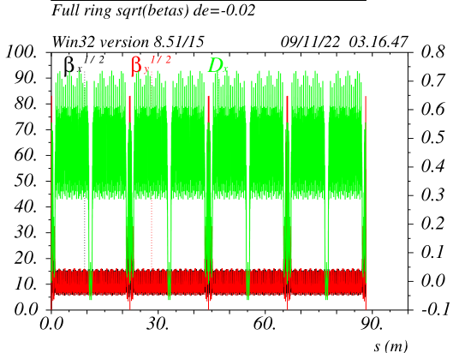
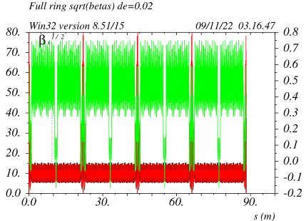
Ring chromatic betas v_23c
- Betas for off energy beam are very much unchanged for the full ring at least up to de +/-2%
- Lattice is very periodic and all linear and non linear elements are periodic as well in between the FFs

Slide 27




FF check of full Achromaticity v_23c
2*betax & 0.5*betay
2*betax* & 2*betay*
By changing the incoming betas in the FF in the
DS+FF_Matching section the IPs betas do change correspondingly.
No change of sextupoles in the ARCS or FF is needed except a very small change in the ARCs to make up for the different chromaticity in the DSFFM.
This is not completely true because the DSFFM does not preserve the incoming Ws in the FF, thus generating chromatic betas.
This has been be improved at the DSFFM level for later versions

Slide 28


Can we beat the competition?
- Iphone camera system “industrial grade” is
extremely compact efficient and cheap.
- 9 lenses (many are special) are all what is needed to
make a nearly chromatic and aberrations free telescope.
- I thought that accelerator optics could never match this, but I am not so sure anymore
The FF has 24 lenses.
It can be assumed the sextupoles+nearby_quadrupoles to be single anamorphic lens (as the “special” iphone lenses)
Considering that for simplecticity reasons two independent systems are needed for X and Y plane, the FF is made of:
12 lenses/plane => not that far from the Iphone-FF !!!!
Iphone camera system resolution is further improved (~factor two) with computational power reprocessing the CCD image.
FF aberrations can be further reduced by further global optimization of FF+ARCs sextupoles

Slide 29
Conclusions
The beam dynamics of a dedicated FF system for a circular or linear collider has been extensively studied
Specific contributions of chromatic aberrations have been identified and general tools to eliminate (not by compensating, but by not generating) such aberrations have been built and successfully employed
The present FF design is an achromat corrected up to the fifth order, with very small geometric aberrations
The chromatic behavior of the FF and its integration in a ring can be further understood and optimized
The geometric aberrations in general and the FD fringe fields have to be fully addressed as well. The DA off energy has not been analyzed/optimized at all.
I hope that this study be useful to the young generations of accelerator physicists in order to understand as many BD issues as possible and provide useful hints to finally design and build future colliders.

