Slide 1
WP3 progress summary
T3.2: Placement optimisation
- Placement PA31-1.0 analysed and documented, report is being completed
- Visits with affected departments and communes in CH and FR started
- Micro optimisation ongoing due to feedback from local stakeholders
PA31-2.0, 2.1, 2.2, 2.3, 2.4, 2.5 towards a baseline variant PA31-3.0
T3.3: Strategy for transnational environmental impact assessment framework
- Strategy document published as deliverable
- Contract with consortium for initial state analysis and permitting concluded and started
Preparation for field studies has begun and field studies start in spring for 4 seasons
T3.4: Strategy for managing excavated materials
- Mining The Future competition revealed credible pathways for re-use
- Presented at EU conference on Research Infrastructures (ICRI 2022, Brno, Czech republic)
- Input from regional governments in France led to the development of a strategy that aims at
local innovative re-use for creating added value for agricultural spaces and forests

Slide 2
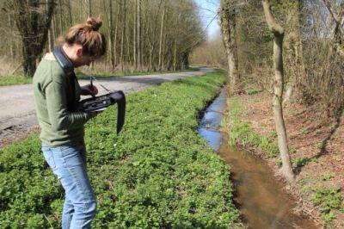
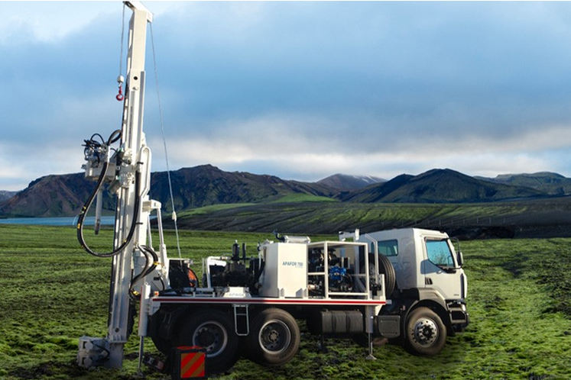
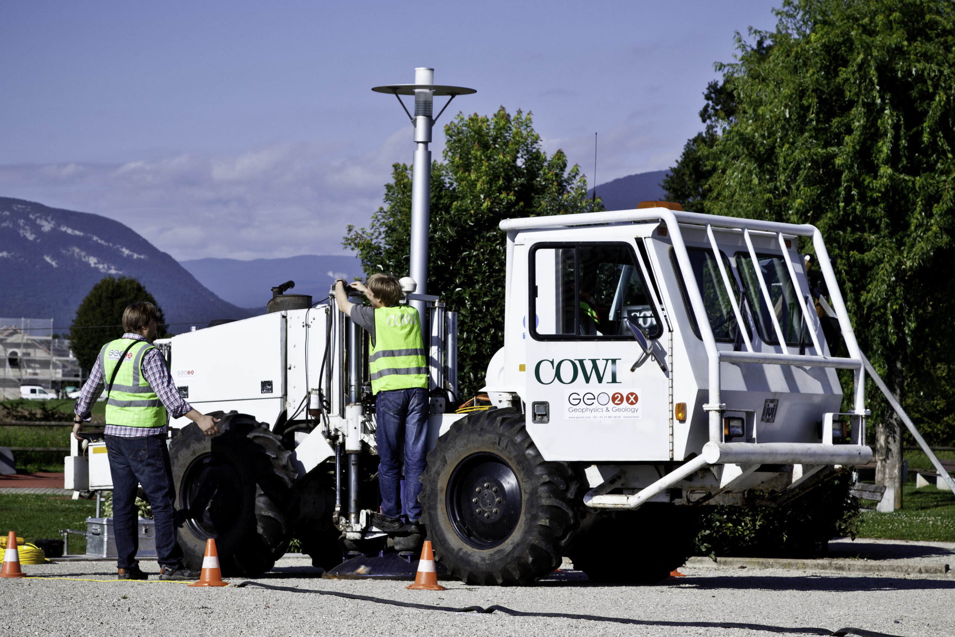
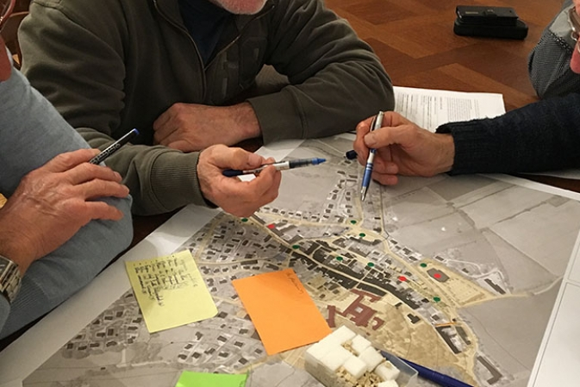
Activités prévues
2023
Techniques classiques de mesures avec des relevés métriques et altimétriques, des photographies, des inventaires de la faune et de la flore, des analyses de l’eau, de l’air, du trafic routier ainsi que de la pollution sonore et lumineuse existante.
Forages exploratoires de petite taille et de courte durée lorsque des données précises devront être relevées sur la stabilité des sols, dans des zones qui représentent des défis particuliers pour l’ouvrage souterrain.
2024
2024
Techniques acoustiques de cartographie du sous-sol au moyen de camions-vibreurs et équipement similaire. Elles permettent d’obtenir une image des couches géologiques sans nécessiter de forages.
Identification des opportunités et synergies Optimiser les emplacements des sites en surface, identifier des opportunités et synergies en vue de créer des retombes pour tous.
2023/24

Slide 3
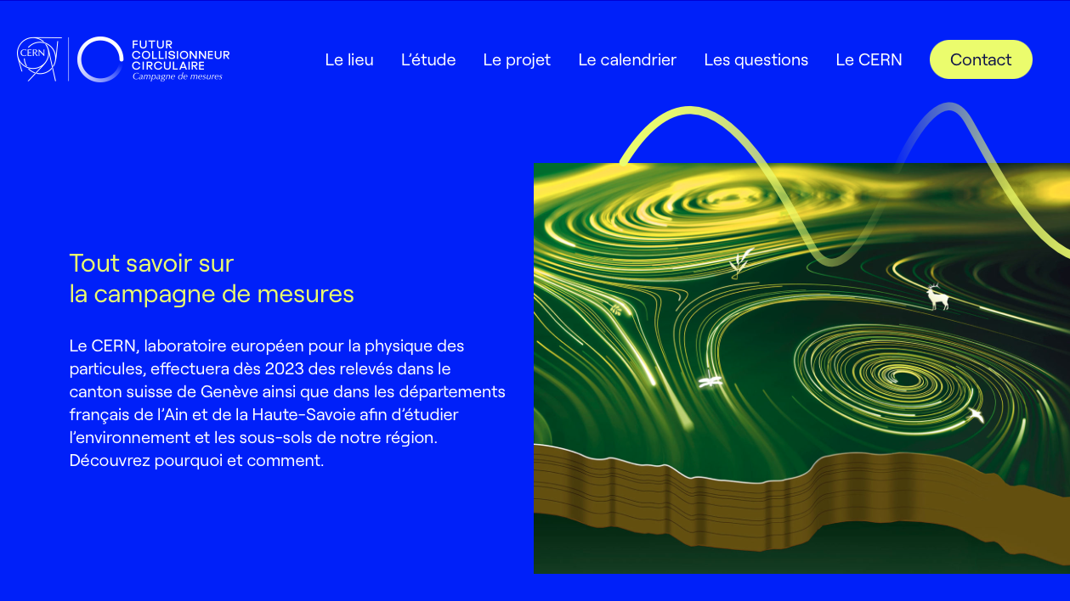
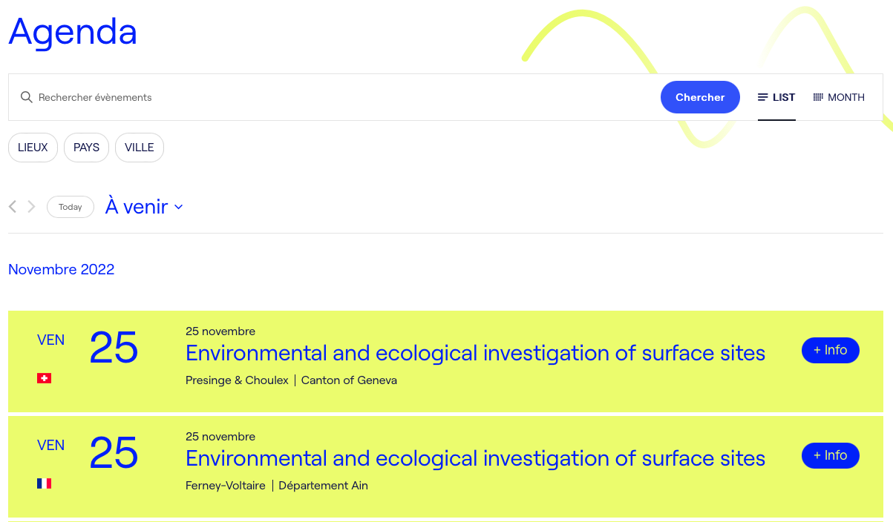
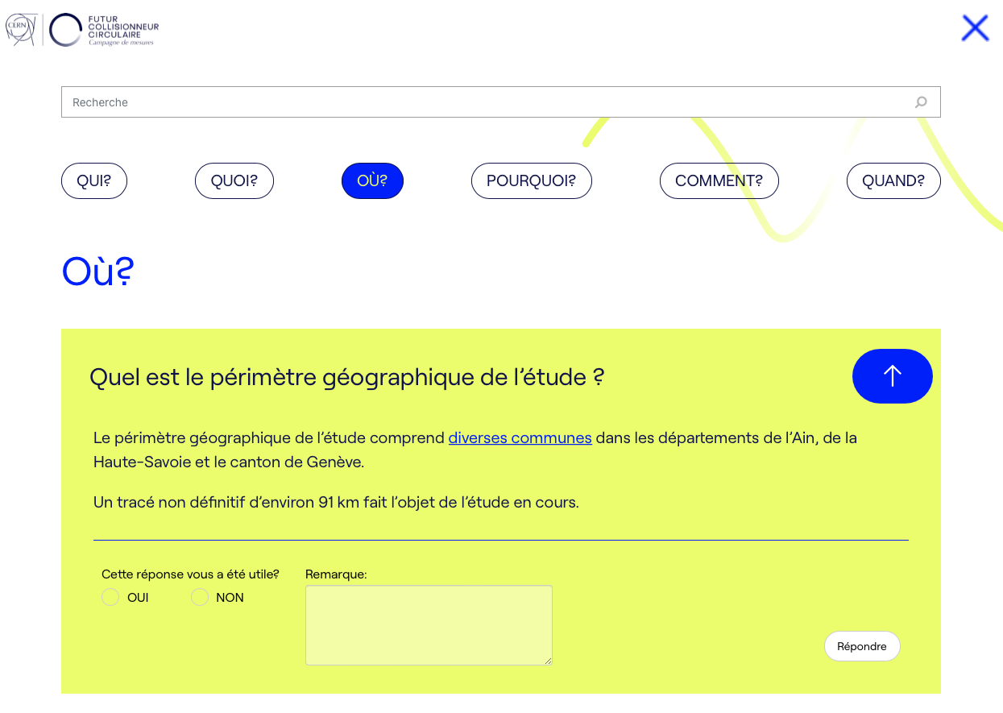
www.fcc-faisabilite.eu
Information sur l’étude
Questions (FAQ)
Calendrier
Formulaire de contact

Slide 4
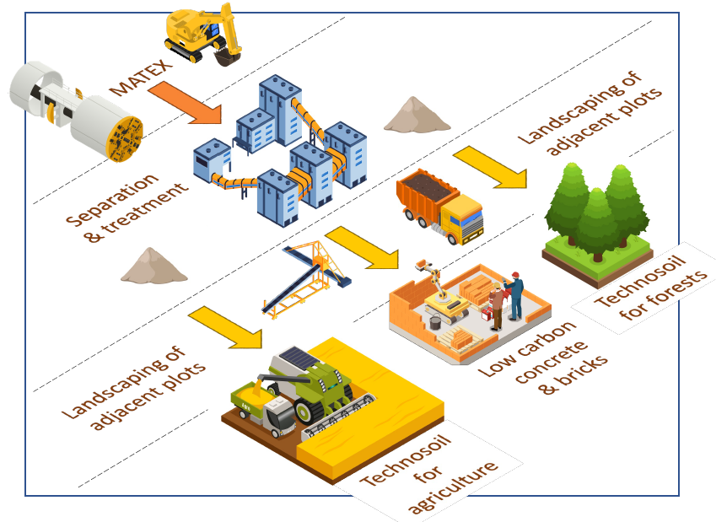
Local innovative excavation materials re-use
AMBERG consortium: In-situ separation (crossbelt elemental analyzer) and preparation for use as construction material on site (shotcrete, bio-mineral binder), onsite production of low-carbon construction elements without cement/concrete.
BG consortium: Online-analysis and preparation of “molasse” for construction elements from sandstone, filling material for concrete, low-carbon concrete, terra cotta bricks, etc.
ARCADIS consortium: treatment of the materials with calcium-based stabiliser for the production of “pressed bricks” as substitute for high carbon-footprint construction materials using mobile production facilities on site.
EDAPHOS consortium: Combining mineral molasse material and organic material to produce fertile soil with on-site production plants by using microbiology to accelerate humus creation. Fertile soil as top layer for agricultural use, recultivation.

