Slide 1
CERN Basketball Club
General Assembly
26th September 2022

Slide 2
Agenda
Last season report (President)
Financial state of the club (Treasurer)
Planning for next season (President)
Discussion

Slide 3
2021-2022 Committee
Borja Fernandez Adiego – President/CERN1R
George Iakovidis – Vice President
Pedro Felix Lopez Macia – CERN1R
Jeronimo Ortola Vidal – Treasurer/CERN2R
Manuel Gonzalez Berges – Secretary/CERN2R
Nikolaos Kasioumis – CERN2R
Francois Boyer – Member
Franck Perret – Coach

Slide 4
2020-2021 Status
Members
  CERN 1: 12 players
  CERN 2: 14 players
  Only trainings: ~6 person paid
Gyms
  Tuesdays: Chavanne
  Wednesdays: Bude
  Thursdays: Saint Genis Diamanterie
Competitions – GAB
    CERN 1 - League Cobalt / League A / Cup
    CERN 2 - League Titane / League C / Cup
COVID’19
    GAB stopped all competitions at end of 2021 and restarted on the 21/02/2022

Slide 5
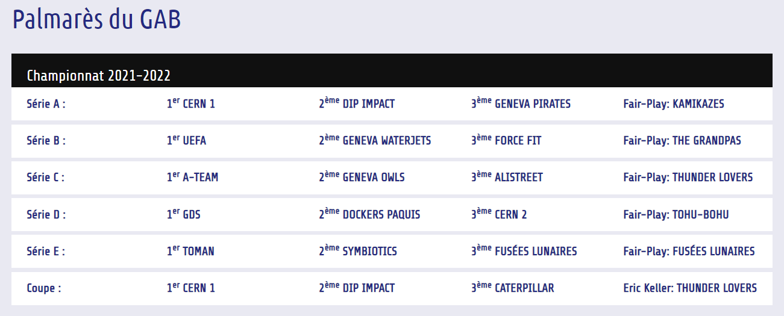
CERN1 2021/22 Championship
https://gabasket.ch/palmares-du-gab/

Slide 6
CERN2 2021/22 Championship
https://gabasket.ch/palmares-du-gab/

Slide 7
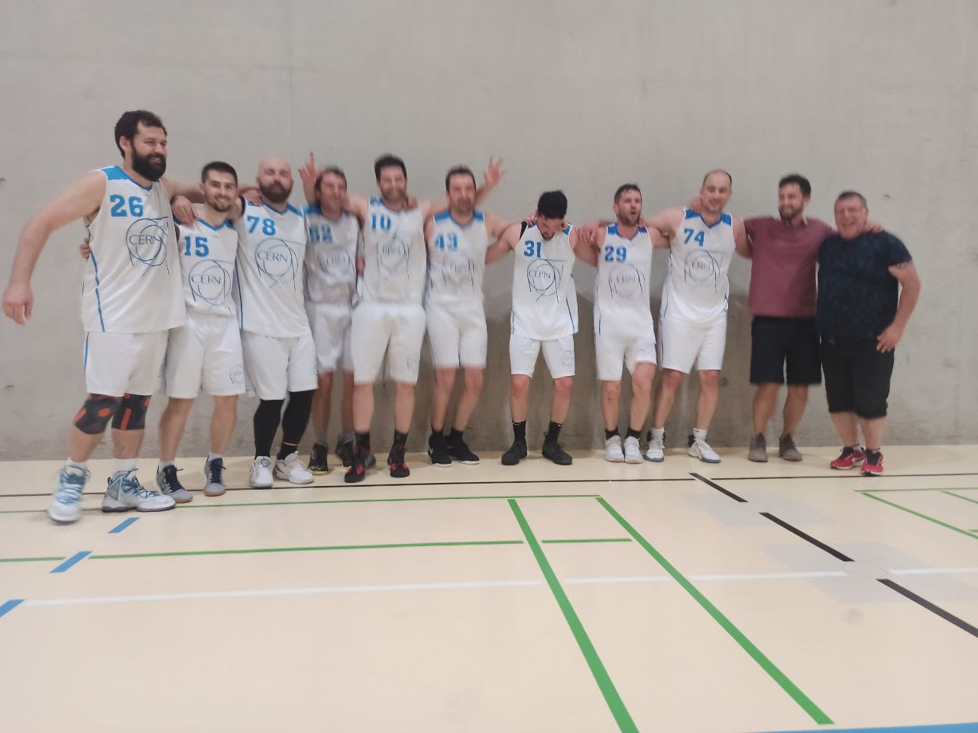
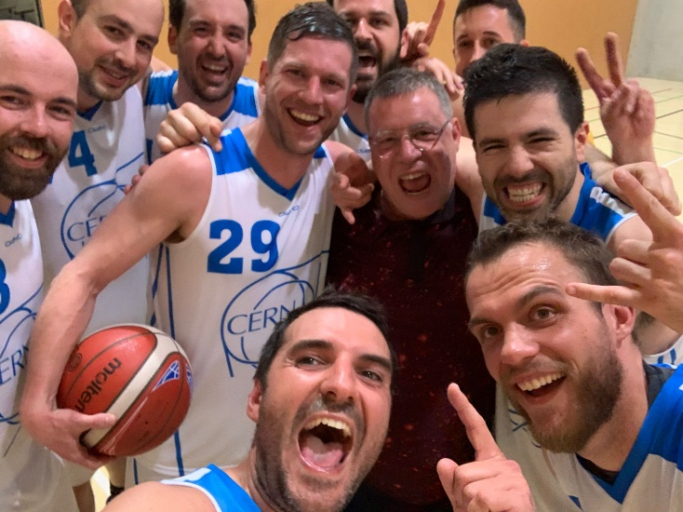
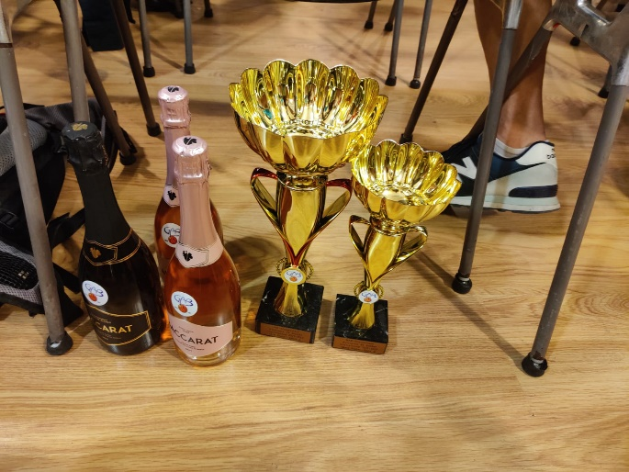
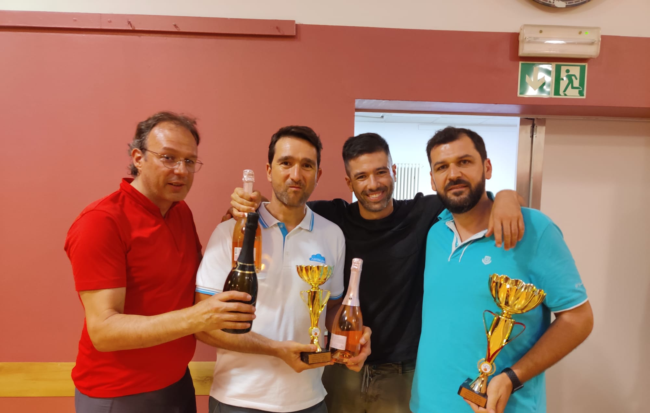
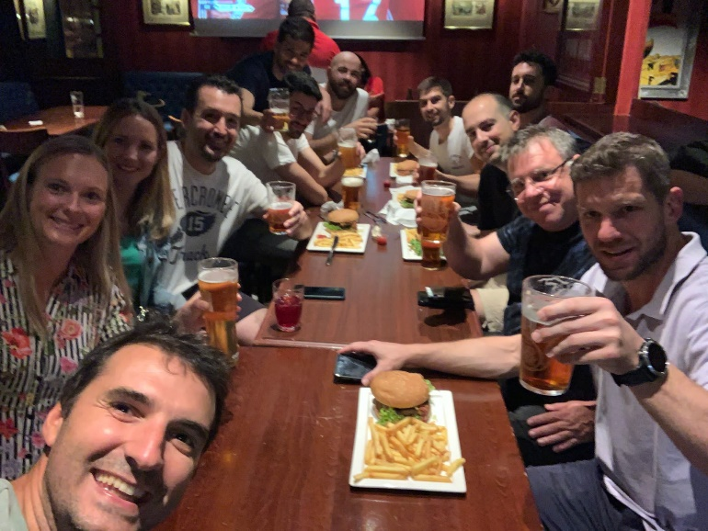
CERN1 2021/22 Championship

Slide 8
Social events
Xmas dinner to be organized at the end of November / beginning of December

Slide 9
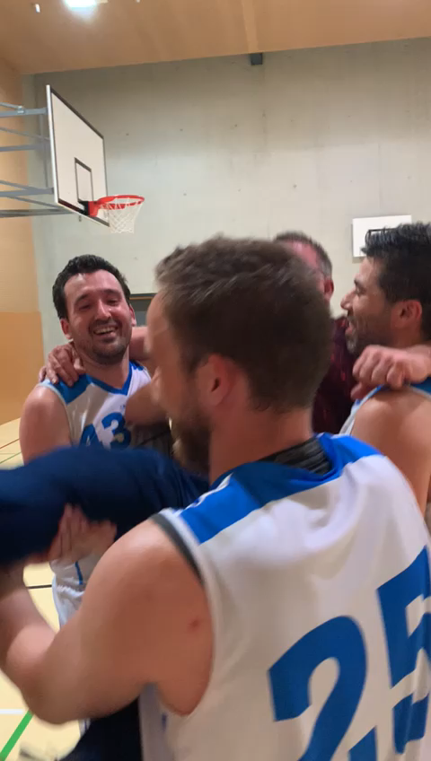
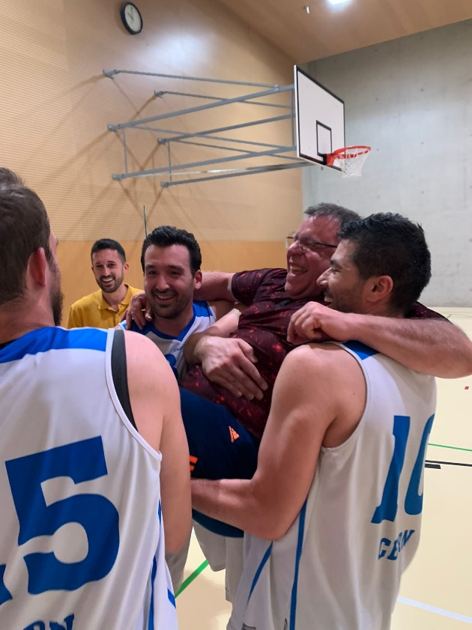
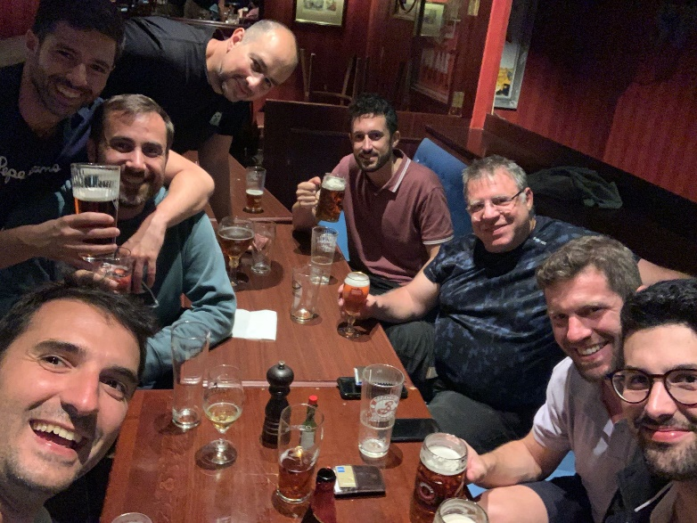
Thanks coach!

Slide 10
Thanks to all the people in the committee and everyone in the club

