Slide 1
Startup jobs
Ash Ravikumar

Slide 2

“People crazy enough to think they can change
the world, end up changing the world”
- Apple commercial “think different”
Starters
Joiners

Slide 3
All startups need talent.
Single biggest challenge :
Attract the best talent
(competing with established company)

Slide 4
Startups
Many will not have an exact match to your profile/expertise/…
But, reach out to the founders to tell them why you want to work with them

Slide 5
Where to find startup jobs

Slide 6
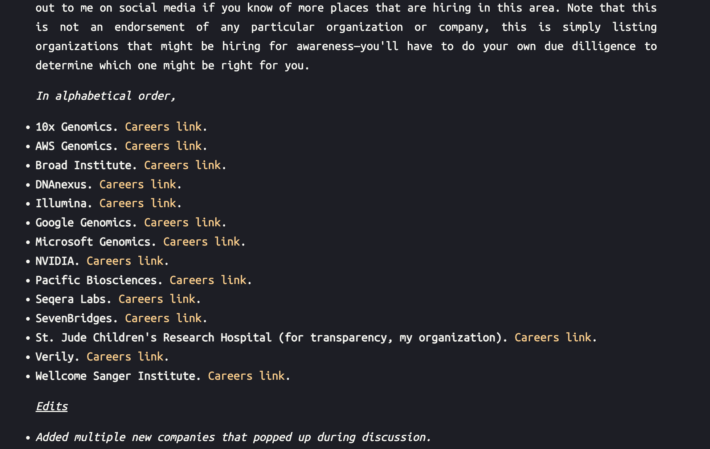
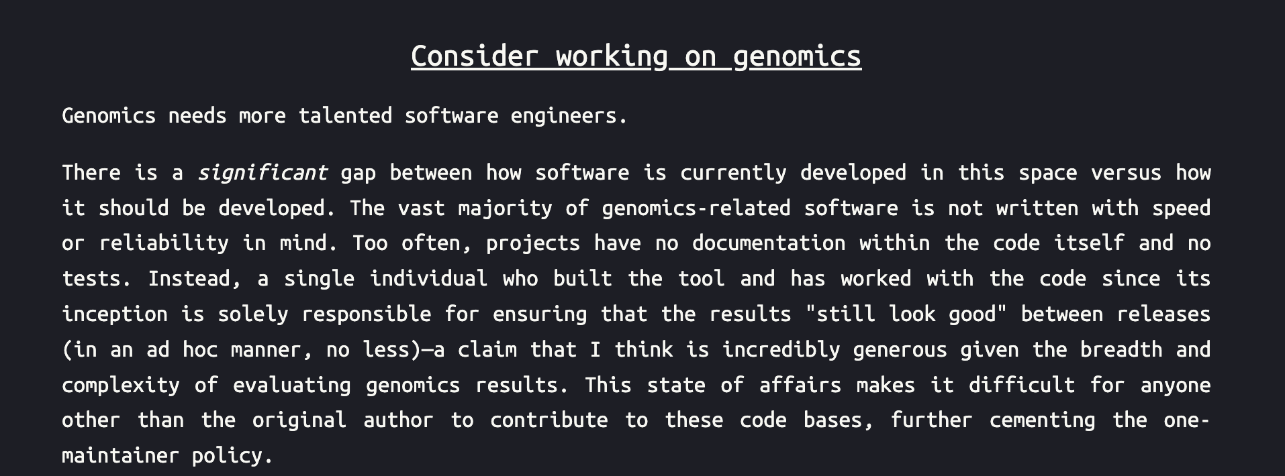
Science based startups
https://claymcleod.dev/blog/2022-11-19-consider-working-on-genomics.html

Slide 7

Hiring in London & Lausanne
https://boards.greenhouse.io/isomorphiclabs

Slide 8
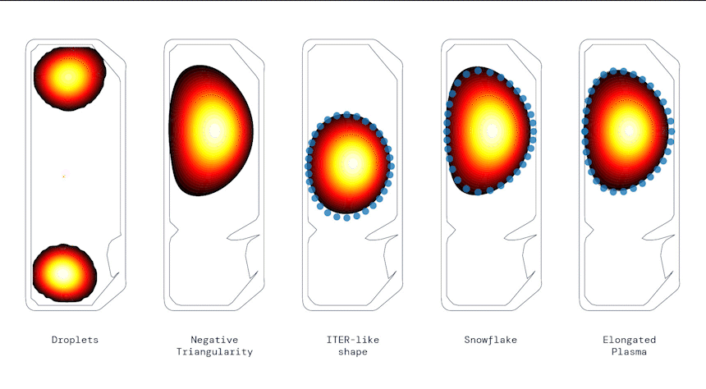
Deepmind Science
https://www.deepmind.com/blog/accelerating-fusion-science-through-learned-plasma-control

Slide 9

Angel list
https://angel.co/jobs

Slide 10
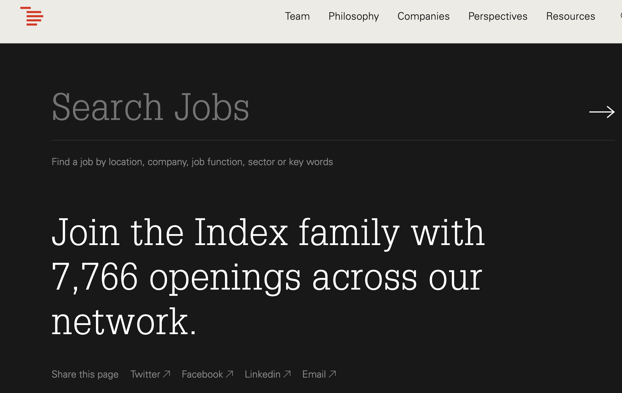
Venture Capital firms
https://www.indexventures.com/startup-jobs

Slide 11
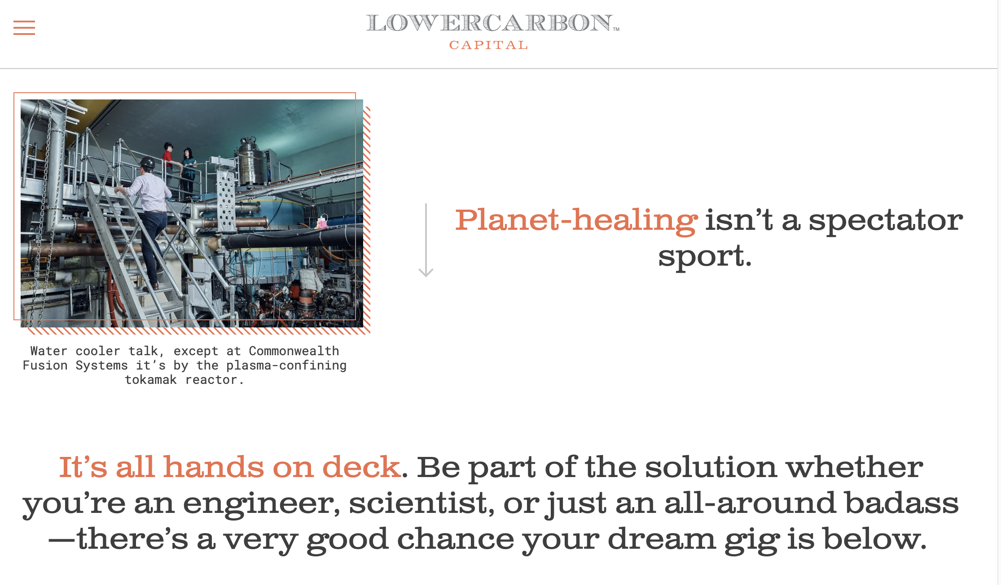
https://lowercarboncapital.com/get-off-the-couch/

Slide 12
Thanks!
Ashwin.Ravikumar@cern.ch

