Slide 1



The central role of Gauss constraint across LQC and LQG
Matteo Bruno
[gr-qc] 2302.03638
[gr-qc] 2306.10934
[gr-qc] 2401.12927
[gr-qc] 2405.03019

Slide 2
Three points program
Introduction to nondiagonal Bianchi models [Montani, MB ‘23]
    Minisuperspace and Ashtekar variables
    Flux quantization procedure
Abelianization of the Gauss constraint [Montani, MB ‘23]
    Gauge freedom and canonical transformation
    Revised Gauss Constraint and Quantum-level implications
Yang-Mills approach for the cosmological sector [MB ‘24] [MB ‘24]
The central role of Gauss constraint across LQC and LQG
Slide 1

Slide 3













Nondiagonal Bianchi models
Minisuperspace
[Landau, Lifshits ‘74]
[Belinski ‘14]
[Montani, MB ‘23]
Globally hyperbolic spacetime
$$ℳ=ℝ×Σ$$
Homogeneous space prescription
$$q_{ij}\left(t,x\right)=η_{IJ}\left(t\right)ω_{i}^{I}\left(x\right)ω_{j}^{J}(x)$$
$$Σ$$
Nondiagonal metric decomposition
$$η_{IJ}=Γ_{AB}R_{I}^{A}R_{J}^{B}$$
$$ξ_{2}$$
Maurer-Cartan equation
Lie algebra generators
$$dω^{I}+\frac{1}{2}f_{JK}^{I}ω^{J}ω^{K}=0$$
$$\left[ξ_{I},ξ_{J}\right]=f_{IJ}^{K}ξ_{K}$$
$$a_{1}$$
$$a_{2}$$
Metric configuration variables
$$\{a_{1},a_{2},a_{3},θ,ψ,φ\}$$
$$ξ_{1}$$
$$ξ_{3}$$
$$a_{3}$$
The central role of Gauss constraint across LQC and LQG
Slide 2

Slide 4
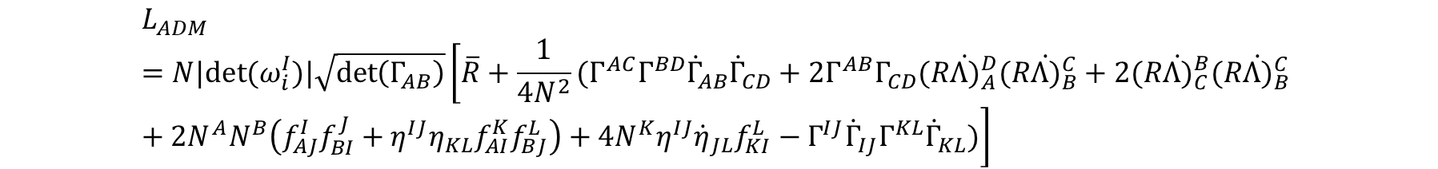

Nondiagonal Bianchi models
Ashtekar variables
Lagrangian
$$L_{ADM}=N|det⁡(ω_{i}^{I})|\sqrt{\det\left(Γ_{AB}\right)}\left[\overline{R}+\frac{1}{4N^{2}}(Γ^{AC}Γ^{BD}{\dot{Γ}}_{AB}{\dot{Γ}}_{CD}+2Γ^{AB}Γ_{CD}(R{\dot{Λ)}}_{A}^{D}(R{\dot{Λ)}}_{B}^{C}+2(R{\dot{Λ)}}_{C}^{B}(R{\dot{Λ)}}_{B}^{C} +2N^{A}N^{B}\left(f_{AJ}^{I}f_{BI}^{J}+η^{IJ}η_{KL}f_{AI}^{K}f_{BJ}^{L}\right)+4N^{K}η^{IJ}{\dot{η}}_{JL}f_{KI}^{L}−Γ^{IJ}{\dot{Γ}}_{IJ}Γ^{KL}{\dot{Γ}}_{KL})\right]$$
Ashtekar connection
$$A_{i}^{a}=\left[\frac{1}{2}ε^{abc}\frac{a_{c}}{a_{b}}Λ_{b}^{J}R_{K}^{c}f_{IJ}^{K}−\frac{1}{4}ε^{abc}\frac{1}{a_{b}a_{c}}η_{IJ}Λ_{b}^{K}Λ_{c}^{L}f_{LK}^{J}+\frac{γ}{2N}a_{\left(a\right)}R_{L}^{a}\left(η^{LJ}{\dot{η}}_{JI}+N^{A}η^{LK}η_{IJ}f_{AK}^{J}+N^{A}f_{AI}^{L}\right)\right]ω_{i}^{I}$$
Electric field
$$E_{a}^{i}=|det⁡(ω_{i}^{I})|\operatorname{sgn}\left(a_{\left(a\right)}\right)\left|a_{b}a_{c}\right|Λ_{a}^{I}ξ_{I}^{i}$$
The central role of Gauss constraint across LQC and LQG
Slide 3

Slide 5






Nondiagonal Bianchi I model
Ashtekar variables
Lagrangian
$$L_{ADM}=N|det⁡(ω_{i}^{I})|\sqrt{\det\left(Γ_{AB}\right)}\left[\overline{R}+\frac{1}{4N^{2}}(Γ^{AC}Γ^{BD}{\dot{Γ}}_{AB}{\dot{Γ}}_{CD}+2Γ^{AB}Γ_{CD}(R{\dot{Λ)}}_{A}^{D}(R{\dot{Λ)}}_{B}^{C}+2(R{\dot{Λ)}}_{C}^{B}(R{\dot{Λ)}}_{B}^{C} +2N^{A}N^{B}\left(f_{AJ}^{I}f_{BI}^{J}+η^{IJ}η_{KL}f_{AI}^{K}f_{BJ}^{L}\right)+4N^{K}η^{IJ}{\dot{η}}_{JL}f_{KI}^{L}−Γ^{IJ}{\dot{Γ}}_{IJ}Γ^{KL}{\dot{Γ}}_{KL})\right]$$
$$0$$
$$0$$
$$0$$
Ashtekar connection
$$A_{i}^{a}=\left[\frac{1}{2}ε^{abc}\frac{a_{c}}{a_{b}}Λ_{b}^{J}R_{K}^{c}f_{IJ}^{K}−\frac{1}{4}ε^{abc}\frac{1}{a_{b}a_{c}}η_{IJ}Λ_{b}^{K}Λ_{c}^{L}f_{LK}^{J}+\frac{γ}{2N}a_{\left(a\right)}R_{L}^{a}\left(η^{LJ}{\dot{η}}_{JI}+N^{A}η^{LK}η_{IJ}f_{AK}^{J}+N^{A}f_{AI}^{L}\right)\right]ω_{i}^{I}$$
$$0$$
$$0$$
$$0$$
Electric field
$$E_{a}^{i}=|det⁡(ω_{i}^{I})|\operatorname{sgn}\left(a_{\left(a\right)}\right)\left|a_{b}a_{c}\right|Λ_{a}^{I}ξ_{I}^{i}$$
The central role of Gauss constraint across LQC and LQG
Slide 4

Slide 6













Nondiagonal Bianchi I model
Flux quantization
Quantization in the flux polarization as in [Ashtekar, Wilson-Ewing ‘09]
The fluxes computed on the faces of the fiducial cell
$$p_{2}$$
$$ξ_{2}$$
Credits: Beatrice Gorga
$$ξ_{2}$$
$$p_{2}$$
$$p_{1}$$
$$p_{1}$$
Rotation
$$p_{3}$$
$$p_{3}$$
$$ξ_{1}$$
$$ξ_{3}$$
$$ξ_{1}$$
$$ξ_{3}$$
Geometric operators depend on diagonal fluxes only!
Basis states of the Hilbert space:
$$|p_{1},p_{2},p_{3},θ,ψ,φ⟩$$
The central role of Gauss constraint across LQC and LQG
Slide 5

Slide 7






Abelianization of the Gauss constraint
Gauge freedom
$$G_{a}|_{℘_{Mt}}=0$$
$$℘_{Mt}=\{a_{1},a_{2},a_{3},θ,ψ,φ,π_{1},π_{2},π_{3},π_{θ},π_{ψ},π_{φ}\}$$
Mismatch in the number of degrees of freedom!
M. Bojowald’s suggestion in [Bojowald ’00, ‘13]
$$A_{i}^{a}\left(t,x\right)=φ_{I}^{a}\left(t\right)ω_{i}^{I}(x)$$
$$G_{a}=ε_{abc}φ_{I}^{b}p_{c}^{I}$$
$$E_{a}^{i}\left(t,x\right)=|det⁡(ω\left(x\right))|p_{a}^{I}\left(t\right)ξ_{I}^{i}(x)$$
Recover the gauge freedom adding a rotation
$$℘_{\overline{Mt}}=\{a_{1},a_{2},a_{3},θ,ψ,φ,α,β,γ,π_{1},π_{2},π_{3},π_{θ},π_{ψ},π_{φ},π_{α},π_{β},π_{γ}\}$$
$$\left\{\begin{aligned}π_{α}=0 \\ π_{β}=0 \\ π_{γ}=0\end{aligned}\right.$$
Three abelian constraints
The central role of Gauss constraint across LQC and LQG
Slide 6

Slide 8
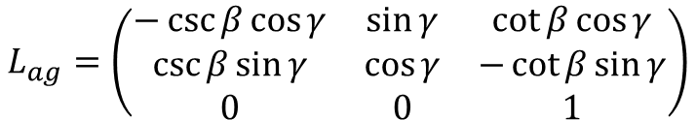
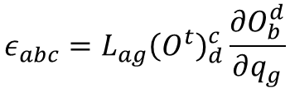
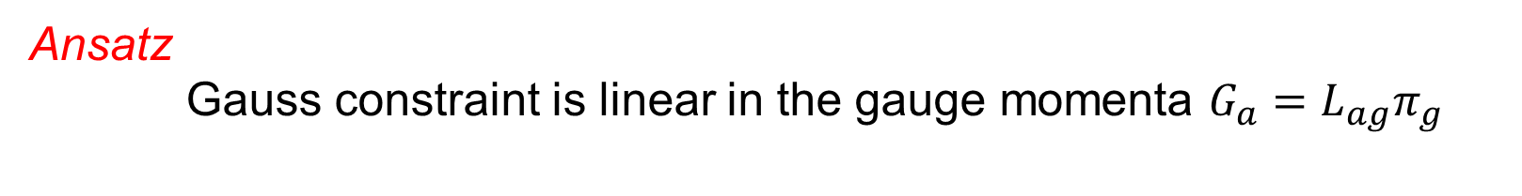
Abelianization of the Gauss constraint
Canonical transformation
Lie condition $φ_{I}^{a}dp_{a}^{I}−π_{n}dq_{n}=0$ provides, perturbative in configurational variables, a linear dependence between Gauss constraint and gauge momenta
Ansatz
Gauss constraint is linear in the gauge momenta $G_{a}=L_{ag}π_{g}$
$$ε_{abc}=L_{ag}{\left(O^{t}\right)}_{d}^{c}\frac{∂O_{b}^{d}}{∂q_{g}}$$
System of 9 independent equations
Admits a unique solution!
$$L_{ag}=\left(\begin{matrix}−\csc{β}\cos{γ} & \sin{γ} & \cot{β\cos{γ}} \\ \csc{β\sin{γ}} & \cos{γ} & −\cot{β\sin{γ}} \\ 0 & 0 & 1\end{matrix}\right)$$
The central role of Gauss constraint across LQC and LQG
Slide 7

Slide 9

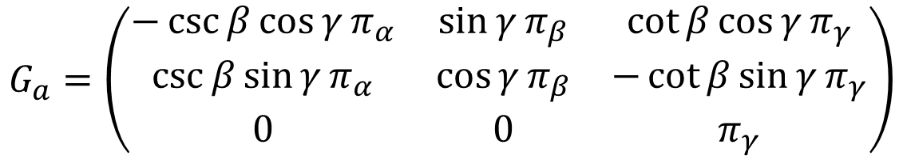

Abelianization of the Gauss constraint
The Abelian contraints
$$G_{a}=\left(\begin{matrix}−\csc{β}\cos{γ}π_{α} & \sin{γ}π_{β} & \cot{β\cos{γ}}π_{γ} \\ \csc{β\sin{γ}π_{α}} & \cos{γ}π_{β} & −\cot{β\sin{γ}}π_{γ} \\ 0 & 0 & π_{γ}\end{matrix}\right)$$
From a SU(2) symmetry,
three U(1) appear!
The Gauss constraint is recast into three abelian constraints, namely the gauge momenta
This feature holds at the quantum level
$${\hat{G}}_{a}\left|Ψ\right\rangle =0 ⟺ {\hat{π}}_{g}\left|Ψ\right\rangle =0$$
The wavefunction factorizes
$$Ψ\left(p_{1},p_{2},p_{3},θ_{1},θ_{2},θ_{3},α,β,γ\right)=φ\left(α,β,γ\right)Φ(p_{1},p_{2},p_{3},θ_{1},θ_{2},θ_{3})$$
$${\hat{π}}_{g}\left|Ψ\right\rangle =0 ⇒ φ=const$$
The Hilbert space previously defined is the gauge-invariant one
The central role of Gauss constraint across LQC and LQG
Slide 8

Slide 10
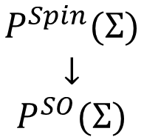
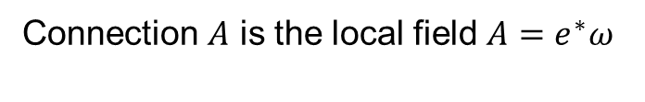


Cosmological sector of Loop Quantum Gravity
A Yang-Mills approach
[Brodbeck ‘96]
[Bojowald, Kastrup ‘00]
[MB ‘24]
[MB ‘24]
Yang-Mills variables
$$\begin{matrix}P^{Spin}(Σ) \\ ↓ \\ P^{SO}(Σ)\end{matrix}$$
Connection $ω$ is a 1-form on $P^{Spin}(Σ)$ with value in the Lie algebra of SU(2)
Dreibein $e$ is a section in $P^{SO}(Σ)$
Ashtekar variables
$$\begin{matrix}↓ \\ Σ\end{matrix}$$
Connection $A$ is the local field ${A=e}^{∗}ω$
Electric field $E$ is built from the dreibein $E=\sqrt{q}d^{3}x⊗e$
The request of homogeneity for $ω$ yields to a homogeneous geometry for $Σ$
The central role of Gauss constraint across LQC and LQG
Slide 9

Slide 11
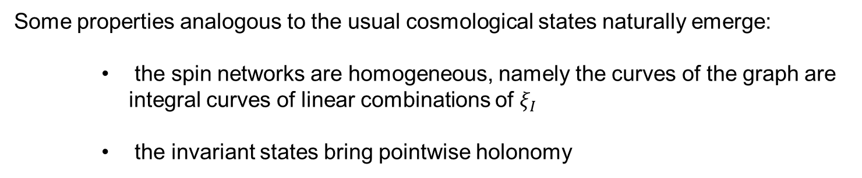
Cosmological sector of Loop Quantum Gravity
Quantum states
Configurational space $𝒜=\left\{A \right| A=e^{∗}ω, ω homogeneous\}$
The set of constraints are the same of LQG
Spin-network states as cylindric functions on $𝒜$
Some properties analogous to the usual cosmological states naturally emerge:
    the spin networks are homogeneous, namely the curves of the graph are integral curves of linear combinations of $ξ_{I}$
    the invariant states bring pointwise holonomy
The central role of Gauss constraint across LQC and LQG
Slide 10

Slide 12
Conclusions
The diagonal quantization in LQC is quite general within the minisuperspace approach
The Abelianization of the quantum theory is a feature of the minisuperspace. The three U(1) simmetries arise from decomposing the Gauss constraint in three abelian ones
We can identify a cosmological sector with the same constraints as LQG and perform a quantization that yields spin-network states exhibiting properties akin to those in LQC
The central role of Gauss constraint across LQC and LQG
Slide 11

Slide 13

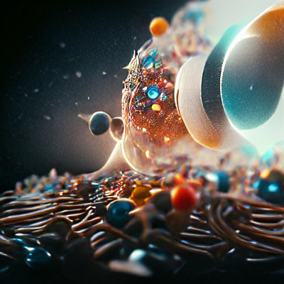
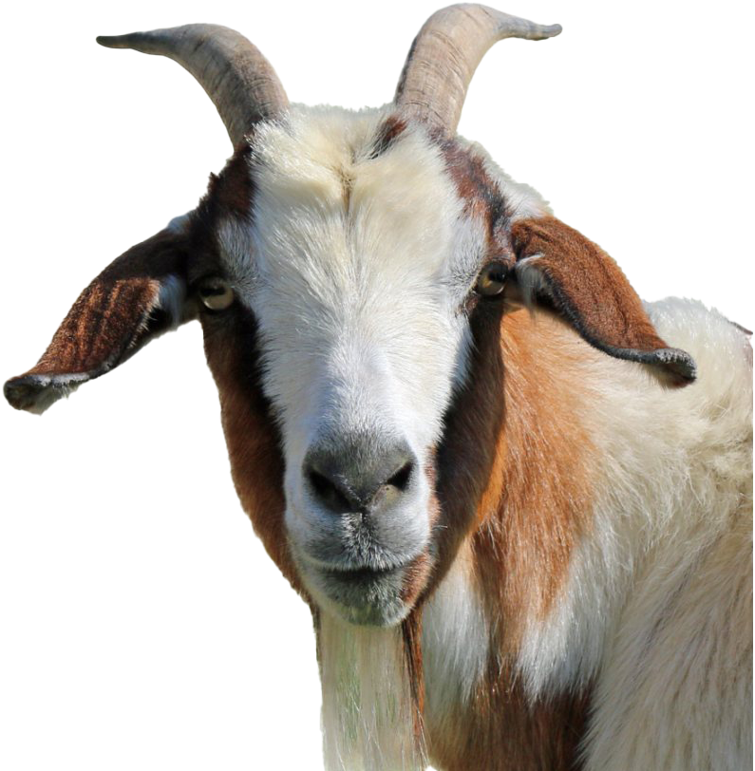
Thank you for your attention
The central role of Gauss constraint across LQC and LQG
Matteo Bruno
CGM Research Group

