Slide 1


IFAST Video Meeting, 18/10/2022
A. Ballarino, CERN

Slide 2
Update on HiTAT Workshop
A. Ballarino, L. Rossi
Selected dates: 9-10 March (preferred) or 16-17 March
Location: CERN or nearby, e.g. Archamps. If at CERN, a number of rooms will be reserved in the CERN hostel
Workshop announcement: before end of November 2022
Draft program in preparation. Focus is on REBCO tape
First day: conductor and cables (including characterization)
Social dinner
Second day: magnets and associated technology

Slide 3
Specification of REBCO Tape

Slide 4
HTS tape for the IFAST CCT
Geometry
4 mm width
2×20 μm/40 μm of Cu on both sides
40-50 μm substrate
Unit length
50 m or multiples
Electrical properties
Critical current ≥ 650 A @ 20 K and 5 T (B any direction) - 10 K of temperature margin
Critical current ≥ 800 A @ 10 K and 5 T (B any direction) – Operating conditions
Mechanical properties
Axial tensile strength ≥ 400 MPa (zero Ic reduction)
Minimum bending diameter: 40 mm (zero Ic reduction)
Total quantity
3 km
Cable: two tapes co-wound. Operational current ∼ 1100 A
Potential suppliers: SuperPower, Theva, Shangai Superconductors, Fujikura, SuperOx (Japan)
Requirements based on presentation of
E. De Matteis and L. Rossi on 27th September 2022
A. Ballarino, 18/10/2022

Slide 5
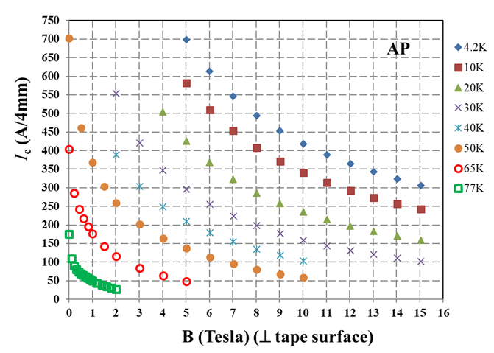
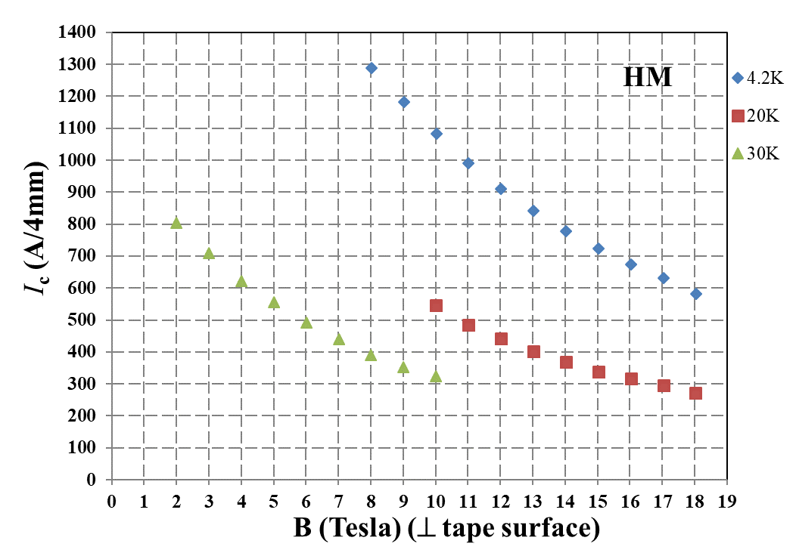

Critical current of SuperPower tape (4 mm width)
A. Ballarino, 18/10/2022

Slide 6
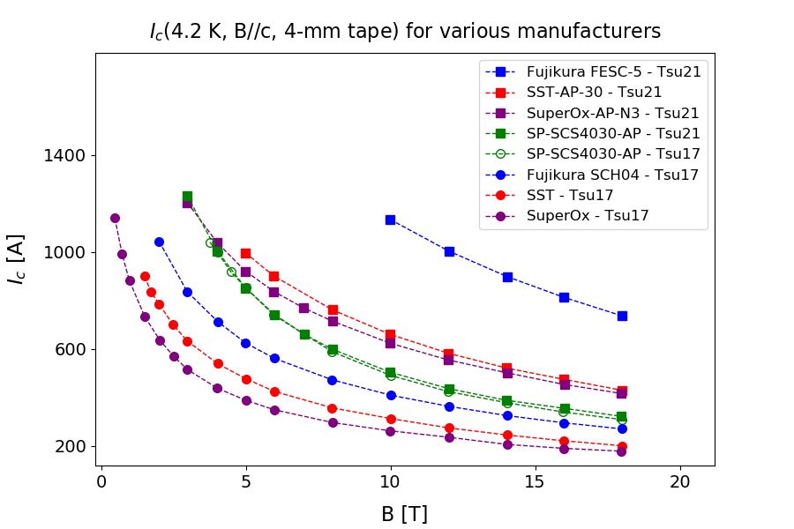
Critical current of REBCO tapes (4 mm width)
G. Succi et al., EDMS EDMS Nr: 2747837
A. Ballarino, 18/10/2022
Notes:
Lift factor (4.2 K vs 20 K) 1.6 at 5 T

