Slide 1
        Upgraded portable muography detector for faster infrastructure measurement
Muographers’23
June. 18-23, 2023
Centro Congressi Federico II
applicable to multi-purposes muography test
Tadahiro Kin*, Wataru Sekiguchi, and Hamid Basiri
IGSES, Kyushu University, Japan

Slide 2
Outline
Introduction
Features of upgraded portable muography detector
Experiments for detector performance test
Results and discussion
Summary & prospects

Slide 3
Outline
Introduction
Features of upgraded portable muography detector
Experiments for detector performance test
Results and discussion
Summary & prospects

Slide 4


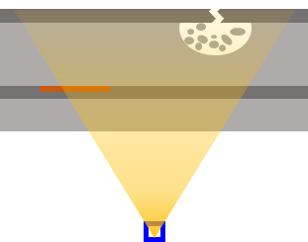
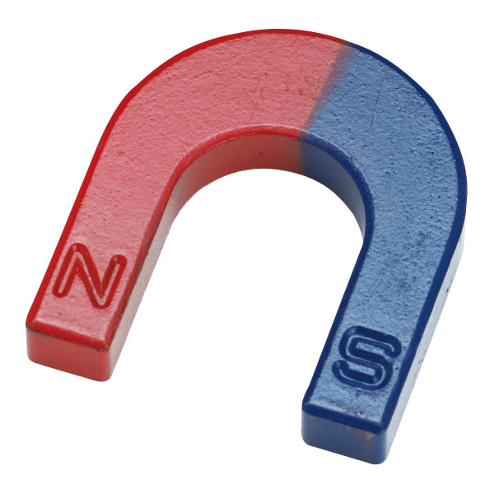
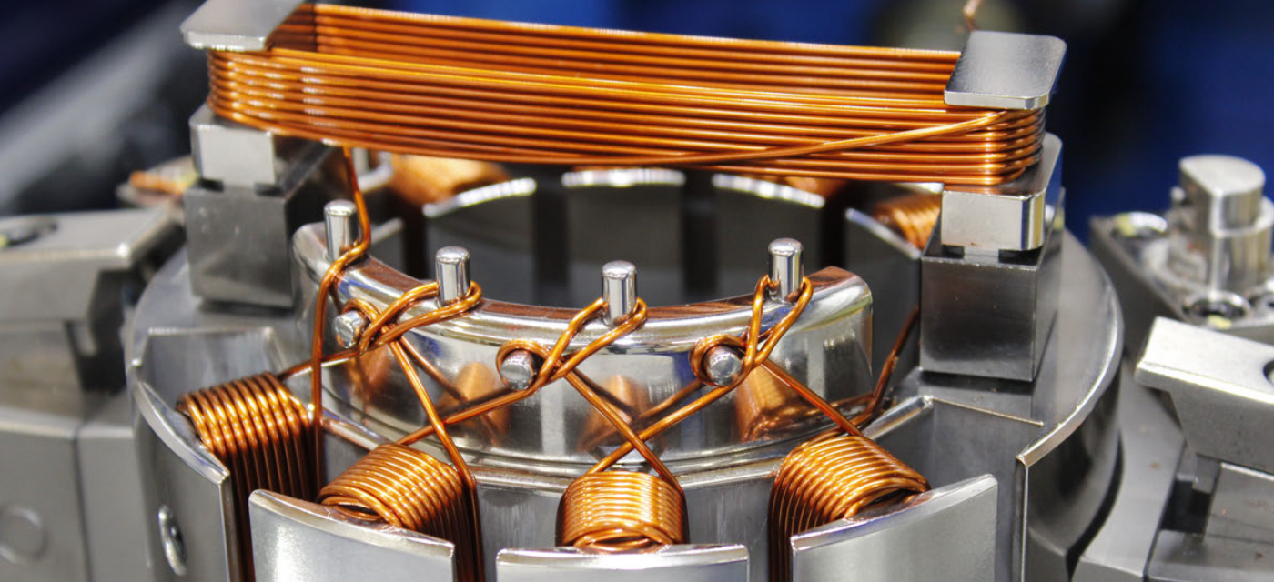
Introduction
Targets of Kyushu University’s Muography
Target with required dynamic range to reveal interested structures
Underground Cavity
10 cm to 50 m
Dam
1 m to 100 m
Bridge
1 cm to 20 cm
Plant 1 cm to 5 m
Cavity
Corrosion
Fire Bricks Loss
Permeation
Tunnel
Recently, we also added
“magnetic field muography”
Magnetic Field
10 cm to 50 m (depends on a target)
→ Please join the last date presentation by Hamid BASIRI (my PhD course student).

Slide 5
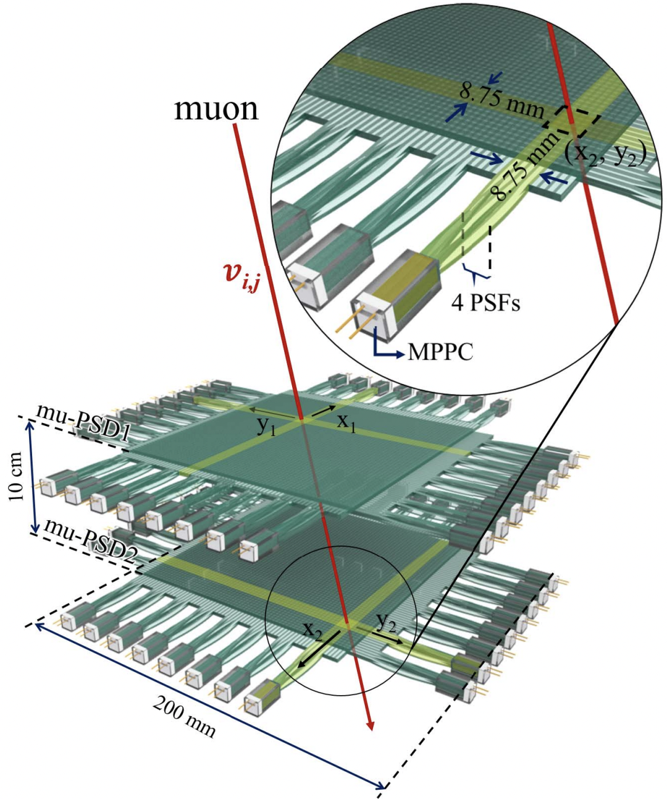
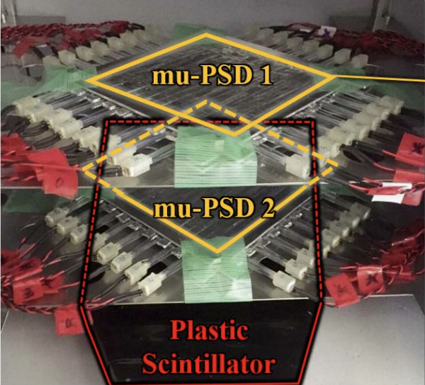
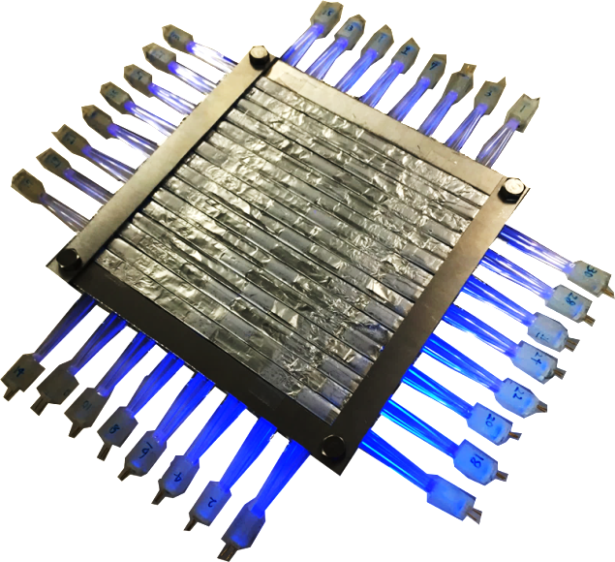
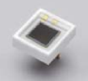
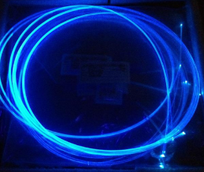
Introduction
Prototype portable muography detector
K. Chaiwongkhot et al., IEEE Trans. Nucl. Sci. 65, 2316 (2018).
muon position sensitive
detector (mu-PSD)
muon
134 mm
32 MPPCs
134 mm
PSF
  Sensitive Area 14 x 14 cm²
  Angular Resolution ~8 mrad
Muon Identificati PS ex. trigger
Cost: ~$18,000
Square (2 x 2 mm²) cross section
Temperature Control System (ΔT ~0.3 ºC)
DAQ: EASIROC Module (64ch MPPC readout module)

Slide 6
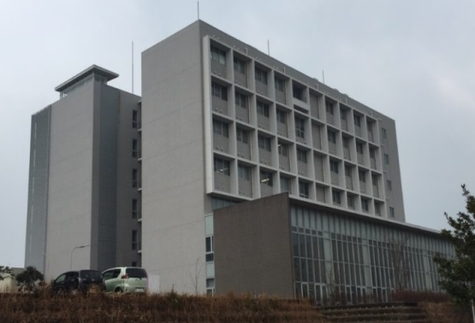
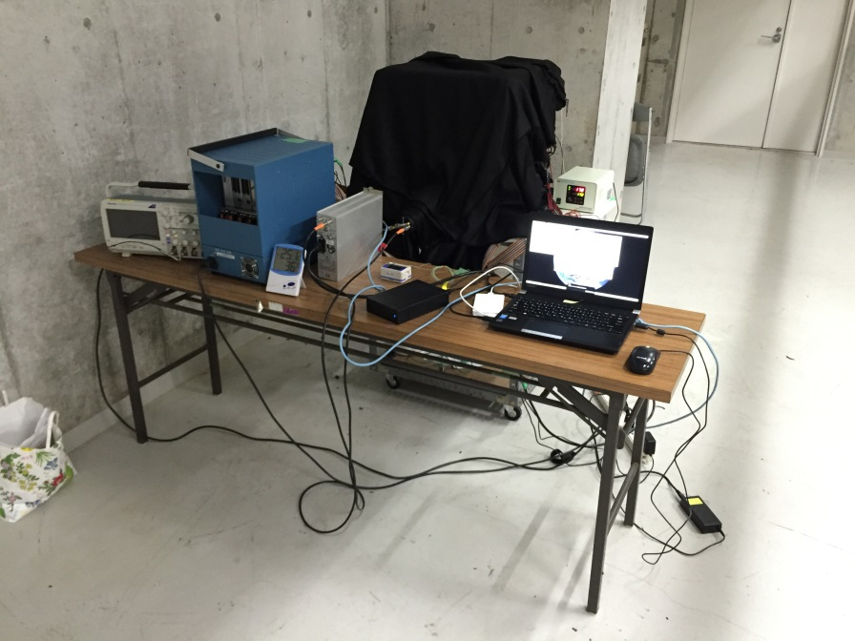
Introduction
Results by the prototype detector
Test measurement
K. Chaiwongkhot et al., IEEE Trans. Nucl. Sci. 65, 2316 (2018).
C-Cube, Kyushu Univ.
Room Area
Open
Ceiling
Space
Room Area
Library
detector position
Basement
Location:
・ C-Cube, Chikusi campus, Kyushu Univ., Japan
・ 3.5 meters below the ground
Measurement Time：
・Foreground: 390 hours (16 days)
・ Open sky: 235 hours (10 days) beside the building
Detector Temperature：
・ 17.0±0.3 ºC
Prototype Muography Detector

Slide 7
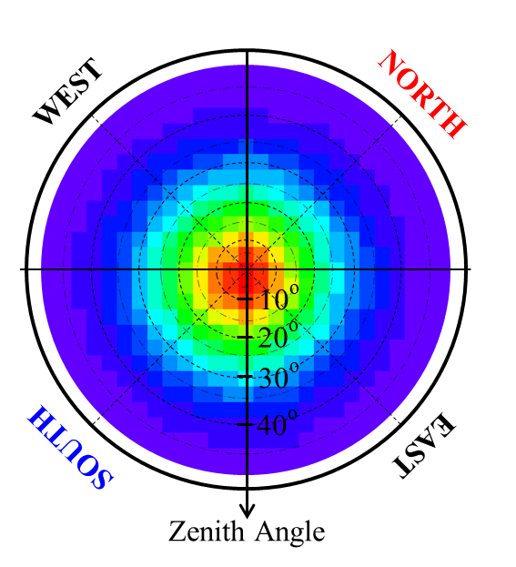
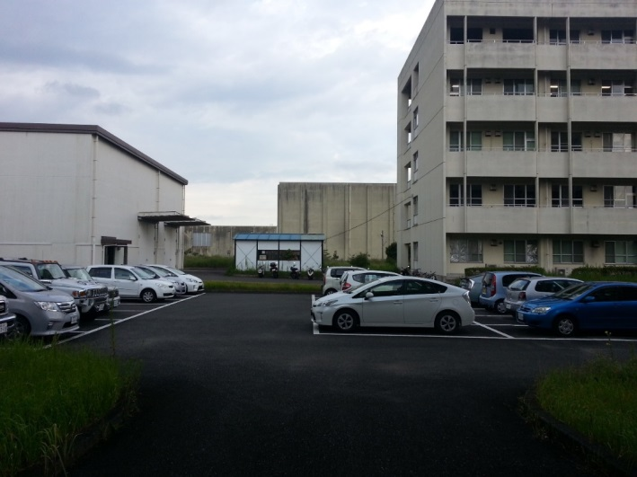
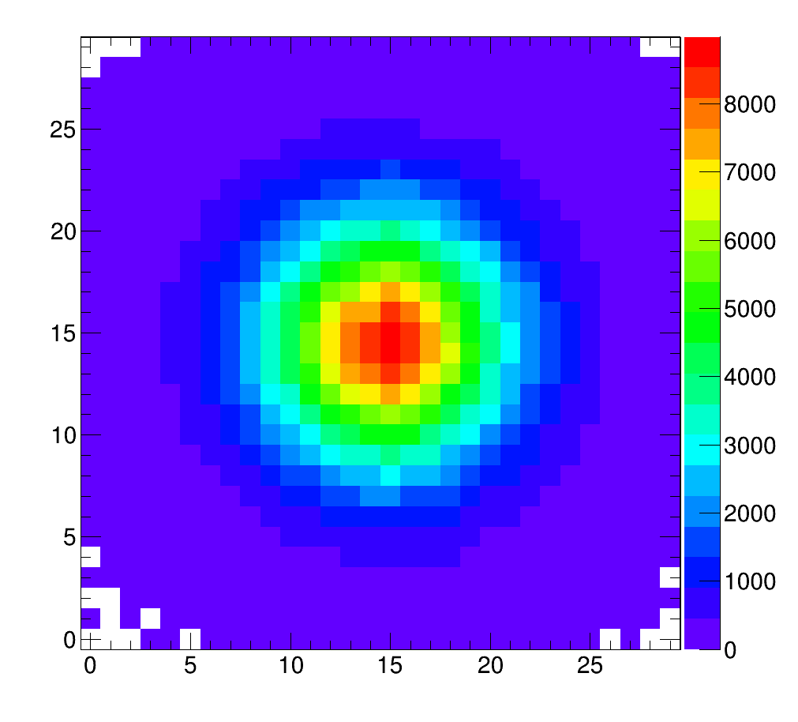
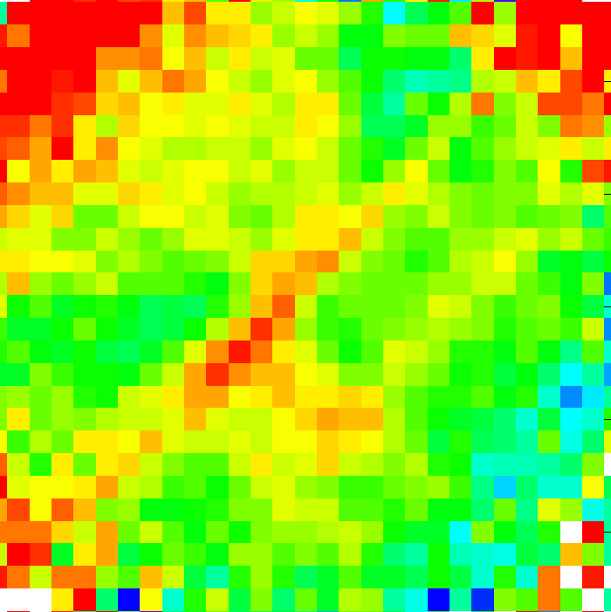
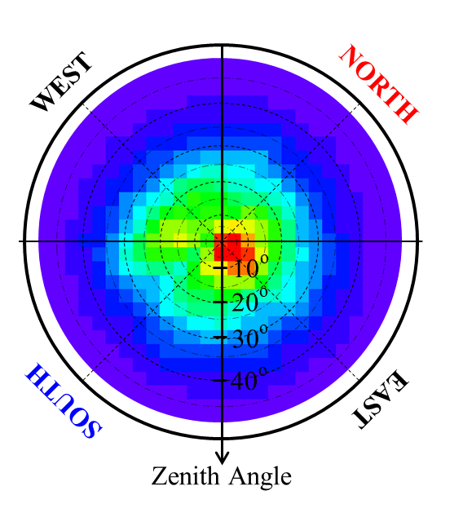
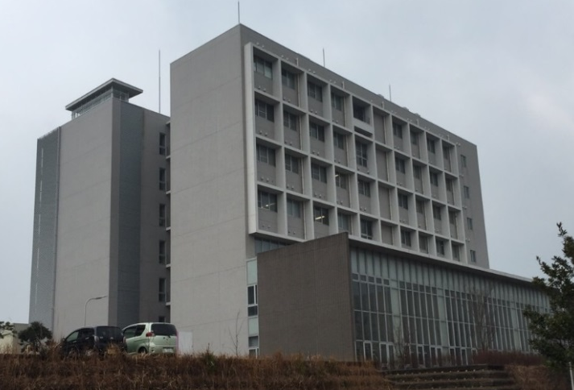
Introduction
Results by the prototype detector
0~40º Open Air
Absorption Rate Map
40º
West
East
Attenuation Rate
Low
High
Experimental Room
WEST
NORTH
Open-sky Measurement
Muon Intensity
Low
High
Foreground Measurement
C-Cube, Kyushu Univ.
10º
20º
30º
40º
SOUTH
EAST
Detector was placed at 3.5m below Ground
Zenith Angle

Slide 8
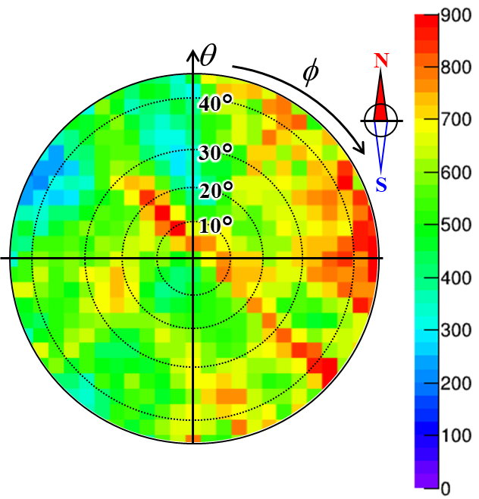
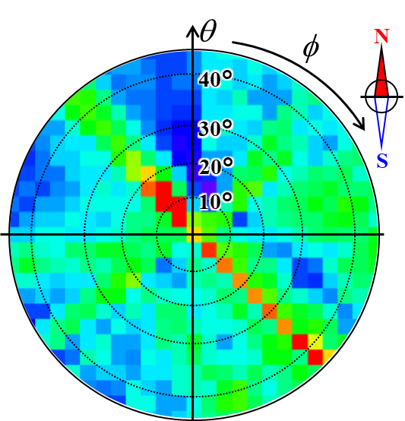
Introduction
Results by the prototype detector
Experimental result
Simulation (concrete only)
Concrete thickness [cm]
The building includes a lot of experiment rooms which equip large instruments.
Difference is mainly caused by the lack of them in the simulation.

Slide 9

Introduction
Issues on the prototype detector to be updated
For the future applications, such as dams and underground structure measurements, require shorter measurement time.
Detection are of a single MPPC is 9 mm², but connected four fibers whose sum of cross section area is 4 mm² $×$4 = 16 mm².
MPPCs are consumables, but replacement is hard work.

Slide 10
Outline
Introduction
Features of upgraded portable muography detector
Experiments for detector performance test
Results and discussion
Summary & prospects

Slide 11
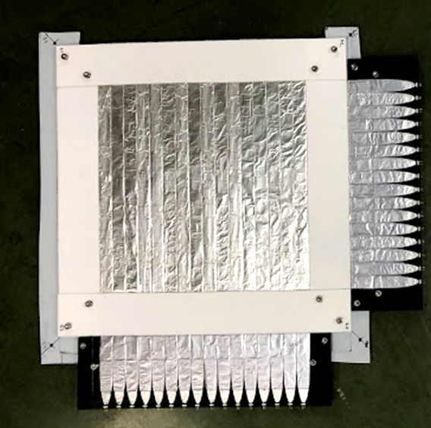
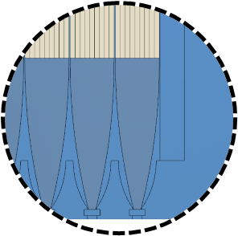
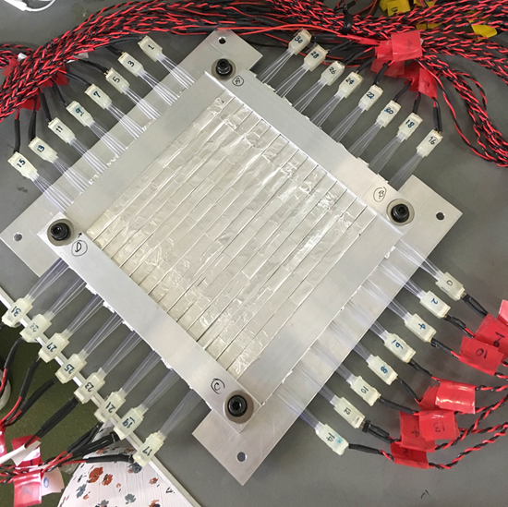
Features of upgraded detector
Muon position sensitive detector
9 PSFs (2 x 2 mm²) for each MPPC
4.9 times larger sensitive area
296 mm
NC fabricated
“light-guide” support
134 mm
296 mm
134 mm
MPPC
Prototype mu-PSD
Laser processing
acrylic light guide
Upgraded mu-PSD

Slide 12
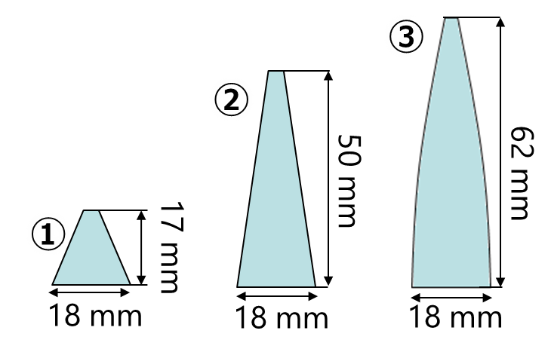
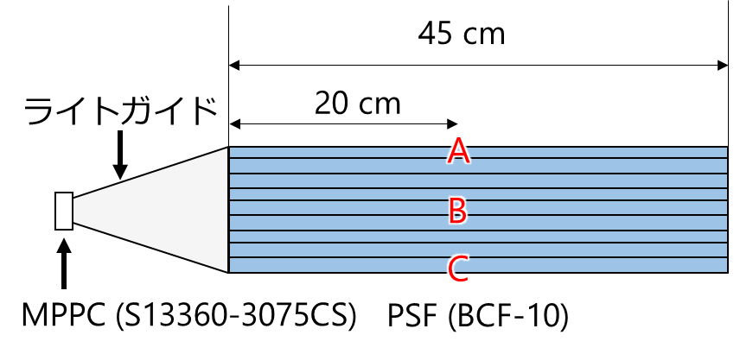
Features of upgraded detector
Optimization of acrylic light guide shape
Three position measurement of ⁹⁰Sr beta-ray source
→ light detection efficiency and uniformity check
Candidates
long linear edge
light guide
source positions
short linear edge
parabola edge

Slide 13
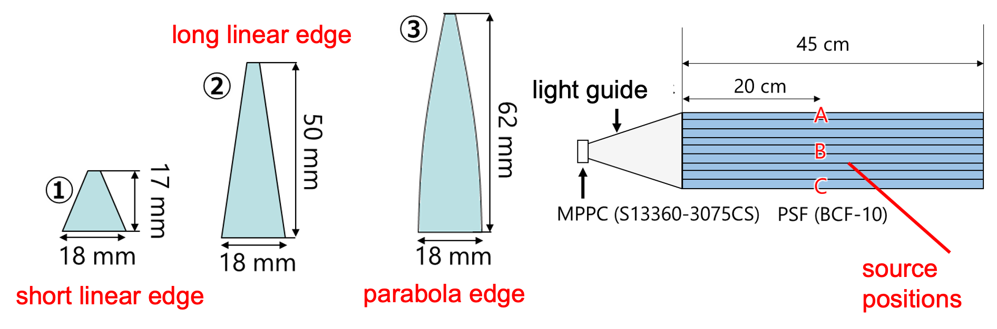
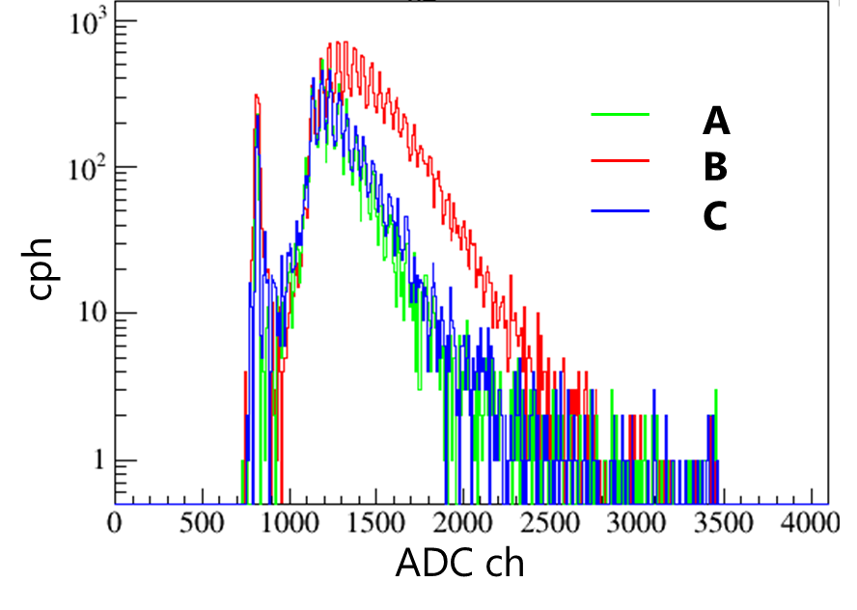
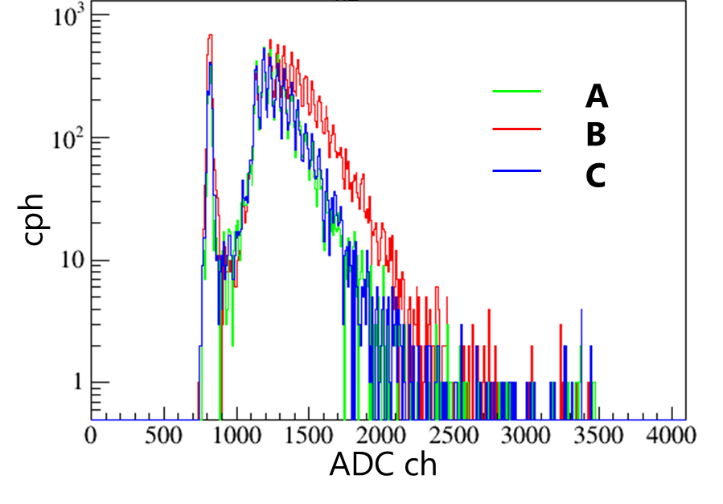
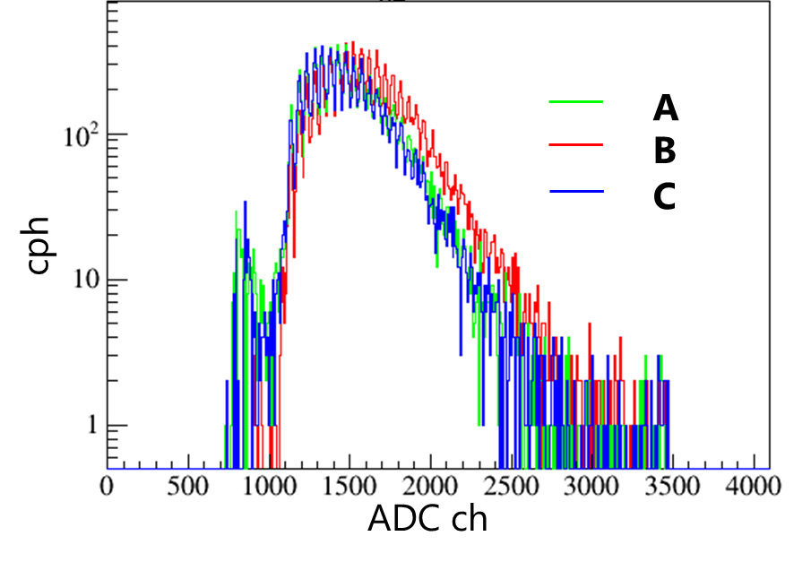
Features of upgraded detector
Optimization of acrylic light guide shape
Average pulse height of MIP muons |  | 波高値 [-]
 | A | B | C
① | 1265.2 ± 2.0 | 1435.7 ± 1.6 | 1294.2 ± 2.2
② | 1288.3 ± 1.7 | 1388.2 ± 1.6 | 1295.3 ± 1.8
③ | 1517.1 ± 2.1 | 1605.1 ± 2.1 | 1497 ± 2.1
①
②
③

Slide 14
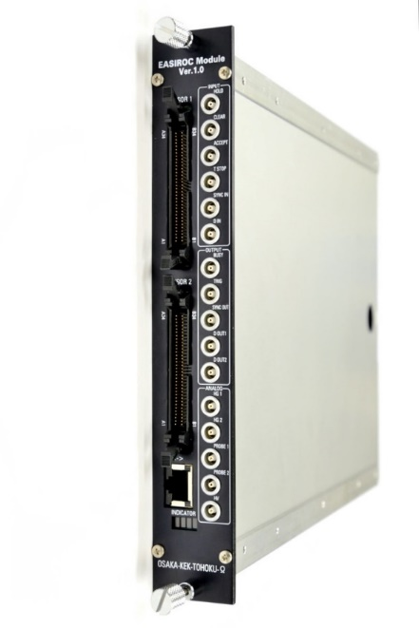
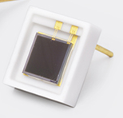
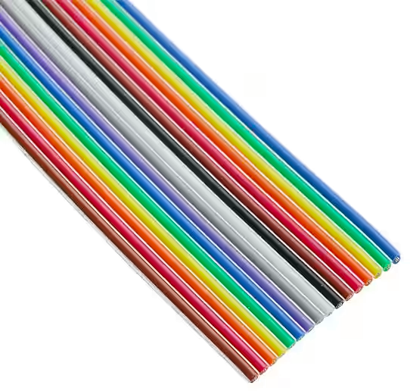
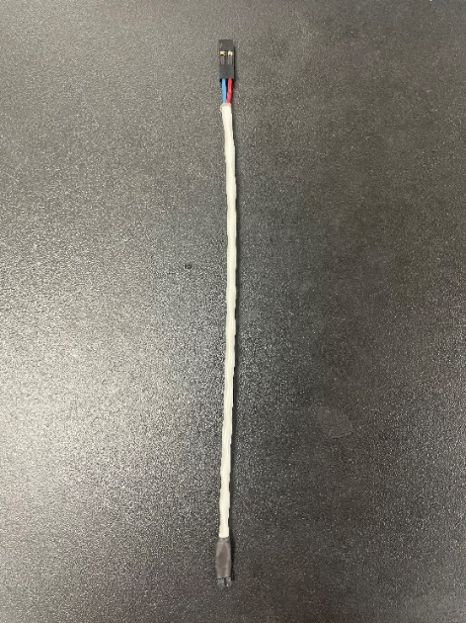
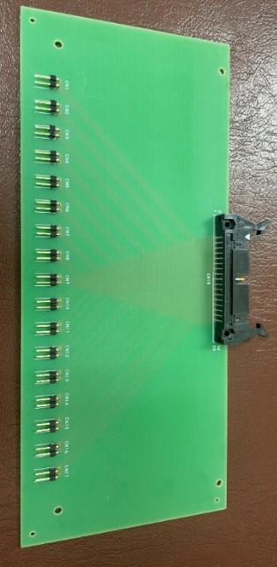
Features of upgraded detector
Data acquisition system
Flat cable conversion board
Just insert
Flat cable
34 pins half-pitch connectors
16-ch MPPCs and 1-ch thermometer
MPPCs
Flat cable
EASIROC module
for 64-ch MPPC readout
Shielded twisted pair cable

Slide 15
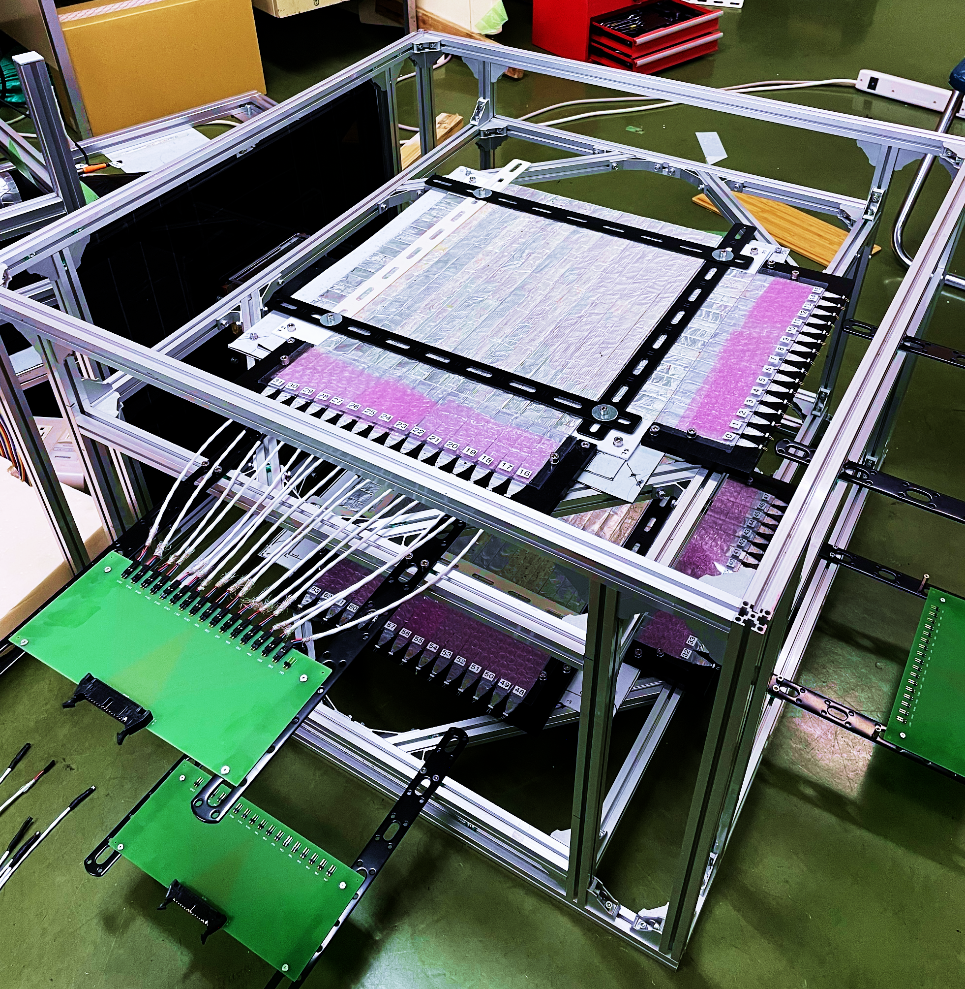
Features of upgraded detector
Upgraded in 2022 !!
Larger
muon Position
Sensitive
Detector
Whole size (portable):
  W 800 x L 800 x H 500 mm³
Larger sensitive area:
  296 x 296 mm² (4.9 times)
Easy maintenance:
  by robustDAQ system cabling
New cabling systes
for robust MPPC
Connection

Slide 16
Outline
Introduction
Features of upgraded portable muography detector
Experiments for detector performance test
Results and discussion
Summary & prospects

Slide 17
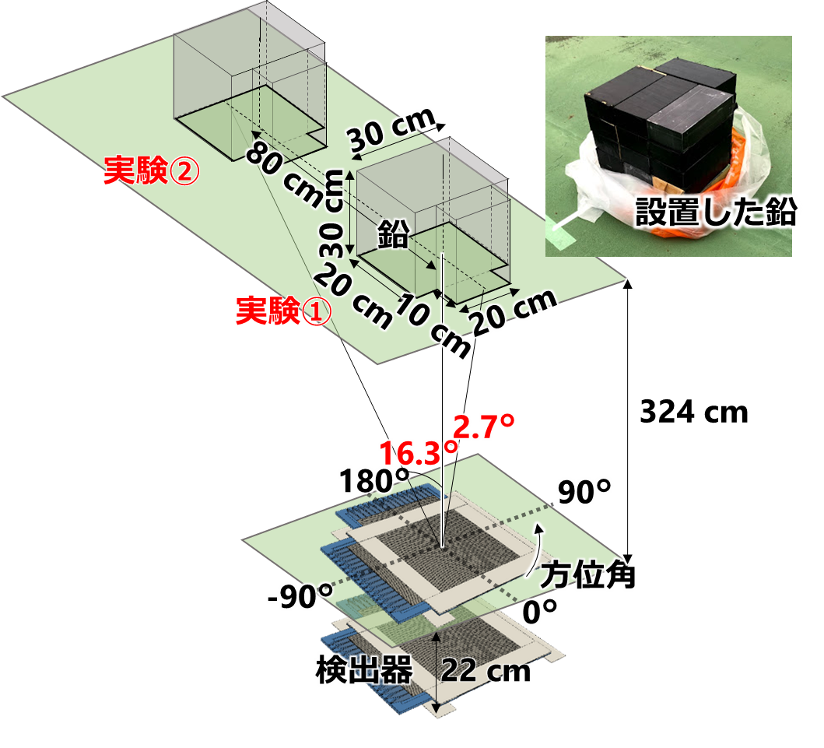
Detector performance test
Experiment conditions
8 mrad sized lead blocks placed on the roof
Experient 2
Lead
Photo of
lead blocks
Experiment 1
Lead blocks placed at 0 degrees of zenith angle
Measurement time: 140 hours
Experient 1
Experiment 2
Lead blocks placed at 16.3 degrees of zenith angle and azimuthal 180 degrees of azimuthal angle.
(3-pixel shift from Experiment 1)
Measurement time: 220 hours
azimuthal
angle
Upgraded detector

Slide 18
Outline
Introduction
Features of upgraded portable muography detector
Experiments for detector performance test
Results and discussion
Summary & prospects

Slide 19
Performance test results
Detector stability –before air pressure correction -
Counting rate [cph]
(red line)
Atmospheric pressure [hPa]
(blue line)
Elapsed time [hour]

Slide 20
Performance test results
Detector stability –after air pressure correction -
Counting rate [cph]
(red line)
Negative correlation
-18.7 cph/hPa
Elapsed time [hour]
→ Sufficiently stable

Slide 21
Performance test results
Detector stability –after air pressure correction -
Counting rate [cph]
(red line)
Negative correlation
-18.7 cph/hPa
We expected 20,000 cph by the larger sensitive area. But photon lost between PSF and light guide and attenuation by longer PSF decreased 20% of photons.
→ But 4 times faster compared with prototype.
Elapsed time [hour]

Slide 22
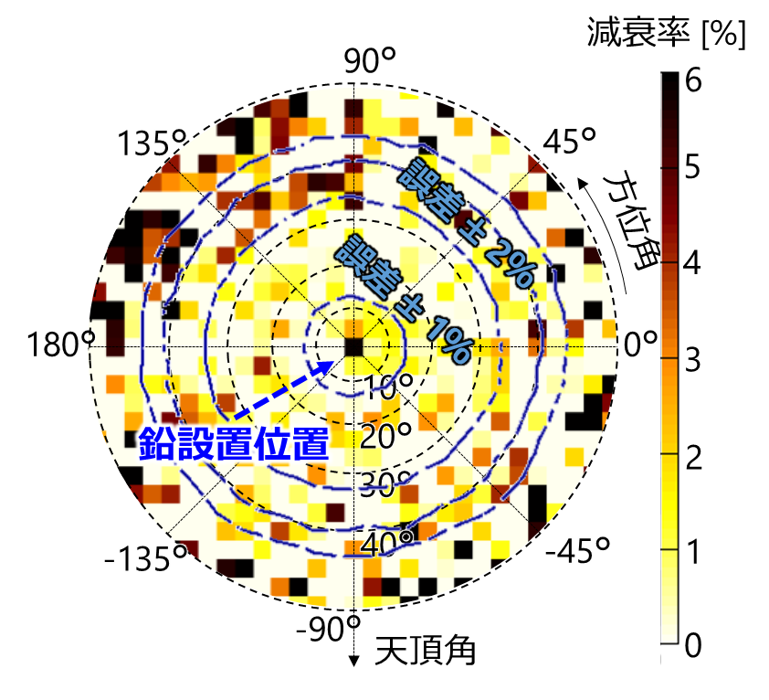
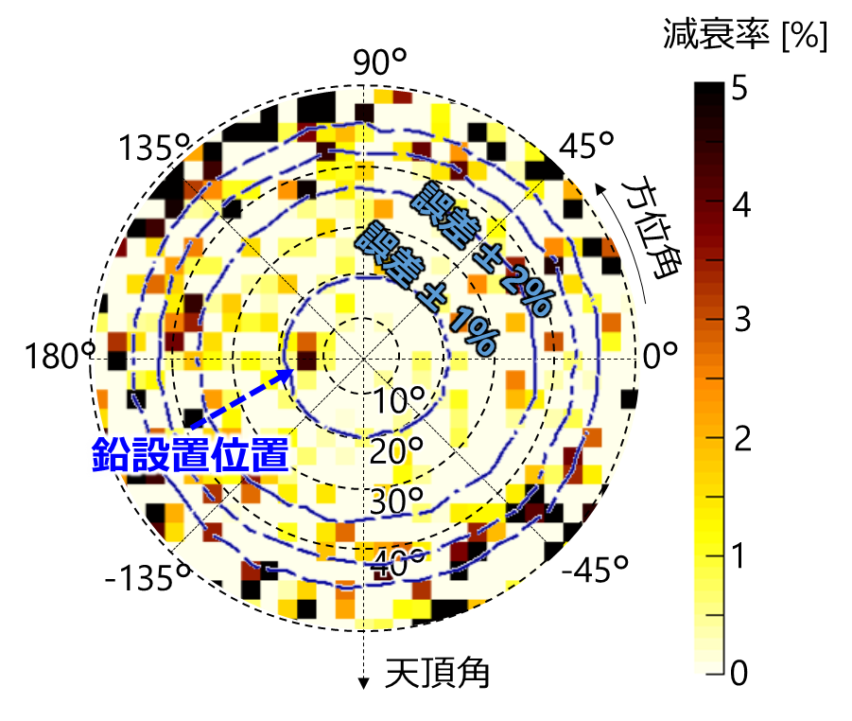
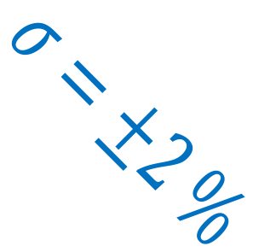
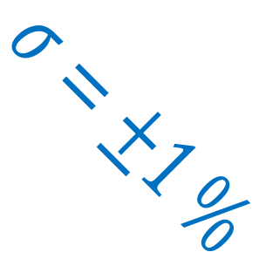
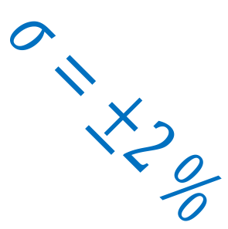
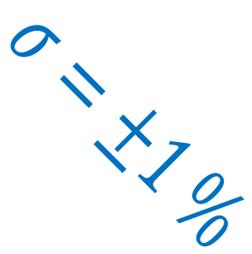
Performance test results
Experiment 1
Experiment 2
実験結果
$$σ=±2 \%$$
$$σ=±2 \%$$
$$σ=±1 \%$$
$$σ=±1 \%$$
absorption ratio [%]
absorption ratio [%]
Lead block position
Lead block position
←zenith angle
Absorption by lead block 5.8 ± 0.8%
Absorption by lead block 4.4 ± 0.8%
simulation 6.6 ± 0.4%
simulation 5.3 ± 0.5%
Lead blocks were observed within single pixel, ~8 mrad
with expected absorption ratio, i.e. density.

Slide 23
Outline
Introduction
Features of upgraded portable muography detector
Experiments for detector performance test
Results and discussion
Summary & prospects

Slide 24
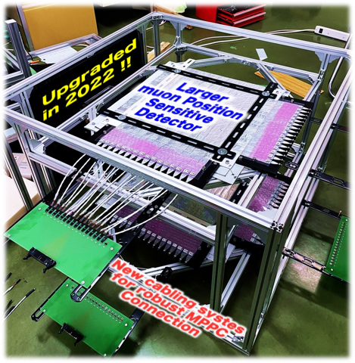
Summary and prospects
Summary: Our 2nd detector was fabricated.
4 times faster stable counting rate by larger sensitive area
8 mrad angular resolution
5% absorption can be detected with less than 20% of statistical uncertainty
Prospects
Test survey of underground during drilling tunnel.
Scattering muography by combination with prototype.
Applied for test measurement of Magic-µ (magnetic field imaging by cosmic-ray muons).

