Slide 1






Detector optimization in Muon Scattering Tomography
Maxime Lagrange on behalf of the TomOpt authors*
Muographers2023 - International workshop on muography, June 19-22 2023 Naples
*G.Strong¹, T. Dorigo¹, P. Vischia², A. Giammanco³, H. Zaraket⁴, M. Lagrange³, F. Bury⁵, F. Nardi¹, A. Orio⁶, M. Lamparth⁷, A. Bordignon¹, M. Safieldin³, J. Kieseler¹
¹INFN-Padova, ²Universidad de Oviedo and ICTEA, ³Université catholique de Louvain, ⁴Lebanese University, ⁵University of Bristol,
⁶Muon systems, ⁷Technical University of Munich
Contact: maximelagrange98@gmail.com

Slide 2
OUTLINE
I - Introduction to TomOpt concept
II - TomOpt demonstration
III - TomOpt and momentum estimation
IV - Conclusion

Slide 3
I - Introduction to TomOpt

Slide 4

Optimizing a detector for a desired task
What to act on?
Optimization becomes a minimization problem
Detector parameters 𝑥
𝑚𝑖𝑛 ℒ( 𝑥 )
Position
Efficiency
“Finding the local-minimum of a differentiable function”
Spatial resolution
Span
Iterative gradient-descent algorithm:
Minimizing cost, constraints and error on prediction
at iteration 𝑘:
Loss function ℒ( 𝑥 )
𝑥^{(𝑘+1)} = 𝑥^{(𝑘)} + 𝜂 . ∇_{𝑥} ℒ( 𝑥^{(𝑘)} )
Error
Cost & constraints
Requires a fully differentiable simulation pipeline
“Toward the end-to-end optimization of particle physics instruments with differentiable programming” T. Dorigo, A. Giammanco, P. Vischia (editors) MODE Collaboration

Slide 5



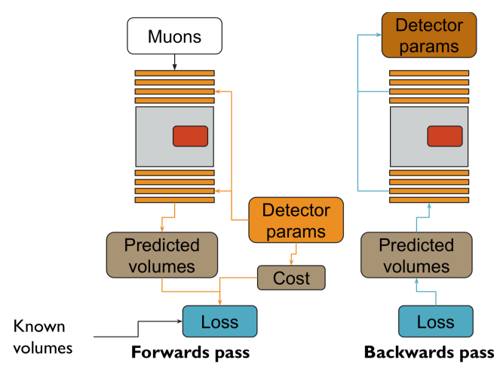
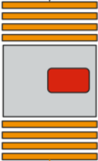
TomOpt: differentiable optimisation
TomOpt iteration routine
1
Initial detector configuration
Positions x,y,z
Spatial resolution
Efficiency
Span dx, dy
1
Volume of interest
Detector panels

Slide 6
TomOpt: differentiable optimisation
TomOpt iteration routine
1
Initial detector configuration
2
Cosmic muon source sampled from literature
2
𝝁
1

Slide 7
TomOpt: differentiable optimisation
TomOpt iteration routine
1
Initial detector configuration
2
Cosmic muon source sampled from literature
2
3
Muon detection and propagation through matter
𝝁
3
1
Reconstructed Hits
Propagation
Custom made differentiable muon detection and propagation models

Slide 8
TomOpt: differentiable optimisation
TomOpt iteration routine
1
Initial detector configuration
2
Cosmic muon source sampled from literature
2
3
Muon detection and propagation through matter
3
4
Volume prediction
1
Using reconstructed hits and a given reconstruction method, predict the desired figure of merit
4

Slide 9
TomOpt: differentiable optimisation
TomOpt iteration routine
1
Initial detector configuration
2
Cosmic muon source sampled from literature
2
3
Muon detection and propagation through matter
3
4
Volume prediction
1
5
Loss function computation
Loss function ℒ(𝑥)
4
Error
Cost
5
Prediction ⁻ Simulated truth
$, external constraints

Slide 10
TomOpt: differentiable optimisation
TomOpt iteration routine
1
Initial detector configuration
2
Cosmic muon source sampled from literature
2
3
Muon detection and propagation through matter
3
4
Volume prediction
1
5
Loss function computation
6
Gradient-descent optimisation
4
𝑥^{(𝑘+1)} = 𝑥^{(𝑘)} + 𝜂 . ∇_{𝑥} ℒ( 𝑥^{(𝑘)} )
5
6
Updated
parameter
Initial
parameter
Loss
gradient

Slide 11
TomOpt: differentiable optimisation
TomOpt iteration routine
1
Initial detector configuration
2
Cosmic muon source sampled from literature
2
7
3
Muon detection and propagation through matter
3
4
Volume prediction
1
5
Loss function computation
6
Gradient-descent optimisation
4
7
Modified geometry used at step
1
5
6
Repeat until Loss function minimum is found

Slide 12
II - TomOpt demonstration

Slide 13
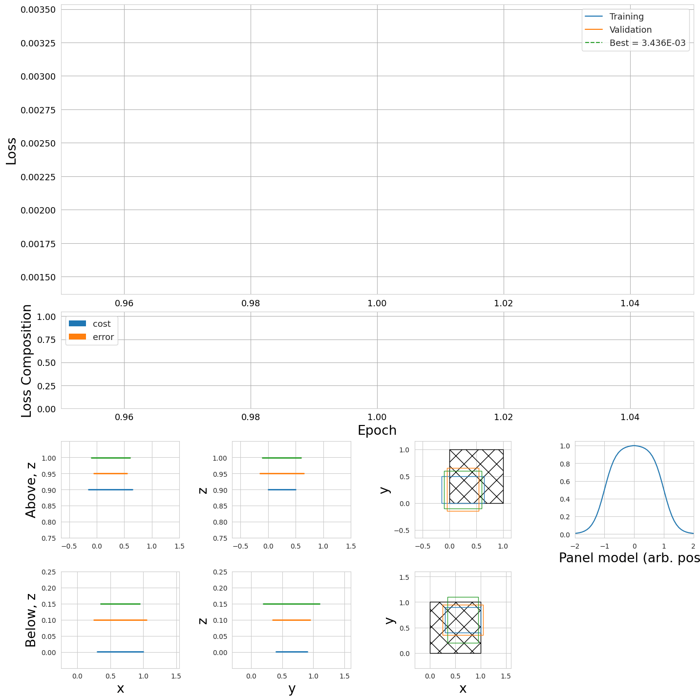
TomOpt: X₀ inference performance driven optimisation
30 free parameters:
x,y,z position
xy span
Loss function
ℒ
Sub-optimal initial geometry
Volume of interest
Upper panels vertical placement
Lower panels vertical placement
panels span and horizontal placement

Slide 14
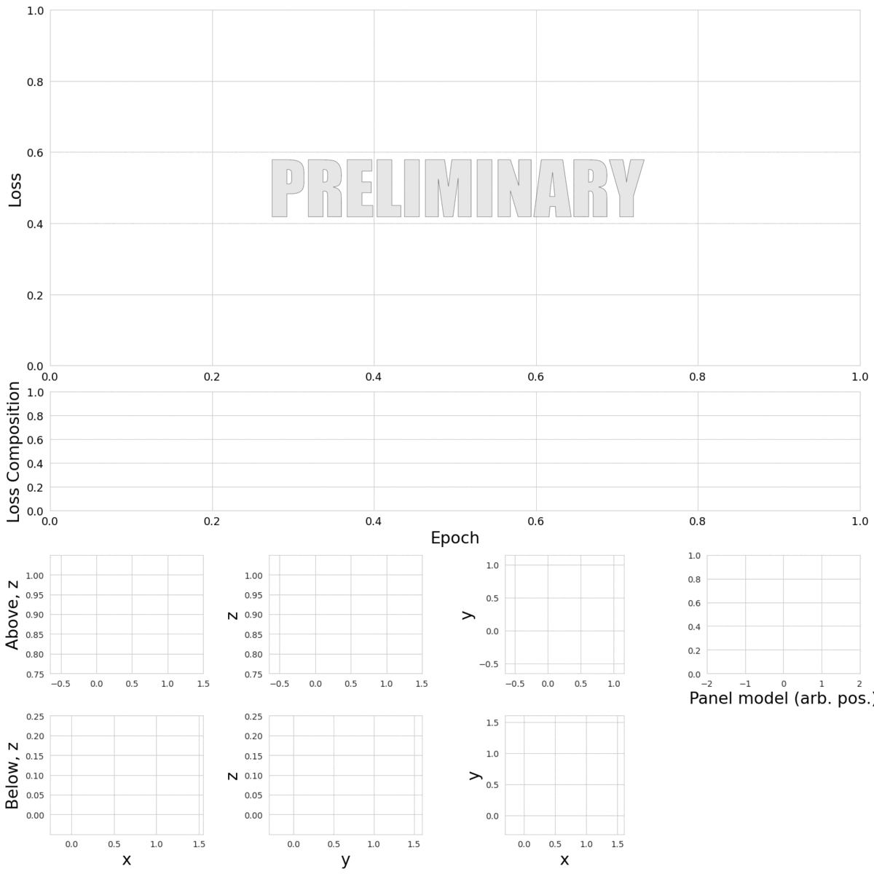
TomOpt: X₀ inference performance driven optimisation

Slide 15
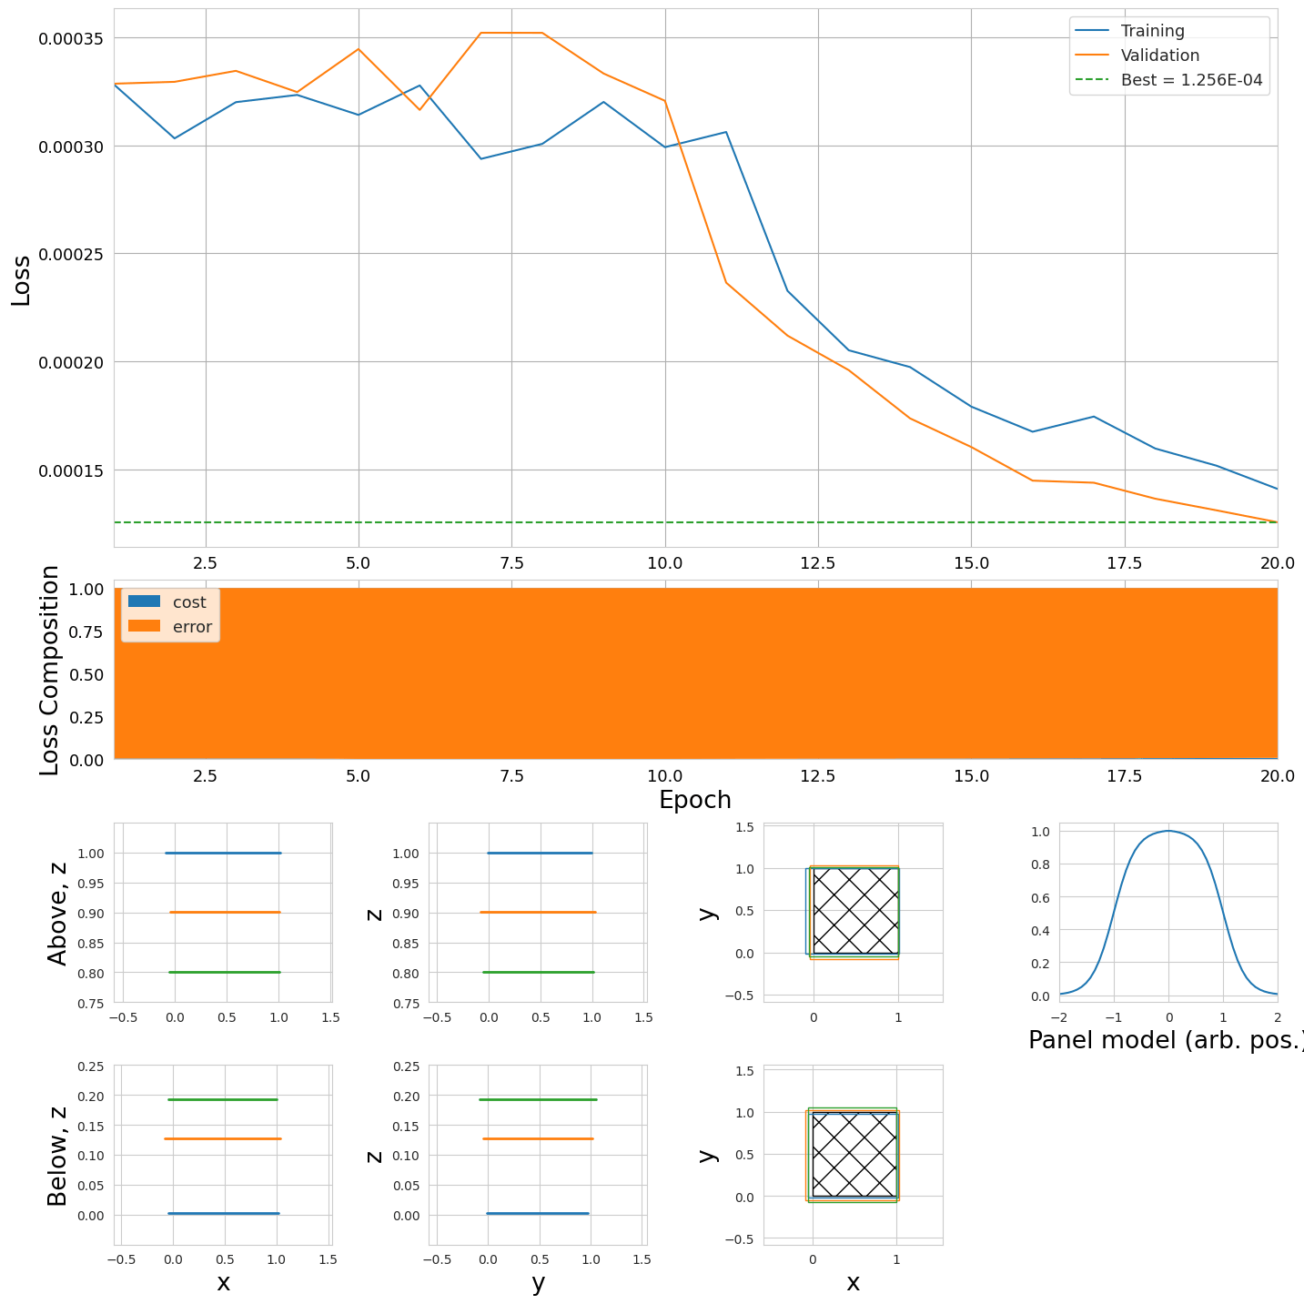
TomOpt: X₀ inference performance driven optimisation
z placement grants optimal angular resolution
Acceptance is not ideal
Panels now cover the whole volume of interest

Slide 16
III - Momentum measurement module

Slide 17
Momentum measurement module
Spatial resolution error
Setup:
4 lead absorbers (10cm thick)
10 detection planes
𝜇
10 cm
Detection
planes
Passive
scatterer

Slide 18
Momentum measurement module: input variables
Deflection angles
Scattering angle
Fit residuals r
r₀
Linear fit
r₁
𝜽_{deflection, 0}
r₂
𝚫𝜽_{scattering}
𝜽_{deflection, 1}
r₃

Slide 19
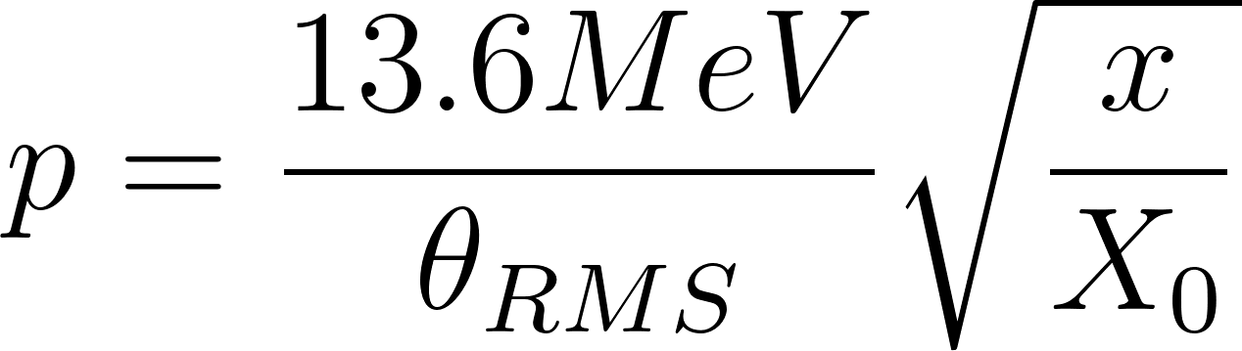
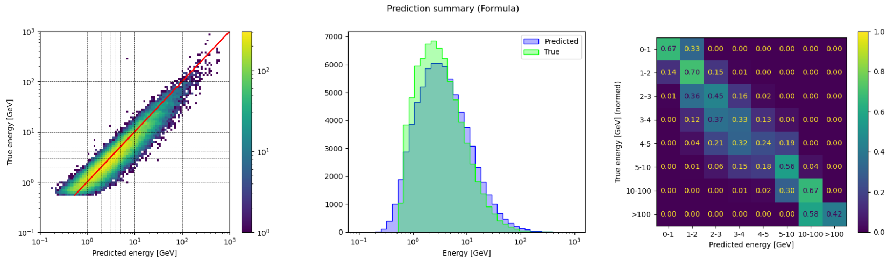
Momentum inference: Scattering formula regression
Input variable
Inference method
4 scattering angle measurement
Perfect spatial resolution
Multiple Coulomb scattering model
𝜟𝜽_{RMS} = ¼ 𝛴 𝜟𝜽_{i}

Slide 20
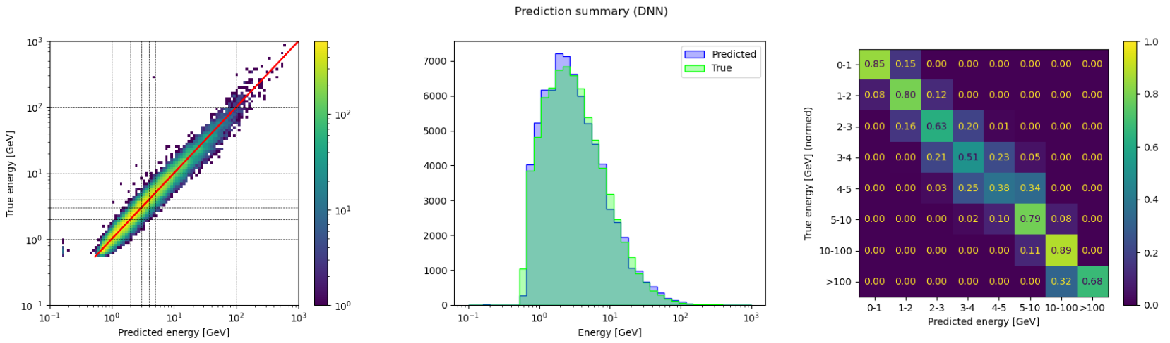
Momentum inference: DNN regression
Input variable
Inference method
8 deflection angles
10 residuals
4 scattering angles
Perfect spatial resolution
DNN
Three 64 neurons layers
Infer on log(𝑝)

Slide 21
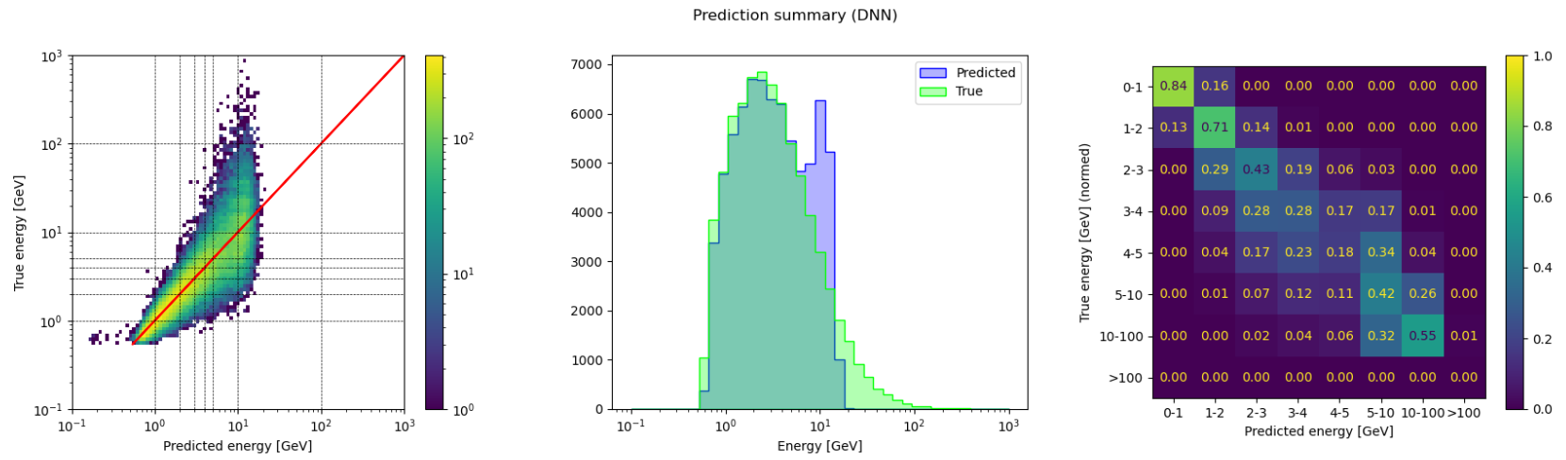
Momentum inference: DNN regression
Input variable
Inference method
8 deflection angles
10 residuals
4 scattering angles
2mm spatial resolution
DNN
Three 64 neurons layers
Infer on log(𝑝)

Slide 22
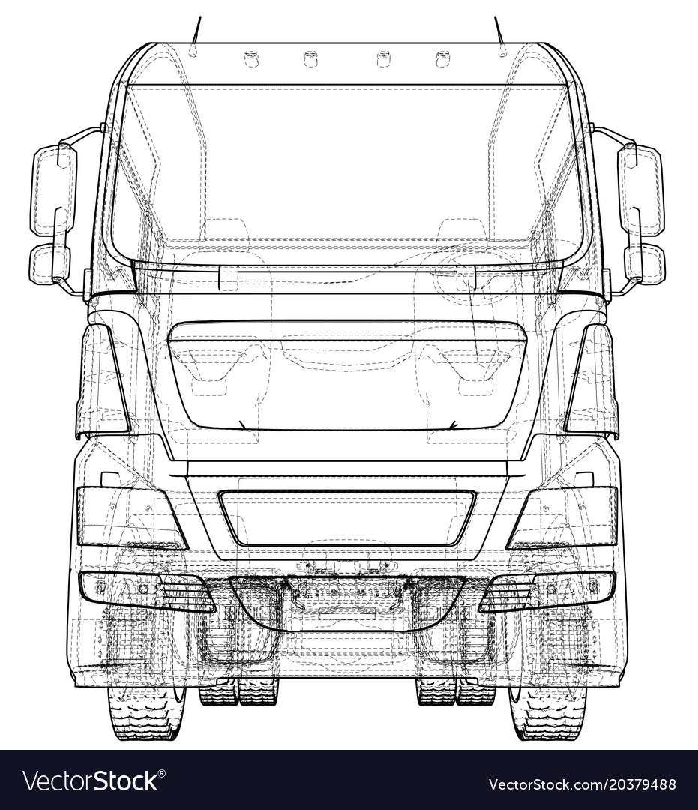
Question TomOpt will answer
Is it worth it to add a muon energy spectrometer to the detector?
OR
}
momentum measurement module

Slide 23
IV - Conclusion

Slide 24
CONCLUSION
In the future
TomOpt optimises detector configuration for specific Muon Scattering Tomography tasks
TomOpt offers a fully differentiable MST simulation pipeline
As long as differentiability is preserved, it can be adapted to any MST experiment
Open source release of the software
Publication incoming!
Include momentum measurement sub-detector in the optimisation chain
Don’t hesitate to contact us!
Check out related MODE collaboration work:
“Toward the end-to-end optimization of particle physics instruments with differentiable programming” T. Dorigo, A. Giammanco, P. Vischia (editors)
Contact: maximelagrange98@gmail.com

Slide 25
BACKUP SLIDES

Slide 26
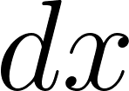




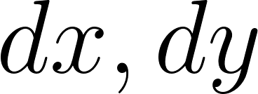
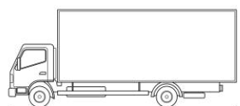
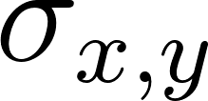



Hardware parameters
Number of detection planes
Plane i
Placement
Dimension
Spatial resolution
Efficiency
Technology
RPC’s
Scintillators
MicroMegas

Slide 27
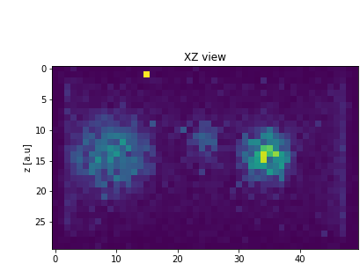
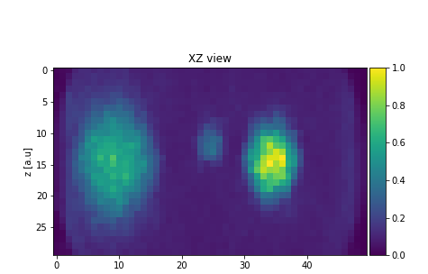
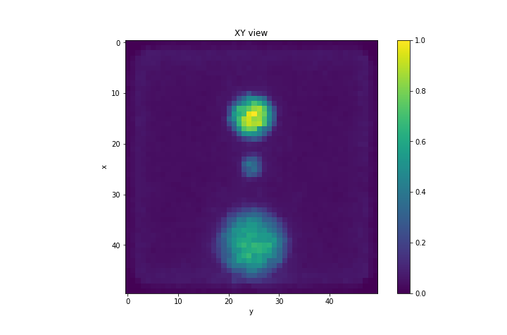
Software parameters
1 - Reconstruction algorithm (POCA, ASR, Maximum Likelihood, Binned Clustered Algorithm, etc..)
b - Angle Statistic Reconstruction
algorithm (ASR)
a - Point Of Closest Approach (POCA)
INPUT
muon tracks
hits
II - Material classifiers
Typical MST reconstruction parameters
Pb
Cuts on scattering angles
Noise reduction sensitivity
Fe

Slide 28
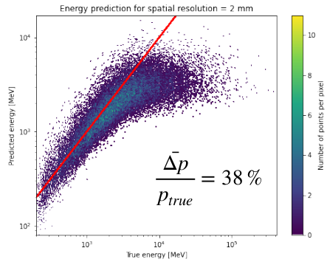
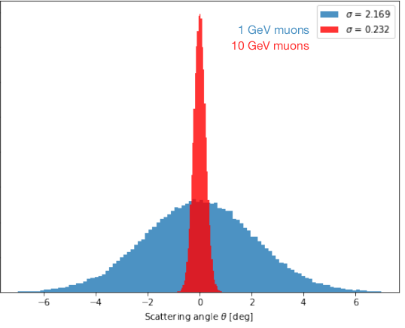
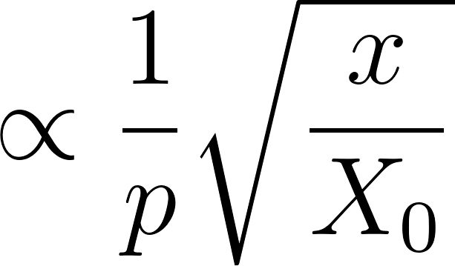
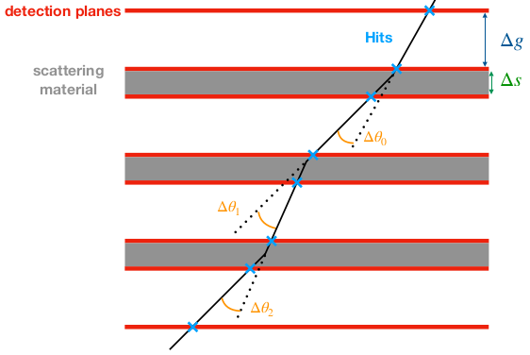
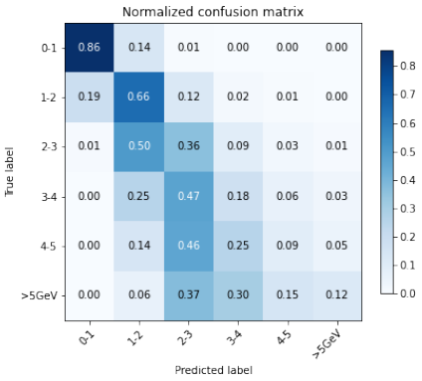
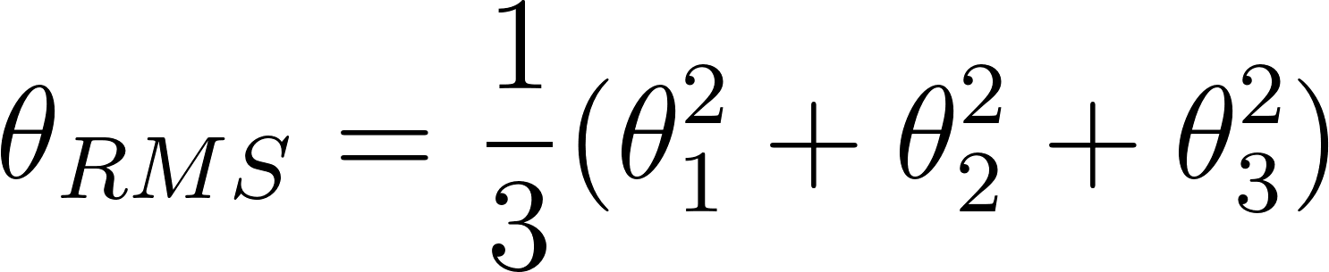
Muon momentum measurement
Muon scattering amplitude
Scattering angle measurement
Multiple Coulomb scattering model

Slide 29
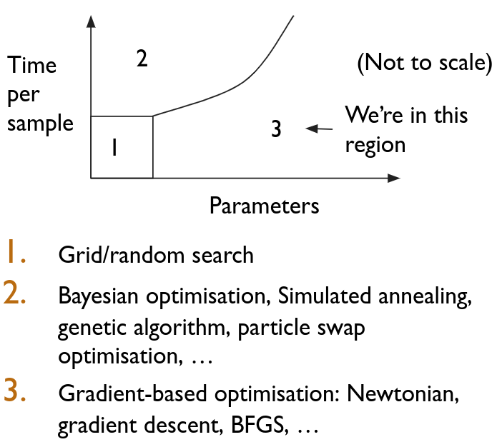
Parameter space in MST
Hardware
Tracking system technology (RPC’s, scintillators, micromegas, drift tubes, etc..)
Spatial resolution
Efficiency
Tracking system (# planes, dimensions, geometry)
LHC-type experiments
MST
Software
Reconstruction algorithms
Material classifiers
Image recognition, clustering

Slide 30
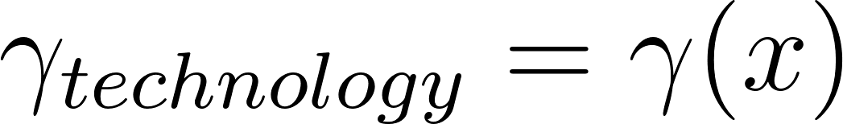
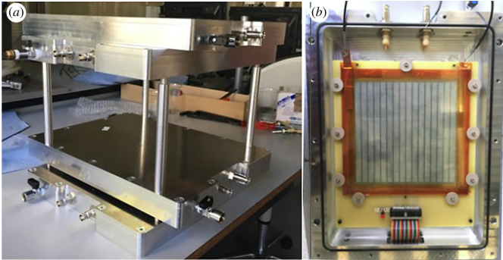
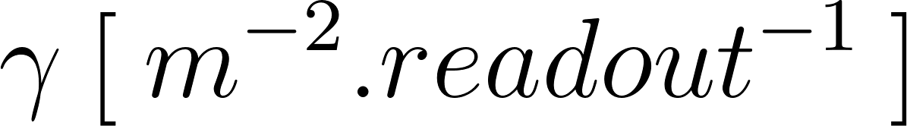
Detector parameters and cost
Global cost c(θ, φ) can be expressed as a function of local cost parameters θ
and a set of parameters φ describing the overall detector conception such as
number and size of detector modules and their respective positions
Given its design and technology choices, how to estimate detector cost?
Local cost 𝛾
Global cost C(𝛄,𝜑)
Local cost 𝛾
Cost specific to the
technology used
Describe overall detector conception
with the performance properties of the given technology e.g time, spatial resolution, efficiency
Sealed RPC prototype in development at UCLouvain
Portable muoscope in
development at UCLouvain

Slide 31
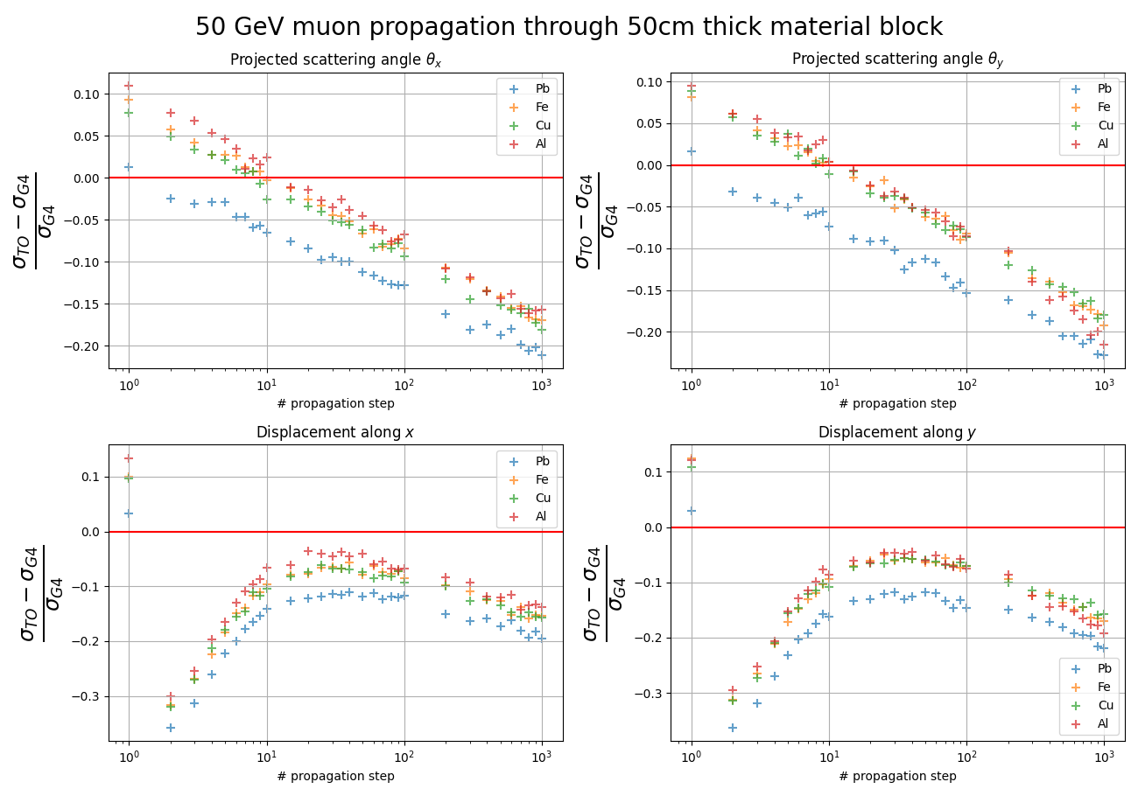

Slide 32
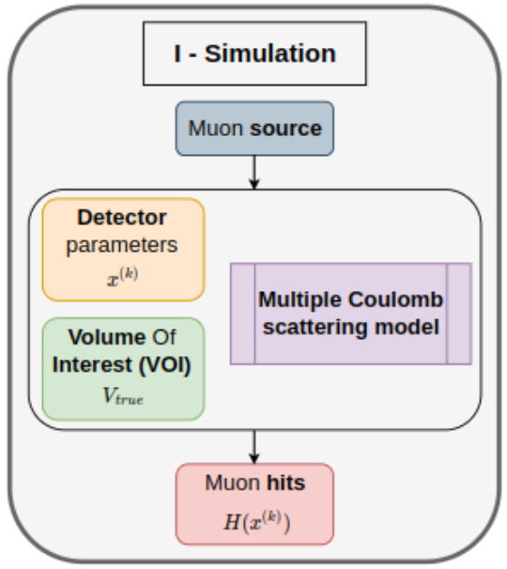
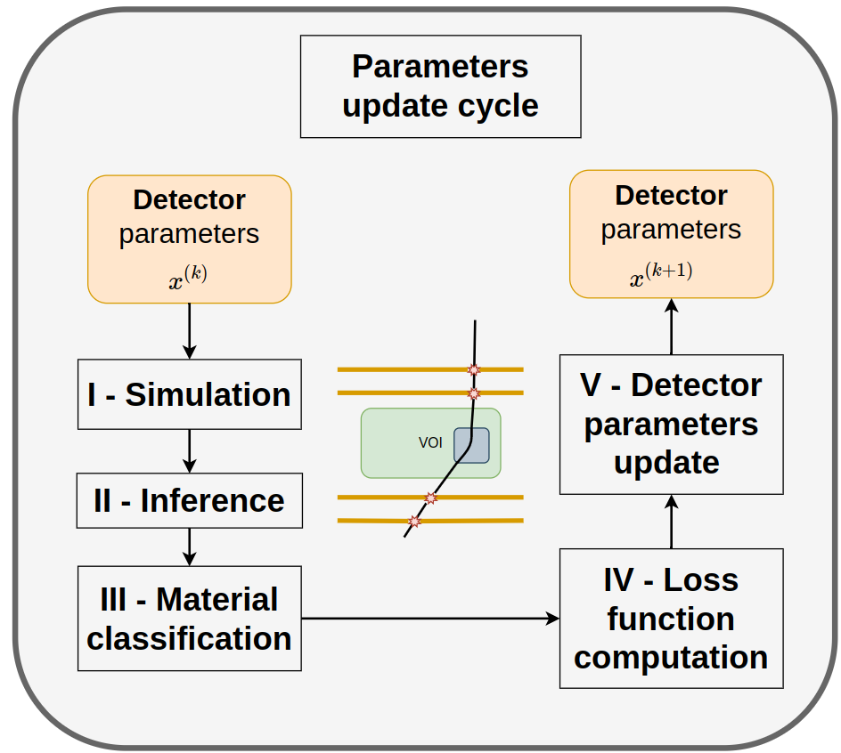
TomOpt

Slide 33
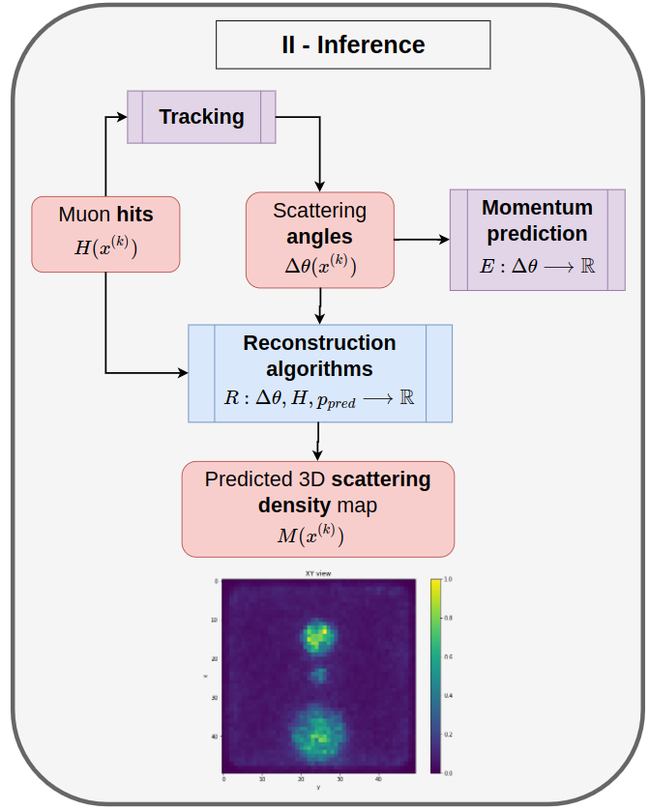
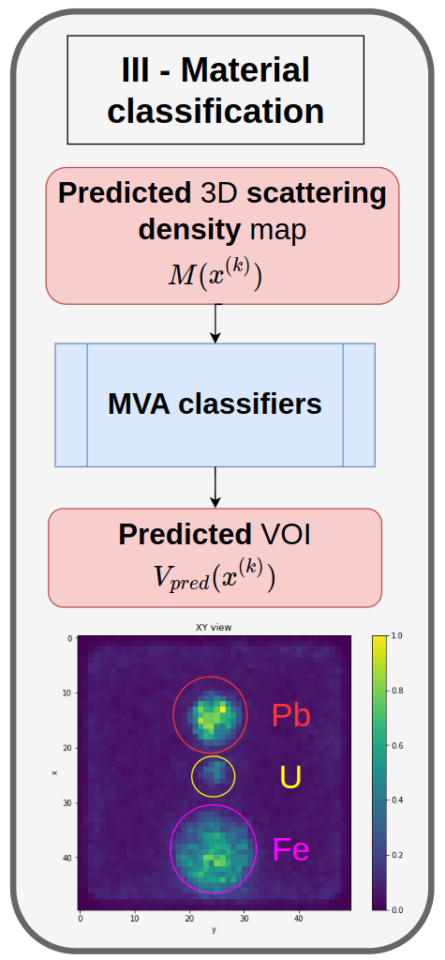
TomOpt

Slide 34
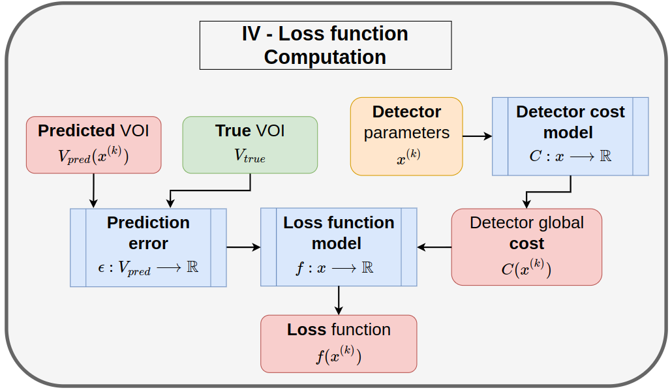
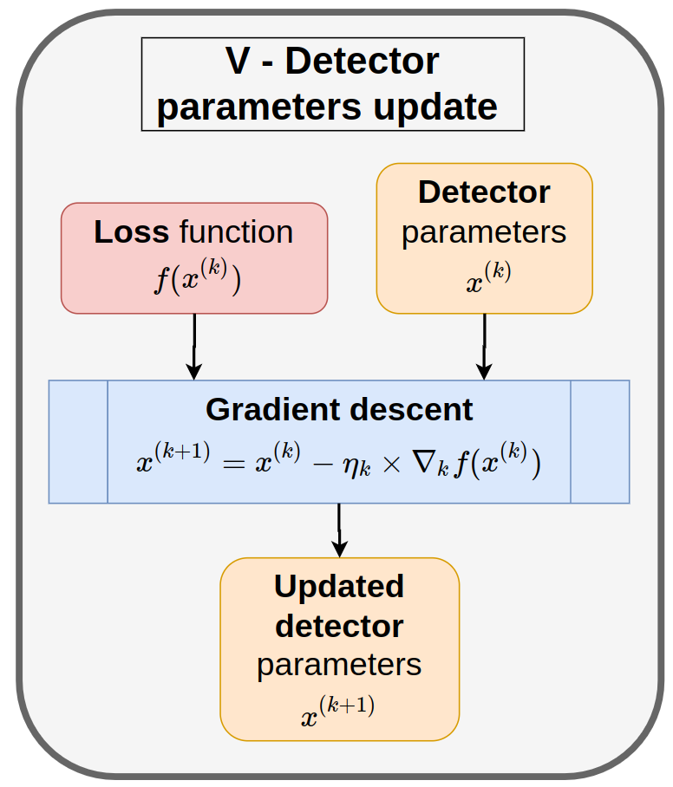
TomOpt

