Slide 1

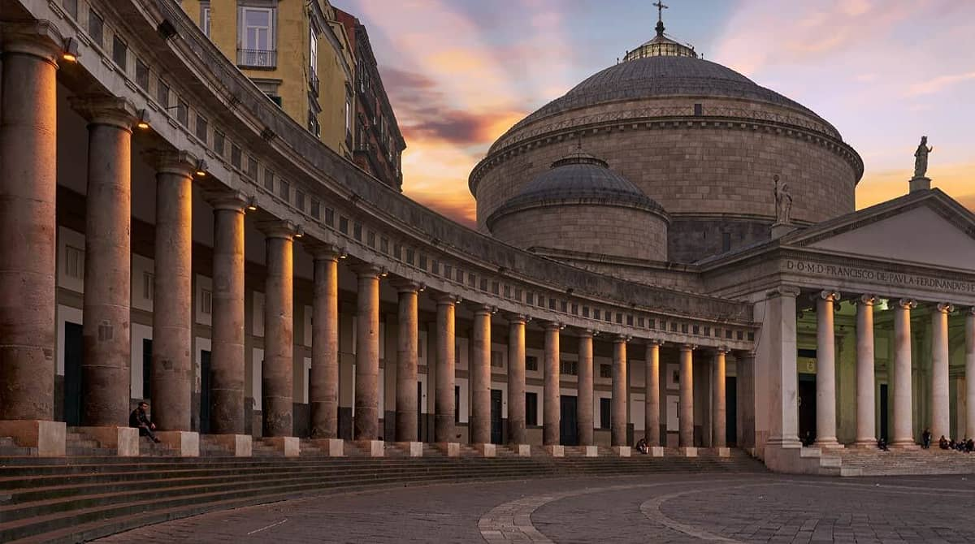

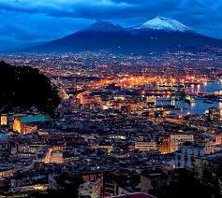




Use of Generative Adversarial Neural Networks in Muography
R. López, C. Fernández, C. Díez, P. Gómez, A. Orio, P. Martínez
Muographers 2023: International workshop on muography
19th-22nd June 2023

Slide 2
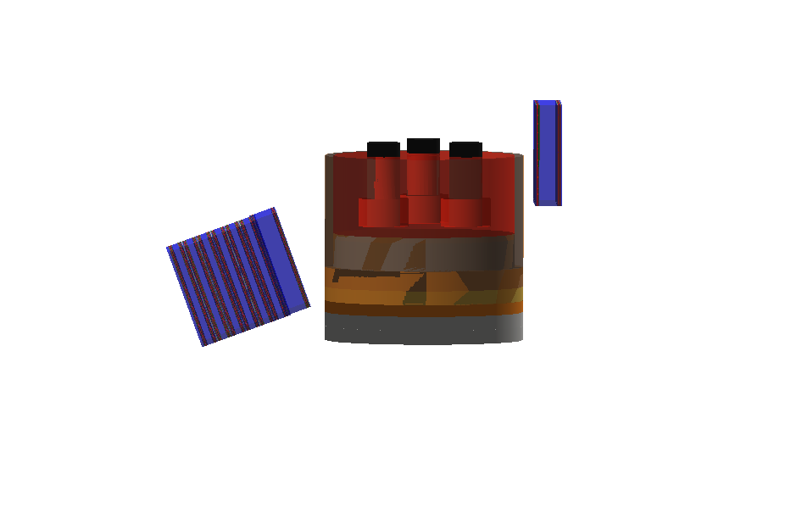
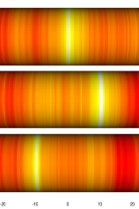
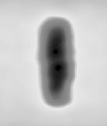
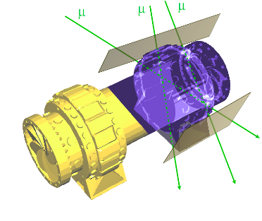
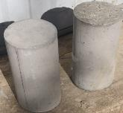
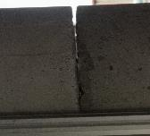

Context: muography for industrial applications
Idea: use muon tomography as a Non-Destructive Testing (NDT) technique in the industry
    Preventive maintenance of equipment (estimation of the degradation)
    Quality control of the production process (measurement of liquid interfaces, tolerances, etc)
    Risk assessment and evaluation (continuous monitoring of structural integrity)
Muography has some unique properties that can be very useful for these applications
    Large power of penetration (no problem to deal with several meters of steel)
    No need to physically “touch” the object → can be applied to equipment in production

Slide 3
Some specifics of industrial applications
Industrial applications usually involve to work with very well known geometries
  In corrosión, wear, defect, etc detection the nominal geometry is known from designs
A full image reconstruction of the object is not critical for the application
It is more important to estimate accurately a few interesting parameters from the data
Example 1: pipes
Example 2: ladle furnace
Only the thickness of the pipe is interesting for the application (1 parameter or maybe a few to account for asymmetries in the wear of the walls)
Only the position of the slag-mixture interface is really interesting for the application (1 parameter)

Slide 4
Suitability for traditional ML methods
Since the number of parameters is relatively small this can be attacked by traditional ML
    Simple fully connected DNNs operating in regression mode to the parameters of interest
Basic muon distributions (angular deviation, spatial deviation, etc, etc) can be used as input
    They can be quantified for example through quantiles or any other technique
Ideally one could use real data to train the algorithms since often this is no problem
    Think about the pipe problem: companies have hundreds of new, fresh, perfect pipes
To achieve good stats these algorithms require also MC simulations to complete the training
    This is problematic since tools such as GEANT4 can be very time consuming
    For example, in a simple setup with pipes can take 6 minutes to simulate one hour of data
Several efforts have been performed to speed up simulations
    See for example
https://indico.cern.ch/event/1022938/contributions/4487326/

Slide 5
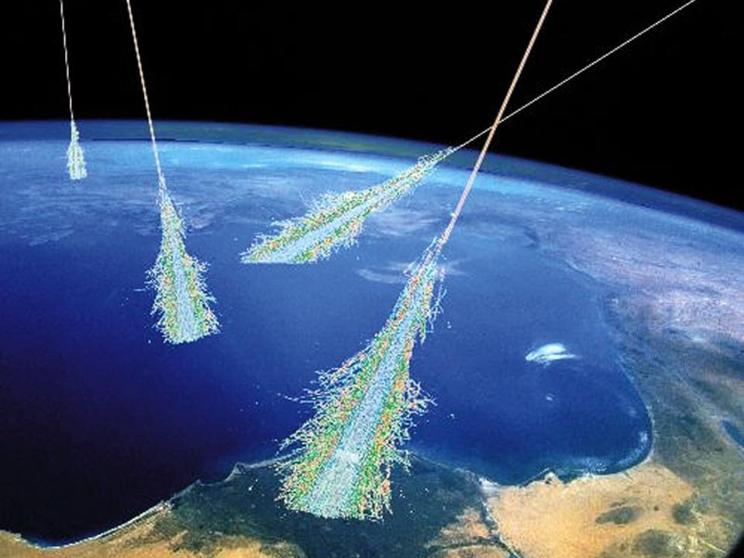
Simulation for scattering muography
Simulation for scattering muography has three different components
Muon propagation
through matter
Muon flux generation
Detector simulation
Most generators parametrize the muon flux as a function of altitude/latitude etc
This part is usually relatively fast
CRY is a good example
Implementation of energy loss and multiple scattering at least
Can be very time consuming specially for complex geometres
GEANT4 very prcise on this
A model of the detector response has to be considered for precise MC simulation
This part can be critical and it is typically difficult to implement
No general récipes, every detector needs its own model

Slide 6
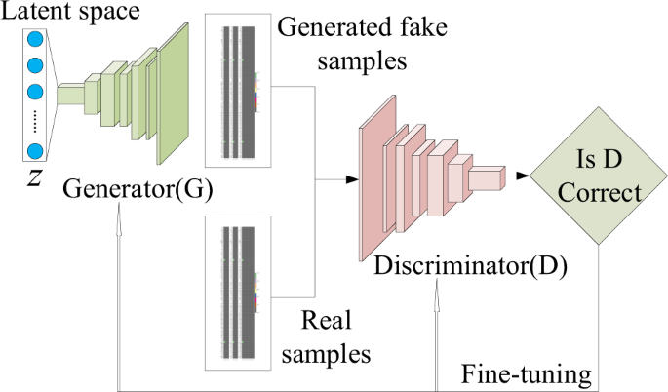
Generative Adversarial Neural Networks
We propose to use Generative Adversarial Neural Networks to produce MC simulation

Slide 7
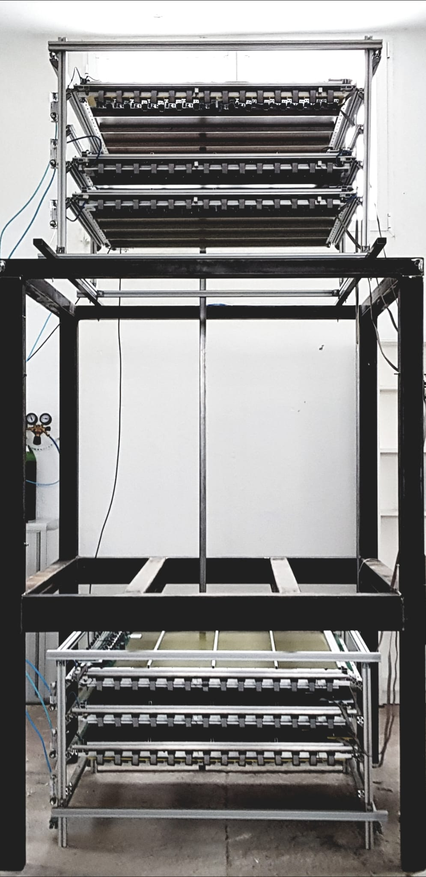
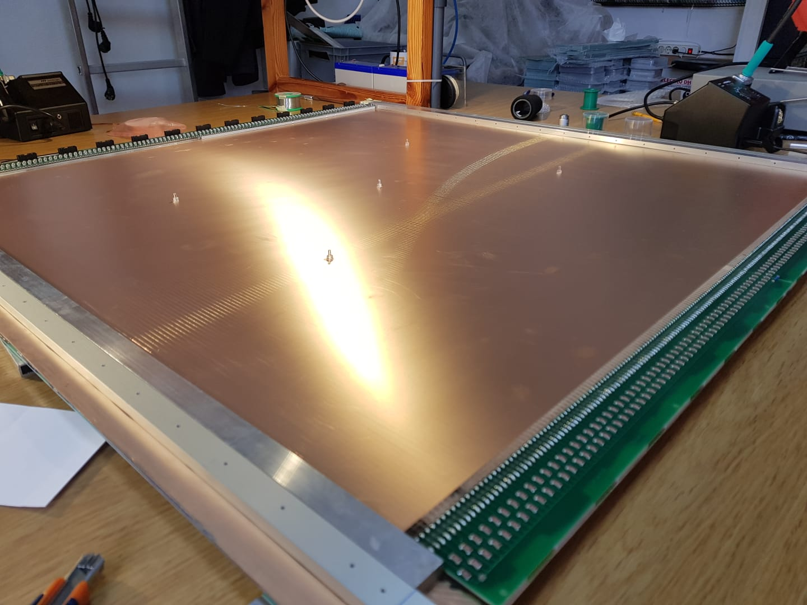
Our Muography setup (I)
Multiwire Proportional Chambers with tungsten-gold wires of 50 microns diameter every 4mm
  Each chamber is a 89x89 cm^2 double layer with orthogonal wires to measure x and y
Custom made electronics, ~ 95% efficiency, few microseconds deadtime, configurable trigger
1m²

Slide 8
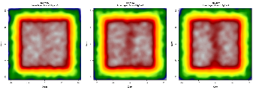
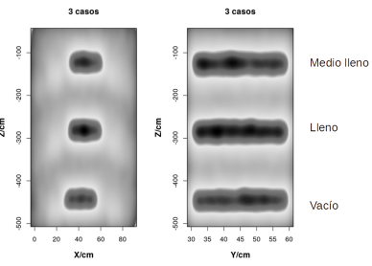
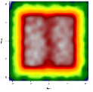
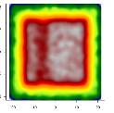
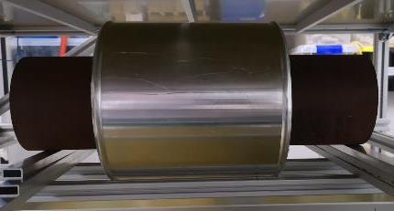
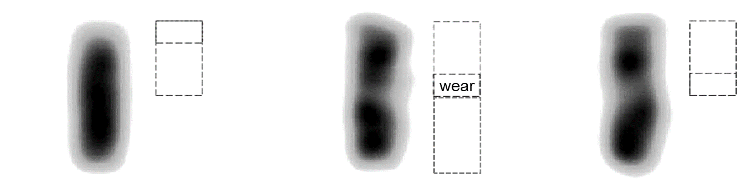
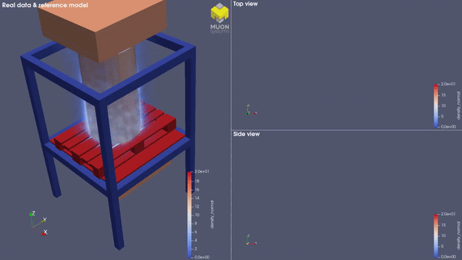
Our Muography setup (II)
Prestressed concrete
grout level detection
Pipe corrosion
Measure of the wear: 1mm resolution
1 min exposure
Tailings
0.2g·cm⁻³ density loss detection
Cracks in concrete
Measure of the crack size:
2mm resolution
10 min exposure time
Density maps
Furnace hearth
Measure of the wall refractory:
1cm resolution
15 min exposure
Real data 3D reconstruction of a silicon smelting furnace

Slide 9

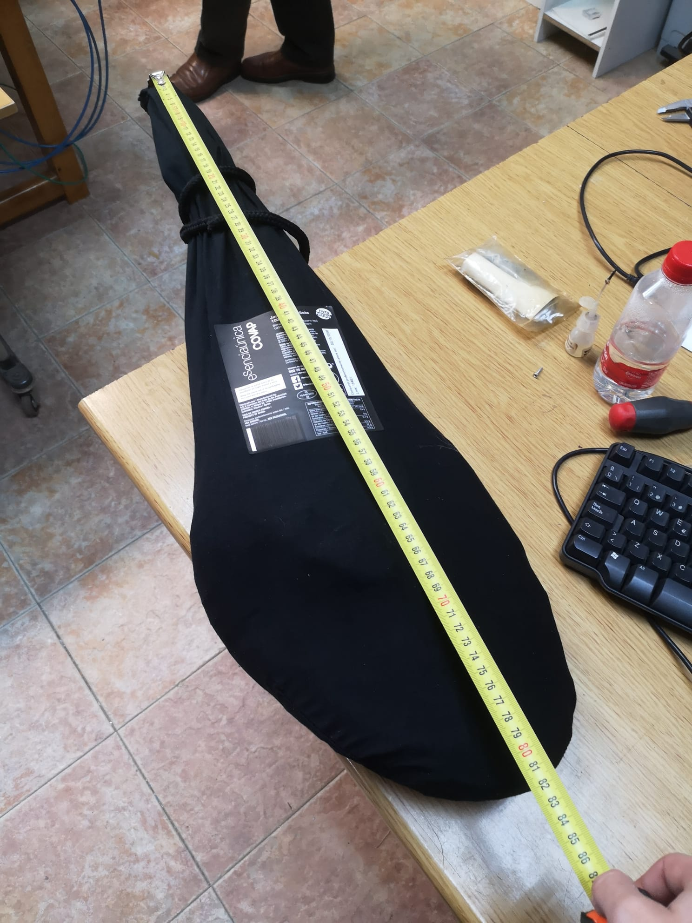
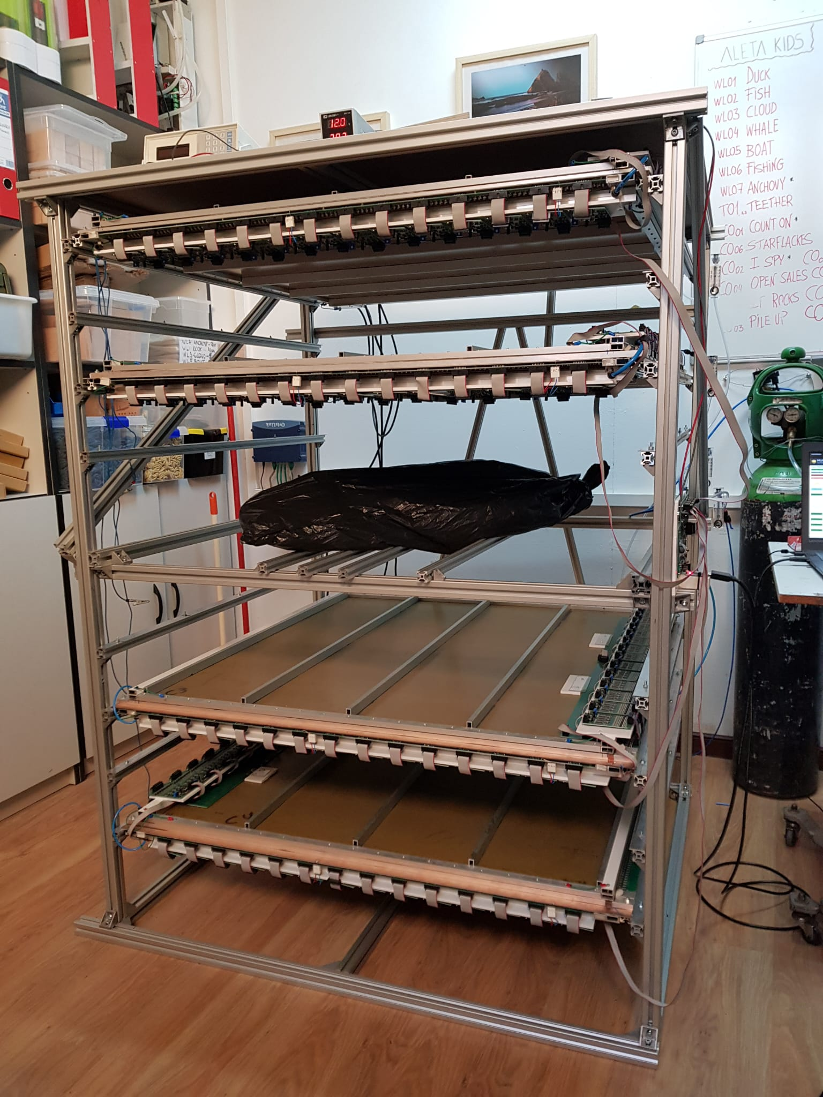
Validation of the technology
Let’s have some fun (sorry!)
Iberic Ham “Pata Negra”

Slide 10
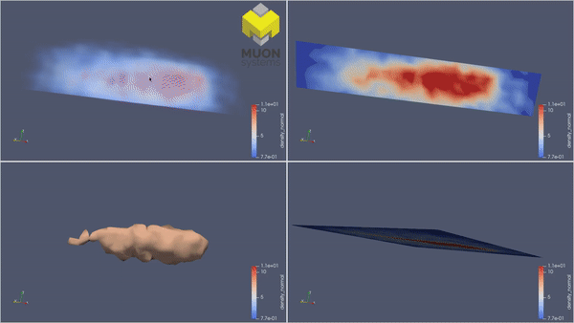
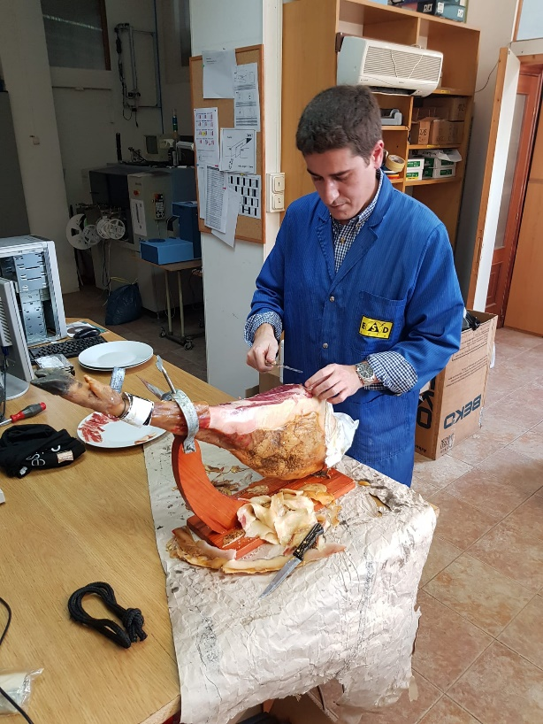
Validation of the technology
Let’s have some fun (sorry!)
Nice 3D reconstruction of the ham even if containing light elements
Systematic studies on this kind of sample could not be continued…
…as the sample misteriously dissappeared

Slide 11
Our Muography setup for the GAN studies
Our GAN simulation is running for a muography setup as the one used for the pipe problem
    This setup corresponds to the one from Muon Systems (see previous slides)
Simulator target: predict lower segment having the upper segment as input
    This means that we rely on CRY for the simulation of the upper segment
    All tests performed on MC samples where detectors are assumed to be perfect
Upper detector
x1, y1, vx1 = atan(θx1), v1y = atan(θy1)
Lower detector
x2, y2, vx2 = atan(θx2), v2y = atan(θy2)
L
r=20cm
Target variables
Δx=x2 - L vx1 - x1
Δy=y2 - Lvy1 - y1
Δvx= vx2 - vx1
Δvy = vy2 - vy1

Slide 12
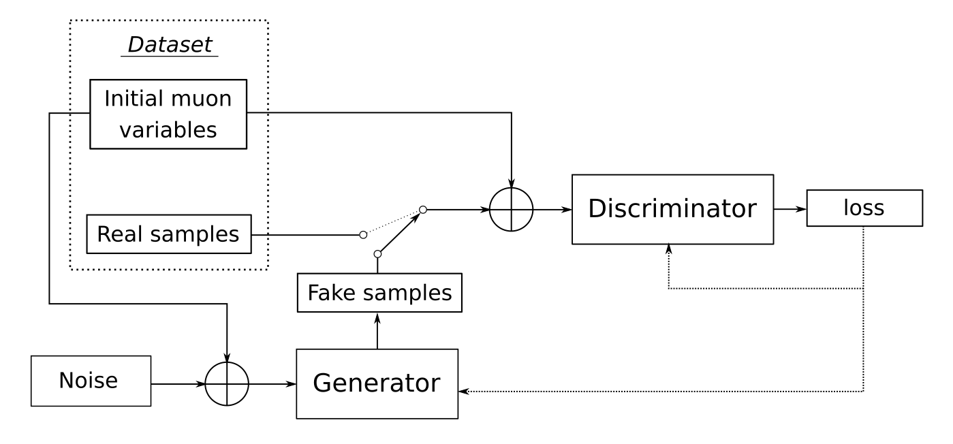
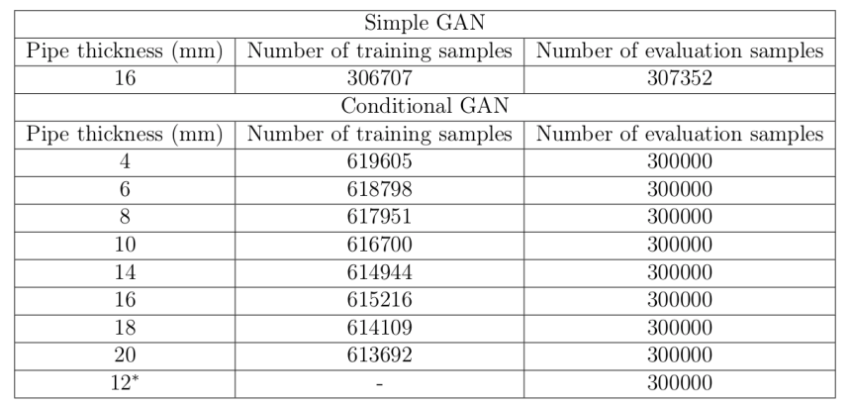
First attempt: simple GAN
Our first attempt uses a simple GAN
    Keras + TensorFlow
    The variables of the segment in the first detector are given as input to the generator
    Loss function: Mean Squared Error
    Architecture: 512, 256, 256, 128, 64, 16 LeakyReLU
    Latent space dimension: 64
    Optimizer: Adam, 0.001 (halves every 50 epochs)
    Trained for 200 epochs (Total training time ~ 2-3 hours, GeForce RTX 3090)

Slide 13
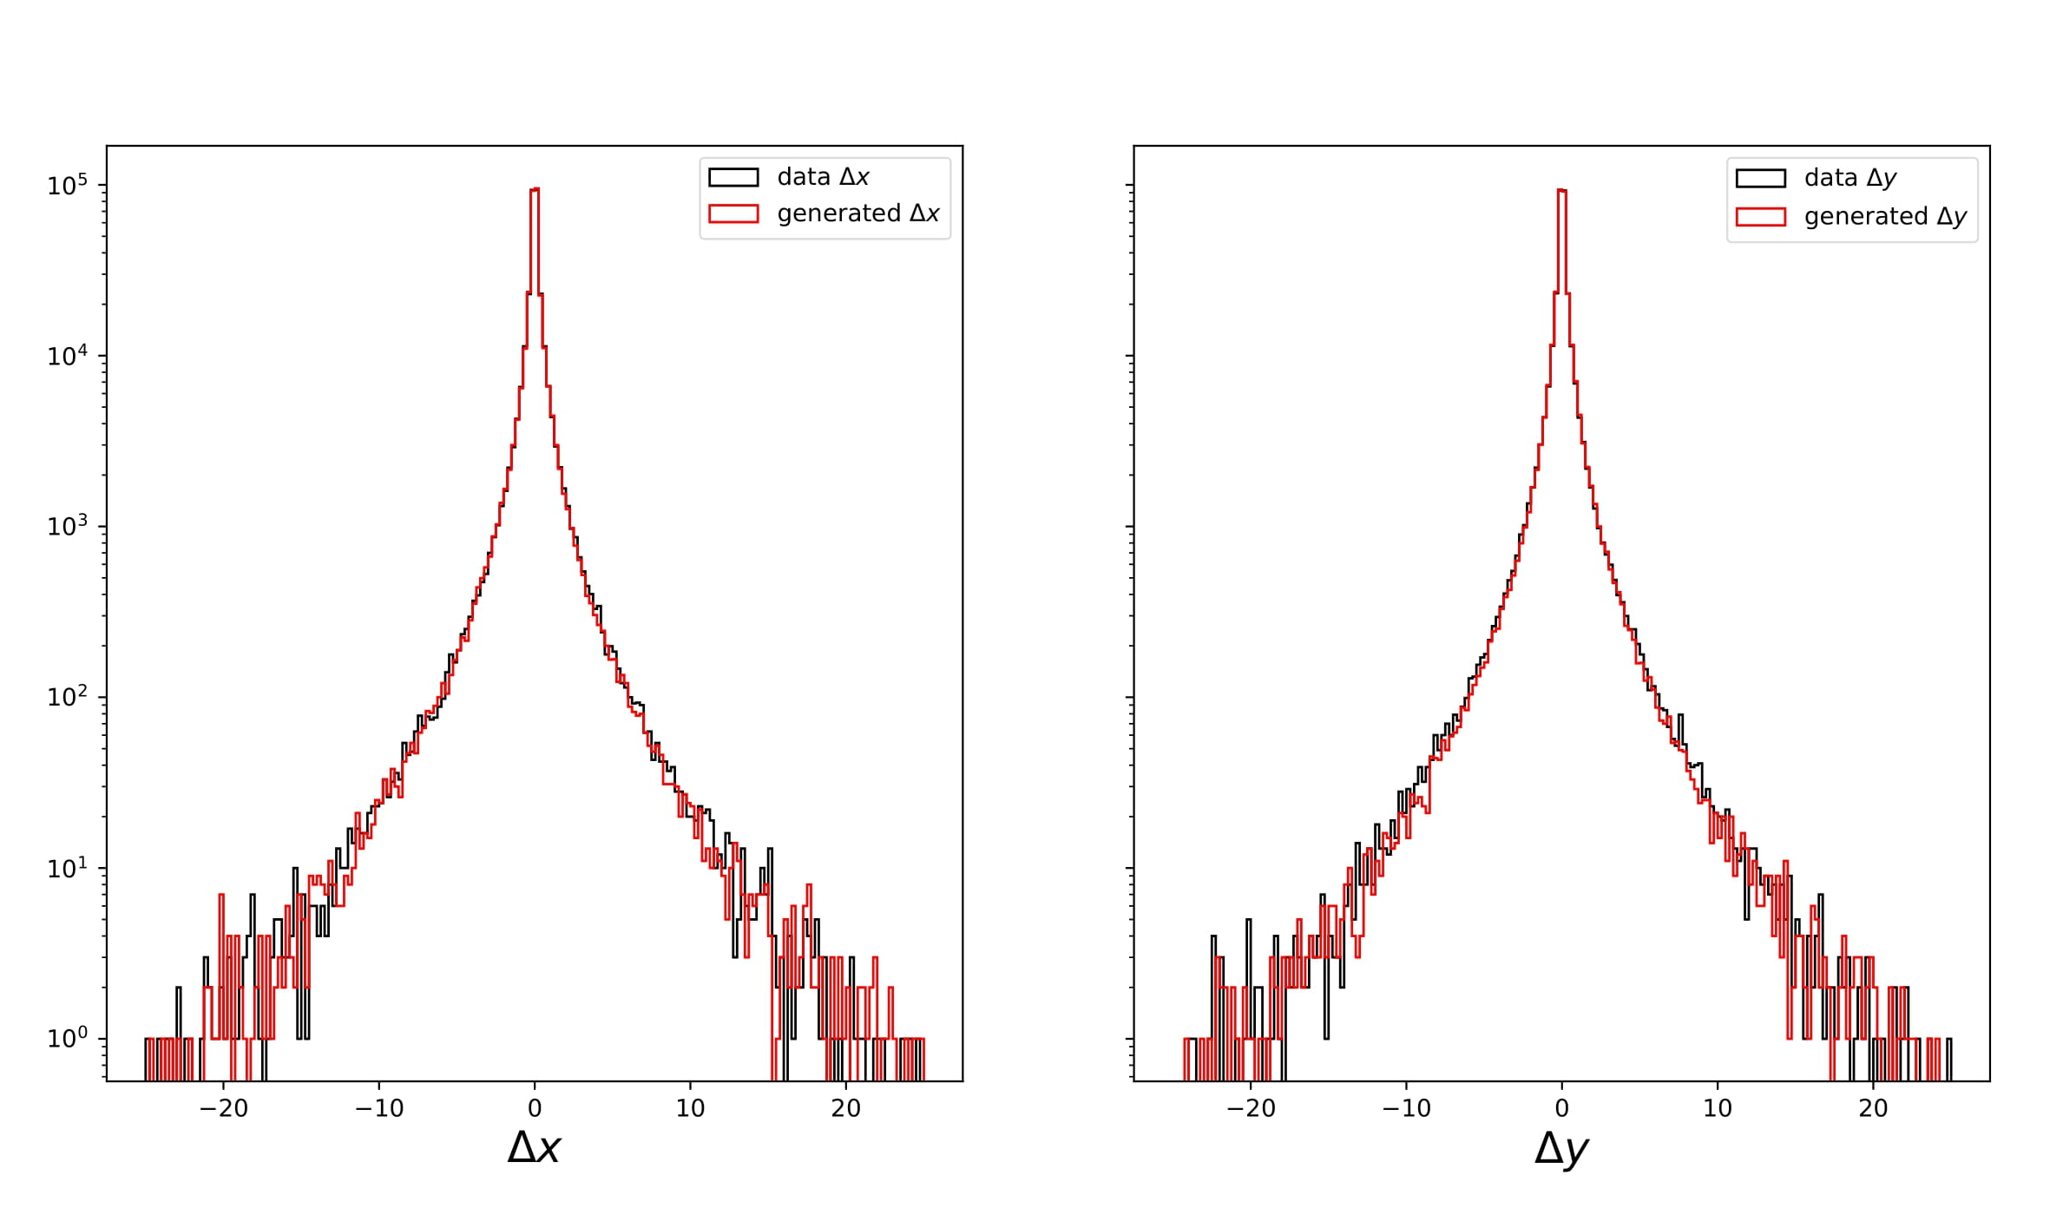
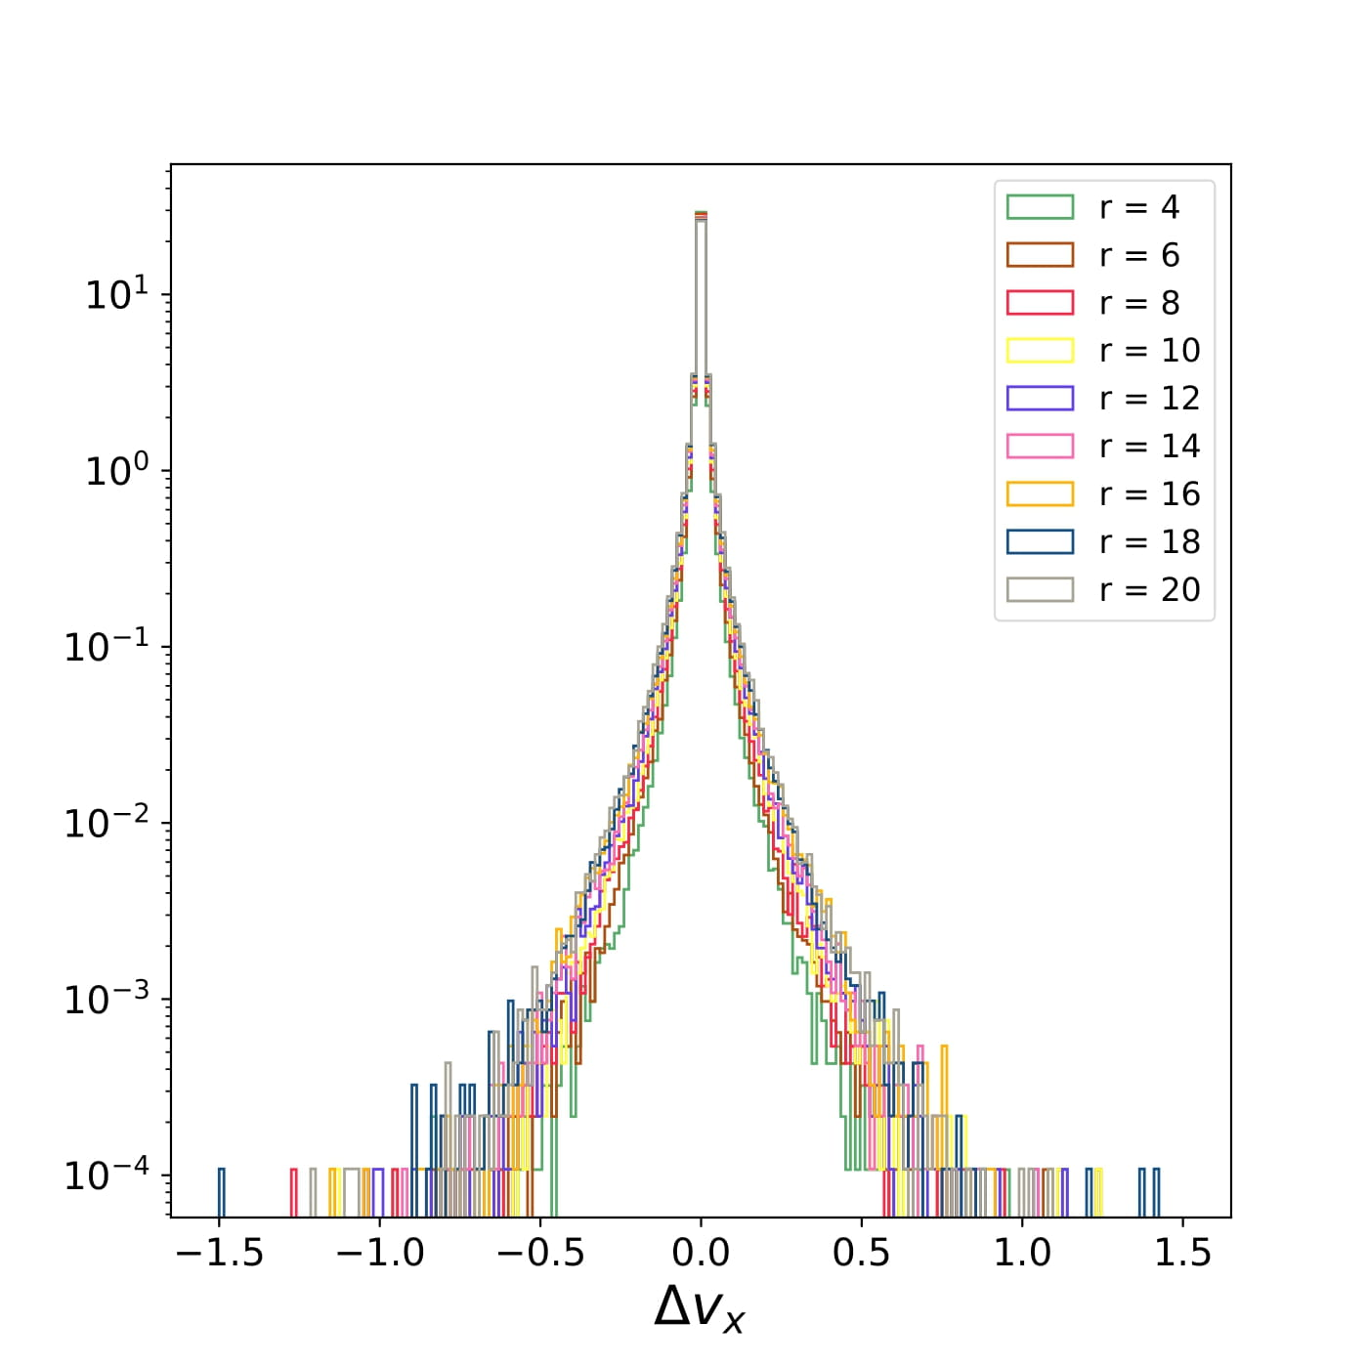
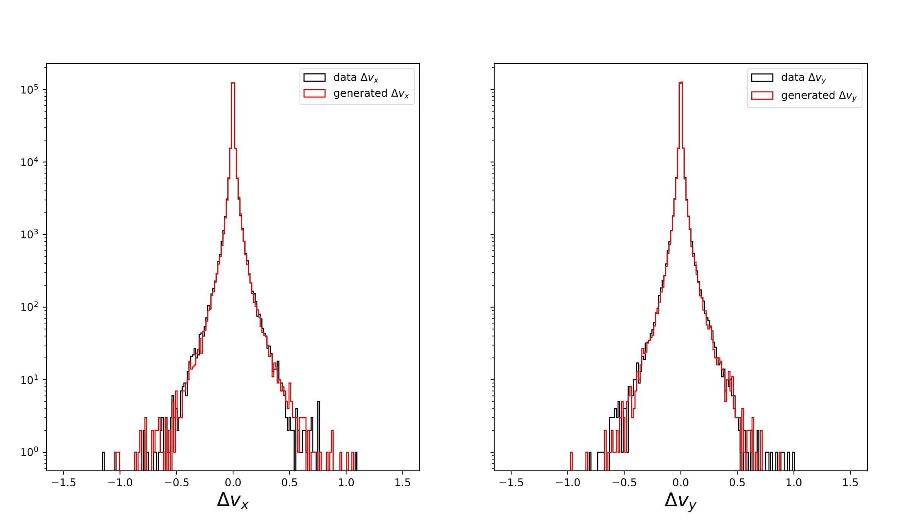
Results using a conventional GAN (I)
The GAN is able to produce the correct 1D distributions with a ~ 1 mm resolution
GEANT4 simulation for different
pipe thickness (mm)
r = 16 mm

Slide 14
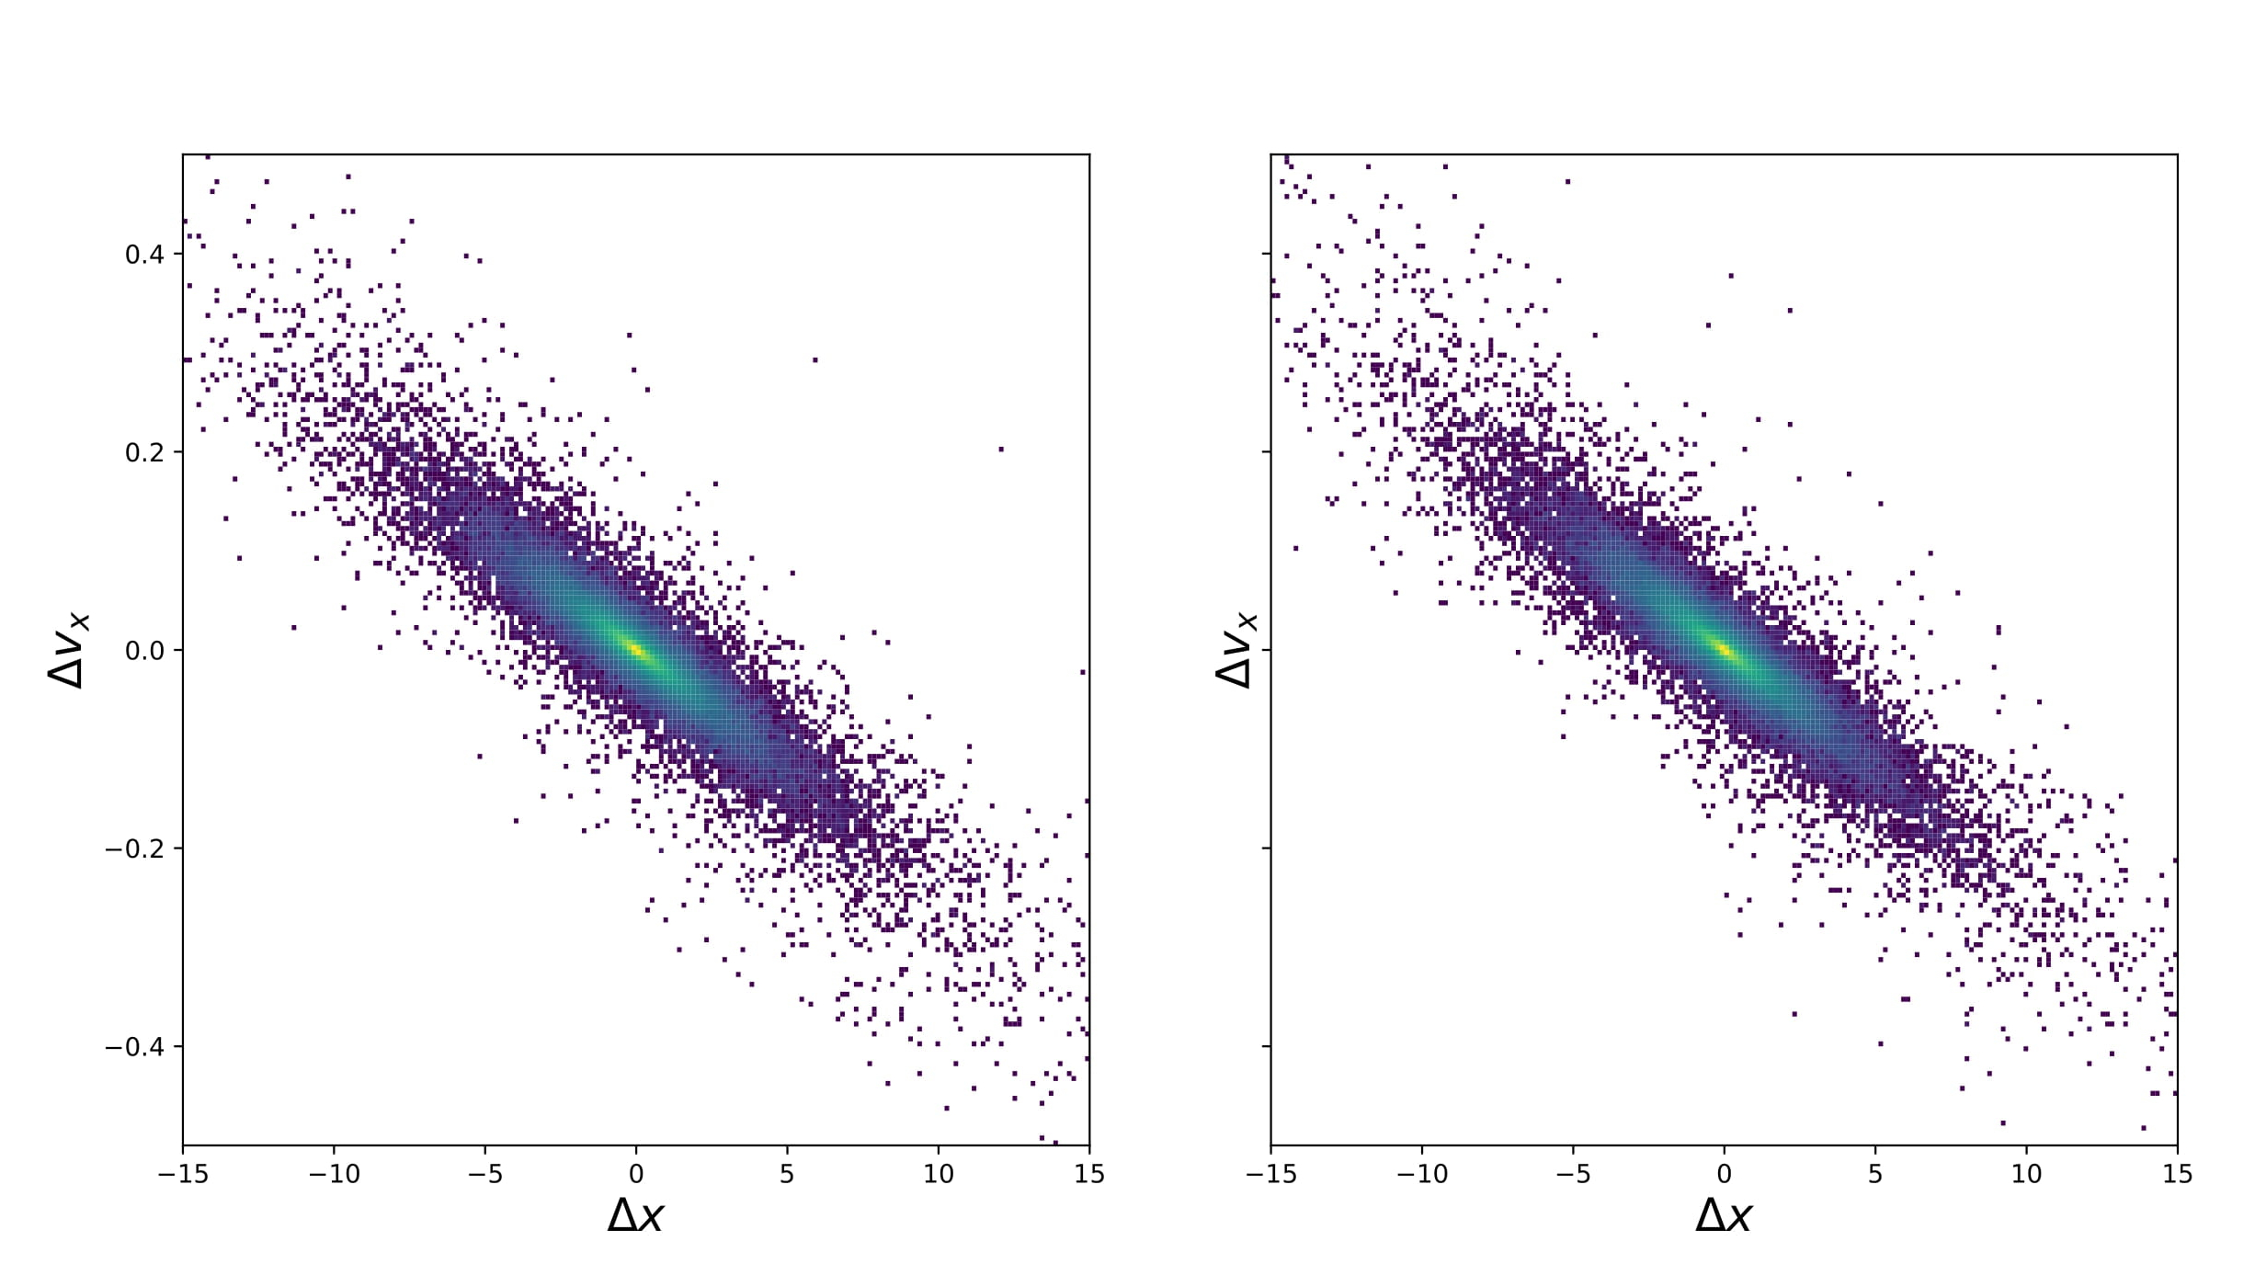
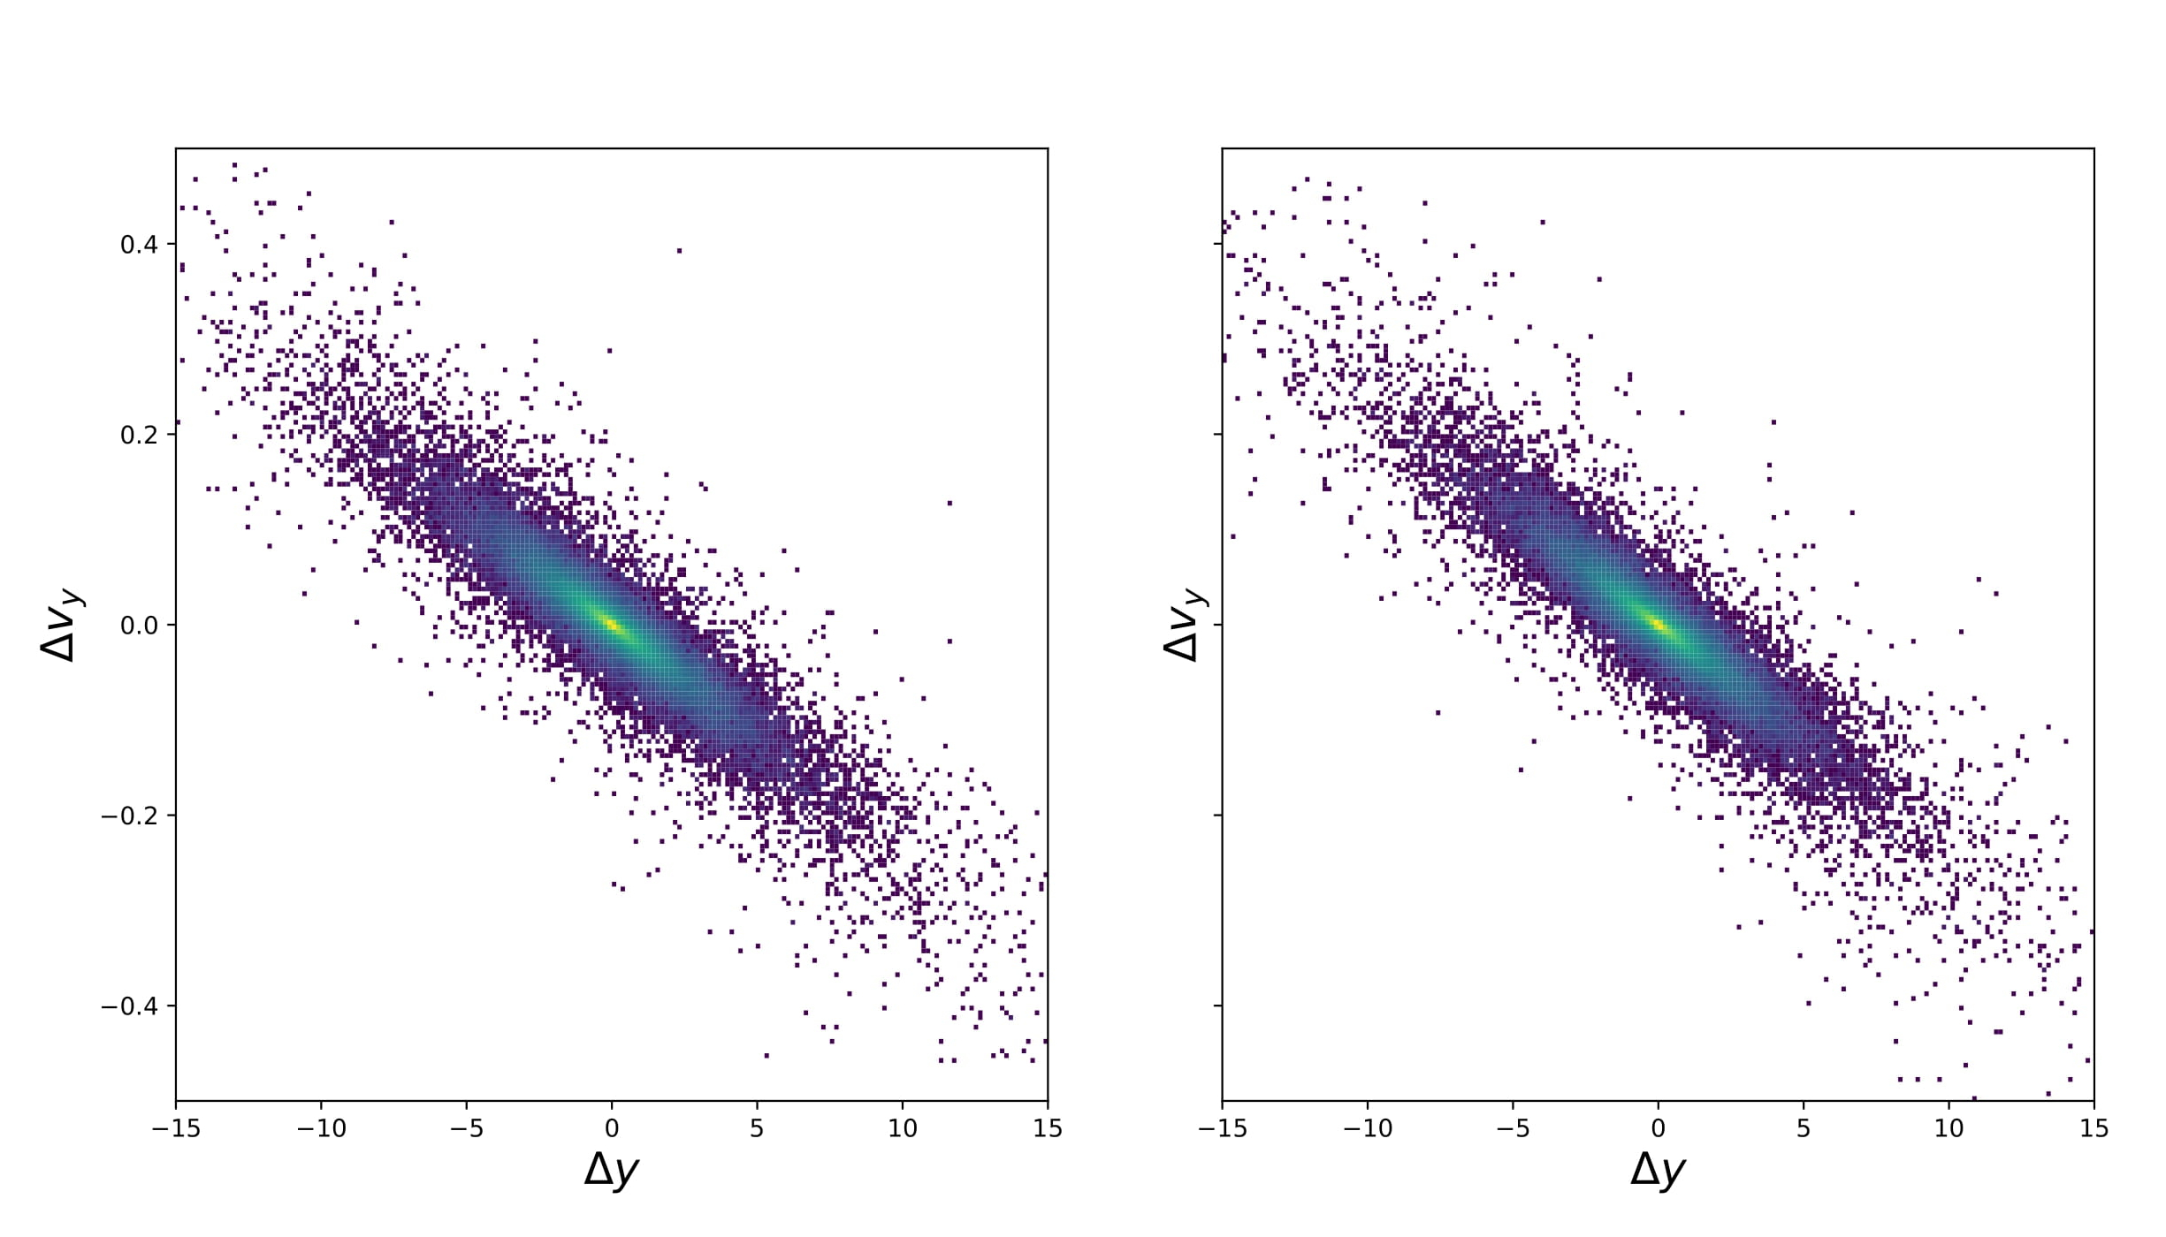
Results using a conventional GAN (II)
Correlations among variables seems to be very well described as well by the GAN
real
predicted
r = 16 mm
real
predicted

Slide 15
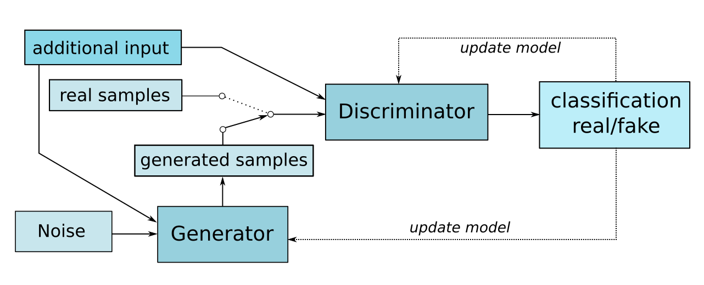
Second attempt: Wasserstein conditional GAN
Our second attempt uses a Wasserstein conditional GAN
    Keras + TensorFlow
    The variables of the segment in the first detector are given as input to the generator
    The thickness of the pipe to be generated is also provided as input
    Critic + Loss function → more stability
    Architecture: 32, 64, 128 LeakyReLU
    Latent space dimension: 64
    Optimizer: Adam, 0.001 (halves every 50 epochs)
    Trained for 1000 epochs (Total training time ~ 2-3 hours, GeForce RTX 3090)

Slide 16
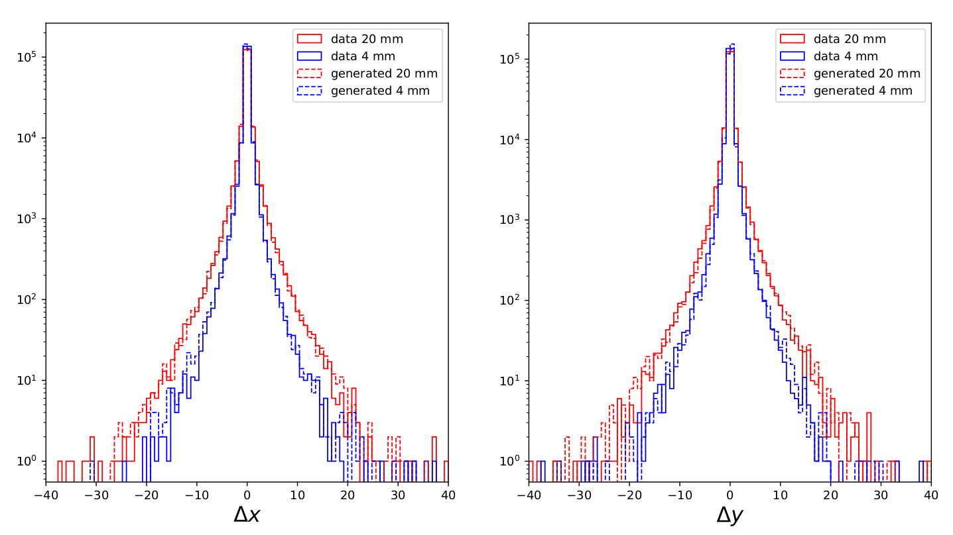
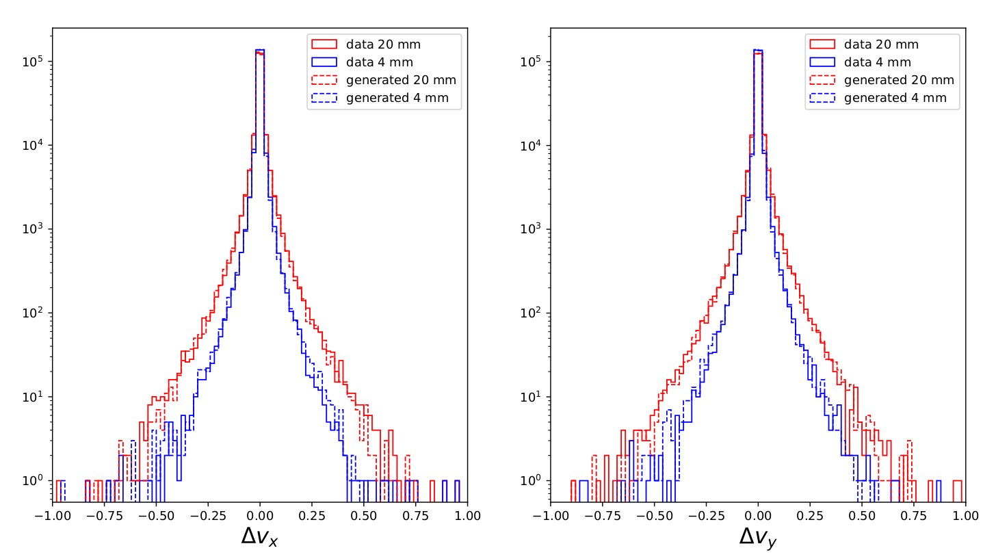
Results using a conditional WGAN (I)
The WGAN also provides very good results in describing the 1D distributions (and correlations)

Slide 17
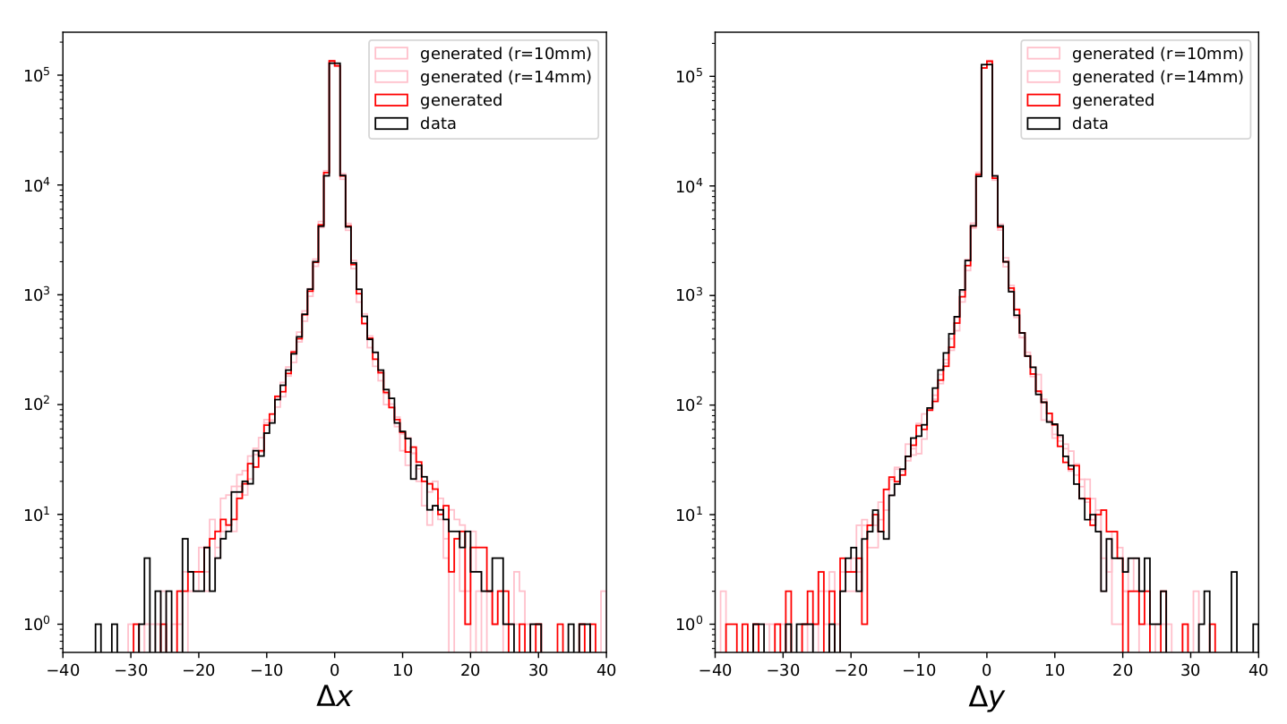
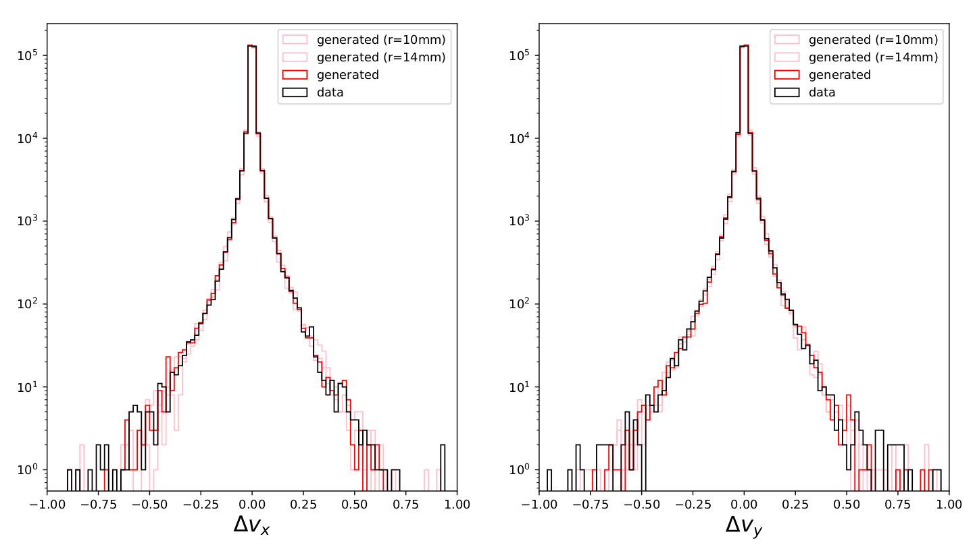
Results using a conditional WGAN (II)
The WGAN seems to be able to interpolate well if trained with a large range of example
Training based on samples with a
thickness of 4, 6, 8, 10, 12, 16, 18
and 20 mm. Looking results of the
WGAN when asking for a sample
of 14 mm.

Slide 18
Conclusions
We have explored the possibility to use GANs to generate fast MC simulation in muography
Two different kinds of GANs tested: simple + Wasserstein, conditional GAN
    Both are giving very good results in terms of similarity to the targeted distributions
    The Wasserstein GAN seems to be in general more stable and easier to converge
    The Wasserstein, conditional GAN is able to interpolate to non-trained thicknesses
Our setup has tested only the muon propagation part of the simulation
    If trained with real data from a real detector → capacity to learn the detector response
    We are focusing on this right now as it would be a ML driven detector simulation
The observed speed-up with respect to GEANT4 is of about 50 times for this pipe setup

