Slide 1
AN AUTOMATED TESTING PROCEDURE TO EVALUATE
INDUSTRIAL DEVICES COMMUNICATION ROBUSTNESS
Author: Filippo Tilaro
Supervised by: Brice Copy

Slide 2
Overview
Scope & Objectives
IT & Industrial Security Model
Security Metrics & Testing Requirements
  ISA-99
  ISCI CRT
Test-bench implementation
  Testing Techniques
  Device Monitoring
  Vulnerability Reporting System
  Reproducibility

Slide 3

Background
Technological Evolution:
  Growing interconnectivity between the fabric and the management level
  IT functionalities with inherent vulnerabilities into control devices
  Lack of security standards and guidelines
  Growing number of discovered PCS vulnerabilities
    2010: VxWorks and STUXNET
    2011: Sunway ForceControl and pNetPower, Beckhoff TwinCAT 'TCATSysSrv.exe' Network DoS, Rockwell RSLogix Overflow, Measuresoft ScadaPro, Cogent DataHub, AzeoTech DAQFactory Stack Overflow, Progea Movicon, ScadaTEC ModbusTagServer and ScadaPhone Remote Buffer Overflow, Scadatec Procyon 'Coreservice.exe' Stack Buffer Overflow, Siemens WinCC Flexible Runtime Heap Overflow, ActiveX in Advantech Broadwin WebAccess, Sunway ForceControl SCADA SHE, Control Microsystems (Schneider Electric) ClearSCADA Remote Authentication Bypass, Inductive Automation Ignition Disclosure, Siemens SIMATIC S7-300 Hardcoded Credentials, Password Protection Vulnerability in Siemens SIMATIC Controllers (S7-200,300,400,1200), Siemens SIMATIC S7-1200 PLC, Honeywell ScanServer ActiveX Control
Result: recovery from attacks is expensive in terms of:
  time, cost, effort

Slide 4
IT vs Industrial Security Model
Different requirements:
  Performances
    best-effort vs real-time
  Availability
    reboot strategy vs no downtimes admitted
  Network architecture
    generic services (DNS, Domain Controller, …) vs industrial services
Updating and patching
Communication protocols
  Public vs proprietary
Software and component lifetime

Slide 5
Approach
Objectives:
  To improve the Process Control System (PCS) security level
Strategy:
  Investigate cyber security standards (ISA-99, NERC-CIP, IEC 62351)
    ISA-99 as reference model -> ISCI Communication Robustness Test (CRT)
  Determine key cyber security aspects relevant to CERN
  Design and implement a test bench:
    Assess the PCSs devices network robustness
    Discover and Classify vulnerabilities of control system devices
    Integrating more and more specific attacks
  Defining metrics for security evaluation

Slide 6
ISCI CRT Testing Phases
5 security testing phases:
  Discover Protocol Functionalities and Attack Surface
  Storms and Maximum Load Tests
  Single Field Injection
  Combinatorial Fields Injection
  Cross State Fuzzing (for Stateful Protocols)
Fulfilling the ISCI CRT requirements:
  Integration of the CRT tests into the TRoIE test-bench developed at CERN

Slide 7

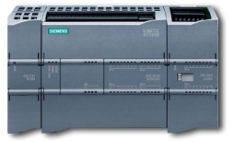


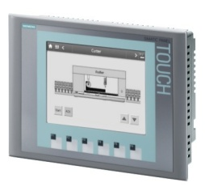









Test-bench diagram
System Testing
Target
Extended Peach Fuzzing
Panel
Partner
Attacker
System Monitoring
Reporting System
Vulnerabilities DB
Configurator
Traffic Analyzer
Signals Monint.
Web front-end

Slide 8
Protocol Robustness Testing
IEEE defines robustness “in the degree to which a system or component can function correctly in the presence of invalid inputs or stressful environmental conditions.“
What is a robustness failure?
  Failure to return the expected packet
  Inability to progress to next protocol state
  Dropped connections
  Lost or modified data
  MORE IMPORTANT: Any unexpected effect in the process control!

Slide 9
Testing Techniques
Brute Force Testing:
  Simple but inefficient
  Not all the combinations are interesting
Fuzzing & Grammar Testing:
  Not random: essential for debugging!
  Not exhaustive but we can cover specific sequences
  Grammar driven
  Integration of the security specialists’ knowledge

Slide 10
Fuzzing Testing Requirements
A Common Framework:
  No standalone scripts
Scalability
  Handle and organize the growing amount of tests (almost infinite combinations)
Tests Customization
  Protocol header format
  Protocol field values
  Protocol state machine
Reproducibility
  Essential for any debugging activity

Slide 11
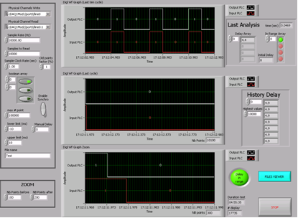
I/O Monitoring
Objective:
  Detect any delay or anomaly in the device’s process control I/O during the phase of testing
Precedent solution : with the use of another PLC
  The analysis was affected by synchronization issues between the PLC under test and the monitoring one
  Low Analysis Time Resolution, not enough to fulfill the ISCI requirements
Current solution : with a Digital Acquisition Card (DAC)
  No synchronization issues
  Finer time resolution than the previous one

Slide 12
Device Status Monitoring
Internal resources of the device under test:
  Scan-cycle & execution time
  Memory usage
  CPU status
  I/O signals memory & communication modules conditions.
No common way to query the device
  Open-source library
  Proprietary libraries
    Supported by the vendors
    Compatible with different versions of the same device model
    Specific API to gather diagnostic information

Slide 13
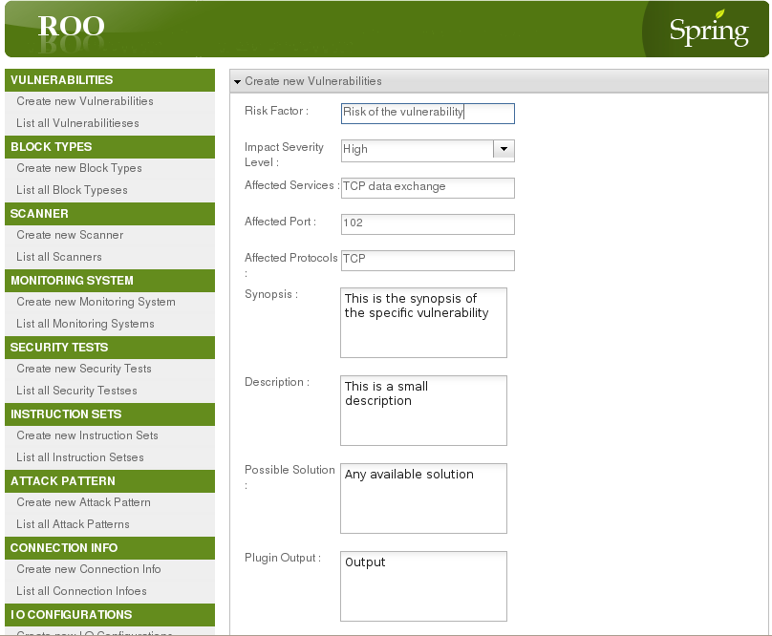
Testing Reporting System
No standard common format to store vulnerabilities
Vulnerability classification & query support:
  Improve data analysis
  Track progresses
  Redeploy attacks
  Check device version status

Slide 14












Tests Reproducibility
3-Layers Architecture
Reverse Proxy & Access Control
REST Web Service
Extended Peach Framework
JSON
Authentication to run a test
Built-in invariant test definitions
No specific security knowledge
OS Compatibility
Client

Slide 15

Any Questions
Thank you for attending!

