Slide 1
The cybersecurity in ALICE
- as seen from user’s perspective
Peter Chochula
CERN/ALICE

Slide 2
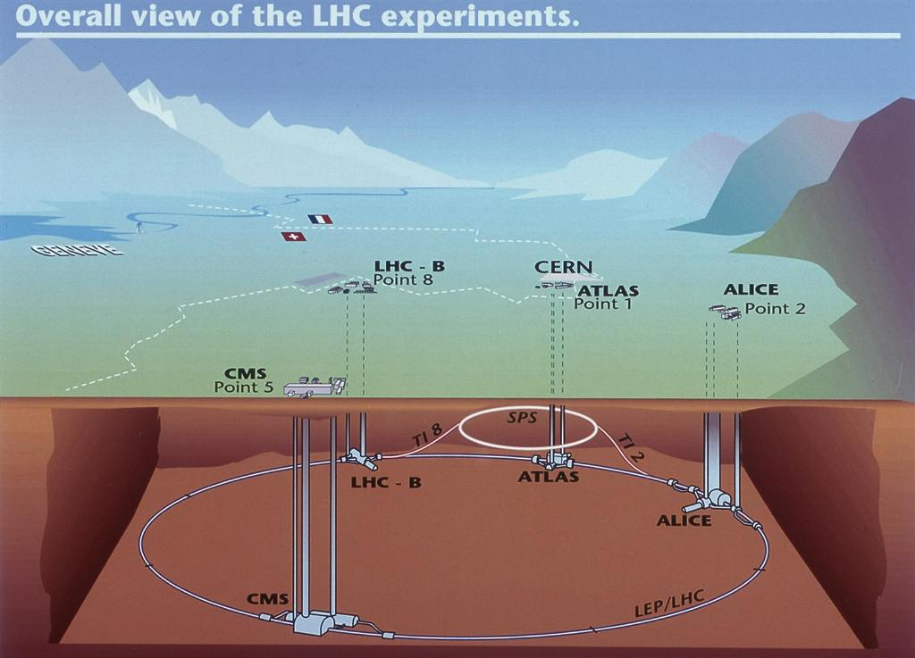
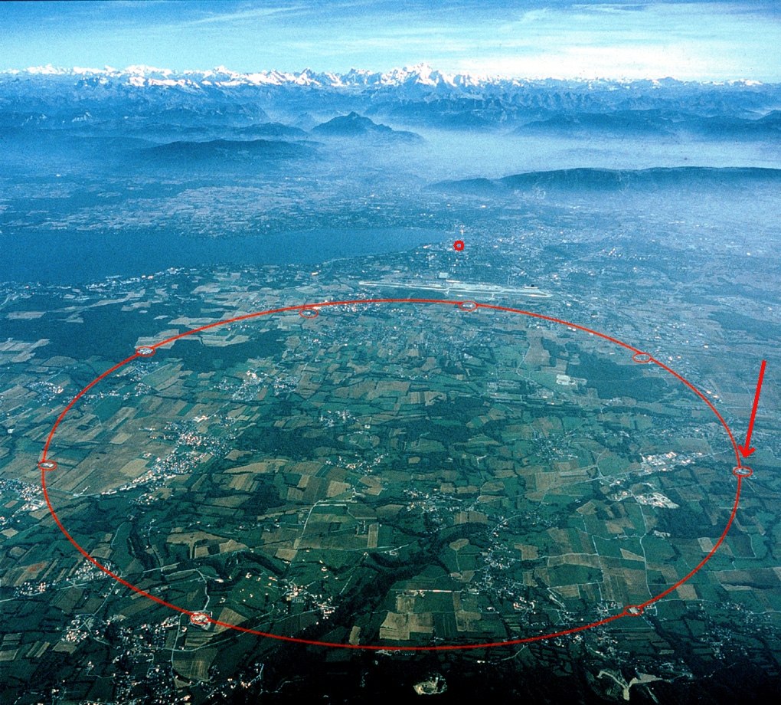
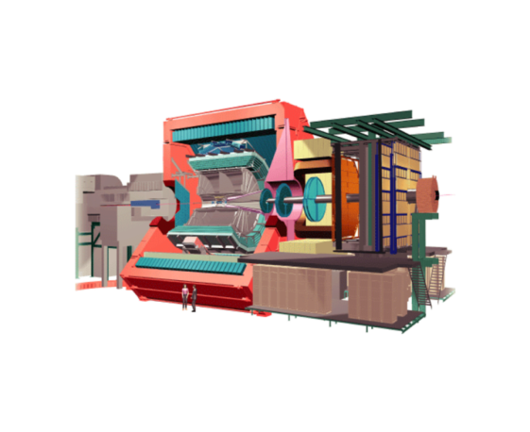
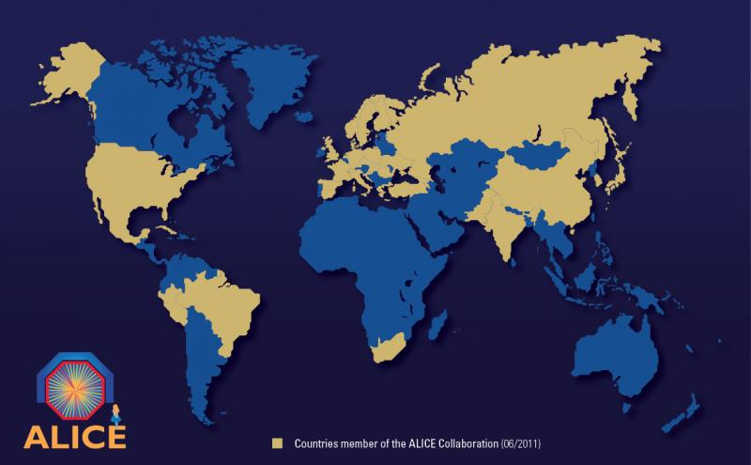
The ALICE experiment at CERN LHC
Basic task – study of heavy ion collisions at LHC
The design of ALICE allows for p-p studies as well
Experiment
Size: 16 x 26 metres (some detectors placed >100m from the interaction point)
Mass: 10,000,000 kg
Detectors: 20
Magnets: 2
The ALICE Collaboration:
Members: 1300
Institutes: 116
Countries: 33

Slide 3
ALICE - a very visible object, designed to detect the invisible...

Slide 4
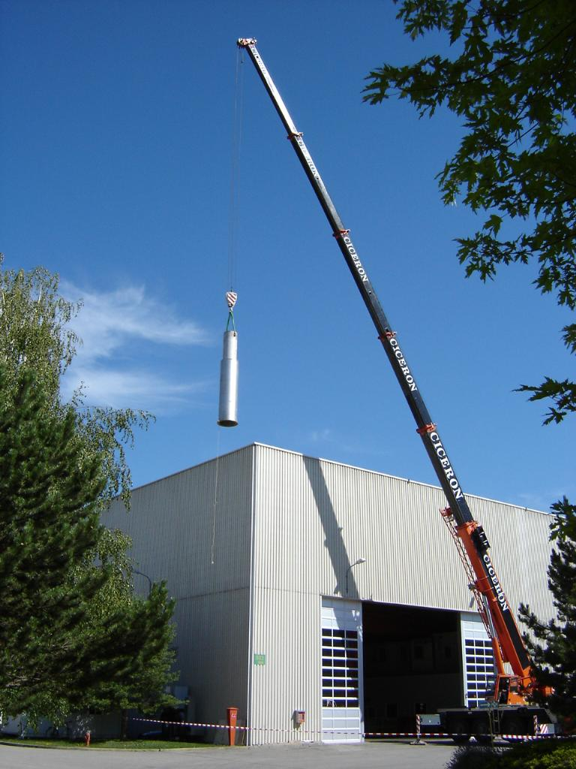
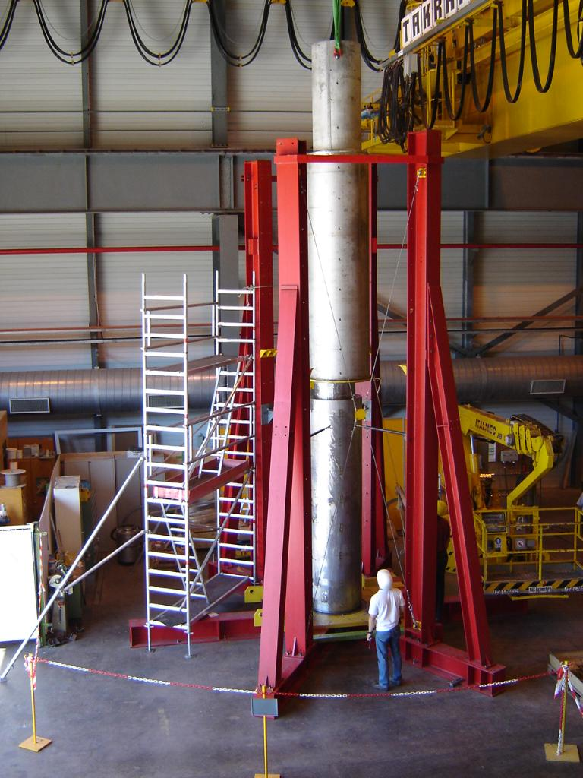

Slide 5
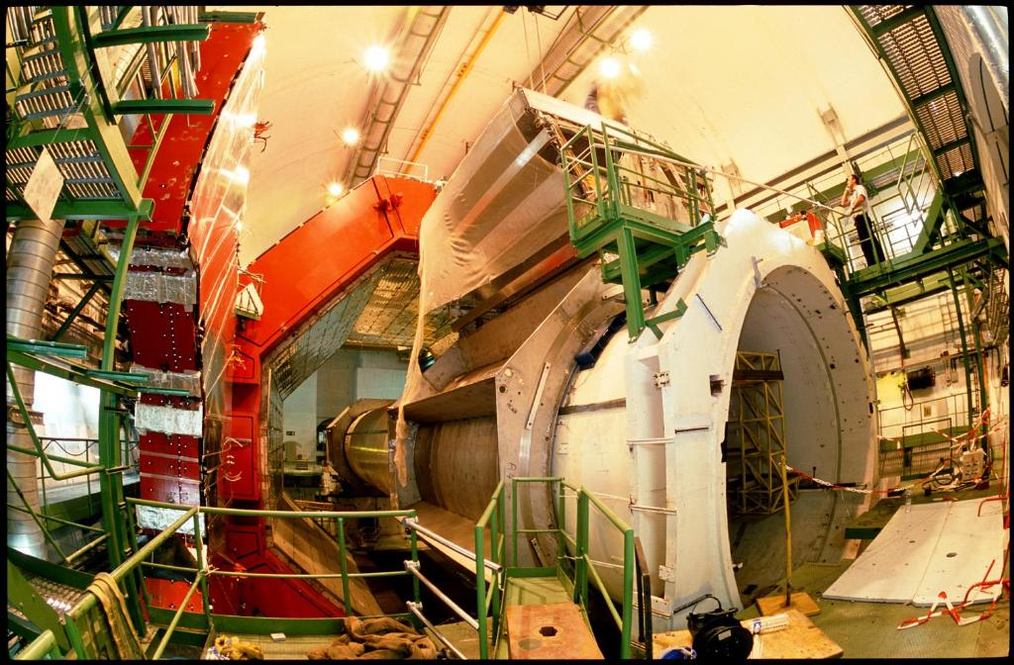
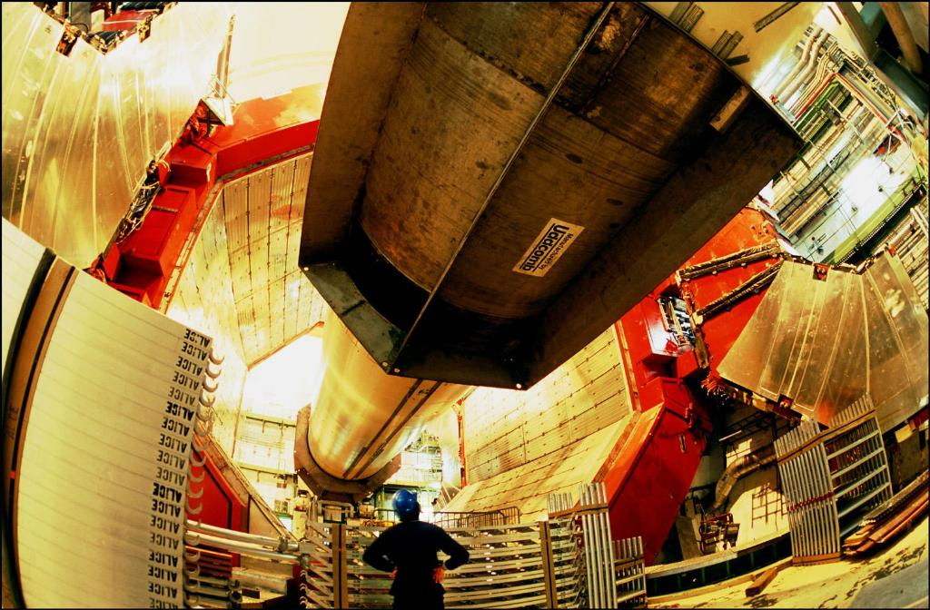

Slide 6
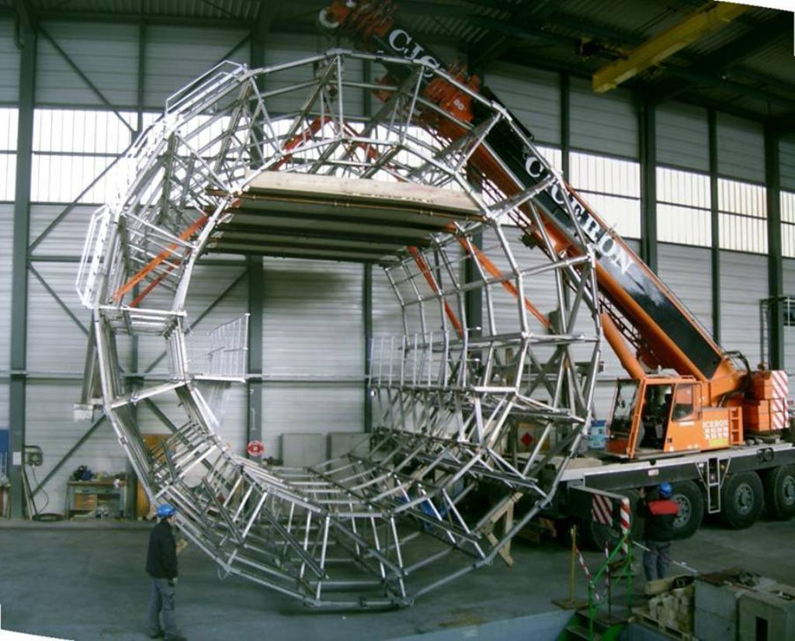
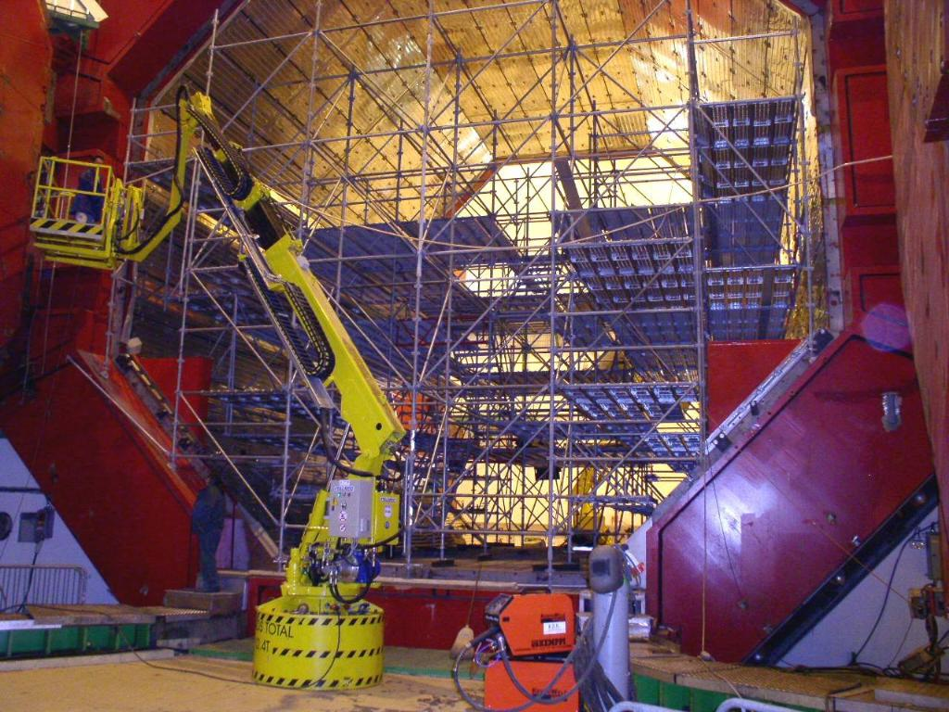

Slide 7
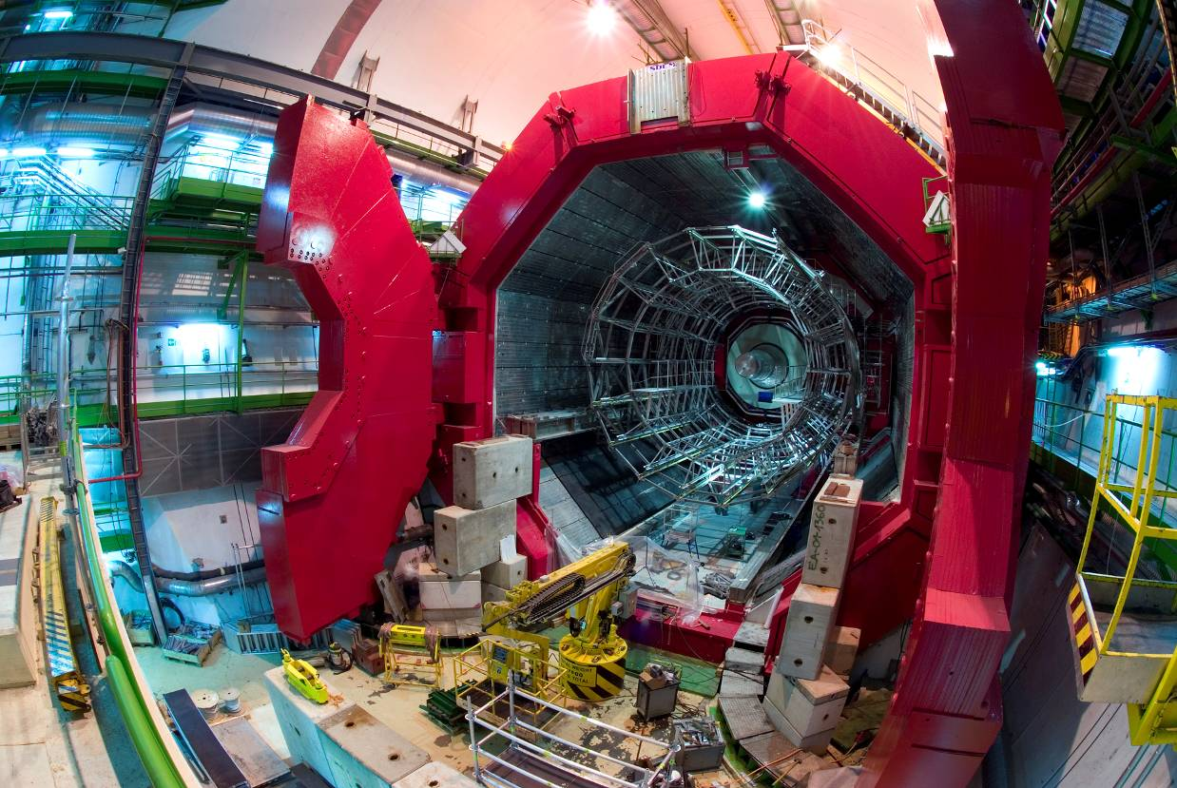

Slide 8
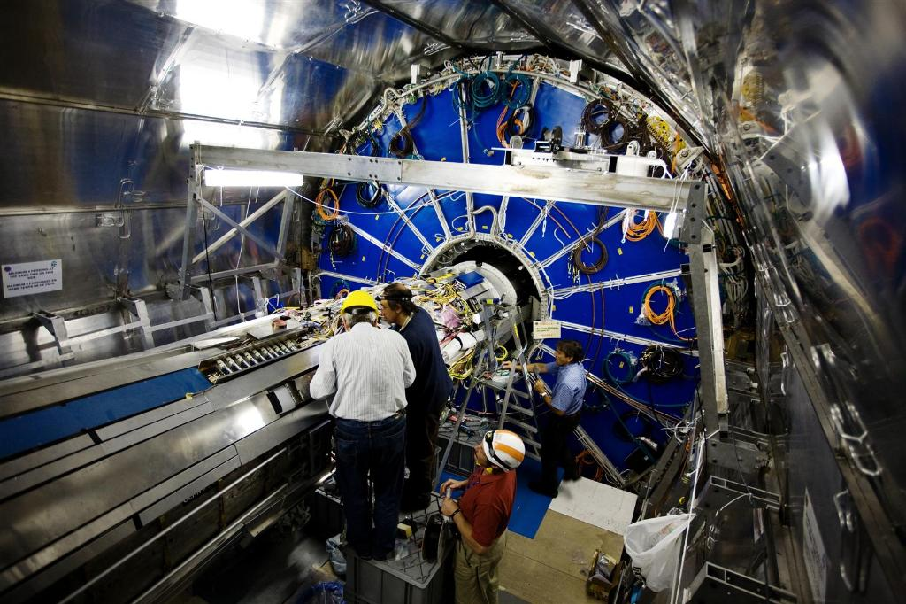
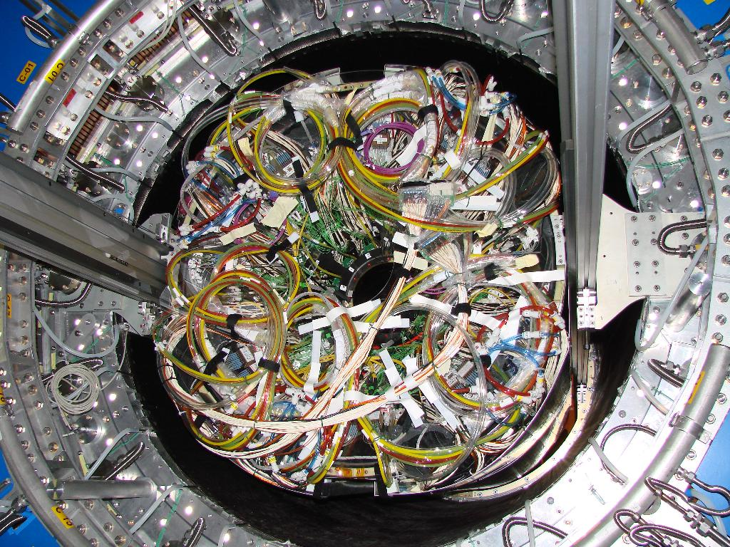

Slide 9
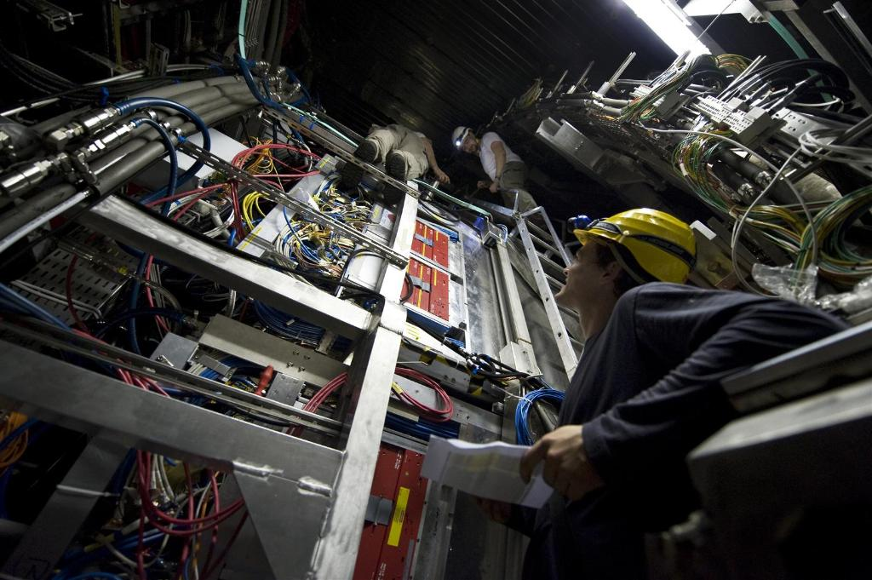
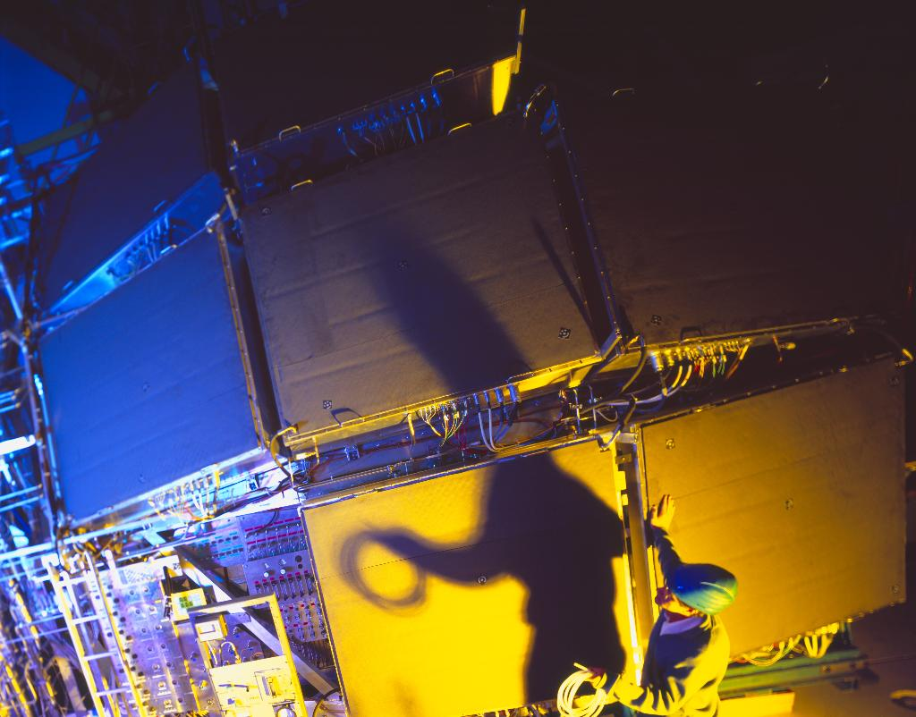

Slide 10
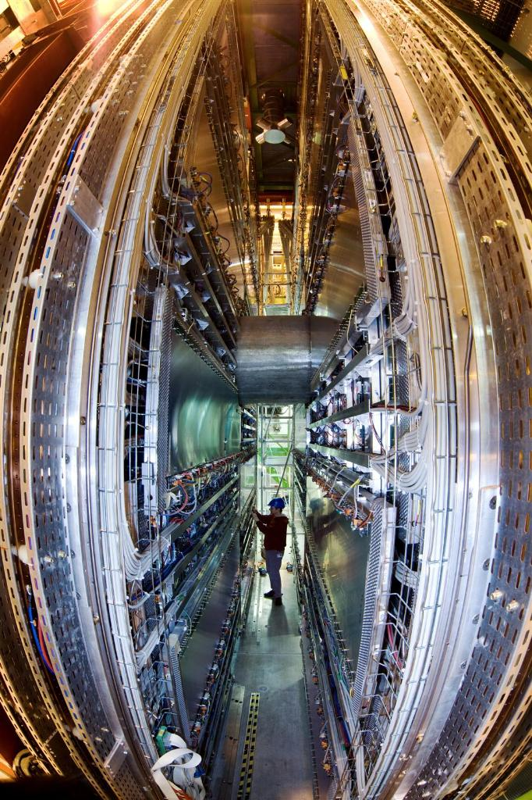
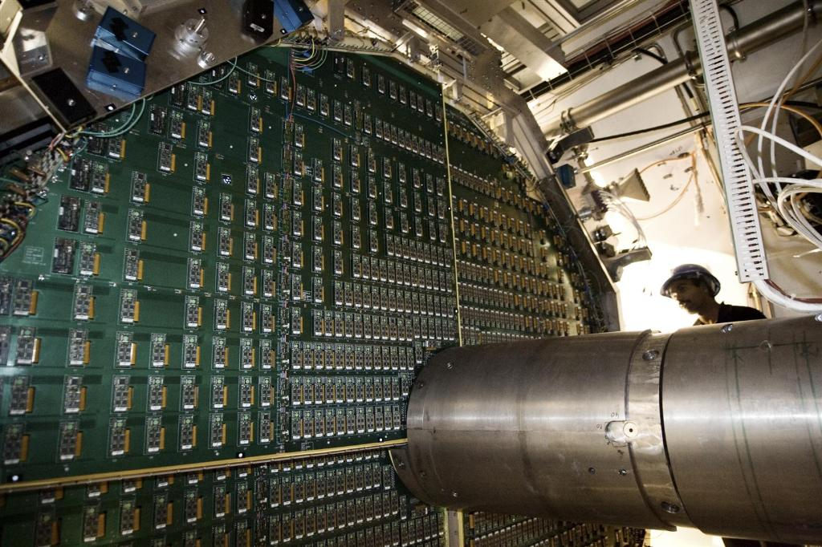

Slide 11
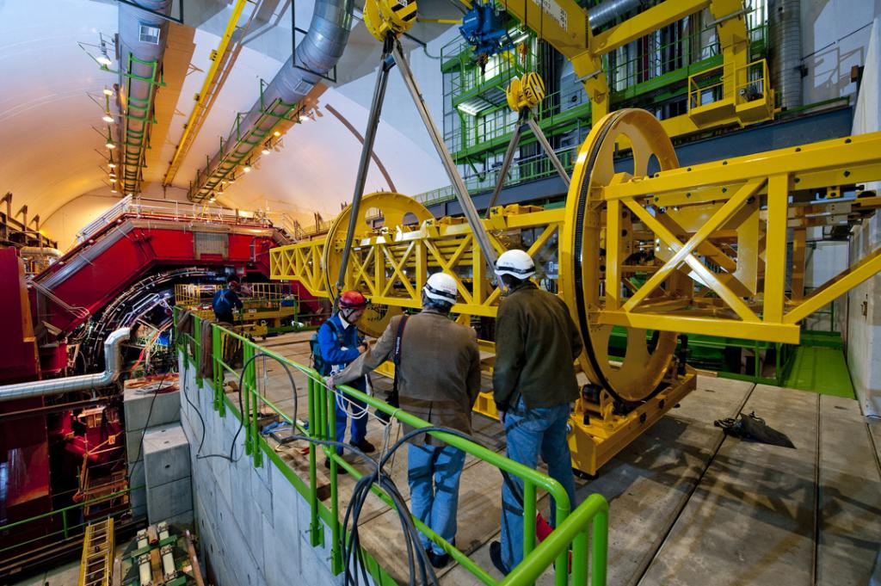
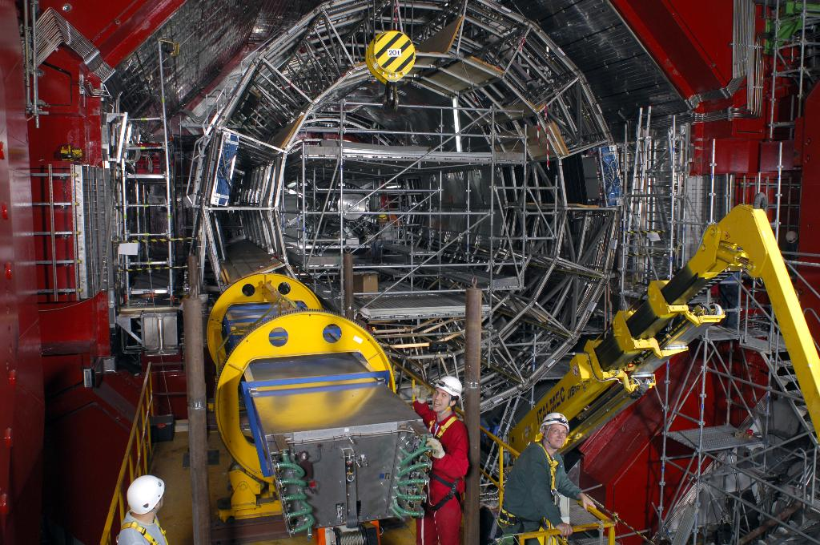
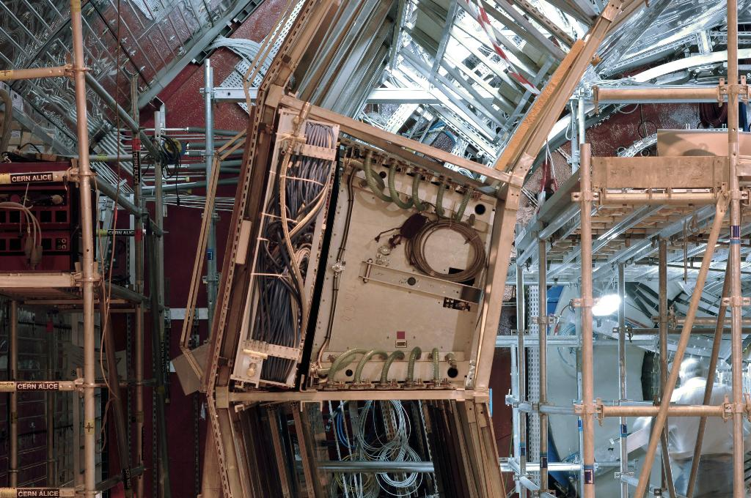

Slide 12
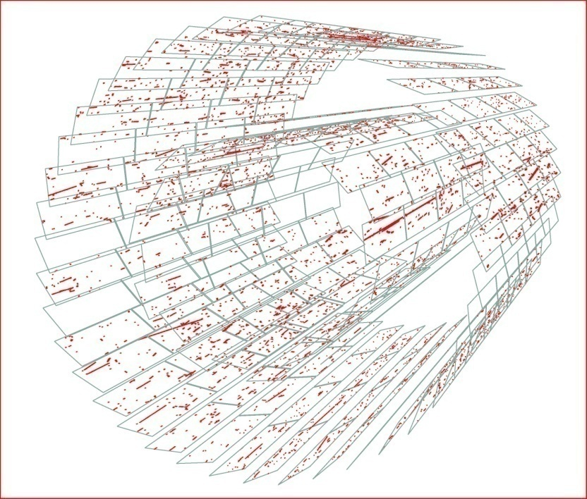
Operational since the very beginning
Historically first particles in LHC were detected by ALICE pixel detector
Injector tests, June 15 2008

Slide 13
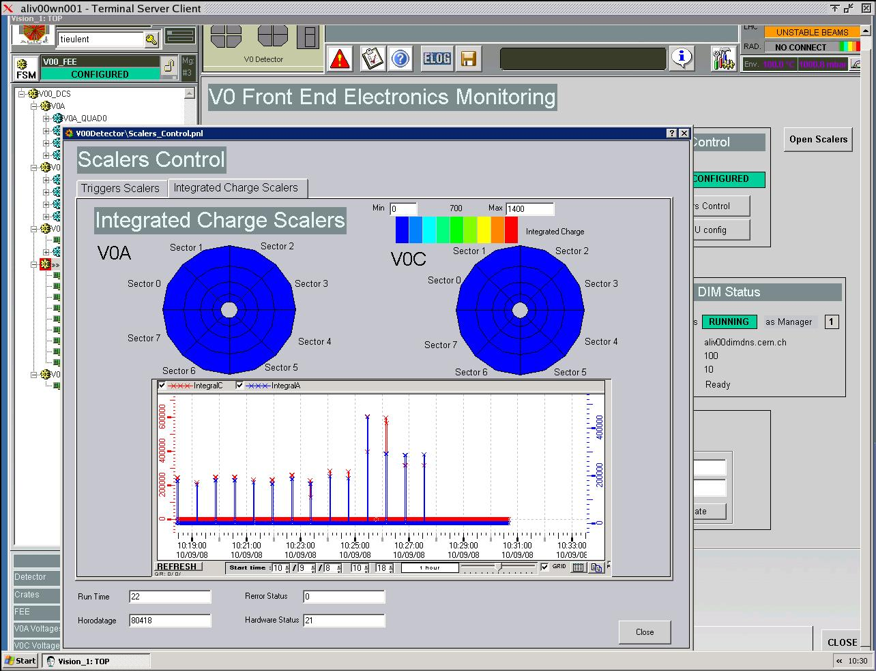
First proton collisions
Luminosity monitor (V0)

Slide 14
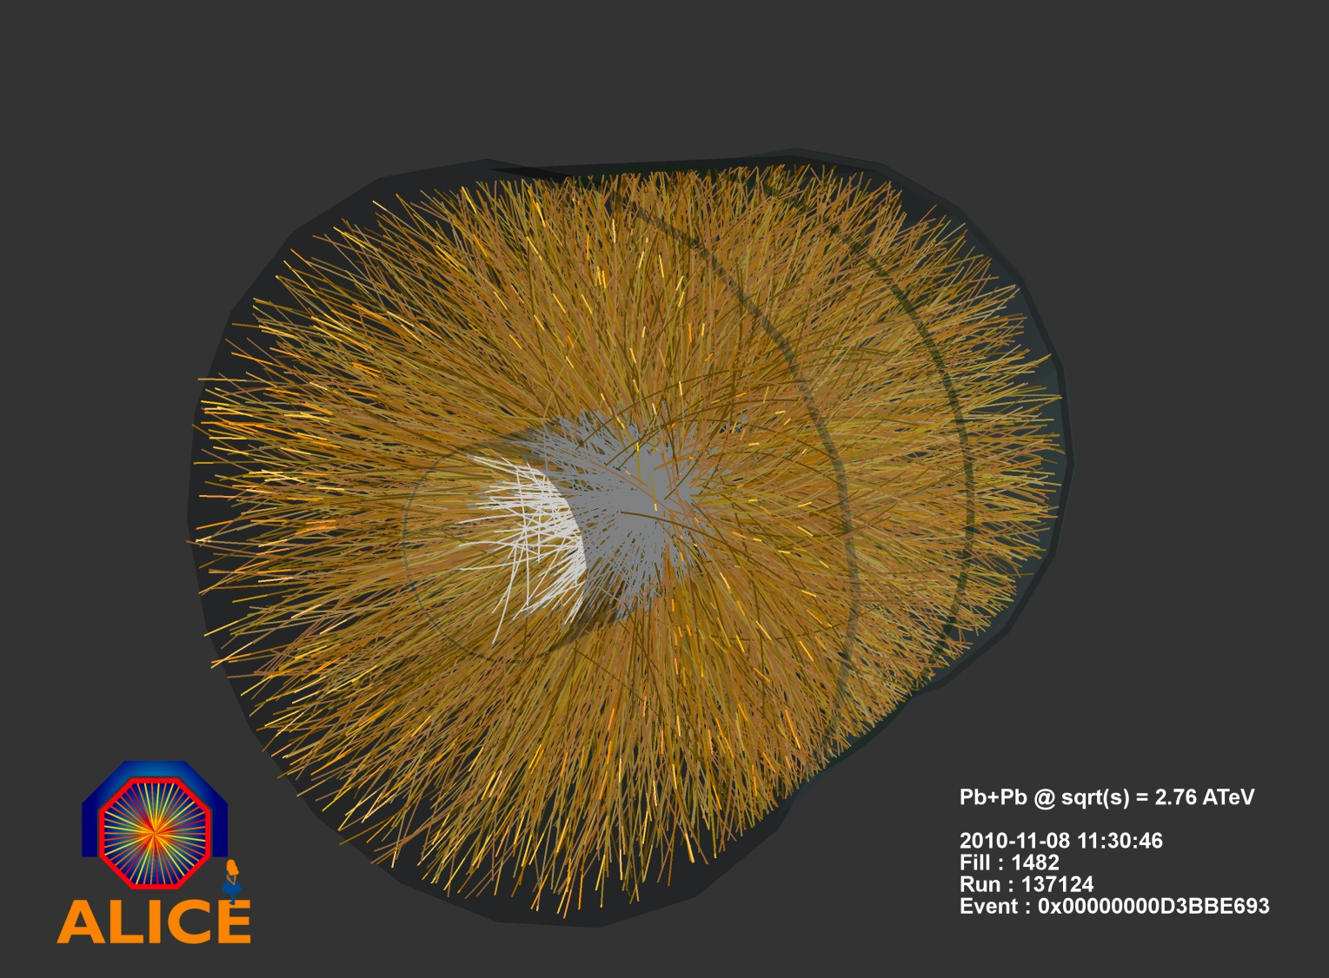
First ion collisions

Slide 15
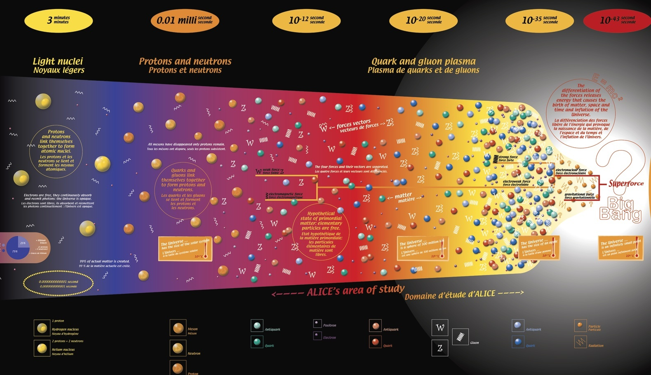
What do we do?
The particle collisions allow us to recreate conditions which existed very short (μs) after the Big Bang
3 minúty
0,01 ms
10⁻¹² s
10⁻²⁰ s
10⁻²⁹ s
10⁻⁴³ s
10¹² C
10¹⁵ C
10¹⁷ C
10¹² C
10¹⁵ C
10¹⁷ C
CERN is trying to answer many questions
Where does the mass come from?
  How does the matter behave at temperatures higher than in the middle of the Sun?
    Why is the mass of protons and neutrons 100times higher than the mass of contained quarks?
        Can we release quarks from protons and neutrons?
          Why is the mass of the Universe much higher that we can explain?
            Where did all the antimatter go?
              ......????????????????????????????????????????????????????????????????

Slide 16
ALICE is primary interested in ion collisions
  Focus on last weeks of LHC operation in 2011 (Pb-Pb collisions)
During the year ALICE is being improved
In parallel, ALICE participates in p-p programme
So far, in 2011 ALICE delivered:
  1000 hours of stable physics data taking
  2.0 10⁹ events collected
  2.1 PB of data
  5300 hours of stable cosmics datataking, calibration and technical runs
  1.7 10¹⁰ events
  3.5 PB of data
    IONS STILL TO COME IN 2011!

Slide 17
Where is the link to cyber security?
The same people who built and exploit ALICE are also in charge of its operation
  In this talk we focus only at part of the story, the Detector Control System (DCS)

Slide 18
The ALICE Detector Control System (DCS)

Slide 19
External Services and Systems
Alice Systems
OFFLINE
Conditions
Database
ECS
TRIGGER
Electricity
DAQ
HLT
Ventilation
Cooling
Detector Controls System
Magnets
Gas
Archival
Database
Access Control
SCADA
LHC
1000 ins/s
Safety
Infrastructure
Up to 6GB
Configuration
Database
B-field
Devices
Space Frame
Devices
Devices
Beam Pipe
Devices
Environment
Radiation
DETECTORS & detector-like
systems
SSD
TPC
TRD
TOF
HMP
PHS
FMD
T00
PIT
LHC
TRI
AD0
SPD
SDD
V00
PMD
MTR
MCH
ZDC
ACO

Slide 20

Dataflow in ALICE DCS
  6GB of data is needed to fully configure ALICE for operation
  Several stages of filtering applied to acquired data
GAS
COOLING
FEE
HV
LHC
ALICE on-detector electronics
LV
FEE
Magnets
Safety
Detector devices
300 000 values/s
read by software
External sub-systems
Offline
(GRID)
Operator UIs
DCS data processing farm
DCS data storage
(ORACLE, fileservers)
30 000 values/s
Injected into PVSS
Data Consumers
1000 values/s
Written to ORACLE after smoothing in PVSS
>200 values/s
Sent to consumers

Slide 21
Building blocks of ALICE DCS
1200 network-attached devices
270 crates (VME and power supplies)
4 000 controlled voltage channels
18 detectors with different requirements
  Effort to device standardization
    Still large diversity mainly in FEE part
      Large number of busses (CANbus, JTAG, Profibus, RS232, Ethernet, custom links…)
HVPS
LVPS
FEE
…

Slide 22
180 000 OPC items
100 000 Front-End (FED) services
1 000 000 parameters supervised by the DCS
Monitored at typical rate of 1Hz
Hardware diversity is managed through standard interfaces
  OPC servers for commercial devices
  FED servers for custom hardware
    Provides hardware abstraction, uses CERN DIM (TCP/IP based) protocol for communication
OPC SERVER
Device DRIVER
DEVICE ACCESS and ABSTRACTION
OPC SERVER
HVPS
Device DRIVER
LVPS
FED SERVER
Device DRIVER
FEE
FED SERVER
Device DRIVER
…

Slide 23
110 detector computers
60 backend servers
DCS Oracle RAC (able to process up to 150 000 inserts/s)
DNS
FS
BACKEND SYSTEMS
PVSS
MON
DETECTOR SYSTEM
RAC
CENTRAL SYSTEMS
PVSS
ACC
PVSS
PVSS
PVSS
PVSS
Core of the DCS is based on commercial SCADA system PVSSII
PVSS
PVSS
DETECTOR SYSTEM
OPC SERVER
Device DRIVER
PVSS
DEVICE ACCESS and ABSTRACTION
OPC SERVER
PVSS
HVPS
Device DRIVER
PVSS
LVPS
FED SERVER
PVSS
Device DRIVER
FEE
FED SERVER
Device DRIVER
…

Slide 24
PVSSII Architecture
User Application
UI
UI
UI
ALICE Framework
CTL
API
JCOP Framework
PVSSII
DM
EM
DRV
DRV
DRV
      PVSSII system is composed of specialized program modules (managers)
      Managers communicate via TCP/IP
      ALICE DCS is built from 100 PVSS systems composed of 900 managers
      PVSSII is extended by JCOP and ALICE frameworks on top of which User applications are built

Slide 25
User Interface
Manager
User Interface
Manager
User Interface
Manager
Control
Manager
API
Manager
In a simple system all managers run on the same machine
In a scattered system, the managers can run on dedicated machines
Data
Manager
Event
Manager
Driver
Driver
Driver

Slide 26
In a distributed system several PVSSII systems (simple or scatered) are interconnected
User Interface
Manager
User Interface
Manager
User Interface
Manager
User Interface
Manager
User Interface
Manager
User Interface
Manager
User Interface
Manager
User Interface
Manager
User Interface
Manager
Control
Manager
Control
Manager
Control
Manager
API
Manager
API
Manager
API
Manager
Distribution
Manager
Data
Manager
Distribution
Manager
Data
Manager
Data
Manager
Event
Manager
Event
Manager
Event
Manager
Distribution
Manager
Driver
Driver
Driver
Driver
Driver
Driver
Driver
Driver
Driver

Slide 27
Each detector DCS is built as a distributed PVSSII system
  Mesh, no hierarchical topology
  Detector specific
PVSS
CENTRAL SYSTEMS
DETECTOR SYSTEM
PVSS
PVSS
PVSS
PVSS
PVSS
PVSS
PVSS
DETECTOR SYSTEM
OPC SERVER
Device DRIVER
PVSS
DEVICE ACCESS and ABSTRACTION
OPC SERVER
PVSS
HVPS
Device DRIVER
PVSS
LVPS
FED SERVER
PVSS
Device DRIVER
FEE
FED SERVER
Device DRIVER
…

Slide 28
ALICE DCS is built as a distributed system of detector systems
Central servers connect to ALL detector systems
    global data exchange
    synchronization
    Monitoring…
PVSS
CENTRAL SYSTEMS
DETECTOR SYSTEM
PVSS
PVSS
PVSS
PVSS
PVSS
PVSS
PVSS
DETECTOR SYSTEM
OPC SERVER
Device DRIVER
PVSS
DEVICE ACCESS and ABSTRACTION
OPC SERVER
PVSS
HVPS
Device DRIVER
PVSS
LVPS
FED SERVER
PVSS
Device DRIVER
FEE
FED SERVER
Device DRIVER
…

Slide 29
OPERATIONS LAYER
PVSSII distributed system is not a natural system representation for the operator
ALICE DCS Is modeled as a FSM using CERN SMI++ tools
  Hide experiment complexity
  Focus on operational aspect
PVSS
PVSS
CENTRAL SYSTEMS
DETECTOR SYSTEM
PVSS
PVSS
PVSS
PVSS
PVSS
PVSS
CH
CH
CH
CH
CH
CH
CH
CH
CH
PVSS
CH
CH
CH
CH
DETECTOR SYSTEM
CH
CH
CH
CH
CH
CH
OPC SERVER
CH
CH
CH
CH
CH
CH
CH
CH
CH
CH
Device DRIVER
PVSS
CH
DEVICE ACCESS and ABSTRACTION
OPC SERVER
PVSS
HVPS
Device DRIVER
PVSS
LVPS
FED SERVER
PVSS
Device DRIVER
FEE
FED SERVER
Device DRIVER
…

Slide 30
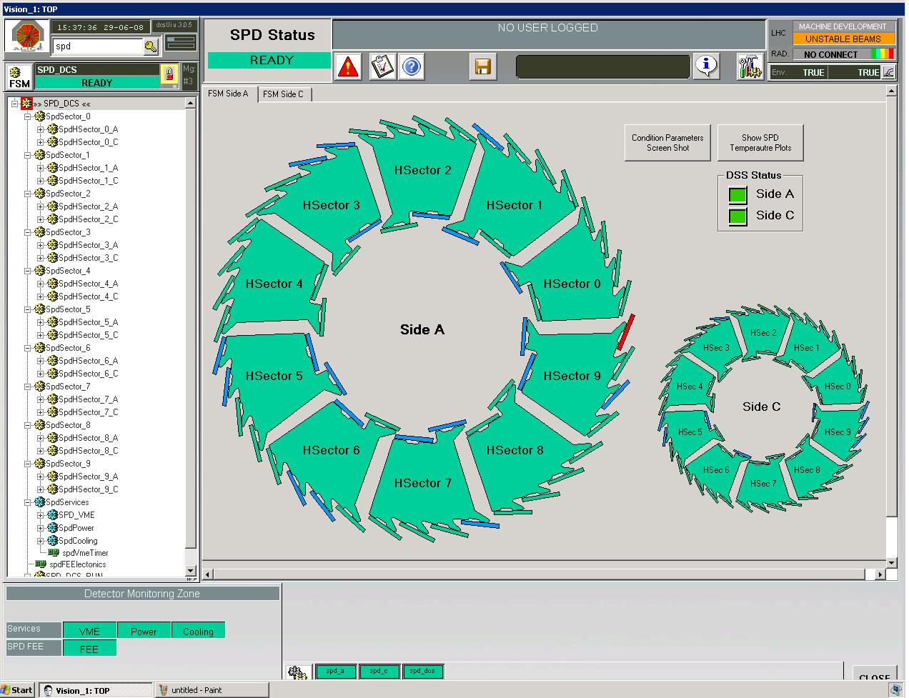
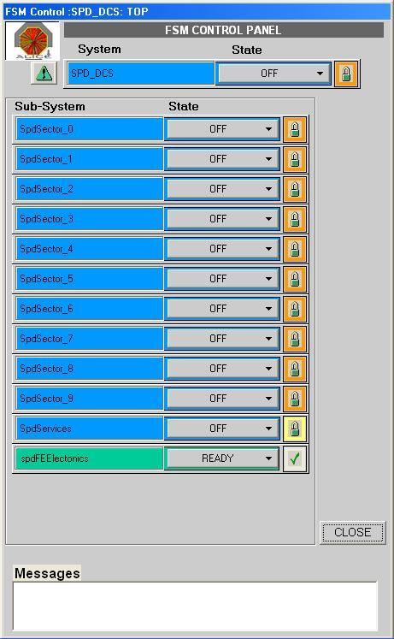
UI LAYER
OPERATIONS LAYER
PVSS
PVSS
CENTRAL SYSTEMS
DETECTOR SYSTEM
PVSS
PVSS
PVSS
PVSS
PVSS
PVSS
CH
CH
CH
CH
CH
CH
CH
CH
CH
PVSS
CH
CH
CH
CH
DETECTOR SYSTEM
CH
CH
CH
CH
CH
CH
OPC SERVER
CH
CH
CH
CH
CH
CH
CH
CH
CH
CH
Device DRIVER
PVSS
CH
DEVICE ACCESS and ABSTRACTION
OPC SERVER
PVSS
HVPS
Device DRIVER
PVSS
LVPS
FED SERVER
PVSS
Device DRIVER
FEE
FED SERVER
Device DRIVER
…

Slide 31
DCS Computing model
Two categories of DCS computers:
  Worker nodes – executing the controls tasks and running detector specific software
  Operator node – used by operators to interact with the system
ON
PVSS
PVSS
PVSS
WN
PVSS
FED

Slide 32
ALICE network architecture

Slide 33
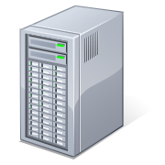
Remote access to the DCS network
General Purpose Network
Application gateway
ALICE Network
No direct user access to the ALICE network
Remote access to ALICE network Is possible via the application gateways
  User makes RDP connection to the gateway
  From the gateway further connection is granted to the network

Slide 34
ALICE host exposed to NetA:
Can see all NetA and ALICE hosts
Can be seen by all NetA hosts
NetA
EXPOSED
ALICE Network
TRUSTED
NetB host trusted by ALICE:
Can see all ALICE and NetB hosts
Can be seen by all ALICE hosts
NetB

Slide 35
Are we there?
The simple security cookbook recipe seems to be:
  Use the described network isolation
  Implement secure remote access
  Add firewalls and antivirus
  Restrict the number of remote users to absolute minimum
  Control the installed software and keep the systems up to date
Are we there?
  No, this is the point, where the story starts to be interesting

Slide 36
Remote access
Why would we need to access systems remotely?
ALICE is still under construction, but experts are based in the collaborating institutes
  Detector groups need DCS to develop the detectors directly in situ
    There are no test benches with realistic systems in the institutes, the scale matters
ALICE takes physics and calibration data
  On-call service and maintenance for detector systems are provided remotely

Slide 37
The user challenge
Natural expectation would be that there are few users requiring access to the controls system
The today’s reality is more than 400 authorized accounts...
  Rotation of experts in the institutes is very frequent
    Many tasks are carried out by students (graduate or PhD)
  Commitments to collaboration expect shift coverage
    Shifters come to CERN to cover 1-2 weeks and then are replaced by colleagues

Slide 38
How do we manage the users?

Slide 39
Authorization and authentication
User authentication is based on CERN domain credentials
  No local DCS accounts
  All users must have CERN account (no external accounts allowed)
Authorization is managed via groups
  Operators have rights to logon to operator nodes and use PVSS
  Experts have access to all computers belonging to their detectors
  Super experts have access everywhere
Fine granularity of user privileges can be managed by detectors at the PVSS level
  Only certain people are for example allowed to manipulate very high voltage system etc.

Slide 40

Operator access to computers
ACR
CR3
Detector 1
operator
ON
Detector 1
WN
Detector 2
operator
ON
Detector 2
Central Systems
WN
Central
operator
ON

Slide 41
Could there be an issue?

Slide 42
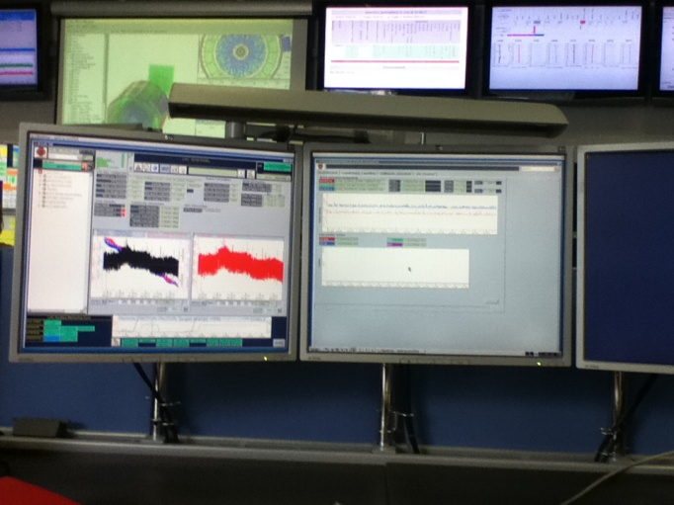
Authentication trap
During the operation, the detector operator uses many windows, displaying several parts of the controlled system
  Sometimes many ssh sessions to electronic cards are opened and devices are operated interactively
At shift switchover old operator is supposed to logoff and new operator to logon
  In certain cases the re-opening of all screens and navigating to components to be controlled can take 10-20 minutes, during this time the systems would run unattended
    During beam injections, detector tests, etc. the running procedures may not be interrupted
Shall we use shared accounts instead?
  Can we keep the credentials protected?

Slide 43
Information leaks
Sensitive information, including credentials, can leak
  Due to lack of protection
  Due to negligence/ignorance

Slide 44
….in scripts
echo " ----- make the network connections -----"
rem --- net use z: \\alidcsfs002\DCS_Common XXXXXX /USER:CERN\dcsoper
rem --- net use y: \\alidcscom031\PVSS_Projects XXXXXX /USER:CERN\dcsoper
echo " ------ done ---------"
rem ---ping 1.1.1.1 -n 1 -w 2000 >NULL
START C:\Programs\PVSS\bin\PVSS00ui.exe -proj lhc_ui -user operator:XXXXXX
-p lhcACRMonitor/lhcACRDeskTopDisplay.pnl,$panels:BackGround:lhcBackground/
lhcBackgroundMain.pnl;Luminosity_Leveling:lhcLuminosity/
lhcLuminosityLumiLevelling.pnl;Collisions_Schedule:BPTX/
lhc_bptxMonitor.pnl;V0_Control:lhcV00Control/lhcV00ControlMain.
These examples are real, original passwords in clear text are replaced by XXXXXX in this presentation
# Startup Batch Program for the LHC Interface Desktop
#
# Auth : deleted v1.0 4/8/2011
# - rdesktop -z -f -a 16 -k en-us -d CERN -u dcsoper -p XXXXXX -s “D:
\PVSS_Profiles\ACRLHCDesk.bat” alidcscom054
rdesktop -z -g2560x1020 -a 16 -k en-us -d CERN -u

Slide 45
…. In documentation
Entries like this :
The relevant parameters are
• Window dimension : 1920x1050;
• RDT credential : host = alidcscom054, user = dcsoper, password = XXXXXX;
• shell command to start : D:\PVSS_Profiles\ACRLHCBigScreen.bat
• panel to reference : lhcACRMonitor/lhcACRMain.pnl
Thesis
Web pages
Can be found in
Reports
…..
Twikies
Printed manuals
We protect our reports and guides, but institutes republish them very often on their unprotected servers

Slide 46
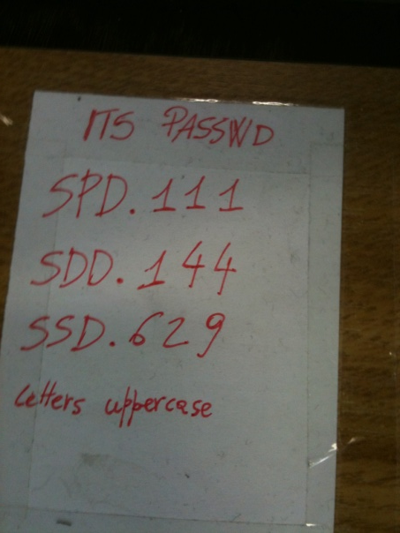
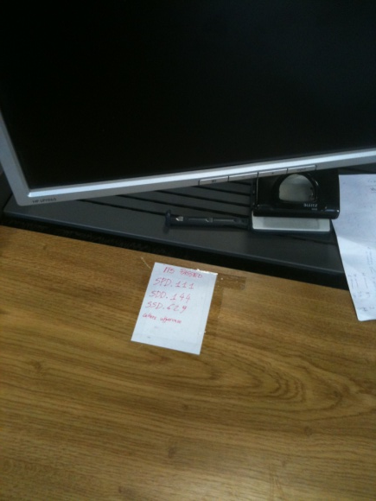
... or even worse!

Slide 47
Using shared accounts
In general, the use of shared accounts is undesired
However, if we do not allow for it, users start to share their personal credentials
Solution – use of shared accounts (detector operator, etc.) only in the control room
  Restricted access to the computers
  Autologon without the need to enter credentials
  Logon to remote hosts via scripts using encrypted credentials (like RDP file)
  Password known only to admins and communicated to experts only in emergency (sealed envelope)
Remote access to DCS network allows only for physical user credentials

Slide 48
OK, so we let people to work from the control room and remotely.
Is this all?

Slide 49
Data exchange
The DCS data is required for physics reconstructions, so it must be made available to external consumers
The systems are developed in institutes, and the elaborated software must be uploaded to the network
Some calibration data is produced in external institutes, using semi-manual procedures
  Resulting configurations must find a way to the front end electronics
Daily monitoring tasks require access to the DCS data from any place at any time
How do we cope with that requests?

Slide 50
Getting data OUT of DCS
GPN
Public DCS fileserver
Private fileserver
Exposed gateway
ALICE DCS Network
DCS Worker Nodes

Slide 51
DCS WWW monitoring
WWW is probably the most attractive target for intruders
WWW is the most requested service by institutes
ALICE model:
  Users are allowed to prepare a limited number of PVSS panels, displaying any information requested by them
  Dedicated servers opens these panels periodically and creates snaphosts
  The images are automatically transferred to central Web servers
Advantage:
  There is no direct link via the WWW and ALICE DCS, but the web still contains updated information
Disadvantage/challenges:
  Many

Slide 52
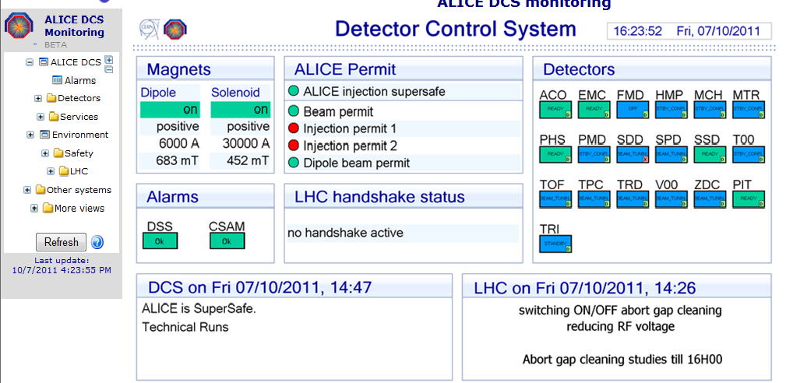
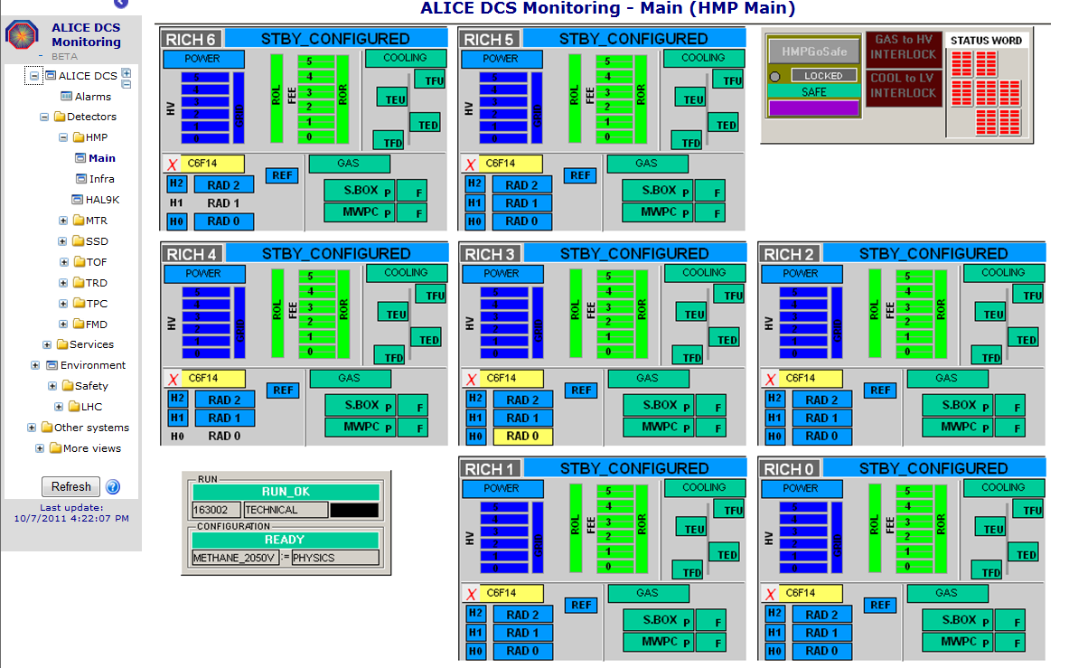
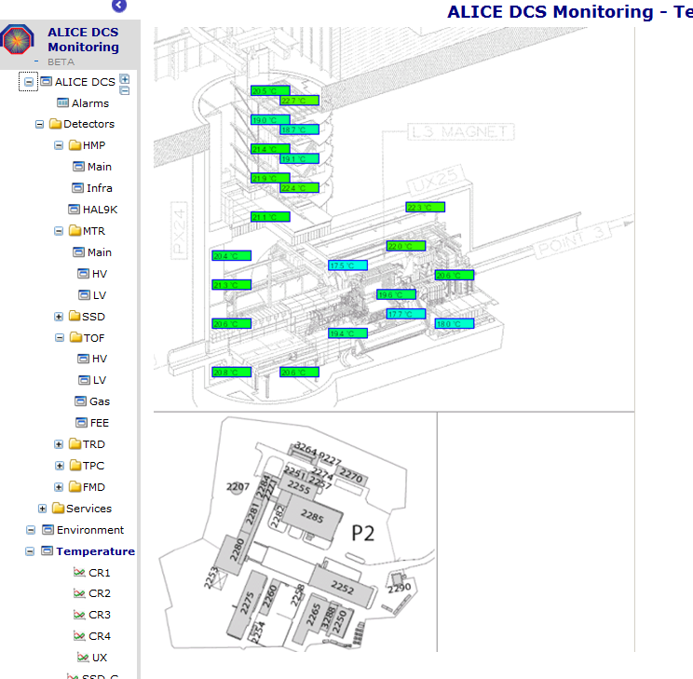
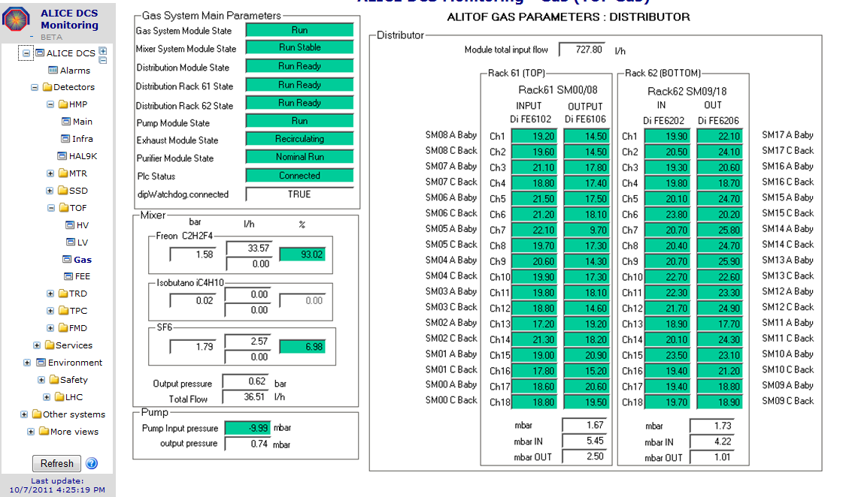
WWW monitoring

Slide 53
Getting data OUT of DCS
GPN
Public DCS fileserver
Private fileserver
Exposed gateway
ALICE DCS Network
DCS Worker Nodes

Slide 54
Getting data OUT of DCS
Public WWW server
GPN
Public DCS fileserver
Private fileserver
Exposed gateway
ALICE DCS Network
DCS Worker Nodes
WWW generator

Slide 55
Data for OFFLINE
Certain DCS data is required for offline reconstruction
  Conditions data
  Configuration settings
  Calibration parameters
Conditions data is stored in ORACLE and sent to OFFLINE via dedicated client-server machinery
Calibration, configuration, memory dumps, etc. are stored on private fileserver and provided to offline
OFFLINE shuttle collects the data at the end of each run

Slide 56
Getting data OUT of DCS
Public WWW server
GPN
Public DCS fileserver
Private fileserver
Exposed gateway
ALICE DCS Network
DCS Worker Nodes
WWW generator

Slide 57
Getting data OUT of DCS
Public WWW server
GPN
Public DCS fileserver
Private fileserver
Exposed gateway
ALICE DCS Network
DCS Worker Nodes
Trusted OFFLINE server
WWW generator
DCS Database
File exchange server
DB access server

Slide 58
Data to ALICE online systems
During the runs, DCS status is published to other online systems for synchronization purposes
  Run can start only if DCS is ready
  Run must be stopped if DCS needs to perform safety related operations
  Etc.
Conditions data is sent to online and quasi-online systems for further processing
  Data quality monitoring
  Calibration parameters for HLT
  Etc.

Slide 59
Getting data OUT of DCS
Public WWW server
GPN
Public DCS fileserver
Private fileserver
Exposed gateway
ALICE DCS Network
DCS Worker Nodes
Trusted OFFLINE server
WWW generator
DCS Database
File exchange server
DB access server

Slide 60
Getting data OUT of DCS
Trusted DAQ fileserver
ALICE DAQ
Trusted DIM consumers
Public WWW server
GPN
Public DCS fileserver
DIM/DIP servers
Private fileserver
Exposed gateway
ALICE DCS Network
DCS Worker Nodes
Trusted OFFLINE server
WWW generator
DCS Database
HLT
File exchange server
Trusted HLT gateway
DB access server

Slide 61
External data published to other sources
DCS provides feedback to other systems
  LHC
  Safety
  ...

Slide 62
Getting data OUT of DCS
Trusted DAQ fileserver
ALICE DAQ
Trusted DIM consumers
Public WWW server
GPN
Public DCS fileserver
DIM/DIP servers
Private fileserver
Exposed gateway
ALICE DCS Network
DCS Worker Nodes
Trusted OFFLINE server
WWW generator
DCS Database
HLT
File exchange server
Trusted HLT gateway
DB access server

Slide 63
Getting data OUT of DCS
Technical network
Trusted DAQ fileserver
ALICE DAQ
Trusted DIM consumers
Public WWW server
Trusted DIP consumers
GPN
Public DCS fileserver
DIM/DIP servers
Private fileserver
Exposed gateway
ALICE DCS Network
DCS Worker Nodes
Trusted OFFLINE server
WWW generator
DCS Database
HLT
File exchange server
Trusted HLT gateway
DB access server

Slide 64
Getting data OUT of DCS
Technical network
Trusted DAQ fileserver
ALICE DAQ
Trusted DIM consumers
Public WWW server
Trusted DIP consumers
GPN
Public DCS fileserver
DIM/DIP servers
Private fileserver
Exposed gateway
ALICE DCS Network
DCS Worker Nodes
Trusted OFFLINE server
WWW generator
DCS Database
HLT
File exchange server
Trusted HLT gateway
DB access server

Slide 65
Getting data OUT of ALICE
A number of servers in different domains need to be trusted
  The picture still does not contain all the infrastructure needed to get the exchange working (nameserves, etc.)
Filetransfer OUT of the DCS network is not limited
  Autotriggered filetransfers
  Data exchange on client request

Slide 66
Getting data to ALICE DCS
All file transfers to ALICE DCS are controlled
  Users upload the data to public fileservers (CERN security apply) and send transfer request
  After checking the files (antivirus scans), data is uploaded to private DCS fileservers and made visible to DCS computers
Automatic data flow to ALICE DCS is possible only via publisher/subscriber model
  DCS clients subscribe to LHC services, environment monitors, safety systems …. and data is injected into the PVSS

Slide 67
Getting data IN to DCS
GPN
Public DCS fileserver
Private fileserver
Exposed gateway
ALICE DCS Network
DCS Worker Nodes
MANUAL
procedure

Slide 68
Getting data IN to DCS
Technical network
Trusted DAQ fileserver
ALICE DAQ
Trusted DIM publishers
Trusted DIP publishers
GPN
Public DCS fileserver
DIM/DIP clients
Private fileserver
Exposed gateway
ALICE DCS Network
DCS Worker Nodes
HLT
Trusted HLT publishers

Slide 69
Are people happy with this system?
One example for all

Slide 70
From: XXXXXXXX [mailto:XXXXXXX@YYYYYYYY.ZZ]
Sent: Tuesday, February 1, 2011 11:03 PM
To: Peter Chochula
Subject: Putty
Hi Peter
Could you please install Putty on com001? I’d like to bypass this annoying upload procedure
Grazie
UUUUUUUUUUUU

Slide 71
Few more
  Attempt to upload software via cooling station with embedded OS
  Software embedded in the frontend calibration data
  …..
  We are facing a challenge here
  … and of course we follow all cases….
  The most dangerous issues are critical last minute updates

Slide 72
DCS
External Services and Systems
Alice Systems
OFFLINE
Conditions
Database
ECS
TRIGGER
Electricity
DAQ
HLT
Ventilation
Cooling
Detector Controls System
Magnets
Gas
Archival
Database
Access Control
SCADA
LHC
1000 ins/s
Safety
... And the whole IT infrastructure and services
(domain services, web, DNS, installation services, databases,...)
Infrastructure
Up to 6GB
Configuration
Database
B-field
Devices
Space Frame
Devices
Devices
Beam Pipe
Devices
Environment
Radiation
DETECTORS & detector-like
systems
SSD
TPC
TRD
TOF
HMP
PHS
FMD
T00
PIT
LHC
TRI
AD0
SPD
SDD
V00
PMD
MTR
MCH
ZDC
ACO
72

Slide 73
Firewalls
In the described complex environment firewalls are a must
  Can be the firewalls easily deployed on controls computers?

Slide 74
Firewalls
The firewalls cannot be installed on all devices
  Majority of controls devices run embedded operating systems
    PLC, front-end boards, oscilloscopes,...
  The firewalls are MISSING or IMPOSSIBLE to install on them

Slide 75
Firewalls
Are (simple) firewalls (simply) manageable on controls computers?

Slide 76
Firewalls
There is no common firewall rule to be used
The DCS communication involves many services, components and protocols
  DNS, DHCP, WWW, NFS, DFS,
  DIM, DIP, OPC, MODBUS, SSH,
  ORACLE clients, MySQL clients
  PVSS internal communication
Efficient firewalls must be tuned per system

Slide 77
Firewalls
The DCS configuration is not static
  Evolution
  Tuning (involves moving boards and devices across detectors)
  Replacement of faulty components
Each modification requires a setup of firewall rules by expert
  Interventions can happen only during LHC access slots, with limited time for the actions
    Can the few central admins be available 24/7?

Slide 78
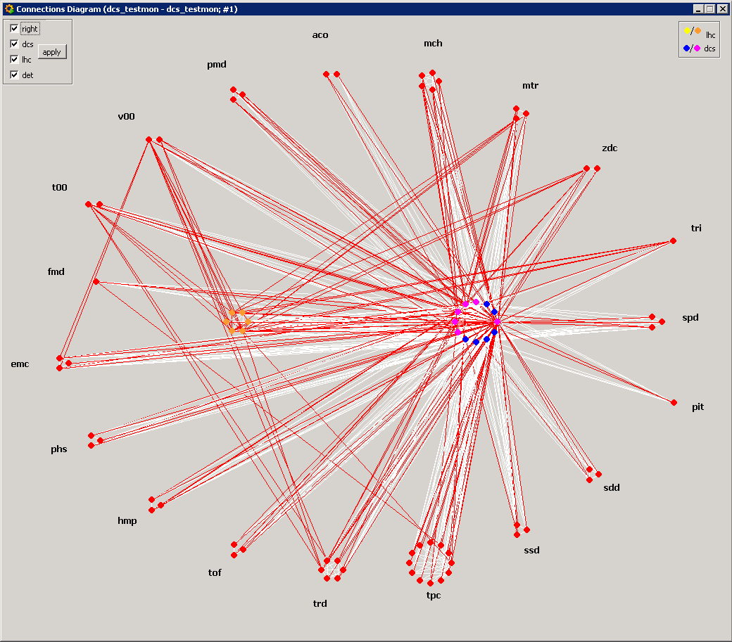
System Complexity
Example of the cross-system connectivity as seen by monitoring tools
  Red dots represent PVSS systems

Slide 79
Firewalls
Firewalls must protect the system but should not prevent its functionality
  Correct configuration of firewalls on all computers (which can run firewalls) is an administrative challenge
  Simple firewalls are not manageable and sometimes dangerous
    for example Windows firewall turns on full protection in case of domain connectivity loss
      Nice feature for laptops
        Killing factor for controls system which is running in emergency mode due to restricted connectivity
And yes, most violent viruses attack the ports, which are vital for the DCS and cannot be closed...

Slide 80
Antivirus
Antivirus is a must in such complex system
But can they harm? Do we have resources for them?

Slide 81
Antivirus
Controls systems were designed 10-15 years ago
  Large portion of the electronics is obsolete (PCI cards, etc.) and requires obsolete (=slow) computers
Commercial software is sometimes written inefficiently and takes a lot of resources without taking advantage of modern processors
  Lack of multithreading forces the system to run on fast cores (i.e. Limited number of cores per CPU)

Slide 82
Antivirus
Operational experience shows that fully operational antivirus will start interacting with the system preferably in critical periods like the End of Run
  When systems produce conditions data (create large files)
  When detectors change the conditions (communicate a lot)
    adopt voltages as a reaction to beam mode change
    Recovery from trips causing the EOR...

Slide 83
Antivirus and firewall finetuning
Even a tuned antivirus typically shows on top 5 resource hungry processes
CPU core affinity settings require huge effort
  There are more than 2300 PVSS managers in ALICE DCS, 800 DIM servers, etc.
The solutions are:
  Run firewall and antivirus with very limited functionality
  Run good firewalls and antivirus on the gates to the system

Slide 84
Software versions and updates
It is a must to run the latest software with current updates and fixes
  Is this possible?

Slide 85
Software versions and updates
ALICE operates in 24/7 mode without interruption
Short technical stops (4 days each 6 weeks) are not enough for large updates
  DCS supervises the detector also without beams
  DCS is needed for tests
Large interventions are possible only during the long technical stops - around Christmas
Deployment of updates requires testing, which can be done only on the real system
Most commercial software excludes the use of modern systems (lack of 64 bit support)
Front-end boards run older OS versions and cannot be easily updated
ALICE deploys critical patches when operational conditions allow for it
  Whole system is carefully patched during the long stops

Slide 86
Conclusions
The cybersecurity importance is well understood in ALICE and is given high priorities
The nature of a high energy physics experiment excludes a straightforward implementation of all desired features
  Surprisingly , the commercial software is a significantly limiting factor here
Implemented procedures and methods are gradually developing in ALICE
The goal is to keep ALICE safe until 2013 (LHC long technical stop) and even safer afterwards

