Slide 1

Cyber Security for the
Control System Engineer
Steven Hartman
Spallation Neutron Source
Oak Ridge National Laboratory

Slide 2


Slide 3
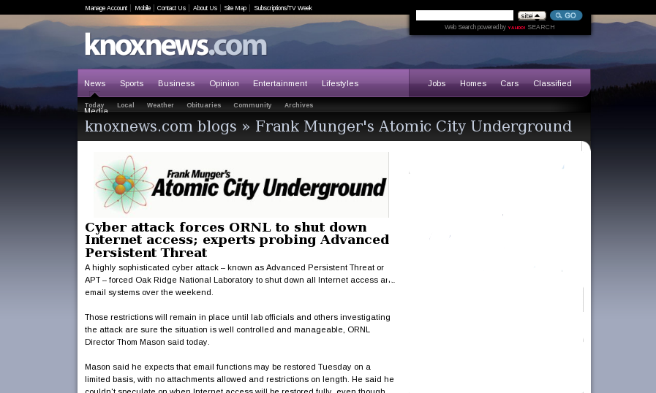
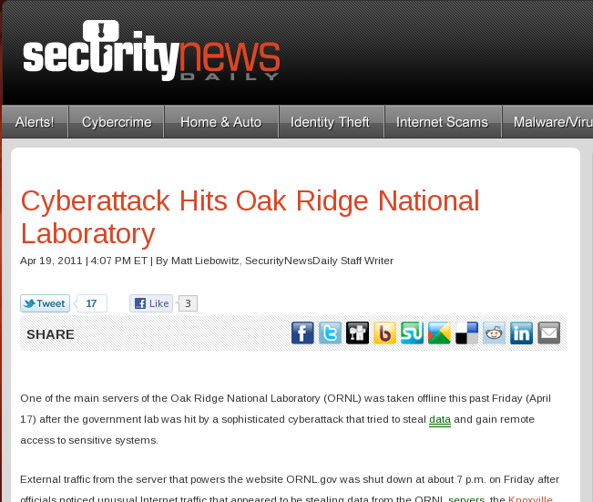

Slide 4
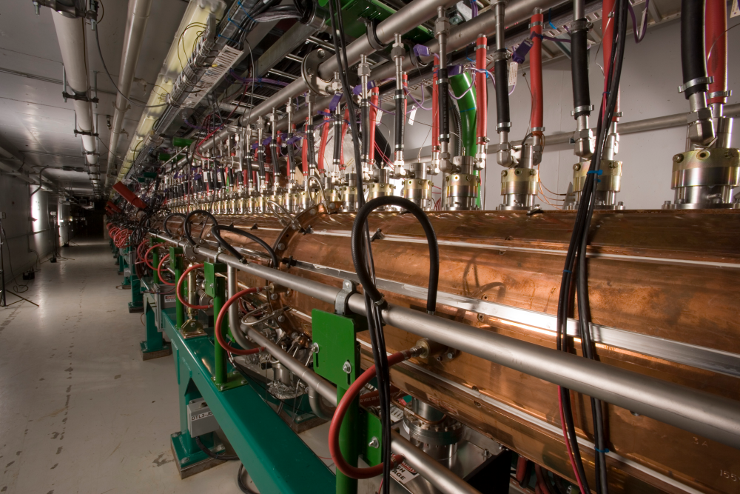
Particle Accelerator

Slide 5
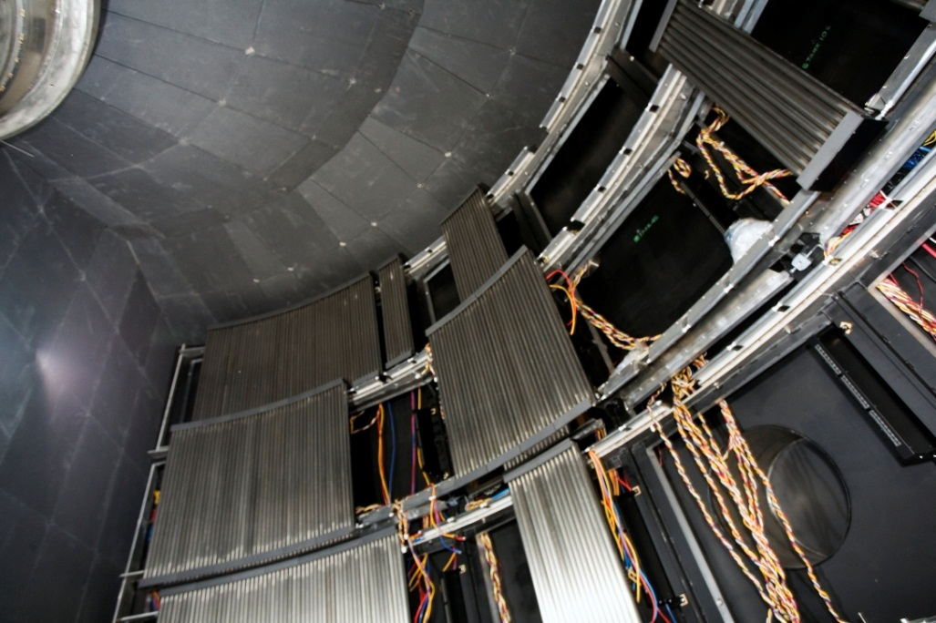
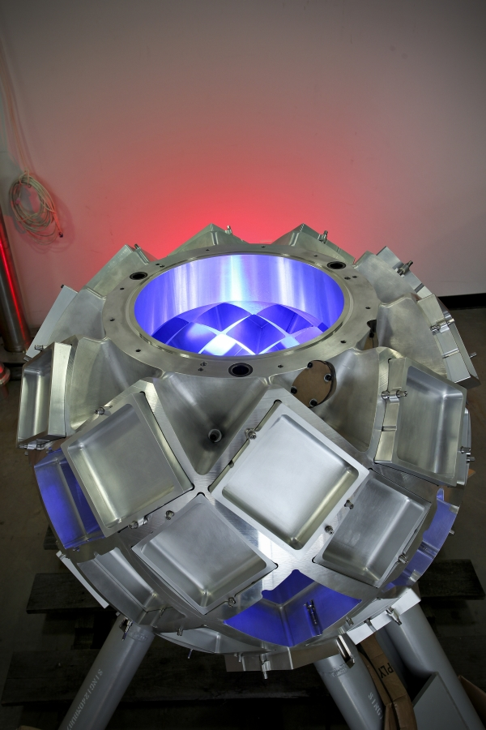
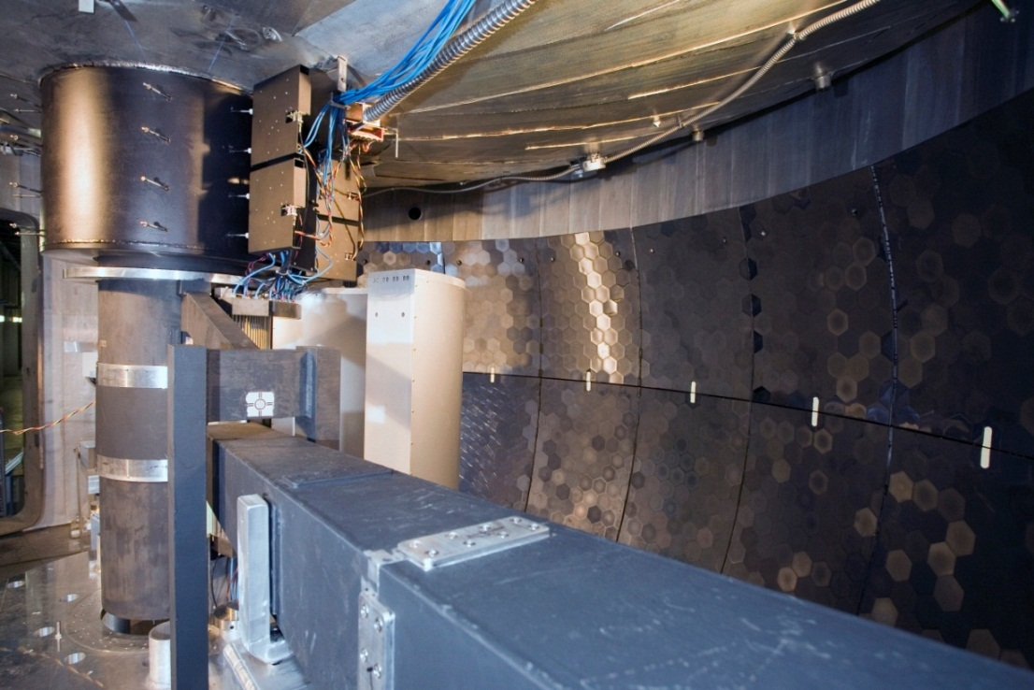
Beam Line Instruments

Slide 6
