Slide 1



Securing a Control System:
Experiences from ISO 27001 Implementation
National Superconducting Cyclotron Laboratory
Vasu Vuppala, Ph.D., PMP
John Vincent, Ph.D.
Jay Kusler
Kelly Davidson
{vuppala,vincent,kusler,davidson}@nscl.msu.edu
National Superconducting Cyclotron Laboratory,
East Lansing, Michigan, USA.

Slide 2
Overview
Background
ISO/IEC 27000
Argus the ISMS
  Risk Assessment
  Controls
  Lifecycle
Retrospection
  Project Statistics, Challenges
  Lessons Learnt
  FRIB Data Security
Conclusion

Slide 3
The Problem

Slide 4
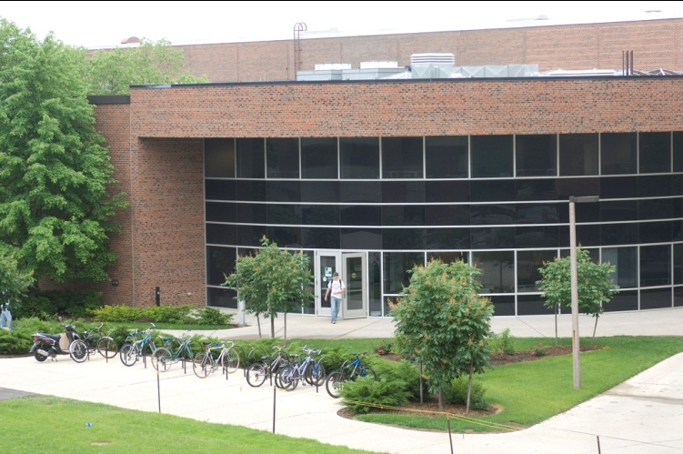
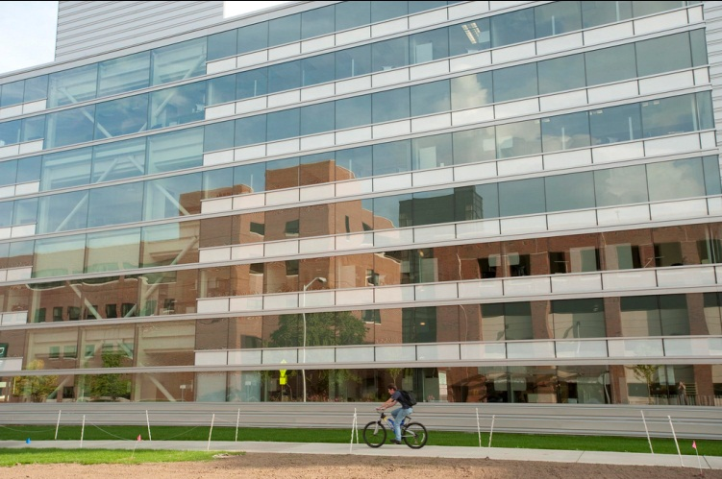
Background: NSCL
Rare Isotope Research
Two Superconducting Cyclotrons
Located on Campus of Michigan State University, USA
About 400 Employees
Building the Facility for Rare Isotope Beam (FRIB)
Electronics Department
  RF, Power Supplies, Control Instrumentation, Controls Software
  Approx 40 Employees

Slide 5
Background: The Initial Problem
Restrict Traffic to Control Network
Reduce Inadvertent Disruptions to Experiments
Group Based Access Control to EPICS Channels
  Groups of Devices
  Groups of Users
Ability to Reserve/Release Devices (Their Channels)
Solutions
  Updating IOC database, and reload
  Modify Channel Access
More Problems: IOC Security, Embedded Controllers, PLCs, Network, Servers, License Keys, Physical Access, People ….

Slide 6
ISO/IEC 27000

Slide 7
ISO/IEC 27000 Series Standards
27000 – Overview
27001 – Specification
27002 – Code of Practice (Controls)
27003 – Implementation Guidance
27004 – Information Security Management Measurement
27005 – Information Security Risk Management
27006 – Certification/Registration Process

Slide 8
ISO/IEC 27001
The Specification
Process Approach: Plan-Do-Check-Act (PDCA) Model
Defines ISMS Requirements
  Establish, Implement and Operate, Monitor and Review, Maintain and Improve
Documentation Requirements
Management Responsibilities
  Commitment, Resources, Training, Awareness
Internal Audits
Management Review
ISMS Improvement
  Corrective and Preventive Actions
Plan
Do
Check
Act

Slide 9
ISO/IEC 27002
A Code of Practice: Annex to 27001
Security Clauses (11)
  Main Security Categories (39)
    Security Objective
    Security Controls
Security Clauses
  Security Policy
  Information Security Organization
  Asset Management
  HR Security
  Physical Security
  Communication and Operations Management
  Access Control
  Information Systems
  Information Security Incident Management
  Business Continuity Management
  Compliance

Slide 10
Argus The ISMS

Slide 11
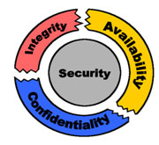
Argus The ISMS
Information: Data that is important to an organization.
Information Security - Preservation of the Following for Information:
  Confidentiality: Not Disclosed to Unauthorized Entities
  Integrity: Accuracy and Completeness
  Availability: Accessible and usable upon demand
Management System: Framework of policies, procedures, guidelines and associated resources to achieve the objectives of the organization
Information Security Management System (ISMS): A management system to establish implement, operate, monitor review, maintain, and improve information security.

Slide 12
Information Security
Requirement Sources
  Assessing Risks to the Organization
  Legal, Regulatory, Contractual Compliance
  Organization’s objectives for Information Processing
Protection of information from threats for business continuity, minimize risk
Information Security is Achieved by Implementing a Set of Controls
What are Controls?
  Policy, Procedure, Organization Structure, Software/Hardware Functions
    Means of Managing Risk

Slide 13
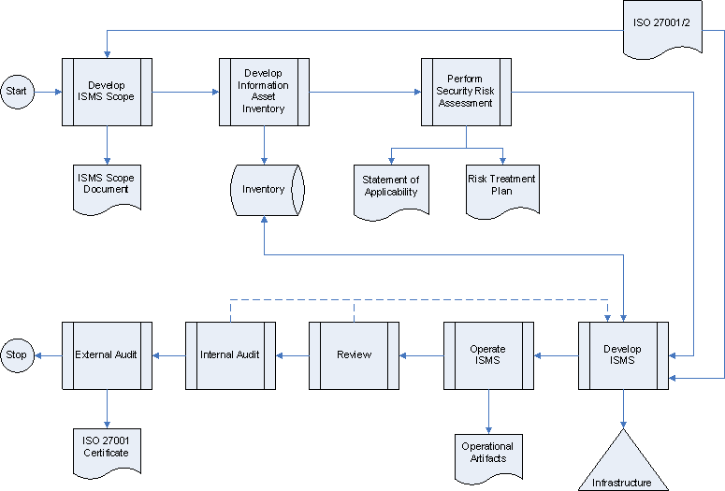
Argus The ISMS: Roadmap

Slide 14
Argus: Risk Assessment

Slide 15
Information Assets, Containers, Owners
Information Assets (IA): Information That is of Value to the Organization
  Examples: Controls Software Source, Channel Data, IOC Configuration, HR Database etc
IA Containers: Where Information Assets Reside/Stored
  Technology: File Server, Software, Database etc
  Physical: Folder, Paper, Printed Manual, etc
  Human: Intellectual Property, Ideas, Special Processes
Information Asset Owners, Custodians

Slide 16
Risk Assessment Method
Based on OCTAVE Allegro
Establish Risk Measurement Criteria: Identify and Prioritize Impact Areas:
  Employee Safety & Health, Quality Objective, Reputation, Productivity, Financial, Legal
Identify Information Assets
Identify Information Asset Containers: Technical, Physical, Human
Identify Areas of Concern: Conditions that can affect IA
Identify Threat Scenarios: Actors, Means, Motives, Outcomes
Evaluate Impact of Each Threat
Identify Risks: Threat + Impact
Analyze Risks

Slide 17
Risk Assessment Method: Example
Impact | Value
No Impact | 0
Low | 1
Medium | 2
High | 3

Slide 18
Argus: Asset and Risk Profiles

Slide 19
Argus Controls

Slide 20
Documentation
Argus Handbook: Informal Overview
  Argus ISMS Policy: Formal Policy for ISMS
    Argus ISMS Procedure: PDCA Steps
  Argus Documentation Policy
    Argus Document Procedure
  Management Responsibilities
  Internal Audits Procedure
  Management Review Policy
  Argus Corrective and Preventive Action Policy
  Argus Controls
    Policy, Procedures, Guidelines etc from ISO/IEC 27002
Policies
Procedures
Guidelines, Checklists, Templates, Standards

Slide 21
Information Security Organization
EEDH
ISB
ISM
IAT
ITG
HRM
PSM
EE Department Head (EEDH)
  Information Security Board (ISB)
  Information Security Manager (ISM)
  Physical Security Manager (PSM)
  Human Resource Security Manager (HRSM)
  Internal Audit Team (IAT)
  IT Management Group (ITG)

Slide 22
Information Asset Classification

Slide 23
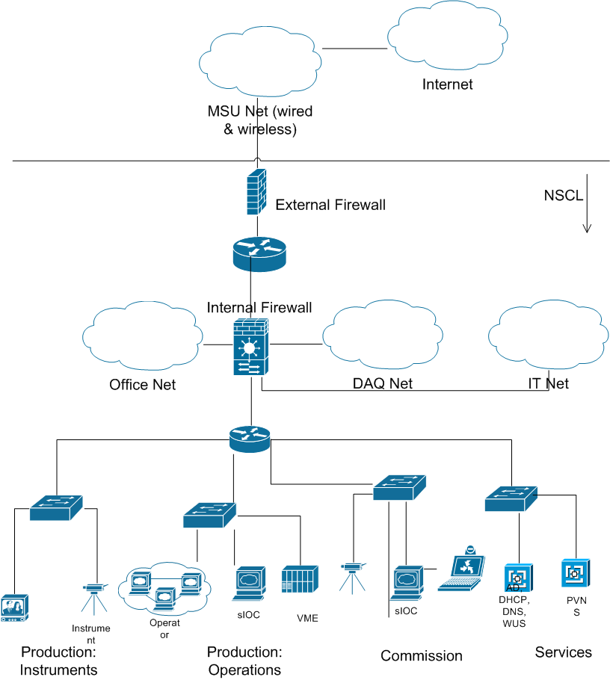
NSCL Networks

Slide 24
Access Control Matrix

Slide 25
Physical & HR Controls
Physical
  Outer Perimeter
    Magnetic Card and PIN
    Time Based
    Front-desk
  Accelerator Facility
    Magnetic Card
HR
  Pre-Employment
    Background Criminal Check
  Post-Employment
    Account, Entry Card Revocation
    Assets Transfer

Slide 26
Business Continuity (BC)
Disaster Recovery (DR)
  Backup Tapes Transported Offsite: Weekly
  Offsite Live Backup (almost done)
  Restoration Logs
  Redundancy
BC Procedures
  Not Tested
  To Be Hosted Offsite

Slide 27
Communication and Ops Controls
Operating Procedures
Change Management
Segregation of Duties
Separation of Development, Test, and Operational Facilities
  Shutdowns
  Networks to be Segregated
Malicious and Mobile Code
Backups
Network Controls
Removable Media: Handling, Disposal
Information Exchange
Monitoring: Access Logs, Fault Logs, Clock Sync (NTP)

Slide 28
Other Controls
Software Development, Maintenance, Acquisition
  Authentication
  No Clear Text Passwords
  No Passwords in Code
  Design and Code Reviews
IS Incident Management
  Trouble Report System
Compliance:
  Legal, Intellectual Property, Regulatory
  Limited IS Requirements
Guideline: Use Admin Account Only When Needed

Slide 29
Argus: Lifecycle

Slide 30
Argus: Lifecycle I
Plan
  Define Scope and ISMS Policy
  Develop Approach to Identify, Evaluate, and Treat Risks
  Identify and Analyze Risks
  Evaluate Risk Treatment Options
  Select Controls to Treat Risks: Statement of Applicability
Do
  Develop Risk Treatment Plan (RTP)
  Implement RTP
  Measure Effectiveness of Controls
  Manage Information Security Incidents
  Implement Training and Awareness Programs
Plan
Do
Check
Act

Slide 31
Argus: Lifecycle II
Check
  Monitor and Review Argus
  Conduct Internal Audits
  Measure Argus’ Effectiveness Based on Audits, Incidents, Feedback etc
  Review Risk Assessment
Act
  Identify Improvements Based on Reviews/Audits
  Identify and Implement Corrective and Preventive Actions

Slide 32
Argus: Retrospection

Slide 33
Project Statistics
Scope: NSCL Electronics Department
Time:
  Start: August 2009
  Expected End: Early 2012
Effort (in Person Hours)
  Planned: ~1000
  Current: ~800
Cost :
  Audit: Approximately 30,000.00 USD
    Pre-Assessment
    Stage I & II External Audits
    Two Post-certification Audits (Yearly)

Slide 34
Current Status
Completed
  Risk Assessment
  Statement of Applicability
  Initial Set of Documentation
  Selection of Registrar
Ongoing
  Vetting of Policies and Procedures (Documentation)
  Initial Stages of Implementation
Expected
  Internal Audit: Nov 2011
  External Audits: Dec 2011
  Certification: Early 2012

Slide 35
Challenges
Control System Design
No Encryption, Authentication, Authorization
Secure Software Development Practices
PLC Hardening
Cabling, Password Aging, Employee Agreement
Culture
Open Research and Education Environment
Organizational Changes
Interest Level: Non-technical and Mundane Work

Slide 36
Lessons Learnt I
Start Small. Implement. Expand.
  Not Necessary to Include the Whole of IT
  Use Existing Processes. Do Not Make Drastic Changes
  Use Small Iterations
Leverage Existing Management Systems
  ISO 9001, 14001, 18001,…
Reserve Resources, If Possible
Management Support is Crucial
Don’t Lose Focus or Morale
Needs Support From Every Unit in the Organization
Define What You Have, Then Go For Best Practice

Slide 37
Lessons Learnt II
Infrastructure
  Document Management System
  Incident Reporting/Management System
  Training System

Slide 38
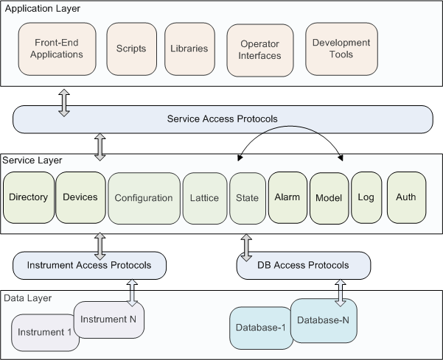
Control System Information Architecture

Slide 39
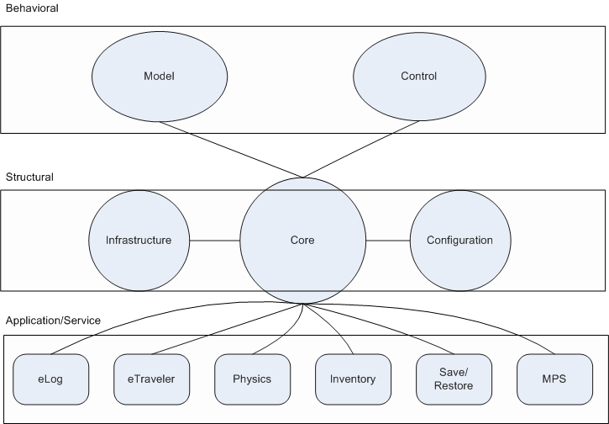
FRIB Database Architecture
Security

Slide 40
FRIB Data Security
Structural
  Who Can Modify Attributes of a Cavity?
  Area Based Component Hierarchy
  Access Control on Areas
Behavioral
  Who Can Modify the Voltage (PV) on a Power Supply?
  Operations Based Component Hierarchy
  Access Control on the Operations Elements
  Standalone ‘Reserve/Release’ Application
  Not Very Clear How to Implement it on EPICS
    Modify IOC db Files. IOCs Reload db Files
Application
  Who Can Write to Operations LogBook?

Slide 41
Conclusions
Started as a Small Technical Problem and Grew to a Large Project
What did we gain?
Understanding of our Vulnerabilities, Threats, and Risks
Change in Culture
Security in Architecture
References
  ISO/IEC 27001
  ISO/IEC 27002
  ISO 27k Toolkit
  OCTAVE Allegro

Slide 42
Thank you!
“We spend our time searching for security and hate it when we get it.” - John Steinbeck

