Slide 1
Technical Network Dependencies and Risk Questionnaire
Status Report
Pierre Charrue (CERN) – Terri Lahey (SLAC)

Slide 2
Abstract
Accelerator Control Systems are critical to the operation of modern accelerators. In large control systems, there are often a large number and variety of networked computers. Each computer has its own security issues, and depends upon services running on other computers. In this presentation, we describe an inventory application built to improve the security and reliability of the controls system computers. The inventory tracks multiple security-related attributes of the computers on the CERN Technical Network and analyzes risks, so that we can mitigate risks and plan for future control system enhancements.

Slide 3
Outline
Networking and Databases
The TN dependencies and Risk Questionnaire project (TNQ)
The TNQ in details
The situation today
Plans

Slide 4
Outline
Networking and Databases
The TN dependencies and Risk Questionnaire project (TNQ)
The TNQ in details
The situation today
Plans

Slide 5
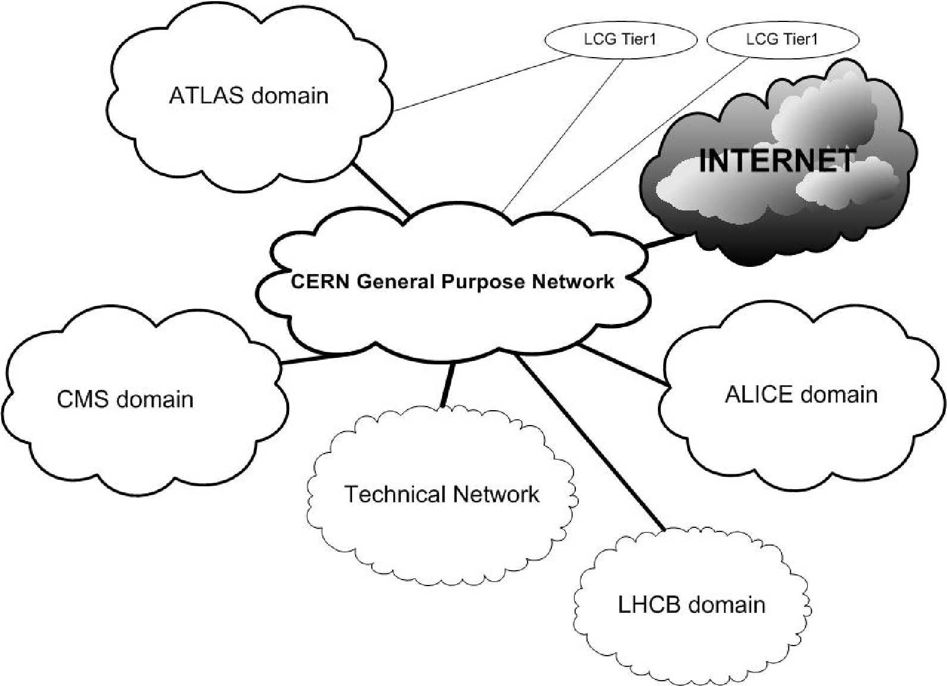
Networking at CERN
General Purpose Network (GN)
  For office, mail, www, development, …
  No formal connection restrictions by CNIC
Technical Network (TN) and Experiment Network (EN)
  For operational equipment
  Formal connection and access restrictions
  Limited services available
  (e.g. no mail server, no external web browsing)
  Authorization based on MAC addresses
  Network monitored by IT/CS
Notes:
Desktop Computing, testing, access from outside, …
File systems (DFS, …), databases (CERNDB, …), servers (DNS, …)
Breakpoints can be defined
TOCSSiC

Slide 6
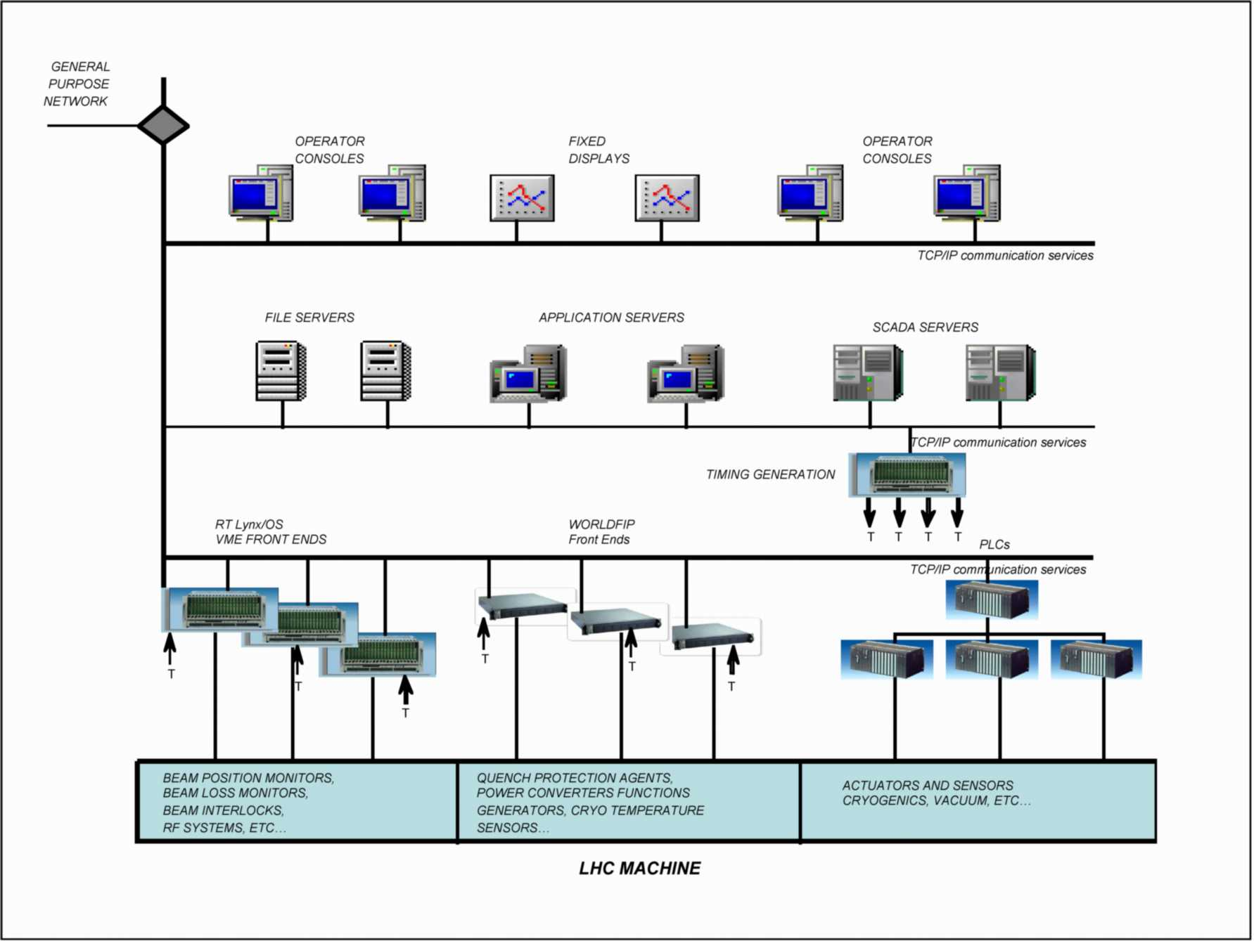


The Technical Network
Trusted Application Gateways
Office development PC
CERN Public Gateways
(LXPLUS, CERNTS)
CERN Firewall
Connection to Internet
INTERNET
Home or remote PC

Slide 7
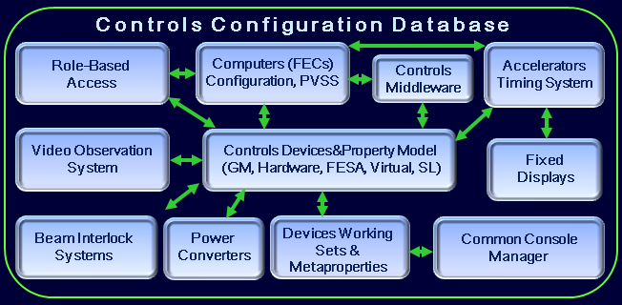
Databases - CCDB
The CCDB contains a detailed description of all Controls hardware and software entities with:
  Name
  Type
  Description
  Location
  And several configuration definitions such as timing, alarms, in operation, …
Each device used in the controls infrastructure has an entry in the CCDB
Access in read and write is protected by a CERN identification
The Controls Configuration Database

Slide 8
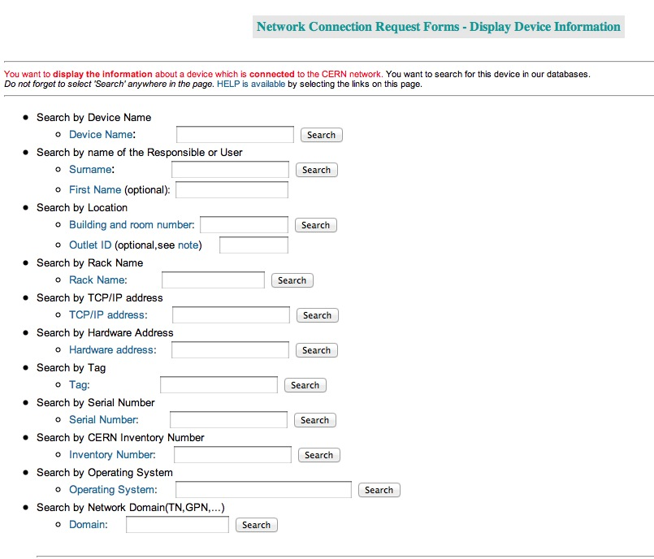
Databases - Netops
Any device that has an IP address MUST be defined in the NETOPS database
All devices in the NETOPS database has:
  A main user
  A responsible
  A location
  A hardware address
  A name
  An IP number
Prior to be connected to the CERN network, a device has to be declared in the NETOPS database
Access to the NETOPS database is protected by a CERN identification

Slide 9
Outline
Networking and Databases
The TN dependencies and Risk Questionnaire project (TNQ)
The TNQ in details
The situation today
Plans

Slide 10
Project Goals and scope
Improve the security and hence the reliability of the Accelerator Control Infrastructure.
Identify the most critical security risks in the Control System so we can fix them.
Identify solutions to improve the security, so that we can pursue funding and implementation
The scope covers all devices connected to the TN, their Operating Systems and the software described in the CCDB (mainly FrontEnd device servers and Operation Console Applications)

Slide 11
Project phases and deliverables
Phase I
  Make an inventory of service/system and their dependencies
  Implement a questionnaire to collect the A&T sector data
  Implement a Data Base with a web interface to enter the data
  Populate the database
  Extract the security risks from A&T sector data
Phase II
  Mitigate these risks with management and derive the actions needed to address them
  Propose action in management
  Proceed with implementation of agreed actions

Slide 12
Project phases and deliverables
Create database and web-based application using existing tools used by CERN:
  ORACLE including PLSQL & APEX
  Benthic (golden, goldview, pledit)
Work with LHC Controls Security Panel (LCSP), includes representatives from all A&T sector departments and central IT
Work with IT networking, CERN Security Officer, and Controls Database Experts

Slide 13
Inventory and Dependencies
A questionnaire has been created to identify
  Service/System [is made of Device and DataStore]
  Device [has Operating System, Users, location, Application]
  User [has name, password]
  Application [has language, version, review]
  Other attributes .. (see an extract next slide)
For each attribute its risk is evaluated
  Low, Medium, High/Unknown, Inherited

Slide 14
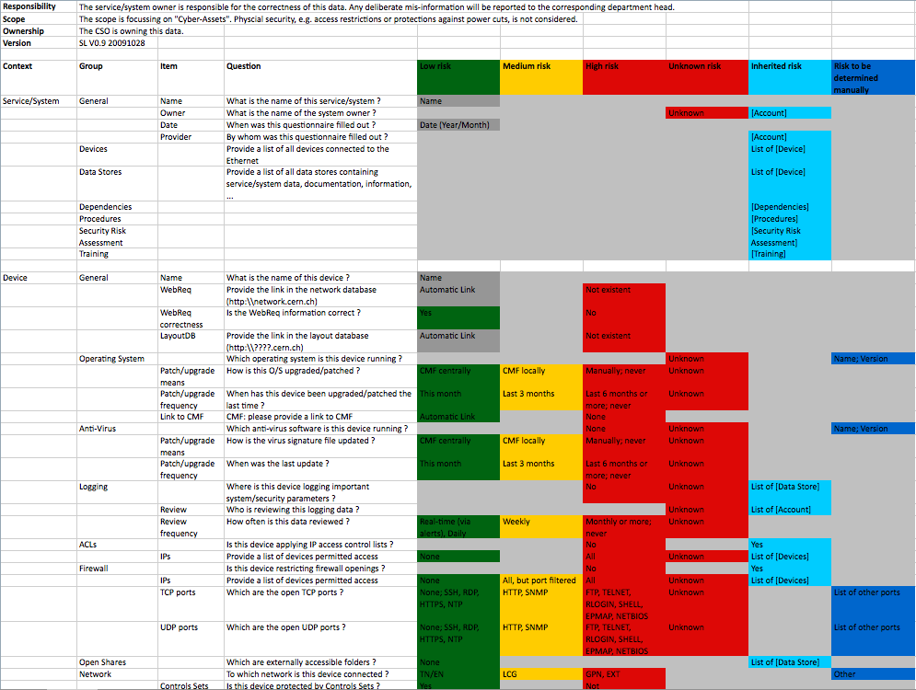
Courtesy S.Lueders

Slide 15
Outline
Networking and Databases
The TN dependencies and Risk Questionnaire project (TNQ)
The TNQ in details
The situation today
Plans

Slide 16
TN Questionnaire - Principles
There is no duplication of data
CCDB, NETOPS & HR data are linked and not copied into TN questionnaire
  NETOPS
    Computer definitions, including network domains
    Set Definitions
  CCDB
    Software: DSC, Applications, Class Software (eg.FESA)
    Software Families
  HR people information

Slide 17
TNQ Principles (2 of 3)
Extreme care has been taken to ease the work of the end-user entering data
  Use existing data
  Derive TNQ data from existing data
  automate wherever possible
  simplify data entry
    Apply the same changes to groups of devices by “group & owner” (template or copy) to avoid data entry for each individual devices
Also improves data reliability

Slide 18
TNQ Principles (3 of 3)
Connectivity between the TNQ and CCDB/NETOPS Databases:
  Button to launch LANDB or CCDB window to edit or check data
    LANDB: computers and sets
    CCDB: computers and software
Track which items have not been updated, so we can
  identify remaining work
  display only those items that need update

Slide 19
TN Questionnaire – Phase 1
Using standard ORACLE-APEX, a web-based questionnaire has been developed in close collaboration with the DM section
3 major topics:
  Systems (BI, BT, CRYO, OP, RF, …)
  Computers (FrontEnd, PLC, Console, …)
  Software (FESA servers, CCM application, …)
A lot of data is taken directly or derived from the CCDB and NETOPS databases

Slide 20
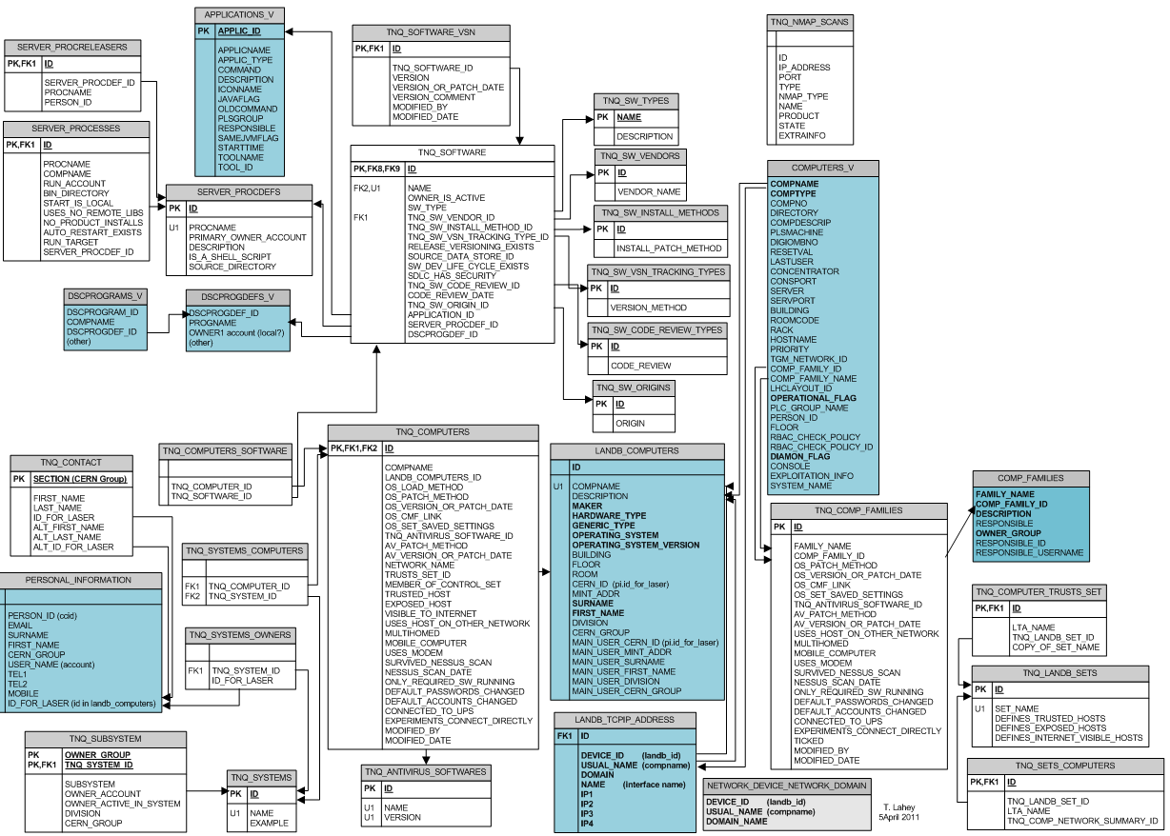
Oracle tables defined in the TNQ
In GREY data coming from outside (CCDB, NETOPS, HR, …)

Slide 21
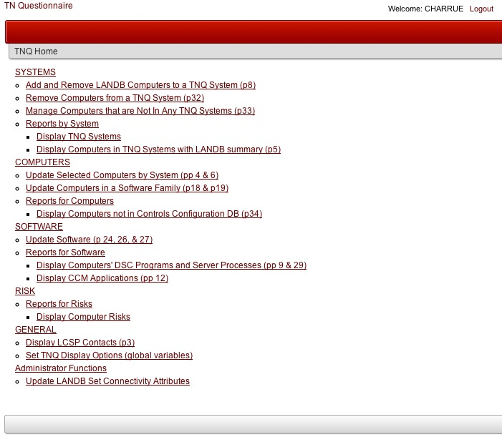
TN Questionnaire – Phase 1
NICE identification
SYSTEMS
COMPUTERS
SOFTWARE
RISK REPORTS

Slide 22
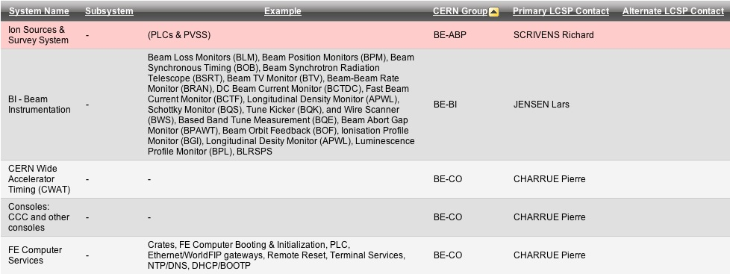
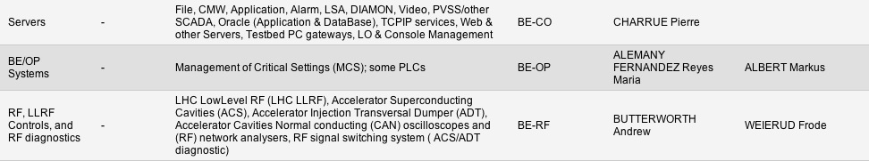
Systems
33 Systems have been identified so far
Coordinat-ing with CCDB system names

Slide 23
TNQ for Systems
TNQ actions on the Systems:
  Add and Remove LANDB Computers (TN and Trusted) to a TNQ System
  Remove Computers from a TNQ System
  Manage NETOPS Computers that are Not In Any TNQ Systems
  Reports by System
    Display TNQ Systems
    Display Computers in all TNQ Systems with LANDB summary

Slide 24
TNQ for Computers
TNQ actions for computers:
  Update Selected Computers by System
    Answer questions for one computer
    Filter list of computers & apply answers to list of computers (*)
    Also useful for interactive reports
  Update All Computers in a Software Family
    Answer questions for family & apply answers to all computers (*)
    Also useful for interactive reports
  Reports for Computers
    Display Computers not in Controls Configuration DB

Slide 25
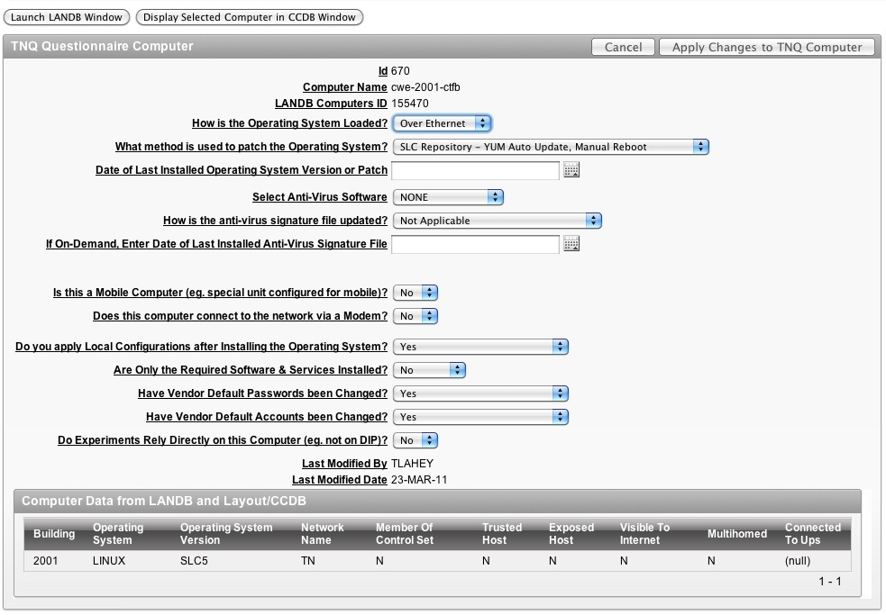
Computer Questionnaire
Launch buttons to NETOPS or CCDB

Slide 26
TNQ for Software
TNQ actions for software:
  Update Software
  Reports for Software
    Display Computers' DSC Programs (CCDB)
    Display Server Computers’ Processes (snapshot)
    Display CCM Applications (CCDB)
  Automate lists of Software
    Adding list of FESA and other class software
    Automating lists of Server Processes
    Add other existing lists of software, as identified

Slide 27
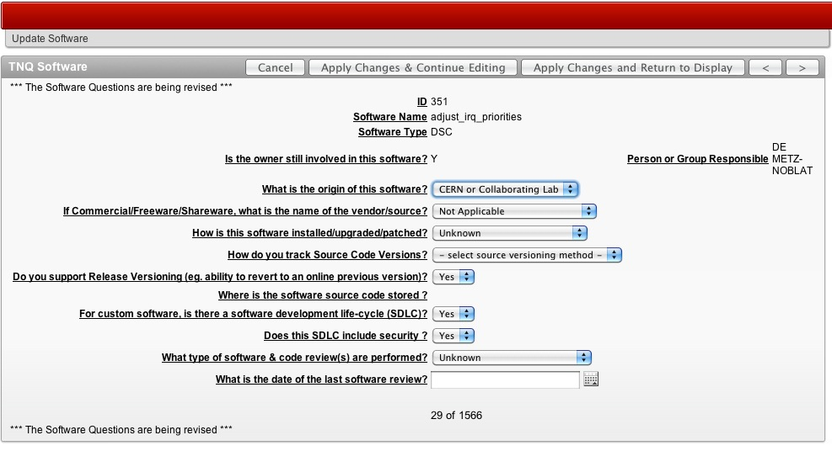
Software Questionnaire

Slide 28
Outline
Networking and Databases
The TN dependencies and Risk Questionnaire project (TNQ)
The TNQ in details
The situation today
Plans

Slide 29
Current state of the TNQ
The TN questionnaire is in production since mid April’11 and system owners started to populate data into the questionnaire
In addition, a positive side effect is that NETOPS and CCDB databases are being cleaned
  Report summaries display problems that are simple to find and fix. LCSP member found
  Computers assigned to the wrong group/person or with wrong description
  Computers where responsible/user group are empty, likely no reassignment when someone left CERN is
  Unexpected computer definitions, eg. 2nd IP address
  We can find computers that are obsolete or in the wrong NETOPS set
This cleaning of the CCDB or NETOPS is eased by the buttons to launch the existing editors
Remember that the TNQ does NOT write in CCDB or NETOPS

Slide 30
Future Plans
Define more RISK assessments
  Combine risk factors, eg. computers visible to TN and their update dates/methods
Adding more features
  Create reports of computers with special network routing
  Create reports of computers with difficult access (in tunnel)
Network Scans
  Load data from Network scans
  Use it to compare expected open ports
Derive more data
  Summary from Central Management of windows/linux: Date Patches applied, Patches needed, Reboot Needed

Slide 31
Summary
The TN Questionnaire is ready in production
  Uses data from other database to reduce work and improve data reliability
  Eases update by applying answers to groups of computers, etc.
The LCSP members are now entering the data to populate the TN Questionnaire DB
While entering data, LCSP is Reviewing and Cleaning up existing data
We have plans for adding more Features to the TN Questionnaire
Extract and present first Risk assessments in the coming months and propose mitigation actions

