Slide 1

How things go wrong.
The lucky one and the unlucky one
Dr. Stefan Lüders (CERN Computer Security Officer)
3rd (CS)²/HEP Workshop, Grenoble (France)
October 9th, 2011

Slide 2
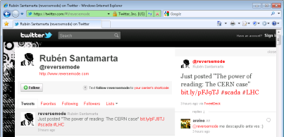
The Lucky One

Slide 3
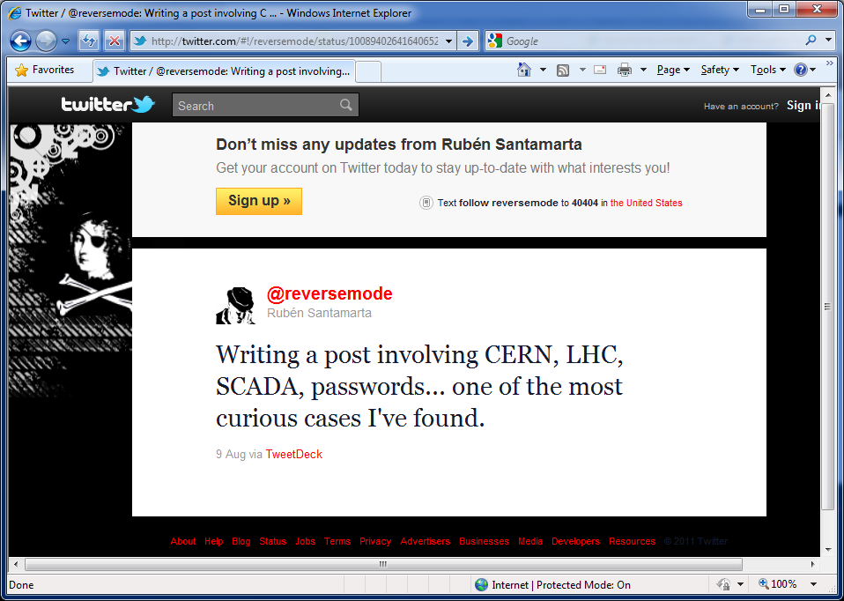
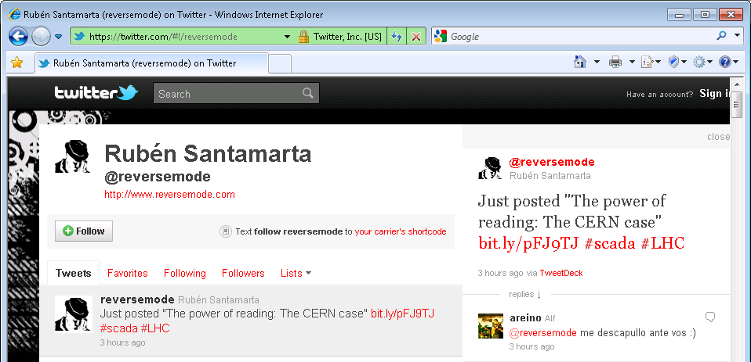
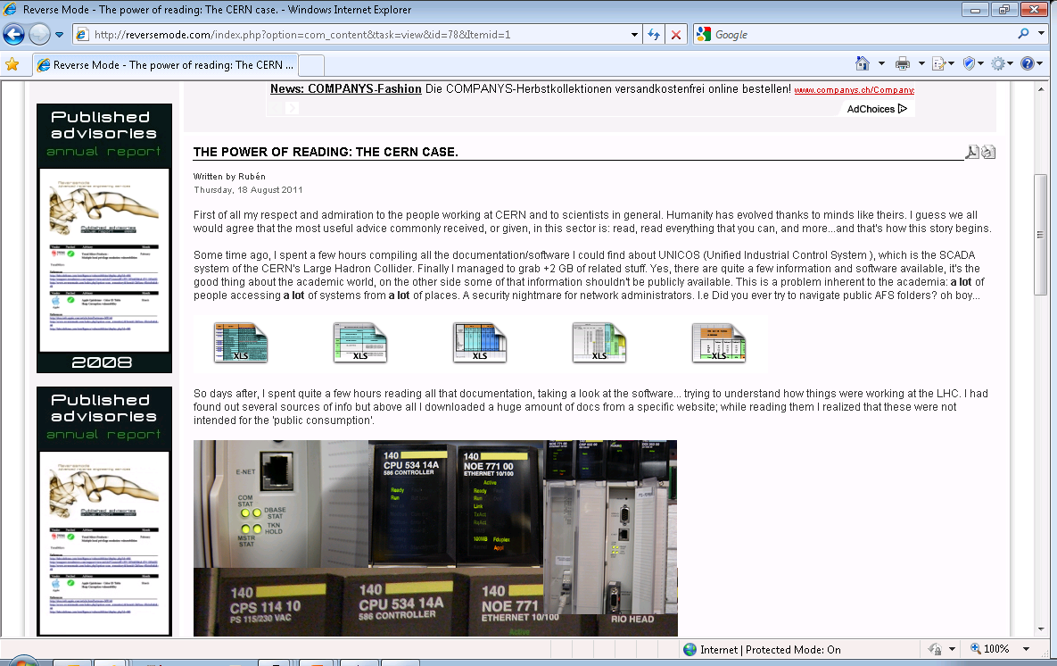
The SCADA Researcher
A month earlier, the Researcher reported to the
U.S. Department of Homeland Security
who informed us via SWITCH and MELANI.

Slide 4
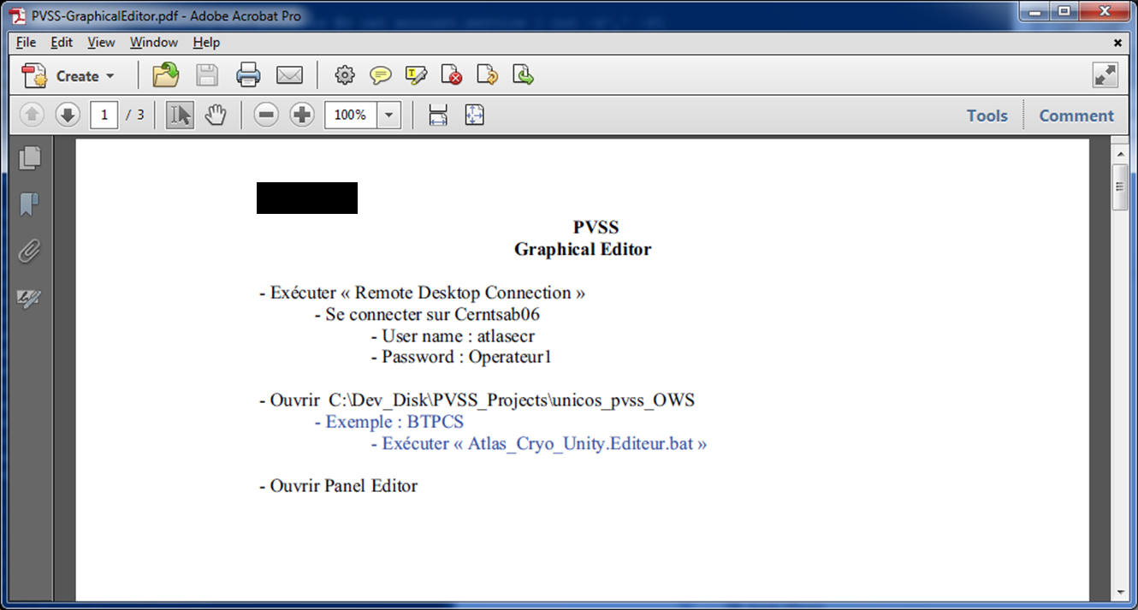
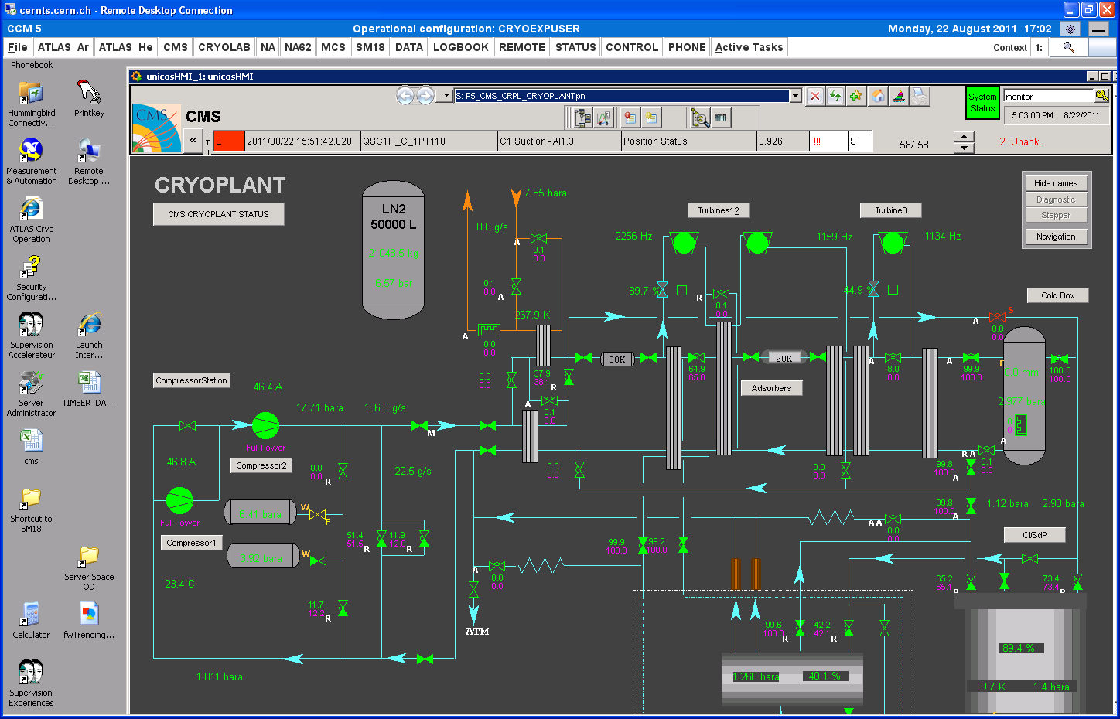
What happened?

Slide 5

Counter-Measures
Standard event response:
  Inform stakeholders
  Prepare press statement
  Take documents offline incl. Google cache
  Change passwords on all instances (can be costly!)
  Check access logs for unauthorized activity:
  We’ve been able to identify the corresponding actions,
  e.g. the original scan for the document and WTS accesses
Lessons Learned:
  Starting to block access from the Internet for selected service accounts
  (i.e. non-personal accounts)
  Working on a general policy prohibiting service accounts
  on LXPLUS and CERNTS

Slide 6
The Unlucky One

Slide 7
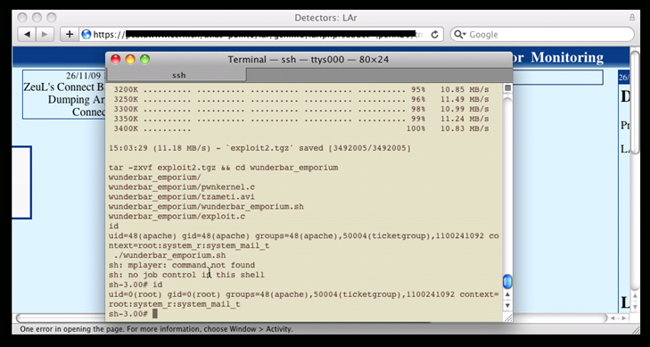
The Attack

Slide 8
Counter-Measures
Standard event response:
  Inform stakeholders
  Prepare press statement
  Check network logs and attacker Ips
  Forensics of compromised server
  Difficult if local admins already have tampered with the data
  Determination of compromise extent
  Reinstallation after all (painful)
Lessons Learned:
  Patching is a must
  Central syslogging is a must, too
  Adequate security training is beneficial for all
  (“Once bitten, twice shy” ☺)
  Deployment of so-called “Security Baselines”

Slide 9
Security Baselines
  …define basic security objectives
  …are simple, pragmatic & complete, and do not imply technical solutions
All systems/services must be implemented and deployed in compliance with their corresponding
“Security Implementation Document”
  Non-compliance will ultimately lead to reduced network connectivity
  (i.e. closure of CERN firewall openings, ceased access to other network domains, full disconnection from the network).
Today, we have Security Baselines…
  …for servers (EDMS 1062500)
  …for file hosting services (EDMS 1062503)
  …for web hosting services (EDMS 1062502)
  …for Industrial Embedded Devices (EDMS 1139163)

Slide 10
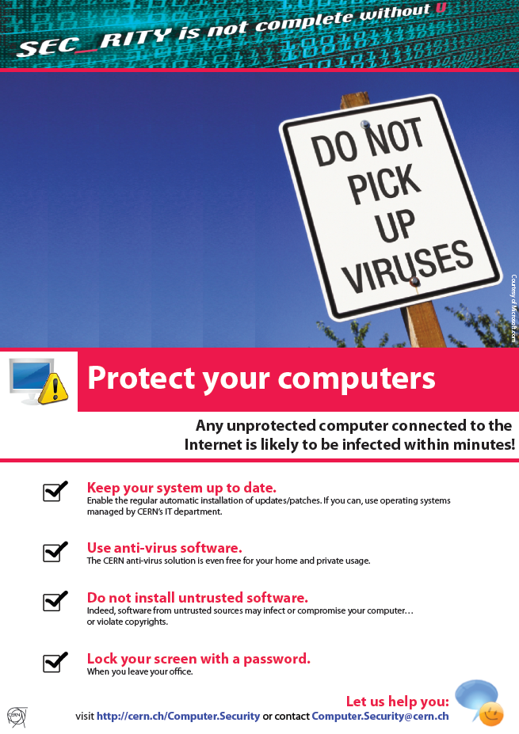
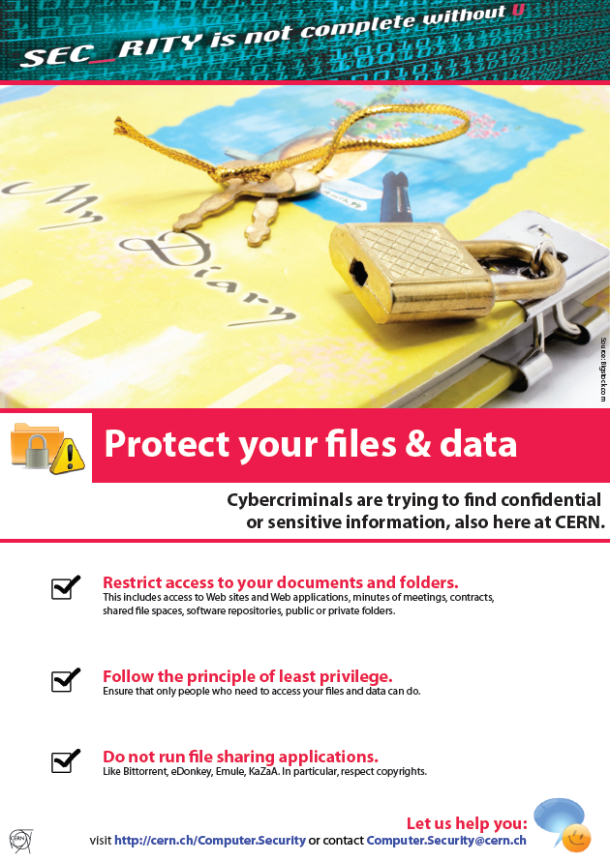



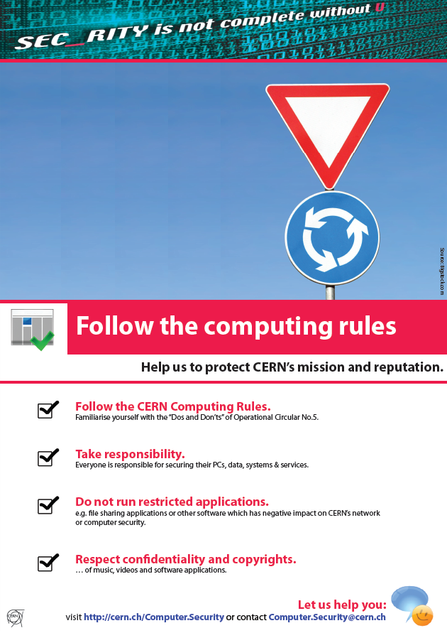






Prevention is the key
Training & Awareness
  Dedicated training courses on
  “Secure programming in Java/PHP/Perl/Python”
  and “…for Web applications”
  Mandatory on-line security course every
  two years for all CERN account owners
  Awareness poster campaign through-out CERN
  Check out at
  http://cern.ch/security/training/en/index.shtml
Consulting & Assistance
  Helping system owners with securing their
  services
Website scanning
  …plus Nessus…

Slide 11
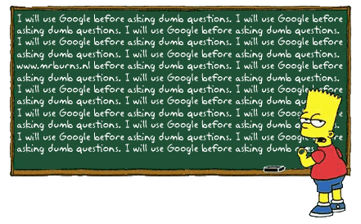
Thank you!
Questions?

