Slide 1

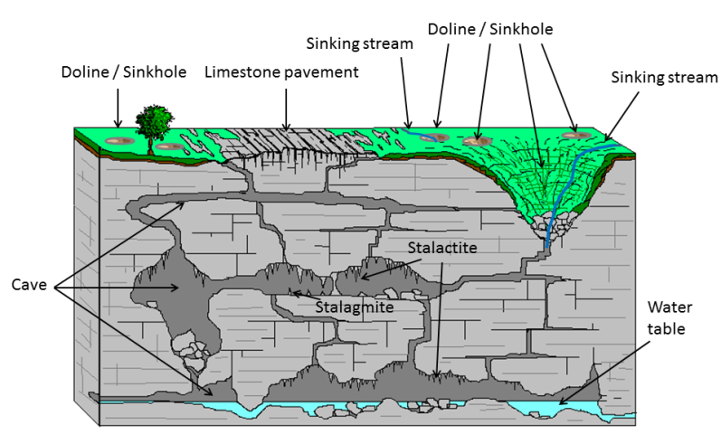
Commonality - Karst Physiography and Landforms
E.g., Turkey, (North) Iraq, Syria, Lebanon, West Bank, Israel, Jordan, KSA, etc
Source: Geological Survey Ireland (www.gsi.ie)
DenisNaughten.ie

Slide 2

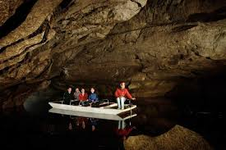
Lebanon Ireland
DenisNaughten.ie

Slide 3
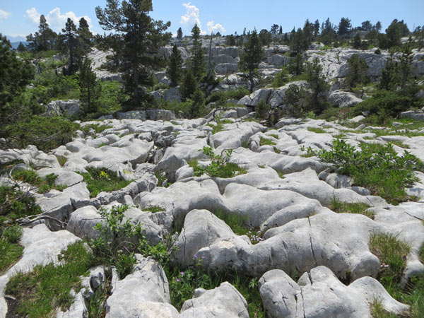
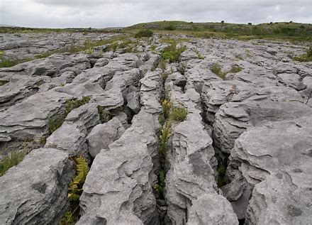
Lebanon Ireland
DenisNaughten.ie

Slide 4
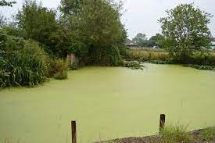
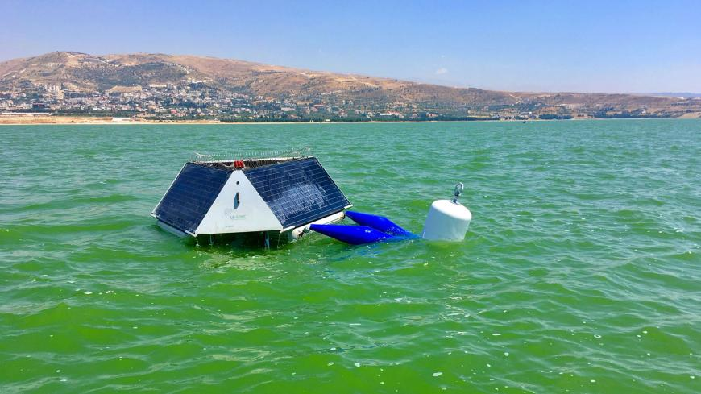
Commonalities with Middle East:
Eutrophication
Ireland Lebanon
DenisNaughten.ie

Slide 5
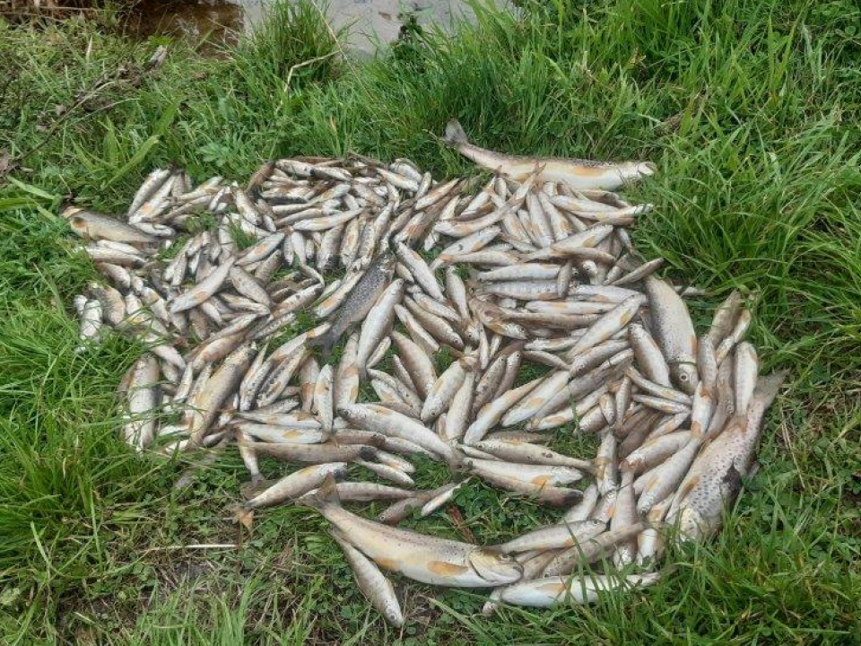
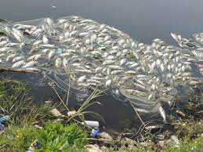
Fish Kills
Eutrophication and toxic algae
Ireland Egypt
DenisNaughten.ie

Slide 6

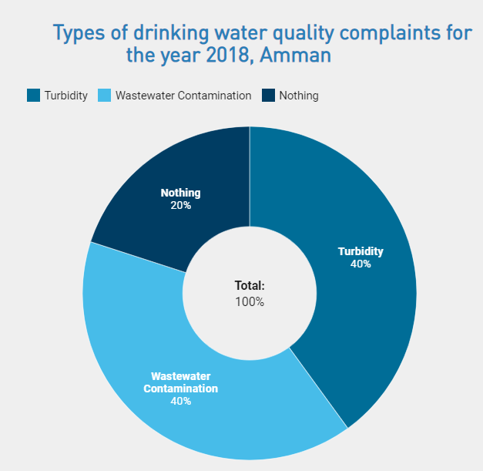
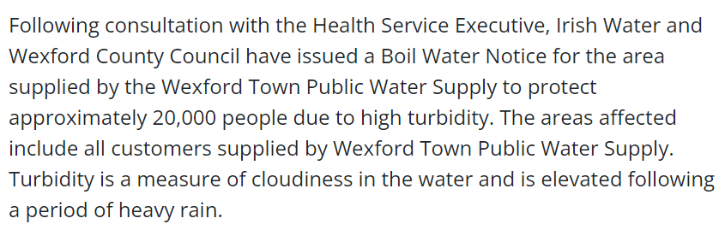
Ireland Jordan
DenisNaughten.ie

Slide 7

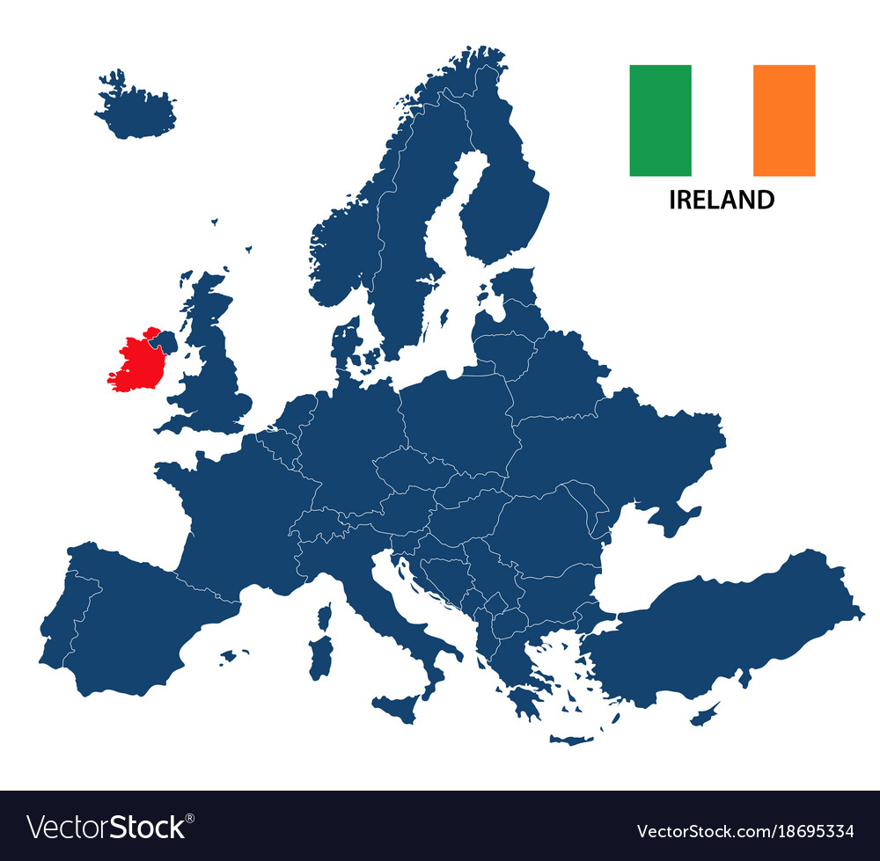
Ireland and Water - Summary:
Total population ~5 Million
Main city = Dublin
High proportion of population in rural areas
Atlantic marine (temperate) climate
Rainfall 800-2,400 mm/yr, depending on location
80% of population is served by centralized water supply
25-30% of population served by groundwater
Water supplies are susceptible to (even short) dry weather conditions
Freshwater resources and ecosystems are affected by pollution from:
  Agriculture
  Wastewater discharges
  Industry
DenisNaughten.ie

Slide 8
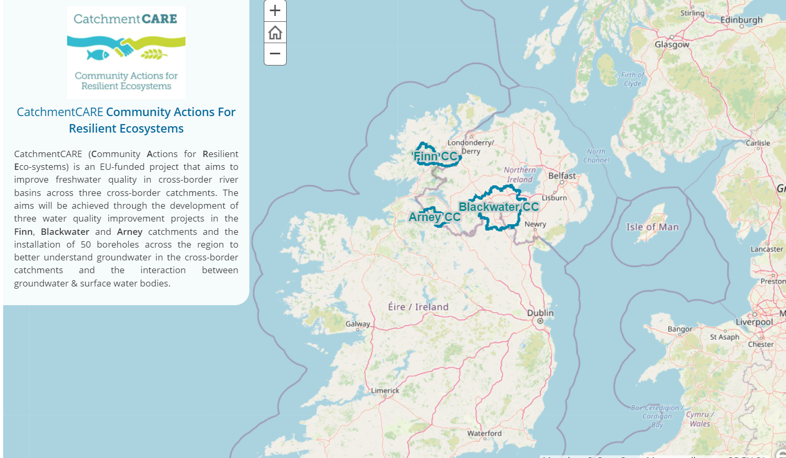

www.catchmentcare.eu
DenisNaughten.ie

Slide 9
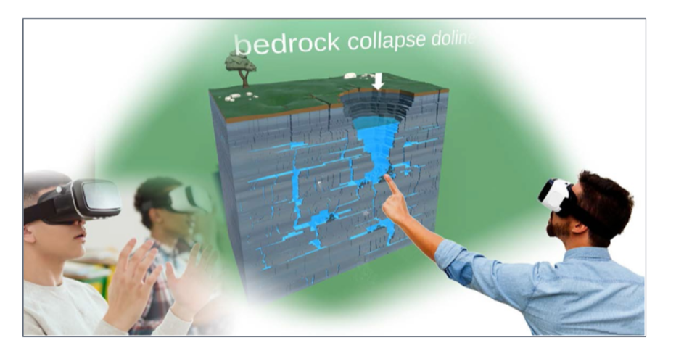
DenisNaughten.ie

Slide 10

DenisNaughten.ie

Slide 11
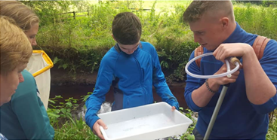
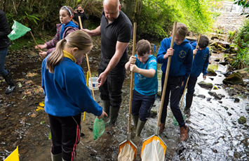
Citizen science
DenisNaughten.ie

Slide 12
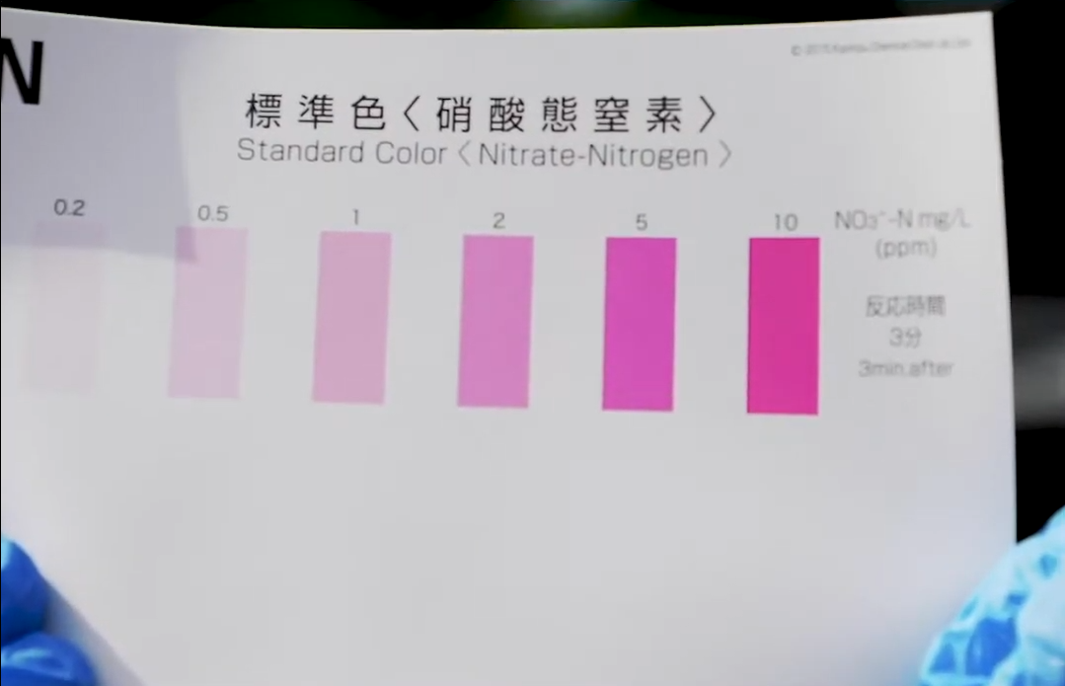
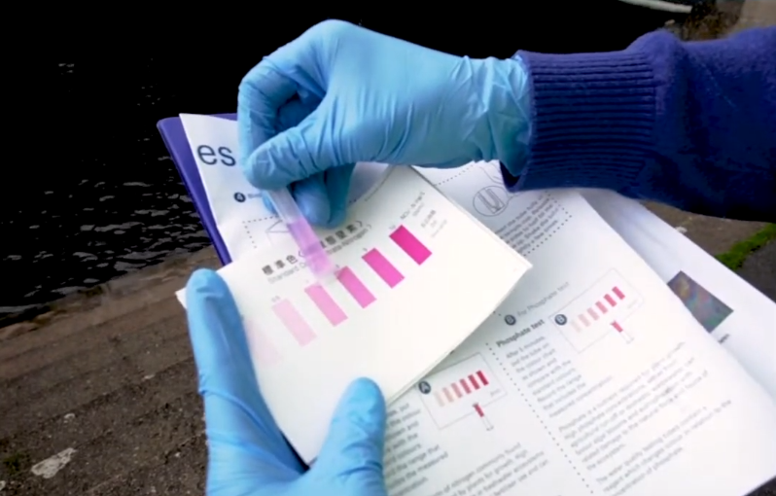

Waterblitz
Water Institute, Dublin City University
DenisNaughten.ie

Slide 13
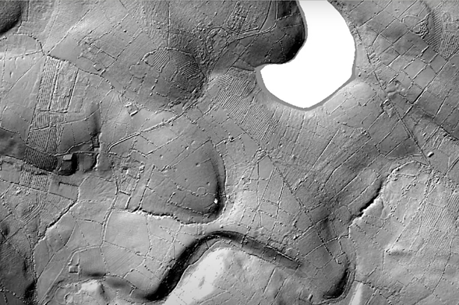
LiDAR (Light Detection & Ranging)
DenisNaughten.ie

Slide 14
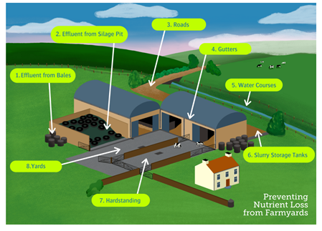
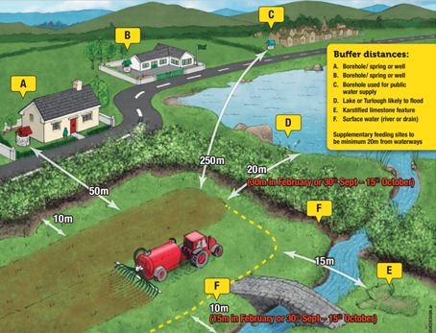
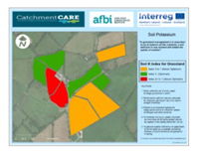
DenisNaughten.ie

Slide 15


Check out more on www.catchmentcare.eu
DenisNaughten.ie

