Slide 1
The analysis components developing responsible for vetoing bad momentum resolution muons for Run 3
October, 5, 2022
Oleksandr Shelestiuk

Slide 2
Outlook
ATLAS
Muon detection by subdetectors and chambers.
What is the main idea?
Software and libraries

Slide 3
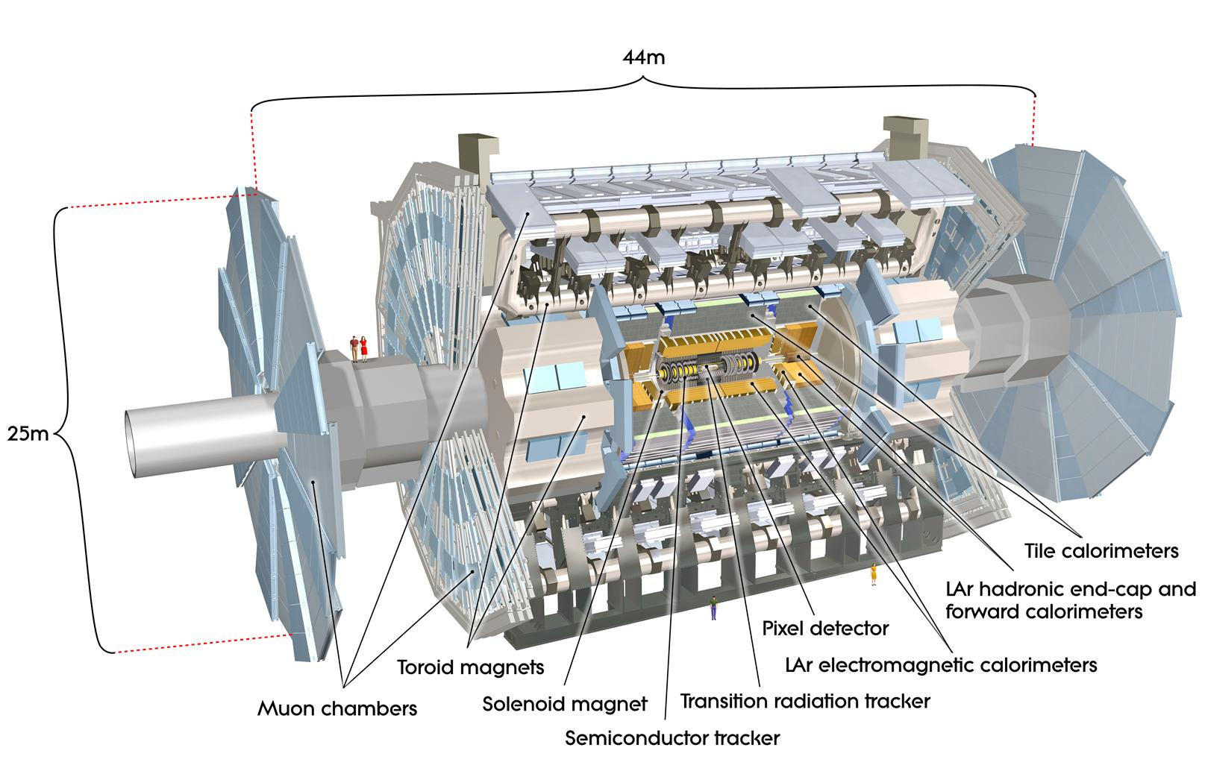
ATLAS - the largest LHC experiment in CERN
The ATLAS detector has a layout that is typical for a collider detector.
There are two types of detector components:
1. tracking detectors, which measure the position of a crossing charged particle with minimal disturbance;
2. calorimeters, which measure the energy of a particle by total absorption.
Dimensions:
Height: 25 m;
Length 44 m.
The overall weight of the detector is approximately 7000 tonnes.

Slide 4
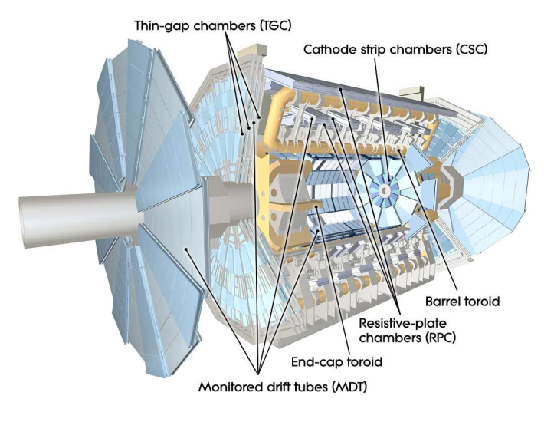
Muon detecting
Muon system parts:
Thin-gap chambers (TGC)
Cathode strip chambers (CSC)
Monitored drift tubes (MDT)
Toroids: barrel and 2 end-caps
Resistive plate chambers (RPC)

Slide 5
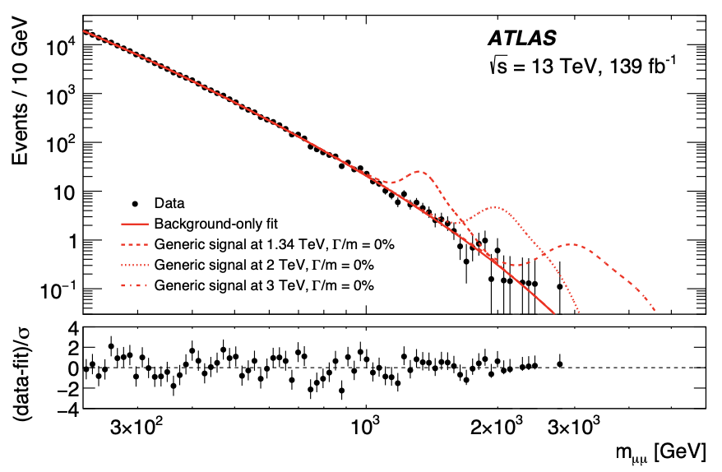
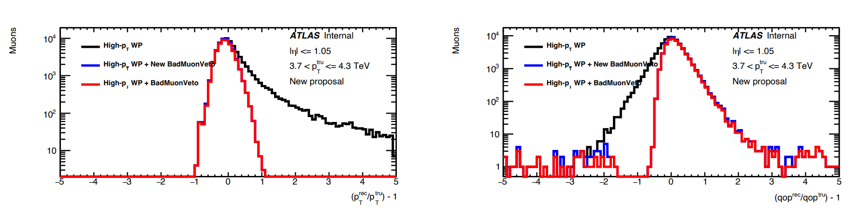
What is the main purpose?
arXiv:1903.06248
Muons with bad momentum resolution must be rejected from our data sample to study High-pT muons in events used in searching for very high energy new particles in the new Run 3 data-set.
The previous vetoing muons charts for Run 1 and Run 2

Slide 6



What will be involved?
What will be used?
How will it be used?
the main programming languages for coding; + Monte Carlo Method.
1. Vetoing bad resolution muons via MC method
2. Comparing with nominal muons; calculation of errors.
plots, data structuring by Ntuples/TTress
3. Plot making based on further results.

Slide 7
Thank you for attention!

