Slide 1
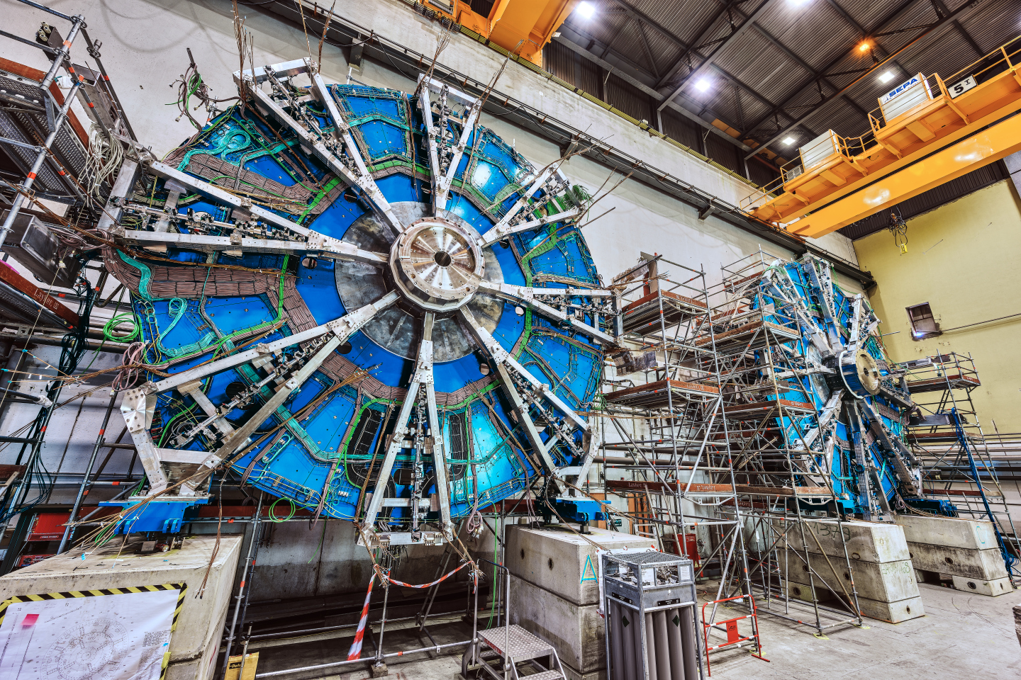
STGC detector.
Strip data analysis.
October, 05, 2022
Tiulchenko Mariia

Slide 2
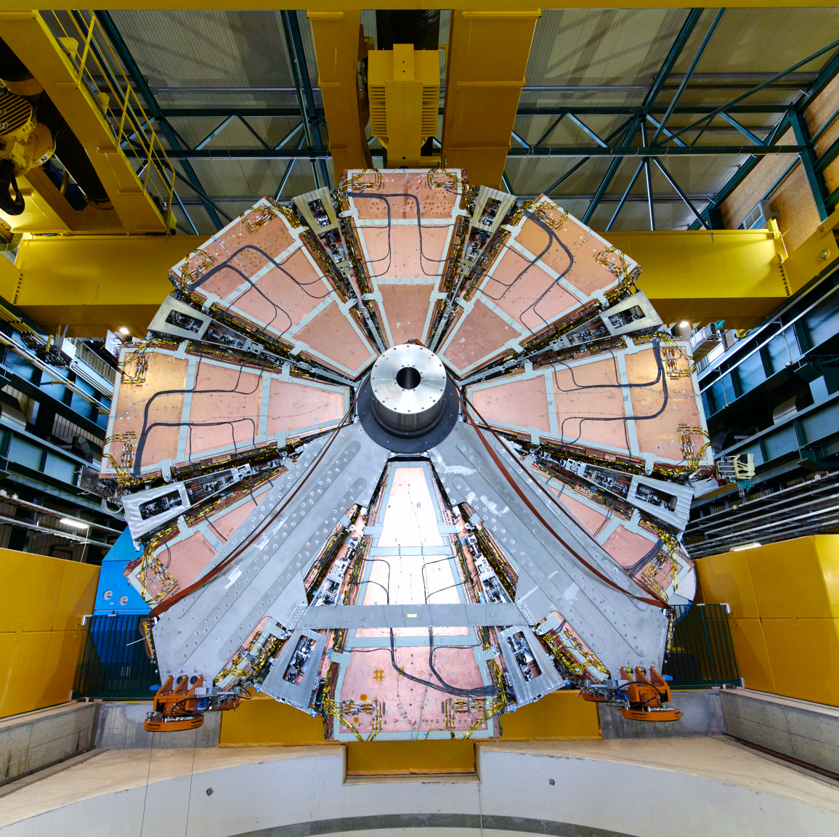
Outline
The ATLAS Experiment
The ATLAS Muon
Spectrometer
New Small Wheel
STGC detector
Strip data analysis
Conclusions

Slide 3
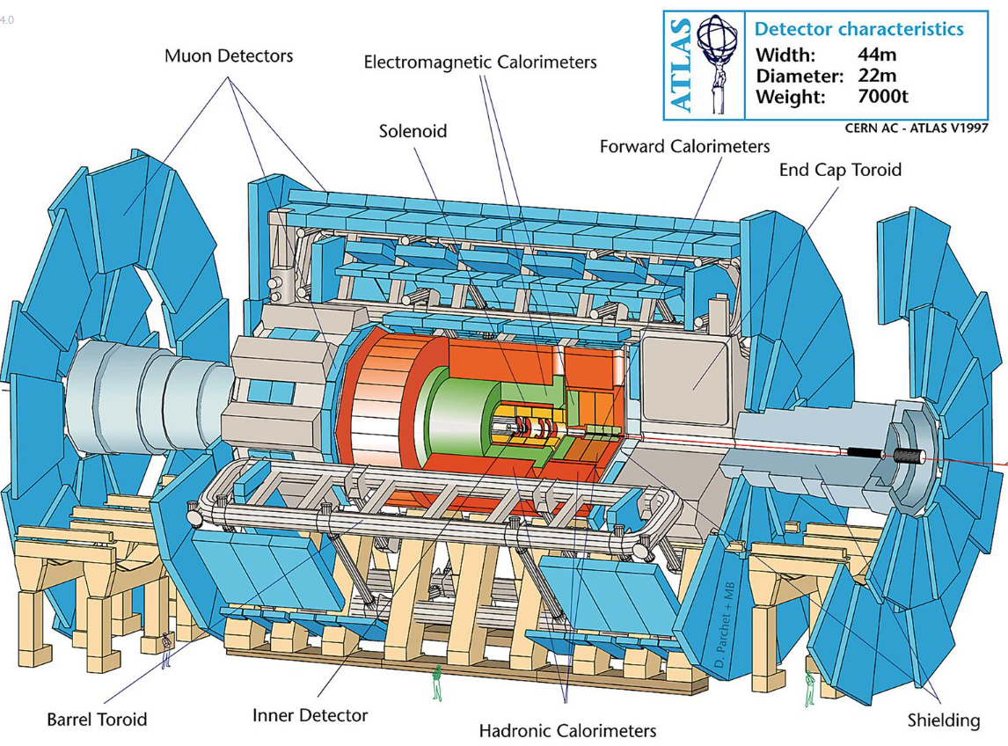
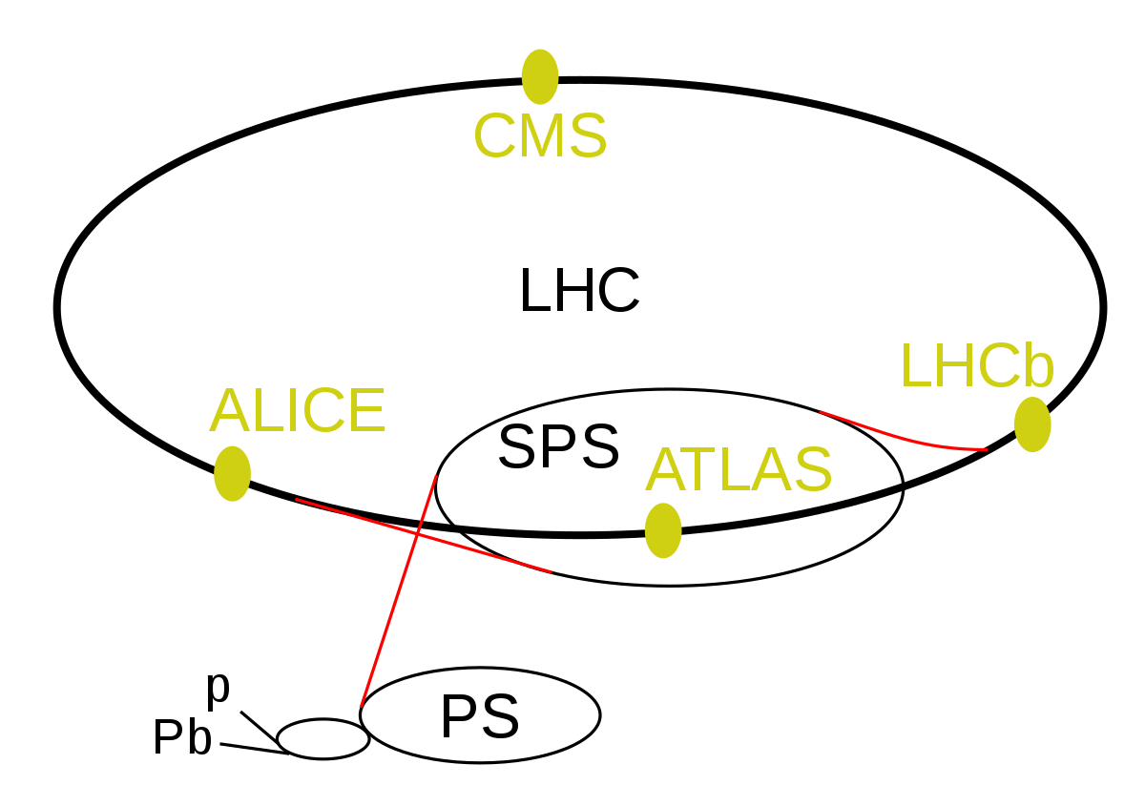
The ATLAS Experiment
The ATLAS experiment is one of the largest particle experiments at the Large Hadron Collider (LHC).
ATLAS stands for "A Toroidal LHC Apparatus".
The ATLAS detector is a general-purpose particle detector studying the fundamental interactions of elementary particles and searching for new physics.

Slide 4
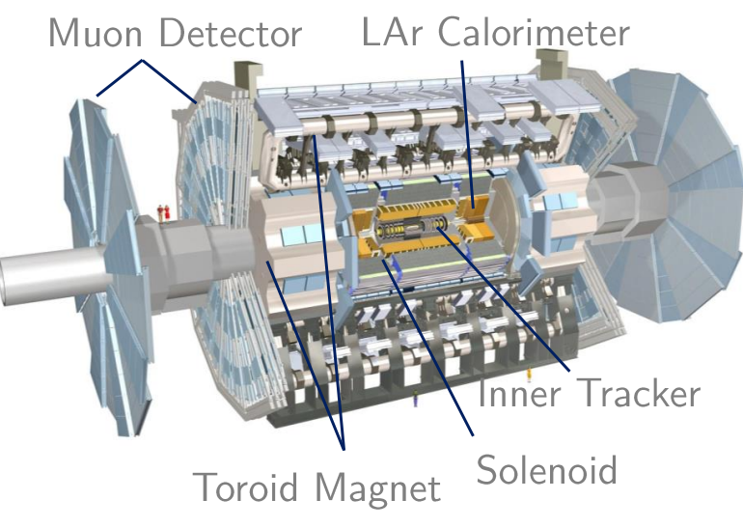
The ATLAS Muon Spectrometer
The outermost layer of the ATLAS detector;
Together with the toroid magnet identify and measure momentum and electric charge of muons;
Organized into 3 stations - wheels:
Small Wheels
Big Wheels
Outer Wheels

Slide 5
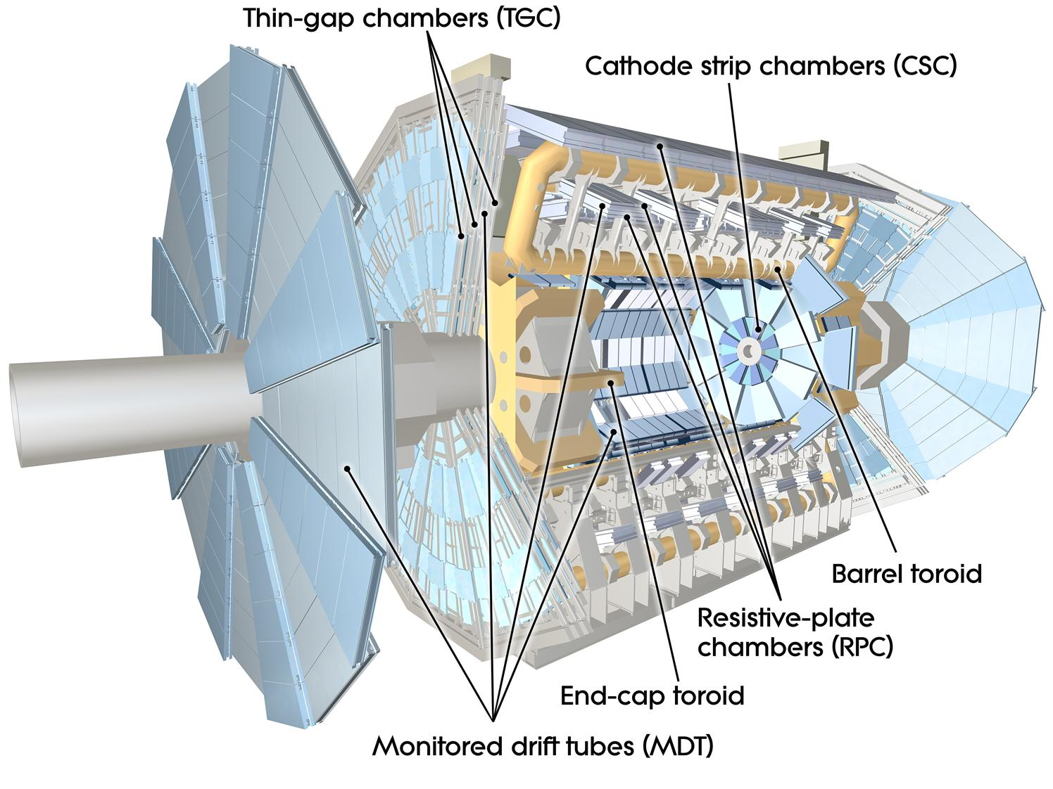
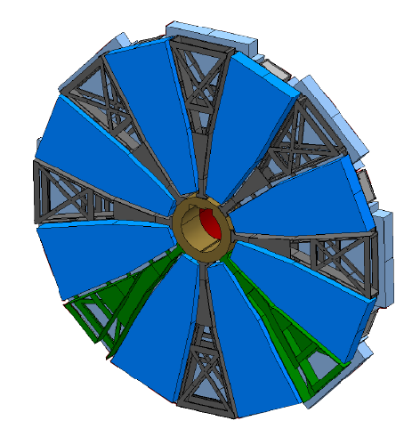
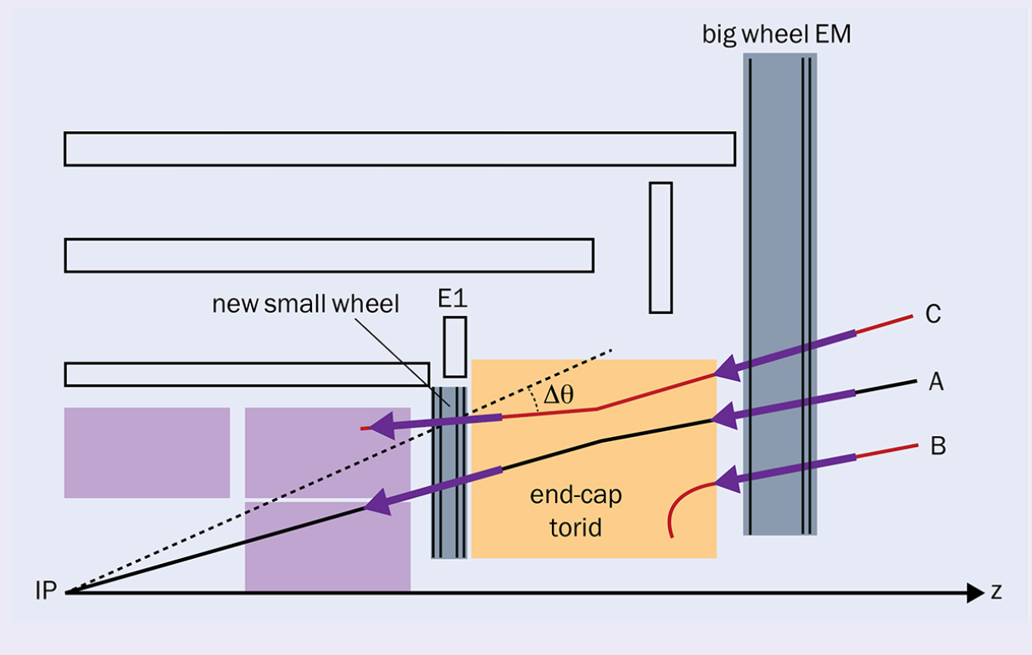
New Small
Wheel
“Old” Small Wheels were replaced in 2021.
New Small Wheels provide precise muon tracking capabilities through confirmation of whether a particle originated from the interaction point, thus reducing our chances of saving data from unwanted background events.
NSW
~10 m
Detector area: ~2400 m2;
Each of them weighs more than 100 tones;
~10 m in diameter;

Slide 6
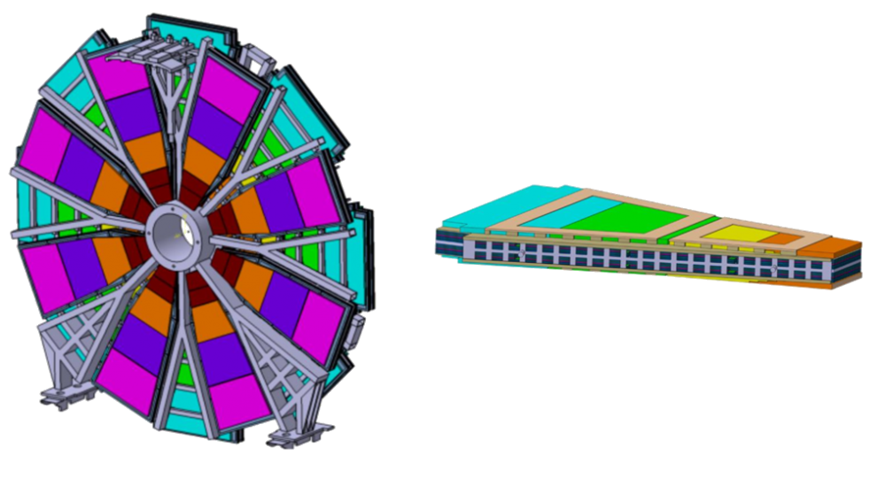
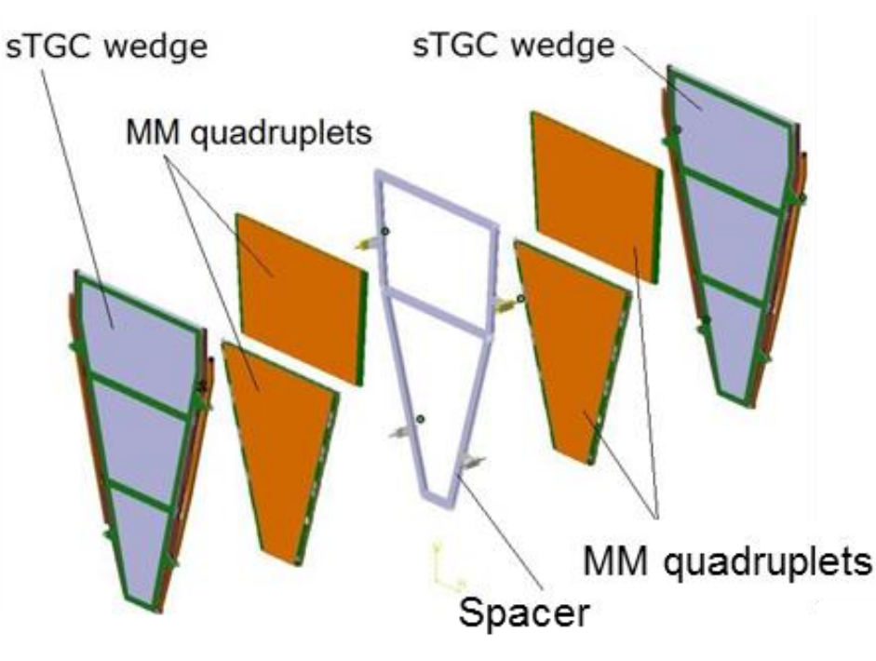
New Small
Wheel
One sector:
Consists of 3 quadruples.
3.5 m
Using two innovative gaseous detectors
Micromegas - MM
STGC
Each wheel has 16 sectors: 8 small and 8 large.
Each sector contains two layers of gaseous chamber technologies:
MM and sTGC.
Two million MM readout channels and 350,000 sTGC electronic readout channels.

Slide 7
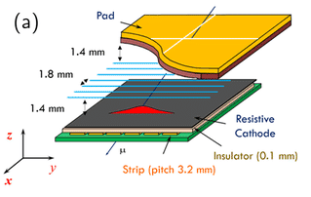
STGC detector
STGC - Small-strip Thin Gap Chamber
Gaseous detector.
Readout with wires, pads, and strips.
HV applied to the wires and two cathodes grounded to create a strong electric field for the drifting free charge and multiplication of electrons to create signals.
HV applied to the wires and two cathodes grounded to create a strong electric field for the drifting free charge and multiplication of electrons to create signals.
Ionization and avalanche process.

Slide 8



Strip readout commissioning and data quality analysis
My project is strip data analysis. It aims at commissioning the sTGC detector and performing studies with the sTGC strip readout.
What my work will involve:
Analyzing charge, timing, and hit rate from the sTGC strips;
Categorizing defects;
Generating reference plots to summarize the detector and electronics operational status from 32 sTGC sectors(ROOT, python).
Identification of defective channels.
Why do we need that?
Provide feedback to the operational team and guide any attempts to fix problems.

Slide 9
Conclusions
ATLAS experiment - it is the largest particle detector experiment on the LHC.
The muon spectrometer aims at tracking and triggering muons. It is made of 3 stations.
NSW - it is a recently upgraded innermost Wheel of the ATLAS Muon Spectrometer, composed of two gaseous chamber technologies: MM and sTGC.
STGC - the primary trigger detector, that is responsible for the identification of proton bunch crossing as well as tracking of muons at high precision.
My project is about the identification and investigation of defective channels in order to make quick feedback to the operational team and solve issues.

Slide 10
Thank you for attention!

