Slide 1
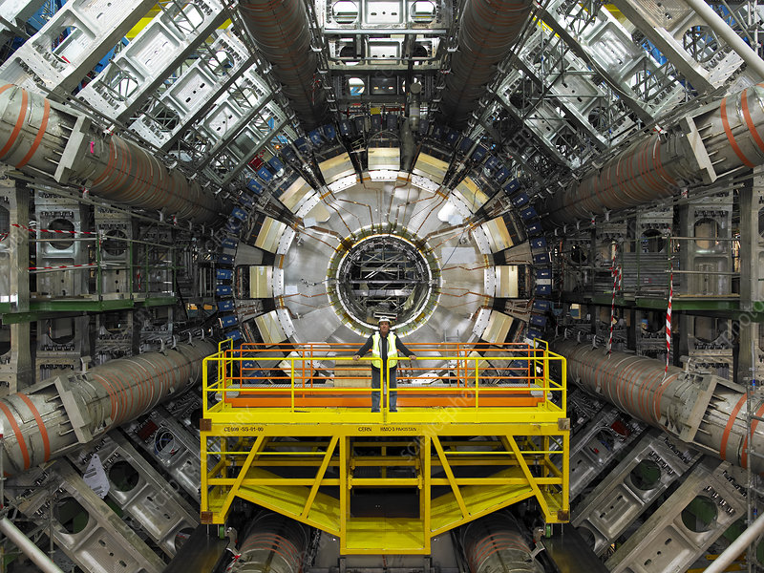
Study of sMDT Chambers at the ATLAS Experiment
Fedir Boreiko
October 4, 2022

Slide 2
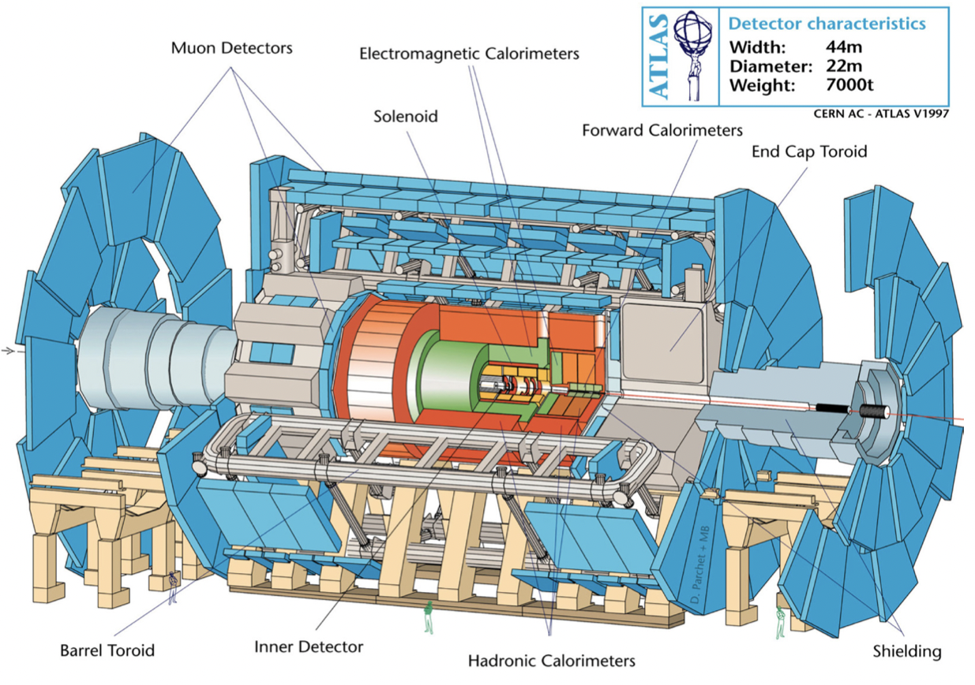
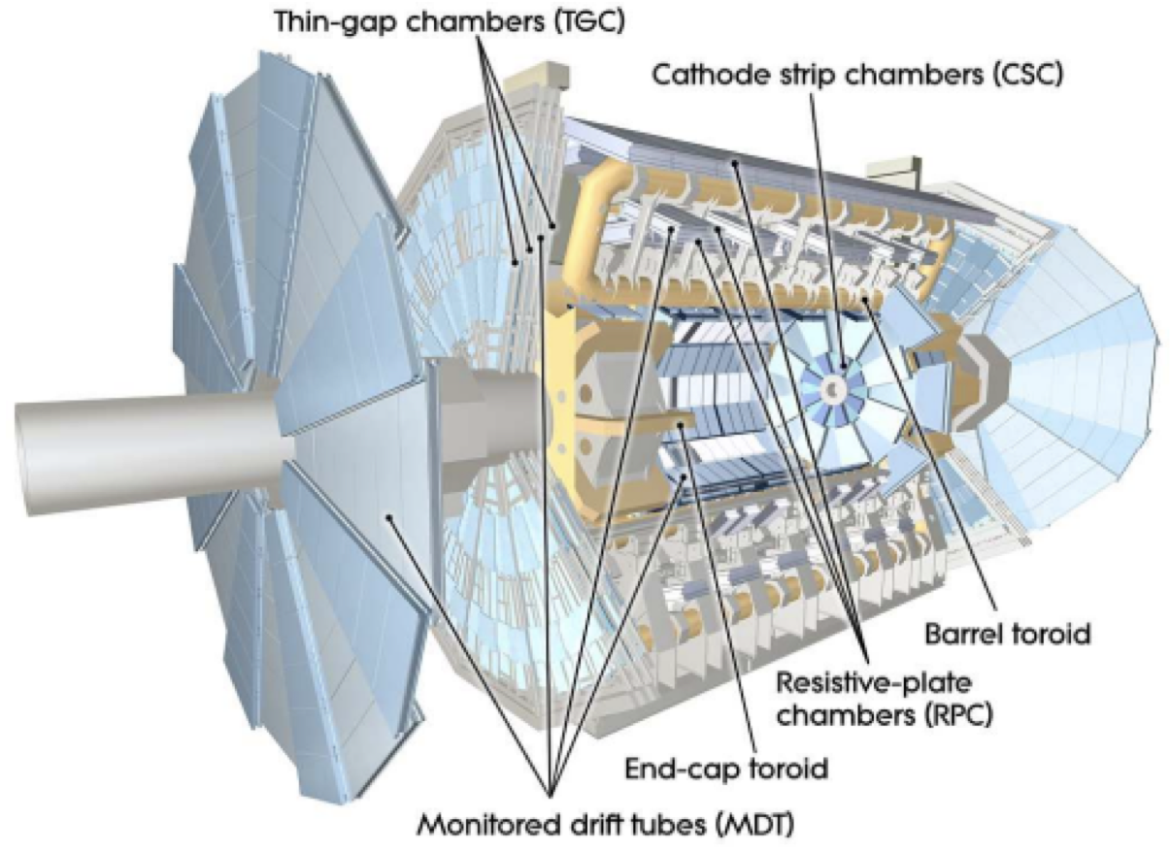
The ATLAS Experiment
sMDT Barrel Inner Sector 7A (BIS7A)
Figure 1-1
Figure 1-2

Slide 3
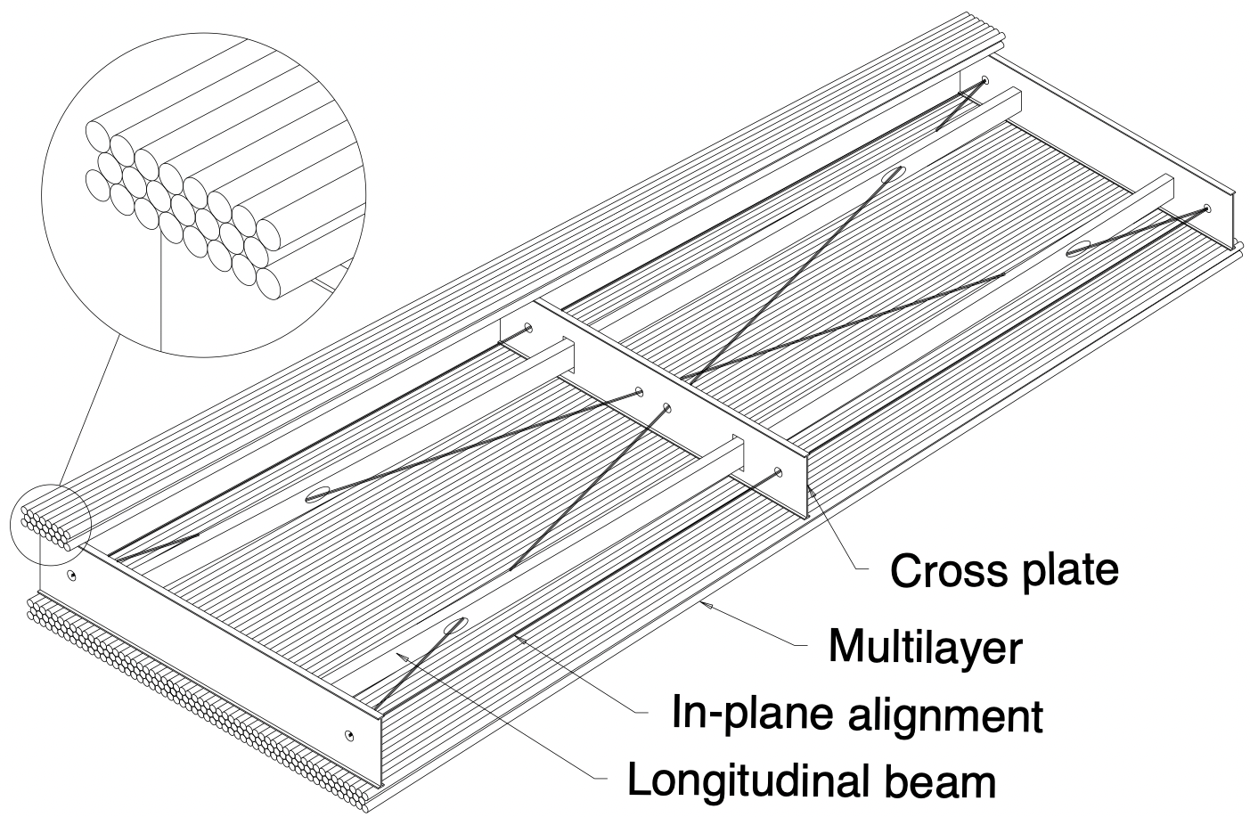
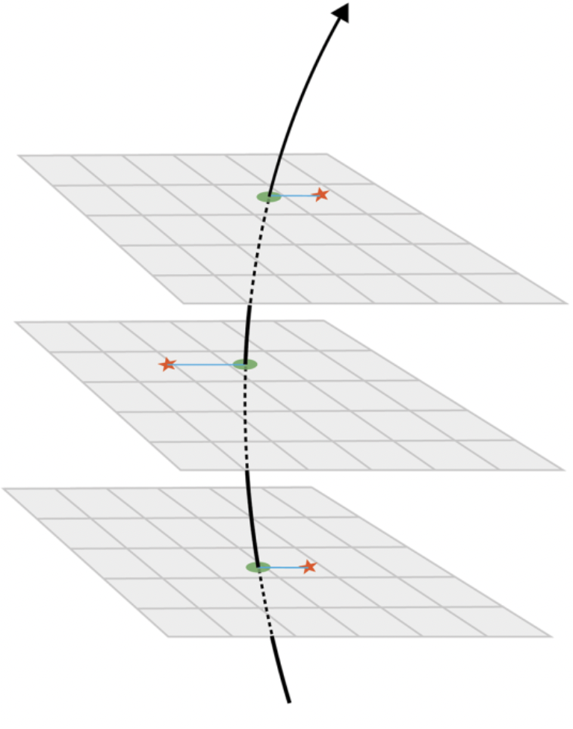
Monitored Drift Tube (MDT) Chambers
The muon momentum determination by ATLAS MDT chambers is based on the deflection of a charged particle in the magnetic field.
Muon momentum can be determined as:
$p[GeV/c]=0.3⋅B[T]R[m]$, [2.1]
$q=e$, $R$ - curvature radius.
$$R$$
Figure 2-1

Slide 4
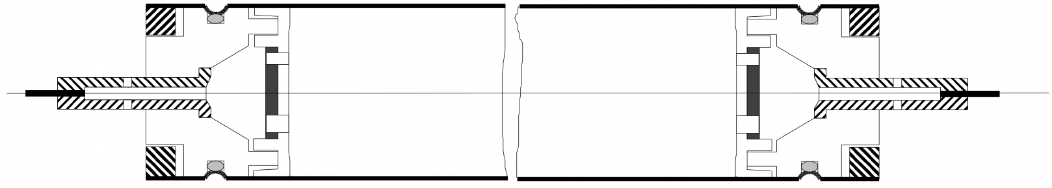
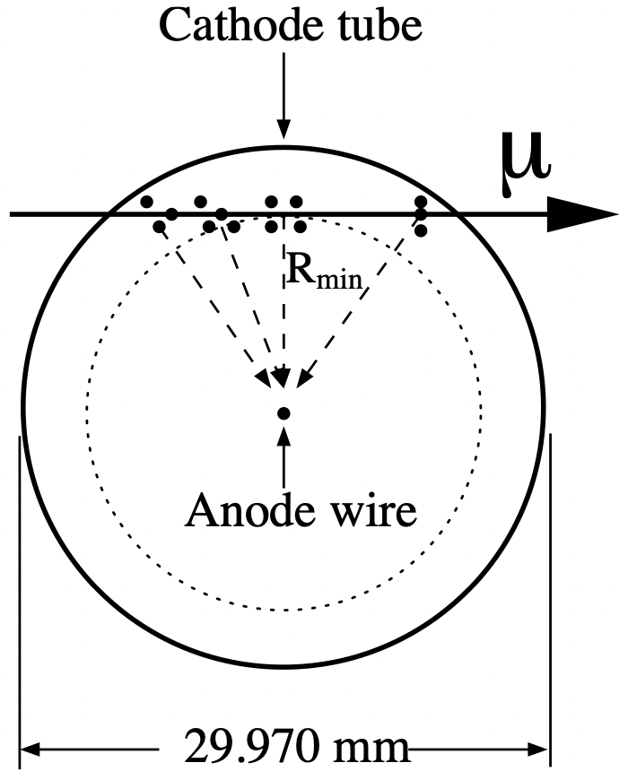
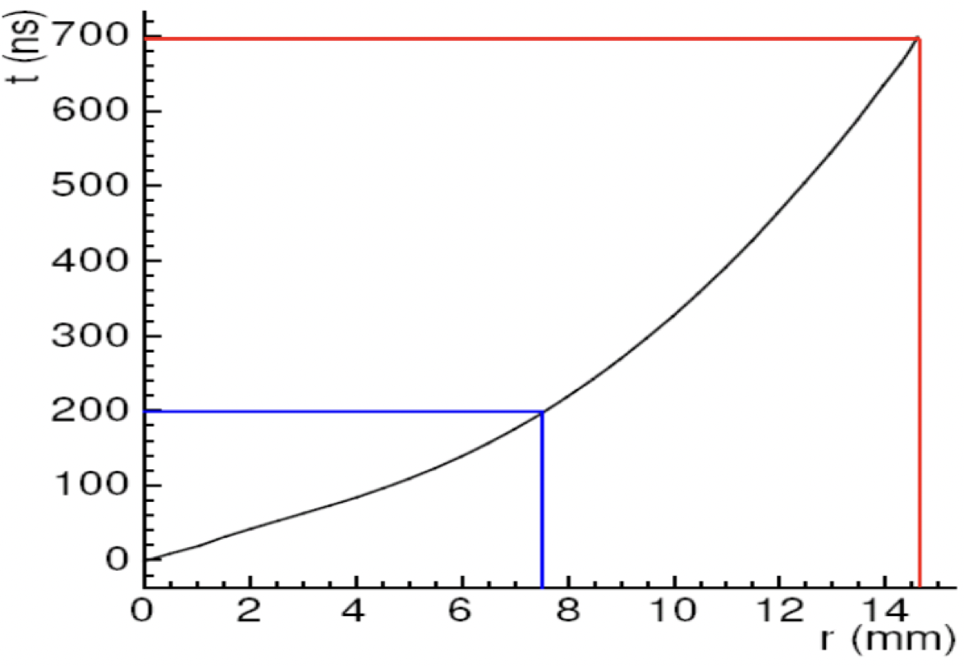
Functioning Principle of Cylindrical Drift Tubes
The basic detection element is a cylindrical aluminum drift tube with a diameter of 29.97 mm and filled with an Ar/CO2 mixture (93%/7%) at a pressure of 3 bars.
Figure 3-1: Schematic view of a monitored drift tube.
Drift velocity:
$\overset{⃗}{v}=μ\overset{⃗}{E},$ [3.1]
$μ$ - charge mobility.
The electric field in the tube:
$E(r)=\frac{V}{ln(\frac{R}{r_{min}})}\frac{1}{r}$, [3.2]
$r_{min}$ - radius of the anode wire,
$R$ - inner radius of the tube,
$V$ - potential difference between anode wire and tube wall.
Figure 3-2: Drift tube operation in a magnetic field with a curved drift path.
Figure 3-3: RT relation of the MDT chamber.

Slide 5
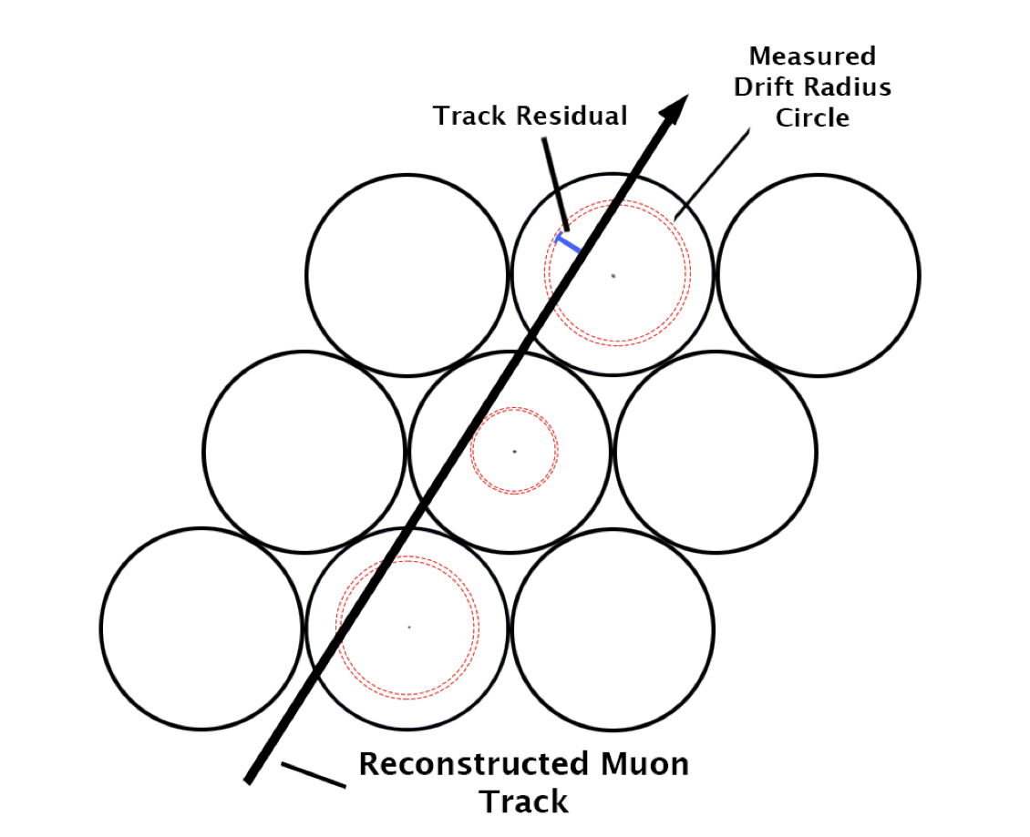
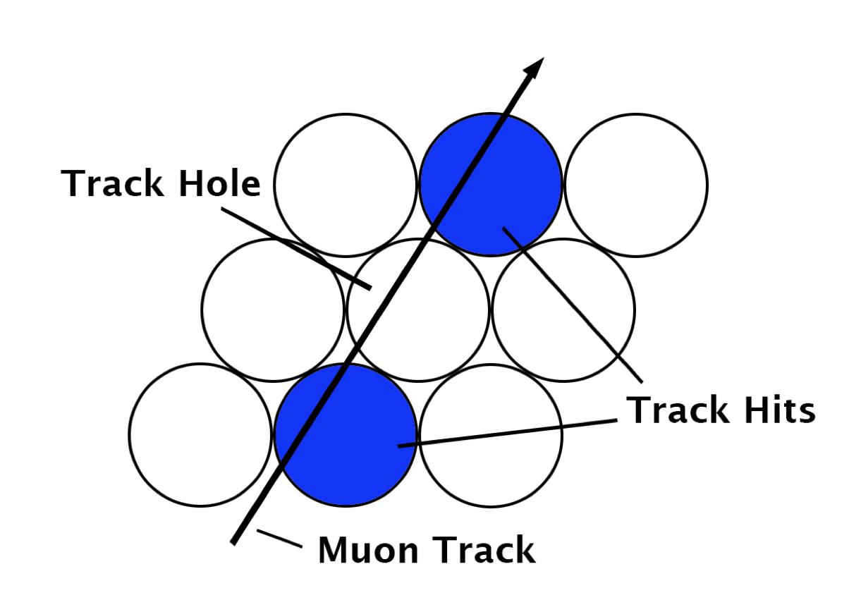
Tube Resolution and Efficiency
$$Resolution=\sqrt{σ_{biased}^{2}+σ_{unbiased}^{2}}$$
$$ε=\frac{trackhits}{trackhits+holes}$$
Figure 4-1: Visualization of the biased residuals for a track.
Figure 4-2: Visualization of a track hole.

Slide 6
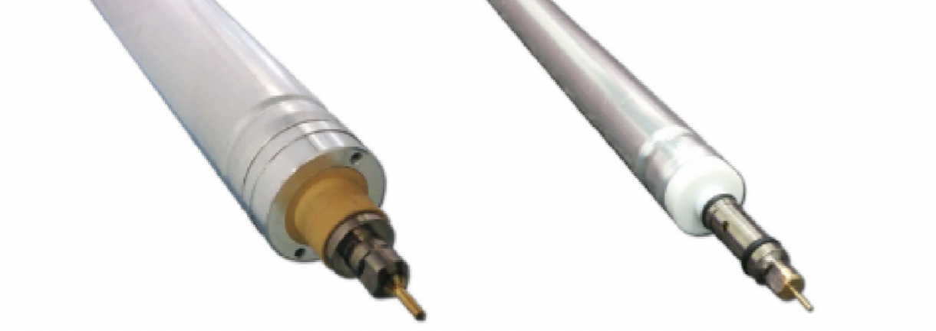
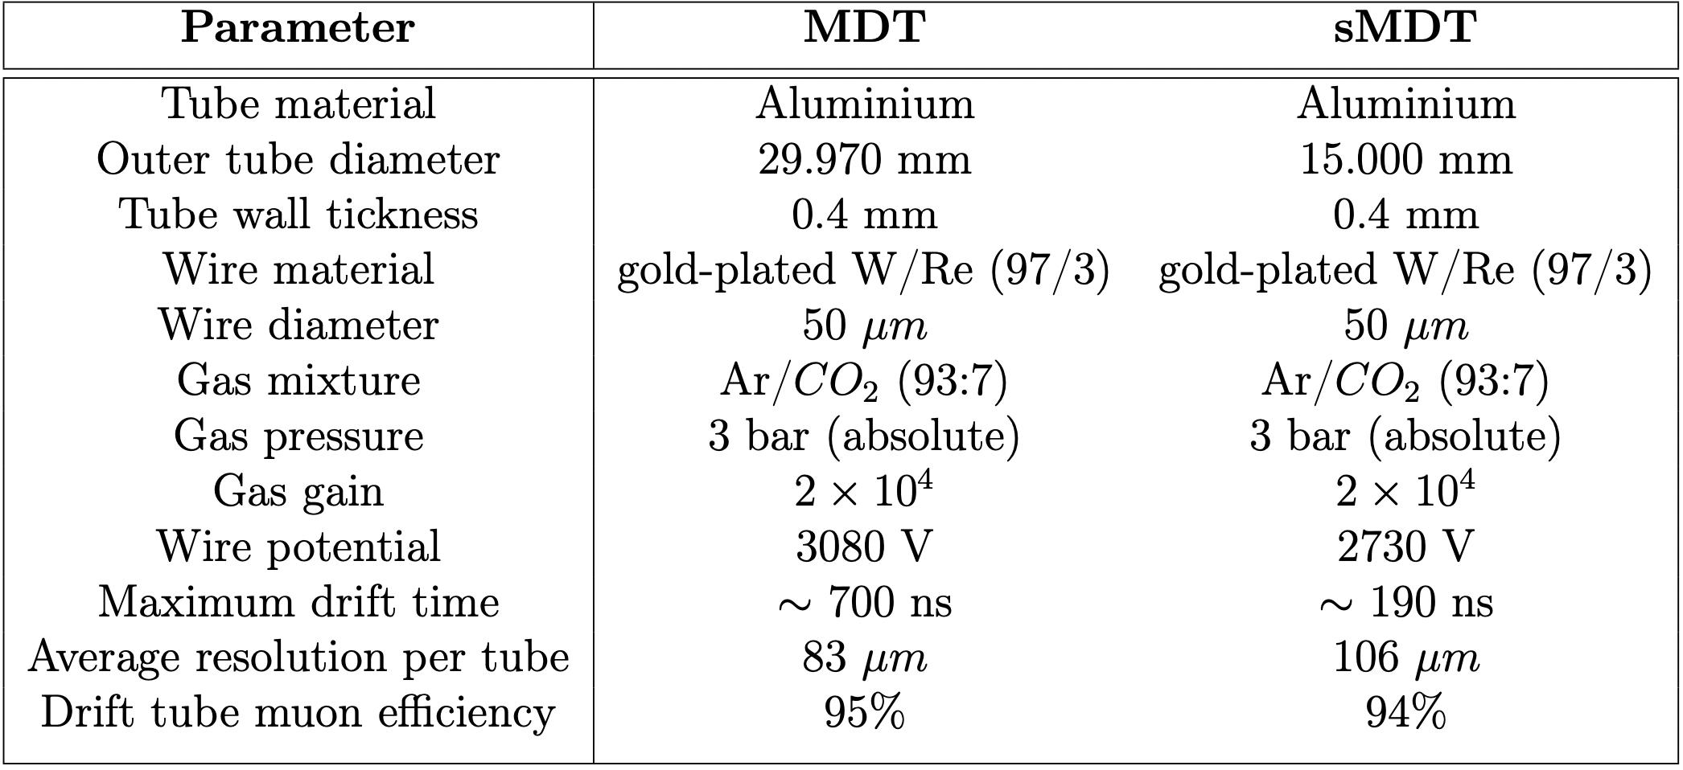
small Monitored Drift Tube (sMDT) Chambers
Advantages of sMDT Chambers:
- Smaller radius (7.5 mm compared to 15 mm), which shortens the maximum drift time to 175 ns compared to 700 ns for MDTs, which means the electronic dead time is 4 times smaller for sMDTs, allowing for sMDT chambers to function 8 times higher rates than MDT chambers.
- The smaller size of sMDT chambers allows them to be installed in certain areas of the muon spectrometer that other chambers could previously not be mounted.
- However, sMDT chambers have significantly poorer resolution than MDT chambers.
Figure 5-1: Main MDT and sMDT chamber parameters.

Slide 7
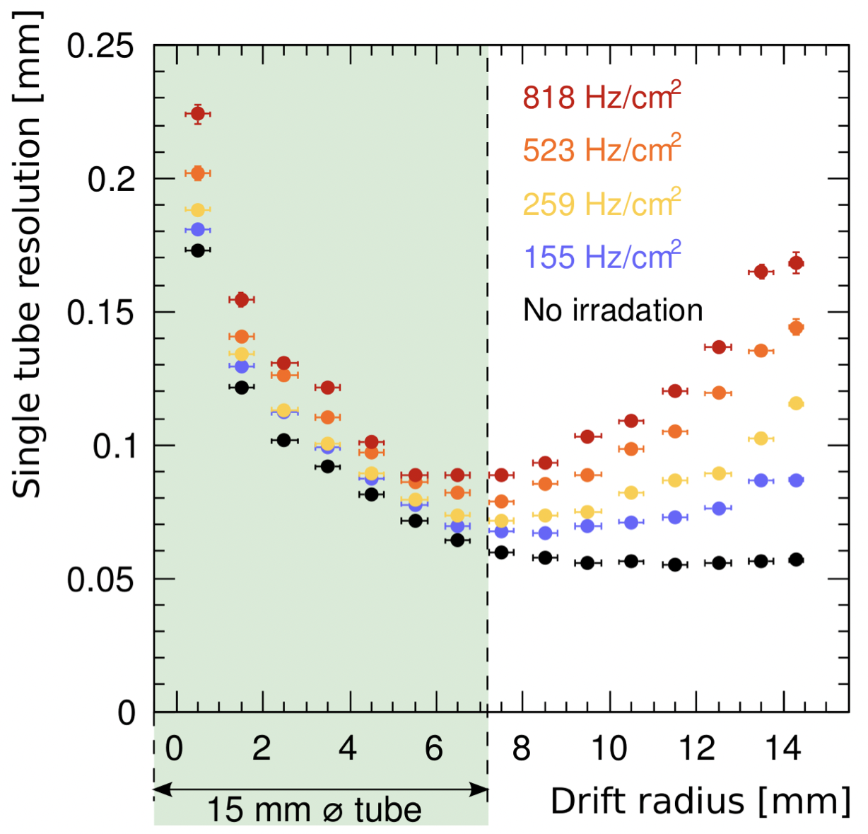
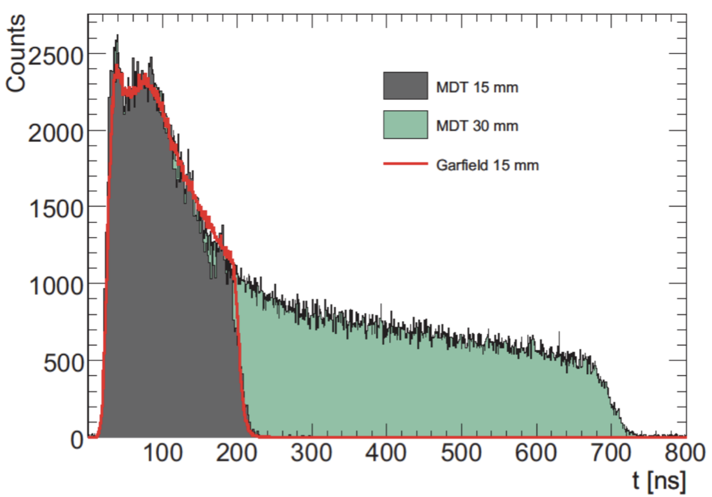
small Monitored Drift Tube (sMDT) Chambers
Figure 6-1: Measured spatial resolution of MDT chambers vs the drift radius at different rates of radiation.
Figure 6-2: The plot of drift times for an sMDT chamber compared to that of a MDT chamber.

Slide 8
Thank you for your attention!

