Slide 1
Transverse stability in RCS and TESLA cavity
Preliminary considerations
Alexej Grudiev
4/10/2022

Slide 2
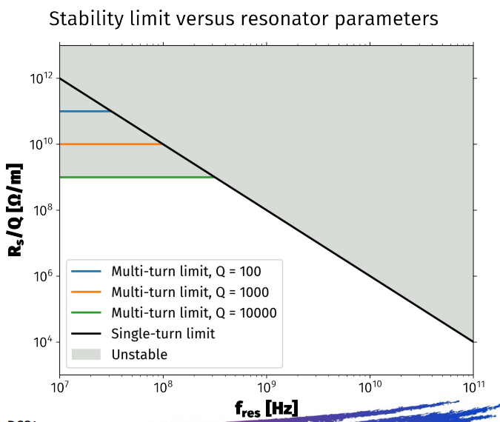
Single-turn stability limit in MC RCS from David Amorim. 2022-09-06_HEMAC_RCS1_impedance_resonator_scan_v2.pdf (cern.ch)
Some RCS parameters:
  f_RF = 1.3GHz
  C = 5990m
  Einj = 63.1GeV/c
  dE = 14.2 GeV/c per turn
  N_turns = 20
  V_RF = 20.1 GV
  Sigma_z = 25mm
Single turn stability limit: Rs/Q*f^2 = 100 [MΩ/m*GHz^2]

Slide 3
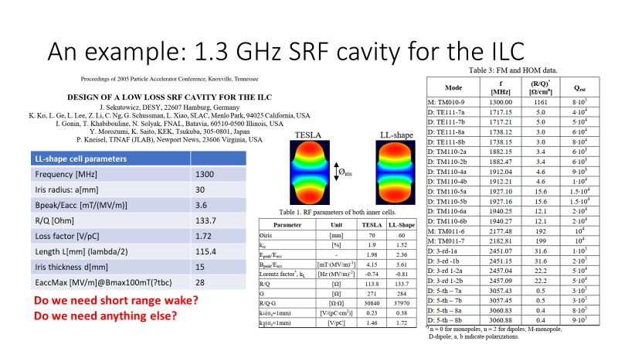
ILC cavity parameters, reminder from:R/Q in linacΩ
SRF cavity parameter model for HEC RF system design (cern.ch)
Max R/Q

Slide 4
One HOM from LL ILC cavity and S-turn stability
Some RF cavity parameters:
  Active Acc. Gradient: 30 MV/m
  Cavity length: L_cav~1m
  V_cav: 30MV
  N_cav = 20100/30 = 670
Max R/Q HOM: R/Q = 32 linacΩ/cm^2 => Rs/Q = R/Q/2*c/ω = 3.1 kΩ/m per cavity
For 670 cavities: Rs/Q = 2.1 MΩ/m
f = 2.45 GHz,
Ncav*Rs/Q*f^2 = 12.6 [MΩ/m*GHz^2] < 100, Single turn stability limit from David
It is below stability limit by about factor 8 for one HOM.
In fact, all HOMs must be taken into account for S-turn stability calculation

Slide 5
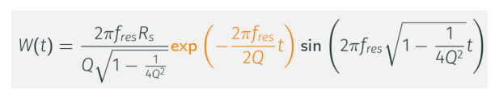
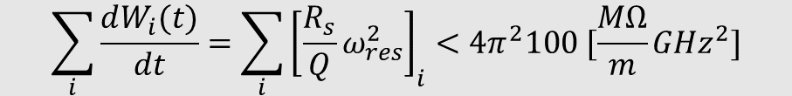
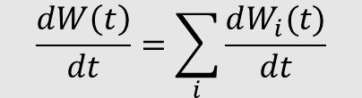
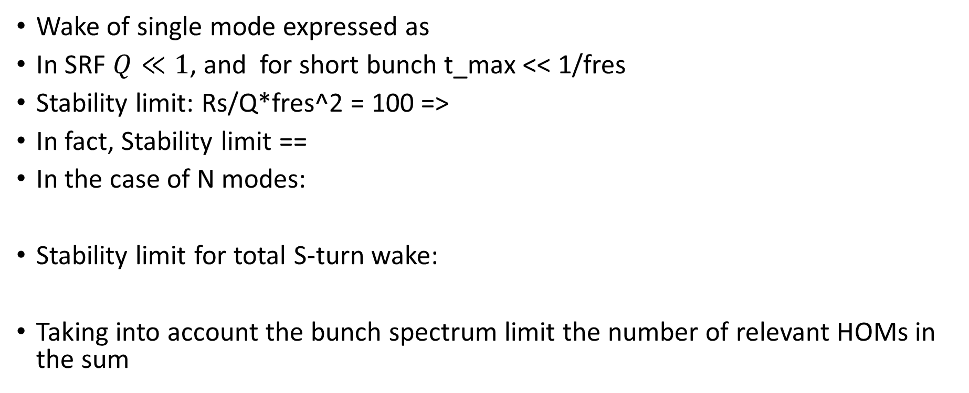
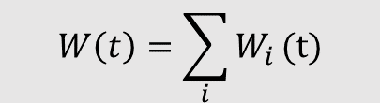



Stability for several HOMs
Wake of single mode expressed as
In SRF $Q≪1$, and for short bunch t_max << 1/fres
Stability limit: Rs/Q*fres^2 = 100 =>
In fact, Stability limit ==
In the case of N modes:
Stability limit for total S-turn wake:
Taking into account the bunch spectrum limit the number of relevant HOMs in the sum
$$W\left(t\right)=ω_{res}\frac{R_{s}}{Q}ω_{res}t$$
$$\frac{dW\left(t\right)}{dt}=ω_{res}\frac{R_{s}}{Q}ω_{res}=4π^{2}100 [\frac{MΩ}{m}{GHz}^{2}]$$
$$\frac{dW\left(t\right)}{dt}=const$$
$$W\left(t\right)=\sum_{i}{W_{i}}\text{(}\text{t}\text{)}$$
$$\frac{dW\left(t\right)}{dt}=\sum_{i}{\frac{dW_{i}(t)}{dt}}$$
$$\sum_{i}{\frac{dW_{i}(t)}{dt}}=\sum_{i}{{\left[\frac{R_{s}}{Q}ω_{res}^{2}\right]}_{i}}<4π^{2}100 [\frac{MΩ}{m}{GHz}^{2}]$$

Slide 6
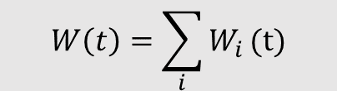

Physical interpretation of stability limit
$$W\left(t\right)=ω_{res}\frac{R_{s}}{Q}ω_{res}t$$
$$W\left(t\right)=\sum_{i}{W_{i}}\text{(}\text{t}\text{)}$$
Σ HOM_i
W(t)
W(t)
Tail
Tail
HOM_2
Transverse kick depends on the derivative of the wake
HOM_1
t
t
Head
Head

Slide 7
Stability for several HOMs up to 3 GHz
This is closer to the stability limits calculated by David: Rs/Q*f^2 = 100
BUT it is still factor 3 lower. More detailed studies needed

Slide 8
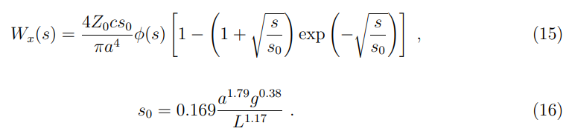









Closed expression of total Transverse wake.
Karl Bane (2003, SLAC-PUB-9663)
Wake per meter length
Derivative of the wake
per meter length :
Total wake of 670 cavities:
Stability limit:
Big discrepancy between KB model and HOM sum. Probably due to KB model applicability for s << s0=1.6mm, where derivative is very high and for s > s0 it goes down -> less kick on the witness particle
Nevertheless KB model can be used for beam dynamic simulations where Wx will be convoluted with realistic bunch distribution
s0=1.6mm !
$$\frac{dW_{x}(s)}{ds}=\frac{4Z_{0}c}{πa^{4}}e^{−\sqrt{s/s_{0}}}$$
$$\frac{dW_{x}(0)}{ds}=\frac{4Z_{0}c}{πa^{4}}$$
$$\frac{dW_{x}(0)}{dt}=\frac{4Z_{0}c^{2}}{πa^{4}}$$
$$\frac{dW\left(0\right)}{dt}L=\frac{4Z_{0}c^{2}L}{πa^{4}}$$
$$L=670m$$
$$\frac{4Z_{0}c^{2}L}{πa^{4}}=36000\frac{MΩ}{m}{GHz}^{2}$$
$L=L_{cav}$ $N_{cav}$
$$a=30mm$$
$$4π^{2}100 \left[\frac{MΩ}{m}{GHz}^{2}\right]=3950 \left[\frac{MΩ}{m}{GHz}^{2}\right]$$
The wake derivative is about factor 9 larger than stability limit. Hm!?

Slide 9
KB wake and discrepancy with HOM estimate
Wake
Wake derivative
Big (~x10) reduction from
W’_x(0) -> W’_x(~σz=8mm)

