Slide 1
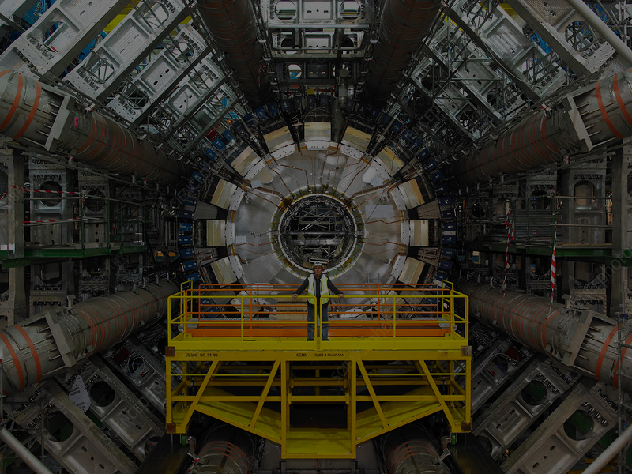
Study of sMDT Chambers at the ATLAS Experiment
Fedir Boreiko
December 14, 2022

Slide 2
Introduction
The functioning principle of small Monitored Drift Tube (sMDT) Chambers.
The analysis of the performance of sMDT Chambers.
2022 13.6 TeV collision data processing and the obtained results.
What could be done next?
1

Slide 3
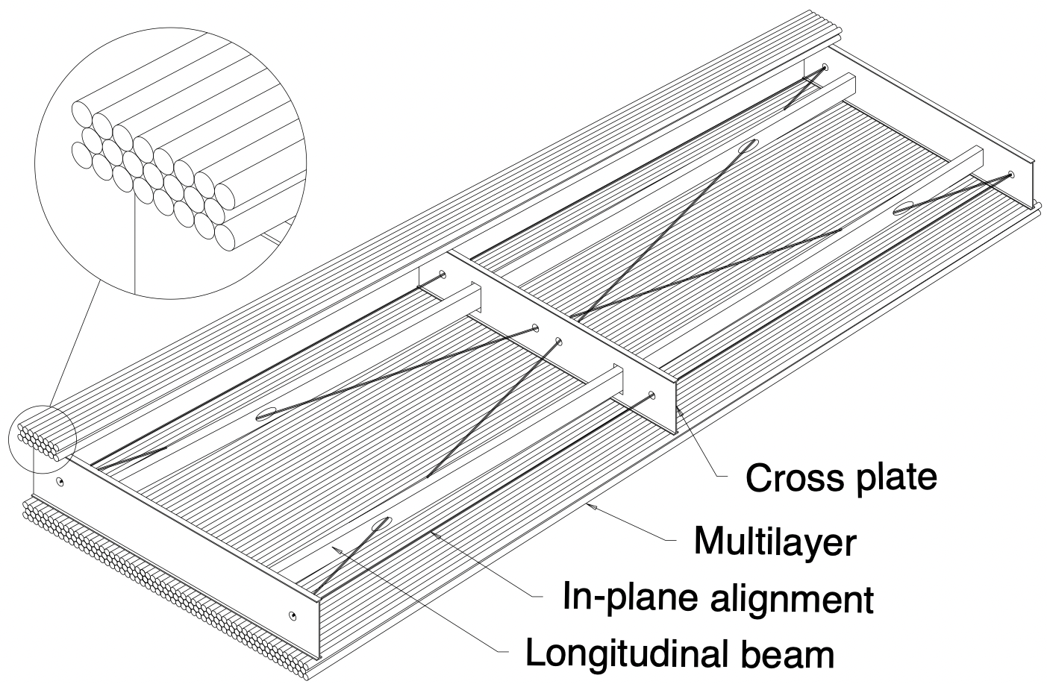
Small Monitored Drift Tube (MDT) Chambers
The monitored drift tube is the dominant tracking technology of ATLAS muon spectrometer.
ATLAS (s)MDT determines the muon momentum by reconstructing the muon trajectory in the known magnetic field and determining the curvature radius.
Figure 2-1
2

Slide 4
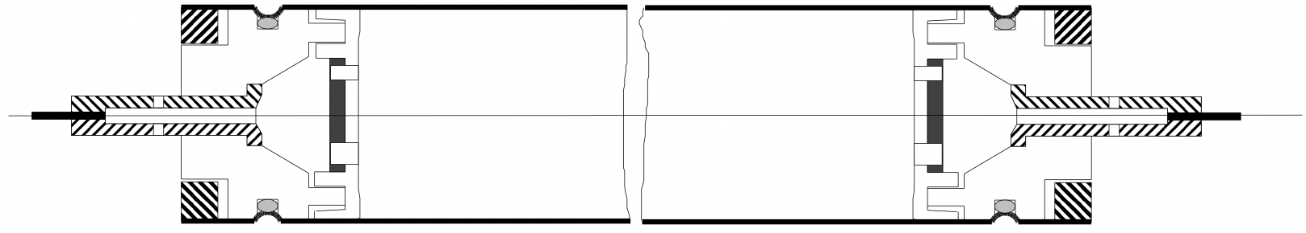
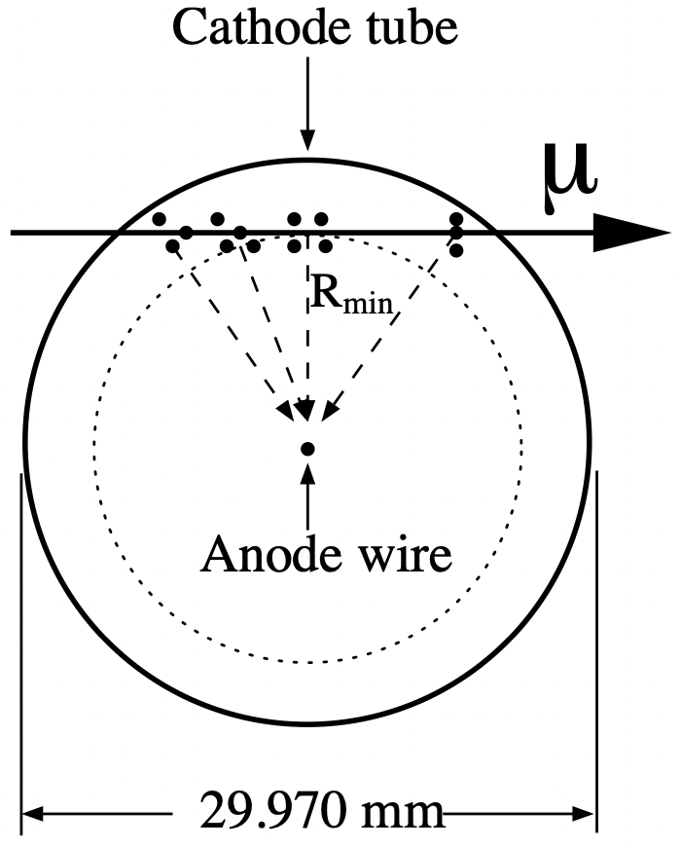
The functioning principle of Drift Tubes
The Drift Tube consists of a tube wall, a wire in the center, and a gas mixture, which fills the space between them.
The tube wall is grounded, while high voltage is applied to the wire.
When a muon transverses the drift tube, it ionises the gas atoms along its trajectory, creating free electron-positive ion pairs.
A signal is formed by the movement of the ions and electrons toward the electrodes and is then measured by readout electronics.
Figure 3-1: Schematic view of a monitored drift tube.
Figure 3-2: Drift tube operation in a magnetic field with a curved drift path.
3

Slide 5
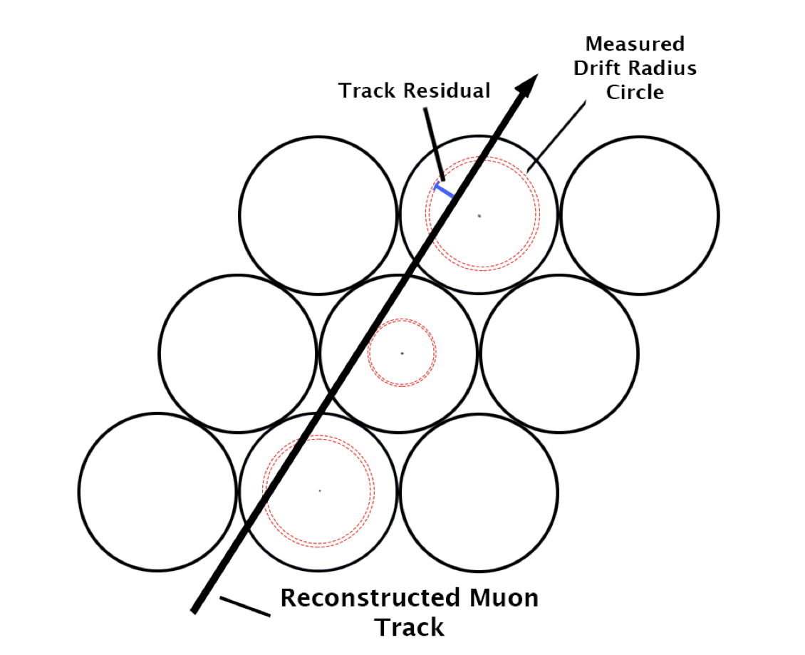
Important quantities
μ
The Drift Time - the time needed for electrons to reach the anode wire from their creation point.
The Drift Radius - the shortest distance from the electron creation point to the anode wire.
The Track - the shortest distance between the reconstructed muon track and the wire.
The Residual - the difference between the Drift Radius and the Track (Biased and Unbiased Residual).
Track
Figure 4-1: Visualization of the reconstructed muon track.
4

Slide 6
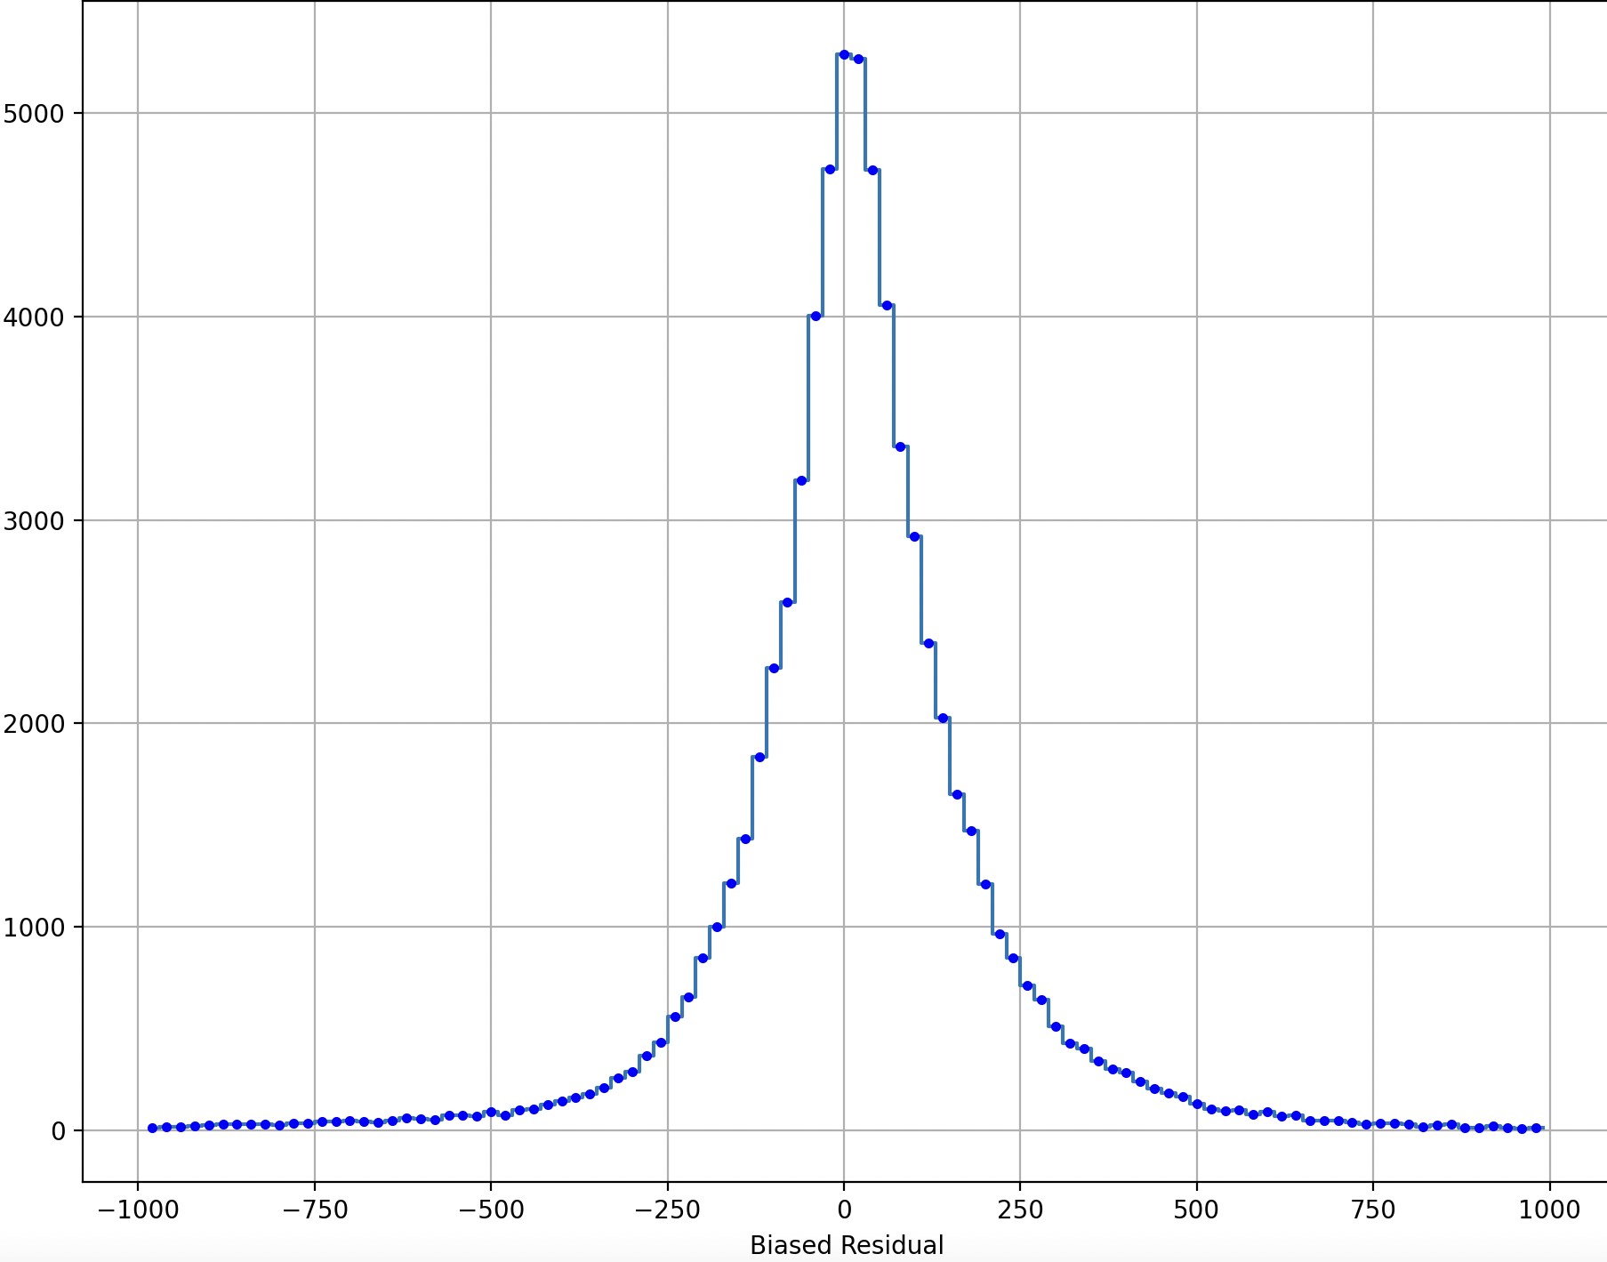
Performance analysis: the Residual Fit
The objective is to fit an equal-mean double Gaussian to the histograms of Biased and Unbiased Residuals.
x, bins = np.histogram(residual*1000, bins = np.arrange(-1000, 1000, 20))
The weighted mean:
$$mean=\frac{∑(x⋅bins)}{∑(x)}$$
The weighted σ:
$$σ=\sqrt{\frac{∑((bins-mean)^{2}⋅x)}{∑(x)}}$$
Figure 5-1: BME4C13 Biased Residual.
5

Slide 7
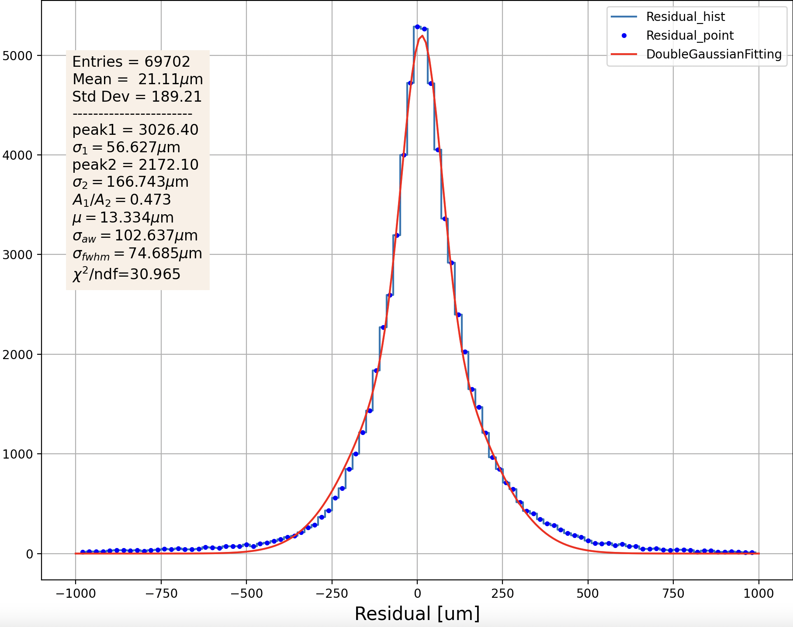
Performance analysis: the Residual Fit
The fitting equal-mean double Gaussian function:
$$doubleGfit=peak_{n}⋅e^{-\frac{1}{2}(\frac{x-m}{sigma_{n}})^{2}}+peak_{w}⋅e^{-\frac{1}{2}(\frac{x-m}{sigma_{w}})^{2}}$$
$peak_{n}$ , $sigma_{n}$ , $m$ , $peak_{w}$ and $sigma_{w}$ are fitted to max(x), σ/2, mean, max(x)/10 and σ*2
The resulting weighted value of σ:
$$σ=\frac{peak_{n}⋅|sigma_{n}|+peak_{w}⋅|sigma_{w}|}{peak_{n}+peak_{w}}$$
Figure 6-1: BME4C13 Fitted Biased Residual.
6

Slide 8
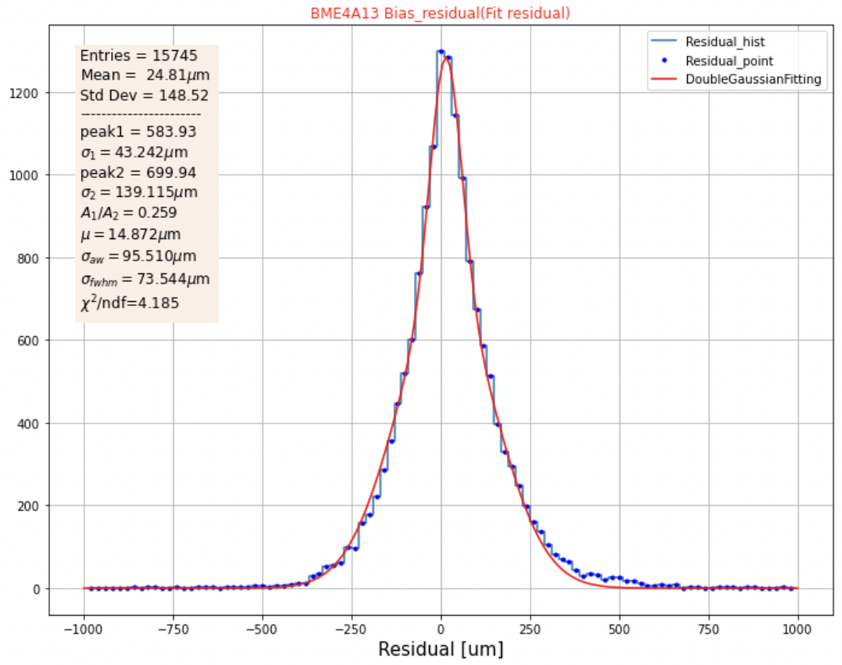
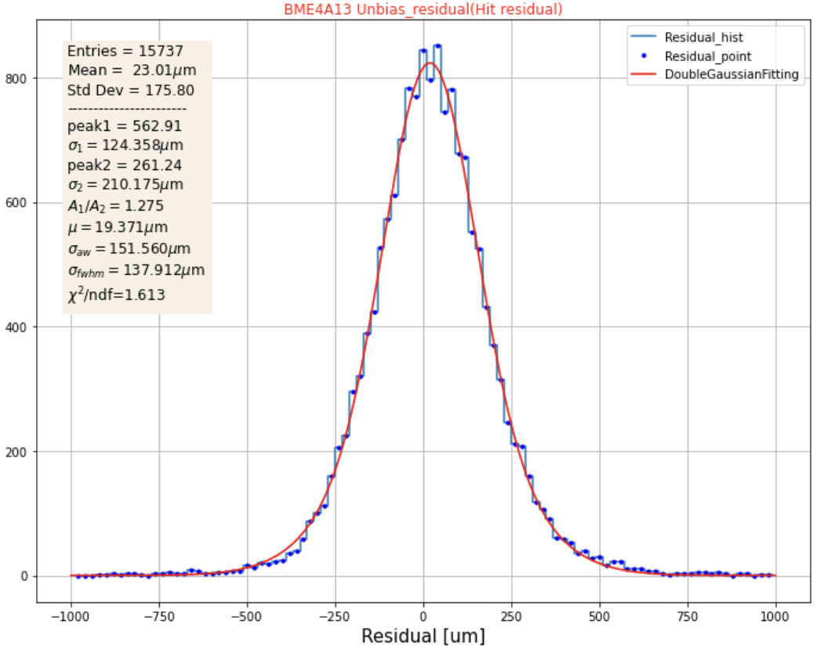
Biased and Unbiased Residual Fit
Figure 7-1: BME4A13 Fitted Biased and Unbiased Residual.
7

Slide 9
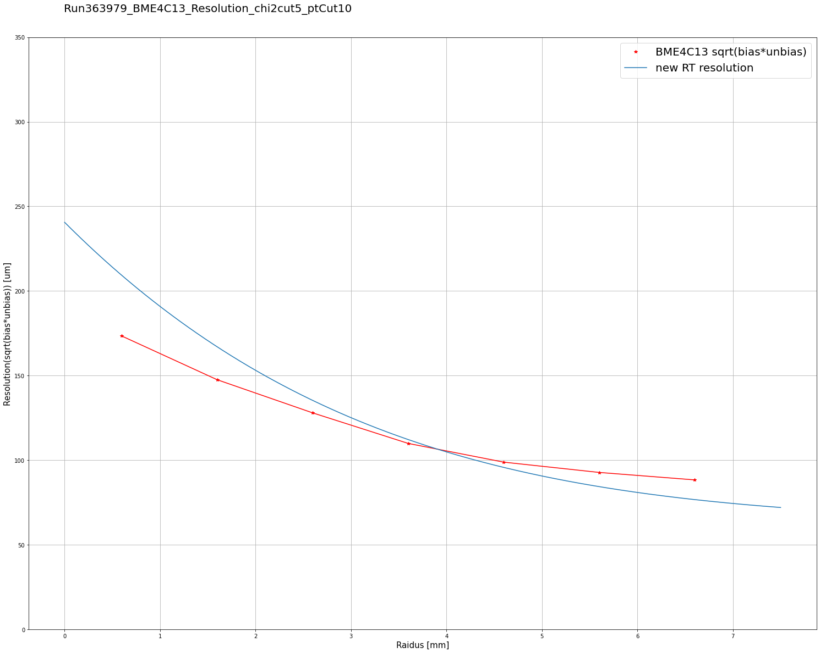
Performance analysis: Resolution
To plot the Resolution as a function of the Drift Radius, the Tube Radius is split into 7 equal intervals with a step of 1. For each interval, we compute biased and unbiased sigmas σ of residuals corresponding to a track that lay in the boundaries of a particular interval.
Having the $σ_{biased}$ and $σ_{unbiased}$ , the Resolution is equal to: $R=\sqrt{σ_{biased}⋅σ_{unbiased}}$
Figure 8-1: BME4C13 Resolution.
8

Slide 10
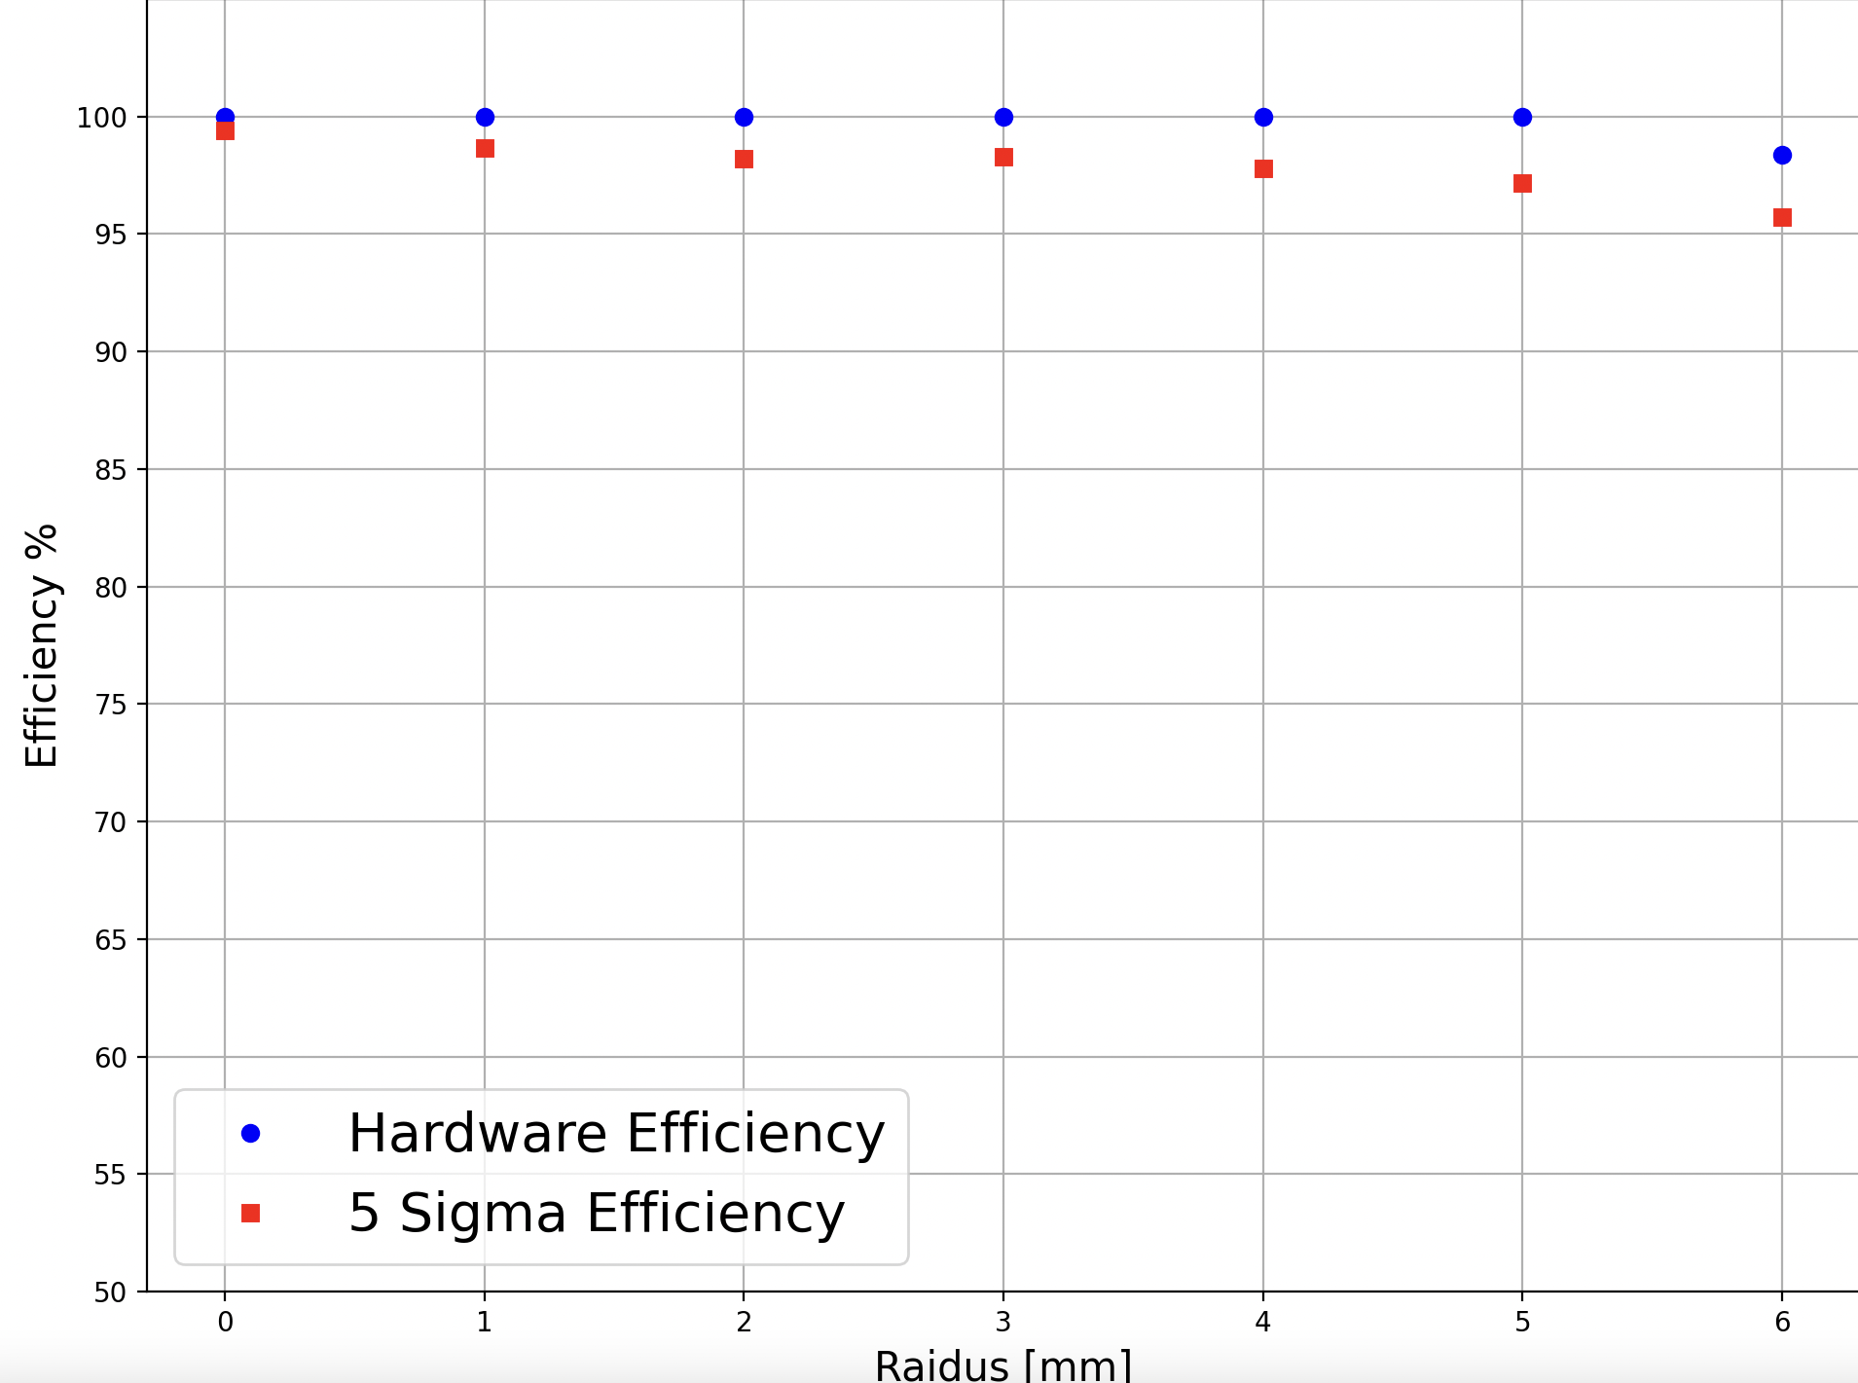
Performance analysis: Efficiency
In order to plot the Efficiency as a function of Drift Radius we follow the same method of splitting the Tube Radius into 7 intervals with a step of 1, subsequently processing Tracks that lay in boundaries of a particular interval.
For Sigma Efficiency: The hits are counted as efficient if they pass the following condition:
Unbiased residual < 5 * sigma resolution
For Hardware Efficiency: The hits counted as efficient are the hits with:
Unbiased Track < Maximum Radius
(7.1 mm for sMDT chambers)
Figure 9-1: BMG2A14 Efficiency.
9

Slide 11
2022 13.6 TeV collision data: processing
The task is to process data from 14 BME and BMG sMDT chambers in regions 51, 52, 103, and 104 from run 437124.
Dataset:
data22_calib.00437124.calibration_MuonAll.daq.RAW.lumiblock-0region.ntuple.root
Cut 1: n-tuples of each event need to be separated to contain information from a single Segment.
Example of a particular event with 12 MDT hits:
mdt_segIndex = [0, 0, 0, 1, 1, 1, 2, 2, 2, 2, 2, 2]
mdt_r = [1.076483, -0.509408, -2.672133, … , -11.933061, 11.101686]
len(mdt_segIndex) = len(mdt_r) = 12
seg_nMdtHits = [3, 3, 6] seg_nSegments = 3. (number of Segments in the event)
mdt_segIndex = [0, 0, 0] , mdt_r = [1.076483, -0.509408, -2.672133], seg_nMdtHits = 3
mdt_segIndex mdt_segIndex = [1, 1, 1] , mdt_r = [-1.076500, 0.509400, 2.674335], seg_nMdtHits = 3
mdt_segIndex = [2, 2, 2, 2, 2, 2] , mdt_r = [-9.066158, …, 11.101686], seg_nMdtHits = 6
10

Slide 12
2022 13.6 TeV collision data: processing
Cut 2: Introduced by selecting events where there are segments matched to tracks (trkSeg_nTrkSegs > 0). Simultaneously, the chamber name is attributed to each event in the dataset.
Refit the Segments, obtain the new Track and the unbiased Track, and attribute the new variables to the spreadsheet.
μ
μ
Track
New Track
Figure 11-1: Visualisation of matching segments to a track.
Figure 11-1: Segment refitting
11

Slide 13
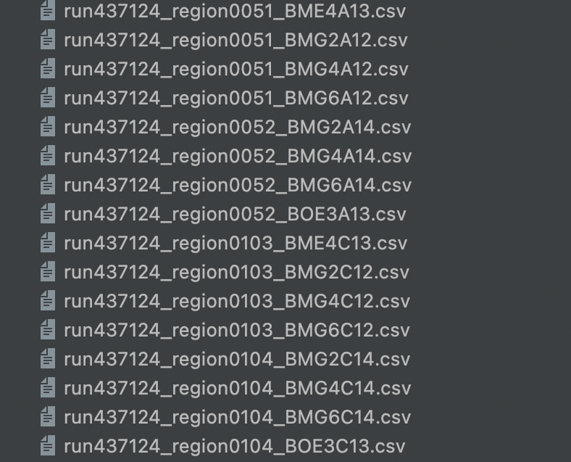
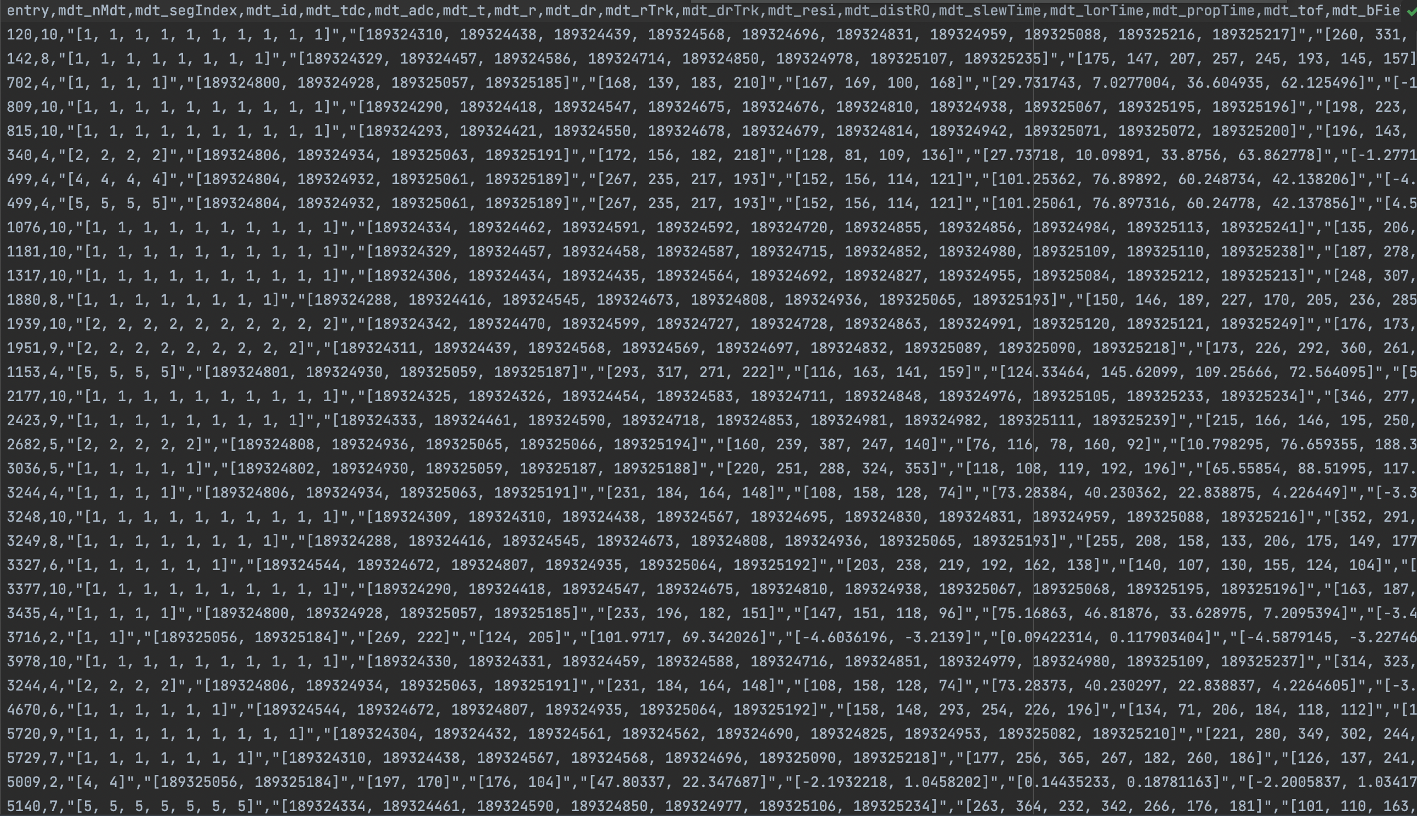
2022 13.6 TeV collision data: processing
After creating the pandas Dataframes out of selected data, writing it into .csv spreadsheets, and distributing the events according to the chamber names, 14 sMDT chamber datasets were produced.
( … )
( … )
( … )
12

Slide 14
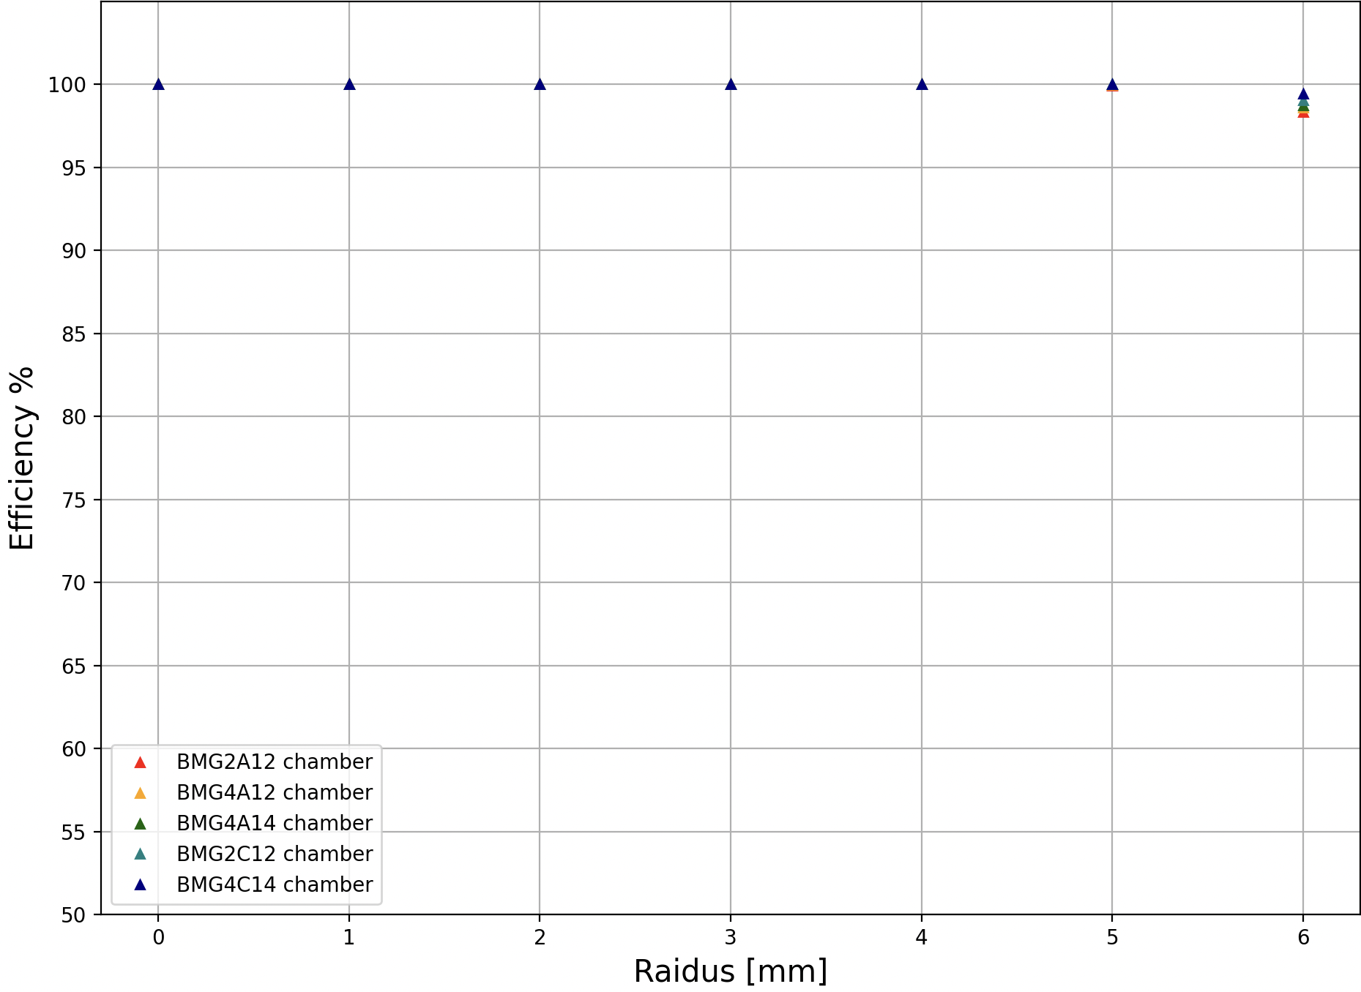
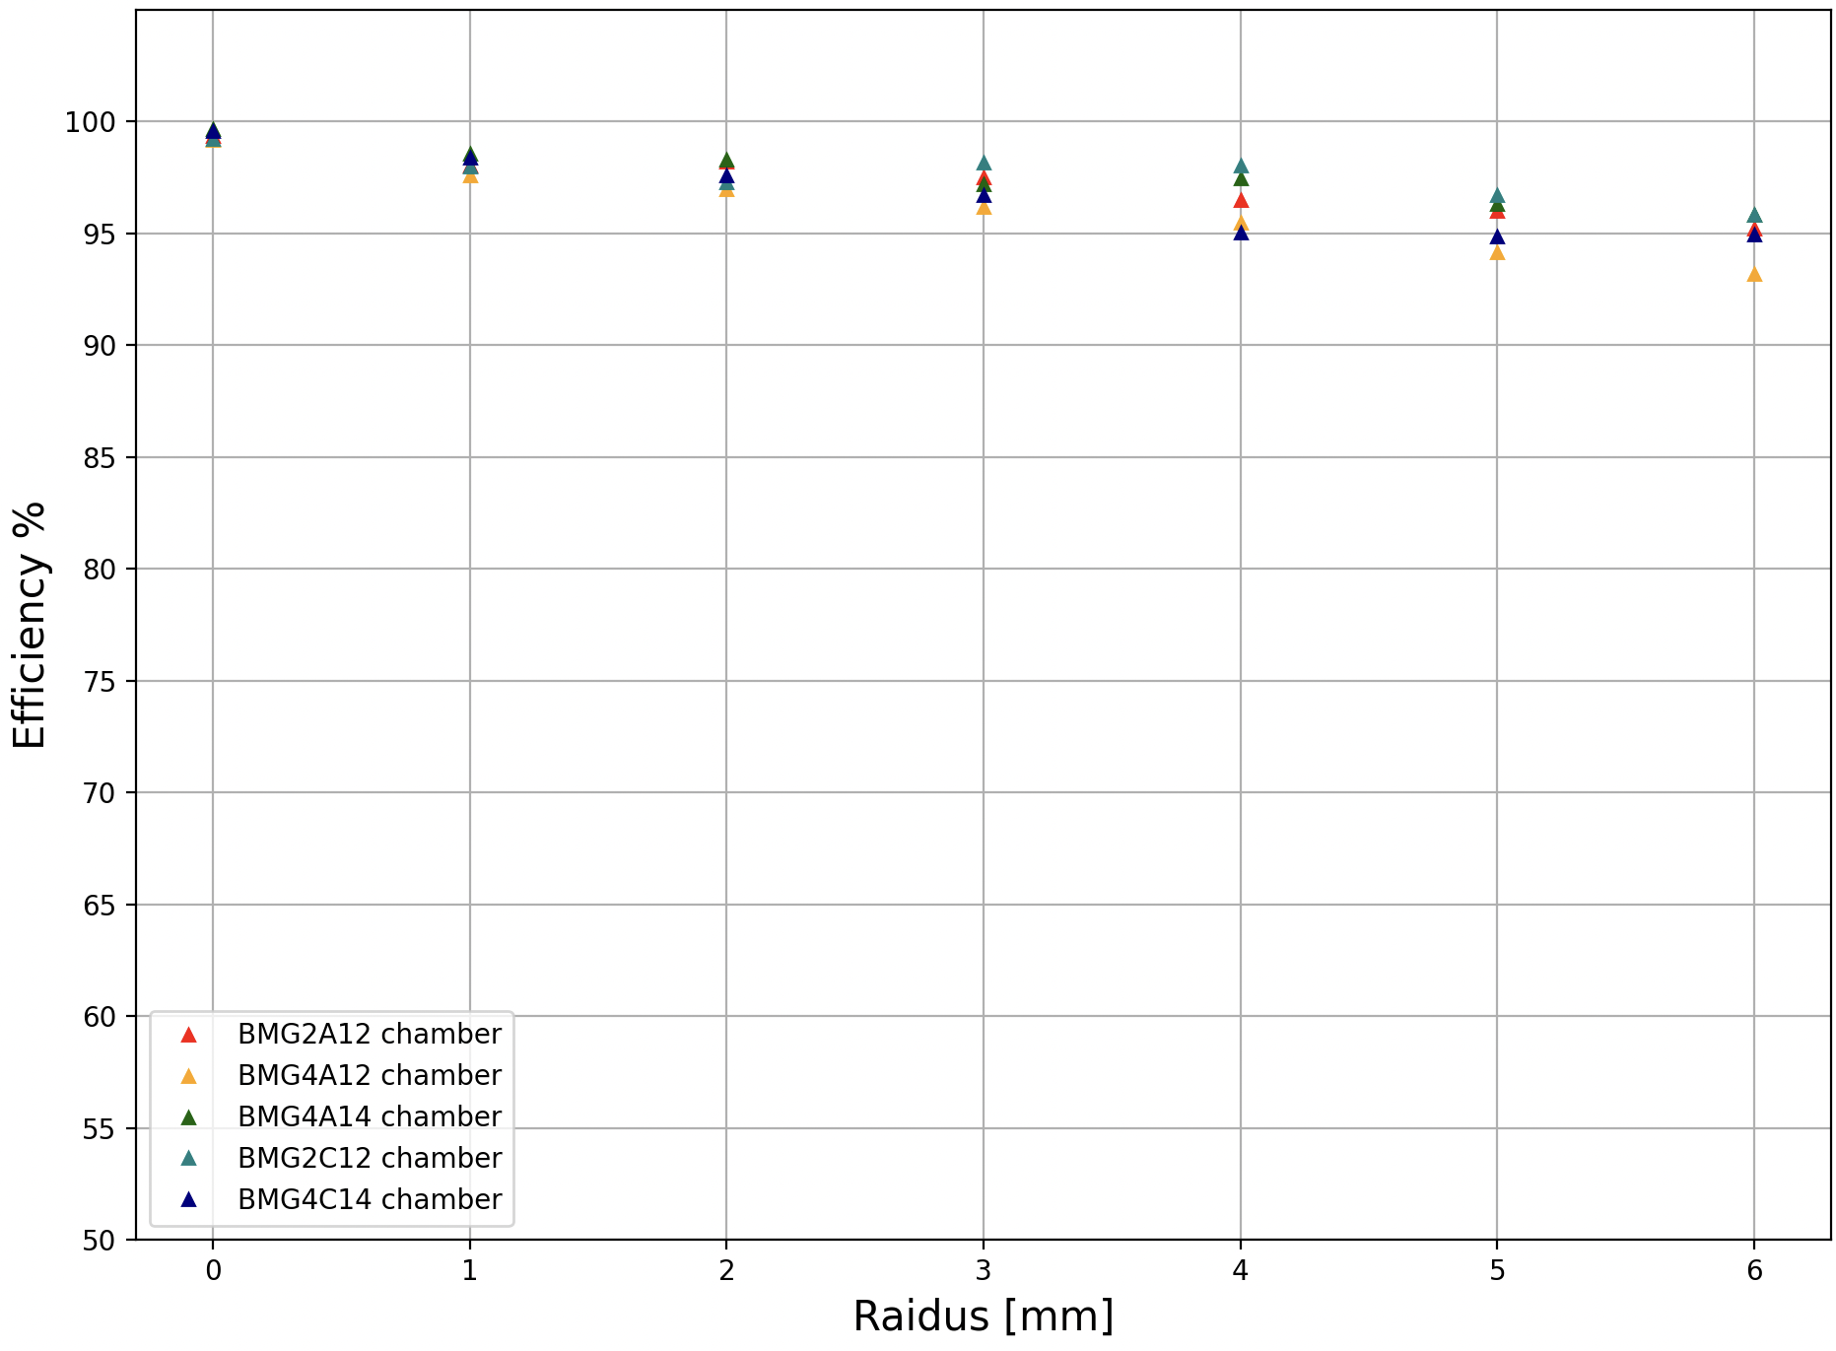
sMDT Chambers’ Hardware and Sigma Efficiency
Hardware Efficiency
5-Sigma Efficiency
Cut: data.shape[0] > 500
13

Slide 15
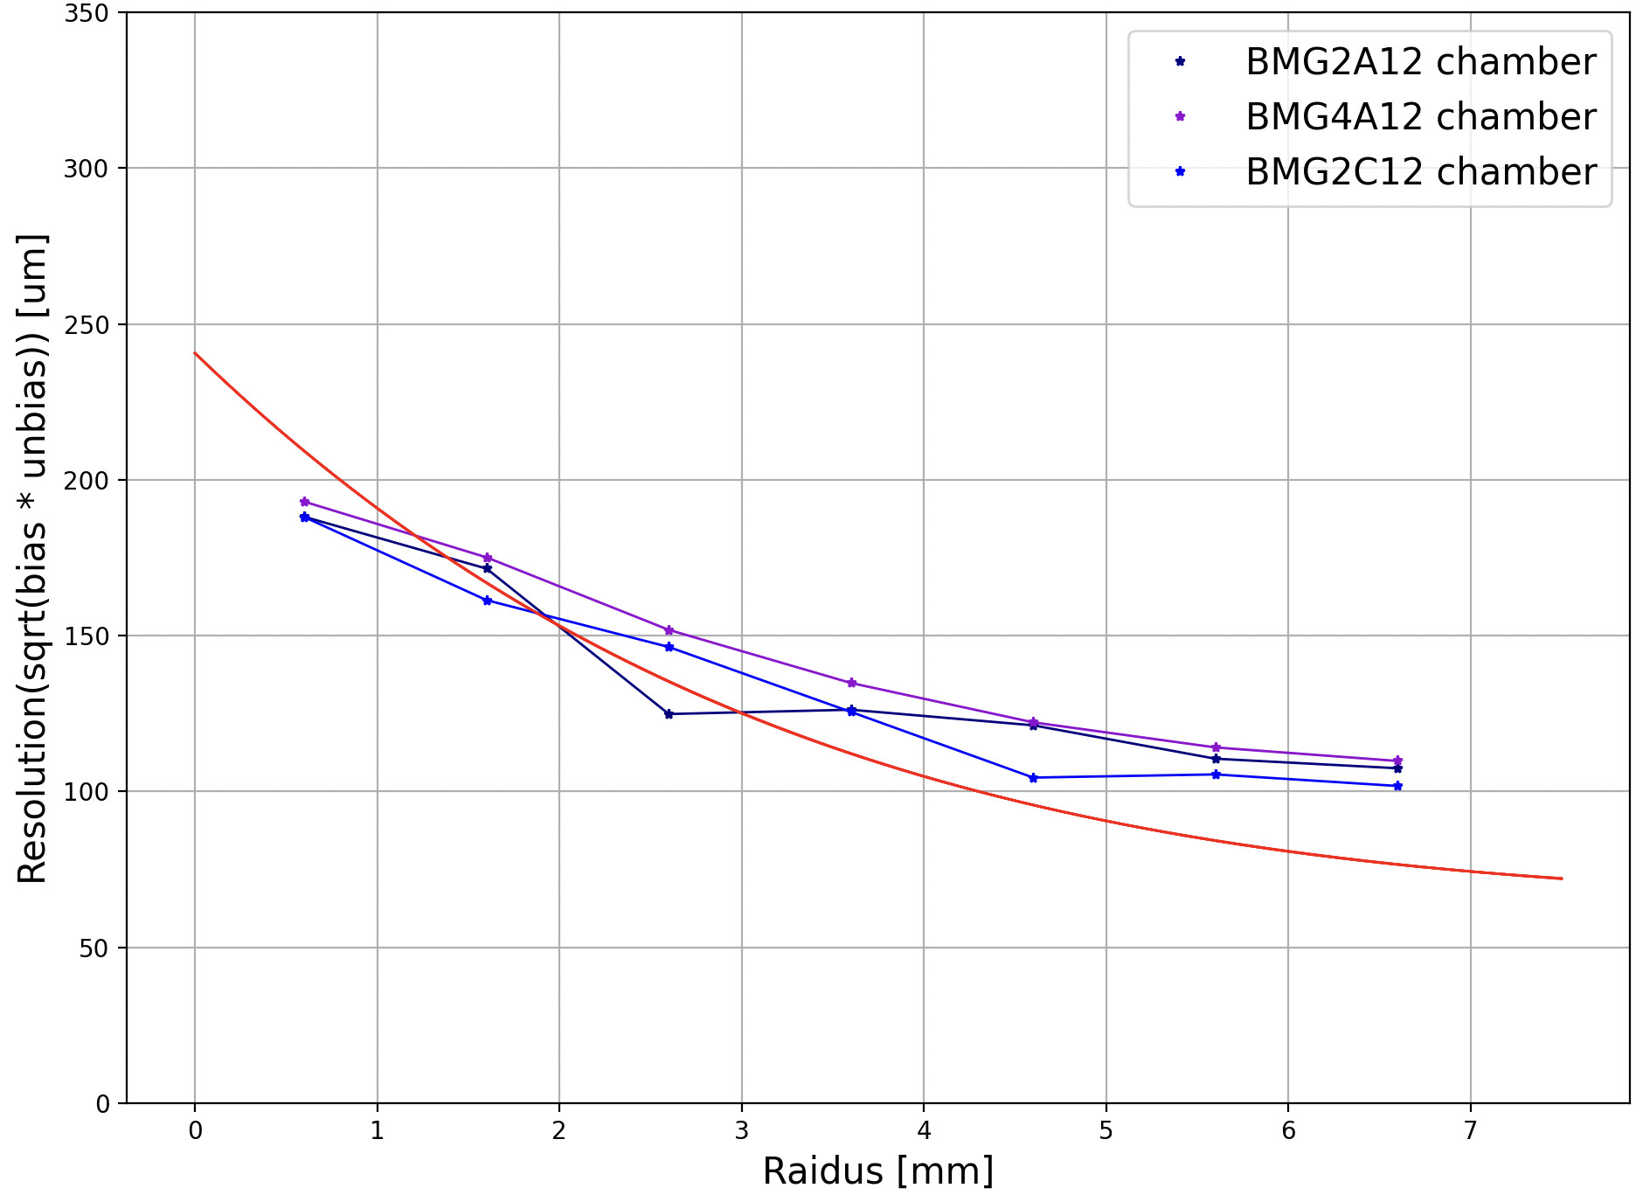
sMDT Chambers’ Resolution
Cut: data.shape[0] > 1000
14

Slide 16
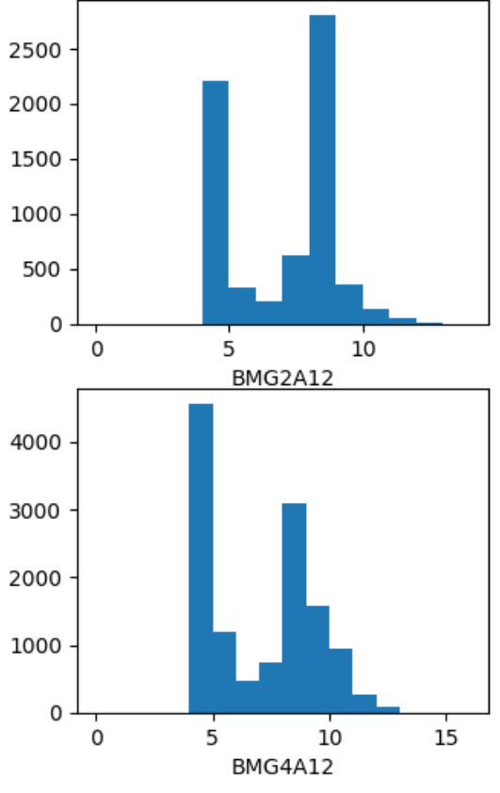
What lacks and what will be done next
- Adding the error to the Resolution graph. This will indicate whether the deviation lies within the boundaries of the statistical error. Otherwise, the method of plotting the resolution needs to be revised.
- Investigating the cause of insufficient data on most chambers. On average, the shape of processed datasets is around 800. Moreover, the average Hits per Segment ratio for the dataset is around 7 Hits per Segment, which means that a great part of the data could not be taken into account.
- Producing more plots to investigate the chamber’s behavior, such as 2D histograms of Residuals vs Tube radius, Track Hit Occupancy, and others.
?
Figure 15-1: seg_nMdtHits ratio
15

Slide 17
Thank you!

Slide 18
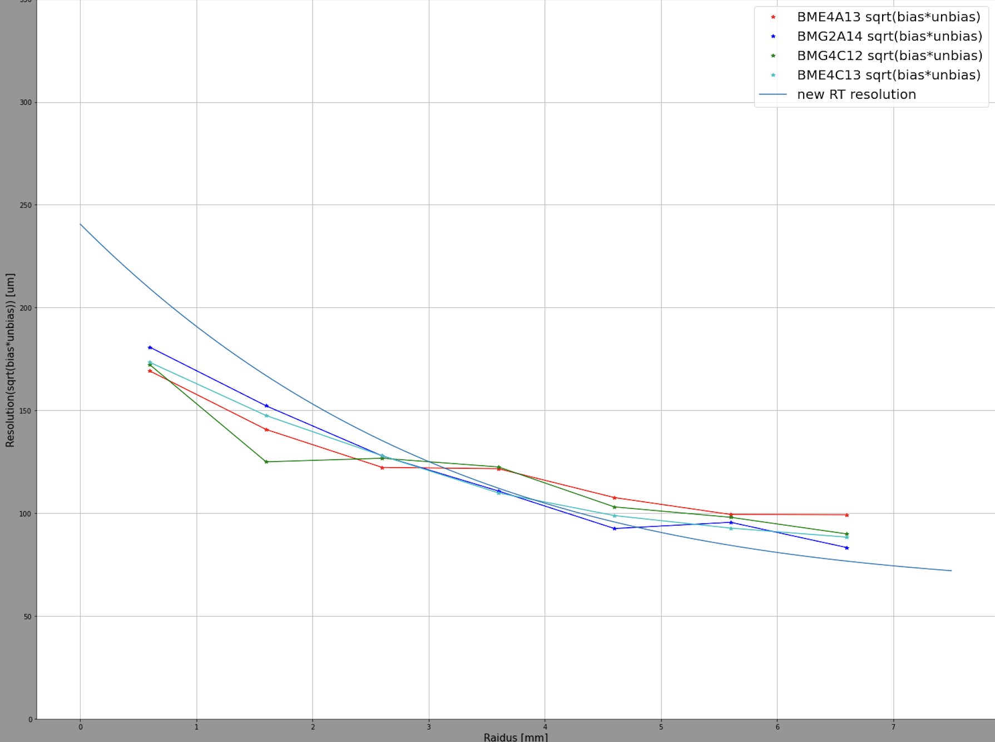
sMDT Chambers’ Resolution
17

