Slide 1
Commissioning and operation of the ATLAS NSW
sTGC detector
By Tiulchenko Mariia
14.12.2022

Slide 2
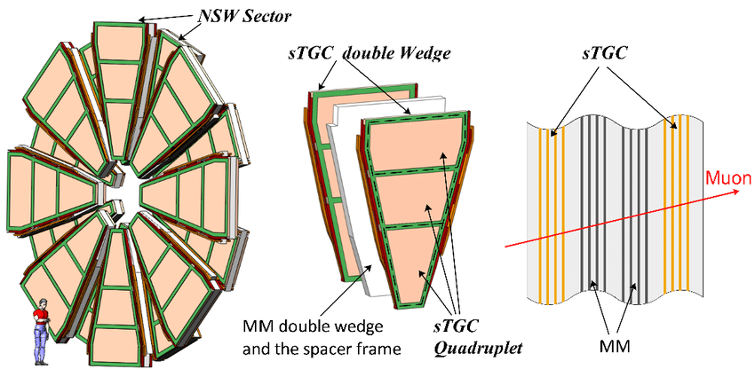
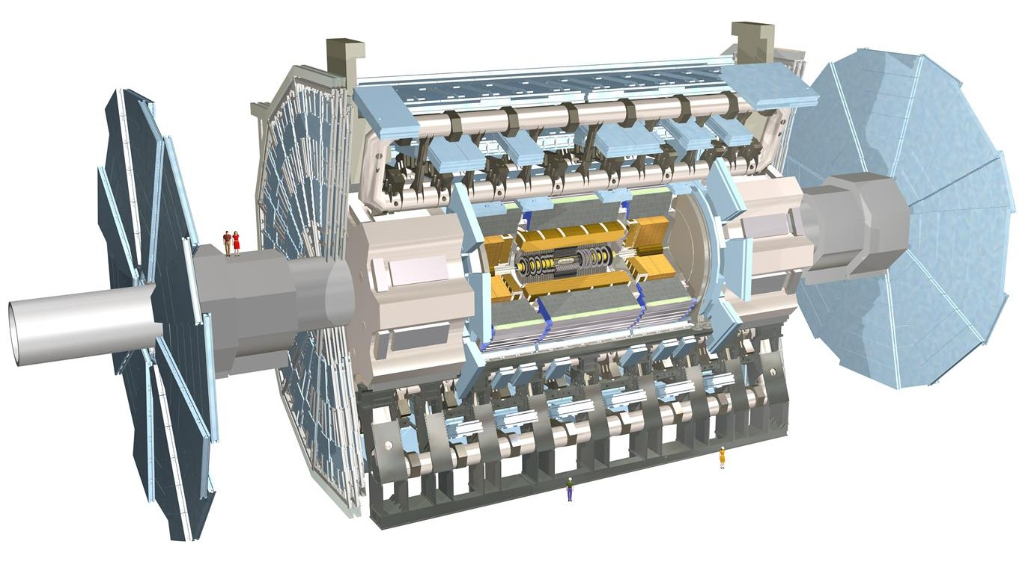






ATLAS . Muon Spectrometer . NSW
Big wheel
Outer wheel
µ
New Small wheel
X
X
Small wheels
X
End-cap toroid
Big wheel and Outer wheel
Interaction point
The muon spectrometer is the outermost layer
of the ATLAS experiment, which together
with the toroid magnet identify muon particle trajectories and measure muon transverse momentum
New Small Wheels provide precise muon tracking and fast triggering capabilities in the ATLAS forward region.
NSWs have 32 sectors. Each sector
utilizes two different types of
novel gaseous detectors: sTGC and MM.

Slide 3
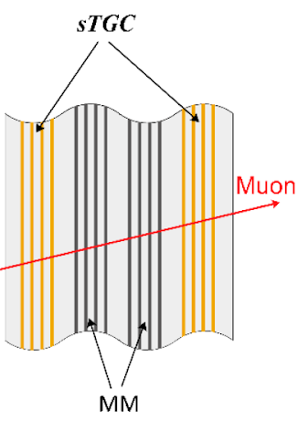

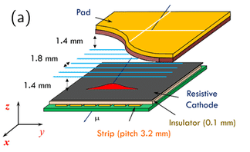
sTGC
Sector
~1000 strip
Quad 3
Quad 2
Quad 1
Each sector has 8 layers of sTGC detector.
sTGC is a detector filled with gas (CO2:n-pentane 55:45 ). It consists of different readout channels such as wires, pads, and strips.
HV is applied to the wires while two cathode planes are grounded to create a strong electric field for the ionized electrons from a passage of a charged particle to drift toward wires and initiate avalanches.
Induced charge signals could be picked up from the readout electrodes to determine the position of the incident particle
1 strip

Slide 4

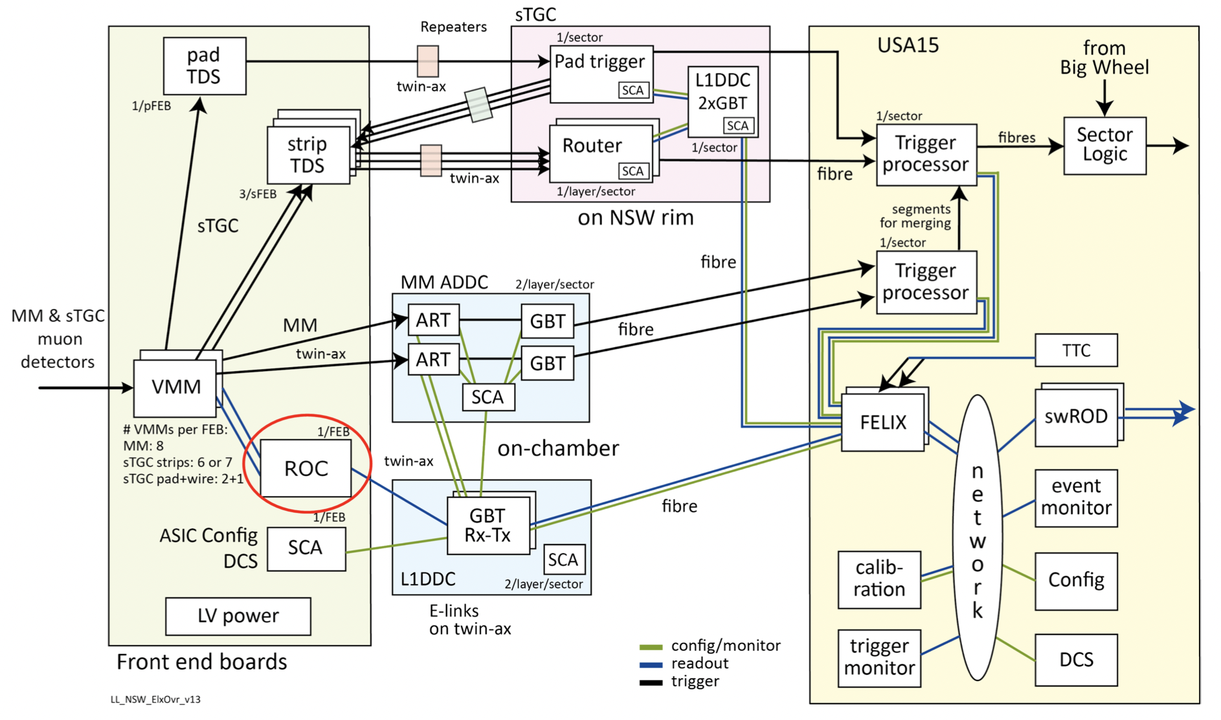
Readout electronics and data acquisition system
Simplification
The electronics sub-system for the sTGC detector system is responsible to amplify the tiny induced charge current, record the induced signal charge and time, and send the digitized hit data from the Front-end (sit next to the detector) to the back-end (and the ATLAS control room).
A trigger is sent by FELIX(Back-end electronics system), analyzed by ROC, and stored in its buffer. After that, ROC refers to the VMM channels, where the needed information is selected from the VMMs’ buffers, and the unnecessary data is removed.
Pads
Strips
VMM
ROC
GBTx Rx-Tx
FELIX
Wires
Links
Links
Fibres
x8
x3
Front-end
Back-end

Slide 5
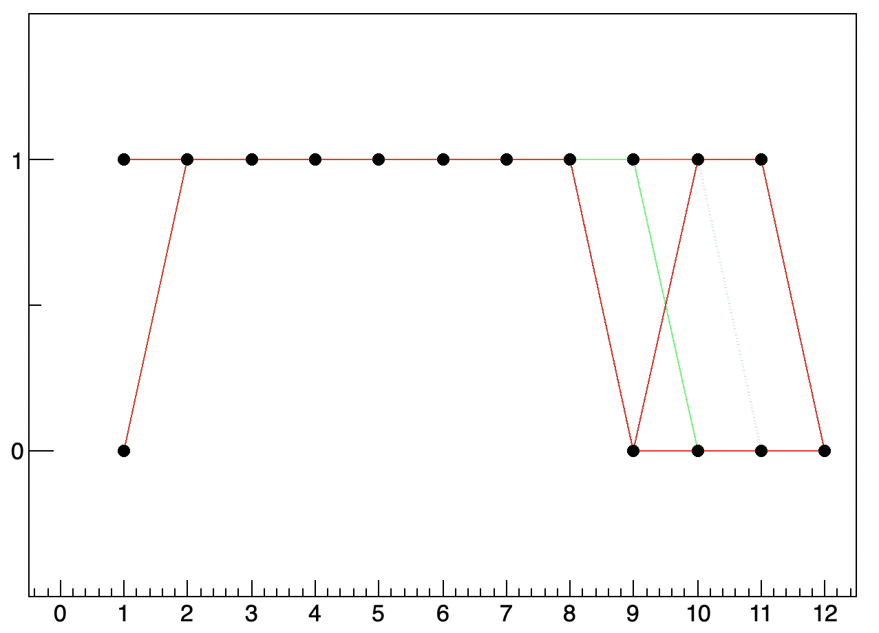
ROC. ROC clocks
64 links
State
Good/bad
Margin
TTC system, TTC signals
In purpose to check the health state of the electronics, we send a test trigger(TTC). In ROC the trigger is recognized by ROC clocks.
There are a few various ROC clocks that differ from each other in their phases.
While setting different ROC phases, we are trying
to make the ROC recognize data correctly and send it back.
The graph displays the status of 64 different links.
The number 1 stands for serviceability, 0 - for malfunctioning of the
ROC phase. 0 means that the ROC phase number * can’t be used for
the exact ROC. The margin is illustrated on the graph as a straight line
from 2 to 8. These various ROC phases can be used for all of the 64 links.
ROC register number
Bit
1
2
3
4
5
6
7
8
Register state
TTC = trigger and timing control signal. It is made specially to check the state of the electronics.
ROC clock
1
0
1
0
1
0
1
0

Slide 6
Strip data analysis
My project is a strip data analysis
Process the data of all strip readout channels;
Generate reference plots to summarize the detector and electronics operational status from 32 sTGC sectors to analyze charge, timing, and hit rate;
Identify the problem(s) through the operation with other parts of the sTGC electronics system(ROC, links).

Slide 7
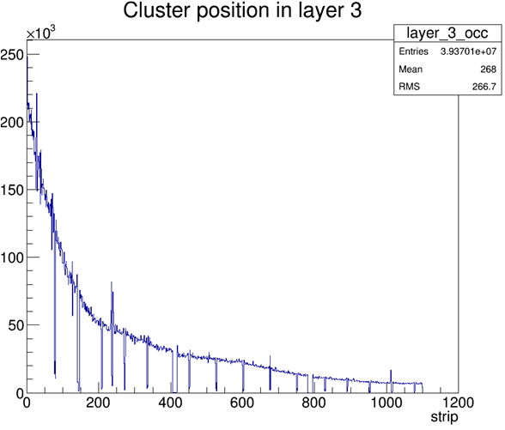
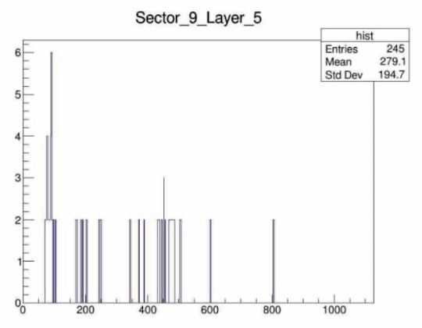
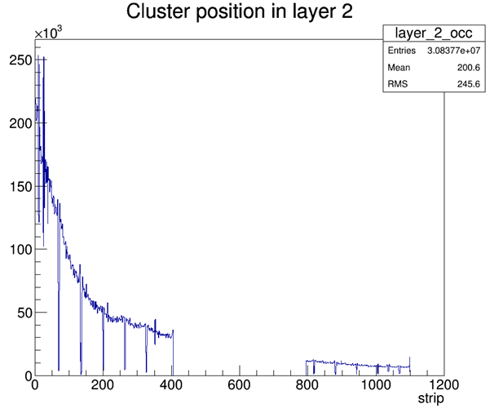
Plotting
What was done and was is expected to be done in future
Some real recent data distribution for
more than 1lb
The number of hits per strip vs. strip channel number
Exponential trend
The data was taken for only one luminosity block and from the early low-intensive run, so the plots represent low statistics.
After excising the analysis, a recent high-statistics data sample will be analyzed.
Sometimes graph shows us some problems with electronics.
In the case, shown on the graph, there is a possibility that the whole front end board is not supplied by high voltage.
However, there are lots of other problems that can occur. In order to prevent taking wrong data, I need to analyze other parts of the electronics.
N,
number
of hits
Strip channel number

Slide 8
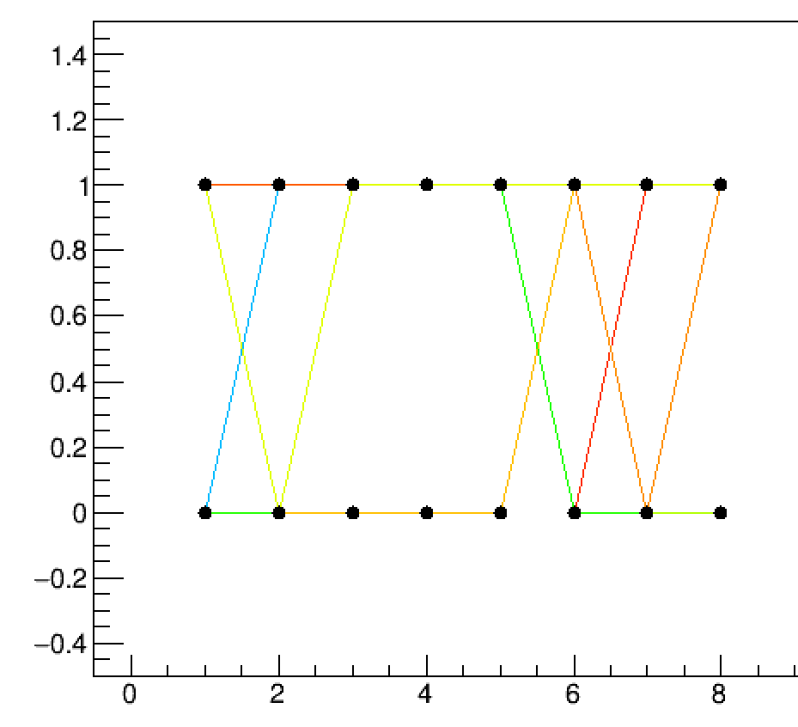
What else do need to be done?
Process other sectors in order to find the general margin. It will help to set up a ROC phase correctly and, as a consequence, continue getting strip data correctly.
Analyze strip hit data with new data from more luminosity blocks (a lot of new data from the previous year is already acceptable).
Analyze strips’ charge and timing.
Health state
Sector 2
ROC phase

Slide 9



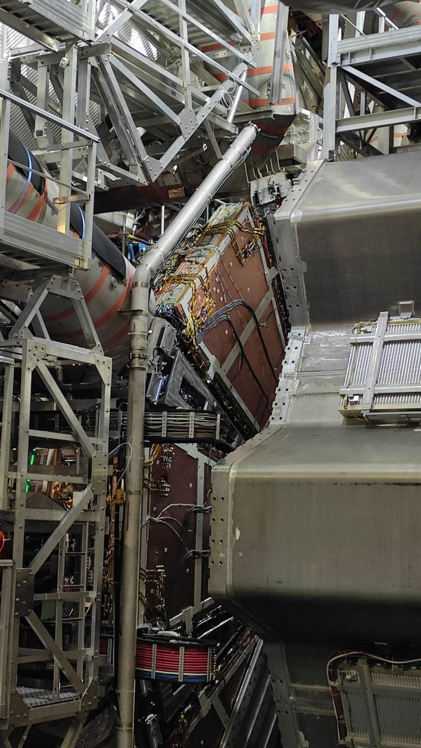




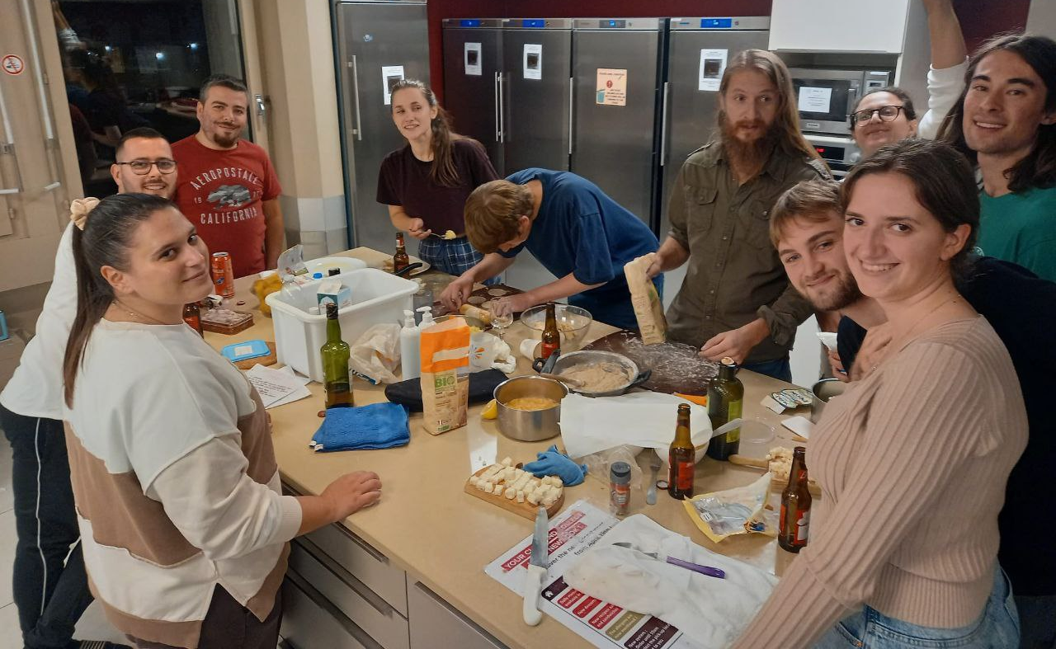
Thank you for attention!
Paris
NSW
Lyon
International dinner

