Slide 1



CMS HGCAL: ADC Driver Using I²C for Hexaboard Sensor Development
Margot Lockwood
André David
December 14th, 2022
M. Lockwood
CMS HGCAL

Slide 2


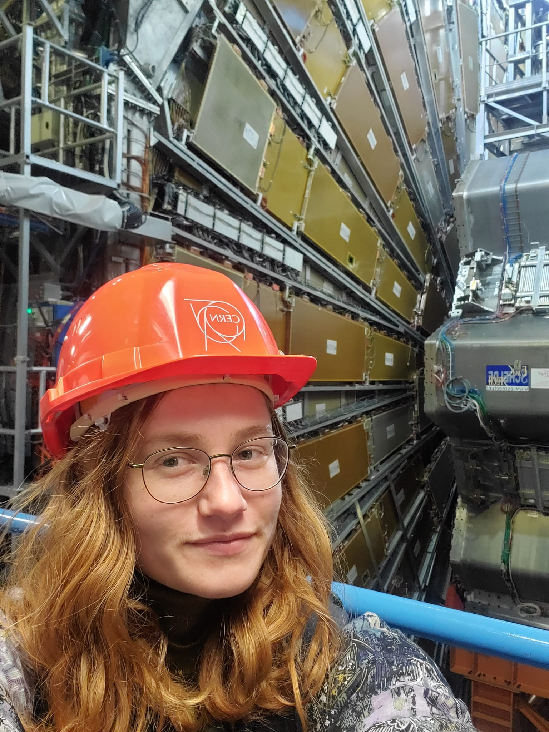

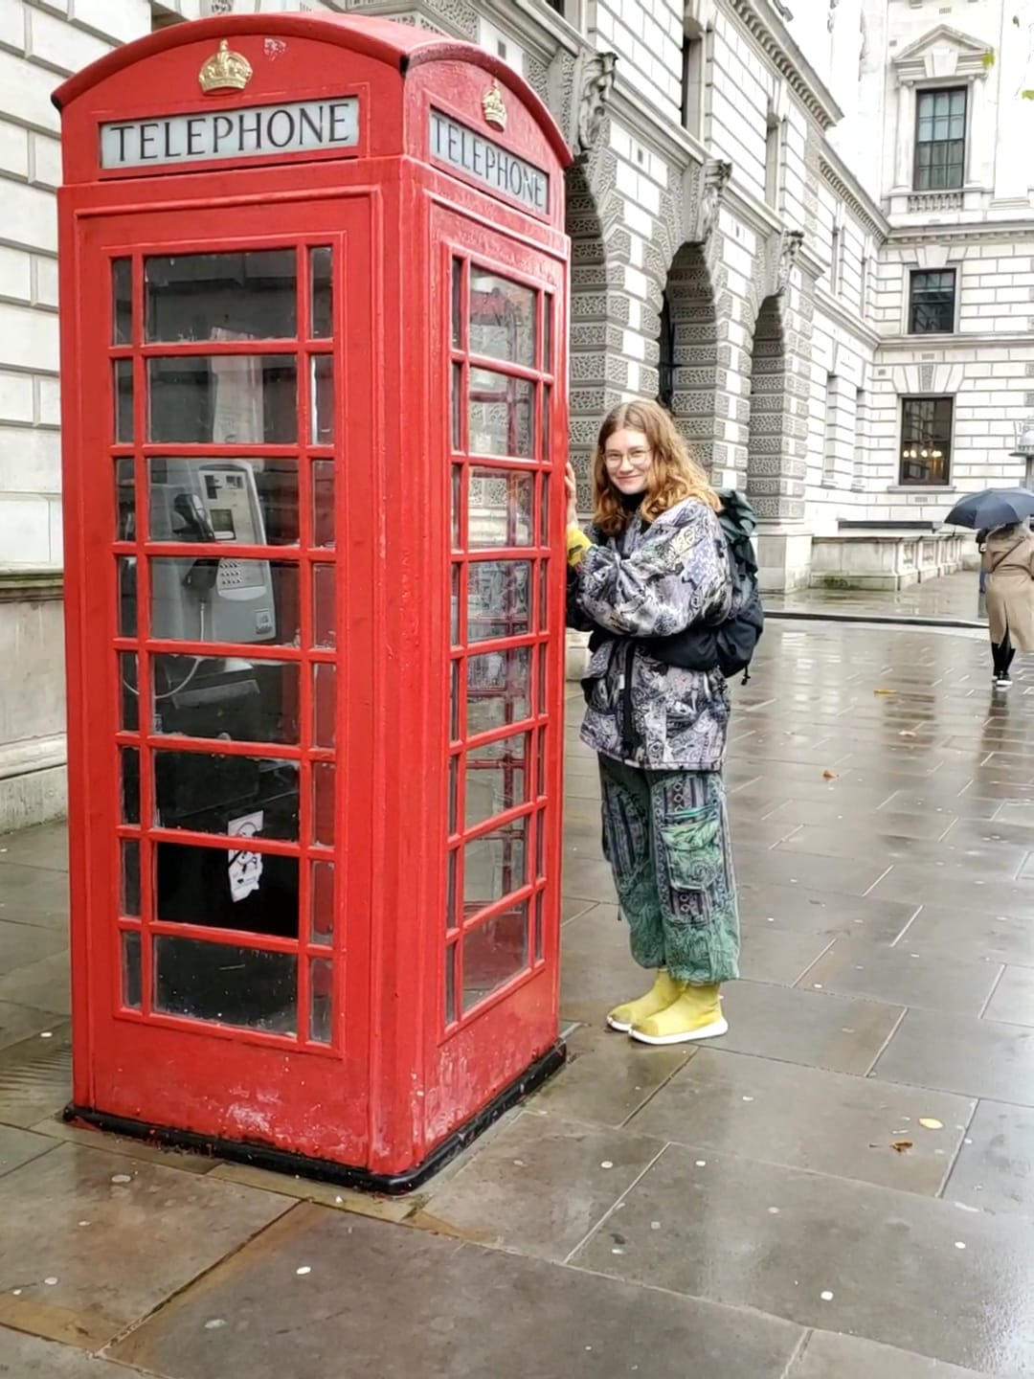
Margot Lockwood
Physics student at the University of Kansas interested in interdisciplinary scientific research in order to study the fundamental nature of the universe and to better the planet through technological advances.
Hobbies: Climbing, Art, Fermentation, Travel

Slide 3

Outline
Background information
  HL-LHC and HGCAL
  Project Goal
  Project Specific Terminology
Project Details
  Chip Overview
  Driver Implementation
  Driver in Action
  What’s Next?
Reflection
M. Lockwood
CMS HGCAL

Slide 4
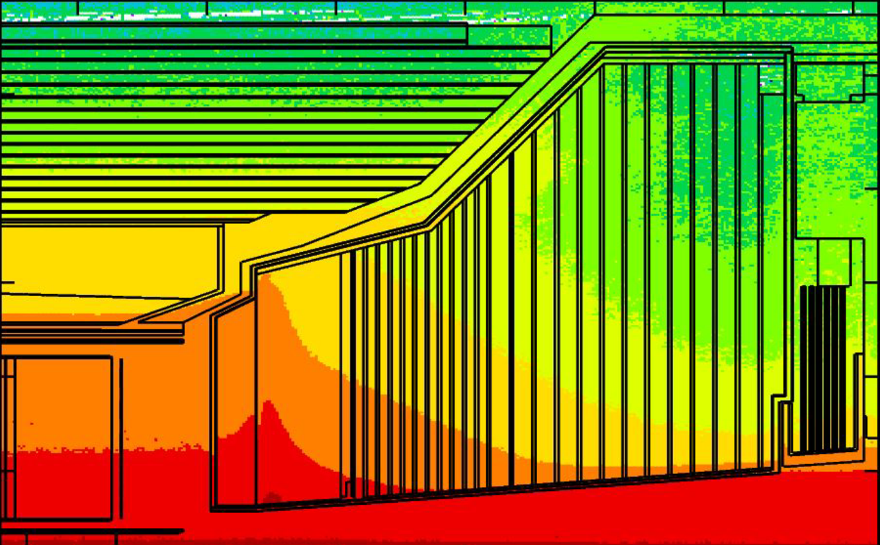
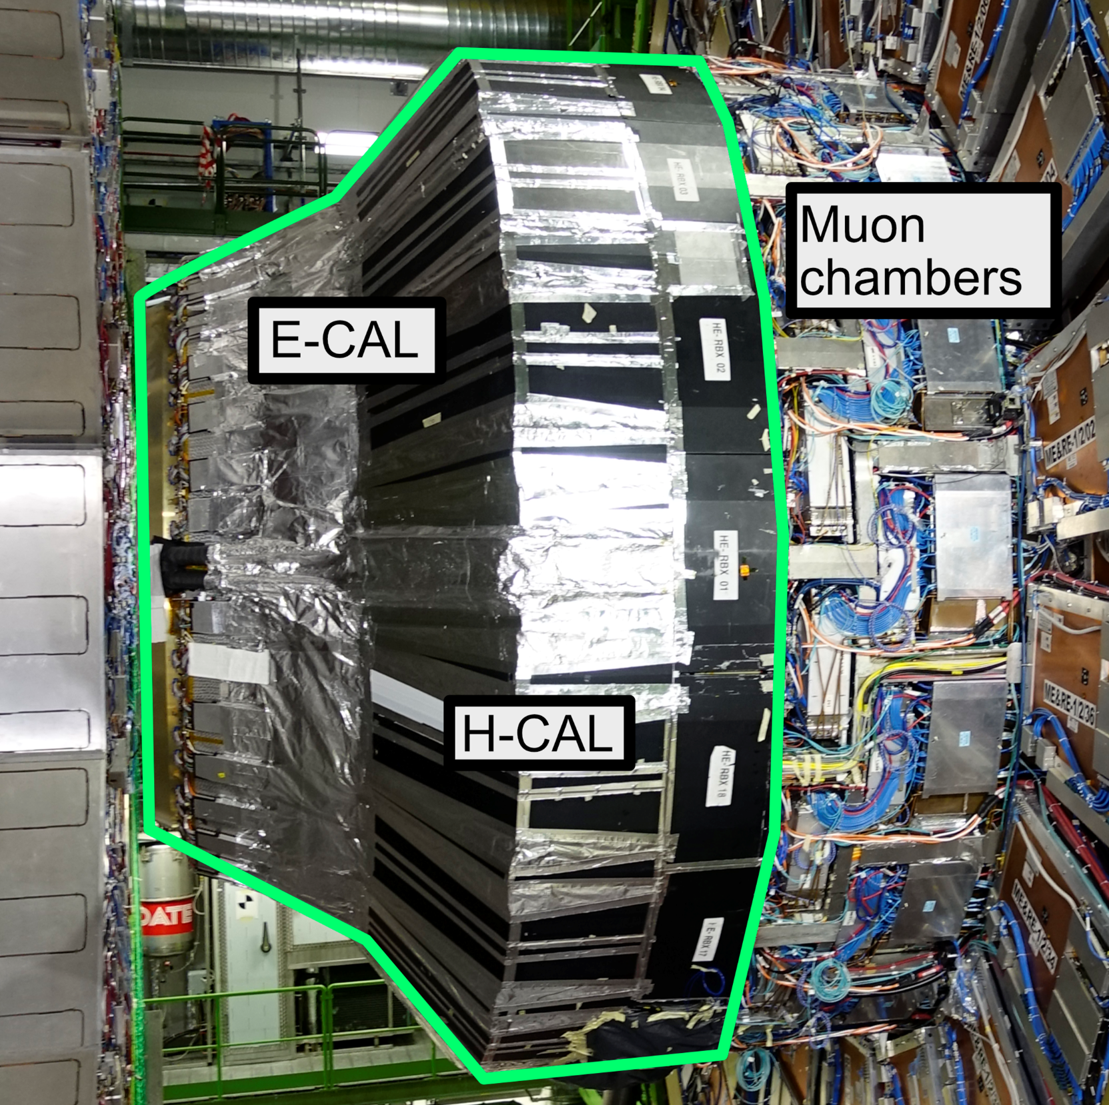
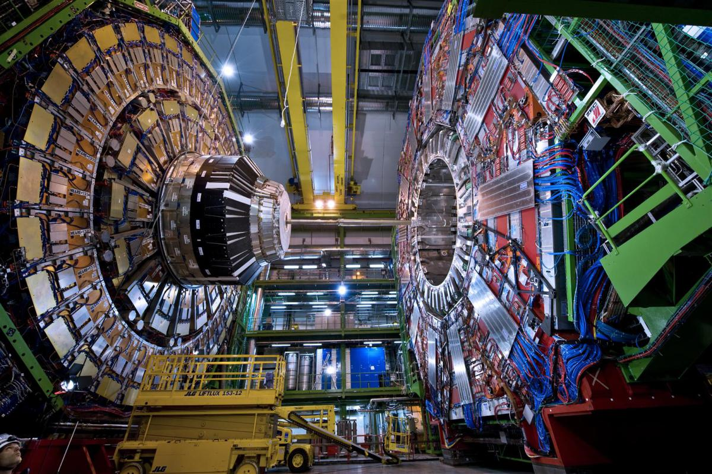
Background: High Granularity Calorimeter (HGCAL) Endcap Upgrade
High Luminosity (HL)-LHC will increase beam density
  2 x 10³⁴ s⁻¹cm⁻² → 5 – 7.5 x 10³⁴ s⁻¹cm⁻²
    More collisions
    More data (rare physics! Better precision)
    More pile-up (40 → 140-200)
HGCAL Upgrade will enhance particle identification, energy resolution, and pile up rejection
  Harsh radiation environment
  High precision spatial, energy, and timing information
  20ps timing precision required
M. Lockwood
CMS HGCAL

Slide 5
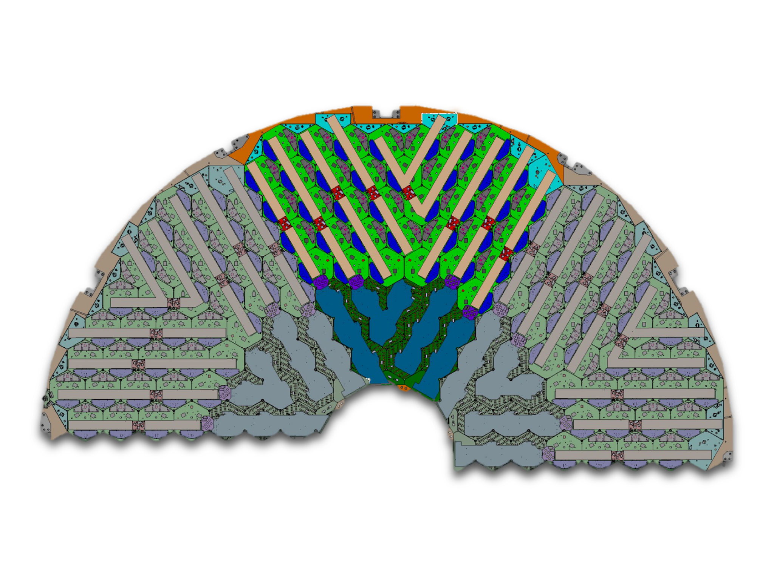

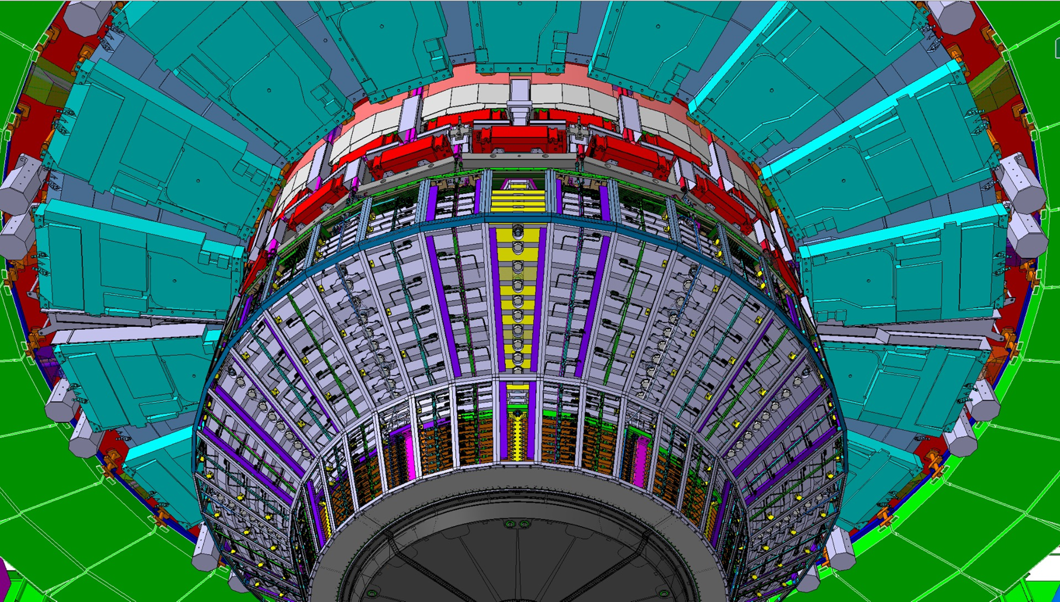
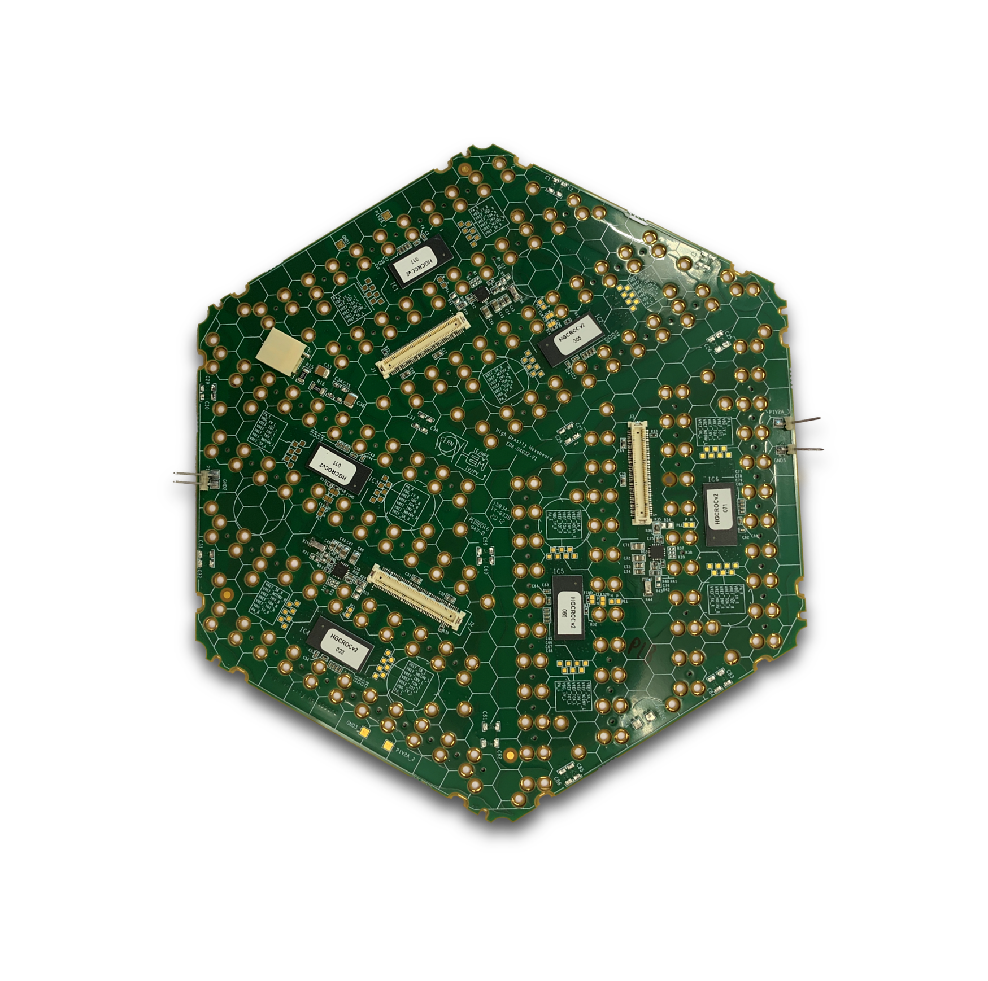
High Granularity Calorimeter (HGCAL) Endcap Upgrade: Electromagnetic Section (CE-E)
To upgrade the EM section of the calorimeter 620 m² of silicon sensors are being installed (26 layers)
M. Lockwood
CMS HGCAL

Slide 6
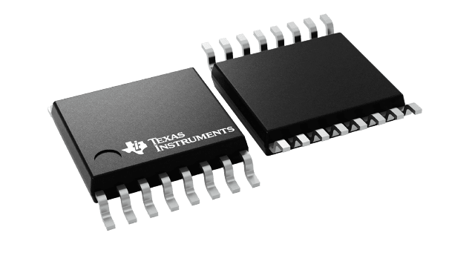
My Project
Create driver to readout voltages on ROC using ADS112C04 chip, an ADC, with I²C protocol
M. Lockwood
CMS HGCAL

Slide 7
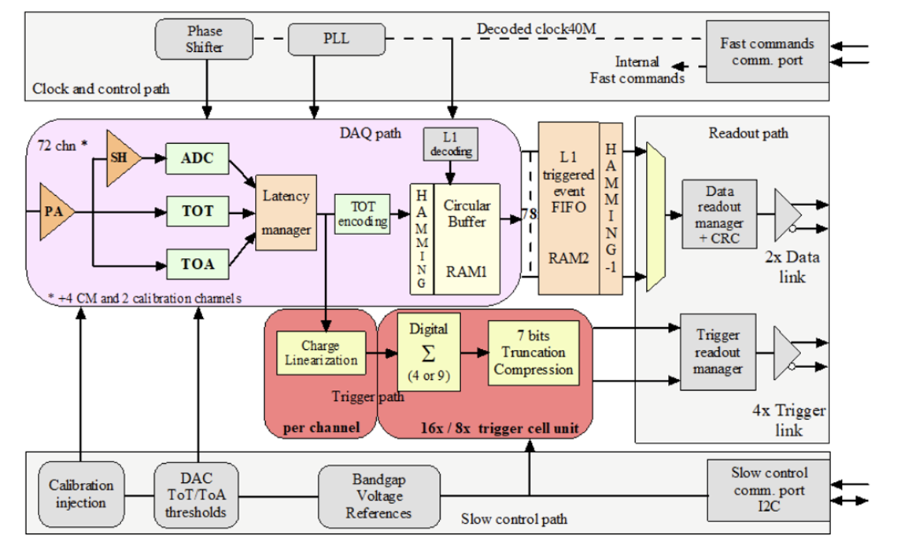
Terminology
ROC- Read Out Chip
Reads data from the silicon sensor
Contributes to trigger system and DAQ system
3-5 ROCS per hexaboard divided into two halves
M. Lockwood
CMS HGCAL

Slide 8
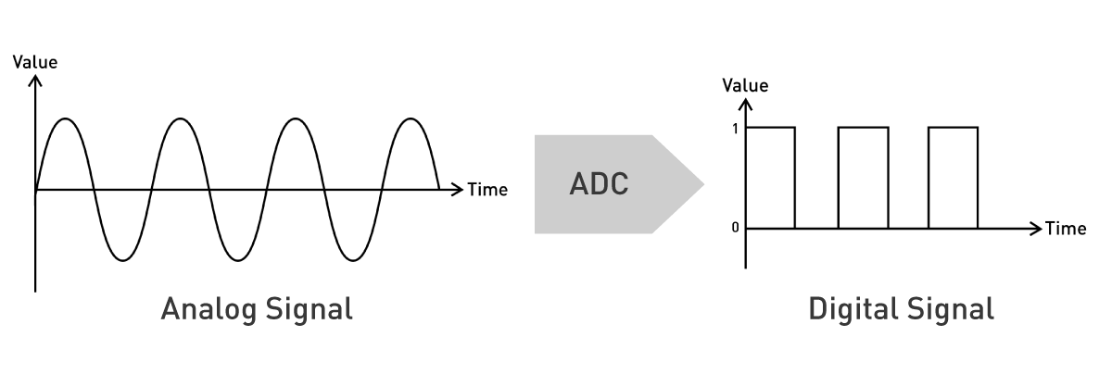
Terminology
Example:
Let 1 LSB=0.03125°C
We can then convert a binary number to a sensible piece of data:
00 0011 0010 0000 → 25°C
For a negative number the far left bit represents sign. We subtract 1 and flip all bits
11 1100 1110 0000 - 1 =
11 1100 1101 1111
flip(11 1100 1101 1111) =
00 0011 0010 0000
Thus, 11 1100 1110 0000 → -25°C
(800 in decimal)
ADC - Analog to Digital Converter
Allows analog sensors (light, sounds, pressure, voltage, ect) to communicate with microcontrollers
M. Lockwood
CMS HGCAL

Slide 9
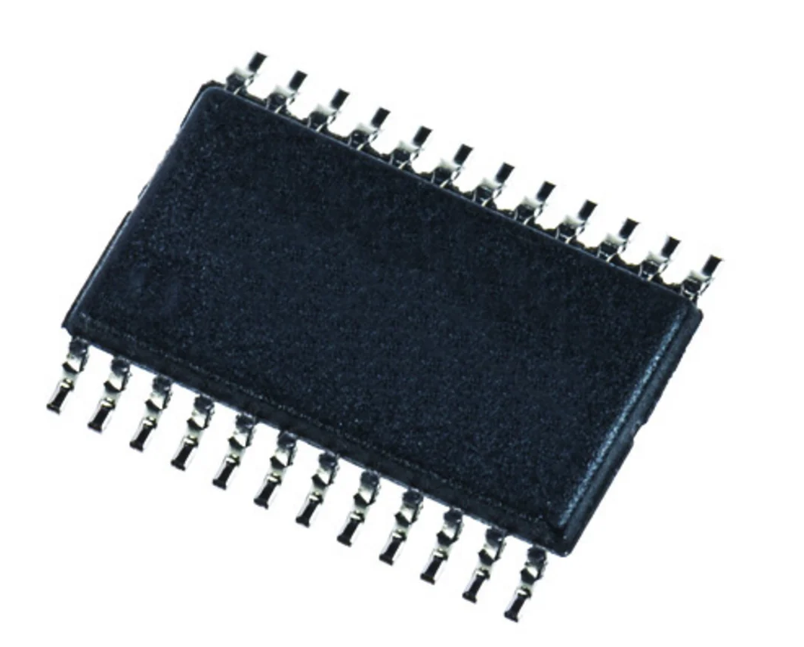
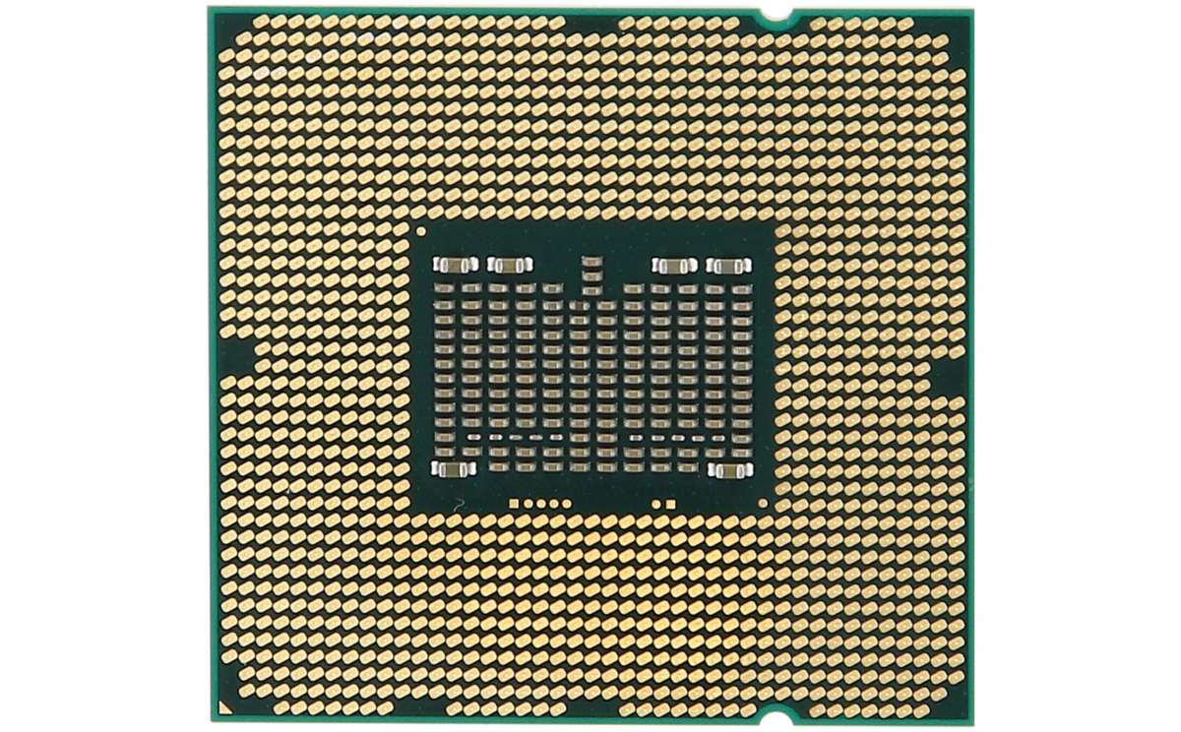
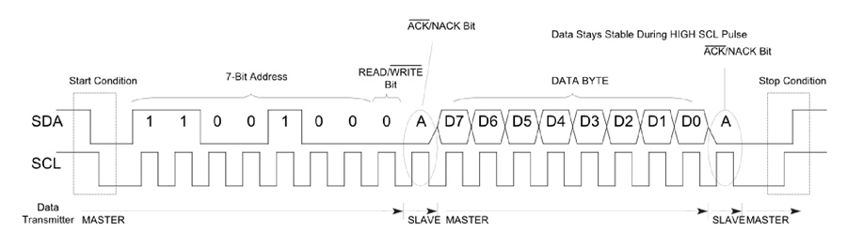
Terminology
Queen
Worker Queen
Worker Queen
Worker
I²C - Inter-Integrated Circuit
Uses two lines (SDA and SCL) for bidirectional communication
Can use System Management Bus (SMBus)
Queen
SDA
SCL
Worker
(similar to DNA translation with start codon [AUG], information, then stop codon [UAA/UAG/UGA])
M. Lockwood
CMS HGCAL

Slide 10
My Project
Create driver to readout voltages on ROC using ADS112C04 chip, an ADC, with I²C protocol
M. Lockwood
CMS HGCAL

Slide 11
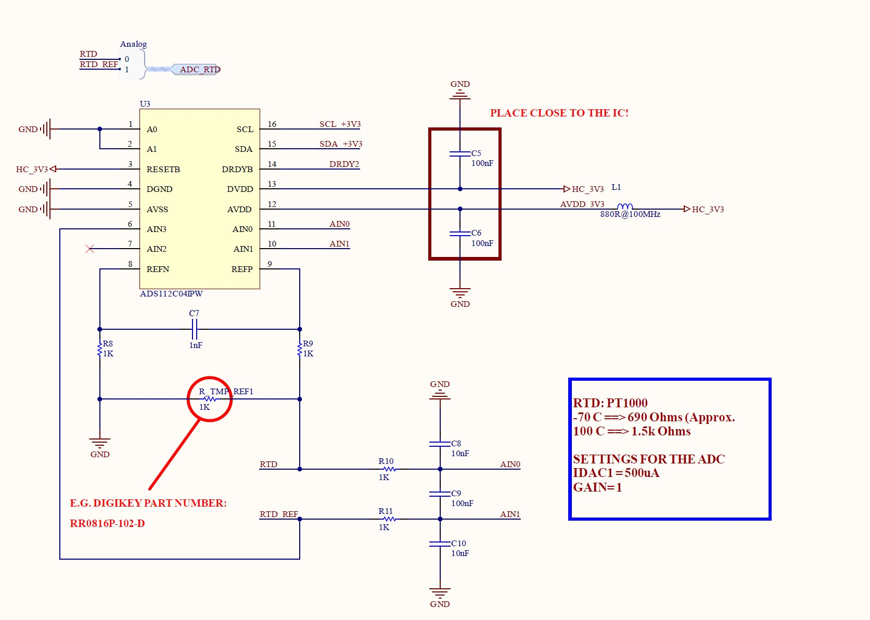
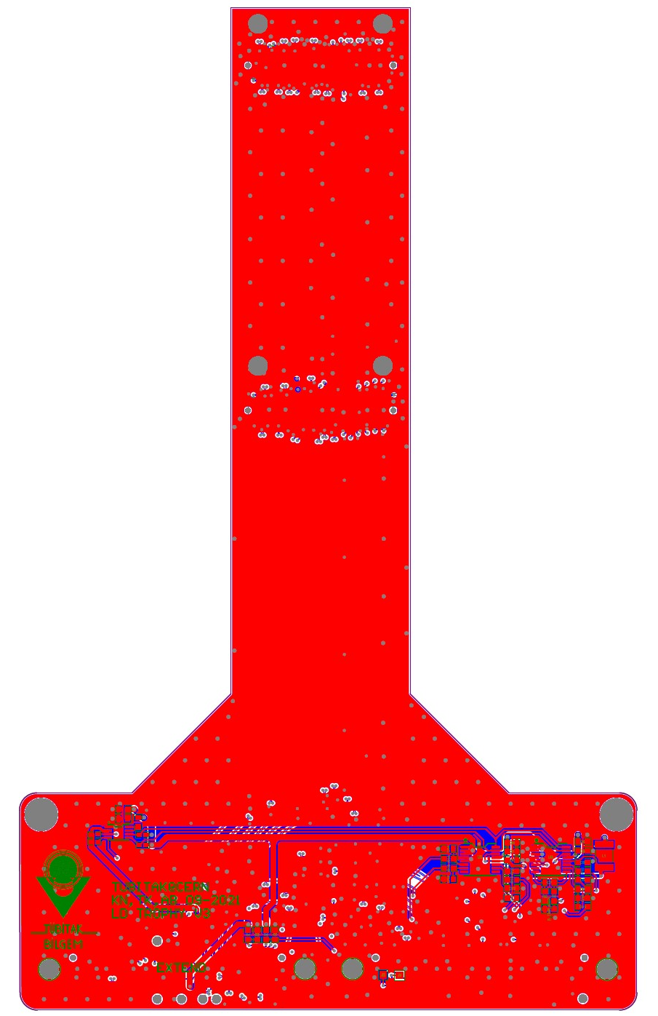
ADS112C04
Uses I²C
ADC converter
Has built in internal temperature sensor
4 registers with various configurations
Can be connected to variable temperature resistor (schematic pictured left)
Can be used to probe dozens of internal voltages on the ROC
  This well help problem solve issues with the silicon sensor
Connected to trophy board (which looks like a trophy I guess?) which is connected to hexaboard
M. Lockwood
CMS HGCAL

Slide 12
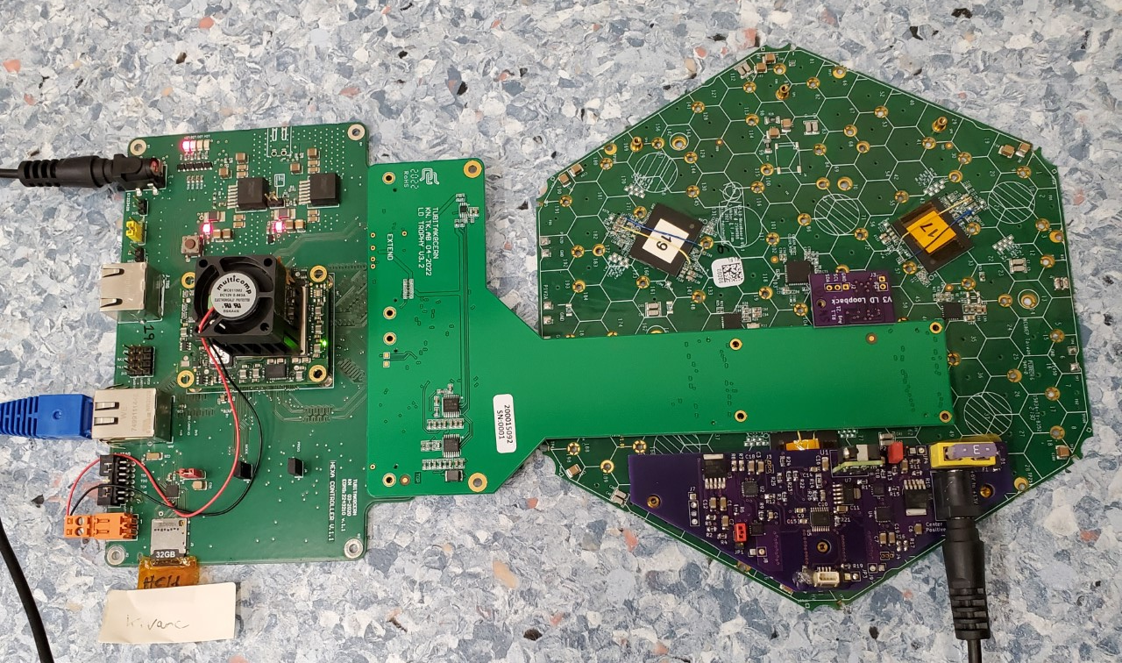
My physical set up: 640257
M. Lockwood
CMS HGCAL

Slide 13
My physical set up: 640257
M. Lockwood
CMS HGCAL

Slide 14
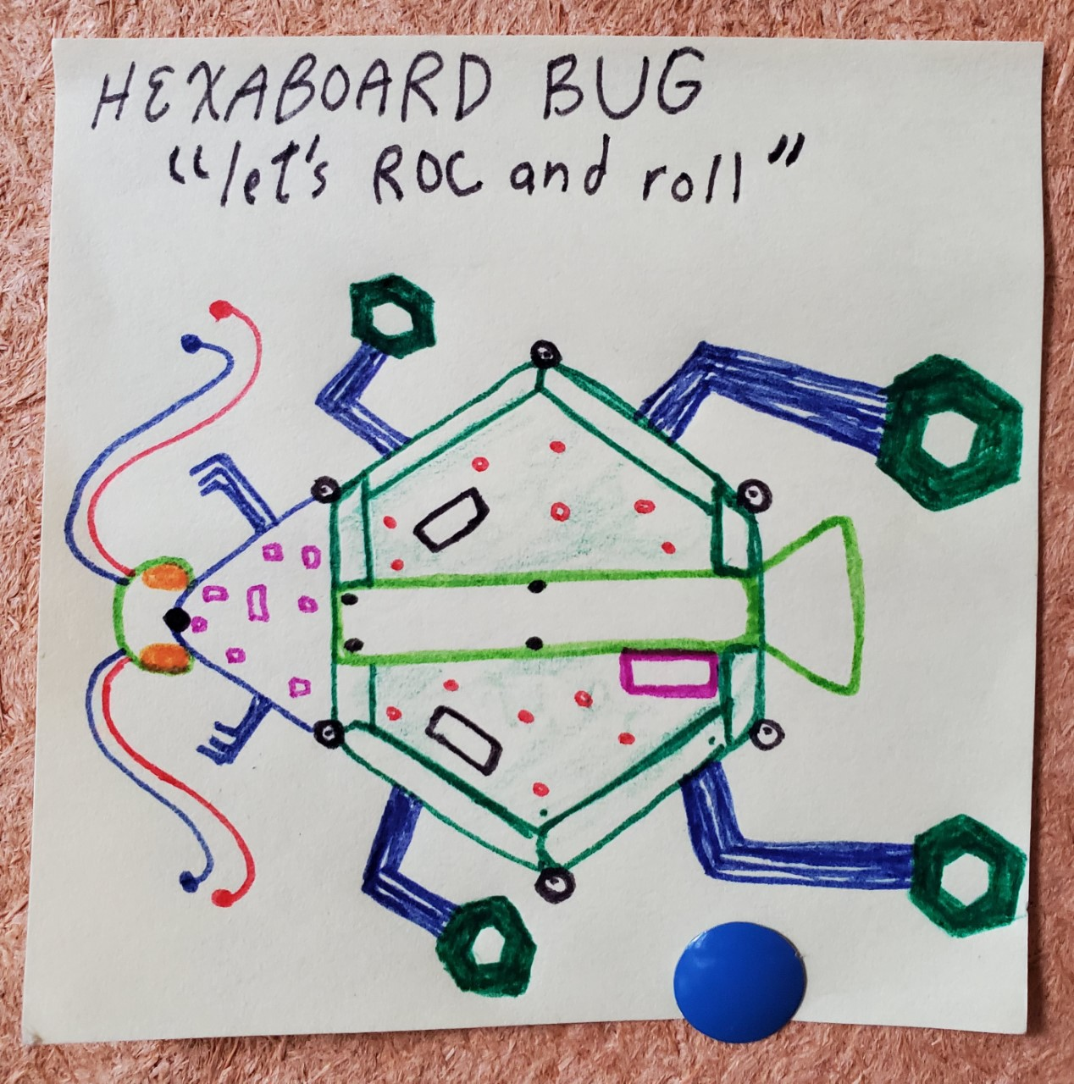
My physical set up: 640257
ROCS
M. Lockwood
CMS HGCAL

Slide 15
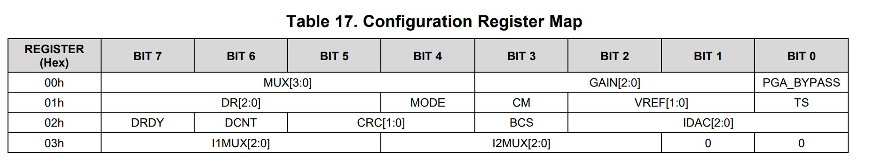
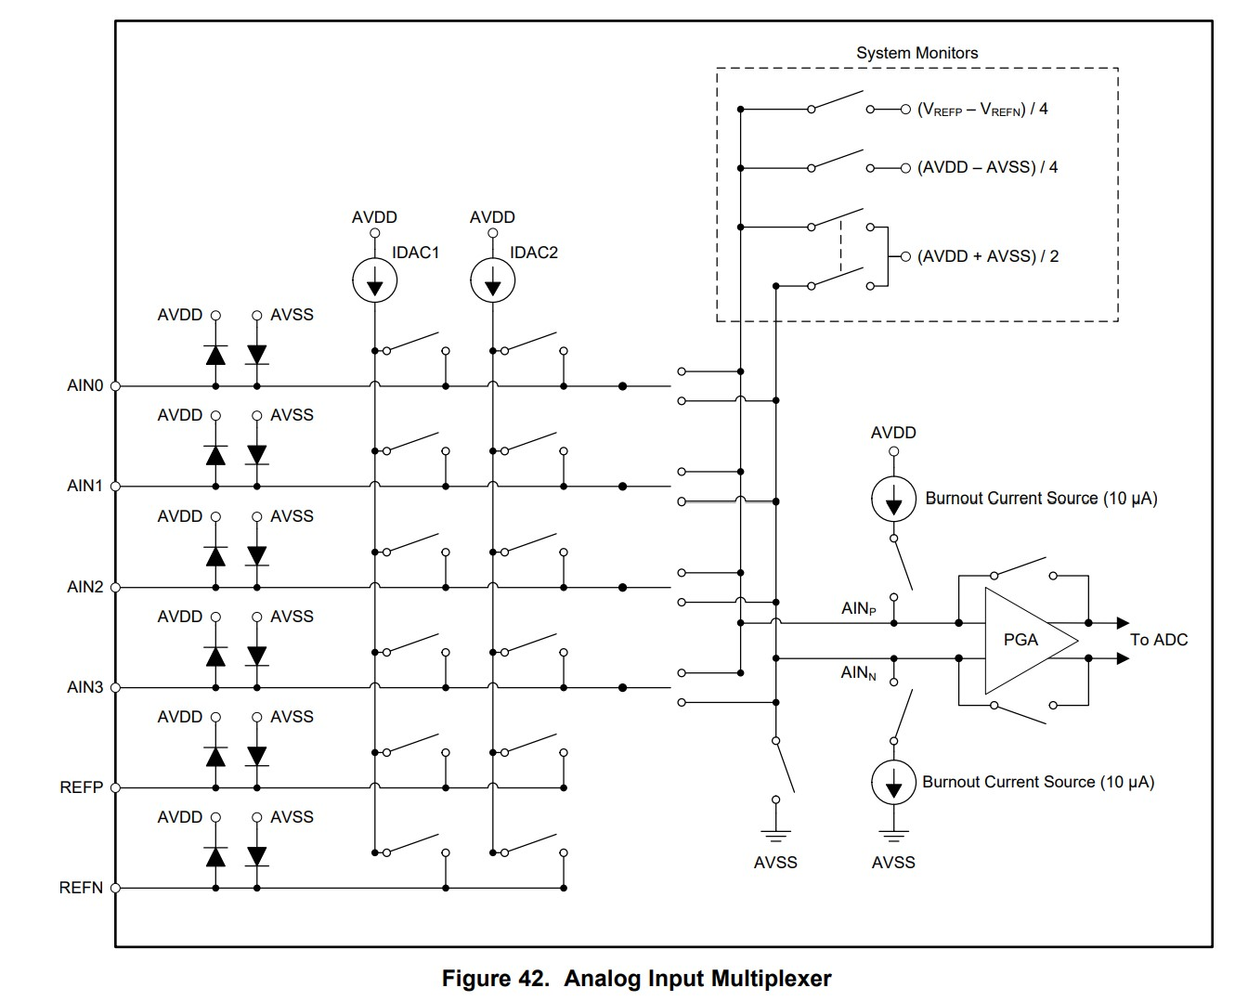
Driver Implementation
trophyADC.py: Object oriented!
  Classes: TrophyADC
    RDT: temperature dependent resistor readings
    ADC1: probing ROC
  Methods
    Configure
    Basic commands
    Reading raw data
    Converting data to voltages or temperatures
    Basic statistics
    Calibration (by shorting PGA to mid supply voltage)
config.yml-----------------------------
checkBus.py: scans I²C Bus for acknowledging addresses with configurable devices
readme.md
Can control data rate, gain, operating mode, reference voltage, current setting, ect.
Register configuration makes physical changes!

Slide 16
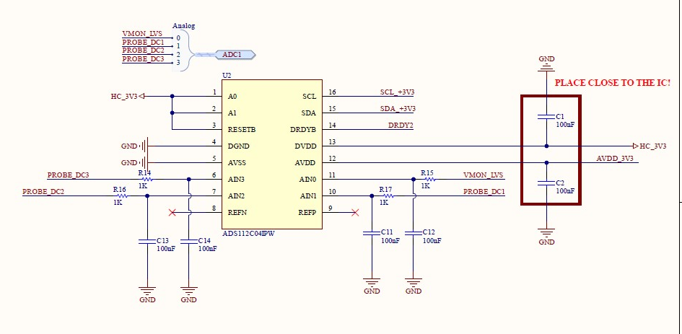
Driver In Action
Currently using my ADC driver: measure noise in coulombs to calibrate ROC
  Translate ROC ADC into ROC DAC injection value
  setting different ROC DAC injection values and and reading voltages (my ADC)
    Reading data from both halves of each of the 3 ROCS for different voltages to make calibration curve

Slide 17
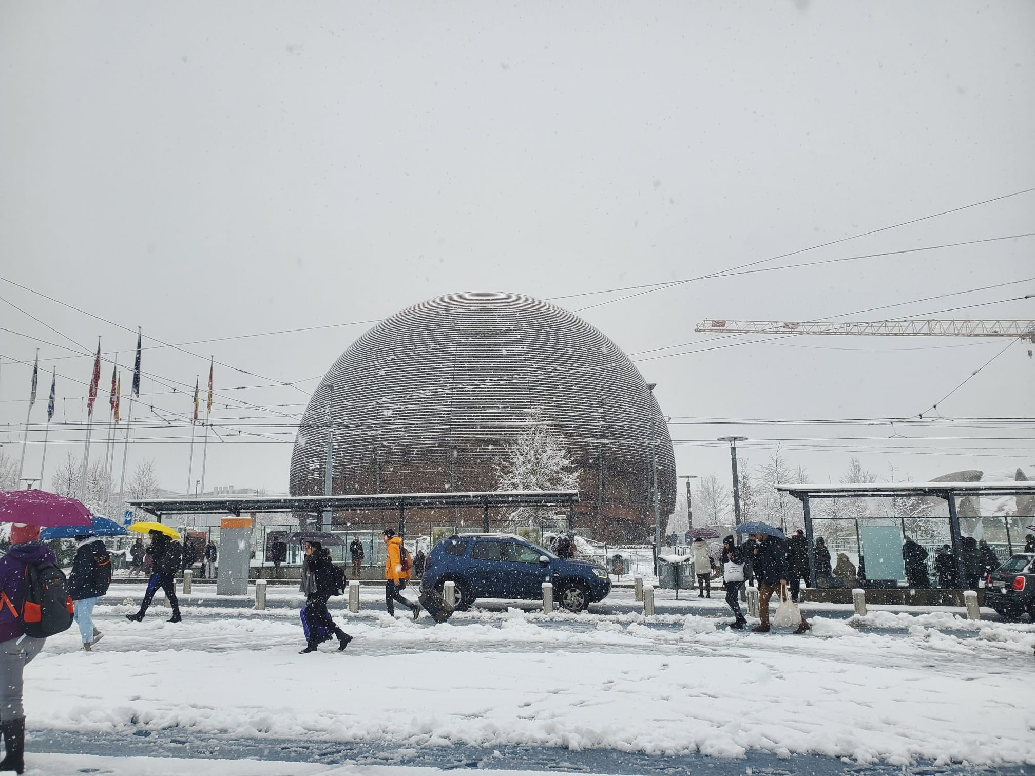
What’s Next?
Use the driver
  Do the data values make sense?
  Modifying other scripts to use my driver
I would love to continue to work on HGCAL
  Make more SWAMP objects
  Remotely in January
  Gradschool?
  Continue work this spring/summer?
M. Lockwood
CMS HGCAL

Slide 18
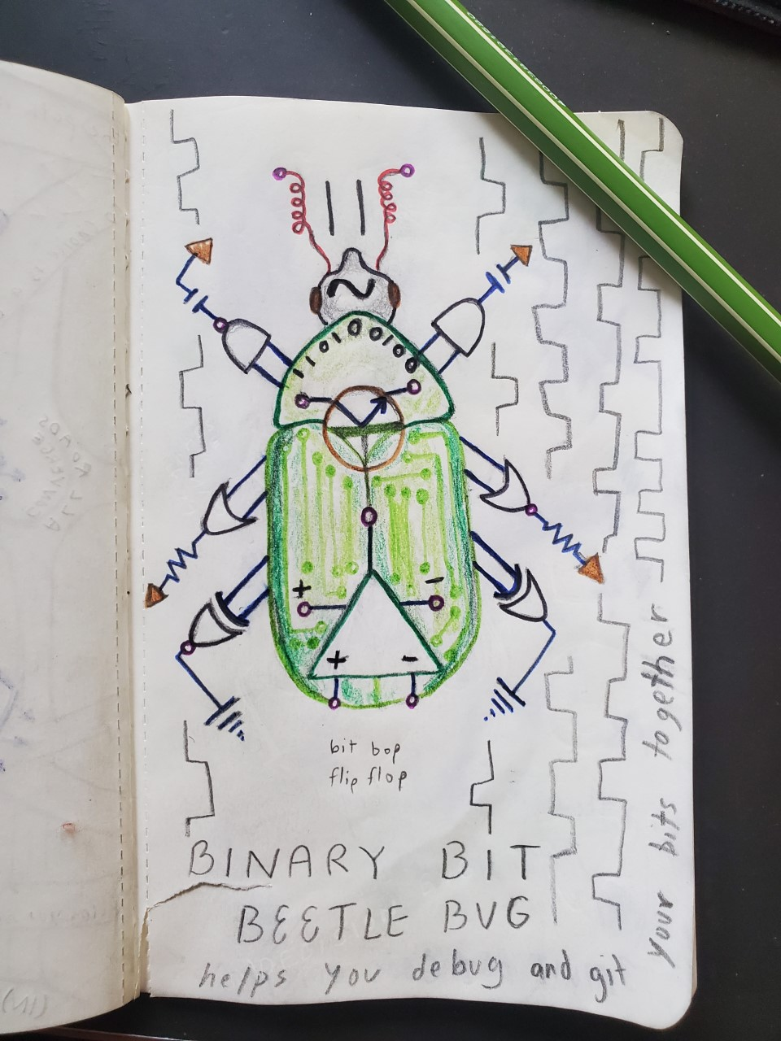
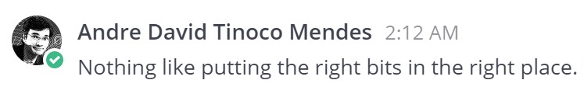
Outtakes
I have learned a lot…
  Programming, detector development, electronic interfacing, cultural exchange
  2 monitors >> 1 monitor
  CERN is the best
  I need to learn another language
  I like cities???

Slide 19
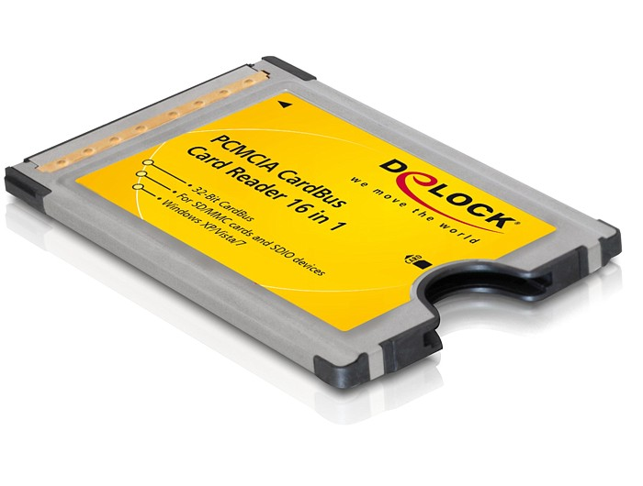
Acronyms and Abbreviations running list…
CERN :)
LHC
CMS
ATLAS
ALICE
HGCAL
HCAL
LUCY
HEP
ToT
ToA
PA
TDC
CM
BX
I²C
SMBus
FPGA
DAQ
ROC / HGCROC
ADC
DAC
L1
PCB
ZYNQ PL
ZYNC PS
FIFO
AXI
SWAMP
TOF
It can be hard to communicate (with computers and people) but communication is important and useful.
Miscommunication (often unknowingly) is common. Successful communication is rewarding.
PCMCIA - People Can't Memorize Computer Industry Acronyms
TRENZ
PS
PL
SDA
SCL
VHDL
ECON
IpGBT
PS (but different than the earlier PS)
SPS
CM
DR
TS
YAML (YAML Ain’t Markup Language) -- A recursive acronym
PGA
SPS (different than earlier SPS…)
IDAC
RTD
PT Resistor
MAD - Material Access Device
RF Cavity
LEIR
LINAC
LEAR
TWA (three word acronym)
???
Personal Computer Memory Card International Association
M. Lockwood
CMS HGCAL
‹#›

Slide 20
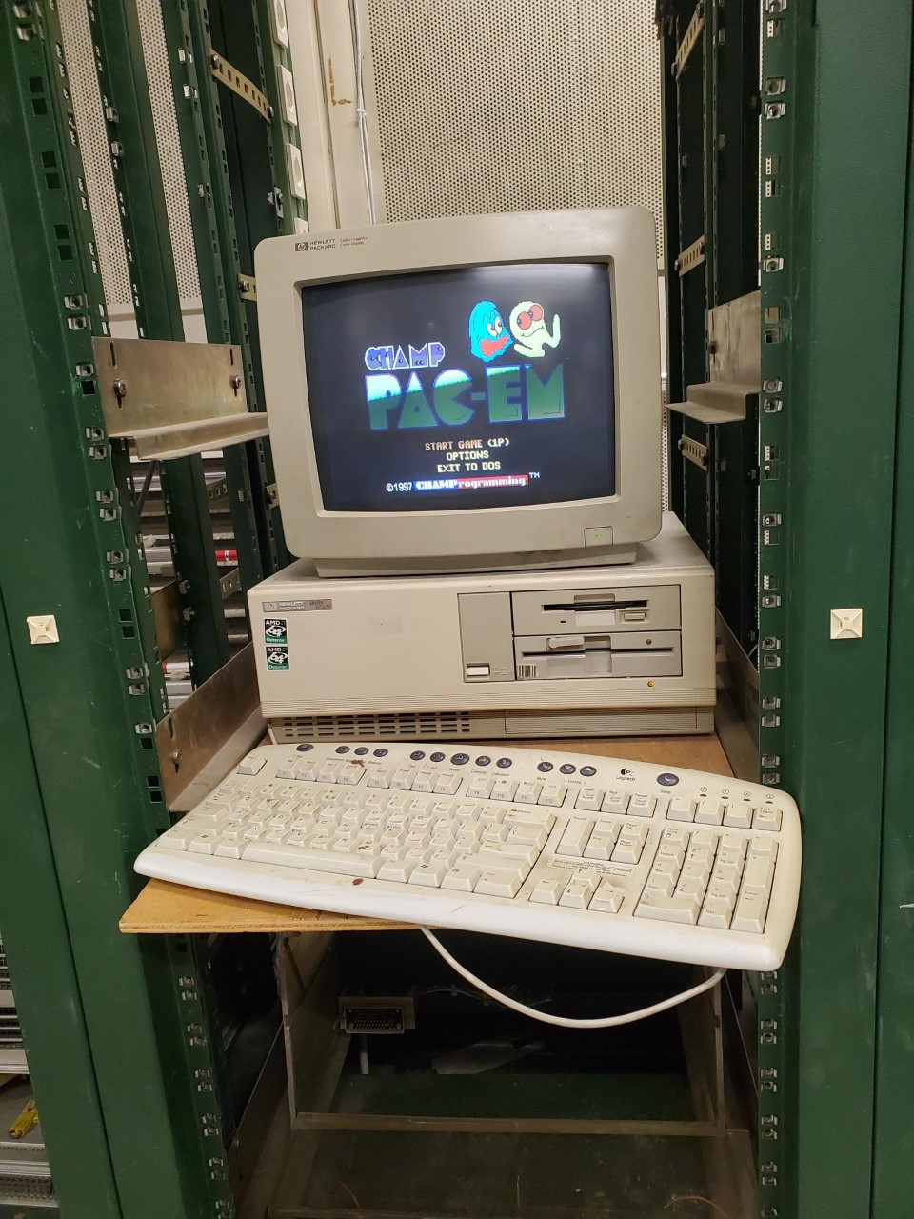
Outtakes
Highlights:
  Beam test
  1st time communicating with my ADC
  Fedor’s excitement seeing a Dyson vacuum
  Orsay and Versailles
  Sparking water on tap at CERN
  Cheese (munster!)
  Andre giving chocolate
  Asking people from different locations “do you have this/ what do you call this” and about stereotypes
  Being excited to work Monday mornings
Travel:
  Chamonix, Lyon, Paris, Barcelona, London, Prague (tomorrow)

Slide 21
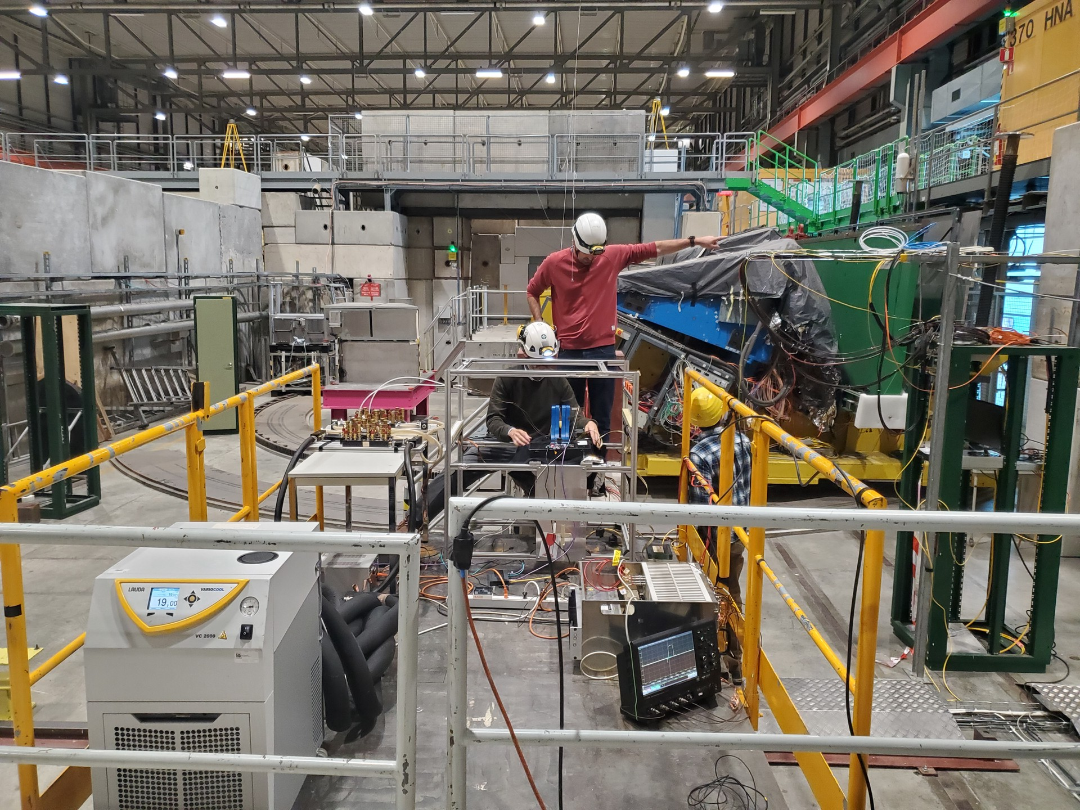
Thank You!
Questions?
Acknowledgments
André David, Arnaud Steen, and the HGCAL CMS team for mentorship and help
Steve and Tom for organizing this experience
US State Department in coordination with University of Michigan for funding this experience
M. Lockwood

Slide 22

Extra slides…
M. Lockwood

Slide 23


Outtakes: Program changes suggestions
Do not go to CERN directly from airport, but wait so we can rest and look alive in our ID photos
More group lectures
Be registered with CMS instead of ATLAS

Slide 24
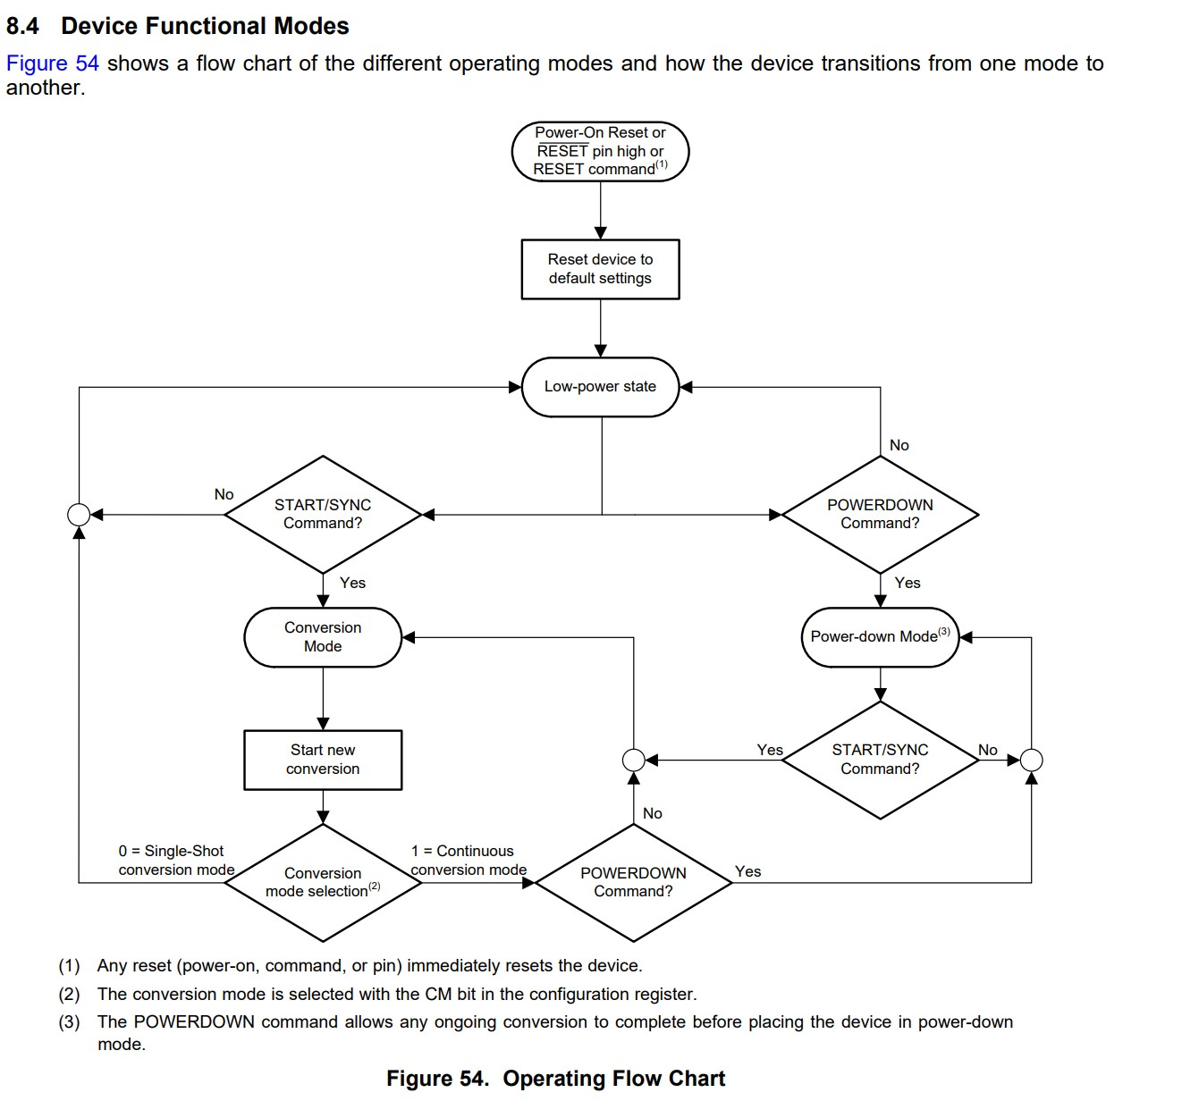
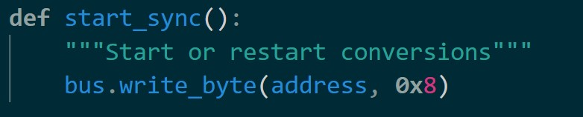
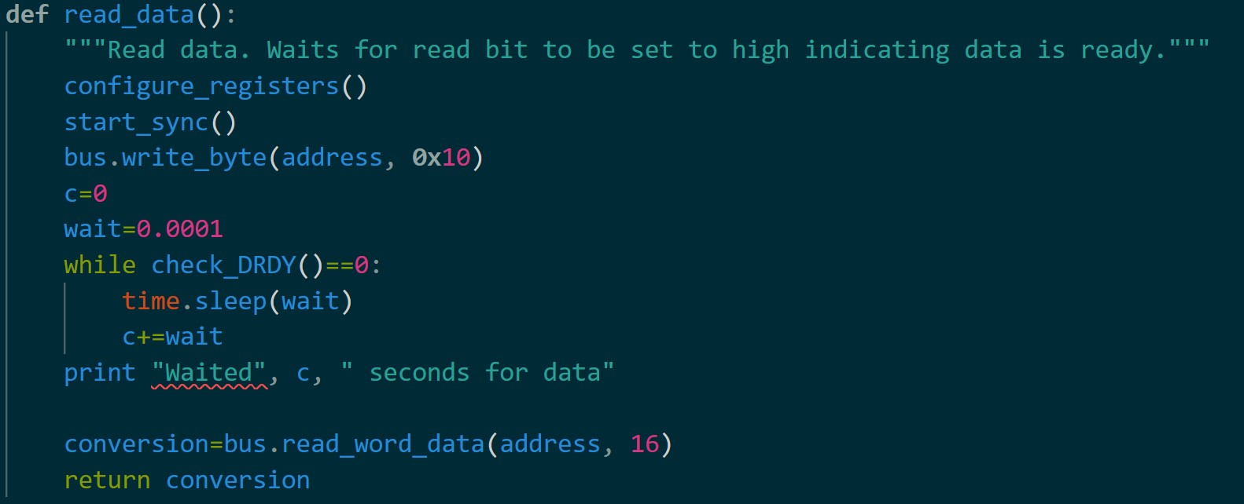
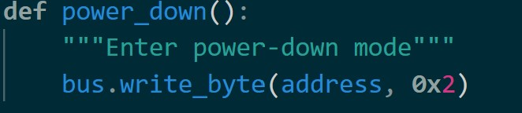
Overview of Device Operation
M. Lockwood
CMS HGCAL

Slide 25
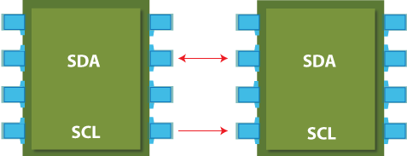
Terminology
Example: °C
1 bit=0.03125°C
00 0011 0010 0000 → 25°C
11 1100 1110 0000 → -25°C
ROC- Read Out Chip
Reads data from the channels of the silicon sensor
Contributes to trigger system and DAQ system
3-5 ROCS per hexaboard divided into two halves
ADC - Analog to Digital Converter
Allows analog sensors (light, sounds, pressure, voltage, ect) to communicate with microcontrollers
I²C - Inter-integrated circuit
uses two bidirectional lines (SDA and SCL)
Queen Worker
M. Lockwood
CMS HGCAL

Slide 26
