Slide 1
Task 10.5:
Nonevaporable getter (NEG) coating under synchrotron radiation (SR)
2nd I.FAST WP10 meeting on 17 Jan 2023
Oleg B. Malyshev (UKRI)
Task 10.5 leader

Slide 2
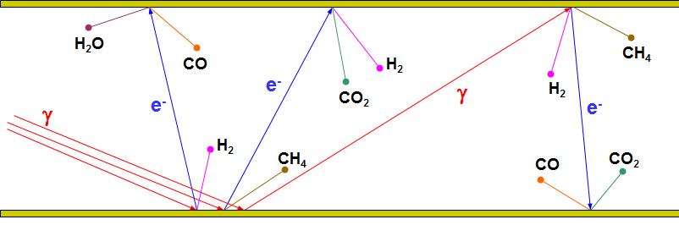
Vacuum in particle accelerators
All particle accelerators need vacuum. The main reason is beam-gas interaction leading to a beam quality degradation:
  Increases beam size (emittance)
  Reduces beam lifetime
  Increases radiation hazard
  Encourages recombination
Photon stimulated desorption (PSD) is one of the most important sources of gas in the presence of synchrotron radiation (SR) or any photons with E > 5-10 eV.
PSD can be considered as a two-step process:
  first, photons with energy > 5-10 eV cause the photoelectron emission,
  then the photoelectron stimulate gas desorption.

Slide 3
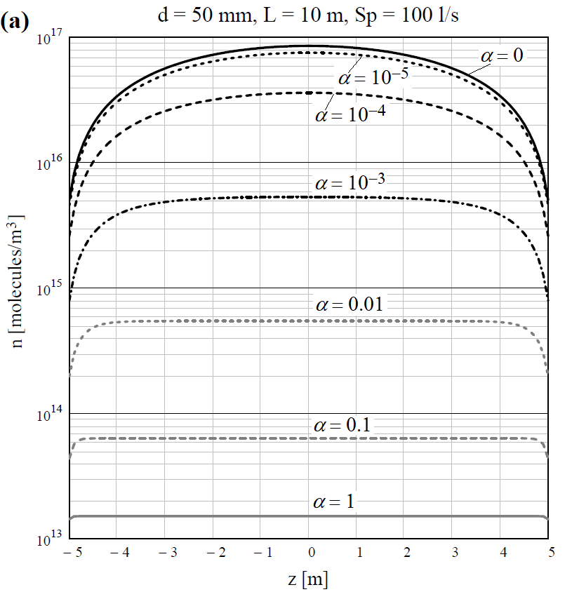
Why a NEG coated chamber required?
To minimise unwanted collisions between accelerated particles and residual gas molecules to a tolerable level, the specified nas density must be met.
1) Effect of distributed pumping
A gas density n as a function of coordinate z for various sticking probabilities α
Efficiency of lump pumps at the ends of vacuum chamber is low for narrow vacuum chambers
2) Average gas density n reduces proportionally with PSD yields, η.
O.B. Malyshev. Vacuum in Particle Accelerators: Modelling, Design and Operation of Beam Vacuum Systems. (2019)

Slide 4
What non-evaporable getter (NEG) coating does?
Reduces gas desorption:
  A pure metal or metal alloy (Ti, Zr, V, Hf, etc.) film 0.5-3-μm thick without contaminants.
  A barrier for molecules from the bulk of vacuum chamber.
Increases distributed pumping speed, S:
  A sorbing surface on whole vacuum chamber surface
  providing a pumping speed of S = α⋅A⋅v/4;
where α – sticking probability, A – surface area, v – mean molecular velocity
Vacuum NEG Bulk
Coating
Main benefits of NEG coating:
Can be activated at low temperature of 150-160 °C
Meeting challenging vacuum specification at UHV or XHV
Lower cost of vacuum system
  Less number of pumps, thus less controllers and cables
  Smaller size of the pumps, thus lower cost per unit
The only solution for narrow vacuum chambers

Slide 5
What is really need for vacuum system design
There are not enough PSD data for various NEG coatings.
  A future machine vacuum deign can't be done properly without these data.
What information have to be obtained:
Experimentally measured PSD yields, η, and sticking probabilities, α, for H₂, CH₄, CO, CO₂ (for modelling future machines)
  for various types of NEG coatings (composition and structure),
  as a function of photon dose,
  as a function of activation temperature and duration,
  as a function of film thickness,
  for shapes similar to vacuum chamber of future machines,
  etc.
Practical knowledge and experience on what happens in case of various operation issues:
  SR induced activation, recovery rate after a vacuum accident,
  SR induced pumping,
  a leak during NEG activation,
  SR beam alignment fluctuation,
  non-uniform temperature during activation: overheated NEG, underheated NEG,
  not uniformly coated and partially coated chambers (a chamber with an antechamber),
  effect of storage in vacuum, in nitrogen, in argon, in air, ...,
  NEG lifetime,
  other questions from machine operation experience.

Slide 6




Task 10.5 objectives
Building facilities for photon stimulated desorption (PSD) yield measurement on beamlines
  at DLS and Soleil
Obtaining and analysing the photon stimulated gas desorption (PSD) experimental data from Non-Evaporable Getter (NEG) coated prototypes under conditions similar to future light sources
  Surface preparation at DESY
  Coating with NEG at UKRI, later at DESY and Soleil
  Pumping property testing of NEG coated samples in all partners labs

Slide 7
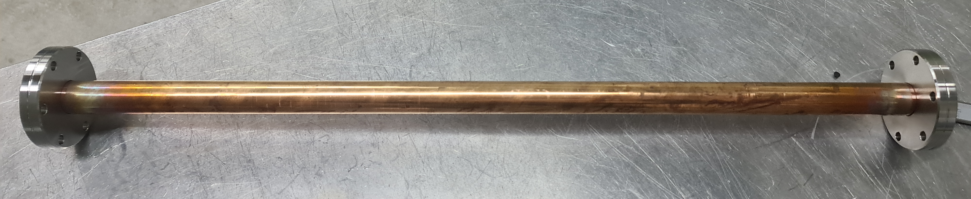
Samples for pumping properties evaluation
It was agreed that a project standard sample for pumping properties evaluation is
  made of OFHC or OFS copper samples
  ID = 20 mm
  L = 500 mm
  equipped with two CF40 flanges
Courtesy of L. Lilje and R. Sirvinskaite (DESY)

Slide 8
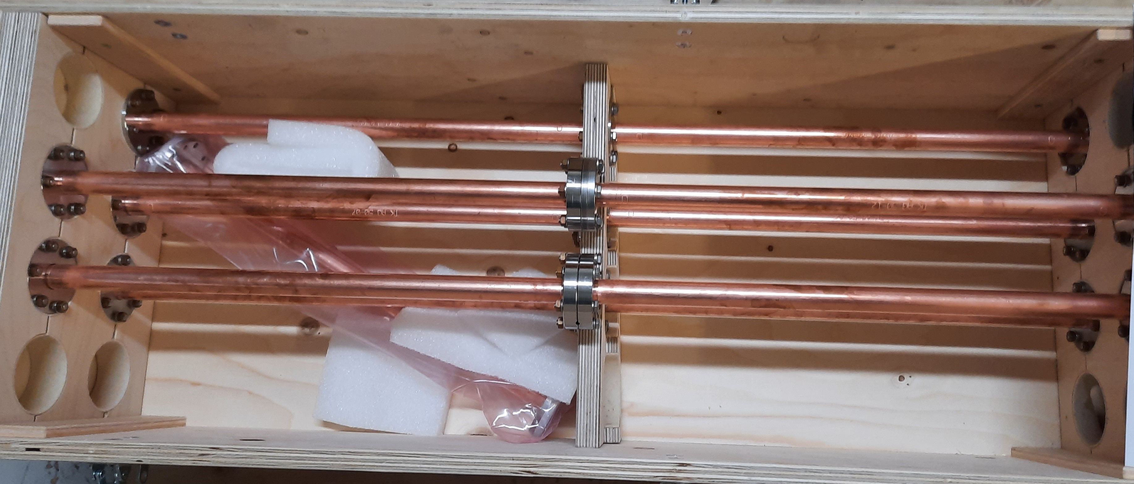
Samples for pumping properties evaluation
It was agreed that a project standard sample for pumping properties evaluation is
  made of OFHC or OFS copper samples
  ID = 20 mm
  L = 500 mm
  equipped with two CF40 flanges
11 samples have been provided by DESY in March 2022.
3 samples were used for comparison of cleaning/etching procedures
  After arriving the samples to the UKRI
  an inner surfaces of the samples found to have some black coverage. It was found that this is a silver oxide.
  Thermal outgassing was a factor 2-3 higher than a reference sample cleaned at UKRU
  The cause of this was found and the DESY cleaning procedure has been changed to address this issue.
8 identical samples will be
  coated at UKRI
  then tested in 4 labs for comparing (cross-verifying) the results obtained on different facilities

Slide 9
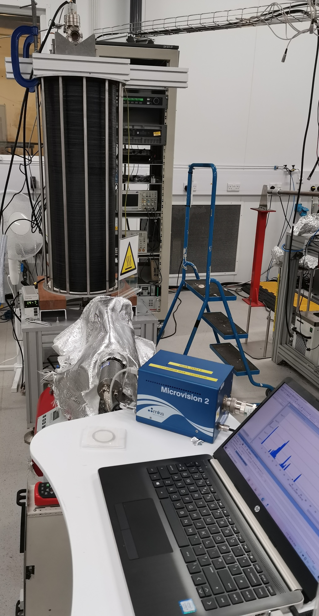
NEG deposition facility at UKRI (Daresbury Laboratory)
The updated facility is used for a routine coating of tubes with
  a length of 0.5 - 1 m
  Inner diameter 5-100 mm
  CF16-CF150 flanges
Presently a final testing coating is ongoing on a tube with ID = 20 mm and L = 1 m then for PSD a standard PSD sample will be coated with NEG

Slide 10
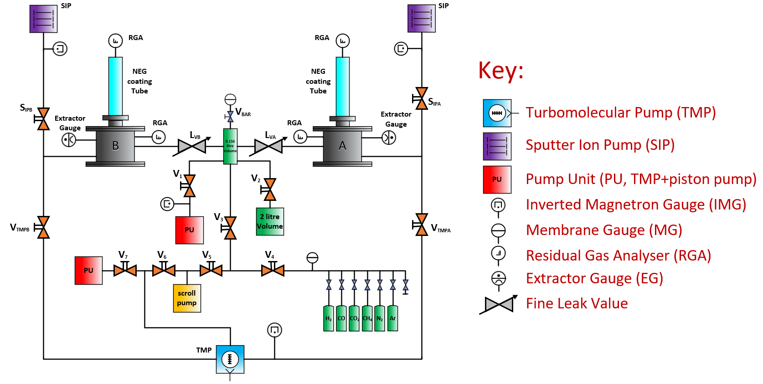
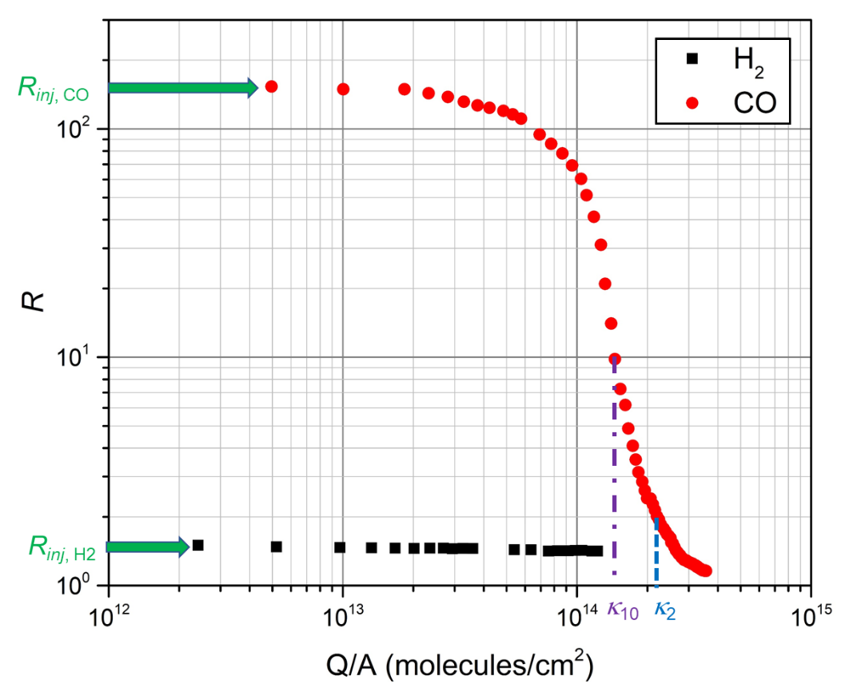
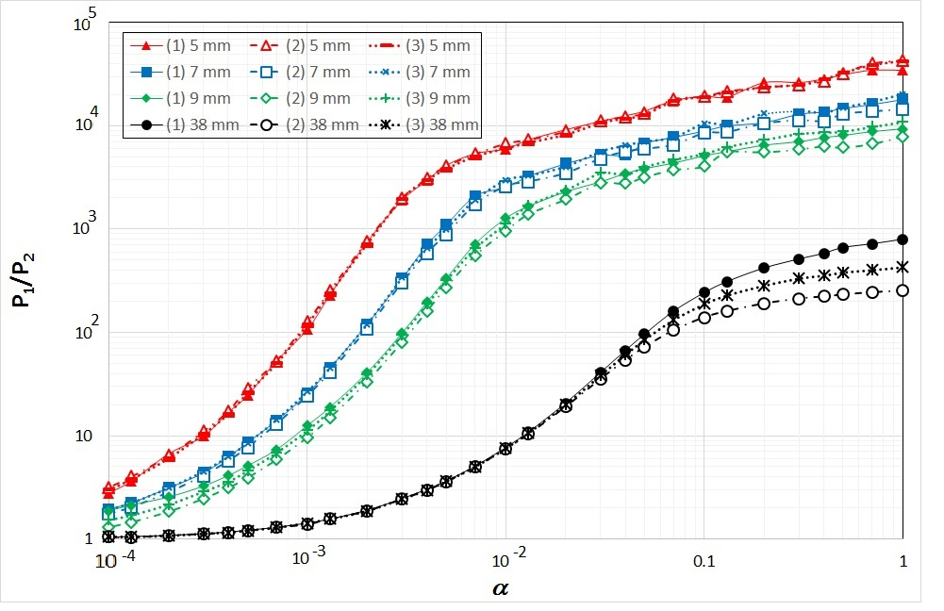
Facilities for pumping properties evaluation at UKRI (DL)
The pumping properties evaluation facilities are used for a routine measurements of initial sticking probability α and sorption capacity κ.
Up to 4 samples can be tested at the same time.
Pressure ratio R = P_{bot}/P_{top} as a function of
sticking probability α obtained with TPMC modelling
Typical result:
R = P_{bot}/P_{top}

Slide 11
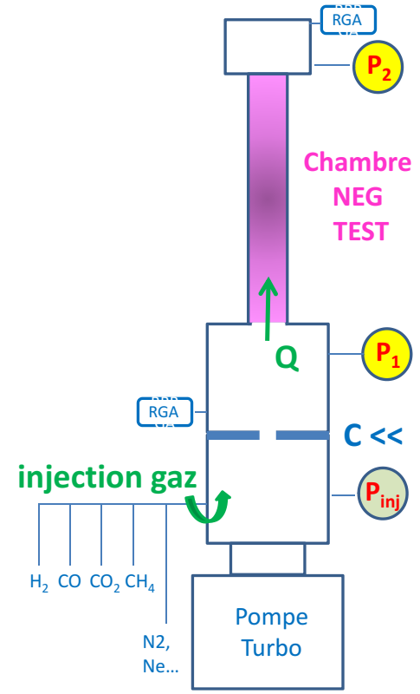

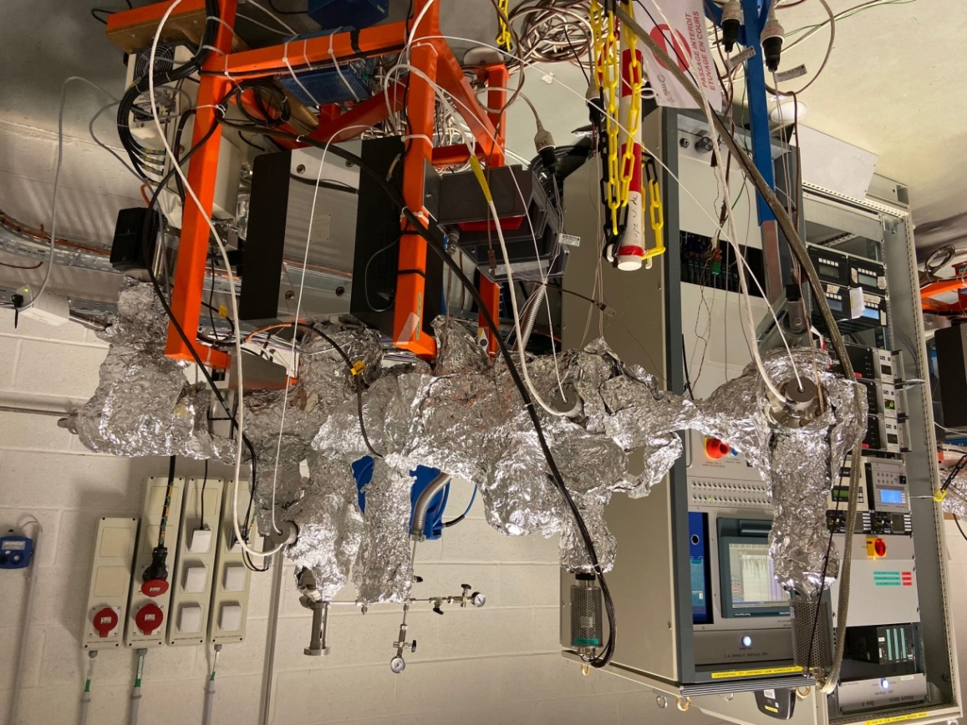

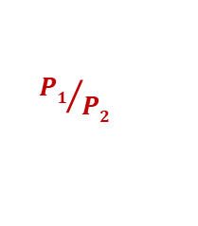
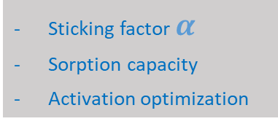
Facilities for pumping properties evaluation at Soleil
@ Vacuum LAB
2 Transmission Method Test Benches for NEG coating characterization
Sticking factor $α$
Sorption capacity
Activation optimization
Gas inlet
P_{inj}
P. Costa Pinto, P. Chiggiato, A. Sapountzis, T. Sinkovits, M. Taborelli, CERN
80th IUVSTA Workshop, NSRRC, Hsinchu, Taiwan (2016)
C <<
Turbo
P₂
P₁
Courtesy of C. Herbeaux (Soleil)
Facility is in operation and it is ready for IFAST Task 10.5 samples
2 samples has been coated at UKRI and sent to Soleil
Transmission Method
${P1}/{P2}$
is calibrated with MOLFLOW+ to find $α$

Slide 12
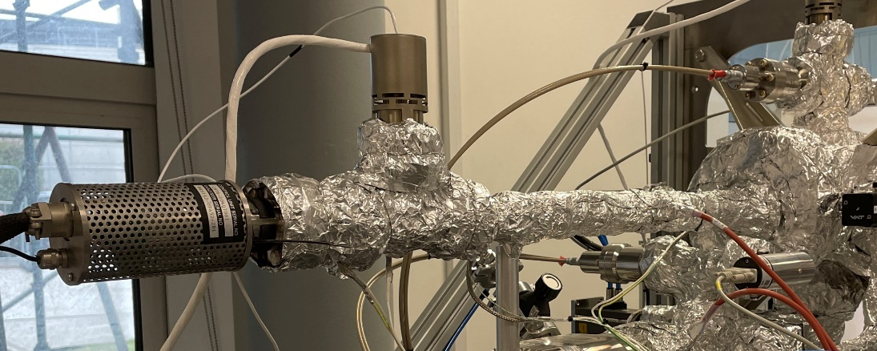
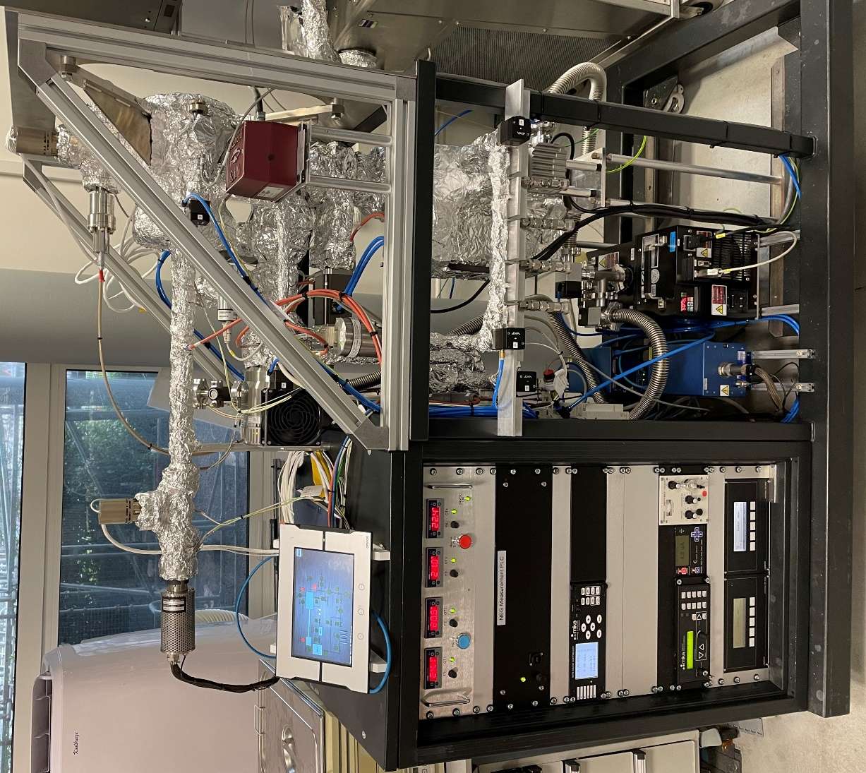
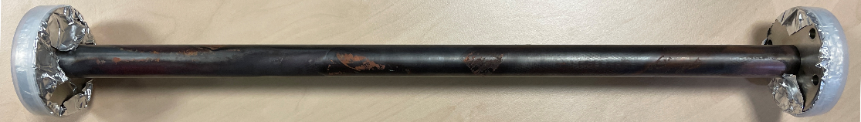
Facility for pumping properties evaluation at DSL
Pumping speed measurement system completed and ready for operational testing:
RGA-based or extractor gauge pressure ratio method to estimate sticking probability
Pumping provided by a 300 l/s TMP and a 150 l/s SIP
Gas injection through dedicated system based on expansion volumes
Four gases (H₂, CO, CO₂, CH₄) let through regulated leak valve, expected operating pressures up to 10⁻⁵ mbar
System to be controlled by PLC
Status:
First coated (Zr) test vessel supplied by Daresbury Laboratories (UKRI, UK)
System currently in commissioning (to be ready for samples by summer 2023)
Courtesy of C. Burrows (DSL)

Slide 13
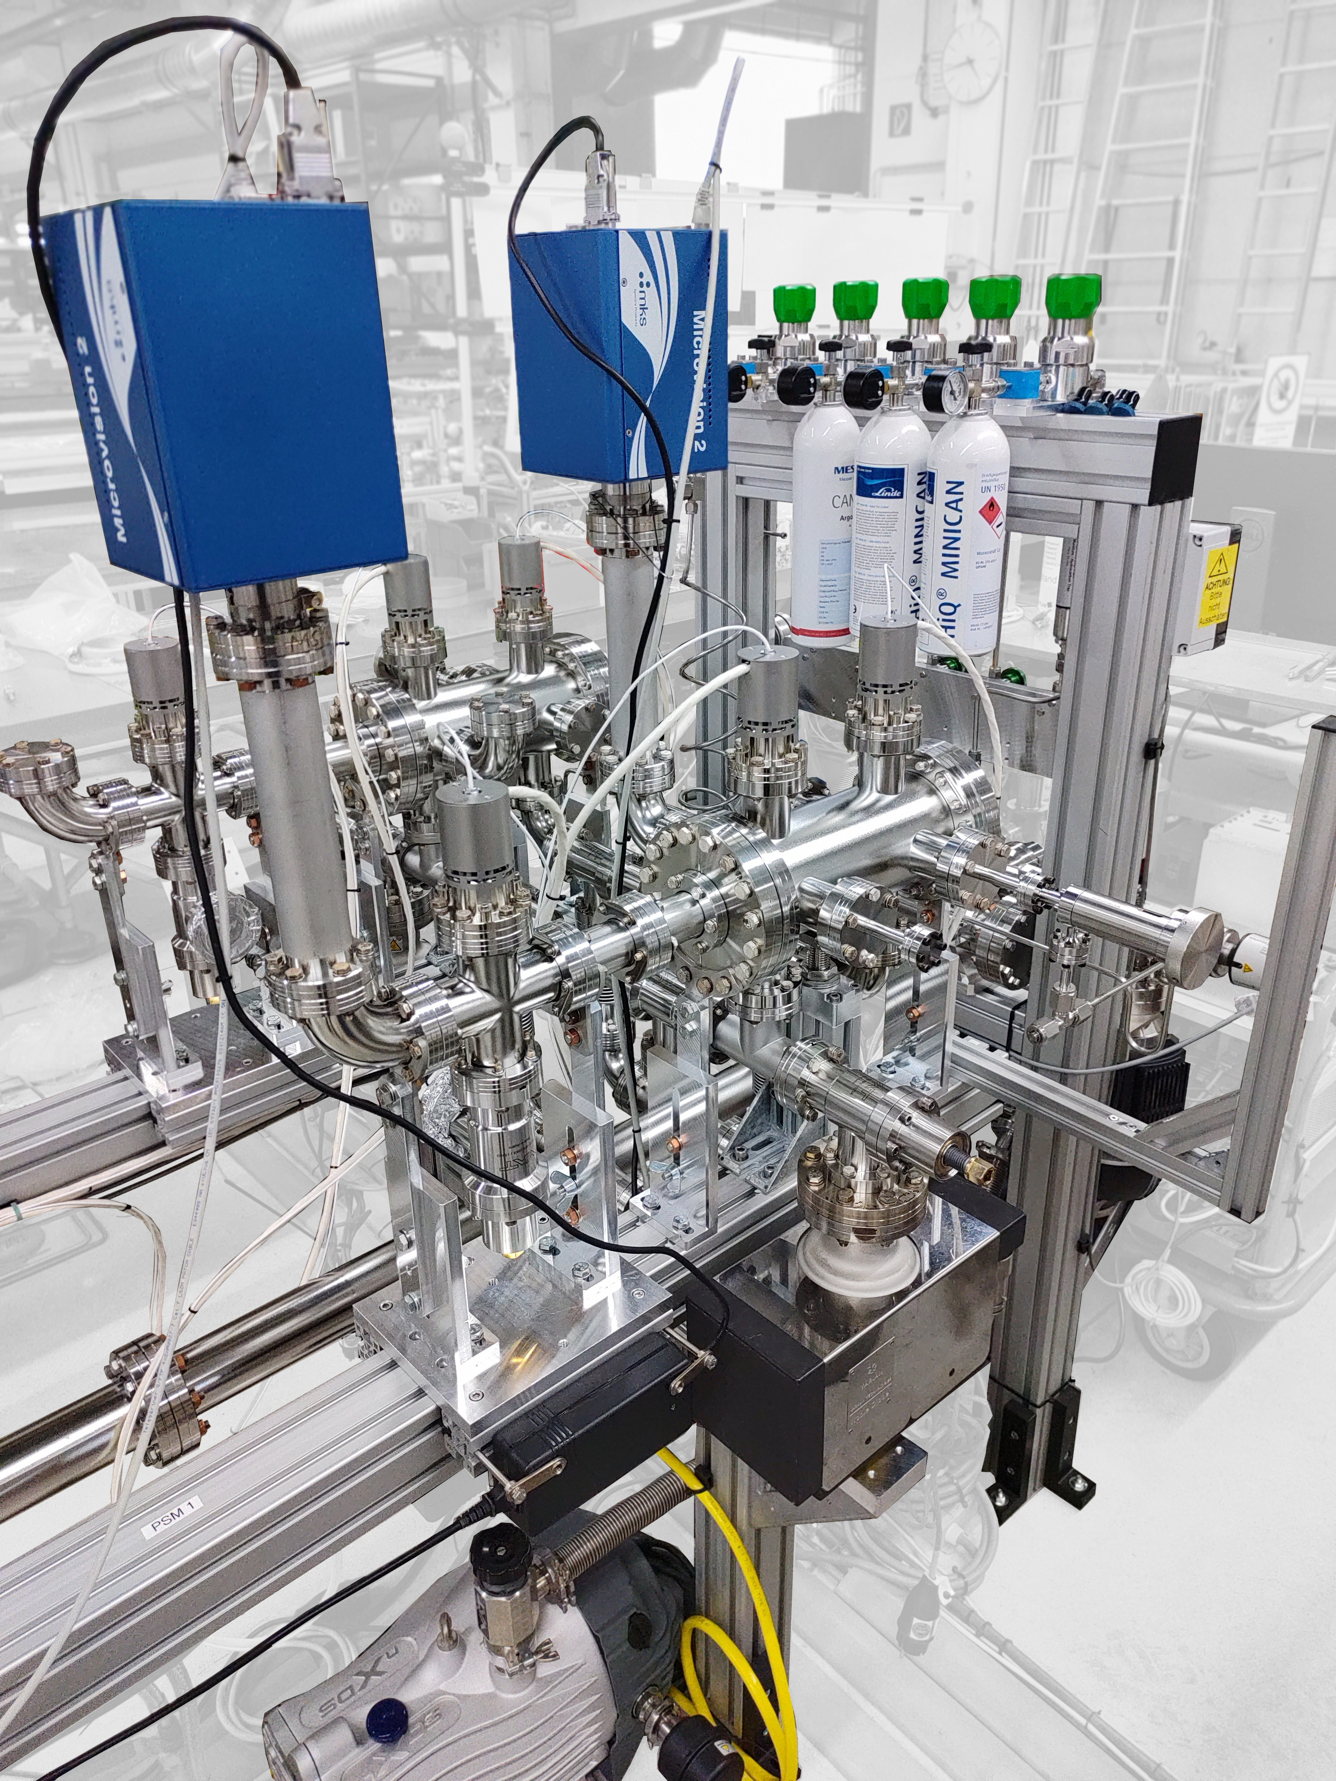
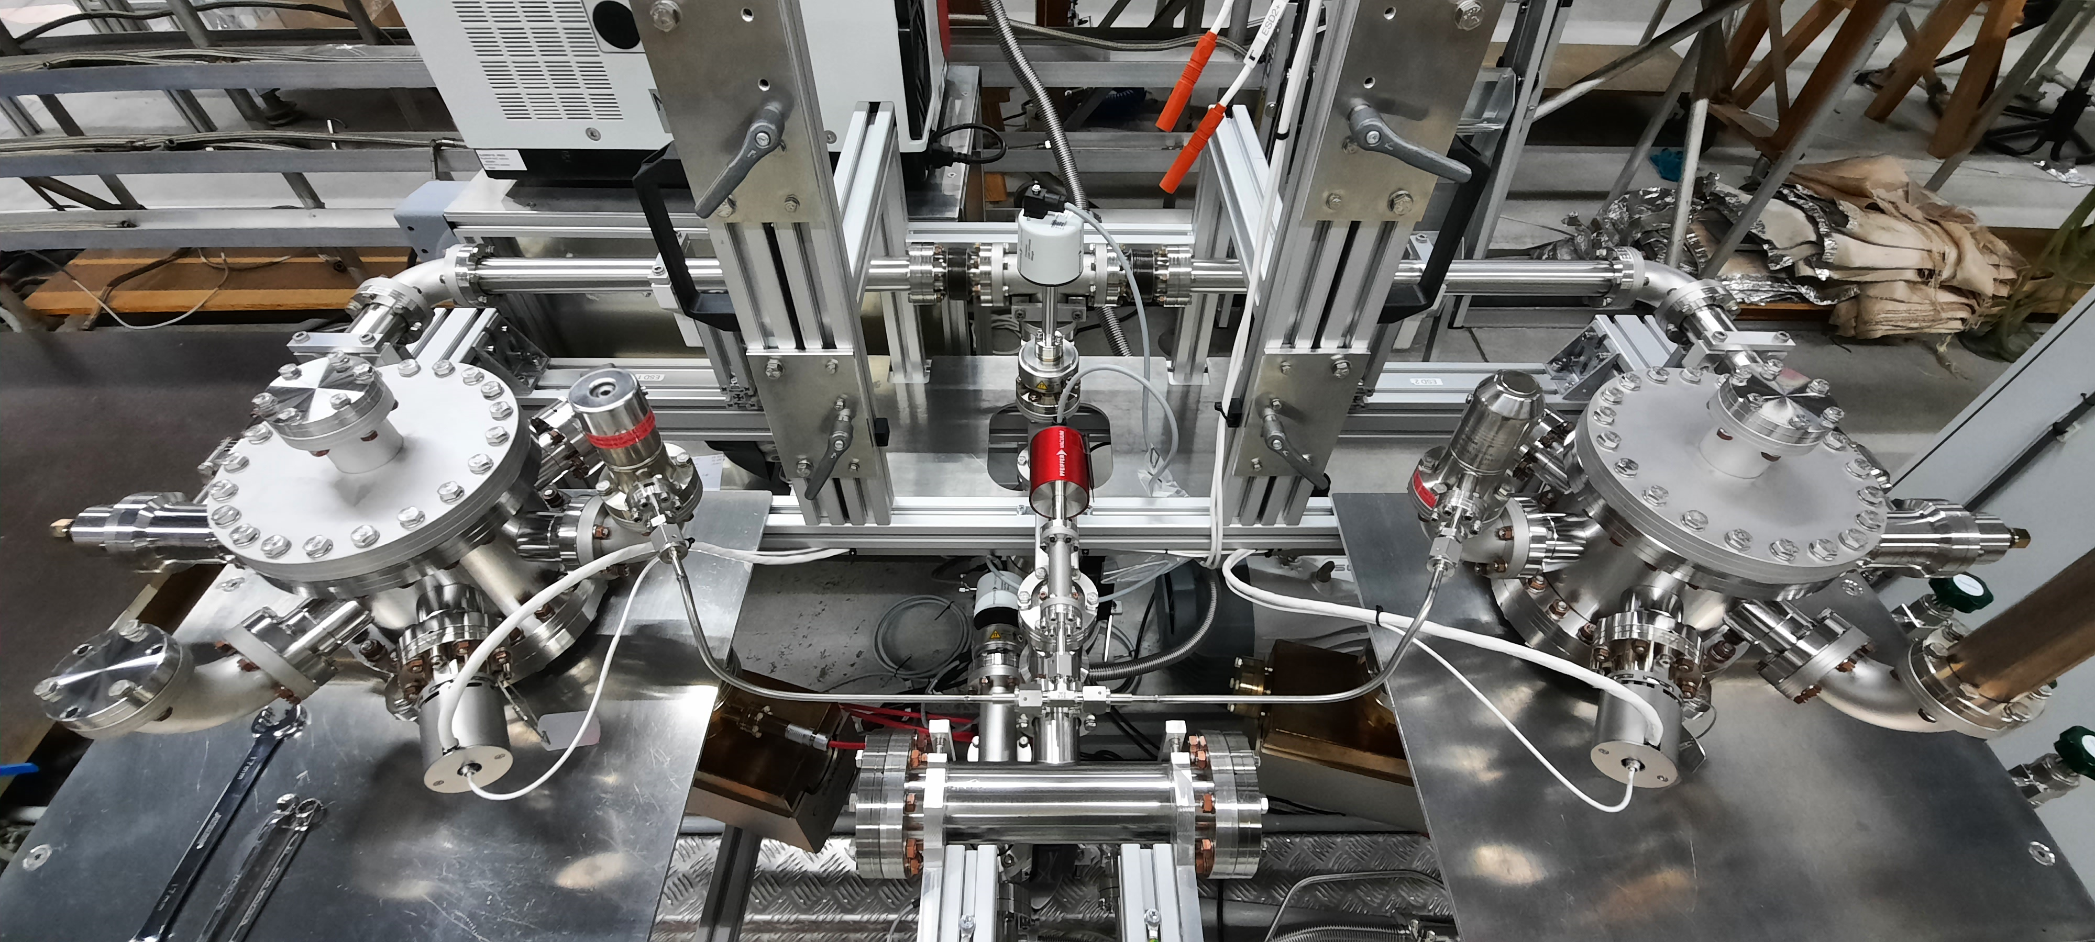
Facility for pumping properties evaluation at DESY
Pumping test setup is in operation
RGA or extractor gauge-based pressure ratio measurements
Another mirroring system is lacking RGAs
ESD setup (one of the two mirroring chambers) is ready for commissioning and pumping tests
Courtesy of R. Sirvinskaite (DESY)

Slide 14
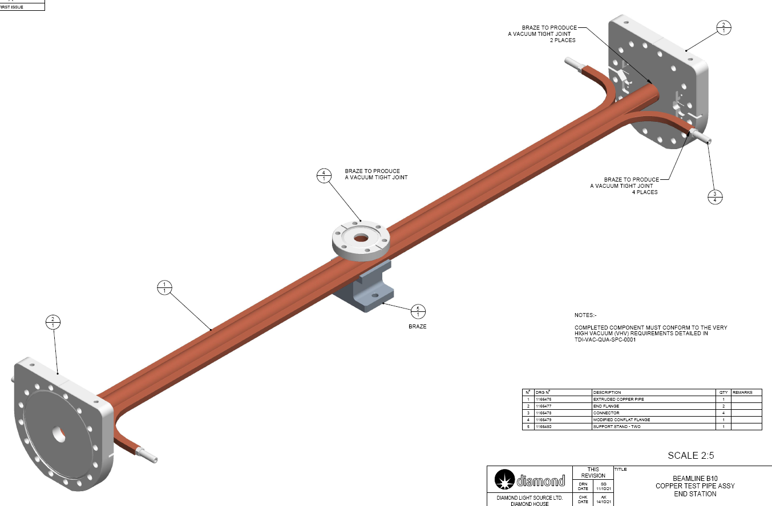
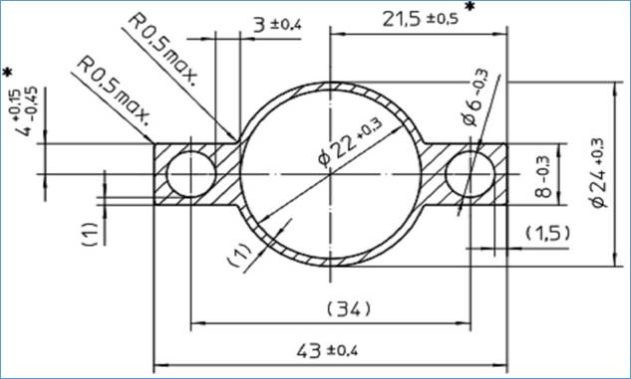
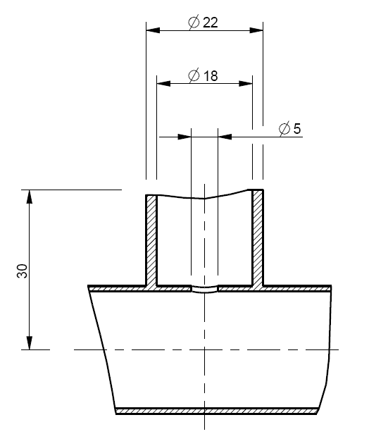
Sample for PSD measurements
Samples jointly designed by Soleil and DLS
  Central port is circular with ID = 18 mm and with 5-mm hole to vessel body
  Central and end flanges are brazed
9 samples has been provided by Soleil in Oct. 2022.
    4-month delay by the industrial manufacturer SAES REAL
    More samples can be produced in a future.
  Initially, samples have been or will be cleaned by a manufacturer
  Later, samples will be cleaned at DESY following a procedure being developed in an ongoing research
  First two samples will be coated with Zr at UKRI (DL) in January and February 2023
    so identical samples will be initially tested in DLS and Soleil for comparing (cross-verifying) the results obtained on different facilities
Courtesy of C. Burrows (DSL)

Slide 15
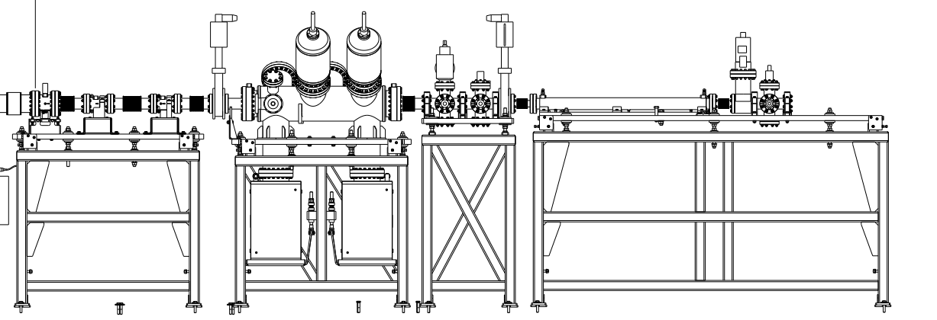
An updated facility for PSD studies on SR beamline at Soleil
Overview
Typical Soleil dipole front-end:
  Photon flux: 3.4 × 10¹⁴ photon/(s·mrad·mA)
  Critical energy: 8.379 keV
Beam width at test piece 1-50 mm
Test vessel angular range of up to 30 mrad (1.8º)
Status
Front-end section: reconditioned during 2020
Experimental end-station: operated in 2022 with samples coated with NEG at SAES getters
The samples will be NEG coated at UKRI (DL) and installed during a Soleil shutdown in Aug 2023
  Soleil is under shutdown till 15th March 2023 because the electricity cost
gauge+RGA
P_{T} [mbar]
S [l.s⁻¹]
C [l.s⁻¹]
S.R
Q [mbar.l.s⁻¹]
beam collimation
(gas load)
TEST Chamber
SIP
SIP
Turbo molecular pump
+ gauge+RGA
Turbo molecular pump
+ gauge+RGA
Courtesy of C. Herbeaux (Soleil)

Slide 16
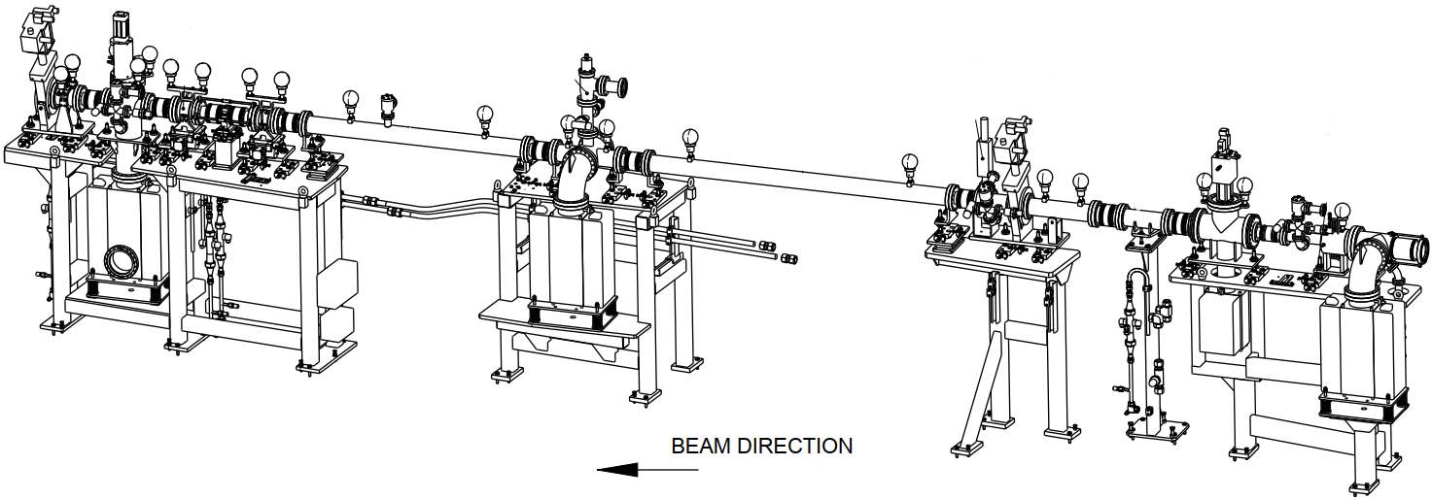
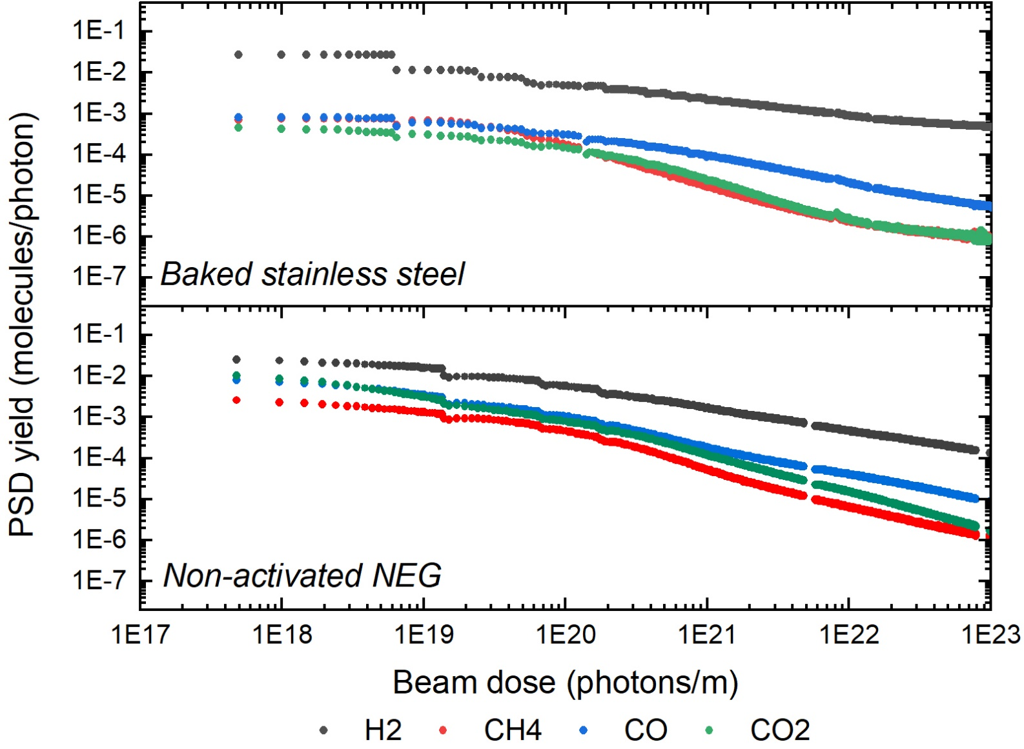
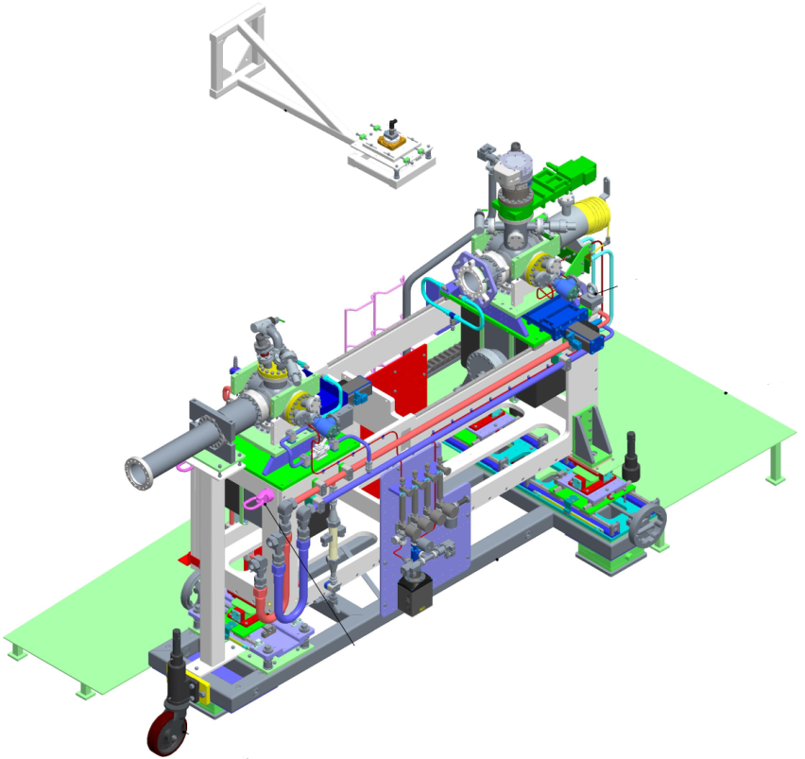
A facility for PSD studies on SR beamline at DSL
DLS dipole front-end (FE10B):
  installed November 2020
  photon flux: 3.86 x 10¹⁴ photon/(s·mrad·mA)
  critical energy: 8.379 keV
  test vessel angular range of up to 60 mrad (3.5º)
Status
Experimental end-station: under post-installation conditioning with a stainless steel DLS type uncoated sample till Feb 2022
Stainless steel DLS type sample NEG coated at UKRI (DL) was installed during a DLS shutdown in March 2022 and remain under SR till present
  PSD data collected for uncoated and non-activated coated vessels
  Activation trials started on NEG coated (TiZrV) vessel and initial PSD measurements performed
  Analysis ongoing for comparison to previous behaviours
1st copper sample coated with NEG could be installed during a following DLS shutdowns starting on the 26th May 2023.
Courtesy of C. Burrows (DSL)

Slide 17
Summary
Task 10.5 team works in full capacity according its plan
All necessary capabilities exist at least with two partners
  Deposition facilities are operational at UKRI and DESY, in conditioning at DSL, can be used at Soleil
  Pumping property evaluation facilities are operational at UKRI, DESY and Soleil, in conditioning at DSL.
SR beamlines
  Both PSD facilities have been commissioned with NEG coated samples and are ready for IFAST Task 10.5 samples
    in Soleil from summer 2023
    at DLS from 26th May 2023
Samples:
  11 samples for pumping property measurements have been produced:
    3 samples has been used at UKRI for comparing copper cleaning procedures by TD measurements
    8 samples have to be re-cleaned at DESY and sent to UKRI for NEG coating and testing in 4 labs
  9 samples for PSD measurement have been designed and produced
    delivered to UKRI for NEG coating in October 2022 and
    to be installed on SR beamlines in May-Aug 2023
Milestone MS48 report, Y1 and P1 contributions submitted on time

Slide 18
Acknowledgment (Task 10.5 team)
DLS
Matthew Cox
Chris Burrows
Hugo Shiers
Ryan Russell
DESY
Lutz Lilje
Ruta Sirvinskaite
Nils Plambeck
Ralph Böspflug
Sven Lederer
Soleil
Christian Herbeaux
Nicolas Béchu
Vincent Le Roux
Jonathan Gaudio
UKRI (STFC/DL/ASTeC)
Oleg Malyshev
Reza Valizadeh
Eleni Marshall
Adrian Hannah
James Conlon

Slide 19
Thanks for your attention

