Slide 1
LASERS for Plasma Accelerators, Targets and Focal Spot Stabilisation
Leonida A. GIZZI
CNR, Istituto Nazionale di Ottica, Pisa, Italy
also on behalf of F. MATHIEU and C. THAURY
iFAST 2nd Annual Meeting

Slide 2

WP6 Task structure and objectives
WP6: Novel particle accelerators concepts and technologies (Objectives)
Define a roadmap towards low-energy and high-energy physics applications
Organise the biannual European Advanced Accelerator Concepts workshop (EAAC)
Build a roadmap for new, efficient laser drivers for laser-plasma accelerators
Develop innovative targets for laser-plasma acceleration
Develop a new passive system to improve laser-driver control and quality
Leo Gizzi, I.FAST 2nd Annual meeting, 17-21 April 2023
Task | Name | Task Leader
6.1 | Novel Particle Accelerators Concepts and Technologies (NPACT) | R. Assmann (DESY) - WP Leader
6.2 | Lasers for Plasma Acceleration (LASPLA) | L. A. Gizzi (CNR)
6.3 | Multi-scale Innovative targets for laser-plasma accelerators | C. Thaury (CNRS)
6.4 | Laser focal Spot Stabilization Systems (L3S) | F. Mathieu (CNRS)
Participants: CEA, CERN, CNR, CNRS, DESY, INFN, U. OXFORD, THALES, AMPLITUDE Technologies

Slide 3
WP6 Deliverables and Milestones
D6.3:
Report being finalized
Leo Gizzi, I.FAST 2nd Annual meeting, 17-21 April 2023
MS21: Report on the novel accelerator landscape in Europe, facilities, projects and capabilities at the beginning of the 2020’s. Lead – DESY, M24, Publication, website (Task 6.1)
MS22: LASPLA Workshop/School. Lead – CNR, M30, Report (Task 6.2)
MS23: Target manufacturing and characterization. Lead – CNRS, M12 Report (Task 6.3) - Report delivered
MS24: Hypothesis on the causes of the instabilities of the focal spot profile. Lead – CNRS, M24 Publication (Task 6.4)

Slide 4
WP6 - Task 6.2:
LASers for PLAsma accelerators (LASPLA)
Task Leader: Leonida A. GIZZI – CNR-INO

Slide 5
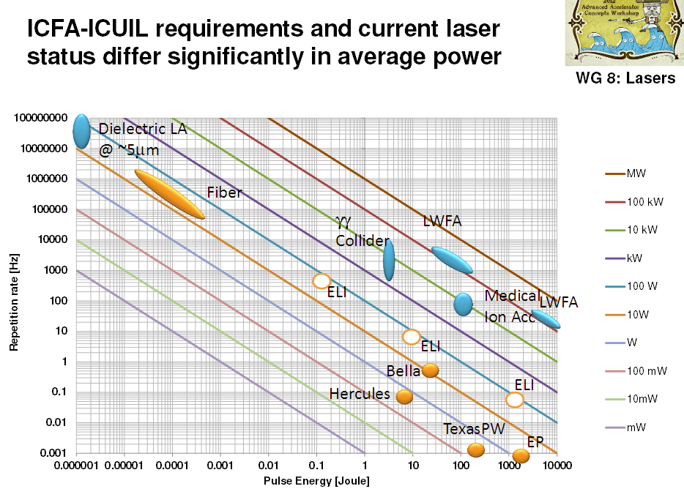
Status of laser driver development for LPA
Current reqirement for LPA driver: PW-class system, with high repetition rate (≈kHz) Demanding high average power
Machine drivers
Current industrial technology: ≈ Ti:Sa technology, pumped by flash-lamp pumped lasers
  Robust, reliable industrial technology
Mature technology: ≈ Ti:Sa technology, pumped by diode-pumped lasers
  Strong R&D effort in place (e.g HAPLS@ELI)
  ≈ 3-5 years to go to first industrial LWFA demonstrator (e.g. Eupraxia) [1]
Beyond TiSA: targeting higher wall-plug efficiency and rep. rate, kHz and beyond, stability, control (space, time, spectral);
  5-10 yrs for first efficient, multi-kW-scale demonstrator,
  A strategy is needed to steer effort in the LPA laser driver direction: LASPLA
Major effort required to fill the gap between existing and required laser technology
[1] L.A. Gizzi et al., A viable laser driver for a user plasma accelerator, NIM A 909 , 58 (2018); https://doi.org/10.1063/1.4984906

Slide 6
EURONNAC Special Topics
18–24 Sep 2022, Hotel Hermitage, La Biodola Bay, Isola d'Elba, Italy
Special Topic S-ST3:
Laser Technology and LPA Results (e-, p+, ion)
Conveners:
Leonida Antonio GIZZI (CNR-INO also at INFN, Pisa)
Stefan KARSCH (LMU, München)
Session conceived to contribute to the objectives of the Task 6.2, aiming at a roadmap to foster delivery of advanced industrial laser drivers with high-repetition rate and higher efficiency, for the first user laser-plasma based accelerators.

Slide 7
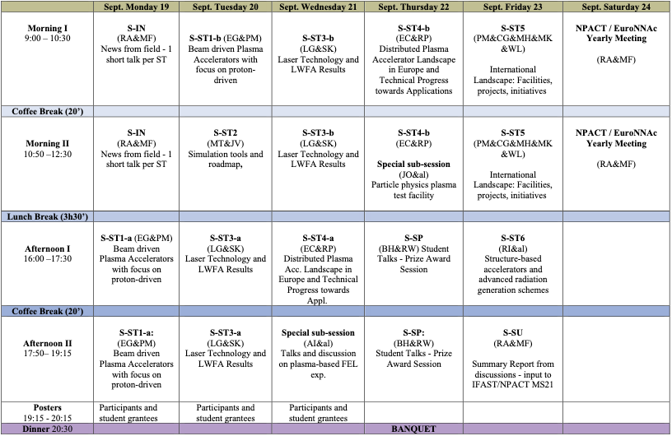
Sessions on Laser Technology and LPA

Slide 8

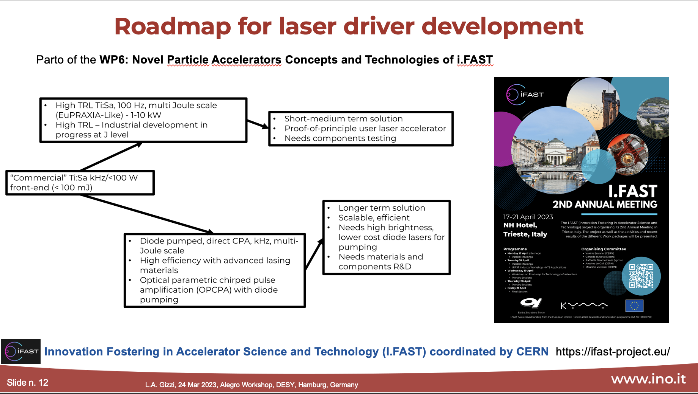
Advanced LinEar collider study GROup

Slide 9
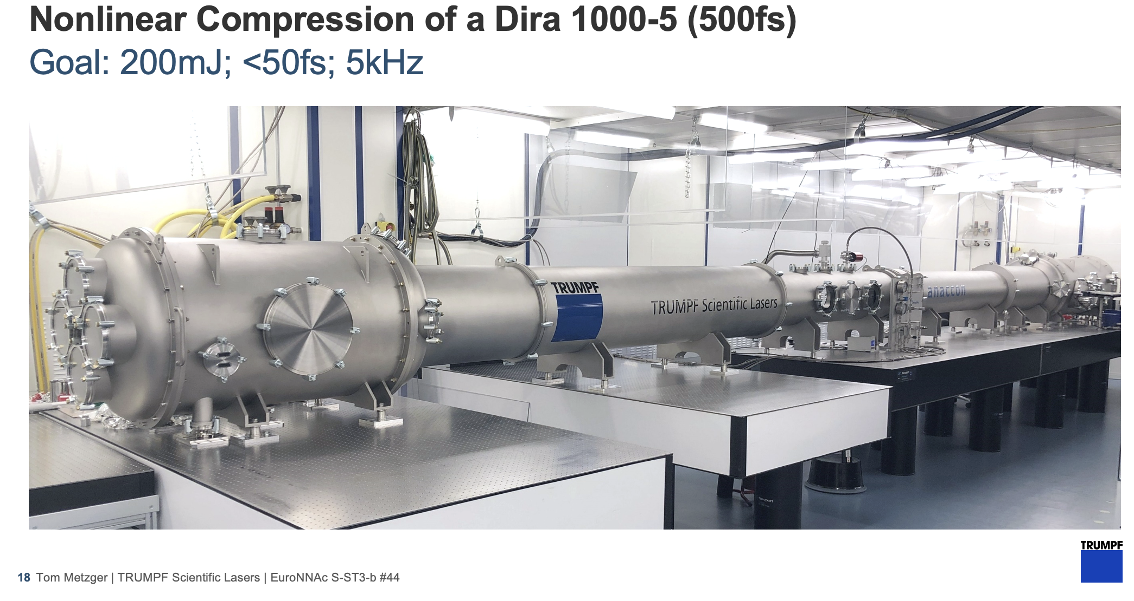
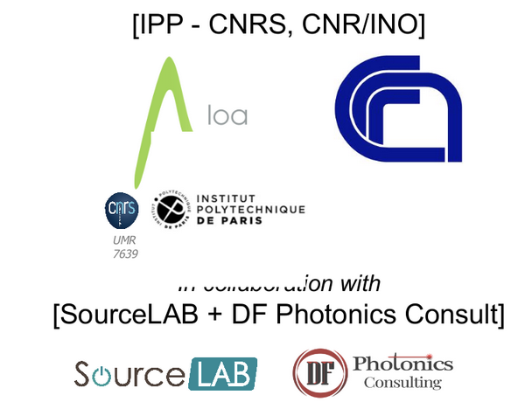
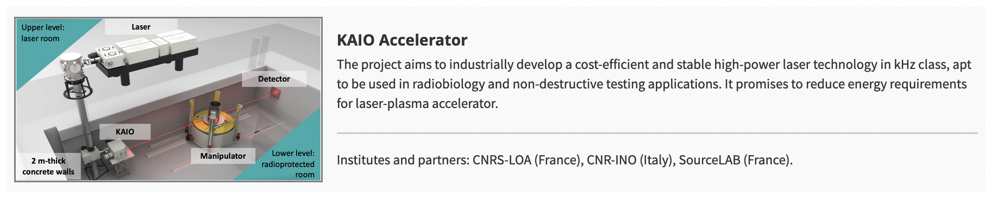

Laser driver relevant Highlights 1/2
Development emerged clearly on industrial scientific laser development towards the kW regime of Ti:Sa systems.
Marked progress on the use of robust, efficient industrial multi kW, Yb:YAG thin disk laser technology:
  plasma-modulation resonant wakefield
  non-linear spectral broadening for multi-TW, kW, kHz femtosecond pulse generation with high efficiency (up to 80%)

Slide 10

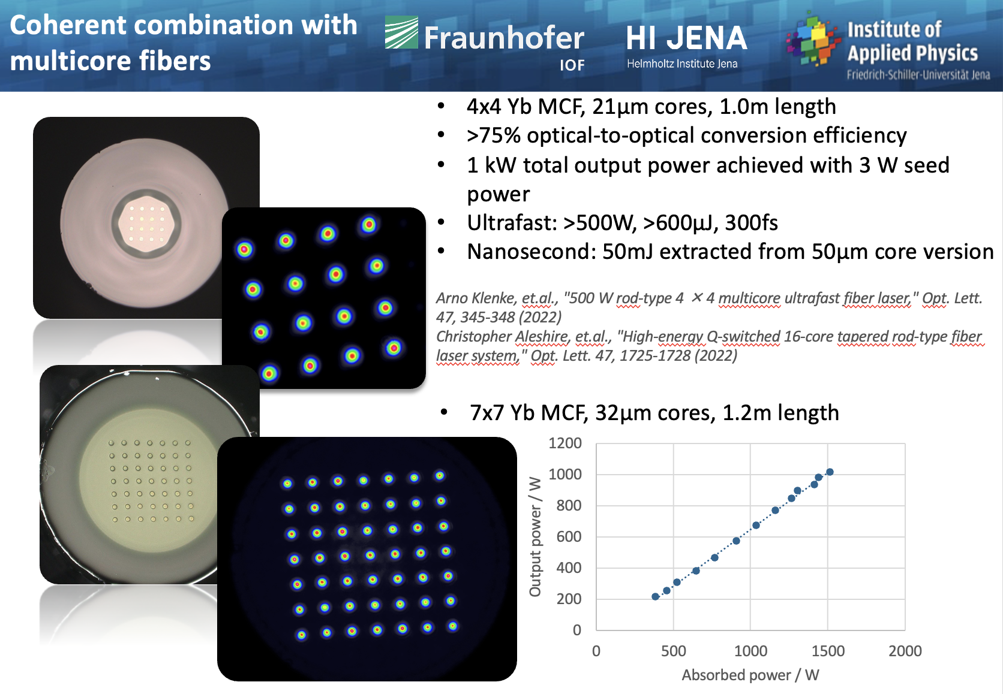
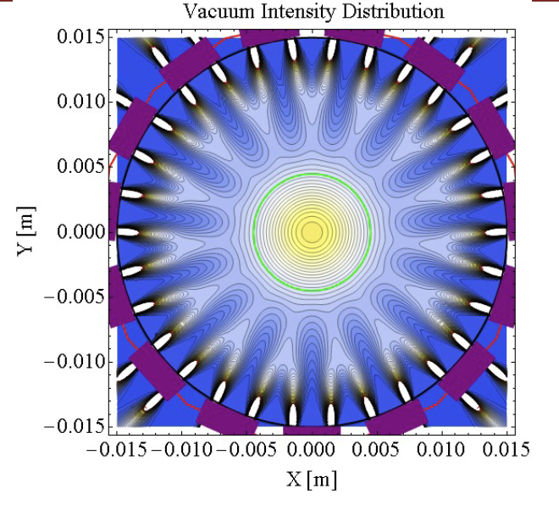
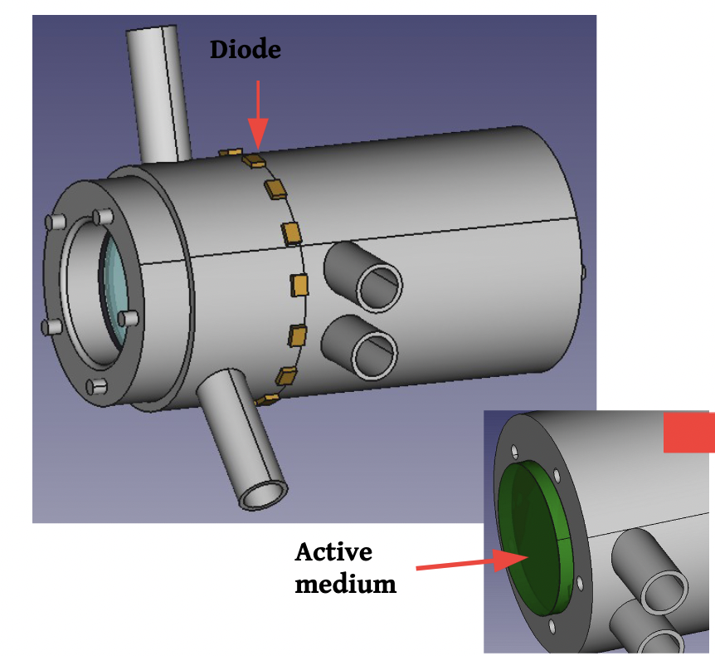
Laser driver relevant Highlights 2/2
Fiber coherent combination aiming at few cycle, 100 Hz, with self-phase modulation and J-scale pulses with multi-core fibers.
  Demonstrated wp efficiency of 30% is an extremely valuable result.
Direct diode-pumping of Thulium doped new materials (sesquioxides) is expanding, entering development phase
Jens Limpert

Slide 11
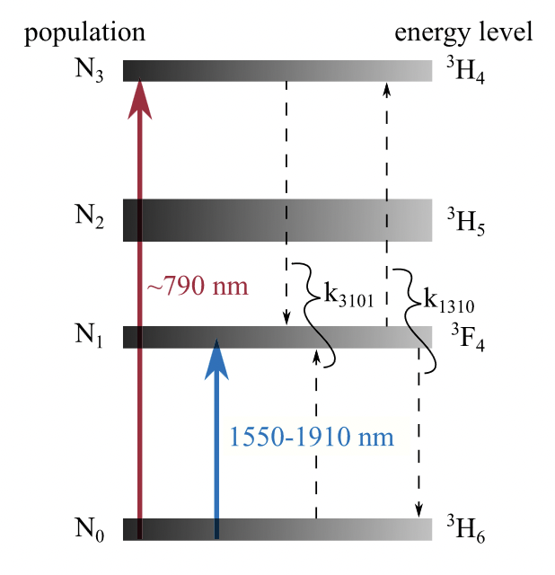
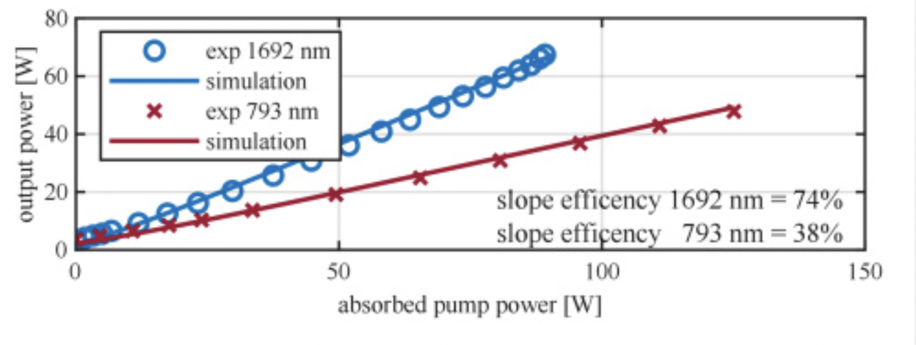
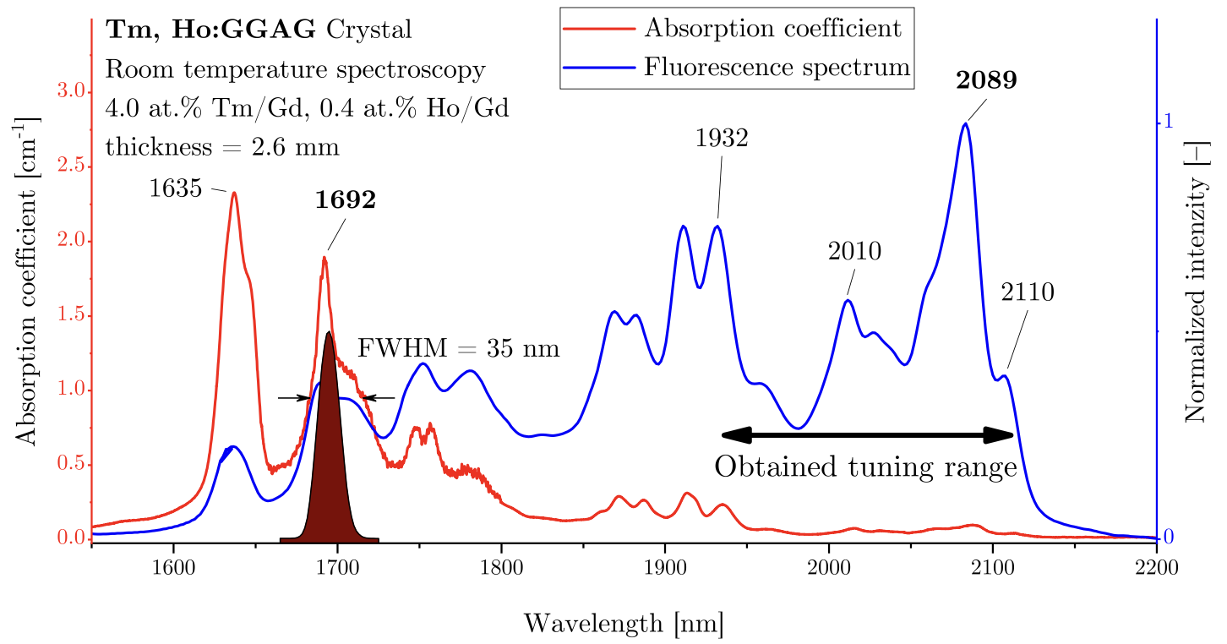
Higher wpe: In-band pumping for low qd
Thulium based gain medium can also be pumped with in-band absorption with virtually marginal quantum defect:
High efficiency and lower heat deposition.
>80% slope efficiency demonstrated in fibers
Mathias Lenski et al., "Highly efficient, in-band pumped thulium-doped fibers for high-power ultrafast 2 μm wavelength laser systems,"
Proc. SPIE 12400, Fiber Lasers XX: Technology and Systems, 124000N (8
March 2023); doi: 10.1117/12.2650475
New path for intra-band pumping and marginal quantum defect: step change in wpe?

Slide 12


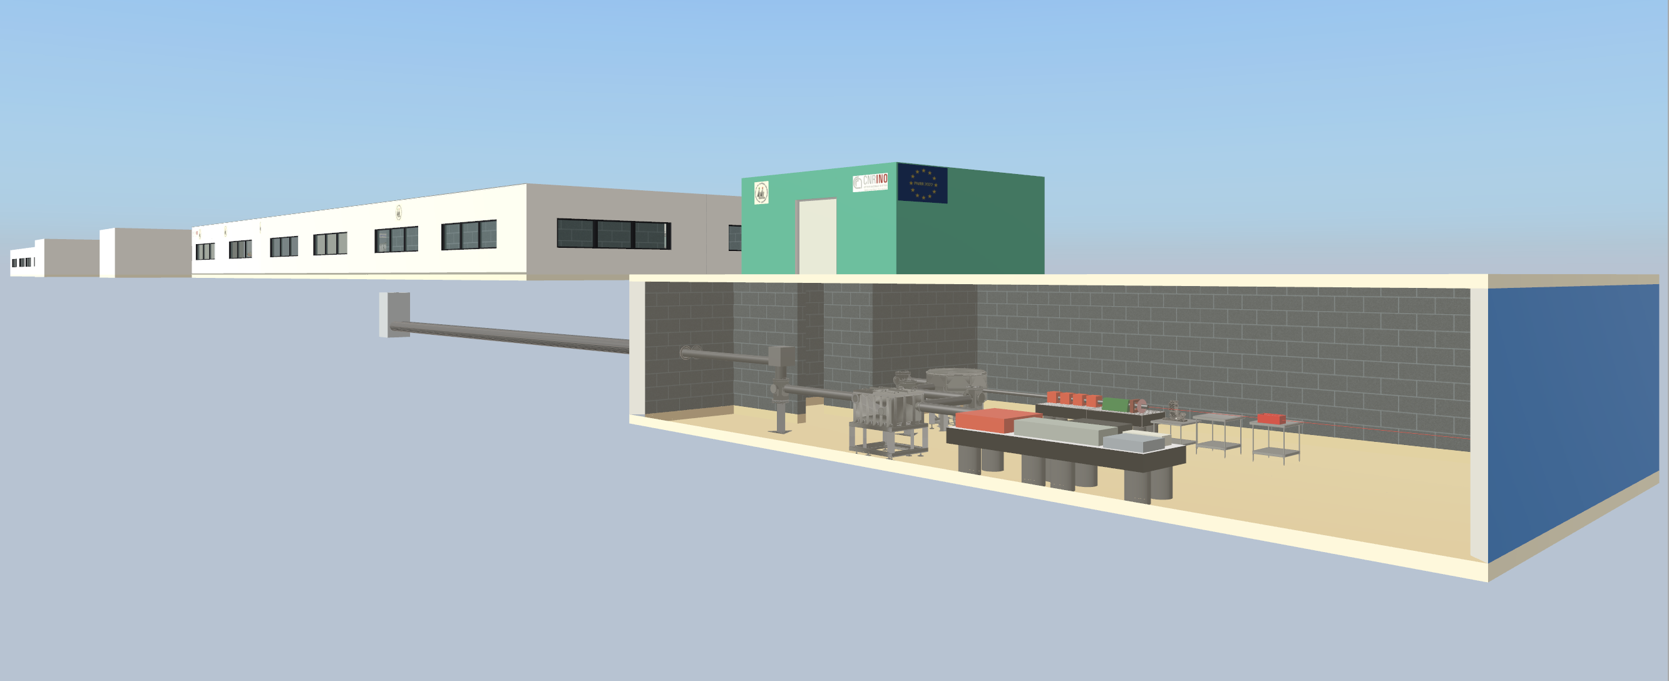

Establishing 100 Hz Ti:Sa laser driver
EuPRAXIA
PW class,
100 Hz repetition rate,
multi kW average power,
diode pumped
Full therma load transport
Eupraxia laser development is aimed at delivering more efficient, kW-PW laser driver for plasma acceleration at >100 Hz rate
Leo Gizzi, I.FAST 2nd Annual meeting, 17-21 April 2023
EuAPS@CNR-Pisa
30 TW peak power
100 Hz repetition rate
100 W average power
Diode pumped
Thermal load effects
CURRENT
PW class,
Hz repetition rate,
≈10 W average power
flashlamp pumped
No thermal load transport
Multi M€ funding

Slide 13
WP6 - Task 6.3:
Multiscale innovative targets for laser-plasma acceleration
Task Leader: Cedric THAURY, CNRS-LOA

Slide 14


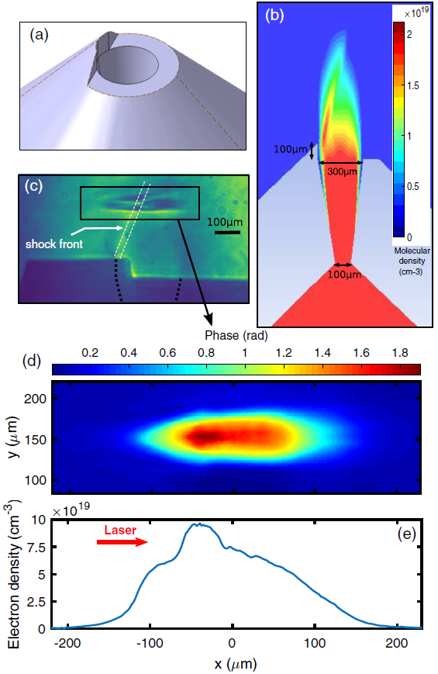
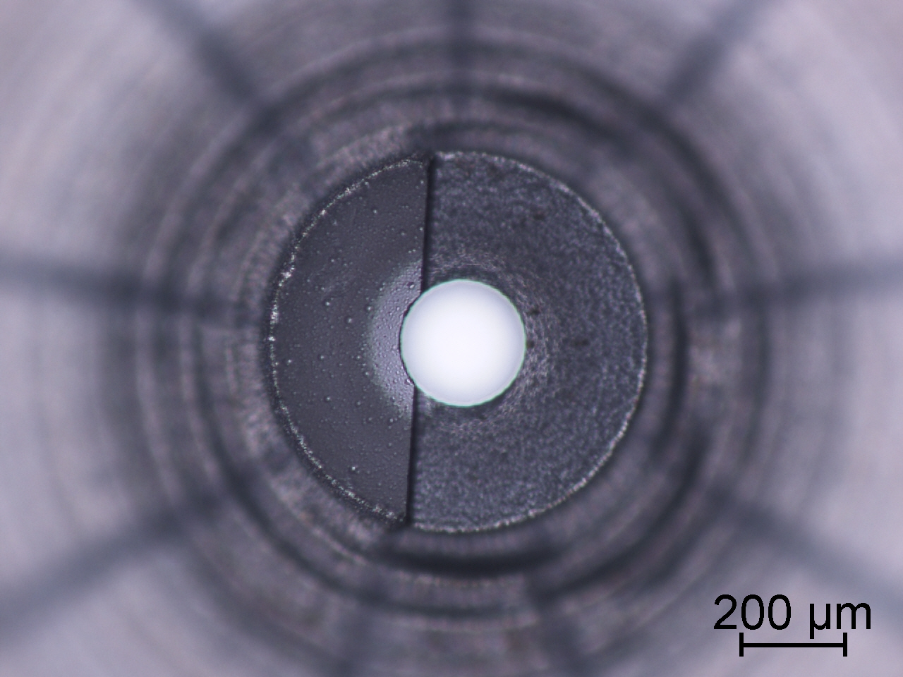
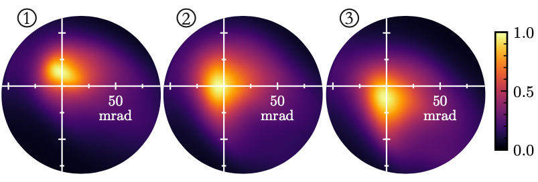
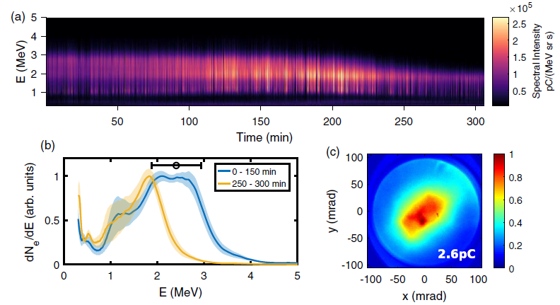
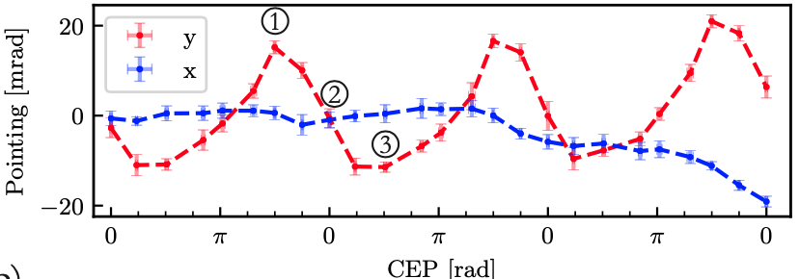
Task 6.3 multi-scale innovative targets for laser-plasma accelerators : low-energy kHz accelerator
Glass nozzles with shock
→ stable acceleration at a kHz rep. rate
Control of the laser CEP
→ improved stability and beam stearing
CEP –π/2
CEP 0
CEP π/2
12 M shots
Leo Gizzi, I.FAST 2nd Annual meeting, 17-21 April 2023
L. Rovige et al., RSI 92, 083302 (2021)
J. Huits et al. Phys. Rev. X 12, 011036 (2022)

Slide 15

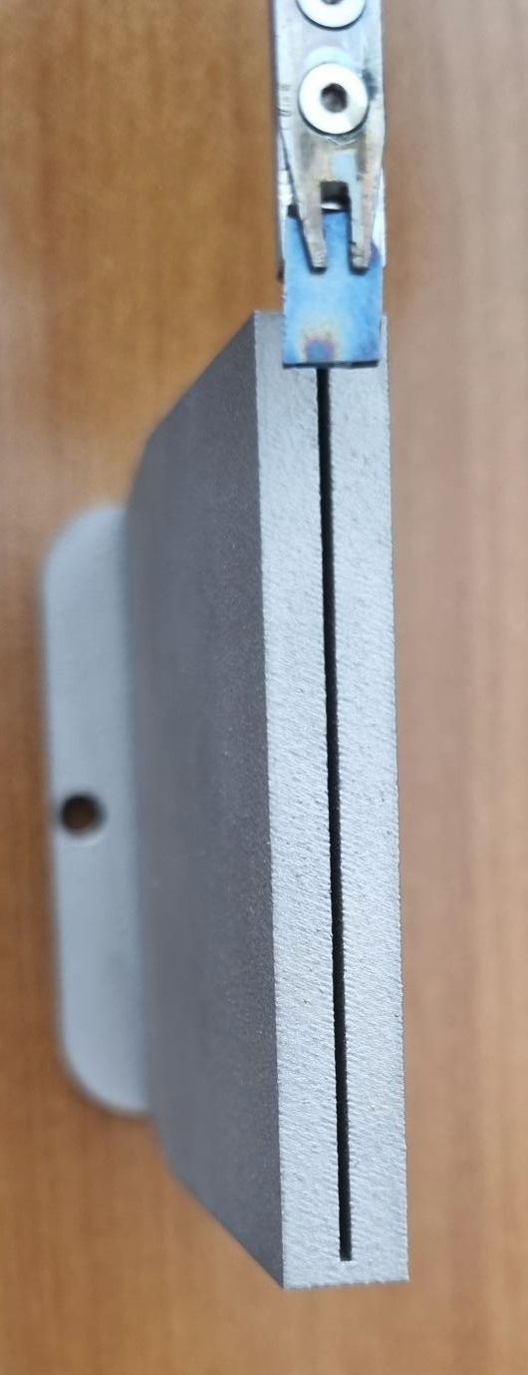
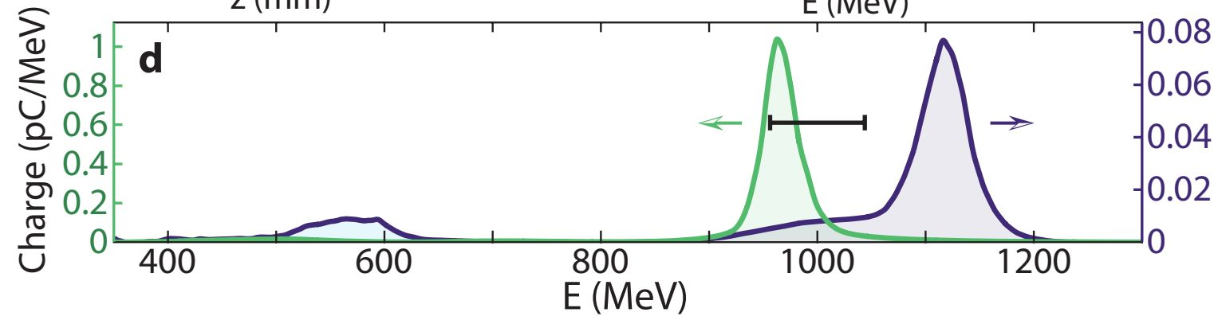
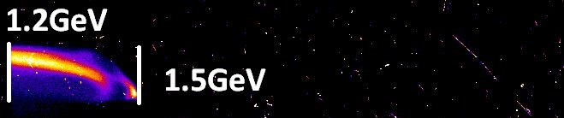

Task 6.3 multi-scale innovative targets for laser-plasma accelerators : high-energy accelerator (also for future laser drivers)
First demonstration of controlled injection and acceleration in a laser-plasma waveguide
→ High quality GeV beam with a J-class laser (LOA)
→ High quality 2.5 GeV beam with a 10 J laser (Apollon)
6cm long target
Leo Gizzi, I.FAST 2nd Annual meeting, 17-21 April 2023
LOA results (1.5 J)
Apollon results (10 J)
Best electron spectrum
without guiding
Best electron spectrum
with guiding
Oubrerie et al. Light Sci Appl 11, 180 (2022), Oubrerie et al J. Opt. 24 045503 (2022)

Slide 16
WP6 - Task 6.4:
Laser focal Spot Stabilization Systems (L3S)
Task Leader: Francois MATHIEU, CNRS-LULI

Slide 17
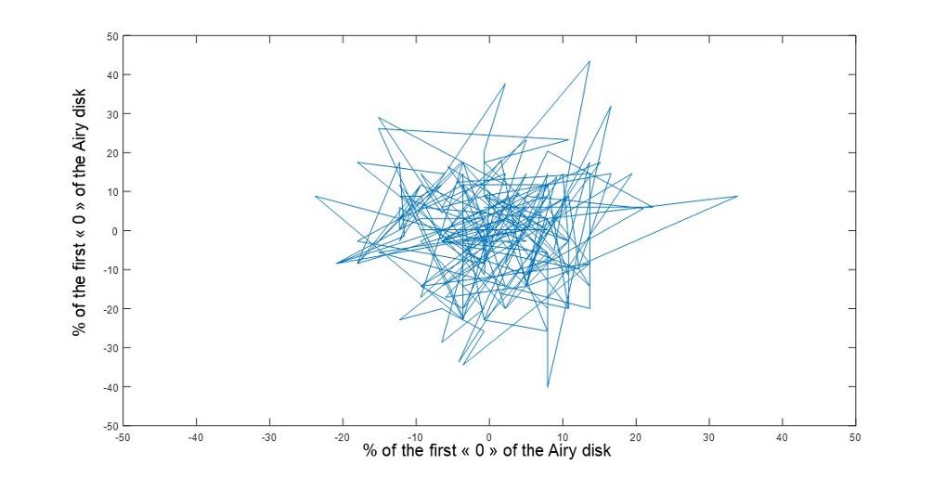
Task 6.4 - Summary of activities in P1
Characterization of beam pointing stability with high sensitivity for accelerator-level performace
Installation of an active stabilization loop in the amplification stages
  Beam stability improved by a factor 2
  Characterization of the mechanical frame under progress
  Aiming at +/- 0,15 µrad PTV stability requisite for particle beam stability in a laser driven accelerator
Measurement done over 1 hour in the target chamber
The beam stability is ± 3 µrad PTV
Objective is ± 0,1 µrad PTV
Leo Gizzi, I.FAST 2nd Annual meeting, 17-21 April 2023

Slide 18
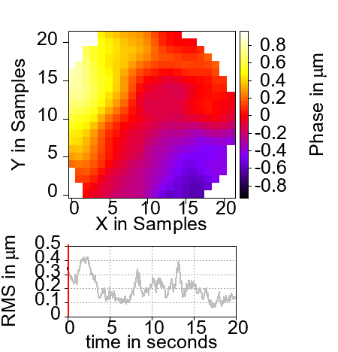
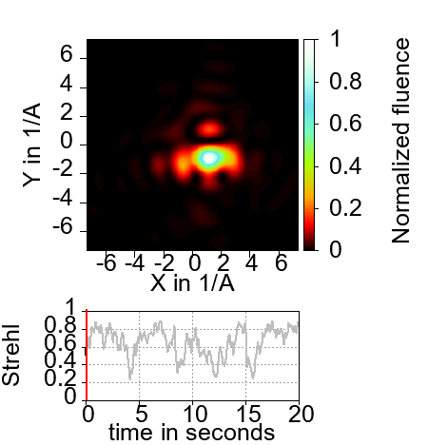
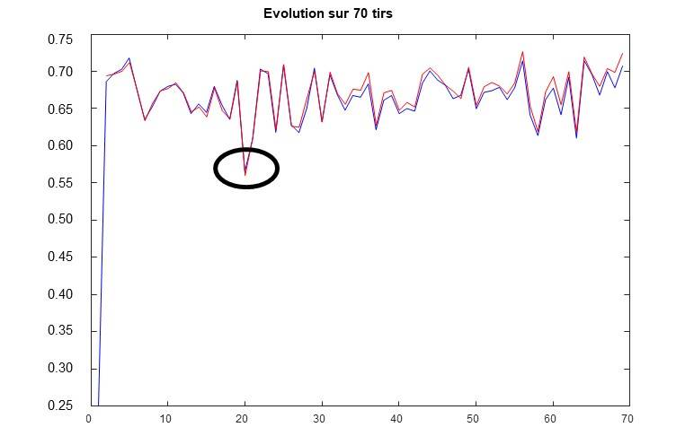
Task 6.4 - Summary of activities in P1
Characterization of focal spot stability with most advanced metrology framework
Installation of new system to minimize airflow
  Strehl stability improved up to ± 7.8%.
  Procurement of an 1kHz active loop under progress
  Aiming at +/- 2% PT>V stability on the Strehl ratio, since this impacts beam pointing stability
Measurement done with a wavefront sensor running at 200Hz and a cw laser
Strehl ratio varies from 0.25 to 0.85
Leo Gizzi, I.FAST 2nd Annual meeting, 17-21 April 2023

Slide 19
Summary
Year 2 Highlights of Tasks WP6.2-3-4: strong progress on laser driver developments:
  Increasingly involving industrial partners with new developments for use of robust, commercial Yb:YAG ps, kW, multi-kHz (High TRL): sync with iFAST Innovation Fund (Kaio-accelerator)
  Infrastructure developments pushing industrial femtosecond Ti:Sa laser technology: moving now to kW, 100 Hz (High TRL)
  Fiber and other laser schemes with new materials and for direct diode pumping architectures markedly aiming at high efficiency (low-medium TRL)
Laser stability and quality control progressing to the required specifications for LPA
Target technology including guiding and injection control is developing fast
Milestones and Deliverables on track
Next: Combined WP6 Laser and Target Tasks meeting @ EAAC2023, 18-22 September, Elba, Italy
Leo Gizzi, I.FAST 2nd Annual meeting, 17-21 April 2023

Slide 20
Thank you for your attention!

