Slide 1
R&D for HTS and MgB₂ Superconducting magnets for beam lines, ion gantries
and the IRIS research infrastructure
@ INFN-LASA (Milan)
Industry Workshop on HTS developments and applications
Stefano Sorti, on behalf of LASA team

Slide 2
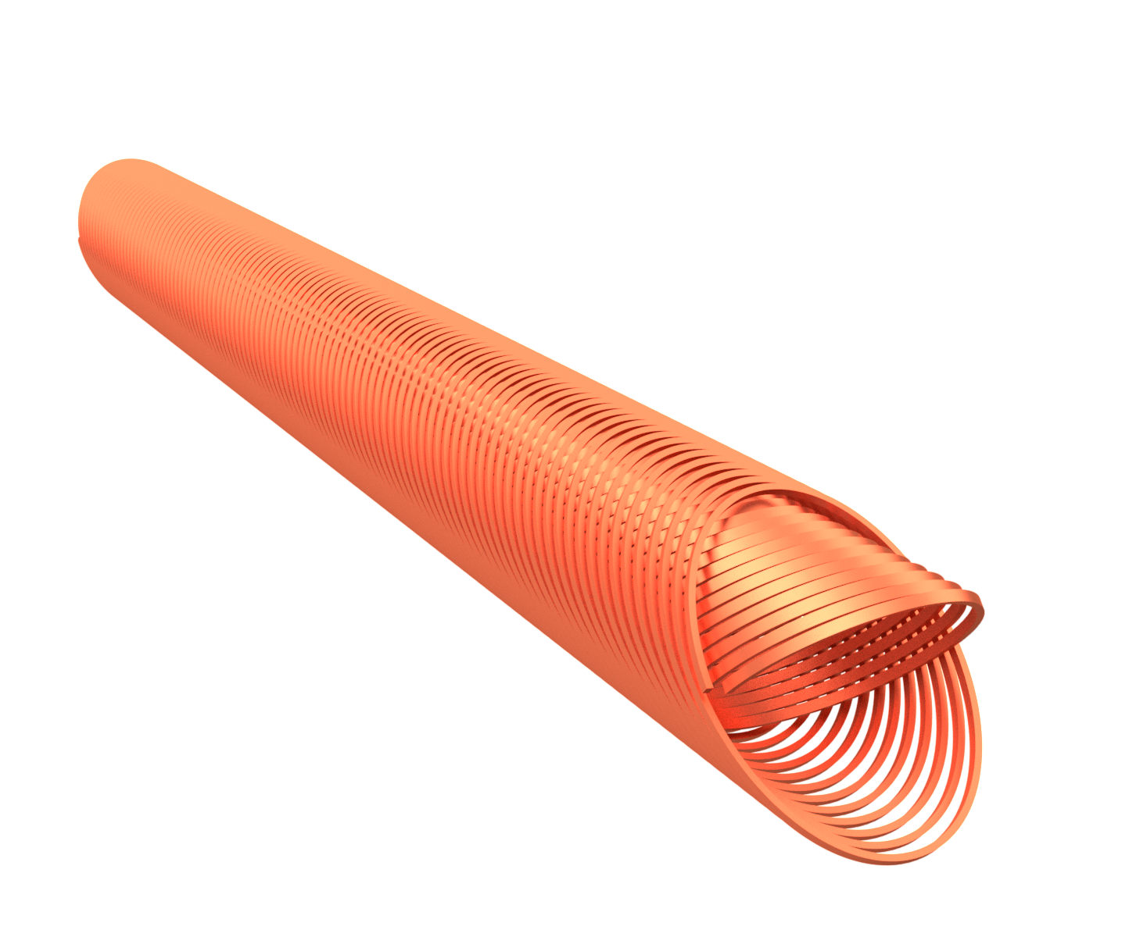
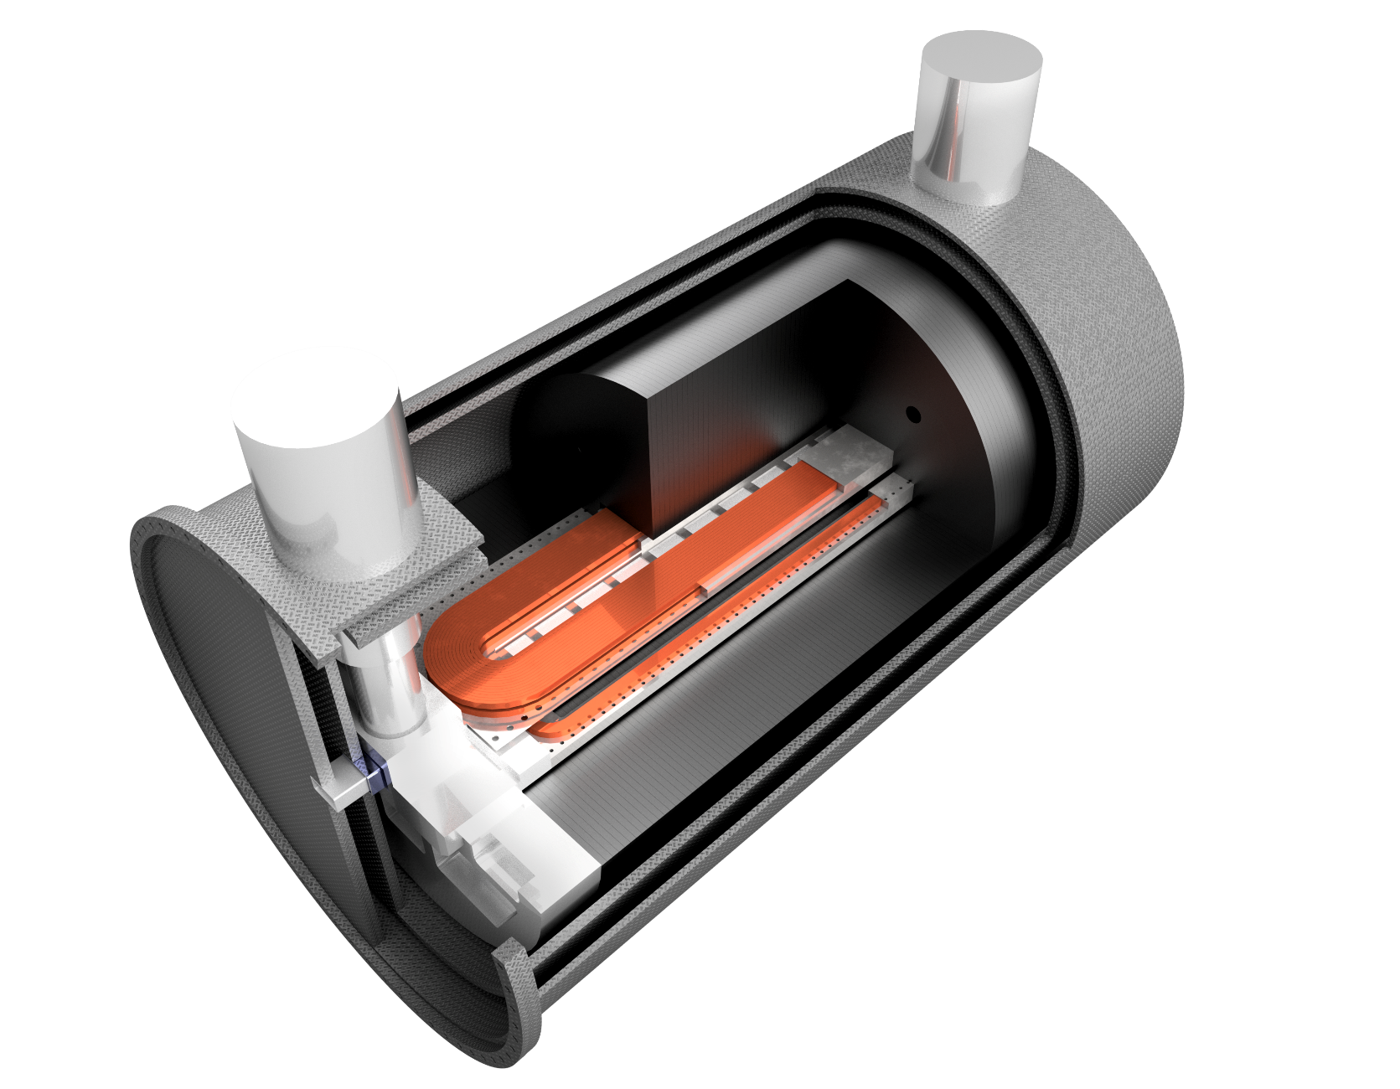
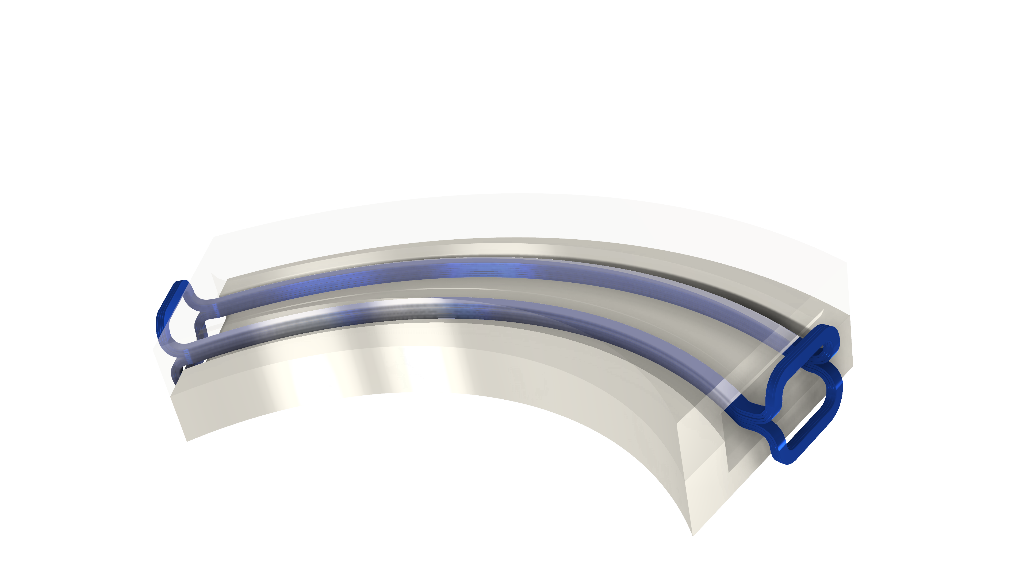
Contents
I.FAST WP8, Innovative superconducting magnets
(tasks on CCT in HTS)
ESABLiM project, Energy Saving Accelerator and Beam Line Magnets
IRIS project, an Innovative Research Infrastructure on applied Superconductivity

Slide 3
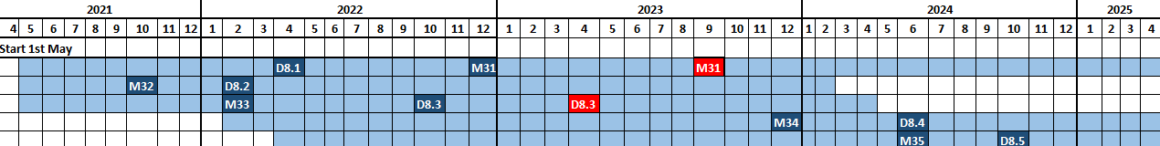
IFAST WP8: main overview
SCOPES:
Exploring Canted Cosine Theta (CCT) with HTS superconductor (main goal), proceeded by a combined function CCT based on LTS, involving the industries that want to learn about the CCT magnets
Form a permanent European Strategy Group, open to worldwide partners, to discuss the European strategy for HTS magnets for accelerators, and to improve Industry involvement in this technology
TASKS:
8.1 - Coordination and HTS Strategy Group
8.2 – Preliminary Engineering design of comb. CCT magnet
8.3 – Preliminary Engineering design of HTS CCT
8.4 - Construction of combined CCT magnet demonstrator
8.5 – Construction of HTS CCT magnet demonstrator
8.6 – Development of ReBCO HTS nuclotron cable
Institutes
Industries
8.1
8.2
8.3
8.4
8.5

Slide 4
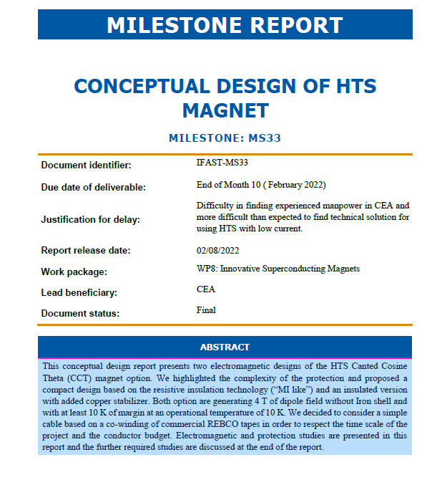
IFAST WP8.3: Defining the parameters
Parameter | Unit | MI | Insulated
Inductance | mH | 117.9 | 139.8
Stored Energy | kJ | 71.0 | 82.9
Cable current | A | 1100 | 1090
Groove current density | A/mm² | 1698 | 618
B₀ | T | 4
Turns per layer | - | 85 | 88
Cable per groove | - | 18 | 19
Cable path section | mm x mm | 4 x 2.9 | 4 x 8.4
Frame length (In / out) | m | 36.3 / 39.3 | 38.3 / 43.2
Total Length (cable / Tape) | km | 1.5 / 3.0 | 1.7 / 3.4

Slide 5
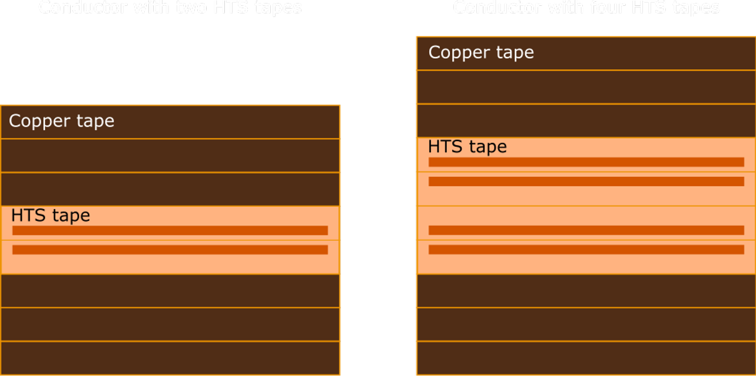
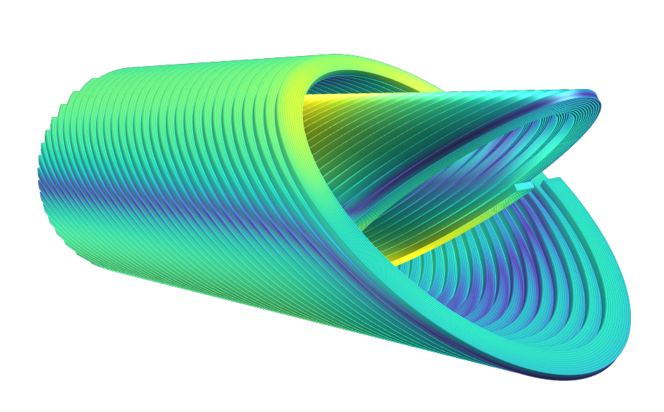
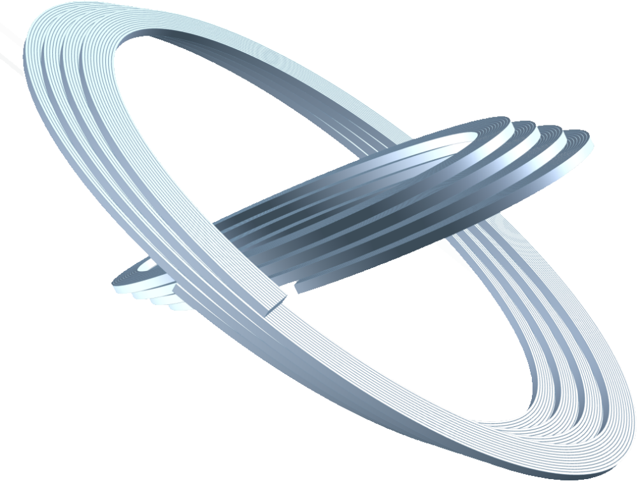
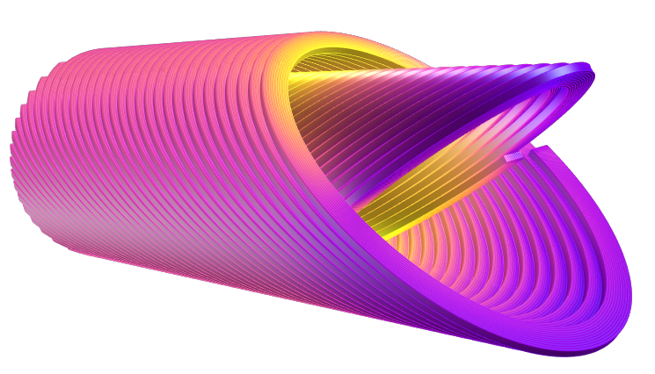
IFAST WP8.3:
Redacting Deliverable D8.3
INS option with Cu stabilizer is pursued. Final T_{op} is 20 K, Two further design options:
  2-tapes cable (980 A)
  4-tapes cable (1990 A)
Soldering all tapes inside the
cable under consideration;
Hard-way bending must be
avoided or minimized.
Accelerator-level field-quality
(integral below-unit), no iron
yoke (shielding open problem);
Quench analysis was used to determine the required thickness of copper stabilizer tapes in the cable.
LOADLINE FRACTION [%]
80
70
60
50
40
30
FLUX DENSITY [T]
4.5
4.0
3.5
3.0
2.5
2.0
1.5
1.0
0.5
5

Slide 6

IFAST WP8: from 8.3 to 8.5
Scientific partners leading the conceptual design of the magnet (Deliverable 8.3).
Industry partner Elytt SL is transforming scientific design into a construction project for a real operating magnet demonstrator including drawings, description of the construction process, design and construction of the tooling and magnet components.
Finally, the demonstrator will be tested and qualified in conditions near to the operative ones by cold test at scientific partners’ facilities.
Active and proactive role in developing ideas, approaches and processes in the technological challenges of building an operative magnet

Slide 7
Energy Saving Accelerator and Beam Line Magnets (ESABLiM)
Study of new cryogen-free superferric magnets in MgB₂ (and HTS) to substitute resistive magnet for heavy particles beam lines;
Reduce the peak power loss from 10 to 50 times, by working @ T= 8-20 K with solid conduction cooling.
Different apporaches, the ones we are focusing on are:
  Revamping: reuse the same iron yoke and magnet interfaces. Substitute copper coil, only, with MgB2 (or HTS conductors)
  Develop superferric magnets for accelerators and beamlines suitable designed and optimized for low power consumption

Slide 8
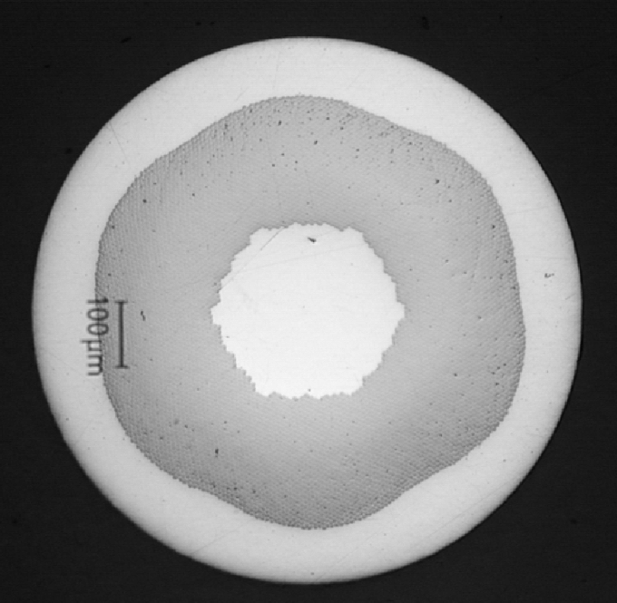
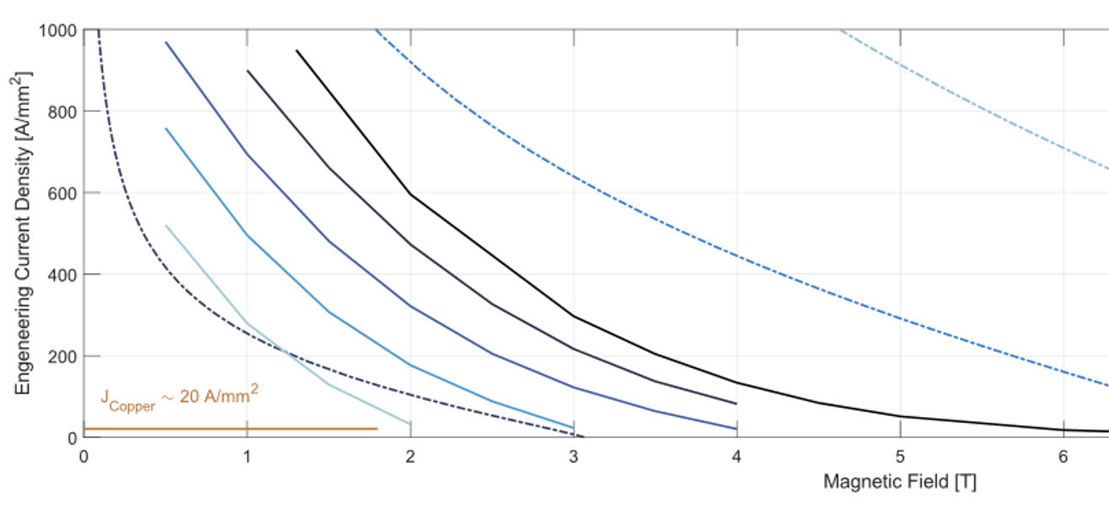
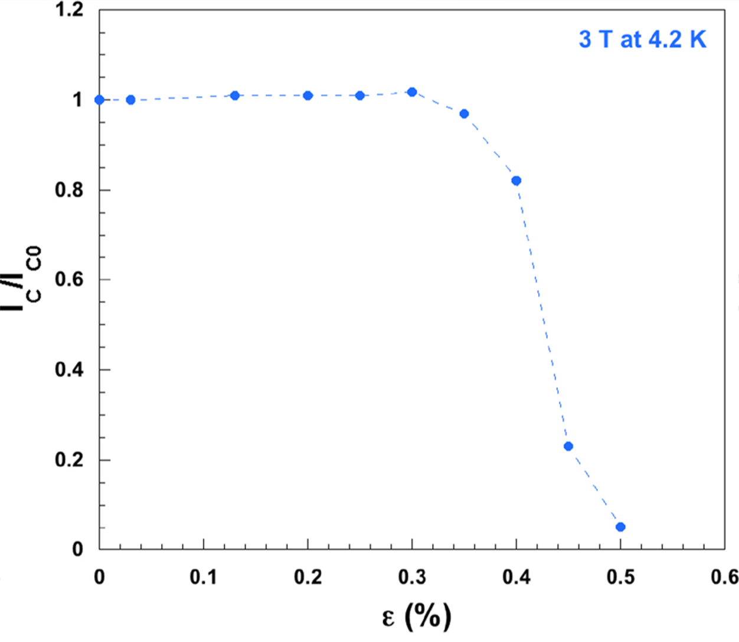









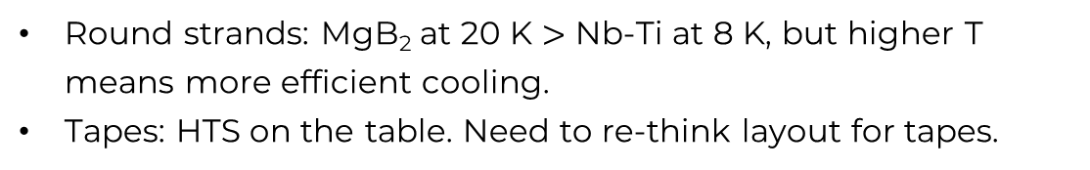
ESABLiM: conductors choice
Nb-Ti
MgB₂
Round strands: MgB₂ at 20 K $>$ Nb-Ti at 8 K, but higher T
means more efficient cooling.
Tapes: HTS on the table. Need to re-think layout for tapes.
Issue of MgB₂ :
strain sensitivity
8

Slide 9
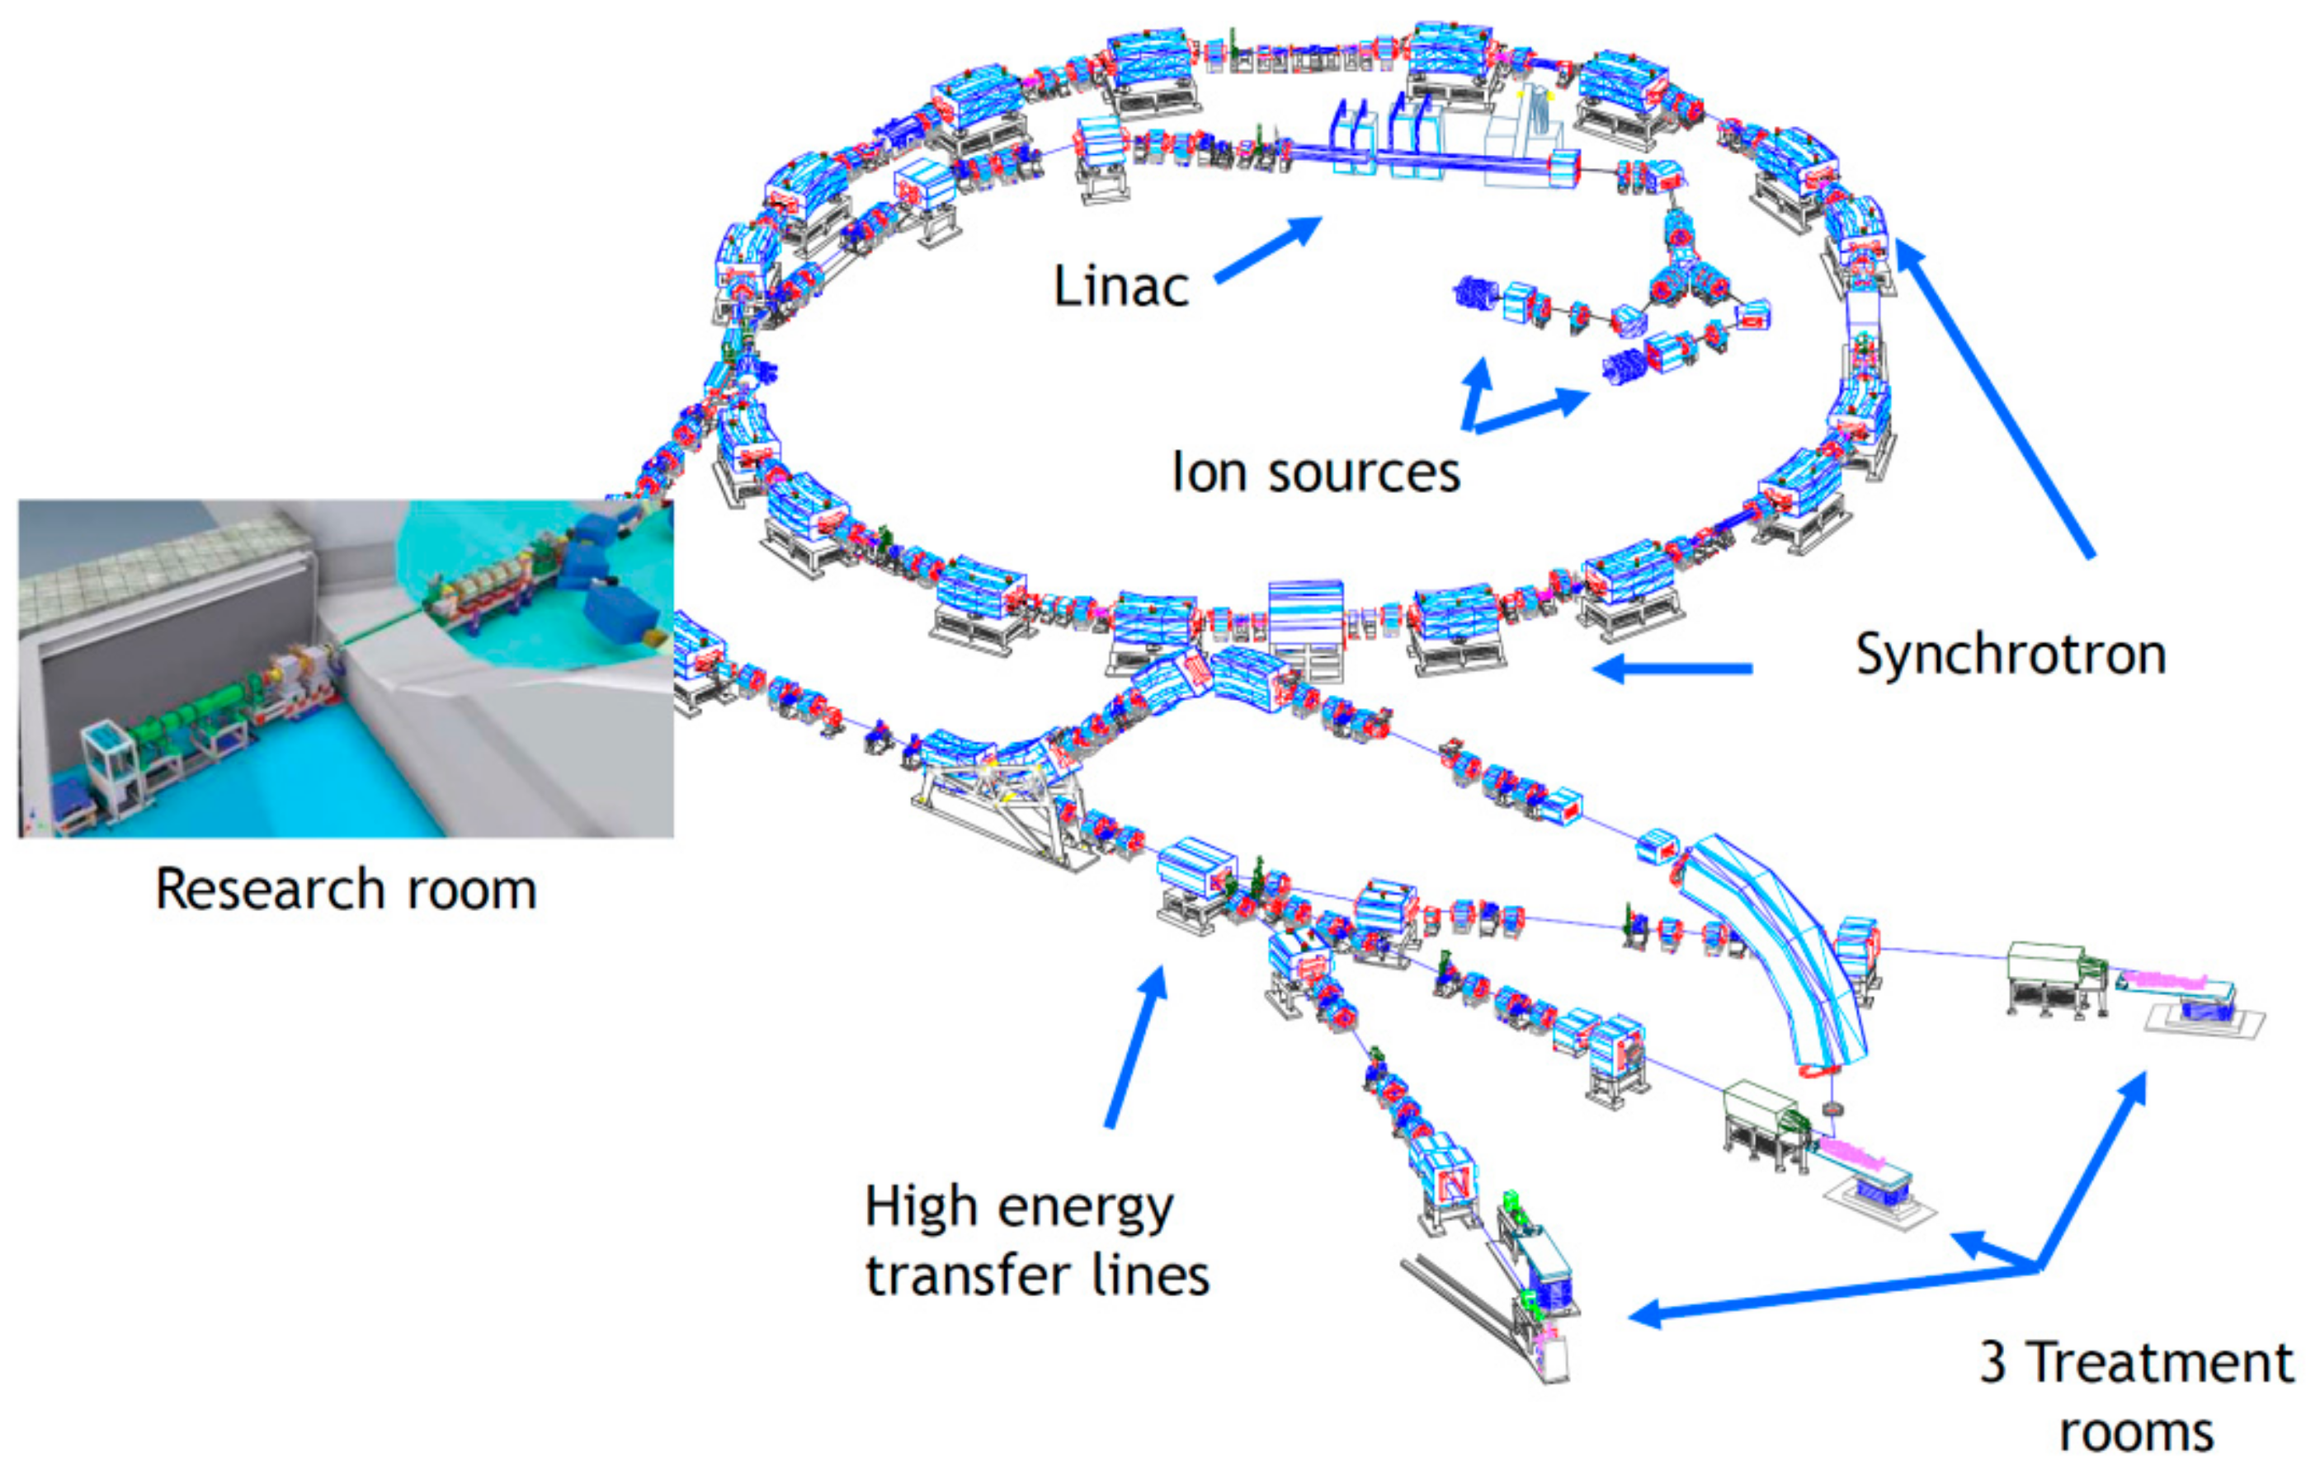
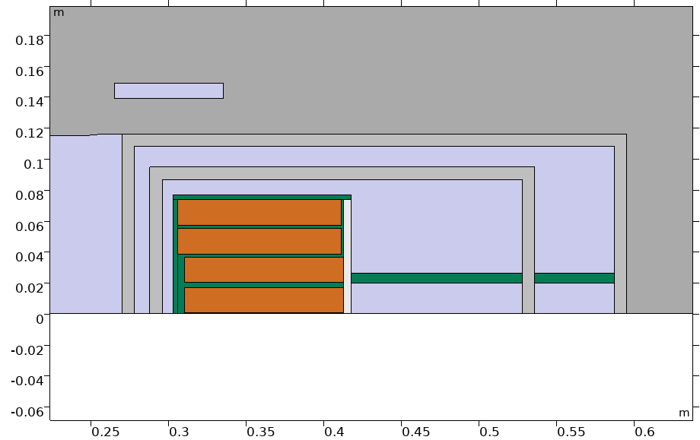
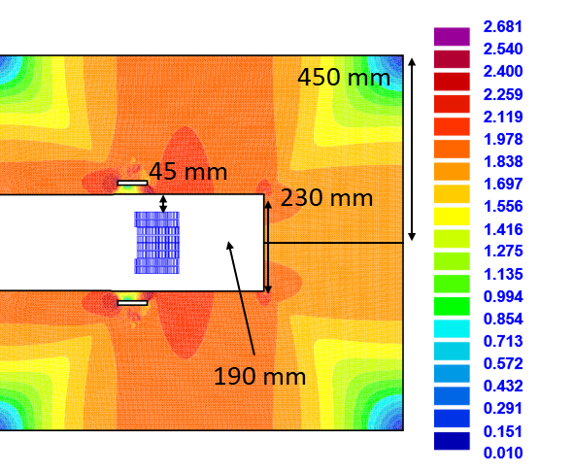
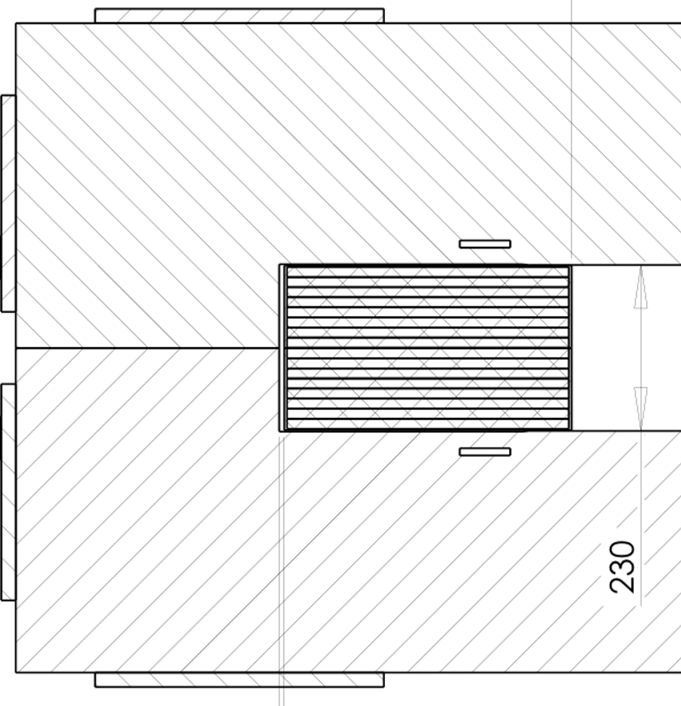
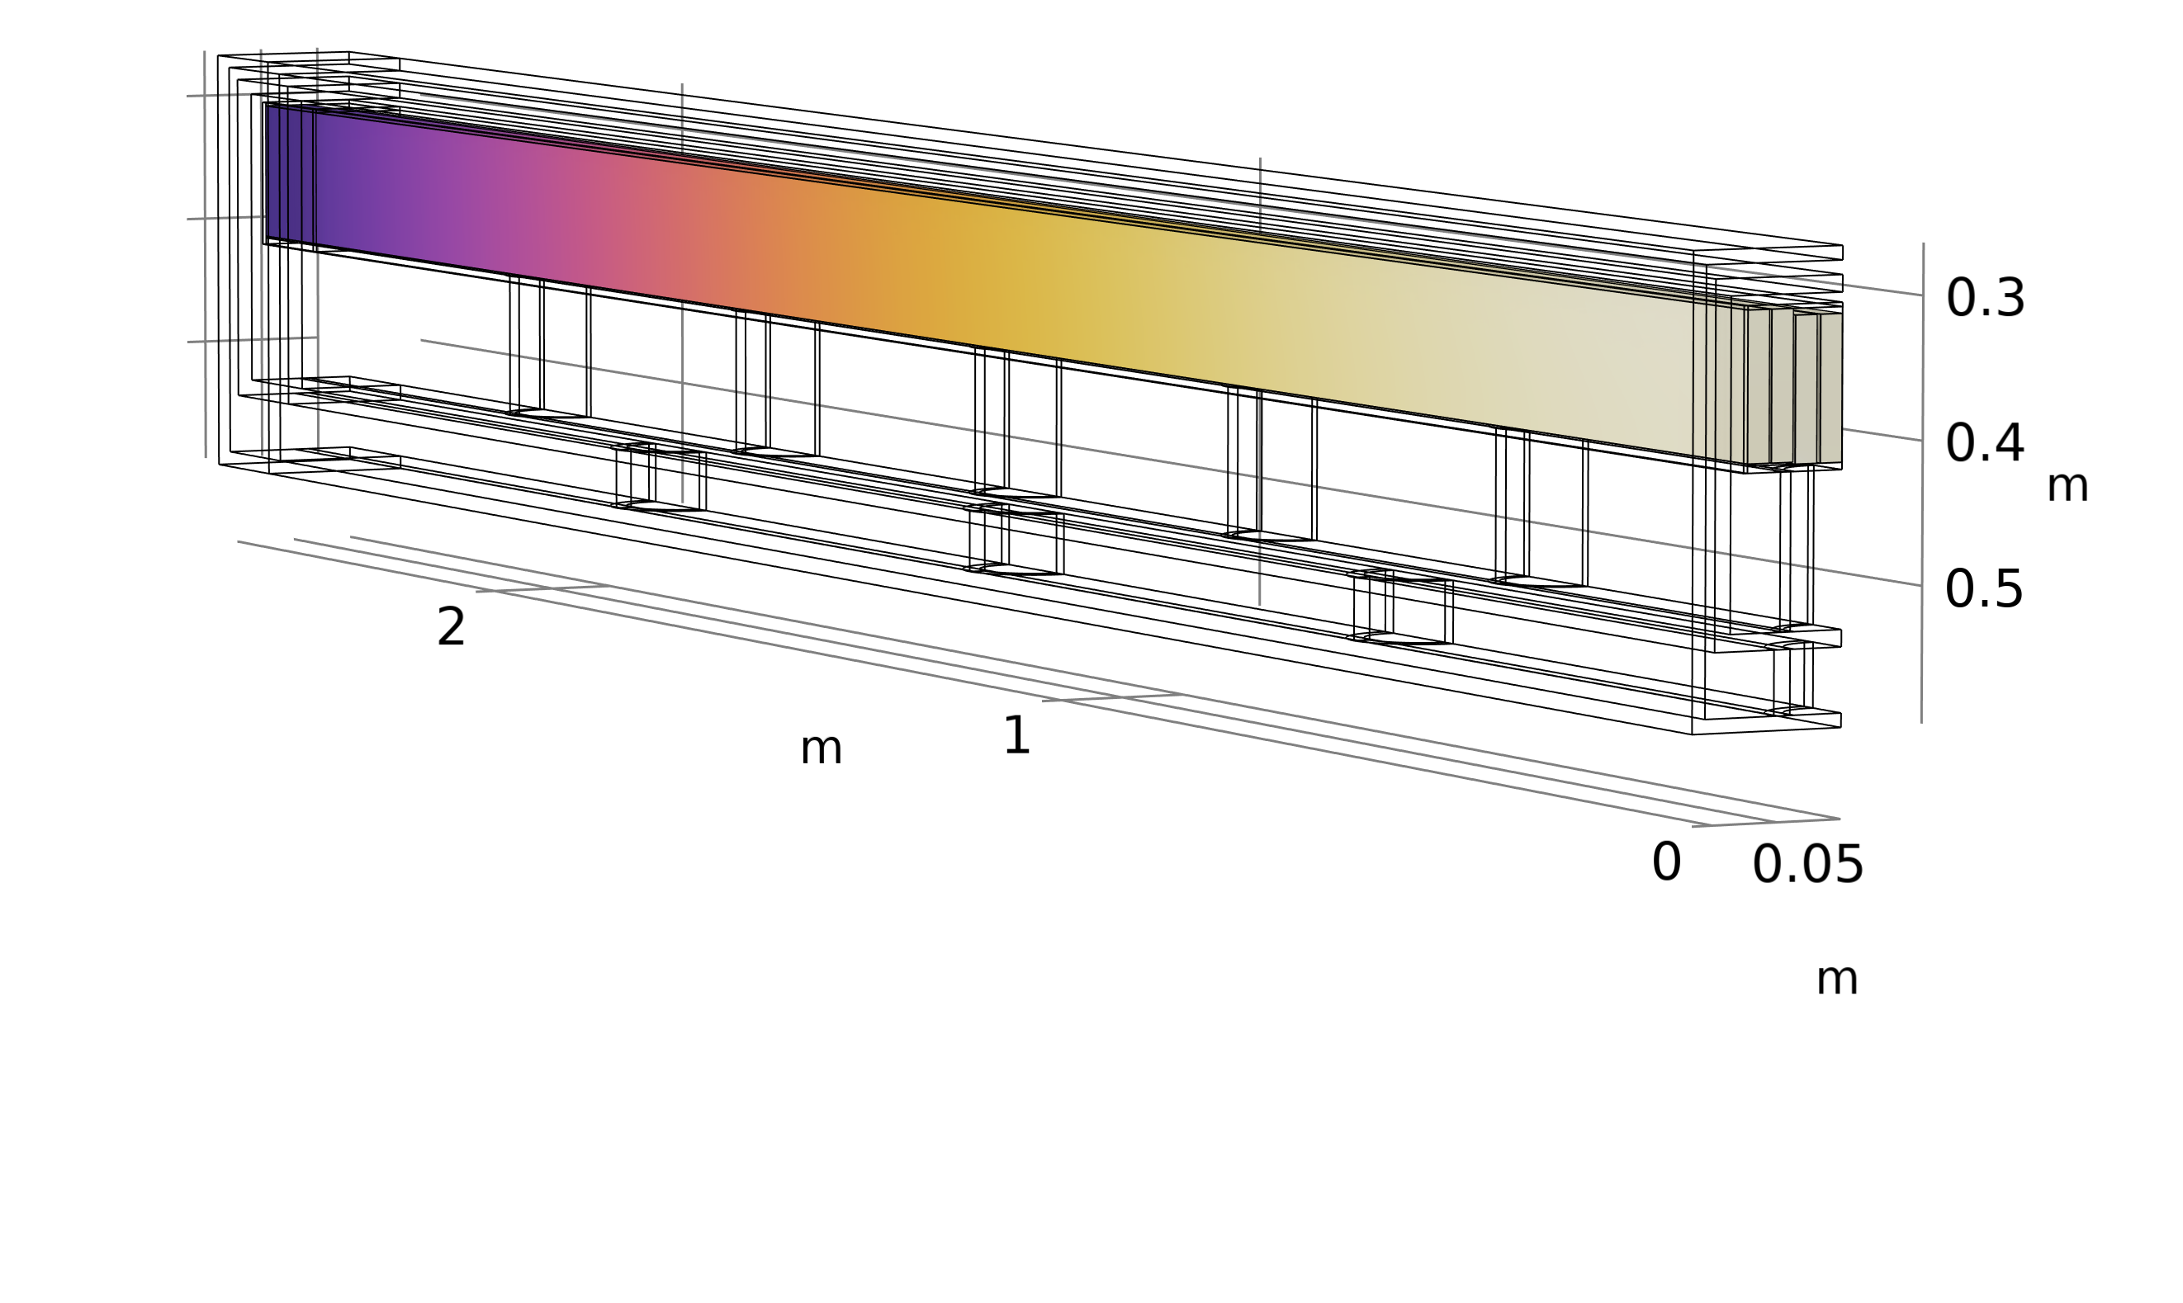
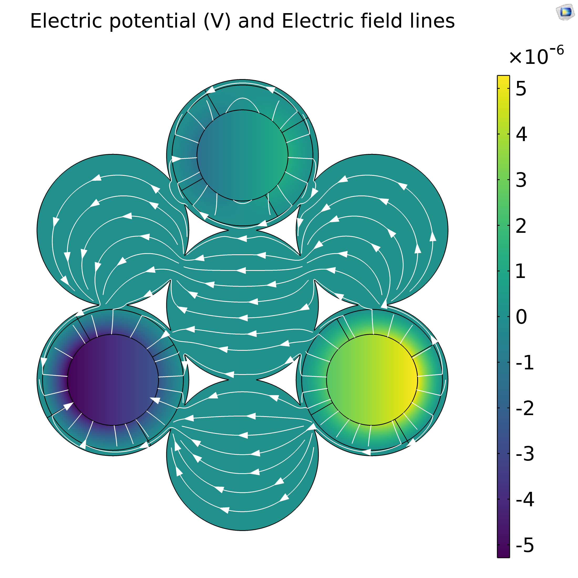
ESABLiM: first case study
Ramped Window-frame Bending Magnets, installed at CNAO (IT); Coil compatible with minimum bending radius required for MgB₂;
Actual coil: 80 channels each carrying 2.28 kA.
S.C: coil: 630 ropes ( 3 SC + 4 Cu); each one carries 276 A (low current for heat losses).
Empty space by new coil for mechanical supports and cryogenic systems.
Actual consumption 30 kW DC (equiv.);
The case study set-up prescribes 6 cryocoolers for a total of 7.4 kW DC at 10 K, with an incoming 20 K case expected to consume the half. Gain factor >4.
Courtesy of Samuele Mariotto
13 K
10 K
13 K
9

Slide 10
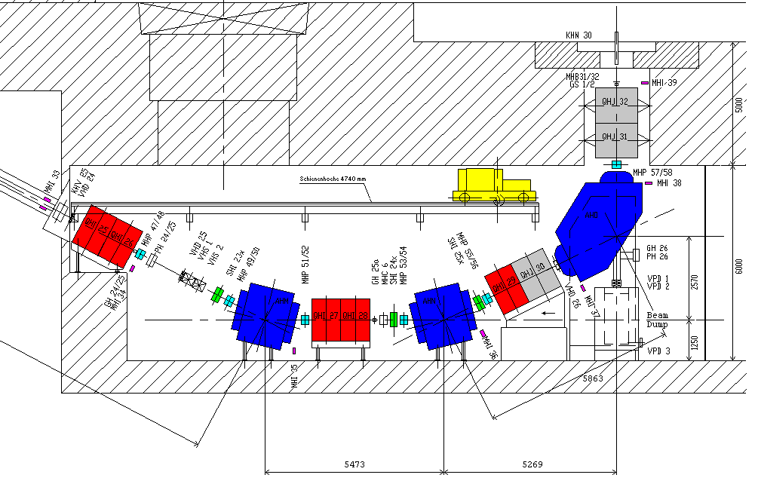
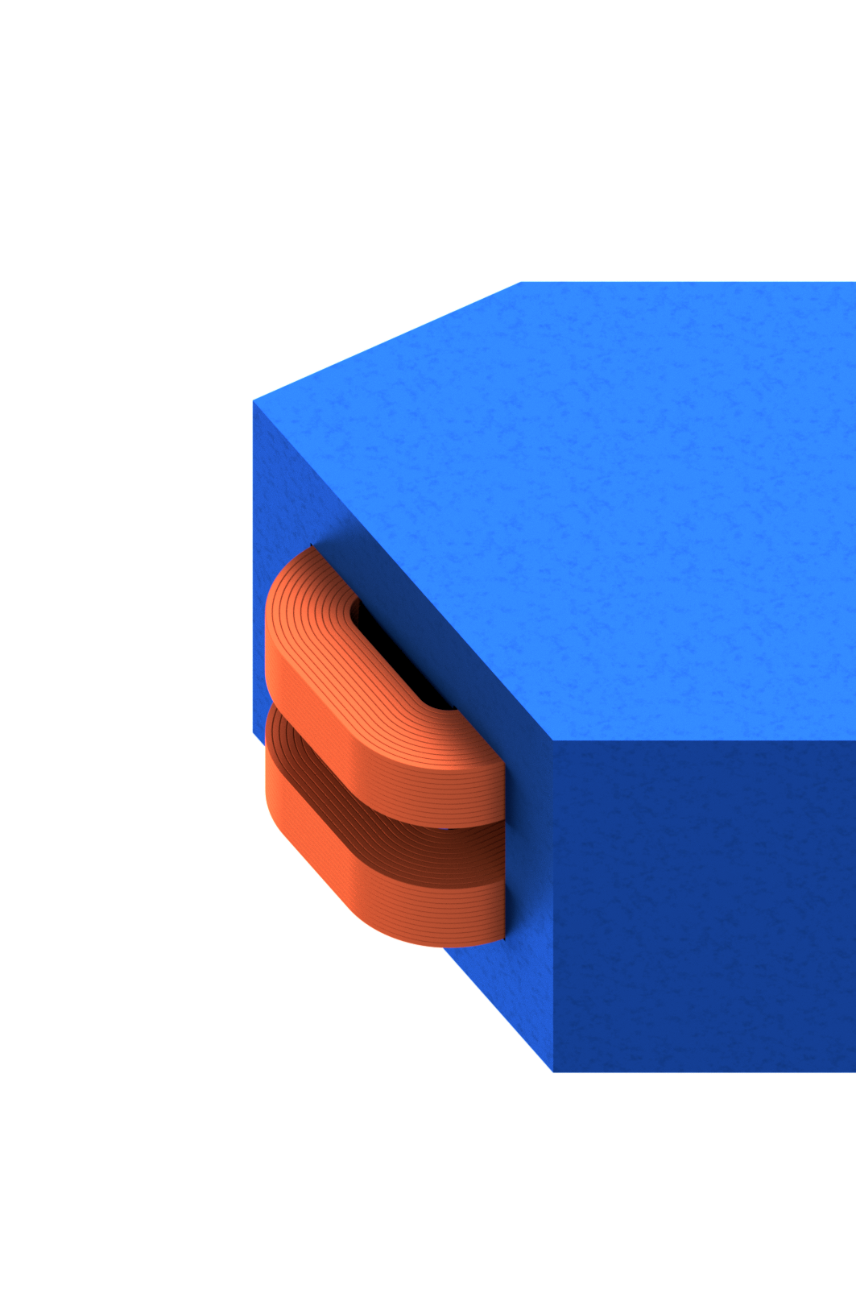
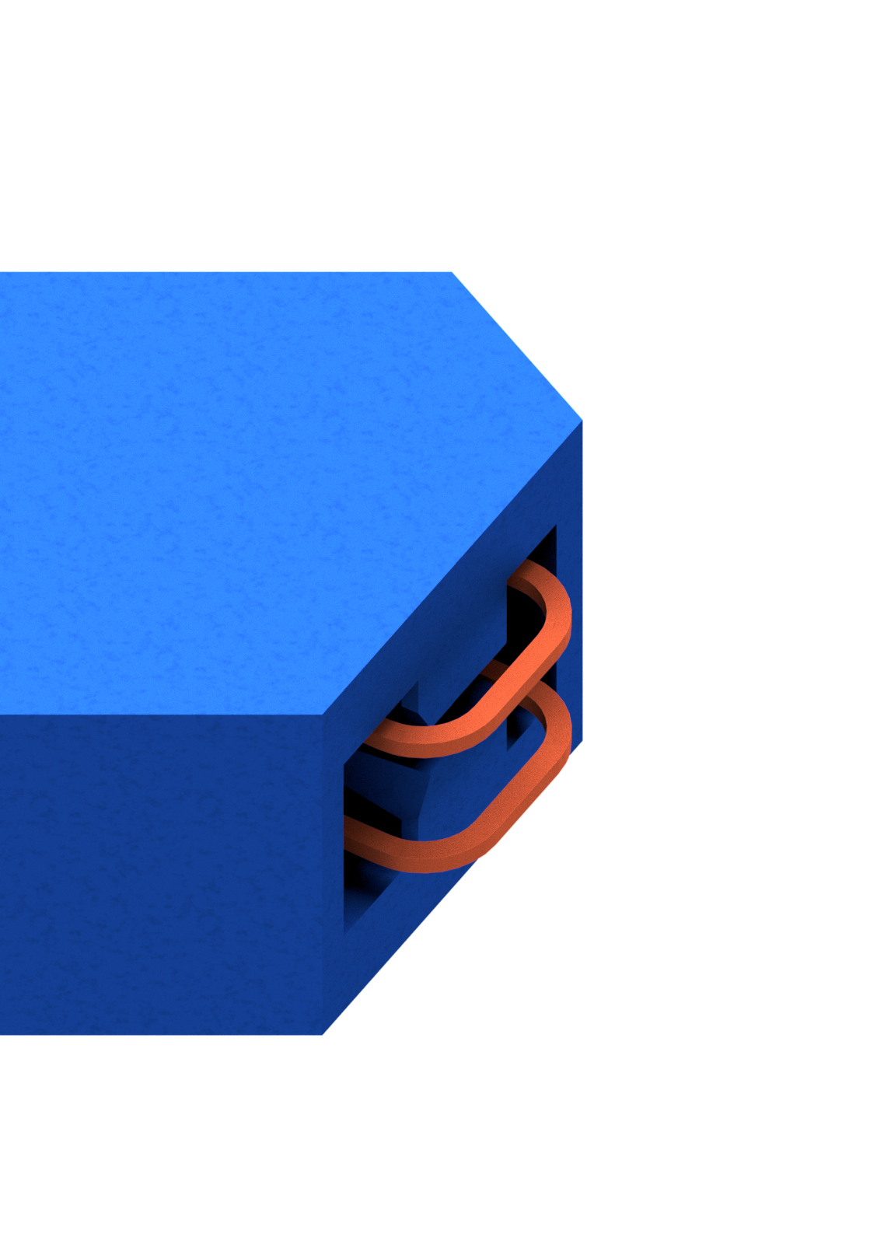
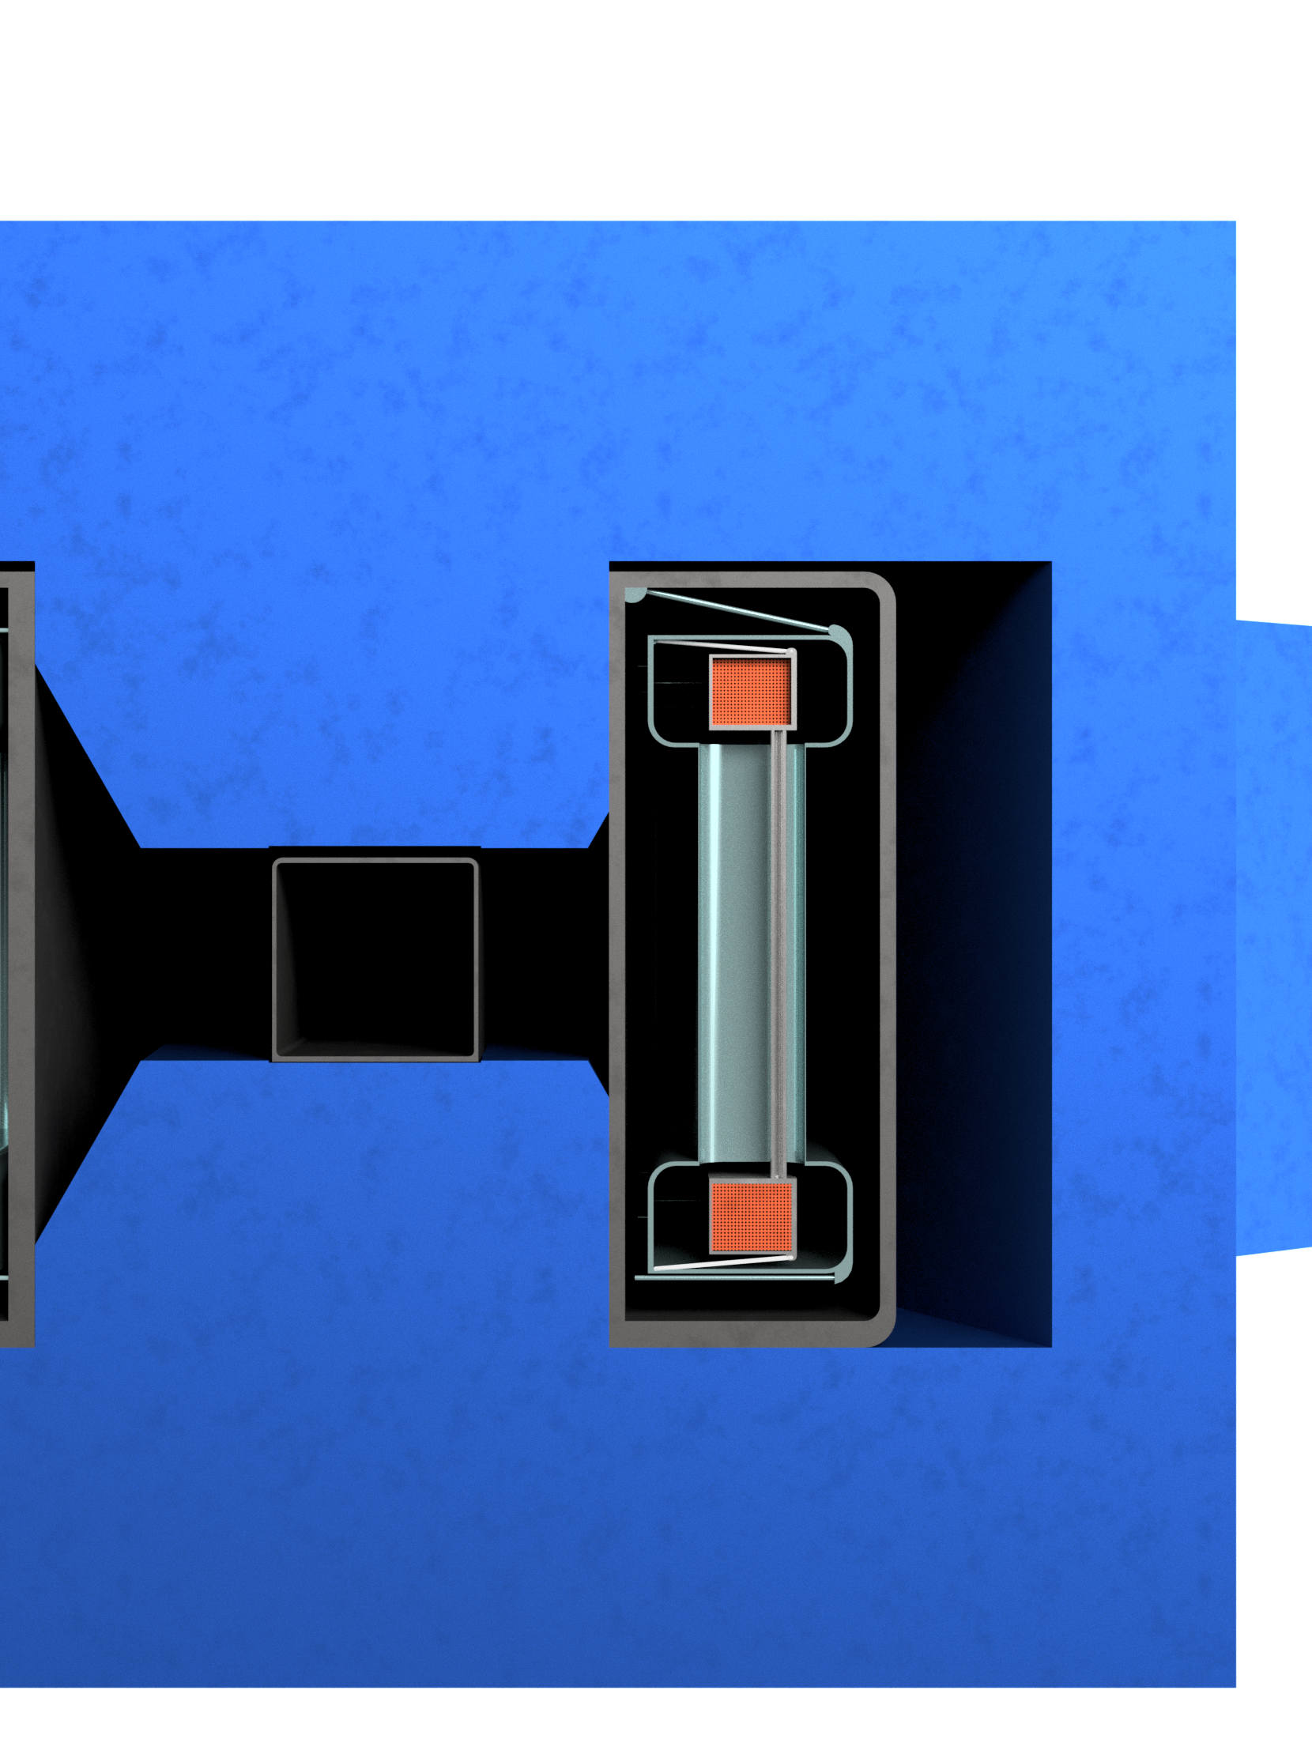
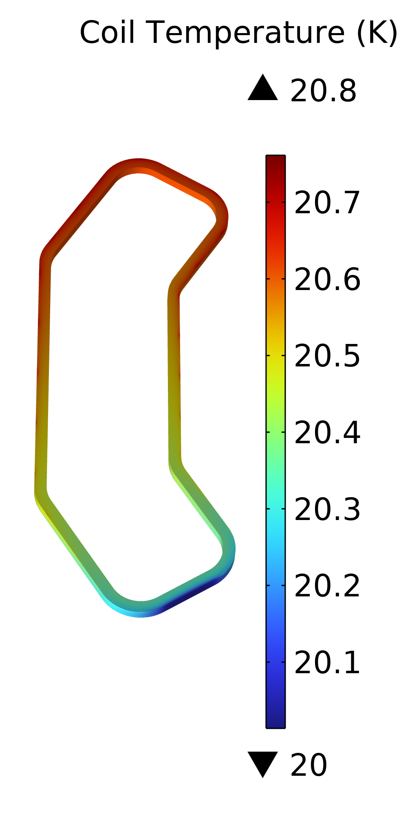
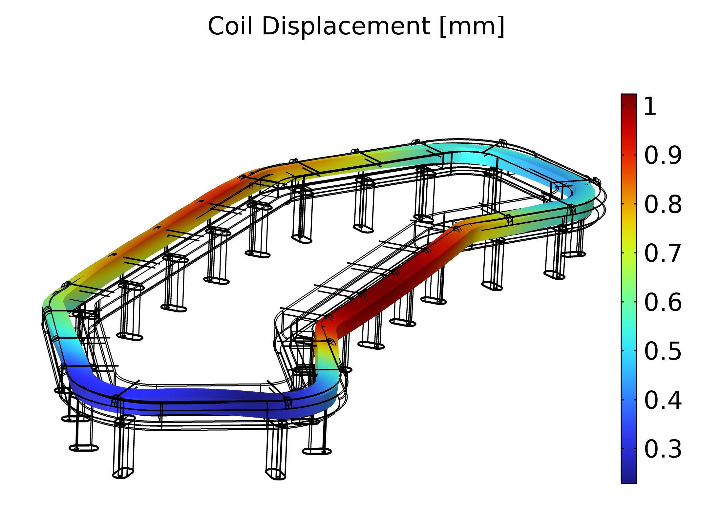
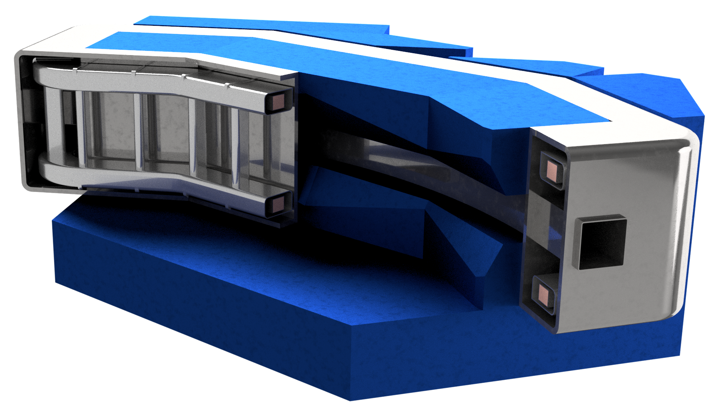
ESABLiM: second case study
DC Bending Magnets, installed at Spallation Source, PSI (CH); flat racetrack coil.
1.45 T largely given by yoke, coil far from it: safe operation of S.C. at 20 K (50% L.L. margin and 8 K T. margin).
Actual coil: 144 channels each carrying 1 kA.
S.C: coil: 484 ropes ( 4 SC + 3 Cu); each one carries 300 A (low current for heat losses).
Empty space by new coil for mechanical supports and cryogenic systems.
Actual consumption 190 kW DC (May-Dec);
The case study set-up prescribes 2 cryocoolers for a total of 5 kW DC at 20 K. Gain factor 40.
CRYOSTAT
COIL SUPPORT
THERMAL SH.
10

Slide 11

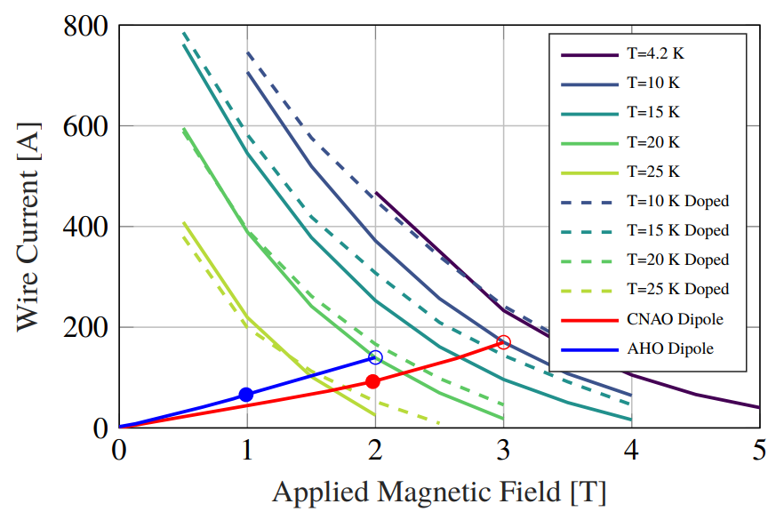
ESABLiM, industry partnership:
ASG and ASG Columbus
Direct involvement of ASG for the choice of case studies and investigating incoming demonstrator magnets. Fundings for research personnel at university.
Interest form ASG Columbus in contributing with their MgB₂ conductors.
Common interest in developing a “magnet portfolio” about the revamping of magnets.

Slide 12





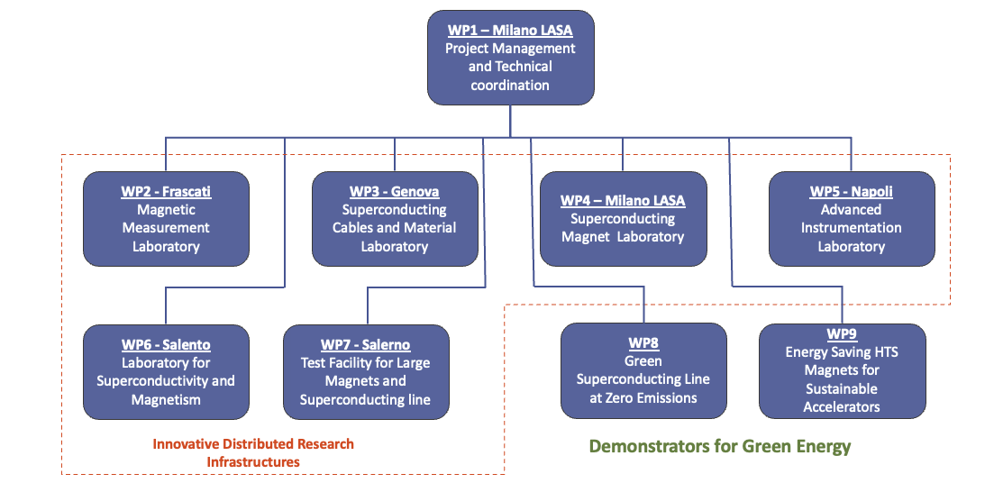
IRIS project
A distributed research infrastructure
A wide range of
objectives
Fundamental Physics instrumentation
Societal Applications
  Green: energy transport at zero emission and energy saving magnets;
  Medical: Superconductivity could play a key role in heavy ion therapy by enabling a rotatable gantry;
Two full-scale demonstrators.
Final deadline is 30 October 2025.

Slide 13
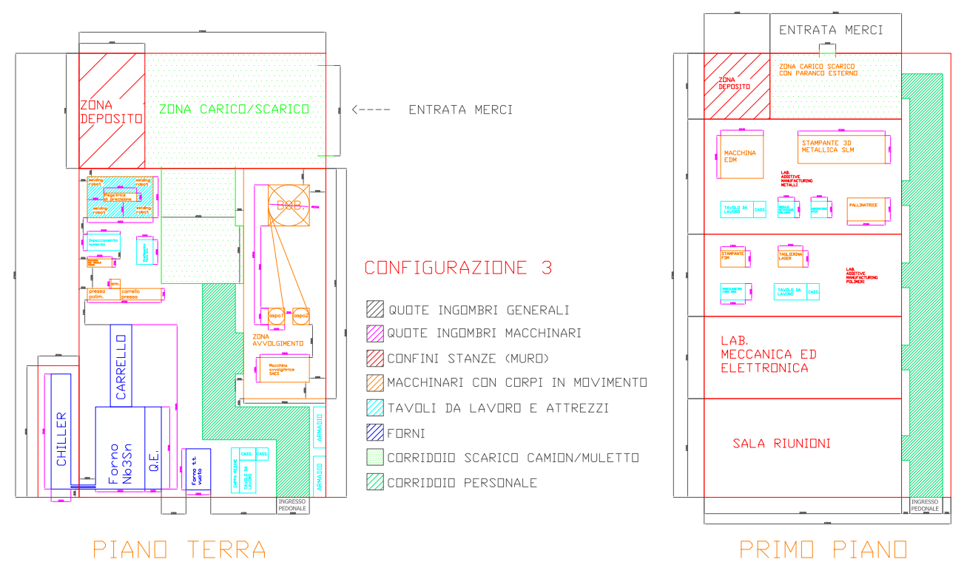
Infrastructures in WP4
4.1 Civil Engineer with technical services for Magnet Laboratory
4.2 QA bare magnet test stand
4.3. Winding machines
4.4. Instruments and large equipment for superconducting winding and magnet assemby laboratory
4.5 3D Additive Manufacturing for Metal and Polymers for rapid protyping
DRAFT

Slide 14
Demonstrators (WP8, WP9)
Green Superconducting Line
Energy Saving HTS magnet
Energy transport at 0³ emission:
  Zero (almost) emission of C02 :
  consumption will be 1% over 1000 km
  Zero emission of e.m. radiation (DC)
  Zero (almost) land consumption: a 50 cm underground pipe can carry the 5 GW power of 30 m X 50 m overhead line.
25 kV - 40kA, at 20 K (50+ kV testing)
Round MgB₂ strands, cooled with He gas;
after IRIS, investigation on LH cooling.
Main goal: 8 T – 20 K, 10 K margin,
conduction cooled.
Aperture 80 mm X 50 mm, with 700 mm straight section, for cable test (at INFN-Genova).
Additionally, technology driver for 15 T – 20 K magnets for FCC or Muon-C.
Around 10 km of 12 mm wide ReBCO tape. Stack cable with controlled-insulation.
Charging time in the range of (a few) hours.

Slide 15
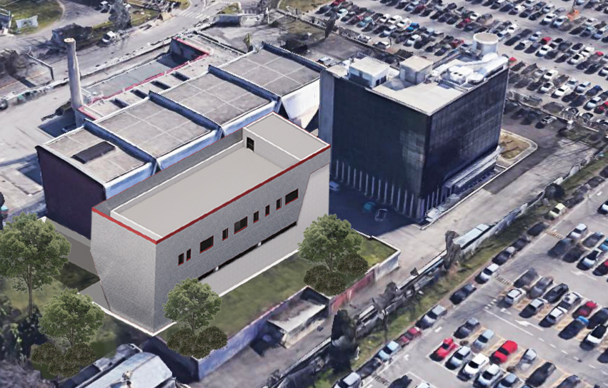
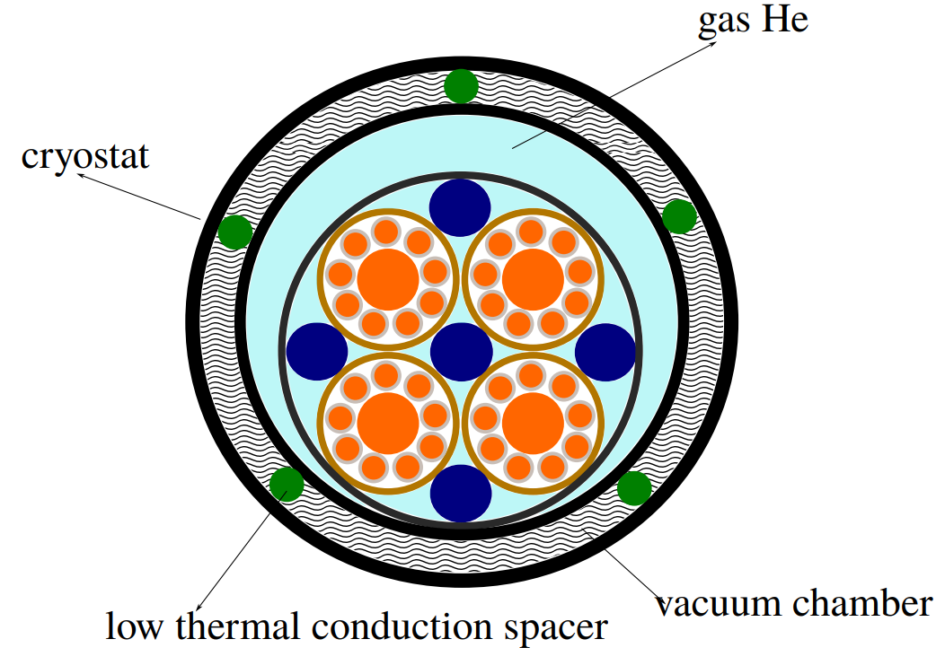
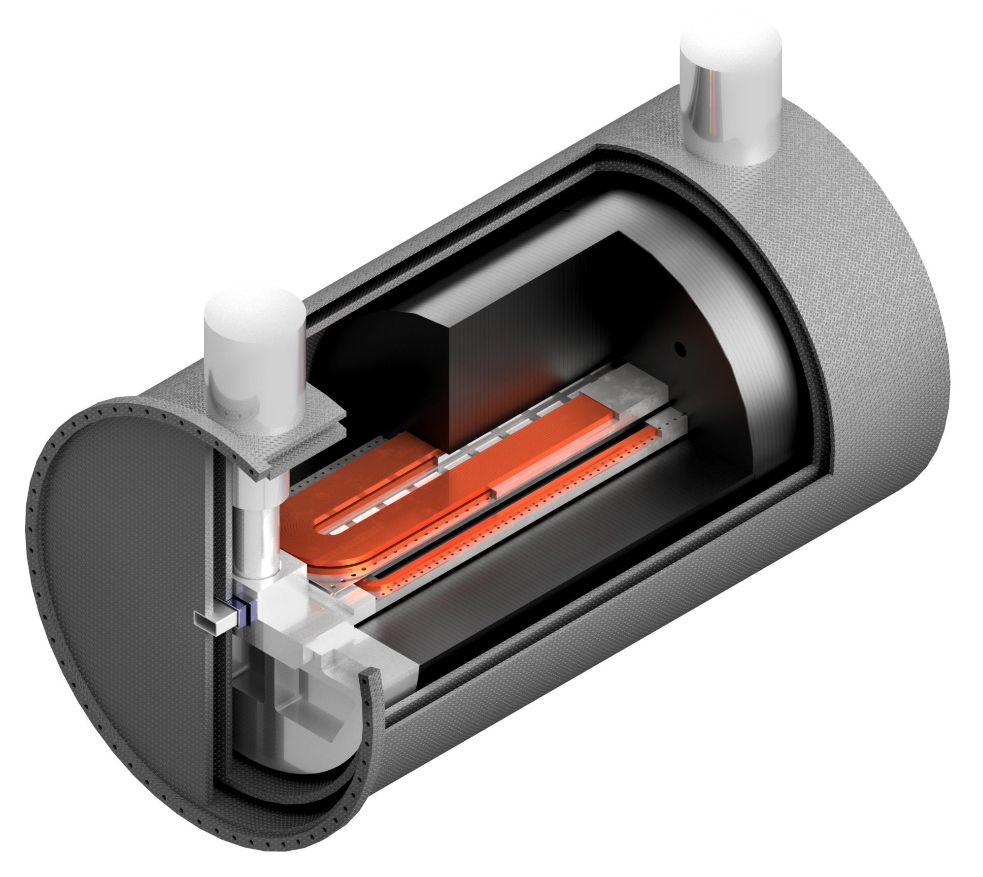
Industrial partners in WP4, WP8 WP9
Calls for infrastructures
Call for both demonstrators
Bids under scrutiny for large equipment
Incoming for building and procuring
Bids under scrutiny
Manufacturing of both demonstrators
Iron Yoke
Coils
Cryocooler
Vessel
& Shield
Anti-Cryostat
Al end-frame

Slide 16
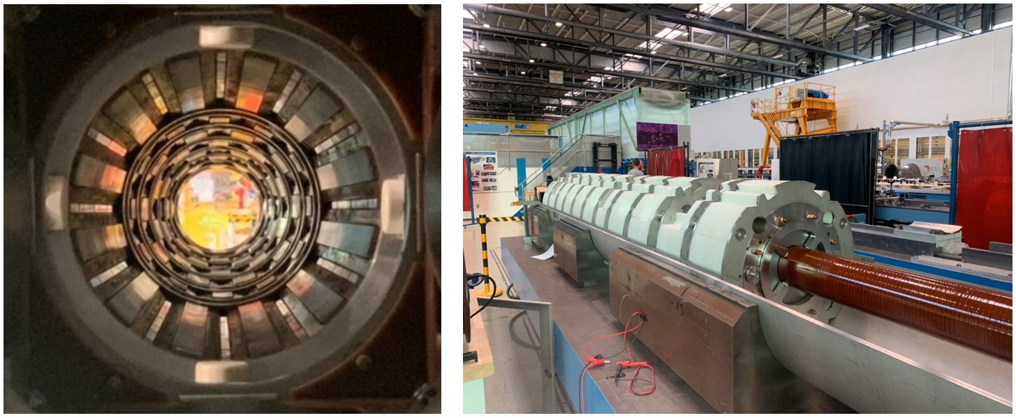
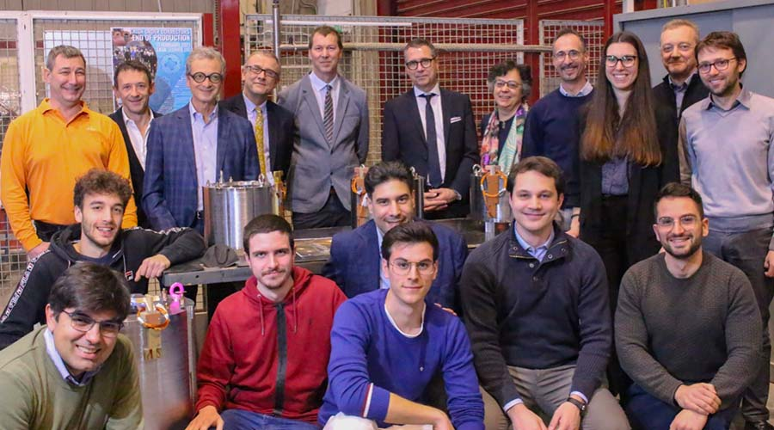

Special Mention: HOCM for HL-LHC
INFN-LASA recently concluded the program for the design and construction of 54 High-Order Corrector Magnets for the Hi-Lumi upgrade of LHC at CERN;
The project was concluded successfully and in time. A key ingredient was a strong partnership with the companies SAES RIAL Vacuum and SAES Getters;
SAES RIAL Vacuum was responsible for manu-facturing of all the production magnets and it was actively involved in many steps from prototyping to testing.

Slide 17
THANKS FOR THE ATTENTION!

