Slide 1
AI-driven optimization of operation and maintenance of future accelerators
Andrea Apollonio - andrea.apollonio@reshape.systems
Acknowledgements: T. Cartier-Michaud, L. Felsberger, C. Obermair, colleagues from CERN EPC, MPE, RF groups
20/04/2023

Slide 2
Why should we use AI for design, operation and maintenance of particle accelerators?
Enhanced Performance and Efficiency: Particle accelerators are complex and require precise tuning for optimal performance. AI can analyze large amounts of data, such as accelerator performance data, sensor readings, and experimental results, in real-time, and identify patterns and anomalies that may be difficult for humans to detect. This can lead to improved accelerator performance, higher efficiency, and reduced downtime, resulting in cost savings and increased productivity.
Faster Design and Optimization: Designing and optimizing particle accelerators can be time-consuming and labor-intensive. AI can assist in automating and accelerating the design process by using algorithms that can generate, simulate, and optimize accelerator configurations. This can result in faster development cycles, reduced trial and error, and improved performance of the accelerator.
Predictive Maintenance: Particle accelerators require regular maintenance to ensure smooth operation and prevent breakdowns. AI can analyze data from sensors, monitors, and other sources to predict potential equipment failures or performance degradation, allowing for proactive maintenance and minimizing unplanned downtime. This can save time and resources, as maintenance can be planned more efficiently, and costly equipment failures can be prevented.
Enhanced Safety: Particle accelerators can involve hazardous materials, high voltages, and other safety risks. AI can be used to monitor and analyze safety parameters in real-time, identifying potential safety hazards and triggering appropriate responses, such as shutting down the accelerator or activating safety protocols. This can improve safety and reduce the risk of accidents or incidents.
Optimization of Experimental Parameters: Particle accelerators are used in various scientific experiments, and the performance of the accelerator can impact the outcome of these experiments. AI can analyze experimental data, optimize experimental parameters, and recommend adjustments to achieve desired results. This can save time and resources in experimental trials, and potentially lead to faster scientific discoveries.
Adaptive Control: Particle accelerators often require precise control of various parameters to maintain desired performance. AI can provide adaptive control strategies that can continuously optimize accelerator parameters in real-time based on changing conditions, such as beam intensity, energy, and stability requirements. This can result in improved accelerator performance and stability, leading to better experimental results.

Slide 3
Why should we use AI…explained by AI
Enhanced Performance and Efficiency: Particle accelerators are complex and require precise tuning for optimal performance. AI can analyze large amounts of data, such as accelerator performance data, sensor readings, and experimental results, in real-time, and identify patterns and anomalies that may be difficult for humans to detect. This can lead to improved accelerator performance, higher efficiency, and reduced downtime, resulting in cost savings and increased productivity.
Faster Design and Optimization: Designing and optimizing particle accelerators can be time-consuming and labor-intensive. AI can assist in automating and accelerating the design process by using algorithms that can generate, simulate, and optimize accelerator configurations. This can result in faster development cycles, reduced trial and error, and improved performance of the accelerator.
Predictive Maintenance: Particle accelerators require regular maintenance to ensure smooth operation and prevent breakdowns. AI can analyze data from sensors, monitors, and other sources to predict potential equipment failures or performance degradation, allowing for proactive maintenance and minimizing unplanned downtime. This can save time and resources, as maintenance can be planned more efficiently, and costly equipment failures can be prevented.
Enhanced Safety: Particle accelerators can involve hazardous materials, high voltages, and other safety risks. AI can be used to monitor and analyze safety parameters in real-time, identifying potential safety hazards and triggering appropriate responses, such as shutting down the accelerator or activating safety protocols. This can improve safety and reduce the risk of accidents or incidents.
Optimization of Experimental Parameters: Particle accelerators are used in various scientific experiments, and the performance of the accelerator can impact the outcome of these experiments. AI can analyze experimental data, optimize experimental parameters, and recommend adjustments to achieve desired results. This can save time and resources in experimental trials, and potentially lead to faster scientific discoveries.
Adaptive Control: Particle accelerators often require precise control of various parameters to maintain desired performance. AI can provide adaptive control strategies that can continuously optimize accelerator parameters in real-time based on changing conditions, such as beam intensity, energy, and stability requirements. This can result in improved accelerator performance and stability, leading to better experimental results.
Generated with ChatGPT
Possibilities for AI application are almost unlimited nowadays

Slide 4


Advantages vs disadvantages of AI
Advantages
Disadvantages
Unique capabilities to find patterns in data
Flexibility (from data exploration to predictions)
Easy scaling with complexity
Alternative viewpoint on known problems
Under continuous development
Data quality is key
Steep learning curve
Model results are intransparent
Resource intensive
Under continuous development

Slide 5
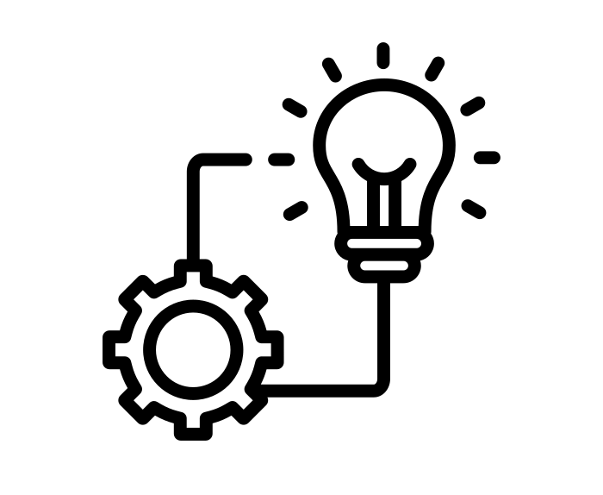


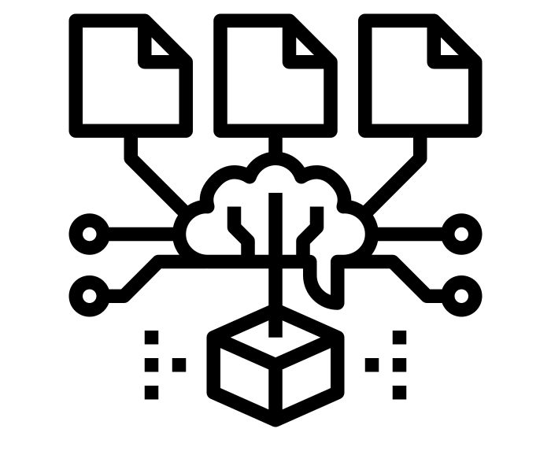
The AI Workflow
Data Cleaning
Prepare dataset for analysis
Exploration
Understand data, relevant features
Modelling
Classification, prediction,...
Implementation
Deploy model in operation setting
50+%
Effort [%]
20-30%
10-20%
5-10%

Slide 6

Challenges of next generation particle accelerators
Innovation
New technologies vs reliability
Enhanced safety
Asset protection
Personnel protection
Increased performance
Physics output
Number of patients treated
Neutron fluence
…
Sustainability/Reduced costs
Energy efficiency
Availability
Operational efficiency
Can AI help to tackle these challenges?

Slide 7
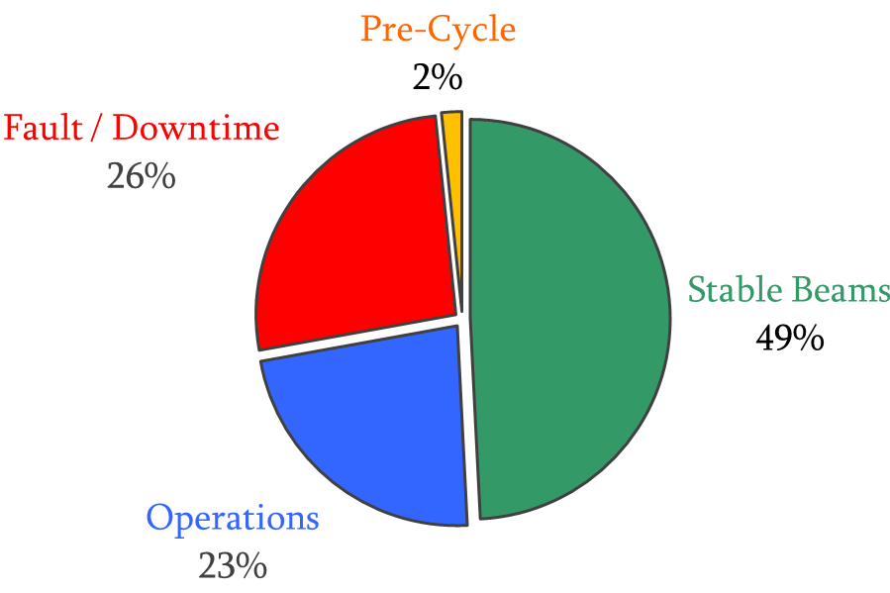
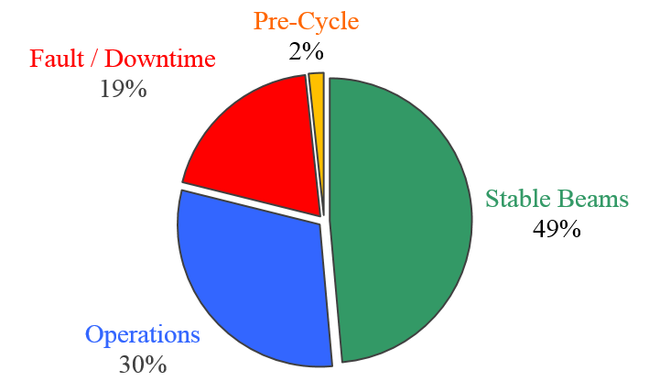
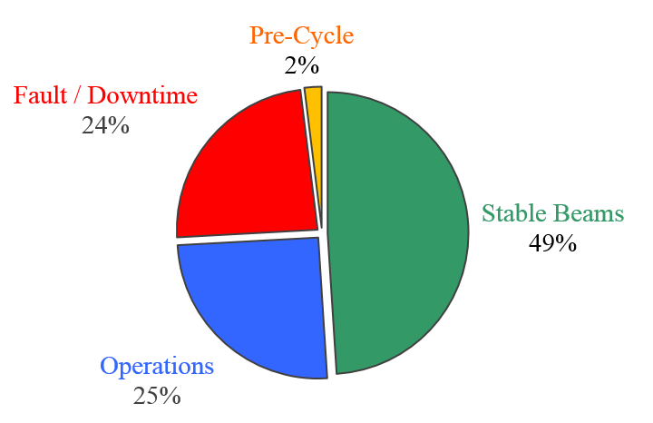
Accelerator availability
*References – Availability Working Group reports (2016, 2017, 2018)
LHC example (Run2)*:
2016
(156 days)
2017
(140 days)
2018
(164 days)
Availability (A) is a measure of the useful time of accelerator operation
A(reliability, maintainability)
Reliability (R) is a measure of the failure frequency
R(number of systems, operating conditions)
Maintainability (M) is a measure of how fast we can recover from failures
M(diagnostics time, logistics time, repair time)
Unfavorable scaling with increasing complexity
We need new ways to address this challenge in the future!

Slide 8
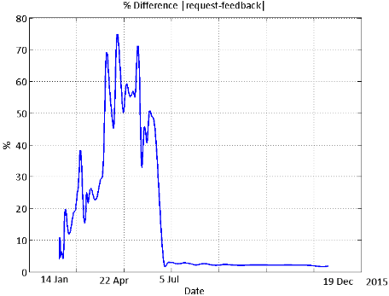
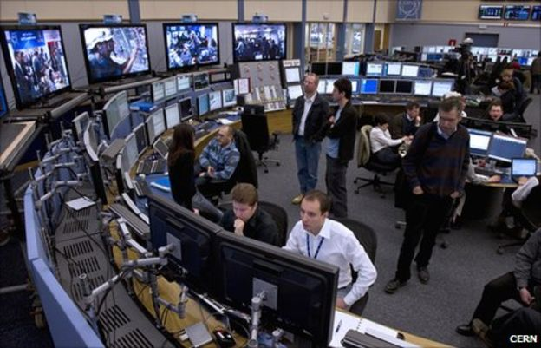
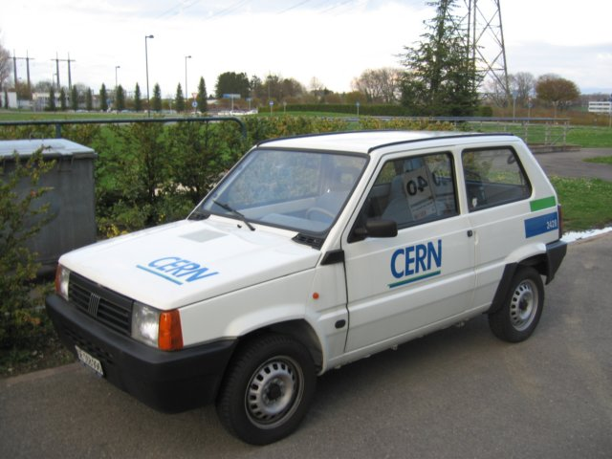

Can AI help for operation and maintenance of particle accelerators?
Failure
Identification
Diagnostics
Logistics
Repair
AI for anomaly detection and failure prediction
Switch from reactive to proactive approach
Remote/robotics
maintenance
Switch from manual to automated

Slide 9
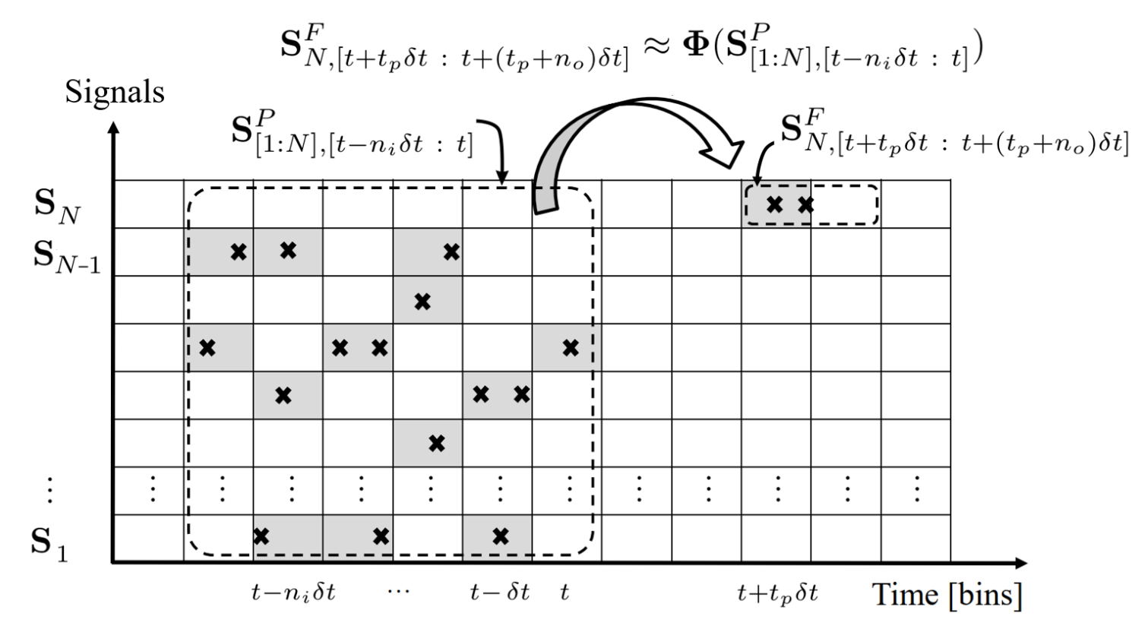
Failure identification example: PSB alarm system
Idea: use historical data from CERN PSB alarm system for failure prediction
Goal: identify failure precursors and hidden system dependencies in alarm system
Data sources: alarm system, fault tracker, operations logbook, system logbooks, AMMSs
Problems: synchronization of different data-sources, modification of alarm definitions, high class imbalance
Findings: failure precursors can be identified among N=100 signals with as low as 10 failure events in the training set
“Explainable Deep Learning for Fault Prognostics in Complex Systems: A Particle Accelerator Use-Case”, L. Felsberger et al.

Slide 10
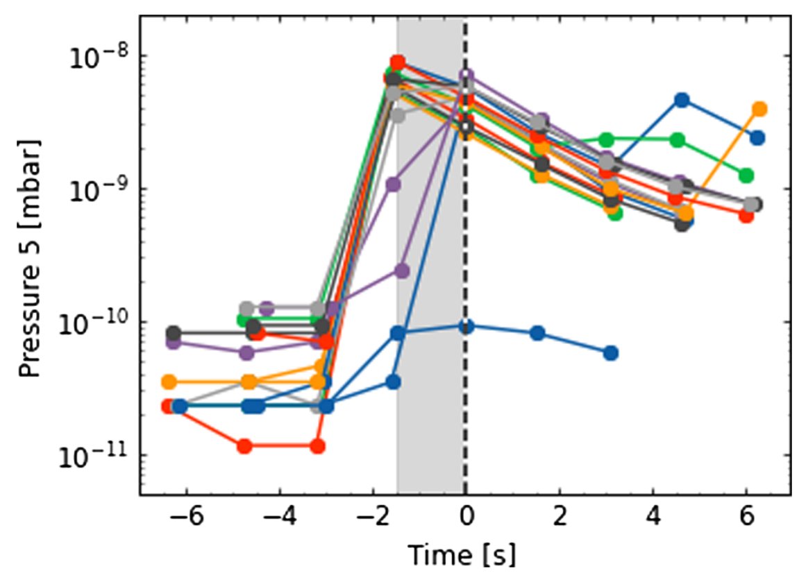
Failure identification example: CLIC RF breakdown prediction
t=0 breakdown
Idea: analyze data from CLIC RF test stand (XBOX) to predict the occurrence of breakdowns
Goal: improve conditioning (recovery algorithms) and optimize availability through dynamic failure compensation
Data sources: XBOX control system
Problems: synchronization of data acquisition devices, high class imbalance
Findings:
Trend data (scalar): possible precursor of primary RF breakdowns (tbc with further tests)
Event data (timeseries): 89.7% accuracy in the prediction of follow-up breakdowns
“Explainable machine learning for breakdown prediction in high gradient RF cavities”, C. Obermair et al.

Slide 11
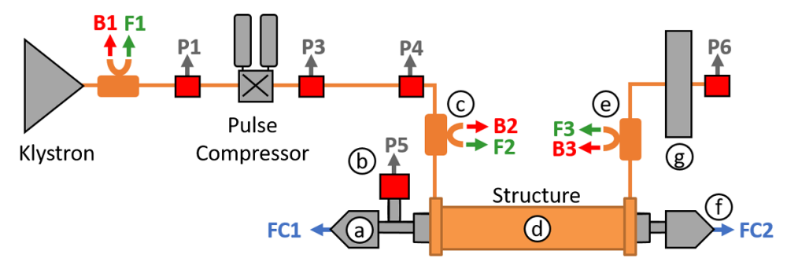
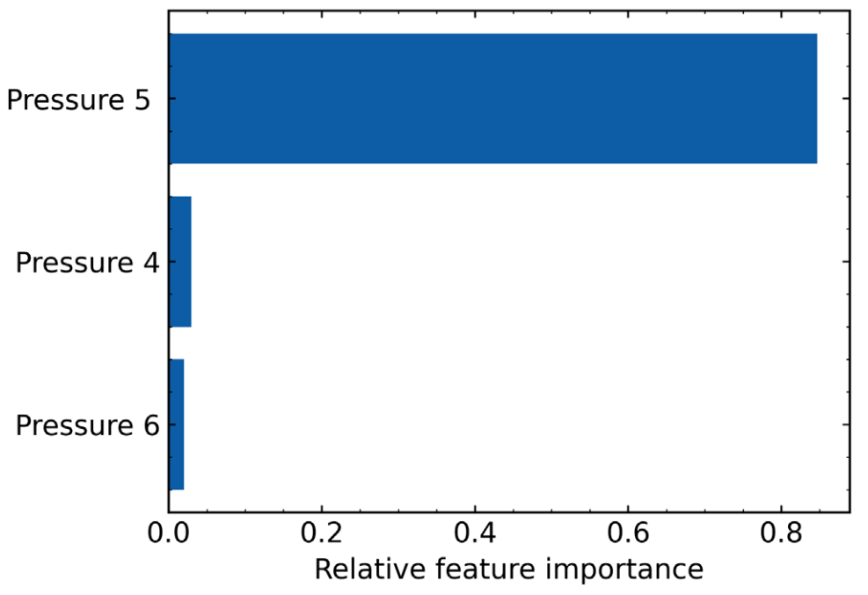
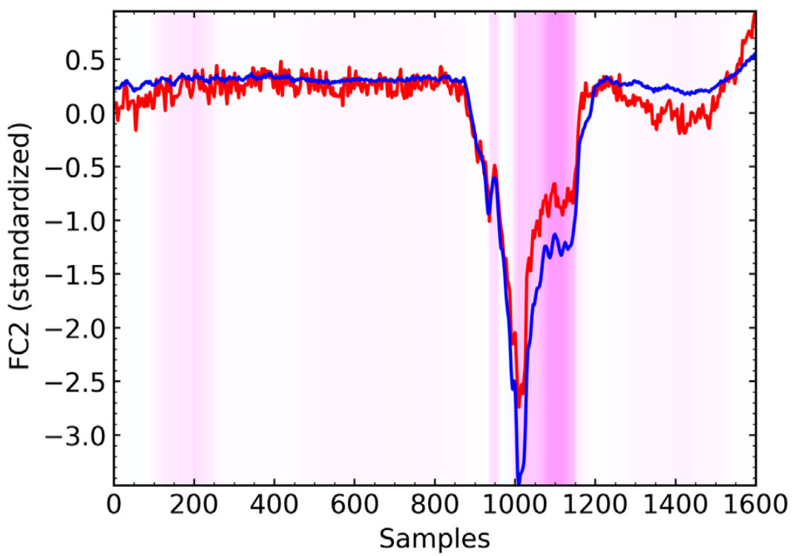
The role of explainable AI
AI models often feel like “black boxes”, where given (large) inputs a result/action is returned
Having control over model decisions can be an essential ingredient for a successful application of AI models, especially in safety-critical applications
Explainable AI aims at “opening the black box” and providing insights into model decisions
SHAP values: assess feature importance for model predictions
CLIC RF test setup
Feature importance
Healthy
Breakdown
(next pulse)
Trend data
Event data
“Explainable machine learning for breakdown prediction in high gradient RF cavities”, C. Obermair et al.

Slide 12
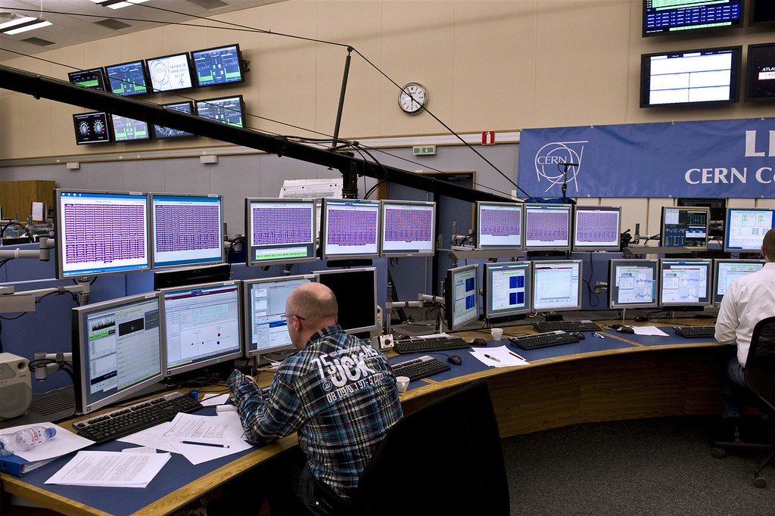

Diagnostics: use of Large Language Models
Operation and maintenance of particle accelerators relies on highly trained staff
Operators: problem identification and initial diagnostics
On-call experts: dedicated support for complex problem resolution
Management of organizational knowledge is a great challenge for large research institutions
Can be problematic in situations of high turnover
Difficult to ensure continuity in case of key members leaving the organization
CERN Control Center
Latest developments in Large Language Models (LLMs) could help to develop solutions to increase operational efficiency
Easy access to historical information
Faster fault diagnostics and problem resolution

Slide 13



Organization of AI activities - my 2 cents
Within an organization
Across organizations
Definition of case studies (boundaries, constraints, data sources,...)
Support during data exploration and result interpretation
Definition of common case studies
Examples: beam control, failure prediction, dose delivery to patients
Standardization of data sources
Example: fault tracking systems
Identification of common AI solutions
Examples: models, deployment strategies
Accelerator expert
Data cleaning
Identification of models suitable for case study
Model implementation
ML expert

Slide 14
Conclusions and Outlook
AI shows extremely high potential for a wide range of applications in particle accelerators
Close collaboration between accelerator experts and AI experts required for successful application
Systems will have to be conceived to be AI-friendly in the future to fully exploit its potential
Application of advanced methods for anomaly detection and failure prediction is a must for next generation particle accelerators
Latest LLMs could be used to improve management of organizational knowledge

Slide 15
The most dangerous sentence in engineering:
“We have always done it this way”
andrea.apollonio@reshape.systems
20/04/2023

