Slide 1

11Tesla Dipole Presentation
Carmen Abad on behalf of the WP11 Team
04/10/2022

Slide 2
Content
Context of the 11T Dipole
Design
11T Dipole hybrid DP301
  Magnet setup
  DP301 activities

Slide 3
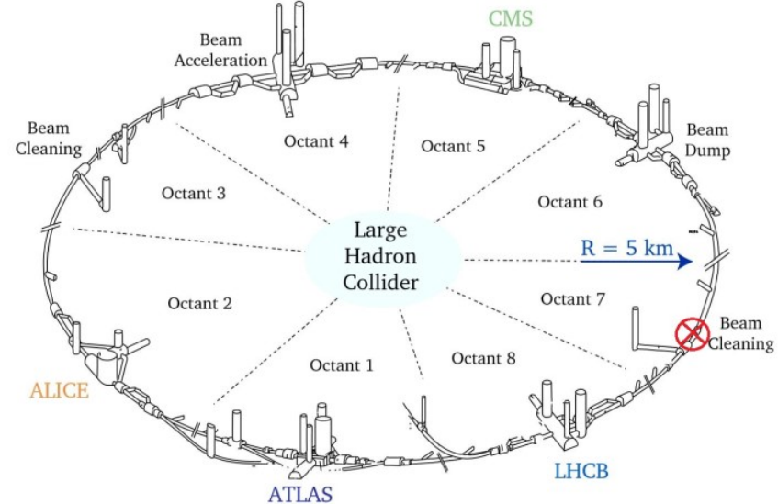
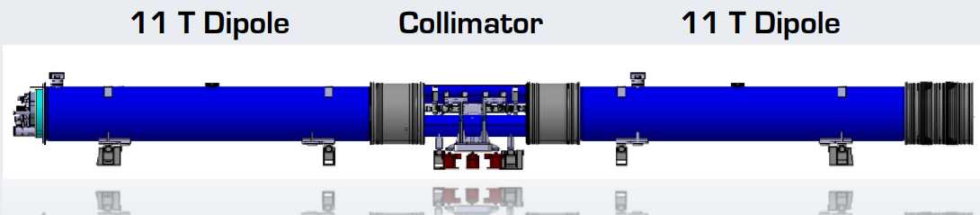
Context of 11T Dipole Magnet
11 Tesla Dipole Magnet is a part of the HL-LHC program to increase the beam intensity.
Objective: replace the LHC dipoles by two 5.5m 11T, to have space to insert a collimator in the Beam Cleaning point.
  LHC dipoles:
    Conductor NbTi
    15m long
    8.3Tesla
  11Tesla dipole:
    Conductor Nb3Sn
    5.5m long
    11.2Tesla
  The collimator cleans the particles that are scattered in the beam before they reach the collision zone.
From EDMS 2186616

Slide 4
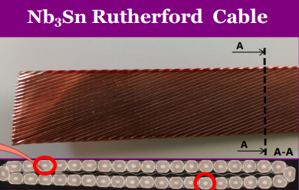
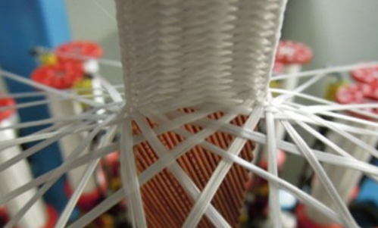
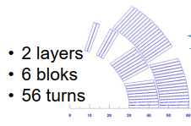
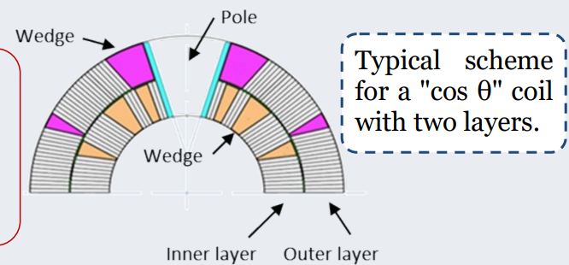
Design
COIL
Conductor: Nb3Sn
Cable: Rutherford
Insulation: twisted fiberglass
Wedge: Cu-alloys
Cos theta cross-layout
Two coil layers
Quench heaters (impregnated and external)

Slide 5
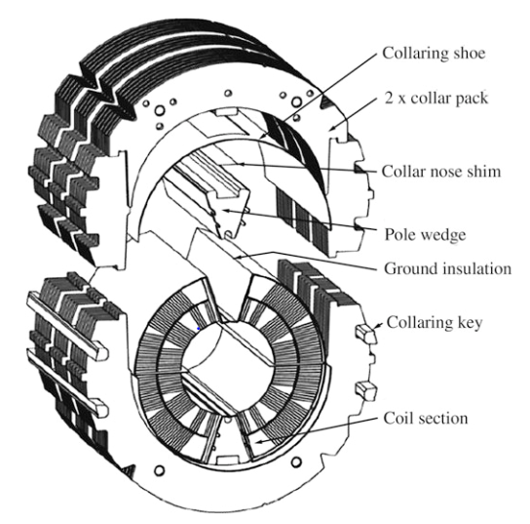
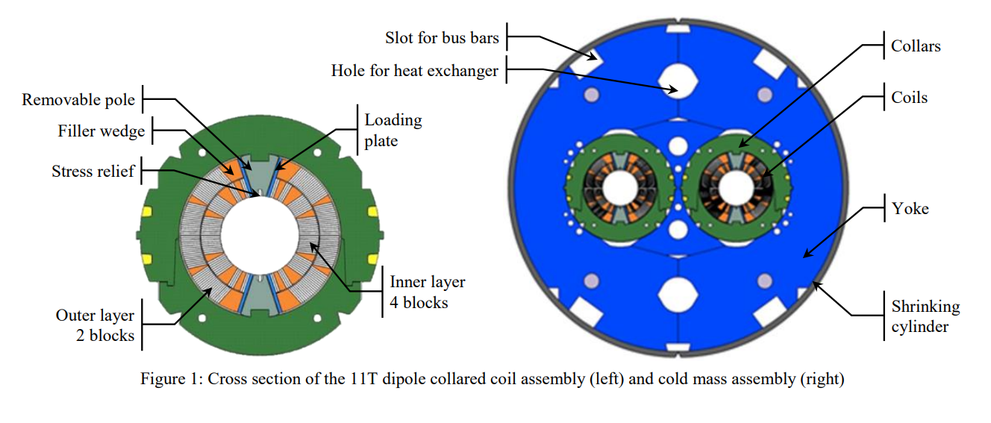
Design
COLLARED COIL
Ground insulation layers around the coils (Kapton).
St steel collars.
The collars are separate in the apertures.
Removable pole of Titanium or St Steel.
Azimuthal coil prestress introduced by adding shims in the pole-loading plate contact.
Collaring: close the collar with keys.

Slide 6
Design
MAGNET
Shell
Center yoke

Slide 7
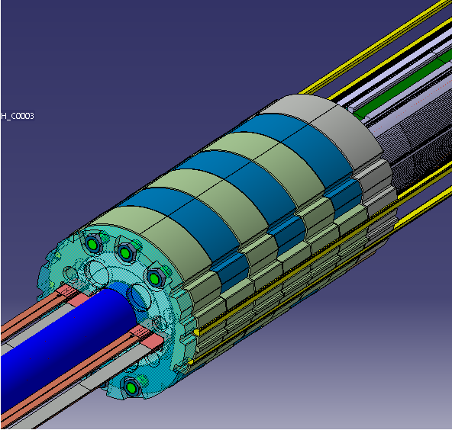
11T Dipole Hybrid – DP301
Extensive campaign of FEM computations→ Mitigation solutions report (C. Garion, M. Morrone): solutions that could reduce the stress within the cables of the coil head:
  Pole of St steel (instead of titanium).
  New shimming plan with excess reduction in the pole ends.
  One aperture with end cage. Limit relative movement of first coil block (inner) with respect to pole key.
More new features:
  Collaring shoe (coil protection sheet) divided in two layers. Better relative sliding in between the parts.
Hybrid concept: two independently powered apertures.
Courtesy of T. Sahner

Slide 8
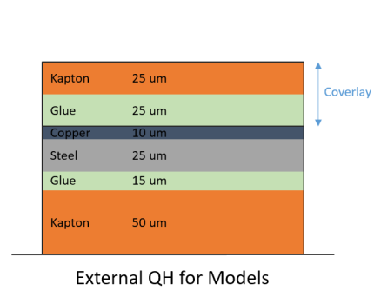
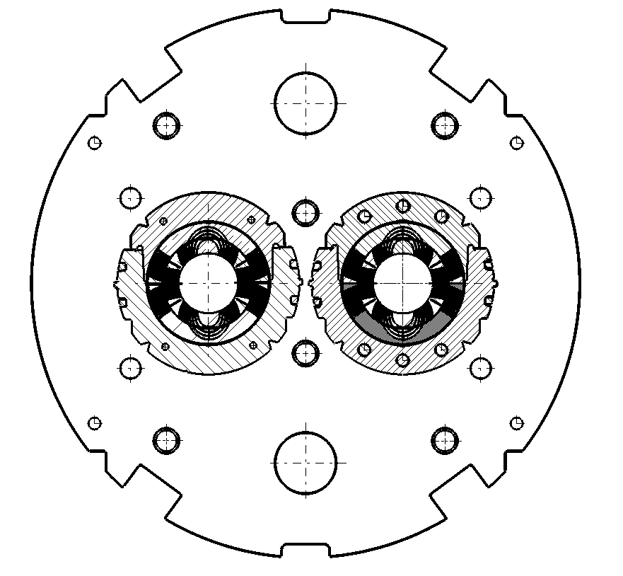


DP301 Magnet setup
11T Hybrid Short Magnet DP301
View from the connection side
APERTURE 1 SP301
Without cage
Composed of:
Coil #108 – 1st generation
Coil #214 - 2nd generation
APERTURE 2 SP302
With end cage
Composed of:
Coil #212 - 2nd generation
Coil #213 – 2nd generation
Coil #108
Coil #212
Cable characteristics
1st generation (RRP)
2nd generation (PIT)
Coil #214
Coil #213
NOTE:
Coils 108,212,213 already used in the past
Coil 214 new (spare)

Slide 9
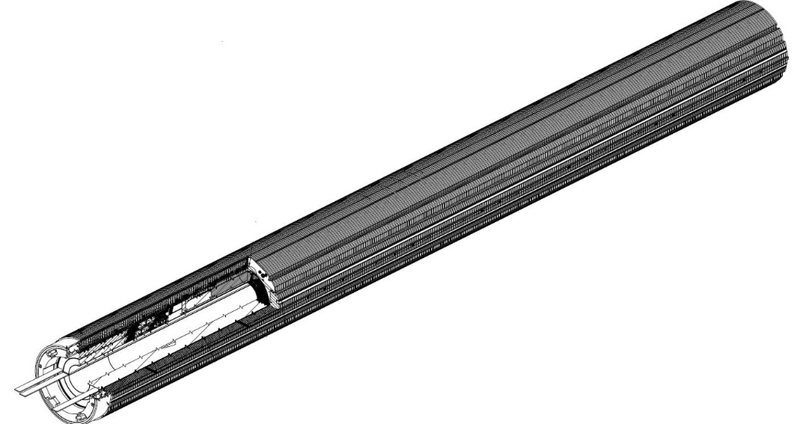
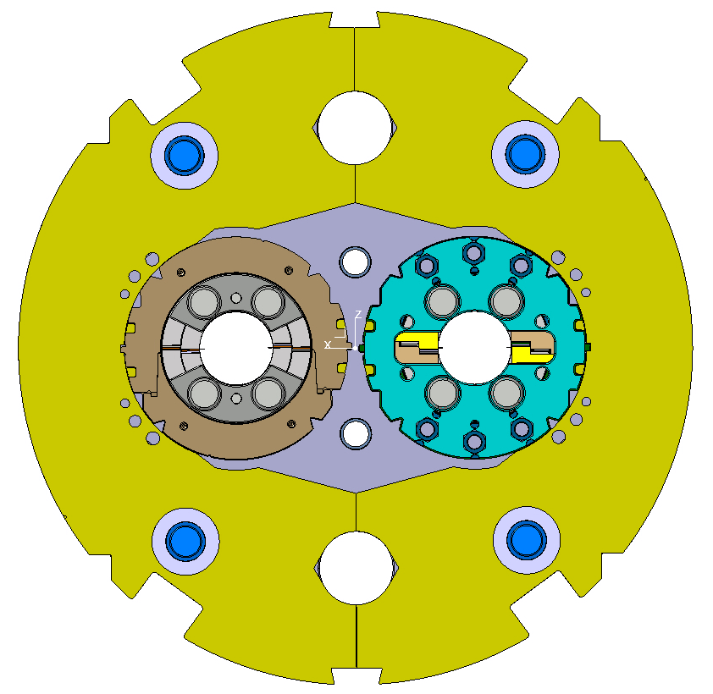
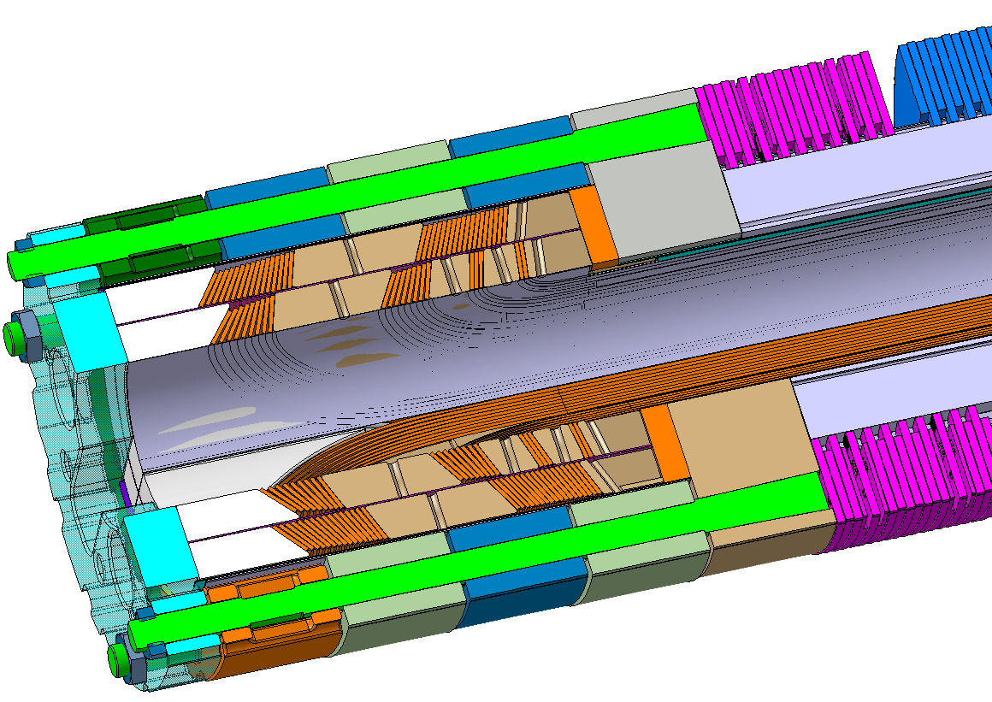
DP301 Magnet setup
INSTRUMENTATION
  Strain gauges
    Collar nose
    Tie rods of end cage
    Bullets of end plate
  Optical fibers
    Coil azimuthal
    Pole longitudinal
  Acoustic sensors
CNCS1
CNCS2
CNCS3
CNCS4
CM1
CM2
CM3
CM4
CCS1
CCS2
CCS3
CCS4
Courtesy of M. Guinchard

Slide 10
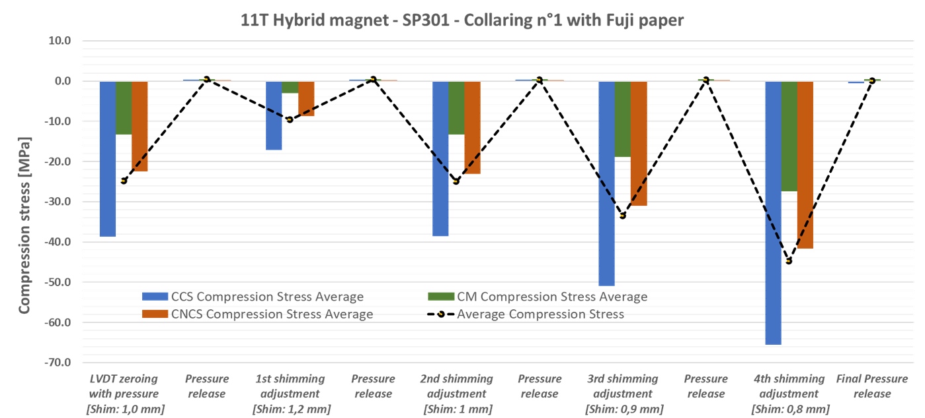
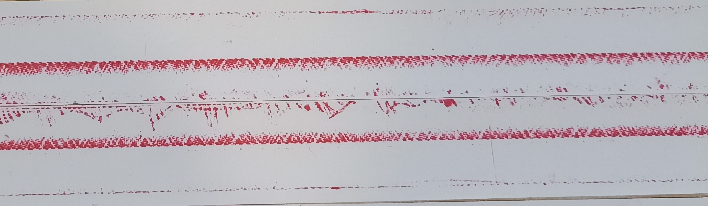
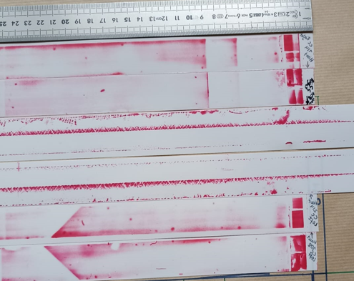
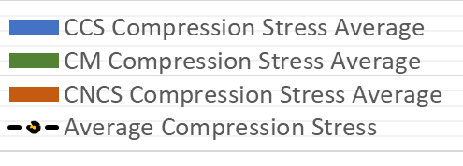
DP301 activities
First and second collaring trial of the aperture 1 have been carried out.
  Pressure sensitive film (Fuji film) are introduced in the pole to coil contact and mid plane to provide a view of the stresses. Some layers of ground insulation were adapted to the addition of this layers.
  Instrumented collars with strain gauges to control the stresses during the operation.
SG compression stresses
Fuji paper visual inspection
Courtesy of of S. Mugnier.

Slide 11
References
Nb3Sn Accelerator Magnets. Designs, Technologies and Performance. Daniel Schoerling Alexander V. Zlobin Editors
Evaluation Script for Analysing Pressure Measurement Films with Ofﬁce Scanners. Patrick Ebermann, Felix Wolf.
Magnet Design and Technology Booklet.
Mitigation solutions on the 11T magnet. C. Garion, M. Morrone
EDMS 2711698. M. Guinchard, S. Mugnier

Slide 12
THANKS FOR YOU ATTENTION

