Slide 1
SMC Project
Juan Carlos PEREZ
SMT update on projects
October 11th 2022

Slide 2
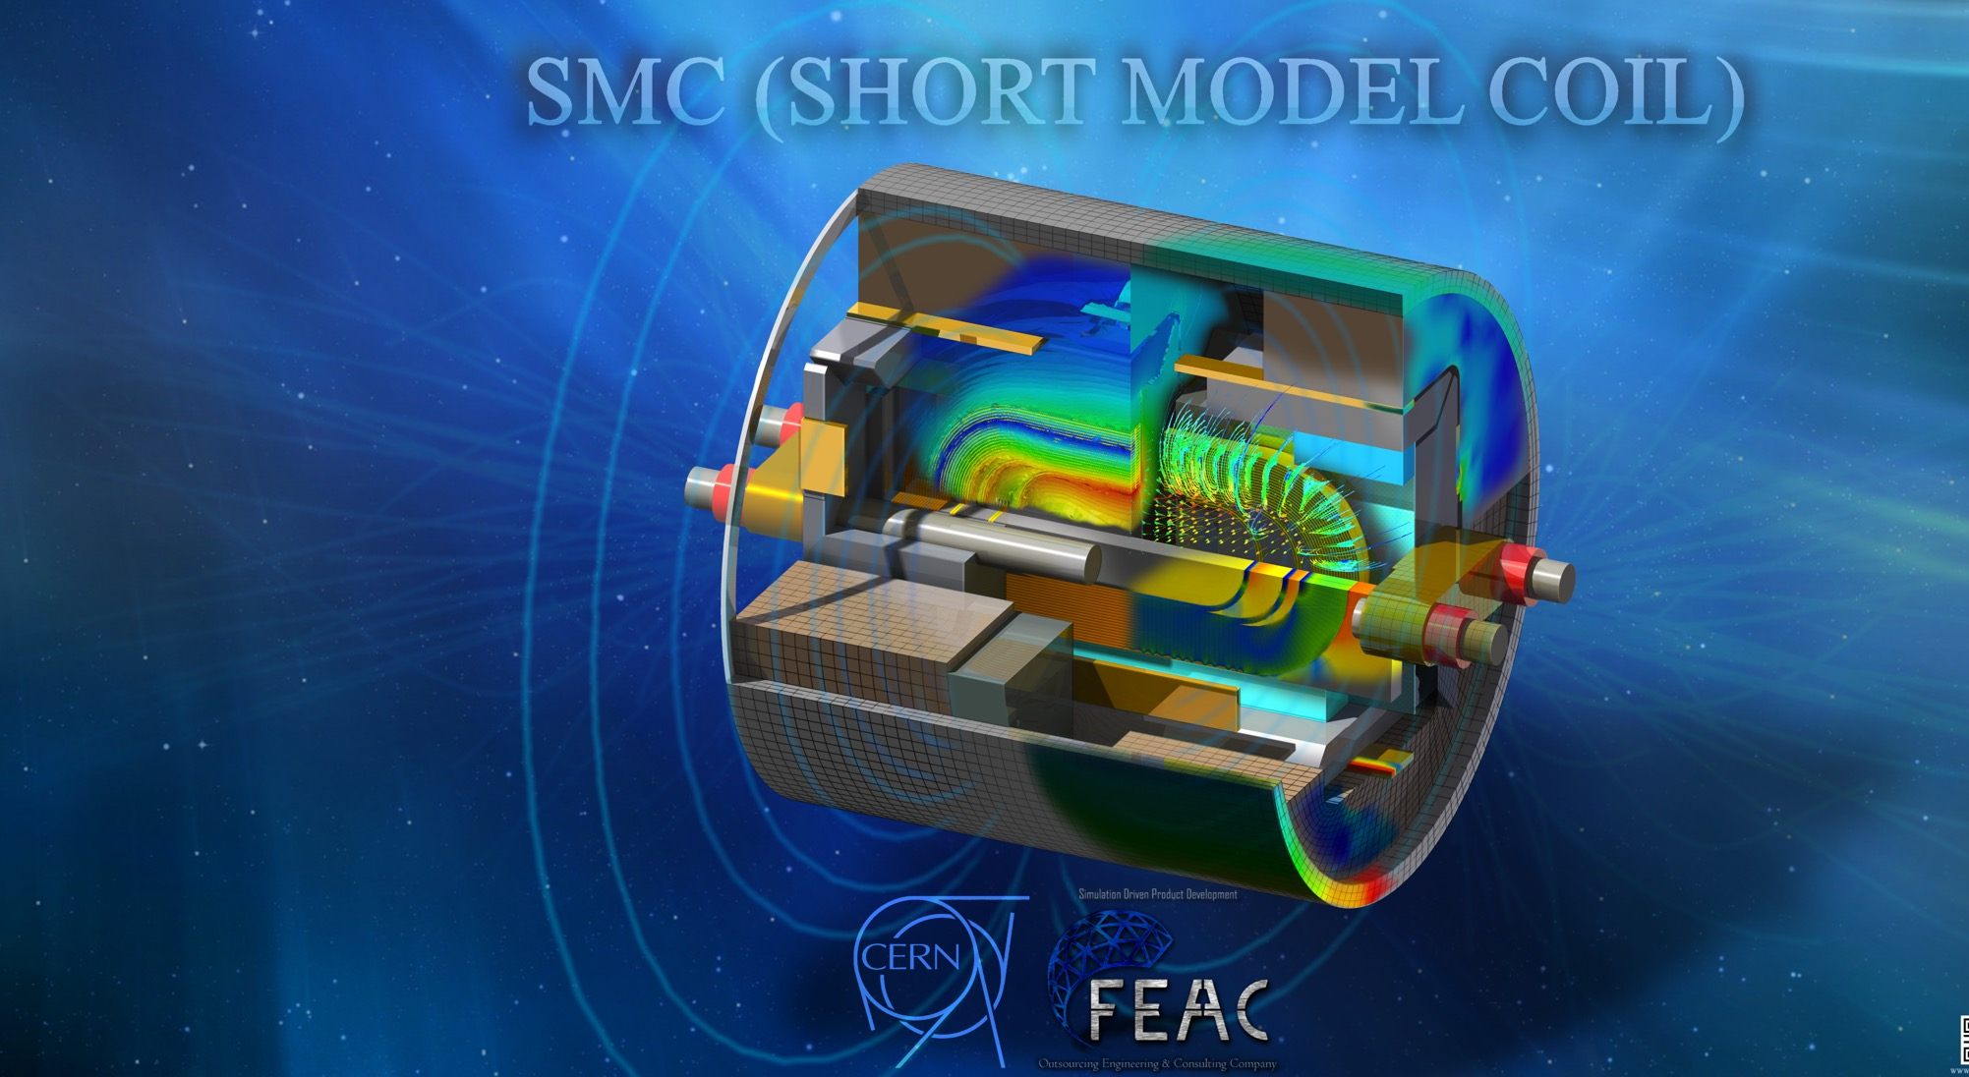
Contents
Introduction: SMC history
Aim of SMCs magnet
SMC 1st generation configuration
FEM models
1st G magnet performance overview
SMC 2nd generation program
SMC 2nd generation design
SMC 2nd generation schedule
SMC future activities

Slide 3
History: SMC as NED
Three initial partners in FP6-CARE-NED: CEA, CERN & RAL started the informal project Short Model Coil beginning 2007
The aim was to build a small magnet with limited resources as successor to NED awaiting a larger new initiative (FP7-EuCARD)
Project leaders: A. Devred and after 5 months G. de Rijk
  Afterwards M. Bajko and since 2010 J.C Perez
Design by CEA, RAL, CERN & LBNL
Structure manufacturing followed by CEA
Coil manufacturing by RAL, CERN & CEA
The original design was reported in 2 reports (on CERN CDS: EuCARD-PUB-2009-005. - 2009 and EuCARD-PUB-2009-004. - 2010
)

Slide 4
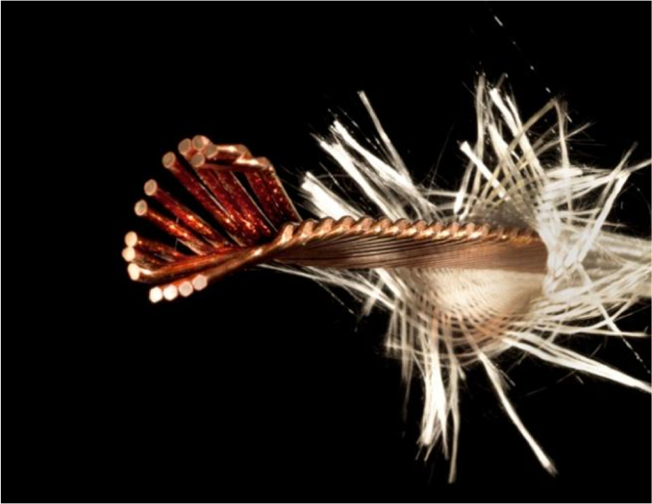
SMC and EuCARD-FRESCA2
When EuCARD-WP7-HFM was started in 2009, the need for an SMC step in the Fresca2 construction was clearly identified (experience at LBNL)
The SMC project was partly “annexed” into EuCARD
Initial aim of SMC in EuCARD:
    Learn to make coils and structure
    Get experience with Nb₃Sn conductors
    Certify manufacturing procedures for the EuCARD2-FRESCA2 magnet
  Initial planned FRESCA2 preparation SMCs
    Cable 14 strand, 1.25 mm Alstom IT
    Cable 14 strands, 1.25 mm EAS-Bruker PIT
    Cable 18 strands, 1.00 mm EAS-Bruker PIT (FRESCA2 cable)
  CEA wound a SMC coil with PIT EAS strand using Hiltex S2-Glass tape + ceramic precursor (CEA formulation) as cable insulation outside EuCARD

Slide 5
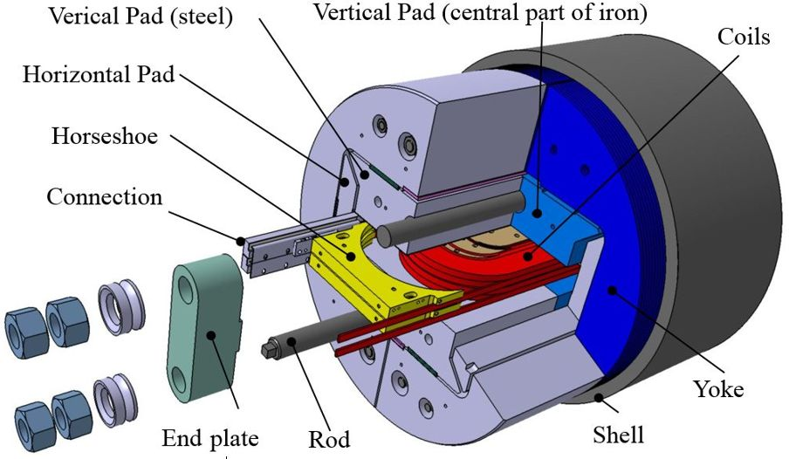
Aim of the SMCs magnet
SMC is a tool to learn:
Technologies needed for a Nb₃Sn based high field magnet fabrication:
    Cable insulation
    Coil reaction
    Coil impregnation
    Trace fabrication
    Bladder fabrication
Techniques of coil fabrication and magnet assembly
    Winding
    Coil instrumentation and Protection
    Structure instrumentation
    Magnet assembly with bladders and keys
    Nb₃Sn – Nb-Ti cable connection
SMC is a tool to qualify:
  Nb₃Sn cables ibn a real magnet configuration
SMC was considered as the “STEP 0“ to build a Nb₃Sn accelerator magnet at CERN

Slide 6
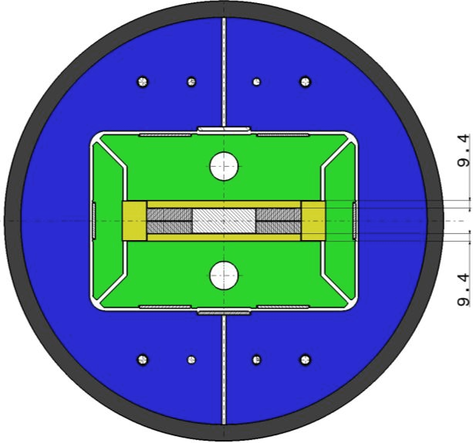
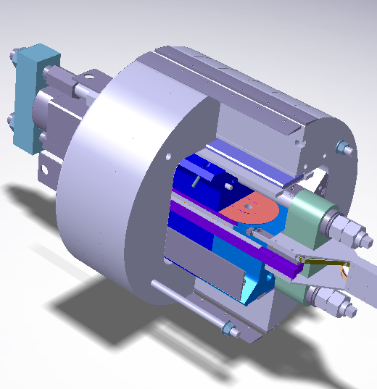
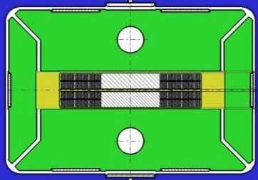
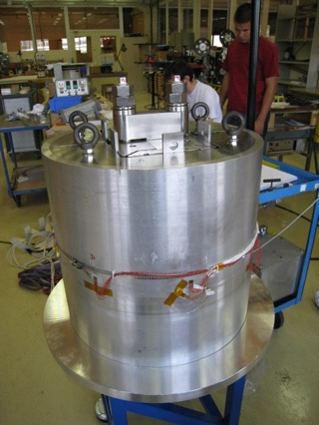
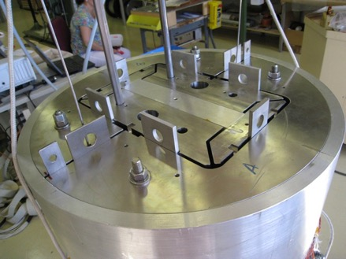
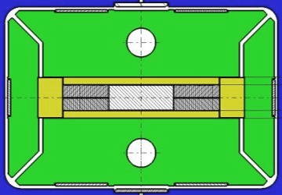
SMC configuration
Longitudinal compressing system
Vertical key
2 coils configuration
Iron yoke
Lateral pad
Racetrack Nb₃Sn coil
Longitudinal rods
Vertical pad
Single coil configuration
Coil pack and Iron yoke mounted in the instrumented shell

Slide 7
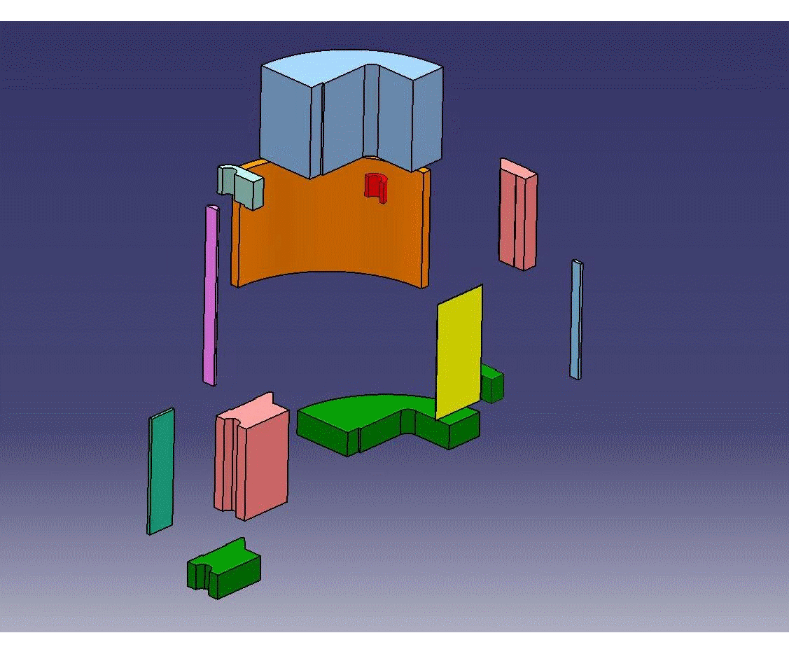
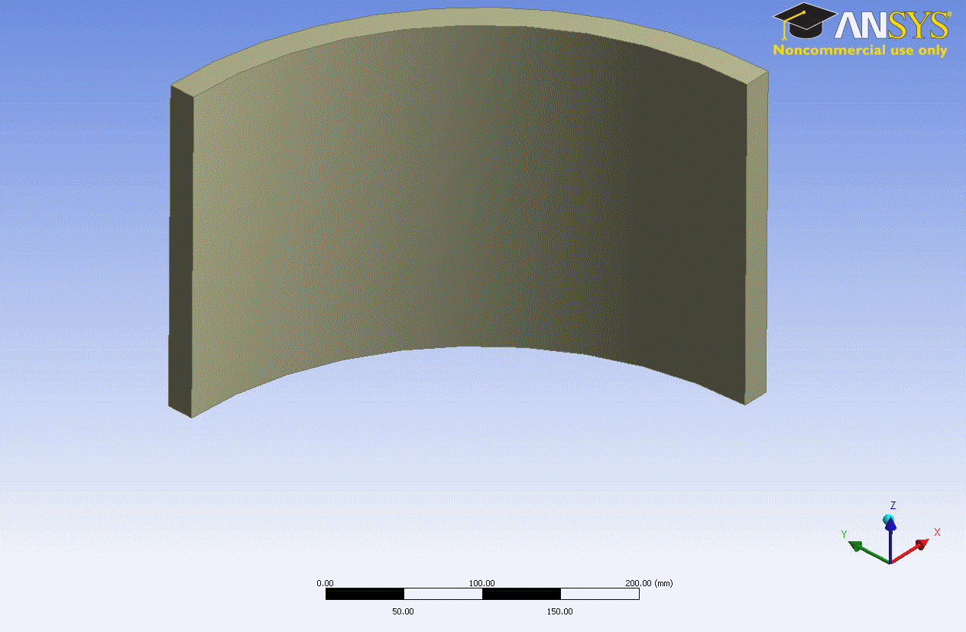
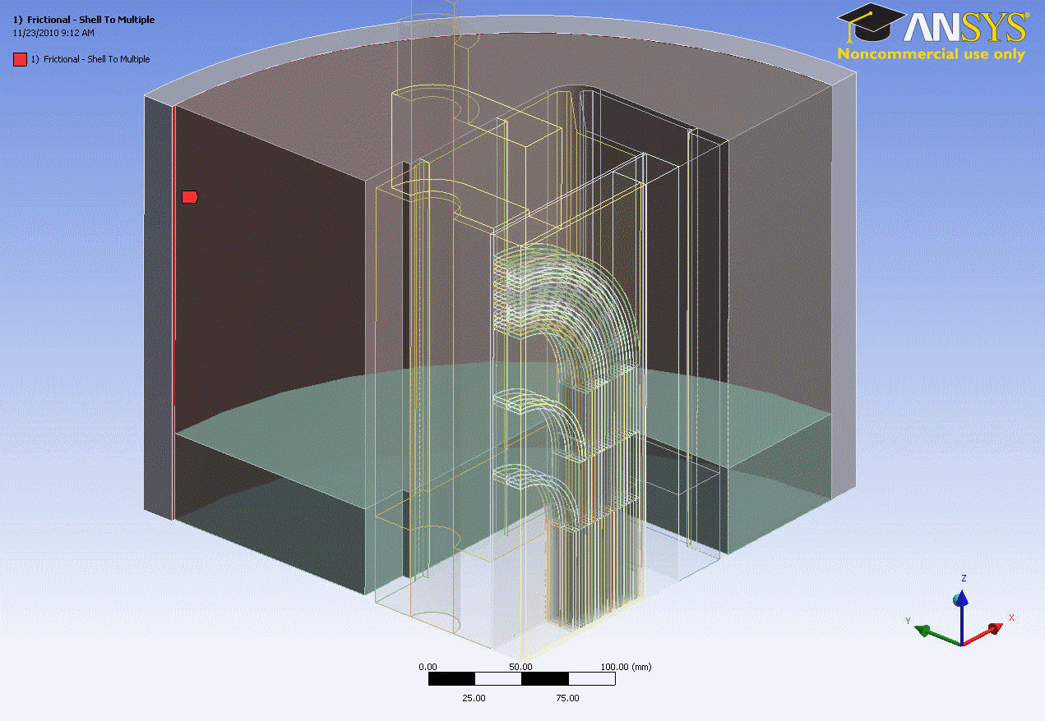
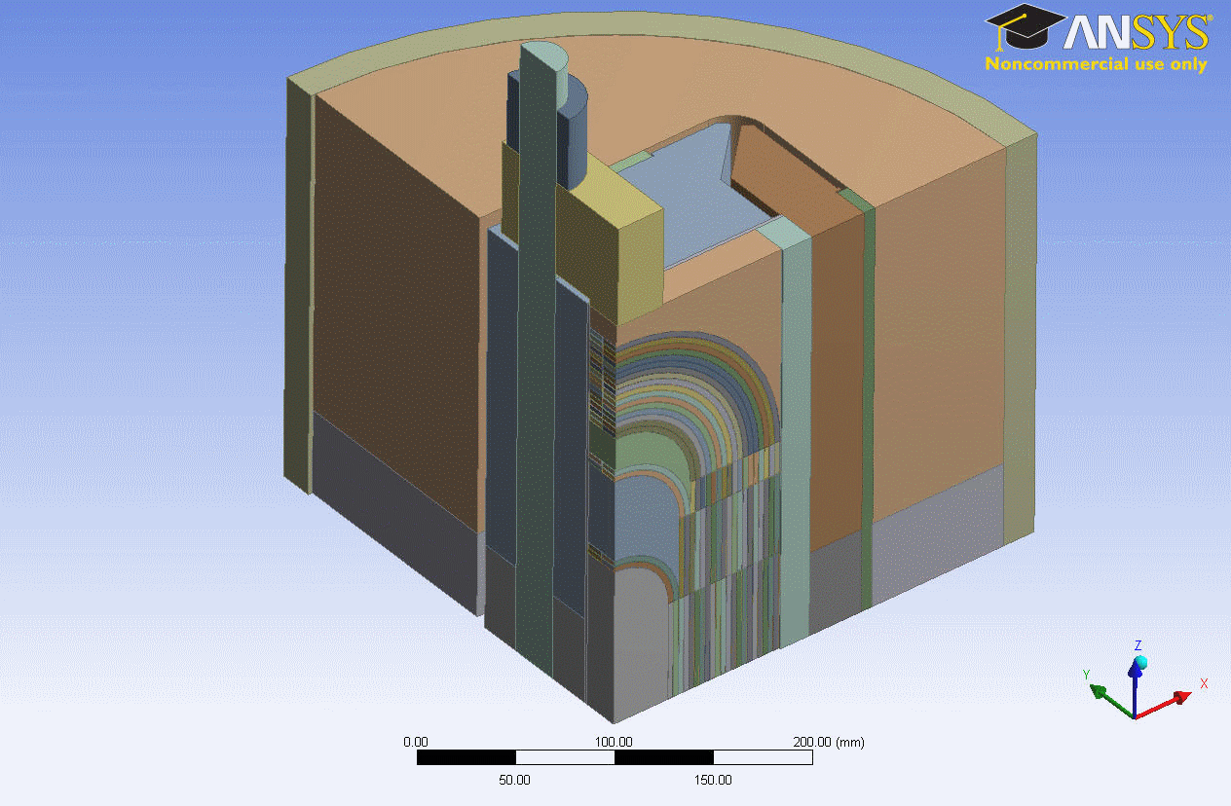
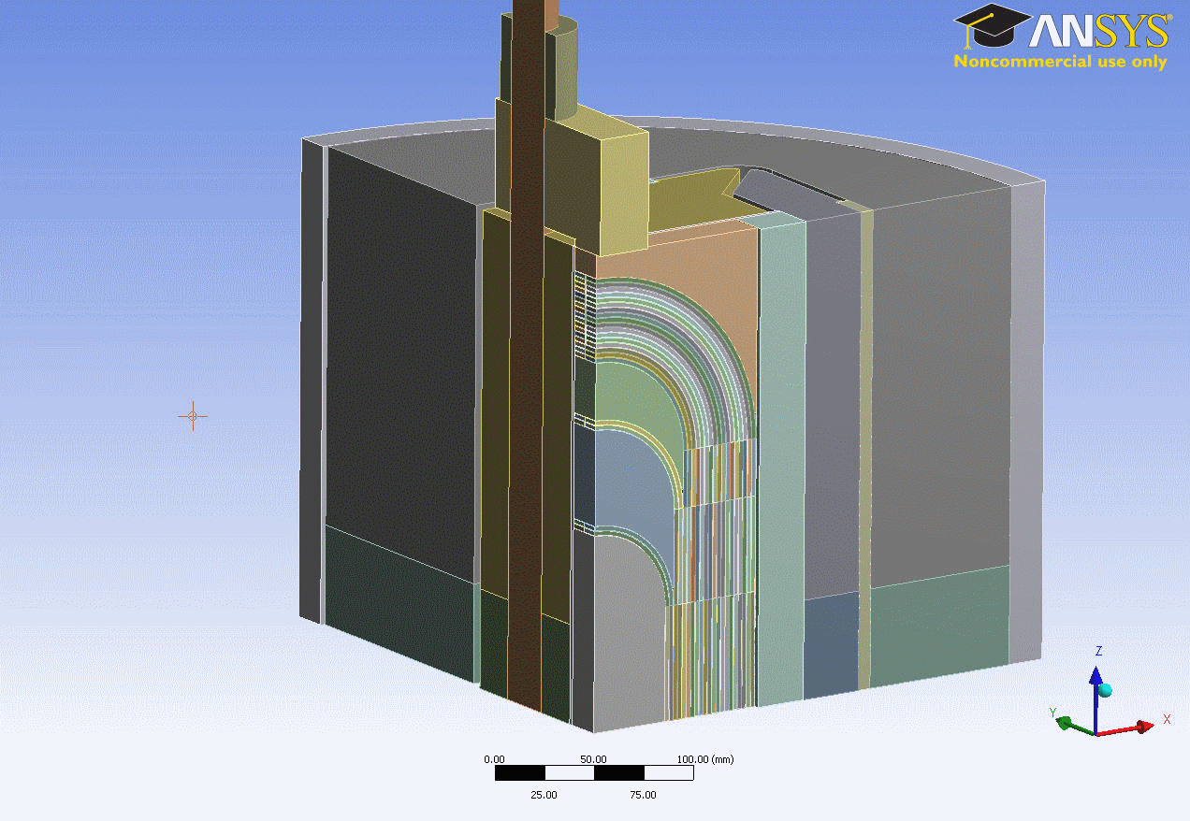
SMC FEM Models
Courtesy of C. Kokkinos 2011
CATIA
ANSYS
Design Modeler
ANSYS Mechanical
Assembly Design
Geometry Design
Contact Regions
Parametric Coil Block
Meshing Process
ANSYS Workbench
Direct use of parameterized CATIA models
Friendly environment for FEA
Makes use of the new features and capabilities of the latest version of ANSYS

Slide 8
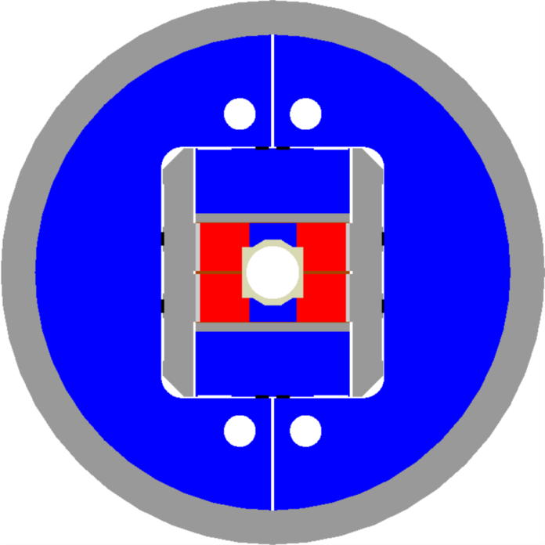
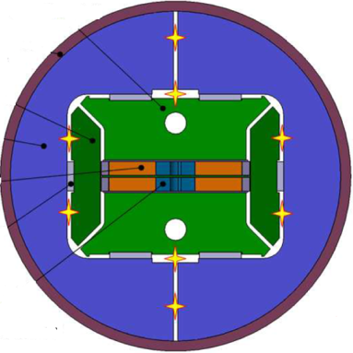
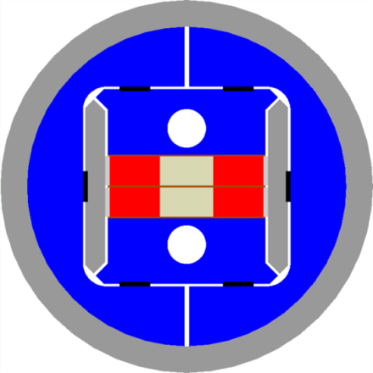
From SMC to RMC (Racetrack Model Coil) towards FRESCA2
SMC
RMC
FRESCA2
RMC goals: test FRECA2 cable and FRESCA2-type coils in realistic conditions
Constrains:
Layer jump similar to FRESCA2
Power supply limit 20 kA
Magnet OD: 560 mm

Slide 9
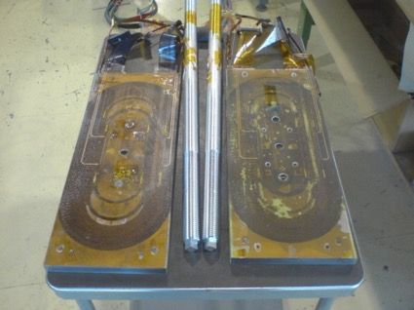
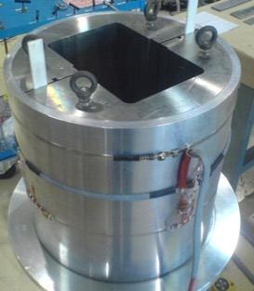
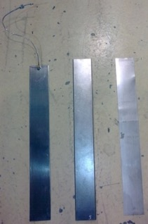
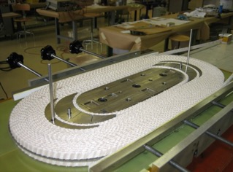
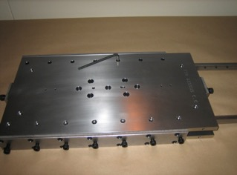
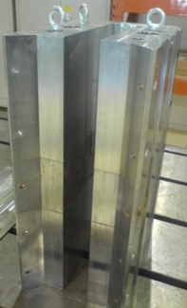
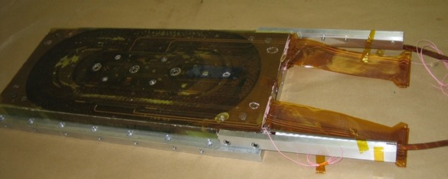
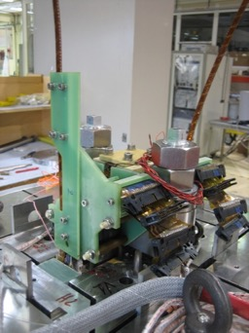
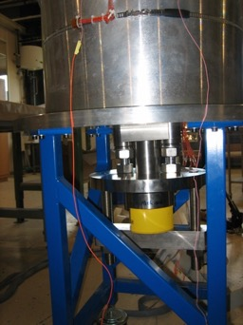
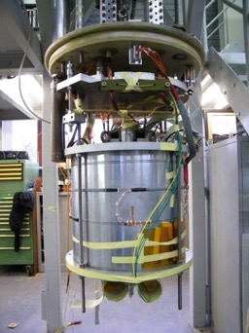
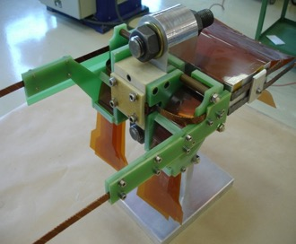
SMC parts & initial mock-up
Coil and reaction mould
Coils & Rods
Shell & Yoke
Pads
Bladders
Keys
Shims
Instrumented coil
Interconnection mock-up
Connection Side
Non-Connection Side
Ready for cold tests

Slide 10
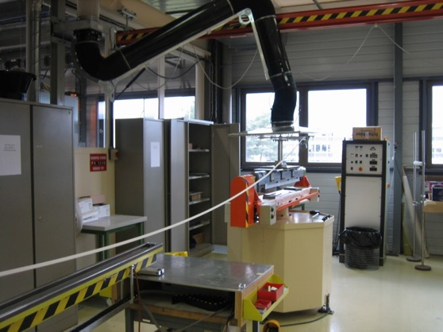
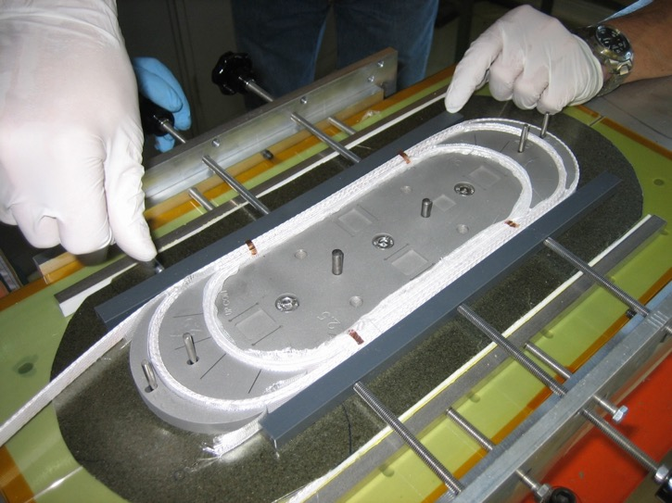
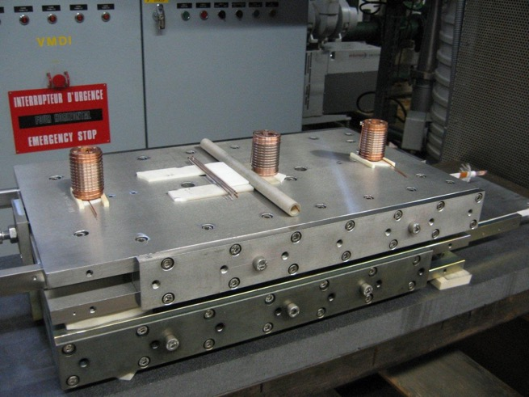
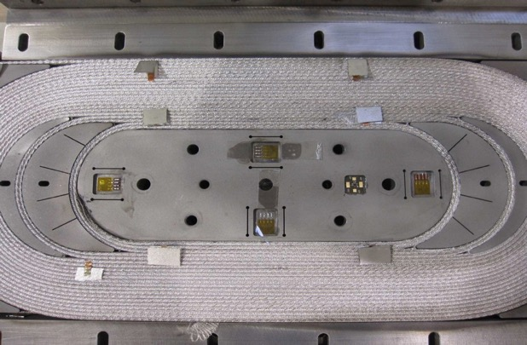
Coil fabrication in 2011
Winding machine
Winding operation
Coil ready for reaction
Instrumented coil

Slide 11
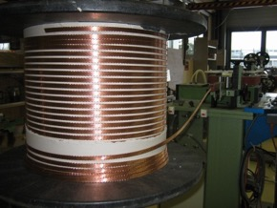
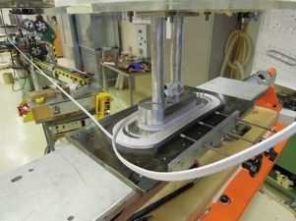
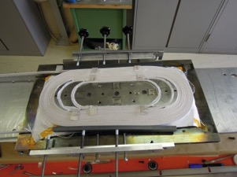
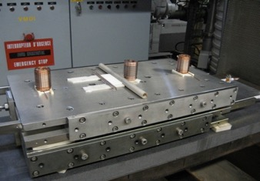
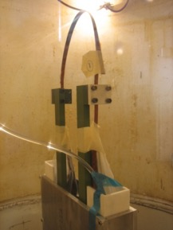
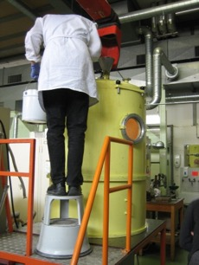
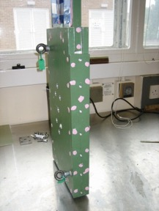
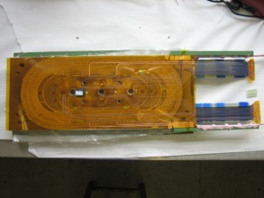
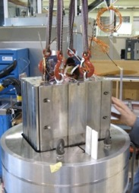
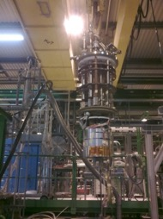
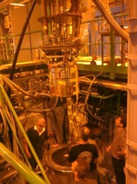
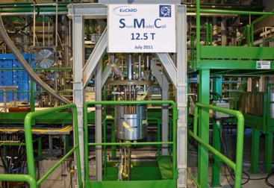
Manufacturing steps for first generation coils
The first SMC coil was manufactured in 2009
The first SMC magnet was tested in 2011 and showed limited performance at around 50% of I_{ss}

Slide 12
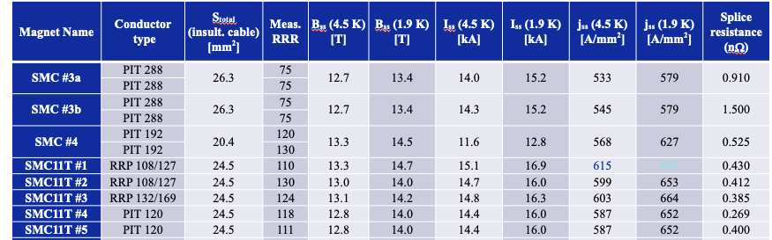
SMC magnets
Powering test data courtesy from H. Bajas And al.
In 2016 the, coil components geometry was designed to accommodate the 11T Dipole cable size. Due to the largest size of the conductor, the assembly of the coil-pack was modified to fit a single coil.
  SMC is used to characterise the Nb₃Sn conductor in a real magnet configuration: Conductor type, Residual Resistivity Ratio (RRR) and Short Sample limits (field, current, eng. current density)
See SMC Design Report on https://edms.cern.ch/document/2787054/1 from D. Molnar

Slide 13
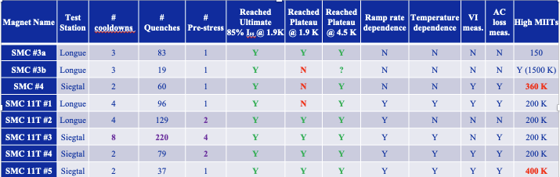
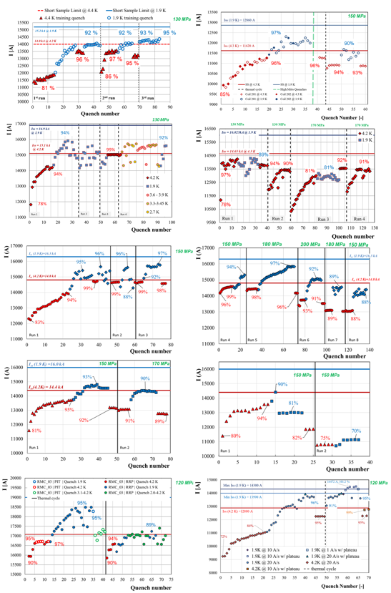
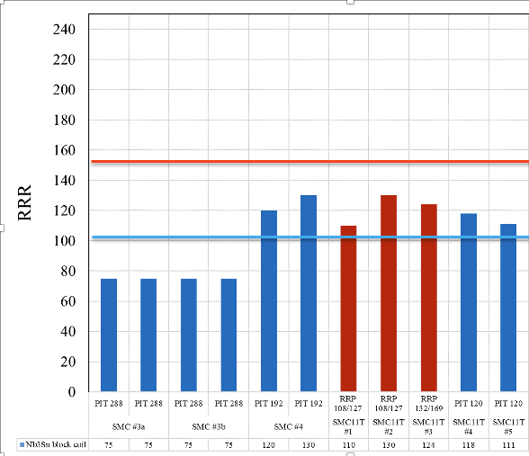
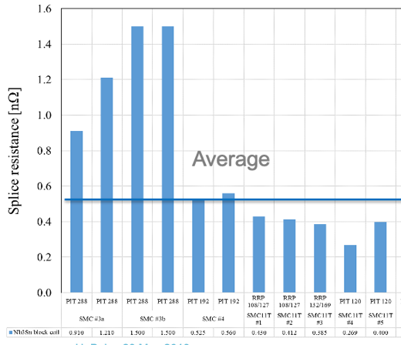
Cold powering tests overview
A lot of training curves!
RRR Measurements comparison
Splices

Slide 14
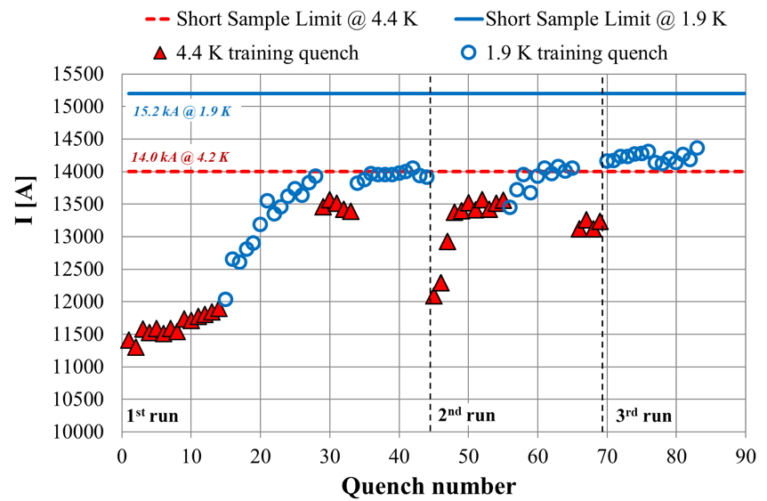

Magnet performances overview (few examples)
I_{q}/I_{ss} (1st Quench) measurements comparison
130 MPa
92 %
92 %
93 %
95 %
96 %
97 %
95 %
86 %
81 %
One plot to illustrate some of the analysis
First Quench (@ 4.5 k) occurring at:
I_{q}/I_{ss} = 78.7 ± 7.5 %

Slide 15


Magnet performance overview
I_{q}/I_{ss} (plateau current) comparison
Nbr. of quenches to reach plateau
And many others studies:
  Thermal cycle effect
  Pre-stress effect
  Quench current vs. Ramp rate
  Lorenz forces cycling loading effect
  High quench integral effect
  Effect of current plateau on quench current
See for detailed information on https://edms.cern.ch/document/1836763/1 from R. Ortwein

Slide 16




SMC & other magnets record field
2018: FRESCA2
14.6 T at 1.9 K, 100 mm aperture
World record field for a dipole magnet with a usable aperture
RMM 50 mm
2022: RMM1b
16.5 T at 1.9 K, 50 mm aperture
World record field for a dipole magnet

Slide 17


SMC 2nd generation program
An extension of the existing SMC program for epoxy resin characterisation and removable pole study was proposed in 2018 (Internal note 2018-36 & EDMS 2140690)
This document was modified in 2021 (EDMS 2682457).
The SMC program will be composed of several parts since it is a tool which can contribute to different aspects of the technology development (EDMS 2680109, Theme 5). The first part of the program presented in EDMS 2682457 document focuses on the question of training reduction through impregnation systems and adhesion conditions inside the coil.
To address these two points, a sequence of coils is listed in a table in slide 19.

Slide 18
SMC 2nd generation coils & tooling
New layer-jump design
New reaction mould design
Detachable pole
New impregnation mould design

Slide 19

SMC 2nd generation program schedule
Naming | Cable | POLE | Epoxy | Cable insultation
SMC2G-101 | SMC-11T | impregnated | CTD 101K | S2 0.150 mm no mica
SMC2G-102 | SMC-11T | impregnated | Araldite®MY750 + Aradur®HY5922 [5] | S2 0.150 mm no mica
SMC2G-103 | SMC-11T | impregnated | Mix61 [5] | S2 0.150 mm no mica
SMC2G-104 | SMC-11T | impregnated | Araldite®MY740 + Aradur®HY609 +DY062 [5] | S2 0.150 mm no mica
SMC2G-105 | SMC-11T | detachable | CTD 101K | S2 0.150 mm no mica
SMC2G-106 | SMC-11T | detachable | Best performing | S2 0.150 mm no mica

Slide 20
SMC 2nd generation coil production status
Naming | Cable | POLE | Epoxy | Cable insultation | Staus
SMC2G-101 | SMC-11T | impregnated | CTD 101K | S2 0.150 mm no mica | Assembled in Structure #1
SMC2G-102 | SMC-11T | impregnated | Araldite®MY750 + Aradur®HY5922 [5] | S2 0.150 mm no mica | Completed. Waiting for assembly
SMC2G-103 | SMC-11T | impregnated | Mix61 [5] | S2 0.150 mm no mica | Completed. Coil with NC
SMC2G-103b | SMC-11T | impregnated | Mix61 [5] | S2 0.150 mm no mica | Waiting for Heat treatment
SMC2G-104 | SMC-11T | Impregnated | Araldite®MY740 + Aradur®HY609 +DY062 [5] | S2 0.150 mm no mica | Completed. Waiting for assembly
SMC2G-105 | SMC-11T | Detachable | CTD 101K | S2 0.150 mm no mica | Completed. Waiting for assembly

Slide 21

Potential resin candidates for future coils
Discussions to be held with TDM work package of HFM program and others.
Instrumentation, cables, resins…..

Slide 22
Thank you!
More to come soon……

Slide 23
Additional slides

