Slide 1
Physics Beyond Colliders and the Gamma Factory
Gianluigi Arduini

Slide 2
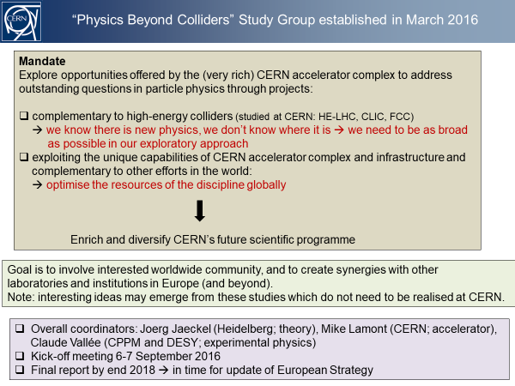
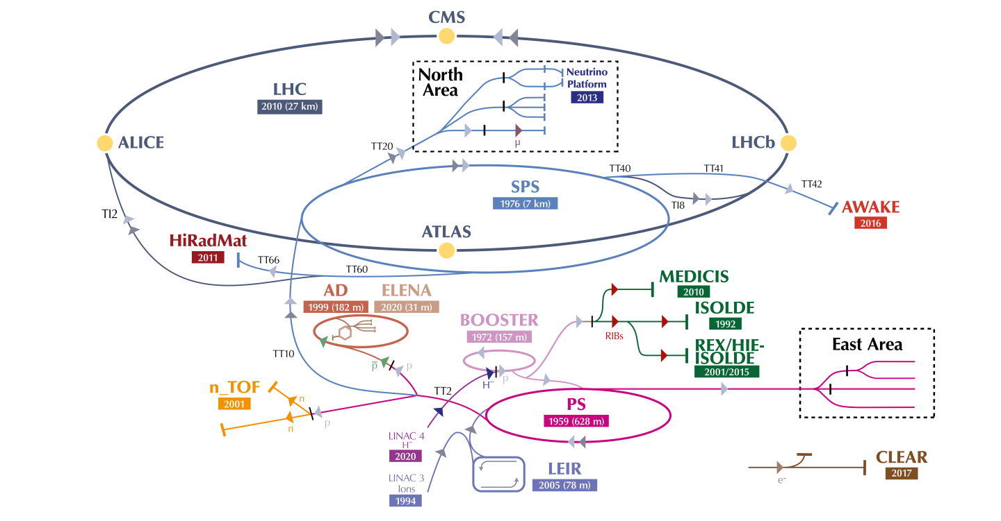
Physics Beyond Colliders
Mandate 2016-2020
Fabiola Gianotti – PBC Kick-off Workshop – 6-7 September 2016

Slide 3
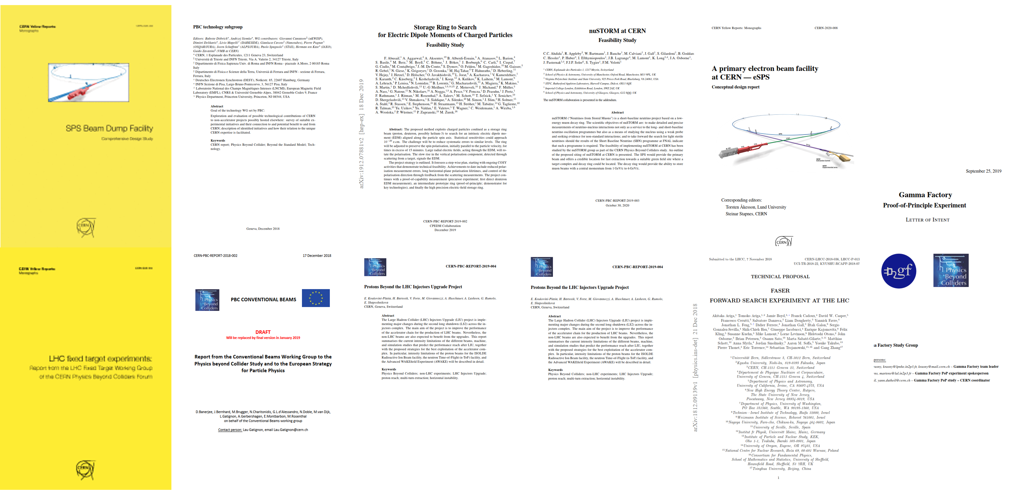
A lot of work produced
Several documents summarizing studies and findings in the period 2016-2019
Input from PBC presented in preparation of the European Strategy for Particle Physics Update
PBC Summary Report: arXiv:1902.00260
PBC BSM Report: arXiv:1901.09966
PBC QCD Report: arXiv:1901.04482
PBC Accelerator Reports:
http://cds.cern.ch/collection/PBC%20Reports?ln=en
Gamma Factory: Proof of Principle Experiment (https://cds.cern.ch/record/2690736/files/SPSC-I-253.pdf)

Slide 4

ESPP & PBC
…..A diverse programme that is complementary to the energy frontier is an essential part of the European particle physics Strategy. Experiments in such diverse areas that offer potential high-impact particle physics programmes at laboratories in Europe should be supported, as well as participation in such experiments in other regions of the world…..

Slide 5
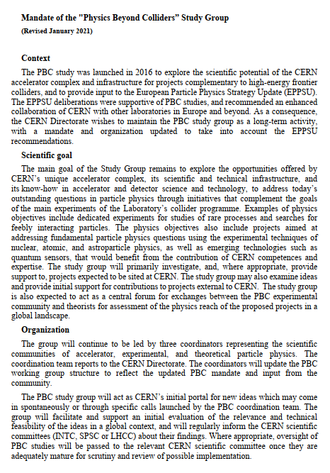
Physics Beyond Colliders
New Mandate (2021)
Complementarity to the goals of the main experiments of the Laboratory’s collider programme
Supporting projects using experimental techniques of nuclear, atomic, and astroparticle physics as well as emerging technologies such as quantum sensors benefitting form CERN competence and expertise
Central forum for exchanges between PBC experimental community and theorists to assess the physics reach of proposed projects in a global landscape
CERN’s initial portal for new ideas, facilitating and supporting the evaluation of their relevance and technical feasibility
Coordinators: G. Arduini (CERN), J. Jaeckel (Heidelberg), C. Vallée (CPPM, Marseille)
Notes:
Started in 2016 provided important input for the 2020 ESPP now reconducted as a long term activity by the directorate

Slide 6
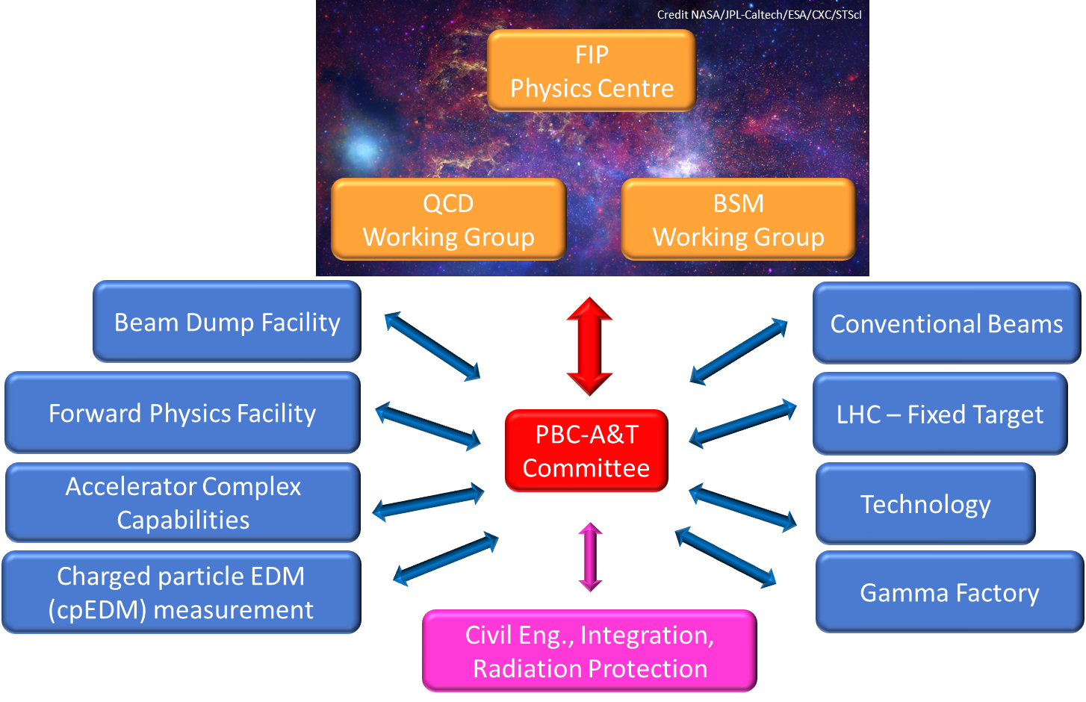
Organization

Slide 7

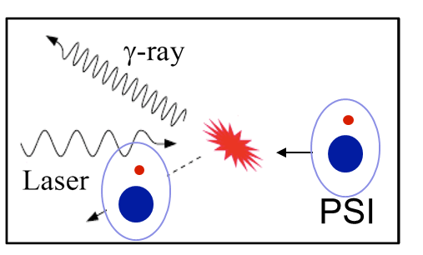


Gamma Factory
Conveners: Y. Dutheil, W. Krasny, A. Martens (IJCLab Orsay)
Novel research tool
Opens-up possibility for a wide range of measurements and experiments (see Witek presentation)
One of them:
Cooling of ion beams in the SPS for LHC ion experiments (ALICE3)

Slide 8
Gamma Factory: why a Proof of Principle in the SPS?
Integration of a Fabry Perot Cavity + remote operation of the driving laser in a in a high intensity hadron machine is a primer
Proof of principle with ²⁰⁸Pb⁷⁹⁺
R&D:
  High finesse Fabry-Perot Cavity (~5 mJ per pulse - up to 40 MHz)
  Laser System (1034 nm – 1.2 eV): challenging oscillator with low phase noise if coupled to high finesse cavity

Slide 9
Status (PoP)
MoU for a Gamma Factory Proof of Principle Experiment at the SPS signed by:
  IN2P3
  Jagiellonian University Krakow
Addendum with IJCLab on laser system specification/development/locking tests under preparation ➔ A large amount of work already ongoing at Orsay!
Market Survey for laser oscillator being finalized (SY/STI)
Two PBC Fellows working part-time on Gamma Factory SPS PoP (R. Ramjiawan and G. Mazzola – Machine Experiment preparation and analysis, FLUKA simulations, …)
Synergies with CLEAR proposal for Compton Backscattering photon source (PhD student co-financed by CLEAR/PBC) and ERL design (PERLE@Orsay)

Slide 10
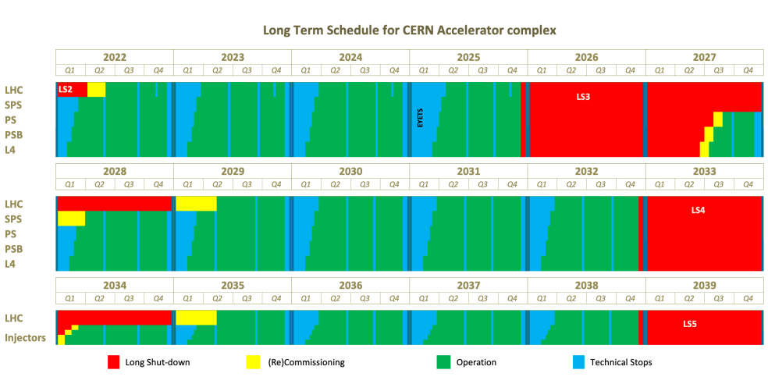
Timeline
Closest deadline: delivery of cooled ions for ALICE3 ion operation (Run 5)
Need to demonstrate the principle with in the first half of Run 4
Specify required modifications to the laser system for the selected ion specie
Commission the injectors for the production of the selected ion specie and the corresponding cooling scheme in the SPS before the start of Run 5
Need to make the more invasive and time-consuming preparations for the PoP during LS3
Version published 24/06/2022

Slide 11
Gamma Factory SPS PoP
Initial estimates (2019) of the material costs of the PoP: ~2-2.5 MCHF.
Aim for European Grant
The most suitable framework is EU INFRA-DEV Grants:
  Scope: ….aims at supporting the development of new concepts for the next generation of research infrastructures of European interest ….Major upgrades of existing infrastructures may also be considered if the end result is significantly transformative and equivalent to a new infrastructure concept. Proposals for RI concept development will tackle all key questions concerning the technical and conceptual feasibility of new or upgraded fully fledged user facilities (2021-22 call)
  At least 50% of the contributions to the Study should come from the participants to the Grant
  Muon Collider Design Study has been awarded a 3 Euros INFRA-DEV grant (32 Institutes involved – Cost of the Study: 10 MCHF – 3 MEuros from EU – including overheads)
  Next call: Beginning 2024 ➔ need to start preparing the proposal

Slide 12
Towards an EU Grant Proposal
Need to enlarge the collaboration ➔ MoU
Seek support from TIARA
Need to define required resources and contributions from CERN/partners ad their time profile

Slide 13
This Workshop: what is needed?
A revised estimate of
Main milestones/deliverables and their timeline
Material and personnel required
What are the installation activities that require a long shut-down (LS)?
What can be done during end of year stops ?
What is the expected duration of the beam tests in order to have a possible demonstration of the concept in time for possible application during Run 5 for ALICE3?

