Slide 1
GF PoP – R2E assessment
G. Mazzola¹, L. S. Esposito¹, K. Bilko¹, R. G. Alia¹
¹ SY/STI
SPS PoP Workshop
24-25 October 2022

Slide 2
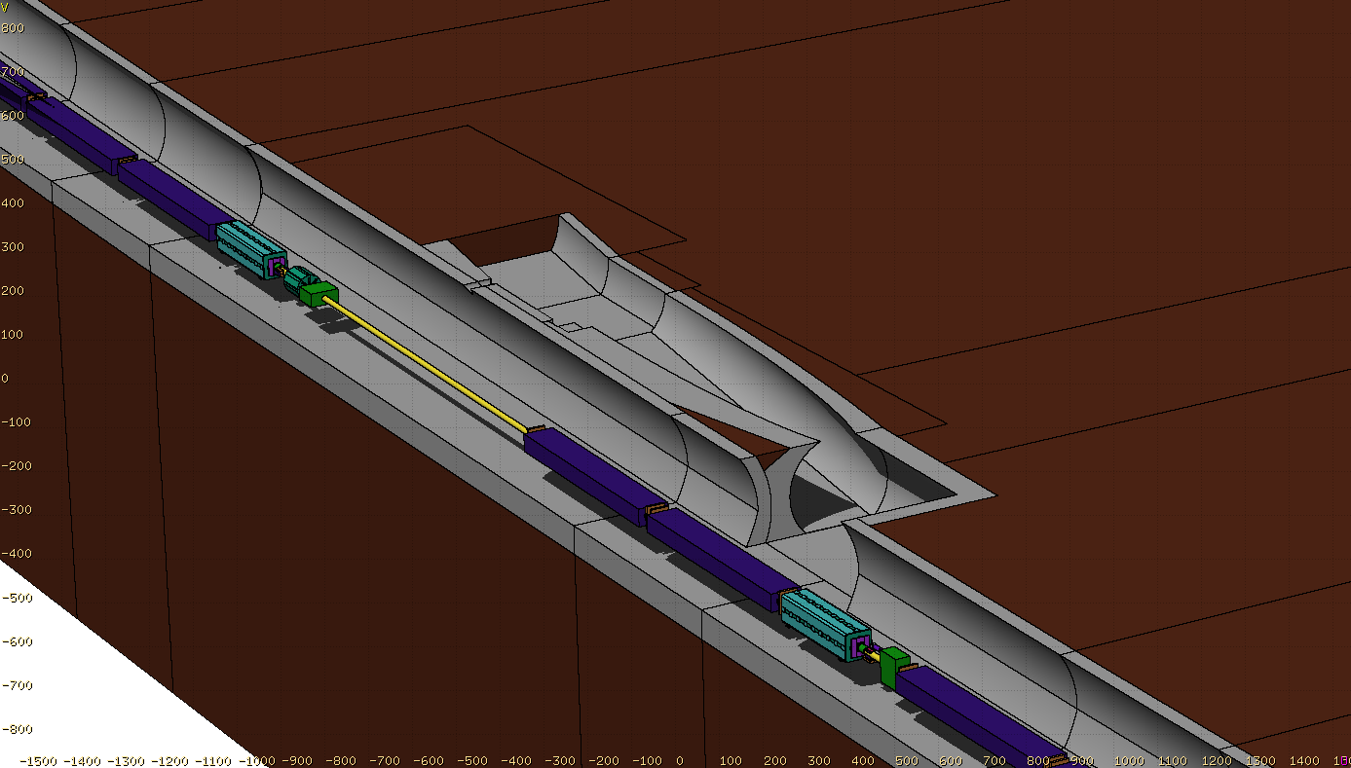


Introduction
Two main subjects investigated for R2E assessment:
SPS-LSS6/ARC6 Benchmark
FLUKA setup and beam loss mechanism validation
GF PoP – R2E
R2E studies for GF electronic components installation in service tunnel

Slide 3
SPS-LSS6/ARC6 Benchmark
FLUKA setup and beam loss mechanism validation

Slide 4
Benchmark R2E – SPS LSS6/ARC6
Benchmark of different detectors measurements in SPS-LSS6/ARC6 sectors through FLUKA MC code
Validation of assumption on beam loss mechanisms for the specific sectors considered
Consolidation of work process and FLUKA setup for GF-PoP/R2E related studies

Slide 5
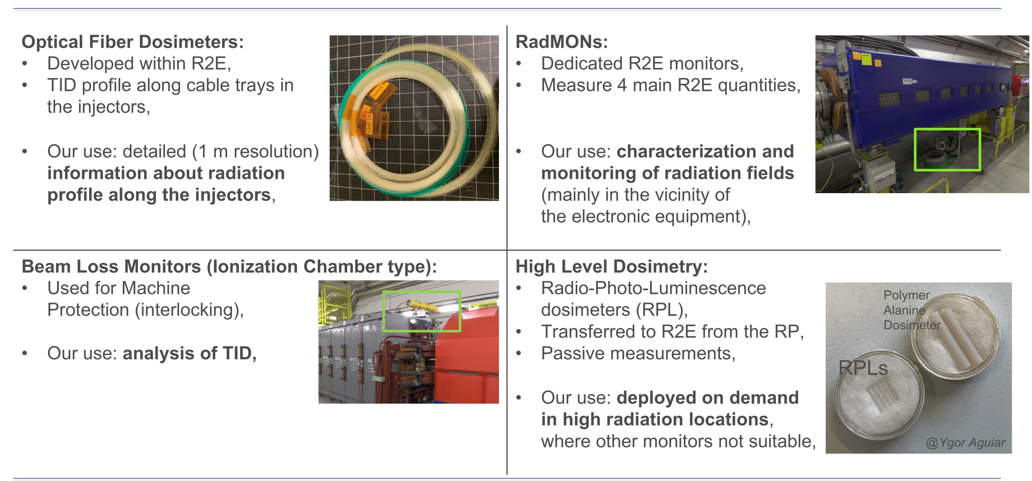
Detectors
by Kacper Bilko (R2E project)

Slide 6


Simulation setup
SPS tunnel and relative optics recreated starting from TWISS file → creation of FLUKA input
Simulation geometry:
  From QF62010 to QD62410 in order to cover LSS6 and ARC6 → Four complete periods ($139.5m$)
  Service tunnel for GF PoP electronics implemented
  Detectors: BLMs, OF along all tunnel (standard and non-standard position), RPLs, nMOS

Slide 7
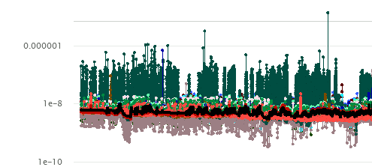
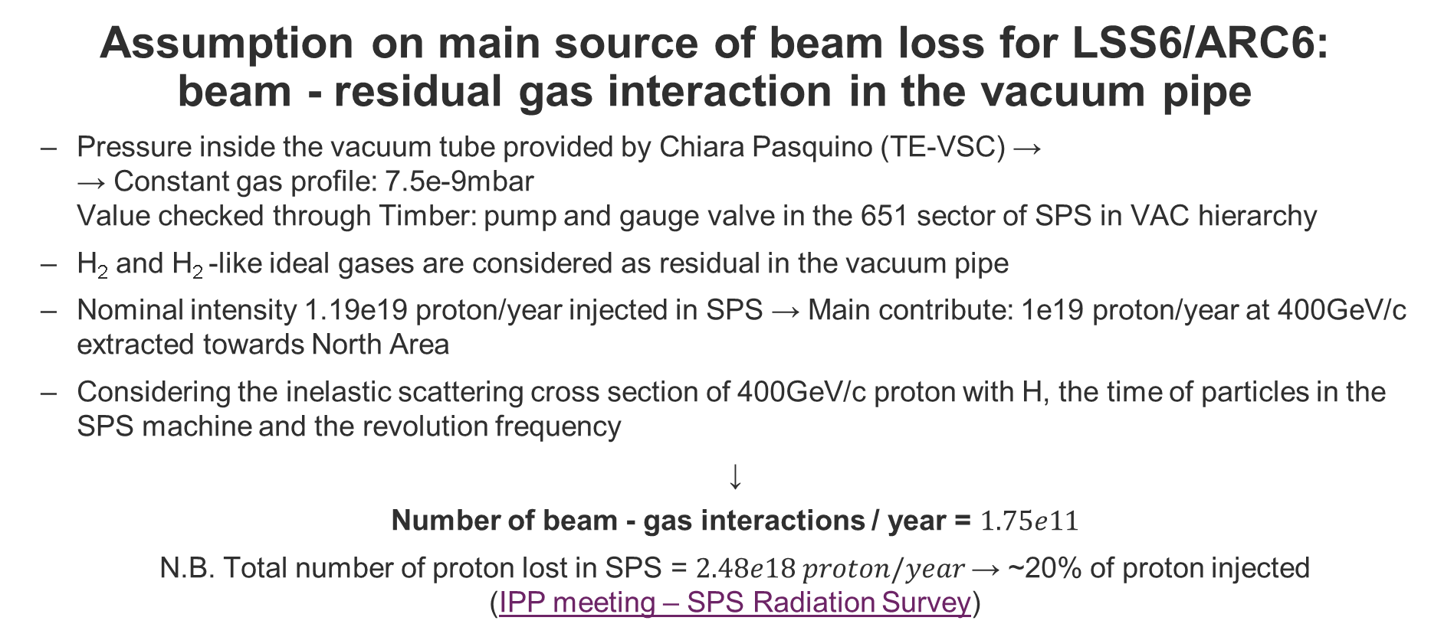
Simulation assumption
Assumption on main source of beam loss for LSS6/ARC6:
beam - residual gas interaction in the vacuum pipe
  Pressure inside the vacuum tube provided by Chiara Pasquino (TE-VSC) →
  → Constant gas profile: 7.5e-9mbar
  Value checked through Timber: pump and gauge valve in the 651 sector of SPS in VAC hierarchy
  H₂ and H₂ -like ideal gases are considered as residual in the vacuum pipe
  Nominal intensity 1.19e19 proton/year injected in SPS → Main contribute: 1e19 proton/year at 400GeV/c extracted towards North Area
  Considering the inelastic scattering cross section of 400GeV/c proton with H, the time of particles in the SPS machine and the revolution frequency
↓
Number of beam - gas interactions / year = $1.75e11$
N.B. Total number of proton lost in SPS = $2.48e18 proton/year$→ ~20% of proton injected
(IPP meeting – SPS Radiation Survey)

Slide 8
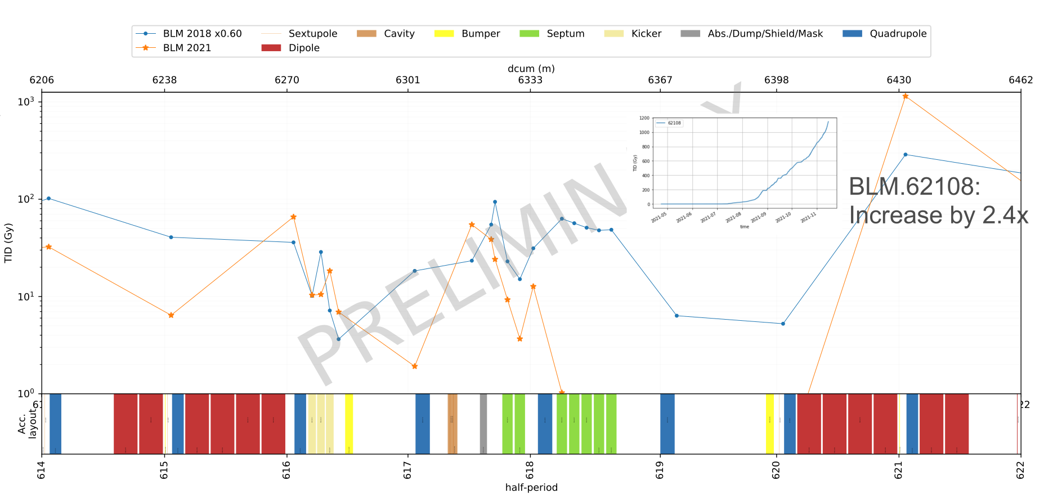
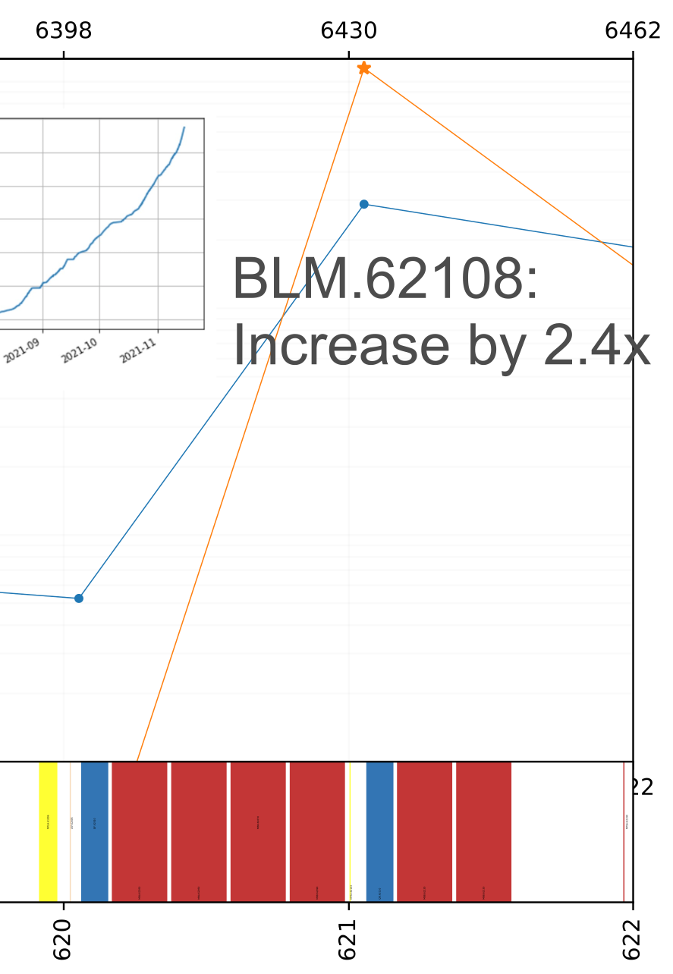
Data TID – LSS6
Results from 2018 and 2021 are available for BLMs
OF is in a non-standard position along LSS → difficult interpretation of results
Peak reached with BLM621 = 1148Gy in 2021
BLM620 ~ 0.16Gy → not reliable in 2021
by Kacper Bilko

Slide 9
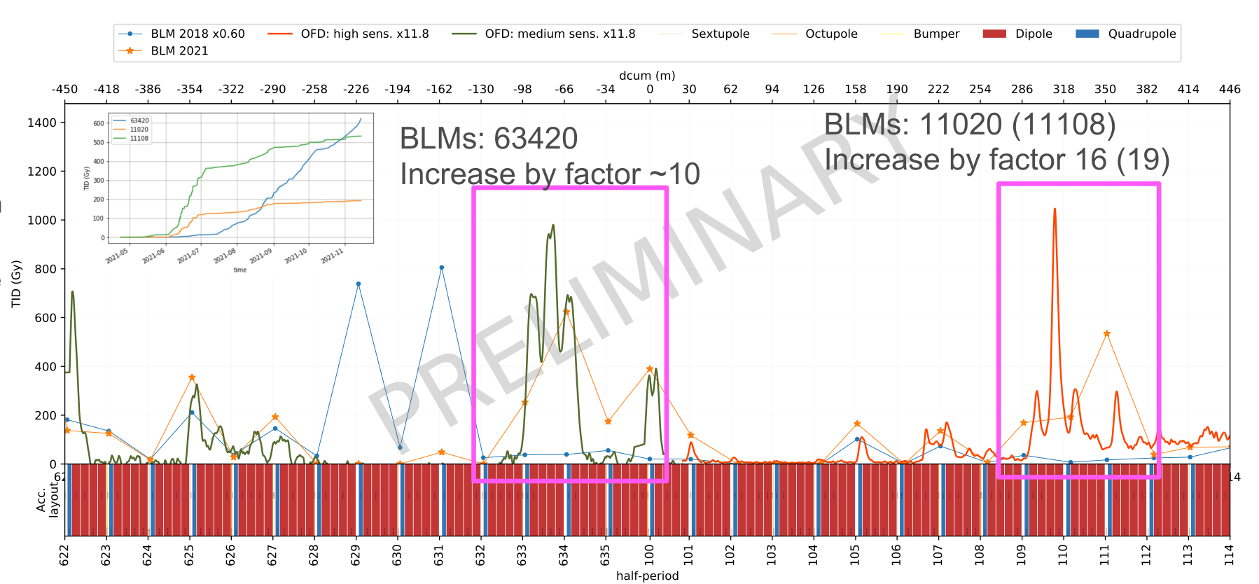
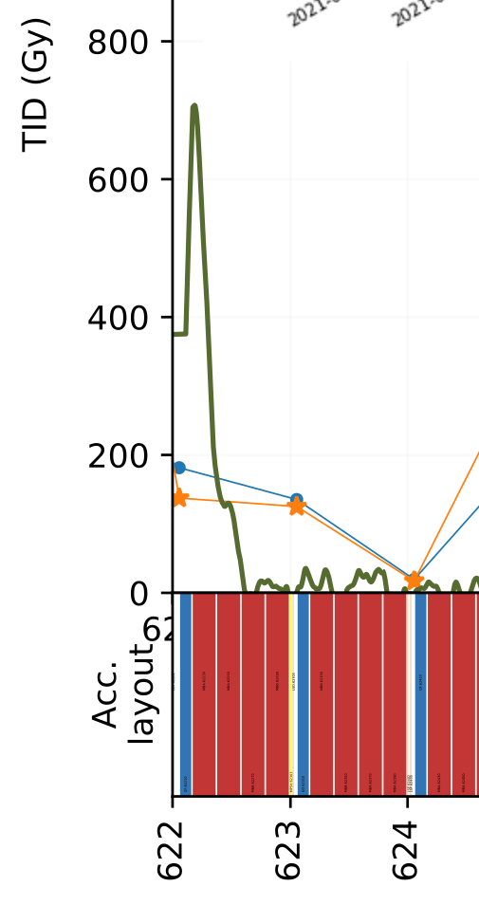
Data TID – ARC6
Results for BLMs and OF (in standard position) available for all ARC6
Values OF multiplied for a factor 11.8 for comparison with BLMs results
Peak reached with OF after QD62210 ~ 60Gy
by Kacper Bilko

Slide 10
FLUKA Dose
FLUKA results normalized using calculated beam-gas interactions
BLM# | Gy FLUKA | Gy measured
BLM620 | 1.97E-03 | 0.16
BLM621 | 1.44E-02 | 1148.00
BLM622 | 3.44E-03 | 137.00
BLM623 | 4.07E-03 | 126.00
BLM624 | 2.61E-03 | 17.10
Values from simulation are lower of a factor $\sim 4e4$ on average
Data from BLM620 not reliable
Trend of results comparable with the data

Slide 11
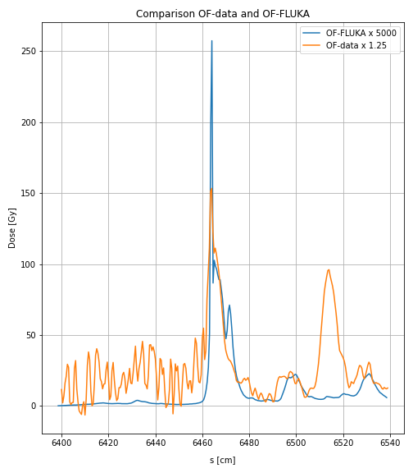
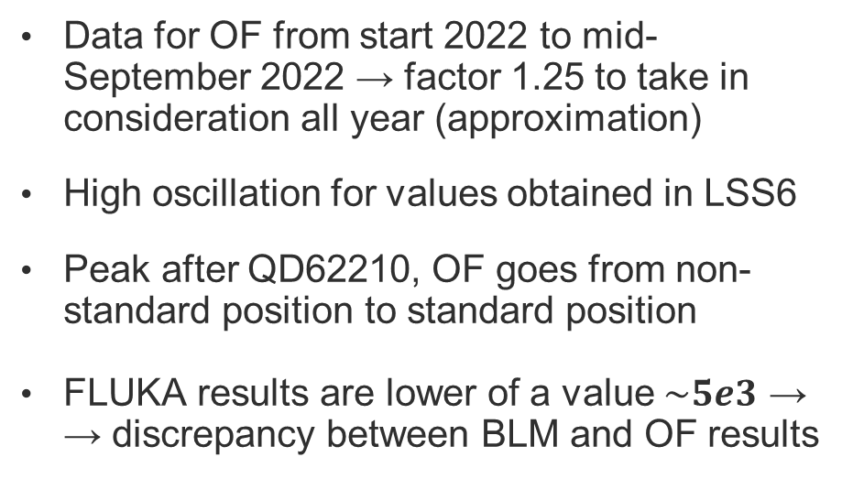
FLUKA Dose
Data for OF from start 2022 to mid-September 2022 → factor 1.25 to take in consideration all year (approximation)
High oscillation for values obtained in LSS6
Peak after QD62210, OF goes from non-standard position to standard position
FLUKA results are lower of a value $\sim 5e3$ →
→ discrepancy between BLM and OF results

Slide 12
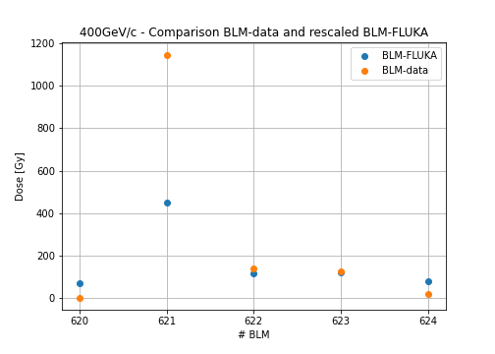
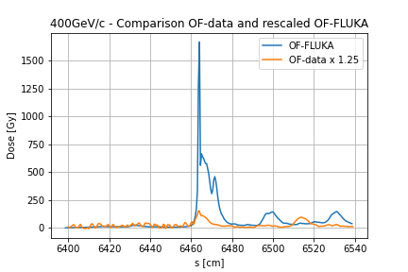

FLUKA Dose – Primaries calculation
BLM results from FLUKA and the relative measurements are fitted in order to calculate the number of primaries needed for each BLM
Number of primaries obtained for each BLM is averaged
TID from OF is recomputed with the new normalization factor
Normalization factor = $5.66e+15$ $p/y$

Slide 13
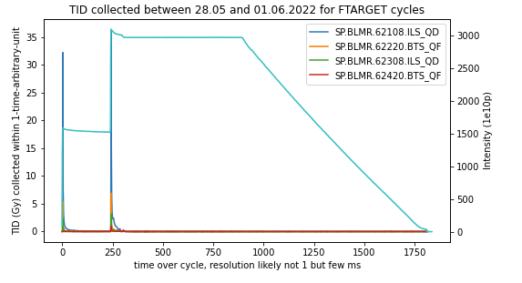
Discussion (1)
Considering the high discrepancy between data and simulation: beam-gas losses as main source investigated
Online TID scored by BLMs in the simulated sector during the NA slow extraction
-TID peak at injection of protons and not during flat top
-No constant behavior as expected if the main source is the beam-gas loss

Slide 14
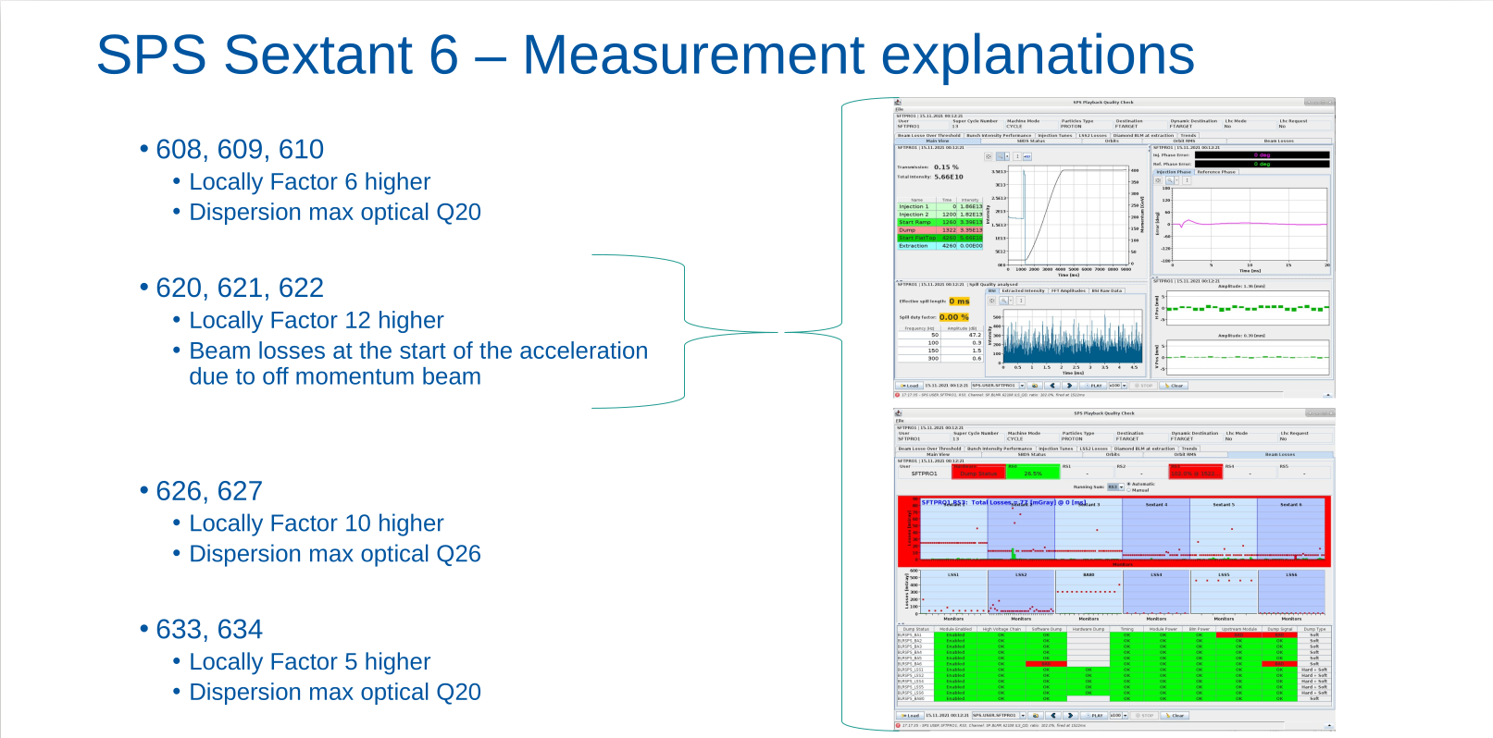
Discussion (2)
Considering the discrepancy between OF and BLM results:
energy of beam lost investigated
IPP meeting – SPS Radiation Survey
Beam uncaptured during injection and not during flat top → proton has not reached the 400GeV/c.
The proton is lost at lower energy and thus the dose gradient is different

Slide 15
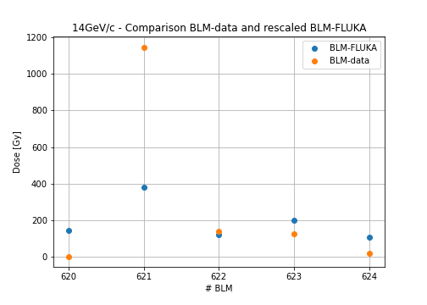
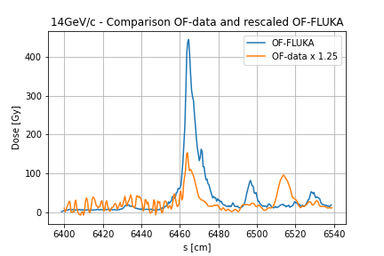
FLUKA Dose – 14GeV/c proton
Same setup and same assumption on the beam loss mechanism → beam-gas interaction
Number of primaries computed through the fit of BLM results → $9.11e16 proton/year$
Discrepancies between OF and BLM still present but reduced from a factor ~ 10 to a factor ~3

Slide 16
GF PoP – R2E
R2E studies GF electronic components installation in service tunnel

Slide 17
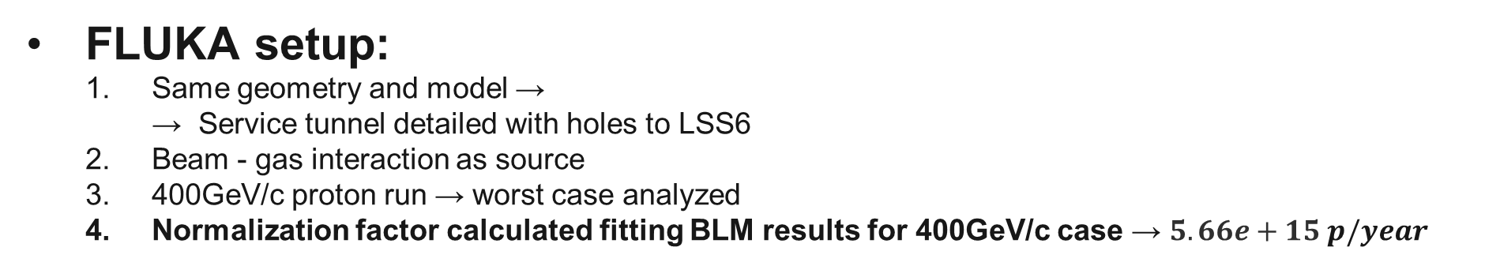
GF PoP – R2E
FLUKA setup:
  Same geometry and model →
  → Service tunnel detailed with holes to LSS6
  Beam - gas interaction as source
  400GeV/c proton run → worst case analyzed
  Normalization factor calculated fitting BLM results for 400GeV/c case → $5.66e+15 p/year$
Scoring – R2E quantities [1][2] :
  High Energy Hadron Equivalent Fluence = proportional to the number of SEU (Single Event Upset) due to hadrons of energy > 20MeV. Neutron of lower energies are weighted according to the ratio of their SEU cross section to the one of > 20 MeV hadrons
  Silicon 1 MeV-neutron Equivalent Fluence = fluence weighted by a damage function
  Thermal Neutron Equivalent Fluence = proportional to the number of SEU's due to thermal neutrons. Neutrons of higher energies are weighted according to the ratio of their capture cross section to the one of thermal neutrons (following the 1/v law)
  Total Ionizing Dose

Slide 18
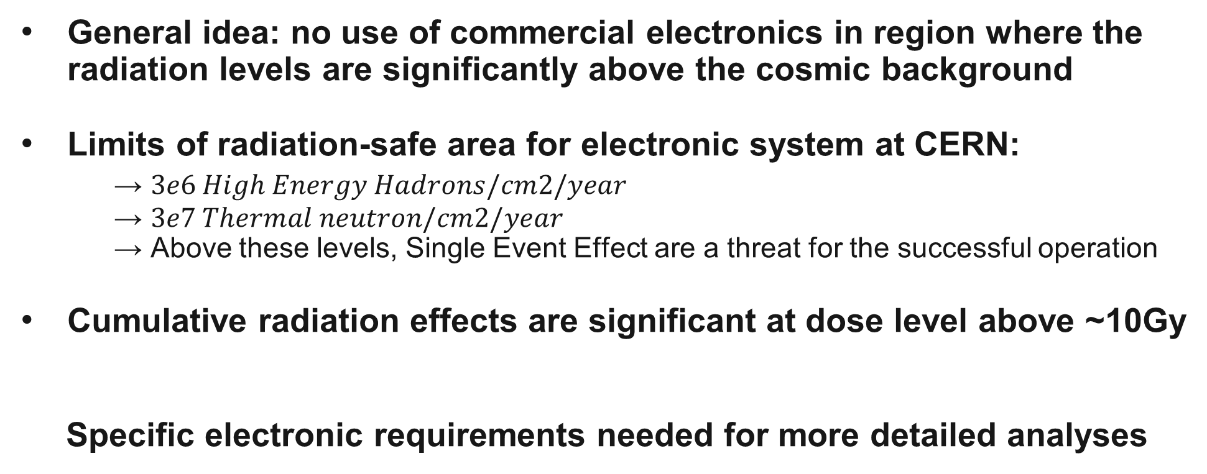
R2E limits @ CERN
General idea: no use of commercial electronics in region where the radiation levels are significantly above the cosmic background
Limits of radiation-safe area for electronic system at CERN:
→ $3e6 High Energy Hadrons/cm2/year$
→ $3e7 Thermal neutron/cm2/year$
→ Above these levels, Single Event Effect are a threat for the successful operation
Cumulative radiation effects are significant at dose level above ~10Gy
Specific electronic requirements needed for more detailed analyses

Slide 19
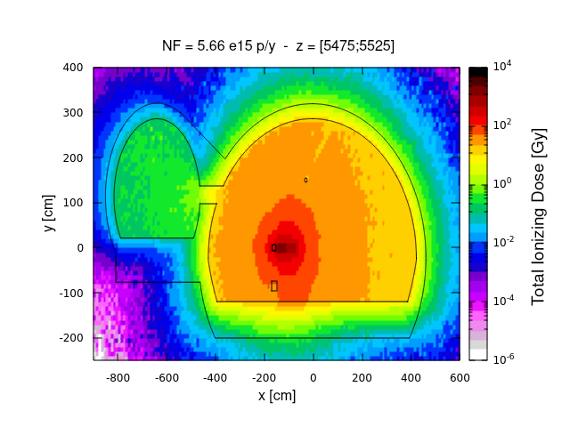
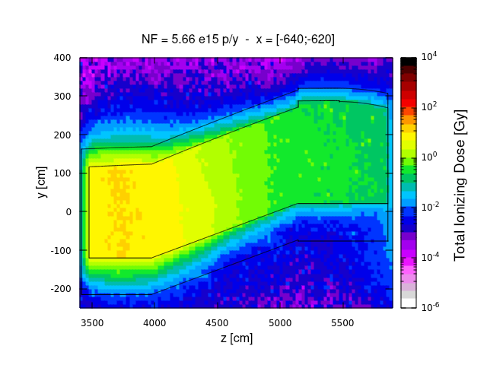
FLUKA – TID Results
During proton run, electronics for GF PoP is non-operational → Cumulative radiation effects:
At laser location reached values of TID ~ $1 Gy$
TID in side tunnel – Hole for laser included
TID in side tunnel

Slide 20
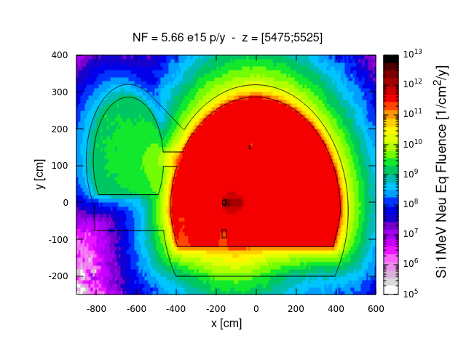
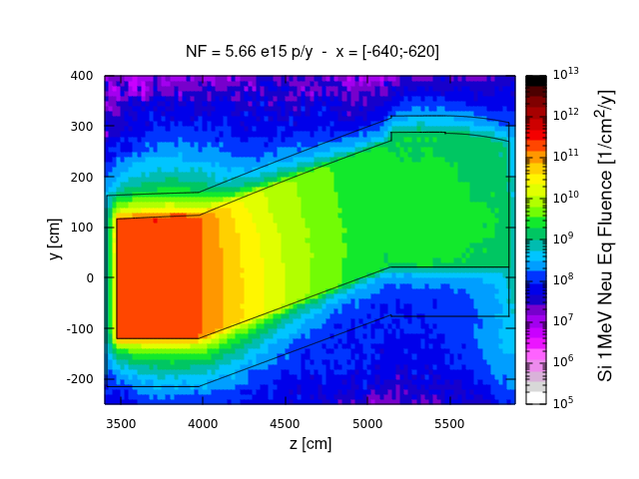
FLUKA – 1MeV-Neu Eq Results
During proton run, electronics for GF PoP is non-operational → Cumulative radiation effects:
At laser location reached values of Si 1MeV- Neu Eq Fluence $\sim 6e9 1/cm2/year$
1MeV Neu. Eq. Fluence in side tunnel – Hole for laser included
1MeV Neu. Eq. Fluence in side tunnel

Slide 21
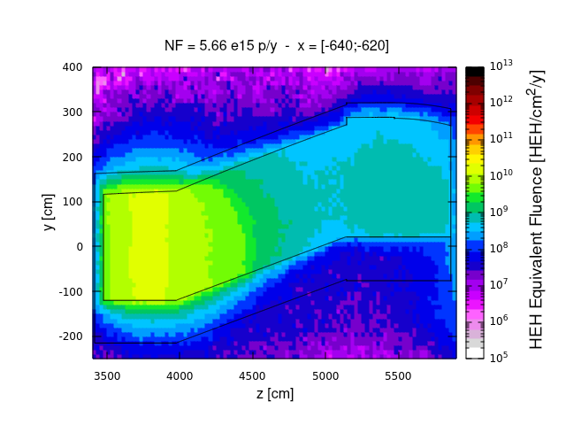
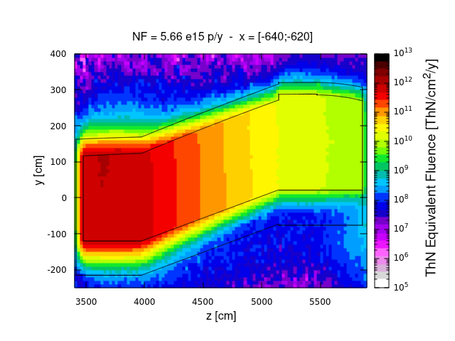
FLUKA – ThN and HEH Results
Levels of Th. Neutrons and HEH in the service tunnel above the limit for a radiation-safe area
HEH eq. fluence in side tunnel – Effect of holes visible
Th. Neutron eq. fluence in side tunnel

Slide 22
Conclusion
The assumption of beam-gas as the main source of beam losses in LSS6/ARC6 resulted to be wrong →
→ difficulties in simulation of real situation due to complex system
Discrepancies between OF and BLM pose some difficulties in obtaining a right parametrization fit using beam-gas as main source
Using the fitted normalization factor, in the worst case of 400GeV/c proton losses, R2E results in service tunnel are above the limits defined for a radiation-safe area and cumulative radiation effects are evaluated

Slide 23
Next Step
Deployment of new detectors (RPLs and BatMONs) in the side tunnel. Through the fit of detectors’ results, a more precise estimation of R2E quantities in the service tunnel could be computed
Simulation with Partially Stripped Ions for R2E studies
→ beam-gas interaction is expected to be the main source of losses
→ electronics in position and operative

Slide 25
BACK UP SLIDES

Slide 26
References
[1] K. Roeed, M. Brugger and C. Pignard
PTB irridiation tests of the LHC radiation monitor (RadMon)
CERN ATS Note 2011-012, 2011 http://cds.cern.ch/record/1329478?ln=es
[2] K. Roeed, M. Brugger, D. Kramer et al.
Method for measuring mixed field radiation levels relevant for SEEs at the LHC
IEEE Transactions on Nuclear Science, vol. 59, no. 4, pp. 1040-1047, 2012.

Slide 27
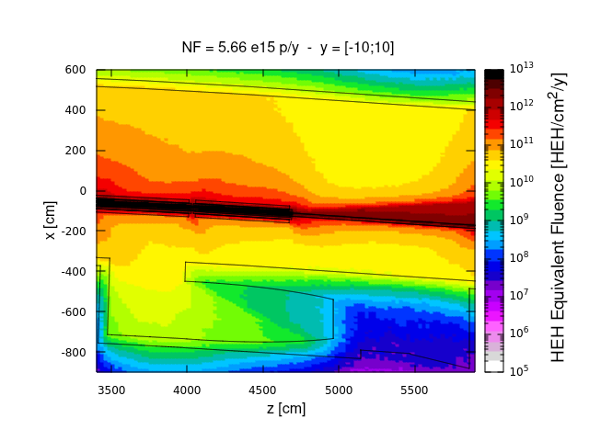
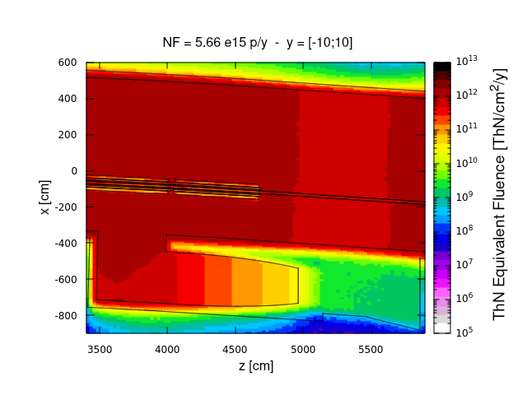
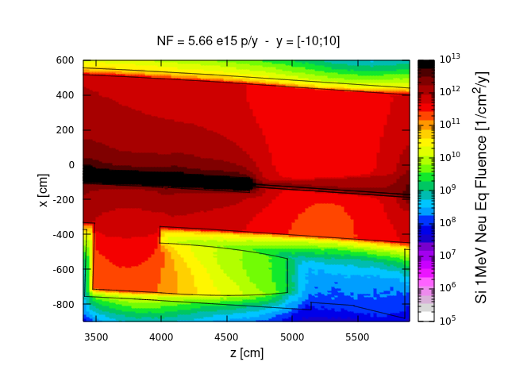
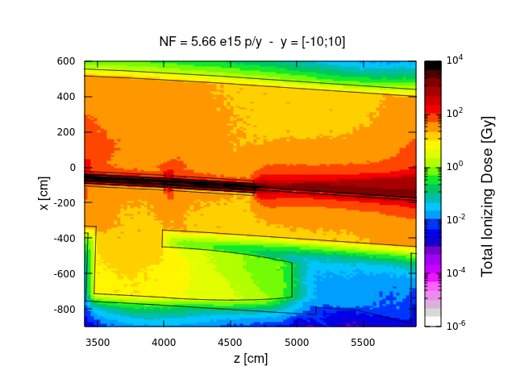
HEH/ThN results - zx

