Slide 1

RF synchronisation for
Gamma-Factory POP in SPS
H. Damerau, W. Höfle, Ben Woolley
γγ Factory Meeting, 25 October 2022, CERN

Slide 2
Introduction - Reminder
SPS main RF system frequency is 200 MHz.
SPS RF systems are located in point 3 of the SPS (cavities, power, LLRF).
RF synchronization regularly done in the SPS for
  extraction of beam to LHC (point 4 of LHC)
  extraction of beam to AWAKE (point 4 of SPS)
  during crab cavity MDs (prototype system in point 6 of SPS).
Common to all schemes is that the beam is re-synchronized in the SPS to external reference signals from the receiving machine or experiment.
During the process the beam can be shifted in time to the right position with respect to a fixed revolution frequency pulse of the SPS.
A high precision of the synchronization requires distribution of RF signals with low drift and jitter.
AWAKE synchronization has been the most precise implemented in the SPS
  based on scheme developed for the beam transfer to LHC
New SPS LLRF commissioned in 2021/2022 compatible with scheme deployed in AWAKE, LHC and for SPS crab cavity tests in point 6 of SPS

Slide 3
Strategy for Gamma factory synchronisation with SPS
Minimization of the amount of new electronics that need to be designed
Use a scheme proven in AWAKE to provide stability for the Laser lock
Deployment in parallel with SPS crab cavity activities that continue in BA6/LSS6 of SPS until at least 2025
  nota bene: electronics for the SPS crab cavity synchronization is located on the surface of the SPS, BA6
    electronics and the reference oscillator for γγ PoP should be located underground as close as possible to the Laser in a temperature stabilized location, must be also fire safe according to HSE requirements if outside the Laser room
choices
  start with 160 MHz reference RF
    generate 400 MHz with PLL similar to AWAKE RF system
  start with 800 MHz reference RF
    optional harmonic lock of the Laser
    straight division to generate all needed signals
      synchronised division needed if bunch position with respect to 160 MHz phase should be repeatable from cycle to cycle

Slide 4
Alternative paths
If ionizing radiation is prohibitive in the under ground area have electronics on the surface
  requires a phase stabilized link from the surface to the tunnel (copper cable using signal reflected to compensate drifts on the surface), use extremely low regulation bandwidth to not degrade phase noise performance of generator; requires study
White Rabbit (WR) to RF VME module developed for SPS
  phase noise performance required may be in reach in the future (by LS3?), presently > 50 fs
  phase noise performance below 100 Hz would need to become a requirement for a future upgrade of the WR system
  is being targeted as the future technology for distributing clocks between the RF systems in LHC and to experiments in LHC (400 MHz)
  easily scalable
https://indico.psi.ch/event/12911/contributions/38449/attachments/23038/40710/llrf_tom_16_9.pdf

Slide 5
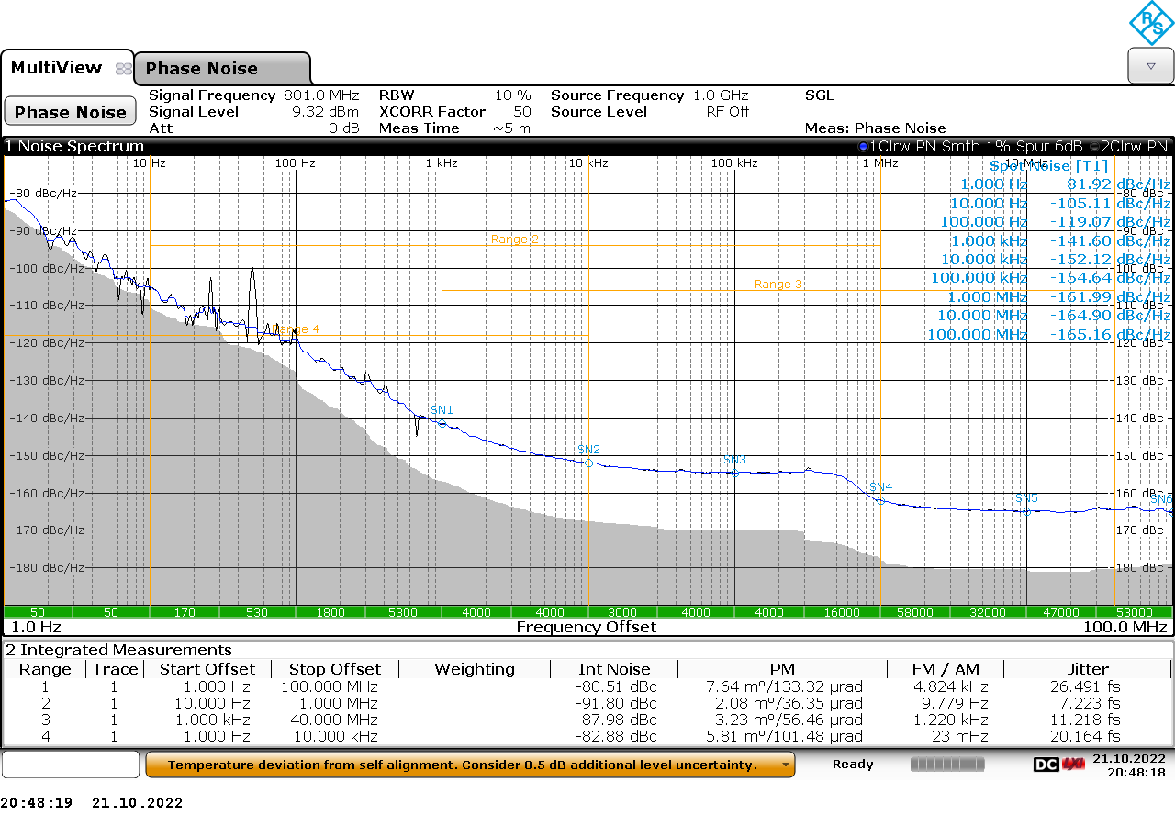
Phase noise of commercial generator
Rohde & Schwarz SMA 100B with low phase noise options
1 Hz → 40 MHz, estimated 23.5 fs @801 MHz

Slide 6
Design choices for γγ PoP synchronization
Choice of frequencies adapted when compared to the 2018 plan
  https://indico.cern.ch/event/802131/
Signal | Frequency | Ratio | “h” | need
Reference RF source, f_{Ref} | 801.6 MHz | 1 | 924 x 20 | optional
Laser mode-locker, f_{ML} | 160.32 MHz | f_{Ref}/5 | 924 x 4 | must have
2×SPS RF system freq., 2f_{RF,SPS} | 400.8 MHz | f_{ML}×5/2 | 924 x 10 | must have
SPS revolution frequency f_{rev,SPS} | 43.3 kHz | f_{ML}/3696 | 1 | must have
Common frequency f_{c} equal to f_{rev, SPS} | 43.3 kHz | f_{ML}/3696 | 1 | must have
Bunch repetition rate, f_{rep} | 40.08 MHz | f_{c} x 924 | 924 | optional pulse-picking
SPS RF frequency f_{RF, SPS} | 200.2 MHz | f_{c} x 4620 | 924 x 5 | in FC BA3
frequency numbers above rounded: exact is 40.076 767 MHz

Slide 7
New scheme for the γγ factory POP
Commercial equipment
Existing RF design
Supplied by experiment
BA6
BA3/Faraday Cage
801.6 MHz master
?
Laser PLL
Laser
Reference
frequency
160.32 MHz
frev = fc, 400.8 MHz
synchronous dividers
Fiber link (with stabilization)
Fiber receiver/transmitter
10 MHz
SPS synchro
optional
Buffer amplifiers
400.8 MHz
Fast pulse triggers
LLRF
Timing
Re-use of the AWAKE scheme minimizes
new developments and commissioning time
some dedicated equipment required
40 MHz, frev, …
Fast pulse triggers

Slide 8
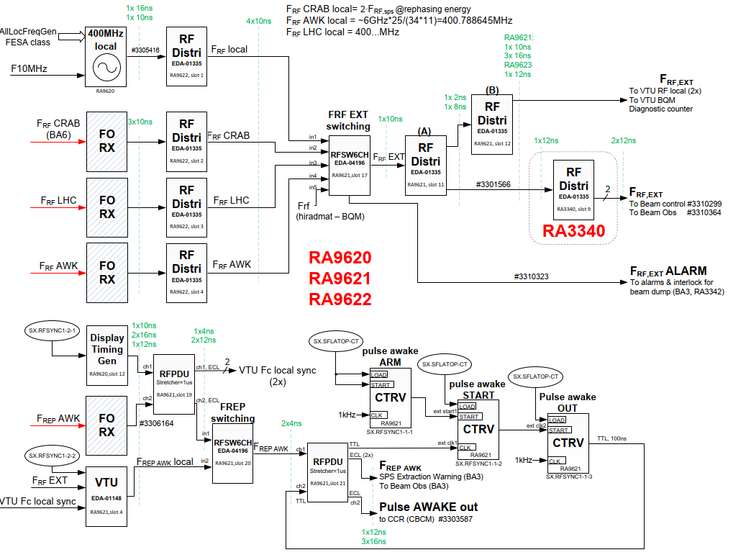
SPS BA3 side (1)
G. Hagmann
SY-RF-FB

Slide 9
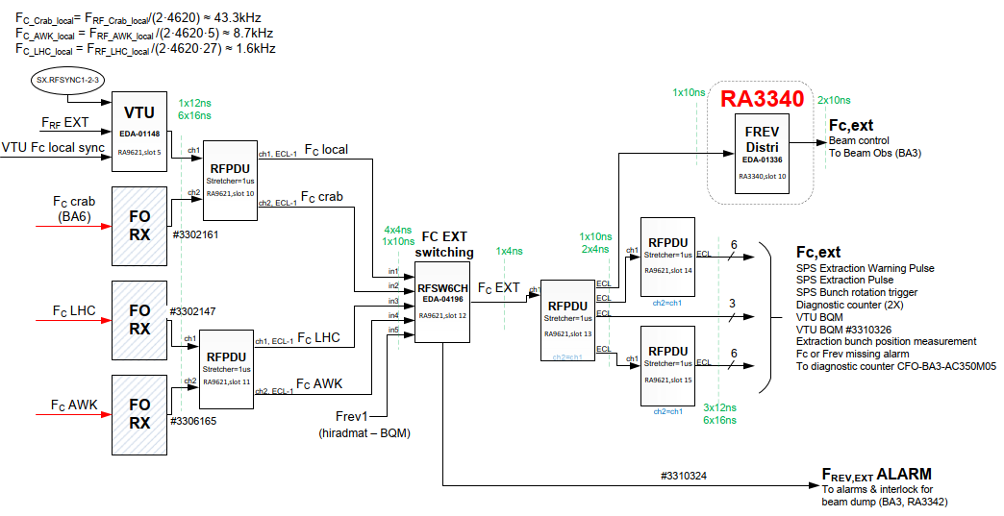
SPS BA3 side (2)
G. Hagmann
SY-RF-FB

Slide 10
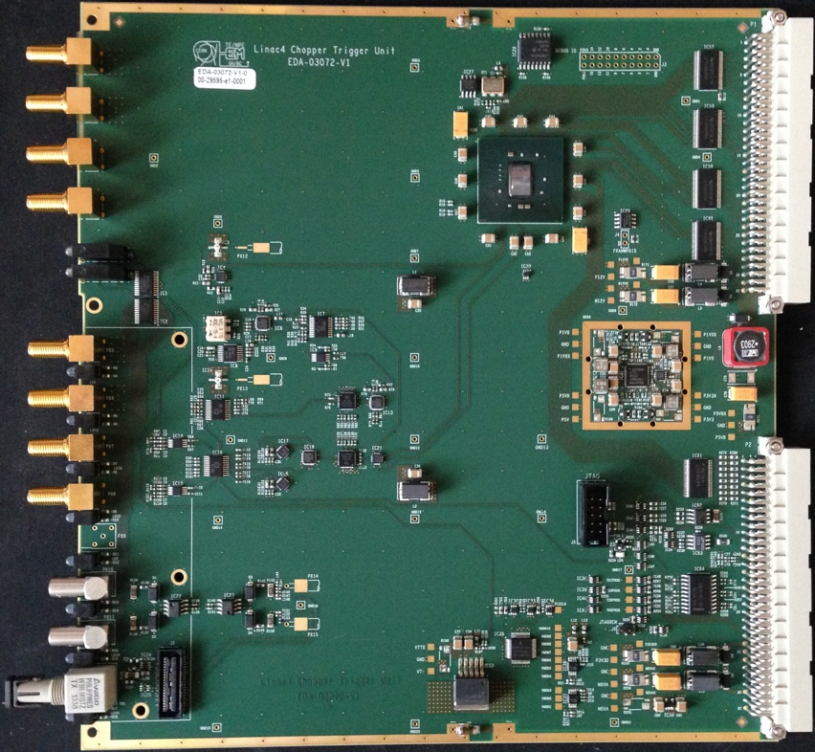
Precision triggers – in house developed RF VME board
Synchronous trigger units (CTU)
Generation of triggers from 400 MHz RF for beam observation
Works with 800 MHz input, too (limit 1 GHz)
Delayed output
  step size: 1.25 ns (at 800 MHz input) plus fine delay (ps resolution)
  long delays possible (ms range)
  dedicated firmware and software for AWAKE
divider can be synchronized with external reference trigger
smallest division ratio is 10 (t.b.c.)
  cannot be used to generate 160 MHz and 400 MHz from 800 MHz
test of phase noise done (out of spec input of 1.6 GHz)
    divide by 10
    phase noise too high to provide 160 MHz reference
    just acceptable phase noise to provide signals for SPS
      400.8 MHz jitter is few ps

Slide 11
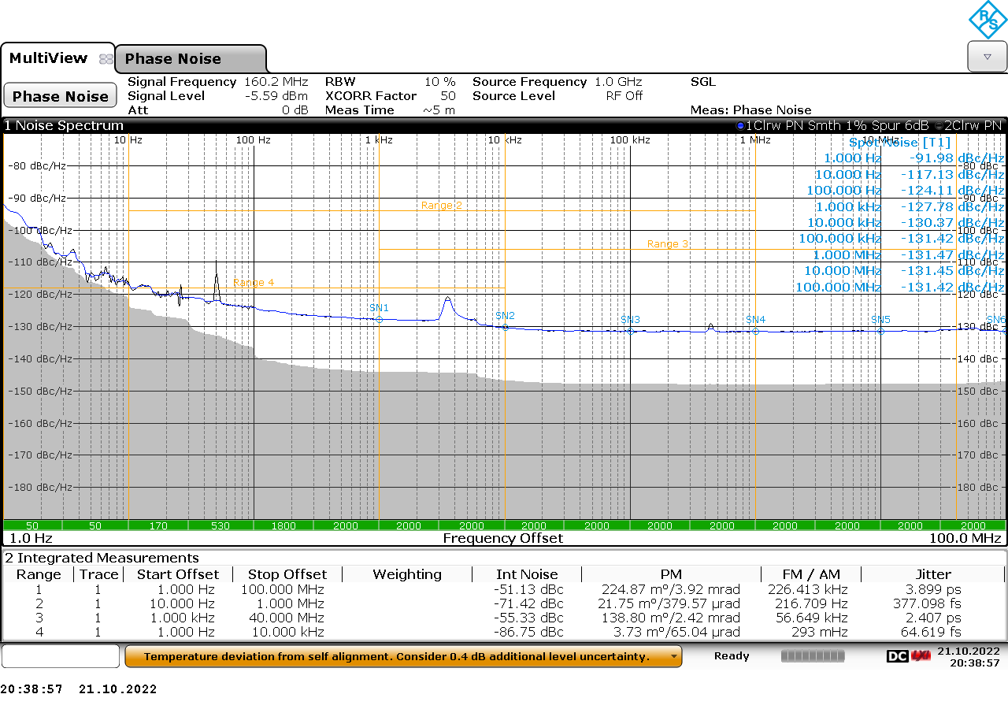
Phase noise of divider for AWAKE clocks
RF input from R&S SMA 100B at 1602 MHz, then divide by 10 by VME-CTU

Slide 12
New developments needed
Divide by 5 and powers of 2
suitable components
  /2, /4: HMC394LP4 / 394LP4E
    https://www.analog.com/media/en/technical-documentation/data-sheets/hmc394.pdf
    noise floor: -153 dBc/Hz
    added jitter: t.b.c.
  /5: HMC438MS8G / 438MS8GE (160 MHz from 800 MHz)
  https://www.analog.com/media/en/technical-documentation/data-sheets/hmc438.pdf
    noise floor: - 153 dBc/Hz
    added jitter: t.b.c.
to be checked how the synchronization needs to be done
  800 → 160 MHz free running
  800 MHz / 2 synchronized with subharmonic of 160 MHz using a less performing scheme (few ps jitter ok for SPS)

Slide 13
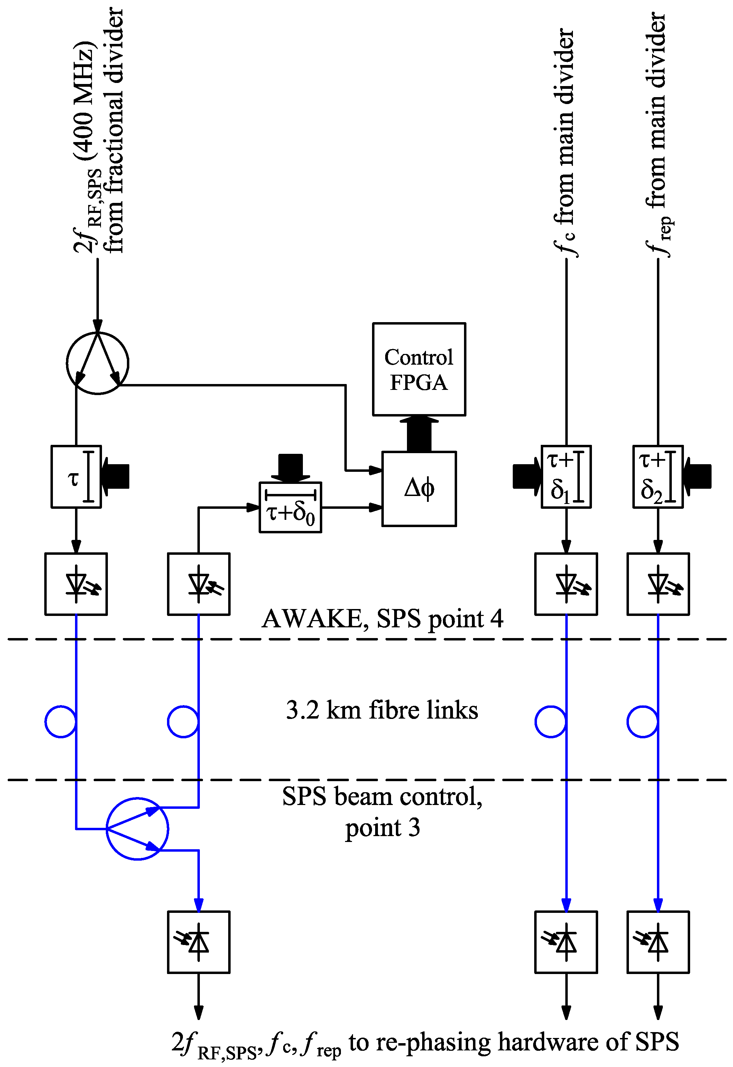
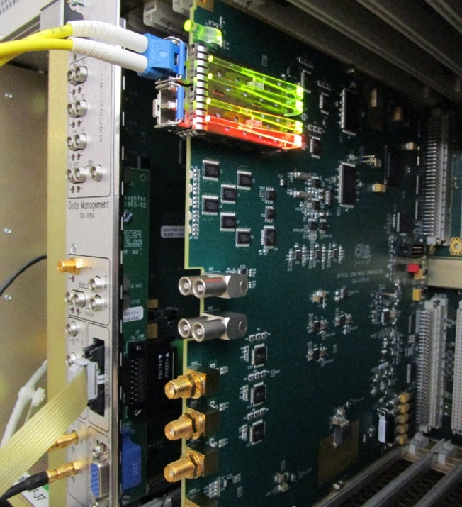
Fiber link stabilization
Simplified diagram
Installed and commissioned
Also used for crab cavity tests
Logging of temperature and compensation delay for correlation
D. Barrientos, J. Molendijk, Phase stabilization over a 3 km optical link with sub‑picosecond precision for the AWAKE experiment, IEEE Real Time Conf., 2016

Slide 14
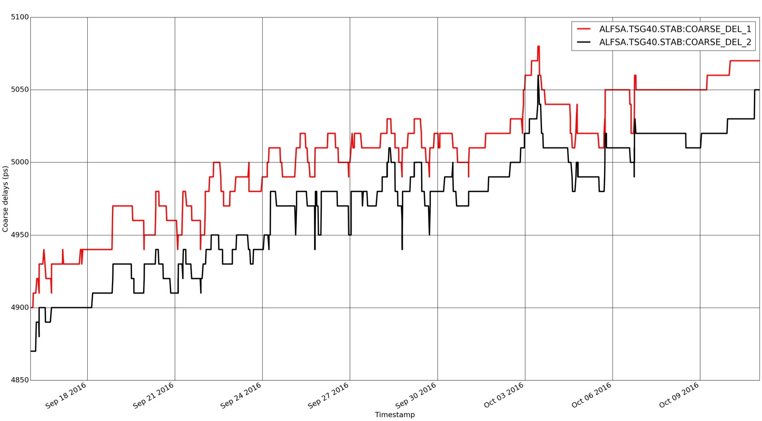
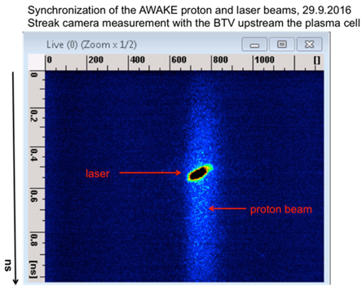
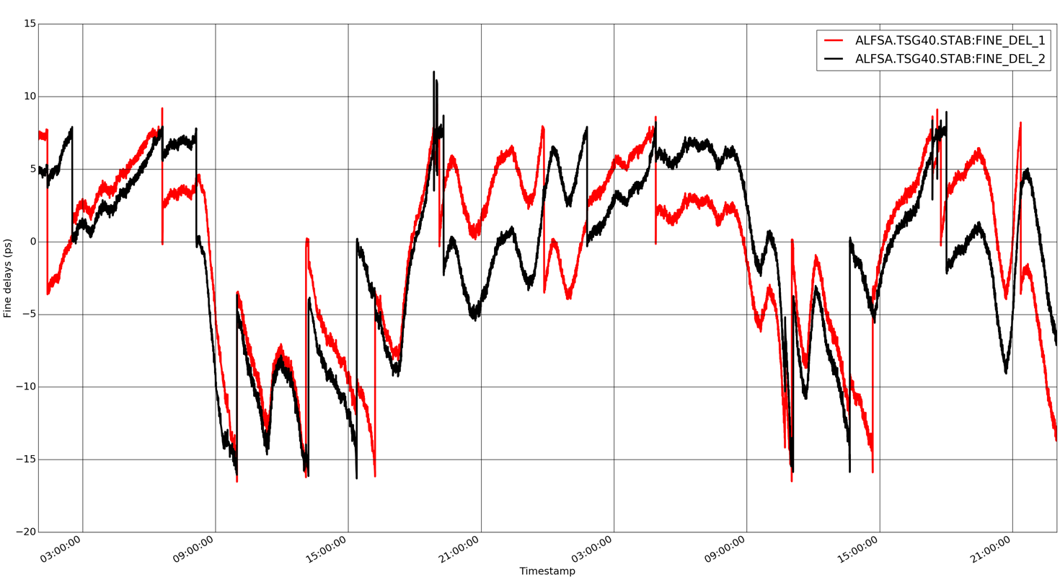
Fiber Link Stabilization - Results
250 ps
25 days - Coarse delay
RF reference fiber link stabilization from AWAKE laser room to SPS BA3 FC (400 MHz signal)
System operational since September 2016
→ It means without this stabilization we would have the above variations !
35 ps
2 days - Fine delay

Slide 15
Hardware
Hardware and installation shopping list (based on AWAKE scheme)
Low phase noise master oscillator 800 MHz, commercial (60 kCHF)
Development / purchase of dividers (30 kCHF)
  Low noise divider /5 (synchronization?)
  Low noise divider /2 (synchronization)
  Alternatively PLL to produce 400 MHz from 160 MHz for SPS synchronization
CTUs to produce clocks (15 kCHF)
Phase shifter (except if alternative option with PLL chosen) (3 kCHF)
Fiber links BA3 to BA6 (six fibers operational, incl. 2 spares)
  10 MHz from BA3 FC (non stabilized) (5 kCHF)
  400 MHz (stabilized, same fiber loop back) (15 kCHF)
  Frev = fc, stabilized (two fibers per signal) (15 KCHF)
Fire poof climatized rack in LSS6 and local cabling (10 kCHF)
  1 RF VME crate with timing (15 kCHF)
Faraday cage adaptations in BA3 with cabling (5 kCHF)
Instrumentation, surveillance of links, lab (30 kCHF)
Local cabling, Ethernet, controls etc. (20 kCHF)
Material and Installation 223 kCHF

Slide 16
Resources (workforce)
2 technical students or 1 Fellow (“Quest”) from late 2024
allocation of CERN staff for supervision 0.15 FTE over 5 years, x5
Schedule
Develop required for electronics ahead of LS3
  2 technical students or 1 Fellow (“Quest”), 2025 (?) to 2027
allocation of CERN staff for supervision 0.15 FTE over 5 years from planning of the request for funding to the installation and hardware commissioning in 2027, need department commitment for this

Slide 17
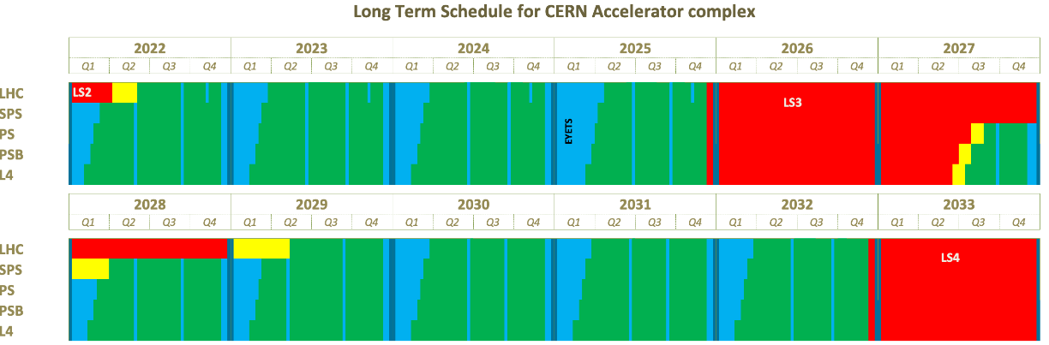
Schedule

Slide 18
Next possible steps
estimate cycle time required for synchronisation / re-phasing (will be longer for Pb⁷⁹⁺ than for p to AWAKE), similar to Pb for LHC (left over from 2019)
check possible experiment using existing equipment from crab cavity installation (phase noise)
check stability (jitter) of ion bunch in time with respect to reference (input to specification of fiber link) or base on AWAKE experience
study remote controls and diagnostics needed
get more accurate estimates for
  optical fiber links
  fire safety for rack, acceptable environmental conditions outside laser room, how to deal with the non-ionizing radiation estimates
decide if option for White Rabbit should be kept open

Slide 19
Spare

Slide 20
A possible scheme for the γγ factory POP
Commercial equipment
as presented 28.03.2022
Existing RF design
Supplied by experiment
BA6
BA3/Faraday Cage
400.8 MHz master
Laser PLL
Laser
Reference
frequency
40.08 MHz
frev, fc, 400.8 MHz
synchronous divider (CTU)
Fiber link stabilization
Fiber receiver/transmitter
10 MHz
SPS synchro crate
Buffer amplifiers
400.8 MHz
Fast pulse triggers
Proton LLRF
Timing
Re-use of the AWAKE scheme minimizes
new developments and commissioning time
some dedicated equipment required
Various frequencies distributed
Fast pulse triggers

Slide 21
Design choices for AWAKE synchronization at 400 GeV/c
Choice of frequencies given by existing parameters and constraints
  klystron frequency for electron beam (3 GHz) , existing hardware
  SPS RF (200 MHz)
  range of frequencies for laser mode locker
  ratios as far as possible integers
  If fractional ratios, small integer ratios preferred (choice 25/11) between SPS RF (200 MHz given) and Laser mode locker (→ 88 MHz)
Signal | Frequency | Ratio | “h”
Laser phase locked loop, f_{LPLL} | 5.9958 GHz | 1 | 870 x 691152
Electron acceleration, f_{RF,e} | 2.9979 GHz | f_{LPLL}/2 | 870 x 345576
2×Laser mode-locker, 2f_{ML} | 176.347 MHz | f_{RF,e}/17 | 870 x 20328
Laser mode-locker, f_{ML} | 88.1735 MHz | f_{RF,e}/34 | 870 x 10164
2×SPS RF system freq., 2f_{RF,SPS} | 400.8 MHz | 2f_{ML}×25/11 | 870 x 23100
SPS revolution frequency f_{rev,SPS} | 43.3 kHz | f_{ML}×5/10164 | 870 x 5
Common frequency, f_{c} | 8.67 kHz | f_{ML}/10164 | 870
Laser Pulse repetition rate, f_{rep} | 9.97 Hz | f_{c}/870 | 1

Slide 22
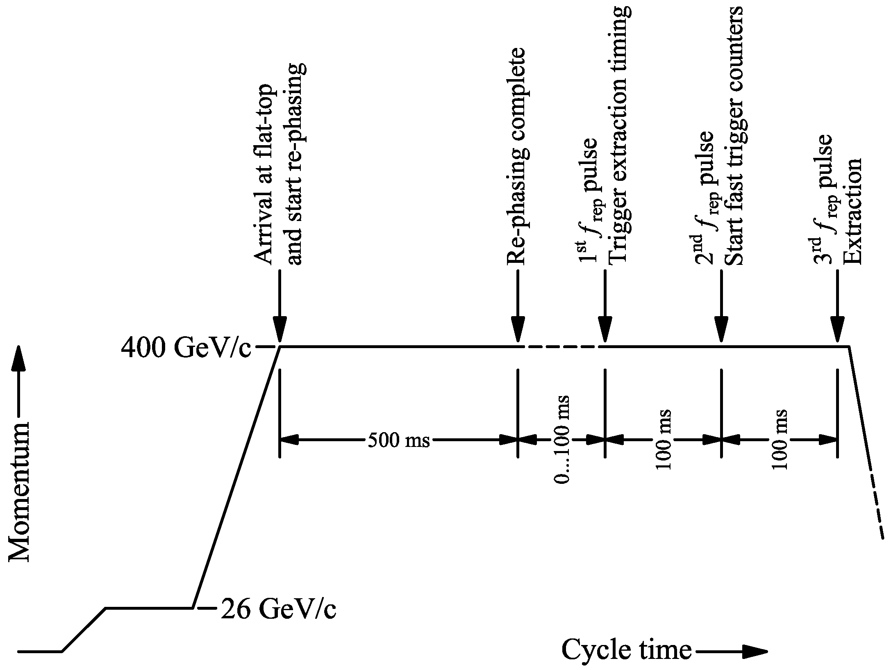
SPS AWAKE Cycle
check in SPS (fc)
versus azimuthal
position of beam
bunch rotation
& extraction
warnings
“timing: SPS driven”
“AWAKE driven”

Slide 23
AWAKE: Synchronizing 3 Beams
AWAKE Synchronization and RF distribution must deliver a wide range of RF signals for laser, electron and proton beams
Precision trigger pulses for beam instrumentation
Reference: signals (f_{ML}, f_{rep}) for laser
Signals for proton/electron beams and fast triggers shifted
Signal | Frequency | Ratio
Laser phase locked loop, f_{LPLL} | 5.9958 GHz | 1
Electron acceleration, f_{RF,e} | 2.9979 GHz | f_{LPLL}/2
2×Laser mode-locker, 2f_{ML} | 176.347 MHz | f_{RF,e}/17
Laser mode-locker, f_{ML} | 88.1735 MHz | f_{RF,e}/34
2×SPS RF system freq., 2f_{RF,SPS} | 400.8 MHz | 2f_{ML}×25/11
Common frequency, f_{c} | 8.68 kHz | f_{ML}/10164
Pulse repetition rate, f_{rep} | 9.97 Hz | f_{c}/870
Laser pulse
φ
Electron beam
φ
τ
Proton beam
τ
Simultaneous arrival of beams in AWAKE

Slide 24
Simplified overview synchronization and RF distribution
GPS receiver
Commercial equipment
Existing RF design
10 MHz (reference)
BA4/building 871
Awake specific RF design
TSG40
BA3/Faraday Cage
6 GHz master
Laser PLL
Laser
5995.8 MHz
(reference)
88.2 MHz (divider)
9.97 Hz, 8.68 kHz, 400.8 MHz
Main RF divider
Fiber link stabilization
Fiber receiver/transmitter
2997.9 MHz
10 MHz
Electron
LLRF
400.8 MHz
Fractional divider SPS
Buffer amplifiers
SPS synchro crate
200.4 MHz
Timing
Buffer amplifiers
176.3 MHz
Fast pulse triggers
Fast pulse triggers
Proton LLRF
Timing
Various frequencies distributed (many!)
Fast pulse triggers (~20 adjustable)
Extraction and bunch rotation triggers

Slide 25
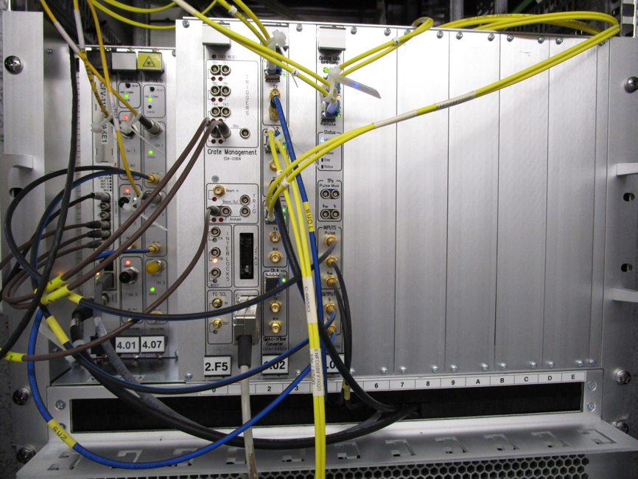
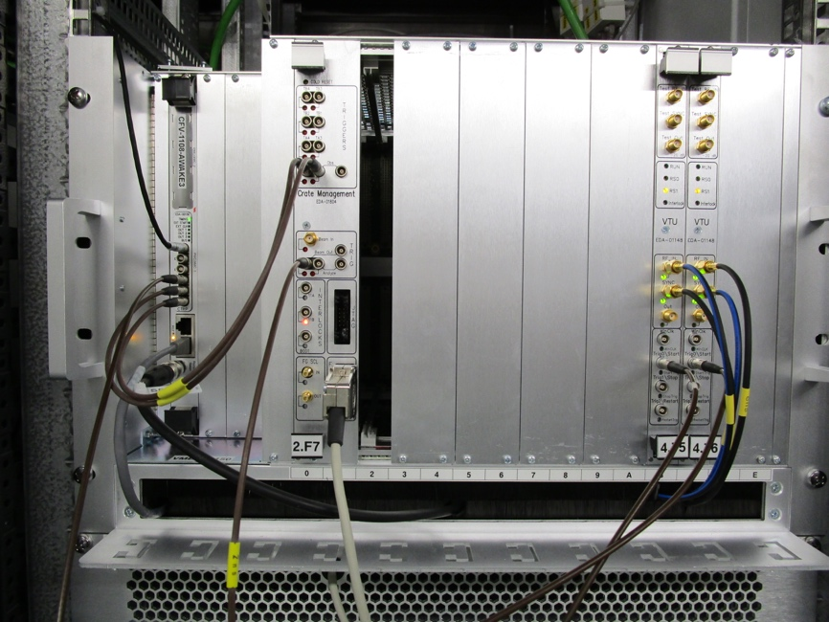
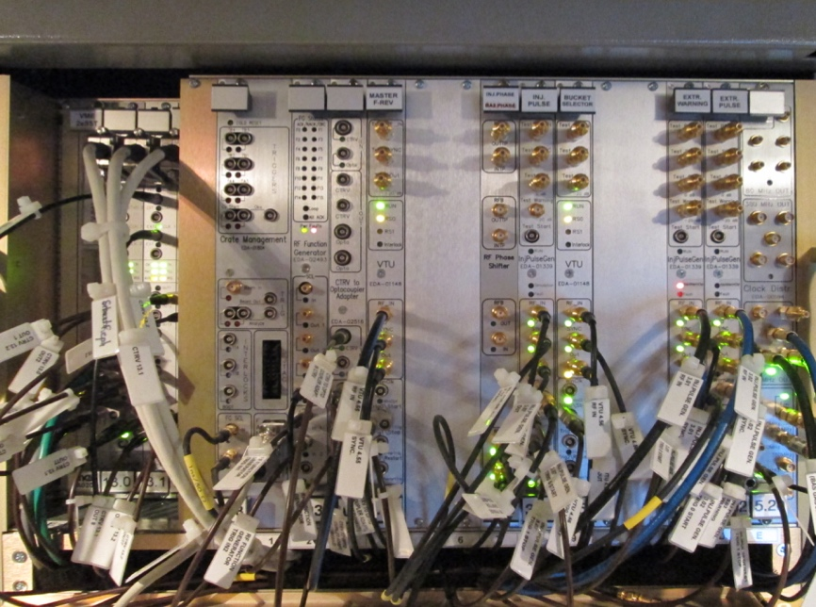
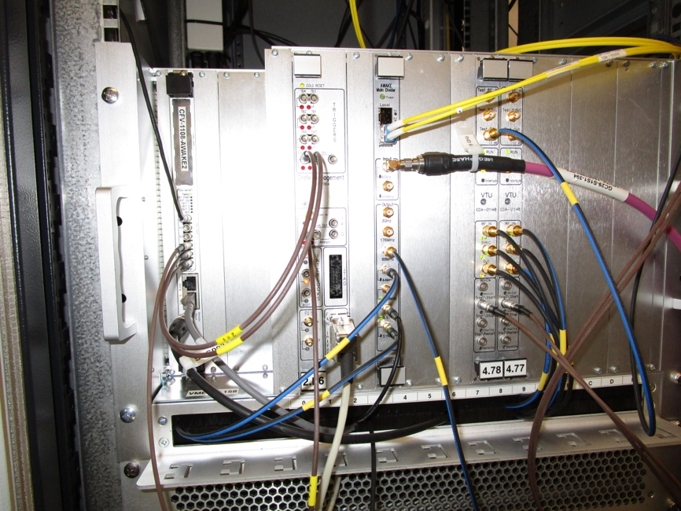
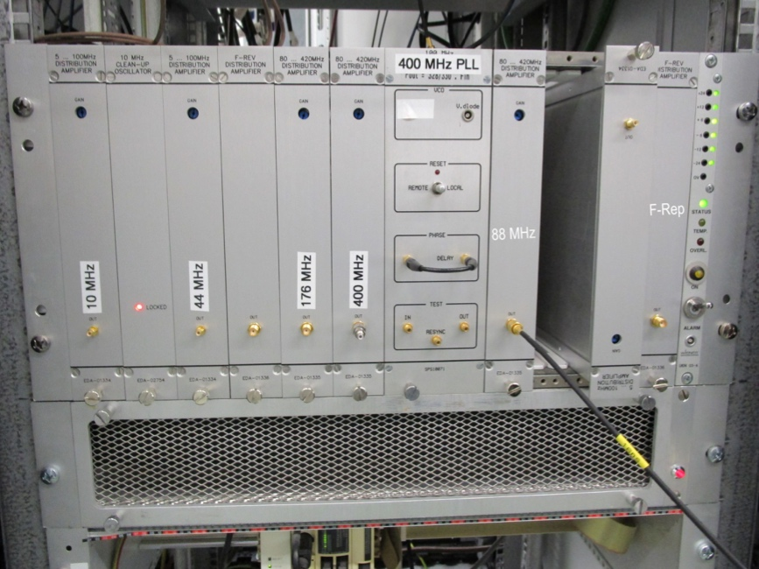
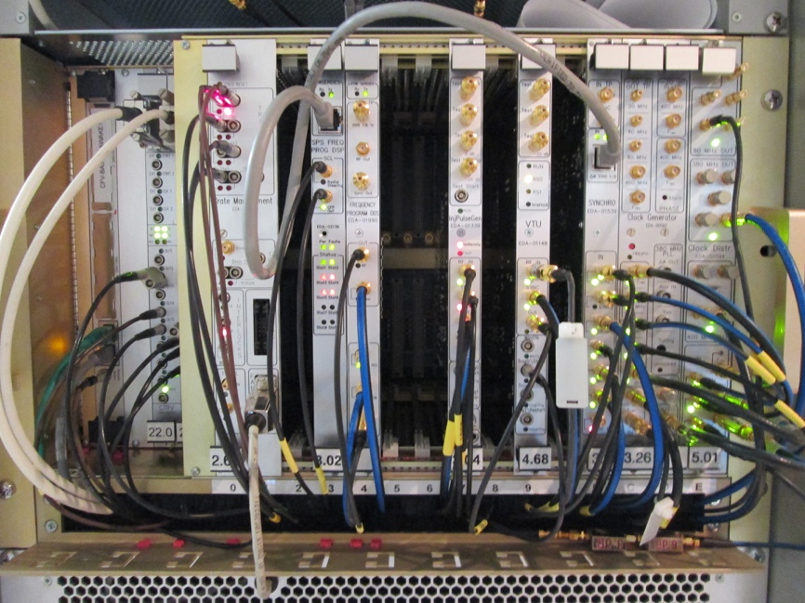
Hardware installation
TSG40
BA3/Faraday Cage
Link compensation
Fast triggers
Synchro crate
Main divider, RF trains
Distribution, frac. divider
AWAKE crate
RF master oscillator, distribution EUROPA crate, optical distributions

Slide 26
Simplified overview synchronization and RF distribution
GPS receiver
Commercial equipment
Existing RF design
AWAKE specific RF design
10 MHz (reference)
BA4/building 871
TSG40
BA3/Faraday Cage
6 GHz master
Laser PLL
Laser
5995.8 MHz
(reference)
88.2 MHz (divider)
9.97 Hz, 8.68 kHz, 400.8 MHz
Main RF divider
Fiber link stabilization
Fiber receiver/transmitter
2997.9 MHz
10 MHz
Electron
LLRF
400.8 MHz
Fractional divider SPS
Buffer amplifiers
SPS synchro crate
200.4 MHz
Timing
Buffer amplifiers
176.3 MHz
Fast pulse triggers
Fast pulse triggers
Proton LLRF
Timing
Various frequencies distributed (many!)
Fast pulse triggers (~20 adjustable)
Extraction and bunch rotation triggers

Slide 27
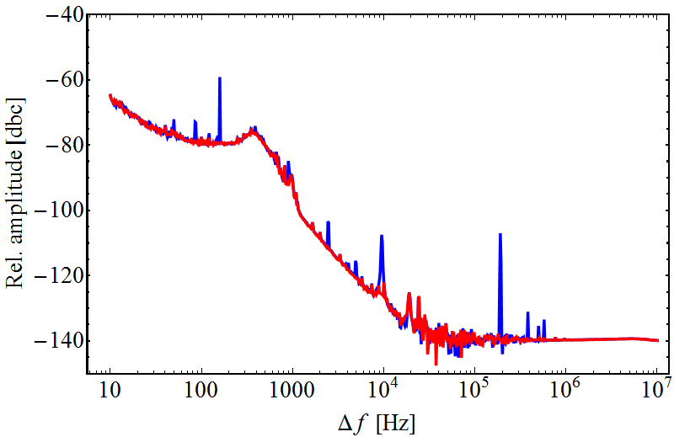
Laser synchronization
Two stage synchronization process
  Fundamental lock at f_{ML} = 88.2 MHz, commissioned
  Unambiguously define phase of laser and f_{ML} from RF distribution
  Harmonic lock at 5.995 GHz (68 × f_{ML}), under test
  Low jitter phase-lock of laser
Jitter with 88 MHz fundamental lock
Measured jitter 10 Hz – 10 MHz
~130 fs (without spurs)
~150 fs (with spurs)
Decrease possible with harmonic lock (~ 30 fs)
Independent measurement with separate PD from Laser against external reference

Slide 28
Simplified overview synchronization and RF distribution
GPS receiver
Commercial equipment
Existing RF design
AWAKE specific RF design
10 MHz (reference)
BA4/building 871
TSG40
BA3/Faraday Cage
6 GHz master
Laser PLL
Laser
5995.8 MHz
(reference)
88.2 MHz (divider)
9.97 Hz, 8.68 kHz, 400.8 MHz
Main RF divider
Fiber link stabilization
Fiber receiver/transmitter
2997.9 MHz
10 MHz
Electron
LLRF
400.8 MHz
Fractional divider SPS
Buffer amplifiers
SPS synchro crate
200.4 MHz
Timing
Buffer amplifiers
176.3 MHz
Fast pulse triggers
Fast pulse triggers
Proton LLRF
Timing
Various frequencies distributed (many!)
Fast pulse triggers (~20 adjustable)
Extraction and bunch rotation triggers
Ready

Slide 29
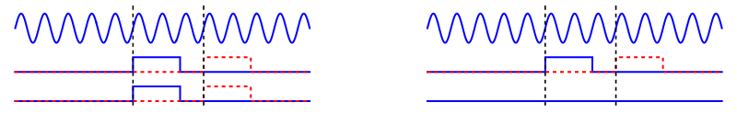
Control of synchronous proton transfer to AWAKE
Shift f_{c}, f_{rep} and 2f_{RF, SPS} sent to SPS with respect to internal signals used in AWAKE (laser, precision triggers)
2-step shift process to move proton delay with respect to AWAKE:
  Pre-settable number of 2f_{RF, SPS} clock periods (bucket number)
  Fine time/phase within a single period of 2f_{RF, SPS}
Implemented programmable phase shift in new fractional divider
…
2f_{RF,SPS}
…
f_{c}
…
f_{rep}

Slide 30
Simplified overview synchronization and RF distribution
GPS receiver
Commercial equipment
Existing RF design
AWAKE specific RF design
10 MHz (reference)
BA4/building 871
TSG40
BA3/Faraday Cage
6 GHz master
Laser PLL
Laser
5995.8 MHz
(reference)
88.2 MHz (divider)
9.97 Hz, 8.68 kHz, 400.8 MHz
Main RF divider
Fiber link stabilization
Fiber receiver/transmitter
2997.9 MHz
10 MHz
Electron
LLRF
400.8 MHz
Fractional divider SPS
Buffer amplifiers
SPS synchro crate
200.4 MHz
Timing
Buffer amplifiers
176.3 MHz
Fast pulse triggers
Fast pulse triggers
Proton LLRF
Timing
Various frequencies distributed (many!)
Fast pulse triggers (~20 adjustable)
Extraction and bunch rotation triggers

Slide 31
Fiber link stabilization
Simplified diagram
Installed and commissioned
Also used for crab cavity tests
Logging of temperature and compensation delay for correlation
D. Barrientos, J. Molendijk, Phase stabilization over a 3 km optical link with sub‑picosecond precision for the AWAKE experiment, IEEE Real Time Conf., 2016

Slide 32
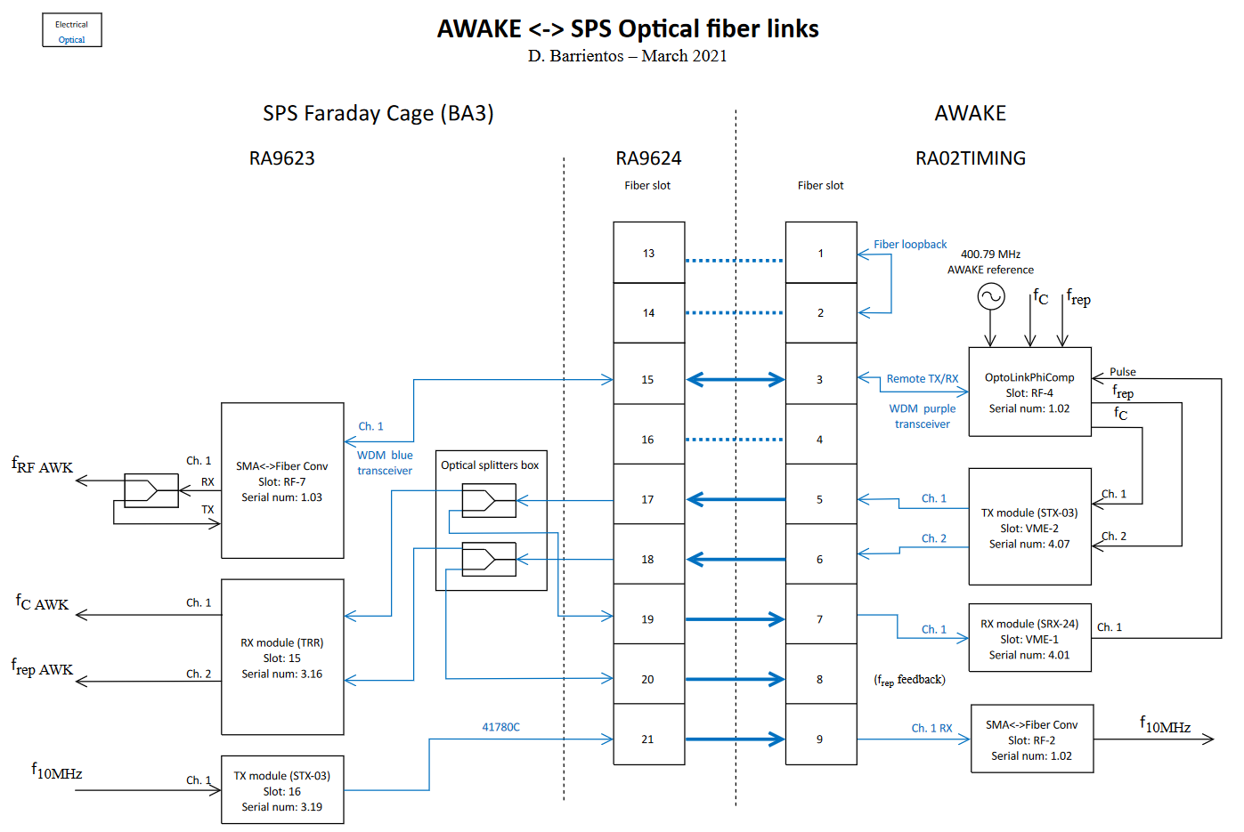
AWAKE Fiber links

Slide 33
Fiber Link Stabilization - Results
250 ps
25 days - Coarse delay
RF reference fiber link stabilization from AWAKE laser room to SPS BA3 FC (400 MHz signal)
System operational since September 2016
→ It means without this stabilization we would have the above variations !
35 ps
2 days - Fine delay

Slide 34
Simplified overview synchronization and RF distribution
GPS receiver
Commercial equipment
Existing RF design
AWAKE specific RF design
10 MHz (reference)
BA4/building 871
TSG40
BA3/Faraday Cage
6 GHz master
Laser PLL
Laser
5995.8 MHz
(reference)
88.2 MHz (divider)
9.97 Hz, 8.68 kHz, 400.8 MHz
Main RF divider
Fiber link stabilization
Fiber receiver/transmitter
2997.9 MHz
10 MHz
Electron
LLRF
400.8 MHz
Fractional divider SPS
Buffer amplifiers
SPS synchro crate
200.4 MHz
Timing
Buffer amplifiers
176.3 MHz
Fast pulse triggers
Fast pulse triggers
Proton LLRF
Timing
Various frequencies distributed (many!)
Fast pulse triggers (~20 adjustable)
Extraction and bunch rotation triggers

Slide 35
Precision triggers – in house developed RF VME board
Synchronous trigger units (CTU)
Generation of triggers from 400 MHz RF for beam observation
Step size: 2.5 ns plus fine delay (ps resolution)
Long delays possible (ms range)
dedicated firmware and software for AWAKE
Triggers delivered to streak cameras
Switchable between single pulse and 10 Hz operation for AWAKE
G. Hagmann

