Slide 1
Cost/timeline review – laser/optical cavity
Aurélien MARTENS

Slide 2
Introduction
A draft scope of work document w/ deliverables has been prepared since July:
  https://www.overleaf.com/project/6124d9bd73fca9fa2e078469
  Please read/comment/amend directly in the overleaf or by email to Yann and Aurelien
  Any mistake is purely mine, please accept my apologies
I’ll go through cavity (FPC) first and then laser in TI18

Slide 3
FPC: Reminder of challenges
Dust is an enemy → cavity gain reduction, mirror burning at few 10kW.
  We experienced that recently…
  Think well pumping logic, mirror isolation, avoid opening
Mirror vibration is an enemy → mechanical decoupling
Laser transport before cavity injection is new → must be prototyped and validated
Integration in accelerator always touchy → design, interfaces, installation time
Total remote operation → new, planning risk mostly

Slide 4
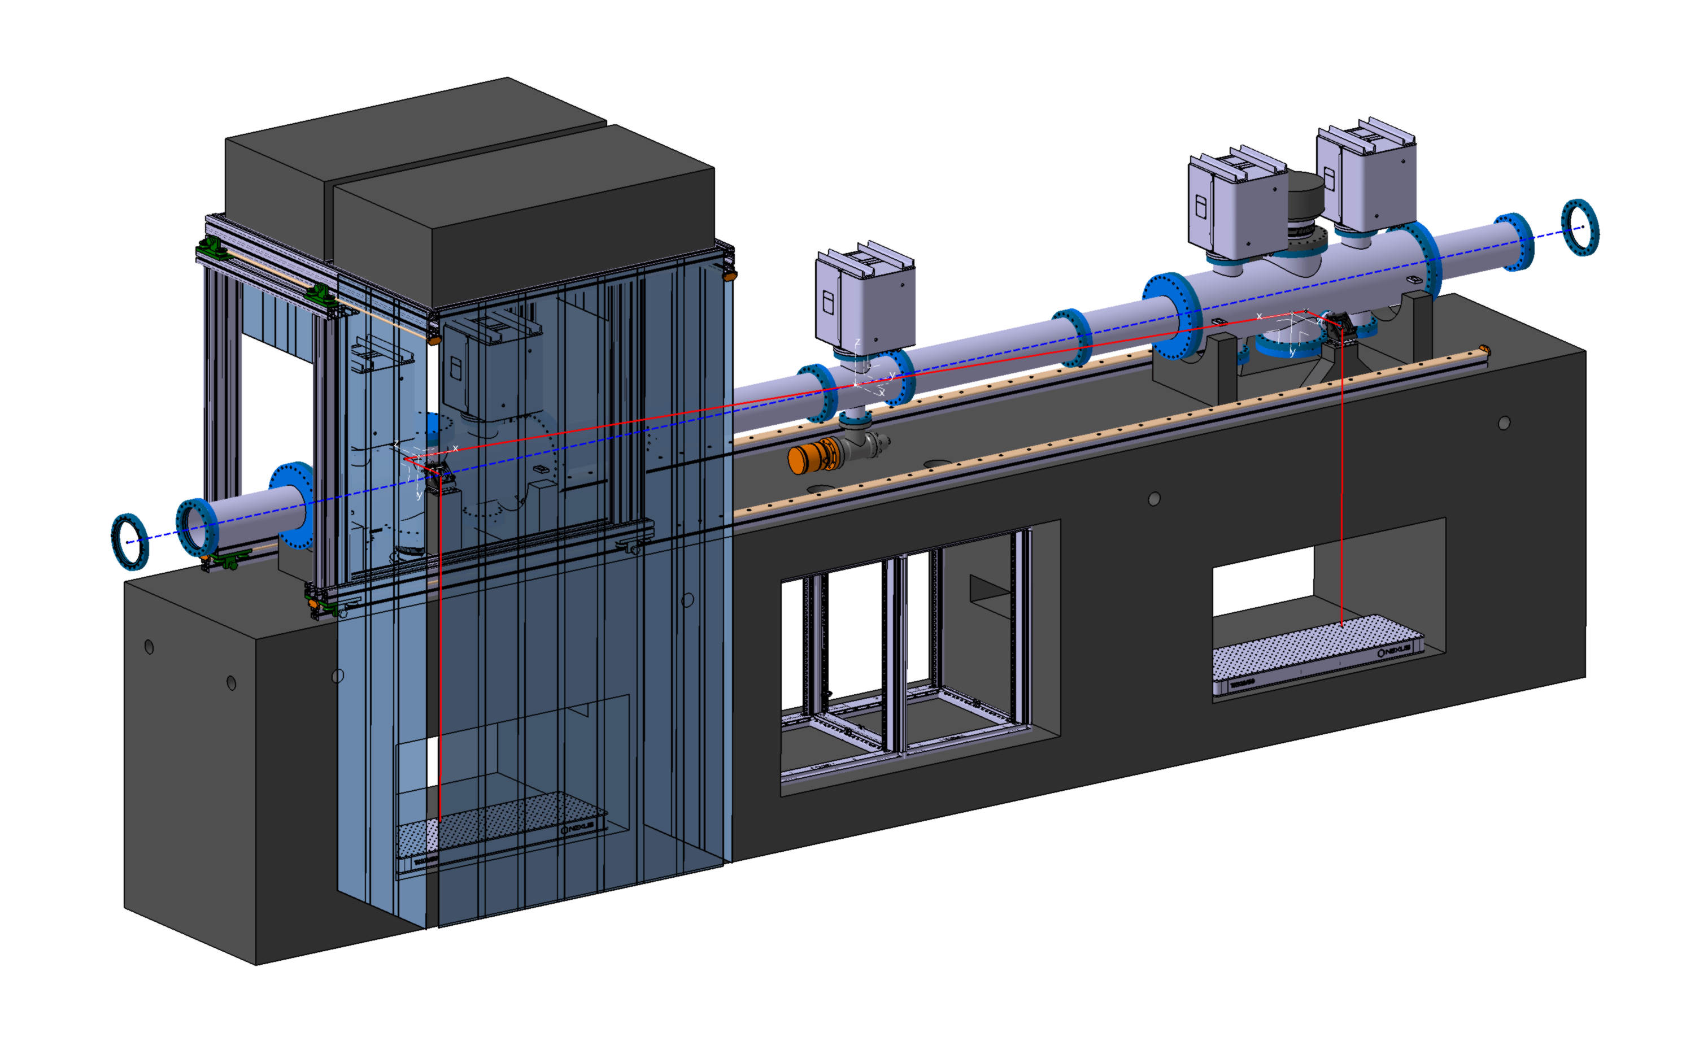
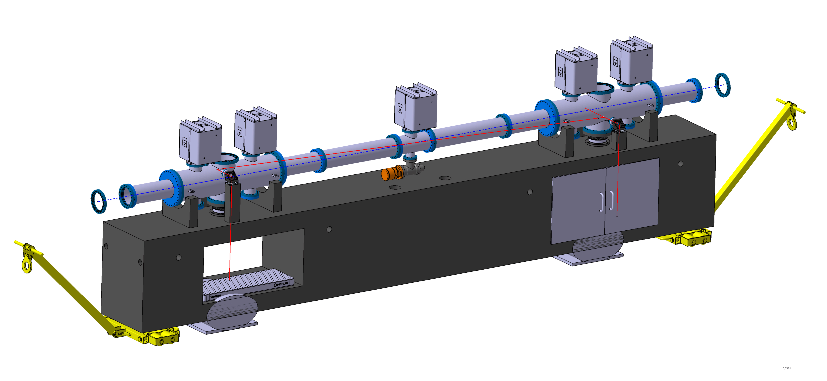
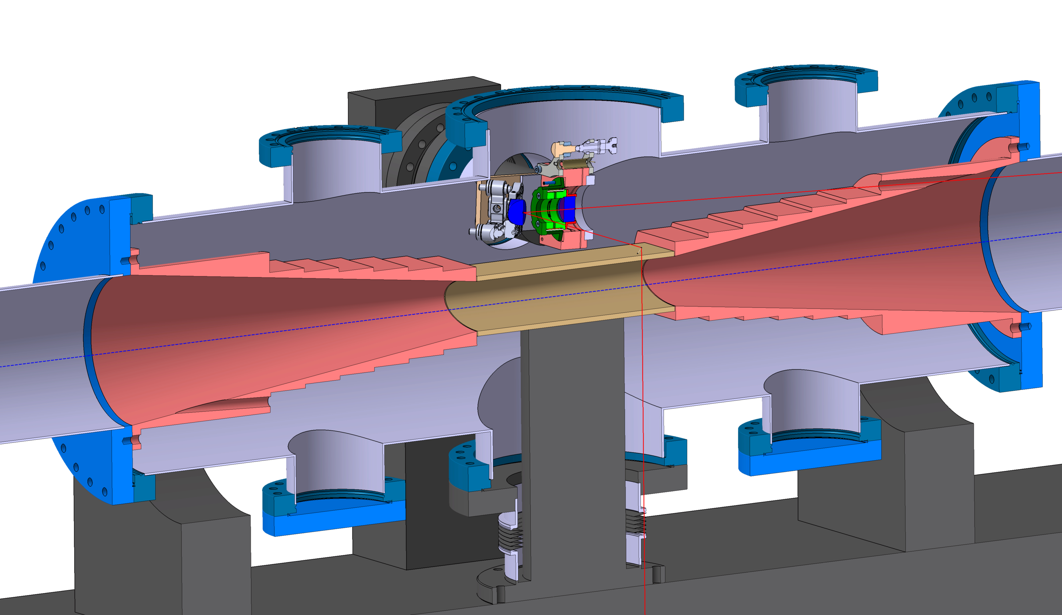
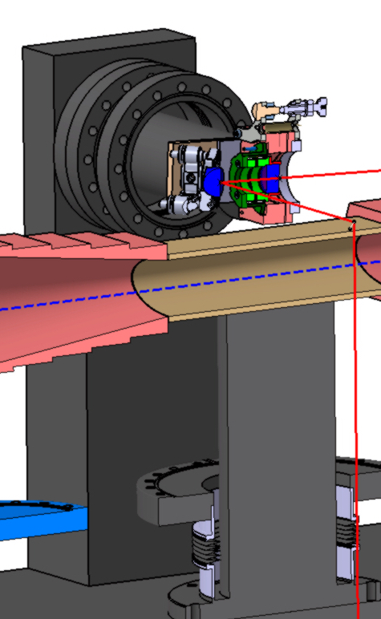
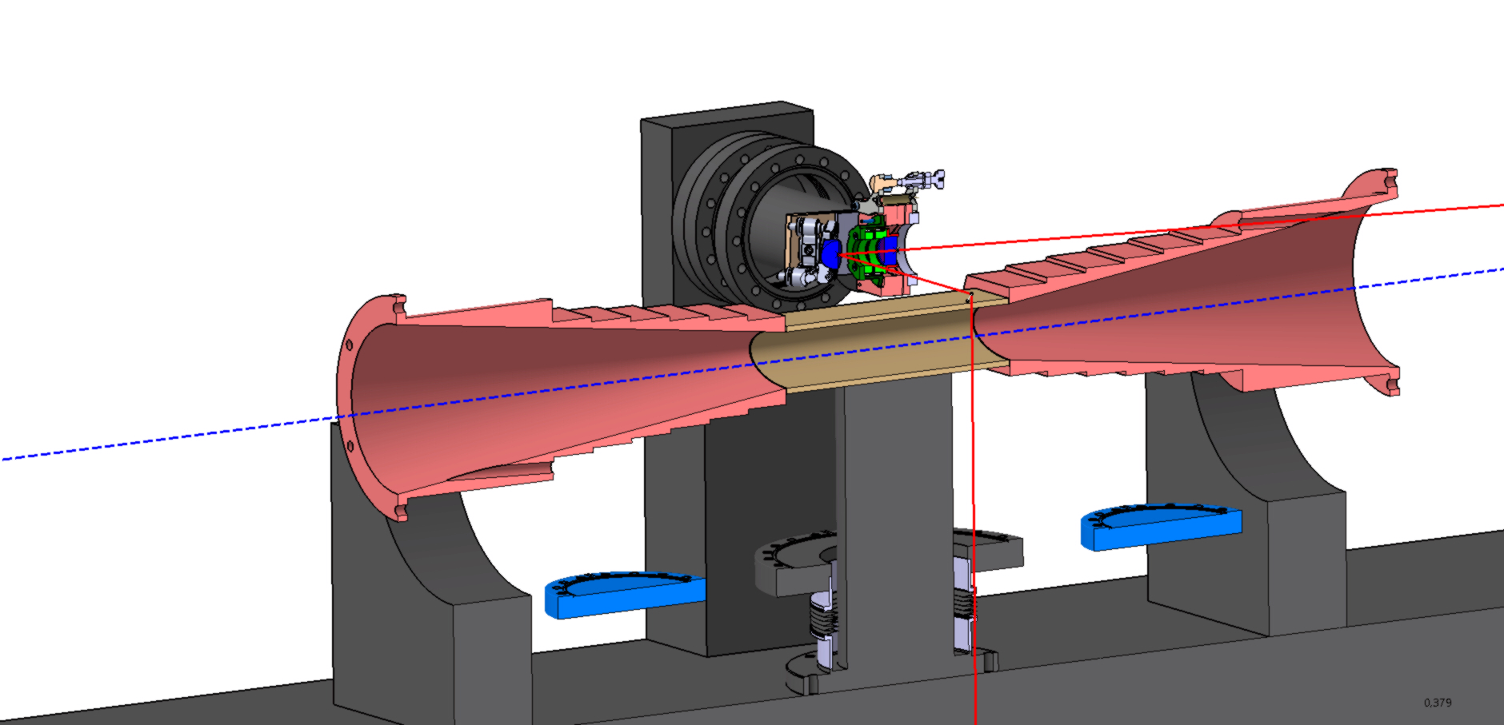
FPC: Recent updates

Slide 5
FPC: To do list
Update vacuum → Chiara ?
BPMs ← Thibaut
move-able air flow → storing area ? (not TI18 entrance given radiation flux)
Ability to remove cavity – “just in case”
Interface with laser transport line (design ?)
Discuss installation procedures…

Slide 6
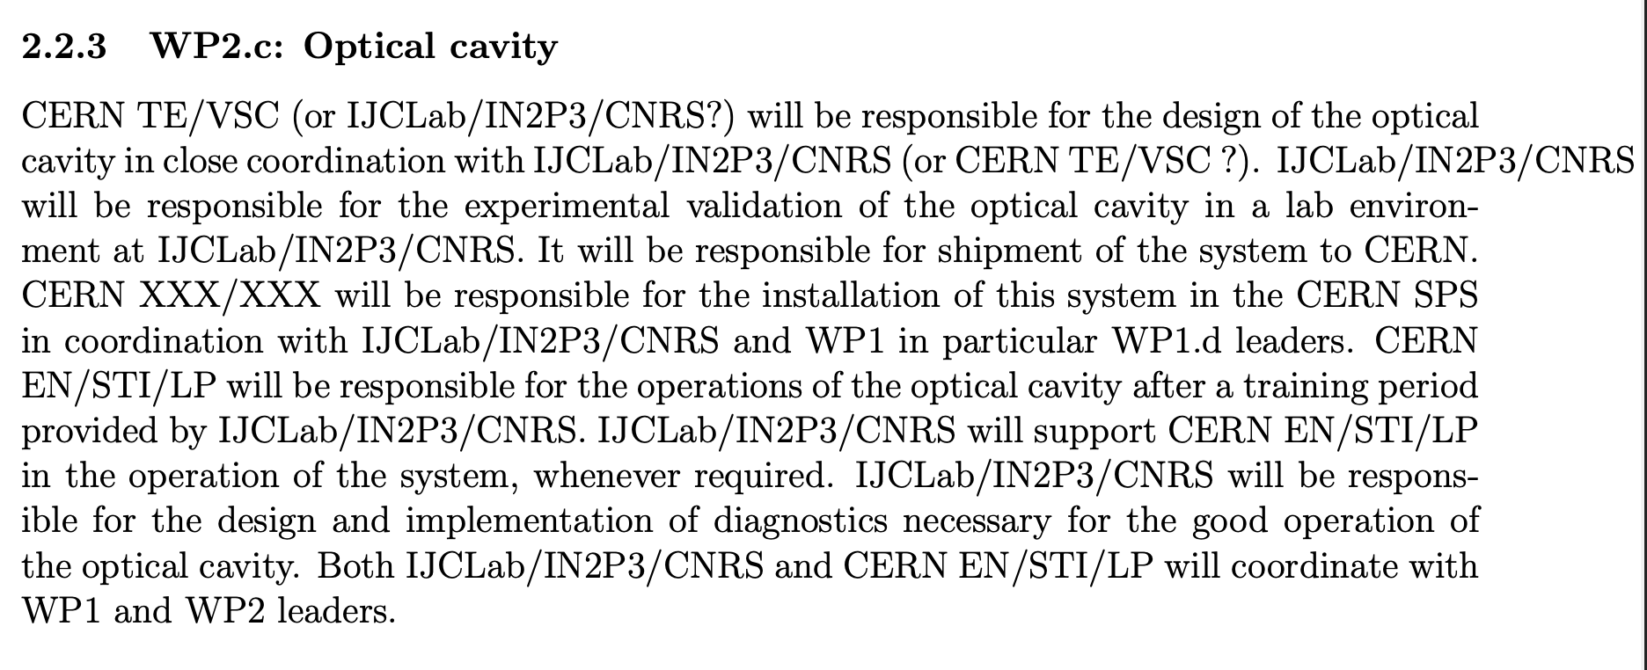
FPC: Scope of work @ Orsay
Design must be finalized : close links in between TE/VSC and IJCLab needed. Responsible must be clarified (maybe TE/VSC ?) but IJCLab can contribute much to the design/drawing aspects (mechanics and optics) and TE/VSC on interfaces including vacuuming elements.

Slide 7
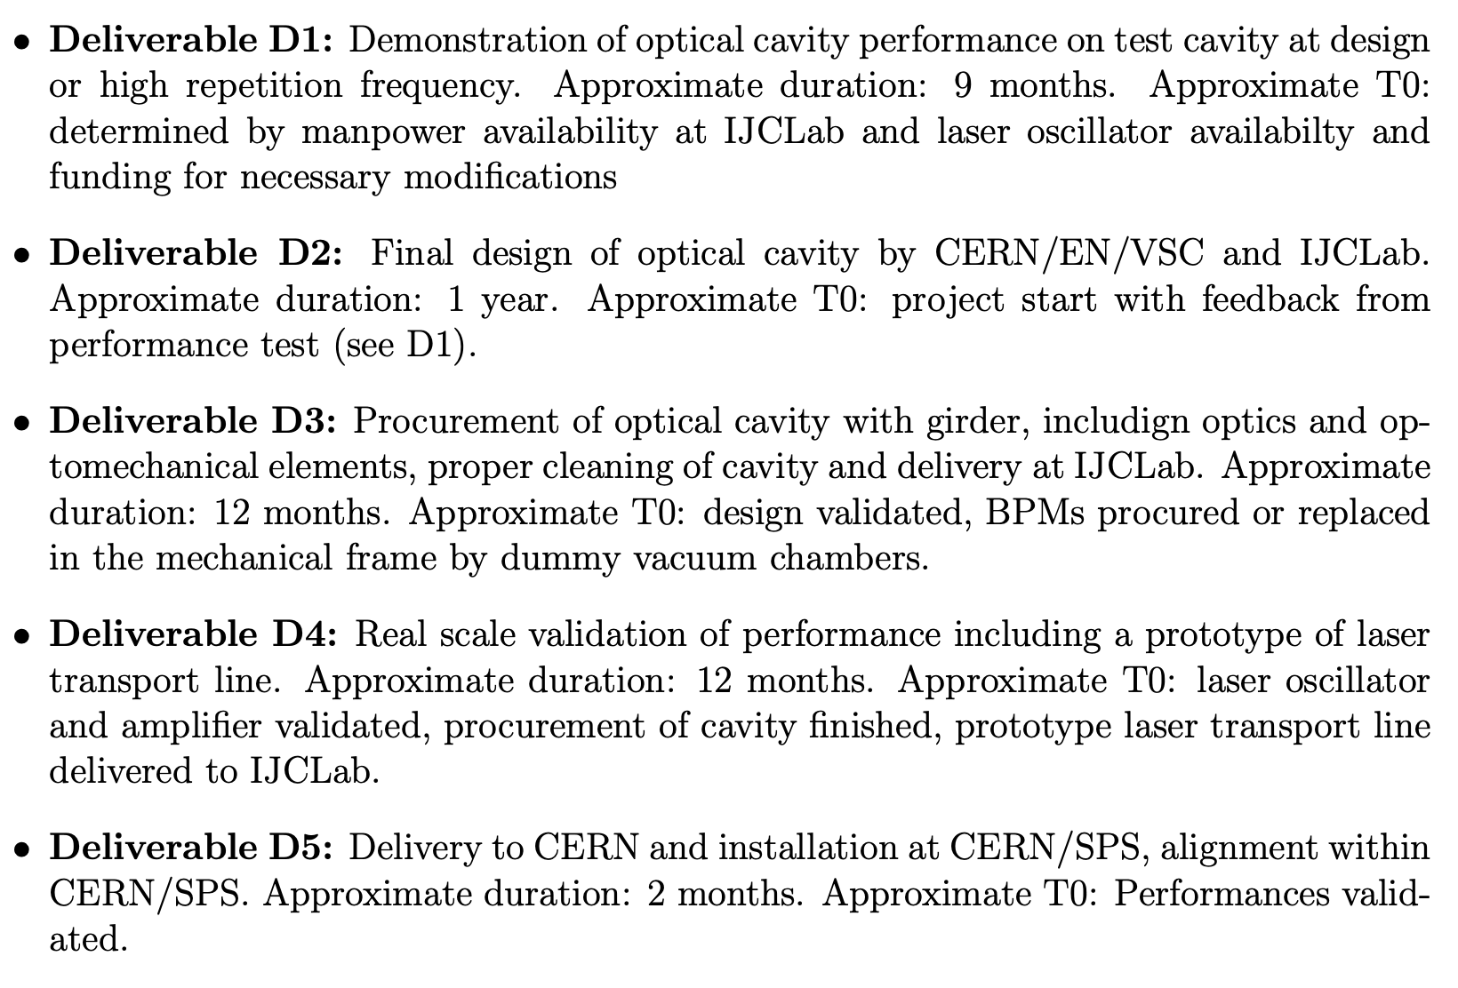
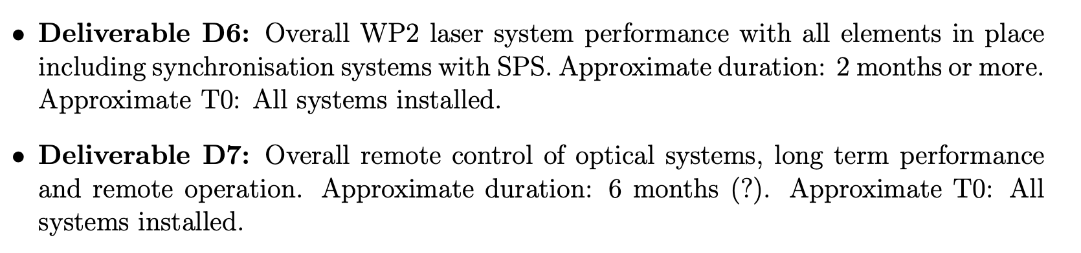
FPC: Timeline
Could start already, but finalization needs D1 output. BPMs design missing. Manpower (un)availability driven.
12 months is probably realisitic (mirrors already 6months)
9 months
Gross estimate still many uncertainties ← already shrinking
Gross estimate still many uncertainties
Gross estimate still many uncertainties. But mostly already validated in lab before.
Under STI/LP umbrella ?

Slide 8
FPC: Cost estimate
~<200kE (including pulse picking)
@IJClab: pure staff manpower
Gross estimate of 300kE prior recent crisis…and excluding vacuum elements
9 months
@IJClab: 10kE/y + PhD student (130kE) + postdoc (130kE)
10kE ??
Travels to CERN
Costing from past experience where available – prior all recent crisis

Slide 9
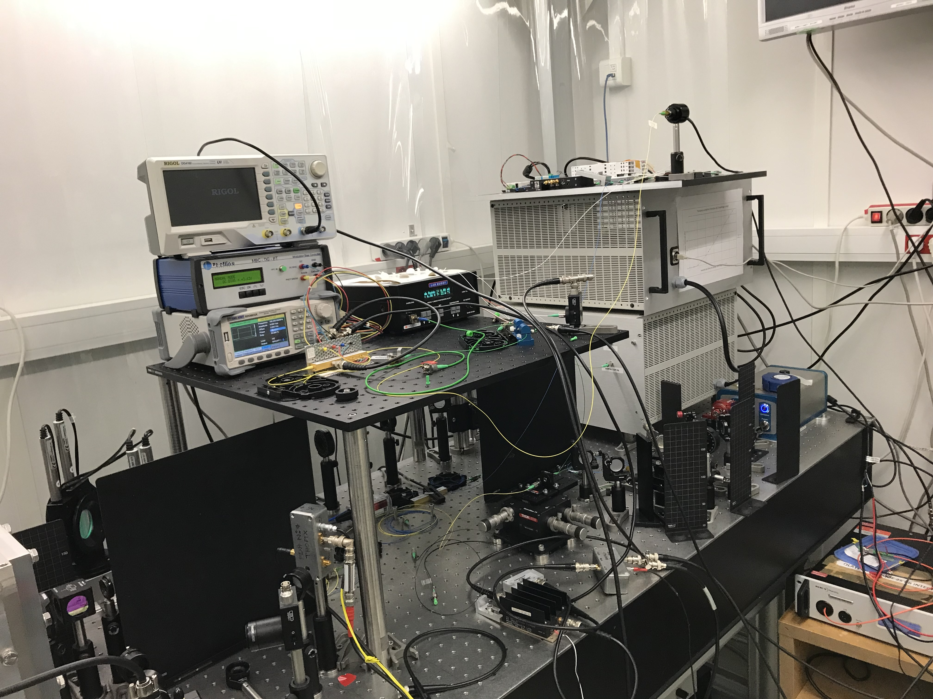
Laser: Reminder of challenges
Very low phase noise → laser + amp choice
Pulse picking → new, touchy, some experience needed
Laser transport → beam stability (imagery + stabilizations)
Tunable pulse duration → careful design needed

Slide 10




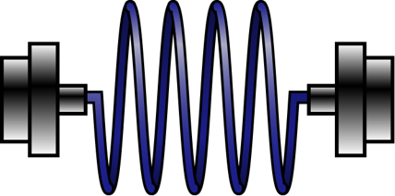







Laser: Conceptual laser scheme for GF-PoP synchro
F₀
10MHz in
$$\sim$$
X
$≲$1MHz
LO
RF
x100
$≲$F_{rep}
1%
Laser, 160MHz
$$\sim$$
DC
Isolator
x100
MOD
10MHz
99%
Fiber
F₀/4
EOM
7dB losses
Fibered polarization rotator
2dB losses
Laser, 40MHz
Careful discussion with ixblue (EOM provider) about reduction of insertion losses → to be planned with STI/LP.
Local synthetiser must be at 800MHz ? (integer harmonic of 160MHz) not 400MHz as initially planned
Lock can be performed at 800MHz
The 40MHz laser after pulse picking must deliver around 10mW (still at least one EOM before amplifier) → 300mW for the 160MHz laser w/o including compressor that will induce about a factor 3 losses
We will need to insert a fibre amplification stage between fibre injection and fibre polarization rotator with their safety elements.

Slide 11
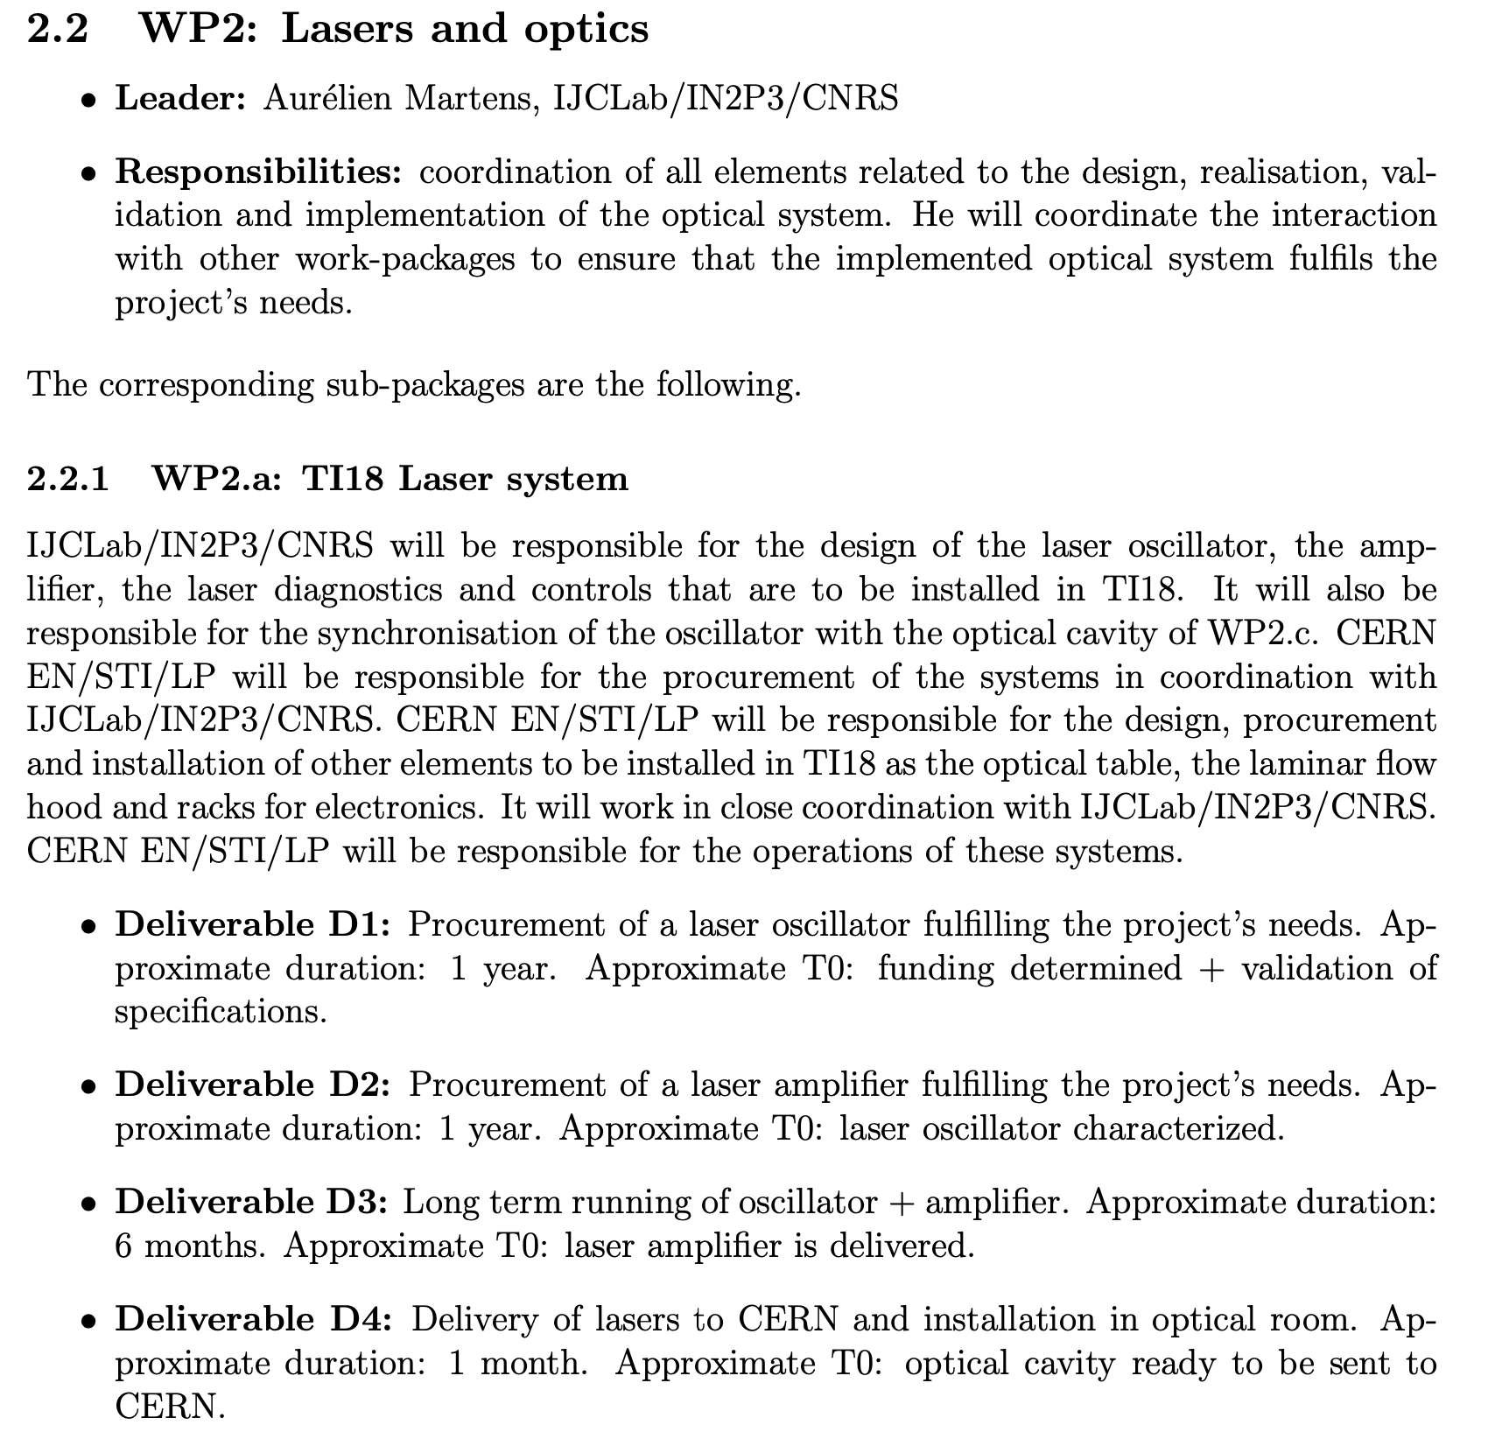
Laser: Scope of work @ Orsay
Or IJCLab ?

Slide 12
Laser: Timeline
Assumes full validation in lab before

Slide 13
Laser: Cost estimate
~<100kE + 50kE ? For pulse picking + 50kE for all electronics
150-300kE depending on technological choice
PhD student + postdoc work already included in cavity work
Travels to CERN
Costing from past experience where available – prior all recent crisis

Slide 14
Overall laser + cavity timeline
Remarks:
Critically assumes 1 post-doc + 1 phD are provided for the work at Orsay (full time)
not including laser transport line, assumed a proto can be tested within this timeline at Orsay
system as a whole sent to CERN within LS3, can be installed by parts though.
installation timeline requires relevant CERN experts inputs…

